Slide 1
Learning Hub
Short Presentation – 155
Strengthening Authentication
Notes:
Welcome to the < > <Course/Workshop>!

Slide 2
Presentation Outline
Part 1 – Identification and authentication
Part 2 – Threats to authentication
Part 3 – Methods of authentication
Part 4 – Attributes of authentication
Part 5 – Using typical types of authentication

Slide 3
Part 1 – Authentication
What are identification and authentication?
What do we authenticate?
Notes:
<Insert the module description from the LNA.>
Note for the Learning Advisor:
-If you only have 1 objective, write a sentence.
-If you have more than 1 objective, use a bulleted list.
-In both cases, write your objectives according to Bloom’s Taxonomy (measurable objectives).

Slide 4
What Are Identification and Authentication?
Identification means providing a unique identification to an entity:
Username
Role
Device ID Number
Authentication means providing a level of assurance to the accuracy of the identification
Different schemes of authentication provide different levels of assurance
The level of assurance needed is in relation to the sensitivity of the information system being accessed

Slide 5
What Do We Authenticate?
Objectives defined in the Directive on Identity Management:
To manage identity in a manner that mitigates risks to personnel and organizational and national security, while protecting program integrity and enabling trusted citizen-centered service delivery
To manage identity consistently and collaboratively within the Government of Canada and with other jurisdictions and industry sectors, where identity of employees, organizations, devices and individuals is required
To manage credentials, authenticate users or accept trusted digital identities for the purposes of administering a program or delivering an internal or external service
Reference: Directive on Identity Management (https://www.tbs-sct.gc.ca/pol/doc-eng.aspx?id=16577)

Slide 6
Part 2 – Threats to Authentication
What is the role of authentication?
What happens when authentication cannot be trusted?
Notes:
<Insert the module description from the LNA.>
Note for the Learning Advisor:
-If you only have 1 objective, write a sentence.
-If you have more than 1 objective, use a bulleted list.
-In both cases, write your objectives according to Bloom’s Taxonomy (measurable objectives).

Slide 7
Fraud Committed by Deepfake Voice
First machine-learning deepfake used in a scam
A CEO was fooled into believing he was talking to the CEO of the parent company
Following orders, a transfer of funds was immediately initiated
Source: https://www.forbes.com/sites/jessedamiani/2019/09/03/a-voice-deepfake-was-used-to-scam-a-ceo-out-of-243000/?sh=7c2bf38c2241

Slide 8
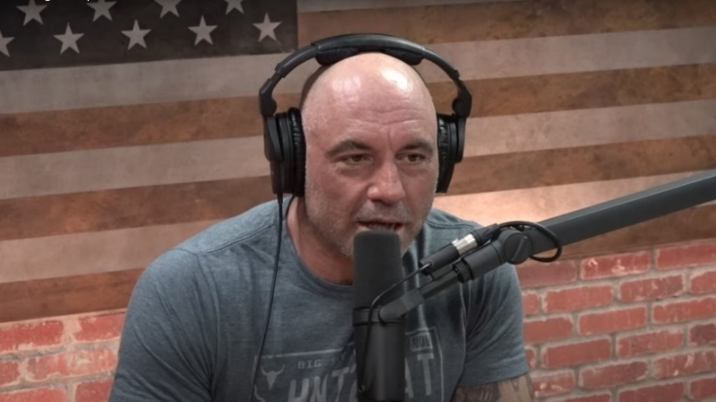
DeepVoice Example
Joe Rogan’s voice was “deepfaked”
The audio clips demonstrate machine-learning capabilities
Source: https://youtu.be/DWK_iYBl8cA

Slide 9
Authentication
Authentication is critical operation for interactions:
Between users
Between systems and users
Between users and systems
Authentication protects:
Privacy
Confidentiality
Integrity
Authenticity
Availability
Non-repudiation

Slide 10
Challenges to Authentication
Online services are expanding faster than we can secure them
Authentication methods are not up to the level of sophistication of attackers
Older methods still used are very inadequate:
Social Insurance Numbers
Photo ID
Printed invoice

Slide 11
Part 3 – Methods of Authentication
In this module the learner will explore:
Identification and authentication
Factors of authentication
Pathways to authentication

Slide 12
Identification and Authentication Methods
Factor(s) of authentication
System
Identity
Notes:
A two step approach: Claiming who you are, such as stating a username, is “Identification”. The next step, “Authentication” is to provide a level of assurance that your claim is legitimate. It should be commensurate with the sensitivity of the data that the user will be granted to access.

Slide 13
Authentication Scheme Components
Knowledge Factors
Passwords
PIN codes
Security questions
Authentication Factors
Possession Factors
Card
Key
Token
Inherence Factors
Scans of fingerprints, palm, and iris
Voice and face recognition
Signature metrics and figure drawing
Location Factors
Geolocation
Network identifiers
GPS coordinates
Supplemental Factors
Behavioural Factors
Time of day
Nature of the transaction
Volume of transactions
Notes:
This is an extended approach to the typical three factors routinely defined. There is a lot of implementation of security measures dependent on location and behaviour. Financial institutions routinely deny transactions based on the failure of location and behavioural factors.
The GC will implement additional monitoring and detection that is based on the use of a GC network, of a dedicated network segment, etc.

Slide 14
Multiple-Factor Authentication
X%
Y%
Z%
Factor 1
Factor 2
2FA

Slide 15
Multiple-Factor Authentication
70%
90%
97%
Password
Text PIN
2FA

Slide 16
Multiple-Factor Authentication
70%
90%
Password
Text PIN
37%
40%
Weak Authentication
Security Questions

Slide 17
Multi-Factor Authentication
Can increase the assurance level – when done right
One path, multiple authentication – stronger than the best authentication
Multiple paths, multiple authentication – weaker than the worst authentication
Notes:
2FA means combining 2 of the factors of authentication. Note, having an authentication consisting of a password + pin code is not 2FA; it is still only 1 method (both are in the same category). True 2 factor combines two methods (or 3 for MFA).

Slide 18
Part 4 – Attributes of Authentication
Which attributes should be considered for authentication?
Which authentication methods implement the attributes?

Slide 19
Attributes of Authentication
Strength and assurance (robustness)
Unforgeable
Not exposed to outsiders
Protected from insiders
Protected from interception
Protected from storage breach
Protected from replay attack
Protected from social engineering
Industry-recognized and adopted
Deployment
Low cost
No special equipment
Accuracy and reliability
Low false acceptance rate (FAR)
Low false rejection rate (FRR)
User-friendliness
Low user effort
Convenient
Enrollment time
Possibility of modification
Remote use
No privacy impacts
Notes:
This is a sample of typical operational requirements of an authentication scheme. It is not comprehensive obviously. The requirements can be weighted for a more specific evaluation score of different schemes.

Slide 20
Attributes of Authentication – Signature
Strength and assurance (robustness)
Unforgeable
Not exposed to outsiders
Protected from insiders
Protected from interception
Protected from storage breach
Protected from replay attack
Protected from social engineering
Industry-recognized and adopted
Deployment
Low cost
No special equipment
Accuracy and reliability
Low false acceptance rate (FAR)
Low false rejection rate (FRR)
User-friendliness
Low user effort
Convenient
Enrollment time
Possibility of modification
Remote use
No privacy impacts
Note: This documentation is not official and for discussion purposes only
Notes:
This is a sample of typical operational requirements of an authentication scheme. It is not comprehensive obviously. The requirements can be weighted for a more specific evaluation score of different schemes.

Slide 21
Attributes of Authentication – Chip and PIN
Strength and assurance (robustness)
Unforgeable
Not exposed to outsiders
Protected from insiders
Protected from interception
Protected from storage breach
Protected from replay attack
Protected from social engineering
Industry-recognized and adopted
Deployment
Low cost
No special equipment
Accuracy and reliability
Low false acceptance rate (FAR)
Low false rejection rate (FRR)
User-friendliness
Low user effort
Convenient
Enrollment time
Possibility of modification
Remote use
No privacy impacts
Note: This documentation is not official and for discussion purposes only
Notes:
This is a sample of typical operational requirements of an authentication scheme. It is not comprehensive obviously. The requirements can be weighted for a more specific evaluation score of different schemes.

Slide 22
Attributes of Authentication – Iris Scan
Strength and assurance (robustness)
Unforgeable
Not exposed to outsiders
Protected from insiders
Protected from interception
Protected from storage breach
Protected from replay attack
Protected from social engineering
Industry-recognized and adopted
Deployment
Low cost
No special equipment
Accuracy and reliability
Low false acceptance rate (FAR)
Low false rejection rate (FRR)
User-friendliness
Low user effort
Convenient
Enrollment time
Possibility of modification
Remote use
No privacy impacts
Note: This documentation is not official and for discussion purposes only
Notes:
This is a sample of typical operational requirements of an authentication scheme. It is not comprehensive obviously. The requirements can be weighted for a more specific evaluation score of different schemes.

Slide 23
Attributes of Authentication - Password
Strength and assurance (robustness)
Unforgeable
Not exposed to outsiders
Protected from insiders
Protected from interception
Protected from storage breach
Protected from replay attack
Protected from social engineering
Industry-recognized and adopted
Deployment
Low cost
No special equipment
Accuracy and reliability
Low false acceptance rate (FAR)
Low false rejection rate (FRR)
User-friendliness
Low user effort
Convenient
Enrollment time
Possibility of modification
Remote use
No privacy impacts
Note: This documentation is not official and for discussion purposes only
Notes:
This is a sample of typical operational requirements of an authentication scheme. It is not comprehensive obviously. The requirements can be weighted for a more specific evaluation score of different schemes.

Slide 24
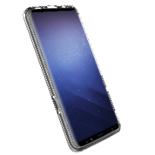
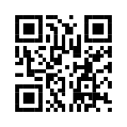
One-Time Password
Enrollment
Website with OTP Capability
Laptop Registering Account
Cell with OTP App
Synchronizing
Authentication
Password
PIN
OTP
Current OTP Expected
2FA Authentication
Cell with OTP App

Slide 25
Attributes of Authentication – One-Time-Password
Strength and assurance (robustness)
Unforgeable
Not exposed to outsiders
Protected from insiders
Protected from interception
Protected from storage breach
Protected from replay attack
Protected from social engineering
Industry-recognized and adopted
Deployment
Low cost
No special equipment
Accuracy and reliability
Low false acceptance rate (FAR)
Low false rejection rate (FRR)
User-friendliness
Low user effort
Convenient
Enrollment time
Possibility of modification
Remote use
No privacy impacts
Note: This documentation is not official and for discussion purposes only
Notes:
This is a sample of typical operational requirements of an authentication scheme. It is not comprehensive obviously. The requirements can be weighted for a more specific evaluation score of different schemes.

Slide 26
Part 5 – Tips to Use Authentication
Best practices for password use
Best practices for biometrics
Best practices for one-time-password use

Slide 27
Best Practices for Password Use
Minimize user effort and password fatigue:
Do not generate your own passwords
Do not memorize your passwords
Use a trusted password manager:
To generate pseudo-random robust and unique passwords
To protect the passwords in one or more encrypted vaults
Safeguard access to vaults with strong authentication

Slide 28
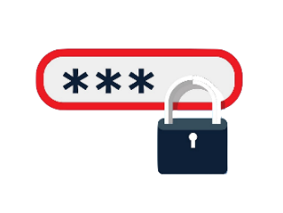
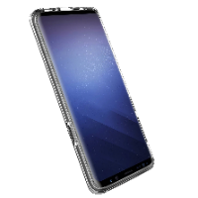
Best Practices for Password Use
Do not log into services from unmanaged devices
Leverage your trusted devices for authentication
Full Disk Encryption:
Biometric + PIN access
Password Manager:
Biometric
Website: Password +
Second Factor

Slide 29
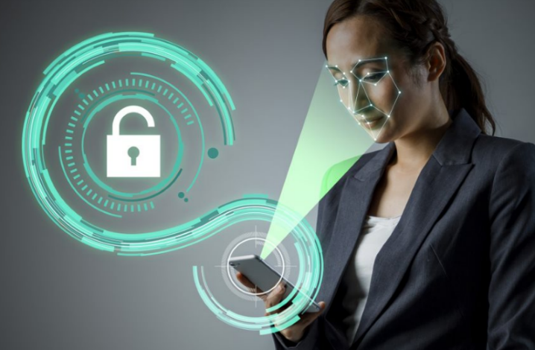
Best Practices for Biometrics Use
Convenient for repeated use:
Unlock phone or laptop
Access security area in workplace
Use with local encrypted storage
Use as a second factor

Slide 30
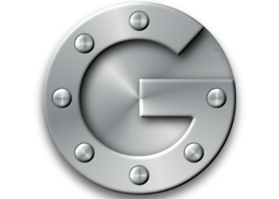
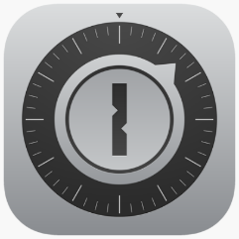
Best Practices for Software OTP
Use as a second factor for authentication
Use from a trusted device
Implement recovery methods
GoogleOTP
FreeOTP

Slide 31
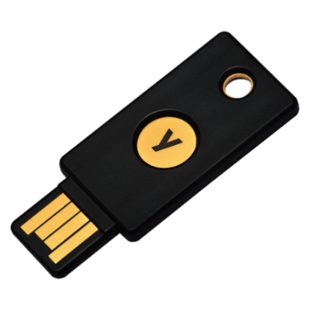
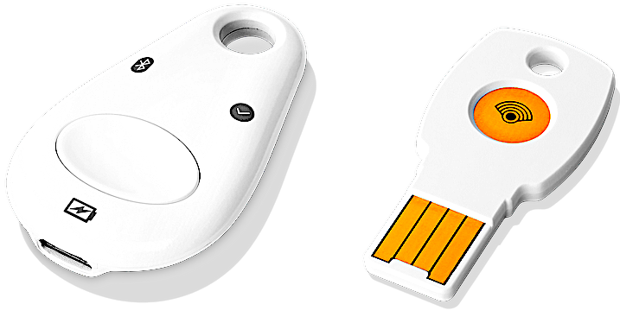
Best Practices for Hardware OTP
Use as a second factor of authentication
Use devices compatible with Fast ID Online (FIDO) security standard
Use two devices to have a backup if you lose one
Implement a handling strategy, as you would a security badge
Google Titan Key Bundle
Yubikey

Slide 32
Conclusion
Summary:
Authentication
Threats to authentication
Methods of authentication
Attributes of authentication
Tips to use authentication methods

Slide 33
Questions

