Slide 1
An Introduction to the GC Minimum Viable Business Architecture Playbook
For discussion purpose
Last update: September 2022

Slide 2
Outline
Purpose
Vision for EA and EBA
MVEA practice elements
Appendix

Slide 3
1. Purpose
Purpose of this work and subgroup is to co-develop a Minimum Viable Business Architecture Practice across the GC, which would:
Support lower maturity/complexity smaller departments and agencies in establishing a viable and sustainable BA practice (accelerator)
Serve as a formal baseline / lowest common denominator for a GC E/BA practice (consistency)
From there, departments could add whatever suits their specific architecture needs, as long as we would share common foundations:
A common vision of BA with a minimal value proposition
Minimal Stakeholders and Roles
Minimal Services with Key Activities with their outputs / artefacts/ del;ioverables / …
Minimal Metamodel and Knowledgebase (BA Repository)
Skillset and competencies etc.. and additional resources
Notes:
« What can you do that is EA; doesn’t cost a fortune but still helps deliver the projects as well as ensure those projects are strategically aligned? »
Key questions:
WHY? A common vision of EA and its value proposition
By WHO? For WHO?Minimal Stakeholders and Roles
WHAT? HOW? Minimal Services with Key Activities
Minimal Metamodel and Knowledgebase (EA Repository)
Also:
What would be a desirable evolution/growth path from there?
What does this mean for Business Architecture?
MVEA should be based on what WORKED, not on what COULD work, what should work or what we want EA to be

Slide 4
1. Purpose
Key principles framing the MVBA WG work and deliverables:
Minimal Viable BA Framework, can’t be too specific and prescriptive; if any HOW must be very high-level
Allow for a flexible application: offers a “menu” / options that would fit the particular context and size of the Organization; “3 Tiered-approach/Artefacts” (+ a Tier 0?) serving as a Menu and/or a Practice Roadmap
Keeps the Architecture lingo & “complexity” hidden from users – focuses on VALUE©
Focused on the WHY/WHAT/WHERE/WHEN/WHO before the HOW – value proposition and purpose before models & artefacts;
Anchored in the GC EA Framework and Practice; GC EA BizArch ‘Guide’ vs our work here
Pragmatic (what has been proven to work); realistic (what CAN be; not SHOULD be); lucid (“culture eats strategy for breakfast”); Simple (easy to implement). “Implementable / Usable”
Notes:
« What can you do that is EA; doesn’t cost a fortune but still helps deliver the projects as well as ensure those projects are strategically aligned? »
Key questions:
WHY? A common vision of EA and its value proposition
By WHO? For WHO?Minimal Stakeholders and Roles
WHAT? HOW? Minimal Services with Key Activities
Minimal Metamodel and Knowledgebase (EA Repository)
Also:
What would be a desirable evolution/growth path from there?
What does this mean for Business Architecture?
MVEA should be based on what WORKED, not on what COULD work, what should work or what we want EA to be

Slide 5
2. Vision for EA and BA

Slide 6
Let’s first agree on a EA vision… (1 of 3)
What is EA? “Enterprise Architecture is the design, improvement and optimisation of information-intensive business systems” – Graham Berrisford
“Architects are largely on the wrong track. They are focused on how to create a well-structured enterprise architecture instead of how to create a well-architected organization.“
Enterprise Architects are the urban planners of digital organizations. They provide a “framework to digital transformation”
“The urban planner looks at how all the individual buildings fit together, considers how the structure and layout of a city affect the lives of its inhabitants, and helps to realize the overall vision of the city”
“Urban planners not only set building codes and plans common services such as roads and water, they actively participate in making those plans a reality.”
Notes:
Source: Kevin Brennan https://www.cutter.com/article/urban-planner-metaphor-ea-490976, cited in a RCMP deck
“The urban planner is somewhat analogous to the enterprise architect and enterprise architecture team in that the urban planning team needs to understand what the building architect (solution architect) does, but also need to understand a wide range of topics that the building architect doesn’t need to deal with”
- Doug McDavid https://www.linkedin.com/pulse/architecture-sandwich-doug-mcdavid
What is our mission, our goal? It isn’t to build a blueprint of the organization and it isn’t to describe our organization’s operating model in terms of capabilities and technologies. Our mission, if we choose to accept it, is to architect our organization for long term success and sustainability.”

Slide 7
Let’s first agree on an EA vision… (2 of 3)
How should this evolve in a growing ‘Product Management’ approach? Does it impact the HOW only or also the WHAt; WHERE; WHEN; WHO
What is EA’s purpose? “The primary purpose of Enterprise Architecture is to inform, guide and constrain the decisions made by an enterprise, especially those related to investments.” - DNDAF
Minimal Value Items:
Brings a broad view to investment decisions; maximizes investment returns, aligning short-term & local needs with long-term & strategic direction
Guide investments to reusable solutions, solution components and solution designs
Ensures that decisions are deliberate in cases where a program will not use an enterprise solution
Additional Value Items (not an exhaustive list):
Enables the Department/Agency to develop more strategic Investment plans
Reduces overall complexity and improves operational sustainability; foster longer-term operating model transformation
Enables employees at all levels to embrace a culture of continuous innovation and adopt a horizontal approach in furthering government business
Notes:
Guide investments to reusable solution, solution components and solution designs
Provide a conceptual framework (a “mental model” of the business problem and solution, with proper context) to help guide/prioritize activities and decision-making
Clarify/show the business, information, data, application and technology implications - for better/more informed designs
Help identify any gaps in the requirements. Identify reuse opportunities from/for the enterprise. Ensure enterprise integration and sustainability, post-project.
Making sure that the right enterprise infrastructure is created along the way
Identify and mitigate risks to the enterprise
Identify and expand opportunities for the enterprise
An EA Program to “align and manage the development of capabilities with established business priorities.”

Slide 8
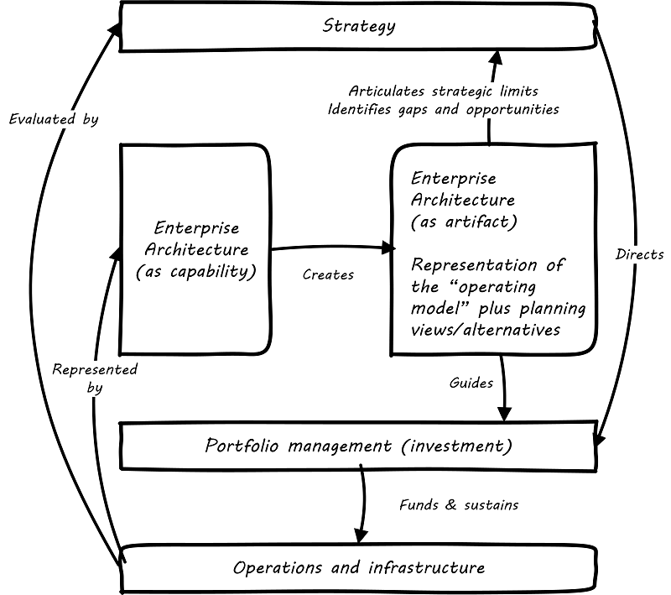
Let’s first agree on an EA vision… (3 of 3)
How does EA work? “An enterprise architecture is a corporate asset that is both a practice and a tool.”
An EA program as “the means to deliver and maintain the enterprise information required for enterprise decision-making”
An EA Program to “align and manage the development of capabilities with established business priorities”
An EA Program that is…
Business outcome-driven:
EA supporting the delivery of business value and business priorities; EA can’t simply be a “compliance stick” in this fast-evolving digital era
Actionable and Just-Enough, Just-in-Time:
providing actionable guidance to initiatives and services through “signature-ready recommendations”;
As per Gary Doucet: “Think global, Act local”
https://pubs.opengroup.org/dpbok/standard/chap-arch-portfolio.html#defining-ea
Notes:
An architecture is both descriptive and prescriptive

Slide 9
What is Business Architecture, in this context?
“Let’s work the problem, people.
Let’s not make things worse by guessing.”
Gene Kranz, Flight Director Apollo 13
About:
Business focus
Business problems and opportunities focus
Explore and Refine the Business Problem

Ensure a clear understanding of the business problem before discussing solutions.
Early engagement with TBS to ensure alignment prior to proceeding with the investment planning process.
Ensure that investments are conceived in a manner that aligns with the Government of Canada’s Digital Standards.
Don’t Jump Directly to Solutions
Notes:
An architecture is both descriptive and prescriptive

Slide 10
What is Business Architecture, in this context?
Key concepts and principles:
Three layers of Value: replacing the traditional “carrot vs stick” with “local value AND enterprise value”:
‘Big E’ Value: GC value. Often the initial driver to establish the EA/BA team.
‘Small E’ value: Departmental value. Better Departmental performance, risk management, etc.
‘Local’ value: Making sure that programs and initiatives engaged with BA get value from it (the only way to make the practice sustainable).
Scope of the BA practice based on Who it services and Where it sits:
BA part of EA, serving the CIO (most of current GC BA practices & teams);
BA part of EA, serving the CIO and COO/CEO (Strategic Business Architecture); or
BA stand-alone, serving the CIO and COO/CEO (Enterprise Business Architecture).
BA Practice shouldn’t rely on “selling” it – value should drive its adoption.
BA is a lot about spending time on the problem before discussion solution; which does require a change in culture.
Start with a heatmap / list of valuable items and related activities. Prioritize them.
BA should have a strong role in demand intake and project planning at the onset.
Make Business Architecture and EA "doable" by multiple groups on the department. Cut through the notion that EA is a closed off island that is mysterious and impractical to everyone else in the department. Particularly Business Architecture is the most "accessible" of the domains and if we can create an MVP that can be reused and adopted by multiple teams within a department then that will be a success.

Slide 11
3. MVEBA practice elements

Slide 12
MVBA Table of Content
A repeatable approach to prioritize the BA effort (based on the departmental context, priorities, etc.);
BA outcomes/benefits/metrics;
BA outputs;
BA services model with supporting outputs and integration points:
with supporting BA content (such as BA artefacts and Knowledgebase);
BA Scenarios / “use cases” / incl. in the area of Investment management and existing practices in GC Dep’ts
BCM and ACM and other Ref models to develop or use (and when/how to use them), including in support of GC EARB presentations
Potential services already flagged:
Business clarity service (in a broad GC and Departmental context);
Advising the business planning (digital portfolio); and
Representing the Organization to external stakeholders (to Industry).
RACI - Associated [extended] Roles & Responsibilities.;WHO: Roles and Exprtise
Expected Size / Cost of a MVBA? (ratio?); and
Additional: Contacts; Ent/Int Resources; “Educational”/Evangelization” material
Relationship with Clarity/APM and the broader GC EA
Review the GC BA Guide
Notes:
Those different Op Models would be based on the environment, the EA Unit capacity, the organizational needs & priorities, etc.

Slide 13
EA Operating Model Patterns
Three “iterations” of E/BA Operating Models based on capacity more than maturity:
Minimum Viable EA:
Strategic EA:
Embedded EA:
An EA “Light”
Mostly tactical
Mostly reactive
Often, but not necessarily, IT-driven
Focused on engaging with and advising major initiatives
No knowledgebase; highly dependant on the knowledge of individual architects
A fully established EA
Mostly Strategic
Mix of Reactive and Pre-emptive / Anticipative
Business-driven but still mostly IT-centric
Includes some enterprise knowledgebase used to store & generate artefacts
Strategic – overseeing tactical alignment
Mostly Pre-emptive / Anticipative
Business-driven and both business & IT-centric
Includes an enterprise knowledgebase accessed and leveraged by non-architects to produce insight
Notes:
Those different Op Models would be based on the environment, the EA Unit capacity, the organizational needs & priorities, etc.

Slide 14
BA Operating Model Patterns
Minimum Viable EA:
Strategic EA:
Embedded EA:
Minimal Business Architecture:
Business Architecture is embedded within the EA practice through some of the EA deliverables and activities
Strategic Business Architecture: Business Architecture is formalized as an EA domain with a Business Architect role (full-time or not) included in the overall Organization architecture framework & practice
Enterprise Business Architecture:
Business Architecture is elevated to an enterprise practice, lives outside EA and serves business purposes
Notes:
/

Slide 15
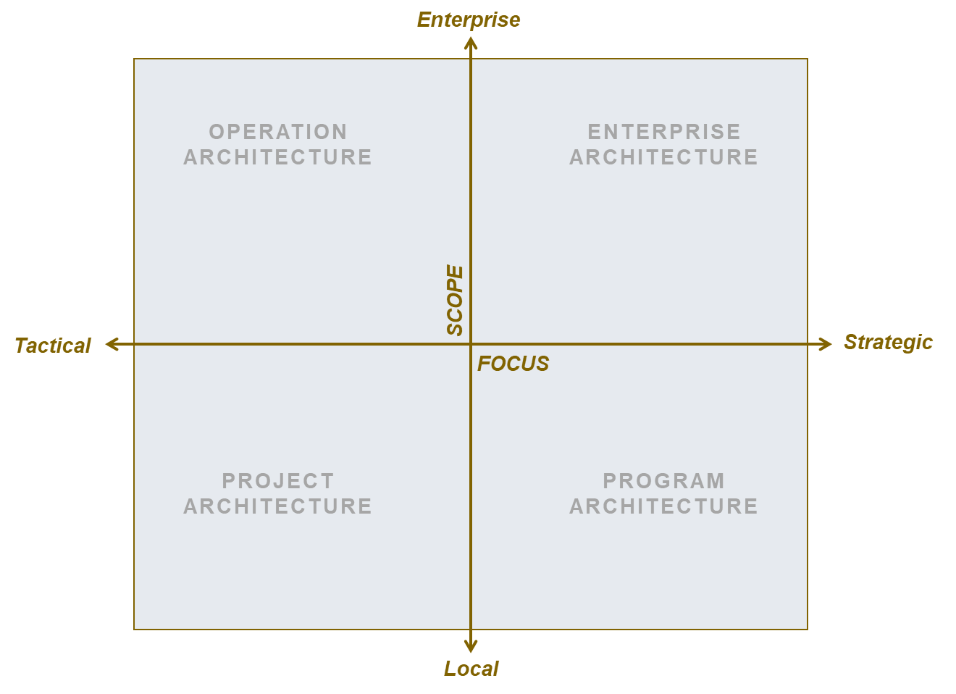
Scope
Minimum Viable EA:
Strategic EA:
Embedded EA:

Slide 16
Key Stakeholders
Minimum Viable EA:
Strategic EA:
Embedded EA:
Practitioners:
Enterprise Architects
Some Domain Architects (might not be under EA functional authority)
Some Solution Architects (might not be under EA functional authority)
Practitioners:
Enterprise Architects
Segment / Portfolio Architects (for larger organizations)
Domain Architects (framed by EA)
Solution Architects (framed by EA)
Practitioners:
Enterprise Architects
Segment / Portfolio Architects (for larger organizations)
Domain Architects (contributing to EA)
Solution Architects (contributing to EA)
Technical Architects?
Core EA Clients & Partners
IT Business Relationship Managers
Project and Programme Managers
Business & Data Analysts
Solution Architects & Engineers
Business Owners / Executives
IT Service Managers and Centers of Expertise
Core EA Clients & Partners
IT Business Relationship Managers
Application and Technology Portfolio Management Office
Enterprise Project Management Office
Chief Data Office
Business Owners / Executives
Business & IT Planners
Core EA Clients & Partners
Business, Vendor and IT Relationship Managers
Application and Technology Portfolio Management Office
Chief Digital Office
Senior Governance Bodies
Business & IT Planners
Notes:
Context to MVEA:
« Enterprise Solution Architecture »
No enterprise-coordinated solution Architecture practice
No (or low-maturity) organizational-level PPM
Enterprise architecture might focus on one or more business domains and not cover the whole enterprise
Context to Strategic EA:
Established organizational-level transformation leadership
Architecture-domain representation allows for ar hitgecture roadmapping
Context to Embedded EA:
« Self-Service EA / EA as an organizational culture »

Slide 17
Key Services and Activities
Minimum Viable EA:
Strategic EA:
Embedded EA:
Advisory Service – Major Initiatives & Projects
Establish standards, principles and guidelines and actively promote and align transformation efforts to those standards
Architecture Development and “Evangelization” service: strengthen and spread the enterprise perspective
Advisory Service – Major Initiatives & Projects
Maintain standards, principles and guidelines and actively promote and align transformation efforts to those standards
Advisory Service - Investment Portfolio & Plans
Collaborate with business lines to identify opportunities for improved business value through digital enablement.
Develop IM/IT Strategies to realize the capabilities required by the Organization
Advise innovative proof of concepts to drive HC-PHAC architecture
Maintain standards, principles and guidelines and oversee alignment to those standards
Advisory Service - Investment Portfolio & Plans
Collaborate with business lines to identify opportunities for improved business value through digital enablement.
Develop IM/IT Strategies to realize the capabilities required by the Organization
Oversee innovative proof of concepts to drive HC-PHAC architecture
Actively participate in the delivery of digital change within the organization to achieve its digital transformation, especially through the introduction of key capabilities and innovative technology.
Notes:
Architecture Assurance & Guidance service
Education & Evangelization service
Strategic Consulting / Roadmapping service
Blueprinting service
Research & Innovation service
Highlight opportunities to maximize enterprise value from transformation and/or reduce enterprise risks
Ensure alignment of tactical design decisions with enterprise/strategic decisions & policies
Oversee adherence to enterprise design decisions & policies
Champion & oversee the implementation of enterprise capabilities
Enable Business solutions planners & designers to align with strategic direction and leverage existing assets
Allow more open collaboration between IT and business units; promoting enterprise-thinking
Mature the enterprise capacity to innovate and adapt as a whole

Slide 18
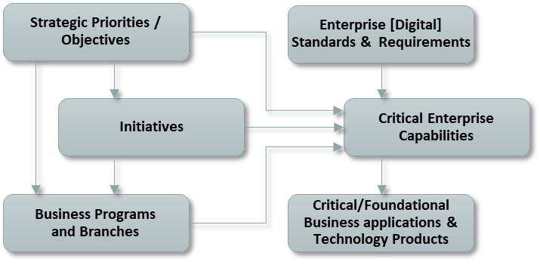
Knowledgebase + Key Artefacts/Deliverables
Minimum Viable EA:
Strategic EA:
Embedded EA:
Knowledgebase:
Single window to EA with a centralized information store for architecture artefacts and deliverables
Basic/Foundational Enterprise [Architecture] Repository, used by architects only, with the following core concepts
Knowledgebase:
Extended Enterprise [Architecture] Repository offered as a service to partners
Knowledgebase:
Extended Enterprise [Architecture] Repository offered as a service to clients
Additional enterprise objects to support Strategic and Embedded EA could include:
Business Services
Information Concepts / Business Data Entities
Business Processes
Strategic Outcomes
Application Services / Microservices
[…]

Slide 19
Proposed Key questions
EA or BA? BA
What is the output?

Slide 20
Appendix

Slide 21
Architecture Guidance & Assurance across HC-PHAC investment lifecycle
Investment Lifecycle
Strategic Planning
Portfolio Planning and Management
Initiative Definition and Planning
Solution Design to Deployment
Delivery Benefit Realization
Strategic requirements
Enterprise / Business Architecture
Clarify enterprise strategy (official, emerging and shadow) and describe the resulting enterprise future state
Help define or reframe transformation and innovation opportunities aligned to business outcomes
Establish more transparent, evidence- based decision-making on investment portfolio that reflects and leverages the enterprise needs and plans
Help clearly articulate business impacts, benefits, constraints and integration potential of proposed change
Solution Architecture
Policy requirements
Embed value / enterprise design requirements into conceptual solution design to maximize enterprise alignment and outcomes
Identify major projects’ interdependencies and re-use opportunities
Architecture objectives

Slide 22
Architecture Guidance & Assurance across HC-PHAC investment lifecycle
Investment Lifecycle
Strategic Planning
Portfolio Planning and Management
Initiative Definition and Planning
Solution Design to Deployment
Delivery Benefit Realization
Strategic requirements
Enterprise Architecture
EARB: Conceptual design endorsement
Enterprise Frameworks, Reference Models and Standards
Enterprise Capabilities Portfolio Management
Enterprise Architecture Capability-based Guidance
Concept Case Review
Solution Architecture
Policy requirements
Solution Architecture QA and Guidance
Business Analysis QA
Option Analysis QA
Procurement Guidance
Technical Architecture Guidance
Digital Transformation Enablement (Project Portfolio Management
Application & Technology Portfolio Management
IT Business Relationship Management
Strategic Objectives
Business Programs and Branches
Initiatives
Enterprise Capabilities
Enterprise Requirements
Applications
Legend:
Application Portfolio
Project Portfolio
EA Repository
Minimum Viable EA
Architecture Delivery
Strategic EA

Slide 23
What Value is Needed and Expected From EA?
Enable Digital Business
Use ecosystem modeling to identify new business models
Explore how disruptive technologies will impact current business model
Evolve business capabilities to accommodate right blend of agility, reliability, security and scalability
Address Emerging Technologies
Identify and proactively address risks and business opportunities resulting from cloud, social media, big data, mobility, internet of things, and so on.
Plan how business capabilities need to evolve to address those risks and opportunities.
Increase Speed and Agility
Reduce time to market of new products/services.
Enable new functionality needed.
Enable interoperability and agility in response to changing needs.
EXAMPLES
Reduce Risk
Improve alignment of IT initiatives with strategic business needs.
Reduce chance of "dead-end" technology investments.
Improve Operational Efficiency
Increase economies of scale through standards.
Eliminate unused solutions, applications and technologies.
Deliver a manageable IT environment.
Improve Effectiveness
Focus investment where it produces the most business value.
Improve user experience by reducing complexity.
Notes:
Do not expect that all stakeholders will automatically support an enterprise architecture effort that will be all things to all people. At specific points in time, the usage pattern of enterprise architecture will shift, depending on people and other environmental demands of the EA effort. Use stakeholder analysis and an enterprise architecture maturity assessment to understand what is the possible value that EA can deliver, realistically, today.

Slide 24
How can we leverage opportunities to rebalance EA?
Enterprise Scope
Operations Architecture:
Enterprise Architecture:
Identify enterprise infrastructure services that can be shared or upgraded?
Identify cost savings?
Implement enterprisewide strategic capabilities such as collaboration, app integration or mobility?
Address risks & opportunities from disruptive technologies?
Improve investment management?
Support budget cuts?
Identify services that can be shared?
Help M&A or divestitures?
Tactical Focus
Strategic Focus
Project Architecture:
Program Architecture:
Reduce project risk?
Support reuse of existing enterprise services?
Ensure development of new services that other solutions can leverage?
Support major business unit planning?
Ensure that major systems upgrades build new holistic and integrated capabilities?
Enable pace layering?
Local Scope
Graphic from Gartner

Slide 25
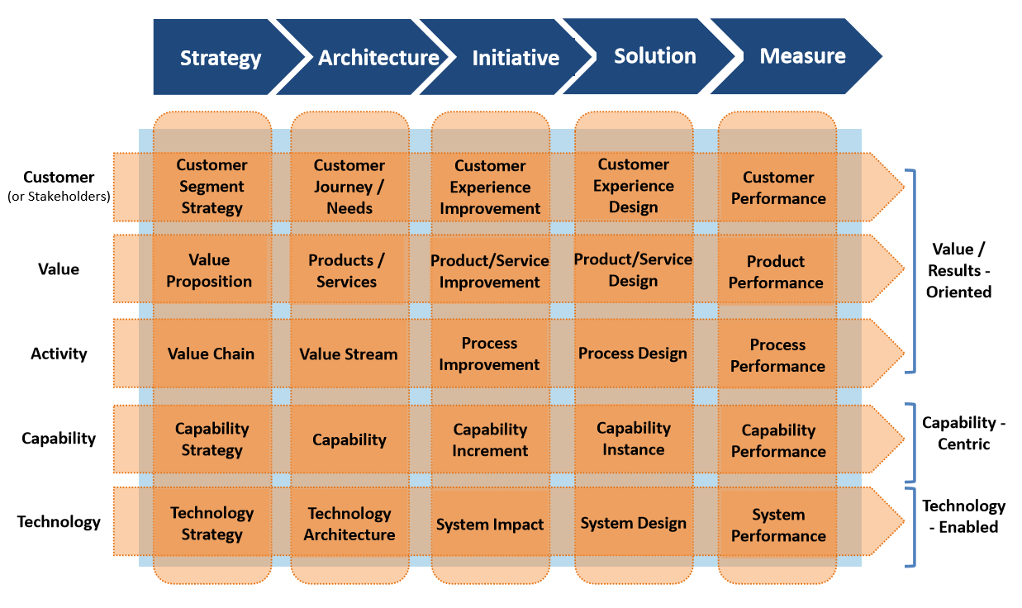
BMO EBA Lifecycle
‘Architecture’ stage:
Future state architecture and standards
Alignment with IT Strategy?
Support and enable strategy development and strategic planning
Core BA focus
Guide and direct initiative planning and solution design
Provide alignment and traceability between strategy and execution; and between business and technology

Slide 26
Business Architecture enabling Strategy Execution

Slide 27
Business Architecture enabling Solution Design & Deployment
Source: A Guide to the Business Architecture Body of Knowledge® (BIZBOK ® Guide)

