Slide 1
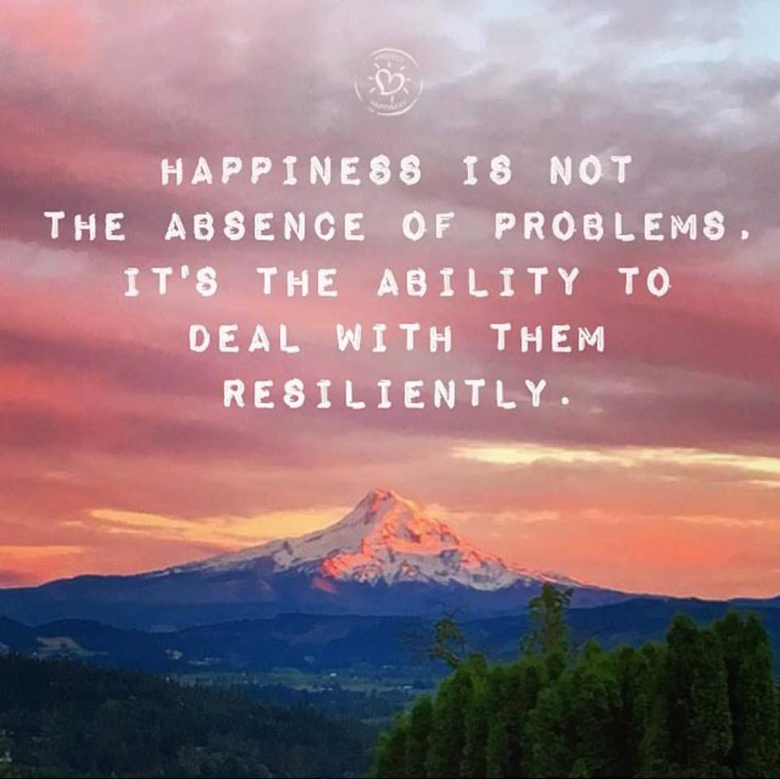
Welcome
Thanks for joining un in week 6, we’ll start soon
As with previous webinars, this webinar will be recorded for sharing further
Notes:
Slide for when people wait to start the WebEx
REMEMBER:
Give participants the privilege to chat to “all participants” (by Ctl-K, checking the chat for “all participants” box)
Start the recording, and pause it while waiting for the participants to join.
Continue recording for starting the session, just before removing this slide.
Ask participants to use the check for yes and cross for no, so they warm up to the idea of interacting.
---
Please, via the chat box, introduce yourself with
Name
Department or Agency
Where you’re located
Your expectations for this session

Slide 2
Mindful Change Leadership Development Program
Week 7 (of 8)
27 May 2021
Notes:
To mention the following in French:
« Comme avec toutes les sessions du GC, s'il vous plaît, sentez-vous libre d'utiliser la langue de votre choix pour poser des questions ou participer à la discussion., La séance d'aujourd'hui sera conduit principalement en anglais, il y aura d'autres sessions en français qui seront promus via le groupe GCConnex (ou donner des dates précises, si disponible). »
As with all GoC sessions, please, feel free to use the language of your choice to ask questions or participate in the discussion., today’s session will be conducted mainly in English, there will be other sessions in French that will be promoted via the GCConnex group (or give specific dates, if available).

Slide 3



Mindful Centering Exercise
Time required: 2 minutes
Repeat the following phrases, aloud if possible and whispering is good too
  I am a kind person (Je suis amiable)
  I love myself (Je m’aime)
  I do my best (Je fais de mon mieux)
  I am enough (je suis assez moi-même)
Notes:
Mindful breathing https://www.youtube.com/watch?v=ZE-r-x2T4ok
This is one way of doing it, getting it depends on the practice of.
Noticing is very important in the practice of Mindfulness.
Noticing where your thinking is, that’s the first step to become more Mindful.

Slide 4
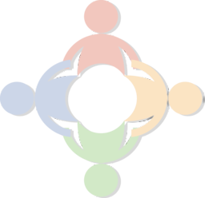




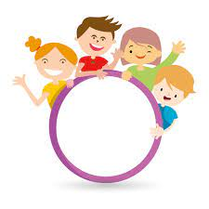


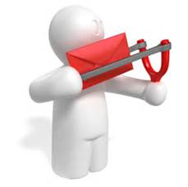

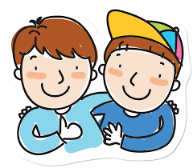

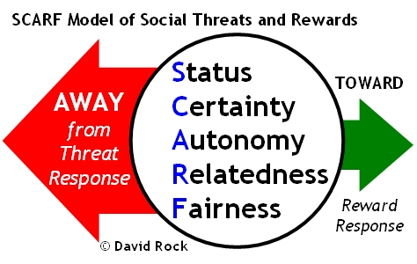

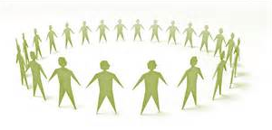



Questions/Insights from last week (6)
Notes:
Plenary: Open mic to have your comments, challenges, surprises… particularly would like to hear from someone who hasn’t spoke
Raise your hand to speak, type in the chat… be mindful about the time, let’s take as many as we can in 10 mins.

Slide 5

Agenda – week 7
Centering exercise
Debrief from last week 6
Today’s intentions
  Mindful Walking Exercise
  Mindful Loving Kindness
Some articles regarding, EQ, Leadership
Your take away assignment

Slide 6

Today’s Goals: Focus, Compassion, Clarity, Creativity
  Mindful Walking Exercise
  Mindful Loving Kindness

Slide 7

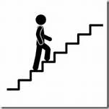

Mindful Walking Exercise
“Where can you take a mindful walk during your day?”
“If you can, go outside and into nature when you walk. Researchers in Finland found that city dwellers reported significantly more stress relief when they took a walk through a park or woodland than those who strolled through a city center.” - https://siyli.org/mindful-walking/
For us, let’s go for a mindful walk on the stairs, just one floor (up or down), and come back.
Pay attention to your pace, your breathing, your
steps, your motion, your effort, your balance,
your heart.
Notes:
Let’s take 10 minutes… starting now

Slide 8
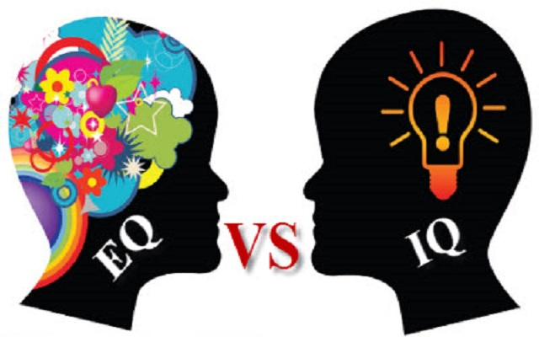
EQ: a core leadership skill
Self-awareness… allows people to tune into their feelings… involves recognising one’s own emotions and their effects, and also having the self-confidence about one’s self-worth and capabilities.
Self-control… maintaining standards of honesty and integrity, taking responsibility for one’s behaviour, being adaptable in the face of change and being innovative and open to new ideas.
Motivation… passion for work … not just be about money and status.
Empathise…probably one of the most important … can read an organisation’s power dynamics, emotional currents and power relationships, while sensing what people working for … what they are looking out for.
Interpersonal skills… to guide and influence people, they should know how to negotiate and resolve conflicts, collaborate, co-operate, to create group synergy in pursuing collective goals.
https://bluenotes.anz.com/posts/2017/04/emotional-intelligence-a-core-leadership-skill/
Notes:
Emotional intelligence: a core leadership skill - Article
According to Salovey and Mayer there are five categories of emotional intelligence.
Self-awareness. The ability to recognize and understand personal moods and emotions and drives, as well as their effect on others. Hallmarks* of self-awareness include self-confidence, realistic self-assessment, and a self-deprecating sense of humor. Self-awareness depend on one's ability to monitor one's own emotion state and to correctly identify and name one's emotions.
[*A hallmark is a sure sign: since self-awareness is necessary for, say, realistic self-assessment, that is, without self-awareness no realistic self-assessment, the presence of of realistic self-assessment is a sure sign (sufficient to conclude that there is) self-awareness.]
Self-regulation.The ability to control or redirect disruptive impulses and moods, and the propensity to suspend judgment and to think before acting. Hallmarks include trustworthiness and integrity; comfort with ambiguity; and openness to change.
Internal motivation. A passion to work for internal reasons that go beyond money and status -which are external rewards, - such as an inner vision of what is important in life, a joy in doing something, curiosity in learning, a flow that comes with being immersed in an activity. A propensity to pursue goals with energy and persistence. Hallmarks include a strong drive to achieve, optimism even in the face of failure, and organizational commitment.
Empathy. The ability to understand the emotional makeup of other people. A skill in treating people according to their emotional reactions. Hallmarks include expertise in building and retaining talent, cross-cultural sensitivity, and service to clients and customers. (In an educational context, empathy is often thought to include, or lead to, sympathy, which implies concern, or care or a wish to soften negative emotions or experiences in others.) See also Mirror Neurons.
It is important to note that empathy does not necessarily imply compassion. Empathy can be 'used' for compassionate or cruel behavior. Serial killers who marry and kill many partners in a row tend to have great emphatic skills!
Social skills. Proficiency in managing relationships and building networks, and an ability to find common ground and build rapport. Hallmarks of social skills include effectiveness in leading change, persuasiveness, and expertise building and leading teams.

Slide 9
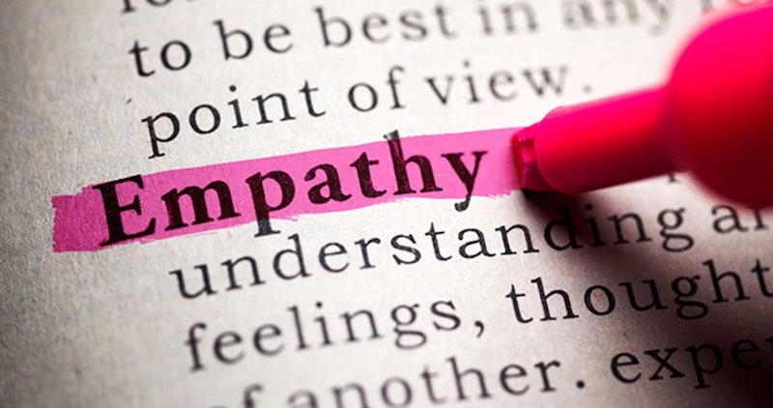
Empathy-is-key-to-effective-leadership
The leadership principle my grandfather shared with me as a child is the same one I now teach Fortune 500 execs : Empathy
Without empathy, you will
never move past zero.
Empathy means
understanding that the
decisions you make
every single day impact
not just you — when you
understand that, you move from “me” to “we.”
http://www.businessinsider.com/why-empathy-is-key-to-effective-leadership-2017-4
Notes:
The leadership principle my grandfather shared with me as a child is the same one I now teach Fortune 500 execs – Article
http://www.businessinsider.com/why-empathy-is-key-to-effective-leadership-2017-4
Empathy Vs Compassion - https://ascentleader.org/difference-between-empathy-and-compassion/

Slide 10
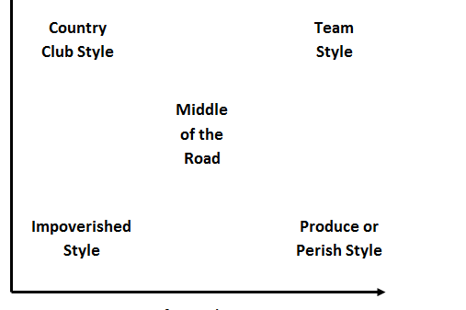
Why self-aware leaders are more productive and effective
Self-awareness is the least visible emotion, but is an incredible predictor of the level of emotional intelligence.
Those who have high self-awareness tend to have at least 10 or 12 competencies, while those who are low have one or two
Distinguish star performers:
Strong achievement drive and high achievement standards
Ability to influence
Conceptual thinking
Analytical ability
Initiative in taking on challenges
Self-confidence
EQ
EQ
EQ
EQ
Four are emotional competencies
* SIYLI – book, page 13
http://www.telegraph.co.uk/connect/better-business/leadership/self-aware-leaders-more-productive-and-effective/
https://siyli.org/resources/search-inside-yourself-book
Notes:
http://www.telegraph.co.uk/connect/better-business/leadership/self-aware-leaders-more-productive-and-effective/
https://siyli.org/resources/search-inside-yourself-book

Slide 11
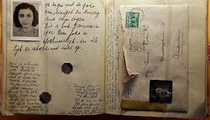
To Be An Effective Leader Keep A Leadership Journal
Ten Questions For Your Leadership Journal
What’s present for me now?
What’s going well? What’s creating that?
What's challenging? What's creating that?
What needs my attention?
What’s meaningful?
What strengths do I notice in myself?
What strengths and contributions do I notice in others?
What am I learning?
What is an action I am committing to?
Anne Frank’s journal
https://www.npr.org/sections/ed/2017/06/23/534056727/75-years-later-anne-franks-diary-still-has-much-to-teach
https://www.forbes.com/sites/hennainam/2017/04/02/to-be-an-effective-leader-keep-a-leadership-journal/#5b82f9e03b4d
http://well.blogs.nytimes.com/2015/01/19/writing-your-way-to-happiness/?ref=health&_r=1
Notes:
Writing Your Way to Happiness – Article http://well.blogs.nytimes.com/2015/01/19/writing-your-way-to-happiness/?ref=health&_r=1
To Be An Effective Leader Keep A Leadership Journal – Article https://www.forbes.com/sites/hennainam/2017/04/02/to-be-an-effective-leader-keep-a-leadership-journal/#5b82f9e03b4d
Picture of Ann Frank’s diary
What’s present for me now? This may feel like an esoteric question to start with but it’s a useful one to get present to what’s going on in this moment for you. Take a few deep breaths, close your eyes, and bring awareness to your body. Stretch and release any tension you’re feeling. Look inside yourself. Notice what emotions are present. Often, we rush through our day without checking in with ourselves. This is an opportunity to greet an old friend and see how they are. It will set you up for rich learning in the questions that follow.
What’s going well? What’s creating that? Acknowledging what's good helps you take a step back from what may have been a very stressful day. It helps you acknowledge yourself and others for the good that’s happening. It helps you learn what’s positive and what's helping you achieve goals.
What's challenging? What's creating that? Acknowledging what's challenging focuses you on what needs your attention for learning and growth. Often, we start off by blaming others, ourselves, or circumstances for what is challenging. That’s fine and a perfectly human response. You can start there. And I urge you to look deeper within yourself. What beliefs, attitudes, or actions by you contribute to what is challenging for you? This process of taking responsibility (without judgment) is a key driver to feeling empowered as a leader rather than a victim of circumstances. It opens you up to experimenting with other ways of leading that may be more effective.
What needs my attention? This is a great question for scanning your environment, both work and personal. Your quality attention is your most precious asset. This helps you become mindful and choose where you invest it.
What’s meaningful? Finding meaning in each day keeps you fueled. It helps you learn about what values are important to you and then lead from these values. It helps you discover purpose and lead from purpose, inspiring and engaging yourself and those around you. Another question in this same vein is "what am I grateful for"? This helps you focus on what’s going right overall which helps to reduce stress, and improve overall well-being. Keeping a gratitude journal has been shown to clinically improve your immune system. It also increases resilience.
What strengths do I notice in myself? This helps you become aware of your strengths and put them into action. You may also want to journal about values you exercised. It builds confidence, trust in yourself, and resilience.
What strengths and contributions do I notice in others? This helps you appreciate and see what others are contributing. You can then powerfully acknowledge and appreciate them. It helps build productive and trusting work relationships.
What am I learning? Scan your writing. Capture any learning that feels most important.
What is an action I am committing to? This helps you move the learning forward into action.
Try this exercise out. Bullet-point answers are fine. I challenge you to try it as a gift to yourself for the next seven days. My hope is that it will help you to become a more inspired, authentic and agile leader.

Slide 12
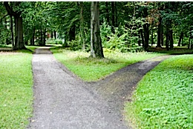
Making a Big (or Small)
Decision? / Decision Time
https://dharmawisdom.org/decision-time/
Resisting the Negative
  People who mediated focused less on the past and future, which led to them experiencing less negative emotion,” Hafenbrack says. “That helped them reduce the sunk-cost bias.
Short-term or Long-term?
  [The research doesn’t] undermine the idea that [meditating] as a long-term practice could be effective,” Barsade says. “However, one of the novel and important things [about the research] is that you can take a brief time out and get a result.
Mindful Decision Making
  “Applying mindfulness technique to decision making leads to clearer thinking and to staying connected to your core values, which is crucial to your peace of mind.” – Phillip Moffitt
http://knowledge.wharton.upenn.edu/article/making-big-small-decision-meditation-can-help/
http://dharmawisdom.org/teachings/articles/decision-time#sthash.ns79B76t.dpuf
Notes:
Making a Big (or Small) Decision? How Meditation Can Help - Article
Resisting the Negative - “People who mediated focused less on the past and future, which led to them experiencing less negative emotion,” Hafenbrack says. “That helped them reduce the sunk-cost bias.”
Short-term or Long-term? - “[The research doesn’t] undermine the idea that [meditating] as a long-term practice could be effective,” Barsade says. “However, one of the novel and important things [about the research] is that you can take a brief time out and get a result.”
http://knowledge.wharton.upenn.edu/article/making-big-small-decision-meditation-can-help/
Mindful Decision Making – Article
http://dharmawisdom.org/teachings/articles/decision-time

Slide 13
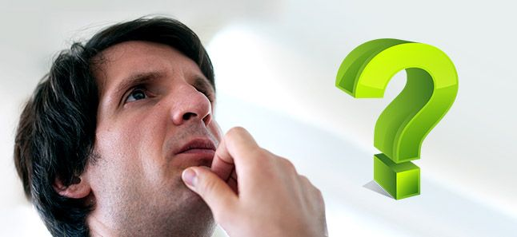
Meditate for Better Decision Making Ability
A good decision is the reflection
of your thoughts and experiences,
and this can be augmented through
meditation.
#1 – Focused mind
#2 – The right balance
#3 – Rational thinking
#4 – A strong mind
#5 – Intuition, perception and observation
#6 – Focus on the present
Calmer mind
Drop the baggage
A strong mind
Strong intuition
https://www.artofliving.org/us-en/meditation/meditation-for-you/meditation-for-better-decision-making
https://www.artofliving.org/meditation/meditation-for-you/meditation-for-better-decision-making
Notes:
Meditation for Better Decision Making Ability - https://www.artofliving.org/meditation/meditation-for-you/meditation-for-better-decision-making
https://www.artofliving.org/us-en/meditation/meditation-for-you/meditation-for-better-decision-making
https://www.artofliving.org/meditation/meditation-for-you/meditation-for-better-decision-making

Slide 14

Mindful – Loving Kindness exercise
Time required – 15 minutes
First, do a Mindfulness Body Scan – Relaxation exercise
Then, follow my voice
During this exercise, I’ll say a few sentences
I invite you to repeat the ones that resonate with you the most, the ones that are true to yourself
  May I be happy
  May I be healthy
  May I live with ease
  May I be free from pain and suffering
  May I be able to let go of everything
  for which I have no control over
  May I find success in all areas for which
  I’m passionate about
Mindfulness exercise – Loving Kindness – 15 mins (https://archive.org/details/LovingKindness15Minsb)
  Download link: https://archive.org/download/LovingKindness15Minsb/Loving%20Kindness%2015%20minsb.mp3
Notes:
Iterations, as follow…
I
Somebody you care so much, someone you admire, bring their image of their face in your mind, their eyes, their smile. And see if you could wish them these well thoughts
Repeat the sentences, if your mind is struggling, just gently come back to the sensation of your breath, and keep repeating your sentences
Next, bring to mind somebody you’re familiar with and who is going through a hard time, someone you know would benefit from this well wishes
Bring to mind someone who plays a function in your life, someone who you don’t know very well; it could be the commissionaire in your way in, perhaps the person who serves you coffee in the shop, the bus driver, or even someone in your office you don’t know that well.
Get a feeling of their presence, what they look like, see how you can wish them these well thoughts.
Next, see if you can wish these well thoughts to everyone listening today, see if you can wish these well thoughts to everyone in your team work, everyone in your building, everyone in your city.
See if you can wish these well thoughts to every single living human being in this planet.
Keep your eyes closed for a few moments
Taking a moment to show yourself gratitude for taking the opportunity out of your busy day to slow down, for reconnecting
The more we practice, the more we’re able to create this gaps between our habitual thoughts and habitual patterns
When you’re ready, you can rub your hands, creating a bit of heat; and you can put your hands over your eyes; and slowly open your eyes
And comeback.

Slide 15
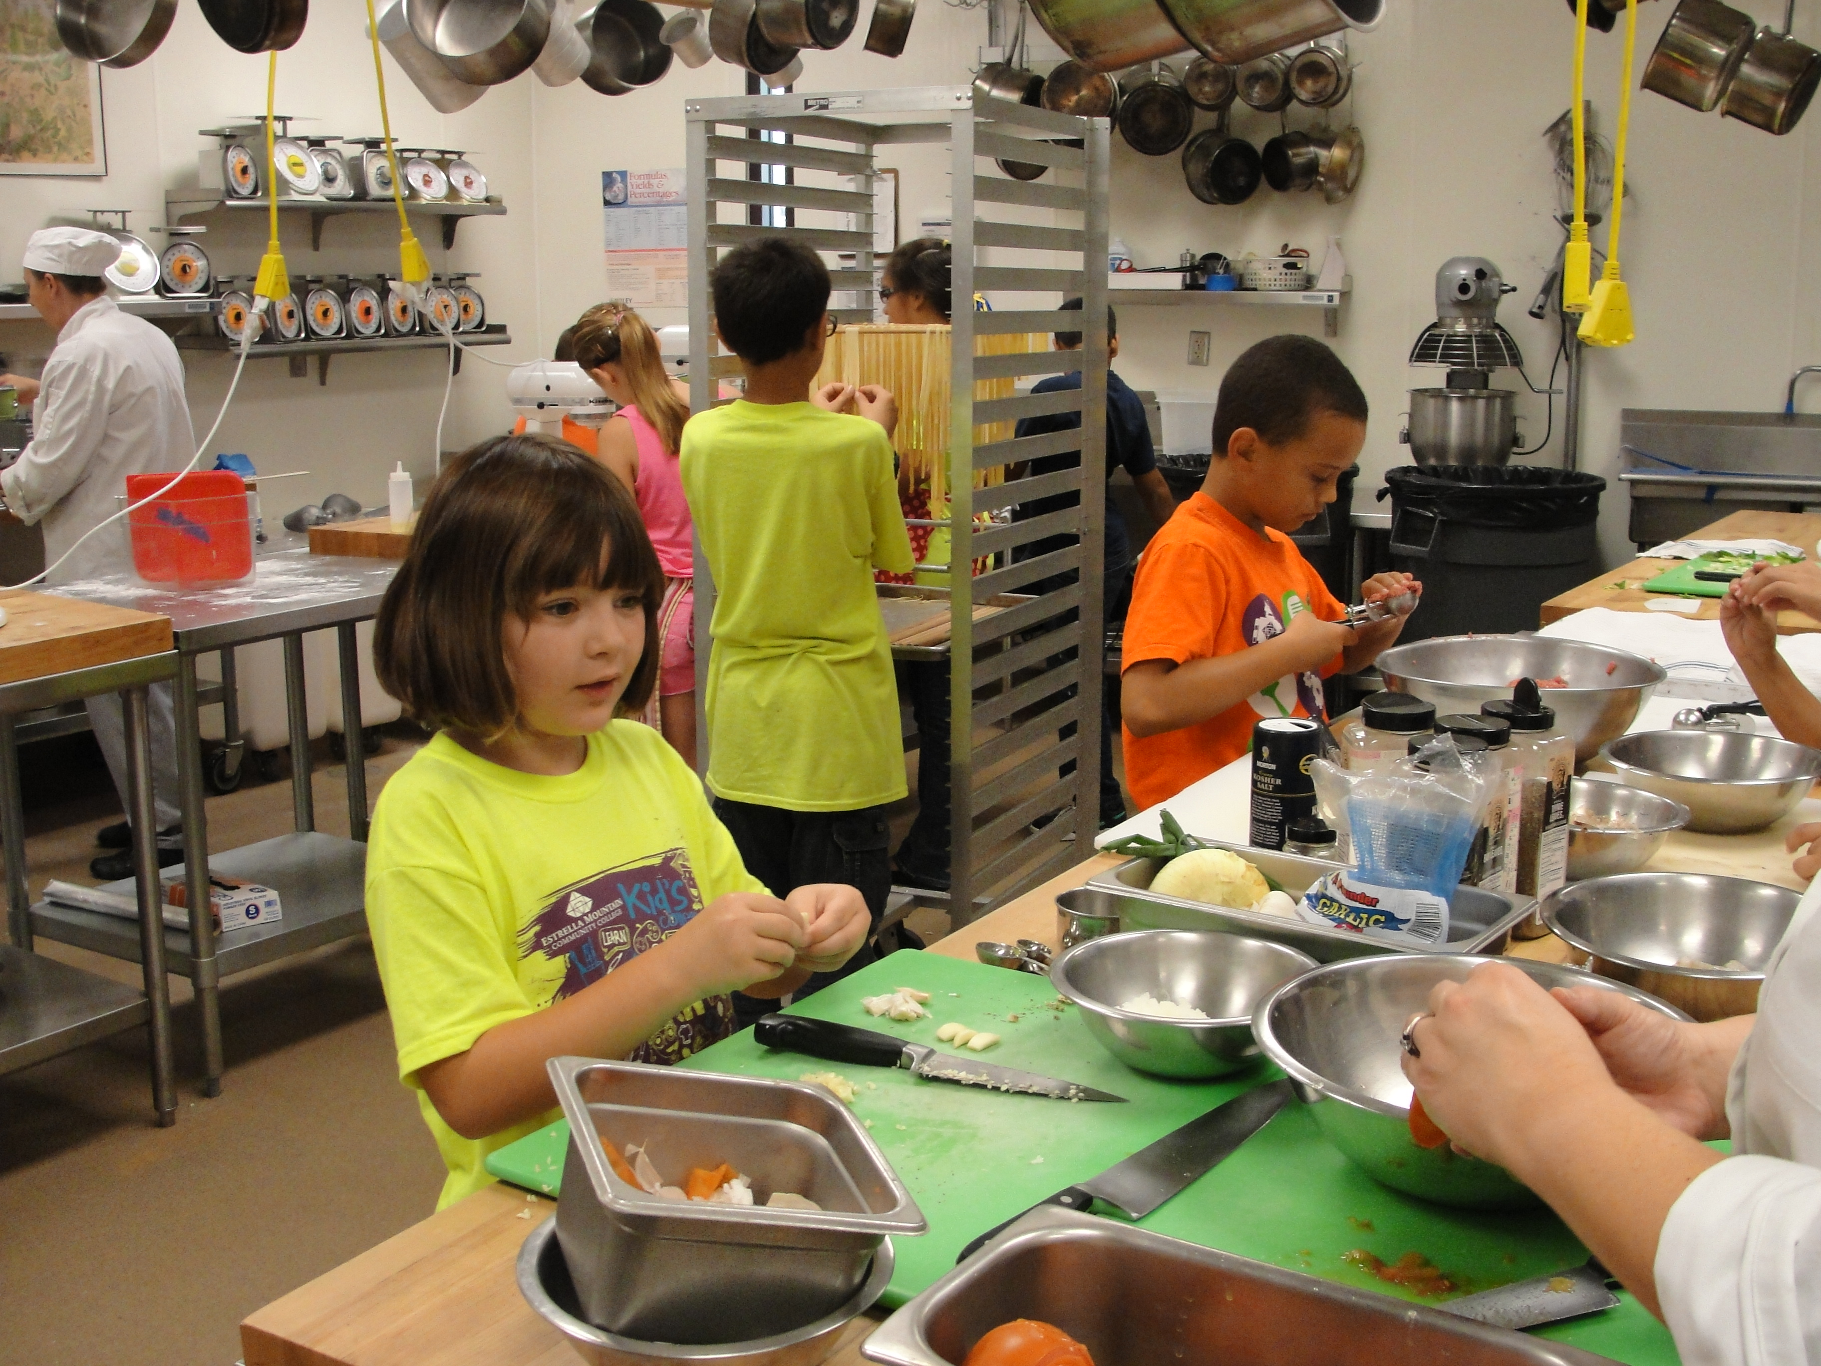
Your take away practice for week 7
Connecting – once a week with you buddy
Gratitude Journaling – daily
Practice, chose one of the following and keep doing it for the whole week - daily
  Self-compassion
  15 mins – https://soundcloud.com/mindfullivingcoach/self-compassion-meditation
  15 mins – https://soundcloud.com/awakeningcompassion/awakening-compassion-class-4
  20 mins – http://self-compassion.org/wp-content/uploads/meditations/LKM.self-compassion.MP3
  Mindful – Loving Kindness exercise
  15 mins – https://archive.org/details/LovingKindness15Minsb
Apply Mindful Centering – as needed
Apply Mindful Walking – as needed
For next and last session : Bring all the questions you have

Slide 16


Be Mindful, Be Happy /
Prenez conscience, soyez heureux
Alejandro Gonzalez https://gcconnex.gc.ca/profile/alejgonz

Slide 17
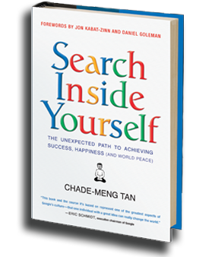

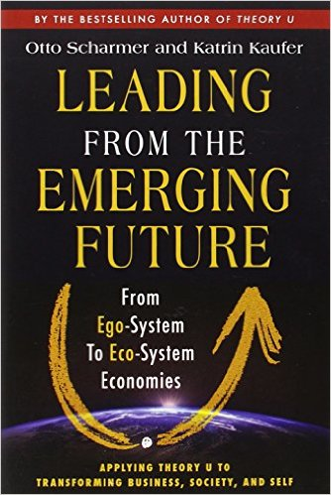
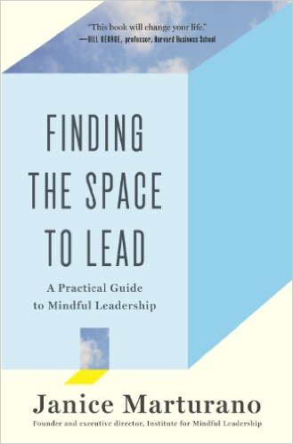
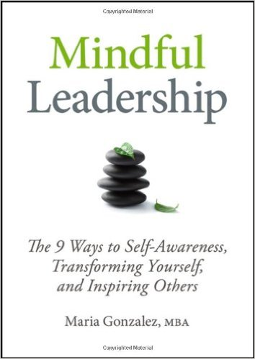
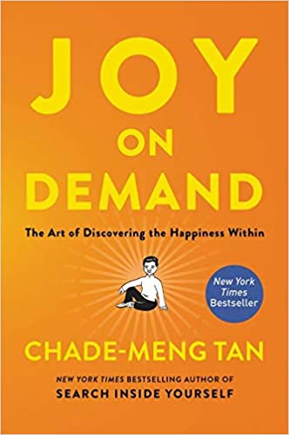
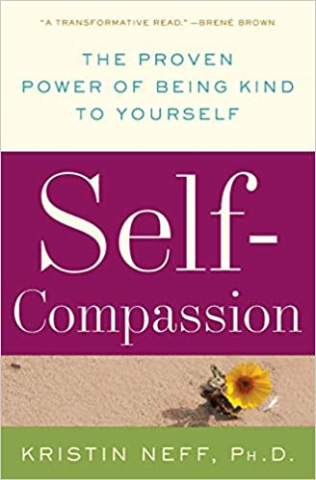
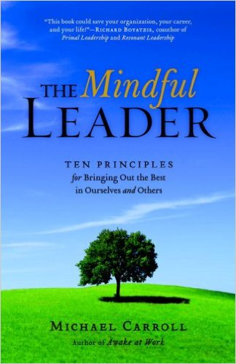
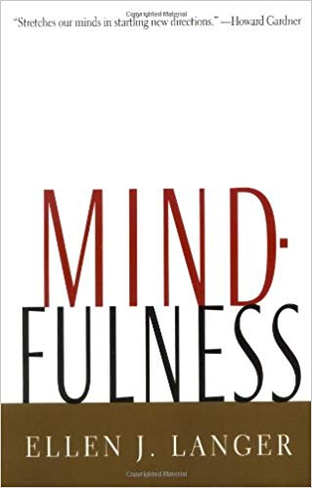
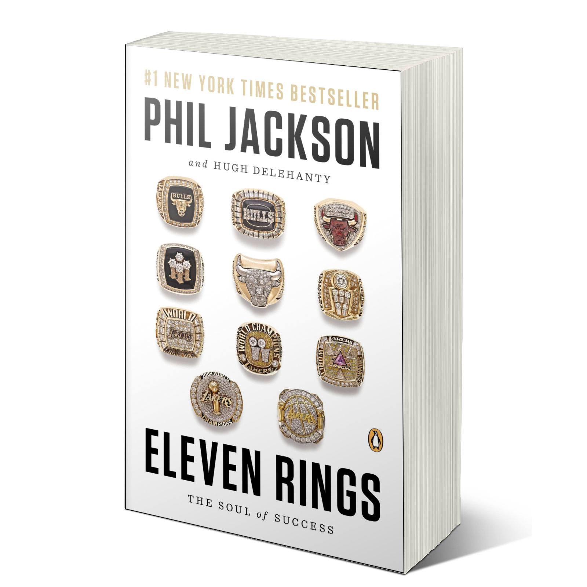
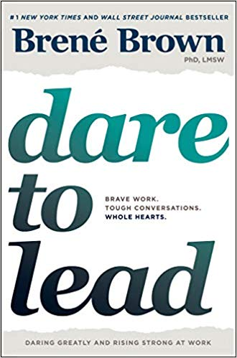

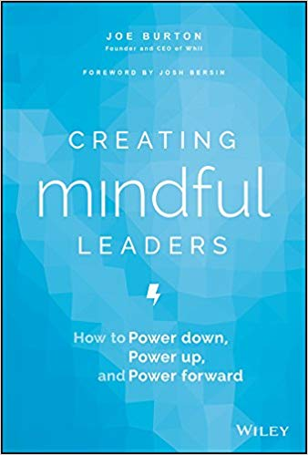
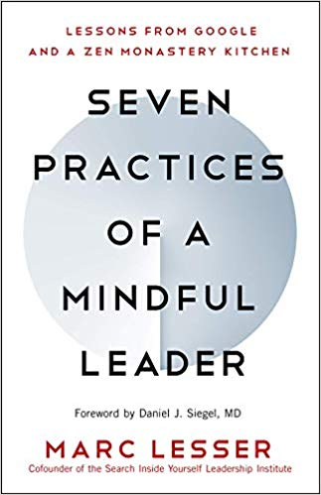
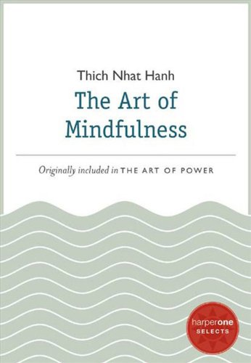
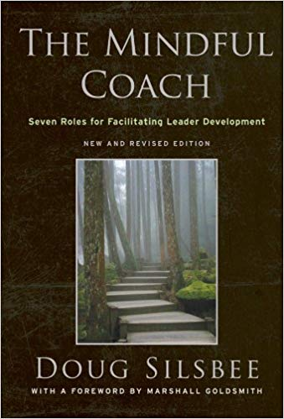
Some Book references
Notes:
References to the books:
First row
https://www.amazon.ca/Search-Inside-Yourself-Productivity-Creativity/dp/0062116924
https://www.amazon.ca/Presence-Human-Purpose-Field-Future/dp/0385516304/
https://www.amazon.ca/Leading-Emerging-Future-Ego-System-Eco-System/dp/1605099260/
https://www.amazon.ca/Finding-Space-Lead-Practical-Leadership/dp/1620402475/
https://www.amazon.ca/Mindful-Leadership-Self-Awareness-Transforming-Inspiring/dp/1118127110/
https://www.amazon.ca/Joy-Demand-Discovering-Happiness-Within/dp/0062378872
Second row
https://www.amazon.ca/Self-Compassion-Proven-Power-Being-Yourself/dp/0061733520
https://www.amazon.ca/Mindful-Leader-Management-Mindfulness-Meditation/dp/1590306201/
https://www.amazon.ca/Mindfulness-Merloyd-Lawrence-Langer-Reprinted/dp/B00C6OOLR6/
https://www.amazon.ca/Eleven-Rings-Success-Phil-Jackson/dp/1594205116/
https://www.amazon.ca/Dare-Lead-Brave-Conversations-Hearts/dp/0399592520
Third row
https://www.amazon.ca/Mindful-Leader-Embodying-Christian-wisdom-ebook/dp/B07KJGHXDW/
https://www.amazon.ca/Creating-Mindful-Leaders-Power-Forward/dp/1119484782/
https://www.amazon.ca/Seven-Practices-Mindful-Leader-Monastery/dp/1608685195/
https://www.amazon.ca/Art-Mindfulness-HarperOne-Select-Selects-ebook/dp/B005HG4H24/
https://www.amazon.ca/Mindful-Coach-Facilitating-Leader-Development-ebook/dp/B00362XL64/

