Slide 1

GC Jobs
Connecting you and your future
Notes:
Live captioning is being provided as a part of this session. You can turn on the captions by clicking on the three dots at the top of your screen and choosing the option for live captions.
If you would benefit from ASL interpretation, you can “pin” the window of our ASL interpreter and that way you will be able to see them at all times during our presentation.
For your information, the session today will not be recorded.
For audience interaction, we will be using Slido throughout the session. It is also possible to use emojis. We are going to open up with an ice breaker

Slide 2

Graduate and focused recruitment
Notes:
Title used to be Graduate Inventories and Program changed to … see slide

Slide 3
“I am a graduate and I want to make a difference”
Recruitment of Policy Leaders (RPL)
Other Specialized Recruitment Initiatives
General GC Recruitment (GC Jobs)
Notes:
Link to pertinent webpage: Public service graduate recruitment programs - Canada.ca
RPL website: Canada.ca/ recruitment-policy-leaders
GCJobs: Job search (cfp-psc.gc.ca)
Focused recruitment initiatives

Slide 4

Did you know?
Departments can rehire students in subsequent semesters who were previously hired through government student programs (FSWEP, CO-OP, RAP).
If you are hired as a student, you could be eligible for bridging. Student bridging supports the hiring of students into temporary or permanent positions in the federal public service after the completion of their educational program.
Notes:
SPEAKING NOTES:
Students can also be re-hired at other departments, not just he one that hired them in the first place/ initially.
If you are already a student and you’re interested in being bridged, I recommend self advocating and networking. You manager won’t know you’d like to stay in government unless you tell them.
*Touch on your own bridging experience if you have been bridged, or your experience as a HR advisor.

Slide 5
General government recruitment (GC jobs)

Slide 6
What is General GC recruitment?
Permanent positions are called “Indeterminate" positions
Short-term employment opportunities in Term or Casual positions (usually for a period of 90 days or less).
Notes:
In addition to the applications you can submit to our student and graduate programs, you can apply for a variety of employment opportunities throughout the year.

Slide 7
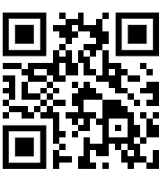
How do I apply?
Go to GC Jobs
Click on “How to apply”
Register for job alerts
Notes:
You need to create a GC jobs account to start your job search.

Slide 8



Where do I look for jobs?
Go to Canada.ca/GCJobs click on Find government jobs and subscribe to job alerts
Separate agencies’ websites
Connections/networking
Notes:
The GCJobs site provides you with all the access to the different employment opportunities within the Core Federal Public Service.
Certain government organizations do not have to post their job opportunities on the GC Jobs website. Some do, but many don’t. You may want to visit these organizations’ websites
GC Connex and GC Collab is accessible to employees (and students, casuals) for temporary opportunities or lateral movement.
Make contacts, network through events and associations, or groups on the various GC platforms (Gcconnex, GCCollab)

Slide 9

Access GC Jobs
Visit Canada.ca/GCJobs
Create an account
Search for specific job opportunities
Notes:
You can also apply for specific job opportunities through the GC Jobs portal. Although you don’t need to create an account to search, you can search any time you want, you do need to create an account to apply. So you may benefit from creating one before you start searching. That way you can apply as soon as you find an interesting opportunity.

Slide 10
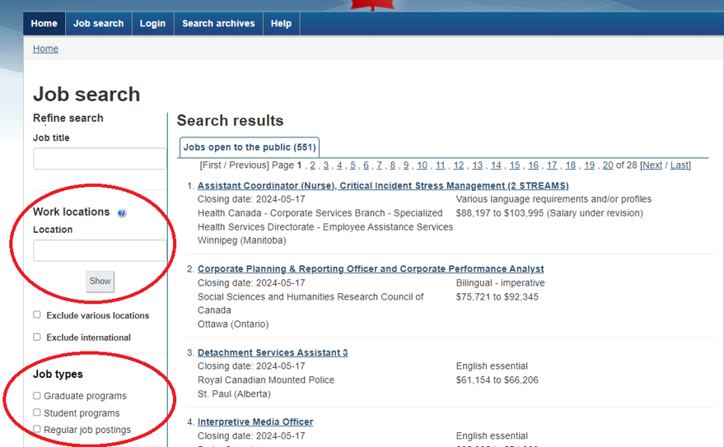
Job search
Use filters such as work locations or job types to refine your search
Notes:
Here you see all the jobs available to the public across the country.
You can now browse for job ads and use filters to refine your search.
To do so, you can filter by location (1) or by job type (2).
Each job offer has different eligibility criteria, be sure to consult the “Who can apply" section.

Slide 11
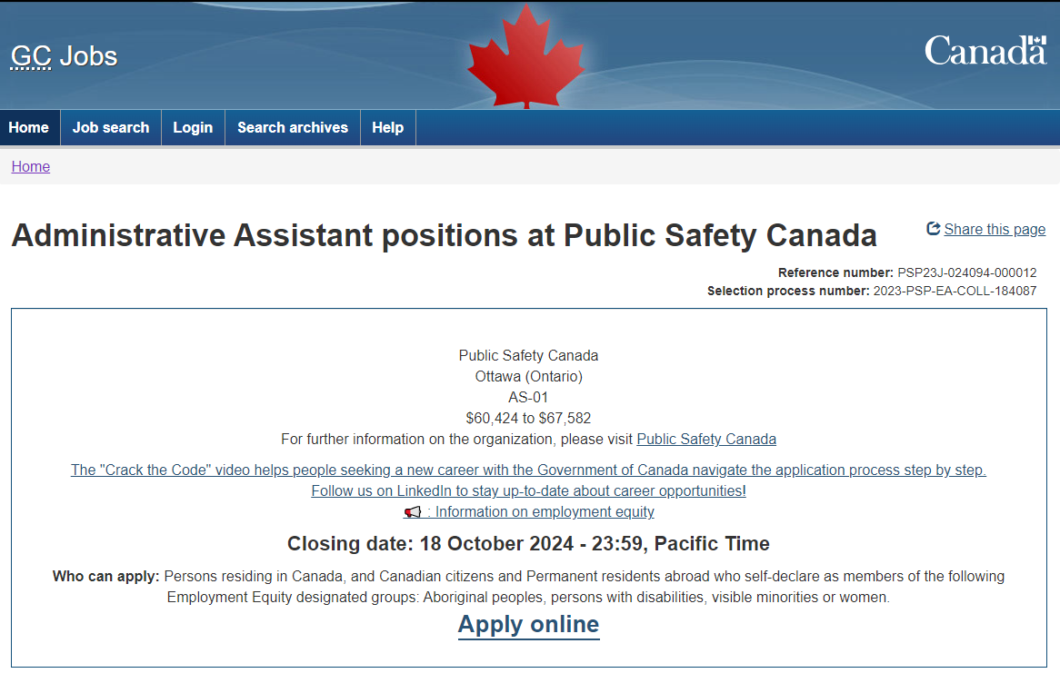
Understanding job posters
Notes:
By clicking on the job advertisement, you will have information related to :
The department / organization
The location
The occupational group
The salary
The closing date : It is very important to apply before that date
And who can apply : It can be internal to the public service or open to the public. It may also be restricted to one or more departments or to a geographic area. If you are not sure, you can ask for more information by emailing the contact listed at the bottom of the page.
You’re now ready to apply!

Slide 12

Job poster terminology
Tenure
Intent of the process
Essential for the job
May be needed for the job (assets)
Bilingual imperative (for example: BBB/BBB)
Notes:
Tenure: means the period of employment. For example, specified period with specific starting and ending dates or indeterminate where there is no defined end date, acting, etc.
Intent of the process: means the reason for the process. For example, to create a pool of qualified candidates.
Essential for the job: the minimum qualifications or criteria that are necessary for the position
May be needed: the qualifications or criteria that may be required for the position
Bilingual imperative: means that the language requirements of the position must be met at the time of appointment

Slide 13
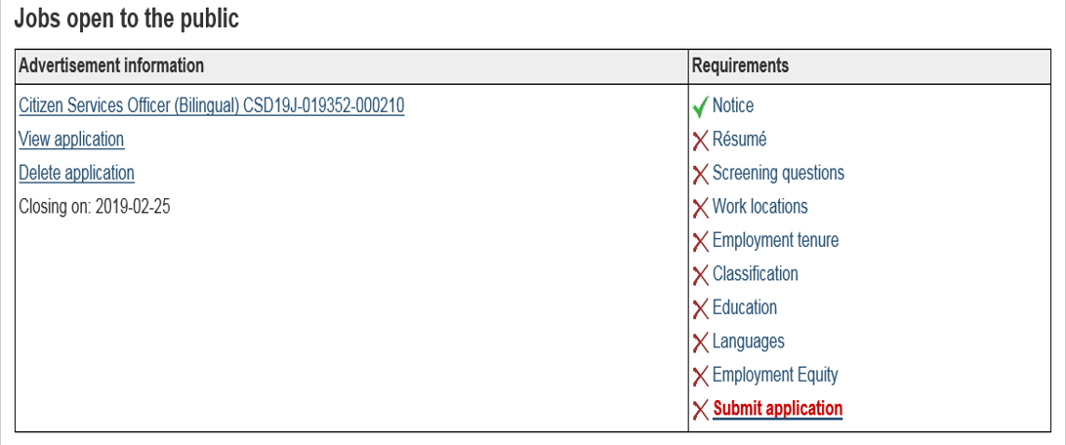
Completing a job application
Landing page image description
Notes:
Once you click on Apply Now, you will be redirected to this screen which will allow you to ensure that you have completed all the sections. In most cases, you won’t need a covering letter to submit your application. Instead, you will be asked to fill screening questions that will help employers narrow-down on the right candidate.

Slide 14
Your resume
Provide enough detailed information so that hiring managers can determine if you meet the requirements of the job.
Make sure you include:
Name and contact information
Highlights of qualifications
Education
Work Experience
Certifications
Awards, scholarships received
Volunteer experience
Notes:
Use past tense and action verbs. Give clear examples Highlights of qualifications (e.g. X years of experience, computer skills, languages spoken, linguistic profile)

Slide 15
Read Carefully and…
Follow the instructions on the advertisement
Submit before the deadline
Submit only what is required
Ensure that the information in your cover letter matches your resume
Be clear and precise
Remember that accommodations are there to help you
Key words are not enough!
Notes:
Read the entire job advertisement including the notes. Be sure your application is in before the deadline! Don’t wait until the last minute to start the application process – certain jobs will ask you to answer specific questions with concrete examples as part of the application process - allow yourself sufficient time to address all the questions.
Key words are not enough. You must provide specific examples in your application to demonstrate how you meet the essential qualifications listed
Use specific and concrete examples of your work experience.
Dates and where the experience was acquired are also important. E.g.: “In my role of __ at Employer X, I wrote reports related to the _ system. For example, in January 2012, I wrote a report on the benefits of improving the system. In order to do this, I had to conduct research through several academic journal studies in order to determine that...”
Focus on what YOU did, and what results YOU accomplished.
Submit only what was asked (e.g. sometimes a cover letter is not required)
Ensure information on your cover letter and resume match
Be succinct but it is okay to go over the industry standard of a two-page resume and one-page cover letter

Slide 16
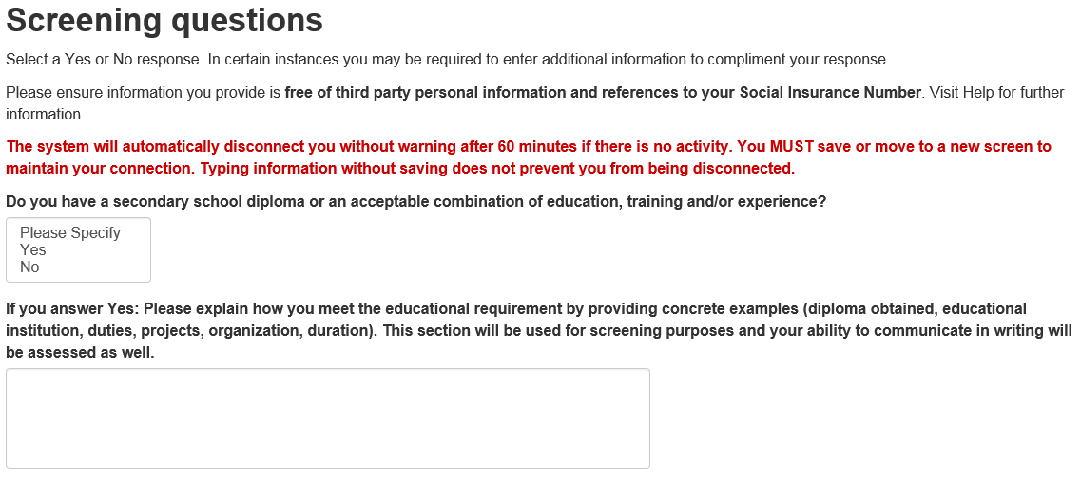
Screening questions section (1 of 2)
Notes:
- To increase the likelihood of being selected, use specific and concrete examples of your work experience.
- Make sure to specify when and where you acquired the experience. It is also important to focus on what you accomplished, and the results you obtained.

Slide 17
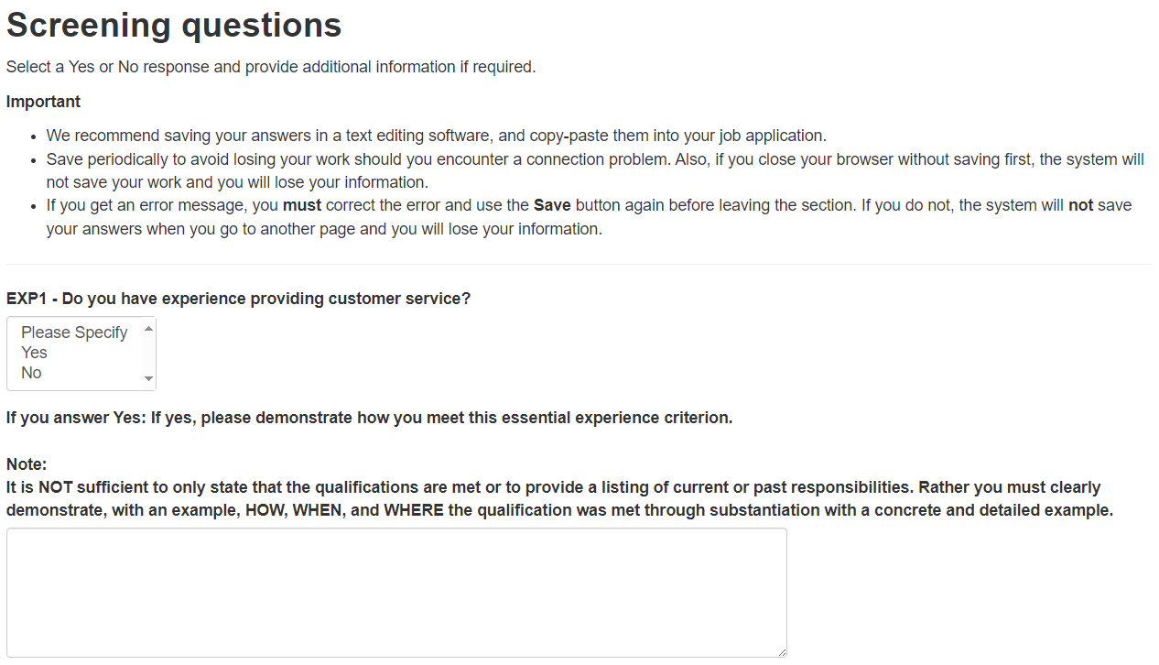
Screening questions section (2 of 2)

Slide 18

Official languages
You can use French or English at any stage in the hiring process wherever you are in Canada.
Notes:
As a candidate, you can choose to be assessed or to be contacted in either English or French at any time during the selection process (assessments can be done through an exam, an interview).
Your job interview, any tests you are required to pass, any email exchanges or phone conversations with human resources or the hiring manager, can be done in either French or English.
The exception, of course, is the Second Language Evaluation (SLE) exams!
Second language evaluation in the public service - Canada.ca

Slide 19
STAR method
Situation: Describe the situation
Task: Give details on what you had to do
Action: Give details on actions you have taken
Result: Describe the result of the situation and the impact

Slide 20





Assessment accommodations
Assessment accommodations remove obstacles from the selection process so that you can demonstrate your abilities to your fullest capacity.
If you are contacted for a test or interview and require adjustments, you should inform the hiring organization of your needs.
Notes:
As an applicant, you can request accommodation, if you have a temporary or permanent functional limitation (visible or invisible) that may impact your performance during an assessment, such as an exam or interview.
Assessment accommodation is a modification or a change made to an assessment procedure, format or content. They do not alter the qualification being assessed nor the proficiency level required but rather the way a qualification is being assessed or the setting (for ex. in a closed room rather than a common room). It is designed to remove barriers to a fair assessment and allow candidates to fully demonstrate their abilities.
Applicants MUST provide information related to functional limitations in order to be accommodated. Not the cause or the diagnosis, but how it relates to the assessment. Your request will be treated confidentially. Requesting accommodation measures is your right and we invite you to exercise that right if you need accommodation measures at any stage of the assessment process.
Communicate your needs to the hiring manager!
Keep in mind, the type of accommodation measures can depend on various factors including, the physical work environment, the hours of work required for the position, and the specific job duties.
If you have a copy of your educational institution’s Learning Intervention Plan, which contains any physical, technological and/or learning accommodation requirements established by your learning institution this can help facilitate your workplace accommodation.

Slide 21

Accommodations in the selection process
Settings
Response format
Scheduling & Timing
Presentation format
Notes:
Settings: To alter the setting of the assessment. For example, changing the test location if it is not wheelchair-accessible, providing a table and a chair that provide greater physical support, or altering the lighting conditions in the assessment room.
Response format: To allow individuals with disabilities to give responses using their preferred communication modality. For example, having the respondent use a tape recorder, a computer, a Braillewriter, or its own adaptive equipment to answer questions.
Scheduling and Timing: Another accommodation strategy is to alter the timing of the assessment such as extended time to complete a test or an interview and/or more breaks during a longer assessment period. It may also include scheduling an assessment session at the most appropriate time of day for a person.
Presentation Format: To alter the medium used to present the instructions or questions to the person. For example, a test booklet may be produced in Braille, large print or audio format. A reader could also be appropriate for persons who are blind. Another example would be to provide instructions through the use of sign language or in writing.
There are many potential factors that may impact your performance during the selection process such as:
A visible or invisible disability (including the temporary kind) from temporary limitations such as recovering from an injury; visible functional limitations such as visual or mobility issues;
Religious reasons
Personal needs (family constraints, time constraints, illness)
It is not limited to disabilities – accommodations can also be for:
Religious reasons
Personal needs

Slide 22



Assessment Accommodation
Help remove potential barriers related to testing (exam / interview)
Does not change the nature or level of the qualification evaluated.
If you require assessment accommodation, check the job advertisement or assessment invitation to find the responsible contact so you can inform them as soon as possible.
Notes:
Applicants MUST provide information related to functional limitations in order to be accommodated. Not the cause, but how it relates to the assessment.
As an applicant, you can request accommodation if you think your disability-related functional limitations will not allow you to fully demonstrate your abilities.
Although assessment accommodations do not alter the qualification being assessed nor the proficiency level required, they may, however, alter the way a qualification is assessed or the setting. Assessment Accommodations don’t change WHAT is being tested or the level required but it may change HOW it is being tested

Slide 23
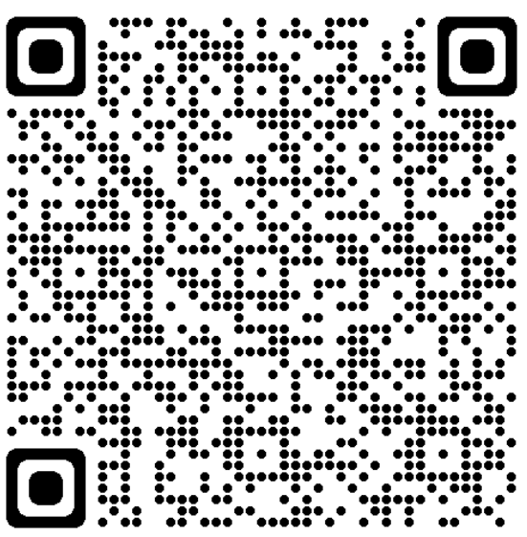
Self-declaration, What is it?
When you apply to any Government of Canada job, you’ll be asked to fill out a self-declaration form to identify yourself as a member of an employment equity group.
Self-declaration is voluntary
Self-declaration is highly encouraged
Self-declaring is a way to fully demonstrate your skills and abilities
Self-declaring help increase the representation in the federal public service
Notes:
Some jobs are open specifically to members of an employment equity group.
Example: Jobs only open to person with a disabilities, as with the Employment Opportunity for Students with Disabilities, part of the Federal Student Work Experience Program - Canada.ca.
For more information, consult the webpage: Self-declaring for Government of Canada jobs - Canada.ca (scan QR code)
Every time you apply to any Government of Canada job, you’ll have the option to self-declare that you belong to an employment equity group. If you don’t self-declare at the application stage, you can still self-declare at any point during the appointment process.

Slide 24

Who can self-declare?
You can self-declare if you are a member of one or more of these 4 designated employment equity groups as identified by the Employment Equity Act:
  Women
  Indigenous Peoples
  Persons with disabilities
  Members of a visible minority
Notes:
SPEAKING NOTES:
Aboriginal peoples in the context of the Employment Equity Act means persons who are Indians, Inuit or Métis
Persons with disabilities: means persons who have a long-term or recurring physical, mental, sensory, psychiatric or learning impairment and who
(a) consider themselves to be disadvantaged in employment by reason of that impairment, or
(b) believe that an employer or potential employer is likely to consider them to be disadvantaged in employment by reason of that impairment,
(and includes persons whose functional limitations owing to their impairment have been accommodated in their current job or workplace)
Members of visibles minorities : means persons, other than Aboriginal peoples, who are non-Caucasian in race or non-white in colour.
Note: You may self-declare to more than one designated group
Employment Equity Act purpose : The purpose of this Act is to achieve equality in the workplace so that no person shall be denied employment opportunities or benefits for reasons unrelated to ability and, in the fulfilment of that goal, to correct the conditions of disadvantage in employment experienced by women, Aboriginal peoples, persons with disabilities and members of visible minorities by giving effect to the principle that employment equity means more than treating persons in the same way but also requires special measures and the accommodation of differences.

Slide 25
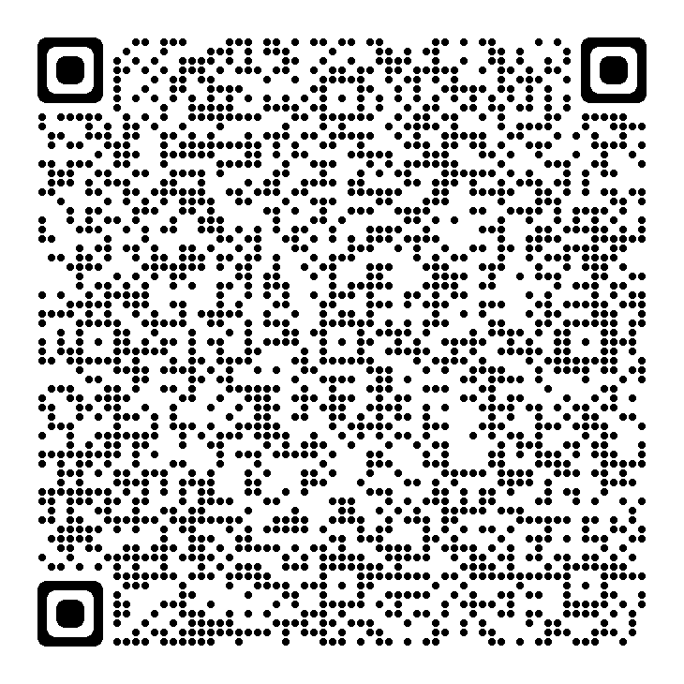
Self-declaring…Why?
If you identify as belonging to one or more employment equity group, and you choose to self-declare on your application, you will:
  Become eligible for tailored programs, mentorship, learning and networking activities;
  Help build a public service that represents Canada’s diversity;
  Allow the public service to identify and eliminate barriers to hiring faced by members of employment equity groups, by measuring their success rates at each step of the hiring process.
Notes:
SPEAKING NOTES:
At the top right corner, you will find the QR code to the webpage Self-declaring for Government of Canada jobs - Canada.ca for more information.
Self-declaration is used:
To identify who belongs to an employment equity group in a hiring process. Some job opportunities are open specifically to members of those groups.
To compile information on designated employment equity group members appointed to the public service, for reporting to Parliament.
For statistical purposes (reports, analyses and special studies).
The Public Service of Canada is committed to building a skilled, diverse workforce that reflects Canadian society. We promote employment equity and, while voluntary, we encourage you to indicate on your application if you are a woman, an Aboriginal person, a person with a disability or a member of a visible minority group.
Self-declaration is voluntary and we encourage you to self declare and make a difference by sharing your unique talents, perspectives and ideas.
Self-declaration helps to create a diverse and inclusive public service that is truly representative of Canada.
By self-declaring as a member of one of the 4 employment equity groups, you’ll be considered for job opportunities where belonging to one of these groups is a requirement. For example: Students jobs only open to person with a disabilities, or students jobs offered only to Indigenous students, or students from a visible minorities.
Your information will be kept confidential.

Slide 26
Self-Declaration: Persons with a disability
If you have a disability and choose to self-declare, you will:
Lead the way to change
Make a difference by sharing your unique talents, perspectives and ideas
Help more people with disabilities to bring their skills to Canada’s public service
Help create a diverse and inclusive public service that is truly representative of Canada
Notes:
Here is the link to the PSC webpage (putting in chat): Self-declaring. Because your perspective counts. - Canada.ca. You can find job opportunities open only for persons with a disability!
For example (adjust text depending on inventories open or provide example of what has been launched):
Digital Career Opportunities for Persons with Disabilities (CS-01, CS-02, CS-03, CS-04) : Digital Career Opportunities for Persons with Disabilities (cfp-psc.gc.ca) Process #: 21-PSC-INV-PWD-EA-CS-2 Closing Date: March 31, 2022 (Mainly IT careers)
Policy and Data Analyst - Careers for Persons with Disabilities - Post-Secondary Recruitment Policy and Data Analyst - Careers for Persons with Disabilities - Post-Secondary Recruitment (EC-01, EC-02, EC-03, EC-04, EC-05) Policy and Data Analyst - Careers for Persons with Disabilities (cfp-psc.gc.ca) Process # 21-PSC-INV-PWD-PSR-EC Closing date: March 31, 2022
- Remember to self-declare as a person with a disability!
Questions? Email us at: cfp.monprochainemploi-mynextjob.psc@psc-cfp.gc.ca

Slide 27
Diversity and Inclusion – Commitments and Initiatives
Accessibility Strategy for the Public Service of Canada
Call to action on anti-racism, equity, and inclusion
Hiring of 5,000 persons with disabilities by 2025
Federal Internship Program for Canadians with disabilities
Specialized recruitment processes
Networks across government and within departments

Slide 28
So? How did we do?
Thank you for participating in our event!
Please take 5 minutes to answer our short anonymous survey.
Insert the unique QR code
for your event/activity
Notes:
SPEAKING NOTES:
The presentation is coming to an end, we have one last slide to share with you our last Tips, but before we do ….
Your feedback is IMPORTANT to us! This is how we can improve our events/information sessions to better meet YOUR needs. Let’s take a 5 minutes to let you answer this quickly.
When completing this survey, please do not provide your name, the names of others, or specific information that could identify you, as this information will be collected anonymously and reported in aggregate.
Your participation is voluntary and there will be no negative impact on your application.
Please let us know if you need a different format to participate in this survey.
If you have any questions, please send an email to: cfp.recrutementrayonnement-recruitmentoutreach.psc@cfp-psc.gc.ca

Slide 29

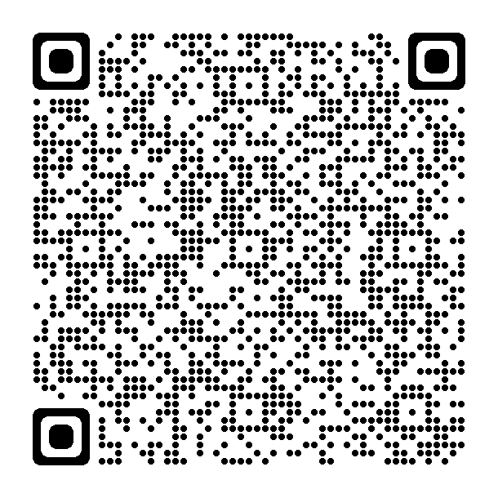
GC Jobs – Connecting you and your future
Questions? Send us an email:
cfp.pfete-fswep.psc@cfp-psc.gc.ca
Follow us on our GC Jobs Facebook page
Follow us on our GC Jobs X page
Follow @Jobs_GC on Instagram
Notes:
SPEAKING NOTES:
QR code brings to Gcjobs webpage – to apply to GC Jobs. GCJobs is the web platform where ALL the federal government job are posted – you can even ensure that you get notify when jobs meeting your job search criteria are posted. Go - create you job alert!
Make sure you don't miss anything, follow us on our social media! Various job opportunities are shared every week, we also promote some information sessions or events.

