Slide 1



Commissioner’s new powers
Modernized Official Languages Act
November 21, 2025
CLO-OCOL.GC.CA

Slide 2






Overview of the Commissioner's new powers
Grounds to refuse or cease investigation
Mediation
Compliance agreement
Investigation summary
Order
Administrative monetary penalty

Slide 3

Complaint process
On the road to compliance

Slide 4

New grounds to refuse or cease investigation

Slide 5
New grounds to refuse or cease investigation
The subject matter of the complaint has already been investigated, deemed founded and reported on by the Commissioner.
The Commissioner has already entered into a compliance agreement with the federal institution in respect of the subject matter of the complaint.
The complaint was not made within a reasonable time frame.
The federal institution has taken corrective measures to resolve the complaint.

Slide 6

Mediation

Slide 7
Mediation
Offered by invitation, at the discretion of the Commissioner
Aims to resolve a complaint through an amicable agreement rather than a formal investigation
Fast process: a complaint can be resolved in less than three months
Positive responses to invitations:
  Federal institutions: nearly half of all cases (46 %)
  Complainants: much less interest (16 %)

Slide 8

Compliance agreement

Slide 9
Compliance agreement
Agreement between the Commissioner and the federal institution subject to the complaint
Sets out the conditions that the institution is committed to meet within a specified time frame in order to resolve the violation of the Official Languages Act
Legal obligation to comply with the conditions set out in the agreement

Slide 10
Compliance agreement
Benefits of entering into a compliance agreement:
Cessation of the investigation
Active participation
Least restrictive power

Slide 11
A compliance agreement may be entered into…
Compliance agreement
At the start of the investigation
During the investigation
After sending the investigation report
After the investigation

Slide 12
Steps to conclude a compliance agreement:
Compliance agreement
Invitation
Dialogue
Signature
Verification

Slide 13
Investigation summary

Slide 14
Investigation summary
Published on the Office of the Commissioner’s website
Pre-established selection criteria
Investigation must be completed before publication of the summary
At least 30 days' notice given to the federal institution before publication

Slide 15

Commissioner’s order

Slide 16
Commissioner’s order
Issued at the end of an investigation that relates exclusively to communications with and services to the public (Part IV) or language of work (Part V)
Formally requires the institution to take certain measures to comply with the Act
Highly coercive tool, generally used as a last resort
Made unilaterally by the Commissioner

Slide 17
Commissioner’s order
To issue an order, the Commissioner must have:
Reasonable grounds to believe that the federal institution has contravened Part IV or V of the Official Languages Act
Made recommendations as part of his final investigation report
  Given the federal institution the opportunity to enter into a compliance agreement

Slide 18
Steps for issuing an order:
Commissioner’s order
Dialogue
Issuance
Verification

Slide 19


Powers pending

Slide 20
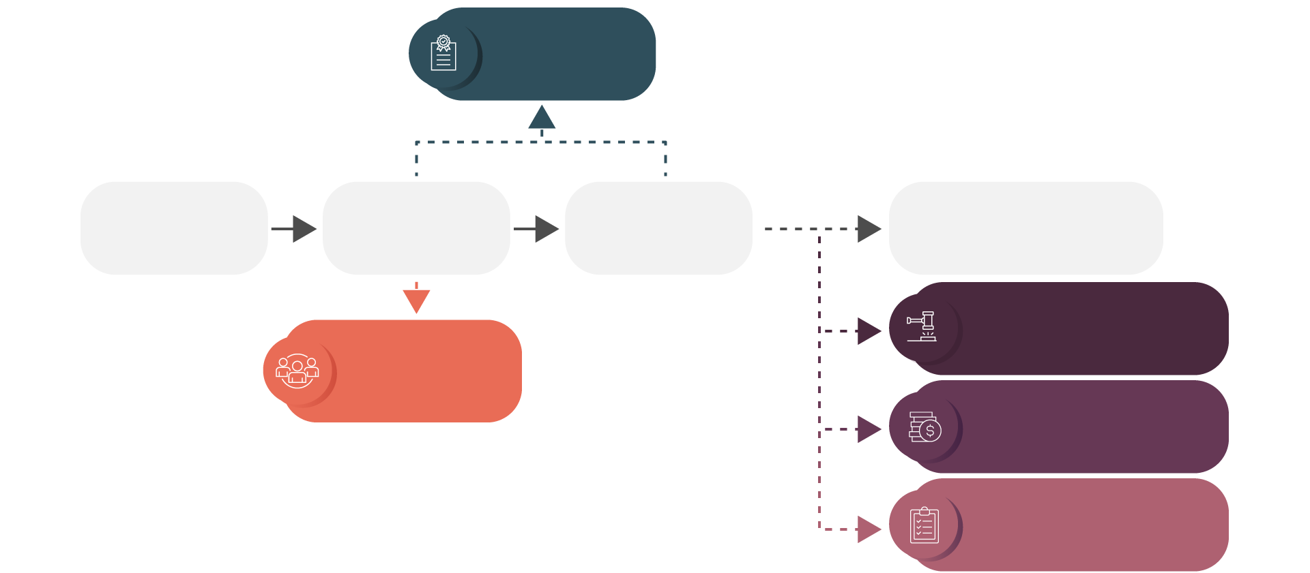
In summary…
Complaint process
Compliance agreement
Reception of the complaint
Investigation
Final investigation report
Follow-up
Commissioner’s order
Alternative dispute resolution modes
Administrative monetary penalty
Publication of an investigation summary

Slide 21

Questions

