Slide 1
Structured data pilot work to date
June 24, 2020

Slide 2
Introduction
Structured data assists machines to better understand web content, provides more rich search results, and assists in voice-based searches.
The DTO/PCO/PP and participating department Structured data pilot project explored the risks and rewards of incorporating structured data schemas into some high visibility GC pages including:
CERB, CCB (FAQ schema)
COVID-19 Symptoms (FAQ schema)
Canada.ca/COVID-19 (Special announcements schema)
Economic Response Plan (FAQ schema)
Contact page (ISED)

Slide 3
Hypothesis
Hypothesis:
Many users task journeys begin with a search.
Structured data’s rich and interactive search results enable users to advance in task completion at the point where their search was initiated.
With this pilot, we have attempted to answer:
Does structured data improve task completion?
Is adding structured data manageable and feasible for departments?
We aimed to:
Address and better understand risks and challenges
Gain insight into measurement approaches
Begin developing formal instructions and guidance

Slide 4
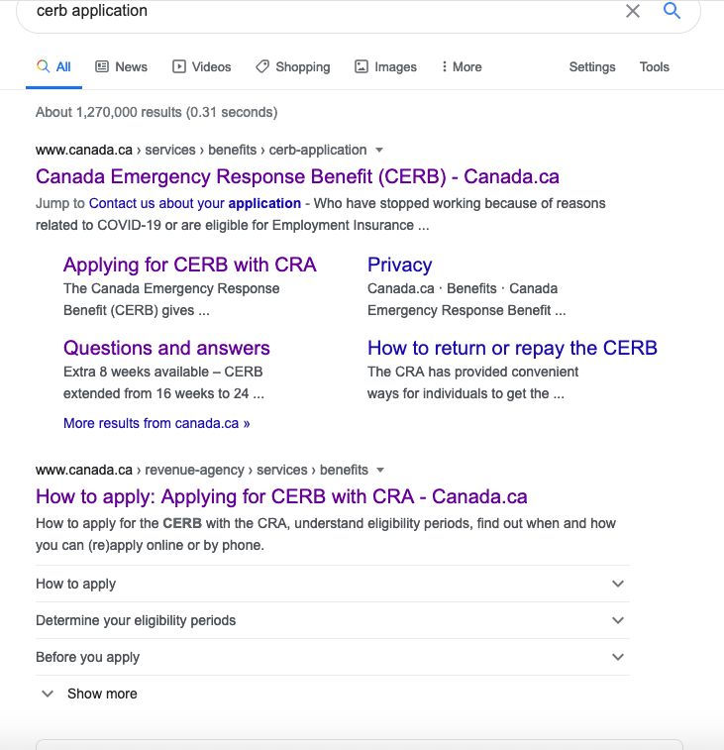
Conclusions
Statistics and test respondents suggest that some users take advantage of rich results, however, we cannot conclude that structured data improves task success
More examples, analytics and testing are required
Departments providing authoritative information need to consider structured data as part of optimization and content strategy
Other sources will fill the gap if GC does not
Workflow changes are relatively simple
Notes:
Context:
Structured data needs to accurately reflect what is on the page to appear effectively
Structured data is simple enough to add to pages, however requires care to avoid duplications and overlaps
User tests and analytics remain inconclusive; most users continue to click on the main search result link, while some users appreciate the detailed results and enhanced visibility of these results

Slide 5
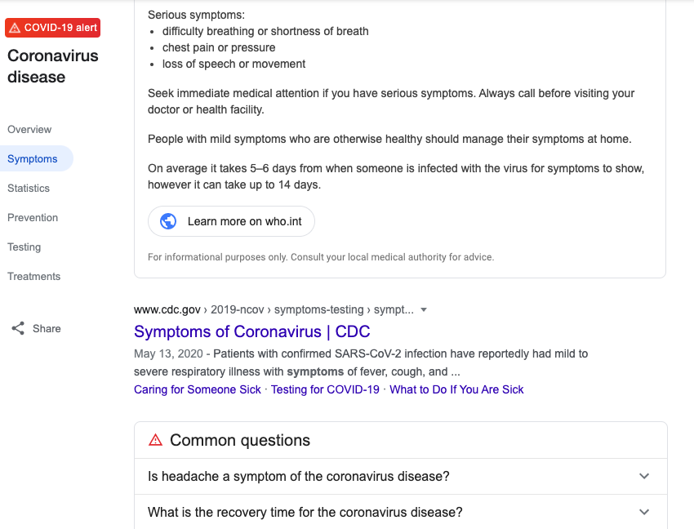
Structured responses influenced by GC (CERB) and others (WHO, CDC)

Slide 6
Structured data pilot project
discover
alpha
beta
Live - ready for general practice
1. develop hypothesis
2. Test
hypothesis
2. Validate and scale
3. Encourage adoption
Hypothesis
✔
Experiment
✔
Pages
Technology/tools
✔
✔
Participating departments
Methods of work
Training
✔
✔
Research approaches
Principles
Standards
✔
✔
✔
✔
Risk identification
Risk mitigation
Sustainability and IM standards
✔
Training
Governance
Communicate standards/expectations
Usability testing
Evaluate
✔

Slide 7
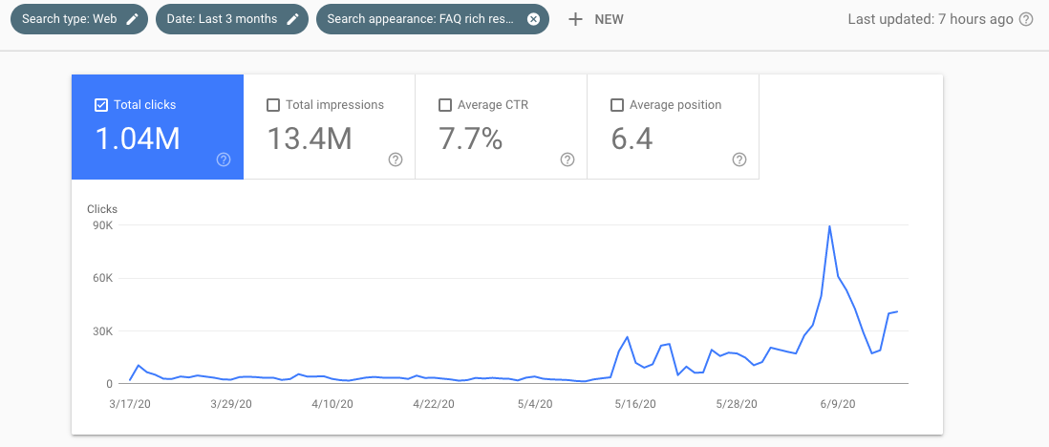
Analytics - FAQ Clicks and impressions
Over 1M clicks and 13M impressions for all FAQ schema rich results in the last 3 months, most of them since we started the pilot:
June 5
CRA: CERB
May 20
CRA: FAQ - Deferral of GST/HST
May 12-16
FIN: added S-A and FAQ to ERP

Slide 8
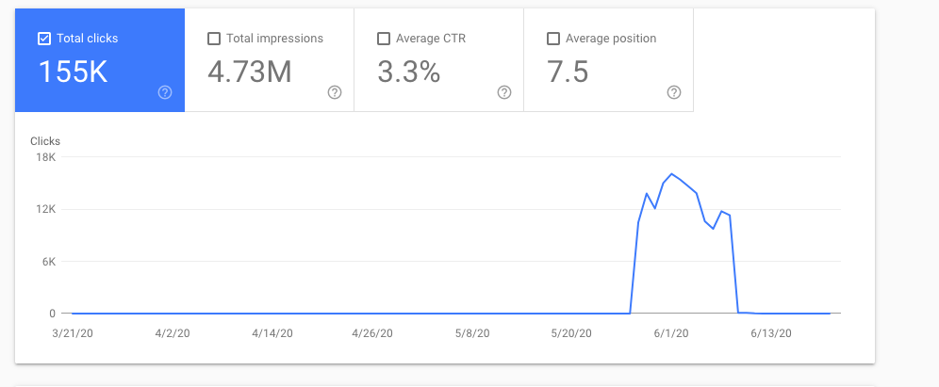
Analytics - Clicks and impressions
Over 150K clicks and 4.73N impressions for all SpecialAnnouncements rich results in the last 3 months, most of them since we started the pilot:
June 7
Special announcements “turned off” after 2 weeks
May 21
Special announcements “noticed” by Google on May 21

Slide 9
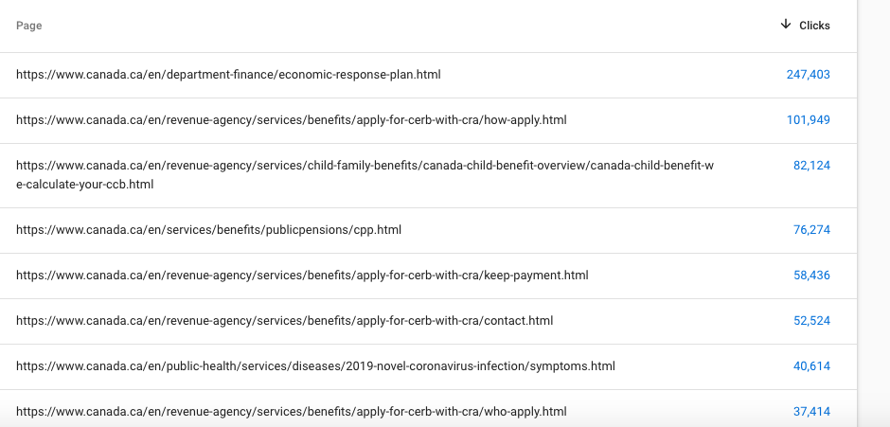
Analytics - Pages driving use
Of pages with FAQ schema added, Economic plan, CERB, and other benefits lead the way.

Slide 10
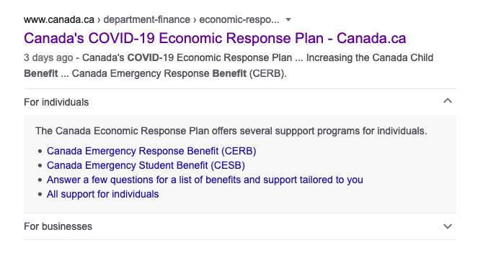
Case study: ERP page FAQ schema - typical usage pattern

Slide 11
Case study: ERP page FAQ schema Total impressions
FAQPage schema was added on Thursday, May 14. Data reflects May 14-18, and combines EN and FR
The FAQ schema rich results had
561,670 impressions
62,944 clicks (11.2%)
For the same period, the ERP page had a total of 826,441 impressions (i.e. rich FAQ schema was shown 68% of the times the ERP page was shown)
CTR is different when the snippet was shown or not:
With snippet: 11.2%
Without snippet: 6.8%
Analysis: the better CTR could be because the snippet was shown when the result was the most relevant

Slide 12
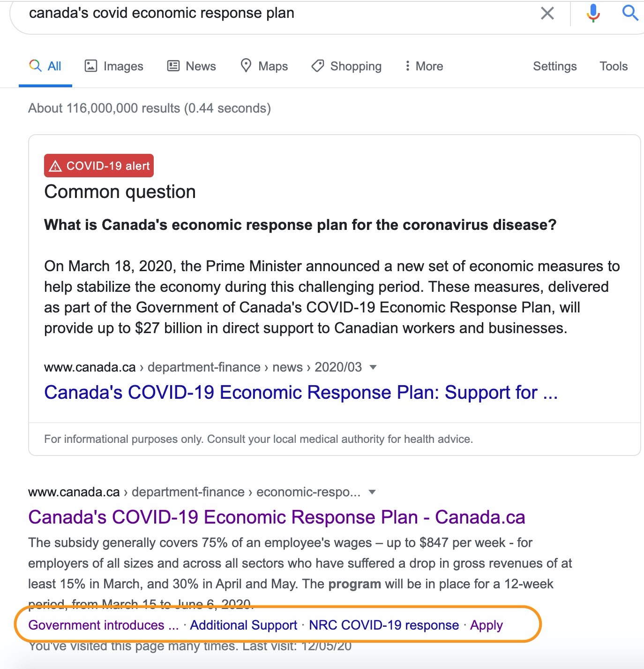
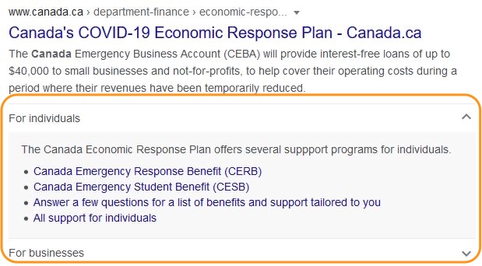
Finance Canada’s learning curve - small adjustments bring greater usefulness in results
2
1
3
Notes:
Logs:
Screenshot 1
initial attempt at Structured Data. Implemented SpecialAnnouncement
inquired if we could use Structured Data to control the area circled
Screenshot not provided
one way to control that area, we found was through the FAQPage type
We listed out top programs
Screenshot 2
improved version of FAQPage
provides a bit more structure by copying the headers
missing a 3rd FAQ - section for industries
could it be because it has low traffic?
No screenshot available
We modified the question to a custom phrase that does not exactly match anywhere on the page
RESULT: everything disappeared
Screenshot: Final_change_of_FAQ.png
re-structured the entire ERP page
matched all headers exactly
RESULT: we were able to have all sections present

Slide 13
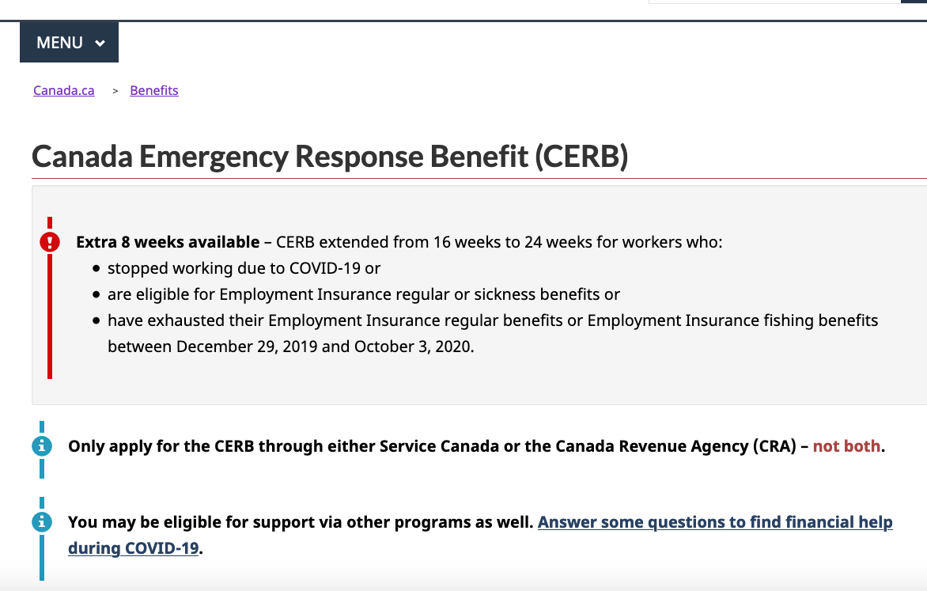
What we have learned
FAQ schema works well when content is optimized to anticipate common questions and provide answers
Co-creating content (web + program) while bearing in mind structured data is a recipe for success
Notes:
Co-creating content (publishing plus program) delivers better content and better SD results

Slide 14
What we have learned
 | What we learned | What requires further study:
Coding and technology | JSON-ld is an effective approach with a clever work-around | Training Find sustainable approach to incorporating code Understand strengths and weaknesses of different CMS RDFa
Governance and IM | Ease of use of JSON with work-arounds; | Governance Maintenance IM standards

Slide 15
Testing structured data results
Testing results hypothesis:
For some people, just seeing what the page will cover (through the Q&A) may help build trust that it is the right result to click on, even if they don't actually expand the question.
IF GC isn’t providing structured data, we “miss out” as the most visible search result in areas where GC is the trusted source

Slide 16
Testing structured data results
We asked 6 participants (3 desktop, 3 mobile) to try to find the answers to 5 different tasks, starting from a Google search result page that would likely show FAQ schema rich results.
1/6 didn’t see any rich FAQ schema results
3/6 saw the rich FAQ schema result, but didn’t use them
2/6 used the rich FAQ schema result (1 mobile, 1 desktop)
Out of the 3 who never used them, 1 said they didn't notice them, but 2/3 said they saw them, that they were useful, and it helped them - one said "shortens the time on the page".
Highlights: https://youtu.be/YhRJlz9zi4o

Slide 17
Measuring success
Metric | Structured data support
Sticking to our roadmap and socializing our plans | Weekly meetings/rapid prototyping/updates to TMC
Overcoming technical/workflow barriers | Using built-in features in AEM, we have been able to incorporate JSON-ld code quite simply
Developing guidance and instructions for GC community | Draft instructions have been developed
Developing/Following IM best practices (e.g. archiving, record-keeping) | More work to be done

Slide 18
Measuring success
Metric | Structured data support
Influencing results/results accuracy | FAQ schema results show up very quickly; sometimes not accurately Special announcements shows up more slowly, though this seems to be improving as the schema becomes more stable
Are Canadians able to find what they need? | Structured results are more highly visible on SERP User testing and analytics remain inconclusive
Are Canadians able to use the information easily? | Some users interact easily with FAQ schema results; though the majority do not interact with them User testing and analytics remain inconclusive

Slide 19
Where we could go next
Encourage departments to use Structured data when it fits a project and/or maps to user tasks.
An organic approach: Work that departments can do:
Build it into department optimization efforts
Create a space on GCWiki for case studies
Encourage departments to share examples within the community
With additional resources and a more normal context: formalizing our approaches
identifying training
developing guidance on standards, IM, UTM, CMS etc.

Slide 20
Questions and discussion

