Slide 1

Professional Development workshops
First nations initiatives
Haley Mitander, facilitator

Slide 2
We have a Variety of
15 workshops to choose from
_____________________________________
Workshops run between
2 - 5 days

Slide 3


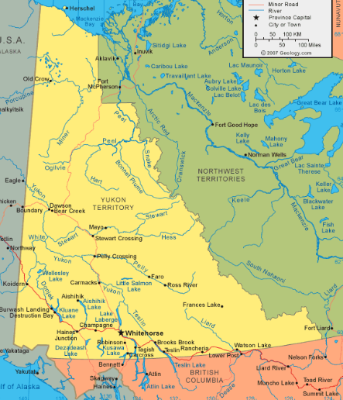
All workshops can be offered in the community

Slide 4
2 day workshops (13)
Intro to First Nations Governance and Public Administration
Understanding Land Claims
Intergovernmental Relations
Financial Management
Policy in the North
Theory and Practice of Negotiations
Organizational and Community Wellness
Strategic Planning
Trust Fundamentals
Human Resources
Communications
Community Economic Development
Power and Influence

Slide 5
3-5 day workshops
3 day workshop
Youth First Nations Leadership Training
content examples
– Traditional leadership values
- History of Canada and Yukon First nations
Discussion on key agreements
Conflict resolution
Decision making
Mock council meeting
3-5 day workshop
First Nations leadership training
(this training is customizable)
Content
Fundamentals of governance and public administration
Roles and responsibilities
Leadership essentials
Strategic planning and policy making
Personal challenges of leadership

Slide 6
2 day workshops (13)
Intro to First Nations Governance and Public Administration
Understanding Land Claims
Intergovernmental Relations
Financial Management
Policy in the North
Theory and Practice of Negotiations
Organizational and Community Wellness
Strategic Planning
Trust Fundamentals
Human Resources
Communications
Community Economic Development
Power and Influence

Slide 7
Instructors are determined based on their area of expertise
___________________________
1-2 instructors can be appointed through Yukon college
Local co-facilitator
Local Guest speakers

Slide 8
Yukon college
Haley Mitander
Facilitator hmitander@yukoncollege.yk.ca
Ph: 867.668.8775

