Slide 1
How uOttawa is Using Enterprise Architecture to Plan its ERP Replacement
Oct 2022
Presented by: Ingrid Hernandez

Slide 2
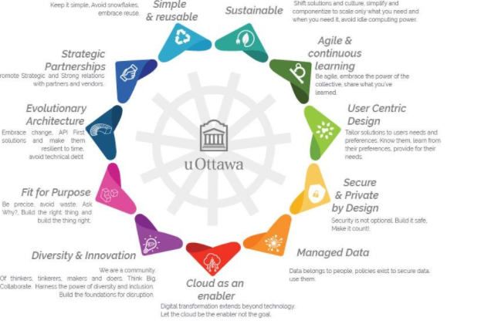
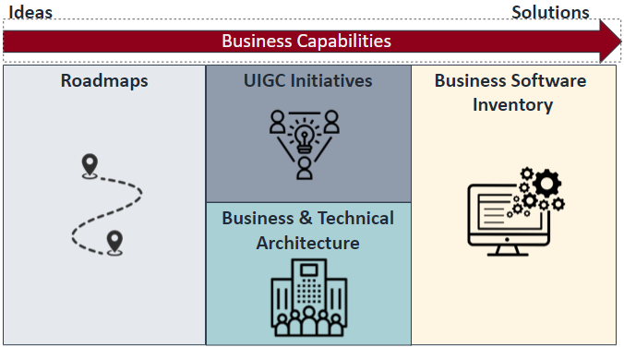
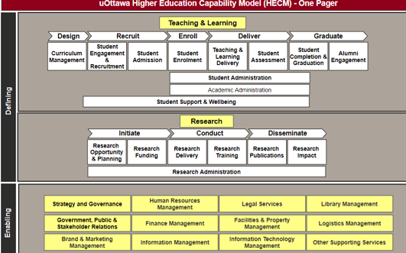
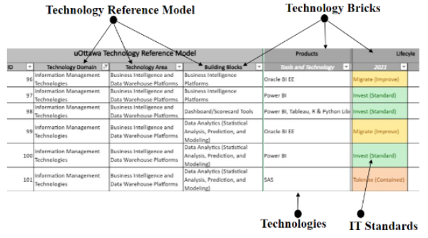
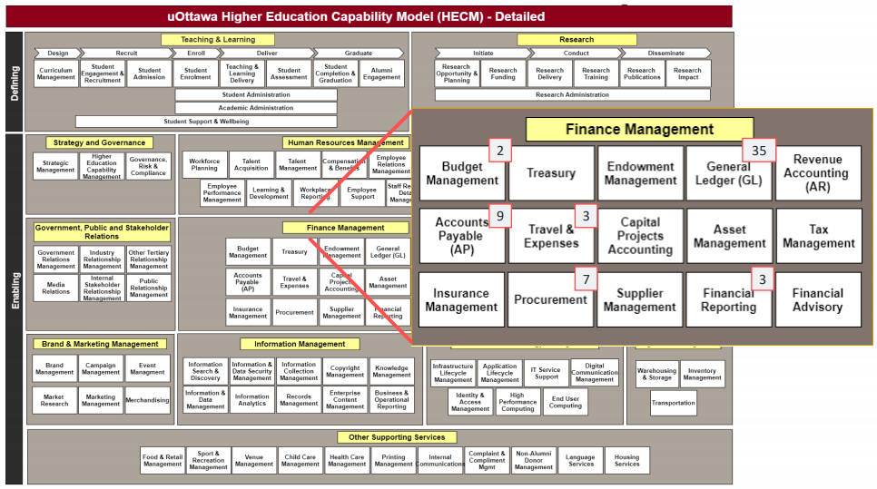
Our EA Journey: 2019-2022
Transformation 2030
More Sustainable
More Impactful
More Agile
More Connected
Governance & Collaboration
EA Principles
Business
Capabilities: Ideas
to Solutions
Guiding, architecture, decisions
UIGC, ARB, AWG
Business Capability Model
Roadmaps, initiatives, architecture, business software inventory
Technology Reference Model
Common language, shared vision, decision-making
Pathway to standards
Putting Theory into Practice
Using EA to drive ERP replacement
The only impossible journey is the one you never begin.
Anthony Robbins

Slide 3
Governance & Collaboration: UIGC, ARB, AWG
UIGC and Sub-Committees
Business / IT Executives
Campus-wide alignment, Transparency, Collaboration, Maximize institutional value from technology investments and practices
Administrative Committee
ARB: University Community:
Business Owners, IT Managers, Architects, etc.
Alignment with overall University strategy, IT strategy, enterprise architecture principles, policies and standards
University Information Governance Council (UIGC)
Academic Information Committee
Research Information Committee
Administrative Information Committee
AWG: Domain Architects Business, Application & Integration, Infrastructure, Data & Information, Security, Solutions
Enterprise architecture reference model & standards, Architecture guidance & reviews
Architecture Review Board (ARB)
Architecture Working Group (AWG)
One’s destination is never a place, but a new way of seeing things.
Henry Miller
Eodem modo typi, qui nunc nobis videntur parum clari
qui sequitur mutationem consuetudium lectorum. Mirum est notare quam littera gothica
odio dignissim qui blandit praesent luptatum zzril delenit augue duis dolore te feugait nulla facilisi. Nam liber tempor cum soluta nobis eleifend option congue nihil imperdiet doming id quod mazim

Slide 4
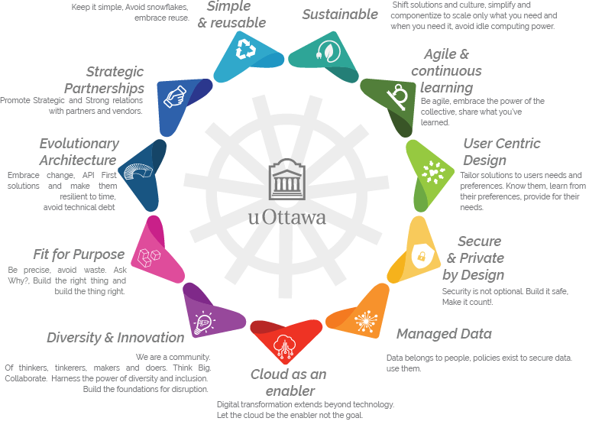
EA Principles: Guiding Architecture Decisions
Initiatives presented to the ARB must show alignment with architecture principles
Eodem modo typi, qui nunc nobis videntur parum clari
qui sequitur mutationem consuetudium lectorum. Mirum est notare quam littera gothica
odio dignissim qui blandit praesent luptatum zzril delenit augue duis dolore te feugait nulla facilisi. Nam liber tempor cum soluta nobis eleifend option congue nihil imperdiet doming id quod mazim

Slide 5
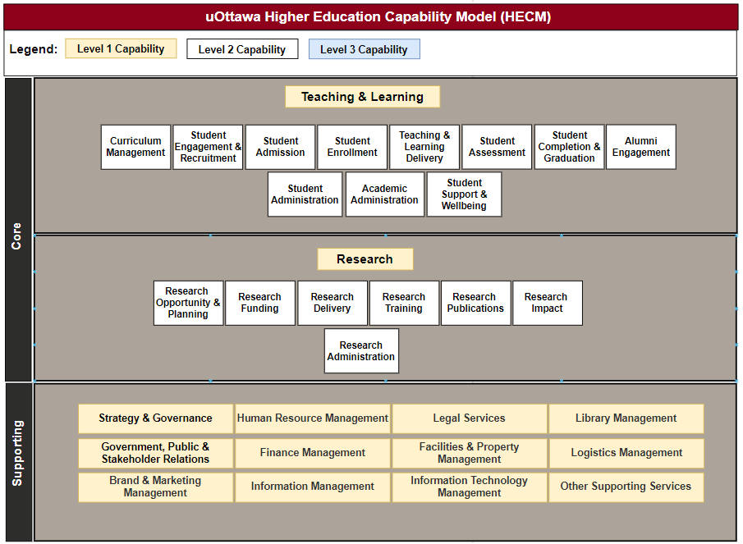
Business Capability Model: Common Language, Shared Vision, Strategic Decision Making
Business Capabilities
High-level view of WHAT an institution does from a business perspective.
Relatively stable, unique and long term.
Structured in a hierarchical manner, but organizationally neutral.
Establishes a common language and contributes to a shared vision across an organization (↑ strategic dialog between IT & Faculties/Services)
Delivered through a combination of PEOPLE, PROCESS and TECHNOLOGY, the HOW
A Business Capability Model is:
A visual structured vision of an organizations set of business capabilities
Essential for a successful Enterprise Architecture practice – better value and business outcomes by ensuring execution is linked to strategic goals and objectives.
Eodem modo typi, qui nunc nobis videntur parum clari
qui sequitur mutationem consuetudium lectorum. Mirum est notare quam littera gothica
odio dignissim qui blandit praesent luptatum zzril delenit augue duis dolore te feugait nulla facilisi. Nam liber tempor cum soluta nobis eleifend option congue nihil imperdiet doming id quod mazim
At uOttawa, Business Capabilities are referred to as Higher Education Capabilities to reflect the educational nature of the institution.

Slide 6
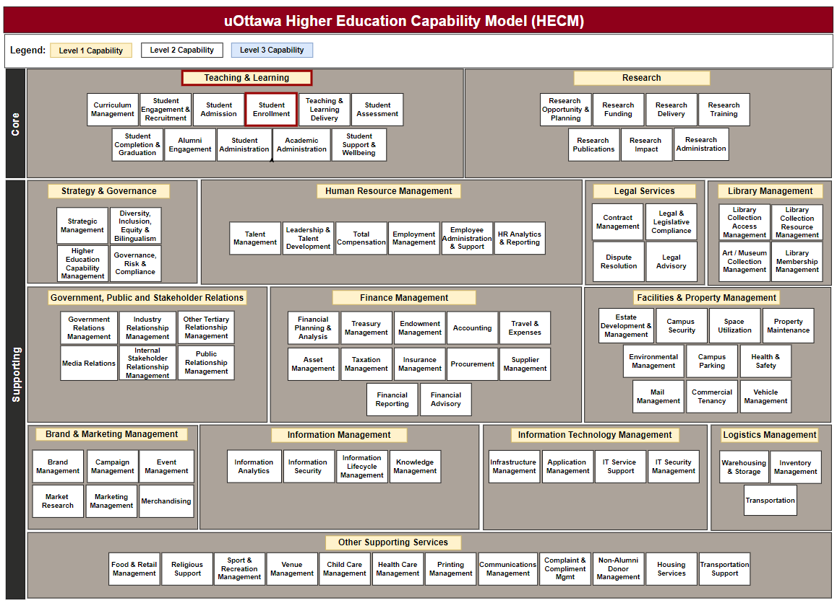
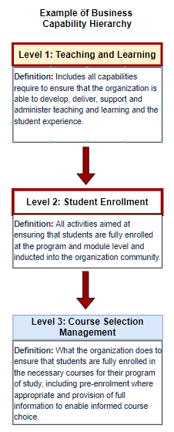
uOttawa’s Higher Education Capability Model (HECM)
Note: The uOttawa HECM is a modified version of industry reference models (CAUDIT, USICA, Info-Tech)
Eodem modo typi, qui nunc nobis videntur parum clari
qui sequitur mutationem consuetudium lectorum. Mirum est notare quam littera gothica
odio dignissim qui blandit praesent luptatum zzril delenit augue duis dolore te feugait nulla facilisi. Nam liber tempor cum soluta nobis eleifend option congue nihil imperdiet doming id quod mazim

Slide 7
Business Capabilities:
Ideas to Solutions
Ideas
Solutions
Business Capabilities
Roadmaps
UIGC Initiatives
Business Software
Inventory
Business Architecture
Eodem modo typi, qui nunc nobis videntur parum clari
qui sequitur mutationem consuetudium lectorum. Mirum est notare quam littera gothica
odio dignissim qui blandit praesent luptatum zzril delenit augue duis dolore te feugait nulla facilisi. Nam liber tempor cum soluta nobis eleifend option congue nihil imperdiet doming id quod mazim

Slide 8
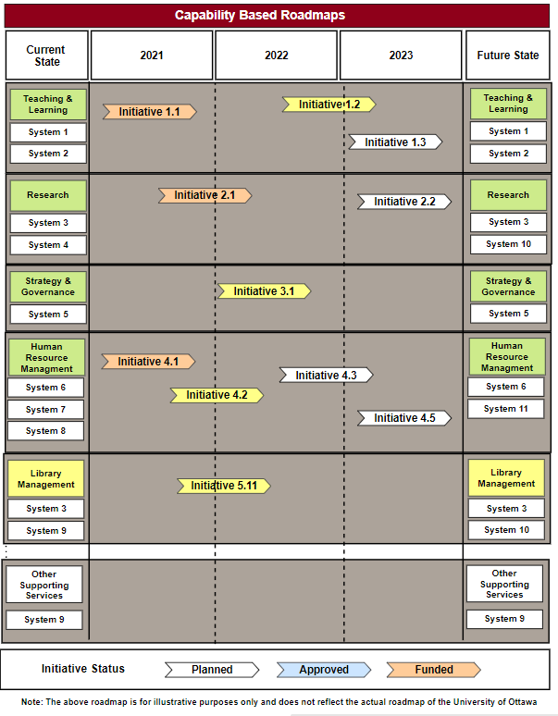
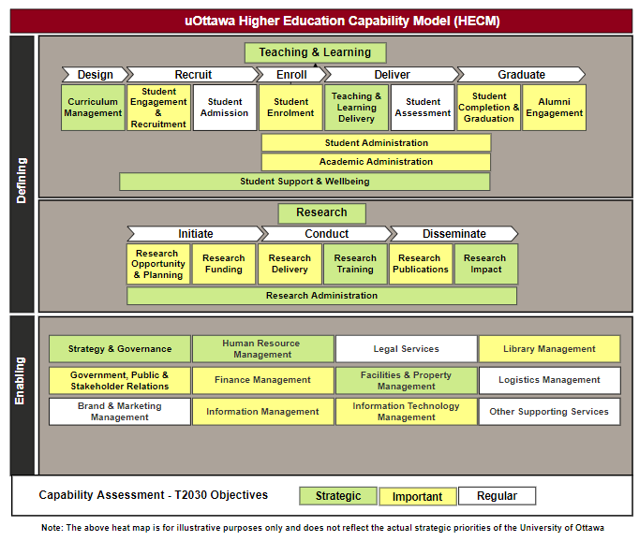
Roadmaps
Roadmaps
CAPABILITY BASED ROADMAPS
Organized around business capabilities, linking strategy & execution
KEY BENEFITS
Alignment between IT investments and long-term business outcomes, Proper scheduling of IT initiatives, Better synchronization of business and IT related plans
STRATEGY
EXECUTION
BUSINESS CAPABILITY MODELS
Help business executives decide WHERE future IT investments should go.
Eodem modo typi, qui nunc nobis videntur parum clari
qui sequitur mutationem consuetudium lectorum. Mirum est notare quam littera gothica
odio dignissim qui blandit praesent luptatum zzril delenit augue duis dolore te feugait nulla facilisi. Nam liber tempor cum soluta nobis eleifend option congue nihil imperdiet doming id quod mazim
CAPABILITY BASED ROADMAPS
Operate with planned IT initiatives and help business executives decide WHEN these investments should be made

Slide 9
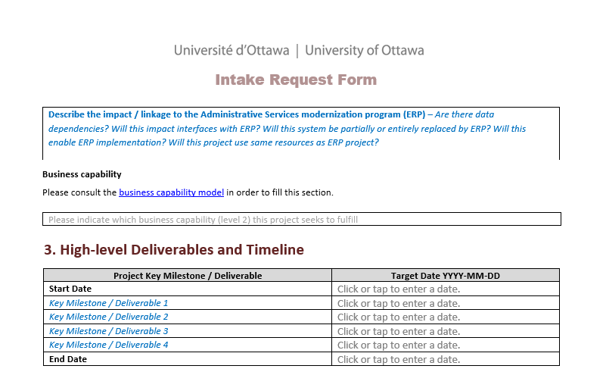
UIGC Initiatives
UIGC Initiatives
Eodem modo typi, qui nunc nobis videntur parum clari
qui sequitur mutationem consuetudium lectorum. Mirum est notare quam littera gothica
odio dignissim qui blandit praesent luptatum zzril delenit augue duis dolore te feugait nulla facilisi. Nam liber tempor cum soluta nobis eleifend option congue nihil imperdiet doming id quod mazim

Slide 10
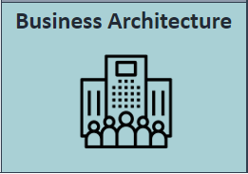
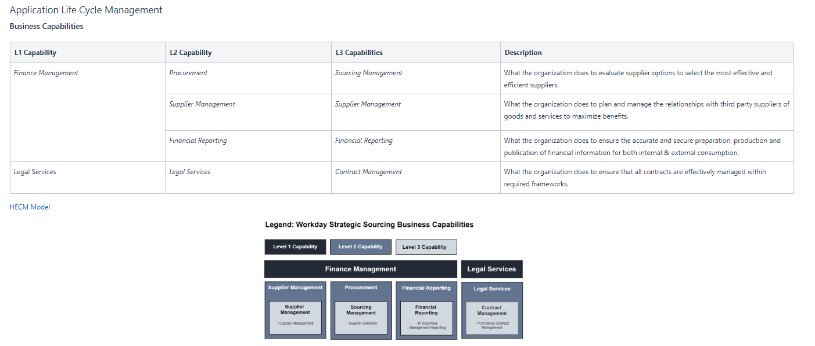
Business Architecture
Business Architecture Document (BAD)
ARB (Architecture Review Board) - Business Architecture Presentation (BAP)
Eodem modo typi, qui nunc nobis videntur parum clari
qui sequitur mutationem consuetudium lectorum. Mirum est notare quam littera gothica
odio dignissim qui blandit praesent luptatum zzril delenit augue duis dolore te feugait nulla facilisi. Nam liber tempor cum soluta nobis eleifend option congue nihil imperdiet doming id quod mazim

Slide 11
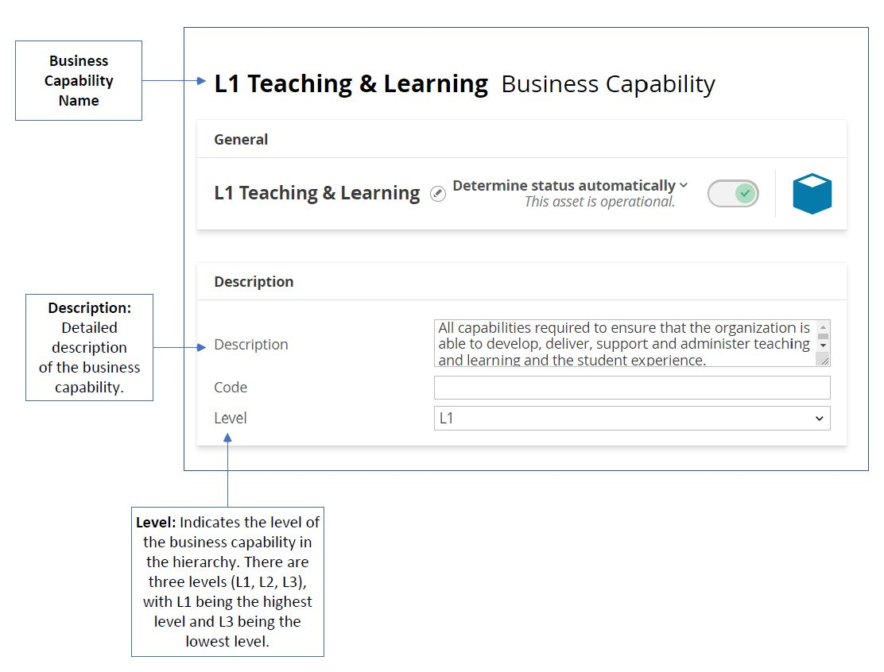
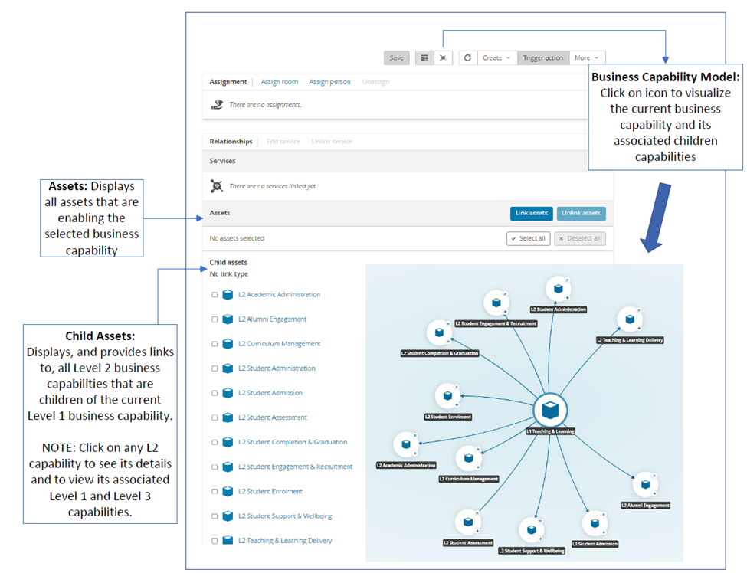
Business Software Inventory
Business Software Inventory
Eodem modo typi, qui nunc nobis videntur parum clari
qui sequitur mutationem consuetudium lectorum. Mirum est notare quam littera gothica
odio dignissim qui blandit praesent luptatum zzril delenit augue duis dolore te feugait nulla facilisi. Nam liber tempor cum soluta nobis eleifend option congue nihil imperdiet doming id quod mazim

Slide 12
Business Capability Model: Key Usage Scenarios
Strategic Alignment: T2030 Objectives / IT Spend
Capability based planning
Scoping and Framing of Initiatives
Business Process Reviews
Investments
Transformation
Investments
Rationalization
Organization
Eliminate redundant or legacy applications
Reuse existing applications
Identify areas of business unit overlap, conflict or harmony
Eodem modo typi, qui nunc nobis videntur parum clari
qui sequitur mutationem consuetudium lectorum. Mirum est notare quam littera gothica
odio dignissim qui blandit praesent luptatum zzril delenit augue duis dolore te feugait nulla facilisi. Nam liber tempor cum soluta nobis eleifend option congue nihil imperdiet doming id quod mazim
Notes:
Organization: Map business units to key capabilities. Contrast key capabilities with business unit responsibilities and accountabilities
Business Process Reviews: Analyze how well capabilities are supported by processes. Key capabilities with weak, poorly documented or manual processes can be prioritized for process improvement.

Slide 13
About the Modernization Program
The University was consulting stakeholders on its new strategic plan, Transformation 2030, the University also decided to hold parallel discussions on its administrative processes.
This review revealed that Financial and Human Resources tools, systems and processes no longer meet the needs of both faculty and service users.
The University then launched the Administrative Services Modernization Program, under the leadership of the Vice-President, Finance and Administration.

Slide 14
The Objectives of the Program
Transformation 2030
More Agile
More Connected
More Sustainable
More Impactful
Program Objectives
Service Excellence
HR, Finance and Performance Information for Decision-Making
Proper Resources Management
Efficiency & Effectiveness
Reduced admin efforts
Intuitive systems/ processes
Improved access to data
Improved data usefulness
Improved data quality
Standardized processes and policy application
Efficient internal controls
Shorter requests resolution time/ faster transactions
Reduced redundant/ low-value touchpoints & systems
Program Benefits

Slide 15
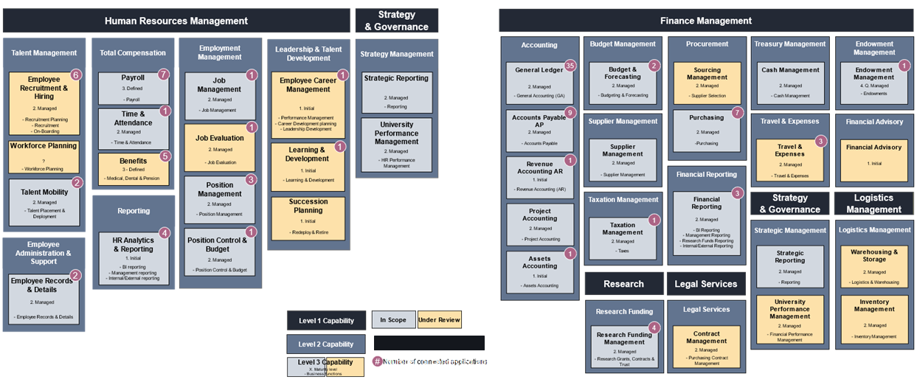
Assessing our current state and defining our scope
Legend

Slide 16
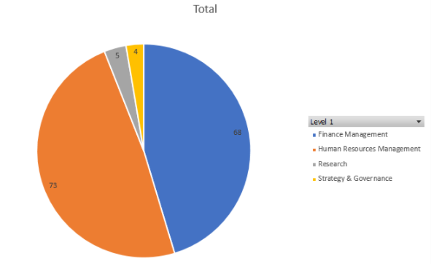
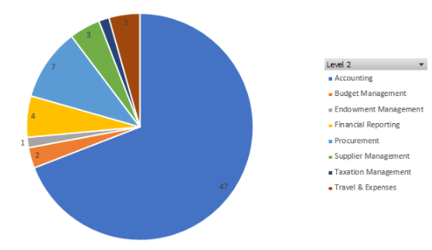
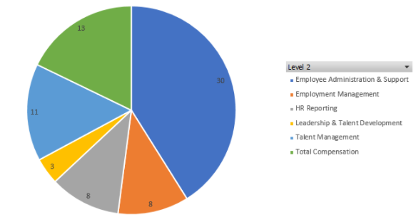
Understanding our ecosystem
Applications per level 1 capability
Finance Management
Human Resources Management

Slide 17
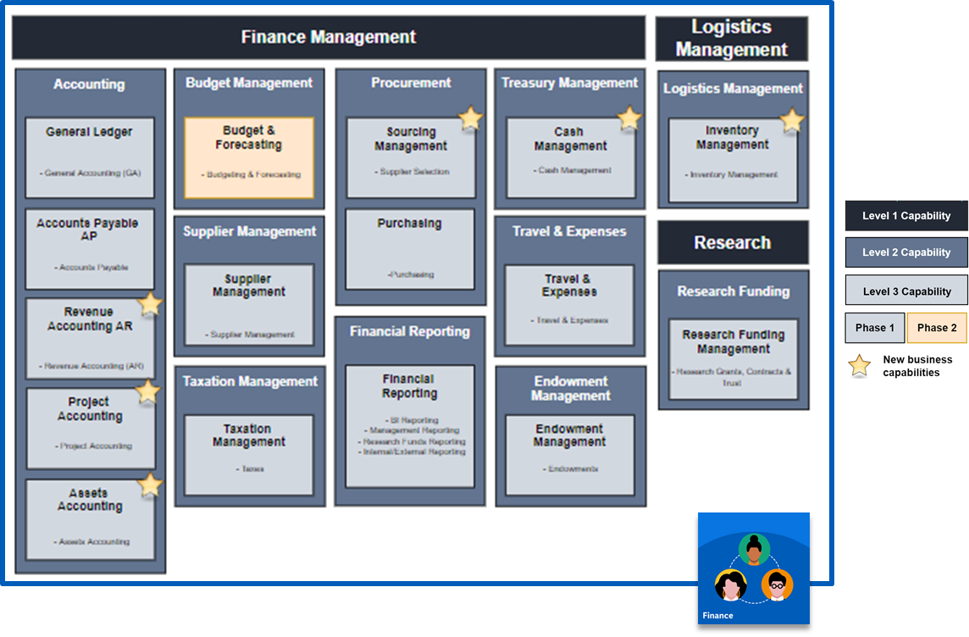
Our desired future state

Slide 18
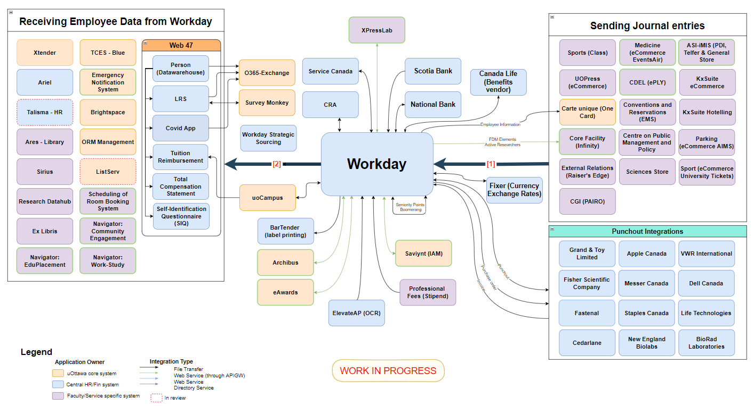
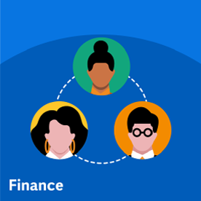
Our desired future ecosystem
121 Integrations
60 Applications
48 Integrations
73 Integrations

Slide 19
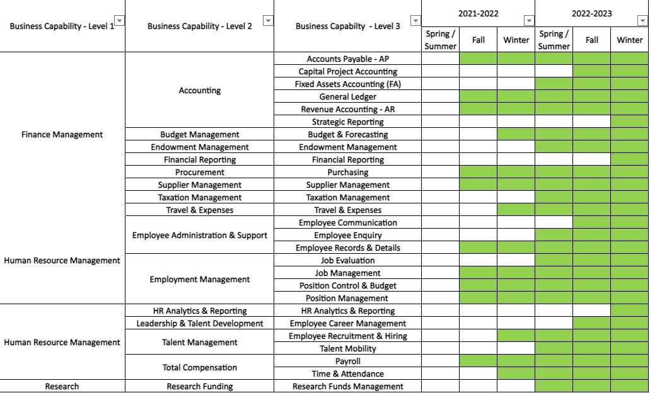
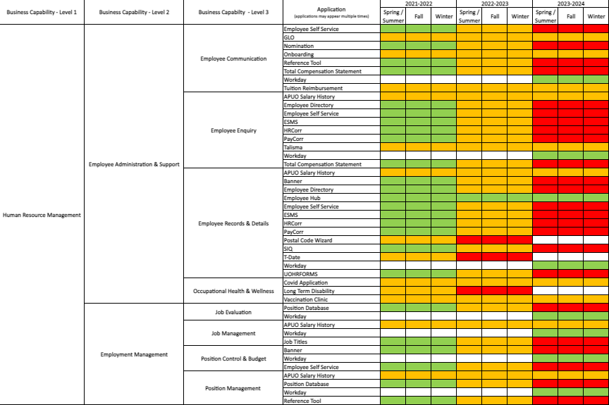
How do we get there?
Legend:
Invest
Tolerate
Migrate/Eliminate
* Under review

Slide 20
How we are leveraging the Capability Model
Current state analysis
Desired future state definition
Discovery sessions with Systems Integrator
Program team structure
Applications analysis & strategy definition
ERP implementation roadmap
Integration strategy definition
IT Standards for IAM, Integration Software, Email, Business Intelligence, etc.

Slide 21
Questions? Contact us.
MaryAnn Welke Lesage
Directrice, Architecture d’entreprise / Director, Enterprise Architecture
Bureau du DPI / Office of the CIO
Technologies de l’information / Information Technology
Université d'Ottawa | University of Ottawa
(613) 219-6150 | mwelke@uottawa.ca
Ingrid Hernández Remedios, M.Sc., CSM, CSPO
Architecte de solutions et Responsable technique | Solutions Architect and Technical Lead
Programme de modernisation des services administratifs | Administrative Services Modernization Program
613-562-5800 (1030)
Valérie Normand
Analyste architecte d’entreprise / Enterprise Architect Analyst
Bureau du DPI | Office of the CIO
Technologies de l’information | Information Technology
Université d'Ottawa | University of Ottawa
Thank you!

