Slide 1
Working as
Ioana Finichiu

Slide 2
What OneTeamGov is
A community focused on radical public sector reform through practical action

Slide 3
About me
A bit about me

Slide 4
Lack of connection
Lack of connection

Slide 5
Lack of perspective
Lack of connection
Lack of perspective

Slide 6
Lack of confidence
Lack of connection
Lack of perspective
Lack of confidence

Slide 7
Lack of empathy
Lack of connection
Lack of perspective
Lack of confidence
Lack of empathy

Slide 8
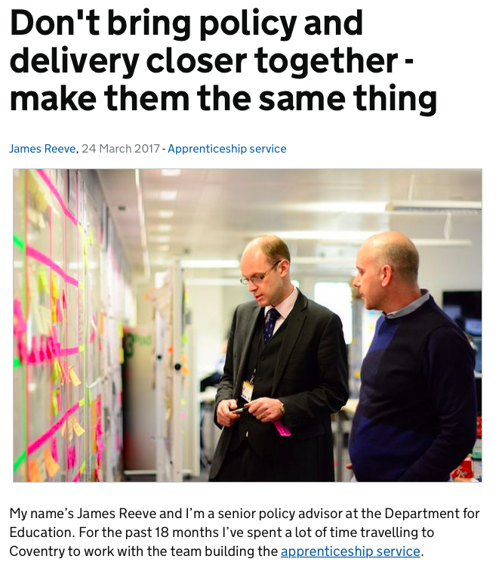
Don’t bring policy and delivery closer together – make them the same thing

Slide 9
The start of the movement
Making a movement
out of an event

Slide 10
OneTeamGov Principles
Work in the open and positively
2. Take practical action
3. Experiment and iterate
4. Be diverse and inclusive
5. Care deeply about citizens
6. Work across borders
7. Embrace technology

Slide 11
OneTeamGov home page

Slide 12
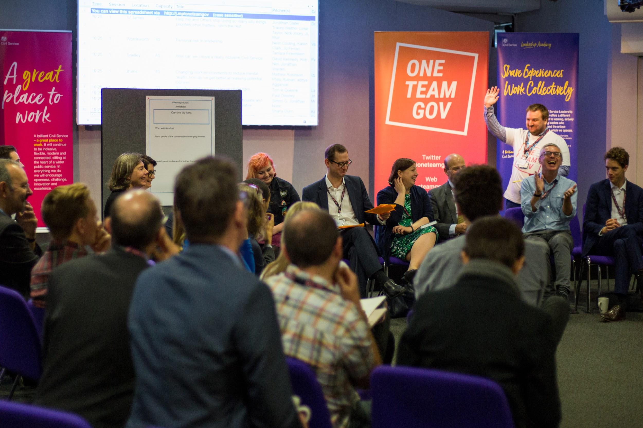
OneTeamGov Global event
One Team Gov Global
16 July 2018
London

Slide 13
The Canadian chapter

Slide 14
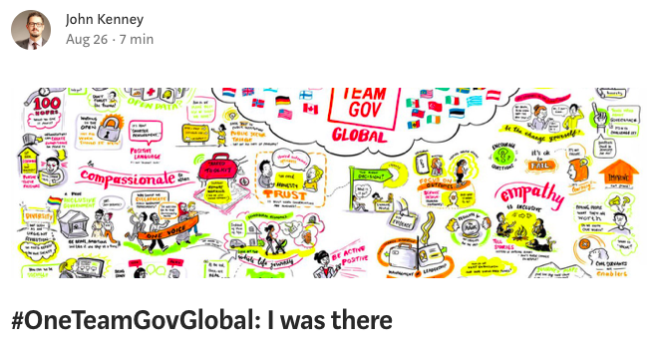
What Canadian public servants are saying

Slide 15
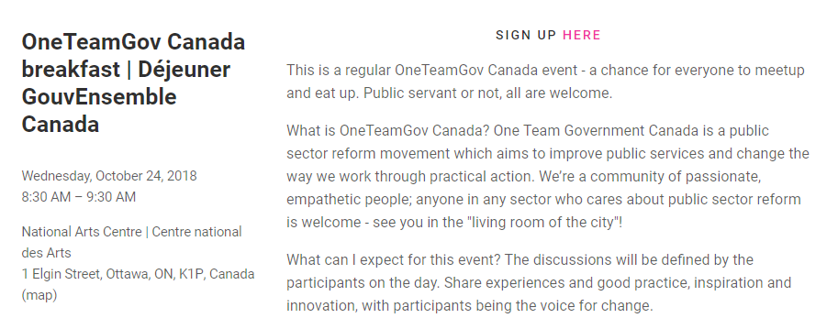
Ottawa event

Slide 16
List of cities that have had events
Ottawa
Winnipeg
Vancouver
Toronto
???

Slide 17
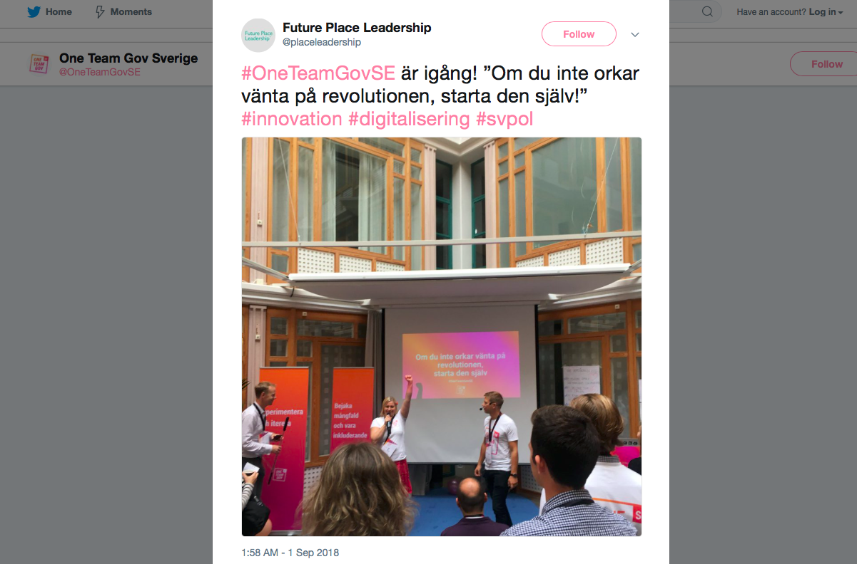
Swedish tweet

Slide 18
Swiss tweet

Slide 19
Why it matters
Why it matters

Slide 20
Why it matters
We’re helping to make
our sector fit for the networked age

Slide 21
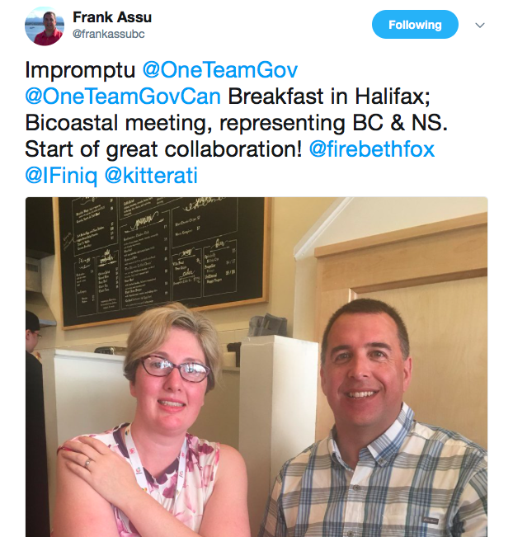
Example tweet

Slide 22
Why it matters
We’re experimenting with new ways of leading

Slide 23
Why it matters
We’re democratising change

Slide 24
Example why it matters

Slide 25
Why it matters
We’re creating space to say unexpected things

Slide 26
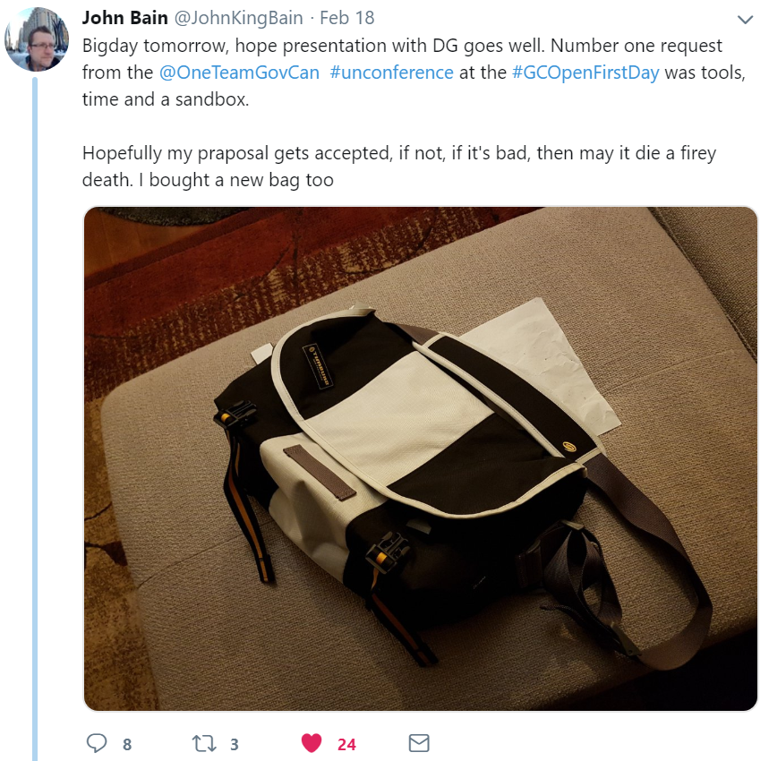
Why it matters

Slide 27
Why it matters
We’re giving people hope

Slide 28
Example of involvement
- Frank Assu, Free Agent
https://frama.link/EmM8EQQF

Slide 29
Announcing the next Global unconference
21.05.2019
Victoria, BC
Canada
Image: shaundsg (CC BY 3.0)

Slide 30
If you’re tired of waiting for the revolution, start it yourself
If you’re tired of waiting for the revolution, start it yourself.

Slide 31
Thank you & Twitter handles
Thank you
Merci
@OneTeamGovCan
@IFiniq

