Slide 1
Notes:
Slide for when people wait to start the WebEx
REMEMBER:
Give participants the privilege to chat to “all participants” (by Ctl-K, checking the chat for “all participants” box)
Start the recording, and pause it while waiting for the participants to join.
Continue recording for starting the session, just before removing this slide.
Ask participants to use the check for yes and cross for no, so they warm up to the idea of interacting.
---
Please, via the chat box, introduce yourself with
Name
Department or Agency
Where you’re located
Your expectations for this session

Slide 2
Mindful Change Leadership Development Program
Week 2 (of 8)
22 April 2021
Notes:
To mention the following in French:
« Comme avec toutes les sessions du GC, s'il vous plaît, sentez-vous libre d'utiliser la langue de votre choix pour poser des questions ou participer à la discussion., La séance d'aujourd'hui sera conduit principalement en anglais, il y aura d'autres sessions en français qui seront promus via le groupe GCConnex (ou donner des dates précises, si disponible). »
As with all GoC sessions, please, feel free to use the language of your choice to ask questions or participate in the discussion., today’s session will be conducted mainly in English, there will be other sessions in French that will be promoted via the GCConnex group (or give specific dates, if available).

Slide 3
Mindful Breathing Exercise – Centering
Time required: 2 minutes
The trick is to shift from “doing” to “being”
Let’s start by doing the following...
Sit with a straight position, as comfortable as possible
It helps if you close or semi-close your eyes
Let’s not worry about time
And take a minute, only a minute...
To breathe, just to breathe
That simple
I’ll let you know when the time is over.
Just continue breathing
We’ll do a short debrief of what you noticed
Notes:
Mindful breathing https://www.youtube.com/watch?v=ZE-r-x2T4ok
This is one way of doing it, getting it depends on the practice of.
Noticing is very important in the practice of Mindfulness.
Noticing where your thinking is, that’s the first step to become more Mindful.

Slide 4
Some Comments from the Polling
More time for break out rooms
What is mindfulness?
→ next slides
Google it, review the info session recording
My reading list → next slides
Technical challenges (log off VPN!!!, map *dot)
How we are going to do networking?
By sharing your experience, asking your questions, responding to others, accepting « going for a coffee » if someone asks… via the Cohort, and by connecting/networking with your Buddy System.
Notes:
More time for break out rooms
We can always make the session 1 ½ hours long…
Or, I’ll do my best to focus on giving break out rooms more time, in order to do so, I’ll try to be more conscise, this may imply my answers be sharpened
, border line mean
E.g., please don’t send me an email saying you can’t make it to the session, it is one more email I need to read, and maybe answer
Same for the comments, if you need to leave the session, feel free to text your buddies, so they keep an eye for you in the case they need to fill you in something fantastic you missed. And plese
In the Following slides
What is mindfulness?
Google it, or look for the recording of the intro session:
A reading list
Technical challenges
My mistake, I’ll be shure I’m logget out of VPN
If a person is having connecting issues, then only that person may benefit from turning off their webcam.
How we are going to do networking?
By sharing your experience, asking your questions, responding to others, accepting « going for a coffee » if someone asks… via the Cohort.
*dot = Depending on Time

Slide 5
What’s the difference between Mindfulness and Meditation?
*The way I see it
~ Time of exercise, the objective, and the experience ~
5 minutes
Relax and realise
Self-awareness
20 minutes to an hour
Engage in reflection or contemplation
Could be mind shifting
Notes:
This is, in my personal experience...
The core are the same, focus on your breathing. A way to compare them are:
The extent of time you typically take to do an exercise
The objective you aim for or achieve doing an exercise
The experience you perceive while doing the exercise
“Mindfulness is defined as being attentive and aware, non-judgementally, whereas meditation is engaging in a mental exercise...” - Wikipedia http://en.wikipedia.org/wiki/Mindfulness_(psychology)
“Mindfulness means presence of heart” - John Kabbat Zinn https://www.youtube.com/watch?v=xoLQ3qkh0w0
“Meditation” noun the action or practice of meditating.
“Meditation” is a practice in which an individual trains the mind or induces a mode of consciousness
Forms: Buddhist meditation, Christian meditation, Daoist meditation, Jain meditation, Jewish meditation, Meditation in the Ravidasi Faith, Transcendental Meditation – Wikipedia
"Mindful meditation: Training the brain on attention and meta-attention with the purpose to develop Emotional Intelligence"
"Meta-attention: attention of the attention, being able to know that your attention has wandered away“
Tan, C (2013). Search Inside Yourself. NY; page 30.
Mindfulness: like the body scan we just did.
Takes about 5 minutes
The objective is to relax and realise what’s going on in your mind
The experience could vary from person to person, but basically is a self-awareness experience
Meditation: having a practice of sitting and observing your breathe
May start by sitting 5 minutes for beginners
A good 20 minutes for those with an established practice, up to 8 hours a day in some days long retreats
The objective is to engage in contemplation or reflection.
The experience could be mind shifting

Slide 6
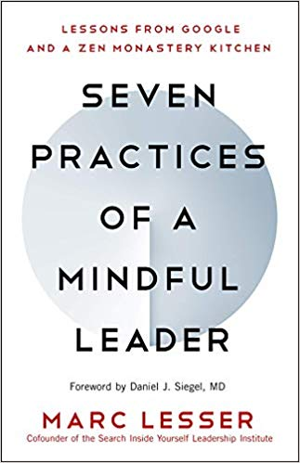
Some Book references
Notes:
References to the books:
https://www.amazon.ca/Search-Inside-Yourself-Productivity-Creativity/dp/0062116924
https://www.amazon.ca/Presence-Human-Purpose-Field-Future/dp/0385516304/
https://www.amazon.ca/Leading-Emerging-Future-Ego-System-Eco-System/dp/1605099260/
https://www.amazon.ca/Finding-Space-Lead-Practical-Leadership/dp/1620402475/
https://www.amazon.ca/Mindful-Leadership-Self-Awareness-Transforming-Inspiring/dp/1118127110/
https://www.amazon.ca/Mindful-Leader-Management-Mindfulness-Meditation/dp/1590306201/
https://www.amazon.ca/Self-Compassion-Proven-Power-Being-Yourself/dp/0061733520
https://www.amazon.ca/Dare-Lead-Brave-Conversations-Hearts/dp/0399592520
https://www.amazon.ca/Eleven-Rings-Success-Phil-Jackson/dp/1594205116/
https://www.amazon.ca/Seven-Practices-Mindful-Leader-Monastery/dp/1608685195/
https://www.amazon.ca/Mindful-Leader-Embodying-Christian-wisdom-ebook/dp/B07KJGHXDW/
https://www.amazon.ca/Creating-Mindful-Leaders-Power-Forward/dp/1119484782/

Slide 7
BEING - buddy engine in newness goals (former Buddy system)
Everyone has a BEING?
If your BEING is composed of:
3, write "we are 3: " and include your 3 names/emails
2, write "we are 2: " and include both your names/emails
If you are looking for a Buddy System: write « need a BE » & your name/email
While in the breakout rooms (next slide), I’ll confirm the BEING buddy engine in newness goals
Notes:
Anyone needs to be in a Buddy System?
If you are only 2, write "we are 2: " and include both your names/emails
If you are looking for a Buddy System: write « need a buddy system » & your name/email
If you are 3,

Slide 8
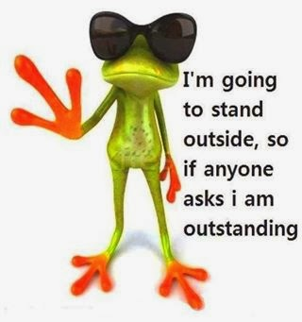
Debrief from last week (1)
Your BEING
Your practice
Debrief
Any outstanding issues?
Notes:
10 minutes in « dyads » of 5
With honesty, report on :
Were there any challenges?
What you noticed

Slide 9
Agenda – week 2: The brain (focus, clarity)
Breathing exercise – 2 minutes
From last week’s Comments
BEING
Debrief from last week
Today’s session goals
What happens in the brain - neuroplasticity
MCL & The Key Leadership Competencies
Your turn for the week
Practice: Body Scan

Slide 10
Today’s Goals: Clarity and Focus
Two of the skills that a Mindful Leader shows are Clarity and Focus
Today, we’ll practice
Clarity by understanding what happens in the brain – neuroplasticity
Introduce Mindful Leadership concepts
Focus by doing a Mindful Body Scan

Slide 11
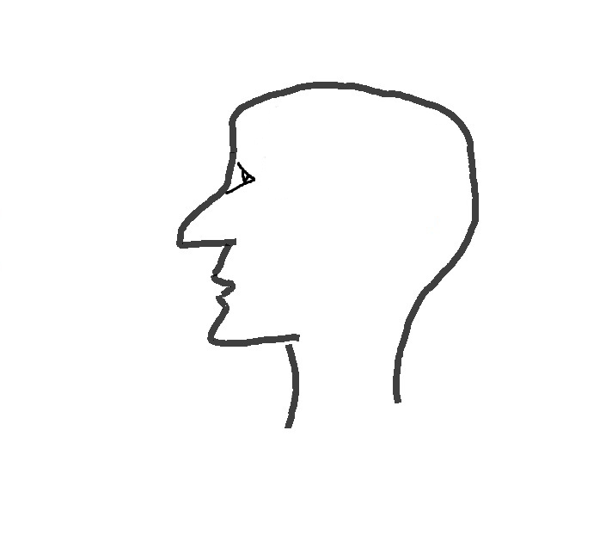
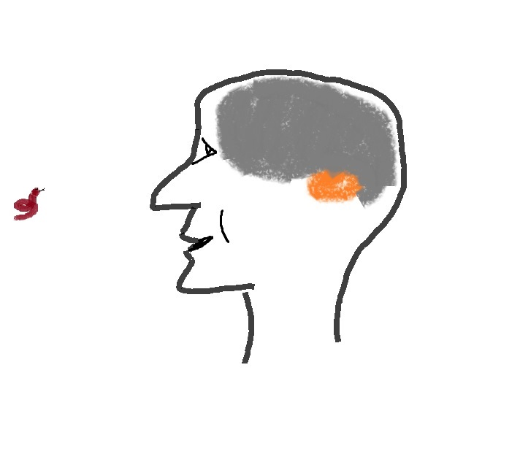
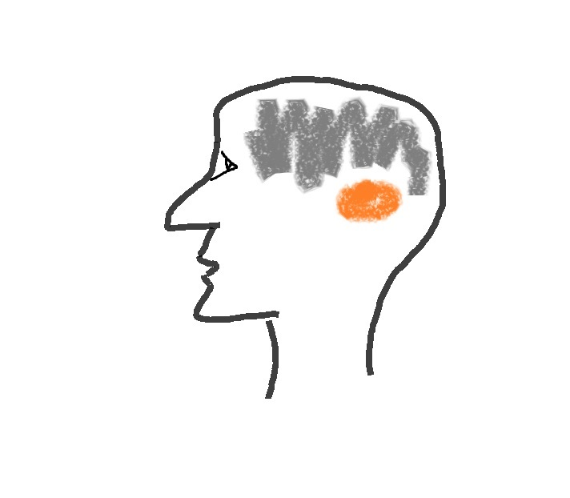
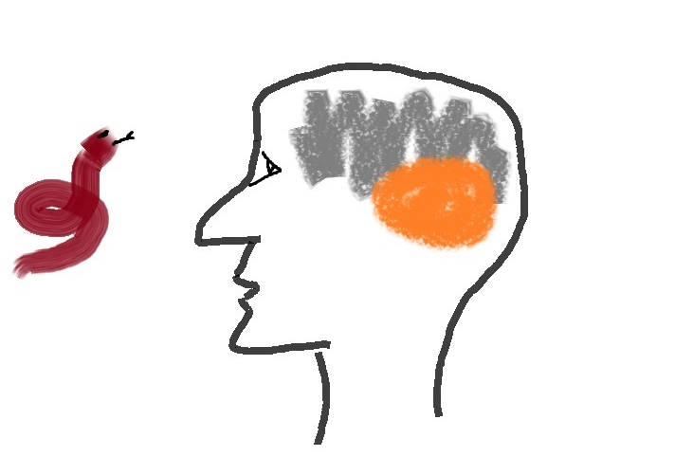
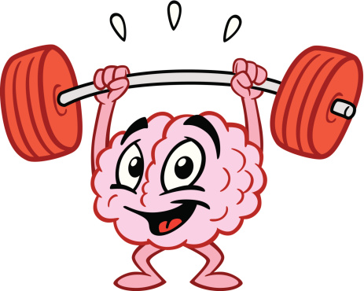
What happens in the brain – the neuroplasticity
Decision making
Emotions
Language
Work
Family
Stress
Media
Amygdala
Mindfulness Practice
Natural dangers
turned → into
Day to day over stimulus
Watch this video at home (15 mins): https://www.youtube.com/watch?v=Awd0kgxcZws

Slide 12
How The Brain and Body Work Under Stress
In times of stress, the brain reduces energy to its “executive system”.

Slide 13
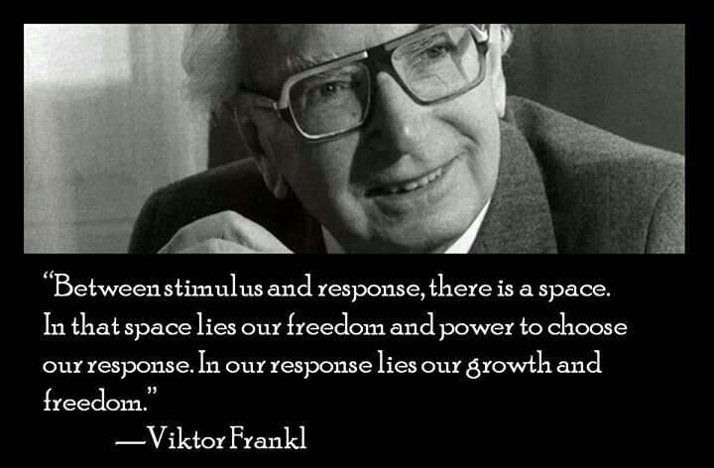

Slide 14
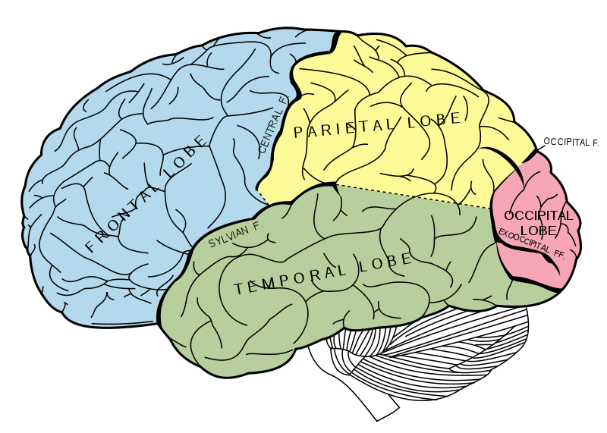
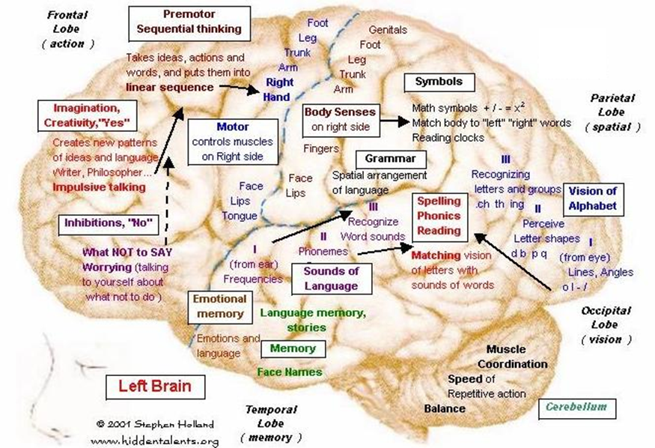

Slide 15
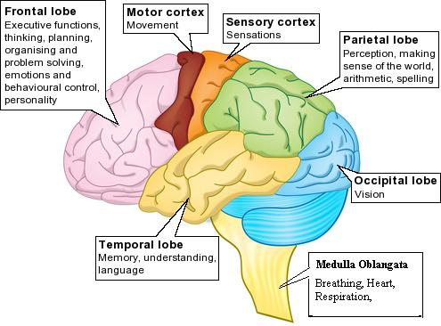
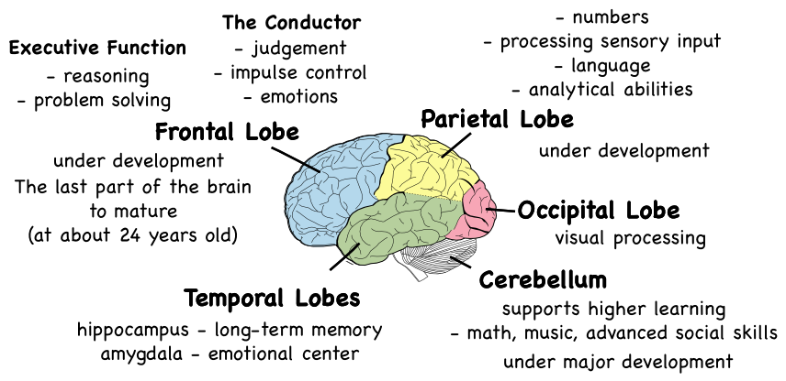
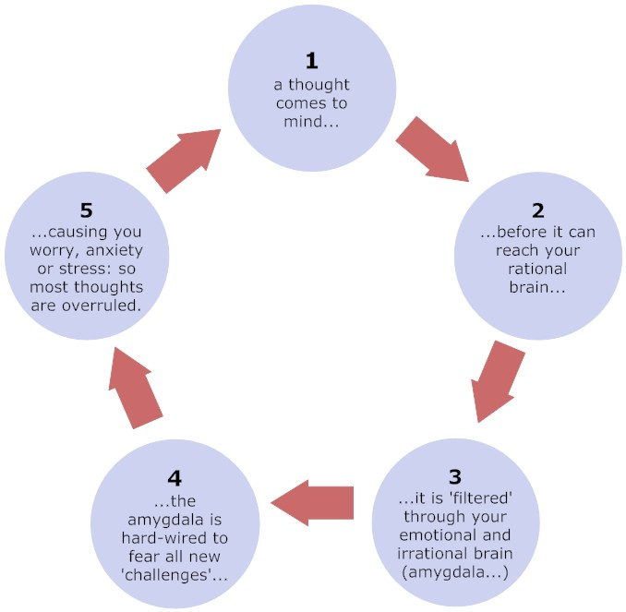
Notes:
Just so you see I did my homework ;)
https://en.wikipedia.org/wiki/Amygdala_hijack
http://www.gostrengths.com/what-is-an-amygdala-hijack/
http://neurosciencefundamentals.unsw.wikispaces.net/The+limbic+System
https://siyli.org/even-old-dogs-can-learn-siyli-tricks-2/

Slide 16
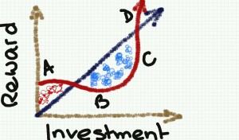
Why Mindfulness Matters
Increased resilience
Focus and concentration
Workplace harmony
Fewer sick days
Greater employee satisfaction and well-being
Stress reduction
Greater creativity
http://www.mentalworkout.com/white-papers/how-mindfulness-can-help-your-employees-and-improve-your-companys-bottom-line/
Notes:
Let’s have some ideas around this... How do you see Mindfulness having an impact in the workplace?
Increased resilience: being mindful increases the ability to be open to new perspectives, to think creatively, to distinguish thoughts from feelings, and to respond to challenges rather than merely reacting. For a leader this helps with strategic thinking.
Focus and concentration: after an eight-week mindfulness course, participants could concentrate better, stay on task longer, more effectively, and remember what they’d done better. In a fast paced environment where leaders have to react quickly to situation this is a great capacity to have.
Workplace harmony: being mindful promotes and creates more empathy and altruism in the workplace. As a leader we are expected to foster a respectful workplace.
Fewer sick days: those who have a practice missed 76% fewer days of work.
Greater employee satisfaction and well-being: being mindful helps significantly to have less emotional exhaustion and more job satisfaction.
Stress reduction: just being mindful helps in reducing stress, anxiety, and depression. The practice helps reducing the levels of the primary stress hormone. As a leader we are put under a lot of stress and any tools that can help manage the pressure is something to be considered.
Greater creativity: Leaders with a mindfulness practice say it helps them create space for innovation and it also helps them to think strategically.
---
How mindfulness can help your employees and improve your company's bottom line – white paper, Mental workout http://www.mentalworkout.com/white-papers/how-mindfulness-can-help-your-employees-and-improve-your-companys-bottom-line/

Slide 17
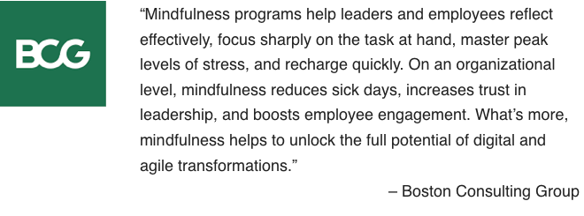
How Mindfulness Practice Benefits CEOs
builds resilience
boosts emotional intelligence
enhances creativity
improves your relationships
helps you focus
Attention
Awareness
Letting be
Leaning into Unpleasant Experiences
Appreciation
Getting unstuck
* Adapted from:
https://hbr.org/2015/12/how-meditation-benefits-ceos
https://www.mindful.org/7-qualities-mindfulness-trained-body-scan/
from: https://www.bcg.com/en-ca/publications/2018/unleashing-power-of-mindfulness-in-corporations
Notes:
https://hbr.org/2015/12/how-meditation-benefits-ceos
https://www.mindful.org/7-qualities-mindfulness-trained-body-scan/
https://www.bcg.com/en-ca/publications/2018/unleashing-power-of-mindfulness-in-corporations
3 mins body scan: https://soundcloud.com/mindfulmagazine/3-minute-body-scan-meditation
Bottom-up: https://www.psychologytoday.com/us/blog/conquer-fear-flying/201306/emotional-control-top-down-or-bottom

Slide 18
What is Mindful Change Leadership?
Refers to the person who is present, non judgmental and cultivates several aspects during their interactions. These aspects are visible and tangible in the Mindful Change Leader:
Focus (focus of attention)
Clarity (self awareness & emotional intelligence)
Creativity (innovation & decision making)
Compassion in the service of others (presence, deep listening)

Slide 19
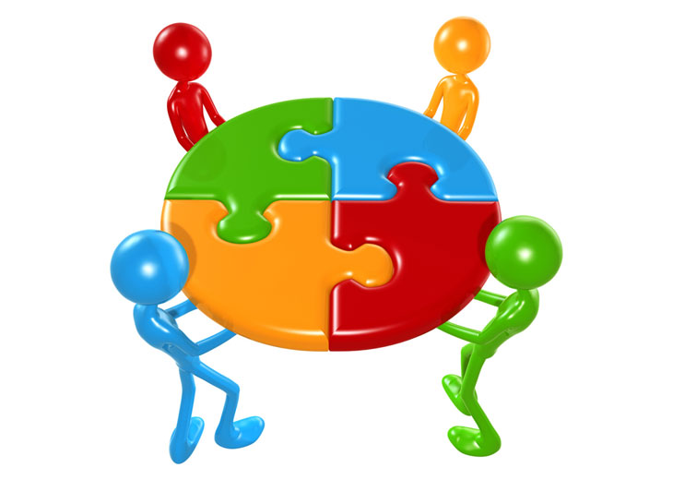
Which Mindful Change Leadership skills support the Key Leadership Competencies?
 | Focus | Clarity | Creativity | Compassion in the service of others
Create Vision and Strategy
Mobilize People
Uphold Integrity and Respect
Collaborate with Partners and Stakeholders
Promote Innovation and Guide Change
Achieve Results
Notes:
From: http://www.tbs-sct.gc.ca/psm-fpfm/learning-apprentissage/pdps-ppfp/klc-ccl/klcp-pccl-eng.asp
Create Vision and Strategy
Leaders define the future and chart a path forward. They are adept at understanding and communicating context, factoring in the economic, social and political environment. Intellectually agile, they leverage their deep and broad knowledge, build on diverse ideas and perspectives and create consensus around compelling visions. Leaders balance organizational and government-wide priorities and improve outcomes for Canada and Canadians.
Mobilize People
Leaders inspire and motivate the people they lead. They manage performance, provide constructive and respectful feedback to encourage and enable performance excellence. They lead by example, setting goals for themselves that are more demanding than those that they set for others.
Uphold Integrity and Respect
Leaders exemplify ethical practices, professionalism and personal integrity. They create respectful and trusting work environments where sound advice is valued. They encourage the expression of diverse opinions and perspectives, while fostering collegiality. Leaders are self-aware and seek out opportunities for personal growth.
Collaborate with Partners and Stakeholders
Leaders are deliberate and resourceful about seeking the widest possible spectrum of perspectives. They demonstrate openness and flexibility to forge consensus and improve outcomes. They bring a whole-of-government perspective to their interactions. In negotiating solutions, they are open to alternatives and skillful at managing expectations. Leaders share recognition with their teams and partners.
Promote Innovation and Guide Change
Leaders have the courage and resilience to challenge convention. They create an environment that supports bold thinking, experimentation and intelligent risk taking. They use setbacks as a valuable source of insight and learning. Leaders take change in their stride, aligning and adjusting milestones and targets to maintain forward momentum.
Achieve Results
Leaders mobilize and manage resources to deliver on the priorities of the Government, improve outcomes and add value. They consider context, risks and business intelligence to support high-quality and timely decisions. They anticipate, plan, monitor progress and adjust as needed. Leaders take personal responsibility for their actions and outcomes of their decisions.

Slide 20
Your turn for week 2
Connecting – once a week with you buddies
Recommended 20 minutes call: 5 mins for each, you can discuss what you found interested, what was challenging, what you like the most
Gratitude Journaling – daily
Practice 5 mins body scan – daily https://archive.org/details/BodyScan6minsB http://elishagoldstein.com/videos/sitting-with-awareness-of-thoughts/​
In case you have a question, a comment or want to share something, please do so via the Cohort
Notes:
http://marc.ucla.edu/mindful-meditations

Slide 21
Reviewing the basics (1/2)
The intention of being (as opposed to doing)
Posture: sit with a straight back, as comfortable as possible in the chair that you are sited, slightly tuck your chin (or cross legged if you feel comfortable)
Mindset: keep an open mind, feel the experience
You experience may vary each day, all is good
Focus on the breathing
Notice
It is about feeling the way you feel, about noticing without judging
have no expectations
have no judgement
have a beginners mind
be an observer... our minds may be busy and noisy
Notes:
http://www.thecalmmonkey.com/#!meditation-recordings/g6x73

Slide 22
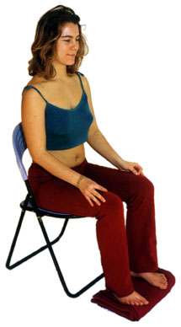
Mindful exercise – Body Scan (2/2)
Time required: 5 minutes
Let yourself experience the exercise
Sit as comfortable as possible in a straight position
Feel free to close your eyes
Follow my voice as I lead you through the exercise
Then, we will do a short debrief of what you noticed.
Notes:
With your back straight, sit as comfortable as possible
Gently bring attention to your breath, no need to change the way you’re breathing, just notice it
Stay there for a few seconds
Now, direct your breath and attention to
Your toes, breath in, breath out
Your feet, in and out, notice what you feel
Every time your attention wanders away, just bring it back gently
Your lower leg, in and out and your upper leg, and notice what you feel
Direct your breath towards your waist, in and out
Your lower back, your abdomen
Your upper back, chest
Now direct your breath and attention to your shoulders, breath in, breath out, and notice
Your arms, your hands and fingers, in and out
Back to your shoulders, and neck, noticing
Your head, your scalp, breath in and out
Focus on your face, your eyes, nose and mouth. Your jaw, noticing
Stay there for a few seconds, breathing in and out
Now, come back… and open your eyes.
Debrief: What did you notice?

Slide 23
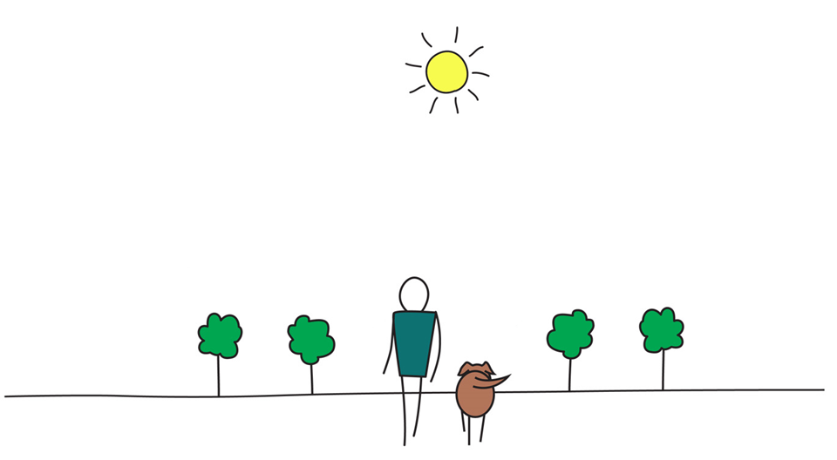
Be Mindful, Be Happy

Slide 24
