Slide 1
Mindful Change Leadership Development Program
What’s with that?
Do we really need one?
Isn’t it just goofy chatty omhhhhh stuff?
What does it even have to do with Learning?
Notes:
Before I start, I’d like to acknowledge I’m coming to you from the traditional territory of the Aschinabee Algonquin people
Sli.do: https://app.sli.do/event/jy6YeaukSMNTvfJPtLHMzy
Code: holf-fca
I’ll lead this session in English, and you’re welcome to express yourself in the language of your choice. Je vais livre la séance en anglais, mäis sentez-vous a l’aisse de parler dans la langue de votre choix.
Thanks to the HOLF for inviting the Interdepartmental Organizational Change Network (IOCN) to present some details about the Mindful Change Leadership Development program
I’m very grateful to be here presenting to you, I consider the HOLF our cousin community, you may wonder why? Both the HOLF and the IOCN have founding members from IRCC.
We’ll start slow with a warm up, using sli.do you can answer the first question now
Then I’ll guide a mindful exercise
And from there we’ll switch speed-presentation mode as in the youtube « 5 times faster » option, don’t worry the slides will be shared…
And I hope to cover all the material prepared slowing down on key slides/information

Slide 2

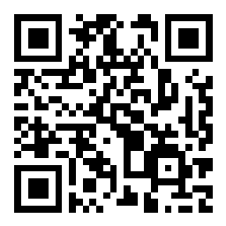
Sli.do
I would say my level of experience with mindfulness is:
How are you feeling right now?
https://www.slido.com/
# holf-fca
https://app.sli.do/event/jy6YeaukSMNTvfJPtLHMzy
Notes:
There are two questions on the Sli.do
(click)
The first one is…
(click)
And the second one is…
Later on I’ll post the results on the chat

Slide 3
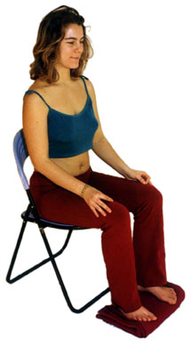

Mindfulness Exercise – Body Scan
Time required: 5 minutes
Take advantage of the opportunity to experience this exercise
Sit as comfortable as possible in a straight position
Feel free to close your eyes
Follow my voice as I lead you through the exercise
Then, we will do a short debrief of what you noticed.
Notes:
To start, let’s experience a mindful exercise…
If you haven’t, take advantage of this invitation to experience this exercise
Sit as comfortable as possible in a way that allows you to stay awake and attentive
Put your feet flat on the ground, your palms on you lap, upside or downside as it feels more comfortable
Feel free to close your eyes, or semi close them
Follow my voice as I lead you through the exercise
Gently bring attention to your breath, no need to change the way you’re breathing, just notice it
Now, direct your breath and attention and focus on…
Your head, particularly on your mouth, your teeth, your jaw, your lips,
breath in, noticing
your face, your eyes, nose, chicks, eyebrows, front head
As we breath out
Now focus on the top of your head, your scalp, your hair, your ears,
As we continue breathing,
Now focus your attention to your shoulders, breath in, breath out, and notice
Your arms, your hands and fingers, in and out
Every time your attention wanders away, just bring it back gently
Back to your shoulders, and neck, noticing
Your upper back, chest
Your lower back, your abdomen
Direct your breath towards your waist, in and out
Your lower leg, in and out and your upper leg, and notice what you feel
Your feet, in and out, notice what you feel
Your toes, breath in, breath out
Stay there for a few seconds, breathing in and out
When you feel like, open your eyes and come back
(Click)
There is another question on slido: « and now, how do you feel? / et maintenant comme tu tes sent? »

Slide 4
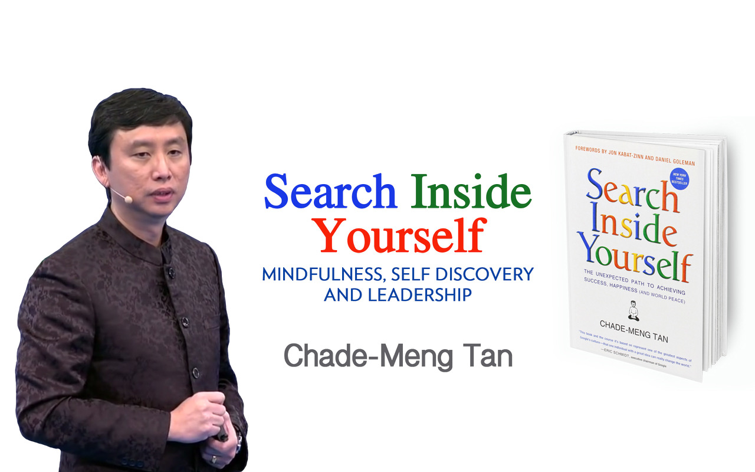
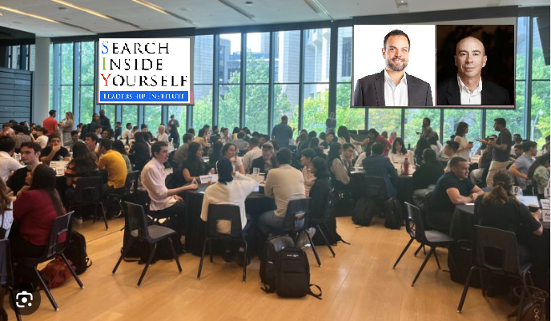
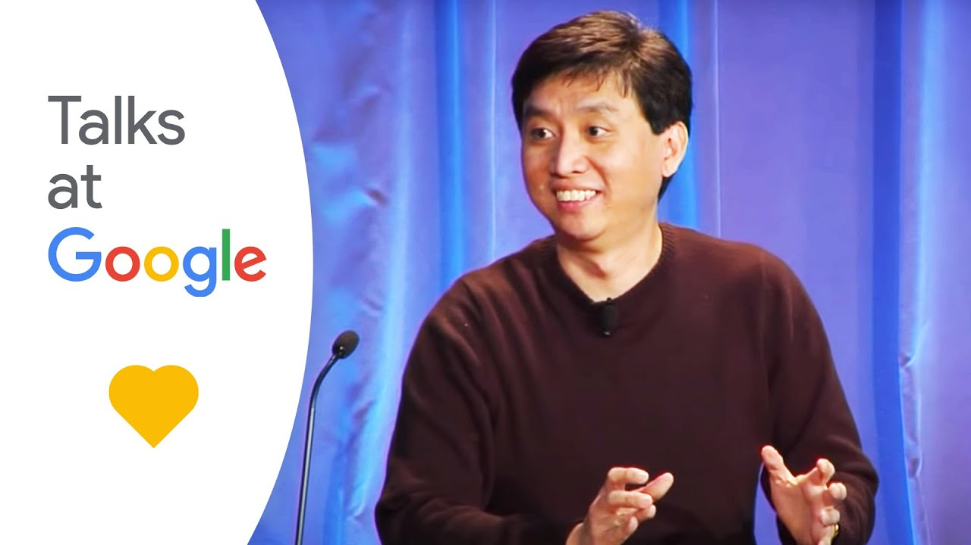
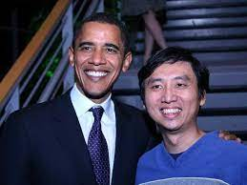
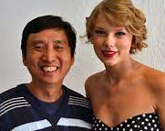
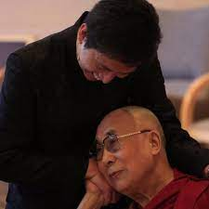





A big
“ah-ha” moment:
Feel
Think
Do
Say
Express
Believe
Notes:
I’d like to share with you how I came to Mindfulness
In early 2013, I watched some “google Talks” videos, where this guy Chade-Meng Tan spoke about Mindfulness
I was fascinated by this guy, and I quote “not only because of his good looks”
(click
“or because he takes pictures with important people and celebrities”
(click)
But because he’s the author of the book Search Inside Yourself, founder of SIYLI and creator of the 2 day course I went to take at Rotman School of Business @ Toronto in October 2013.
During this course I had a big “ah-ha” moment:
(click)
“Aligning myself” and being present, as this is the ultimate goal of being mindful, meaning that what I think, what I feel and what I do are aligned and in harmony
(click)
In other words, have heart, mind and body congruency
And this spoke to me with being aware of my emotions in order to acknowledge where I’m in my transition curve of any given change, and for change management and leadership
Chade-Meng Tan – Google Talks - https://youtu.be/r8fcqrNO7so?si=WaXA9kSqwTECti6W&t=1883
SIYLI - https://siyli.org/
Kristin Neff - https://self-compassion.org/

Slide 5


Short Sessions Participation
GCConnex
Notes:
When I came back from that training, there was what I can describe as an « urge » to do something
So right away, the same Oct of that year, I created a GCConnex group we had our first get together November of 2013 where 5 people attended.
(click)
The graphic, as you can clearly see, represents the attendance and the sumatory of participation to the sessions from 2013 until Sep 2017
(cilck)
The small graphic is an amplification of the first year
(click)
At some point we decided to merge this group with the « parent » group, now called « Change Management to Mindful Change Leadership »
A couple of things to notice:
Mar-May 2015 I had to take a break, because of an ACV
Sep-17 Was given a break
Until 2020 I was able to continue with this initiative

Slide 6
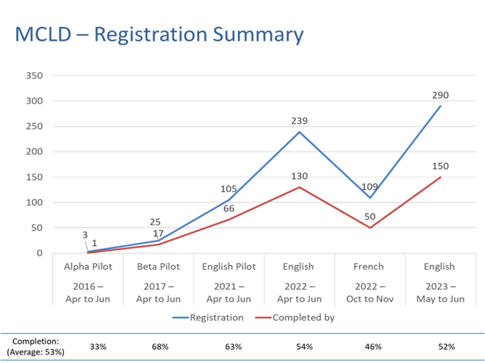
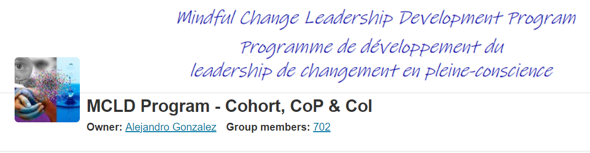
Notes:
((Buy In
How did you get buy-in for the program? How did you sell it? How long did it take to start?
By personal realization, interest and passion
As the program’s success is by volunteer participation, it’s just a matter of promoting it using the GCTools platforms and sending it to some emailing lists
))
By 2015 I had a sense that there was something bigger needed, thus I started alpha piloting the program in early 2016.
As per the graphic, the top blue line represent the number of people registered and the bottom red line how many completed the program.
An Alpha pilot 2016, and a Beta pilot 2017 where I got 25 participants registered and 17 completed the program
(Click)
this is where I knew I got something that could be successful, because of the number of registrants and because of the results I obtained, on next slide
There is a gap here (point to the screen between 2017 and 2021)
Then in mid 2017 I had to pause it because of « change in my work role & priorities », so I was given a pause
(Click)
Then during 2021, while at Indigenous Services Canada, I got the support and I led an English pilot 2021, and I created the “Cohort” in GCCollab platform with over 700 participants now including CoP & CoI.
then English and French offerings 2022, and this year 2023 we delivered the English offering and are in the 4th week of the French offering… so in answering the question “how long did it take to buy in/start?”: I’d say, a few tries.
https://wiki.gccollab.ca/MCLD-DLCP
MCLD - 8 Week Program Details.
MCLD - FAQ
https://gccollab.ca/groups/profile/7978973/mcld-program-cohort-cop-coi-programme-dlcp-cohorte-cdp-et-cdi

Slide 7
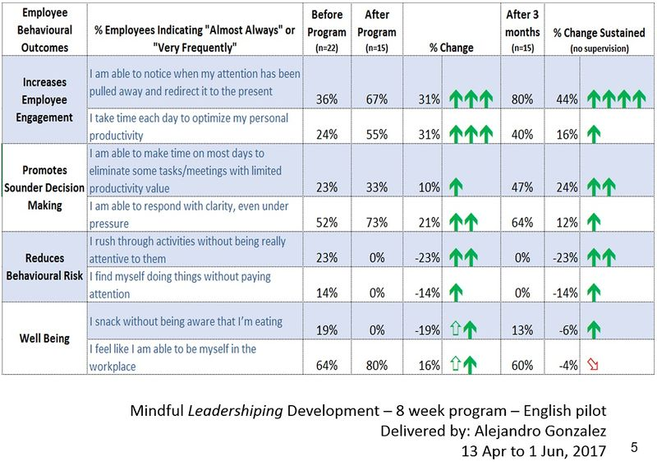
The results - 2017 Mindful Leadershiping Development program
Notes:
https://gcconnex.gc.ca/discussion/view/34647179/the-results-2017-mindful-leadershiping-development-program?language=en

Slide 8
Key Findings - MCLD English Program 2022
20.8%
23.0%
14.0%
20.5%
12.6%
, 3 months after
**76% success rate for self-assessments: 99 responses were received out of the 130 participants who completed the program.
* People who answered "Almost Always", "Very Frequently", and "Somewhat Frequently"
Notes:
Alejandro:
Participants completed self-assessment questionnaires at program registration and again three months after the eight-week program, and we have compiled the data to evaluate the results and impacts of the Mindful Change Leadership Development program.
(click)
The blue columns represent the results of the self-assessment questionnaires completed at registration.
(click)
The green columns represent the final assessment 3 months after the program ended, and the differences between them indicate behavioural changes.
(click)
With improvements in every category as indicated
What we heard from participants was that the program was a life changing experience, it helped them increased their own sense of well-being; and gave them the tools and practices to use with their teams to support employee wellness and well-being.
((A total of 130 participants completed the program, we received 99 final assessments (76% return on self-assessments), and the key findings per category are:
(click on each bullet)
An increase of 12.6% Increase in Employee Engagement – respondents show a sense of clarity of mind.
(Q2. I have difficulty distinguishing what day it is.)
A 23.0% Increase in Promoting Sounder Decision Making - people reported taking time to optimize their productivity.
(Q7. I take time each day to optimize my personal productivity)
Slightly over 20% decrease in Behavioural Risks - participants indicated being more aware of the task at hand.
(Q13. It seems I am running on automatic, without much awareness of what I am doing.)
Close to 21% Increase in Well-Being – respondents feel they are more present while at work and at home.
(Q1. I notice that I am distracted by thoughts about work after working hours or about home related things when I'm working.)
And 14.0% Increase in Resiliency - people reported an improvement in their ability to be present.
(Q21. I find myself listening to someone with one ear, doing something else at the same time.)
))

Slide 9

Mindful Change Leadership Development (MCLD) Program Goal
To increase self-awareness by developing key skills:
Focus,
Clarity,
Creativity, and
Compassion in the service of others
… with a positive impact on well-being and resiliency.
Invitation page and details: https://wiki.gccollab.ca/MCLD-DLCP
Notes:
((Program Overview
Briefly, what is the primary goal of your leadership program? Why did you decide to create/purchase this program over and above what the CSPS offers?
))
Goal of the program / Benefits expected: To increase self-awareness by developing key skills: Focus, Clarity, Creativity, and Compassion in the service of others and become a better Change Leader, with the option to start a mindfulness practice.
The program came to life as a grass-roots initiative, from mixed experiences and available resources, thus it was not available anywhere.

Slide 10

“Leadership is not a rank or a position, it is a choice - a choice to look after the person to the left of us & the person to the right of us.”
- S. Sinek
Notes:
((K… Target Audience
Who is the program designed for (e.g., senior executives, managers, other)?
))
The MCLD program is designed for all, as a leader is not a position or a title, we all are leaders
((
A quote from Simon Sinek, (read from the slide)
Strong leadership is one of the drivers of successful change, and leaders who support the people-side of change are essential to success.
This program delivers and promotes mindfulness practices to increase participants’ self-awareness and resilience, equipping leaders that can nurture mindfulness in their teams, with their colleagues and contribute to employee wellness and well-being.
))

Slide 11
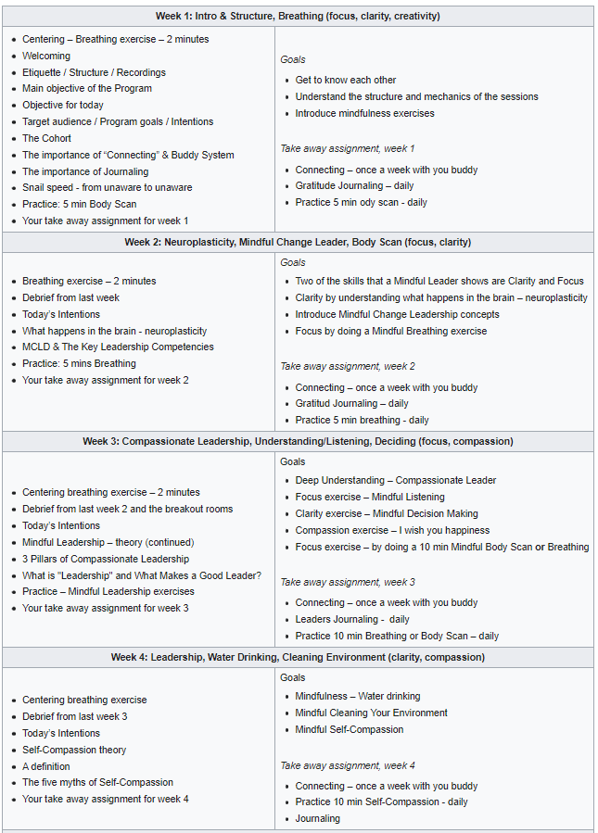
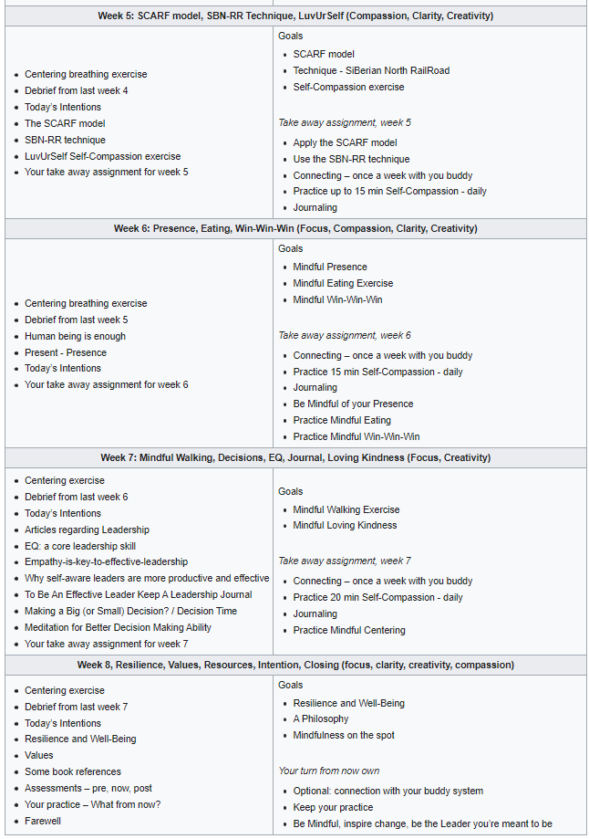
https://wiki.gccollab.ca/MCLD-DLCP
MCLD - 8 Week Program Details.
MCLD - FAQ
Notes:
((About the Curriculum and Content
Regarding the Program Structure
What is the program's duration and format?
))
The program goes for 8 weeks, with a weekly session of 1.5 hours, plus additional homework to an approximate 2 to 3 hours a week total
https://wiki.gccollab.ca/MCLD-DLCP
MCLD - 8 Week Program Details.
MCLD - FAQ
https://gccollab.ca/groups/profile/7978973/mcld-program-cohort-cop-coi-programme-dlcp-cohorte-cdp-et-cdi

Slide 12



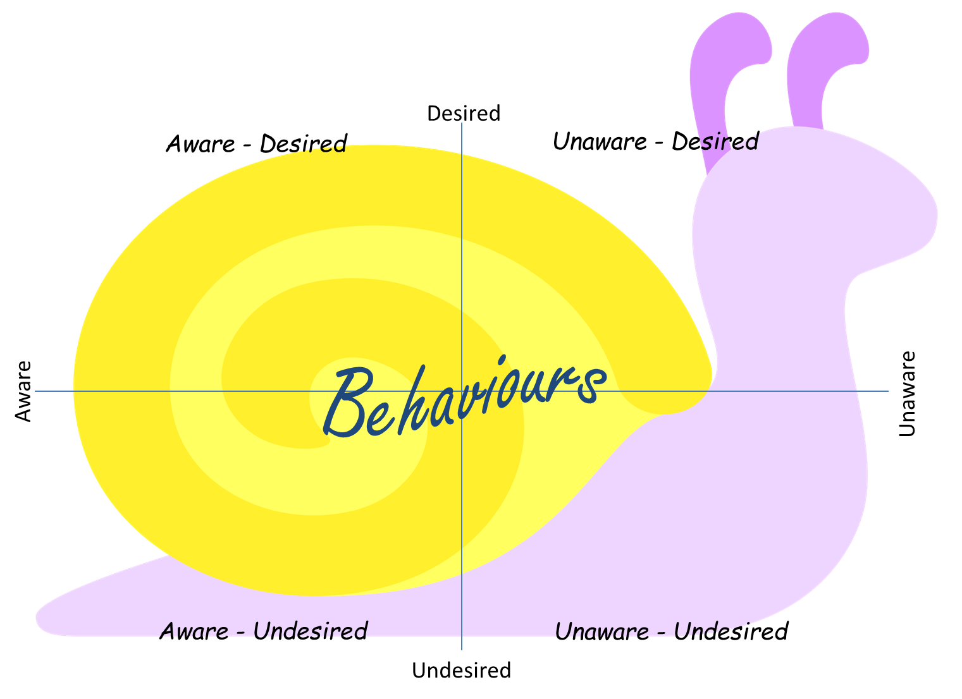

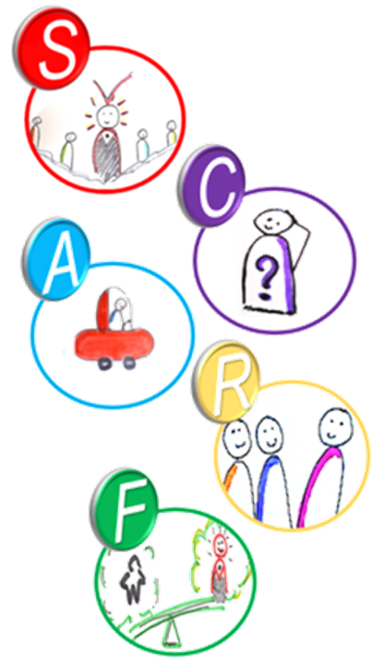


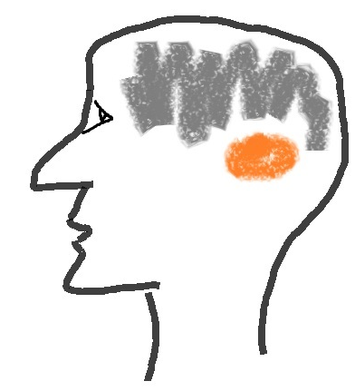
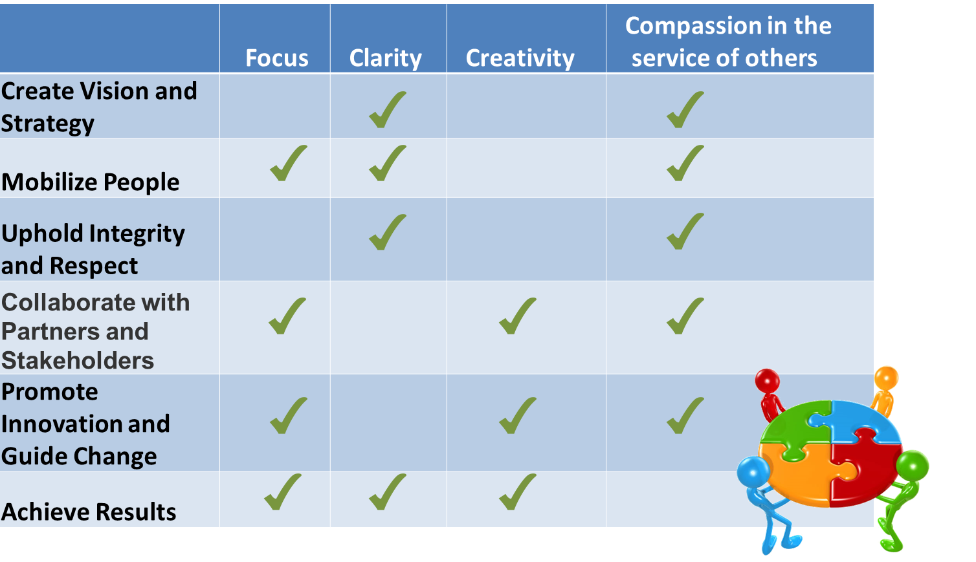
















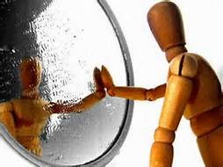



SBN-RR
Notes:
((What are the main topics covered in your program? Did you build it in house or purchase from a vendor? Why did you go the route you did?
))
We see a bit of theory and models, and mindfulness practice, all around mindful Change Leadership, and to name a few:
Every session, we start we a quick centering exercise
Scargot model, adapted from the Four stages of competence model. The buddy system that last for the 8 weeks of the program
Neuroplasticity, and mindful leadership and the leadership competencies of the GoC
Decisions, listening and Compassionate Leadership
E-Cleaning Environment, Autocompasion, do an mindful drinking water exercise
SCARF model, SBN-RR Technique, LuvUrSelf (self-compassion)
Being Human is enough, Presence, Win-Win-Win exercise, mindful eating exercise
Emotional intelligence, Empathy, mindufl walking exercise, loving-kindness exercise
Resilience, Well-being & Mindfulness, Values & Mindfulness, Resources, The Convergence page to maintain the practice https://wiki.gccollab.ca/Convergence …
Say our goodbyes and celebrate
…with a bunch of Mindful related exercises
https://wiki.gccollab.ca/MCLD-DLCP
MCLD - 8 Week Program Details.
MCLD - FAQ
https://gccollab.ca/groups/profile/7978973/mcld-program-cohort-cop-coi-programme-dlcp-cohorte-cdp-et-cdi

Slide 13
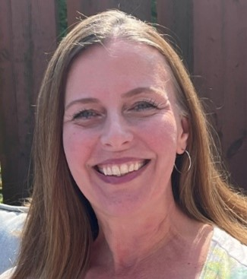
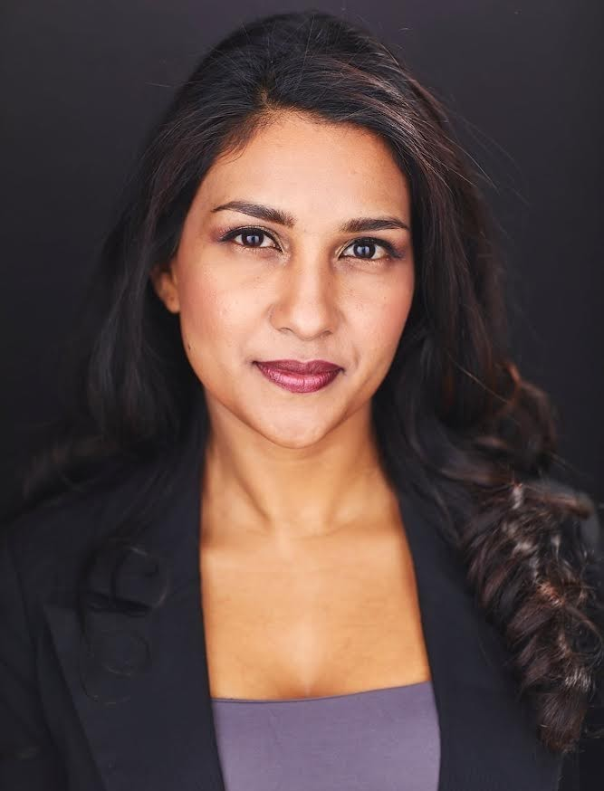
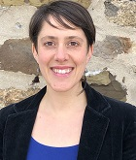

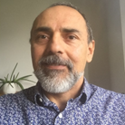
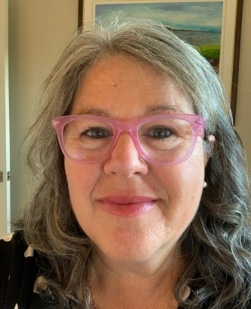
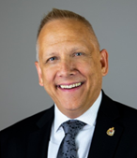
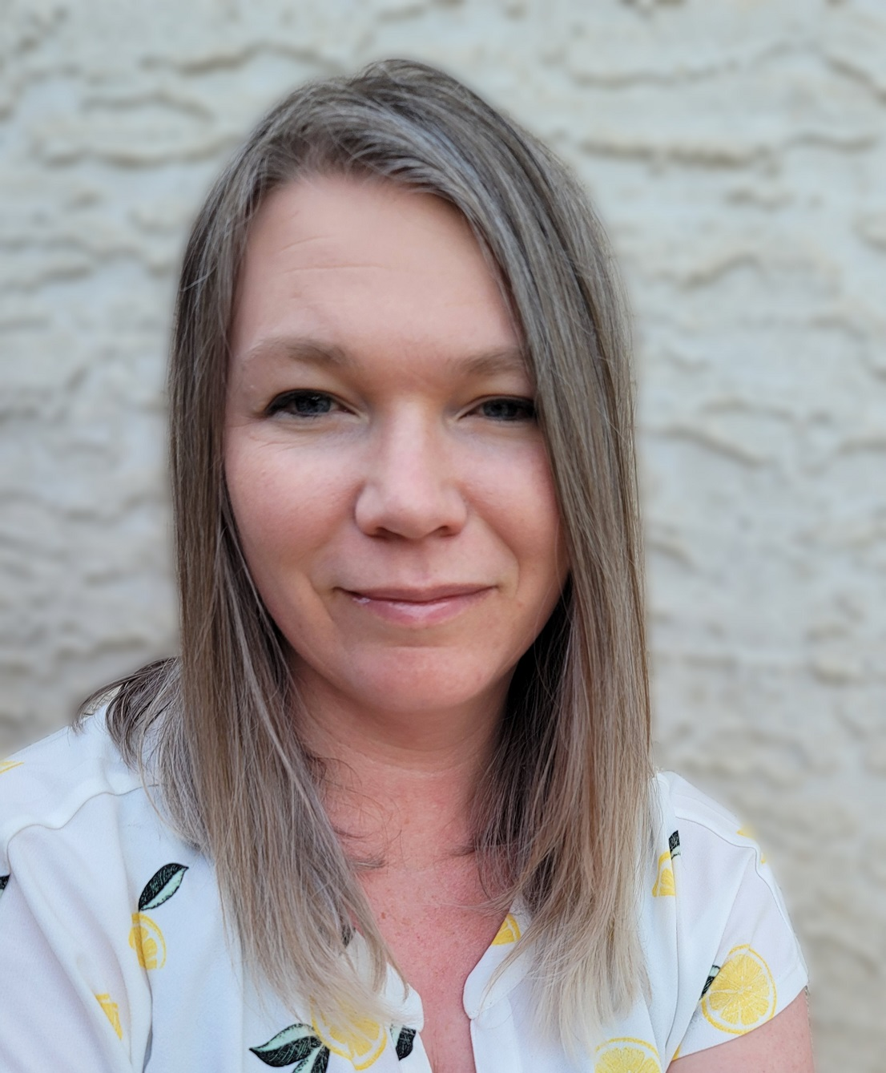
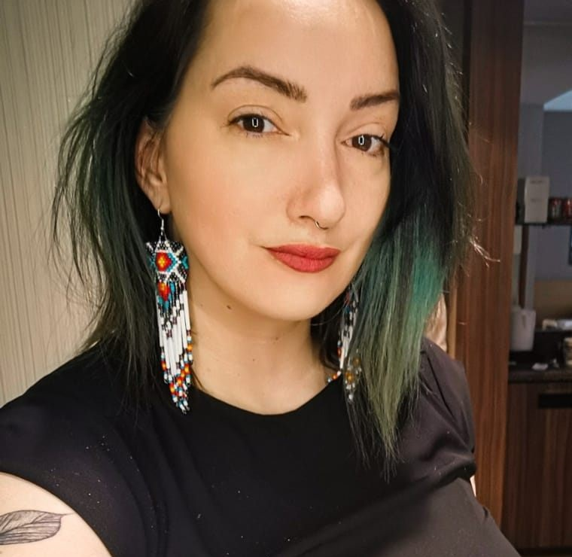

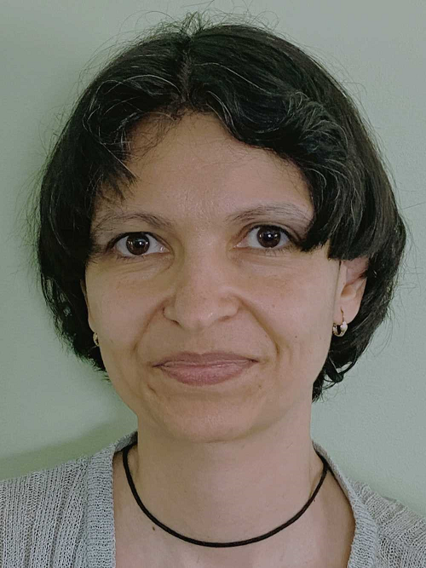

Livré par une équipe d'animateurs bénévoles
Ginette
Casey-Marie
Annie-Claude
Carmen
Alejandro
Marie-Lyne
Robert
Michelle
Dani
Sonya
Galina
Leanne
Notes:
((Resources
How many staff are dedicated to the program? How do they spend their time?
))
Requisite to facilitate is have completed the program, from a base of about 10+ volunteer facilitators from different Departments and Agencies
Usually 2/3 volunteers lead each session, depending on availability and preference
An Investment of up to an hour to participate in a coordination meeting
One or Two hours to prep
And 1.5 hours to deliver
((
Here a partial list of facilitators from various government Departments/Agencies, including:
Service Canada
Governor General
Indigenous Services Canada
Public Services and Procurement Canada
Financial Transactions and Reports Analysis Centre of Canada
Canada Border Services Agency
Treasury Board of Canada Secretariat
Canada Revenue Agency
Immigration, Refugees and Citizenship Canada
))

Slide 14
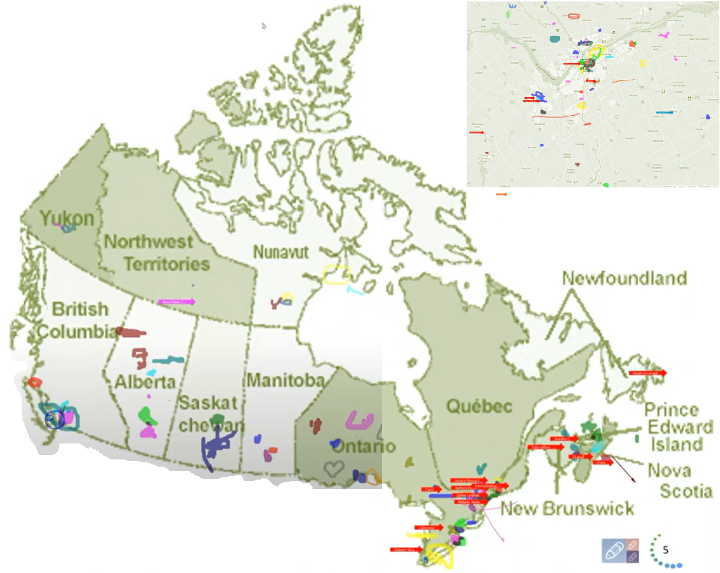
Map of Participation, 2022 English Offering
From across Canada:
From NCR:
Notes:
Alejandro:
The program had participants from across Government and across Canada, as you can see per the slide, the image was co-created at the beginning of the 2022 English offering

Slide 15

MCLD Program Testimonials
"…in a way, your investment in becoming medicine... is a very important investment…" - Elder Malcom Saulis
"I found this course to be extremely powerful and grounding... this really helps to shape how I look at my relationships with my staff… it was excellent. "
"it was very powerful, very interesting, lots of insights. I learned a lot about myself. I found the exercises appropriate in me being more productive, more present in my relationships with my colleagues and also with my family.”
“This series is life changing. I hope to participate more in the future”
"Thank you for this valuable opportunity to grow personally and professionally. It has been an important adjunct to the transformational work we are doing“
“I wanted to also share some specific gratitude... I found the sessions incredibly helpful, useful and well structured… it's already had a wonderful effect on my life”
Notes:
((Leadership Impact (if possible)
Can you share any examples of program graduates making a positive impact within your department?
))
Here are testimonials to the impact that the program has on participants…
"…in a way, your investment in becoming medicine... is a very important investment…" - Elder Malcom Saulis
"I found this course to be extremely powerful and grounding... this really helps to shape how I look at my relationships with my staff… it was excellent. "
"it was very powerful, very interesting, lots of insights. I learned a lot about myself. I found the exercises appropriate in me being more productive, more present in my relationships with my colleagues and also with my family.”
“This series is life changing. I hope to participate more in the future”
"These 8 weeks have been profound… in my view I think this should be mandatory for everyone. it's that powerful"
"Thank you for this valuable opportunity to grow personally and professionally. It has been an important adjunct to the transformational work we are doing at ISC.“
“I wanted to also share some specific gratitude... I found the sessions incredibly helpful, useful and well structured… it's already had a wonderful effect on my life”

Slide 16


Mindfulness and Learning: What’s the Connection?
…regular mindful awareness practice changes how our body and brain respond to stress, possibly strengthening connections in the prefrontal cortex and reducing reactivity in our limbic system, supporting self-reflection and self-regulation. These functions play a critical role in education. To learn, people must engage their prefrontal cortex to focus and monitor their attention and to inhibit impulsive tendencies towards distraction…
- https://www.mindful.org/mindfulness-and-learning-whats-the-connection/
Notes:
The connection between Mindfulness and Learning is that…
A regular mindful practice strengthens connections in the prefrontal cortex, supporting self-reflection and self-regulation. These functions play a critical role in education. To learn, you must engage their prefrontal cortex
- https://www.mindful.org/mindfulness-and-learning-whats-the-connection/

Slide 17

The Future of Learning and MCLD
The future of learning refers to the evolving and innovative methods, technologies, and approaches that will shape how people acquire knowledge and skills in the years to come. It encompasses a shift towards personalized, technology-enhanced, and lifelong learning experiences that adapt to individual needs and the changing demands of the modern world
Cultural Transformation
Embracing Innovation
Resilience and Adaptability
Empathy and Inclusivity
Stakeholder Engagement
Professional Development
Facilitator Well-being
Continuous Improvement
Embracing Innovation
Empathy and Inclusivity
Continuous Improvement
- Source: ChatGPT
Notes:
A mindful change leadership program can play a crucial role in supporting the future of learning in several ways:
I’m going to mention the following 3:
(click x3)
1. **Cultural Transformation:** Such a program can help organizations cultivate a culture of mindfulness and adaptability. This cultural shift is essential for embracing and driving the changes required for the future of learning.
2. **Embracing Innovation:** Mindful leaders are often more open to innovation and are better at integrating new technologies and teaching methods into the learning process. They can encourage the adoption of innovative tools and approaches that enhance learning experiences.
3. **Resilience and Adaptability:** Mindfulness practices can enhance resilience and adaptability in both educators and learners. As the future of learning involves continuous change and adaptability, individuals who are more mindful and emotionally resilient are better equipped to navigate these shifts.
4. **Empathy and Inclusivity:** Mindful leaders tend to be more empathetic and aware of the diverse needs and backgrounds of learners. This can lead to more inclusive and learner-centered approaches, which are central to the future of learning.
5. **Stakeholder Engagement:** Mindful change leaders often engage various stakeholders, including students, teachers, parents, and community members, in the decision-making process. This participatory approach can lead to more meaningful and effective changes in education.
6. **Professional Development:** A mindful change leadership program can focus on developing leadership skills that are aligned with the changing needs of education. This includes leadership skills related to technology integration, data-driven decision-making, and fostering a growth mindset.
7. **Facilitator Well-being:** Facilitators in the future of learning will need to manage increased workloads and adapt to new challenges. Mindfulness can help them cope with stress and maintain their well-being, which ultimately benefits the learning environment.
8. **Continuous Improvement:** Mindful leaders are often more committed to continuous improvement and ongoing self-reflection. This approach aligns with the iterative and evolving nature of the future of learning.
In summary, a mindful change leadership program can support the future of learning by fostering a culture of adaptability, empathy, and innovation, and by equipping leaders with the skills and mindset needed to navigate the evolving landscape of learning effectively.
- Source: ChatGPT

Slide 18


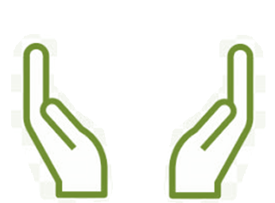
What’s Needed For Success ?
Voluntary Participation
Support from Management
Notes:
Two components which will be key for ensuring the continued success of the program are maintaining voluntary participation and support from management.

