Slide 1
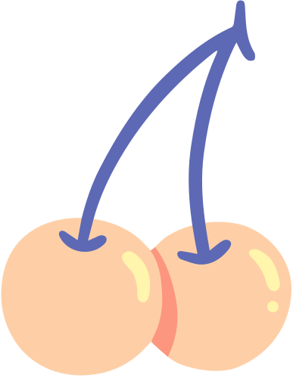
FYN Ecosystem
A learning tool for you!

Slide 2
Objective 1
Objective 2
Objective 3
Objective 4
Leverage existing resources to curate individual learning plans/programs
Augment existing resources with internal resources to share within their network
List different types of resources FYN has available
Access resources from multiple platforms

Slide 3
RESOURCES
Virtual Learning Series
Career Boot Camp
GC Students
Mentorship
EDI programing
Types of Resources available on multiple plaforms - Walkthrough
PLATFORMS
GC (wiki, collab)
Facebook
Twitter
LinkedIn
Instagram
YouTube
and even TIK TOK!

Slide 4
Date:
APRIL 05
INDIVIDUAL LEARNING PLAN
Status:
Self-Reflection
Involve others
Research
where are you in your career?
where do you want to go or what do you want to be?
what do you need to grow?
FYN learning plan resources
talk to colleagues to get honest feedback (be open)
talk to your manager (free vs paid)
reach out to someone you see on VLS
mentor/coach
check out FYN's mentorship page
check out the resources page
watch relevant recordings
lots of resources

Slide 5
1
Share!
TODAY'S CHALLENGE!
2
Area of improvement
Pick a date
3
4
Ask for honest feedback

Slide 6
Thank you!

