Slide 1
Social Media Use Among Adolescents
Candice L. Odgers
Canada at the Cutting Edge of Innovation, Feb 2023

Slide 2
Outline
1
Associations between digital technologies (including social media) are smaller than most assume, with fears versus facts driving the conversation.
2
Social media may be an “outcome” not a cause of mental health problems
Fears that social media is addictive and harmful to adolescent mental health and wellbeing are high, including among adolescents themselves.
3
4
There may be a “new digital divide” emerging in online spaces.
5
Adolescents are going online to seek information and support for mental health problems, but few reliable or youth-centered solutions exist.
2

Slide 3

Concerns about adolescents’ mental health and digital tech were high before COVID but much of this is driven by fears vs. facts.
1
© 2019 Common Sense Media. All rights reserved.www.commonsense.org

Slide 4
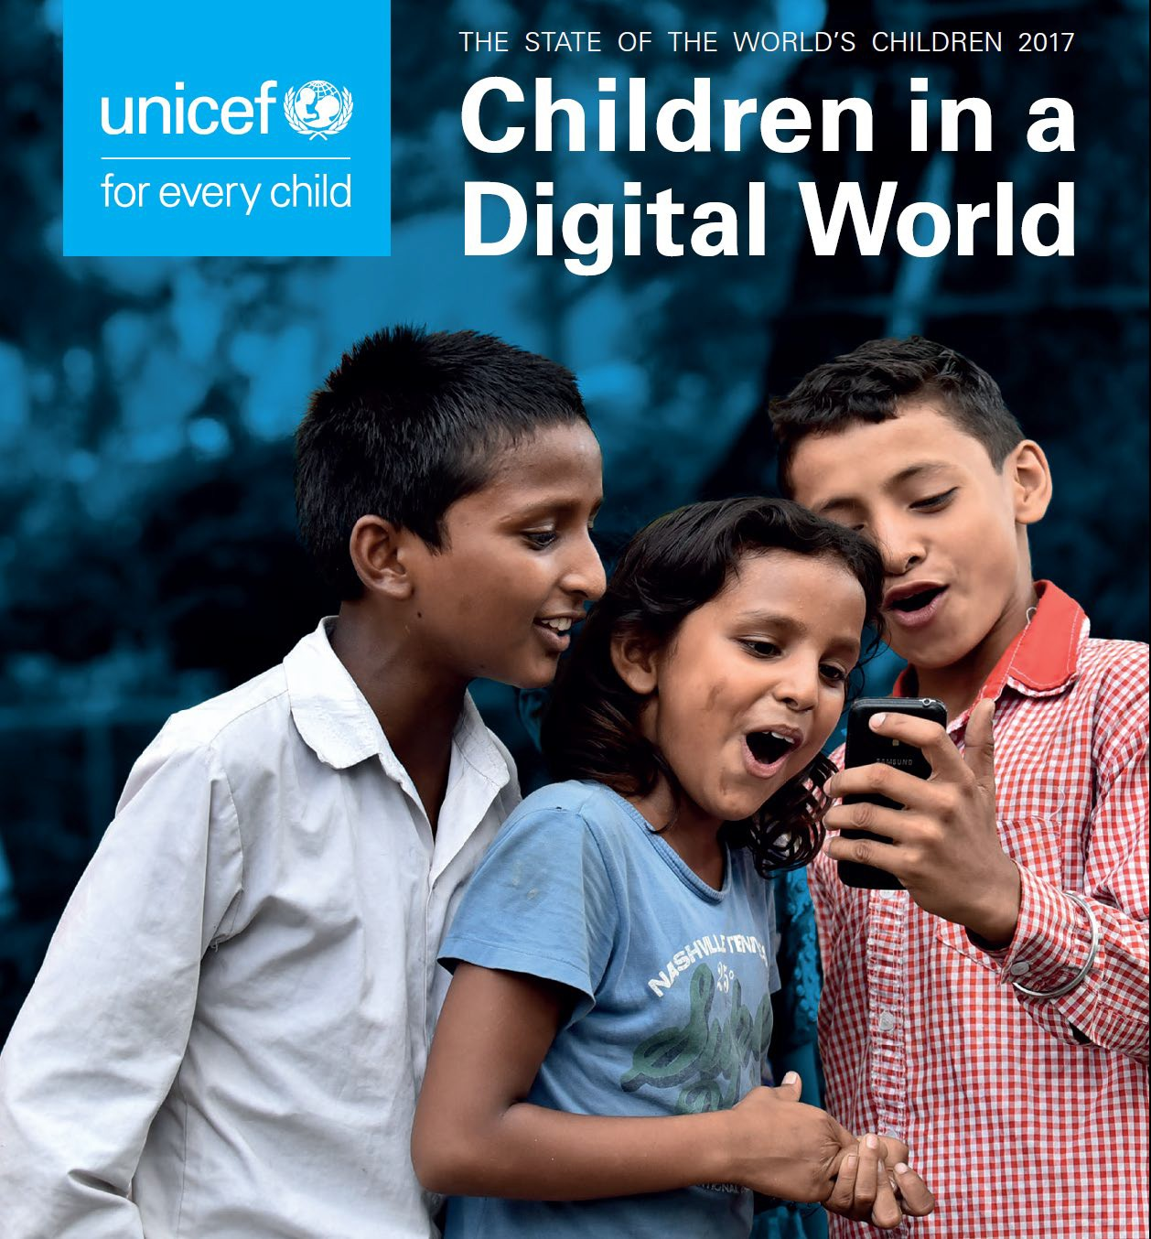
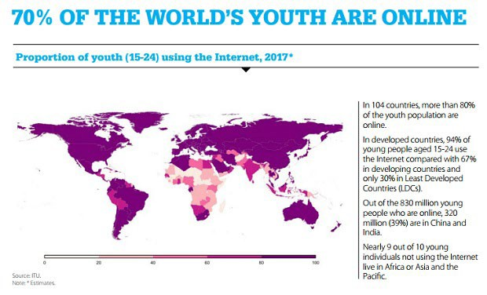
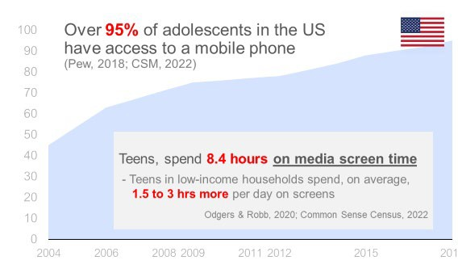
1 in 3 internet users are children

Slide 5
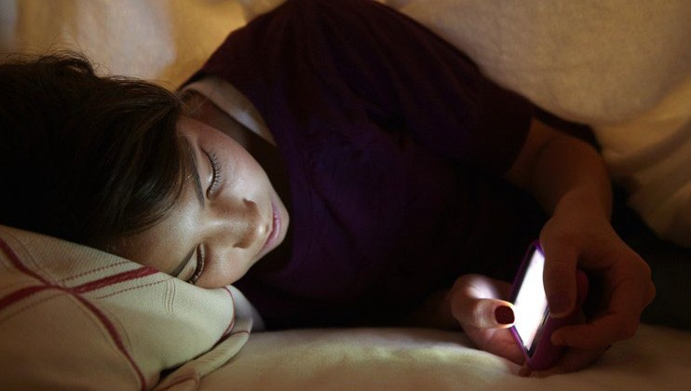
Our Reaction = Fear
Addicted Depressed Disconnected Losing skills Victims

Slide 6

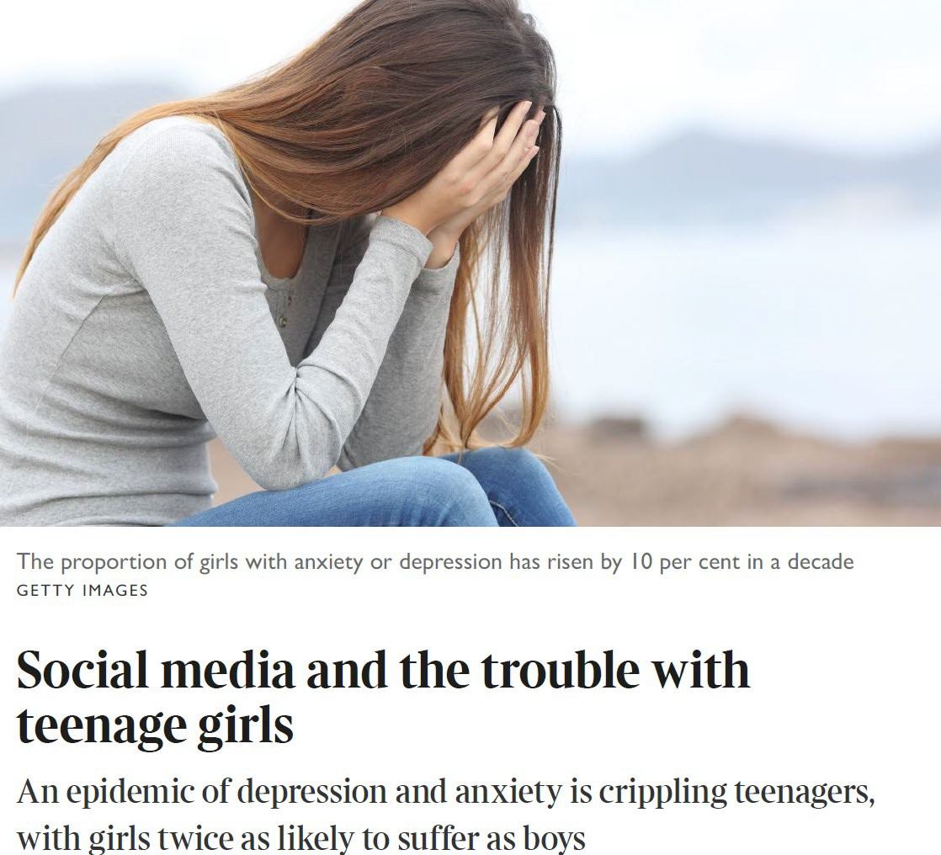
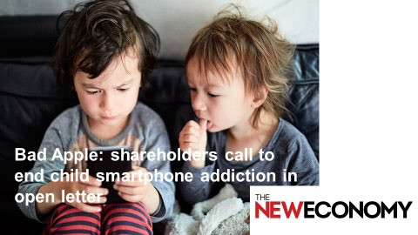

F E A R S
Is Your Child a Phone ‘Addict’?

Slide 7
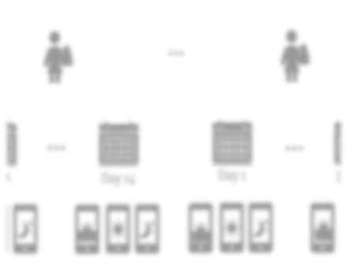
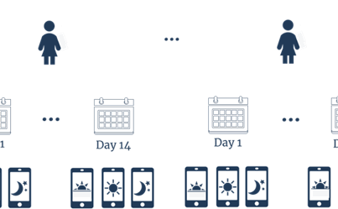

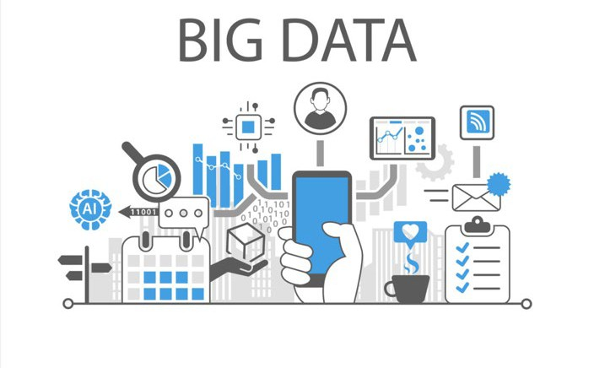

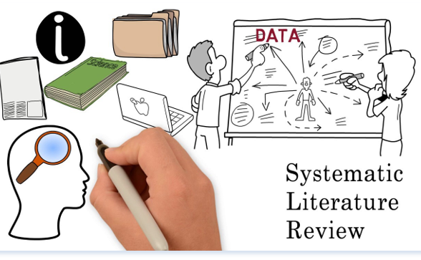
F A C T S
1. Large Surveys
2. Daily Data
Odgers & Jensen (2020) JCPP Review
George & Odgers (2015), Perspectives Psyc Sci
3. Recent Reviews

Slide 8

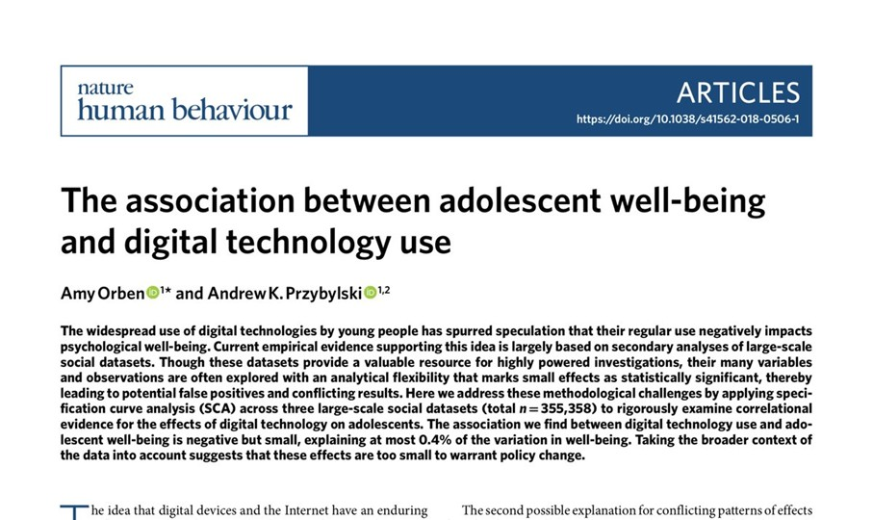
1. Large Surveys and Open Science
355,358 teens surveyed and 3,221,225,472 analyses; tiny associations <1% of variation (0.4% at most)

Slide 9
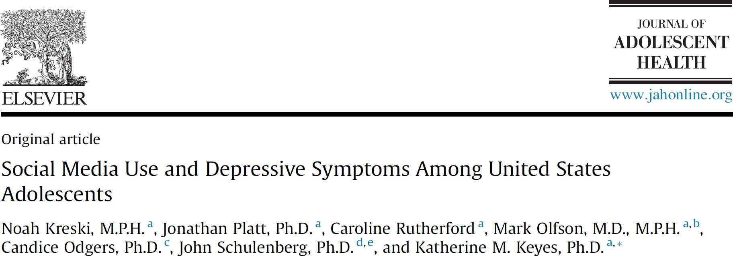

Our recent re-analysis of MTF
“…contrary to the popular narrative, daily social media use is not a strong or consistent risk factor
for depressive symptoms.”
Association did not differ by propensity for
depression; only present for low-risk girls
Between 2009-2017, correlation between social media and depressive symptoms reduced to ns

Slide 10

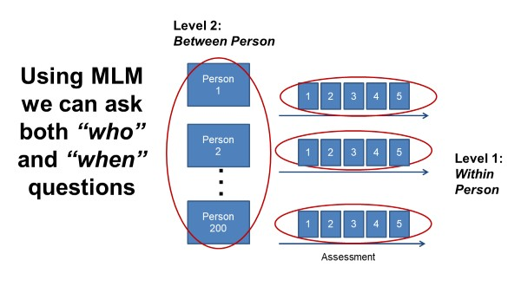
Population vs. Person

Slide 11
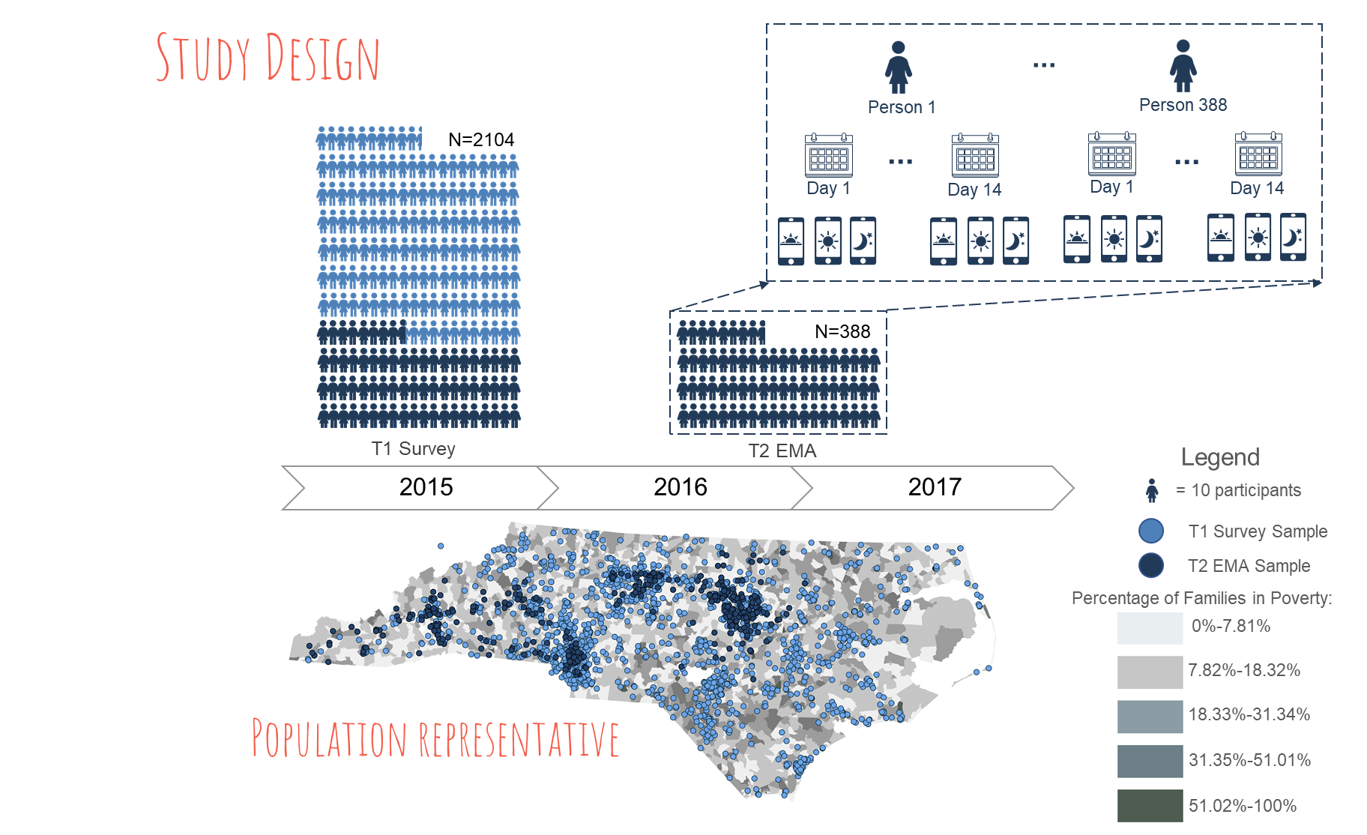
2. Daily Data via Mobile Devices

Slide 12
2. Daily Data via Mobile Devices

Slide 13
2. Daily Data via Mobile Devices
N = 13,017
observations
(5,270 days)
No daily linkages between digital tech usage and daily mental health
Jensen, Odgers et al (2019) Clinical Psych Science

Slide 14
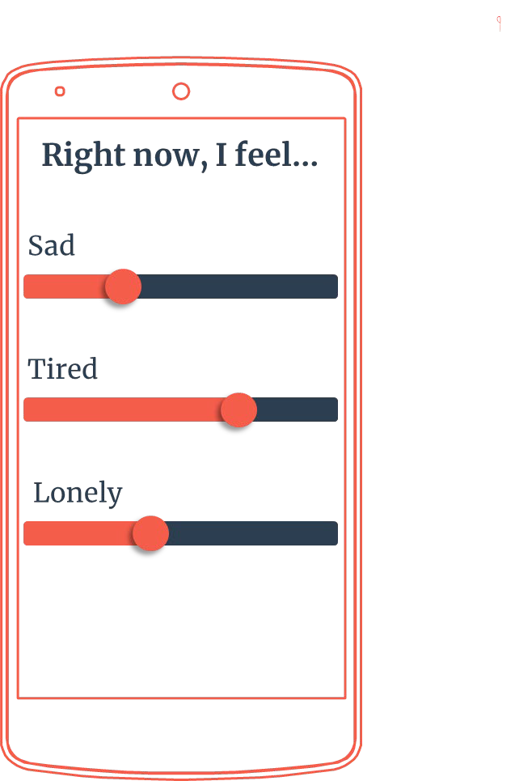
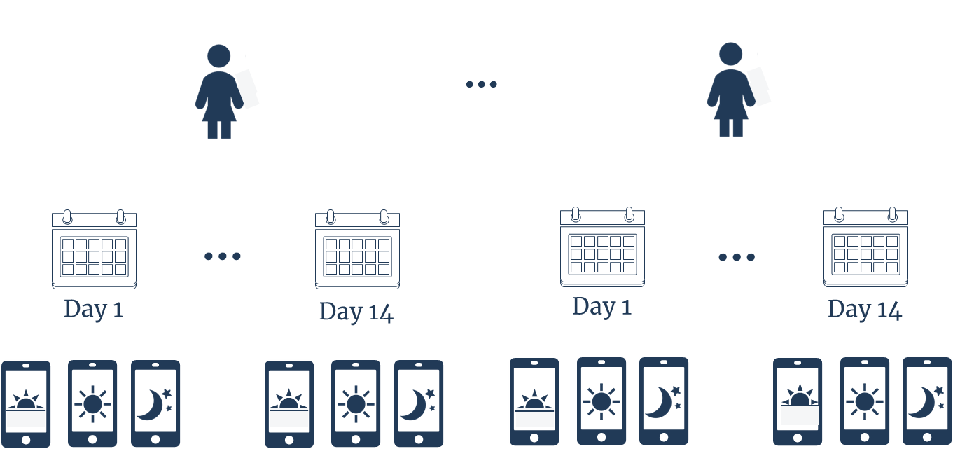
Only link: adolescents more connected via texts reported better wellbeing; similar daily findings

Slide 15



Only link: adolescents more connected via texts reported better wellbeing; similar daily findings
Michaeline Jensen, UNCG
Madeline George, RTI

Slide 16

2
Longitudinal research suggests social media may be on the wrong side of
most equations.

Slide 17

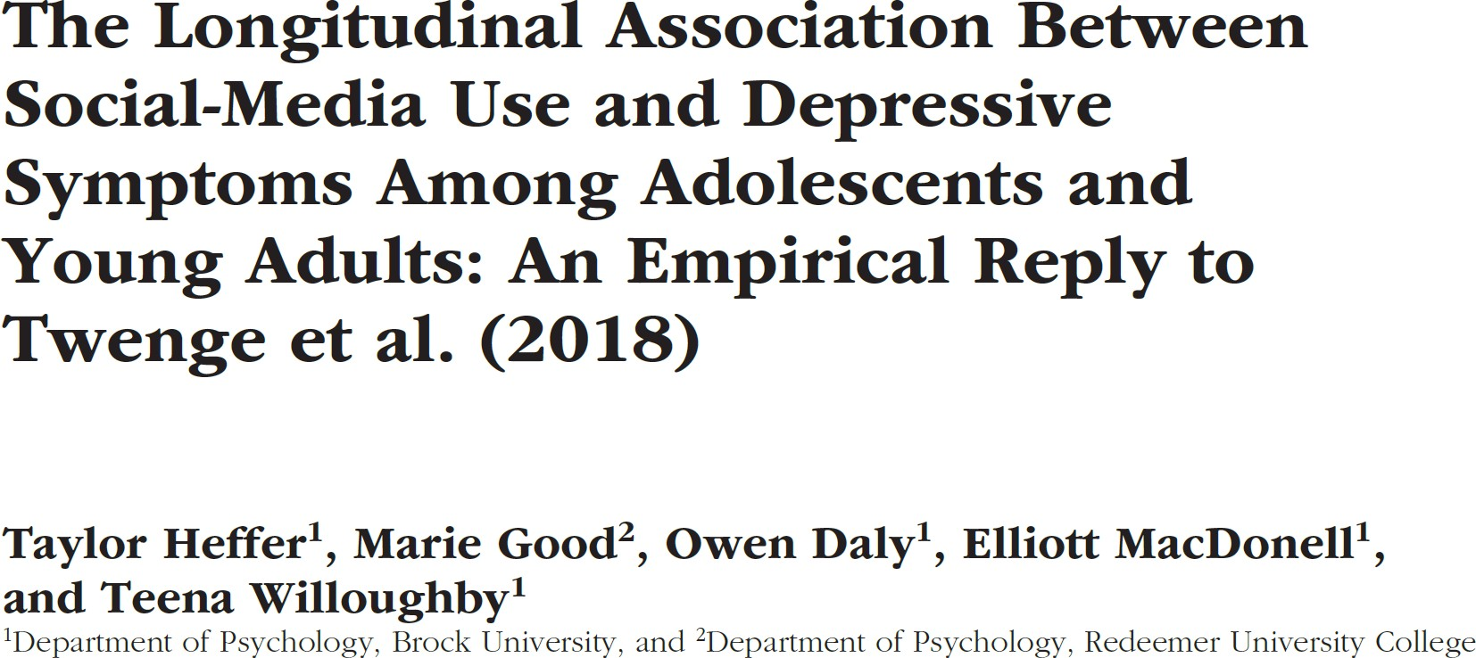
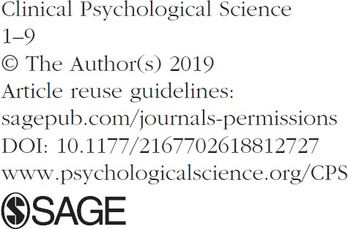
New longitudinal evidence (from Canada)…

Slide 18
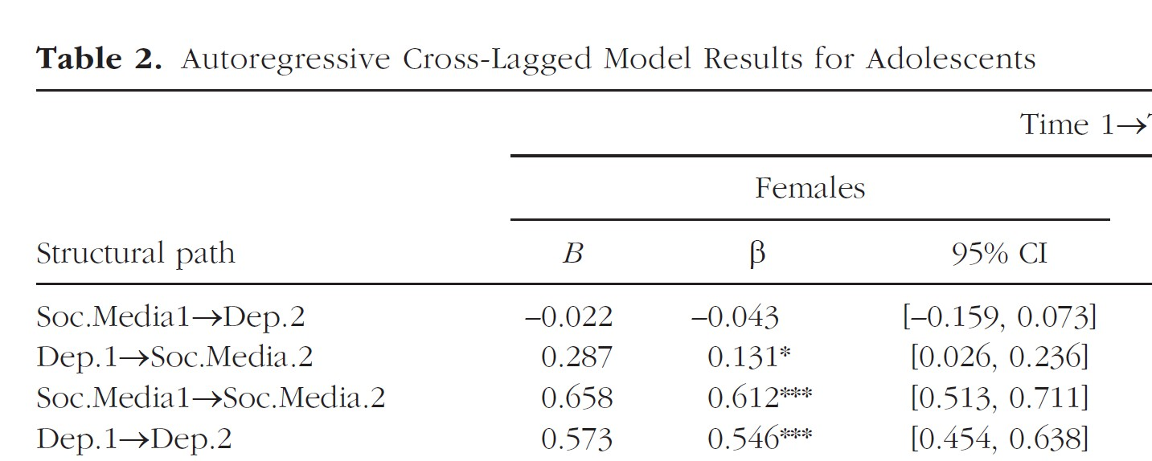

New longitudinal evidence (from Canada)…
Depressive symptoms predict later social media use (girls only), but not vice versa

Slide 19
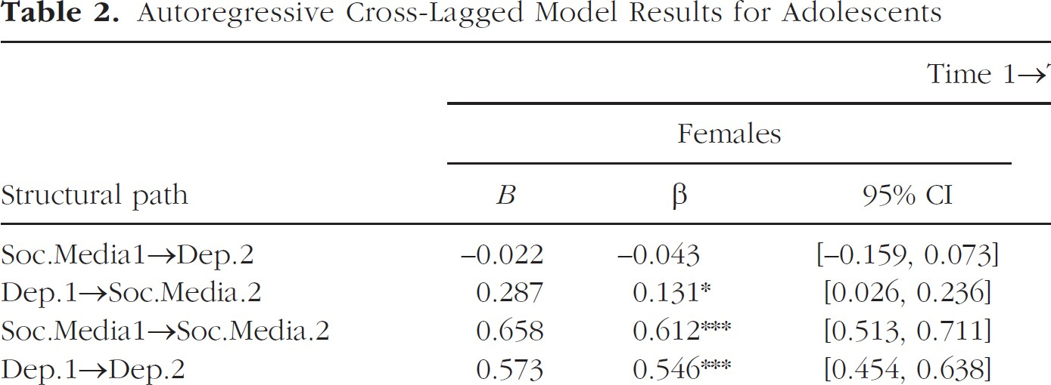

Depressive symptoms predict later social media use (girls only), but not vice versa
N = 1,726
6 yrs of annual assessments
Young adult & adolescents

Slide 20
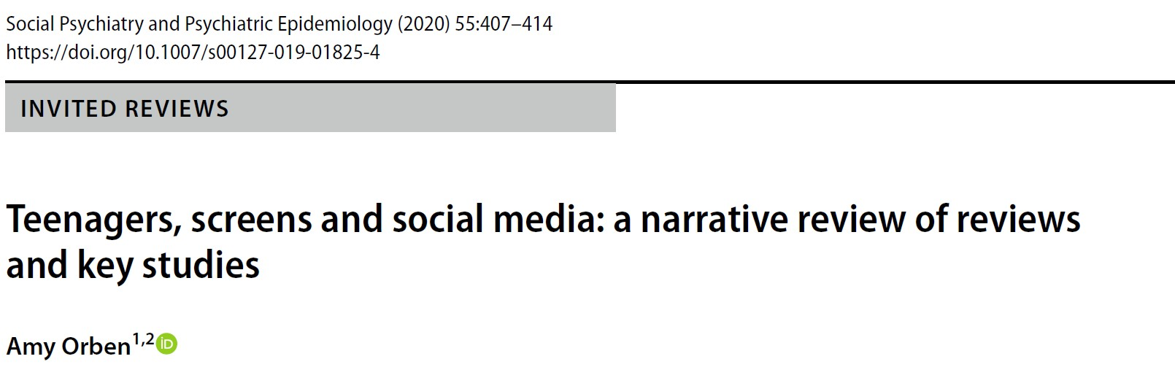
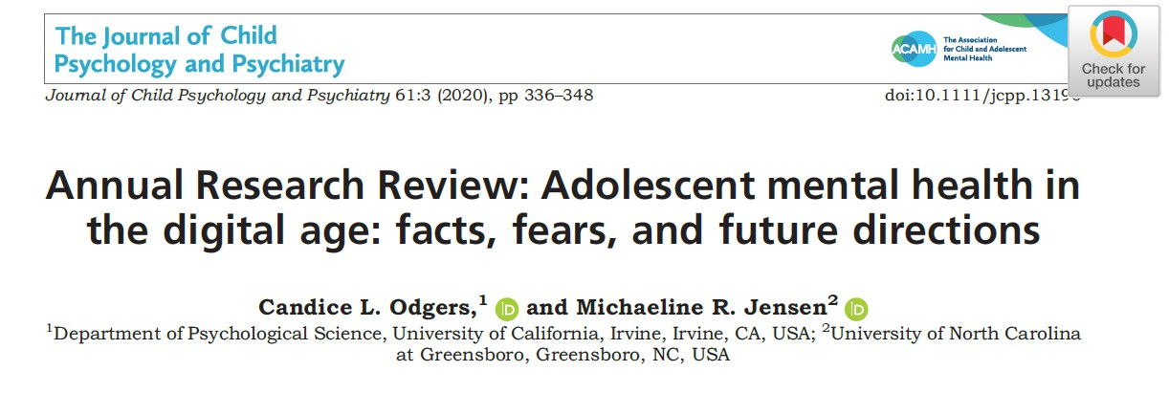
3. Recent Reviews
Mix of small negative, positive and mostly null findings
Almost exclusive focus on screen- time, how much versus how youth are spending time online
Virtually all studies are correlational – no way to distinguish cause from effect
New longitudinal studies suggests early depression predicts later social media use, but not vice versa
One-size fits all approach to modeling and explanations

Slide 21
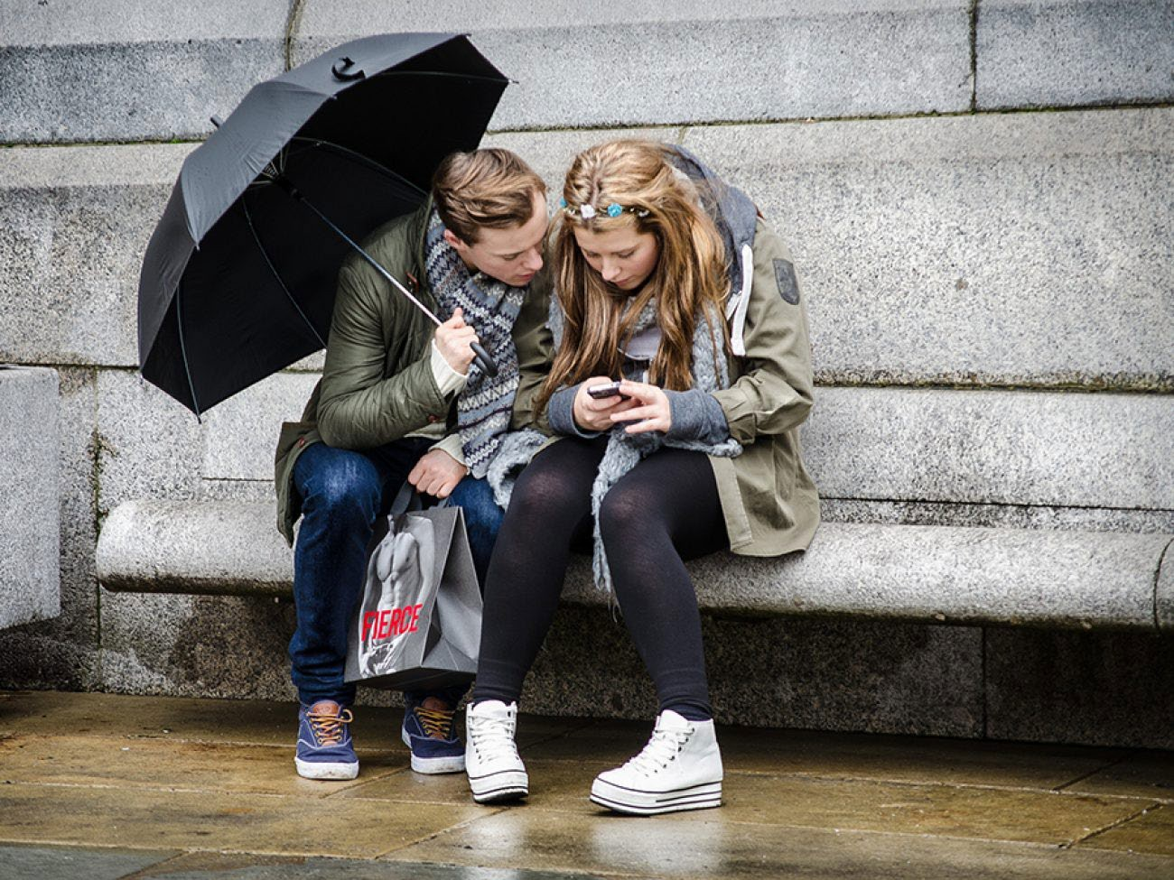

Blaming smartphones, but missing the point…
“The smartphone may be a powerful mirror, reflecting back problems and potentially magnifying existing problems in kids’ offline lives.”
http://bold.expert/blaming- smartphones-but-missing-the-point/
https://bold.expert/depression- worsening-among-girls/

Slide 22
Fears that social media is addictive are high, including among adolescents themselves.
3

Slide 23
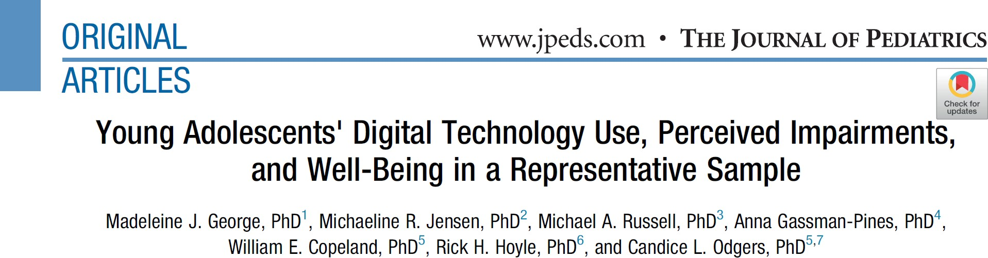
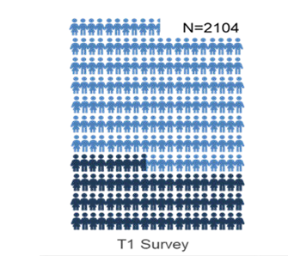

Virtually all teens endorse impairment or addiction related to their digital tech use
But few reliable linkages between SM use with standardized test scores, child or parent-reported symptoms were found
Caution for future research: addictive vs. neutral framing modifies findings (Hancok et al., 2022) and threats due to non-blinding in experimental approaches

Slide 24

New Digital Divide
4

Slide 25
Virtually all of U.S. adolescents now have access to a mobile phone
100
90
80
70
60
50
40
30
20
10
0
Teens, spend 7.5 hours on media screen time
- Teens in low-income households spend, on average,
1.5 to 3 hrs more per day on screens
Odgers & Robb, 2020; Common Sense Census, 2019; Pew 2018
2004
2005
2006
2007
2008 2009 2011 2012 2015
2018
2010
2013 2014
2016 2017

Slide 26
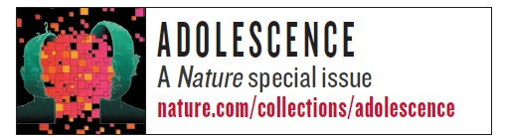
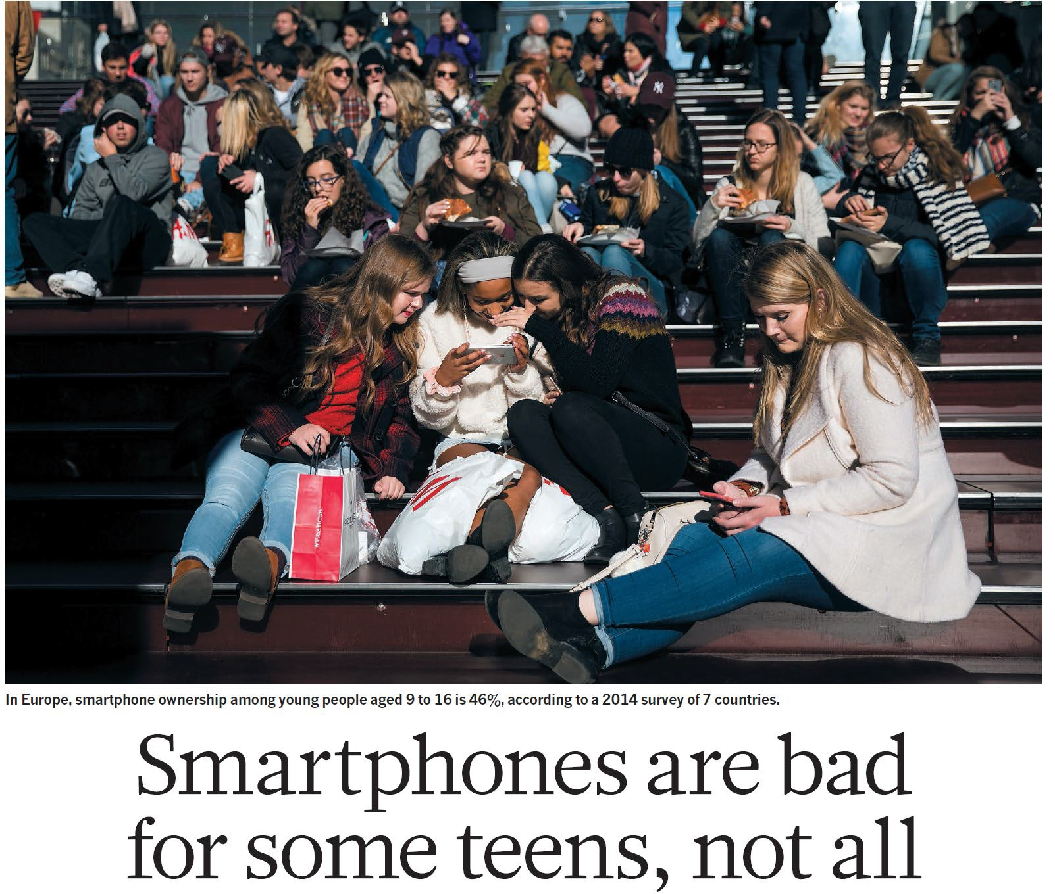
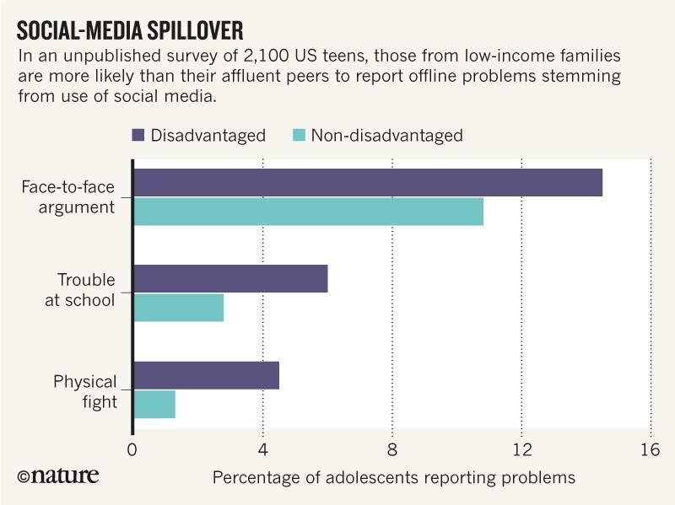

“Opportunity gaps” and segregation in online spaces
Odgers (2018). Nature, 554. 432-434.

Slide 27
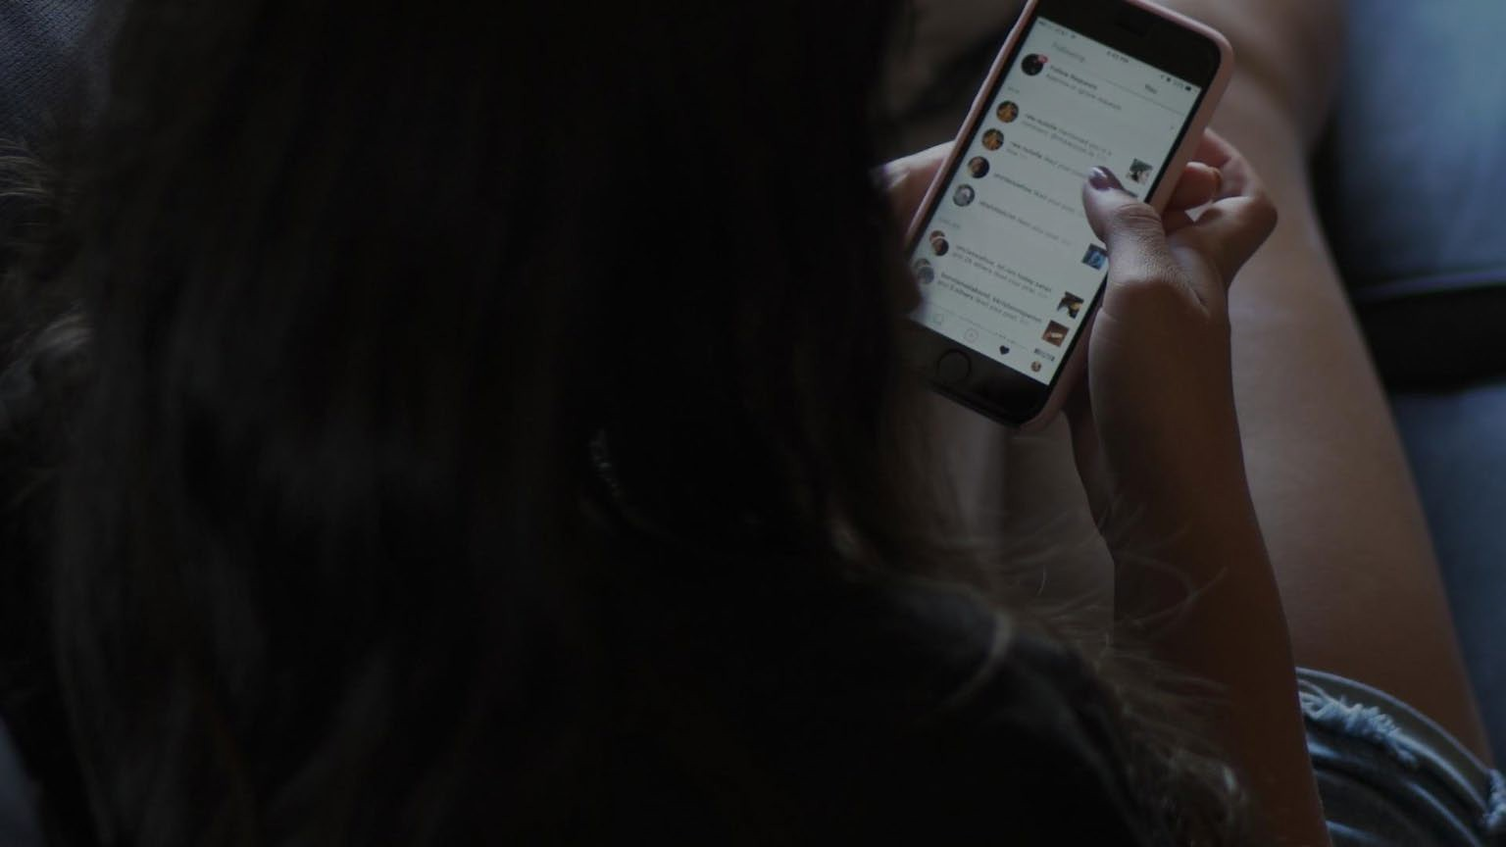
Adolescents are going online to seek information and support for mental health problems, but few reliable or
youth-centered solutions exist
5

Slide 28


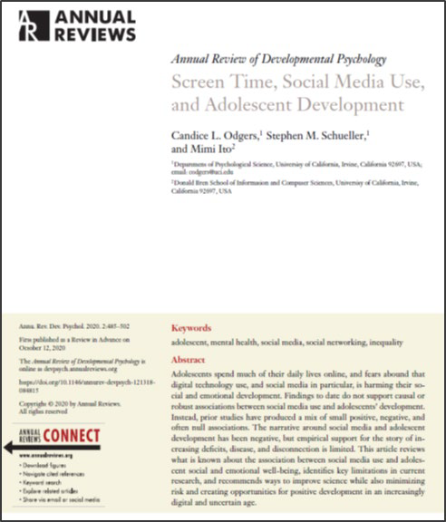
Adolescents are seeking help and support online
87% of adolescents have gone online to seek out information about mental health (Rideout & Fox, 2018)
  42% for anxiety & 30% for depression
  Depressed adolescents more likely to seek support
  Most report SM as providing social support
Some evidence of effectiveness for digital mental health interventions (Hollis et al, 2017), but adolescents often left out of the design and delivery of these solutions
Research-to -practice gap; close to 50% of teens report desire to use an app, but only 6% have used (Grist, 2018)

Slide 29
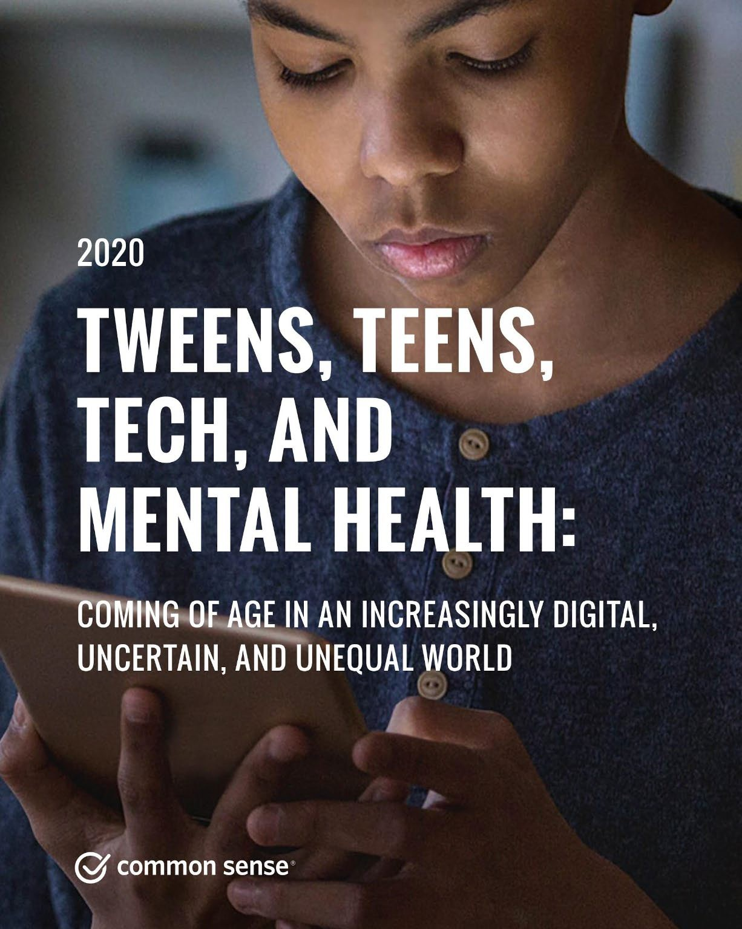

Additional Resources

Slide 30

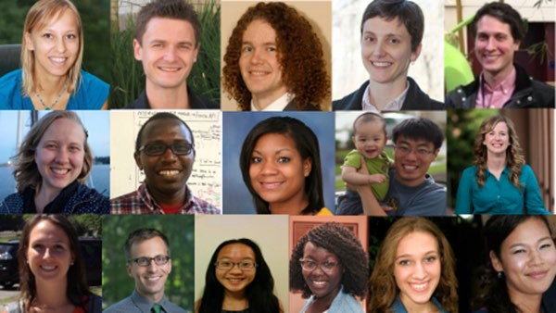



Contact & Team
Candice L. Odgers, Ph.D
codgers@uci.edu adaptlab.org

