Slide 1
Leading workplace modernization
And supporting employees through it
Notes:
Modify Title if necessary.
Hello, I’m [NAME], [POSITION] for workplace Transformation and Enablement, with PSPC Accommodation Management and Workplace Solutions. And I’m here to talk to you about GC workplace and leading workplace modernization.
Personalized this phrase, based on client’s requirements: Based on previous discussions with the Account Manager, your intention is to reduce the amount of individual workstations and increase collaborative spaces. You are also interested in unassigned seating, and you have an increase in FTEs, for a total of 160.

Slide 2
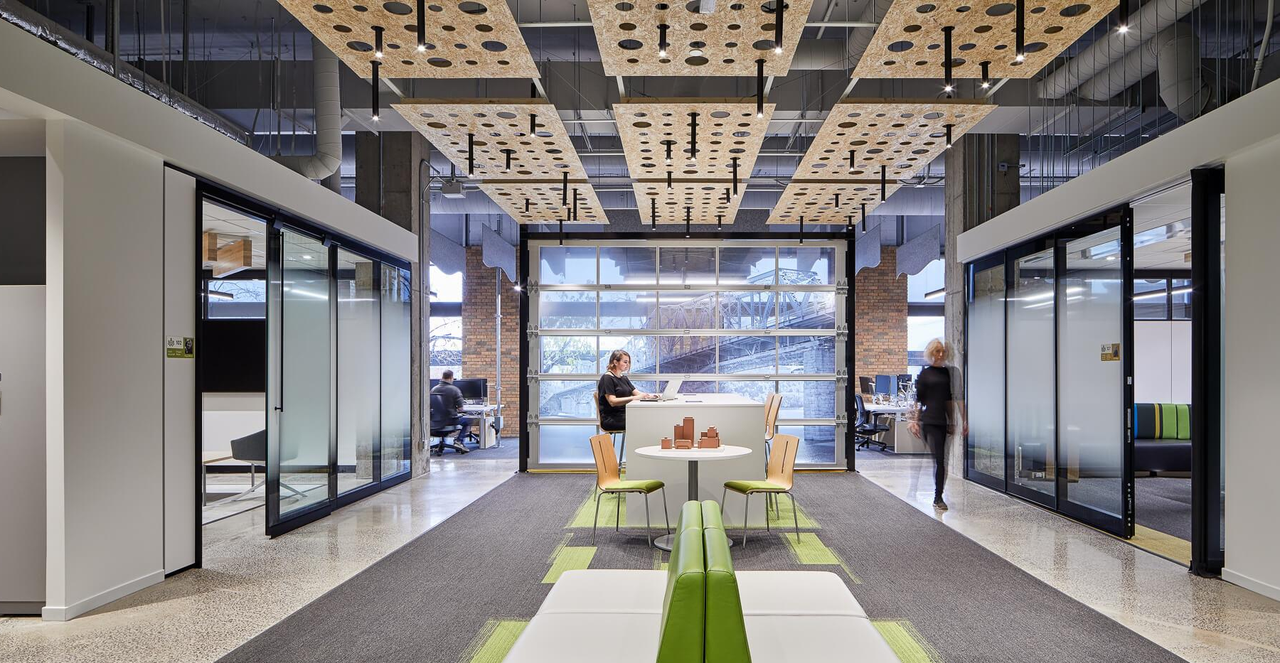
Leading workplace modernization
And supporting its employees through it
Notes:
Modify Title if necessary.
Hello, I’m [NAME], [POSITION] for workplace Transformation and Enablement, with PSPC Accommodation Management and Workplace Solutions. And I’m here to talk to you about GC workplace and leading workplace modernization.
Personalized this phrase, based on client’s requirements: Based on previous discussions with the Account Manager, your intention is to reduce the amount of individual workstations and increase collaborative spaces. You are also interested in unassigned seating, and you have an increase in FTEs, for a total of 160.

Slide 3
Overview
The GCworkplace vision
Introduction to the Roadmap
GCworkplace key design principles
What are the first steps in planning your workplace modernization program
How can we support
Annex A: Change Management
Annex B: Interior Design
Notes:
Personalize as necessary.

Slide 4
How to use this template
Ceci est un répertoire à jour de diapos pour supporter la création de présentations. Ce n'est pas une présentation à partager aux clients.
General
This presentation is separated into sections
Note: Instruction slide is HIDDEN and WILL NOT show in Presentation mode (unless you start the presentation on that slide)
Instructions
Save As before you get started
Based on your audience, REVIEW and DELETE the sections that are NOT required
To remove a section, right-click on the section and select “Remove Section & Slides”
Edit the Title slide and picture based on your audience:
e.g. Generic Gcworkplace presentation , Onboarding Presentation, etc.
Edit the Overview slide based on the sections you have selected to keep
Edit the Thank you slide with the appropriate name(s)
Use the accompanying Word document for notes on each slide (remember to remove the sections that are NOT required for your audience).

Slide 5
Housekeeping
This is an interactive session, please ask questions!
Raise your hand using MS Teams function, and unmute
Or use the chat function if preferred
If needed, turn on closed captioning function
Presentation available in GCDocs (link in meeting invite)
After the meeting, if you do not want to receive any of the chat pop-ups, please leave MS Teams Chat ->Select the three dots (…) and then Leave.

Slide 6
The GCworkplace vision

Slide 7
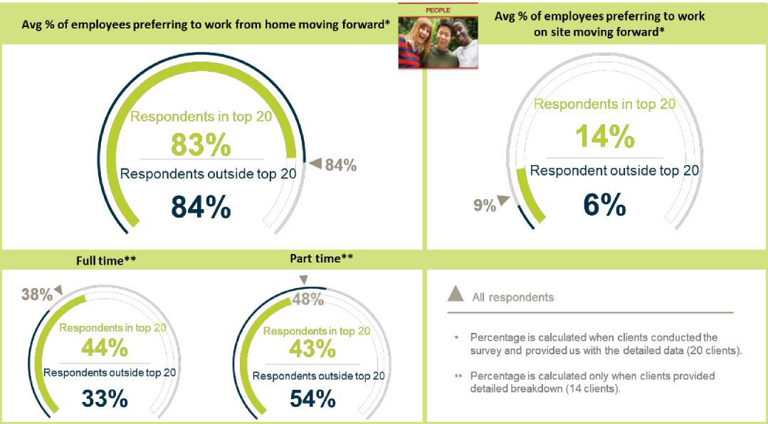
How do employees feel about the future of working in the federal public service?
Based on surveys administered by PSPC to the 32 clients part of the target market–CRDM with targeted clients as of Novmeber 2020.(target market represents approximately 86% of the total office space)
Notes:
Working from home is our new reality. And as we can see here, 84% of the federal government employees surveyed wish to continue working from home either part-time (1-4 days a week) or full-time post-pandemic. The Public Service is now equipped and enabled to be fully productive in a remote working model, the workforce’s mindset and behaviour have shifted , employees have the power to choose an alternative that greatly outperforms the GC office

Slide 8
The landscape is changing
The COVID-19 pandemic has forced a behavioural shift and accelerated modernization; work and private life have started integrating, employees are equipped with modern tools and are being evaluated by more than just their physical presence in the office.
BEHAVIOURAL SHIFT
A WORKFORCE IN FLUX: GENERATION Z
MEASURING PERFORMANCE
EMPOWERMENT
The idea that work and private life exist in two separate universes has been challenged by technology
Modern tools and a culture of trust can empower employees to decide where and how they are most productive
Are their needs being anticipating?
Success is not measured on the physical presence of staff but rather on results, creativity and commitment
Notes:
To understand what the GCworkplace vision is all about, it’s important to know WHY it exists and the context in which it was created. When we take a look at the federal government office landscape, I think we can all agree that it has been changing, it is still changing, and it will keep on changing.
A behavioural shift is happening. The world around us is changing: Citizens are connected 24/7, their expectations are high and they want services in real-time. The idea that work and private life exist in two separate universes has been challenged by technology.
There are a lot of discussions around empowerment lately. With the right tools and their organization’s support, employees can be empowered to decide where and how they want to work to be as productive as they can be. The workplace can be tailored to the needs of employees, not the other way around.
Generation Z is made of people who were practically born with a cell phone in their hands, they are competitive and are known to constantly seek new ideas and experiences. The Government of Canada needs to be able to attract and retain the new generations of workers as well as the experienced professionals who have come up through the ranks. In order to do this, their needs must be anticipated.
Are we measuring performance the right way? Managing by results and deliverables instead of by physical presence. Success should no longer be measured on the physical presence of employees but rather on results, creativity and commitment.
How can the Government of Canada keep up to stay relevant?
The COVID-19 pandemic has forced a behavioural shift and accelerated modernization; work and private life have started integrating, employees are equipped with modern tools and are being evaluated by more than just their physical presence in the office. Our future workplace needs to reflect, accommodate and support the diversity of our people and their contributions.

Slide 9
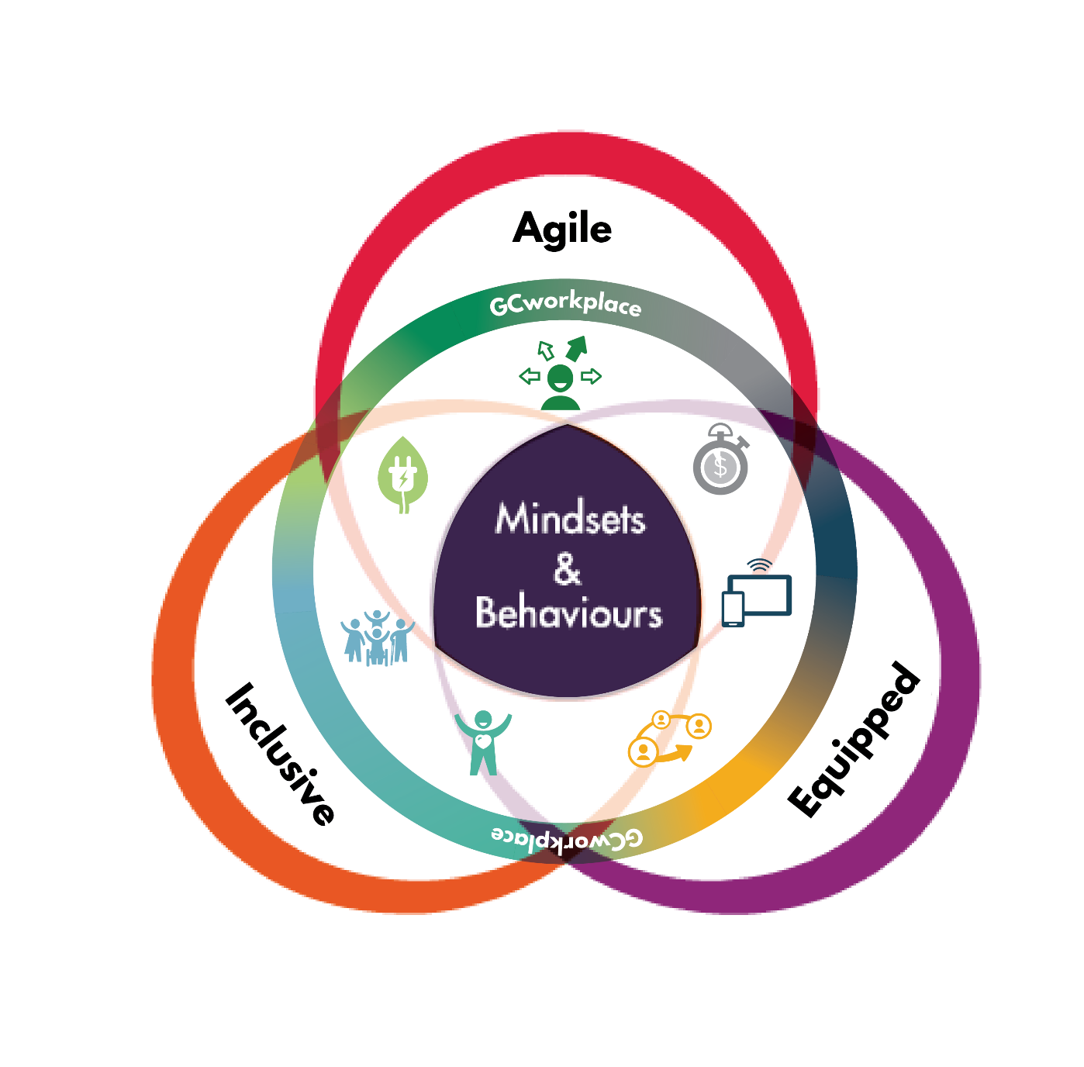
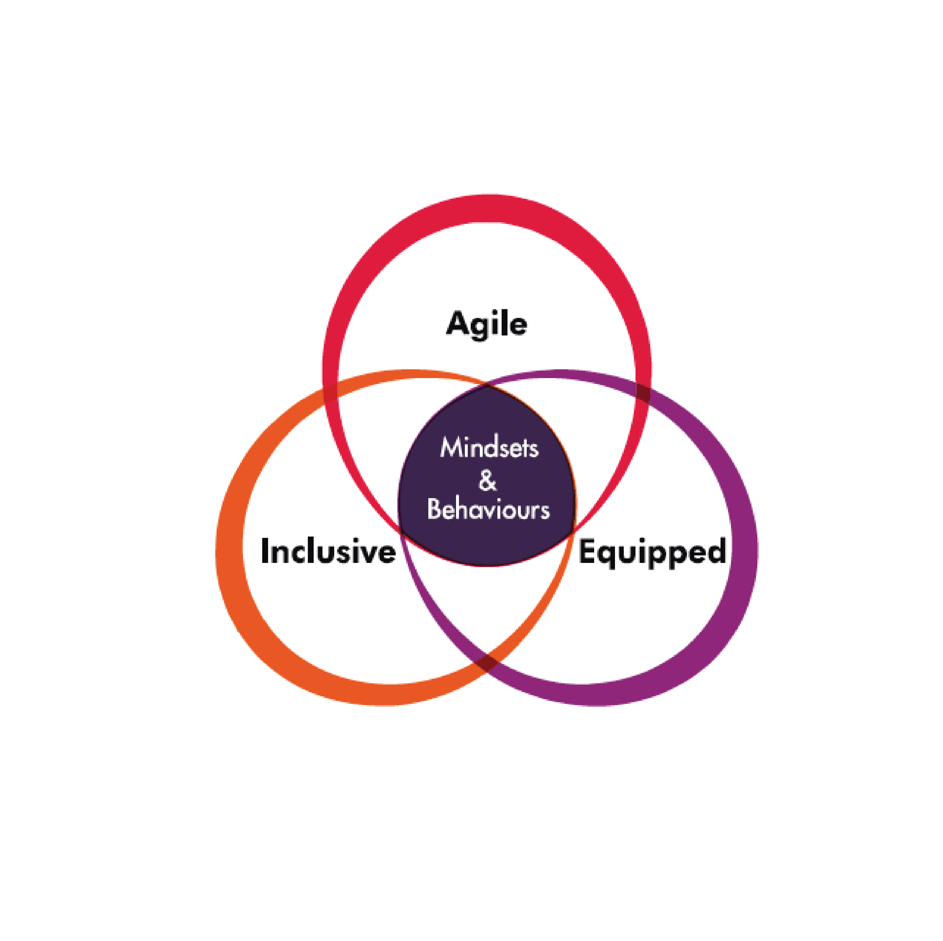
GCworkplace and Beyond2020: one direction
Where the vision for the workforce goes, the vision for the workplace goes
Beyond 2020
Notes:
The workplace is a tool that departments can use to support Public Service Renewal and to embrace the Public Service vision for the workforce.
GCworkplace vision
Fostering a culture of innovation, improving how we leverage digital technology to encourage government-wide collaboration, flexibility, and efficiency. It’s also about putting into place actions that integrate sustainability and improve the overall health and wellbeing of employees and ensuring inclusivity for all.
Beyond 2020
In a time that is increasingly characterized by data, digital, new workplace designs, flatter work cultures, and multiple generations working together, it is critical to examine and adopt the mindsets and behaviours that will meet the changing expectations of Canadians. The desired outcome is a Public Service that is more agile, more inclusive, and better equipped.

Slide 10
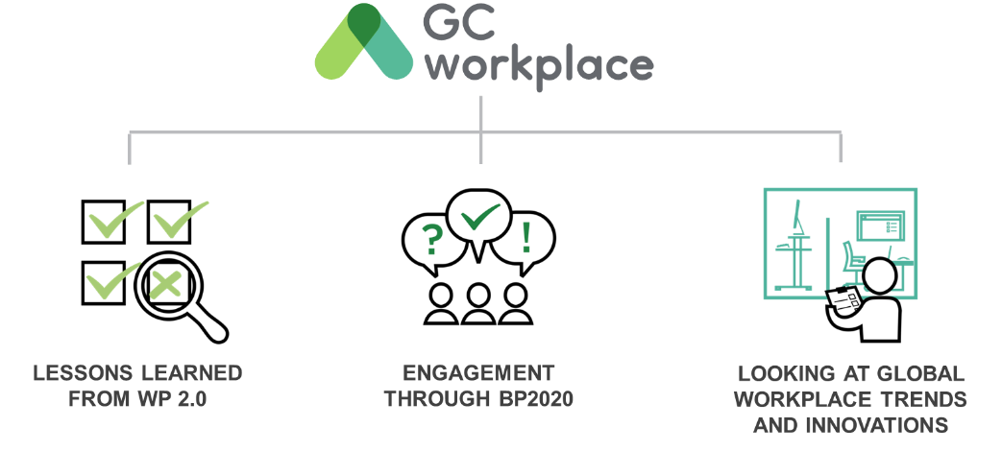
A vision for the Government of Canada workplace
Notes:
In order to develop and refine a vision for a MODERN WORKPLACE for the GC, three main elements were considered:
First, lessons learned from past initiatives (i.e. Workplace 2.0)
Key observations from WP2.0 sought to solve employee needs for quiet spaces, privacy, and concentration spaces.
From what was learned through the delivery of the first activity-based workplace pilot projects.
Second, alignment to the BP2020 vision: In 2013, the Clerk of the Privy Council, in collaboration with public servants across the country, established a vision for public service renewal called Blueprint2020 in which one of the four key priorities was a MODERN WORKPLACE. The GCworkplace vision is, in part, the result of what was collectively heard through the BP2020 consultations and engagement sessions.
And third, global trends: it was based on global trends at the time, [CLICK TO ANIMATE SLIDE], and the vision is constantly evolving to stay relevant in this climate of change.

Slide 11
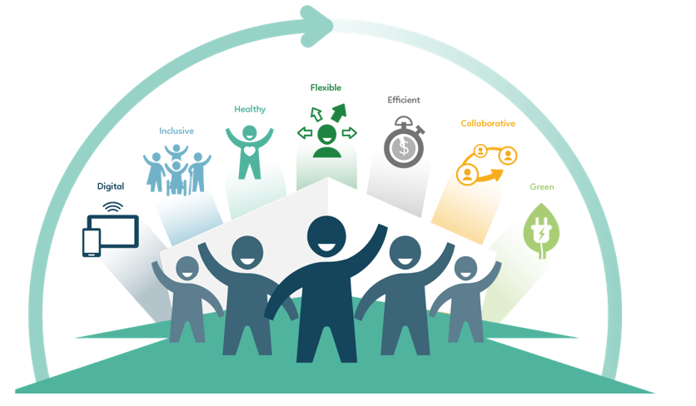
What is a GCworkplace?
GCworkplace is a modern, efficient and inclusive workplace which responds to the public service workforce’s needs and supports a flexible way of working.
GCworkplace is the term adopted by the Government of Canada for workplace modernization.
It is based on the implementation of activity-based working (ABW), which is a way of working that offers all employees shared use of a VARIETY of workpoints, allowing them to CHOOSE the optimal setting to perform their tasks and functions. It optimizes office space and is based on the seven DIMENSIONS of creating a flexible, healthy, efficient, inclusive, collaborative, green and technologically advanced digital space.
Notes:
When we think of a modern workplace, we think GCworkplace. But what IS GCworkplace?
Read the slide.
Over 1,300 employees were surveyed from across Canada, and they ranked “flexibility" as the most important workplace dimension with ‘healthy’ coming in as a a close second. [CLICK TO ANIMATE SLIDE]

Slide 12
Understanding GCworkplace: Flexibility
Home
Office
Work from home to conduct focus work or to avoid commuting
Work from the office to attend a team meeting followed by a coffee chat with a colleague
Other
GCcoworking
Work from a coffee shop in between two meetings
Meet in a GCcoworking location to work with colleagues living in the same neighborhood
Notes:
Flexibility means employees are empowered to decide where it makes the most sense for them to work. These are a few examples of an employee deciding where and how they work to be more productive and efficient, depending on the personal schedule.
[CLICK TO ANIMATE SLIDE]
"I had an appointment this morning close to home so I decided to work from home for the rest of the afternoon. I planned my week in advance to save my non-urgent individual tasks to complete this afternoon."
[CLICK TO ANIMATE SLIDE]
"I'm working on a project with my colleague today, and since we both live in the same neighbourhood we decided to meet at our local GCcoworking site. This will save us 30 minutes of commute time to the office!"
[CLICK TO ANIMATE SLIDE]
"Today my team is brainstorming for a new communications tool that we will be developing. The office is the best place for today's tasks as we will need a lot of space and a large TV monitor."
[CLICK TO ANIMATE SLIDE]
"My day today is filled with client meetings! There are no GCcoworking locations nearby and I would lose a lot of time by commuting back and forth to the office so I will be working in a coffee shop in between my meetings."
With these examples, we can see that having the flexibility to choose where and how you want to work allows for better productivity, and can contribute to work-life balance. Having flexibility is what allows employees to define their own ways of working; working where it makes the most sense for them.

Slide 13
Why the ABW concept benefits you and your employees
Workplace transformation is taking place around the globe. Major trends are driving the business case toward agile space design that improves workforce flexibility and choice. ABW is agile. It is the concept that can potentially address the problems of the traditional and open plan office (noise, privacy, standardization), and that best leverages modern productivity technology and the ability of the workforce to be mobile.
An ABW has ADVANTAGES at every level:
FOR THE USER:
CHOICE AND FLEXIBILITY OF WHERE & HOW TO WORK
ADAPTABLE TO PERSONAL NEEDS & PREFERENCES
ACCESS TO A WIDE RANGE OF WORKPOINTS AND AMENITIES
ACCESSIBLE AND INCLUSIVE
ASSET MANAGEMENT:
FLEXIBILITY TO SUIT WITHIN THE DESIGN STANDARD
ELIMINATES MANY COMMON TENANT SERVICE REQUESTS
PORTFOLIO:
OPTIMIZES USE OF SPACE
Notes:
An ABW is like an ecosystem, if something is missing or inadequate, the entire functionality is threatened
ACTIVITY-BASED WORKING (ABW) is a design concept that recognizes that through the course of any day, employees engage in many different activities and that they need and can choose different types of workpoints to accommodate these activities. An ABW environment focuses on the employees and provides the freedom to decide for themselves: how to work, where to work, which tools to use and with whom to collaborate to get the work done.

Slide 14
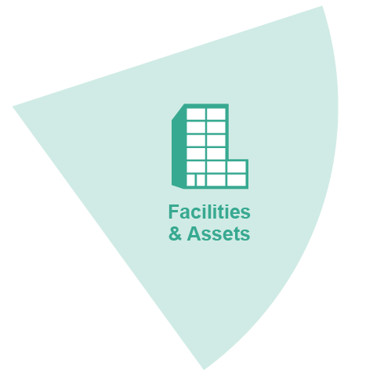
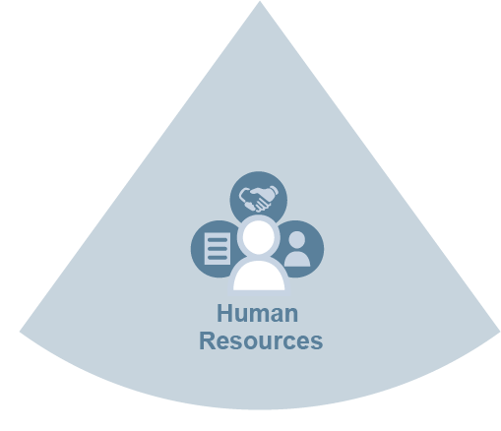
An integrated approach: the employee at the center!
Going beyond space, towards an integrated vision for workplace modernization
An integrated project includes managing all changes in:
the design of our workspaces;
the technology we use;
the processes that support our work;
the culture of our organizations;
the way we work.
Notes:
With GCworkplace, we are going beyond buildings and space, and moving towards a more holistic vision of the workplace modernization.
What’s a modern workspace without the right tools and processes to support new ways of working?
The key enablers of the modern workplace–Information Technology, Information Management, Human Resources (including Occupational Health and Safety), Security, and Facilities–must be aligned to the organization’s vision for the workplace.
The modernization strategies must be integrated to equip GC employees with the right tools and processes to support fundamental changes in the way we work.
Optional: To support departments that are ready to modernize, PSPC has developed the GCworkplace Transformation Playbook . This Playbook is designed to help organizations pinpoint where their workplace is today in reference to where they want their workplace to be tomorrow and beyond and begin to lay out the strategic and tactical actions they can take to move their organization forward. The Playbook will help you prepare for the future–the physical, technological, procedural, cultural and behavioral changes you’ll need to adopt to be successful.
And let’t not forget that the employee pictured here in the middle. They’re the main focus, the reason we are doing this.

Slide 15
GCworkplace Myths
“GCworkplace only works in combination with teleworking”
“GCworkplace is a space reduction initiative”
“It’s a open workplace concept and no one gets an office”
“Gcworkplace doesn’t work in our new post-covid world”
GCworkplace supports a flexible workforce, but it also supports groups that operationally cannot support telework*
GCworkplace is not a space reduction initiative, but rather a space optimization solution. The Space Allocation Standard has not changed.
A GCworkplace offers MORE enclosed workpoints than WP2.0. All workpoints are shared, so everyone has access to an office.
The unassigned environment allows for more thorough cleaning as well as the ability for individuals to select workpoints physically distanced from others.
*Pre-Covid Studies showed that federal workplaces are 47% vacant at any given point thoughout the day or week.

Slide 16
GCworkplace Myths (cont’d)
GCworkplace provides users with full control over the work settings that best suit their personal and functional needs. This creates an accessible and inclusive environment while responding to the need for diversity by giving variety and choice.
“GCworkplace isn’t accessible”
“Gcworkplace won’t work for my team – we have too many special requirements.”
“There won’t be enough workpoints for everyone, it will be stressful trying to locate the workpoint that I need/want.”
GCworkplace acknowledges that the requirements of each government office is different. The design process includes functional programming activities to help customize the space for the users. Special Purpose Space approvals continue to address accommodation requirements beyond the defined general office space.
In a GCworkplace, there are about 2 workpoints per occupant, meaning that even on the rare occurrence of everyone being in the office at the same time, there would never be a shortage of workpoints.

Slide 17
Introduction to the Roadmap

Slide 18
GCworkplace Modernization Roadmap
Assess, imagine & plan
Get on
board
Build the
foundation
Implement & operate
Sustain & reinforce
PROJECT
KICK-OFF
What is
GCworkplace?
What are our goals and who will help us get there?
How do we actually work, how do we want to work, and what change is needed to make that a reality?
How will we make the change happen?
How will we support
the change?
Workplace modernization awareness
Leadership commitment
Organizational and change readiness
Workplace design
Workplace performance
Workplace vision
Functionality and performance assessments
Project implementation
Sustainability
Integrated project team
Workplace modernization project plan
Change management implementation
Celebrations!!!
Governance & working groups
Workplace change management program
An official project* is required for the following steps.
Workplace culture shift
Notes:
So some of you might have seen this roadmap before; the Accommodation Management and Workplace Solutions team had been working on this for a while and it is now available on the Project Resources page of the GCworkplace GCpedia site.
The GCWorkplace Modernization Roadmap is a visual tool that was developed to provide clients with a comprehensive approach so they can imagine a plan and engage in a transformation journey towards a successful GCworkplace modernization.
This GCworkplace modernization roadmap has been developed by experts from our Centre of Expertise to provide clients with the essential elements for workplace modernization, best practices and tools to enable them to reach the organizational and workplace modernization project vision, objectives, outcomes and employees satisfaction and adoption.
1 Click: As you can see, the first step is simply to learn about GCworkplace and create awareness about your workplace modernization.
2 Click: The second step would be to Build the foundation by engaging leadership and getting their commitment, defining a workplace vision, building an integrated team and putting a governance in place and setting up employee working groups. (It’s us, the Transformation and Enablement team that assist you with the fist 2 steps)
3 Click: After that is done, you would start Assessing, imagining and planning. This is where your workplace vision is translated into a design concept, a project plan and a change management program. (The Change management team and ID will assist you with you)
4 Click: The fourth step is about assembling the integrated project team and officially kickoff the fit-up project – design, implement and operationalize the workplace
5. The last step is all about sustaining and reinforcing what was done beforehand, including adjusting, recognizing the effort and celebrating the new modernized workplace once it has been completed and the employees have stettled in.
Note that the bubble size indicates the level of effort and time.

Slide 19
Supporting clients
Get on
board
Assess, imagine & plan
Teams of experts works with the clients throughout the 5 steps of the GCworkplace Modernization Roadmap:
Build the
foundation
PROJECT
KICK-OFF
Implement & operate
Sustain & reinforce
Together we help the clients take the steps and achieve results
Transformation and Enablement
Transformation and Enablement
Change Management NCoE
Interior Design NCoE
PSPC Accommodation Manager
Provide support in the gathering of space requirements and completion of CARQ in light of an upcoming fit-up project
Collaborate in the development of short and long term accommodation requirements
Provide awareness of the GCworkplace program and vision
Provide best practices, guidance and support to client to establish a strong GCworkplace program foundation
Provide best practices, guidance and support in the creation of a workplace change management program and how to sustain the change
Oversee progress and troubleshoot change management implementation
Provide oversight in support for functional programming activities
Assist in understanding GCworkplace design principles and monitor adherence to standards
Provide ongoing advice and guidance during project implementation and delivery
NCoE=National Centre of Expertise
Notes:
You are not alone, we are here to support you. Our team of experts will work with you throughout the 5 steps of the GCworkplace Modernization Roadmap:
Our teams provide advice, support, oversight of progress, troubleshooting, coaching and knowledge development.
Our teams also continuously develop tools and offer Community of practices.

Slide 20
GCworkplace key design principles

Slide 21
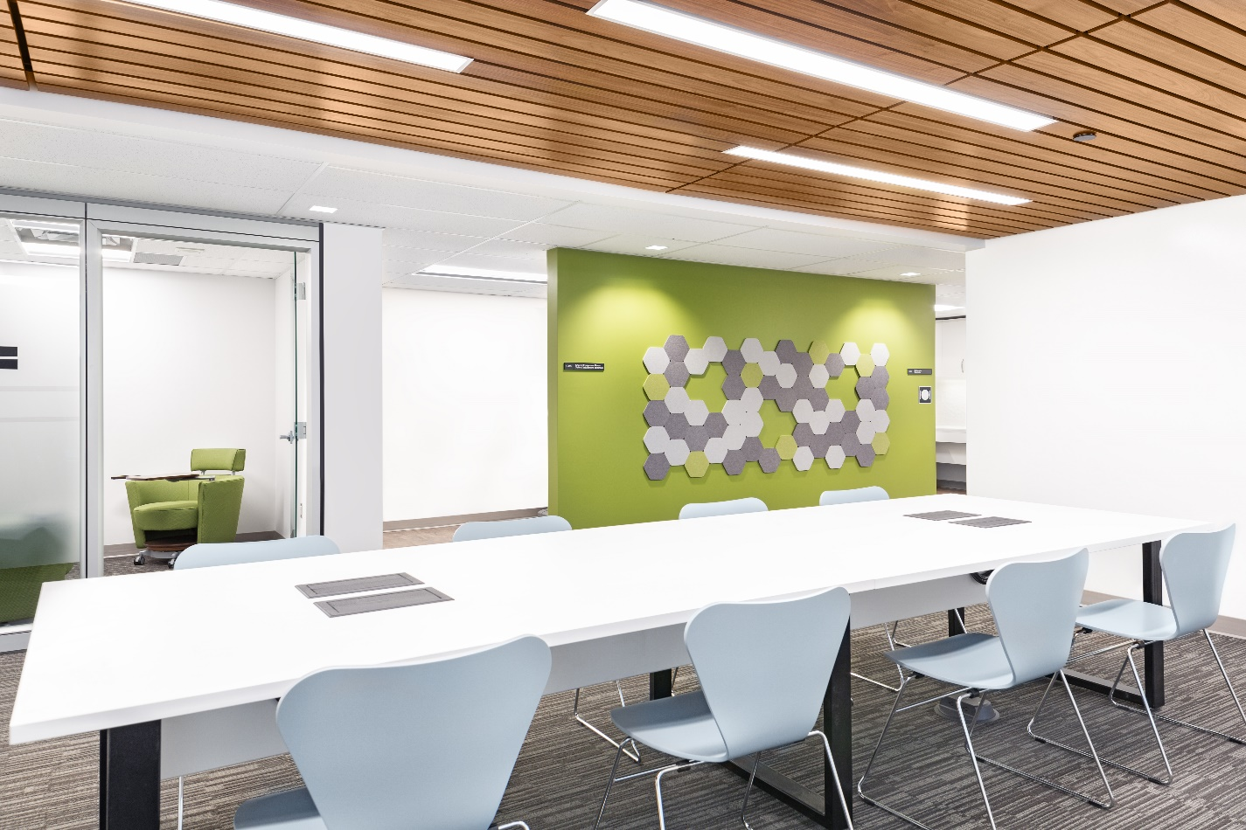
GCworkplace Key design principles
USER-CENTRIC DESIGN
PROMOTE EQUAL ACCESS TO SPACE
DESIGN FOR ACTIVITIES
ZONE BY FUNCTION
PLAN FOR FLEXIBILITY
PLAN FOR CHANGE
Notes:
There are 5 guiding design principles of GCworkplace, and each is supported by strategic design. These key design principles are organized into the following sections: Read the 5 sections
[additional text as required]
USER-CENTRIC DESIGN
A positive employees experience increasing engagement, job satisfaction, creativity and productivity as a strong office design can make employees happier at work. A user centred design, such as GCworkplace, contribute to healthier work habits and reduce stress.
PROMOTE EQUAL ACCESS
GCworkplace is an unassigned work environment where all employees have equal access to various workpoints. GCworkplace promotes a more inclusive work environment that supports the varying needs and preferences of a diverse workforce.
DESIGN FOR ACTIVITIES
GCworkplace is based on the concept of Activity Based Working, which encourages employees to untether from a fixed point and choose the optimal setting for their work activities throughout the day. In order to support choice and flexibility, GCworkplace feature a variety of workpoint types and configurations.
ZONE BY FUNCTION
An integral part of offering choice of work settings is the ability for employees to choose their preferred level of ambient sound and activity. By including three functional zones, GCworkplace ensure that different work environments are available to suit individual work preferences and specific task requirements.
PLAN FOR FLEXIBILITY
GCworkplace is an adaptive template using a modular framework with consistent dimensions that facilitate adaptation over time. Growth can easily be absorbed and layout changes be facilitated by modular planning.

Slide 22
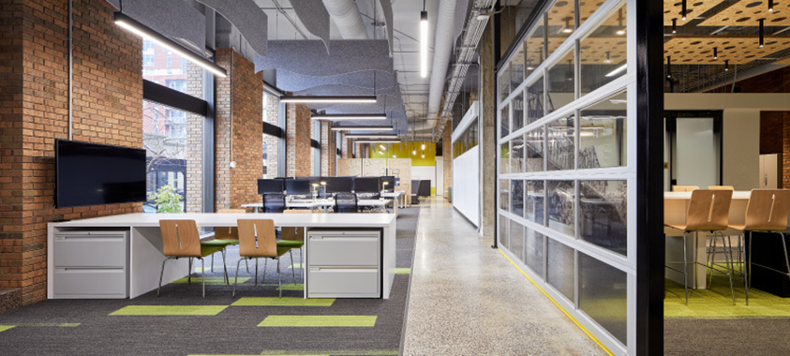
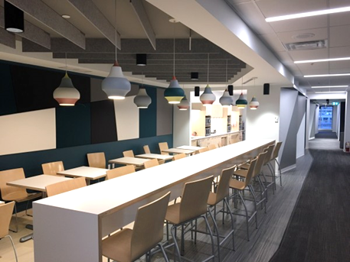
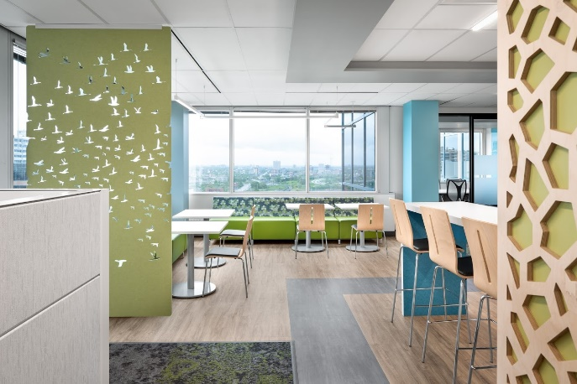
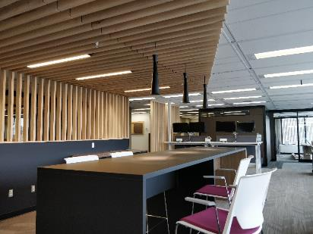
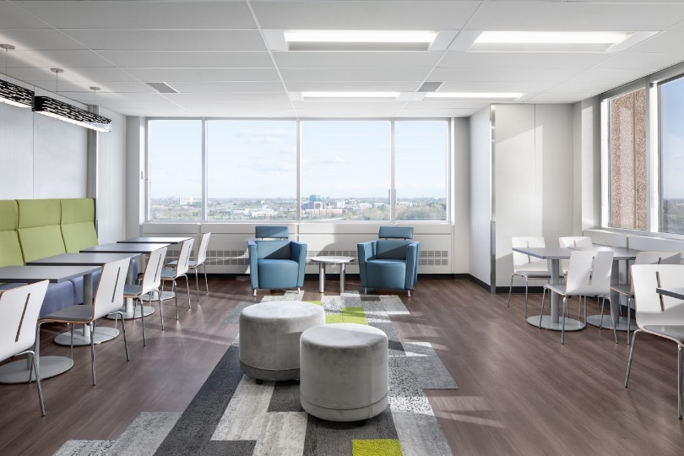
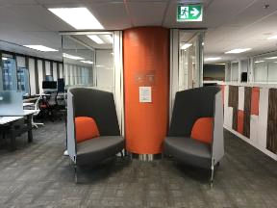
The future is now
PSPC‒Les Terrasses de la Chaudière (Gatineau)
NSERC/SSHRC‒
Constitution Square (Ottawa)
WINNER
Best Offices Ottawa 2018
PSPC‒Place Bonaventure (Montréal)
WINNER Corenet Global REMMY Award
2018
PSPC‒PDP III-9A1 (Gatineau)
NRCAN 580 Booth Street (Ottawa)
Department of Justice
St Andrews Tower (Ottawa)
Notes:
We tried out the standard for ourselves to show leadership and to champion this initiative.
Here are some of those examples as well as early adopters across the GC.

Slide 23
What are the first steps in planning a modernization program
Notes:
Section dédiée plus pour les équipes de projet intégrée

Slide 24
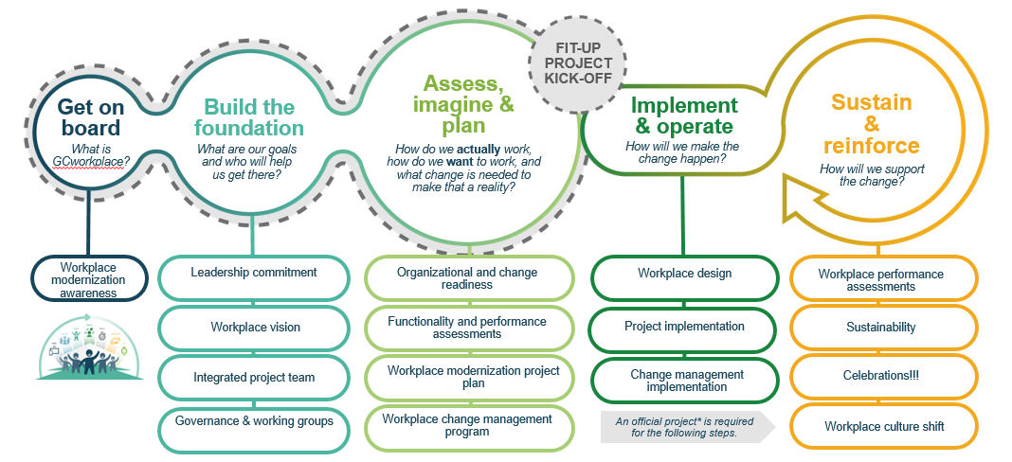
Get onboard!
Familiarize yourself with the GCworkplace vision by visiting the GCworkplace GCpedia page
Seeing is believing! Book an in-person tour or organize a virtual tour of a GCworkplace space, or try one of the 5 coworking sites that have been established in the NCA.
Notes:
A solid foundation on which you can build your modernization initiative is crucial. Through all the pilot projects and testing done in the preliminary phases of GCworkplace and through research on workplace modernization initiatives done around the globe, we’ve identified the key conditions of success for workplace modernization and are developing the tools to help clients build these success factors within their own organizations. Here is how to build the foundation for your modernization project

Slide 25
The importance of a solid foundation
Ensure all leadership is engaged and committed to the change
Find a project sponsor and senior champion(s)
Cleary define a vision for the modernization initiative
Dedicate the required resources
Client integrated project manager
Integrated team including representative from enabling sectors (IM, IT, Security, HR, OHS, Facilities)
Put governance in place and set up employee working groups
Notes:
In the second step of the Roadmap, Build the foundation, there are crucial steps: including ensuring the leadership is engaged and committed to the transformation. Finding a champion within the organization is a good start to promoting the project. Defining a common vision and dedicating proper resources to the project are important milestones. Setting up a governance and employee working groups are also part of building a solid foundation.

Slide 26
Build the foundation… leadership onboarding
Engage leadership and get their commitment to the workplace change. They should be committed to the vision, ready to support the change and become change champions.
The sponsor | The champion(s)
“Owns” and leads workplace change Participates actively and visibly Manages and oversees the change and approach Communicates expected benefits to employees Secures resources for the project ($+FTEs) | Participates actively and visibly Early adopter of the change, adapts quickly and advocates for the change Demonstrates commitment by building a coalition of support
Ask yourself…
Are your sponsor and champions aware of the importance they play in making change successful?
Are your champions building coalitions that are needed for the change to be successful?
Are your champions communicating directly and effectively with employees?
Engage leaders at all levels to ensure a strong coalition of support. Consider a mandatory onboarding program where all leaders must agree to the change.
Notes:
When asked to identify the key contributors to the success of their change initiatives, participants in the PROSCI Best Practices in Change Management study placed active and visible executive sponsorship at the top of the list.
Although the sponsor and champions play key role, all leaders need to be engaged and onboard.

Slide 27
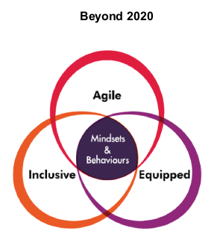
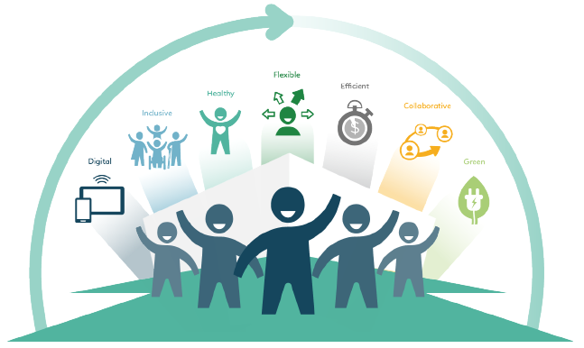
Build the foundation… defining a vision
1
Look at the bigger picture…
2
Ask yourself…
ORGANIZATIONAL GOAL
What do we hope to achieve?
What are the workplace objectives?
What is our vision for the future workplace?
YOUR FUTURE WORKPLACE VISION
ORGANIZATIONAL BENEFITS
How will things be better?
IMPACT TO STAKEHOLDERS
What are the expected benefits?
What are the potential consequences or impacts?
Other departmental priorities, initiatives, strategic objectives
SUCCESS MEASURES (KPI)
What does success look like?
Notes:
Defining a clear vision for the workplace modernization project will identify and help to:
- Define the experience you want your employees to have in the workplace
- Build alignment for the workplace vision at the leadership level
- Provide the organization with guidance to take decisions and envision their future (the reason for the change)
- Reflect the desire to achieve the organization’s overall goals and priorities
- Explore the future workplace
- Must be embraced by senior management and managers

Slide 28
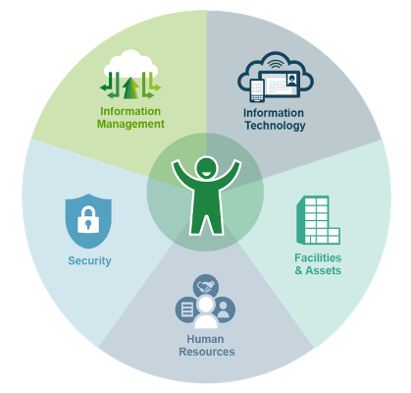
Build the foundation… creating the integrated project team
The key enablers of the modern workplace – Information Technology, Information Management, Human Resources (including Occupational Health and Safety), Security, and Facilities – must be aligned to the organization’s vision for the workplace.
Ask yourself…
Are resources available:
to implement the key enabling elements?
to manage the integration of all the key enablers?
to provide training to employees?
to provide communication advice and develop communications products?
Notes:
An integrated project team is needed to manage all changes:
- the design of our workspaces
- the technology we use
- the processes that support our work
- the culture of our organisations
- the way we work

Slide 29
Build the foundation… setting up governance and working groups
Establish governance; committees and working groups that will support the delivery of the workplace modernization project.
Ask yourself…
Who will make decisions on project elements?
Who will make the decisions on the implementation of the change management strategy?
Is there a structure already in place that can be used?
Are there employee working groups/committees in place that can support specific elements of the project?
Notes:
- Perform an environmental scan to assess which committees are already in place
- Propose to those established groups to integrate a workplace modernization agenda item to all their meetings
- If required, create terms of references (ToR) for each of the groups and ensure roles and responsibilities are clear
- Perform a gap analysis for each of the groups to define their needs in terms of training, tooling requirements, support, coaching, etc.
- Insert text about the importance of setting up governance (look in roadmap doc once it has been updated by Fred+Tara)
- Here is what we have in the roadmap: https://www.gcpedia.gc.ca/wiki/Modernization_Roadmap_How_do_I_do_that_2.4

Slide 30
How can we support

Slide 31
Transformation and Enablement team – R&R
Isabelle Filion
Workplace Transformation and Enablement
Senior Advisor
Mélanie Martel
Workplace Functional Specialist - HR
Advisor and COP
Provide a tour program and GCworkplace general awareness presentations for the clients
Connect and engage with the right leadership within client departments
Assist in defining a workplace vision
Promote the importance in implementing governance and employee working groups
Host a forum through the GCworkplace T&E Sharing group for all participating departments.
Notes:
Let me introduce you to our team. The 2 of us form the National centre of expertise for workplace transformation and enablement under the fit-up program of GCworkplace.
So what do we offer?
Usually, we’ll work directly with the departmental project team / project sponsor to introduce the Gcworkplace onboarding and foundation.
We give advice and support, we continuously develop tools which we share on different platforms and we provide coaching through your Workplace modernization.

Slide 32
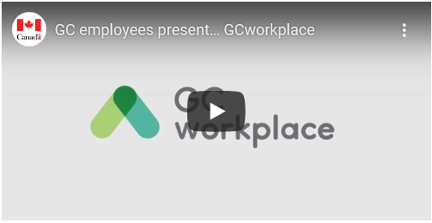
Our tools and platforms
Other tools:
Virtual GCworkplace guided t
ours and general awareness
GCworkplace Onboarding Presentations
Leadership Engagement tool
Building a compelling vision tool
The Transformation Playbook, designed to help you pinpoint where you are today and what to prioritize to get you to where you want to be.
GCworkplace Transformation enablement Sharing Group
Visit the Transformation and Enablement Gcpedia webpage for more details.
About GCworkplace
GCworkplace is challenging what it’s like to work in government. To meet the demands of modern Canada, we’re doing things differently; like retooling work environments to encourage collaboration, using technology in smarter ways, and fostering a culture of flexibility and well-being. It’s time to work how and where it makes sense. Together, we will transform the experience of working for the Government of Canada (GC).
For GC employees
Check out the GCworkplace Video Playlist on YouTube
Join the conversation using #GCworkplace #milieudetravailGC on Twitter or the GCconnex Wire
Join the GCworkplace group on GCconnex - get answers to your burning questions
Watch and listen as GC employees tell you what enables a positive and productive employee experience.
VIDEO: GC employees present... GCworkplace
Download it to view on your media player: GC employees present... GCworkplace (video download) or view it from the GCworkplace playlist on PSPC's YouTube channel
Notes:
T&E sharing group: Are you part of an integrated project team and have questions on specific topics such as HR, IT, IM, Security, Facilities, etc.? Are you a project leader or project manager who wants to share his/her experience?
If you answered YES to any of these questions, or are simply curious to learn more, follow this link: GCworkplace Transformation and Enablement Sharing Group

Slide 33
How does our team fit in the Roadmap?
Assess, imagine & plan
Get on
board
Build the
foundation
Implement & operate
Sustain & reinforce
PROJECT
KICK-OFF
What is
GCworkplace?
What are our goals and who will help us get there?
How do we actually work, how do we want to work, and what change is needed to make that a reality?
How will we make the change happen?
How will we support
the change?
Guide the Project team through the Transformation Playbook
Encourage the implementation of a strong governance and dedicated working groups
Assist the leadership in building a compelling GCworkplace vision
Assist the project leader in developing a Leadership engagement presentation to fully engage the top ranks
of the organization
Provide GCworkplace Onboarding presentation to clients
Provide GCworkplace guided tours to build awareness and desire
Notes:
Now let’s come back to our client modernization roadmap for a minute and see how our tools fit in.

Slide 34
GCworkplace Guided tours and general awareness
Project Story Collection
Testimonials
GCworkplace Youtube Playlist
Center for GCworkplace Innovation
GCcoworking
GCworkplace Academy
Notes:
In order to build general awarennes of the GCworkplace, there are different resources available on the Gcworkplace Gcpedia page.
The Project Story Collection is a collection of stories about recently modernized workplaces. You can explore and learn about these workplaces through different perspectives: leaders, project team members, and most importantly, through employees that are changing the way they work.
Testimonials is a series of testimonials in the form of short texts, videos or photos created by GC employees for GC employees.
The youtube playlist is a series of short videos (2 to 4 mins) about different experiences of Gcworkplace.
The Center of Gcworkplace Innovation is located at 191 Place du Portage and its mandate is to foster knowledge transfer and innovation as well as develop new concepts and tools for the Government of Canada (GC) workplace in collaboration with GC departments, agencies and external partners. The Centre offers tours, training sessions, workshops, and you can host meetings there too! (pre-covid)
Gccoworking: there a 5 GC coworking locations across the NCA. GCcoworking is a common (or shared) GC workplace where GC employees may work as an alternative to their homes or to their usual central workplace locations, or as a touchdown point between meetings. They support the Gcworkpalce vision and provide clients with opportunities to achieve the Gcworkplace vision.
Due to COVID, all Gccoworking sites are presently closed
Gcworkplace Academy is the “Hub” for everything GCworkplace. We started this journey of creating a GCworkplace learning environment for public servants so that everyone could be informed about the new design, innovative changes, and how to navigate in new surroundings. There is a learning road map for all groups: employees, manager, leaders and designers. This platform will eventually include workshops and Virtual tours.

Slide 35
GCworkplace Onboarding Presentation
The Onboarding presentation is a generic GCworkplace presentation designed to build your general awareness of the GCworkplace vision, to provide you with a brief overview of the GCworkplace Modernization Roadmap and the services the Transformation and Enablement team can offer you.
The client can contact us for a personnalized Transformation and Enablement presentation, based on their needs.
Notes:
The Onboarding Presentation is generally the first of a series of presentations: the following usually are an in-depth T&E presentation, including a description our tools (deepdive), a CM presentation and an ID presentation.

Slide 36
Leadership Engagement tool
The Leadership Engagement tool is a ‘build yourself’ tool to assist the client in building a business case to increase the leadership team’s engagement and committment to the workplace modernization.
This presentation includes GCworkplace benefits, global trends, current workplace situation, the impacts of the pandemic, and opportunities for modernization and change.
Notes:
This presentation requires homework from the client. Follow the checklist to for a successful presentation.

Slide 37
‘Building a compelling vision’ tool
This tool will assist your leadership team in building a compelling vision statement.
10-steps process to articulate the vision for your future workplace
Vision board
Notes:
The creation of a vision is a crucial step in your journey, it will enable key decisions for change management, design and stakeholder engagement all throughout the process.
This vision board is to help you create your vision statement (8th out of 10 of the step in the vision tool)
Tagline: catchprase, or slogan, especially as used in a punch line of a joke

Slide 38
Transformation Playbook content
Four Behavioral Personas + Day in the Life Journeys
Five Core Employee Experiences
Maturity Assessment + Strategic Action Plans
Tactical Checklists
Tactical Accelerators
Includes a Workforce Questionnaire template to help you better understand the composition of your teams
And a GC Maturity Assessment Tool that takes you step-by-step through a maturity model.
Notes:
Who created this vision?
In 2017, a cross-section of teams from PSPC, SSC, TBS, CRA, IRCC, GAC and Price Waterhouse Cooper (PwC) united over a 12-week period at PwC Digital’s Experience Centre in Gatineau. IM, IT, HR, Security, and Facilities and Change Management were also crucial to the process. In other words, the vision was created by GC employees, for GC employees.
Together they looked at best practices from the GC and private workplaces around the world. They brainstormed, planned and created a way forward.
The result of their efforts is this Playbook. This playbook is the “go-to” document for everyone involved in making GCworkplace a reality. It should be an evolving document and be updated as we make progress, ideally on a bi-annual basis.
The Transformation Playbook, is designed to help the client pinpoint where they are today and what to prioritize to get them to where they want to be. In this tool you will find:
1) Four Behavioral Personas and Day in the Life Journeys: It’s a portrait of Government of Canada employees based on their common needs, wants and how they work. While you may not see yourself in just one persona, they are useful because they represent the real people GCworkplace is designed for.
These are supported by their future state Day in the Life Journeys which illustrate how you can use the physical spaces and tools to suit the different working styles.
Furthermore, there is the GC Workforce Questionnaire Template. It’s eight questions you can send to your employees to help you better understand the composition of your teams – which ultimately drives the prioritization of your action plans. This questionnaire is optional. If not completed, the action plans will still be generated.
2) Five Core Employee Experiences: Based on common experiences across all the future state Day in the Life journeys, Five Core Experiences have been identified, experiences that all departments need to enable in order to achieve the future vision of GCworkplace.
3) Maturity Assessment and Strategic Action Plans: The maturity assessment is a tool that generates personalized and prioritized action plans. It helps you understand where you are in relation to GCworkplace and provides you with priorities that you should focus on, based on the 5 core experiences. The GC Maturity Assessment Tool is a tool that takes you step-by-step through a maturity model. Once completed, it creates an overview of the gaps and the steps you need to take to close them (strategic actions).
More description of the Maturity assessment, if required: The evaluation is an exercise that the leads (HR, IT, IM, Security, and Facilities) or their delegates can only complete on account of their internal knowledge and expertise for their respective dimensions. Also, it is an exercise to engage their thinking and participation in the implementation of the GCWorkplace Initiative.
Upon completion of the dimension evaluation, Recommended Action Plans are populated as a function of the current status on that particular dimension. This is a very good starting place towards a modernization.
The results for the overall assessment and the recommended Action Plans support the SMEs awareness of the current state (where we are, now) and the required work ahead to bring your organization into the future state.
4) Tactical Checklist: If you need help right now and perhaps you’re moving into a new workplace and need some practical guidance now, these checklists will help you to get on your way to GCworkplace. There are 110 tactical actions that should be considered at every GCworkplace site!
5)Tactical Accelerators: These are tools, policies and capabilities that will support your move towards a GCworkplace. And functional experts have also provided links to relevant sites and templates! (still in development)

Slide 39
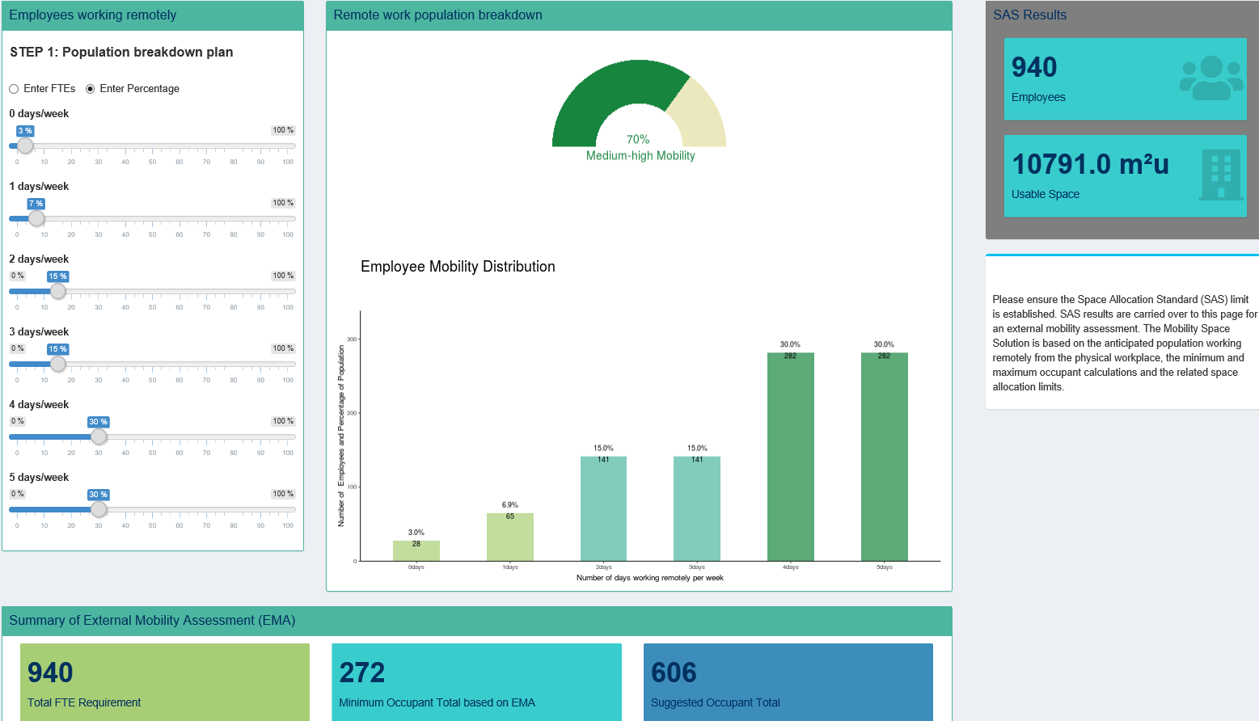
Real Property Space Assessment and Planning App
In this example, (Scenario 1) 940 FTEs are broken down based on their external mobility. The percentages of this chart are populated to represent a 70% medium-high external mobility rating of the population breakdown based on the following percentages: ( 0 / 1 / 2 / 3 / 4 / 5 days) (7% / 7% / 15% / 15% / 30% / 30%) With this, the minimum occupant total in the workplace would be 272 occupants (per week). Upon consideration of mitigating risk and changes to mobility, staff and peak periods throughout an average occupancy (5yrs), we can recommend a suggested space allocation limit calculated with 606 occupants.
Notes:
Background: The Real Property Space Assessment and Planning App is replacing the Space Allocation Standards (SAS) Calculator and development is starting on a Planning Space function that will replace the GCworkplace Planning Workbook. A third function will be developed to combine Furniture Selection within the App.
The space assessment function is used by the PSPC Real Property Services accommodation management community and Real Property and Accommodation Services within Client Departments as part of the real property project planning process.
Space assessments calculate the maximum space allocation limit as per the Space Allocation Standards (2012). This allows users to determine and document the space requirements of client departments, assess their external mobility and its impact on a recommended space allocation. It ensures compliance with the SAS and the GC Workplace Fit-Up Standards.
The App user can perform an External Mobility Assessment (EMA) based on frequency of remote working (see next slide) The EMA offers options of additional space reductions by means of a suggested occupant total in order to calculate a reduced space allocation limit and flexible space solution for consideration.
Given the uptake of ‘remote work’ as a result of the COVID-19 pandemic, clients need support to determine their space requirements in the short and longer term.
With a world-wide pandemic challenging the way we work, Accommodation Management and Workplace Solutions has turned its focus to examining the size, functionality and location(s) of the physical workplace post-COVID.
Early and accurate definition of client requirements is needed including the quantity and frequency of remote working to determine the amount of space required.
A model that uses a modernized Space Allocation Standard combined with an assessment of employee remote working that results in an amount of space required for clients to deliver their programs was developed.

Slide 40
Annex A: Change Management

Slide 41
What is change management?
Project management focuses on delivering the workplace and its enabling elements in
an integrated way
Change management ensures that the changes are embraced, adopted and supported by the employees
Notes:
We use change management to prepare, equip and support employees through their workplace modernization journey.
While project management focuses on delivering the workplace and its enabling elements in an integrated way, change management ensures that the changes are embraced, adopted and supported by the employees – to provide them with the most positive user experience.

Slide 42
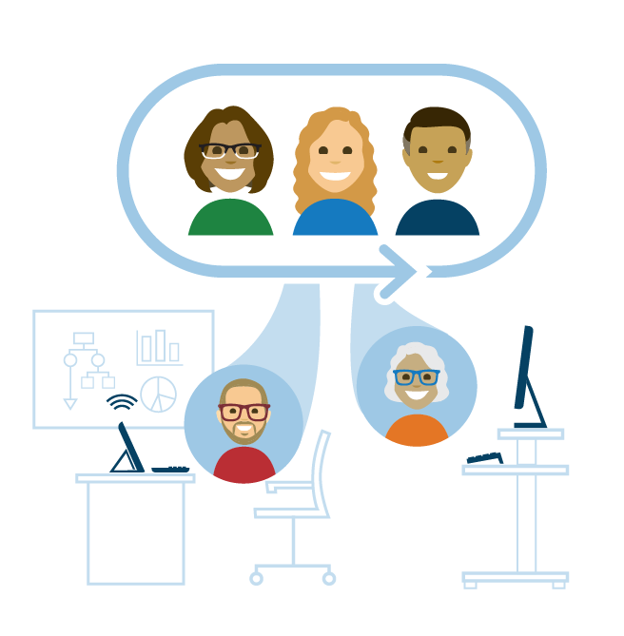
What is change management?
It’s an approach for engaging with employees who are impacted by the change
Change Management
WHY and HOW
POSITIVE USER EXPERIENCE
Project Management
WHO, WHAT, WHEN & WHERE
Notes:
Change management is an approach for engaging with employees who are impacted by the change
An easy way to explain this is to give you some examples of project management activities vs. change management activities in the context of a workplace modernization project.
A common project management activity is the deployment of tablets or laptops. Associated to that, the project management team will typically also send out some form of communication, focused on the WHO, WHAT, WHEN and WHERE. Change management activities related to this deployment would add elements to those communications such as the WHY, linked to the overall modernization vision, and the HOW, relating to training on the new devices. Other typical change management activities include identifying super users and promoting them as experts who can assist their colleagues and sing the praises of the new devices, monitoring adoption of the new devices, tracking employee proficiency and reinforcing the adoption.
Another example comes when it’s time to pick finishes for the new workplace. The project management activity is selecting finishes, typically done by the PM team and senior leaders. Knowing the importance of providing opportunities for employees to participate in the change, change management activities could include having a presentation and voting session where employees pick their favorite colour scheme, then hosting a “celebration” to mark this important milestone.
Integration of the project management and change management activities helps ensures a POSITIVE USER EXPERIENCE.

Slide 43
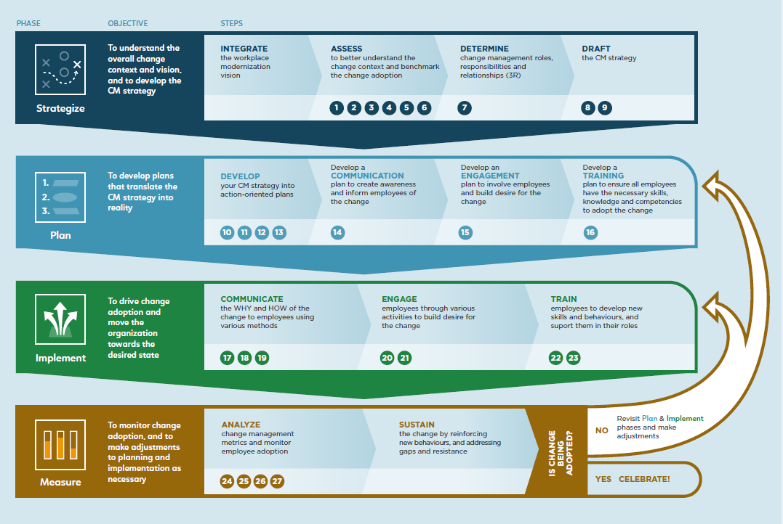
What is change management?
It starts when the change has been defined based on the vision of your future modernized workplace
Change is defined
Change is managed
Change is adopted
“INPUTS”
How we work
How we use the workspace
How our business operates
“OUTPUTS”
Employees adopt the change
Employees realize the solution
Employees are proficient
Notes:
Change management starts when a change has been defined (in order to MANAGE a change, there needs to BE a change)
Here’s a quick view of the approach proposed by the PSPC Workplace Change Management National Centre of Expertise:
Change needs to be defined, typically a decision made by senior management. By adopting GCworkplace, your organization has decided to change the way it works and uses its workspace. But what does that mean specifically for your organization? What other changes will this bring about? These become your “inputs”.
These changes require employees to adopt new behaviours -> this is where you need a change management approach (pictured in the center) that our Workplace Change Management National Centre of Expertise can provide assistance and support with. This approach, along with tools, templates and best practices in workplace change management can be found in their Workplace Change Management Playbook – available on GCpedia.
Finally, you know you’ve been successful at managing change when employees adopt the change, realize the solution and become proficient with new processes and tools. These are the change management “outputs”.
Now, has your organization defined the change?
No – its not too early to think about finding a change management resource [click to next side]
Yes – Do you have a dedicated change management resource?
Yes – Great! I will arrange for a presentation with our change management experts. [no need to show next slide]
No – Let’s look at how we can help [click to next side]

Slide 44
Finding change management resources
The Workplace Change Management National Centre of Expertise can provide guidance and tools to help you find resources. Here are the 3 main options:
INTERNAL RESOURCE
BGIS–TFMS CM SERVICES*
CONSULTANT
Consult your Human Resources office
CM NCoE tools:
Key competencies
Best practices
Consult your Property Facilities Manager (PFM)
*only available if current or new building is in RP-1 or RP-2 portfolio and managed by BGIS
Consult your procurement officer
CM NCoE tools:
SoW template
Evaluation grid
Contact the Workplace Change Management National Centre of Expertise for continuous guidance throughout the lifecycle of your workplace modernization project!
Notes:
The Workplace Change Management National Centre of Expertise can provide guidance and tools to help you find resources. Here are the 3 main options:
OPTION 1: Recruit an internal resource that can take on the lead of the change management function: the employee might already understand the organization, its business, its culture and already has an established network. In order to hire internally, we recommend that you consult your HR office. The Workplace Change Management National Centre of Expertise has developed some tools like key competencies to look for in a change manager as well as best practices to hire one.
OPTION 2 is through the BGIS-TFMS CM services. Find out if your current or new building is part of the RP-1 or RP-2 portfolio and if it is managed by BGIS. If so, contact your Property Facilities Manager (PFM) for more info. If neither of your buildings are managed by BGIS, then this option is not available to you.
OPTION 3 is to hire a consultant through the PSPC Standing Offer and Supply Arrangements or other contracting arrangements. The Workplace Change Management National Centre of Expertise has developed a generic statement of work (SoW) and evaluation grid to assist you with this option, but we encourage you to speak with your procurement officer if this is the option you choose.

Slide 45
PSPC Workplace Change Management Centre of Expertise
PSPC WCM NCoE SUPPORTER
Client department IMPLEMENTER
Introduce workplace change management to clients
Provide change management advice and support
Review progress and troubleshoot obstacles
Develop tools on a continuous basis
Coach and develop knowledge in client organizations
Assess organization and identify change drivers
Develop a change management strategy
Create change management plans
Implement strategy and plans
Reinforce and ensure changes are maintained
Notes:
The Workplace Change Management National Centre of Expertise, or WCM NCoE, works directly with the person or team assigned to change management in your organization. They introduce workplace change management and provide support in the establishment of a change management program and its implementation. They also continuously develop tools which are shared on different platforms and provide coaching through their Workplace Change Management Community of Practice.
The WCM NCoE advisors are the SUPPORTER and you are the IMPLEMENTER.

Slide 46
Top key success factors for workplace change
Establish leadership and governance to develop and manage your Workplace Strategy
Engaging employees by way of activities, meaningful consultations and discussions at all levels on the issues that matter most
Clearly articulating a vision for the workplace that is aligned to vision and benefits for the organisation
Empowering and equipping managers and supervisors to support their employees through the change
Demonstrating active and visible leadership (champions and ambassadors) supporting the vision and the aspects of change throughout the life of the change initiative
Creating opportunities to experience the change through pilots, pathfinders and demonstration: seeing is believing, experiencing is knowing

Slide 47
Annex B: Interior Design

Slide 48
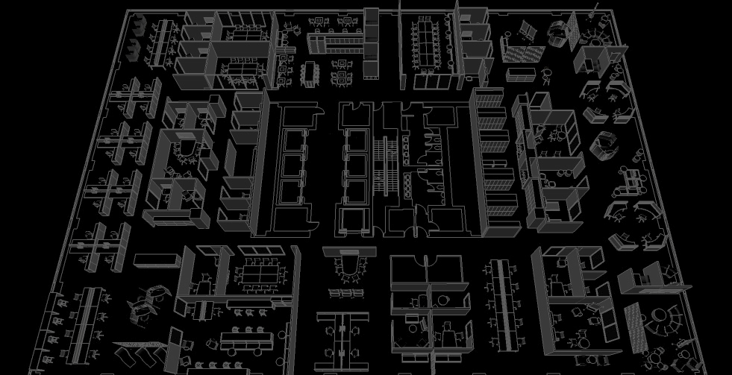
GCWORKPLACE DESIGN GUIDE
TRANSFORMING THE WORKPLACE EXPERIENCE
Notes:
The GCworkplace Design Guide is a document outlining the design principles and best practices pertaining to workplace modernization for the Government of Canada. It is intended to provide an overview of the GCworkplace concept and its context within the greater vision for public service renewal, as well as provide design professionals and project teams the tools and parameters within which to optimize workplace design. This document should be read in conjunction with the Government of Canada Workplace Fit-up Standards and the GCworkplace Toolkit, as well as all relevant national and regional building codes.
Covers fundamental criteria such as Gcworkpalce dimensions (flexible, efficient, inclusive, green, collaborative, healthy and green),
Key design principles,
Building blocks
Design development strategies
Annex: Best Practices Checklist

Slide 49
How is a GCworkplace designed?–5 Key Design Principles
USER-CENTRIC DESIGN
CONCEPTION CENTRÉE SUR L’UTILISATEUR
PROMOTE EQUAL ACCESS
PROMOUVOIR L’ÉGALITÉ D’ACCÈS
DESIGN FOR ACTIVITIES
CONÇU POUR LES ACTIVITÉS
ZONE BY FUNCTION
DIVISER PAR FONCTION
PLAN FOR FLEXIBILITY
PLANIFIER POUR LA FLEXIBILITÉ
PLAN FOR CHANGE
Notes:
- An ABW is like an ecosystem, if something is missing or inadequate, the entire functionality is threatened
Only name the 5 principles here, elaborate on next slides
All principles are co-dependant on each other

Slide 50
User-Centric Design Conception centrée sur l’utilisateur
We are not all one size, therefore a one-size fits all approach to design doesn’t work.
Through an enhanced consultative process, where all users are given a voice, GCworkplace considers the specific work activities identified as well as the varying user preferences to create a functional, supportive workplace.
Notes:
WP2.0 was not designed in a user-centric but rather a prescription based solely on a hierarchical model, with no consultation at the individual level.
GCworkplace is designed for people
Knowing that people have different shapes, sizes, abilities, preferences and circumstances
Not a fully custom tailored solution, always based on a standard kit of parts and standard process, but provides enough flexibility to support all users
A user-centered design approach ensures that a proper PROCESS is followed for requirements gathering which relies on user surveying. This process then leads to the ideal design solution for the organization

Slide 51
Promote Equal Access to Space Promouvoir l’égalité d’accès
GCworkplace promotes a more equitable workplace where everyone has access to the levels of visual and acoustic privacy they require for the task at hand.
Shared workpoints allow for more meaningful amenities and optimized use of space.
Notes:
The workplace is meant to be shared and everyone has access to all amenities
Ex: junior employee who needs a high level of concentration can access that type of space,
Someone who has frequent phone calls can access private space as required
Can reduce ratio of workstations because they are shared, and we can now add more meaningful amentities like more meeting rooms, lounges, focus rooms, etc. depending on the group’s needs
This the KEY to the functionality of the space. The more you carve out workpoints or areas to assign, you are limiting the functionality – crucial to success of the workplace

Slide 52
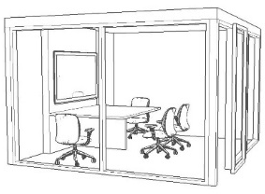
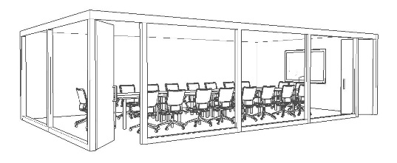
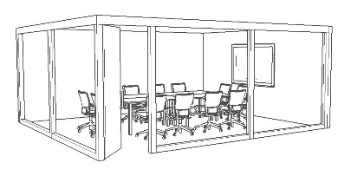
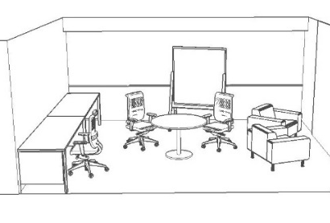
Design for Activities
WORK ROOM
FORMAL MEETINGS & PRESENTATIONS
COORDINATE
ASSEMBLE
PRESENT
CREATE
PROJECT ROOM
TEAM WORK & IDEATION
Notes:
Where before we would hold all meetings in a formal, enclosed setting, there are now a variety of collaborative workpoints that can suit different requirements.
For example, An open, more casual Teaming Area can encourage ideation and brainstorming, while a project room can be reconfigured to meet a group’s ‘divide and conquer’ project for a day.

Slide 53
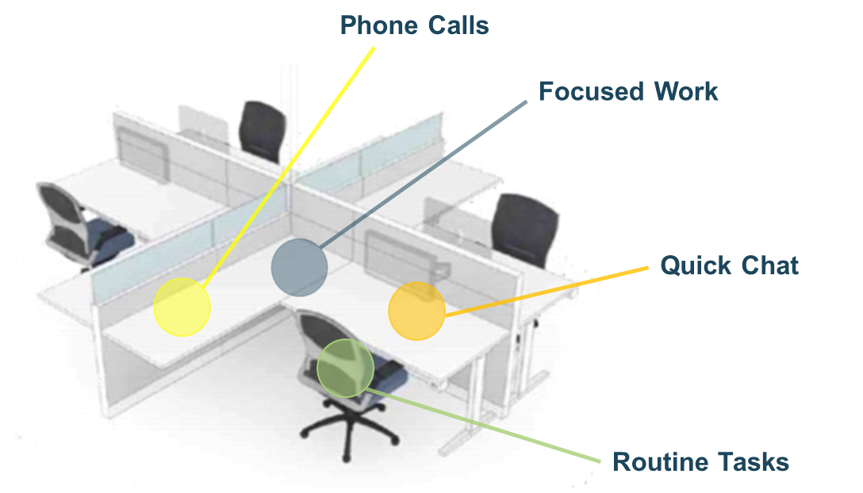
Design for Activities Concevoir pour les activités
Notes:
Same goes for individual workstations
Where before we were doing a multitude of different tasks from one place; from phone calls to focus work, regardless of what your neighbor was doing (or trying to do)
(next slide shows variety of workpoints and zones)

Slide 54
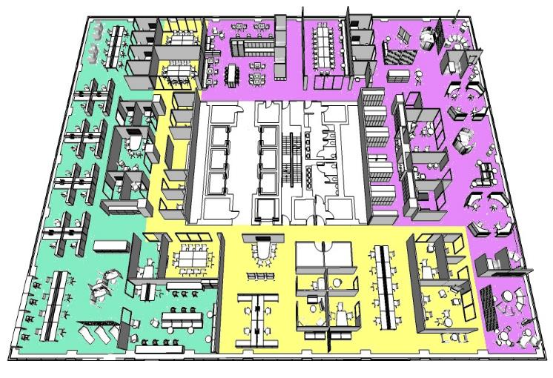
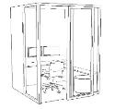
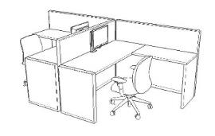
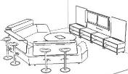
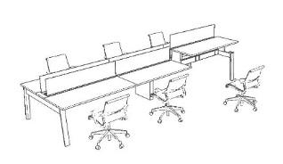
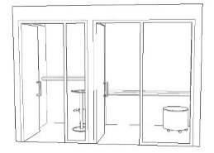
Zone by Function Diviser par fonction
QUIET ZONE
INTERACTIVE ZONE
TRADITIONAL WORKSTATION
TRANSITIONAL ZONE
Notes:
The solution to the problem of the open concept workplace, is ZONING
The workplace is designed in functional zones which ensures that like activities are grouped together, hence reducing noise disruptions
Going back to the User-Centric principle: All workplaces should have zones, size and quantity should be based on the requirements captured in FP
If everyone is able to CHOOSE (equal access) than they can go to the zone that suits there need or preference. If you assign, you cannot dictate who sits in what zone (loud Julie)
Quantities and sizes of zones are based on user requirements
The workpoint distribution in a GCworkplace allows users to find the right workpoint, in the right setting.
(next slide shows zones highlighted)

Slide 55
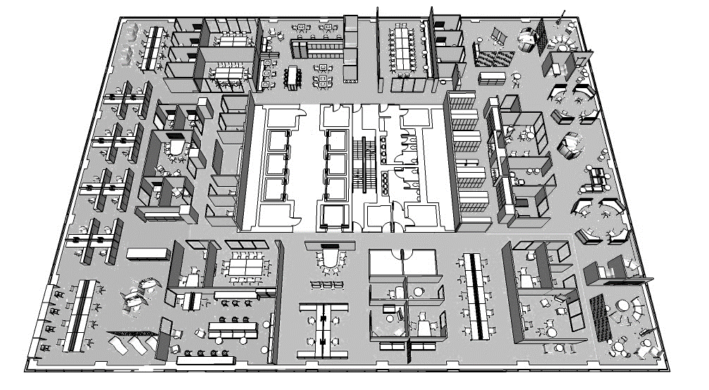
Zone by Function (cont’d)
!
Zoning is imperative to cueing intended behaviors and mitigating sound and visual distractions
DESIGNING FOR TRANSITION TOWARDS A QUIET ZONE
GROUPING COLLABORATIVE WORKPOINTS TOGETHER
PROMPTS A BEHAVIOURAL CHANGE PERTAINING TO NOISE LEVELS
ENCOURAGES SOCIAL INTERACTION AND ‘COLLISIONS’
INCLUDING VISUAL CUES SUCH AS SCREENS AND ARCHITECTURAL ELEMENTS
GROUPING PERSONAL STORAGE TOGETHER
GUIDES CIRCULATION AND DELINEATES ZONES
DIRECTS TRAFFIC AND ISOLATES DISRUPTIVE ACTIVITIES FROM WORK AREAS
QUIET ZONE
TRANSITIONAL ZONE
INTERACTIVE ZONE
Notes:
There are 3 different zones in a GCworkplace
The QUIET Zone, which mainly contains individual workpoints, both open and enclosed, provides the highest level of acoustic privacy
The INTERACTIVE Zone, which contains a mix of open or enclosed collaborative and open or enclosed individual workpoints, provides a space meet, socialize and speak at normal volume
And the TRANSITIONAL Zone is the buffer zone that allows the other two to co-exist.

Slide 56
Plan for Flexibility
Best Practices To Achieve FLEXIBILITY In Design
Promote furniture solutions over permanent or built-in fixtures
Use of mobile furniture where possible (reconfigurable)
Make spaces multi-purpose with a variety of workpoints
Use of demountable partitions
Design with modularity in mind
5m²
5m²
5m²
5m²
5m²
5m²
20m²
20m²
20m²
10m²
10m²
10m²
15m²
30m²
60m²
15m²
15m²
15m²
15m²
30m²
7.5m²
7.5m²
7.5m²
7.5m²
7.5m²
7.5m²
!
Designing in an agile way allows the workplace to easily adapt to ever-evolving requirements
Notes:
The workplace is designed with flexibility in mind. Variety of workpoints ensure that changes in activities or groups can easily be accommodated
Growth can easily be absorbed and layout changes be facilitated by modular planning

Slide 57
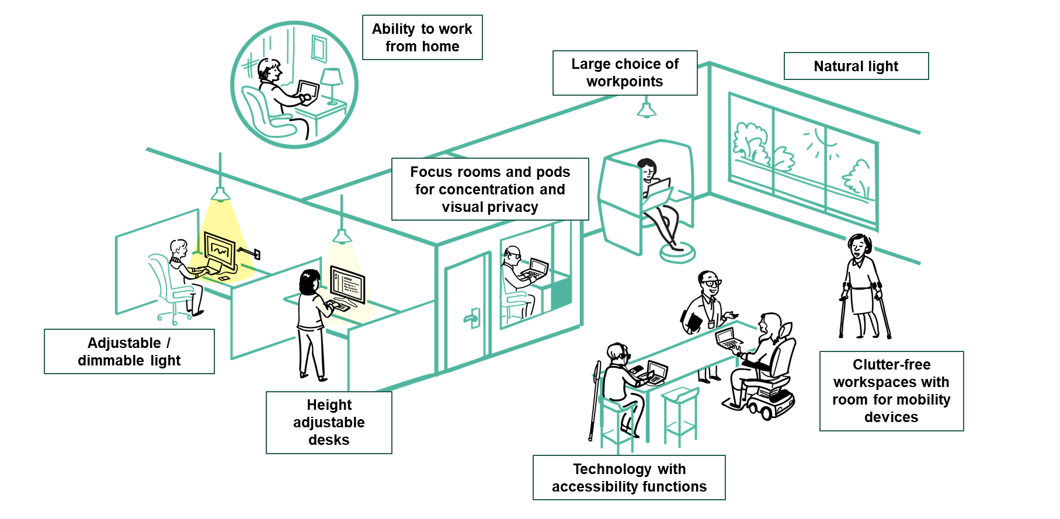
An Accessible and Inclusive Workplace by Design
USER-CENTRIC DESIGN
PROMOTE EQUAL ACCESS
DESIGN FOR ACTIVITIES
ZONE BY FUNCTION
PLAN FOR FLEXIBILITY
Notes:
GCworkplace Design is inherintly Accessible and inclusive as it provides users the choice to self-select from a wide variety of fucntional settings, many with user adjustability, based on each person’s activites, abilities and preferences.
Just because the workplace is now more accessible and inclusive, DTA is still applicable when the workplace does not support an employee’s specific needs

Slide 58
Workpoints
INDIVIDUAL WORKPOINTS
Touchdown
COLLABORATIVE WORKPOINTS
Chat Point
SUPPORT SPACE
Kitchenette
Equipment Area
Focus Pod
Focus Room
Study
Reflection Point
Active Workstation
Phonebooth
Huddle
Teaming Area
Lounge
Work Room
Project Room
Meeting Room
Lockers
Workstation
Storage
GCworkplaces are designed from one kit of parts called WORKPOINTS.
Workpoints are based on function and can vary in size and quantity.
Refer to the GCworkplace Technical Reference Manual for more information on each workpoint.
Notes:
- One kit of parts
Mention 3 workpoint categories and to refer to Design Guide and TRM for more information
Workpoints are distributed to OPTIMIZE the workplace and reflect the functions of the organizations.
Workpoints are not assigned or designed for individuals but rather for the optimum functionality of the workplace. The users have the freedom to chose their preferred work setting
Some workpoints may be assigned to special functions during the design phase (duty to accommodate also remains)
The GCworkplace Space Planning Workbook is the tool which determines the workpoint ratios and distributions

Slide 59
Activity Profiles
Workpoints are distributed to OPTIMIZE the workplace and to reflect the organization’s anticipated modernized way of working. These distributions are categorized as ACTIVITY PROFILES.
The following activity profiles support varying levels of interaction, mobility and activities performed in the workplace.
LOWER LEVEL OF INTERACTION & MOBILITY
HIGHER LEVEL OF INTERACTION & MOBILITY
Notes:
ACTIVITY PROFILES are used as a baseline to identify the organization’s way of working and determine an IDEAL workpoint distribution
Name 3 activity profiles, on a spectrum
The provide a starting point for design and workpoint distribution
Don’t spend too much time on activity profiles as they are on next slide
Through FP in the consultation phase, the ideal Activity Profile will be determined

Slide 60
Activity Profiles – Sample Workpoint Distributions
COLLABORATIVE
INDIVIDUAL
AUTONOMOUS WORKPLACE
COLLABORATIVE
INDIVIDUAL
BALANCED WORKPLACE
COLLABORATIVE
INDIVIDUAL
INTERACTIVE WORKPLACE
ENCLOSED COLLABORATIVE
OPEN COLLABORATIVE
SECONDARY INDIVIDUAL
PRIMARY INDIVIDUAL ENCLOSED
PRIMARY INDIVIDUAL OPEN
Notes:
GCworkplace, unlike previous workplace strategies, establishes an activity profile based on the type of tasks performed in the workplace and the group's level of INTERNAL mobility.
These factors influence the proportions attributed to individual and collaborative workspaces that are unique to the group.
Emphasis is shifting towards design solutions that are more flexible, and tailored to suit the specific functional requirements of its users.
New technology is also influencing how employees work and interact, and subsequently changing how the workplace is designed to support a variety of activities.
Upper and lower limits in workpoint quantities stay consistent from one activity profile to another

Slide 61
GCworkplace Design Process
“Following the outlined process and using the associated tools, ensures a hollistic, functional and compliant GCworkplace design.”
PRE-DESIGN
FUNCTIONAL PROGRAMMING 101
To gather functional requirements and client-specific needs through an online survey and workshops.
DESIGN
SPACE PLANNING
WORKBOOK
DESIGN
GUIDE
DESIGN REVIEW CHECKLIST
TECHNICAL REFERENCE MANUAL
STANDARD FURNITURE TYPICALS
1
2
3
4a
4b
To determine workpoint quantities and ratios in acccordance to the GCworkplace Design standard.
To provide design guidance, key design principles and design strategies prior to beginning the concept design phase.
To ensure that a concept design aligns to the GCworkplace Design standard and follows all key design principles.
To provide technical information, as well as accessibility requirements for all workpoint types.
To provide standard furniture configuarations for each type of workpoint to facilitate the furniture procurement process.
Notes:
The GCworkplace Design Roadmap highlights the design process and provides links to all available tools and documents.
Can be found on the Gcworkplace Gcpedia page, under the RESOURCES tab
OR
Available to external consultants via the GCworkplace Interior Design Resource Centre page on Gccollab (must request access via the generic mailbox – see last slide)

Slide 62
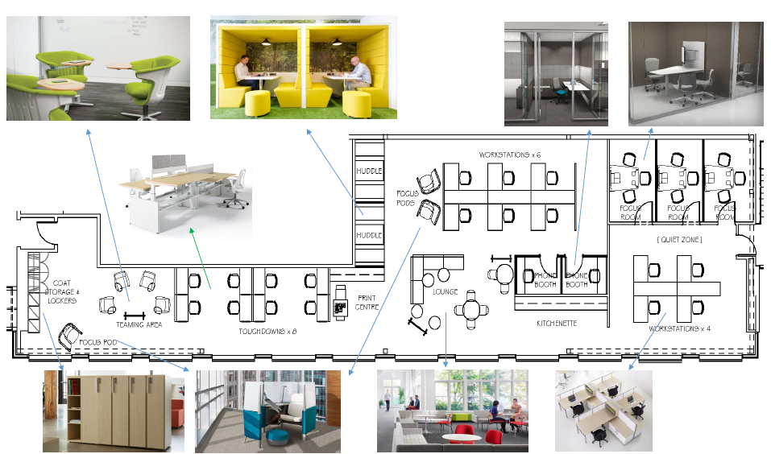
WORKPOINTS
INDIVIDUAL WORKPOINTS | WORKSTATION
 | TOUCHDOWN
 | FOCUS POD
 | FOCUS ROOM
 | STUDY
 | REFLECTION POINT
 | ACTIVE WORKSTATION
 | PHONEBOOTH
COLLABORATIVE WORKPOINTS | CHAT POINT
 | HUDDLE
 | TEAMING AREA
 | LOUNGE
 | WORK ROOM
 | PROJECT ROOM
 | MEDIUM MEETING ROOM
 | LARGE MEETING ROOM
SUPPORT SPACE | KITCHENETTE
 | EQUIPMENT AREA
 | LOCKERS & SHARED STORAGE
Notes:
Define the term ‘workpoint’ (still TBD)
GCworkplace offers a menu of workpoint choices, and we encourage teams to design for as many as possible in the interest of optimizing choice and flexibility for employees;
Examples: Workstation: mid-long term work space with access to others
Touchdown: Short-term landing point between other activities
Focus room: Enclosed space for mid- to long-term focused work
Chat point: Area brief impromptu conversations
Teaming area: Informal open area to accommodate group work and idea generation

Slide 63
Merci / Thank you
For more information on GCworkplace Transformation and Enablement, and to access all the tools referenced in this presentation, please visit the GCworkplace GCpedia page:
https://www.gcpedia.gc.ca/wiki/GCworkplace/Resources
To contact the Transformation and Enablement National Centre of Expertise, please email the GCworkplace generic mailbox:
TPSGC.SIMilieudeTravailGC-RPSGCWorkplace.PWGSC@tpsgc-pwgsc.gc.ca

