Slide 1
GC Task Success Survey:
Q3 Results
October - December 2023
February 2024

Slide 2
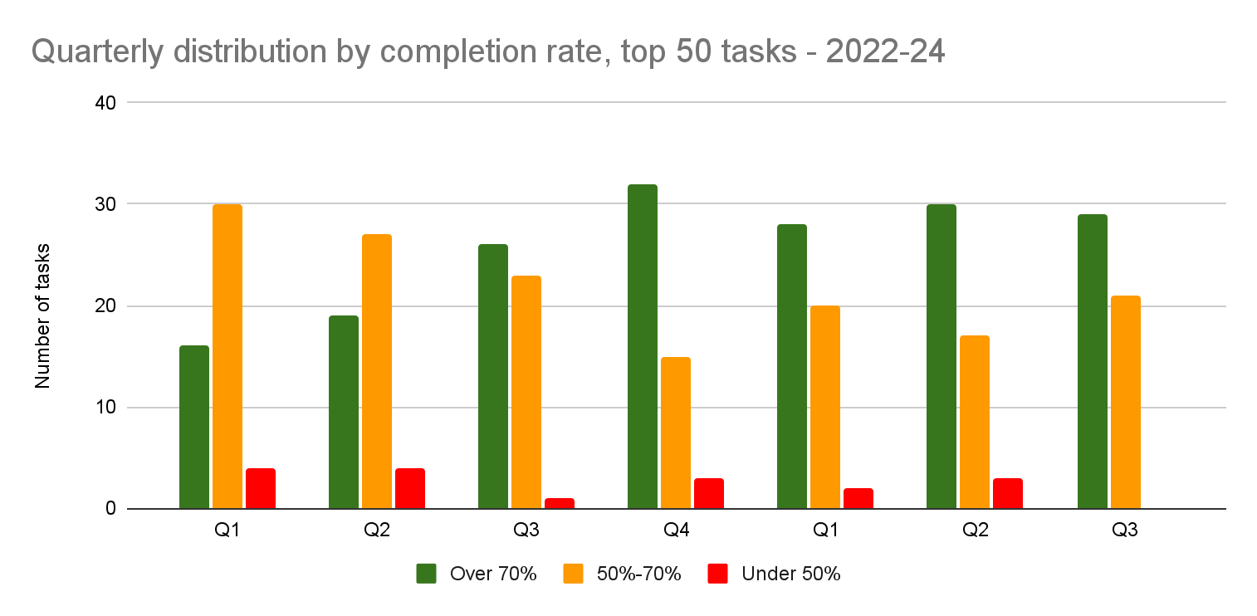
Quarterly comparison: Top 50 tasks
No top 50 tasks under 50% completion score
Most movement between quarters is attributed to fluctuating response volumes.
We saw several positive improvements within the green and orange bands (see slide 6).

Slide 3
Top 50 tasks: Q4 (22-23) and Q1, Q2, Q3 (23-24)
 | Q4 | Q1 | Q2 | Q3
Top 50 task completion average | 72.1% | 69.2% | 71.58% | 73.35%
Tasks over 70% | 32 | 28 | 30 | 29
Tasks between 50%-70% | 15 | 20 | 17 | 21
Tasks below 50% | 3 | 2 | 3 | 0
Most movement between quarters is attributed to response volumes
1 task dropped from green to orange
2 tasks left top 50 due to response vol.
1 task entered due to response vol.
1 task moved up from orange to green 4 tasks entered top 50 due to response volumes
1 task moved up from red to orange. 2 tasks moved out of top 50 - only due to lower response volumes
Notes:
Change in green band
Dropped out of top 50 due to response volume
Find out how much my benefit payment will be (still in green)
ArriveCAN - Make a customs and immigration declaration before flying into Canada (still in green)
Dropped down: How to extend your stay in Canada dropped from green to orange Q3 68% /Q2 73.5%
Entered top 50 due to response volume: Symptoms or risks for a disease or condition
Change in orange band
Moved up: Immigrate as a provincial nominee Q3 71.7% / Q2 69.2%
New tasks to top 50 based on response volume
How to extend your stay in Canada - My Service Canada Account (MSCA) - Check your CPP/OAS application status
My Service Canada Account (MSCA) - Check your estimated monthly Canada Pension Plan (CPP) benefits
My Service Canada Account (MSCA) - Register for an account
Vaccines and treatment
Tasks previously under 50%
Moved up: My Service Canada Account (MSCA) - Register for an account 44.70% - Now 51.10%
Open a My Account 40.20% (not in top 50 tasks now due to response volume - <300 responses but still under 50% 42.1%)
Find out when I can expect my tax refund 47.50% (not a top 50 task - seasonality but still under 50% 237 44.7%)

Slide 4
Top 50 tasks: Q3 (23-24) - By number of responses
Apply for a work permit
Check your (IRCC) application status

Slide 5
Q3 - Highest completion scores in the top 50 tasks
The score to enter the top 10 increased from 81.2% to 83.4%
The 3 tasks that “fell” out of the top 10 still score over 80%
Pension payment dates | 94.40%
Employment Insurance (EI) - Submit an Employment Insurance Report | 90.90%
Get current and forecasted weather for your location | 89.00%
Travel advice and advisories | 88.50%
Find a designated learning institution *new | 85.60%
Symptoms or risks for a disease or condition *new | 84.80%
Canada Pension Plan (CPP) - Check payment information | 84.70%
Calculate payroll deductions | 84.50%
My Service Canada Account (MSCA) - View payment information | 83.40%
Study in Canada – for non-Canadians | 83.40%
Notes:
All tasks are low margin of error
3 tasks moved into top 10 by completion score: (Q2 / Q3 results)
Find a designated learning institution 79.10% / 85.60%
Symptoms or risks for a disease or condition 83.6% / 84.80%
Study in Canada – for non-Canadians 75.00% / 83.40%
3 tasks moved out of top 10 (Q2 / Q3 results)
Check processing times 82.70% / 83.1%
Apply for a work permit 81.70% / 82.0%
Find a job in the private sector 81.20% / 79.8%

Slide 6
Biggest improvements in the top 50: Q2 vs Q3
IRCC secure account - register, sign in, help | 7.80% | IRCC
File a Personal tax return | 6.60% | CRA
Find a designated learning institution | 6.50% | IRCC
My Service Canada Account (MSCA) - Register for an account | 6.3% *not significant/higher margin of error | ESDC
Old Age Security (OAS) - View payment amounts | 6.10% *not significant | ESDC
Sign up for direct deposit or update your banking information | 5.90% *not significant/higher margin of error | CRA/PSPC
Access your pay (MyGCPay, CWA, Phoenix) | 5.80% *not significant/higher margin of error | PSPC/TBS
My Service Canada Account (MSCA) - Check your CPP/OAS application status | 5.1% *not significant | ESDC
My Service Canada Account (MSCA) - Check your estimated monthly Canada Pension Plan (CPP) benefits | 4.5% *not significant | ESDC
Scholarships to study in Canada | 4.20% *not significant/higher margin of error | GAC
Find a visa application centre | 4.00% *not significant/higher margin of error | IRCC
Study in Canada – for non-Canadians | 3.80% | IRCC/GAC
Apply for an Electronic Travel Authorization (eTA) | 3.80% *not significant | IRCC
Contact Immigration, Refugees and Citizenship Canada | 3.70% | IRCC
Get current and forecasted weather for your location | 3.40% *not significant | ECCC
Travel advice and advisories | 3.40% *not significant | GAC

Slide 7
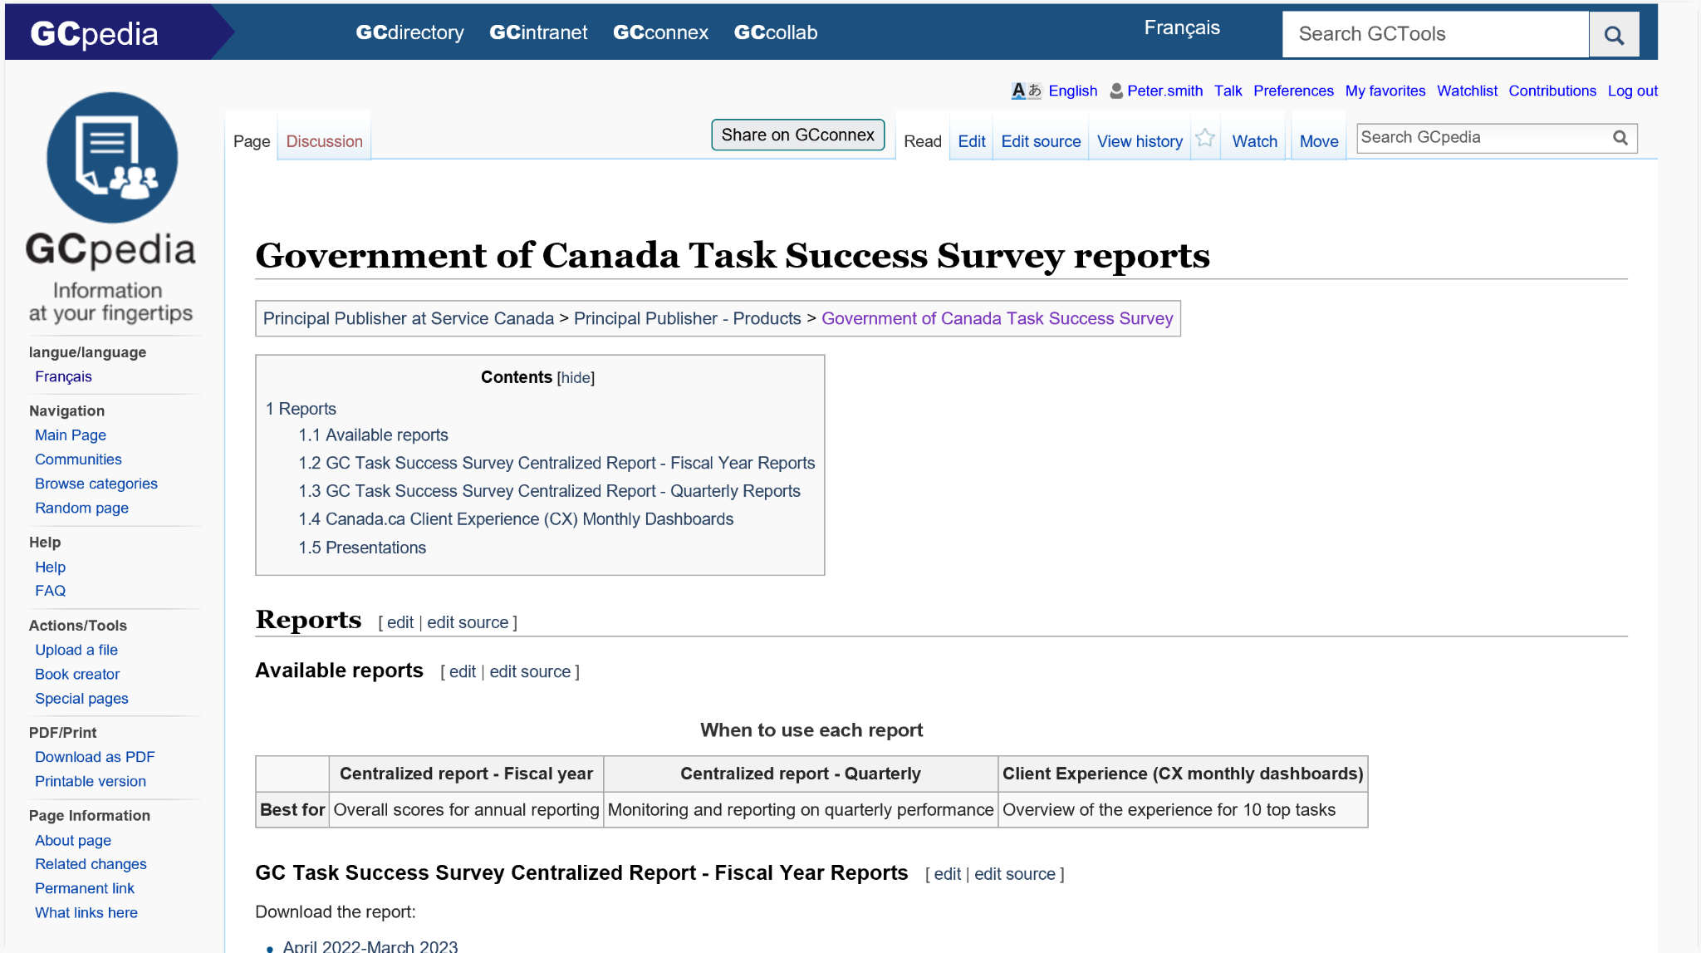
Full report
Download the spreadsheet from
GC Task Success Survey reports on GCpedia

Slide 8
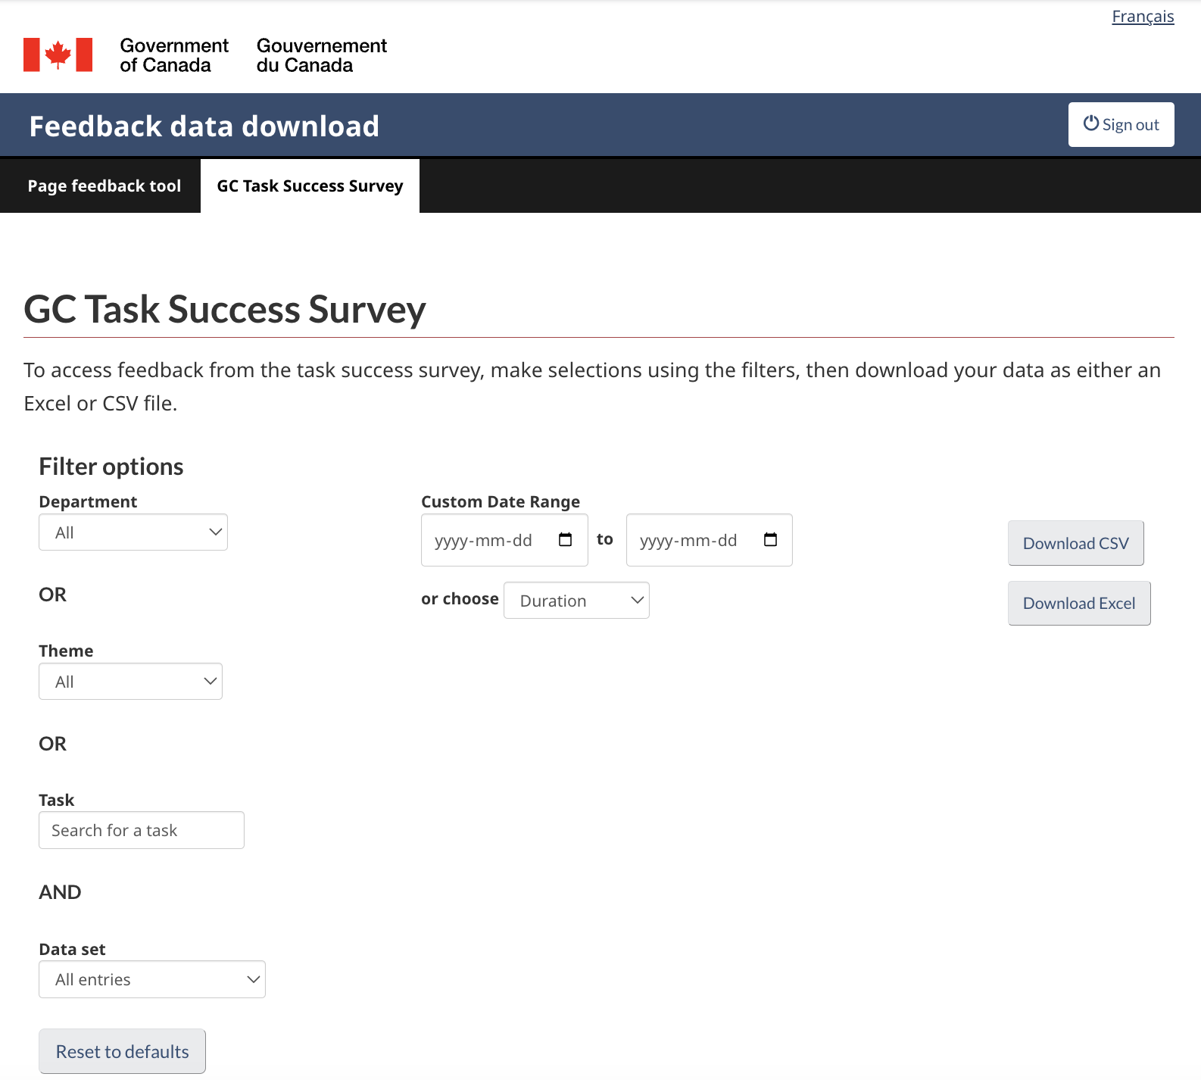
Qualitative data also available
Download survey comments
from the feedback viewer

Slide 9
Thank you for your time
Lana Stewart
A/Supervisor Data and Performance
Digital Transformation Office
Canada Digital Service
lana.stewart@cds-snc.ca
343-551-5967
Lindsay Beaudoin-Rach
A/Manager, Analytics Services
Principal Publisher Service Canada
lindsay.beaudoin@servicecanada.gc.ca
GC Task Success Survey

