Slide 1
FYN Virtual Learning Series,
May 5, 2020
Joy Moskovic,
Digital Enablement Division, TBS

Slide 2
The Government of Canada
Access to Collaboration Tools
External Tools
Powered by GCAccount – includes access to GCWiki and GCMessage
GCTools
GC-Wide
Departmental Tools
2

Slide 3
GCTools - Overview
Leveraging the Tools
EXTERNAL COLLABORATION
INTERNAL #GC NETWORK COLLABORATION
GCaccount
GCconnex
GCintranet
External facing
Includes access to:
GCcollab, GCwiki
GCmessage
Internal only
Internal only
Authoritative, central communications channel to reach all public servants.
GCdirectory - GEDS
GCpedia
GCdirectory - GEDS
External facing
Directory of federal public servants. – Partial access.
Internal only
Internal only
Directory of federal public servants. – Full access.
7

Slide 4
GCTools – Value Proposition
The GCTools help the Public Service achieve its objectives by allowing employees to:
Work better
Learn, share & find knowledge
Engage employees & build relationships
Collaborating digitally involves “working out loud,” where employees can see and benefit from each others’ work.
Employees across the GC share knowledge, learn and develop their competencies through dialogue.
Employees connect, identify colleagues with shared interests and find mentors and opportunities based on their competencies.
3

Slide 5
GCTools during the COVID-19 pandemic
Most departments are limiting or restricting access to Government of Canada networks to employees performing work deemed critical or essential
GCcollab, GCmessage and GCwiki are available outside the network on any device with Internet access
GCTools are the only existing tools that are available, currently functional and open to all public servants

Slide 6
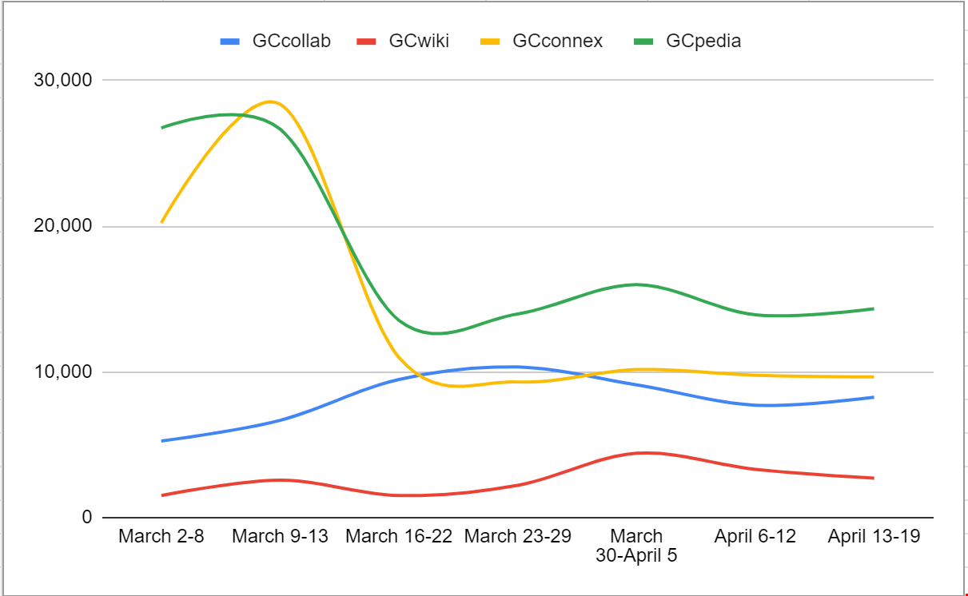
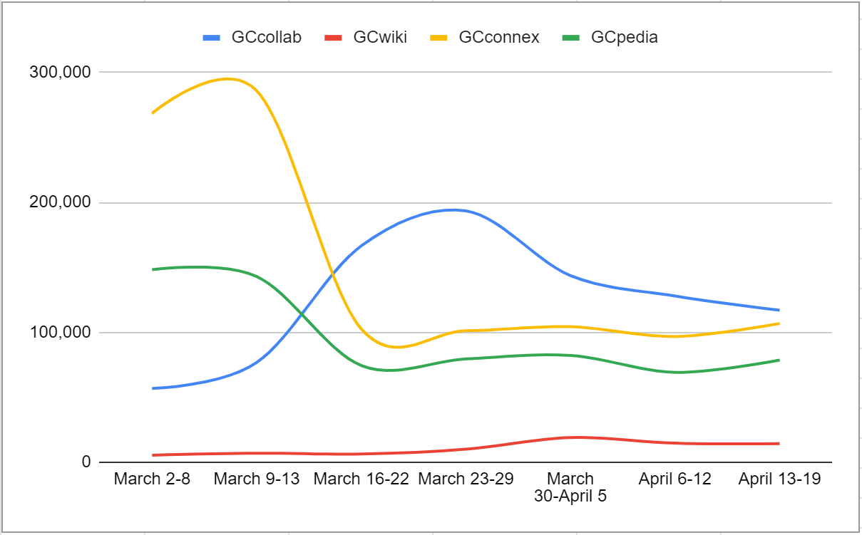
The pandemic’s impact on GCTools use
Unique visitors March 2 – April 19, 2020
Page views March 2 – April 19, 2020

Slide 7
The Road Ahead: Collaboration Tools in the GC
GCcollab joined the GCTools in 2016, joined by GCwiki and GCmessage in 2018
GCpedia and GCconnex have been operational and open to all GC public servants since 2008-2009.

Slide 8
GCTools – Benefits
Connect & Collaborate
Network
Enhance Productivity
Share Information
Communicate & Engage
5

Slide 9
Why or Why Not Use the GCTools?
Open Sharing
Co-creation
Collaboration
Works in progress
Confidential or Sensitive Data
Official Record Keeping
Duplicate Content
Private or Limited Discussion (except GCmessage)
4

Slide 10
Leveraging the GCTools
Main features and functionalities of GCconnex and GCcollab
Your Profile
Career Marketplace
Groups
Discussions
The Wire
Notifications
8

Slide 11
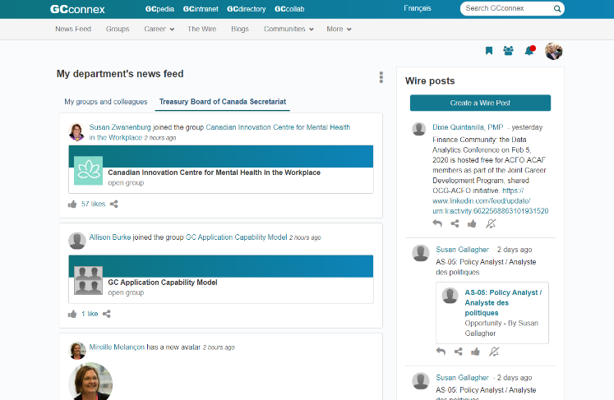
GCconnex
Network, connect, and share information in this collaborative workspace for all GC public servants.
Internal, GC-only
Must be on a Government of Canada device and connected to the internal network.
Great for creating a profile, joining groups and participating in discussions with other public servants.
Browse the Career Marketplace for at-level mobility, mentorship, and micromission opportunities
9

Slide 12
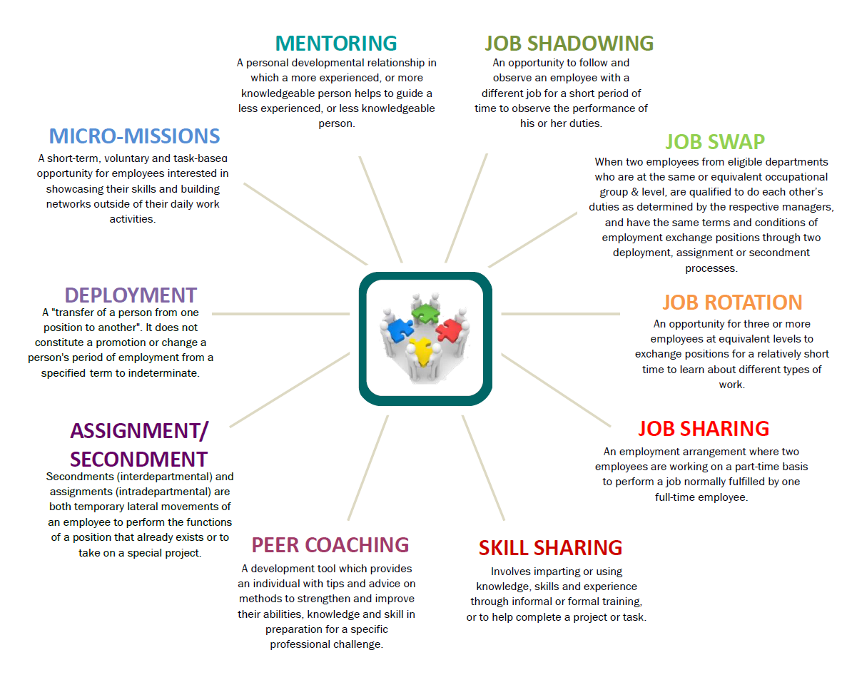
GCconnex and GCcollab: Career Marketplace
For career development and resourcing needs … It matches talent to at-level mobility and professional development opportunities.
Mentoring
Job Shadowing
Job Swap
Job Rotation
Job Sharing
Skill Sharing
Peer Coaching
Assignment / Secondment
Deployment
Micro-Missions
12

Slide 13
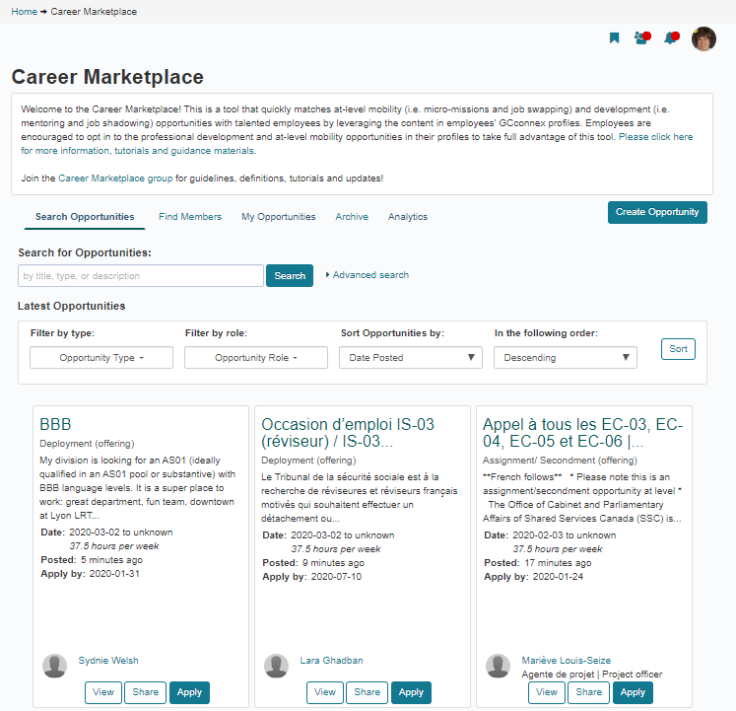
GCconnex and GCcollab: Career Marketplace
13

Slide 14
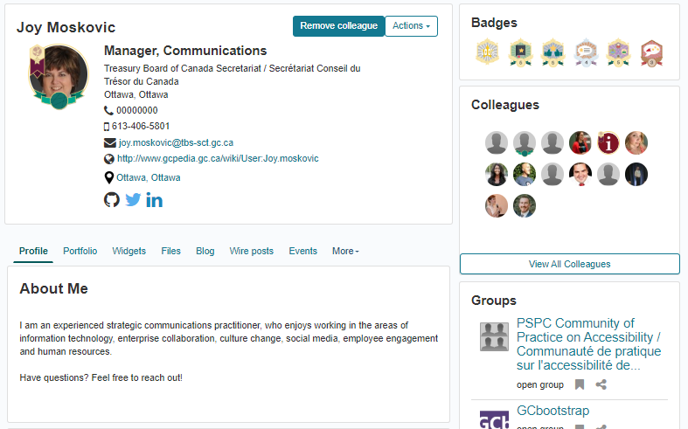
Creating a GCconnex and GCcollab profile
10

Slide 15
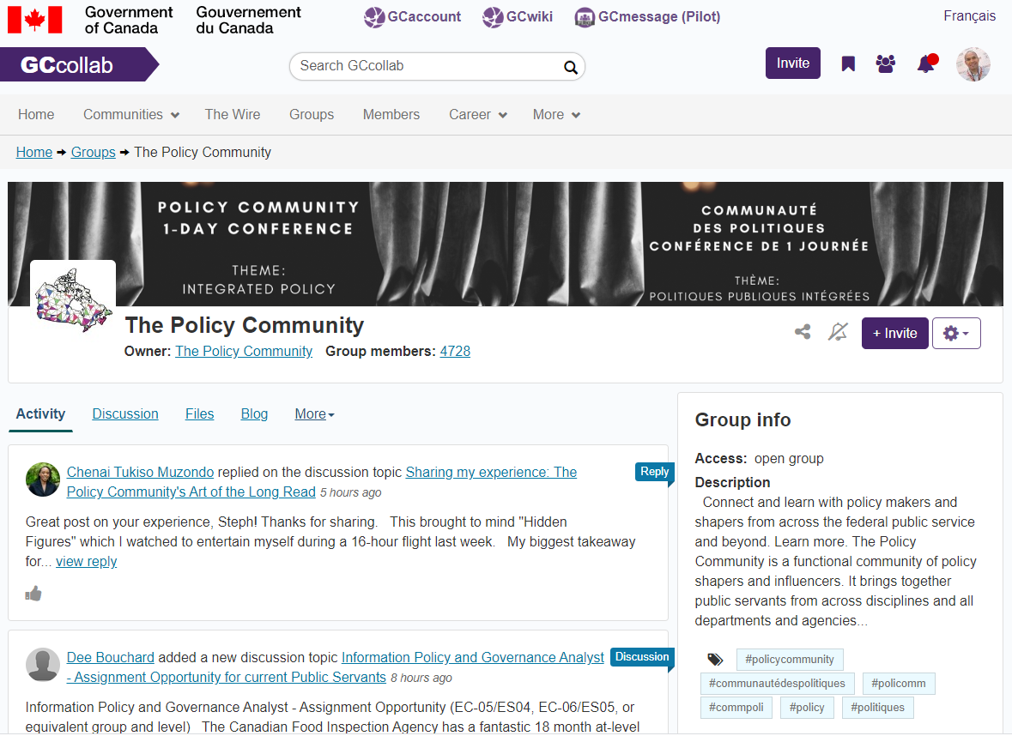
GCcollab (uses GCaccount)
Fully mobile. Access from anywhere, anytime, using any device. Or download the app.
Who can register and contribute?
Federal, municipal, provincial, and international public servants
Students and academics
Crown corporations, NGOs, non-profits, and private sector by request
Any existing user can invite anyone in the world to register.
Create your profile, join groups, participate in discussions, and network with people from within and beyond the GC!
17

Slide 16
Supporting government, supporting each other, supporting Canadians during COVID-19
18

Slide 17
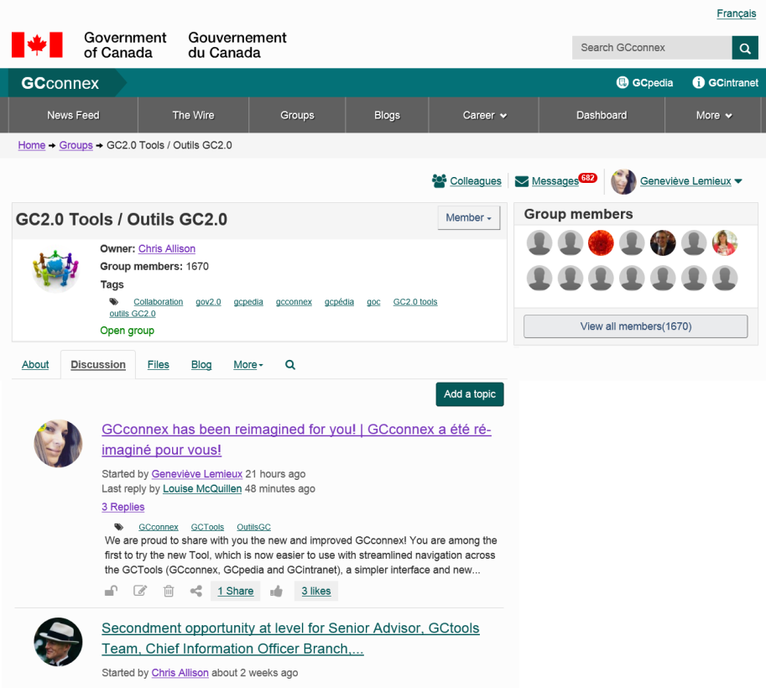
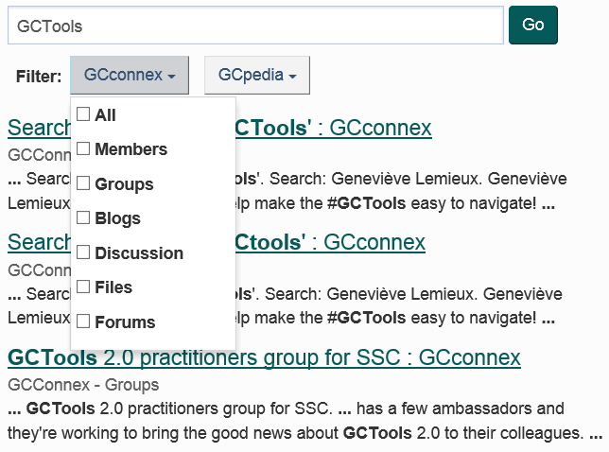
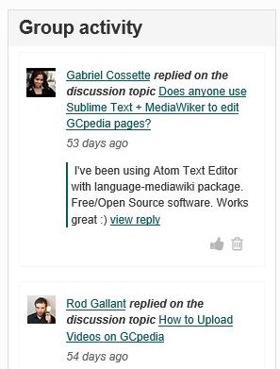
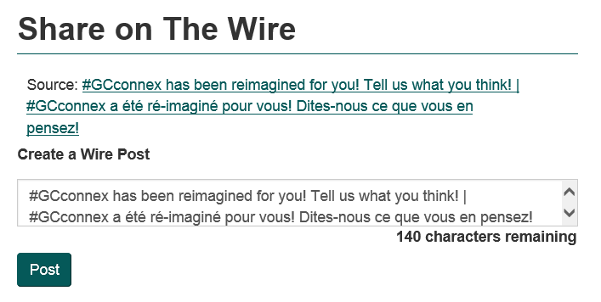
Connecting People and Ideas
Search

Slide 18
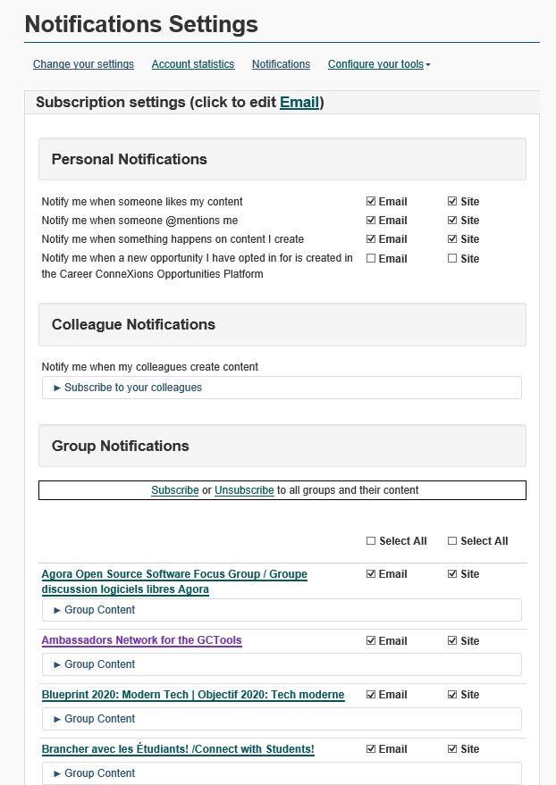
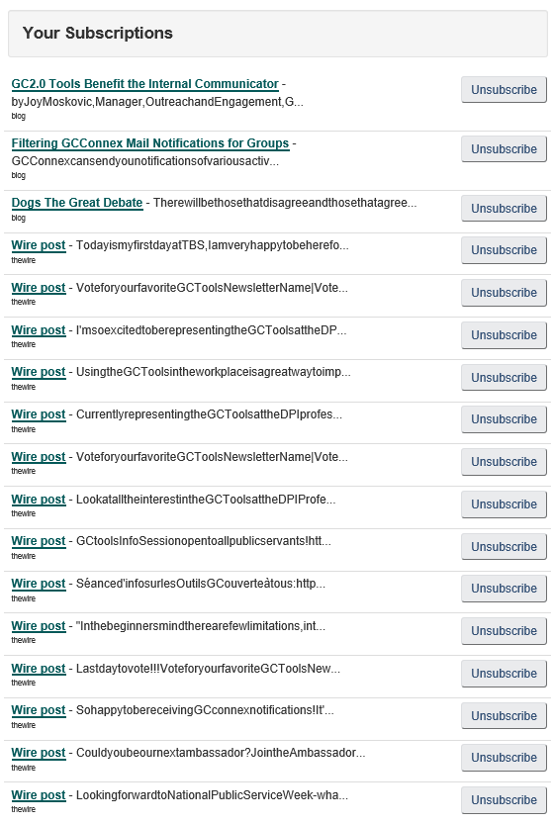
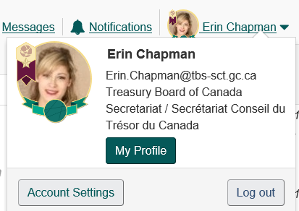
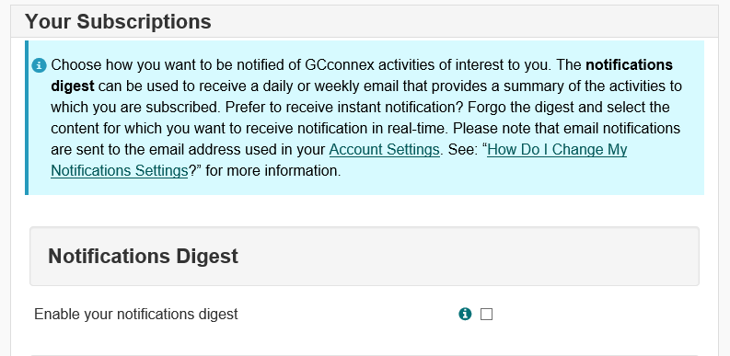
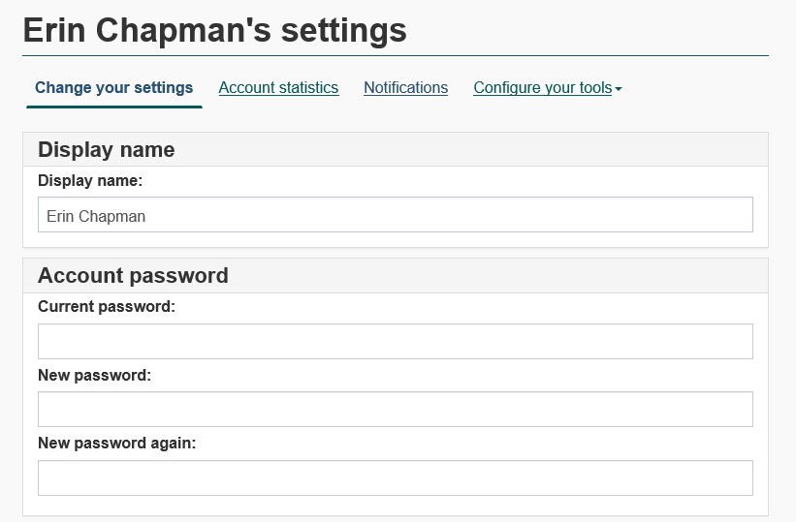
Manage your Notifications

Slide 19
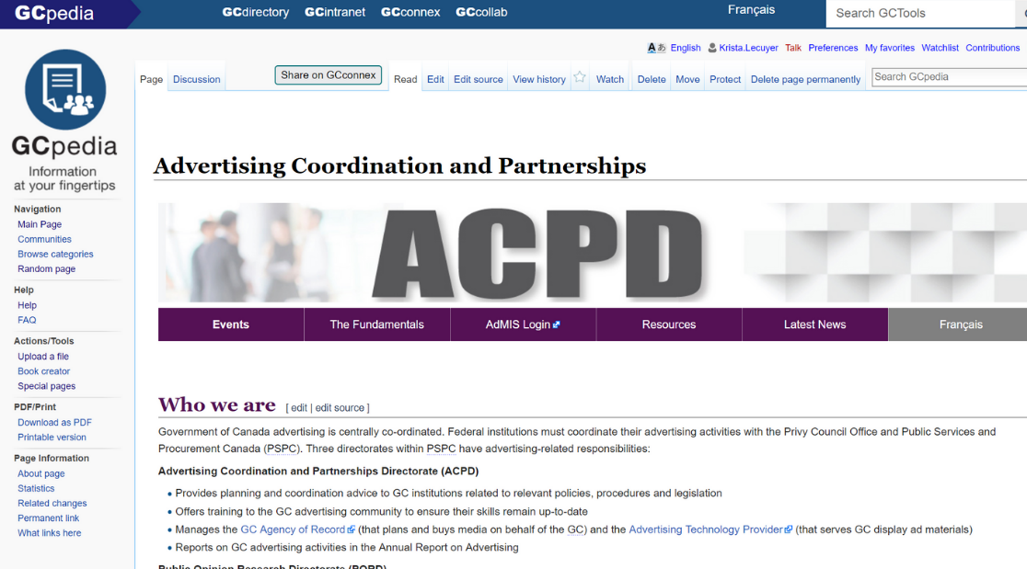
GCpedia
Co-create pages and share information in this collaborative wiki available to all the public service.
Internal, GC-only
Must be on a Government of Canada device and connected to the internal network.
Anyone in the Public Service can view any content
Anyone logged into their account in the Public Service can create a page and edit any content
Great for publishing pages. Ideal for sharing regular updates and links.
Use HTML and CSS coding to customize pages.
14

Slide 20
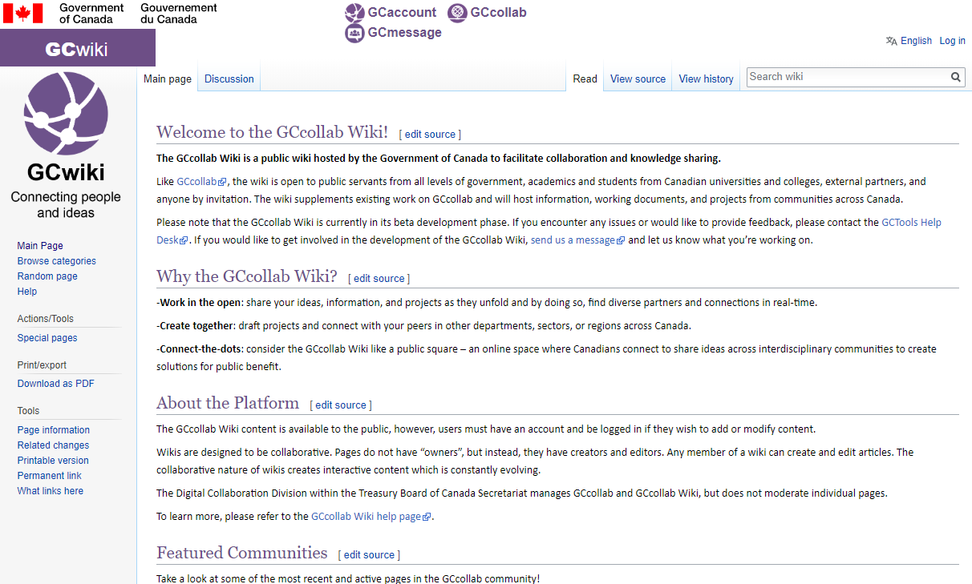
GCwiki (uses GCaccount)
A public square: an online space to connect and share ideas across interdisciplinary communities to create solutions
Pages are visible on the internet.
Pages are only editable by users with a valid GCaccount.
You will be automatically subscribed to updates when a page you create is edited.
Great for announcements and updates, or for sharing your ideas and projects as they unfold.
A fantastic, process-light way to post public information on the Internet.
Pages are mostly text.
HTML and CSS coding are restricted.
19

Slide 21
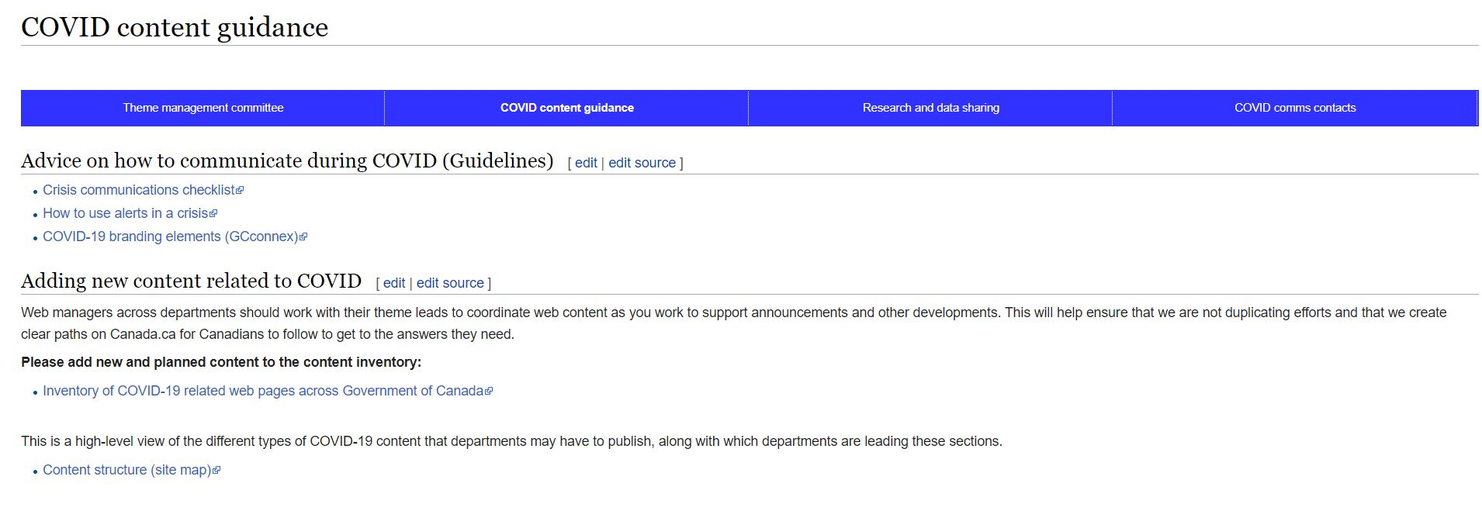
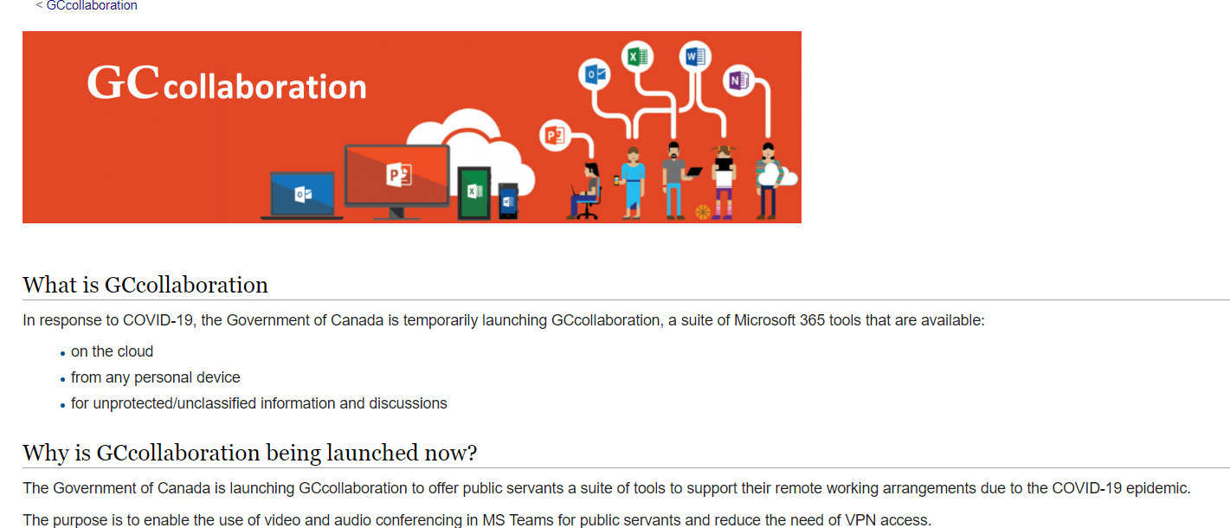
GCwiki – Sharing information during COVID-19

Slide 22
#GCTools
Why you should use the #GCTools
Connect with colleagues Upload your resume Participate in micromissions Learn from others | Create reference materials Stay up to date with projects/initiatives Contribute to an open and transparent public service | Stay informed/get info Career development Find necessary forms
20

Slide 23
#GCTools
Starting Tips and Tricks
1
6
Explore the career section
Create your account
2
Complete your profile and add a picture
7
Manage your notifications
3
8
Check out
help resources
Add colleagues
4
9
Invite your networks
to GCcollab or GCconnex
Join or create groups
5
10
Collaborate and
share content
Post on the Wire
21

Slide 24
#GCTools
Help and additional resources
GCTools Help Pages – support.gccollab.ca
GCTools Tip Sheets
GCTools Group on GCconnex
Welcome to GCconnex Group on GCconnex
GCpedia Co-creators Group on GCconnex
GCcollab Café Group on GCcollab
GCTools Ambassadors
22

Slide 25
Joy Moskovic
Manager, Outreach and Engagement, Digital Enablement
Office of the Chief Information Officer
Treasury Board of Canada Secretariat
Joy.moskovic@tbs-sct.gc.ca
@joymosk
http://ca.linkedin.com/in/joymoskovic
613-406-5801
Add me as a colleague on GCconnex or GCcollab!
Follow us on Twitter @DigiEnablement, @GCcollab, @GCconnex, @GCpedia
24

