Slide 1
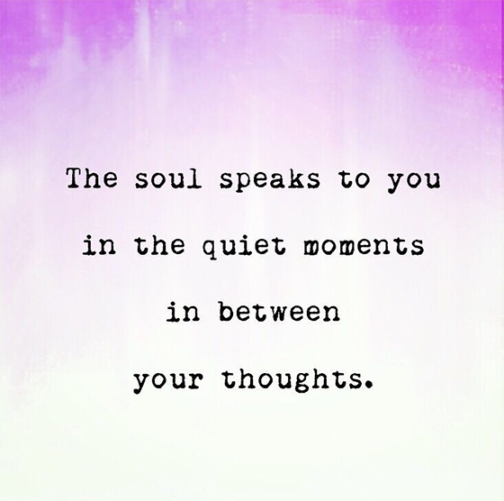
Notes:
Slide for when people wait to start the WebEx
REMEMBER:
Give participants the privilege to chat to “all participants” (by Ctl-K, checking the chat for “all participants” box)
Start the recording, and pause it while waiting for the participants to join.
Continue recording for starting the session, just before removing this slide.
Ask participants to use the check for yes and cross for no, so they warm up to the idea of interacting.
---
Please, via the chat box, introduce yourself with
Name
Department or Agency
Where you’re located
Your expectations for this session

Slide 2
Mindful Change Leadership Development Program
Week 5 (of 8)
27 May 2021
Notes:
To mention the following in French:
« Comme avec toutes les sessions du GC, s'il vous plaît, sentez-vous libre d'utiliser la langue de votre choix pour poser des questions ou participer à la discussion., La séance d'aujourd'hui sera conduit principalement en anglais, il y aura d'autres sessions en français qui seront promus via le groupe GCConnex (ou donner des dates précises, si disponible). »
As with all GoC sessions, please, feel free to use the language of your choice to ask questions or participate in the discussion., today’s session will be conducted mainly in English, there will be other sessions in French that will be promoted via the GCConnex group (or give specific dates, if available).

Slide 3
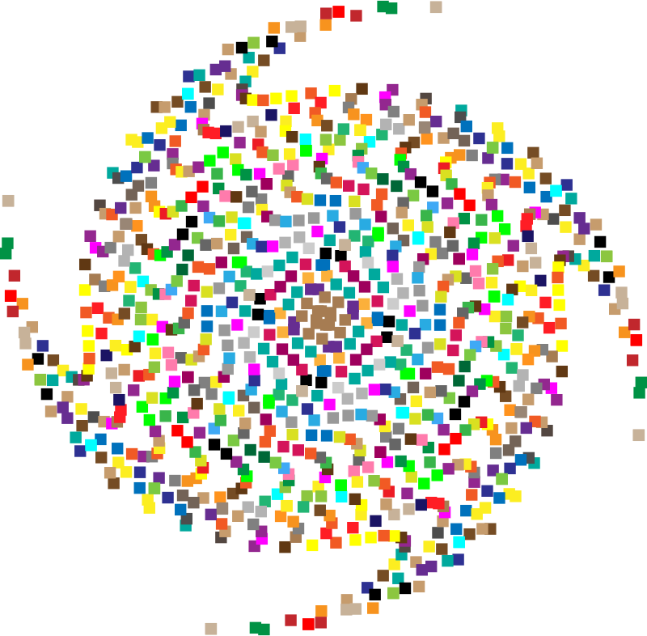
Mindful Breathing Exercise – Centering
Mindful breathing https://www.youtube.com/watch?v=ZE-r-x2T4ok
Notes:
Mindful breathing https://www.youtube.com/watch?v=ZE-r-x2T4ok
This is one way of doing it, getting it depends on the practice of.
Noticing is very important in the practice of Mindfulness.
Noticing where your thinking is, that’s the first step to become more Mindful.
Time required: 2 minutes
The trick is to shift from “doing” to “being”
Let’s start by doing the following...
Sit with a straight position, as comfortable as possible
It helps if you close or semi-close your eyes
Let’s not worry about time
And take a minute, only a minute...
To breathe, just to breathe
That simple
I’ll let you know when the time is over.
Just continue breathing

Slide 4
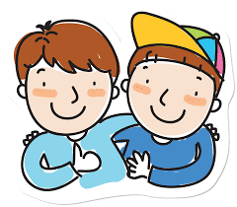
Debrief from last week (4)
Your Buddy System
Your practice :
Plenary
Notes:
Plenary: Open mic to have your comments, challenges, surprises… particularly would like to hear from someone who hasn’t spoke
Raise your hand to speak, type in the chat… be mindful about the time, let’s take as many as we can in 10 mins.

Slide 5
Agenda – week 5
Centering breathing exercise
Debrief from last week 4
Today’s session goals
The SCARF model
Technique - SiBerian North RailRoad
Your take away assignment

Slide 6
Today’s Intentions: Compassion, Clarity, Creativity
SCARF model
Technique - SiBerian North RailRoad
Reminder… Mindful – self-compassion
Reminder… Mindful Cleaning Your Environment

Slide 7
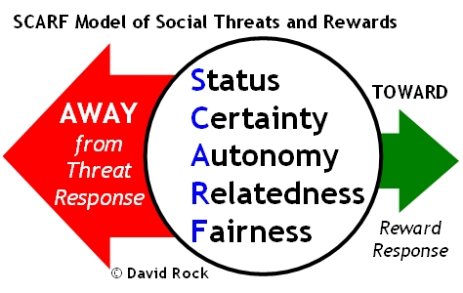
SCARF Model
Status is about relative importance to others.
Certainty concerns being able to predict the future.
Autonomy provides a sense of control over events.
Relatedness is a sense of safety with others – of friend rather than foe.
Fairness is a perception of fair exchanges between people
http://www.edbatista.com/2010/03/scarf.html
Notes:
http://www.edbatista.com/2010/03/scarf.html
https://www.psychologyafrica.com/2013/05/when-leaders-use-their-brain/

Slide 8
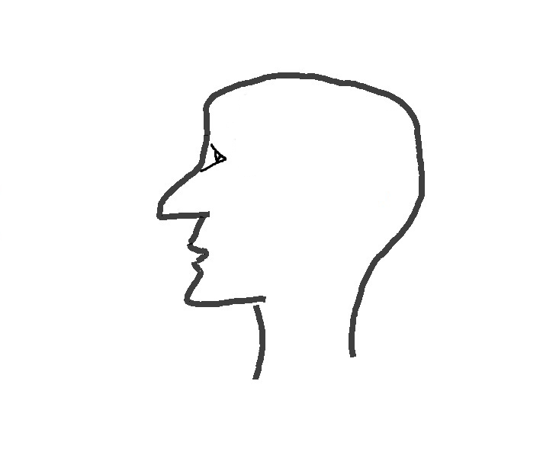
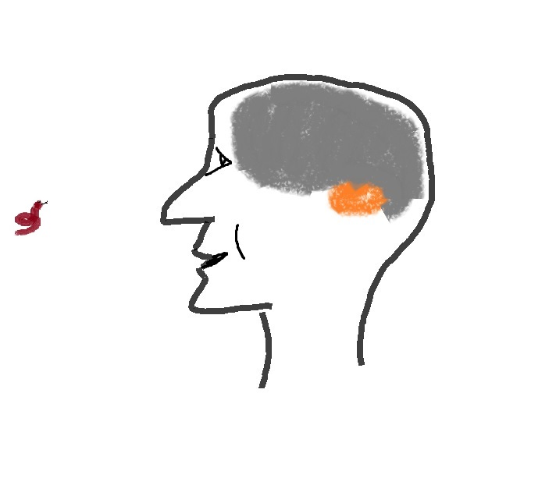
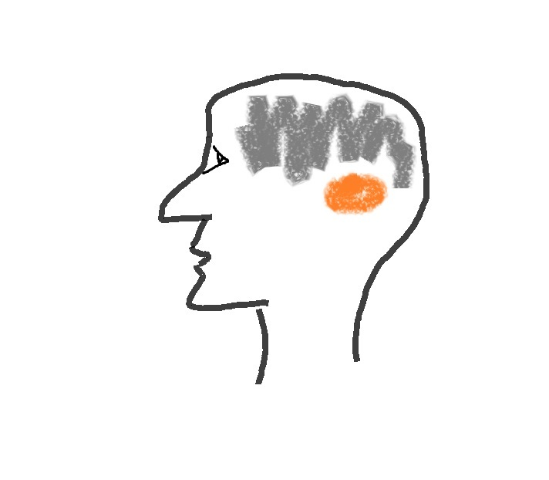
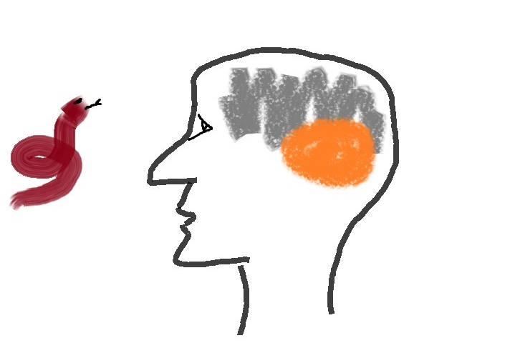
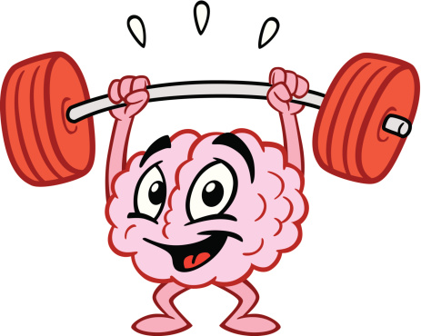
Reminder… What happens in the brain – the neuroplasticity
Decision making
Emotions
Language
Work
Family
Stress
Media
Amygdala
Mindfulness Practice
Natural dangers
turned → into
Day to day over stimulus
Watch this video at home (15 mins): https://www.youtube.com/watch?v=Awd0kgxcZws

Slide 9
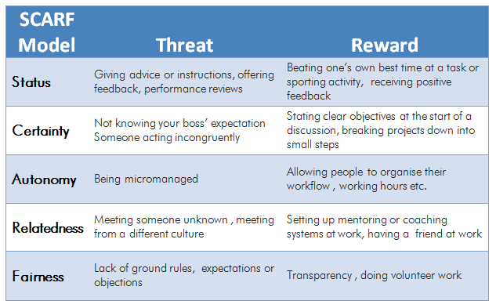
SCARF Model – Some Examples of Actions
That can evoke either a threat response or a reward response:
https://www.psychologyafrica.com/2013/05/when-leaders-use-their-brain/
Notes:
Have a minute to think and reflect about a situation when we chose one or the other, Threat or Reward response
http://www.edbatista.com/2010/03/scarf.html
https://www.psychologyafrica.com/2013/05/when-leaders-use-their-brain/

Slide 10
Technique - SiBerian North RailRoad
Stop – whenever you feel a trigger coming
Breathe – focus your mind on your breath
Notice – experience how you feel, notice your emotions
Reflect – where is that coming from? Is there any judgment?
Respond – take the opportunity to respond with a positive and compassionate outcome in mind.
This is a technique that could be used in your everyday work.
Notes:
Think about it for a minute and come up with real examples on when this technique could have been used for good.
Come up with real examples
And here, you can consult the technique for the Siberian North Rail Road practice: https://siyli.org/take-the-railroad-to-avoid-triggers-2/

Slide 11
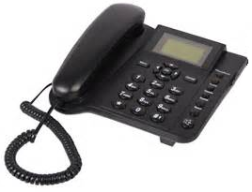
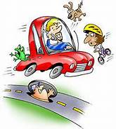
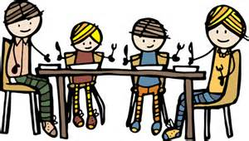
Reminder… Mindful Cleaning Your Environment
Take on the mini-challenge to be mindful around the distractions
Day 17/21 days challenge - KindSpring - Make A Mindful Phone Call
Day 15/21 days challenge - KindSpring - Practice Digital Mindfulness; and
Day 9/21 days challenge - KindSpring - Practice Mindful Emailing
Shifting Priorities: The Art of the Mindful Email https://siyli.org/multitasking/
Check the story of the Monkey and the Panda, use it as for inspiration: https://www.youtube.com/watch?v=8FBIe9iFJ_U *Dot
Notes:
Day 17/21 - https://gcconnex.gc.ca/blog/view/14813318/day-1721-days-challenge-kindspring-make-a-mindful-phone-call
Day 15/21 - http://gcconnex.gc.ca/blog/view/14746376/day-1521-days-challenge-kindspring-practice-digital-mindfulness
Day 9/21 - http://gcconnex.gc.ca/blog/view/14587328/day-921-days-challenge-kindspring-practice-mindful-emailing
Mindful e-mail - https://siyli.org/multitasking/
Monkey & Panda - https://www.youtube.com/watch?v=8FBIe9iFJ_U

Slide 12
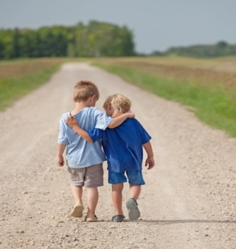
Reminder… Mindful – self-compassion
If you want to hear it from Kristin Neff: Self-compassion Break: https://self-compassion.org/wp-content/uploads/2020/08/self-compassion.break__01-cleanedbydan.mp3 Time required – 5 minutes
Notes:
From: https://centerformsc.org/practice-msc/guided-meditations-and-exercises/
* Self-compassion brea, 5 mins: https://self-compassion.org/wp-content/uploads/2020/08/self-compassion.break__01-cleanedbydan.mp3
I’ll guide us doing a similar/shorter loving-kindness meditation
Time required – 20 minutes
http://self-compassion.org/wp-content/uploads/meditations/LKM.self-compassion.MP3
Iterations, as follow…
Think of something that hooked you, something that you keep repeating yourself in your mind, ideally something light…
Remember, We all are in the same boat
My I (we all) be safe
May I (we all) be peaceful
May I (we) be kind to myself (ourselves)
May I accept myself as I am (may we accept ourselves as we are)

Slide 13
Your take away practice for week 5
Connecting – Buddy System
Gratitude Journaling – daily
Practice up to 15 mins… chose one - daily
Body scan or Breathing 15 mins – https://www.rightlifeproject.com/meditate (may need to scroll down) 15 mins – https://soundcloud.com/dharma-gus/15-min-body-scan-augusta-mbsr
Self-compassion 10 mins – https://soundcloud.com/breathworks-mindfulness/mindfulness-for-women-track-5-self-compassion-meditation 10 mins – https://soundcloud.com/user-640851605/self-compassion-giving-and-receiving-meditation-10-minutes 15 mins – https://soundcloud.com/mindfullivingcoach/self-compassion-meditation 15 mins – https://soundcloud.com/awakeningcompassion/awakening-compassion-class-4 20 mins – http://self-compassion.org/wp-content/uploads/meditations/LKM.self-compassion.MP3
Apply the SCARF Model – as needed
Technique - SiBerian North RailRoad
Reminder… Mindful Cleaning Your Environment
Reminder… Mindful – self-compassion

Slide 14
Reflect about the 3 exercises
Notes:
Take the next few minutes to debrief in small groups (of 4). As in previous weeks, when you’re done just leave the session.
Feel free to share:
What you noticed
What you had a hard time with
What you’re reailzing
An intention you have for the week
etc
I wish you happiness!!

Slide 15
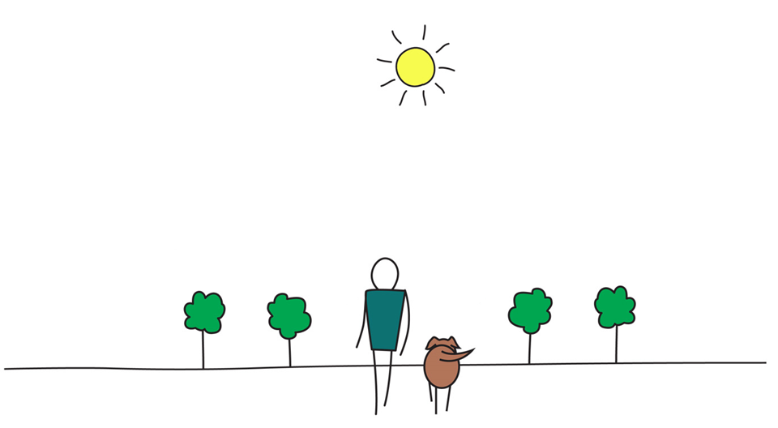
Be Mindful, Be Happy /
Prenez pleine-conscience, soyez heureux
Alejandro Gonzalez https://gcconnex.gc.ca/profile/alejgonz

