Slide 1

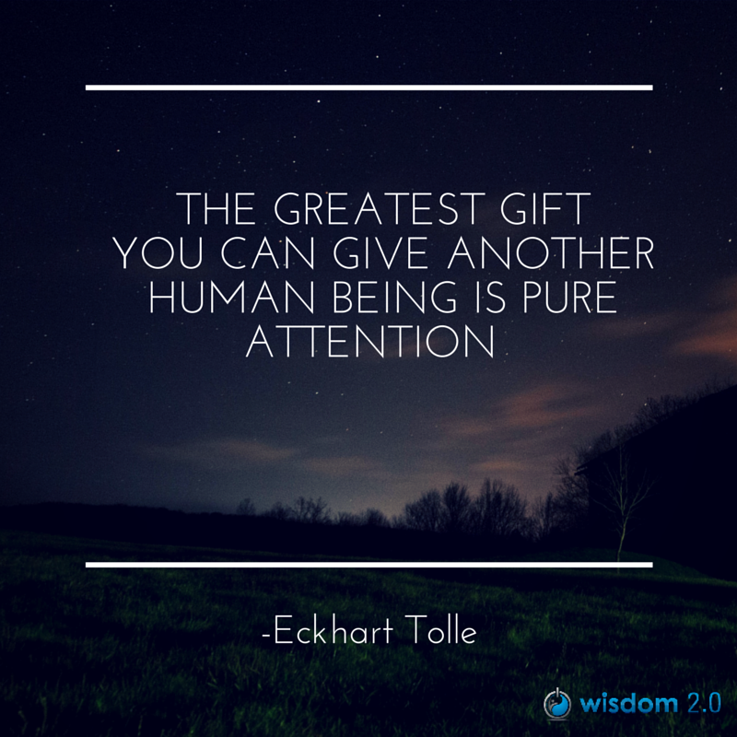
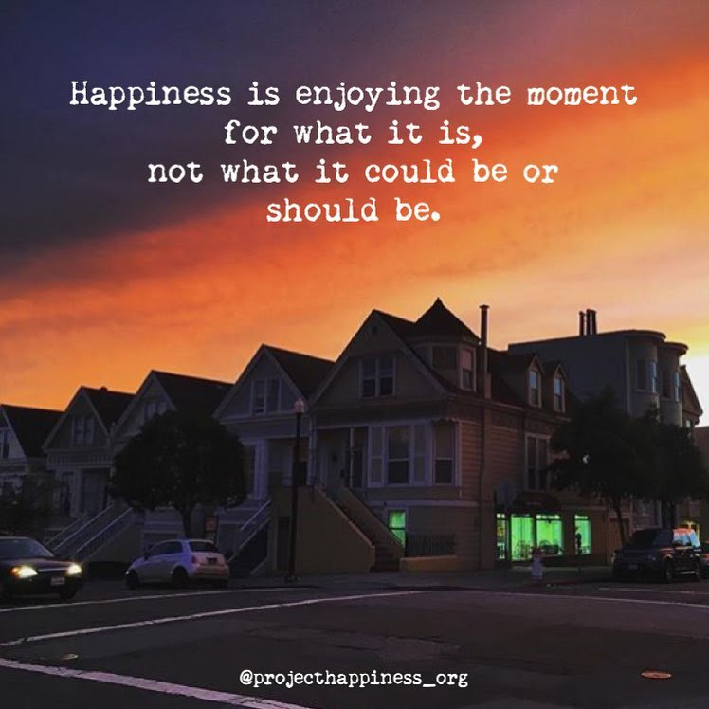
Welcome
Notes:
Alison
(read the quotes for reflection)
(Prep French CC and font size
InBrief: The Science of Resilience https://www.youtube.com/watch?v=1r8hj72bfGo
Brains: Journey to Resilience - https://www.youtube.com/watch?v=HJvDrT6N-mw
Guided Mindfulness Meditation Connecting with Values - https://www.youtube.com/watch?v=V-LsavLI20w
Open/Prep:
Whatcha readin – https://gccollab.ca/blog/view/13204265/whatcha-readin
Convergence - https://wiki.gccollab.ca/Convergence
Clappling images - https://giphy.com/embed/7Xmgrc6ty9XlZU6h2M
Slido - https://app.sli.do/event/3F6GL7XYodTjQVgmCz63bF
)

Slide 2
Mindful Change Leadership Development Program
Week 8 (of 8)
June 27, 2023
Notes:
Michaela
Welcome to the last session of our program / Bienvenue tout le monde à la dernière session de notre programme

Slide 3



Mindful Self-Love Exercise – Centering
Notes:
Alison
For today’s centering exercise, we’ll use a slight variation…. Similar to previous ones, the idea is to shift from “doing” to “being”
Let’s start by doing the following...
Sit in a comfortable attentive position
It helps if you close or semi-close your eyes
Focus on your breathing…
and repeat any of the following phrases aloud or in your mind as they may feel right to you, in this moment…
(read them allowing space in between)
I am a kind person (Je suis amiable)
I love myself (Je m’aime)
I do my best (Je fais de mon mieux)
I am enough (je suis assez moi-même)
(Repeat three to five time, over the space of 2 minutes, then ask participants to…) take a couple of deep breaths, slowly open their eyes, and return to the group session.

Slide 4


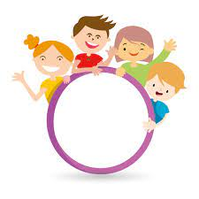



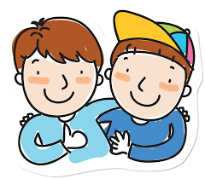


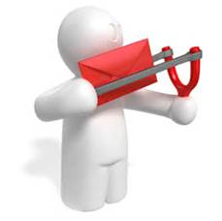



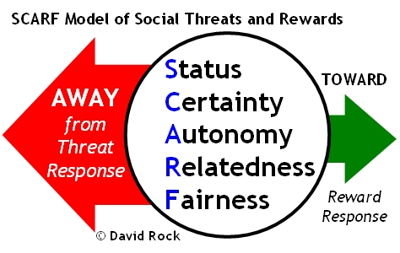


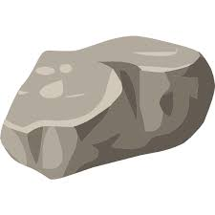



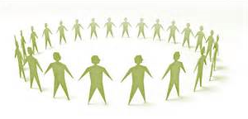
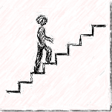
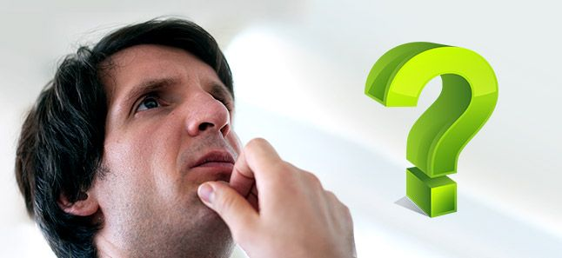


Questions/Insights from last week (7)
Notes:
Alison
Plenary: Open mic to share your comments, challenges, surprises… particularly would like to hear from those who haven’t shared yet
the gratitude journaling
Your practice
Mindful Walking
Leadership Journal
Better Decision-making
Loving Kindness
Raise your hand to speak, type in the chat… be mindful about the time, let’s take as many as we can in about 10 mins.

Slide 5
Agenda – week 8
Centering exercise
Questions/Insights from last week (7)
Today’s intentions: Focus, Compassion, Clarity, Creativity
The connection between resilience, well-being and mindfulness
Practicing mindfulness “on the spot”
Combining mindfulness and personal values
Mindfulness resources (books, apps, videos and events)
Self-Assessment Questionnaires
A period of reflection
Breakout Rooms
Notes:
Casey-Marie

Slide 6

Resilience, Well-being & Mindfulness
In Brief: The Science of Resilience
  Experience Positivity and Gratefulness
  Manage Stress
  Solve Problems
  Regulate Behaviour
  Plan Ahead
  https://www.youtube.com/watch?v=1r8hj72bfGo
Researchers found “individuals with higher mindfulness have greater resilience, thereby increasing their life satisfaction.” They note that resilience “can be seen as an important source of subjective well-being,” and point out many ways mindfulness can promote this state of mind.
https://greatergood.berkeley.edu/article/item/evidence_mounts_that_mindfulness_breeds_resilience
Notes:
Casey-Marie
There is a link between Resilience Well-being & Mindfulness
(read the slide)
We’ll see a couple of videos on resiliency
Keep in mind, there will be a debrief in plenary and in small groups, if you feel like
(play both videos)
Resources in English…
In Brief: The Science of Resilience https://www.youtube.com/watch?v=1r8hj72bfGo
Brains: Journey to Resilience - https://www.youtube.com/watch?v=HJvDrT6N-mw
The 12 Inner Strengths for Lasting Well-being and Resilience - https://www.rickhanson.net/online-courses/the-foundations-of-well-being/inner-strengths-for-well-being/

Slide 7
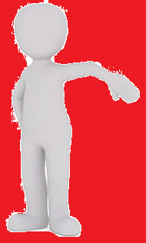
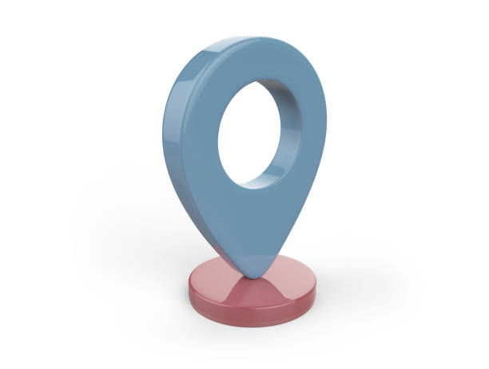
Mindfulness On The Spot… While:
Breathing, with or without sighing
Joining an e-meeting
Saying “hi!”, “good morning!”, “how was your weekend?”
Walking in the present
Showering
Washing dishes
Petting your pet
Making the bed
Cooking
Eating
Colouring
Any other th-ing?
https://www.centerforresilience.org/5-ways-to-practice-mindfulness-right-now
https://positivepsychology.com/meditation-exercises-activities/
https://www.thepathway2success.com/10-mindfulness-activities-you-can-try-today/
Notes:
Leanne
Similar to “Mindfulness on demand”
(Allow participants to use the marking tool)
Put a number in the chat, indicating your preference for doing mindfulness on the spot or a different activity you prefer
(mention an example of how I’m more present)
Being present, not because you need to be or you must be, but because you want to be ☺
Resources in English…
https://www.centerforresilience.org/5-ways-to-practice-mindfulness-right-now
https://positivepsychology.com/meditation-exercises-activities/
https://www.thepathway2success.com/10-mindfulness-activities-you-can-try-today/

Slide 8

Values & Mindfulness
Love
Respect
Courage
Honesty
Wisdom
Humility
Truth
Reverence For Life
True Happiness
True Love
Loving Speech and Deep Listening
Nourishment and Healing
Respect for Democracy
Respect for People
Integrity
Stewardship
Excellence
https://www.southernnetwork.org/site/seven-teachings
https://plumvillage.org/mindfulness/the-5-mindfulness-trainings/
https://www.tbs-sct.canada.ca/pol/doc-eng.aspx?id=25049
Notes:
Leanne
Mindfulness is science based, and as with science it can be used for bad things and for good things. So when mindfulness is combined with your own values the outcomes are positive and enhanced
The three columns are examples of values, from indigenous traditions, from secular traditions, and from the PS
Let’s do this mindfulness exercise, it lasts about 8 mins: Guided Mindfulness Meditation Connecting with Values - https://www.youtube.com/watch?v=V-LsavLI20w
A hint… when in doubt, I usually ask myself “What would someone who loved themselves do?”
Resources in English…
The seven sacred laws animated web series anishinaabe - http://www.turtlelodge.org/the-seven-sacred-laws-animated-web-series-anishinaabe/
Indigenous traditions: The Seven Teachings - https://www.southernnetwork.org/site/seven-teachings
http://www.turtlelodge.org/the-seven-sacred-laws-animated-web-series-anishinaabe/
Buddhism The Five Mindfulness Trainings - https://plumvillage.org/mindfulness/the-5-mindfulness-trainings/
Values and Ethics Code for the Public Sector of Canada - https://www.tbs-sct.canada.ca/pol/doc-eng.aspx?id=25049

Slide 9

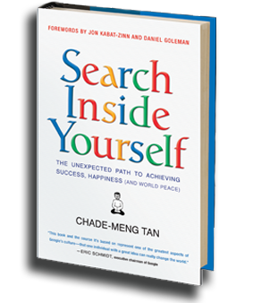

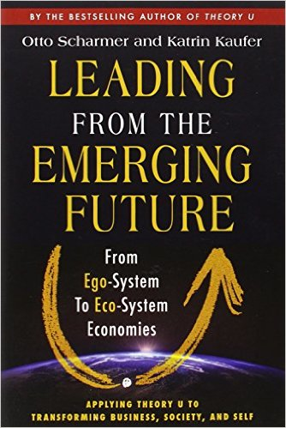
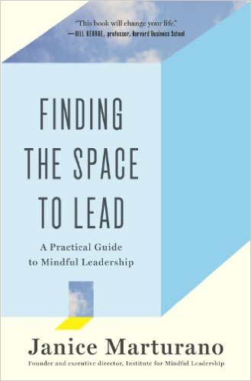



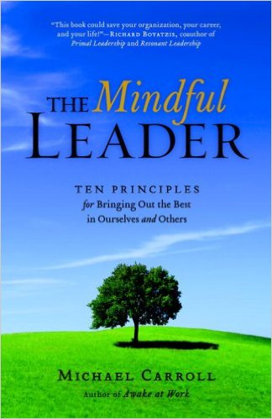
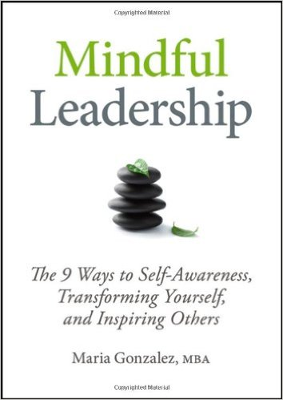




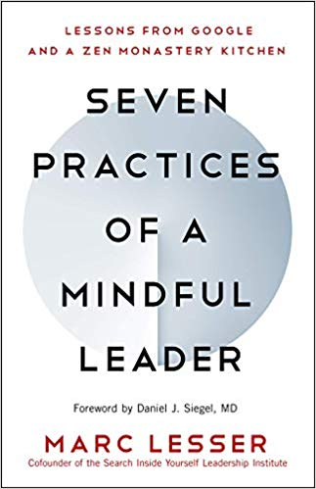
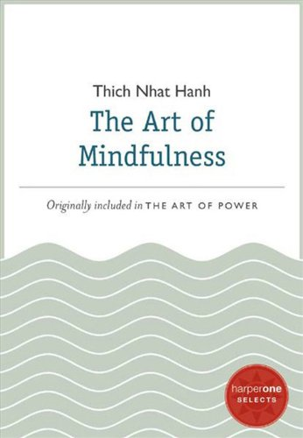
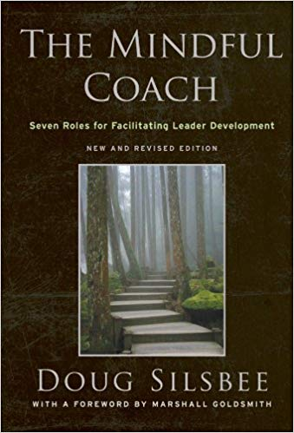
Books
Notes:
Michelle
Please refer to the Cohort page, where carmen started a thread on « whatcha readin? »
Grateful that some of you have shared titles of books that work for you
(put on the chat the link and share the screen)
https://gccollab.ca/blog/view/13204265/whatcha-readin
First row
https://www.amazon.ca/Search-Inside-Yourself-Productivity-Creativity/dp/0062116924
https://www.amazon.ca/Presence-Human-Purpose-Field-Future/dp/0385516304/
https://www.amazon.ca/Leading-Emerging-Future-Ego-System-Eco-System/dp/1605099260/
https://www.amazon.ca/Finding-Space-Lead-Practical-Leadership/dp/1620402475/
https://www.amazon.ca/Mindful-Leadership-Self-Awareness-Transforming-Inspiring/dp/1118127110/
https://www.amazon.ca/Joy-Demand-Discovering-Happiness-Within/dp/0062378872
Second row
https://www.amazon.ca/Self-Compassion-Proven-Power-Being-Yourself/dp/0061733520
https://www.amazon.ca/Mindful-Leader-Management-Mindfulness-Meditation/dp/1590306201/
https://www.amazon.ca/Mindfulness-Merloyd-Lawrence-Langer-Reprinted/dp/B00C6OOLR6/
https://www.amazon.ca/Eleven-Rings-Success-Phil-Jackson/dp/1594205116/
https://www.amazon.ca/Dare-Lead-Brave-Conversations-Hearts/dp/0399592520
Third row
https://www.amazon.ca/Mindful-Leader-Embodying-Christian-wisdom-ebook/dp/B07KJGHXDW/
https://www.amazon.ca/Creating-Mindful-Leaders-Power-Forward/dp/1119484782/
https://www.amazon.ca/Seven-Practices-Mindful-Leader-Monastery/dp/1608685195/
https://www.amazon.ca/Art-Mindfulness-HarperOne-Select-Selects-ebook/dp/B005HG4H24/
https://www.amazon.ca/Mindful-Coach-Facilitating-Leader-Development-ebook/dp/B00362XL64/

Slide 10
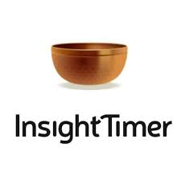







Apps
Notes:
Michelle
Now a days, there are plenty of apps, you may have some in your smartphone
A hint of caution when using them, don’t lose yourself in trying this, and trying that… pick one, stick to it for a week and decide if you like it enough. At that point make a conscious decision and try another one for a week.
References to some apps:
https://calm.com/
https://www.headspace.com/
https://happify.com/
https://www.balanceapp.com/
https://insighttimer.com/en-ca - https://insighttimer.com/fr-ca
(veteran affairs, USA) https://mobile.va.gov/app/mindfulness-coach
https://www.thetappingsolution.com/

Slide 11

Convergence
Page dedicated to leverage the various sessions offered by, and to, Government employees
Sessions offered:
Mindfulness Meditation – ISC/CIRNAC, BC
Well-being – PSPC, NCR (recordings)
Adaptive Inquiry session – IOCN, BC & NCR
https://wiki.gccollab.ca/Convergence
Notes:
Alejandro
If you know of somebody who’s offering sessions that are, or can be, open to the government… let me know and I’ll be happy to add them into this resource
Convergence - https://wiki.gccollab.ca/Convergence

Slide 12
And other references…
Settle Down, Pay Attention, Say Thank You
- https://my.happify.com/hd/3-ways-to-live-mindfully -
What Is Mindfulness? “Presence of Heart” – A Definition – https://greatergood.berkeley.edu/topic/mindfulness/definition
Why Mindfulness Is a Superpower – An Animation https://www.youtube.com/watch?v=w6T02g5hnT4
The 12 Inner Strengths for Lasting Well-being and Resilience - https://www.rickhanson.net/online-courses/the-foundations-of-well-being/inner-strengths-for-well-being/
Meditate With Kevin Hart | LoL Network - https://www.youtube.com/watch?v=egjWRWOUME4
Notes:
Alejandro

Slide 13
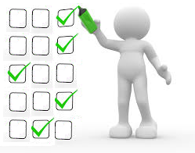
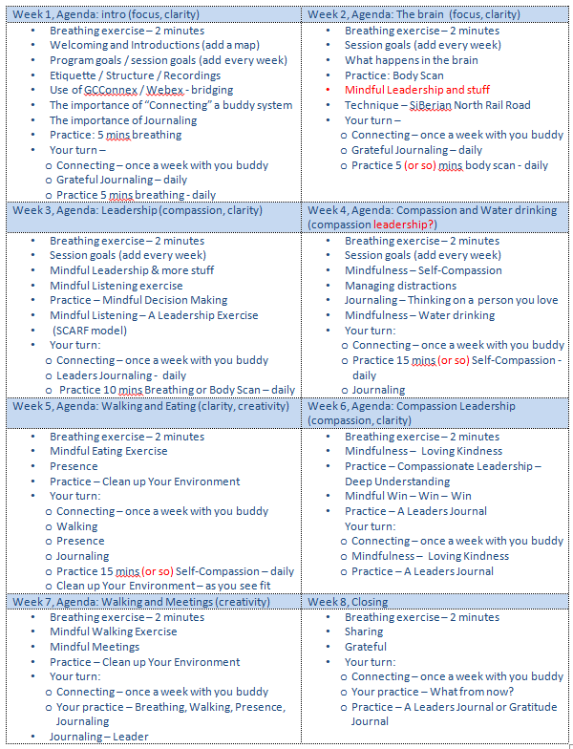
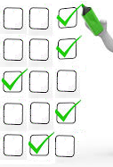

Self Assessment Questionnaires
– pre, post, final
Your self-assessments are very important,
they help report on the results of the program
This week, you’ll get a post-assessment evaluation
And 3 months after a follow up email, asking you to complete the final-assessment again
pre
post
final
★
3 months after
time
Activity
retention
How much is applied
(Behaviours changed)
Benchmark
Notes:
Ginette
(Click on each bullet)
The pre self-assessment you filled out to register for the program, it helps by establishing a benchmark
We are now completing the 8 weeks; the start shows where we are
The post self-assessment is used to identify the knowledge acquired based on the course, in other words the effectiveness of the training
The final self-assessment is used to know how much of the learning is actually applied, as in applying the skills learned and/or behaviours changed
(Read slide)

Slide 14
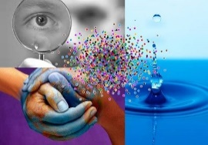

The Main Goal of the MCLD Program
Is to increase self-awareness by developing
key skills:
Focus
Clarity
Creativity
Compassion in the service of others
… with a positive impact on well-being and resiliency.
“Individuals with higher mindfulness have greater resilience, thereby increasing their life satisfaction.” - ScienceDirect
Notes:
Ginette
Remembering the goal of this program is to (read slide)

Slide 15
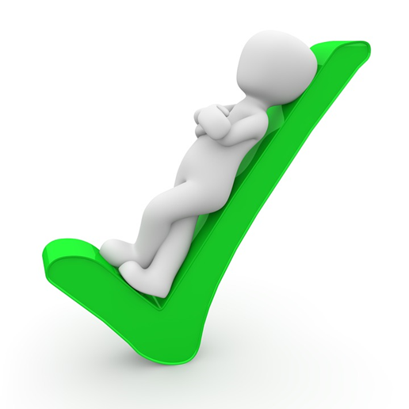




Success
Do you think we succeeded?
Notes:
Ginette
Invite all facilitators to go on camera.
Clapping images - https://giphy.com/embed/7Xmgrc6ty9XlZU6h2M

Slide 16
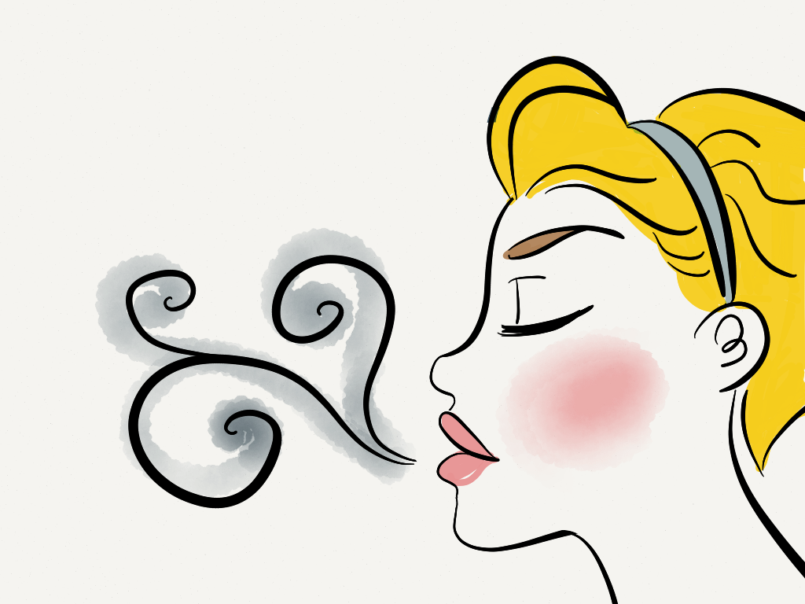

Let’s reflect… for the next 3 slides
On your Learning (1/3)
On the next step(s) for your practice (2/3)
On saying farewell (3/3)
Notes:
Sonya:
In the next three slides we’ll find questions for reflecting
(click)
First is a sli.do poll, we’ll create a wordcloud
(click)
The second and third are for you to share in the chat, or write in your journal, or in share it in your breakout room
(click)
Yes, we’re at the end of this program, and a farewell is also part of this process
(click)
Let’s take a minute to breath and center ourselves so we set our minds in a good reflecting state (do a quick 2 minutes breathing exercise or body scan)

Slide 17

On your Learning (1/3)
In one word, what skill did you improve the most during the MCLD Program?
sli.do with code: # mcld23
https://app.sli.do/event/3F6GL7XYodTjQVgmCz63bF
Notes:
Sonya:
sli.do with code: # mcld23
https://app.sli.do/event/3F6GL7XYodTjQVgmCz63bF
With the goal of the program in mind, answer the sli.do question:
“In one word, what skill did you improve the most during the MCLD Program?”
* (Alejandro to share screen with answers)

Slide 18

On the next step(s) for your practice (2/3)
What is one (or more) thing(s) you will take from this program?
Notes:
Sonya:
For reflection in small groups, and optional to comment in the chat
(read the slide)
As mentioned, this can be shared in your breakout room, included in chat or write it in your daily journal

Slide 19
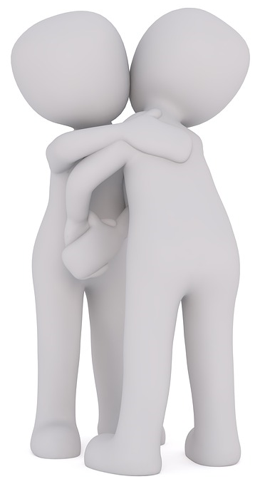
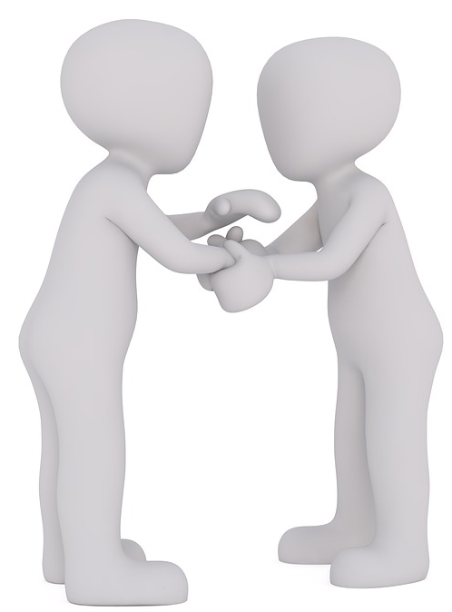
On saying farewell (3/3)
As a farewell, what would you like to share with your colleagues?
Maybe a quick thought
or a phrase
Notes:
Sonya:
In the next couple of minutes you’ll have time to say your farewells in small groups.
Take a moment to think of a quick thought or a phrase you feel like sharing
This can be shared in your breakout room, included in chat or write it in your daily journal

Slide 20

Final Debrief
Notes:
??
(depending on time, open the mic for plenary sharing for 1 or 2 participants):
As usual, you’ll have time to debrief in small groups (of 4-6), you can discuss any reflection questions from before or any of the following prompts from today’s topics:
Resiliency
Value-based Mindfulness
Mindfulness on the spot
Resources
Goal of the MCLD
An intention to bring with you
Farewells
For the small groups, although you may end up meeting new people in the last day, remember we all partcipated in this program during the last 8 weeks.
And we have a special request for closing the program, if you would like to, after you debrief in small groups, come back and share and insight you got or what you liked the most of this program, or anything you’d like to share

Slide 21

Be Mindful, Be Happy
Notes:
??
Host/co-host: we may need to say something about our experience?
Thanks everyone for participating in this program… we wish you happiness ☺

