Slide 1

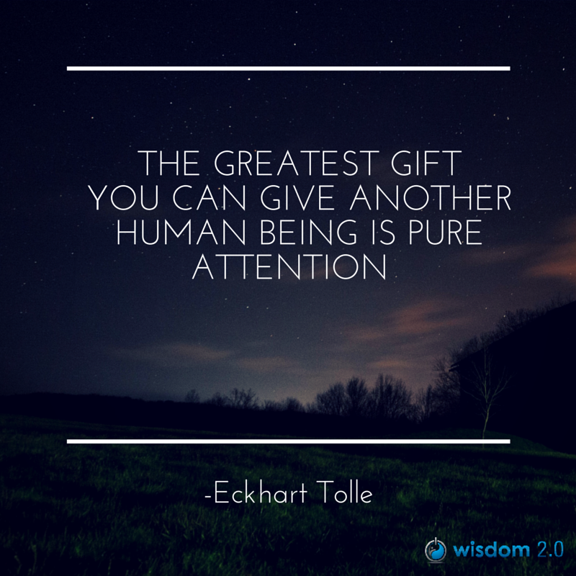
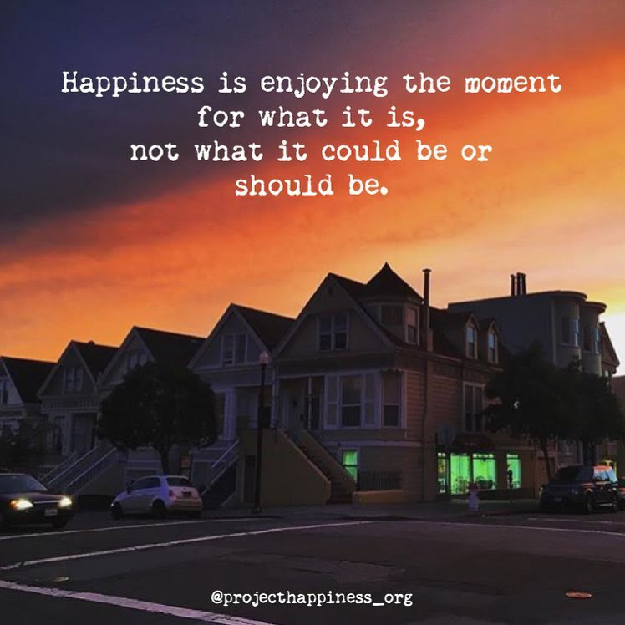
Welcome
Notes:
Option 1 (preferred): if the Elder is OK in sharing the closing prayers first, and then we go into the breakout rooms. This allows us to chat with the Elder while people are debriefing (need to set up a room for the Elder and us) allowing the small groups to have some flexibility with the time they need
Option 2: if the Elder prefers we close with the prayers, we’ll spend some time in small groups to say good bye to your colleagues. Estimated time until 30 minutes before the end time for the session, this will give opportunity to those who would like to share in plenary.
Prep French CC and font size
InBrief: The Science of Resilience https://www.youtube.com/watch?v=1r8hj72bfGo
Brains: Journey to Resilience - https://www.youtube.com/watch?v=HJvDrT6N-mw
Guided Mindfulness Meditation Connecting with Values - https://www.youtube.com/watch?v=V-LsavLI20w
Kevin Hart’s LoL video: https://www.youtube.com/watch?v=egjWRWOUME4
Open/Prep:
Whatcha readin – https://gccollab.ca/blog/view/13204265/whatcha-readin
Convergence - https://wiki.gccollab.ca/Convergence
Clappling images - https://giphy.com/embed/7Xmgrc6ty9XlZU6h2M
Slido - https://app.sli.do/event/4cdJ6BEhYuyfrRJ7tqWt8J
Polls – Session 8

Slide 2
Mindful Change Leadership Development Program
Week 8 (of 8)
tbd
Notes:
Welcome to the last session of our program / Bienvenue tout le monde à la dernière session de notre programme

Slide 3



Mindful Self-Love Exercise – Centering
Notes:
For today’s centering exercise, we’ll use a slight variation…. Similar to previous ones, the idea is to shift from “doing” to “being”
Let’s start by doing the following...
Sit in a comfortable attentive position
It helps if you close or semi-close your eyes
Focus on your breathing…
and repeat any of the following phrases aloud or in your mind as they may feel right to you, in this moment…
(read them allowing space in between)
I am a kind person (Je suis amiable)
I love myself (Je m’aime)
I do my best (Je fais de mon mieux)
I am enough (je suis assez moi-même)
(Repeat once a minute over three to five minutes, then ask participants to…)
take a couple of deep breaths, slowly open their eyes, and return to the group session.

Slide 4













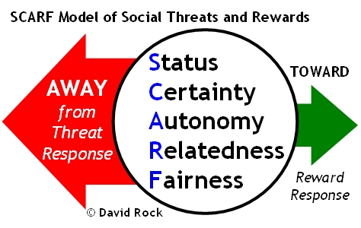


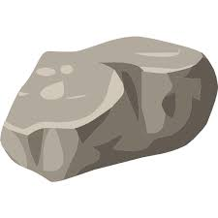



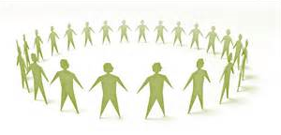
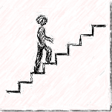
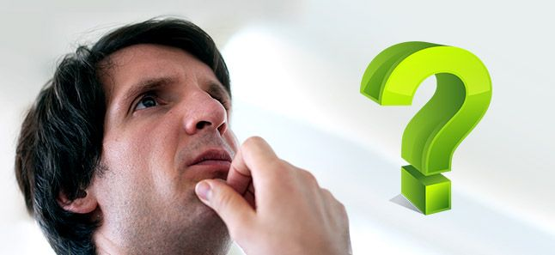


Questions/Insights from last week (7)
Notes:
Plenary: Open mic to share your comments, challenges, surprises… particularly would like to hear from those who haven’t shared yet
the gratitude journaling
Your practice
Mindful Walking
Leadership Journal
Better Decision-making
Loving Kindness
Raise your hand to speak, type in the chat… be mindful about the time, let’s take as many as we can in about 10 mins.

Slide 5

Agenda – week 8
Centering exercise
Questions/Insights from last week (7)
Today’s intentions
Focus, Compassion, Clarity, Creativity
Resilience, Well-being & Mindfulness
Values & Mindfulness
Mindfulness on the spot
Some books, apps & other references
Self-Assessment Questionnaires – pre, post, final
MCLD Goal
Your practice – What now?
Farewell

Slide 6

Resilience, Well-being & Mindfulness
In Brief: The Science of Resilience
  Experience Positivity and Gratefulness
  Manage Stress
  Solve Problems
  Regulate Behaviour
  Plan Ahead
  https://www.youtube.com/watch?v=1r8hj72bfGo
Researchers found “individuals with higher mindfulness have greater resilience, thereby increasing their life satisfaction.” They note that resilience “can be seen as an important source of subjective well-being,” and point out many ways mindfulness can promote this state of mind.
https://greatergood.berkeley.edu/article/item/evidence_mounts_that_mindfulness_breeds_resilience
Notes:
There is a link between Resilience Well-being & Mindfulness
(read the slide)
We’ll see a couple of videos on resiliency
Keep in mind, there will be a debrief in plenary and in small groups, if you feel like
(play both videos)
Resources in English…
In Brief: The Science of Resilience https://www.youtube.com/watch?v=1r8hj72bfGo
Brains: Journey to Resilience - https://www.youtube.com/watch?v=HJvDrT6N-mw
The 12 Inner Strengths for Lasting Well-being and Resilience - https://www.rickhanson.net/online-courses/the-foundations-of-well-being/inner-strengths-for-well-being/

Slide 7
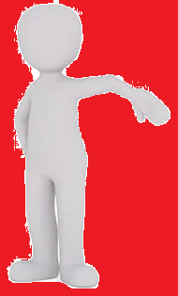
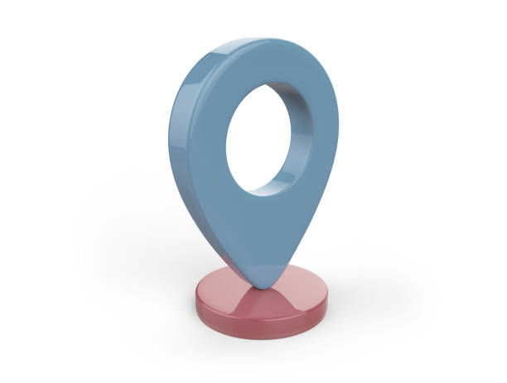
Mindfulness On The Spot… While:
Breathing, with or without sighing
Joining an e-meeting
Saying “hi!”, “good morning!”, “how was your weekend?”
Walking in the present
Showering
Washing dishes
Petting your pet
Making the bed
Cooking
Eating
Colouring
Any other th-ing?
https://www.centerforresilience.org/5-ways-to-practice-mindfulness-right-now
https://positivepsychology.com/meditation-exercises-activities/
https://www.thepathway2success.com/10-mindfulness-activities-you-can-try-today/
Notes:
Similar to “Mindfulness on demand”
(Allow participants to use the marking tool)
Using the marking tool, indicate your preference for doing mindfulness on the spot
(mention an example of how I’m more present)
Being present, not because you need to be or you must be, but because you want to be ☺
Resources in English…
https://www.centerforresilience.org/5-ways-to-practice-mindfulness-right-now
https://positivepsychology.com/meditation-exercises-activities/
https://www.thepathway2success.com/10-mindfulness-activities-you-can-try-today/

Slide 8



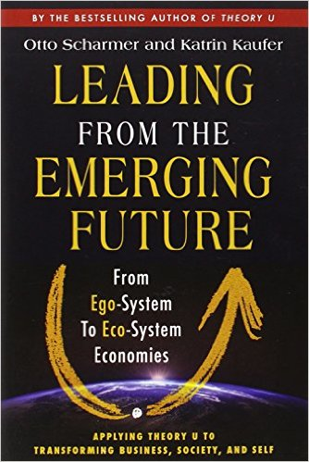
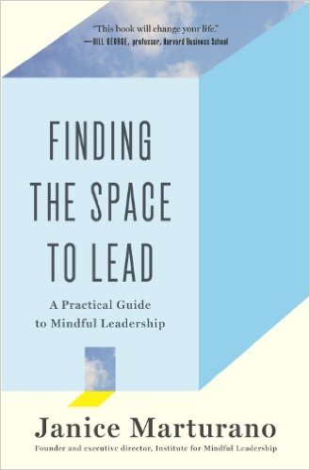



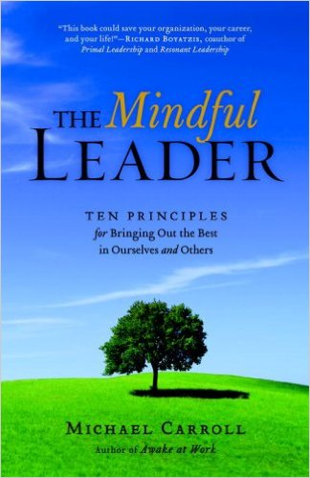





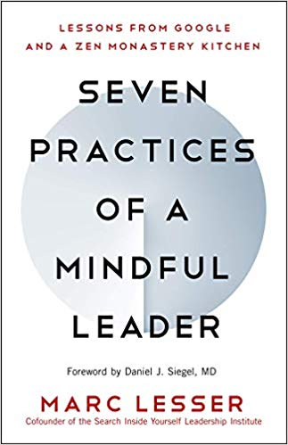

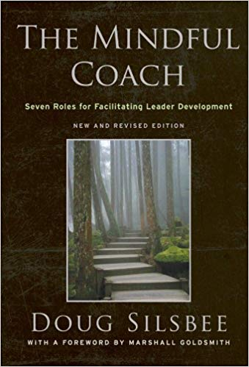
Some Book references
Notes:
Please refer to the Cohort page, where carmen started a thread on « whatcha readin? »
Grateful that some of you have shared titles of books that work for you
(put on the chat the link and share the screen)
https://gccollab.ca/blog/view/13204265/whatcha-readin
First row
https://www.amazon.ca/Search-Inside-Yourself-Productivity-Creativity/dp/0062116924
https://www.amazon.ca/Presence-Human-Purpose-Field-Future/dp/0385516304/
https://www.amazon.ca/Leading-Emerging-Future-Ego-System-Eco-System/dp/1605099260/
https://www.amazon.ca/Finding-Space-Lead-Practical-Leadership/dp/1620402475/
https://www.amazon.ca/Mindful-Leadership-Self-Awareness-Transforming-Inspiring/dp/1118127110/
https://www.amazon.ca/Joy-Demand-Discovering-Happiness-Within/dp/0062378872
Second row
https://www.amazon.ca/Self-Compassion-Proven-Power-Being-Yourself/dp/0061733520
https://www.amazon.ca/Mindful-Leader-Management-Mindfulness-Meditation/dp/1590306201/
https://www.amazon.ca/Mindfulness-Merloyd-Lawrence-Langer-Reprinted/dp/B00C6OOLR6/
https://www.amazon.ca/Eleven-Rings-Success-Phil-Jackson/dp/1594205116/
https://www.amazon.ca/Dare-Lead-Brave-Conversations-Hearts/dp/0399592520
Third row
https://www.amazon.ca/Mindful-Leader-Embodying-Christian-wisdom-ebook/dp/B07KJGHXDW/
https://www.amazon.ca/Creating-Mindful-Leaders-Power-Forward/dp/1119484782/
https://www.amazon.ca/Seven-Practices-Mindful-Leader-Monastery/dp/1608685195/
https://www.amazon.ca/Art-Mindfulness-HarperOne-Select-Selects-ebook/dp/B005HG4H24/
https://www.amazon.ca/Mindful-Coach-Facilitating-Leader-Development-ebook/dp/B00362XL64/

Slide 9
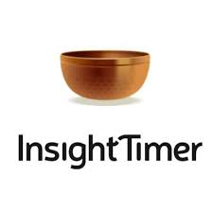







Some App references
Notes:
Now a days, there are plenty of apps, you may have some in your smartphone
A hint of caution when using them, don’t lose yourself in trying this, and trying that… pick one, stick to it for a week and decide if you like it enough. At that point make a conscious decision and try another one for a week.
References to some apps:
https://calm.com/
https://www.headspace.com/
https://happify.com/
https://www.balanceapp.com/
https://insighttimer.com/en-ca - https://insighttimer.com/fr-ca
(veteran affairs, USA) https://mobile.va.gov/app/mindfulness-coach
https://www.thetappingsolution.com/

Slide 10

Values & Mindfulness
Love
Respect
Courage
Honesty
Wisdom
Humility
Truth
Reverence For Life
True Happiness
True Love
Loving Speech and Deep Listening
Nourishment and Healing
Respect for Democracy
Respect for People
Integrity
Stewardship
Excellence
http://www.turtlelodge.org/the-seven-sacred-laws-animated-web-series-anishinaabe/
https://www.southernnetwork.org/site/seven-teachings
https://plumvillage.org/mindfulness/the-5-mindfulness-trainings/
https://www.tbs-sct.canada.ca/pol/doc-eng.aspx?id=25049
Notes:
Mindfulness is science based, and as with science it can be used for bad things and for good things. So when mindfulness is combined with your own values the outcomes are positive and enhanced
The three columns are examples of values, from indigenous traditions, from secular traditions, and from the PS
Let’s do this mindfulness exercise, it lasts about 8 mins: Guided Mindfulness Meditation Connecting with Values - https://www.youtube.com/watch?v=V-LsavLI20w
A hint… when in doubt, I usually ask myself “What would someone who loved themselves do?”
Resources in English…
Indigenous traditions: The Seven Teachings - https://www.southernnetwork.org/site/seven-teachings
http://www.turtlelodge.org/the-seven-sacred-laws-animated-web-series-anishinaabe/
Buddhism The Five Mindfulness Trainings - https://plumvillage.org/mindfulness/the-5-mindfulness-trainings/
Values and Ethics Code for the Public Sector of Canada - https://www.tbs-sct.canada.ca/pol/doc-eng.aspx?id=25049

Slide 11

Convergence
page dedicated to leverage the various sessions offered by, and to, Government employees
Sessions offered:
Mindfulness Meditation – ISC/CIRNAC, BC
Mindfulness, Workplace Well-being – PSPC, NCR
Well-being – PSPC, NCR (recordings)
Well-being – ISC, MB
Adaptive Inquiry session – IOCN, BC & NCR
https://wiki.gccollab.ca/Convergence
Notes:
Convergence - https://wiki.gccollab.ca/Convergence

Slide 12
And other references…
Settle Down, Pay Attention, Say Thank You
- https://my.happify.com/hd/3-ways-to-live-mindfully -
What Is Mindfulness? “Presence of Heart” – A Definition – https://greatergood.berkeley.edu/topic/mindfulness/definition
Why Mindfulness Is a Superpower – An Animation https://www.youtube.com/watch?v=w6T02g5hnT4
The 12 Inner Strengths for Lasting Well-being and Resilience - https://www.rickhanson.net/online-courses/the-foundations-of-well-being/inner-strengths-for-well-being/
Meditate With Kevin Hart| LoL Network - https://www.youtube.com/watch?v=egjWRWOUME4
Notes:
And many more…
If want to… 3.30mins Kevin Hart’s LoL video: https://www.youtube.com/watch?v=egjWRWOUME4

Slide 13
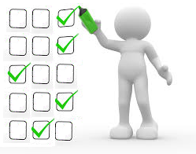
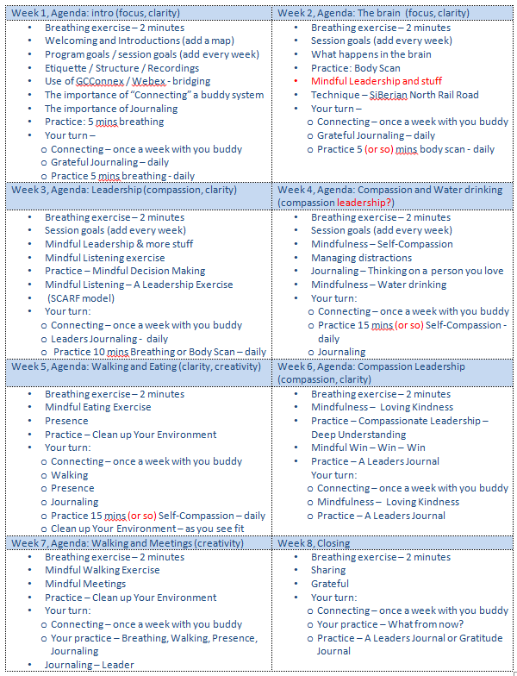
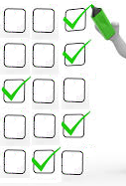

Self Assessment Questionnaires
– pre, post, final
Your self-assessments are very important,
they help report on the results of the program
You will receive a follow up email in 3 months, asking you to complete the assessment again
pre
post
final
★
3 months after
time
Activity
retention
How much is applied
(Behaviours changed)
Benchmark
Notes:
(Click on each bullet)
The pre self-assessment you filled out to register for the program, it helps by establishing a benchmark
We are now completing the 8 weeks; the start shows where we are
The post self-assessment is used to identify the knowledge based on the activity retention
The final self-assessment is used to know how much of the learning is actually applied, as in applying the skills and/or behaviours changed
(Read slide)
We decided only ask you to respond to the final self-assessment + (Read slide)
Now, as we start closing the program, Let’s take a couple of minutes for you to answer the poll (open the poll)

Slide 14


Mindful Change Leadership Development (MCLD) Program Goal
…to increase self-awareness by developing key skills: Focus, Clarity, Creativity, and Compassion in the service of others… with a positive impact on well-being and resiliency.
“Individuals with higher mindfulness have greater resilience, thereby increasing their life satisfaction.” - sciencedirect
Notes:
Remembering the goal of this program is to (read slide)

Slide 15
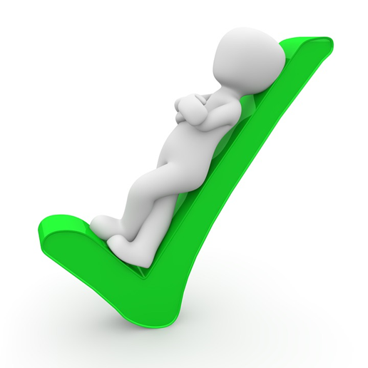




Success
Do you think we succeded?
Notes:
Clapping images - https://giphy.com/embed/7Xmgrc6ty9XlZU6h2M

Slide 16

In one word….
What's the skill you improved the most during the MCLD Program?
sli.do with code: #MCLD
https://app.sli.do/event/4cdJ6BEhYuyfrRJ7tqWt8J
Notes:
https://app.sli.do/event/4cdJ6BEhYuyfrRJ7tqWt8J
With the goal in mind, answer the sli.do

Slide 17

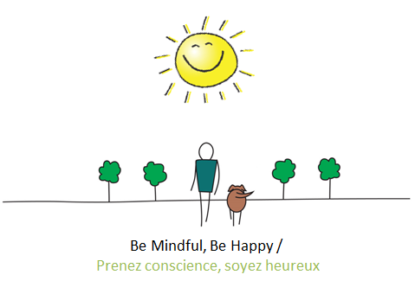
Your practice – What now?
What is the one or two things that
you’ll take with you from this program?
Notes:
For reflection in small groups, and optional to comment in the chat
(read the slide)

Slide 18
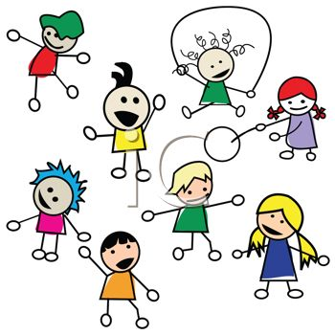
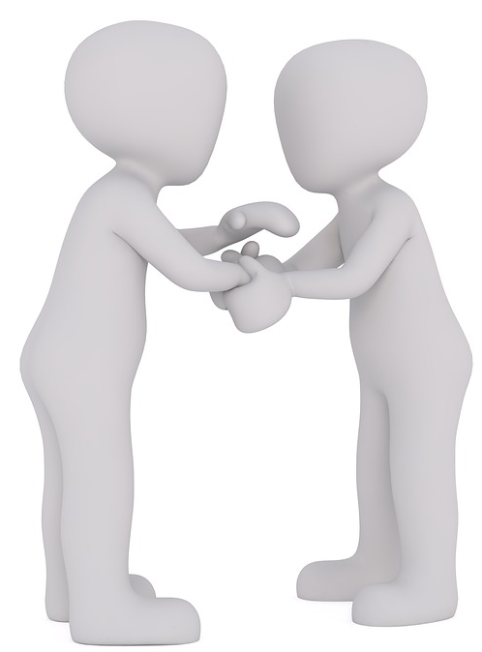
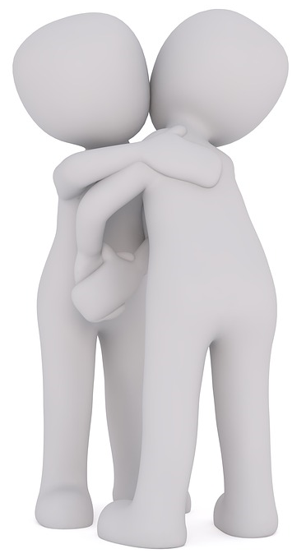
Farewells
Share a quick thought or a phrase
Saying good bye in small groups
Notes:
In prepping for the farewells, you’ll have time to say good bye to your colleagues
You may want to share a quick thought or a phrase you feel like sharing

Slide 19

Reflection for today…
Notes:
(depending on time, open the mic for plenary sharing for 1 or 2 participants):
As usual, you’ll have time to debrief in small groups (of 4-6), here are some prompts for your sharing in small groups:
Resiliency
Value-based Mindfulness
Mindfulness on the spot
Resources
Goal of the MCLD
An intention to bring with you
Farewells
(((Option 1 (preferred): if the Elder is OK in sharing the closing prayers first, and then we go into the breakout rooms. This allows us to chat with the Elder while people are debriefing (need to set up a room for the Elder and us) allowing the small groups to have some flexibility with the time they need)))
Before we go into the small groups, Elder will close the program with his prayers
Elder
(The Elder offers the closing prayers)
For the small groups, although you may end up meeting new people in the last day, remember we all partcipated in this program during the last 8 weeks.
And we have a special request for closing the program, if you would like to, after you debrief in small groups, come back and share and insight you got or what you liked the most of this program, or anything you’d like to share
(((Option 2: if the Elder prefers we close with the prayers, we’ll spend some time in small groups to say good bye to your colleagues (need to set up a room for the Elder and us). Estimated time until 30 minutes before the end time for the session, this will give opportunity to those who would like to share in plenary. )))
And before closing with the Elder’s prayer, I invite you to spend some time in small groups to say good bye to your colleagues…
although you may end up meeting new people in the last day, remember we all partcipated in this program during the last 8 weeks.
You’ll have until (enter the estimated time here) for the small groups
This will give opportunity to those who would like to share in plenary something
(open breakout rooms for until 30 mins before the end of this session)
(Open the mic for a couple of people to debrief in plenary, until 15 mins before the end of ths session)
I want to express my gratitude to Elder for starting us in the right way, for their presence throughout these 8 weeks…
And now, for the closing prayers, Elder…

Slide 20

Be Mindful, Be Happy /
Prenez conscience, soyez heureux
Notes:
(observing Elder Saulis closing prayers)
Host/co-host: we may need to say something about our experience?
Thanks everyone for participating in this program… we wish you happiness ☺

