Slide 1
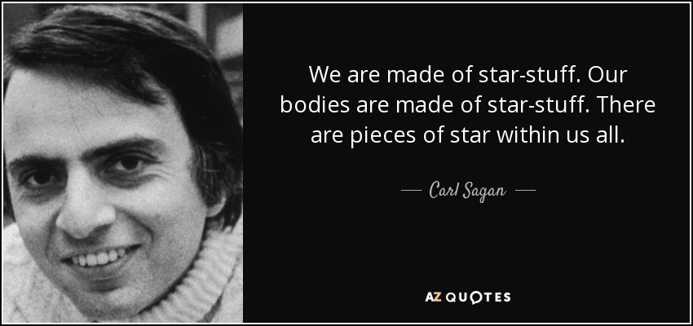
We all are STARS
Notes:
Elder Saulis & Alejandro go into a private room, 15 mins before the start
Alejandro:
Before starting sharing any slide: Land acknowledgement – from the word document
Introduce the Elder
Have the Elder share the opening prayers to send us in a good way
Thank the Elder for his presence
Then Alejandro shares the slides and gives the microphone to Carmen
Carmen 1 – 6
Webcams are welcome, please avoid eating while your webcam is open
Remember logging off from VPN to have a better experience
Sessions are recorded:
Be assured, if ever there is something sensitive recorded, at the petition of those interested, the recording will be edited before posting
The breakout rooms are not recorded, thus what is said in small groups stays there
The recording is also very helpful in case you miss a session
https://www.azquotes.com/quote/866026

Slide 2
Mindful Change Leadership Development Program – English Pilot
Week 1 (of 8)
April 25, 2022
Notes:
To mention the following in French:
« Comme avec toutes les sessions du GC, s'il vous plaît, sentez-vous libre d'utiliser la langue de votre choix pour poser des questions ou participer à la discussion., La séance d'aujourd'hui sera conduit principalement en anglais, il y aura d'autres sessions en français qui seront promus via le groupe GCConnex (ou donner des dates précises, si disponible). »
As with all GoC sessions, please, feel free to use the language of your choice to ask questions or participate in the discussion., today’s session will be conducted mainly in English, there will be other sessions in French that will be promoted via the GCConnex group (or give specific dates, if available).

Slide 3
Mindful Breathing Exercise – Centering
Time required: 2 minutes
The trick is to shift from “doing” to “being”
Let’s start by doing the following...
Sit with a straight position, as comfortable as possible
It helps if you close or semi-close your eyes
Let’s not worry about time
And take a minute, only a minute...
To breathe, just to breathe
That simple
I’ll let you know when the time is over.
Just continue breathing
We’ll do a short debrief of what you noticed
Notes:
Mindful breathing https://www.youtube.com/watch?v=ZE-r-x2T4ok
This is one way of doing it, getting it depends on the practice of.
Noticing is very important in the practice of Mindfulness.
Noticing where your thinking is, that’s the first step to become more Mindful.

Slide 4
The sessions are interactive
Pointer
Dyads
Marker
Connecting
& Debriefs
Erase
Raise
hand
Buddy
System
Debrief
Mark
Evaluation
Notes:
During the sessions, we may or may not use the mentioned functionality or activity

Slide 5
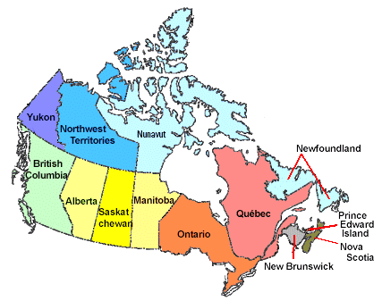
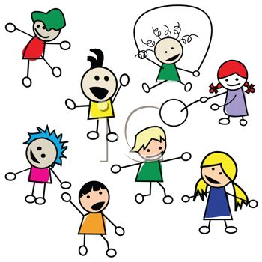
Welcoming
Welcome ☺
NCR – Next Slide
Notes:
For NCR, wait for the next slide
For all others, using the Marker, place a small mark to indicate where you are connecting from

Slide 6
Welcoming
Notes:
Carme 1-6

Slide 7
Agenda - Week 1 – (focus and clarity)
Centering – Breathing exercise – 2 minutes (done)
Welcoming (done)
Miscelaneous (done)
Etiquette / Structure / Cohort / Recordings
Main goal of the Program / Target Audience
Today’s Objective
Snail Model
The importance of “Connecting” & Buddy System
Gratitude Journaling
Practice: 5 min body scan
Your take away assignment for week 1.
Notes:
Alejandro 7 – 18
Be advised: Today session will be the most boring… me talking most of the time

Slide 8
Etiquette
What would we like to see happening in our sessions?
Active participation
Active Listening
Having fun
Respect
Confidentiality
Punctuality
Consider and treat this virtual classroom and the Cohort as safe spaces
We follow the Values and Ethics Code for the Public Sector
Notes:
Webcams are welcome, please avoid eating while your webcam is open
Anything else? Type it in the chat

Slide 9
Structure of the sessions
Centering exercise and check-in
Review of objective / agenda
Share techniques, discuss a bit of the science
Mindful exercise and debrief
Your practice for the week
2 minutes
2 minutes
5 - 25 minutes
5 - 25 minutes
5 minutes

Slide 10
The Cohort
We have aprox 200 people registered to this program, thus I’d consider this to be a MOOC (Massive open online course - Wikipedia)
To support your learning experience, we will be using the “MCLD Cohort”, a GCCollab closed group (already registered?)
The Cohort is a safe space
The Cohort is for registered participants to the program, it serves:
To leverage the collective knowledge
A place where you can ask questions
As a community to share your experience
Review the recording (with comments)
Past « graduates » are invited.
Notes:
Massive open online course – Wikipedia
Past « graduates » will be invited

Slide 11
Session Recordings
Sessions will be recorded for sharing further via the Cohort:
Be assured, if ever there is something sensitive recorded, at the petition of those interested, the recording will be edited before posting
The breakout rooms are not recorded, thus what is said in small groups stays there
The recording is also very helpful in case you miss a session.
Notes:
Massive open online course - Wikipedia

Slide 12
Main Goal of the Program
That you develop your
Mindful
Change Leadership
A Mindful Change Leader refers to the person who is present, non judgmental and cultivates several aspects during their interactions. These aspects are visible and tangible in the Mindful Change Leader:
Focus (focus of attention)
Clarity (self awareness & emotional intelligence)
Creativity (innovation & decision making)
Compassion in the service of others (presence, deep listening)
* Adapted from The Mindful Leadership Institute
Notes:
Adapted from The Mindful Leadership Institute

Slide 13
Target Audience
This program is aimed to all public servants who are willing to invest in their selves to develop their self-awareness
Notes:
This program is for you! the individual, not to your employees / bosses / communities / other trainings / or other people who think may benefit or need this program
This program is for those wishing to take it, meaning voluntary joined the program

Slide 14
Today’s Objectives
Understand this program is a workshop, very hands on and there is a bit of homework to do every day, the idea is that you have the support for you to experience it in a welcoming environment, week by week, step by step, in community via this weekly sessions & the Cohort
The objective of today’s session is to familiarize with the way these sessions will be offered, to know the structure of the sessions and start your first week of your practice.

Slide 15
What’s the difference between Mindfulness and Meditation?
*The way I see it
~ Time of exercise, the objective, and the experience ~
5 minutes
Relax and realise
Self-awareness
20 minutes to an hour
Engage in reflection or contemplation
Could be mind shifting
Notes:
This is, in my personal experience...
The core are the same, focus on your breathing. A way to compare them are:
The extent of time you typically take to do an exercise
The objective you aim for or achieve doing an exercise
The experience you perceive while doing the exercise
And keep in mind, Mindfulness is simple, not easy though
“Mindfulness is defined as being attentive and aware, non-judgementally, whereas meditation is engaging in a mental exercise...” - Wikipedia http://en.wikipedia.org/wiki/Mindfulness_(psychology)
“Mindfulness means presence of heart” - John Kabbat Zinn https://www.youtube.com/watch?v=xoLQ3qkh0w0
“Meditation” noun the action or practice of meditating.
“Meditation” is a practice in which an individual trains the mind or induces a mode of consciousness
Forms: Buddhist meditation, Christian meditation, Daoist meditation, Jain meditation, Jewish meditation, Meditation in the Ravidasi Faith, Transcendental Meditation – Wikipedia
"Mindful meditation: Training the brain on attention and meta-attention with the purpose to develop Emotional Intelligence"
"Meta-attention: attention of the attention, being able to know that your attention has wandered away“
Tan, C (2013). Search Inside Yourself. NY; page 30.
Mindfulness: like the body scan we just did.
Takes about 5 minutes
The objective is to relax and realise what’s going on in your mind
The experience could vary from person to person, but basically is a self-awareness experience
Meditation: having a practice of sitting and observing your breathe
May start by sitting 5 minutes for beginners
A good 20 minutes for those with an established practice, up to 8 hours a day in some days long retreats
The objective is to engage in contemplation or reflection.
The experience could be mind shifting

Slide 16
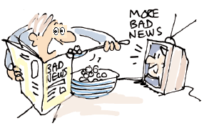
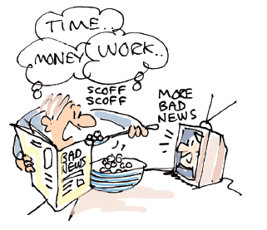
Snail model – From unaware to unaware
Desired
Aware - Desired
Unaware - Desired
Behaviours
Aware
Unaware
D i s r u p t i o n
Aware - Undesired
Unaware - Undesired
Undesired
Notes:
The disruption (or awakening) could’ve happened before this program
As mentioned, this program is focused on self-awareness, and practice
Adapted form https://en.wikipedia.org/wiki/Four_stages_of_competence

Slide 17
The importance of “Connecting”
How do you see us connecting throughout the weeks of this program?
During the session by Dyads, Debriefs (breakout rooms & plenary)
Buddy System
Cohort
The idea is to use all the tools for reflection and engagement
By sharing your experience, what you notice, a reflection, a learning, an opportunity; all of these are what gives life to the platform.

Slide 18
Throughout the program
Dyads
Dyads
Dyads
Dyads
Dyads
Dyads
Dyads
Dyads
Debriefs
Debriefs
Debriefs
Debriefs
Debriefs
Debriefs
Debriefs
Debriefs
Week
1
Week
8
Buddy System
Notes:
Alejandro 7-18

Slide 19
The buddy system (1/2)
Buddy System
To increase support and accountability
You are expected to touch base with your buddies once a week, during that conversation, you will:
Discuss what you found during the week
Recommended 20 minutes call (5 mins for each, you can discuss what you found interested, what was challenging, what you like the most)
Notes:
Carmen 19-end
MCLD program English 2022 – Buddy System.xlsx
https://wiki.gccollab.ca/images/6/63/MCLD_program_English_2022_-_Buddy_System.xlsx

Slide 20
The buddy system (2/2)
Introducing Yourself with your Buddy System:
Considering language preference, you were pre-assigned to a breakout room (email sent last Friday), and in the next 5 minutes you will:
1 minute per person
Quickly introduce yourself
Mention something you’re passionate about, a hobby you have, or something of your interest
Later on, you get in touch to agree on a date and time to connect on a weekly basis
You can later consult who your buddies are by checking this file: MCLD program English 2022 – Buddy System.xlsx
Buddy System
Notes:
MCLD program English 2022 – Buddy System.xlsx
https://wiki.gccollab.ca/images/6/63/MCLD_program_English_2022_-_Buddy_System.xlsx

Slide 21
Gratitude journaling
Take a notebook that will serve you as your journaling reflection or diary – this is personal
Take a couple of minutes to write down what you are grateful for
This could be in bullet form
Even 2 or 3 things per day will do
They can be simple things you did or noticed during the day
http://greatergood.berkeley.edu/article/item/how_to_upgrade_your_gratitude_practice
Notes:
If you seem to be stuck, start writing whatever is in your mind, even something like "I’m supposed to write smething, and my mind is blank. Not sure what to write. What am I greatful for? What is the littlest of the things I’m grateful for?" and something will come any time. When that happens, feel free to leave your sentece interrupted as you are capturing what you’re grateful for.
I’ll start the timer now.
In debrief groups, share what you noticed, what you found challenging, what amazed you, any other thing you’d like to share. 5 mins, go… with similar time distribution. 1 min introduce yourselfs (name, where are you from), 1 minute each for sharing

Slide 22
Your turn for week 1
Connecting – once a week with you buddies
Recommended 20 minutes call: 5 mins for each, you can discuss what you found interested, what was challenging, what you like the most
Gratitude Journaling – daily
This could be in bullet form, even 2 or 3 things per day will do, They can be simple things you did or noticed during the day
Practice 5 mins body scan – daily https://archive.org/details/BodyScan6minsB http://elishagoldstein.com/videos/sitting-with-awareness-of-thoughts/​
In case you have a question, a comment or want to share something, please do so via the Cohort
Notes:
http://marc.ucla.edu/mindful-meditations

Slide 23
Practice – The basics (1/2)
The intention of being (as opposed to doing)
Posture: sit with a straight back, as comfortable as possible, as if your head is pending from the top
in the chair that you are sited, or cross legged if you feel comfortable
slightly tuck your chin
Mindset: keep an open mind, feel the experience
You experience may vary each day, all is good
Focus on the breathing
Notice
It is about feeling the way you feel, about noticing without judging
have no expectations
have no judgement
have a beginners mind
be an observer... the mind may be busy and noisy, just observe it
Notes:
http://www.thecalmmonkey.com/#!meditation-recordings/g6x73

Slide 24
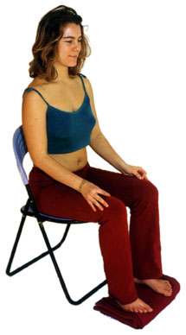
Mindful exercise – Body Scan (2/2)
Time required: 5 minutes
Let yourself experience the exercise
Sit as comfortable as possible in a straight position
Feel free to close your eyes
Follow my voice as I lead you through the exercise
Then, we will do a short debrief of what you noticed.
Notes:
With your back straight, sit as comfortable as possible
Gently bring attention to your breath, no need to change the way you’re breathing, just notice it
Stay there for a few seconds
Now, direct your breath and attention to
Your toes, breath in, breath out
Your feet, in and out, notice what you feel
Every time your attention wanders away, just bring it back gently
Your lower leg, in and out and your upper leg, and notice what you feel
Direct your breath towards your waist, in and out
Your lower back, your abdomen
Your upper back, chest
Now direct your breath and attention to your shoulders, breath in, breath out, and notice
Your arms, your hands and fingers, in and out
Back to your shoulders, and neck, noticing
Your head, your scalp, breath in and out
Focus on your face, your eyes, nose and mouth. Your jaw, noticing
Stay there for a few seconds, breathing in and out
Now, come back… and open your eyes.
Debrief: What did you notice?

Slide 25
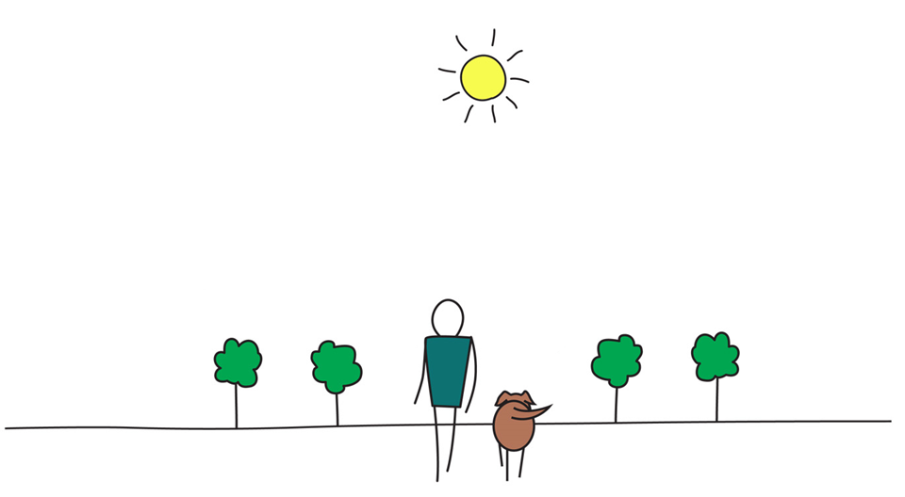
Be Mindful, Be Happy /
Prenez conscience, soyez heureux
Notes:
Aprox 15 mins for debriefing in Breakout rooms, randomly assigned.
Share how the experience went for you, if you had some insights.
Be conscious of the time, share it wisely.
When you’re finish, simply exit the breakout room and the session.

Slide 27
Mindful Breathing Exercise – Breathing
Time required: 5 minutes
The trick is to shift from “doing” to “being”
Let’s start by doing the following...
Sit with a straight position, as comfortable as possible
It helps if you close or semi-close your eyes
Let’s not worry about time
And take a minute, only a minute...
To breathe, just to breathe
That simple
I’ll let you know when the time is over.
Just continue breathing… for one more minute
Notes:
Mindful breathing https://www.youtube.com/watch?v=ZE-r-x2T4ok
This is one way of doing it, getting it depends on the practice of.
Noticing is very important in the practice of Mindfulness.
Noticing where your thinking is, that’s the first step to become more Mindful.

