Slide 1
Mindful Change Leadership Development Program
Session 4
May 29, 2023
Notes:
**** YOU WILL NEED A GLASS OF WATER – INTRODUCING A NEW MINDFUL EXERCISE***

Slide 2
**** YOU WILL NEED A GLASS OF WATER – INTRODUCING A NEW MINDFUL EXERCISE***

Slide 3
“If your compassion does not include yourself,
it is incomplete”
Notes:
Facilitator Alison:
---
**Mikaela – INTRODUCTION + LAND ACKNOWLEDMENT
---
Welcome to session 4 / week four
A reminder this session will be recorded, for those who have missed the session or if anyone would like to review the content again.

Slide 4
Debrief From Last Week / Session 3
Any questions?
Share insights or takeaways with the rest of the group/cohort on:
Discussion exchanged during check-in with buddy system that sparked your attention
Observations on any of the practices (i.e., gratitude journaling, breathing or body scan exercise)
Feel free to share personal experiences, and what tips and tricks, and resources were helpful with the rest of the cohort
Notes:
Facilitator Alison:
----
** ENGAGE PARTICIPANTS - Open the floor – invite 2/3 individuals to share…You can use the « Raise hand feature » in Teams to speak, or use the chat function.
CHECK INS with buddy system: Feel free to break yourself into smaller group if finding common time slots or time zones to meet with your entire group is challenging. Let us know if you need a new group.

Slide 5
Agenda – Session 4
Centering and Mindful Water Drinking exercise
What Is Self-Compassion
The 5 Misconceptions
The 3 Components
How To Practice Self-Compassion And Tame Your Inner Critic
Clearing your mind and environment
Mindful Self-Compassion Break
Practice For Next Week
Breakout Rooms – Case study And Share Take Aways If Time Permits
Notes:
Facilitator Alison:
---
Today’s intentions - will be about exploring: compassion and clarity
Mindful Water drinking
Mindful Self-Compassion
Mindful vs. Mindfull communication
Clearing your mind and environment
Mindful exercises (Breathing or Body Scan)
Mindful Listening
Mindful decision making

Slide 6
Centering and Water Drinking Exercise
The intent is Moment-to-Moment Awareness
Suggested duration: 5 minutes
Guided practices and exercises are available on the Resources slide
“Wherever You Are, be all there”.
Notes:
Facilitator Alison:
------
Briefly touch MINDFUL EATING at the end of exercise?!
Today’s intentions…
We will combine mindful breathing centering exercise and introduce water drinking, and bring our attention and awareness to this moment and to set the space for a beneficial session for all.
Sit as comfortable as possible in a position that allows you to be awake, attentive and comfortable at the same time
You can put your feet flat on the ground, your palms on you lap, facing up or towards the floor, which ever feels more comfortable.
Feel free to close your eyes, or find a soft gaze
Follow my voice as I lead you through the exercise
Gently bring your attention to your breath, no need to change the way you’re breathing, just notice it
Don’t worry about time, to-do list, grocery list, etc.
Just focus on your breathing – inhale exhale
If at any time your mind wanders away, be gentle with yourself, acknowledge that thought, let it be, let it go, and bring your attention back on your breathing
** Inhale and exhale
Now, we’ll take one full minute of breathing for centering ourselves
I’ll let you know when the minute is over
Just continue focusing on your breathing
Sit comfortably, back straight, relaxed legs and arms
Close your eyes or find a soft gaze
Take deep breath, inhale and hold, exhale for 5 seconds
Gently bring attention to your breath
Think about the origins of this water
Think about the time it took for this water to reach your glass
Think about its nourishing nature
Let’s take a moment to think about the origins of this water
As you continue breathing...
Think about the time it took for this water to come to you...

Slide 7
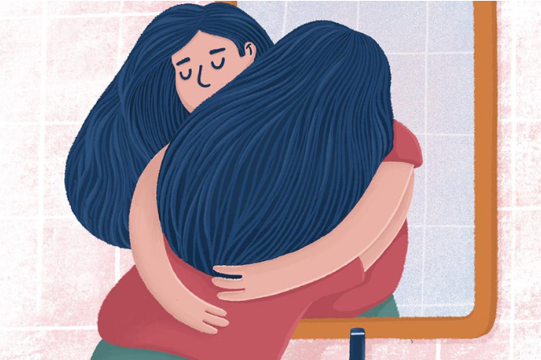
What Is Self-Compassion
Compassion is the sympathetic consciousness of others' distress, concern for the sufferings or misfortunes of others, together with a desire to alleviate it.
Self-compassion is extending compassion to oneself in instances of perceived inadequacy, failure, or general suffering.
Notes:
Facilitator Sonya:
-----

Slide 8
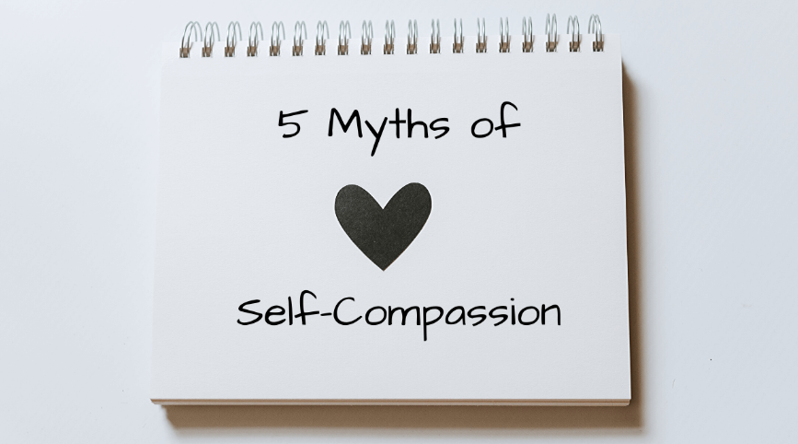
What Self-Compassion Is NOT?
Self-compassion is a form of self-pity
Self-compassion means weakness
Self-compassion will make me complacent
Self-compassion is narcissistic
Self-compassion is selfish
Notes:
Facilitator Sonya:
---
****REFER TO MY NOTES (separate document)

Slide 9
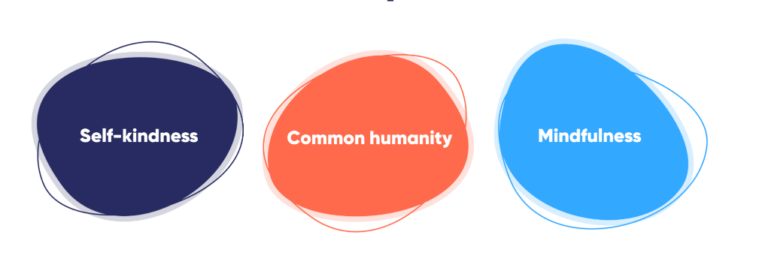
The Three Elements Of Self-Compassion
Being kind and warm to oneself
Understanding that suffering and personal failure is part of the shared human experience
Being mindful of your negative thoughts and emotions, with openness and free of judgment
Notes:
Facilitator Sonya:
-----
****REFER TO MY NOTES (separate document)

Slide 10
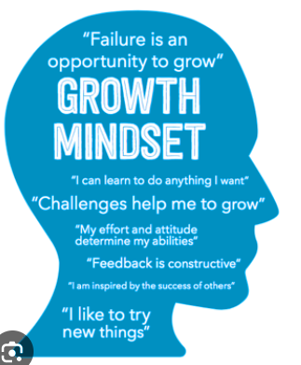
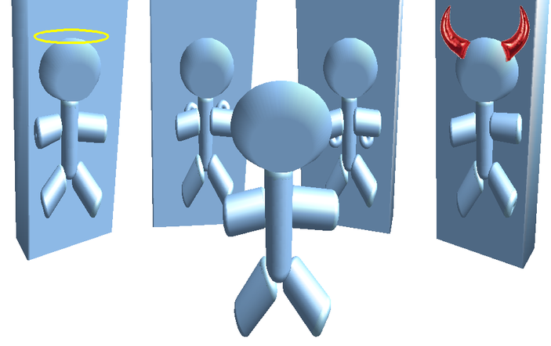
How To Practice Self-Compassion And Tame Your Inner Critic
To accept ourselves as we are means to value our imperfections as much as our perfections
Cultivate Self-Kindness
Self-Compassion Leads To Self-Improvement
Cultivating A Growth Mindset
How my family sees me
How my partner sees me
How my sibling or friends see me
How I see myself
Notes:
Facilitator Sonya:
-------
****REFER TO MY NOTES (separate document)

Slide 11
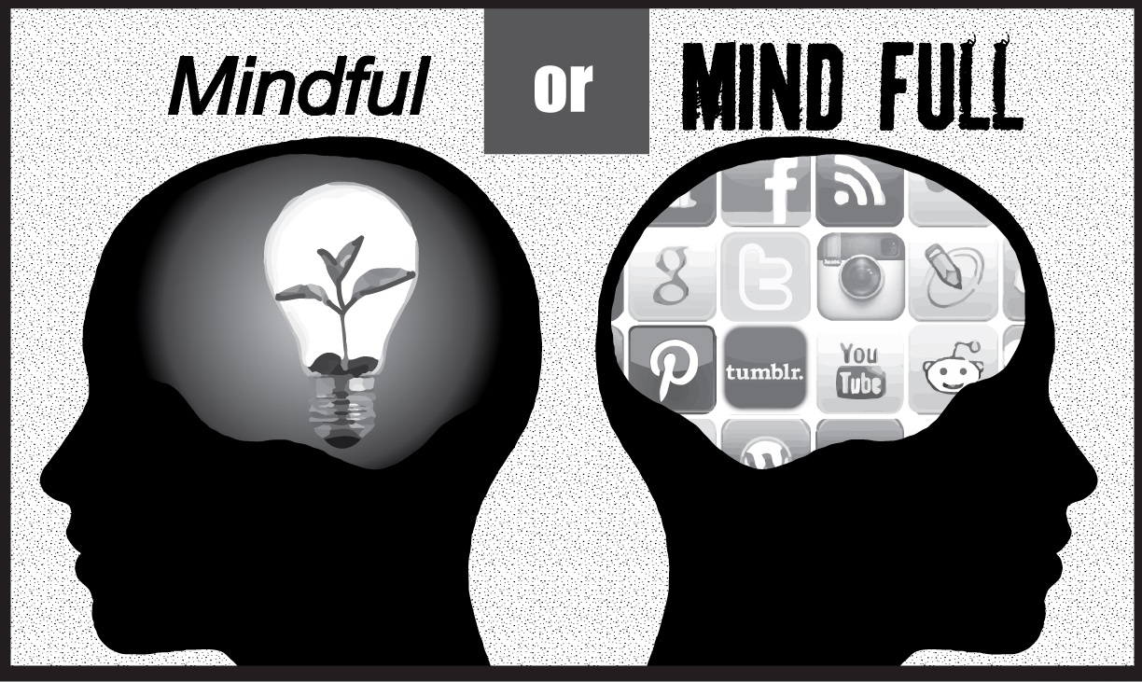
Clearing Your Mind and Environment
Clearing your mind
Your body is present but is your mind?
Being mindful of the moment vs. your mind is full
We live in our thinking instead of living in the moment
Clearer mind and real-time responsiveness
Healthy free-flow thinking
Clearing your environment
Digital mindfulness
Strategies for mindful phone conversations
Mindful emailing
The Six Rules of Conscious Emailing
Notes:
Facilitator Sonya:
---
****REFER TO MY NOTES (separate document)

Slide 12
Practice Self-Compassion Break
Suggested duration: 5 minutes
Guided practices and exercises are available on the resources slide
Notes:
Facilitator Alison:
----
From: https://centerformsc.org/practice-msc/guided-meditations-and-exercises/
* Self-compassion break, 5 mins: https://self-compassion.org/wp-content/uploads/2020/08/self-compassion.break__01-cleanedbydan.mp3 I’ll guide us doing a similar/shorter loving-kindness meditation
Duration – 20 minutes
http://self-compassion.org/wp-content/uploads/meditations/LKM.self-compassion.MP3
Iterations, as follow…
Think of something that hooked you, something that you keep repeating yourself in your mind, ideally something light…
Remember, We all are in the same boat
My I (we all) be safe
May I (we all) be peaceful
May I (we) be kind to myself (ourselves)
May I accept myself as I am (may we accept ourselves as we are)

Slide 13
Practice For Next Week / Session 4
Schedule weekly check-in with your buddy system
Suggested duration: 30 minutes
Daily Gratitude Journaling
Daily Practice
Suggested duration: 5-15 minutes
Choose an intention and practice one exercise per day and take note of how you feel
Guided practices and exercises are available on the Resource slide
Notes:
Facilitator Alison:
-----
For this week, similar to last week… if you have any questions, now is the time to ask…
((click & read from slide until the end))

Slide 14
Breakout Rooms Exercise
Duration: 20 minutes
To assist with discussion:
How to become a compassionate leader (Human-Centered Workplace)
If time permits, return from breakout rooms – share takeaways
Notes:
Facilitator Alison:
----
We’re going to do the debriefs in a few minutes, both in plenary and in small groups. Just before we do that, is there any question regarding the homework?
(give people a few seconds)
Well, now, I’d like to open the floor to 2 or 3 people who would like to do a debrief in plenary. If you’re the first one, just open your mike and speak, if you’re the second or third one, please rise your hand.
((prep for the breakout rooms))
And now, you’ll have the opportunity to do a debrief, in small groups of 4-6 people who are randomly assigned. Just be conscious and share the “airtime” among participants
Debrief on today's exercises, Talk about how the experience went for you.
What did you learn ?
What did you notice?
What was difficult or excessively easy?
((open the breakout rooms))
When done, you can simply exit the WebEx, or come back if you have questions or would like to express a comment

Slide 15
Slow Down. Pay Attention. Wherever You Go, There You Are.
Notes:
Facilitator Alison:
---
Be Mindful, Be Happy

Slide 16
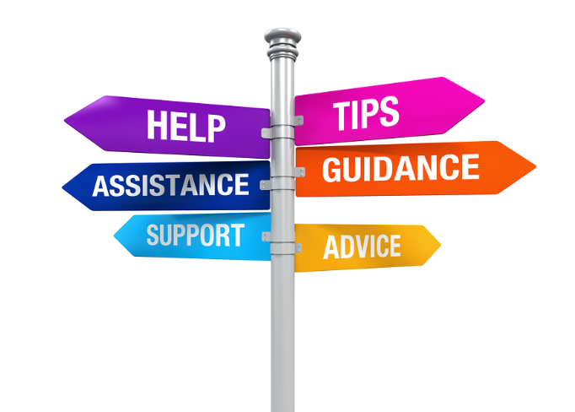
USEFUL LINKS
EXERCISES
3-minutes -Body Scan – HeadSpace
5-minutes -BODY SCAN
2-minutes – Loving Kindness - HeadSpace
5-minutes - BREATHING – HeadSpace
5-minutes -Breathing - SoundCloud
5-minutes -BREATHING - OCEAN TRANQUILITY
2-15 minutes - Various practices - Jim Hjort
5-15 minutes - Mindfulness Exercises For Loving Kindness & Compassion
5-20 minutes - Dr. Kristin Neff - Self-Compassion Guided Practices and Exercises
5 minutes- Self-Compassion Break
15-minutes -Body Scan - SoundCloud
15 minutes - Mindful Self-Compassion - SoundCloud
15-minutes - Awakening Compassion – SoundCloud
Take An Awe Walk: A Guided Awe Walk Mindfulness Practice
YouTube VIDEOS
Dr. Kristin Neff – Self-Compassion Channel
What is Self-Compassion - Dr. Kristin Neff
What is Self-Kindness - Dr. Kristin Neff
2 Minute Tips - How to Practice Self Compassion | Dr Kristin Neff
Psychology Professor Reveals How To Silence Your Inner Critic | Dr Kristin Neff | podcast
Mindful Monkey, The Happy Panda - Lauren Alderfer
THEORY ON SELF-COMPASSION
Dr. Kristin Neff on Self-Compassion
Dr. Kristin Neff - The Three Elements of Self-Compassion
The Five Myths of Self-Compassion by Dr. Kristin Neff
How to practice self-compassion and tame your inner critic – BetterUp
6 Ways to Practice Mindful Eating: Discern between mindless and mindful eating
21-DAY KINDNESS CHALLENGE – KindSpring
THEORY ON DIGITAL MINDFULNESS
Being Connected Within by Jon Kabat Zinn
Strategies for mindful phone conversations | by Lucia Ferreira | Medium
5 Ways to Be Mindful While Using Your Phone - Left Brain Buddha
A Phone Setup That Will Make You More Mindful | by Niklas Göke | Better Humans
Practice Digital Mindfulness - Rumie Byte Learning
How to Practice Mindful Emailing - The On Being Project
How to Manage Emails Mindfully - Leadership Institute
The Six Rules of Conscious Emailing - Mindful.org
BOOKS
The Gifts of imperfections by Brene Brown
I can’t give what I don’t have by Greg Hiebert
Self-compassion by Kristin Neff
Dare to lead by Brené Brown

