Slide 1
Guide for the Retrieval of Personal and Business Assets
EXAMPLE
Ensure to adapt this guide to align with your organization’s IM policies
[name of project]

Slide 2
How to use this guide (delete before sending!)
1. This guide is intended for general office space workstation clean-up, not specifically for large file rooms or special purpose space.
2. Ensure all the information contained in this guide aligns with your internal IM policies and procedures. Collaborate with your IM colleagues. It’s also helpful to host a few refresher courses on the topic prior to having employees go onsite for the paper clean-up.
3. This guide is meant to be sent with the following Communique templates. Any changes you make to the guide will need to be reflected in those documents as well.
COMMUNIQUE Announcement - Retrieval of Personal and Business Assets to Leadership and managers
COMMUNIQUE Announcement - Retrieval of Personal and Business Assets to Employees
*The French version of this document is available here : FR version

Slide 3
Best Practices (delete before sending!)
In your communications, be sure to include information as to why this exercise is important and how employees will be supported through this activity. Make links to the clean-up exercise as the first step to the modernized workspace. Use your project sponsor to send out this important first communication.
Ensure your managers are well equipped to answer any questions or concerns from their own employees.
Consider assigning ‘Clean-up Captains’ either from each team or from your IM group that can help employees when they are on site sorting.
Keep track of progress and celebrate small wins i.e., ‘Paper cleaning update: We are now at 50%! Thank you to everyone who has participated so far!’
Make it fun: one great idea we’ve seen is to hold a contest of who can take the selfie with the biggest pile of paper. That activity was very well received by employees, and they had good participation. The department awarded a restaurant gift card (of their choice) to the winner as incentive. An option for a no cost ‘prize’: throughout your transformation project, every time you have a contest-type activity, the names of the winners get all put together and at the end 1 winner gets picked to attend the ribbon-cutting ceremony and cut the ribbon.

Slide 4
Links of examples from other departments (delete before sending!)
Here is an example of an entire clean-up campaign from another department:
Example - Workplace IM Deck - EN (gcconnex.gc.ca)
Example - Email - The Great Paper Purge of 2021 - GCworkplace project - Bilingual (gcconnex.gc.ca)
Example - Newsletter - Paper Purging - EN (gcconnex.gc.ca)
Example - Email - Training on Information Management - Bilingual (gcconnex.gc.ca)
Example - Newsletter - IM Training - EN (gcconnex.gc.ca)

Slide 5
What is included in the Guide?
1
What and why we are retrieving personal and business assets
2
What to do before going onsite
3
What to do when onsite: what to bring home and how to sort
4
Helpful hints when onsite
5
Clean-up checklist

Slide 6
Thank you for participating in the retrieval of personal and business assets! In this package you will find the tools needed to support a successful clean-up.
1
What?
Personal items need to be removed from the office.
Business assets (IT, furniture, supplies, etc.) need to be sorted and retained and/or disposed of.
Paper-clean up: all documents need to be reviewed, stored/digitized/disposed of based on the information provided in this package
2
When and Where?
Our clean-up efforts are taking place [date range] for [location and floors].
To book a timeslot to visit the office during the clean-up please contact [booking link or contact information].
Work with your manager to determine if you are required to be onsite during a specific time and date.
3
Why?
We are modernizing our workspace to give you more choice over where you work.
We are moving towards a digital-first organization as part of the future of work.
4
How?
Review this guide and follow all onsite signage and instructions.
Collect clean-up supplies [from your clean-up captain] and sort your items accordingly.

Slide 7
Before going to the office
1
Schedule your timeslot here: [link]
Insert slide if you have a detailed scheduling process
2
Complete all required screening/self-assessments
3
Review onsite health and safety requirements with your manager
4
Check to make sure that your access card is still valid. If not, contact: [name of contact]
5
Familiarize yourself with all communications and all onsite packing instructions within this guide

Slide 8
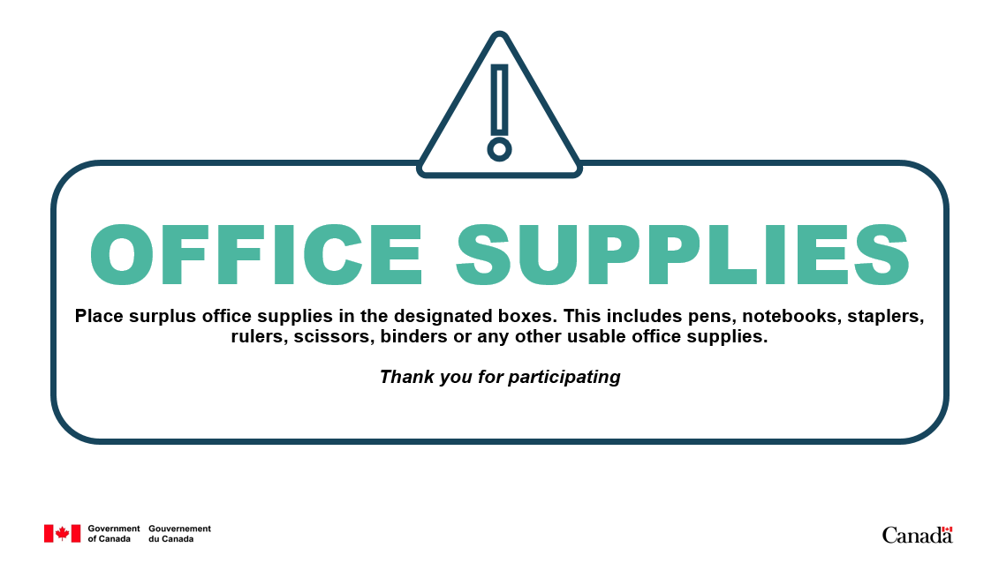
Onsite signage
Follow all onsite health and safety guidelines including any signage related to social distancing, flow of traffic and capacity limits, where applicable.
When arriving onsite, proceed to the marked room/area(s) with your [clean-up captain/representative] to retrieve your clean-up supplies (i.e., boxes, sticky notes, markers and tape).
When cleaning up the office, place all appropriate items in their designated sections identified with the posted signage (see examples).
All retained assets should be placed within the designated location(s).

Slide 9
Floorplan
Insert Floorplan
 | Legend
 | Clean-up Captain Hub
 | Retained Business Assets Drop-off
 | Disposal Area(s)

Slide 10
What needs to be done?
Paper clean-up: All documents need to be reviewed, stored/digitized/disposed of based on the information provided in this package.
All personal belongings need to be removed from workstations, lockers, cabinets and common areas, including the kitchen and coat closets.
Business assets such as stationery, IT peripherals and office supplies must be sorted the designated areas.
Surplus IT equipment (i.e., printers, scanners, desktop computers) that are too large to move must be labeled.
Non-ergonomic furniture must remain at the workstation to be labelled as surplus by the clean-up captains or move vendor.
Insert information/pictures related to labelling instructions
Example: you will be provided with boxes, tape, labels (green, red, blue, and orange) and markers
Green – personal items to be removed by you
Red – boxes of business assets to be retained
Blue – large surplus IT equipment (i.e., printers)
Orange – surplus furniture for decommissioning
Mark your name and/or department on red, yellow and orange labels. No need to mark green labels as you should be taking these items home. If you are packing personal items for a colleague, please put their name on the label.
1
2
3
EXAMPLE

Slide 11
What can you take home?
Take Home
Leave at the Office
Surplus Items
All personal items (i.e., shoes, clothing, food, personal items at workstation in lockers and in the kitchen)
Non-sensitive or personal information
Unclassified training binders that are not online (consider scanning)
IT peripherals as per [your organization’s guidelines] (i.e., keyboard, mouse, charger)
Personal ergonomic equipment (except ergonomic furniture, i.e., desks)
Assets as per [your organization’s guidelines] (i.e., laptops, monitors, etc.)
IT assets not identified as available for employees who work from home (i.e., scanners, etc.)
Port replicators
Printers
VoIP phones
IT peripherals not identified to be available for employees who work from home (i.e., adaptors, power bars, etc.)
Furniture (i.e., office chairs, pedestals, etc.)
Teleconference and videoconference equipment
Classified information (e.g., secret or top-secret documents)
Protected B or C documents
Extra keyboards
Extra mice
Old cell phones
Unwanted IT equipment
Place all surplus items in identified areas on the floor

Slide 12
Why you need to take home your belongings
All workstations and offices in the new workplace will be shared, which means that no personal belongings can be stored there. You will however have access to a locker.
[Insert information related to your locker/cabinet strategy for the ‘new’ workplace.]
Example 1: day lockers will be available for all employees at [location]. All personal items must be removed from the office at the end of each day.
Example 2: lockers will be assigned to individual departments/teams at [location]. Your manager will discuss team norms and expectations surrounding team lockers and what you can and cannot keep in the workplace.
Example 3: lockers will be assigned to employees. Please bring all personal items home at this time. Once the [name of project] is complete, you may bring back select personal items to store in your locker. [include information regarding the quantity that will fit in the lockers, as required]

Slide 13
How complete your Paper clean-up
1
2
3
KNOW
what to clean up first
SORT
your information
DECIDE
to keep or dispose

Slide 14
Know what to clean-up first
1
KEEP
information resources of business value that:
DISPOSE
of any transitory information that:
Support the delivery of programs and services(e.g., policies, guidelines, client records, planning documents).
Captures business activities (e.g., task assignments, project and process documentation, employment offers, contracts, transactions).
Record the evidence and rationalize for decisions or actions (e.g., records of decision, authorizations, briefing notes, legal advice, meeting documents, documents subject to a litigation hold).
Support departmental reporting, performance and accountability (e.g., strategic plans, corporate reports, statistics).
Supports the creation of information of business value but is only needed for a limited time (e.g., convenience copies of presentations or documents, informative emails, newsletters, training material, and working drafts where major changes were documented in a later version).
Does not support the creation of information of business value (e.g., junk mail, meeting notices, holiday and vacation notices, personal information).

Slide 15
Sort your Information
2
Sort your paper into three piles
KEEP
DISPOSE
UNKNOWN
Information of business value
Transitory information
Information you are unsure of
* Documents linked to ATIP requests or litigation hold must be preserved. *

Slide 16
Decide to keep or dispose (1 of 2)
3
VALUE | SENSITIVITY See sensitive information below | ACTION
Legal hold | Any | Do not destroy – Must keep all copies including any scanned versions until the hold is expressly lifted by DoJ. Place all relevant paper documents in a box, clearly labelled with your name and the name of the action (i.e., Thompson v. AGC, Bouchard c. PGC).
IRBV | No | Scan and save in Gcdocs or box and label according to departmental standards. Please contact your BRIM to provide guidance as certain Branches have legal operational requirements to preserve paper copy of information assets.
IRBV | Yes | Scan and save in GCdocs or box and label according to departmental standards. Please contact your BRIM team team to provide guidance as certain Branches have legal operational requirements to preserve paper copy of information assets.
Transitory | No | Place in blue recycle bin.
Transitory | Yes | Shredding services Procedure for the destruction of sensitive departmental information
Unknown |  | Validate with your peer and/or BRIM team to help identify if IRBV or transitory
EXAMPLE
*See decision tree on slide 14 for more details

Slide 17
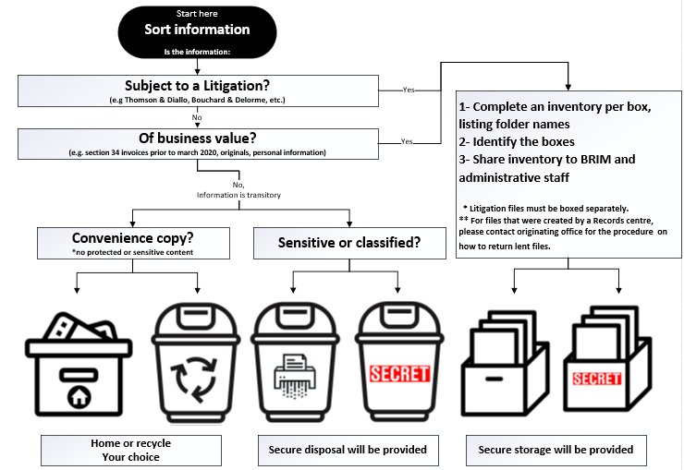
Decide to keep or dispose (2 of 2)
3
EXAMPLE

Slide 18
Before you leave the office
!
!
Ensure all items have been accurately marked with the provided labels. Return any unused labels, boxes and supplies back to the hub.
Ensure you have all personal items. Do not leave any personal items behind, either take them with you or dispose of them.
!
!
Check in with your [clean-up captain] prior to leaving, ensure you manager knows you have fully completed your clean-up.
Once the clean-up effort ends, the project team will sweep the floor and all non-identified items will be disposed on [DATE].

Slide 19
Helpful Hints (1 of 2):
!
!
!
Survey all areas to identify material for disposal, including meeting rooms, hallways and common spaces.
Collection bins will be identified and located in a central location on the floor. Do not place personal affects near disposal areas.
Do not place plastic, CD’s and other non-paper material in the paper recycling or shredding bin.

Slide 20
Helpful Hints (2 of 2):
!
!
!
Identify “surplus” furniture, technology assets and peripherals that are broken or abandoned using a label.
Separate materials prior to disposing of them. Please use the correct receptacles provided.
Do not place chemicals or unknown solutions into the garbage. Place these items in the designated area.

Slide 21
Helpful Hints [COVID-19]:
Optional where health measures are required
!
!
!
Remember to keep two meters apart when cleaning with other employees. Common areas and restrooms are limited [# persons].
Masks are required to be worn throughout the entire duration that you are participating in all clean up initiatives.
Please disinfect all common surfaces after each use. Disinfection stations will be in a central area.

Slide 22
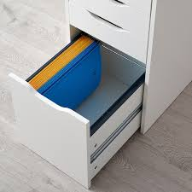
Clean-up Checklist
Digitize as much information as possible and properly shred any sensitive information
Ensure all drawers and cabinets are empty (do not even leave empty folders)
Check behind desks, cabinets, pedestals for any forgotten information or assets
Empty belongings from kitchen cupboards and drawers, coat rooms, conference rooms and other common areas
Ensure plastic bins are sealed with the appropriate zip-tie or security seal, identified, and stored in the approved secure location (as applicable)
Leave empty folders in cardboard boxes, seal the boxes with tape and label them
Ensure that all surplus office supplies are put into cardboard boxes, appropriately labelled and moved to a centralized location

