Slide 1
Information session:
Mindful Change Leadership Development program
April 2024
Notes:
Prep:
Update the Sli.do #mcld - https://app.sli.do/event/ndecSyr9sCAK8nCTSHMcjb
https://wiki.gccollab.ca/MCLD-DLCP , scroll down to the commitment section
MCLD - 8 Week Program Details (https://wiki.gccollab.ca/Mindful_Change_Leadership_Development_Program_Details)
MCLD – FAQ (https://wiki.gccollab.ca/Mindful_Change_Leadership_Development_Program_-_FAQ)
Alejandro:
Good morning good afternoon everyone, First, I would like to acknowledge that I am transmitting to you from the traditional Territory of the Anishnaabe Algonquin People; in Gatineau QC.
We are thrilled to “the Centre” hosting the program and, in collaboration with the IOCN, delivered to you with the support of facilitators from various government Departments/Agencies, including:
Service Canada
Governor General
Indigenous Services Canada
Public Services and Procurement Canada
Financial Transactions and Reports Analysis Centre of Canada
Canada Border Services Agency
Treasury Board of Canada Secretariat
Canada School of Public Service
Today’s information session will be presented by
Ginette Bailey and my self Alejandro Gonzalez, if interested you can read a bit about us and other facilitators via the Invitation page.

Slide 2

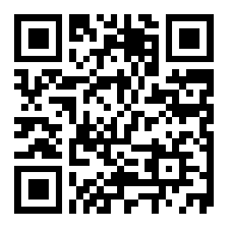
Sli.do
Anonymous questions?
https://www.slido.com/
# mcld
https://app.sli.do/event/vef8EJftsZ6S9NWLoiHdbq
Notes:
There are two questions on the Sli.do
(click)
The first one is…
(click)
And the second one is…
Later on I’ll post the results on the chat

Slide 3

“Leadership is not a rank or a position, it is a choice - a choice to look after the person to the left of us & the person to the right of us.”
- S. Sinek
Notes:
Alejandro:
A quote from Simon Sinek, (read from the slide)
Strong leadership is one of the drivers of successful change, and leaders who support the people-side of change are essential to success.
This program delivers and promotes mindfulness practices to increase participants’ self-awareness and resilience, equipping leaders that can nurture mindfulness in their teams, with their colleagues and contribute to employee wellness and well-being.
This presentation will provide an overview of the program, share the highlights of the program

Slide 4

Objective
Offer participants an overview of the Mindful Change Leadership Development (MCLD) program 2024, English offering
Notes:
Alejandro:

Slide 5

Agenda (In no particular order)
Words from a Sponsor
Share results of previous MCLD program
Share a definition of Mindfulness
and Mindful Change Leadership
Experience quick mindful exercises
Overview of the MCLD program
Q&A
Notes:
Ginette:
(paraphrase from slide)
Please write down your questions, at the end there will be time for Q&A
Raising hand
Comments via the chat
Ask questions anonymously via mentimeter
Or Sli.do https://app.sli.do/event/ndecSyr9sCAK8nCTSHMcjb
code # mcld

Slide 6
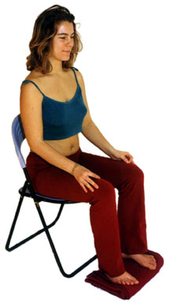

Exercise – Exploring Mindfulness – Body Scan
Time required: 5 minutes
If you haven’t, take advantage of the
opportunity to experience this exercise
Sit as comfortable as possible in a straight position
Feel free to close your eyes
Follow my voice as I lead you through the exercise
Then, we will do a short debrief of what you noticed.
Notes:
Ginette:
To start, let’s experience a mindful exercise…
If you haven’t, take advantage of the opportunity to experience this exercise
Sit as comfortable as possible in a way that allows you to stay awake and attentive
Put your feet flat on the ground, your palms on you lap, upside or downside as it feels more comfortable
Feel free to close your eyes, or semi close them
Follow my voice as I lead you through the exercise
Gently bring attention to your breath, no need to change the way you’re breathing, just notice it
Now, direct your breath and attention and focus on…
Your face, your eyes, nose and mouth. Your jaw, noticing
Your head, your scalf, breath in and out
Now direct your breath and attention to your shoulders, breath in, breath out, and notice
Your arms, your hands and fingers, in and out
Every time your attention wanders away, just bring it back gently
Back to your shoulders, and neck, noticing
Your upper back, chest
Your lower back, your abdoment
Direct your breath towards your waist, in and out
Your lower leg, in and out and your upper leg, and notice what you feel
Your feet, in and out, notice what you feel
Your toes, breath in, breath out
Stay there for a few seconds, breathing in and out
When you feel like, open your eyes and come back
Debrief: Use the chat to mention What did you notice?
We’ll read some of your comments later during this session

Slide 7


Mindful Change Leadership Development Program (MCLD) Goal
To increase self-awareness by developing key skills:
Focus
Clarity
Creativity
Compassion in the service of others
… with a positive impact on well-being and resiliency.
“Individuals with higher mindfulness have greater resilience, thereby increasing their life satisfaction.” - ScienceDirect
Notes:
Ginette:
When you think about your work and try to find a balance between work priorities, your relationships with colleagues and clients, along with home life responsibility, what strikes you as the key skills needed for this balance? Where would you like to improve?
Is it better presence, or more compassion? Is it increased self-awareness or tools for self-reflection?
We believe that this program helps to answer some of these questions and to improve the key skills of presence, self-compassion, relationality, life-work balance, self-awareness and more.
(click)
There are studies showing that individuals with higher levels of mindfulness tend to be more resilient. And also note that both mindfulness and resilience are important skills for improved well-being
By partaking in the program, you will likely increase the level of honesty and trust within yourself, and therefore with others, allowing for an authentic connection with the work that we do at across the Government of Canada.

Slide 8
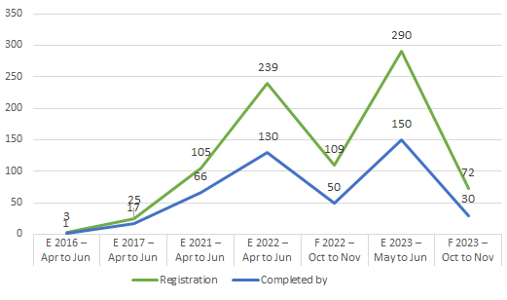
Some Numbers about the MCLD program
Notes:
Alejandro:
The Mindful Change Leadership Development Program has been in development since 2016, by the IOCN
Delivered as a Beta on 2017
Then hosted by ISC in 2021 and 2022, as a pilot and then an English and a French offering
During 2023, the program was hosted by the Centre on Innovation

Slide 9
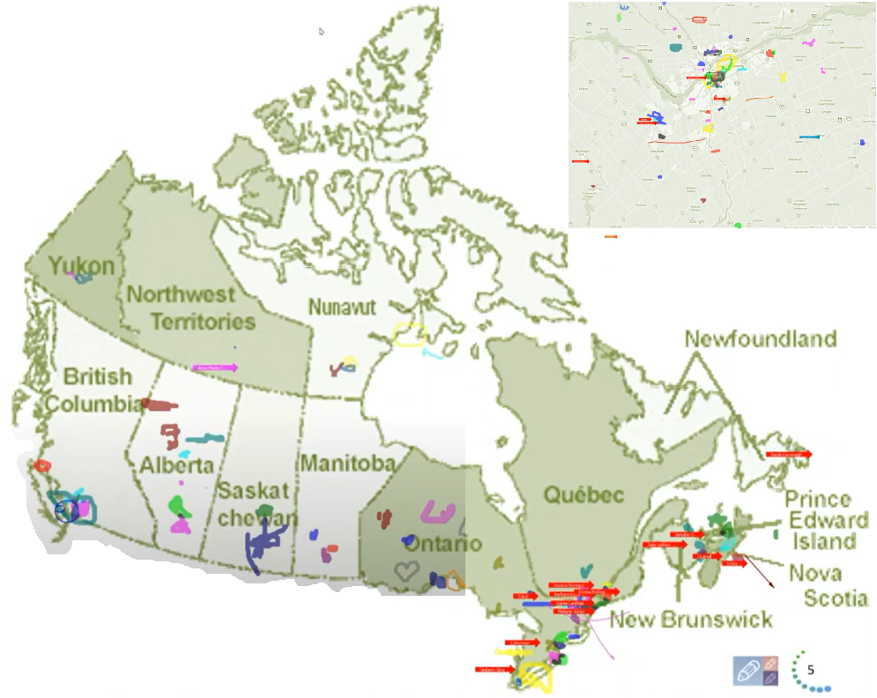
Map of Participation, 2022 English Offering
From across Canada:
From NCR:
Notes:
Alejandro:
The program had participants from across Government and across Canada, as you can see per the slide, the image was co-created at the beginning of the 2022 English offering

Slide 10
Key Findings - MCLD English Program 2022
20.8%
23.0%
14.0%
20.5%
12.6%
, 3 months after
* People who answered "Almost Always", "Very Frequently", and "Somewhat Frequently"
Notes:
Alejandro:
Participants completed self-assessment questionnaires at program registration and again three months after the eight-week program, and we have compiled the data to evaluate the results and impacts of the Mindful Change Leadership Development program.
(click)
The blue columns represent the results of the self-assessment questionnaires completed at registration.
(click)
The green columns represent the final assessment, and the differences between them indicate behavioural changes.
A total of 130 participants completed the program, we received 99 final assessments (76% return on self-assessments), and the key findings per category are:
(click on each bullet)
An increase of 12.6% Increase in Employee Engagement – respondents show a sense of clarity of mind.
(Q2. I have difficulty distinguishing what day it is.)
A 23.0% Increase in Promoting Sounder Decision Making - people reported taking time to optimize their productivity.
(Q7. I take time each day to optimize my personal productivity)
Slightly over 20% decrease in Behavioural Risks - participants indicated being more aware of the task at hand.
(Q13. It seems I am running on automatic, without much awareness of what I am doing.)
Close to 21% Increase in Well-Being – respondents feel they are more present while at work and at home.
(Q1. I notice that I am distracted by thoughts about work after working hours or about home related things when I'm working.)
And 14.0% Increase in Resiliency - people reported an improvement in their ability to be present.
(Q21. I find myself listening to someone with one ear, doing something else at the same time.)
What we heard from participants was that the program was a life changing experience, it helped them increased their own sense of well-being; and gave them the tools and practices to use with their teams to support employee wellness and well-being.

Slide 11

MCLD Program Testimonials
"…in a way, your investment in becoming medicine... is a very important investment…" - Elder Malcom Saulis
"I found this course to be extremely powerful and grounding... this really helps to shape how I look at my relationships with my staff… it was excellent. "
"it was very powerful, very interesting, lots of insights. I learned a lot about myself. I found the exercises appropriate in me being more productive, more present in my relationships with my colleagues and also with my family.”
“This series is life changing. I hope to participate more in the future”
"These 8 weeks have been profound… in my view I think this should be mandatory for everyone. it's that powerful"
"Thank you for this valuable opportunity to grow personally and professionally. It has been an important adjunct to the transformational work we are doing at ISC.“
I wanted to also share some specific gratitude... I found the sessions incredibly helpful, useful and well structured… it's already had a wonderful effect on my life
Notes:
Ginette:
From this set of testimonials, I’ll allow myself to read the first one in full… from Elder Malcom Saulis: "... in a way, your investment in becoming medicine for yourself and for the rest of the world is something that I'm grateful to be witness to as an occasional participant in this program... any kind of investment like this in order to open your mind, your heart and your spirit to the presence of a larger world, which is either spiritual or physical, is a very important investment, and I applaud you for the investment that you've made." - Elder Malcom Saulis, session 8, 5456

Slide 12


Exercise – Noticing
Time required: 3 minutes
The trick is to shift from “doing” to “being”
Let’s start by doing the following...
  Sit as comfortable as possible in a straight position
  It helps if you close or semi-close your eyes
  Let’s not worry about time
  And take a minute, only a minute...
  To breathe, just to breathe
  That simple
  I’ll let you know when the minute is over.
  Just continue focusing on your breathing
We’ll do a short debrief of what you noticed
Notes:
Ginette:
Now, before we go into the details of the program and the Q&A, let’s give a try to another mindful exercise…
As with the first exercise, sit as comfortable as possible in a position that allows you to be awake, attentive and comfortable at the same time
You can put your feet flat on the ground, your palms on you lap, upside or downside as it feels more comfortable
Feel free to close your eyes, or semi close them
Follow my voice as I lead you through the exercise
Gently bring attention to your breath, no need to change the way you’re breathing, just notice it
Let’s not worry about time
Just focus on
Breathing in
Breathing out
If at any time your mind wanders away, being gently with yourself, acknowledge that thought, let it be, and bring back your attention to your focus of attention, your breathing
Breathing in
Breathing out
I’ll let you know when the minute is over
Just continue focusing on your breathing
Debrief: Use the chat to mention What did you notice?
We’ll read some of your comments later during this session

Slide 13
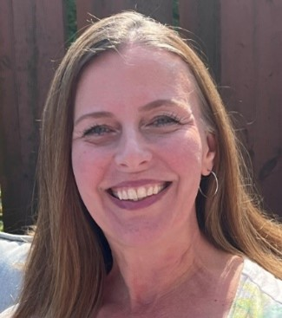
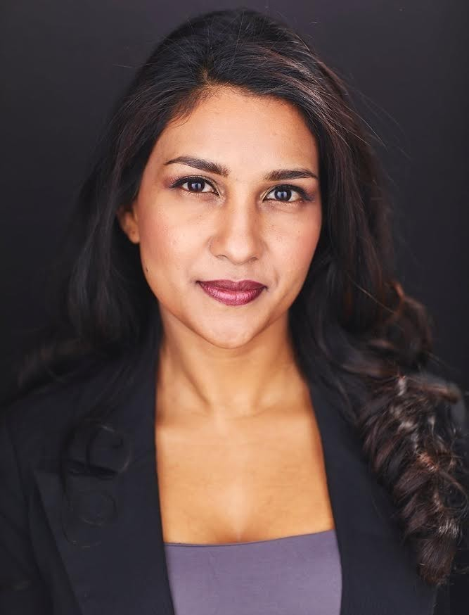
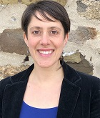

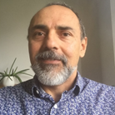
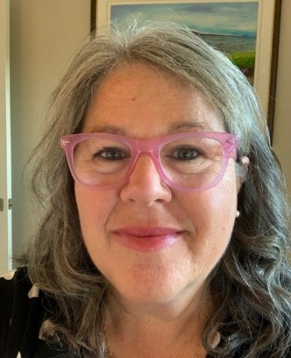
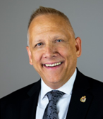
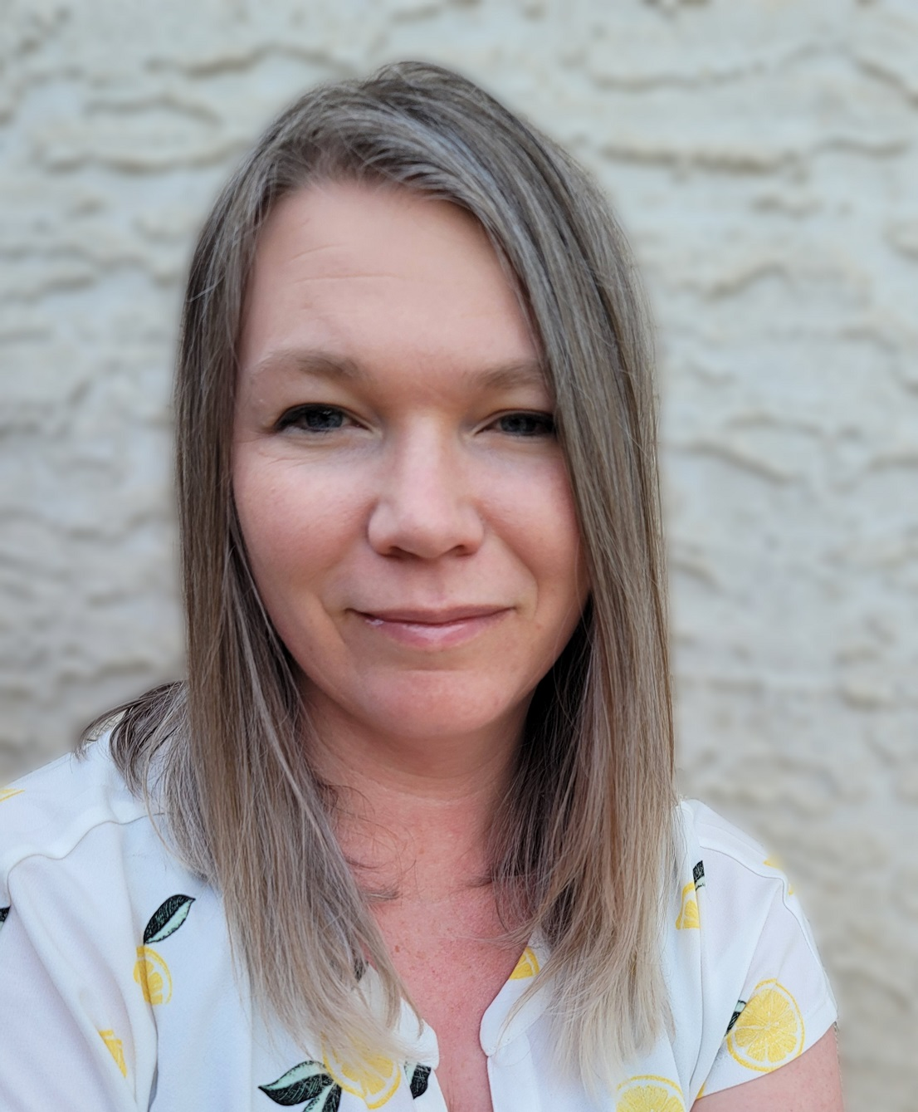
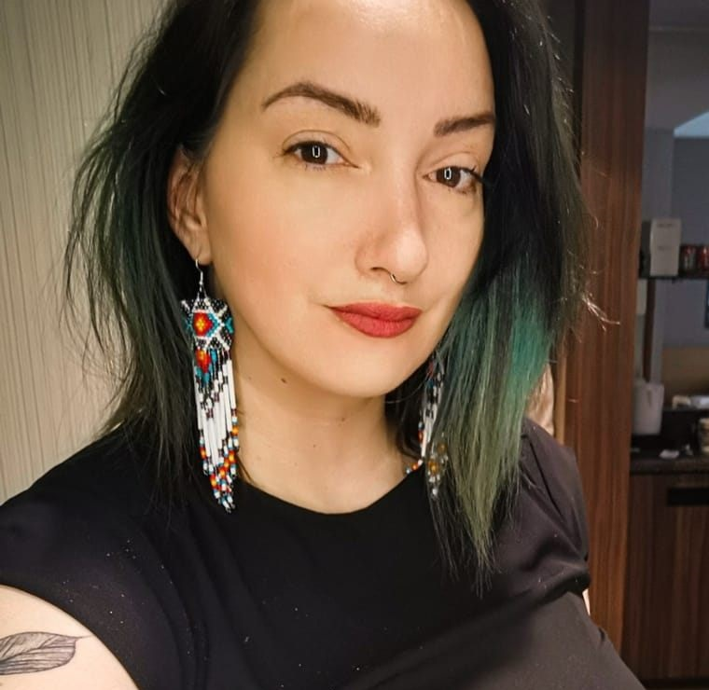
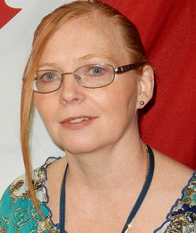
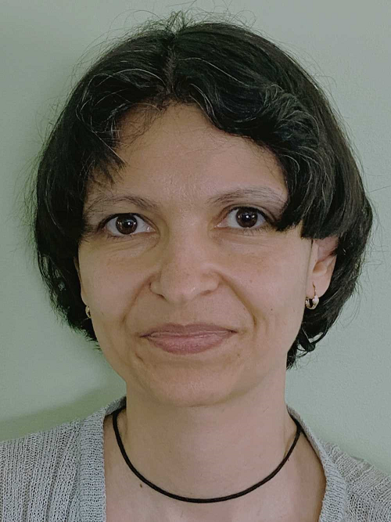

Delivered by a team of volunteering facilitators
Ginette
Casey-Marie
Annie-Claude
Carmen
Alejandro
Marie-Lyne
Robert
Michelle
Dani
Leanne
Galina
… and more…
Notes:
((Resources
How many staff are dedicated to the program? How do they spend their time?
))
Requisite to facilitate is have completed the program, from a base of about 10+ volunteer facilitators from different Departments and Agencies
Usually 2/3 volunteers lead each session, depending on availability and preference
An Investment of up to an hour to participate in a coordination meeting
One or Two hours to prep
And 1.5 hours to deliver
((
Here a partial list of facilitators from various government Departments/Agencies, including:
Service Canada
Governor General
Indigenous Services Canada
Public Services and Procurement Canada
Financial Transactions and Reports Analysis Centre of Canada
Canada Border Services Agency
Treasury Board of Canada Secretariat
Canada Revenue Agency
Immigration, Refugees and Citizenship Canada
))

Slide 14
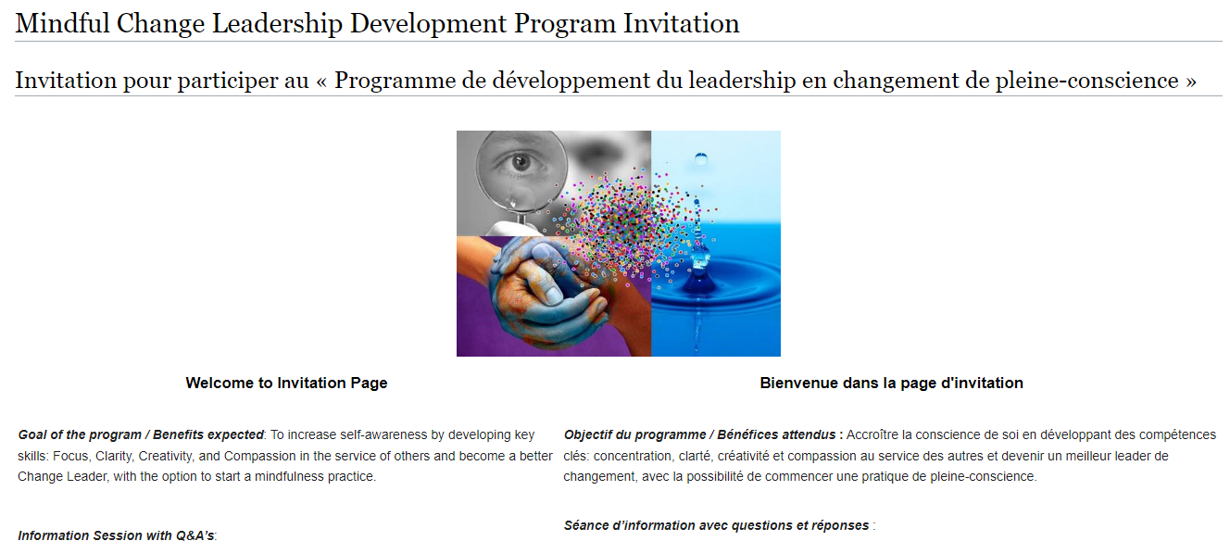
Commitment, Program Overview & FAQ
https://wiki.gccollab.ca/MCLD-DLCP
MCLD - 8 Week Program Details
MCLD - FAQ
Notes:
Ginette:
“This program is aimed at someone who wants it” (not necessary for one who needs it)
Pages to open and explore:
https://wiki.gccollab.ca/MCLD-DLCP , scroll down to the commitment section
MCLD - 8 Week Program Details (https://wiki.gccollab.ca/Mindful_Change_Leadership_Development_Program_Details)
MCLD – FAQ (https://wiki.gccollab.ca/Mindful_Change_Leadership_Development_Program_-_FAQ)

Slide 15
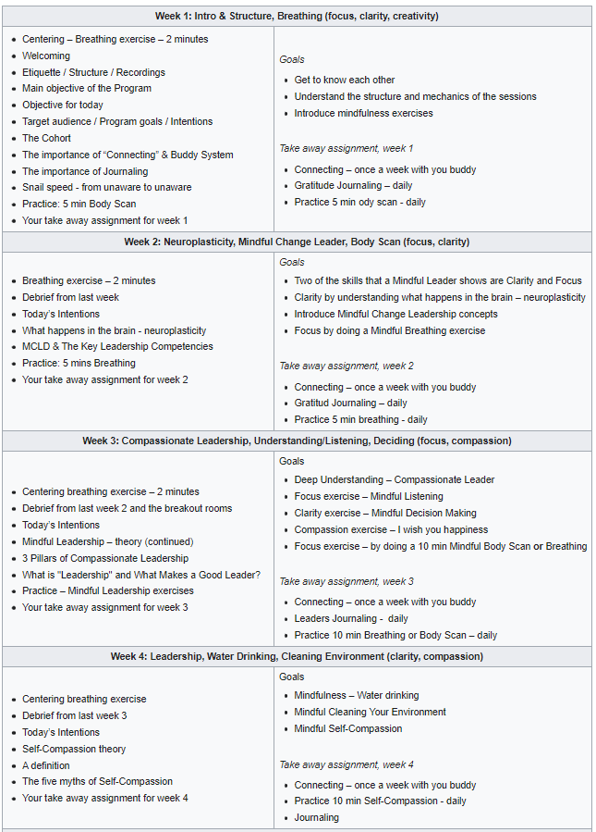
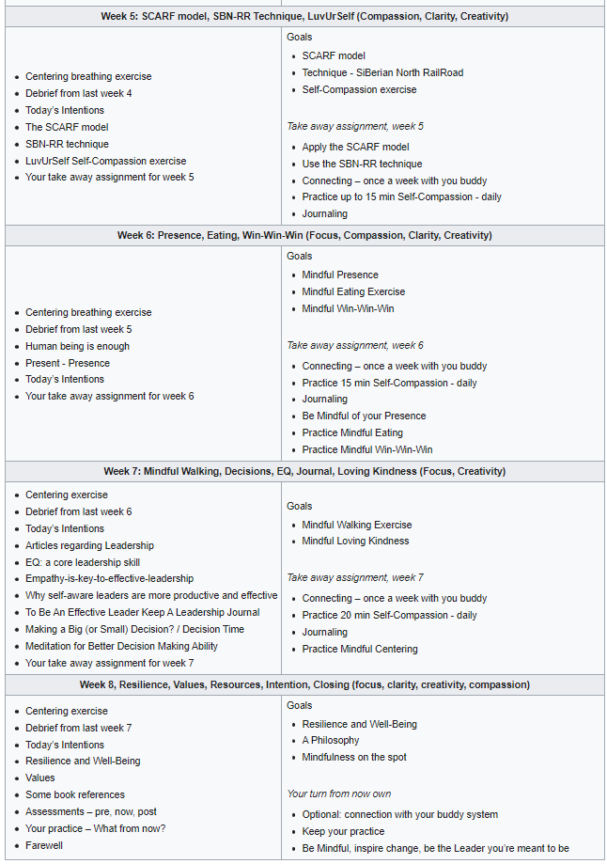
https://wiki.gccollab.ca/MCLD-DLCP
MCLD - 8 Week Program Details.
MCLD - FAQ
Notes:
((About the Curriculum and Content
Regarding the Program Structure
What is the program's duration and format?
))
The program goes for 8 weeks, with a weekly session of 1.5 hours, plus additional homework to an approximate 2 to 3 hours a week total
https://wiki.gccollab.ca/MCLD-DLCP
MCLD - 8 Week Program Details.
MCLD - FAQ
https://gccollab.ca/groups/profile/7978973/mcld-program-cohort-cop-coi-programme-dlcp-cohorte-cdp-et-cdi

Slide 16



What’s Needed For Success?
Voluntary Participation
Support from Management
This opportunity could be added to your Performance Management Agreement & Learning Plan
Notes:
Alejandro:
The sessions and take-home activities require a fairly significant investment by participants, and two components which will be key for ensuring the continued success of the program are maintaining voluntary participation and support from management.
(These 2 success factors are emphasized during the promotion of the program, and employees are encouraged to discuss with their managers to get their support)

Slide 17


Be Mindful,
Be Happy
Open floor for questions
Please use the “raise hand” functionality
Observe:
One question, per participant, per turn
Alternating with the chat and with anonymous
Notes:
Alejandro:
In the meantime that people raise their hand to ask questions), we’ll reflect back on some of the comments put on the chat…. (mention some of the comments for both exercises)
And now, we open the floor for questions, please observe:
One question, per participant, per turn
Alternating with the chat
And Menti
OR Sli.do #mcld - https://app.sli.do/event/ndecSyr9sCAK8nCTSHMcjb, for those who prefer anonymity (provide the Sli.do link and code)

