Slide 1
Notes:
Prep:
Neuroplasticity - https://www.youtube.com/watch?v=ELpfYCZa87g

Slide 2
Mindful Change Leadership Development Program
Session 2 (of 8)
May 15, 2023
Notes:
Welcome to week 2
To mention the following in French:
« Comme avec toutes les sessions du GC, s'il vous plaît, sentez-vous libre d'utiliser la langue de votre choix pour poser des questions ou participer à la discussion., La séance d'aujourd'hui sera conduit principalement en anglais, il y aura d'autres sessions en français qui seront promus via le GCTools (ou donner des dates précises, si disponible). »
As with all GoC sessions, please, feel free to use the language of your choice to ask questions or participate in the discussion., today’s session will be conducted mainly in English, there will be other sessions in French that will be promoted via the GCTools (or give specific dates, if available).

Slide 3
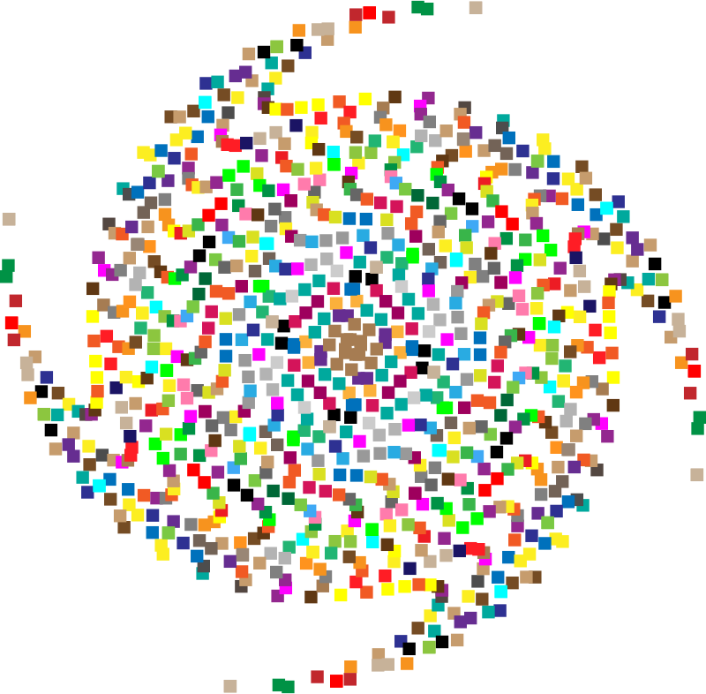
Mindful Breathing Exercise – Centering
Time required: 2 minutes
The trick is to shift from “doing” to “being”
Let’s start by doing the following...
Sit with a straight position, as comfortable as possible
It helps if you close or semi-close your eyes
Let’s not worry about time
And take a minute, only a minute...
To breathe, just to breathe
That simple
I’ll let you know when the time is over.
Just continue breathing
There will be time to do a debrief of what you noticed
Review what comes back from translation
Notes:
Let's start by doing a mindfulness breathing exercise.
Sit as comfortably as possible in a position that allows you to be awake, attentive or attentive and at ease at the same time.
You can put your feet flat on the floor; and rest your hands on your knees, palms up or down, whichever is more comfortable for you.
Feel free to close your eyes or close them halfway.
Follow my voice, which will guide you during the exercise.
Gently pay attention to your breathing. No need to change the way you breathe; just notice your breathing.
Don't worry about time.
Just pay attention:
On inspiration
At expiration
If at any point your mind wanders, be kind to your reason, acknowledge that thought, let it go, and bring your attention back to the object of your attention, which is your breath. .
Inspiration
Expiry
Now we are going to take a full minute of self-awareness breathing.
I'll have you sign when the moment has passed.
Just keep focusing on your breathing.

Slide 4
Mindful Breathing Exercise – Centering
Time required: 2 minutes
Sit comfortable, with back as straight as possible
Close your eyes or find a soft gaze
Focus on your breath
Notes:
Alison:
With this we will come into a mindful centering exercise, one of many, we will do these at the start of all sessions as a way to bring our attention and awareness to this moment and to set the space for a beneficial session for all.
Sit as comfortable as possible in a position that allows you to be awake, attentive and comfortable at the same time
You can put your feet flat on the ground, your palms on you lap, upside or downside as it feels more comfortable
Feel free to close your eyes, or semi close them
Follow my voice as I lead you through the exercise
Gently bring attention to your breath, no need to change the way you’re breathing, just notice it
Let’s not worry about time
Just focus on
Breathing in
Breathing out
If at any time your mind wanders away, being gently with yourself, acknowledge that thought, let it be, and bring back your attention to your focus of attention, your breathing
Breathing in
Breathing out
Now, we’ll take one full minute of breathing for centering ourselves
I’ll let you know when the minute is over
Just continue focusing on your breathing

Slide 5
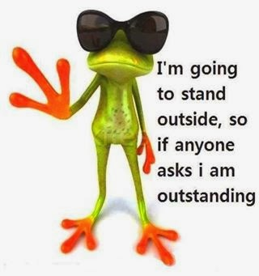
Debrief from last week (1)
Any Insights you’d like to share
Your Buddy Sytem
Your practice
Debrief
Any outstanding issues?
Notes:
(Give space for 2/3 people to share)
(click)
With honesty, report on :
Were there any challenges?
What you noticed?
Any insights you realized?
(click)
(read from silde)
(click)
(read from silde)

Slide 6
Agenda – week 2: The brain (focus, clarity)
Breathing exercise – 2 minutes
From last week’s Comments
Debrief from last week
What happens in the brain - neuroplasticity
MCL & The Key Leadership Competencies
Your turn for the week
Practice: Breathing exercise
Notes:
The agenda for today…
We already went over the first 3 bullets
Today, we will explore two of the skills that a Mindful Leader shows are Clarity and Focus
Today, we’ll practice
Clarity by understanding what happens in the brain – neuroplasticity
Introduce Mindful Leadership concepts
Focus by doing Mindful Breathing

Slide 7
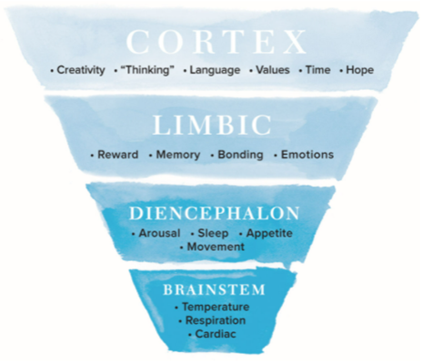
The Brain
“What Happened to You?...”
Hierarchical organization of the human brain – The brain can be divided into four interconnected areas: brainstem, diencephalon, limbic, and cortex. The structural and functional complexity increases from the lower, simpler areas of the brainstem up to the cortex. The cortex mediates the most uniquely “human” functions such as speech and language, abstract cognition, and the capacity to reflect on the past and envision the future
https://www.amazon.ca/What-Happened-You-Understanding-Resilience/dp/1250223180/
https://www.youtube.com/watch?v=JlS8ApNBtuU&t=7s
Notes:
This model talks about how the brain is formed; it has 4 parts to it. The interesting part of this model is that the prefrontal cortex is where the creativity, the thinking, the language, the values, the concept of time and the hope occur in the brain.
When the body gets into a fight or fly response, its reaction is to focus on the basic instincts, managed by the Brainstem and focused on the temperature, the respiration and the cardiac functions.
Just reiterating, this program is focused on awareness and how to be present and access the pre-frontal cortex.
((This program is NOT focused on trauma and healing, if you need help on that matter, please contact a specialist or EAP.))
References…
What Happened to you? : Conversations on Trauma, Resilience, and Healing - https://www.amazon.ca/What-Happened-You-Understanding-Resilience/dp/1250223180/
Jay interviewing Oprah - https://www.youtube.com/watch?v=JlS8ApNBtuU&t=7s
05:57 Commonly misunderstood concept about trauma
09:06 Going beyond success to heal your trauma

Slide 8
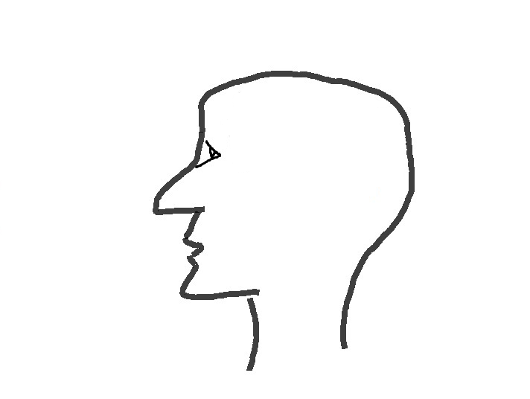
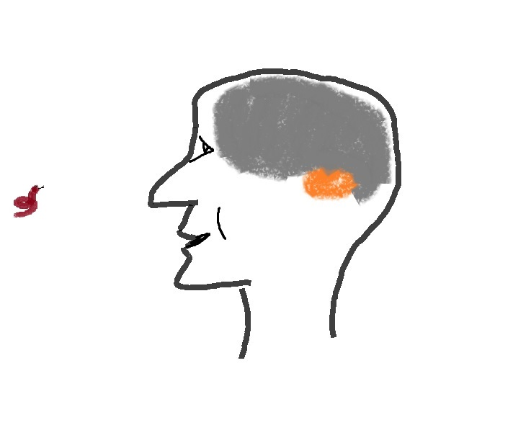
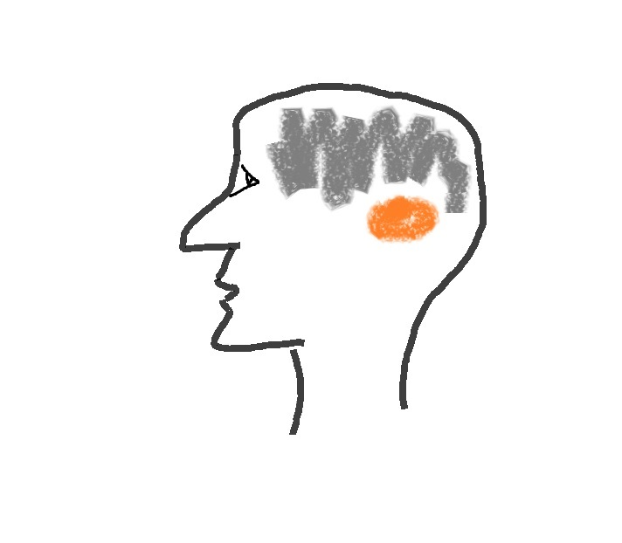
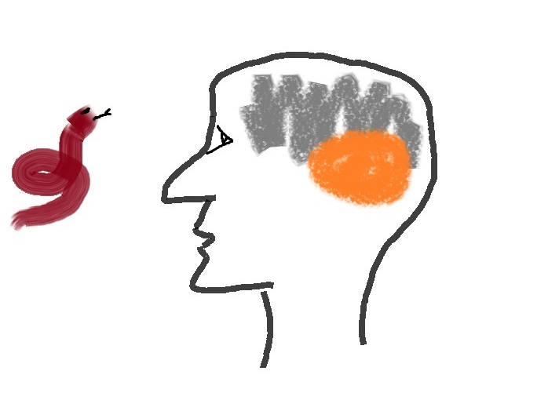
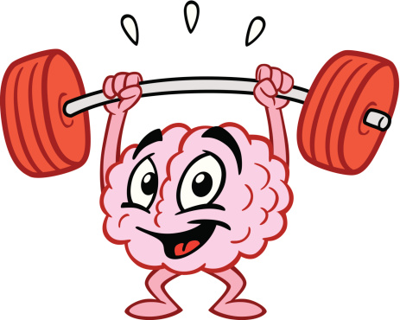
What happens in the brain – the neuroplasticity
Decision making
Emotions
Language
Work
Family
Stress
Media
Amygdala
Mindfulness Practice
Natural dangers
turned → into
Day to day over stimulus
Watch this video at home (15 mins): https://www.youtube.com/watch?v=Awd0kgxcZws
or this video (2 mins) : https://www.youtube.com/watch?v=ELpfYCZa87g
Notes:
In this animation, we’ll explore what happens in the brain.
(click) - You have this image, representing an individual
(click) - In grey, we have the representation of the brain
(click) - As mentioned in the previous slide, the various functions of the brain, among others, are the decision making, the emotions, the language and so on.
(click) - and in orange we have the amygdala
(click) - What had happen in time is, that we have turned natural dangers into daily stimulus
(click) – and with any work related interruptions, family related matters, the email reminders, the social media, etc all of them create an over stimulus to the amygdala
There are studies that prove that the amygdala actually grows in size and the grey matter shrinks.
(click) – what happen with the practice of Mindfulness
(click) – is that we can revert these effects and have the amygdala shrink and the grey matter grow
Similar to the muscles in our body, with a practice of Mindfulness we can strengthen our brains
(play the video: https://www.youtube.com/watch?v=ELpfYCZa87g )
Resources…
https://gcconnex.gc.ca/blog/view/93957388/neuroplasticity-your-survival-superpower-neuroplasticite-votre-superpuissance-de-survie?language=en
https://en.wikipedia.org/wiki/Amygdala_hijack
http://www.gostrengths.com/what-is-an-amygdala-hijack/
http://neurosciencefundamentals.unsw.wikispaces.net/The+limbic+System
https://siyli.org/even-old-dogs-can-learn-siyli-tricks-2/

Slide 9
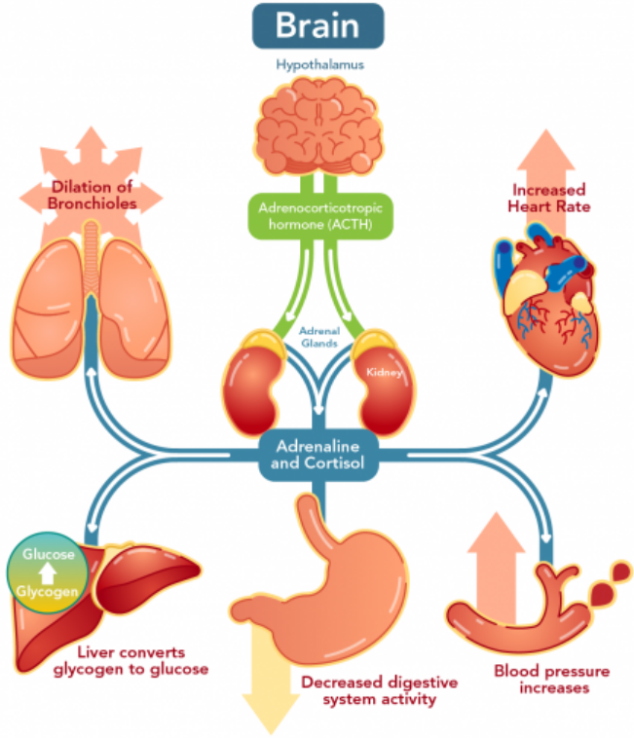
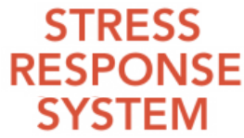
How The Brain and Body Work Under Stress
In times of stress, the brain reduces resources that are normally allocated to systems that are not needed during an emergency.
Notes:
In times of stress, the brain reduces resources related to immune functions, recovery functions, digestive functions, logical reasoning, concentration and memory.
At the same time, the brain increases blood pressure, hormone production, heart rate, breathing rate, muscle tension and sweat rate which explains and prepares the fight, flight or freeze response.
https://letstalkscience.ca/educational-resources/backgrounders/stress-and-brain

Slide 10
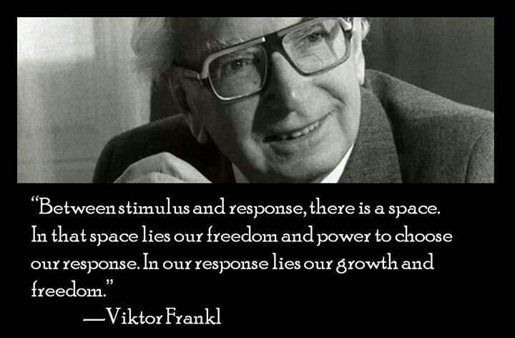
Notes:
(read from slide)
The space Viktor Frankl refers to is precisely the focus of a Mindfulness practice. The idea is to be more conscious about this space, so we can respond to situations.

Slide 11
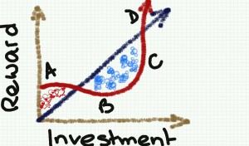
Why Mindfulness Matters
Increased resilience
Focus and concentration
Workplace harmony
Fewer sick days
Greater employee satisfaction and well-being
Stress reduction
Greater creativity
http://www.mentalworkout.com/white-papers/how-mindfulness-can-help-your-employees-and-improve-your-companys-bottom-line/
Notes:
Let’s quickly see some ideas around the importance of Mindfulness... How do you see Mindfulness having an impact in the workplace?
I now ask you to use the pointer (the arrow with your name on it) to indicate which one you’d like to know a little bit more about… I’ll pick 2 of them
((Based on their answers, read the corresponding:))
Increased resilience: being mindful increases the ability to be open to new perspectives, to think creatively, to distinguish thoughts from feelings, and to respond to challenges rather than merely reacting. For a leader this helps with strategic thinking.
Focus and concentration: after an eight-week mindfulness course, participants could concentrate better, stay on task longer, more effectively, and remember what they’d done better. In a fast-paced environment where leaders have to react quickly to situation this is a great capacity to have.
Workplace harmony: being mindful promotes and creates more empathy and altruism in the workplace. As a leader we are expected to foster a respectful workplace.
Fewer sick days: those who have a practice missed 76% fewer days of work.
Greater employee satisfaction and well-being: being mindful helps significantly to have less emotional exhaustion and more job satisfaction.
Stress reduction: just being mindful helps in reducing stress, anxiety, and depression. The practice helps reducing the levels of the primary stress hormone. As a leader we are put under a lot of stress and any tools that can help manage the pressure is something to be considered.
Greater creativity: Leaders with a mindfulness practice say it helps them create space for innovation and it also helps them to think strategically.
)) ---
How mindfulness can help your employees and improve your company's bottom line – white paper, Mental workout http://www.mentalworkout.com/white-papers/how-mindfulness-can-help-your-employees-and-improve-your-companys-bottom-line/

Slide 12
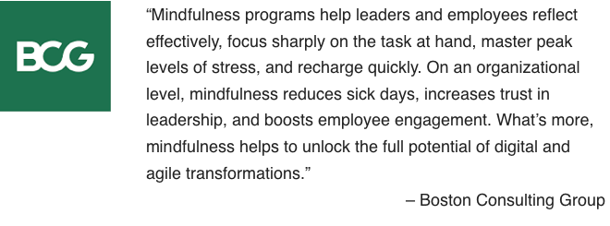
How Mindfulness Practice Benefits CEOs
builds resilience
boosts emotional intelligence
enhances creativity
improves your relationships
helps you focus
Attention
Awareness
Letting be
Leaning into unpleasant experiences
Appreciation
Getting unstuck
* Adapted from:
https://hbr.org/2015/12/how-meditation-benefits-ceos
https://www.mindful.org/7-qualities-mindfulness-trained-body-scan/
from: https://www.bcg.com/en-ca/publications/2018/unleashing-power-of-mindfulness-in-corporations
Notes:
I’ll let people read the two lists at the top
(wait a few seconds)
I just want to highlight on the left “Improves your relationship” because you come more authentic and empathic.
And also on the right, “Leaning into unpleasant experiences”, for example when there is an “elephant on the room” we may feel like we don’t want to talk about it but we need to, mindfulness practice allows you to have a discussion in a more human way, emphatic, compassionate, overall in a better way.
(click)
Now, we have a quote from BCG –which is a huge consultant global group-, I’d like to highlight from the quote that... “Mindfulness practices increases trust in leadership, and boosts employee engagement. What’s more, it helps to unlock the full potential of digital and agile transformation.”
Sources:
https://hbr.org/2015/12/how-meditation-benefits-ceos
https://www.mindful.org/7-qualities-mindfulness-trained-body-scan/
https://www.bcg.com/en-ca/publications/2018/unleashing-power-of-mindfulness-in-corporations

Slide 13
What is Mindful Change Leadership?
Refers to the person who is present, non judgmental and cultivates several aspects during their interactions. These aspects are visible and tangible in the Mindful Change Leader:
Focus (focus of attention)
Clarity (self awareness & emotional intelligence)
Creativity (innovation & decision making)
Compassion in the service of others (presence, deep listening)

Slide 14
Which Mindful Change Leadership skills support the Key Leadership Competencies?
 | Focus | Clarity | Creativity | Compassion in the service of others
Create Vision and Strategy
Mobilize People
Uphold Integrity and Respect
Collaborate with Partners and Stakeholders
Promote Innovation and Guide Change
Achieve Results
Notes:
In the following table, we have the Key Leadership Competency profile from TBS on the left column, and on the top row we have the Mindful Change Leadership skills
This table indicates which competencies is supported by which skill
(click) – in the case of the “Create Vision and Strategy” competency is supported primarily by Clarity and Compassion in the service of others
(click) – “Mobilize people” competency is supported by Focus, Clarity and Compassion in the service of others
(click) and so on and so forth
Now, you may think, well, actually all of the competencies are supported by all of the skills, in a sense yes, the table indicates the skill most predominant or directly related to the competency.
Resources…
Key Leadership Competency profile and examples of effective and ineffective behaviours…
Create Vision and Strategy
Leaders define the future and chart a path forward. They are adept at understanding and communicating context, factoring in the economic, social and political environment. Intellectually agile, they leverage their deep and broad knowledge, build on diverse ideas and perspectives and create consensus around compelling visions. Leaders balance organizational and government-wide priorities and improve outcomes for Canada and Canadians.
Mobilize People
Leaders inspire and motivate the people they lead. They manage performance, provide constructive and respectful feedback to encourage and enable performance excellence. They lead by example, setting goals for themselves that are more demanding than those that they set for others.
Uphold Integrity and Respect
Leaders exemplify ethical practices, professionalism and personal integrity. They create respectful and trusting work environments where sound advice is valued. They encourage the expression of diverse opinions and perspectives, while fostering collegiality. Leaders are self-aware and seek out opportunities for personal growth.
Collaborate with Partners and Stakeholders
Leaders are deliberate and resourceful about seeking the widest possible spectrum of perspectives. They demonstrate openness and flexibility to forge consensus and improve outcomes. They bring a whole-of-government perspective to their interactions. In negotiating solutions, they are open to alternatives and skillful at managing expectations. Leaders share recognition with their teams and partners.
Promote Innovation and Guide Change
Leaders have the courage and resilience to challenge convention. They create an environment that supports bold thinking, experimentation and intelligent risk taking. They use setbacks as a valuable source of insight and learning. Leaders take change in their stride, aligning and adjusting milestones and targets to maintain forward momentum.
Achieve Results
Leaders mobilize and manage resources to deliver on the priorities of the Government, improve outcomes and add value. They consider context, risks and business intelligence to support high-quality and timely decisions. They anticipate, plan, monitor progress and adjust as needed. Leaders take personal responsibility for their actions and outcomes of their decisions.
From: https://www.canada.ca/en/treasury-board-secretariat/services/professional-development/key-leadership-competency-profile/examples-effective-ineffective-behaviours.html

Slide 15
Reviewing the basics (1/2)
The intention of being (as opposed to doing)
Posture: sit with a straight back, as comfortable as possible in the chair that you are seated, slightly tuck your chin (or cross legged if you feel comfortable)
Mindset: keep an open mind, feel the experience
You experience may vary each day, all is good
Focus on the breathing
Notice
It is about feeling the way you feel, about noticing without judging
have no expectations
have no judgement
have a beginners mind
be an observer... our minds may be busy and noisy
Review what’s coming back from translation bureau
For week 1
Notes:
http://www.thecalmmonkey.com/#!meditation-recordings/g6x73

Slide 16
Mindful Breathing Exercise – Breathing (2/2)
Time required: 5 minutes
The trick is to shift from “doing” to “being”
Let’s start by doing the following...
Sit with a straight position, as comfortable as possible
It helps if you close or semi-close your eyes
Let’s not worry about time
And take a minute, only a minute...
To breathe, just to breathe
That simple
I’ll let you know when the time is over.
Just continue breathing… for one more minute
Review what’s coming back from translation bureau
For intro session
Notes:
Mindful breathing https://www.youtube.com/watch?v=ZE-r-x2T4ok
This is one way of doing it, getting it depends on the practice of.
Noticing is very important in the practice of Mindfulness.
Noticing where your thinking is, that’s the first step to become more Mindful.

Slide 17
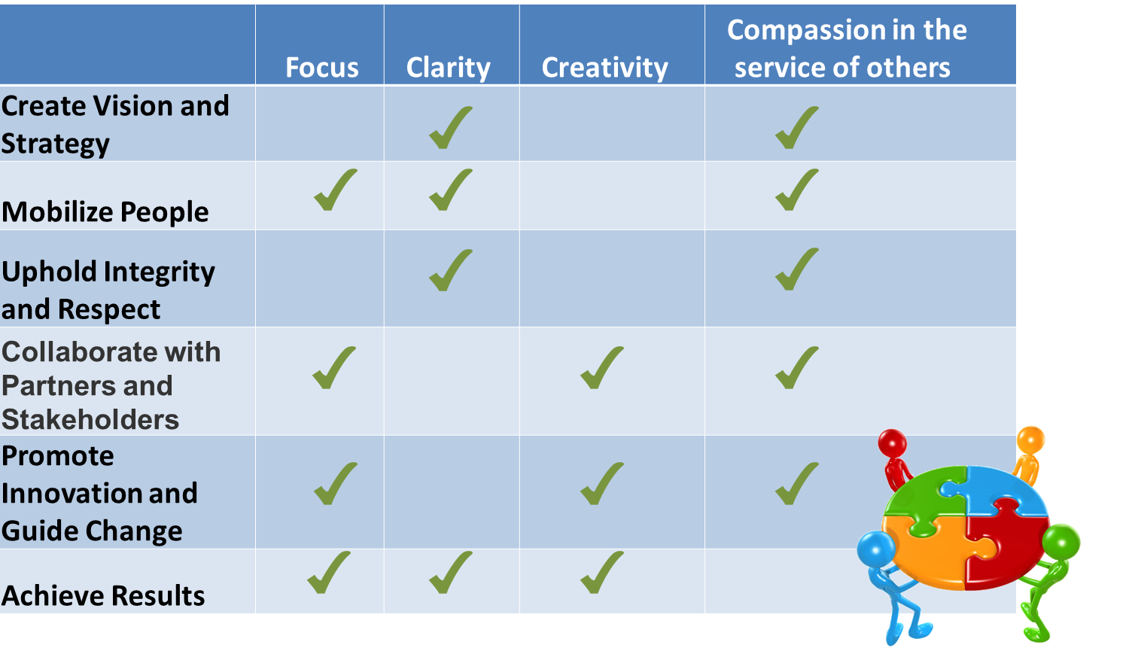
Debrief – Breakout rooms What got your attention?
What got your attention the most?
What Happens in the Brain, Under Stress and Neuroplasticity
Why Mindfulness Matters and the Benefits to CEO’s
How the Mindful Change Leadership skills support the Key Leadership Competencies
Breathing Exercise (possible compared to the Body Scan from last week)
Notes:
We’re going to do the debriefs in a few minutes, both in plenary and in small groups. Just before we do that, is there any question regarding the homework?
(give people a few seconds)
Well, now, I’d like to open the floor to 2 or 3 people who would like to do a debrief in plenary. If you’re the first one, just open your mike and speak, if you’re the second or third one, please rise your hand.
((prep for the breakout rooms))
And now, you’ll have the opportunity to do a debrief, in small groups of 4-6 people who are randomly assigned. Just be conscious and share the “airtime” among participants
Debrief on today's exercises, Talk about how the experience went for you.
What did you learn ?
What did you notice?
What was difficult or excessively easy?
((open the breakout rooms))
When done, you can simply exit the WebEx, or come back if you have questions or would like to express a comment

Slide 18
Your turn for week 2
Connecting – once a week with your buddies
Recommended 20 minutes call: 5 mins for each, you can discuss what you found interesting, what was challenging, what you like the most
Gratitude Journaling – daily
Practice 5 mins breathing – daily http://marc.ucla.edu/mpeg/01_Breathing_Meditation.mp3 https://soundcloud.com/mindfulmagazine/5-minute-breathing-meditation
In case you have a question, a comment or want to share something, please do so via the Cohort
Notes:
For this week, similar to last week… if you have any questions, now is the time to ask…
((click & read from slide until the end))
Other resources…
http://marc.ucla.edu/mindful-meditations
Mindful breathing https://www.youtube.com/watch?v=ZE-r-x2T4ok
3 mins body scan: https://soundcloud.com/mindfulmagazine/3-minute-body-scan-meditation
Bottom-up: https://www.psychologytoday.com/us/blog/conquer-fear-flying/201306/emotional-control-top-down-or-bottom

Slide 19
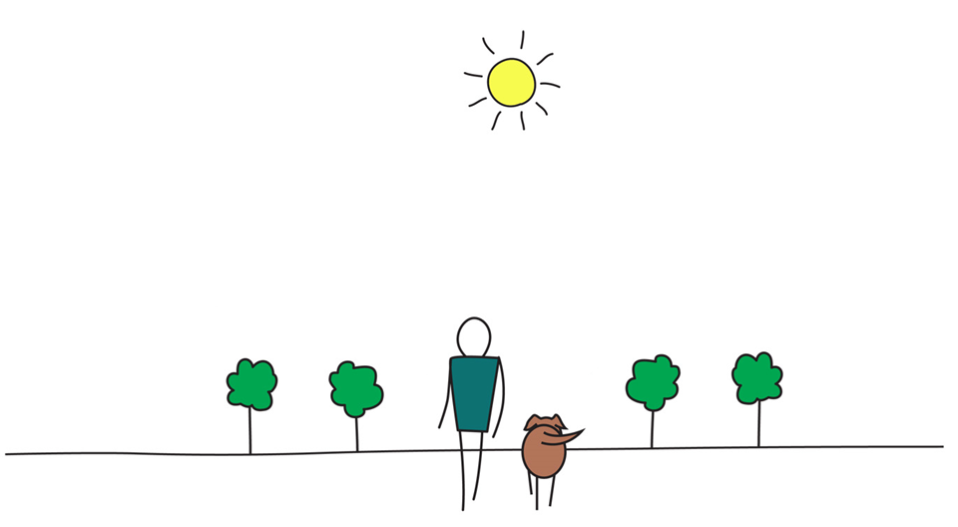
Be Mindful, Be Happy /
Pratiquez la pleine conscience, retrouver le bonheur
Notes:
No speaking notes required – just leave this slide up until everyone has exited the WebEx. Or take it down when people come back to the main room with comments or questions so they can see the facilitators full-screen.

