Slide 1
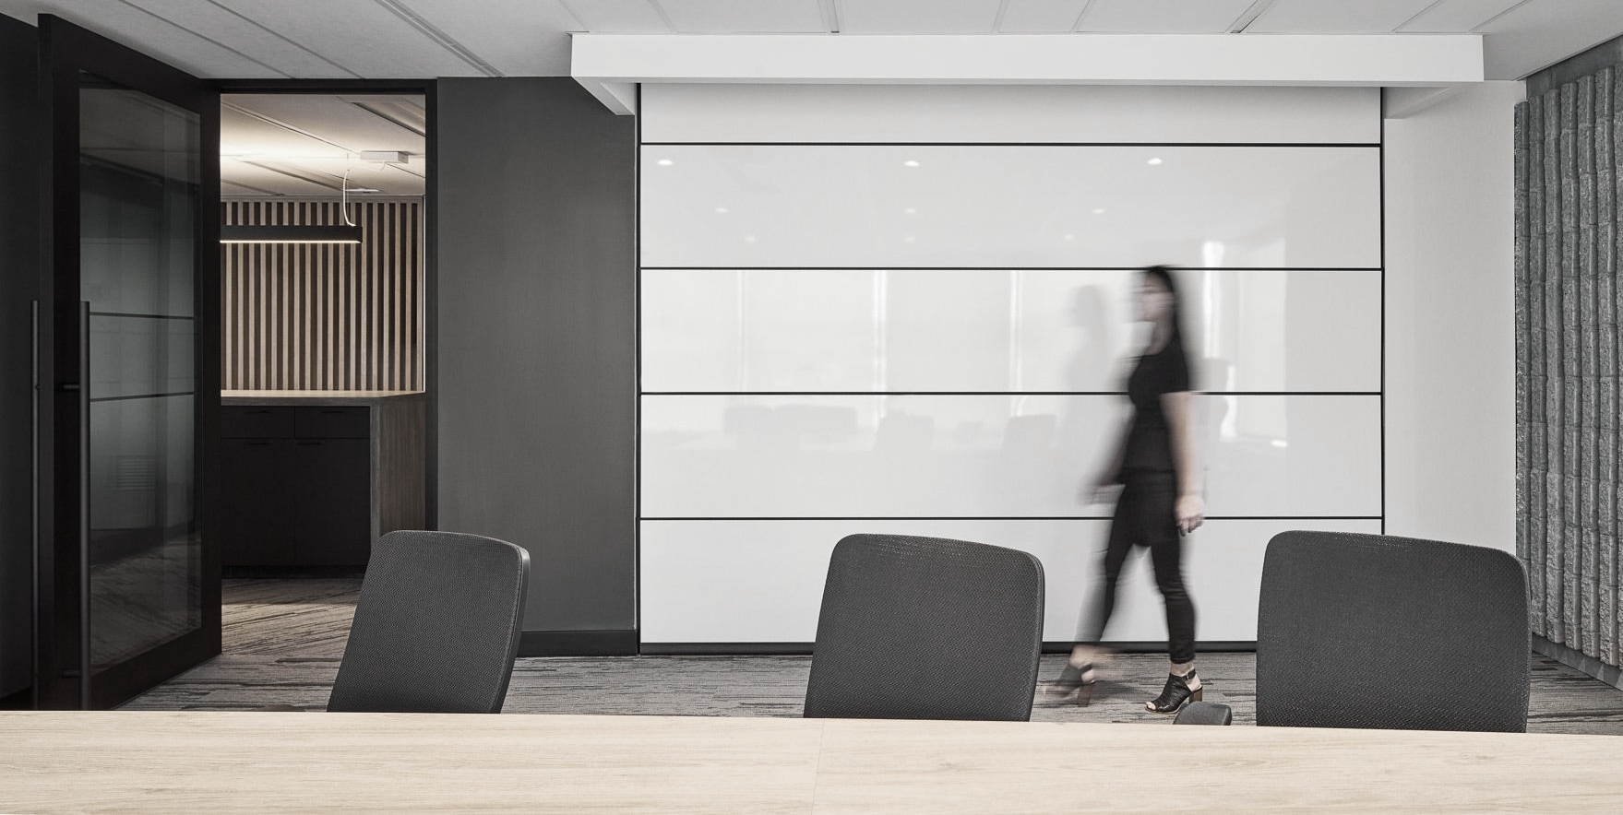
FEDERAL WORKPLACE MODERNIZATION
Flexibility for a Hybrid Future
June 2023
STRATEGIC WORKPLACE ADVISORY GROUP (SWAG) | ACCOMMODATION MANAGEMENT AND WORKPLACE SOLUTIONS

Slide 2
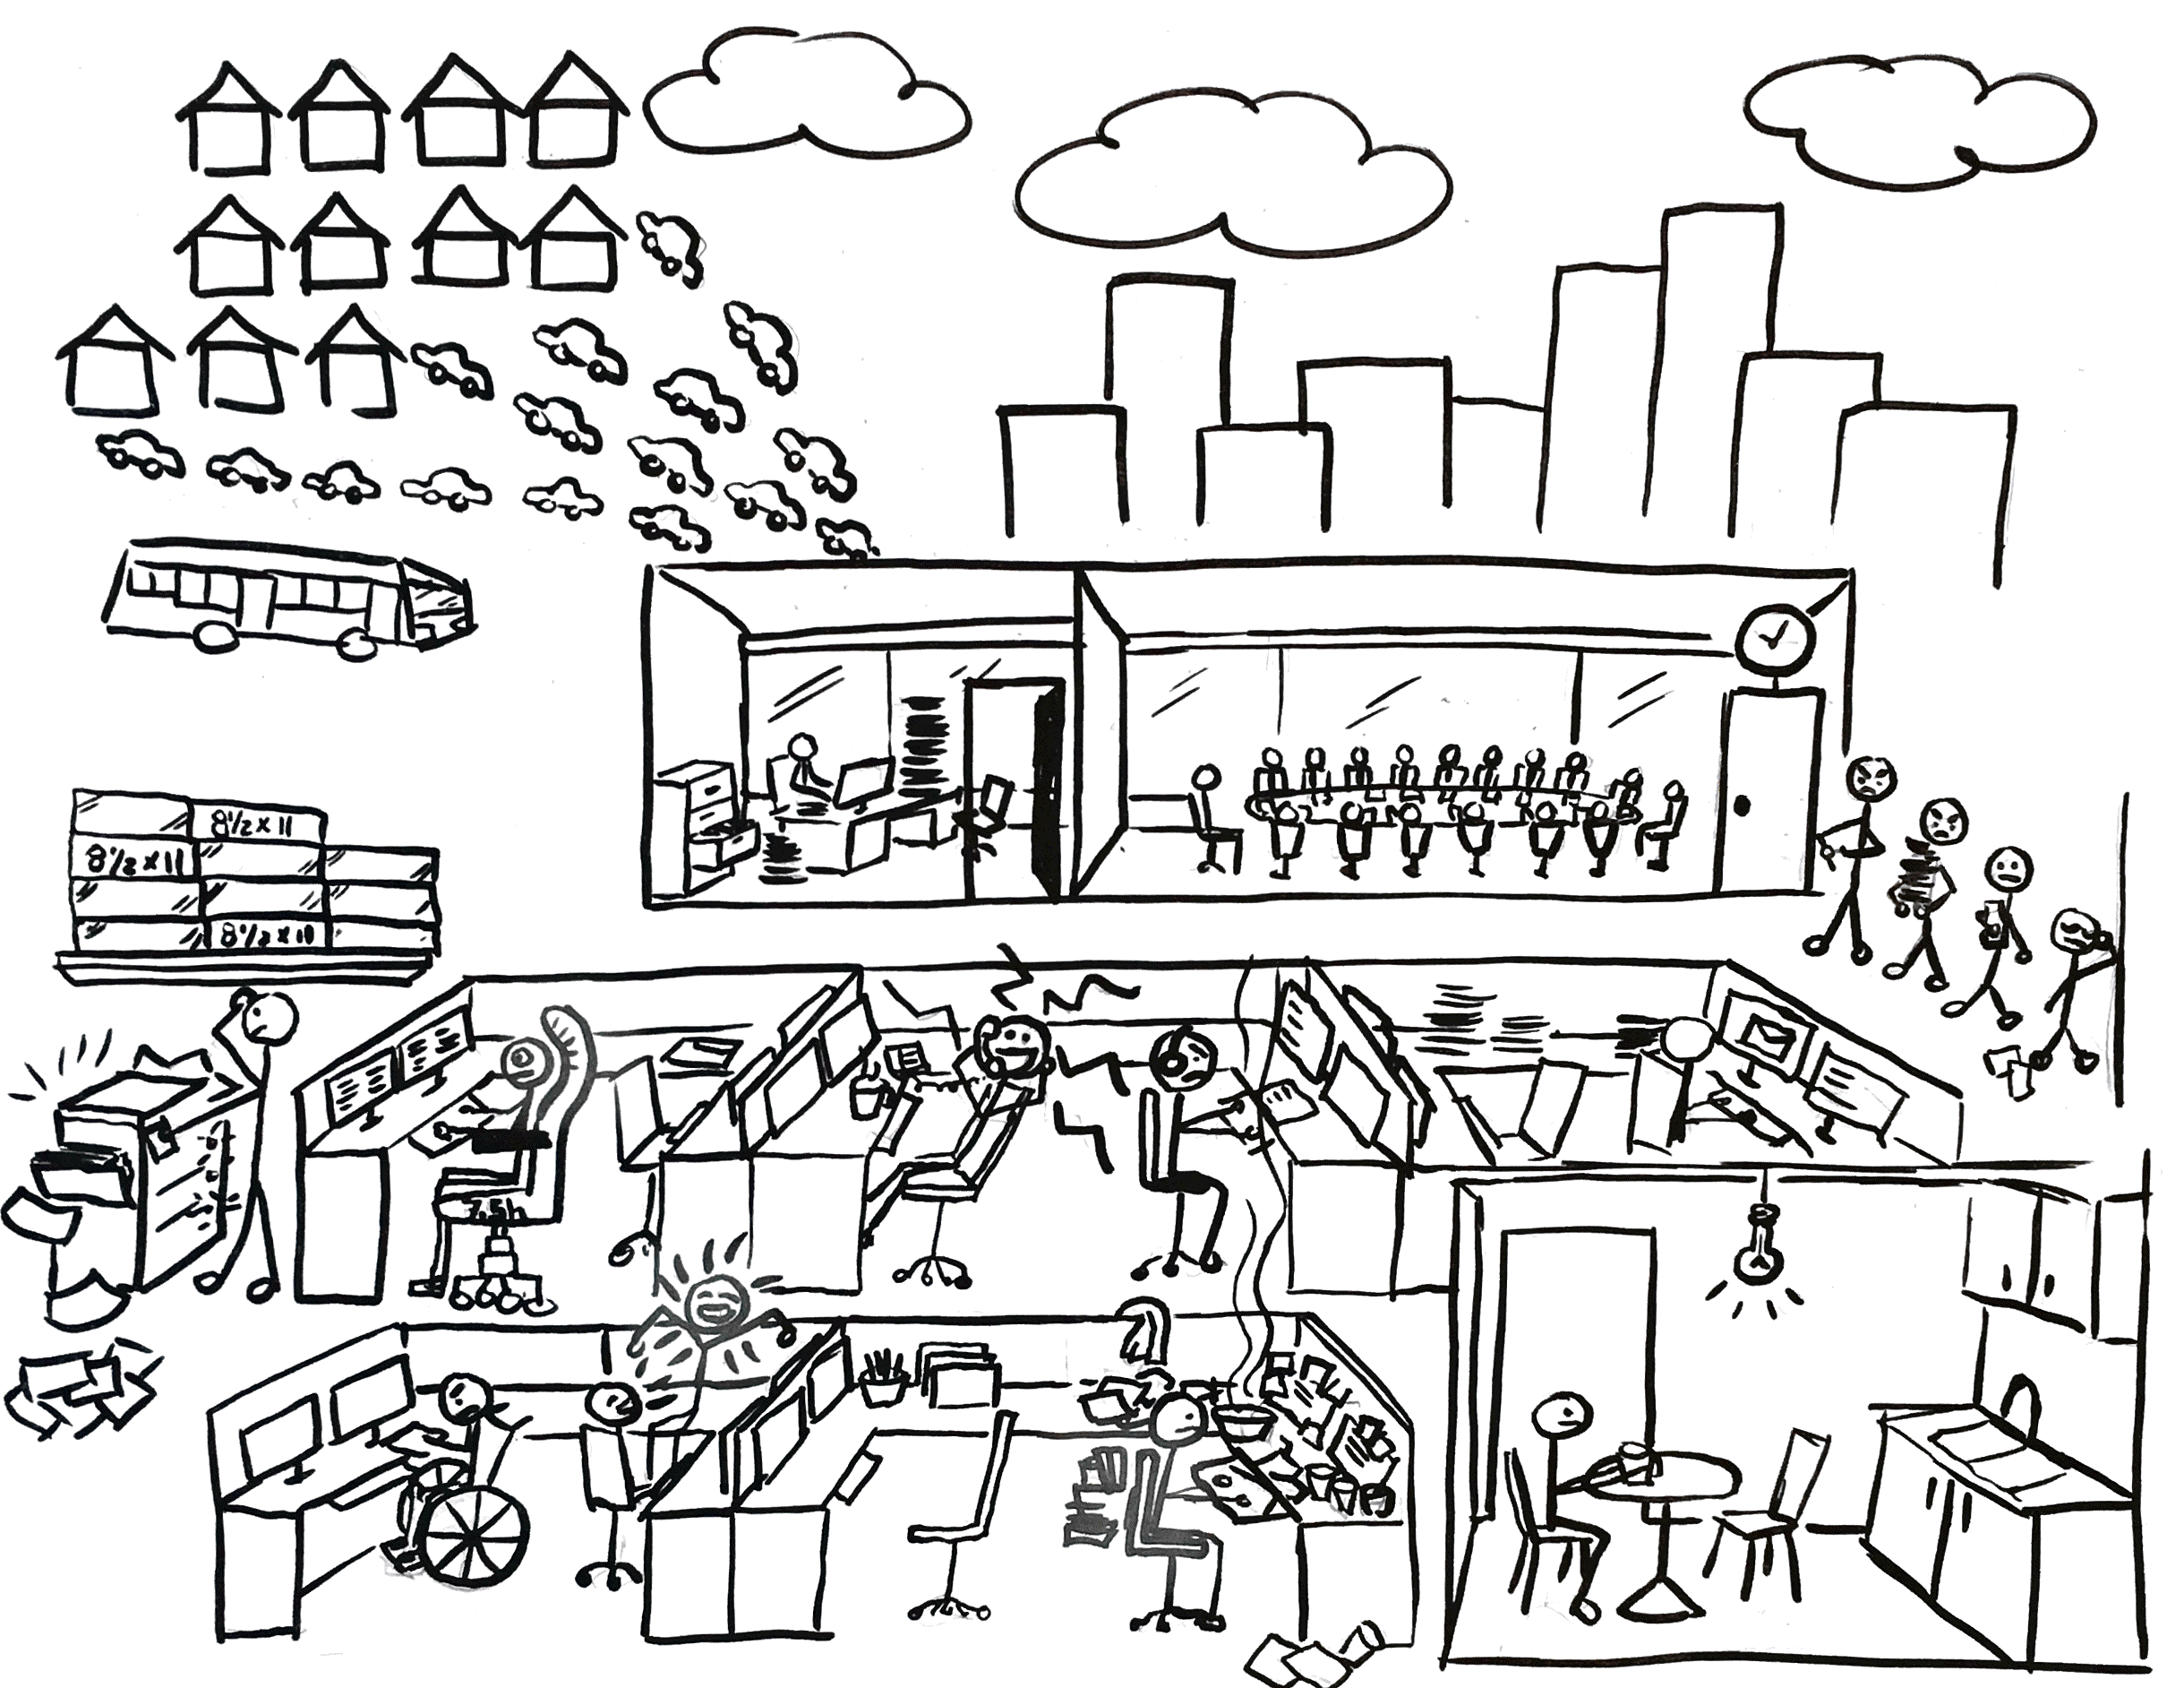
…until 2020
STRATEGIC WORKPLACE ADVISORY GROUP (SWAG) | ACCOMMODATION MANAGEMENT AND WORKPLACE SOLUTIONS

Slide 3
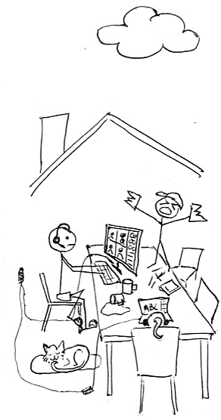
2020 – 2021 – 2022
STRATEGIC WORKPLACE ADVISORY GROUP (SWAG) | ACCOMMODATION MANAGEMENT AND WORKPLACE SOLUTIONS

Slide 4
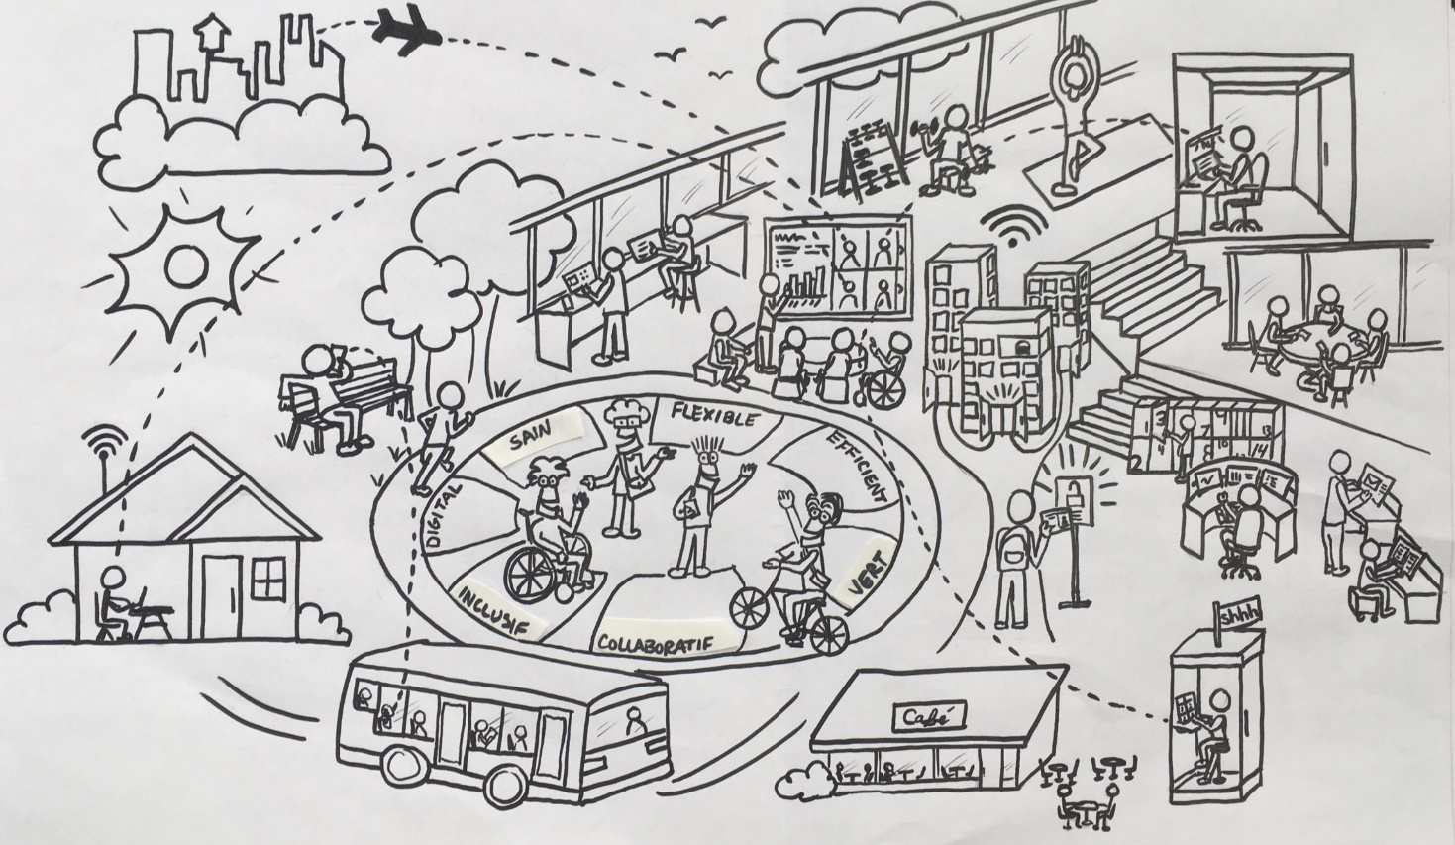
2023 onward…
2020 – 2021 – 2022
STRATEGIC WORKPLACE ADVISORY GROUP (SWAG) | ACCOMMODATION MANAGEMENT AND WORKPLACE SOLUTIONS

Slide 5
Most agree, HYBRID WORKING is here to stay
Where we were…
Where we’re going…
STRATEGIC WORKPLACE ADVISORY GROUP (SWAG) | ACCOMMODATION MANAGEMENT AND WORKPLACE SOLUTIONS
Notes:
Where we were
Everything is assigned
Floors to departments
Workstations to employees
Static/individualistic workplaces
GCcoworking not yet available
Where we’re going…
Office Long Term Plan
Continue modernizing workplaces
Right-sizing departmental space
More interdepartmental space

Slide 6
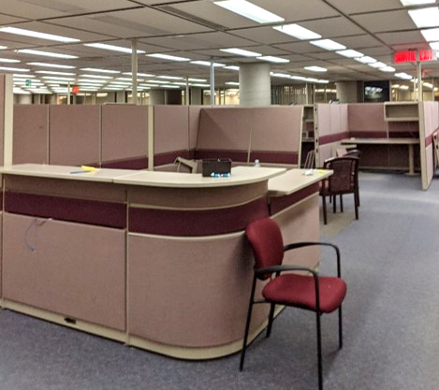
Workplace modernization is...
Going from this…
STRATEGIC WORKPLACE ADVISORY GROUP (SWAG) | ACCOMMODATION MANAGEMENT AND WORKPLACE SOLUTIONS

Slide 7
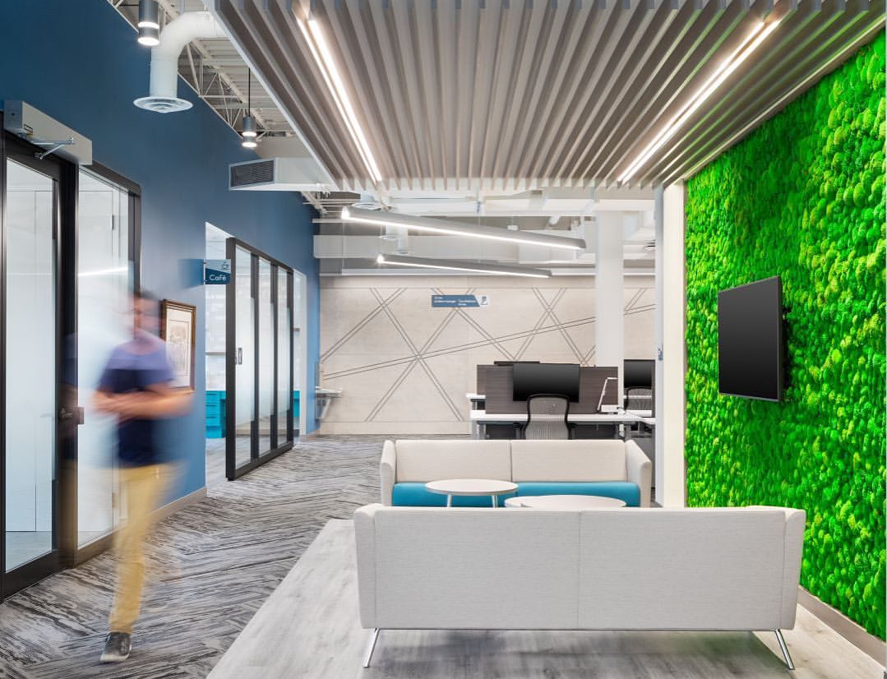
Workplace modernization is...
To this!
STRATEGIC WORKPLACE ADVISORY GROUP (SWAG) | ACCOMMODATION MANAGEMENT AND WORKPLACE SOLUTIONS

Slide 8
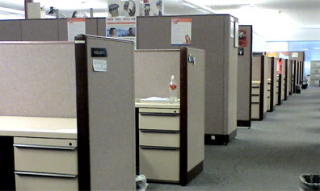
Workplace modernization is...
Turning this…
STRATEGIC WORKPLACE ADVISORY GROUP (SWAG) | ACCOMMODATION MANAGEMENT AND WORKPLACE SOLUTIONS

Slide 9
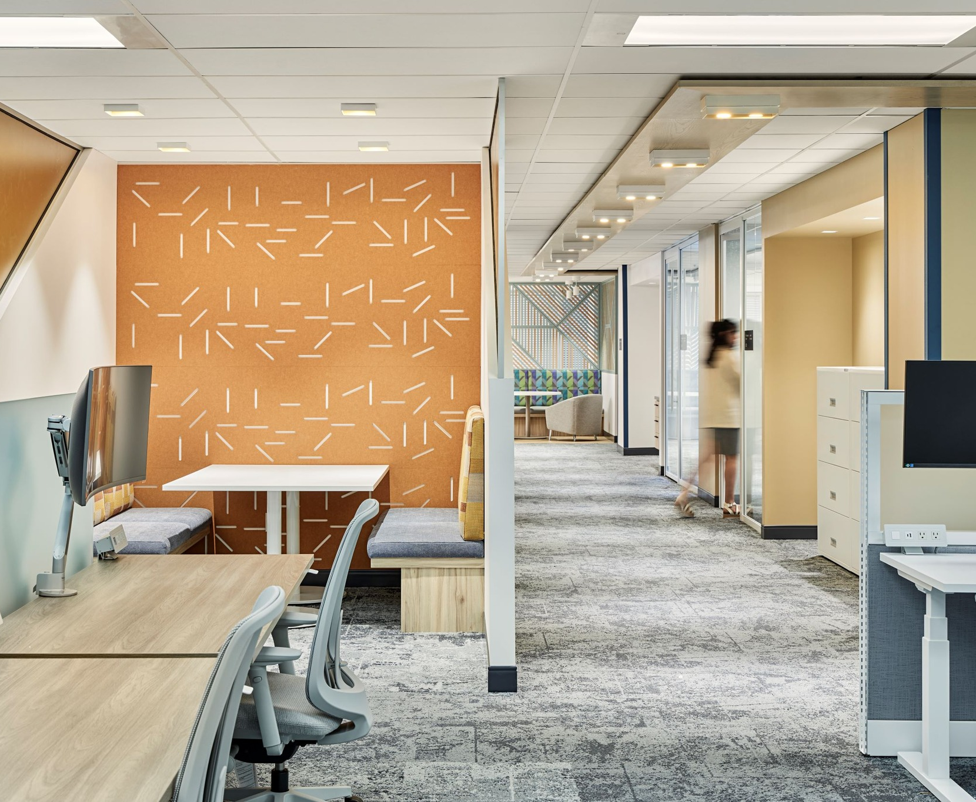
Workplace modernization is...
Into this!
STRATEGIC WORKPLACE ADVISORY GROUP (SWAG) | ACCOMMODATION MANAGEMENT AND WORKPLACE SOLUTIONS

Slide 10
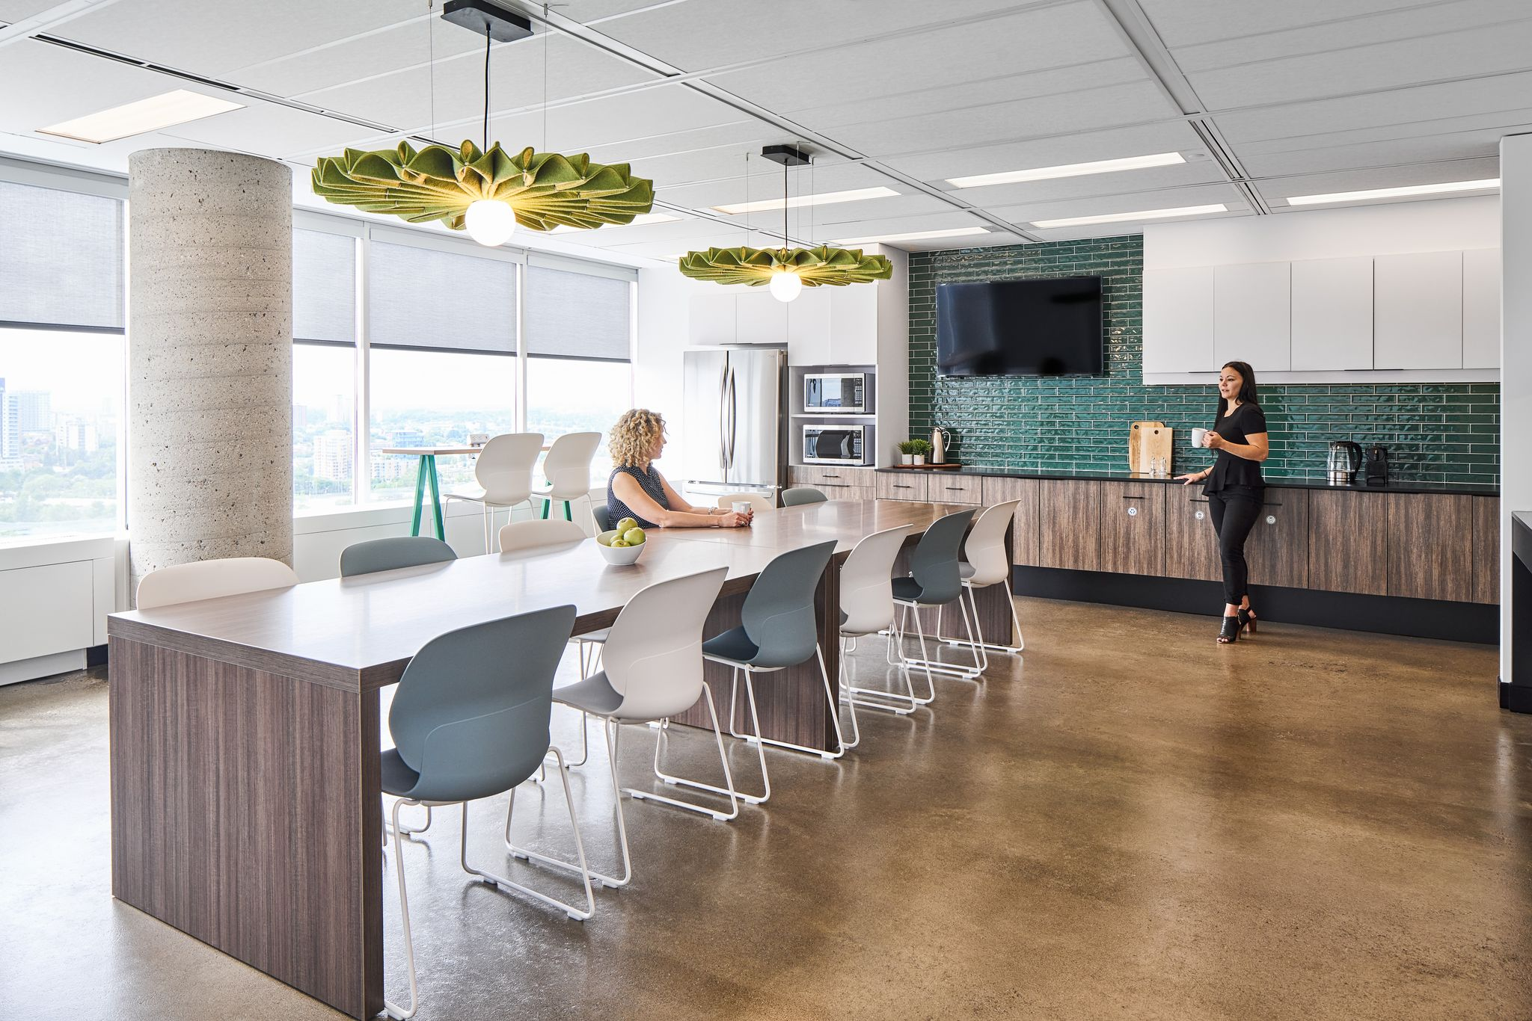
Workplace modernization is...
And this!
STRATEGIC WORKPLACE ADVISORY GROUP (SWAG) | ACCOMMODATION MANAGEMENT AND WORKPLACE SOLUTIONS

Slide 11
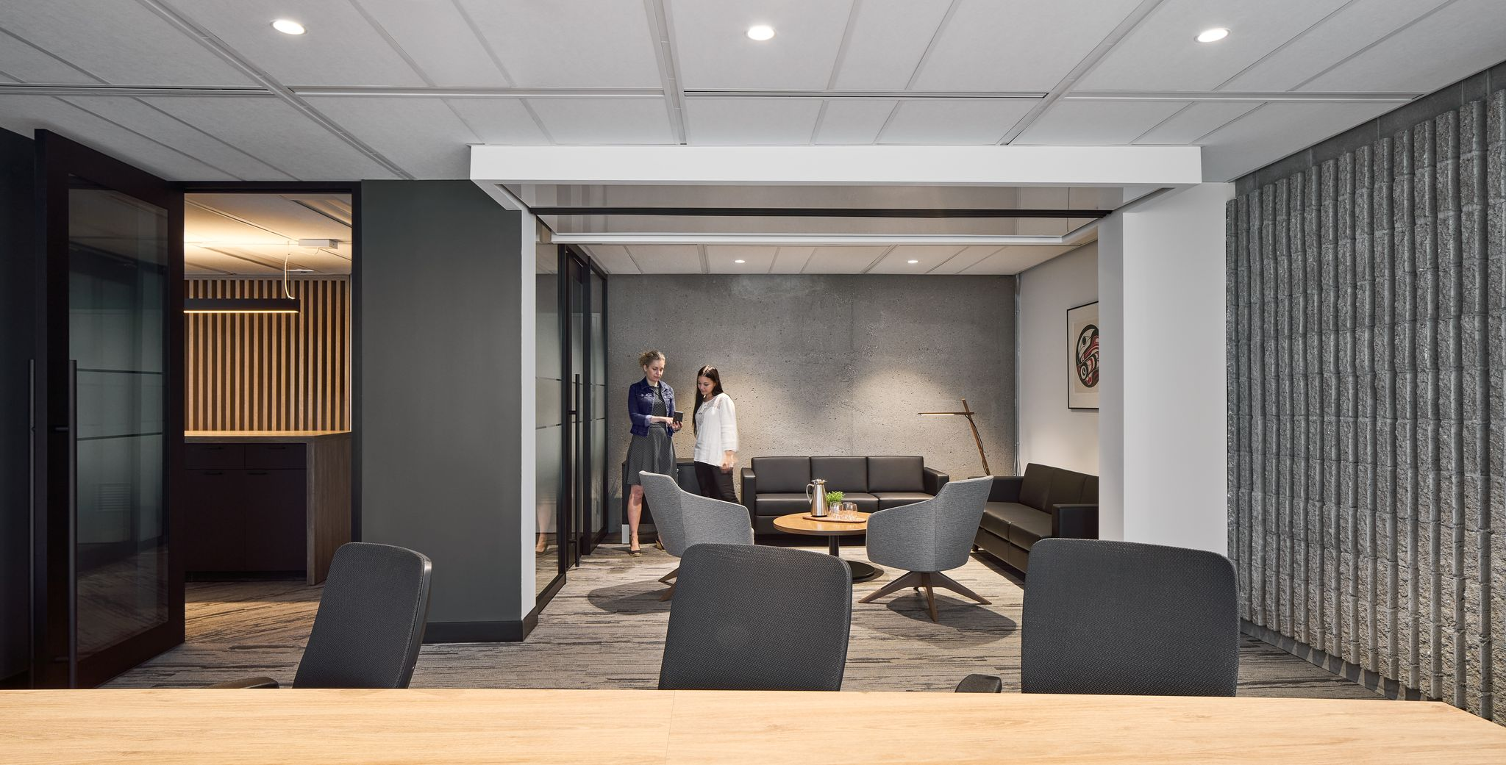
Workplace modernization is...
And this!
STRATEGIC WORKPLACE ADVISORY GROUP (SWAG) | ACCOMMODATION MANAGEMENT AND WORKPLACE SOLUTIONS

Slide 12
Workplace modernization is...
…much more than a fit-up.
Enables a modern way of working
Optimizes office space utilization
Supports diversity, equity and inclusion
Contributes to a positive workplace experience
Attracts new talent and improves employee retention
Empowers a high performing workforce
Contributes to government greening initiatives
STRATEGIC WORKPLACE ADVISORY GROUP (SWAG) | ACCOMMODATION MANAGEMENT AND WORKPLACE SOLUTIONS
Notes:
Workplace is being used as a catalyst to modernizing and transforming the public service workplace culture

Slide 13
The Workplace Modernization Puzzle
Defines the number of employees expected on-site throughout the week
Supports the number of employees expected on-site throughout the week
Hybrid Work Model
Portfolio Strategy
Supports a new, modern way of working in the workplace
Defines a new, modern way of working in the workplace
Physical Workspace
Workplace Utilization
STRATEGIC WORKPLACE ADVISORY GROUP (SWAG) | ACCOMMODATION MANAGEMENT AND WORKPLACE SOLUTIONS

Slide 14
Example
A department adopts a “one fixed team day, and one flex day in the office” hybrid work model
Hybrid Work Model
STRATEGIC WORKPLACE ADVISORY GROUP (SWAG) | ACCOMMODATION MANAGEMENT AND WORKPLACE SOLUTIONS

Slide 15
Example
The portfolio can be optimized / right-sized to this new reality, while accounting for the additional space provided by the GCcoworking program, any projected growth, etc
Portfolio Strategy
STRATEGIC WORKPLACE ADVISORY GROUP (SWAG) | ACCOMMODATION MANAGEMENT AND WORKPLACE SOLUTIONS

Slide 16
Example
Mobile tech and digitized work enable employees to choose the setting within the workplace that best suits their activities, needs, abilities and personal preferences
Workplace Utilization
STRATEGIC WORKPLACE ADVISORY GROUP (SWAG) | ACCOMMODATION MANAGEMENT AND WORKPLACE SOLUTIONS

Slide 17
Example
The space is modernize to
standards through fit-up, the Workplace Transformation Program, etc
Physical Workspace
STRATEGIC WORKPLACE ADVISORY GROUP (SWAG) | ACCOMMODATION MANAGEMENT AND WORKPLACE SOLUTIONS

Slide 18
GCworkplace & Activity-Based Working
Physical Workspace
Workplace Utilization
STRATEGIC WORKPLACE ADVISORY GROUP (SWAG) | ACCOMMODATION MANAGEMENT AND WORKPLACE SOLUTIONS

Slide 19
the Government of Canada’s design standard for General Purpose Office space
is designed to enable
Activity-Based
Working (ABW)
a modern, tech enabled, flexible way of using the workplace
STRATEGIC WORKPLACE ADVISORY GROUP (SWAG) | ACCOMMODATION MANAGEMENT AND WORKPLACE SOLUTIONS
Notes:
GCworkplace: is the Government of Canada’s General Purpose Office space design standard. It is a modern, efficient and inclusive workplace design strategy which supports a flexible way of working.
Is designed to enable
Activity-Based Working (ABW): is a flexible way of working that offers all employees equal access to a variety of workpoints, and the autonomy to choose the optimal settings for their tasks and functions.

Slide 20
Why?
Choice and flexibility of where & how to work
Adaptable to personal needs & preferences
Access to a wide range of amenities and workpoints, both open and enclosed
For employees…
Design is adaptable to suit varying functional requirements
Eliminates many common tenant service requests
Significant reduction in custom modifications for Duty to accommodate (DTA) and ergonomic requirements
For asset management…
Optimizes use of space
Enables departments to ‘right-size’ their office portfolio to reflect their updated requirements for a hybrid work model
For the office portfolio…
STRATEGIC WORKPLACE ADVISORY GROUP (SWAG) | ACCOMMODATION MANAGEMENT AND WORKPLACE SOLUTIONS

Slide 21
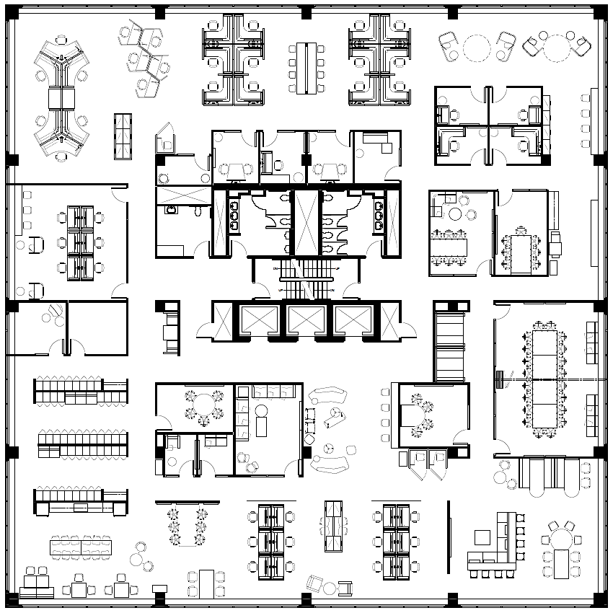
Activity-based working promotes space optimization,
NOT densification.
OCCUPANTS
individuals physically in the workplace at any point in time
vs
POPULATION
all individuals who have been given access and permission to use the workplace in question
STRATEGIC WORKPLACE ADVISORY GROUP (SWAG) | ACCOMMODATION MANAGEMENT AND WORKPLACE SOLUTIONS
Notes:
EXAMPLE
GCworkplace floor for 100 onsite occupants:
Impact of different hybrid work models:
NO remote work ▷ can serve 100 total population
LOW remote work ▷ can serve 120 total population
MED. remote work ▷ can serve 150 total population
HIGH remote work ▷ can serve 180 total population

Slide 22
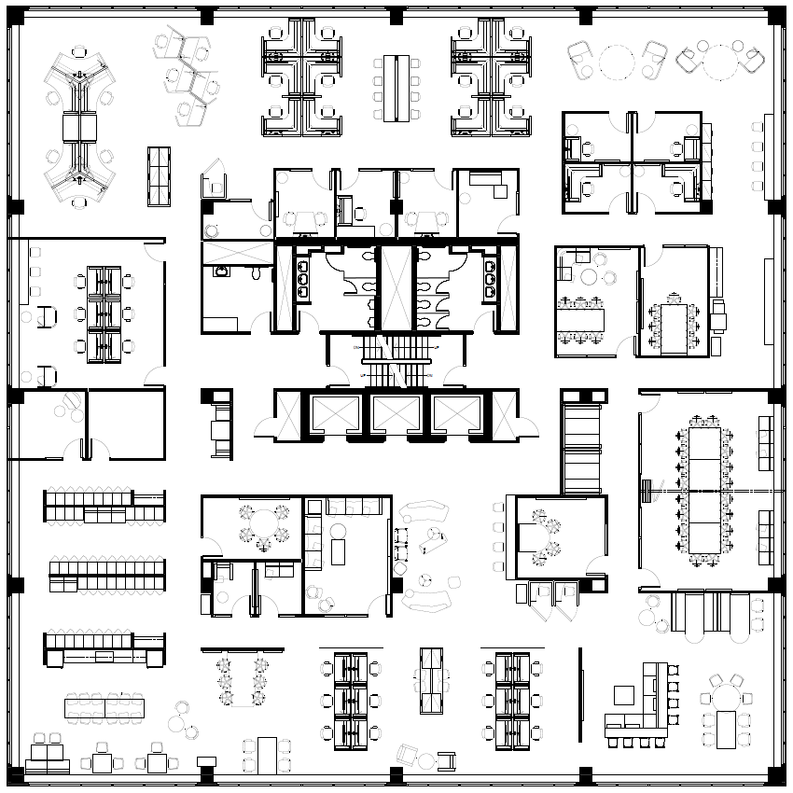
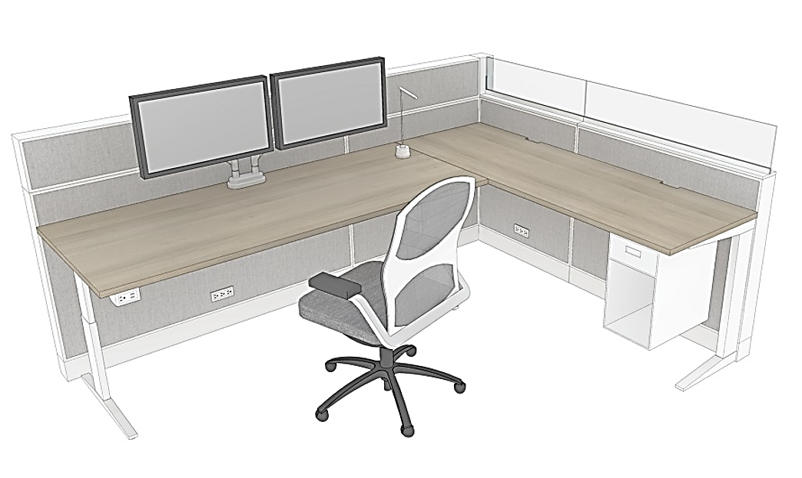
Quiet Zone
Zoning
Transitional Zone
Phone
Call
Routine
Tasks
Focus
Work
Quick
Chat
Different activities have different acoustic and visual privacy requirements. Mobile technology allows the freedom to untether from doing everything from one location.
Interactive Zone
STRATEGIC WORKPLACE ADVISORY GROUP (SWAG) | ACCOMMODATION MANAGEMENT AND WORKPLACE SOLUTIONS
Notes:
The most important improvement from WP2.0 and previous design standards is the concept of zoning

Slide 23
Utilization
Accessibility and inclusivity is achieved when each individual has the autonomy to self-select HOW they need/want/prefer to make use of the workplace and its variety of work settings.
STRATEGIC WORKPLACE ADVISORY GROUP (SWAG) | ACCOMMODATION MANAGEMENT AND WORKPLACE SOLUTIONS
Notes:
The idea with the workpoint variety, and shared, equal access, is that each person has the autonomy to self select the work setting that supports their activities, needs and personal preferences, at any point throughout the day.

Slide 24
The
Ecosystem
Acoustical Zones
Quiet
Transitional
Interactive
interconnected work settings that serve its population and their various activities
shared & equal access utilization to provide flexibility and choice to all users
each part works in harmony to create an efficient and productive work environment for all occupants
The Workplace Ecosystem
Workpoint variety*
Enclosed individual
Enclosed collaborative
Open individual
Open collaborative
*Important Consideration:
Access to all types of workpoints, no matter if they are individual or collaborative, open or enclosed, is required for all users to ensure that the workplace is functional, but most importantly, accessible and inclusive to everyone.
For example: assigning all enclosed individual workpoints to specific individuals would have a negative impact to the workplace’s functionality for everyone else. Instead, strategies like ‘priority use’ can be considered – see next slide.
Support Spaces
Wellness room
Lockers
Kitchenette
Business center
STRATEGIC WORKPLACE ADVISORY GROUP (SWAG) | ACCOMMODATION MANAGEMENT AND WORKPLACE SOLUTIONS

Slide 25
SPECIAL EQUIPMENT / HARD LINES
(ex: GCSI terminal, etc)
Shared by default
Narrow by necessity
PRIORITY ACCESS
(ex: priority use for ADM)
SPECIFIC FUNCTION
(ex: workplace concierge, conflict resolution office)
Because certain functions (ei: secure lines, specialized equipment, etc) have physical needs or limitations
SECURE AREA
(ex: secure suite on a secure floor)
STRATEGIC WORKPLACE ADVISORY GROUP (SWAG) | ACCOMMODATION MANAGEMENT AND WORKPLACE SOLUTIONS
Notes:
So how do we incorporate functions and requirements that NEED to have their own dedicated space?
Starting with the assumption that all workpoints are shared by default will allow for maximum flexibility, the idea is to consider the functional limitation to then determine what the space solution should be

Slide 26
The
Neighbourhood Concept
While choice and flexibility are great, too much choice in location can lead to losing a sense of belonging, especially for someone’s primary workplace. Creating neighborhoods (1 floor = 1 neighborhood) promotes team cohesion and meaningful time in the office.
NEIGHBOURHOOD
Branch A
NEIGHBOURHOOD
Branch B
Team A
Team B
RESTRICTED
Group Y & Z from Branch B only
NEIGHBOURHOOD
Branch C
SHARED FLOOR
Open to all
DEDICATED
Function X, all branches
Team C
SHARED INTERACTIVE FLOOR
Open to all
STRATEGIC WORKPLACE ADVISORY GROUP (SWAG) | ACCOMMODATION MANAGEMENT AND WORKPLACE SOLUTIONS

Slide 27
Ensuring Success
Establish Leadership and governance
Clearly define and articulate a vision for the workplace
Demonstrating active and visible leadership
Engage employees
Empower and equip managers
Create opportunities to experience these changes
STRATEGIC WORKPLACE ADVISORY GROUP (SWAG) | ACCOMMODATION MANAGEMENT AND WORKPLACE SOLUTIONS
Notes:
Easier for smaller orgs

Slide 28
Strategic Workplace Advisory Group (SWAG)
Accommodation Management & Workplace Solutions
Real Property Services
Public Services and Procurement Canada
Contact us for more information!
STRATEGIC WORKPLACE ADVISORY GROUP (SWAG) | ACCOMMODATION MANAGEMENT AND WORKPLACE SOLUTIONS

