Slide 1
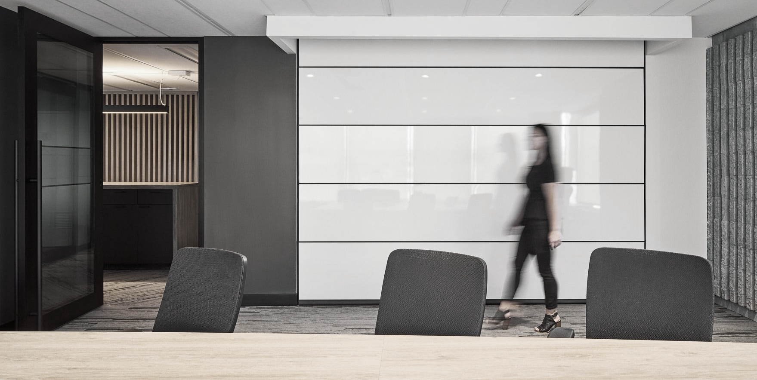



FEDERAL WORKPLACE MODERNIZATION
Flexibility for a Hybrid Future
June 2023

Slide 2
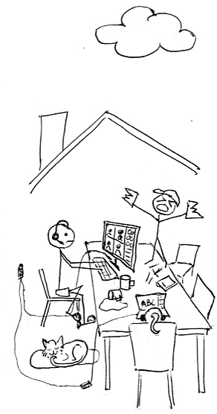
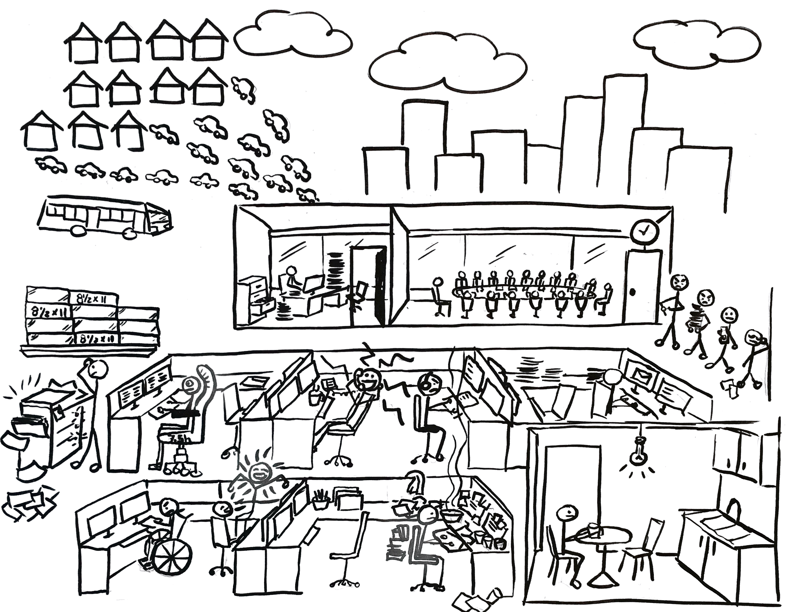
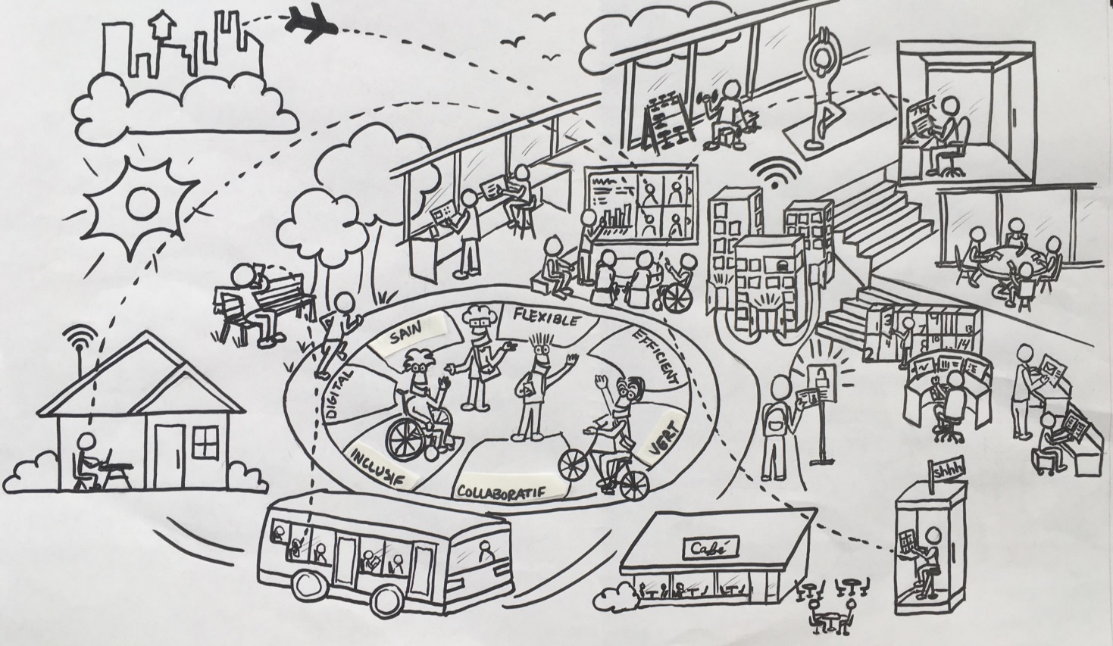


2023 onward…
2020 – 2021 – 2022
…until 2020
STRATEGIC WORKPLACE ADVISORY GROUP (SWAG) | ACCOMMODATION MANAGEMENT AND WORKPLACE SOLUTIONS

Slide 3



Most agree,
HYBRID WORKING is here to stay
Where we were…
Where we’re going…
STRATEGIC WORKPLACE ADVISORY GROUP (SWAG) | ACCOMMODATION MANAGEMENT AND WORKPLACE SOLUTIONS
Notes:
Where we were
Everything is assigned
Floors to departments
Workstations to employees
Static/individualistic workplaces
GCcoworking not yet available
Where we’re going…
Office Long Term Plan
Continue modernizing workplaces
Right-sizing departmental space
More interdepartmental space

Slide 4
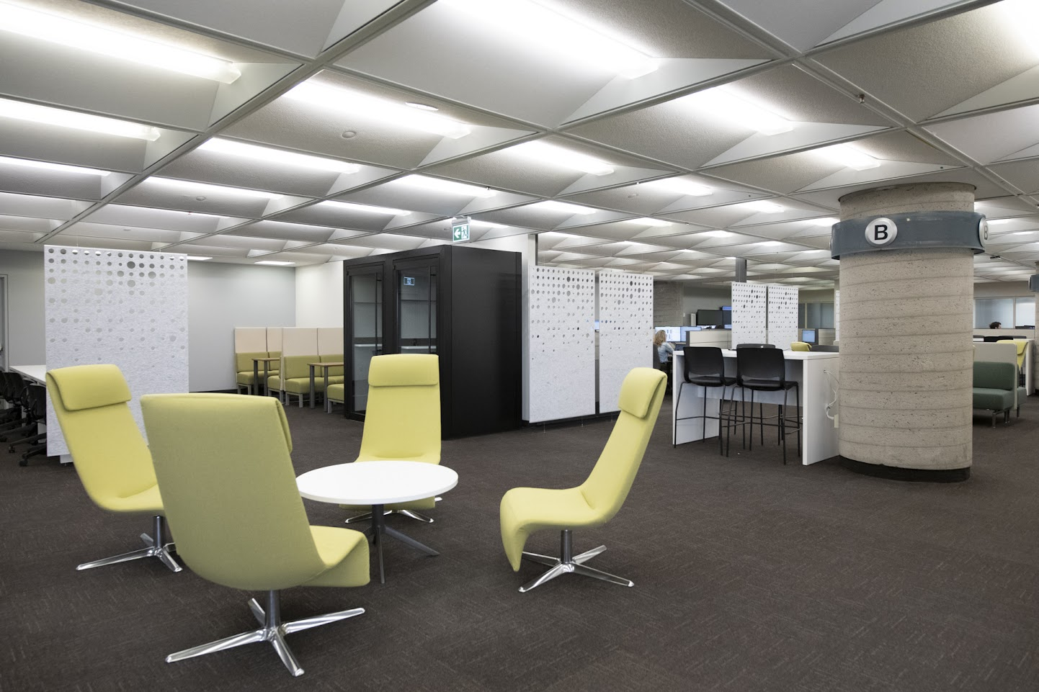
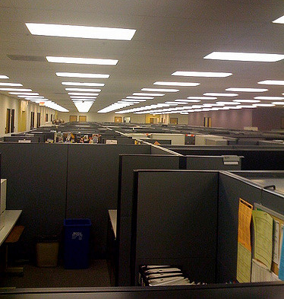
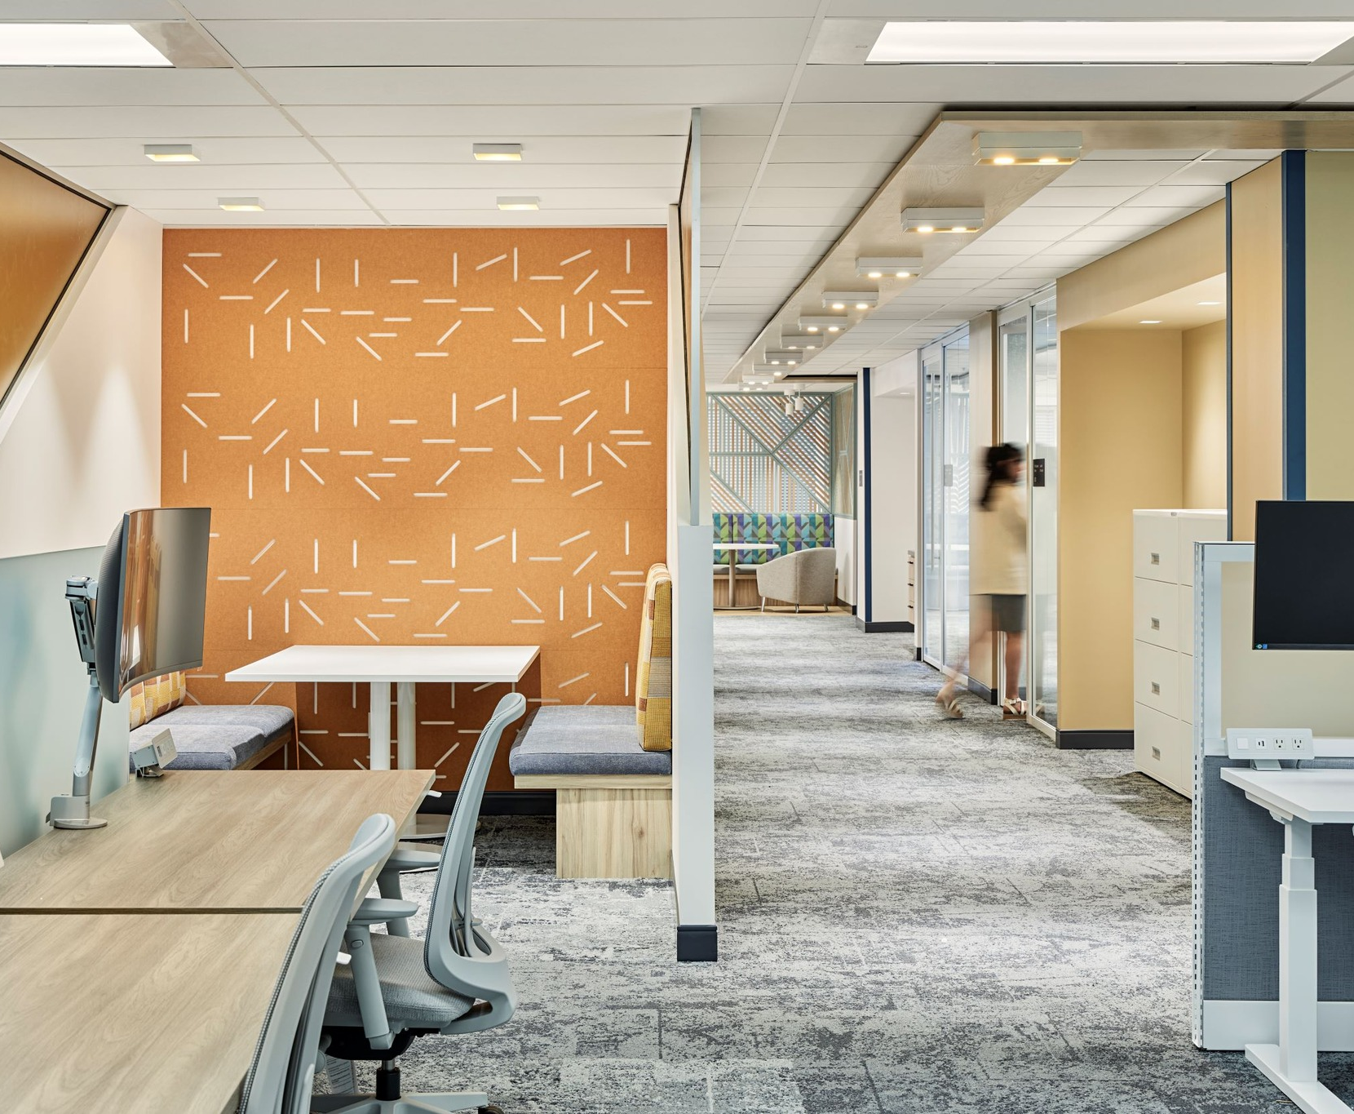
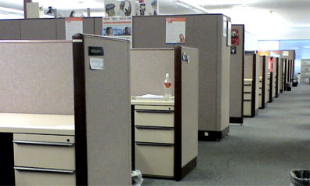
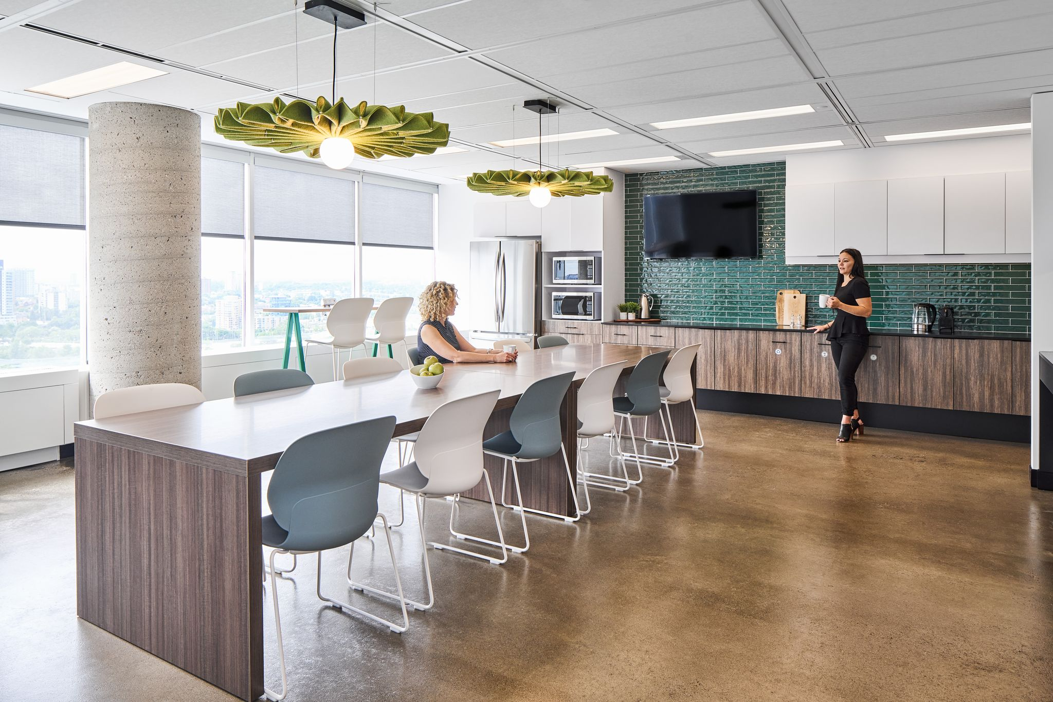
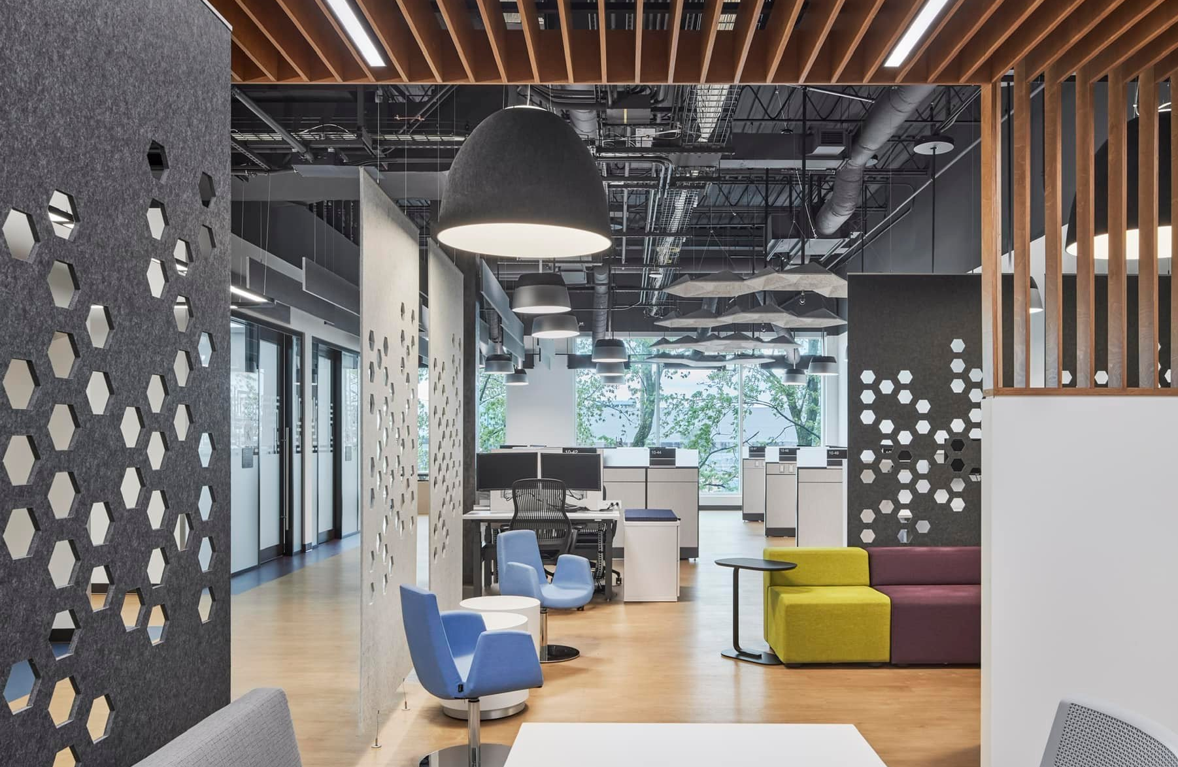
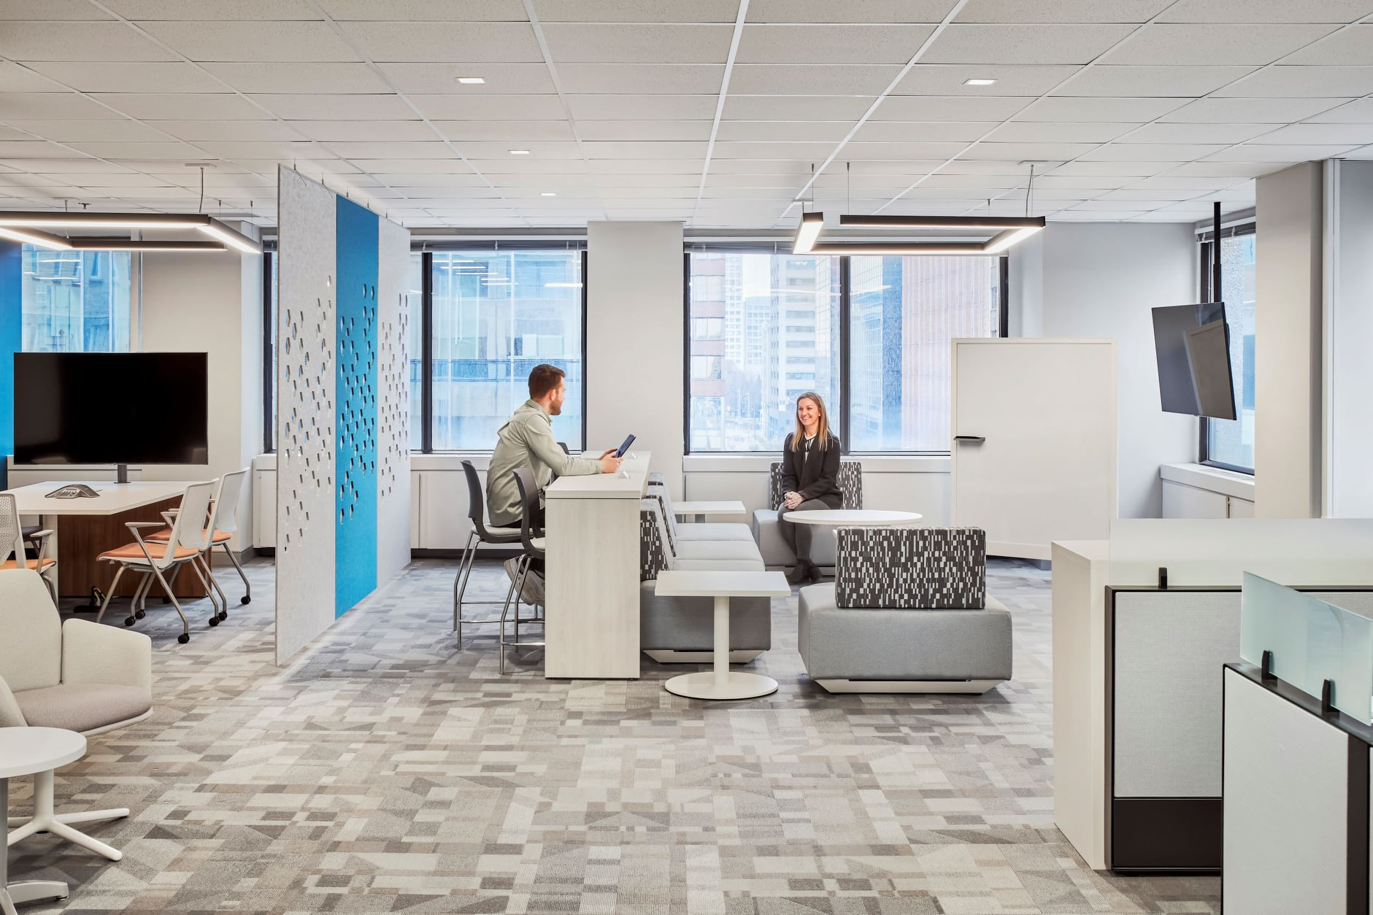
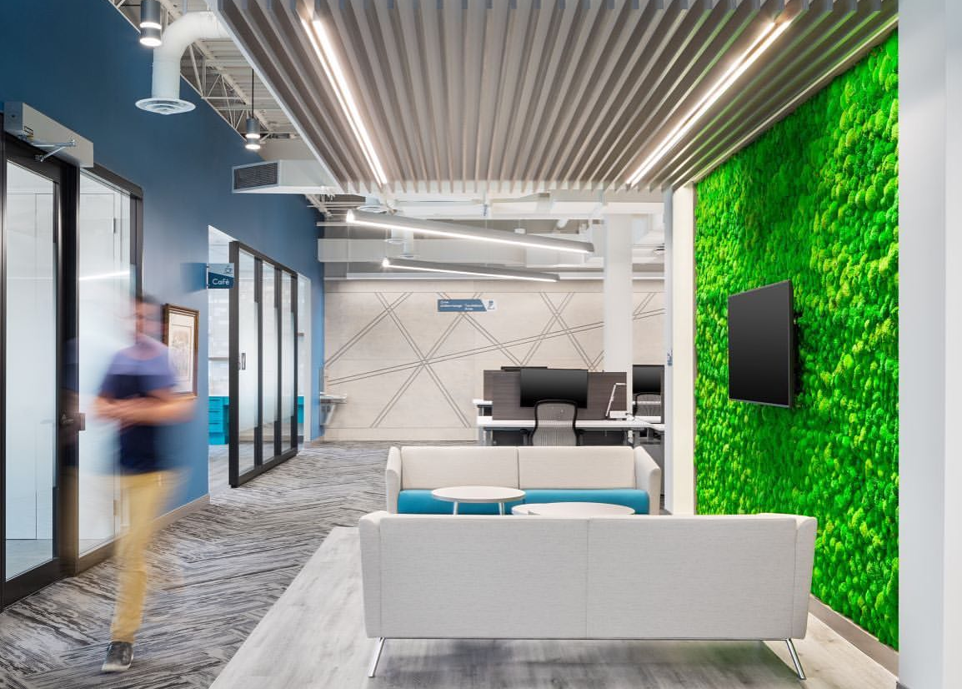
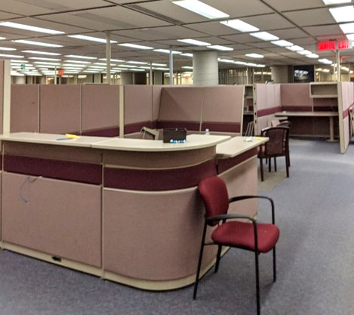
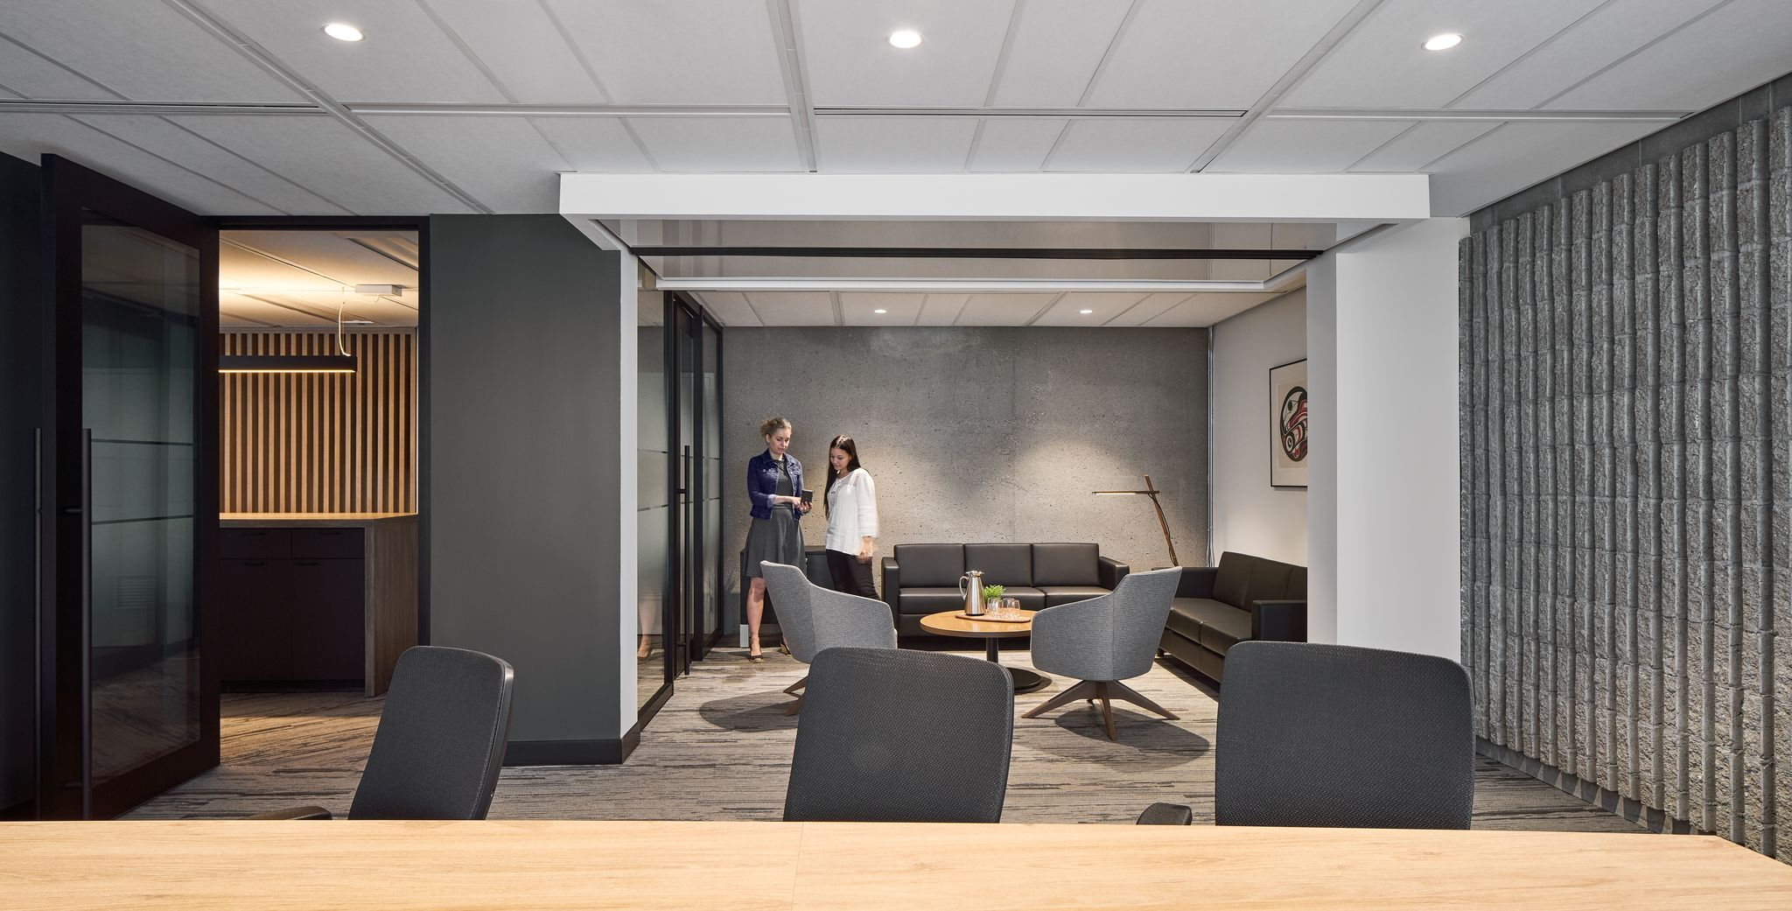
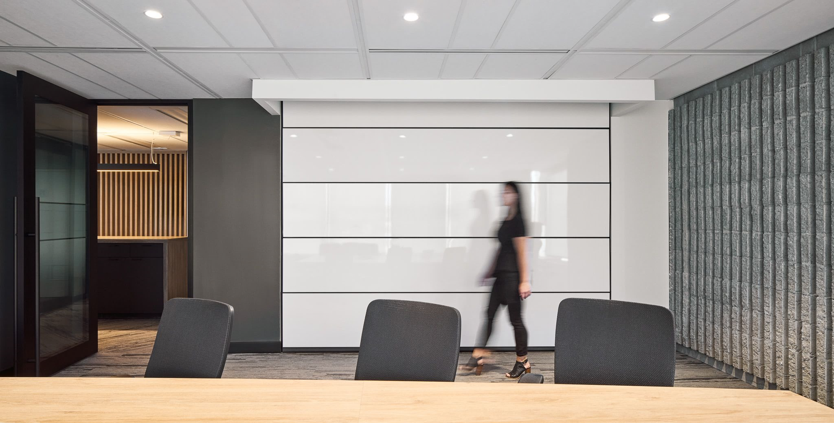
Workplace modernization is...
Going from this…
Transforming this
Turning this…
To this!
To this!
And this!
Into this!
STRATEGIC WORKPLACE ADVISORY GROUP (SWAG) | ACCOMMODATION MANAGEMENT AND WORKPLACE SOLUTIONS

Slide 5

Workplace modernization is...
…much more than a fit-up.
Enables a modern way of working
Optimizes office space utilization
Supports diversity, equity and inclusion
Contributes to a positive workplace experience
Attracts new talent and improves employee retention
Empowers a high performing workforce
Contributes to government greening initiatives
STRATEGIC WORKPLACE ADVISORY GROUP (SWAG) | ACCOMMODATION MANAGEMENT AND WORKPLACE SOLUTIONS

Slide 6






The Workplace Modernization Puzzle
Defines the number of employees expected on-site throughout the week
Supports the number of employees expected on-site throughout the week
Hybrid Work Model
Portfolio Strategy
Supports a new, modern way of working in the workplace
Defines a new, modern way of working in the workplace
Physical Workspace
Workplace Utilization
STRATEGIC WORKPLACE ADVISORY GROUP (SWAG) | ACCOMMODATION MANAGEMENT AND WORKPLACE SOLUTIONS

Slide 7
Example
A department adopts a “one fixed team day, and one flex day in the office” hybrid work model
Hybrid Work Model
STRATEGIC WORKPLACE ADVISORY GROUP (SWAG) | ACCOMMODATION MANAGEMENT AND WORKPLACE SOLUTIONS

Slide 8
Example
The space is modernize to GCworkplace standards through fit-up, the Workplace Transformation Program, etc
Physical Workspace
STRATEGIC WORKPLACE ADVISORY GROUP (SWAG) | ACCOMMODATION MANAGEMENT AND WORKPLACE SOLUTIONS

Slide 9
Example
Mobile tech and digitized work enable employees to choose the setting within the workplace that best suits their activities, needs, abilities and personal preferences
Workplace Utilization
STRATEGIC WORKPLACE ADVISORY GROUP (SWAG) | ACCOMMODATION MANAGEMENT AND WORKPLACE SOLUTIONS

Slide 10
Example
The portfolio can be optimized / right-sized to this new reality, while accounting for the additional space provided by the GCcoworking program, any projected growth, etc
Portfolio Strategy
STRATEGIC WORKPLACE ADVISORY GROUP (SWAG) | ACCOMMODATION MANAGEMENT AND WORKPLACE SOLUTIONS

Slide 11



Why?
Choice and flexibility of where & how to work
Adaptable to personal needs & preferences
Access to a wide range of amenities and workpoints, both open and enclosed
For employees…
Design is adaptable to suit varying functional requirements
Eliminates many common tenant service requests
Significant reduction in custom modifications for Duty to accommodate (DTA) and ergonomic requirements
For asset management…
Optimizes use of space
Enables departments to ‘right-size’ their office portfolio to reflect their updated requirements for a hybrid work model
For the office portfolio…
STRATEGIC WORKPLACE ADVISORY GROUP (SWAG) | ACCOMMODATION MANAGEMENT AND WORKPLACE SOLUTIONS
Notes:
GCworkplace is contributing to the vision for the Government of Canada (GC) workplace; a vision that is shared across the GC and that now guides Public Services and Procurement Canada’s decisions as they relate to the workplace solutions offered to federal departments and agencies and the delivery of workplace modernization projects.
GCworkplace is challenging what it’s like to work in government. To meet the demands of modern Canada, we’re doing things differently; like retooling work environments to encourage collaboration, using technology in smarter ways, and fostering a culture of flexibility and well-being. It’s time to work how and where it makes sense.

Slide 12
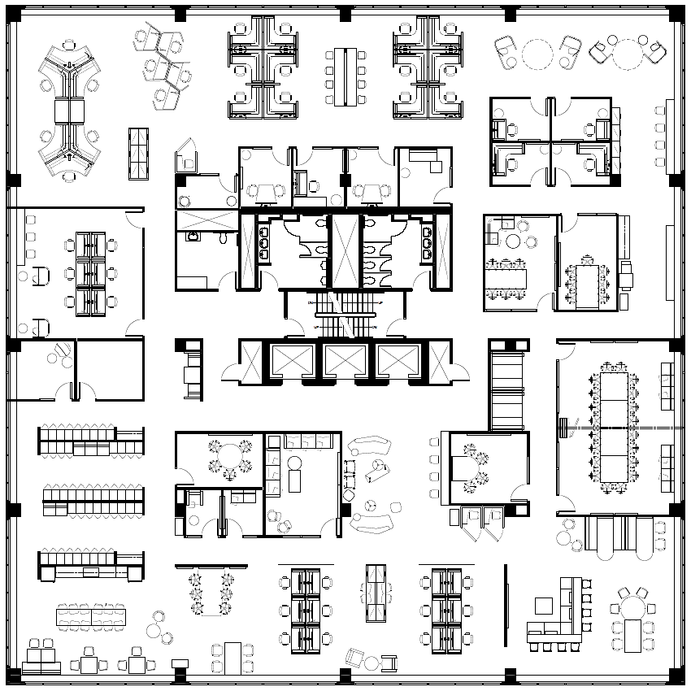
Activity-based working promotes space optimization,
NOT densification.
OCCUPANTS
individuals physically in the workplace at any point in time
vs
POPULATION
all individuals who have been given access and permission to use the workplace in question
STRATEGIC WORKPLACE ADVISORY GROUP (SWAG) | ACCOMMODATION MANAGEMENT AND WORKPLACE SOLUTIONS
Notes:
EXAMPLE
GCworkplace floor for 100 onsite occupants:
Impact of different hybrid work models:
NO remote work ▷ can serve 100 total population
LOW remote work ▷ can serve 120 total population
MED. remote work ▷ can serve 150 total population
HIGH remote work ▷ can serve 180 total population

Slide 13
GCworkplace & Activity-Based Working
Physical Workspace
Workplace Utilization
STRATEGIC WORKPLACE ADVISORY GROUP (SWAG) | ACCOMMODATION MANAGEMENT AND WORKPLACE SOLUTIONS

Slide 14

the Government of Canada’s design standard for General Purpose Office space
is designed to enable
Activity-Based
Working (ABW)
a modern, tech enabled, flexible way of using the workplace
STRATEGIC WORKPLACE ADVISORY GROUP (SWAG) | ACCOMMODATION MANAGEMENT AND WORKPLACE SOLUTIONS
Notes:
GCworkplace: is the Government of Canada’s General Purpose Office space design standard. It is a modern, efficient and inclusive workplace design strategy which supports a flexible way of working.
Is designed to enable
Activity-Based Working (ABW): is a flexible way of working that offers all employees equal access to a variety of workpoints, and the autonomy to choose the optimal settings for their tasks and functions.
Some of the benefits of ABW include;
Choice and flexibility of where & how to work
Adaptable to personal needs & preferences
Access to a wide range of workpoints and amenities
Benefits for asset management:
Adaptable design to suit varying functional requirements
Eliminates most common tenant service requests
Reduction in custom modifications and ergonomic requirements
Benefits for the portfolio:
Optimizes use of space
Enables departments to ‘right-size’ their office portfolio to reflect updated requirements for hybrid work

Slide 15
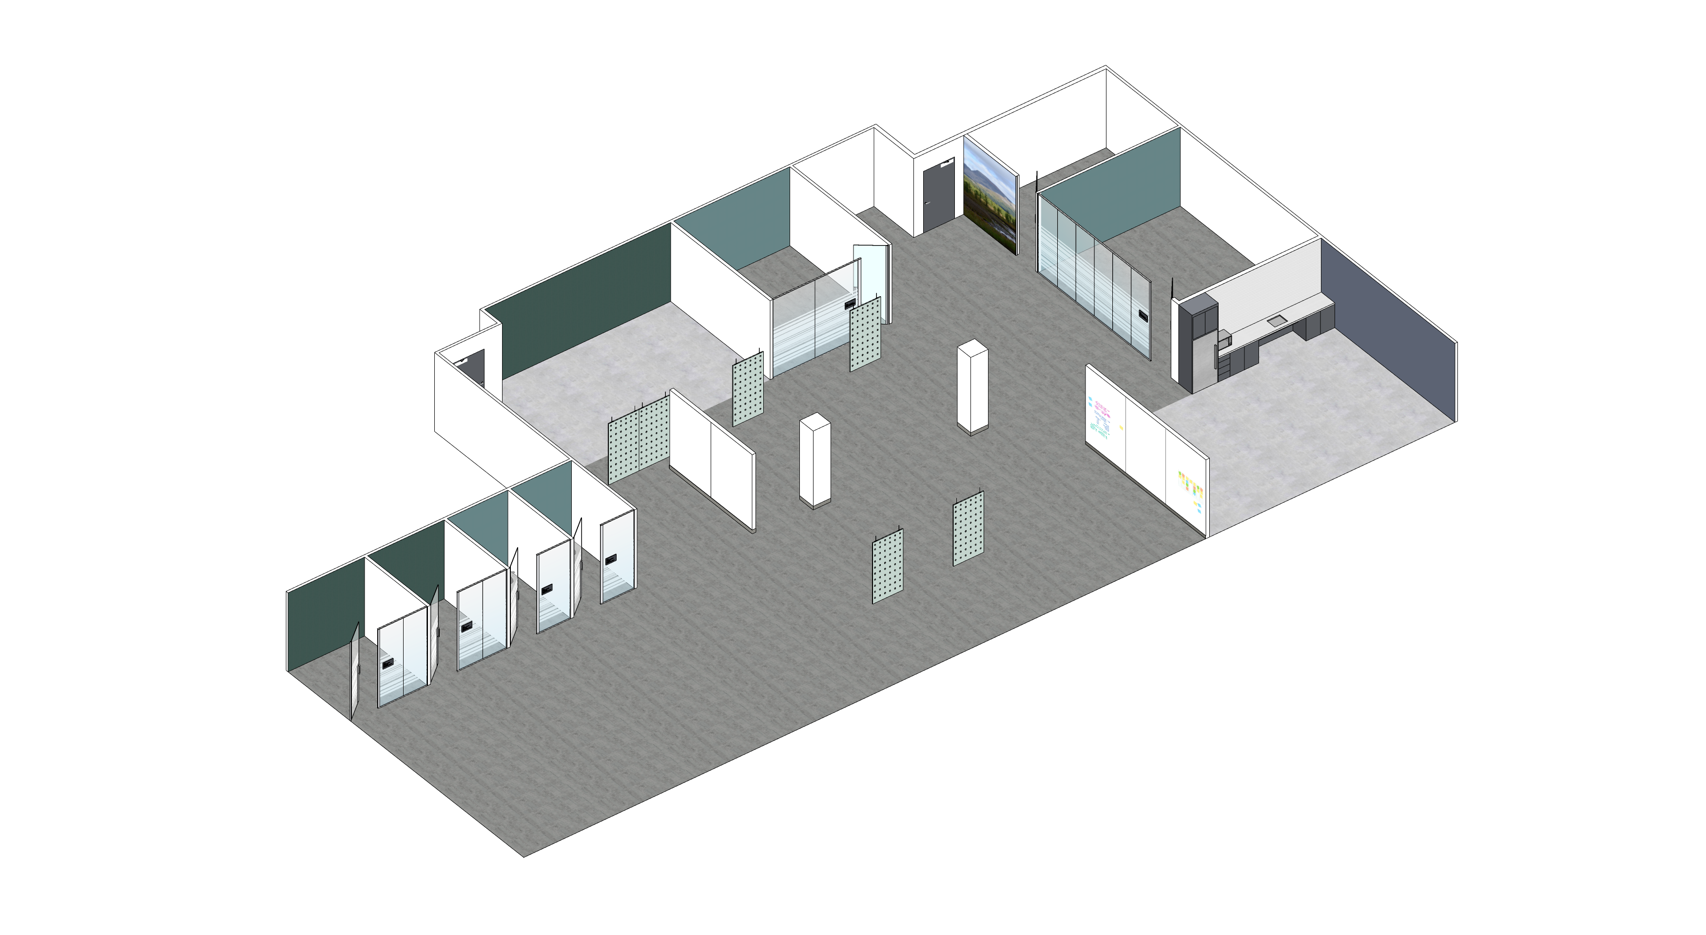
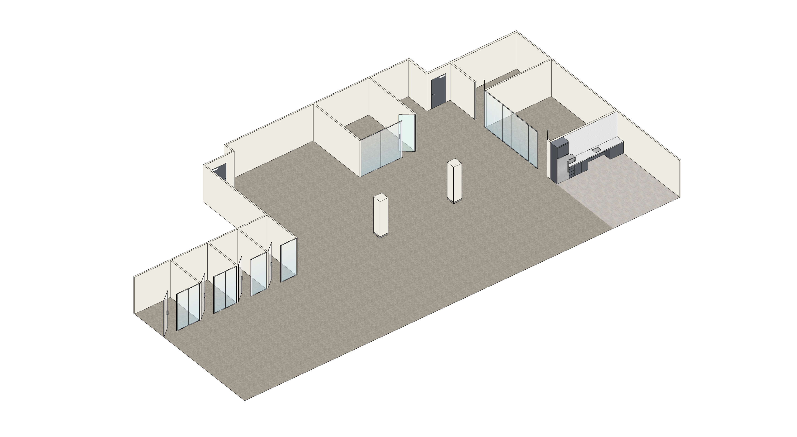
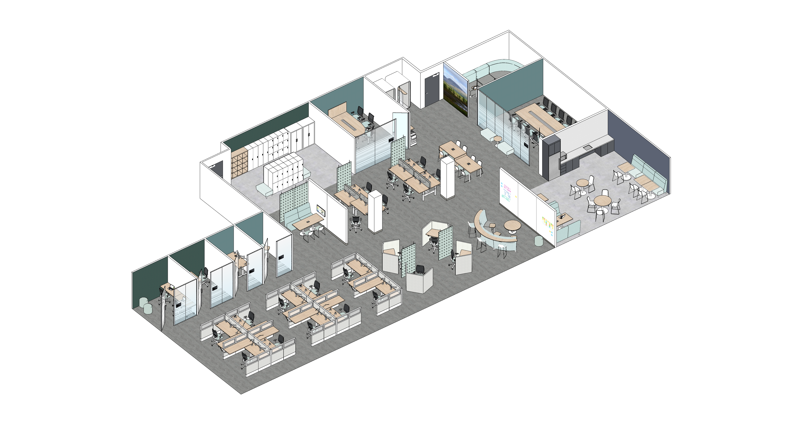


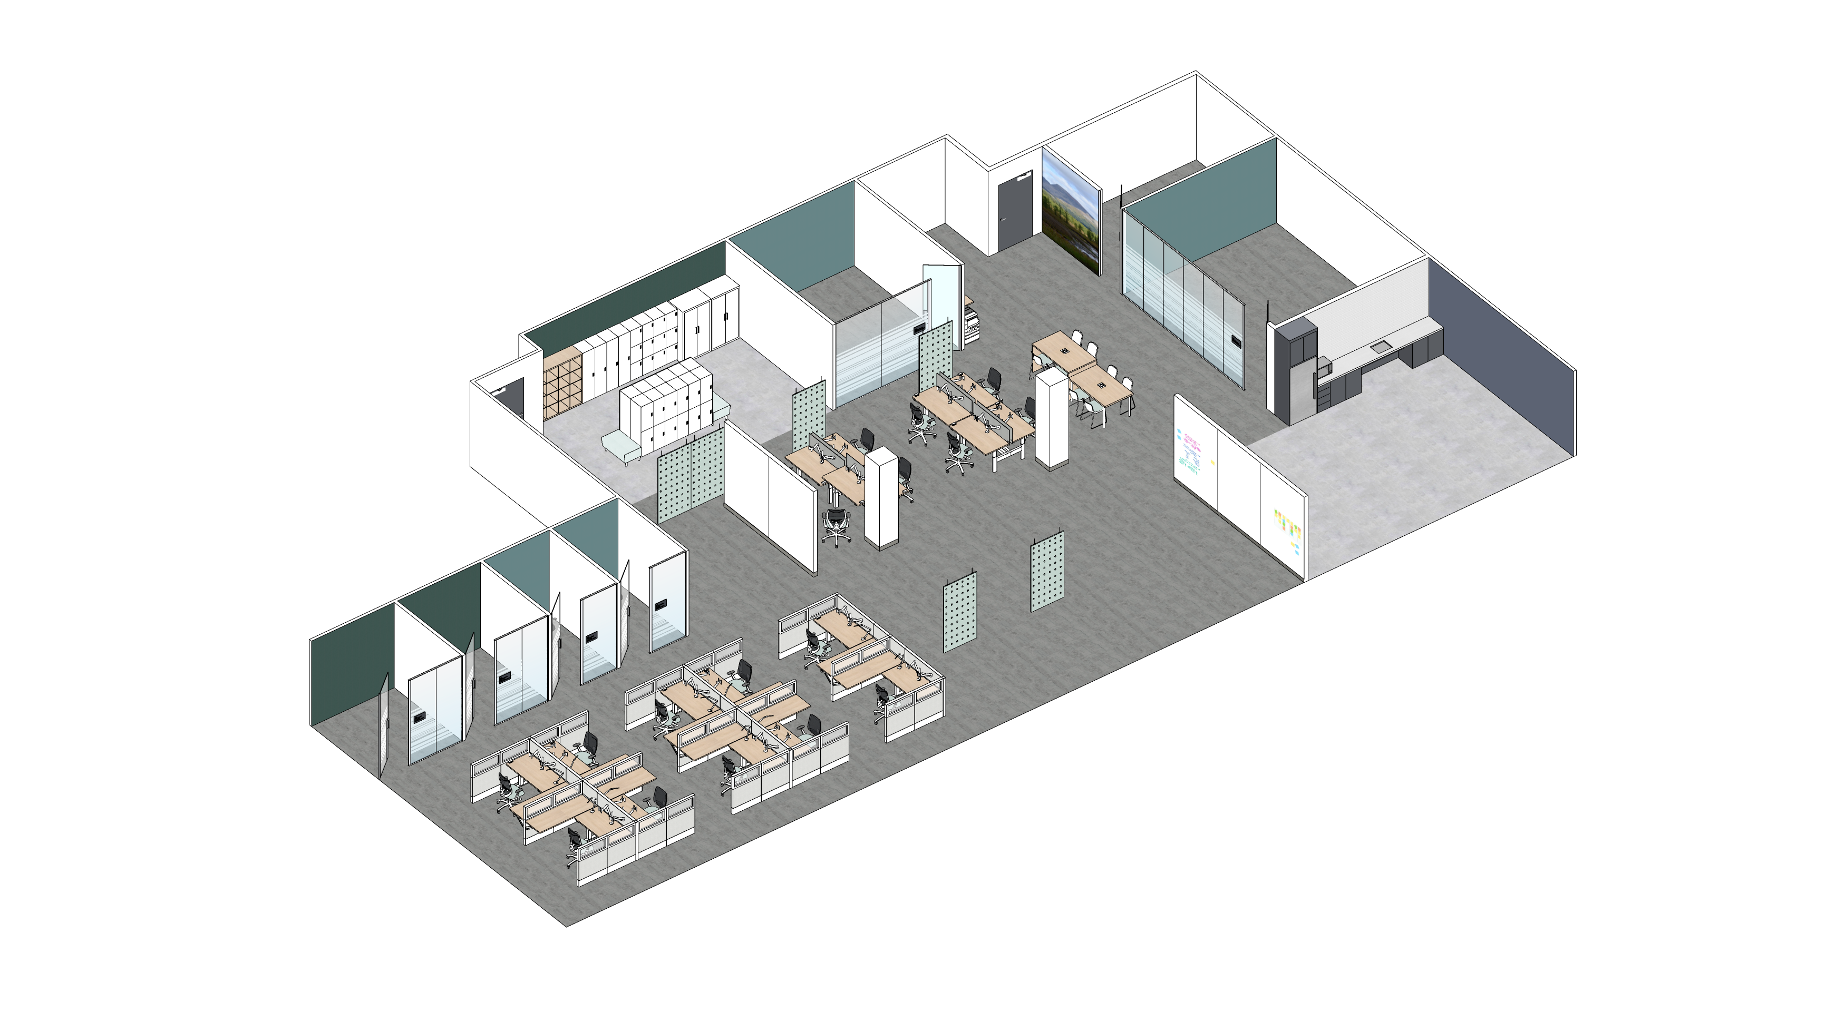
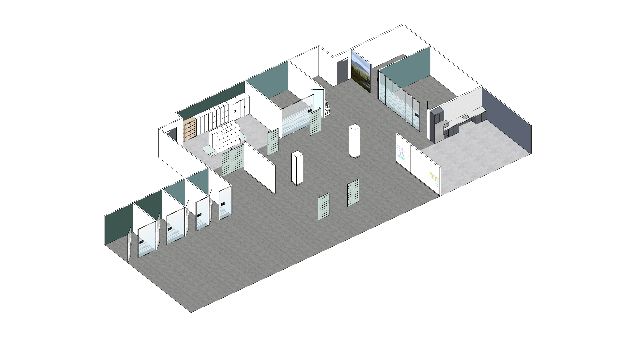
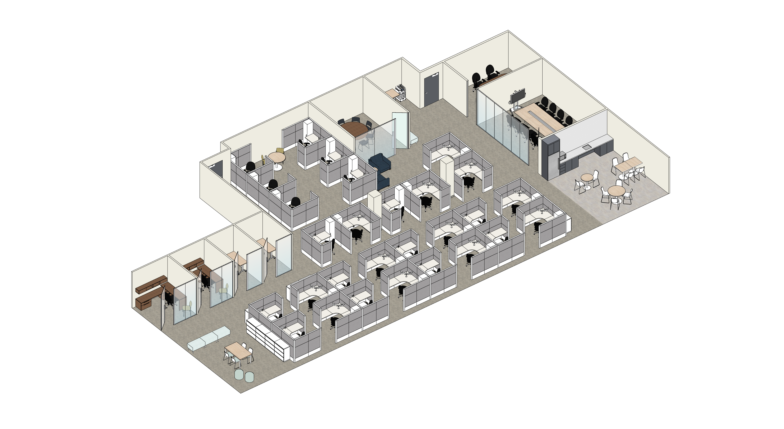

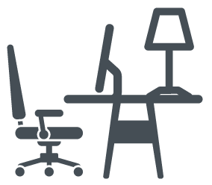


SUPPORT SPACE
VARIETY OF INDIVIDUAL
WORKPOINTS
BEFORE
AFTER
ENABLING VIRTUAL
COLLABORATION
FOSTERING IN PERSON
COLLABORATION
STRATEGIC WORKPLACE ADVISORY GROUP (SWAG) | ACCOMMODATION MANAGEMENT AND WORKPLACE SOLUTIONS
Notes:
The word ‘UNASSIGNED’ has gotten a bad reputation with the focus being on employees ‘losing their workstation or office’ when really, it is the KEY to freeing people from one imposed location, to then gain access to an entire workplace.
Now, with mobile technology and digitized work being the norm, employees are empowered to choose the work setting and environment that best suits their own activities, needs, abilities and personal preferences within the office, at any given time.

Slide 16
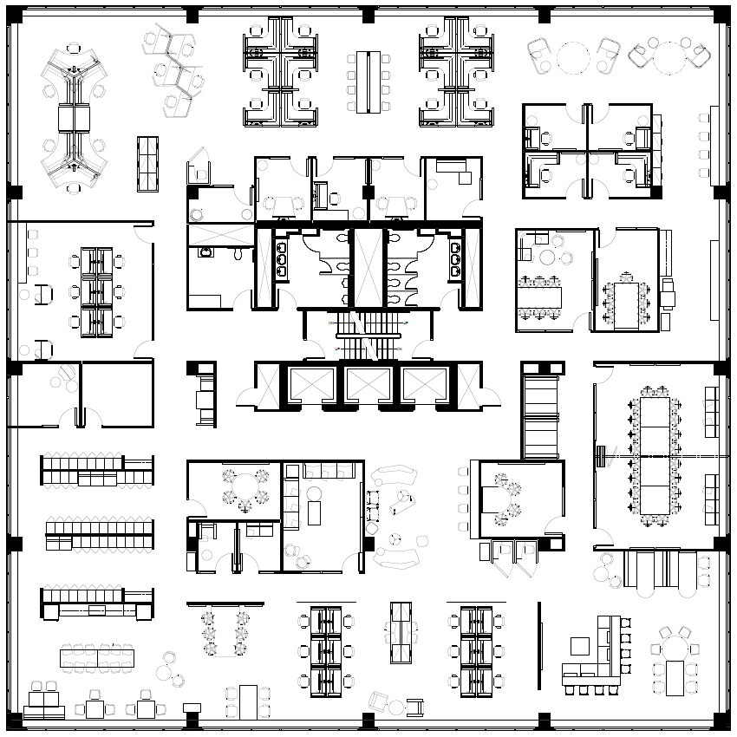




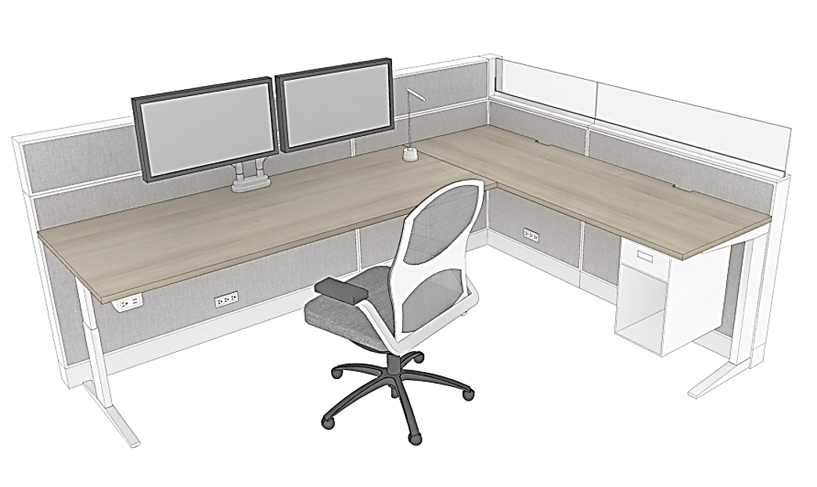


Quiet Zone
Zoning
Transitional Zone
Phone
Call
Routine
Tasks
Focus
Work
Quick
Chat
Interactive Zone
STRATEGIC WORKPLACE ADVISORY GROUP (SWAG) | ACCOMMODATION MANAGEMENT AND WORKPLACE SOLUTIONS

Slide 17







Utilization
STRATEGIC WORKPLACE ADVISORY GROUP (SWAG) | ACCOMMODATION MANAGEMENT AND WORKPLACE SOLUTIONS
Notes:
Starting with the assumption that all workpoints are shared by default will allow for maximum flexibility. However, certain instances, like physical security requirements, fixed equipment or hardwired lines, may require a dedicated space or priority use.
It works for all general office space, and works for everyone. In an activity-based work environment, like GCworkplace, space is designed for functions and activities, not titles or levels.

Slide 18
The
Ecosystem
Acoustical Zones
Quiet
Transitional
Interactive
interconnected work settings that serve its population and their various activities
must remain intact to work effectively and provide flexibility and choice to users
each part works in harmony to create an efficient and productive work environment for all occupants
Workplace Ecosystem
Workpoint variety
Enclosed individual
Enclosed collaborative
Open individual
Open collaborative
Support Spaces
Wellness room
Lockers
Kitchenette
Business center
STRATEGIC WORKPLACE ADVISORY GROUP (SWAG) | ACCOMMODATION MANAGEMENT AND WORKPLACE SOLUTIONS
Notes:
Starting with the assumption that all workpoints are shared by default will allow for maximum flexibility. However, certain instances, like physical security requirements, fixed equipment or hardwired lines, may require a dedicated space or priority use.
It works for all general office space, and works for everyone. In an activity-based work environment, like GCworkplace, space is designed for functions and activities, not titles or levels.

Slide 19
SPECIAL EQUIPMENT / HARD LINES
(ex: GCSI terminal, etc)
Shared by default
Narrow by necessity
PRIORITY ACCESS
(ex: priority use for ADM)
SPECIFIC FUNCTION
(ex: workplace concierge, conflict resolution office)
SECURE AREA
(ex: secure suite on a secure floor)
STRATEGIC WORKPLACE ADVISORY GROUP (SWAG) | ACCOMMODATION MANAGEMENT AND WORKPLACE SOLUTIONS
Notes:
Starting with the assumption that all workpoints are shared by default will allow for maximum flexibility. However, certain instances, like physical security requirements, fixed equipment or hardwired lines, may require a dedicated space or priority use.
It works for all general office space, and works for everyone. In an activity-based work environment, like GCworkplace, space is designed for functions and activities, not titles or levels.

Slide 20


The
Neighbourhood Concept
NEIGHBOURHOOD
Branch A
NEIGHBOURHOOD
Branch B
Team A
Team B
RESTRICTED
Group Y & Z from Branch B only
NEIGHBOURHOOD
Branch C
SHARED FLOOR
Open to all
DEDICATED
Function X, all branches
Team C
SHARED INTERACTIVE FLOOR
Open to all
STRATEGIC WORKPLACE ADVISORY GROUP (SWAG) | ACCOMMODATION MANAGEMENT AND WORKPLACE SOLUTIONS
Notes:
Starting with the assumption that all workpoints are shared by default will allow for maximum flexibility. However, certain instances, like physical security requirements, fixed equipment or hardwired lines, may require a dedicated space or priority use.
It works for all general office space, and works for everyone. In an activity-based work environment, like GCworkplace, space is designed for functions and activities, not titles or levels.

Slide 21
What others are doing/planning
Canada School of Public Service (+/- 1000 FTEs)
Looking to PSPC for assistance to reconfigure office space at multiple locations , in support of hybird work and activity-based working
Canadian Nuclear Safety Commission (+/- 900 FTEs)
Currently modernizing to Gcworkplace through the Workplace Transformation Program. Most employees WFH until completion in Fall 2023.
31 of 32 client departments
(representing 89% of office space)
are currently using or planning to use an unassigned seating approach
Library and Archives Canada (+/- 1000 FTEs)
Building internal capacity to modernize corporate services office space to GCworkplace. Currently in pre-planning phase with PSPC for guidance on modernization plans.
50% of these client departments
are currently onboarded to the GCcoworking program, and another 25% are considering joining this year
STRATEGIC WORKPLACE ADVISORY GROUP (SWAG) | ACCOMMODATION MANAGEMENT AND WORKPLACE SOLUTIONS

Slide 22




Ensuring Success
Establish Leadership and governance
Clearly define and articulate a vision for the workplace
Demonstrating active and visible leadership
Engage employees
Empower and equip managers
Create opportunities to experience these changes
STRATEGIC WORKPLACE ADVISORY GROUP (SWAG) | ACCOMMODATION MANAGEMENT AND WORKPLACE SOLUTIONS

Slide 23
Questions & discussion
Véronique Boton
Manager, Strategic Workplace Advisory Group
Accommodation Management & Workplace Solutions
Real Property Services
Public Services and Procurement Canada
veronique.boton@tpsgc-pwgsc.gc.ca
STRATEGIC WORKPLACE ADVISORY GROUP (SWAG) | ACCOMMODATION MANAGEMENT AND WORKPLACE SOLUTIONS

Slide 24
…until 2020
STRATEGIC WORKPLACE ADVISORY GROUP (SWAG) | ACCOMMODATION MANAGEMENT AND WORKPLACE SOLUTIONS

Slide 25
2020 – 2021 – 2022
STRATEGIC WORKPLACE ADVISORY GROUP (SWAG) | ACCOMMODATION MANAGEMENT AND WORKPLACE SOLUTIONS

Slide 26
2023 onward…
2020 – 2021 – 2022
STRATEGIC WORKPLACE ADVISORY GROUP (SWAG) | ACCOMMODATION MANAGEMENT AND WORKPLACE SOLUTIONS

