Slide 1
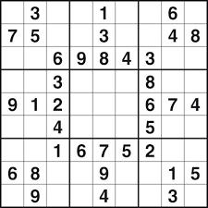
While we start, use the Annotate tool… have fun

Slide 2
Mindful Change Leadership Development Program
Week 7 (of 8)
3 June 2024
Notes:
Leanne:
« Vous savez maintenant que vous pouvez exprimer vos commentaires ou poser vos questions dans la langue officielle de votre choix »
By now, you know you can use the language of your choice to express your comments or questions

Slide 3
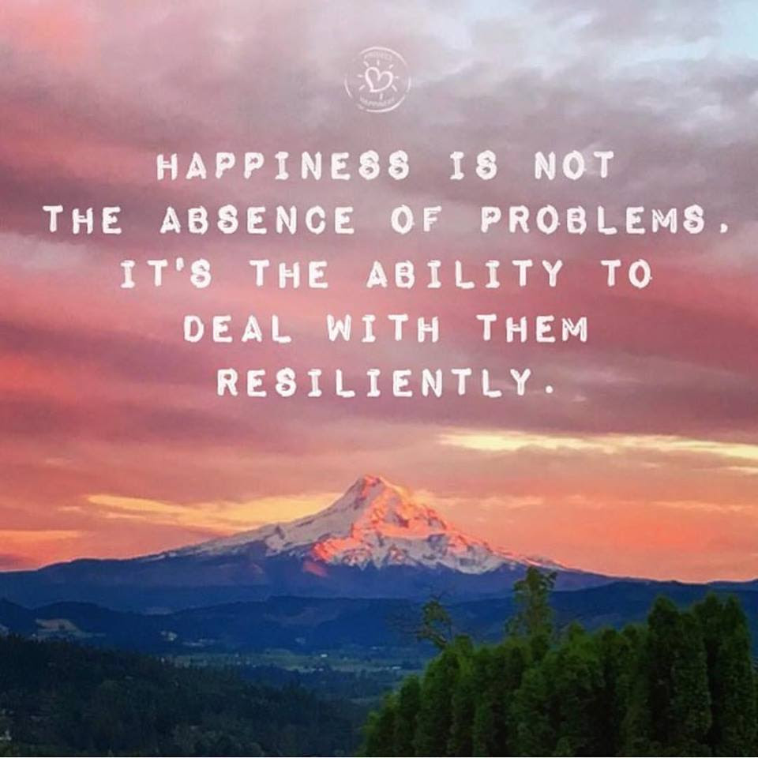
Welcome
Notes:
Leanne:
Facilitators:
(Prep for sharing audio & video, including French CC and 100% font size)
In case needed: https://archive.org/details/LovingKindness15Minsb
Optional: skip the body scan, starting at around 5:18, with a quick intro “take a couple of breaths, close your eyes…” and resume the recording
Video: Mindfulness & EQ connection - https://www.youtube.com/watch?v=s57sce71zNI
10 Minute Timer Options to play during Mindful Movement exercise:
10 Min timer - Cozy Vibes - Silent 10 minute timer with bell at the end - Bing video
10 Minute Timer with Alarm, without music - Bing video
🌌 10 Minute Timer with Alarm, In the Galaxy ( without music ) - Bing video
Mindfulness Bell Sound – YouTube – optional to begin and end the Loving Kindness exercise
Facilitators - Remember to disconnect from VPN
If sharing your screen – select « share computer audio » so participants can hear sound on video and audio clips

Slide 4
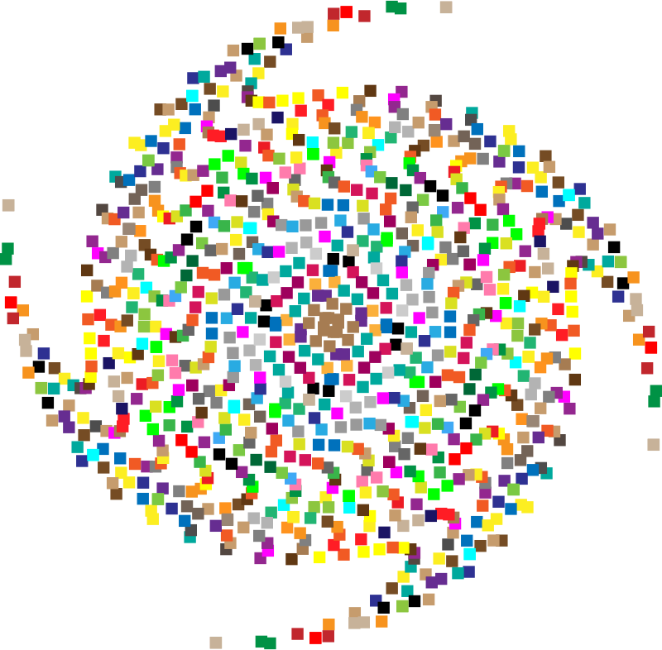
Mindful Self-Love Exercise – Centering
Notes:
Leanne:
For today’s centering exercise, we’ll use a slight variation…. Similar to previous ones, the idea is to shift from “doing” to “being”
Let’s start by doing the following...
Sit in a comfortable attentive position
It helps if you close or semi-close your eyes
Focus on your breathing…
and repeat any of the following phrases aloud or in your mind as they may feel right to you, in this moment…
(read them allowing space in between)
I am a kind person (Je suis aimable)
I love myself (Je m’aime)
I do my best (Je fais de mon mieux)
I am enough (je suis assez moi-même)
(Repeat once a minute over three to five minutes, then ask participants to…)
take a couple of deep breaths, slowly open their eyes, and return to the group session.

Slide 5
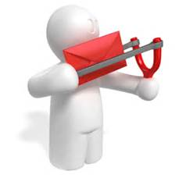
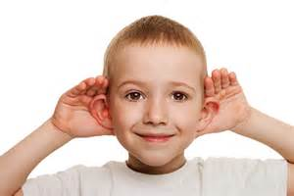
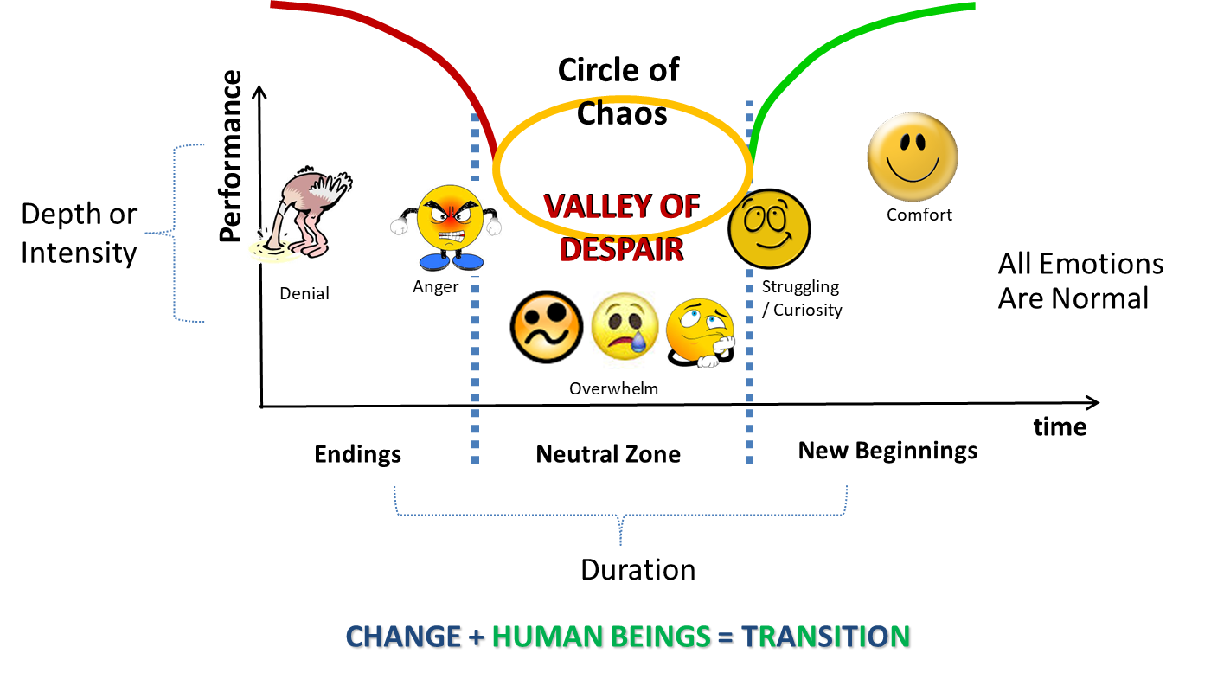
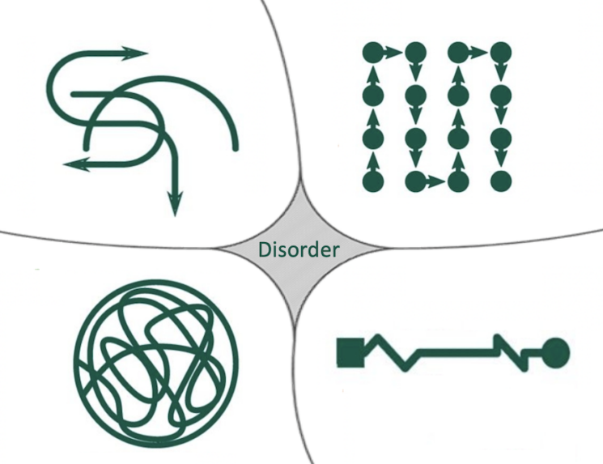
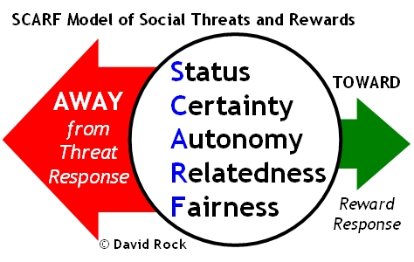
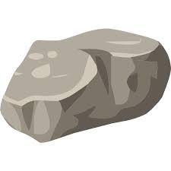
Questions/Insights from last week (6)
SBN-RR
Notes:
Leanne:
Plenary: Open mic to share your comments, challenges, surprises… particularly would like to hear from those who haven’t shared yet
the gratitude journaling
Your practice
Mindful eating
Human Being is enough
Mindful eating
Present, Presence, Presencing
Mindful – Win Win Win
Raise your hand to speak, type in the chat… Let’s hear it from some of you.

Slide 6
Agenda – week 7
Centering exercise
Questions/Insights from last week (6)
Today’s intentions: Focus, Compassion, Clarity, Creativity
Mindful Movement Exercise
Mindful Loving Kindness
Some articles regarding EQ, Leadership
Your take away assignment
Notes:
Leanne:

Slide 7
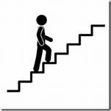
Mindful Movement Exercise
Notes:
Alejandro:
Le mouvement en pleine conscience est un exercice très singulier parce qu’il aide de faire l’union entre le corps et l’esprit. Cette union est centrale à toutes les pratiques du mouvement en pleine conscience. Elle permet justement de s’ancrer dans le moment présent, de se rappeler que les pensées ne sont pas la réalité, mais aussi de créer avec son corps ce que l’on souhaite intégrer dans son esprit : liberté, confiance, lâcher prise, joie, vitalité, etc.
Les méditations en mouvement sont généralement lentes. Il s'agit de sortir du notre mode "actions-réactions" dans lequel nous sommes si souvent, en ralentissant volontairement, pour permettre d'entrainer notre attention à être "en nous" plutôt qu'hors de nous.
Et tout comme dans la méditation immobile, on ne cherche pas à atteindre un objectif :
dans les mouvements méditatifs, on ne cherche pas à atteindre de la souplesse, une posture, un idéal physique ;
dans la marche méditative, on ne cherche pas à aller quelque part.
On cherche juste à (ré)devenir attentif au corps et à ressentir tout ce qui peut être ressenti moment après moment lorsqu'il est en mouvements.
Comment pratiquer le mouvement en pleine conscience?
Si vous le pouvez, levez-vous, vous pouvez aussi faire des mouvements resté assis sur votre chaise
Appuyez-vous sur une chaise stable, un bureau ou un mur
Ressentez votre équilibre ou bien l’ancrage de vos pies sur le sol.
Levez maintenant une jambe ou un bras.
Puis, si vous le pouvez, commencez à faire un premier pas lentement : soulevez votre pied gauche et amenez-le en avant puis placez-le par terre. Sentez le contact du pied gauche avec le sol, du talon jusqu’aux orteils, en même temps que vous prenez conscience de votre poids transféré sur le pied gauche, qui se pose complètement au sol, pour pouvoir alors lever et avancer votre pied droit. Soyez pleinement conscient du contact entre la plante de vos pieds et le sol.
Et chaque fois que votre esprit vous emmène hors de l’exercice, notez-le et ramenez votre attention aux sensations qui se déploient dans vos plantes de pieds.
Vous pouvez remarquer un déséquilibre la première fois que vous pratiquez la marche de manière lente, mais ne vous inquiétez pas votre corps fera les ajustements nécessaires pour retrouver l’équilibre.
Il s'agit juste d'amener de l'attention à la marche y compris aux changements de direction !
Petit à petit, vous pouvez élargir votre attention à votre expérience de la marche à vos jambes en entier, à votre corps tout entier … toujours dans la lenteur, toujours dans la conscience de toutes les sensations qui émergent, qui se modifient puis qui disparaissent et toujours dans la bienveillance quand vos pensées vous distraient de l’exercice.
Vous vous reconnectez à votre corps et à cette incroyable expérience qu’est la marche.
Vous pouvez également expérimentez de marcher sur le rythme de votre respiration (ou l’inverse !).
Par exemple : quand un pied se pose, vous inspirez, puis quand l’autre se pose vous expirez … et ainsi de suite.
Prenons maintenant 7 minutes pour faire l’exercice…le mouvement est de votre choix (une promenade consciente dans le corridor, en montant et en descendant l’escalier, ou à l’extérieur dans le jardin; et pourquoi pas en dansant ou simplement en agitant nos jambes et nos bras sur notre chaise) Portez attention à votre rythme, votre respiration, vos pas, votre mouvement, votre effort, votre équilibre et votre cœur.
Le but est d’être conscient…
Petit rappel avant de commencer: Soyez toujours prudent lorsque vous faites des exercices.
Le délai de 7 minutes commence maintenant.
(Après 7 minutes… reconnaissez les personnes qui sont revenues.)
J’espère que tout s’est bien passé; n’oubliez pas, il y aura du temps pour faire un compte rendu.
« Où pouvez-vous faire une promenade consciente pendant la journée? » https://www.re-connect.fr/marchemeditativeenpleineconscience/
« Si vous le pouvez, sortez et allez marcher dans la nature. Des chercheurs en Finlande ont constaté que les citadins signalaient un soulagement de leur stress beaucoup plus important lorsqu’ils faisaient une promenade dans un parc ou un bois que lorsqu’ils se promenaient au centre-ville. » - https://siyli.org/mindful-walking/
Ressources en français :
https://mbsrlyon.fr/blog/lart-de-marcher-en-pleine-conscience/
https://monespacemeditation.fr/meditation-pleine-conscience-mouvement/
https://plumvillage.org/fr/ressources/les-10-mouvements-de-pleine-conscience
https://montougo.ca/se-sentir-bien/relaxation-et-pause/seance-guidee-de-marche-en-pleine-conscience/#:~:text=En%20quoi%20consiste%20la%20marche,Qu'entendez%2Dvous%3F
https://www.re-connect.fr/lamarchemeditative/
https://www.amazon.ca/MARCHER-PLEINE-CONSCIENCE-THICH-NHAT/dp/2266285262
https://www.bioalaune.com/fr/actualite-bio/33817/bain-de-foret-remede-naturel-anti-stress

Slide 8
Mindful Movement Exercise
“Where can you take a mindful walk during your day?”
“If you can, go outside and into nature when you walk. Researchers in Finland found that city dwellers reported significantly more stress relief when they took a walk through a park or woodland than those who strolled through a city center.” - https://siyli.org/mindful-walking/
For us, let’s go for a mindful walk down the hallway, up and down the stairs, or outside in the garden … for 10 minutes
Pay attention to your pace, your breathing, your steps, your motion, your effort, your balance, your heart
Be safe
*If you are unable to walk, please adapt this exercise to suit your
own movement ability – standing or sitting
Notes:
Alejandro:
Mindful movement is a bridge between sitting meditation and the mindful presence that we can bring with us through the more demanding environment of our day-to-day lives.
Think about where you can take a mindful walk during your day.
For example, mindful walking can serve as a mini-reset during your workday. Try bringing awareness to walking from your desk to the bathroom or to a meeting. Some people step into a stairwell and walk mindfully up the stairs when things get overwhelming, and they need a time out.
If you can go outside into nature, like through a park or woodland, that is a bonus that will boost the stress-reduction benefits and activate your parasympathetic nervous system.
You might consider scheduling a mindful walk during a break or at lunch. Regular practice can help prevent you from reaching overwhelm in the first place.
For today, let’s find somewhere safe to walk where you will not be disturbed such as a hallway, up and down stairs, or outside in the garden … for 10 minutes.
If you are unable to walk, please adapt this exercise to suit your own movement ability – standing or sitting.
When you begin this exercise today, start by standing still and become aware of how you feel. Consider your posture, the weight of your body, feet in your shoes, and your muscles as you balance. Take a few deep breaths and slowly bring your awareness into the present.
Begin moving, a little slower than normal.
Move as mindfully as you can.
Maintain awareness of:
Each footstep as it rolls from heel to toe
The muscles and tendons in your feet and legs
The movement and muscles elsewhere in your body
Pay attention to your breath
Whether you are inside or outside, notice the sights and sounds around you.
Most of all – be safe. Resist the urge to walk on a tight rope for this exercise.
Now let’s take 10 minutes to do the exercise… the goal is to be aware… of what you feel, how you feel, what you hear, what you think… as always, if your mind wanders, that’s fine; just acknowledge the side-trip and gently bring your mind back to the exercise.
10 mins timer starting now.
10 Minute Timer Options to play during exercise:
10 Min timer - Cozy Vibes - Silent 10 minute timer with bell at the end - Bing video
10 Minute Timer with Alarm, without music - Bing video
🌌 10 Minute Timer with Alarm, In the Galaxy ( without music ) - Bing video
(after 10 mins… acknowledge those who came back)
Hope everything went well. Remember there will be time to do a debrief at the end of the session if you would like to share your experience.
Resources:
Mindful Walking & Walking Meditation: A Restorative Practice (positivepsychology.com)
https://siyli.org/mindful-walking/

Slide 9
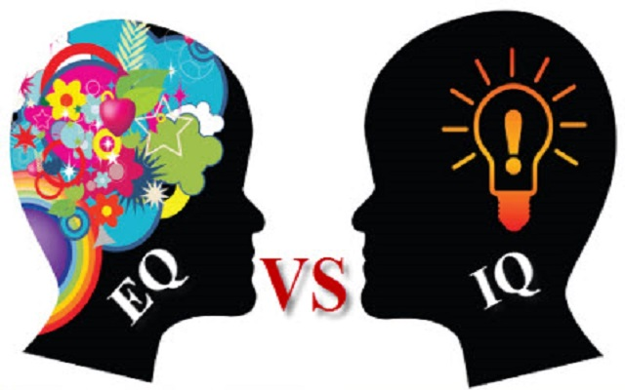
EQ: a core leadership skill
Self-awareness…
Self-control/self-regulation…
Internal Motivation…
Empathy…
Social skills/Interpersonal skills…
Notes:
Casey-Marie:
Emotional intelligence ( EI ) is a concept proposed in 1990 by psychologists Peter Salovey and John Mayer, which refers to the ability to recognize, understand and control one's own emotions and to deal with the emotions of other people.
The emotional intelligence framework has been adapted to business and organizational contexts. In this organizational context, there are a few sub-skills and abilities that contribute to higher emotional intelligence and greater success, among others.
Self-awareness… allows people to tune into their feelings… involves recognizing one’s own emotions and their effects, and also having confidence in one’s self-worth and capabilities.
To listen to your feelings
To recognize your own emotions and their effects
To have confidence in your own values and abilities.
Self-control/self-regulation… ability to manage disruptive impulses and moods, and the propensity to suspend judgment and to think before acting… maintaining standards of honesty and integrity, taking responsibility for one’s behaviour, being adaptable in the face of change and being innovative and open to new ideas.
maintain standards of honesty and integrity
take responsibility for your behavior, adapt to change
demonstrate an innovative spirit and open to new ideas
Internal Motivation… passion for work … not just about money and status… inner vision of what is important in life, a joy in doing something, curiosity in learning
nurture your interest in work… not just money and status
an internalized vision of what is important in life
the joy of doing something and the curiosity of learning…
Empathy… ability to understand others’ emotional makeup, the skill to treat people according to their emotional reactions… can read an organization’s dynamics, emotional currents and relationships, while sensing what people working for… service to clients and customers.
understand the emotional dimension of others and treat them accordingly
understand the dynamics of an organization and the emotional currents that influence it
understanding relationships while being aware of what people are working for.
Social skills/Interpersonal skills… know how to negotiate and resolve conflicts, collaborate, co-operate, and create group synergy in pursuing collective goals/find common ground and build rapport… managing relationships and building networks… effective in leading change, persuasiveness, and expertise building and leading teams
negotiate and resolve conflicts
collaborate, cooperate and create group synergy
finding common ground and building relationships
manage relationships and build networks
effective leadership of teams and change
power of persuasion and strengthening of expertise
Resources:
https://bluenotes.anz.com/posts/2017/04/emotional-intelligence-a-core-leadership-skill/
Ressources en français :
Leadership et intelligence émotionnelle : une clé pour devenir un Leader inspirant ! : https://www.bilan.ch/opinions/david-fiorucci/leadership-et-intelligence-emotionnelle-une-cle-pour-devenir-un-leader-inspirant
Gestion de l'intelligence EMOTIONNELLE de vos collaborateurs 9 mins - https://www.youtube.com/watch?v=gNZ5wZbMArc
Intelligence émotionnelle et leadership 23 minutes: https://www.youtube.com/watch?v=TYlN9PglGjI

Slide 10
L’empathie : l’élément essentiel d’un leadership efficace
« … Vous devez vous souvenir que sans les membres de votre équipe, vous n’avez pas de rôle à jouer … Sans l’empathie, vous n'aboutirez à qu’à rien
…L’empathie signifie que la prise de
décision quotidienne touche toute
votre équipe… lorsque vous en prenez conscience, vous passez de “moi” à “nous” »...
https://www.lesechos.fr/idees-debats/cercle/le-leadership-empathique-130095
Notes:
Casey-Marie:
Voici une question pour vous : entre zéro et neuf, quel est le chiffre le plus puissant ?".
Quelle est votre réponse ?
« C’est vrai que le zéro n'a pas de valeur en soi. Mais quand on lui ajoute quelque chose, il devient très précieux. »
« Il faut toujours se rappeler que, qui que vous soyez, vous n'êtes rien sans les autres. La plupart des gens, des managers, des dirigeants oublient cela une fois qu'ils deviennent puissants. En fin de compte, chacun d'entre nous n'est rien sans la contribution des autres. Mais lorsque nous ajoutons leurs efforts aux nôtres, le résultat est vraiment très puissant. Neuf devient 90 ».
Comme on peut voir sur la diapositive - l’empathie est bien important pour le leadership.
(Lisez le texte de la diapositive.)
Voici ce qu’affirme un auteur reconnu et dirigeant à succès : « …le principe de leadership que mon grand-père m’a transmis lorsque j’étais enfant est celui que j’enseigne maintenant à des cadres dirigeants de Fortune 500 : l’empathie »
Resources en français…
Le beau défi : définir le leadership empathique - https://mouvementsmq.ca/blogue/le-beau-defi-definir-le-leadership-empathique/
L’empathie est la compétence de leadership la plus importante selon les recherches - https://www.forbes.fr/management/lempathie-est-la-competence-de-leadership-la-plus-importante-selon-les-recherches/
Différence entre empathie et la compassion -https://ascentleader.org/fr/difference-between-empathy-and-compassion/
Ressources en anglais…
Le principe de leadership que mon grand-père m’a transmis lorsque j’étais enfant est celui que j’enseigne maintenant à des cadres dirigeants de Fortune 500 – Article http://www.businessinsider.com/why-empathy-is-key-to-effective-leadership-2017-4
Différence entre l’empathie et la compassion – https://ascentleader.org/difference-between-empathy-and-compassion/

Slide 11
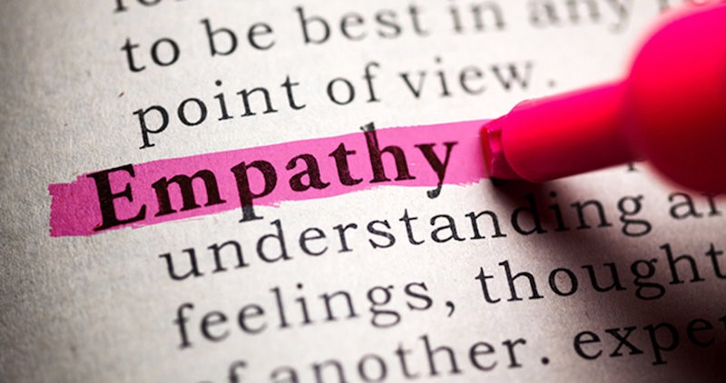
Empathy: the key to effective leadership
“… You must always remember that whoever you are, you are nothing without other people… Without empathy, you will never move past zero.
…Empathy means understanding that the decisions you make every single day impact not just you… when you understand that you move from “me” to “we”… ”
http://www.businessinsider.com/why-empathy-is-key-to-effective-leadership-2017-4
Notes:
Casey-Marie
This is a story from recognized author and successful leader, he says: “…the leadership principle a grandfather shared with him as a child, it is the same one I now teach Fortune 500 execs: Empathy”
(read the slide)
Resources…
Compassion vs empathy: what is the difference? (tonyrobbins.com)
The leadership principle my grandfather shared with me as a child is the same one I now teach Fortune 500 execs – Article http://www.businessinsider.com/why-empathy-is-key-to-effective-leadership-2017-4
Empathy vs. Compassion - https://ascentleader.org/difference-between-empathy-and-compassion/

Slide 12
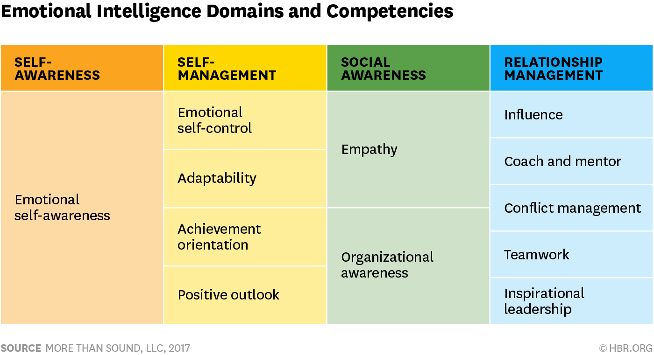
Emotional Intelligence Domains and Competencies
Self-Awareness
Self-Management
Relationship Management
Social Awareness
Emotional Self-Control
Influence
Empathy
Coach and Mentor
Adaptability
Emotional Self-Awareness
Conflict Management
Achievement orientation
Organizational Awareness
Teamwork
Positive Outlook
Inspirational Leadership
Article: https://hbr.org/2017/02/emotional-intelligence-has-12-elements-which-do-you-need-to-work-on
Self-assessment: https://www.tsw.co.uk/blog/leadership-and-management/daniel-goleman-emotional-intelligence/
Notes:
Casey-Marie
This table shows the 12 competencies related to EQ’s domains
Self-awareness, although the least visible emotion it is an incredible predictor of the level of emotional intelligence. Therefore, Self-aware Leaders Show Higher EQ
And those who have high self-awareness tend to have at least 10 or 12 competencies, while those who are low have one or two
Resources…
https://hbr.org/2017/02/emotional-intelligence-has-12-elements-which-do-you-need-to-work-on
Self assessment: https://www.tsw.co.uk/blog/leadership-and-management/daniel-goleman-emotional-intelligence/
Video: Mindfulness & EQ connection - https://www.youtube.com/watch?v=s57sce71zNI (2.5 mins)
Video What Is Emotional Intelligence? - https://www.youtube.com/watch?v=tbKr0EuiVjc (< 2 mins)
Video EQ (Neuroscience & Psicology) - https://www.youtube.com/watch?v=weuLejJdUu0 (< 3 mins)
** Developing EQ - https://www.youtube.com/watch?v=n9h8fG1DKhA (< 4 mins)
Resources in French:
Self assessment: https://nomadity.be/blog_confiance/4-piliers-pour-developper-votre-intelligence-emotionnelle/
9

Slide 13
To Be An Effective Leader, Keep A Leadership (Reflecting) Journal
Ten Questions For Your Leadership (Reflecting) Journal
What’s present for me now?
What’s going well? What’s creating that?
What's challenging? What's creating that?
What needs my attention?
What’s meaningful?
What strengths do I notice in myself?
What strengths and contributions do I notice in others?
What am I learning?
What is an action I am committing to?
“The idea here is getting people to come to terms with who they are, where they want to go… I think of expressive writing as a life course correction.”
– Dr. Pennebaker
https://www.forbes.com/sites/hennainam/2017/04/02/to-be-an-effective-leader-keep-a-leadership-journal/
http://well.blogs.nytimes.com/2015/01/19/writing-your-way-to-happiness/
Notes:
Casey-Marie
(read a few bullets, then the quote on the right)
Any questions anyone?
(if nobody has a question, perhaps read one/two with the **
if someone has a question regarding the list, read from the text)
What’s present for me now? This may feel like an esoteric question to start with but it’s a useful one to get present to what’s going on in this moment for you. Take a few deep breaths, close your eyes, and bring awareness to your body. Stretch and release any tension you’re feeling. Look inside yourself. Notice what emotions are present. Often, we rush through our day without checking in with ourselves. This is an opportunity to greet an old friend and see how they are. It will set you up for rich learning in the questions that follow.
What’s going well? What’s creating that? Acknowledging what's good helps you take a step back from what may have been a very stressful day. It helps you acknowledge yourself and others for the good that’s happening. It helps you learn what’s positive and what's helping you achieve goals.
** What's challenging? What's creating that? Acknowledging what's challenging focuses you on what needs your attention for learning and growth. Often, we start off by blaming others, ourselves, or circumstances for what is challenging. That’s fine and a perfectly human response. You can start there. And I urge you to look deeper within yourself. What are your beliefs, attitudes, or actions that contribute to what is challenging for you? This process of taking responsibility (without judgement!) is a key driver to feeling empowered as a leader rather than a victim of circumstances. It opens you up to experimenting with other ways of leading that may be more effective.
What needs my attention? This is a great question for scanning your environment, both work and personal. Your quality attention is your most precious asset. This helps you become mindful and choose where you invest it.
** What’s meaningful? Finding meaning in each day keeps you fueled. It helps you learn about what values are important to you and then lead from those values. It helps you discover purpose and lead from purpose, inspiring and engaging yourself and those around you. Another question in this same vein is what am I grateful for? This helps you focus on what’s going right overall, which helps to reduce stress and improve overall well-being. Keeping a gratitude journal has been shown to clinically improve your immune system. It also increases resilience.
What strengths do I notice in myself? This helps you become aware of your strengths and put them into action. You may also want to journal about values you exercised. It builds confidence, trust in yourself, and resilience.
What strengths and contributions do I notice in others? This helps you appreciate and see what others are contributing. You can then powerfully acknowledge and appreciate them. It helps build productive and trusting work relationships.
What am I learning? Scan your writing. Capture any learning that feels most important.
What is an action I am committing to? This helps you move the learning forward into action.
Try this exercise. Bullet-point answers are fine. I challenge you to try it as a gift to yourself for the next seven days. My hope is that it will help you to become a more inspired, authentic and agile leader.
Resources…
Writing Your Way to Happiness – Article http://well.blogs.nytimes.com/2015/01/19/writing-your-way-to-happiness/
To Be An Effective Leader, Keep A Leadership Journal – Article https://www.forbes.com/sites/hennainam/2017/04/02/to-be-an-effective-leader-keep-a-leadership-journal/

Slide 14
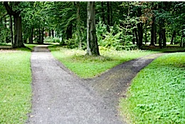
Prendre de meilleures décisions?
Résister au négatif
« Les personnes qui méditaient se concentraient moins sur le passé et l’avenir, de sorte qu’elles ressentaient moins d’émotions négatives », affirme Hafenbrack. « Cela les aidait à réduire la partialité liée aux coûts irrécupérables. »
Court terme ou long terme?
« [Les recherches] ne remettent pas en cause l’idée selon laquelle [la méditation], en tant que pratique à long terme, peut être efficace », déclare Barsade. « Toutefois, l’un des aspects nouveaux et importants [au sujet des recherches] est que vous pouvez prendre une courte pause et obtenir un résultat. »
Prise de décisions consciente
« L’application des techniques de pleine conscience à la prise de décisions vous amène à avoir une réflexion plus claire et à rester connecté à vos valeurs fondamentales, ce qui est crucial pour votre paix d’esprit. » – Phillip Moffitt
Notes:
Alejandro:
Prendre une grande (ou petite) décision? La pleine conscience peut aider.
Regardons maintenant comment même de courtes séances de méditation peuvent réduire la probabilité que des décisions soient prises sur la base d'informations du passé qui ne devraient pas avoir d'incidence sur le choix en cours.
Des études montrent que la pratique de la méditation peut entraîner les participants à atteindre un état plus méditatif même lorsqu'ils ne méditent pas, ce qui les aidera à être moins concentrés sur le passé et l'avenir.
(Paraphrasez le texte de la diapositive.)
Résister au négatif
Selon les résultats des études« Les personnes qui méditaient se concentraient moins sur le passé et l’avenir, de sorte qu’elles ressentaient moins d’émotions négatives », affirme Hafenbrack. « Cela les aidait à réduire la partialité liée aux coûts irrécupérables. »
Court terme ou long terme?
« l’un des aspects nouveaux et importants [au sujet des recherches] est que vous pouvez prendre une courte pause et obtenir un résultat. »
Prise de décisions consciente
« L’application des techniques de pleine conscience à la prise de décisions vous amène à avoir une réflexion plus claire et à rester connecté à vos valeurs fondamentales, ce qui est crucial pour votre paix d’esprit. »
Et je passe la parole à Alejandro.
Ressources en français…
La méditation pourrait aider les patrons à prendre de meilleures décisions - https://www.huffingtonpost.fr/life/article/la-meditation-pourrait-aider-les-patrons-a-prendre-de-meilleures-decisions_27275.html
La méditation pour prendre de meilleures décisions - https://rand-ose.com/post/la-meditation-pour-prendre-une-decision/
Biais Cognitif – L’erreur des coûts irrécupérables (sunk cost en anglais) - https://dantotsupm.com/2021/02/26/biais-cognitif-lerreur-des-couts-irrecuperables-sunk-cost-en-anglais/
Ressources en anglais…
Article - Making a Big (or Small) Decision? How Meditation Can Help (Prendre de grandes [ou petites] décisions? Comment la méditation peut aider) : http://knowledge.wharton.upenn.edu/article/making-big-small-decision-meditation-can-help/
Article - Decision Time (Temps de décision) : https://dharmawisdom.org/decision-time/

Slide 15
Making Big or Small Decisions?
Resisting the Negative
People who meditated focused less on the past and future, which led to them experiencing less negative emotion,” Hafenbrack says. “That helped them reduce the sunk-cost bias.”
Short-term or Long-term?
[The research doesn’t] undermine the idea that [meditating] as a long-term practice could be effective,” Barsade says. “However, one of the novel and important things [about the research] is that you can take a brief time out and get a result.”
Mindful Decision-making
“Applying mindfulness techniques to decision-making leads to clearer thinking and to staying connected to your core values, which is crucial to your peace of mind.” – Phillip Moffitt
http://knowledge.wharton.upenn.edu/article/making-big-small-decision-meditation-can-help/
https://dharmawisdom.org/decision-time/
Notes:
Alejandro:
For the first two quotes on the slide - Hafenbrack and Barsade are authors of a research paper called Debiasing the Mind through Meditation: Mindfulness and the Sunk-Cost Bias.
The paper explores how short meditation sessions can reduce the likelihood that decisions will be made based on information from the past that should have no bearing on the choice at hand.
The Sunk-Cost Bias comes into play when the decision maker has invested significant time and money toward arriving at a particular outcome which is influencing their ability to clearly assess the situation and make a decision that takes the current factors into account.
Meditation has been shown to help people focus on the present and let go of both the past and future.
Even short breaks and little time-outs will get you to a place where you can think better and be in a position to make better decisions. Which can save time and money for everyone — from a consumer searching for a new car all the way to the head of a billion-dollar corporation.
The third quote is from Phillip Moffitt who is a Buddhist meditation teacher.
In the resource listed on the slide, he outlines three stages in the mindfulness process to help clarify thinking when it is muddled by the stress of deciding, and how to stay in touch with one’s deepest values when feeling anxious
The more you practice, the more skillful you become. And over time you naturally become more mindful in other moments of your life. Applying mindfulness techniques to decision making leads to clearer thinking and to staying connected to your core values, which is crucial to your peace of mind.
Resources…
Article - Making a Big (or Small) Decision? How Meditation Can Help: http://knowledge.wharton.upenn.edu/article/making-big-small-decision-meditation-can-help/
Article - Decision Time: https://dharmawisdom.org/decision-time/

Slide 16
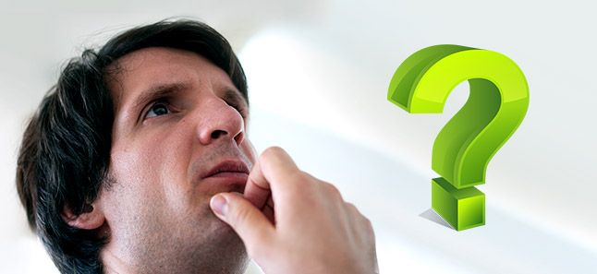
La pleine conscience pour une meilleure prise de décisions
Une bonne décision est le reflet de vos pensées et de vos expériences, et cela peut être renforcé par la pratique de la pleine conscience.
Des idées clés ici :
Esprit concentré et plus calme
Juste équilibre, sans bagage émotionnel
Pensée rationnelle
Esprit fort
Intuition forte, perception et observation
Concentration sur le présent
Notes:
Alejandro:
(paraphrase la diapositive)
Ressources en français…
La méditation pour prendre de meilleures décisions - https://rand-ose.com/post/la-meditation-pour-prendre-une-decision/
La méditation pourrait aider les patrons à prendre de meilleures décisions - https://www.huffingtonpost.fr/life/article/la-meditation-pourrait-aider-les-patrons-a-prendre-de-meilleures-decisions_27275.html
Leadership : 14 qualités pour reconnaitre un bon leader - https://buzznessinfo.com/leadership-14-qualites-pour-reconnaitre-un-bon-leader/
Les différences au niveau de l'intelligence émotionnelle entre les dirigeants efficaces et les moins efficaces dans le secteur public : étude empirique - https://www.cairn.info/revue-internationale-des-sciences-administratives-2011-2-page-405.htm
Ressources en anglaise…
Article – Have better decision-making abilities (Avoir de meilleures capacités décisionnelles) https://www.artofliving.org/meditation/meditation-for-you/meditation-for-better-decision-making
Article – Better Decision Making Ability (Meilleures capacités décisionnelles) https://www.artofliving.org/us-en/meditation/meditation-for-you/meditation-for-better-decision-making

Slide 17
Mindfulness for Better Decision-making
A good decision is the reflection of your thoughts and experiences, and this can be augmented through a mindfulness practice.
#1 – Focused mind
#2 – The right balance
#3 – Rational thinking
#4 – A strong mind
#5 – Intuition, perception and observation
#6 – Focus on the present
Calmer mind
Drop the baggage
A strong mind
Strong intuition
https://www.artofliving.org/us-en/meditation/meditation-for-you/meditation-for-better-decision-making
https://www.artofliving.org/meditation/meditation-for-you/meditation-for-better-decision-making
Notes:
Alejandro:
Here’s how meditation works to better your decision-making ability.
1
Calmer/Focused mind
When you are bombarded with too many thoughts, your mind is unable to arrive at a decision. Meditation helps to clear the thoughts by calming the mind down.
Just how one can see a clear reflection in still waters, similarly a calm mind gives a clear picture of all parameters and possible repercussions of a decision. You are, thus, empowered to take the right decision.
2
The right balance
Our negative emotions like fear, anxiety, guilt, regret or worry subconsciously play a part in the decision-making process. Regular mindfulness practice helps us drop our emotional baggage, be natural, and take decisions from an unbiased frame of mind.
In addition to clearing our personal emotional baggage, mindfulness helps in taking note of other people’s point of view with an unbiased mind. So, even if someone’s opinion is shrouded with anger, you are more likely to understand them instead of dismissing them.
3
Rational Thinking
Meditation helps you balance the thoughts coming from both the left and the right hemispheres of the brain, helping you be solution-driven rather than reaction- or emotionally-driven.
4
A Strong Mind
Mindfulness helps maintain your energy and enthusiasm to a great extent. This, in turn, results in boosting clarity and a holistic approach towards any issue. You can handle a greater workload, manage pressure and deadlines more easily and will be ready to take a sound decision at any given time.
5
Intuition, Perception and Observation
Intuition is the ability to understand something immediately which can be tapped into through mindfulness practices. It cuts through all the clutter to give you the best solution or brief about a situation. With intuition, you can make decisions quickly. Mindfulness practice improves this deep inner wisdom by increasing awareness. Consistent practice strengthens it.
6
Focus on the Present
Focusing on the present allows you to clearly assess the situation and make a decision that takes the current factors into account. Being present also allows you to be an active participant in your life and to make decisions with a greater sense of purpose and meaningful connection to who you are, to your surroundings and to everyone around you.
Article - Have better decision-making abilities https://www.artofliving.org/meditation/meditation-for-you/meditation-for-better-decision-making
Article - Better Decision Making Ability https://www.artofliving.org/us-en/meditation/meditation-for-you/meditation-for-better-decision-making

Slide 18
Mindful Loving Kindness exercise
Time required – 15 minutes
To start, you may want to do a Mindfulness Body Scan – Relaxation exercise
Then, follow my voice
During this exercise, I’ll say a few sentences
I invite you to repeat the ones that resonate with you the most, the ones that are true to yourself
Mindfulness exercise – Loving Kindness – 15 mins (https://archive.org/details/LovingKindness15Minsb)
Download link: https://archive.org/download/LovingKindness15Minsb/Loving%20Kindness%2015%20minsb.mp3
Notes:
Casey-Marie
Mindfulness Bell Sound - YouTube - to begin and end the exercise
Body Scan and Loving Kindness MEDITATION:
Let’s begin (BELL)
To prepare for the loving kindness mediation, sit as comfortably as possible in the chair that you are seated with both seat on the floor (pause), your hands on your laps (pause) and I invite you to close your eyes (pause) and just breath (pause).
Just for now focus on your breathing (pause).
As you breath in, notice the air going into your nostrils, expanding your chest, your abdomen, filling your lungs (pause)
As you breath out, focus the on the air coming out your nostrils, the air may be warmer (pause 10 seconds)
If at any point your mind wanders, gently bring it back and focus your attention on your breathing
Now focus on your feet and your toes and how its touching the ground (pause 5 sec)
As you inhale, focus on your lower legs (pause). Notice your muscles relaxing (pause 5 sec)
As you exhale, focus on your upper legs (pause). Notice your muscles relaxing (pause 5 sec)
Continue breathing and focus on your hips and waist (pause 5 seconds). Just notice Pause 5 seconds)
Now focus on your lower back and stomach (pause). Relax these parts of your body (pause 5 seconds)
Now focus on your middle back and solar plexus (pause 5 seconds). Just notice
Now focus on your upper back and your chest (pause 5 seconds). Notice how these parts rise and fall with your breath (pause)
As you continue breathing, focus on your shoulders and relax them as you breath out (pause 5 seconds)
Now focus on your upper arms (pause), your lower arms (pause), your hands (pause), your fingers (pause). Feel how they relax as you breath in and as we breath out (pause 5 sec)
Focus on your neck and your head (pause), your scalp (pause), Your ears (pause) and your forehead as you breath in and as you breath out (pause 5 sec)
Focus on your face, your eyes, your nose, your mouth, your lips, your jaw (pause) Feel all of those parts relaxing (pause 5 sec). Stay there for a few more moments. (5 sec)
Now we are ready to start the loving kindness meditation exercise (pause)
Just follow my voice during this exercise (pause). Start with yourself, bring loving kindness to yourself. I will say a few sentences and I invite you to repeat the ones that resonate with you the most, the ones that are true to yourself, the ones that align with your heart (pause).
May I be happy (pause)
May I be loved (pause)
May I be healthy (pause
May I live with ease (pause)
May I be free from pain and suffering (pause)
May I be able to let go of everything for which I have no control over (pause)
May I find success in all areas for which I’m passionate about (pause)
(Repeat the sentences) Keep repeating the ones that resonate with you. (repeat the sentences)
(pause 40 sec)
Now bring to mind someone you care a lot about, someone you admire, bring the image of their face in your mind, their eyes, their smile. (pause) Bring loving kindness to them by wishing them these well thoughts.
May they be happy (pause)
May they be loved (pause)
May they be healthy (pause
May they live with ease (pause)
May they be free from pain and suffering (pause)
May they be able to let go of everything for which they have no control over (pause)
May they find success in all areas for which they are passionate about (pause)
(Repeat the sentences) If your mind is struggling, just gently come back to the sensation of your breath, and keep repeating your sentences
(Repeat the sentences) (pause 40 seconds)
Next, bring to mind somebody you’re familiar with and who is going through a hard time, someone you know would benefit from these well wishes.
May they be happy (pause)
May they be loved (pause)
May they be healthy (pause
May they live with ease (pause)
May they be free from pain and suffering (pause)
May they be able to let go of everything for which they have no control over (pause)
May they find success in all areas for which they are passionate about (pause)
(Repeat the sentences) (Pause 40 seconds)
Now, Bring to mind someone who plays a function in your life, someone who you don’t know very well; it could be the commissionaire in your way in, perhaps the person who serves you coffee in the shop, the bus driver, or even someone in your office you don’t know that well. Get a feeling of their presence, what they look like and see how you can wish them these well thoughts. (pause)
May they be happy (pause)
May they be loved (pause)
May they be healthy (pause
May they live with ease (pause)
May they be free from pain and suffering (pause)
May they be able to let go of everything for which they have no control over (pause)
May they find success in all areas for which they are passionate about (pause)
(Repeat the sentences) (Pause 40 seconds)
Next, see if you can wish these well thoughts to everyone listening today, see if you can wish these well thoughts to everyone in your team, everyone in your building, everyone in your city. See if you can wish these well thoughts to every single living human being in this planet.
May they be happy (pause)
May they be loved (pause)
May they be healthy (pause
May they live with ease (pause)
May they be free from pain and suffering (pause)
May they be able to let go of everything (pause) for which they have no control over (pause)
May they find success in all areas for which they are passionate about (pause)
(Repeat the sentences) (pause 40 seconds)
As you continue breathing, Keep your eyes closed for a few moments (pause 5 sec)
In this moment, give yourself gratitude for taking the opportunity out of your busy day to slow down and reconnect. (pause 5 sec)
The more we practice, the more we’re able to create this gaps between our habitual thoughts and habitual patterns (pause)
When you’re ready, you can rub your hands together, creating a bit of heat; and you can put your hands over your eyes; (pause)
Slowly open your eyes (pause) And comeback. (BELL)
Thank you for trusting me and giving me this opportunity to lead you through this loving kindness exercise.
Mindfulness exercise – Loving Kindness – 15 mins (https://archive.org/details/LovingKindness15Minsb)
Optional: skip the body scan, start at around 5:20… “and now we are ready to start the mindul kindness exercise…”
Download link: https://archive.org/download/LovingKindness15Minsb/Loving%20Kindness%2015%20minsb.mp3

Slide 19
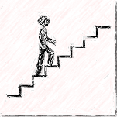
Reflect about today’s exercises
Notes:
Alejandro:
As usual, before going into small groups, let’s do a session debrief. Would anyone like to share their reflections about today’s exercises? (until about 20 minutes before the end of the session):
Mindful movement – what you experienced during the exercise today or how you do or plan to incorporate it into your day
Leadership (Reflecting) Journal
Better Decision Making
Loving Kindness
Take the next few minutes to debrief in small groups. As in previous weeks, when you’re done just leave the session.
Feel free to share:
What you noticed
What you had a hard time with
What you’re realizing
An intention you have for the week
Etc
*IF YOU NEED TO DROP OUT EARLY TO GET TO ANOTHER MEETING PLEASE DO SO NOW SO THERE IS A SMOOTHER EXPERIENCE WHEN THE BREAKOUT SESSIONS START

Slide 20
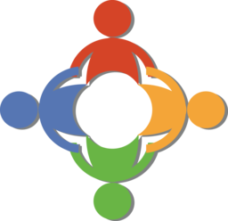
Your takeaway practice for week 7
Connecting – once a week with your buddy
Leadership Reflecting Journaling - daily
Practice, choose one of the following and keep doing it for the whole week - daily
Self-compassion
Mindful Loving Kindness exercise
Apply Mindful Centering – as needed
Apply Mindful Movement – as needed
Apply Mindfulness for Better Decision-making – as needed
For the next and final session: Bring all the questions you have
We will have a special guest for closing remarks
Notes:
Alejandro:
Your takeaway practice for week 7
Continue to connect with your buddy system.
Continue gratitude journalling and incorporate some leadership reflection. There are some journalling prompts on slide 10 to help you to explore self-awareness relating to leadership through self-reflective expressive writing.
Practice either a self-compassion exercise or mindful loving kindness exercise each day to cultivate positive emotions and boost wellbeing.
Apply Mindful Centering as needed - take short breaks and little time-outs to bring you to a place where you can think better and be in a position to make better decisions.
Apply Mindful Movement as needed. Try scheduling a mindful walk into your day.
For the next and final session. Bring all the questions you have.
Homework:
Connecting – once a week with your buddy
Leadership Reflecting Journaling - daily
Practice, choose one of the following and keep doing it for the whole week - daily
Self-compassion 15 mins – https://soundcloud.com/mindfullivingcoach/self-compassion-meditation 15 mins – https://soundcloud.com/awakeningcompassion/awakening-compassion-class-4 20 mins – http://self-compassion.org/wp-content/uploads/meditations/LKM.self-compassion.MP3
Mindful Loving Kindness exercise 15 mins – https://archive.org/details/LovingKindness15Minsb 20 mins – https://www.tarabrach.com/meditation-loving-presence-2/
Apply Mindful Centering – as needed
Apply Mindful Movement – as needed
For the next and final session: Bring all the questions you have

Slide 21
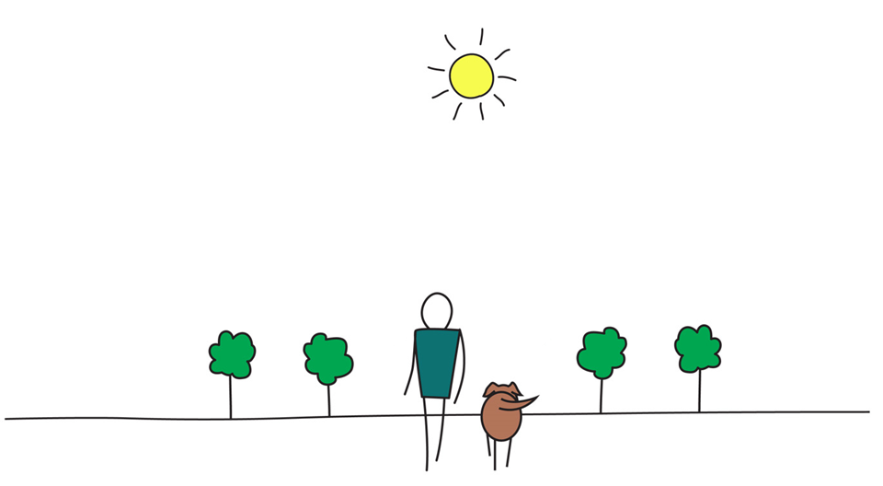
Be Mindful, Be Happy
Notes:
Alejandro:
Thank you so much for being in this session today. There is just one more session to go! I hope you have a great week everyone! I wish you all happiness.

