Slide 1
Mindful Change Leadership Development Program
Week 5 (of 8)
27 May 2023
Notes:
Alison:
« Vous savez maintenant que vous pouvez utiliser la langue de votre choix pour exprimer vos commentaires ou vos questions »
By now, you know you can use the language of your choice to express your comments or questions

Slide 2
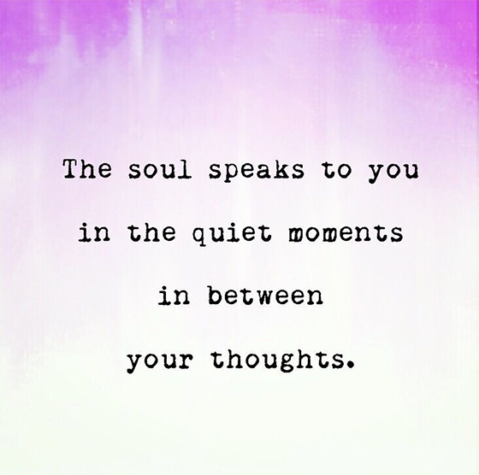
Sould Speaks in Quite Moments
Notes:
Alison:
Prepping: (Friendly reminder: prep for sharing audio & video, including French CC and 100% font size)
Slido: https://app.sli.do/event/57kcbwnsgjewqnEKVdfCh3
Chaotic movement https://youtube.com/shorts/fK1VmX9mzRw?si=ZJ4uHGDgE69g5ubl
Cynefin model intro (4 mins) - https://www.youtube.com/watch?v=epXqgrm2hs4
Complexity toolbox 1: How do you get your message across in a complex, changing world? (3 mins) - https://www.youtube.com/watch?v=llGDvQE1gl0
Complexity toolbox 2: Complexity Check-In (3.5 mins) - https://www.youtube.com/watch?v=D4MSzpqAKls
Complexity toolbox 3: Safe to fail experiments (3 mins)- https://www.youtube.com/watch?v=i_h2WJ1qNRA
Cognitive Reframing, Short #dog #puppy #funny #bordoodle #prettydogs #doglovers #charliedog – YouTube - https://www.youtube.com/shorts/UtMY7S5XbSg
SCARF Model (3.5 mins) - https://www.youtube.com/watch?v=hNAcCc1oWR4
How to find the perfect relationship (4 mins) - https://www.youtube.com/watch?v=bUMFZM5WBrI
They had us in the first half not gonna lie (1.2 mins) - https://www.youtube.com/watch?v=xaqdK6JPpcg

Slide 3

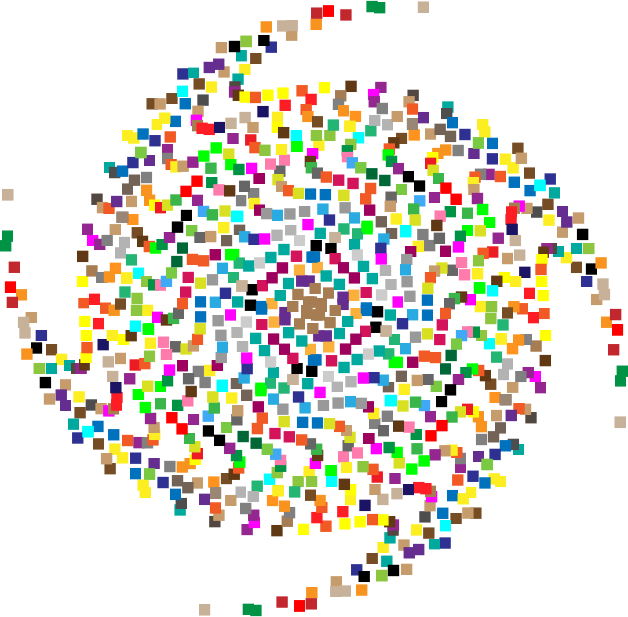

Mindful Self-Compassion Exercise – Centering
I recommend watching the youtube video for this exercise it’s 5 minutes
Notes:
Alison:
For today’s centering exercise, we’ll use a slight variation…. Similar to previous ones, the trick is to shift from “doing” to “being”
Let’s start by doing the following...
Sit with a straight position, as comfortable as possible
It helps if you close or semi-close your eyes
Focus on your breathing and repeat in your mind the following sentences that feel right to you, in this moment…
Repeat twice or three times, pausing between each phrase:
May I be safe
May I be peaceful
May I be kind to myself
May I accept myself as I am
https://www.youtube.com/watch?v=7YGaumwvKyM – very sweet song that reflects the may I be happy mantra – with children
https://www.youtube.com/watch?v=dW8cAINxJn4 - may I be happy meditation 10 minutes
https://www.youtube.com/watch?v=qHboKCw5PcQ - loving kindness meditation
French exercise:
Puis-je être en sécurité
Puis-je être en paix
Puis-je être indulgent(e) envers moi-même
Puis-je m’accepter tel que suis

Slide 4






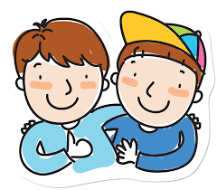
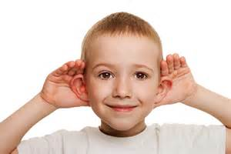



Insights from last week (4)
Your Buddy System
Your practice :
Plenary
Notes:
Alison:
Let’s have a few people share some insights, challenges or surprises you experienced or noticed from last week’s practice, including
the gratitud journaling.
the Mindfulness Breathing or Body Scan,
Mindful Water Drinking
Self-Compassion
Cleaning up your e-environment
Feel free to raise your hand to speak or type in your comments and question in the chat. We would love to hear from some of the people that we haven’t heard from previously.
A friendly reminder that if you are joining by telephone, press *6 to to unmute yourself and then press *6 again to mute. If you don’t bridge your telephone to webex, the breakout rooms will likely not work for you.

Slide 5

Agenda – week 5
Centering breathing exercise
Debrief from last week 4
Change & Transition
The SCARF model
Technique – SBN-RR
Self Love
Your takeaway assignment
Notes:
Alison:

Slide 6
Change and Transition
time
Depth or Intensity
Duration
CHANGE + HUMAN BEINGS = TRANSITION
Notes:
Alison:
(click)
There are two kinds of changes – voluntary and involuntary.
Voluntary changes are the changes you choose to make and are prepared for. Examples include quitting a job, accepting a promotion, taking early retirement, or starting your own business. When you take charge and choose to make a change in your life, you may feel excited, relieved or anxious – all typical reactions.
Involuntary changes are ones that happen and are beyond your control. These can be a change in health; a change in a relationship due to death or divorce; a change in your work situation such as being laid-off, fired or forced to retire; or a decrease or increase in demand for your skills or services. Initially, some people react to involuntary changes with anger, sadness or fear.
Number of changes:
Change can happen in more than one area of your life at once – at home, to your health, to your family. Sometimes your individual change areas can feel somewhat manageable. But when change occurs in several areas, it can feel overwhelming, leading to a great deal
Typically changes are based on an external event. Something happens that results in a fundamental difference in your situation, therefore involuntary.
(click)
How people react and adjust to the change is the transition.
A transition is the process people go through when making a change and it follows a similar process as the grief process.
Every person experiences change differently for each of the changes they go through.
(click)
For each individual, each transition varies on its depth or intensity and duration
People go through the transition individually, as opposed to in a group and lock steps, all at the same time, and will choose to support or not support the change as individuals.
(click)
CHANGE + HUMAN BEINGS = TRANSITION

Slide 7

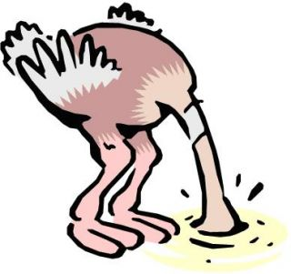





All Transitions Have Three Phases
Performance
Comfort
All Emotions Are Normal
Denial
Anger
Struggling / Curiosity
Overwhelm
time
Endings
Neutral Zone
New Beginnings
Have to let go of who we were in the old
Not who we were
Not yet who we will be
Begin to identify
with the new ways
*Adapted from William-Bridges model
Notes:
Alison:
Let us now explore the three phases of the human transition process.
(click)
The first phase of the transition process is called “Endings”
According to William Bridges Transition model, all change begins with an end. Think about a change in your life and see what you had to give up before committing to the new reality; for example, if one marries, one must renounce celibacy; to change jobs, you must give up your existing job before starting a new one;
(click)
Endings: Denial, anxiety, Shock, Confusion, Uncertainty, Resentment, Sadness, Anger, Fear, Blame - It’s about loss and letting go of the old reality / It’s important for people to identify and talk about what they are loosing
In this phase, people discover that they must forget the predictable and comfortable environments to which they have become accustomed. They feel a loss of control. There are also people who can be truly optimistic and those who are less comfortable with change. So it's important to make sure you respect all of each person's points of view.
(click)
Have to let go of who we were in the old
(click)
The second phase of the transition process is called “Neutral Zone”.
The "neutral zone", also known as the "nowhere between two places", is the most difficult for most people since it is the space that separates the old reality and the new reality, where lack of clarity can create uncertainty and anxiety. But it can also be a period of great creativity and innovation, during which we prepare to enter the new reality.
Neutral Zone: Undirected energy typified by confusion, Anger, Fear, Frustration, Extreme anxiety, Scepticism, Apathy, Isolation, Dislocation, Bargaining, Depression, Some optimism, Discovery, Creativity - Also referred to as the psychological no-man’s-land or the limbo between the old and the new / Still emotionally charged / It’s a time of exploration
As people move through transition points, they may blame and develop anger. People may also feel uncertain, fearful, confused, or experience an unusual outburst of frustration or anxiety. Patience is key here. We must focus on the future rather than the past. And as in the case of finality, we must continue to encourage the optimists and support those who have the most difficulty with change.
(click)
Not who we were, Not yet who we will be
(click)
The last phase of the transition process is called “New Beginnings”.
People in this phase have chosen to engage and participate in the development of new processes based on the new environment. They are now more comfortable with the transition, they may even look forward to moving forward and perhaps have hope of developing new confidence, relationships and new achievements.
New beginnings: Commitment, Enthusiasm, Trusting, Excitement, Relief / Anxiety, Hopeful/Sceptical, Impatience, Acceptance, Realisation of loss / Acknowledgement of possibilities and new ways / Starts versus beginnings /Ambivalence/Timing
People have chosen to commit and participate in building the new process with the new environment. Now that they are more comfortable with the transition, they can become impatient for progress and may be hopeful about building new trust, relationships and achievements.
(click)
Begin to identify with the new ways
(click)
All emotions are normal
Your attitude towards change may help: glass half full or half empty?
The more perceived control you have over a situation, the healthier you feel about it. Regardless of what changes you are going through, you do have control over your responses to that change. You can exert control by making decisions about how much risk you want to take.
Graphic adapted from Kübler-Ross Grief Cycle, Williams-Bridges Transition Model
https://commons.wikimedia.org/wiki/File:Kubler-ross-grief-cycle-1-728.jpg

Slide 8
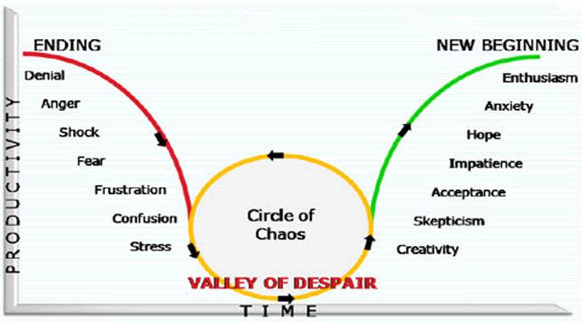
Individual Response to Change (Transition/Reactions)
Which is also similar to other human dynamic processes, like grief or team dynamics
*Adapted from William-Bridges model
Notes:
Alison:
This is another adapted model, in this one the “Circle of Chaos” or “Valley of Despair” are more obvious and likely occurs more often nowadays with the world we live in and the constant changes coming at us

Slide 9
Remember, be aware!
time /
temps
Endings
Neutral Zone
New Beginnings
Fins
Zone neutre
Nouveaux départs
Notes:
Alison:
Friendly reminder, models helps us understand what’s going on.
(click)
They are easy to understand, they go from left to right, with a gentle descent and rise, when in reality this may occur
(click)
//
Rappel amical, les modèles nous aident à comprendre ce qui se passe.
(Cliquez sur)
Ils sont faciles à comprendre, ils vont de gauche à droite, avec une descente et une montée douces, alors qu'en réalité cela peut se produire
(Cliquez sur)

Slide 10
Change, Transition & Chaos
Circle of
Chaos
Performance
Comfort
VALLEY OF DESPAIR
Depth or Intensity
Denial
VALLEY OF DESPAIR
Anger
Struggling / Curiosity
All Emotions Are Normal
Overwhelm
time
Endings
Neutral Zone
New Beginnings
Duration
CHANGE + HUMAN BEINGS = TRANSITION
Notes:
Alison:
In this slide we are just showing the various graphics over-impossed
We have the Circle of Chaos, also known as the Valley of Dispair
(click)
The transition zones, Endings, Neutral Zone and New Beginings
(click)
Then we have the different reactions
(click)
Each transition has its own Depth or Intensity and Duration, depending on each person
(click)
Rememberigng that all émotions are normal
(click)
And when we have CHANGE + HUMAN BEINGS = TRANSITION
Graphic adapted from Kübler-Ross Grief Cycle, Williams-Bridges Transition Model
https://commons.wikimedia.org/wiki/File:Kubler-ross-grief-cycle-1-728.jpg

Slide 11

SCARF Model of Social Threats and Rewards
Status
Certainty
Autonomy
Relatedness
Fairness
AWAY
from Threat Response
TOWARD
Reward
Response
http://www.edbatista.com/2010/03/scarf.html
Notes:
Casey-Marie:
It is a very interesting model, it is not easy to grasp at once but once understood all of it or the intention of it, it is really valuable.
(state what each letter signifies for SCARF)
We have prepared a few more slides in order for us to share with you and explain what this model means. The thing is to identify what we walk away from as a threat response because we feel as though something is threatening us. So we change this from a threat response to a reward response, in psychology this is known as Cognitive Reframing. I will explain from the slides and there is also a short video.
Status is about relative importance to others. Or how I am perceived within the group.
Certainty concerns being able to predict the future. Or the need to have all the details, to know how things will happen, and to plan the future in advance.
Autonomy provides a sense of control over events. This is the need to take initiative and demonstrate creativity.
Relatedness is a sense of safety with others – of friend rather than foe. This is the need to belong to a group for formal and informal relationships.
Fairness is a perception of fair exchanges between people. Or the need for fair exchanges and justice.
Thus, happiness hormones are secreted when these five SCARF needs are met, and we increase our confidence. On the contrary, while stress hormones are released when one or more needs are not met. We have doubts and become distrustful.
In the next two slides, we'll take a closer look at the model. We'll also watch a short video.
Resources in English:
http://www.edbatista.com/2010/03/scarf.html
https://jvrafricagroup.co.za/blog/when-leaders-use-their-brain
Resourcess en Français :
Le neuroleadership démystifié? Pour susciter l’engagement - https://optimumtalent.com/publications/le-neuroleadership-demystifie-pour-susciter-lengagement/?lang=fr
Collaborer et influencer plus efficacement https://icfquebec.org/article/379

Slide 12
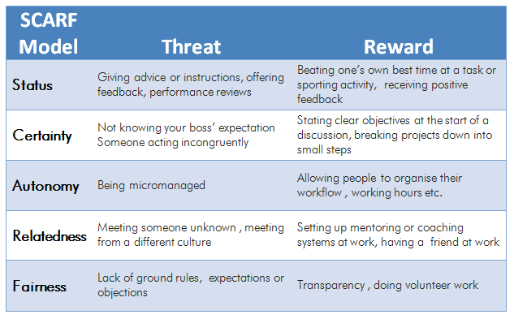
SCARF Model – Some Examples of Actions
That can evoke either a threat response or a reward response:
https://jvrafricagroup.co.za/blog/when-leaders-use-their-brain
Notes:
Casey-Marie:
“In explaining this we can identify what is a threat or a reward – what we see as a threat or a reward the way something is presented.”
(explains what is perceived as a threat and what is perceived as a reward based on the slide)
Have a minute to think and reflect about a situation when we chose one or the other, Threat or Reward response
https://www.mindtools.com/pages/article/SCARF.htm
https://childcareta.acf.hhs.gov/systemsbuilding/systems-guides/leadership/scarf-model

Slide 13


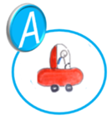


Status - This is the individual's place within a group.
Certainty - This is their need for security.
Autonomy - This is the feeling of being able to make their own choices.
Relationships - It's the need to belong.
Fairness - It is the need to have a system that is fair.
https://www.koherence.fr/scarf-engagement-motivation-collaborateur-dispositif-rh/
Notes:
Casey-Marie:
Status - This is the individual's place within a group, the importance they are given (or at least, the importance they feel). This directly influences their self-esteem.
Certainty - It reassures employees to have an idea of ​​what the future holds for them; this is their need for security.
Autonomy - This is the feeling of being able to make choices and exercise control over one's environment. It also represents the possibility of self-development.
Relationships - It's the need to belong, to work in a healthy relational environment. Otherwise, we spend our time covering our backs!
Fairness - It is the need to evolve within a system perceived as fair, equitable and caring.
In summary, If a leader wants to ensure the commitment of his or her team members, it would be a good idea for him or her to recognize the values ​​and status involved in projecting the team into a certain security and certainty towards the future, and also to allow the development of proactivity and autonomy by promoting team spirit and good relations and by promoting transparency to allow the evolution of his or her team in a system perceived as fair, equitable and caring or simply fair play.
Resources in English:
Introduction to the SCARF Management Model – https://www.youtube.com/watch?v=K-IW7PQcMpE
Take the SCARF Assessment from NeuroLeadership Institute - https://www.youtube.com/watch?v=IOU6uCwx6Tk
The secret to giving great feedback avec sous-tritres en francais : https://www.youtube.com/watch?v=wtl5UrrgU8c
Scarf Model adjusted avec sous-titres en francais: https://www.youtube.com/watch?v=NDJg-1bX_Qk
https://childcareta.acf.hhs.gov/systemsbuilding/systems-guides/leadership/leading-ourselves/scarf-model
https://www.mindtools.com/pages/article/SCARF.htm
Ressources en français :
Les leviers d’engagement de vos collaborateurs: https://www.koherence.fr/scarf-engagement-motivation-collaborateur-dispositif-rh/
Utiliser le modèle SCARF dans le management des ressources humaines https://matheo.uliege.be/bitstream/2268.2/3179/4/TFE%20QUENTIN%20MARLIER.pdf
Le SCARF MODEL, les 5 leviers de motivation ! - https://www.youtube.com/watch?v=UcH0y3wmhVw
Maintenant on va regarder la vidéo sur le modèle SCARF: le neuroleadership, 2 mins - https://www.youtube.com/watch?v=ImPUk6OhJM0

Slide 14
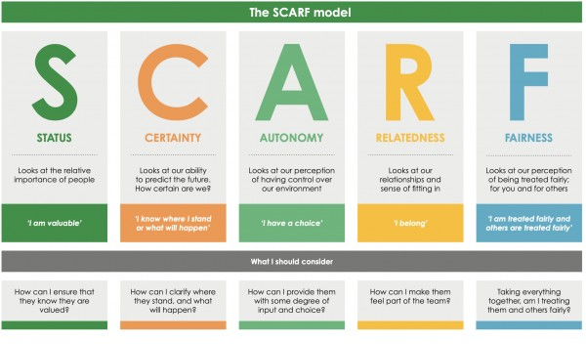

SCARF Model v2
https://www.youtube.com/watch?v=hNAcCc1oWR4
Notes:
Casey-Marie:
In this slide, I like reading it with the “MWe” concept in mind, remember it?
((the way to read ths image is,
Status, looks at the relative importance of people.
From the individual’s perspective it says “I am valuable”
And from the collective, what I as a leader should consider is “How can I ensure that they know they are valued?”
And so on))
How to Use the SCARF Model to Understand Trust and Connection (youtube.com) - https://www.youtube.com/watch?v=hNAcCc1oWR4

Slide 15
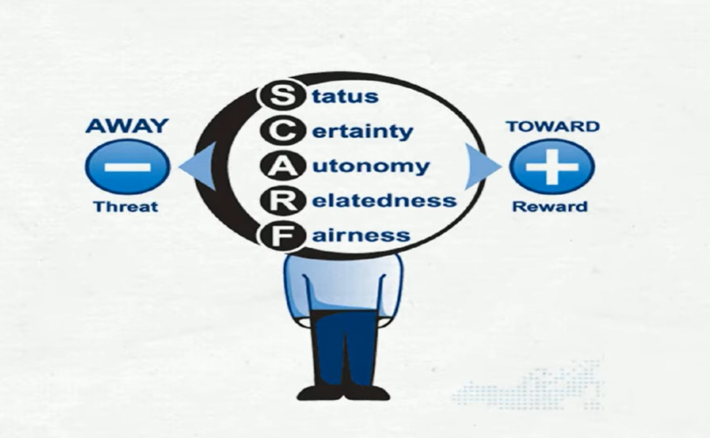
The SCARF Model for Trust and Connection
Notes:
Casey-Marie:
((We don’t use “insert video” as some Deparments don’t allow youtube
Instead, we share the screen (audio & video) directly from youtube using a web browser.))
Video link: https://www.youtube.com/watch?v=hNAcCc1oWR4

Slide 16

Technique – SBN-RR
SBN-RR
Stop – whenever you feel a trigger coming
Breathe – focus your mind on your breath
Notice – experience how you feel, notice your emotions
Reflect – where is that coming from? Is there any judgment?
Respond – take the opportunity to respond with a positive and compassionate outcome in mind.
This is a technique that could be used in your everyday work.
https://siyli.org/take-the-railroad-to-avoid-triggers/
Notes:
Casey-Marie:
(check the time… ideally we still have about 25 mins left in the session… likely 13h35’ish)
The following technique is used for helping regulating our reactions and emotions, called SBNRR tool for “Stop / Breathe / Notice / Reflect / Respond”. Or in French: “Stop / Respire / Constate / Réfléchis / Réponds”. When an external event triggers a sudden surge of emotions in me, following this sequence allows me to give the neocortex time to do its work of distancing, analyzing and regulating emotions, for a more effective response.
(read the slide)
(click)
Now, we’ll open the microphone for some sharing.
Think about it for a minute and come up with real examples on when this technique could have been used for good.
Come up with real examples
Ressources in English:
Technique SBN-RR - https://siyli.org/take-the-railroad-to-avoid-triggers/
Ressource en français :
L’outil SBN-RR : https://www.aureliendaudet.com/muscler-intelligence-emotionnelle-2-jours-4-semaines/

Slide 17
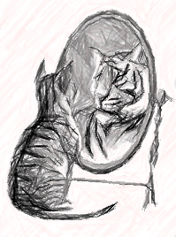

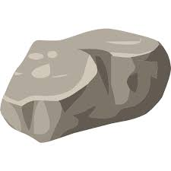


Treat yourself as if you were worthy of love… because you are
https://my.happify.com/hd/why-you-should-treat-yourself-like-someone-you-love/
https://www.youtube.com/watch?v=xaqdK6JPpcg
Notes:
Casey-Marie:
This slide is about treating yourself as if you are worthy of love because you are. You have here the Rock, as a child he used to get attacked. He did not know how to deal with his life, in order to protect his heart because others were a threat to himself he became a rock. But as he grew up, he learned how to be himself and be gentle, vulnerable. Don’t be ashamed of who you are, be yourself, because everyone else’s place is taken.
(check the time… ideally we still have about 18 mins left in the session… likely 13h40’ish)
How to find the perfect relationship (4 mins) - https://www.youtube.com/watch?v=bUMFZM5WBrI
They had us in the first half not gonna lie (1.2 mins) - https://www.youtube.com/watch?v=xaqdK6JPpcg
Resources in English:
Self Love Practice: https://www.youtube.com/watch?v=cFeCUfw657g
How To Let Your Light Shine Bright - https://www.youtube.com/watch?v=CWpiCOmbVuY
Self-Love Exercise - https://www.youtube.com/watch?v=ZsTKyYOuK84
Ressources en français :
Voila ce qu’il faut faire pour réussir à s’aimer soi même, 6 mins – https://www.youtube.com/watch?v=18jn-K34aNA&t=39s
Exercice dans le miroir, Augmenter l'amour de soi, 4 min - https://www.youtube.com/watch?v=HTlnAbAax_0
Apprendre à vous aimer, 6 min - https://www.youtube.com/watch?v=6L0vo7dx_SE
Se traiter soi-même comme on traiterait un ami- https://www.sarah-baumann-hypnose.com/post/se-traiter-soi-m%C3%AAme-comme-on-traiterait-un-ami
Développer l’éstime personelle
1 - https://www.youtube.com/shorts/TkjSsCZxwEs
2 - https://www.youtube.com/shorts/GBMDjw8h_co
3 – https://www.youtube.com/shorts/kpn4L_uvAH4
4 - https://www.youtube.com/shorts/SfTQNTvRPMg
Mylène Muller - https://www.youtube.com/channel/UCryuWe_q6Z_pLn8fd7E0Cyg/search?query=aimer%20soi-meme

Slide 18
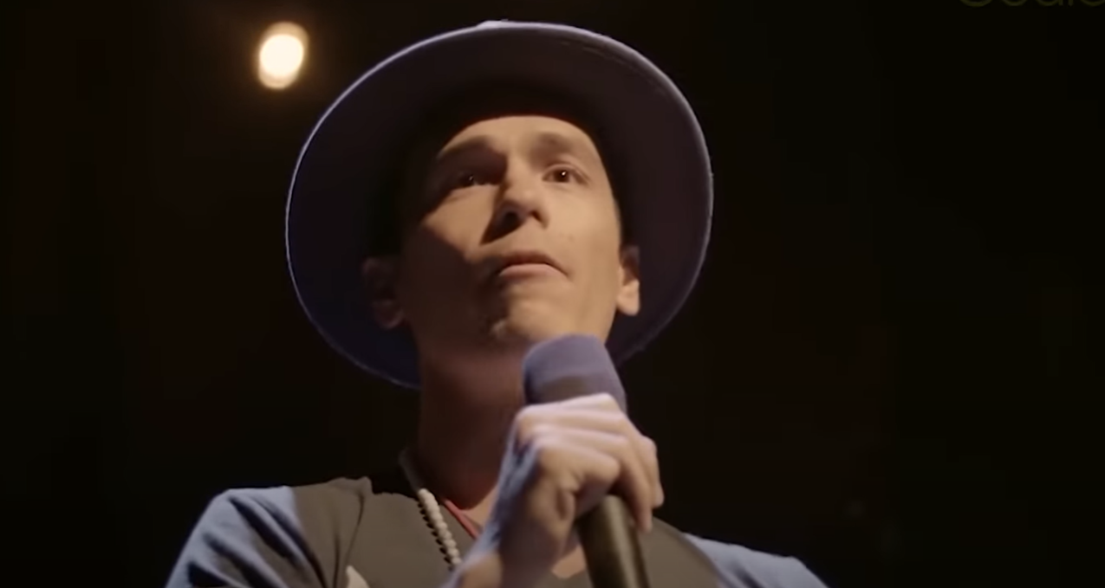
How to find the perfect relationship
Notes:
Casey-Marie:
((We don’t use “insert video” as some Deparments don’t allow youtube
Instead, we share the screen (audio & video) directly from youtube using a web browser.))
Video link: https://www.youtube.com/watch?v=bUMFZM5WBrI

Slide 19

They had us in the first half not gonna lie
Notes:
Casey-Marie:
((We don’t use “insert video” as some Deparments don’t allow youtube
Instead, we share the screen (audio & video) directly from youtube using a web browser.))
Video link: https://www.youtube.com/watch?v=xaqdK6JPpcg

Slide 20
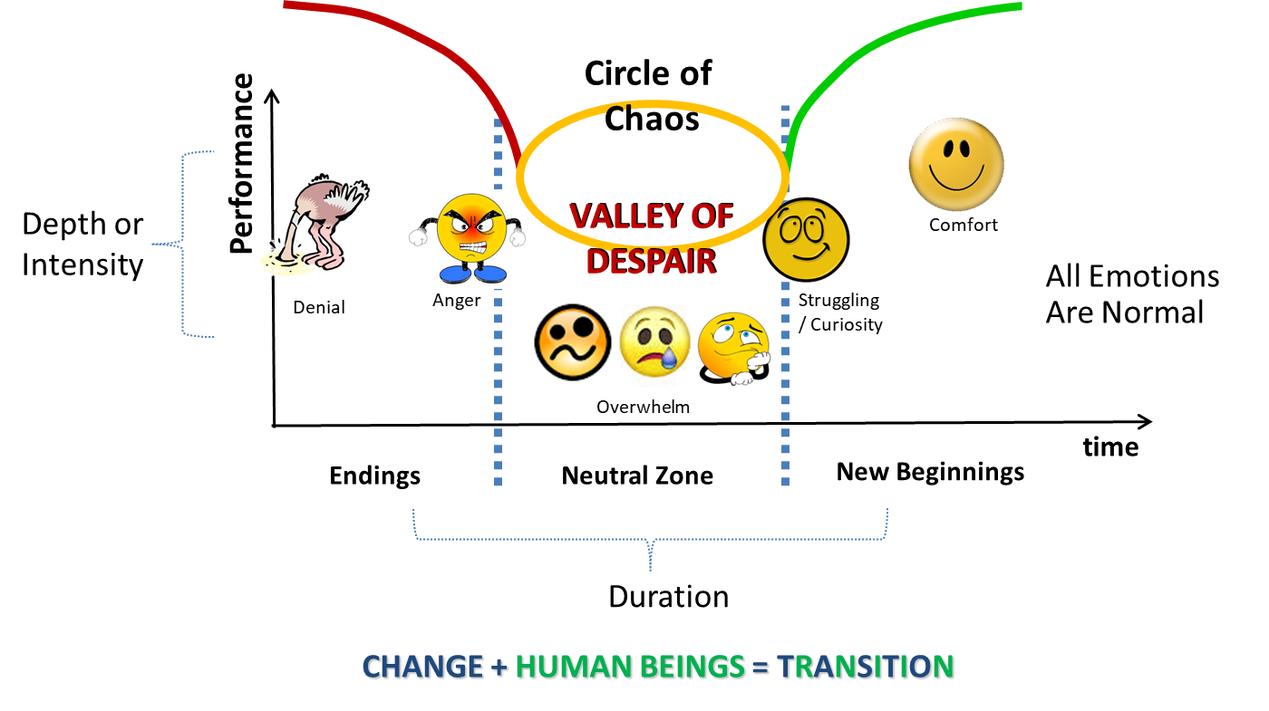
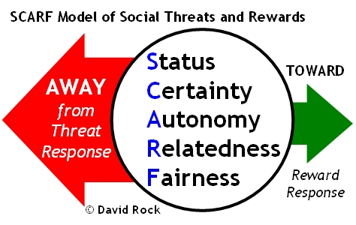
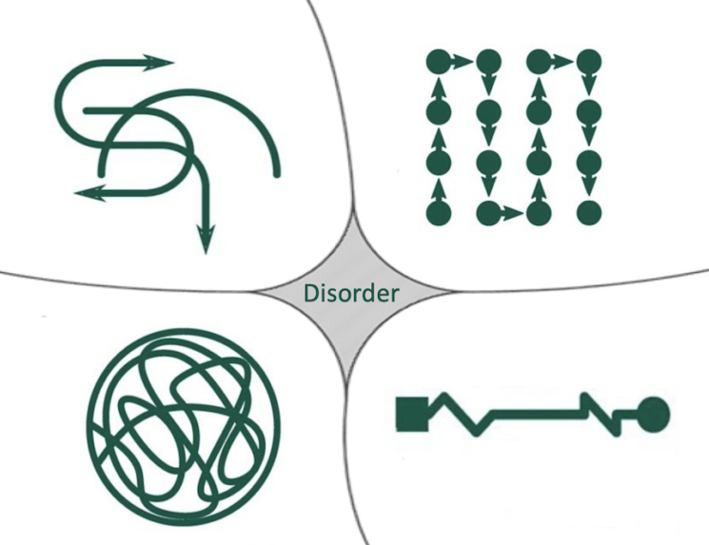


Reflect about the models & exercises
Plenary & Small Groups
SBN-RR
Notes:
Casey-Marie:
Now, before going into small groups debrief, let’s do a plenary debrief, let’s open the microphone for a few of you who would like to share your reflections about today’s exercises in plenary
Give the voice to 2-4
((Then create breakout rooms of 4 or 5 participants))
Now we’ll do debrief in small rooms… you’ll have about xx minutes total, be conscious about sharing the time, we’ll see you after that do review the homework and answer any questions you may have.
For the small groups, you may want to shares about:
Change and Transition
Cynefin, Adaptive Action, VUCA models
About the SCARF model,
The SBN-RR technique
Love yourself
See you soon

Slide 21




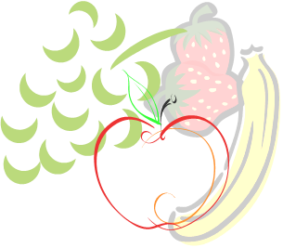
Your take away practice for week 5
Connecting – Buddy System
Gratitude Journaling – daily
Practice up to 15 mins… chose one - daily
  Body scan or Breathing
  Self-compassion
Cynefin, Adaptive Action, VUCA models
Apply the SCARF Model – as needed
Technique - SBN-RR
Notes:
Casey-Marie:
Be aware: next week we’ll do a Mindful Eating exercise, you’ll need a small fruit or a veggie for this, something like a grape, blueberry or a slice of an orange or mandarin, a piece of a carrot, cucumber or any veggie
Homework:
Connecting – Buddy System
Gratitude Journaling – daily
Practice up to 15 mins… chose one - daily
Body scan or Breathing
15 mins – https://www.rightlifeproject.com/meditate (may need to scroll down)
15 mins – https://soundcloud.com/dharma-gus/15-min-body-scan-augusta-mbsr
Self-compassion
10 mins – https://soundcloud.com/breathworks-mindfulness/mindfulness-for-women-track-5-self-compassion-meditation
10 mins – https://soundcloud.com/user-640851605/self-compassion-giving-and-receiving-meditation-10-minutes
15 mins – https://soundcloud.com/mindfullivingcoach/self-compassion-meditation
15 mins – https://soundcloud.com/awakeningcompassion/awakening-compassion-class-4
20 mins – http://self-compassion.org/wp-content/uploads/meditations/LKM.self-compassion.MP3
Cynefin, Adaptive Action, VUCA models
Apply the SCARF Model – as needed
Technique - SBN-RR

Slide 22
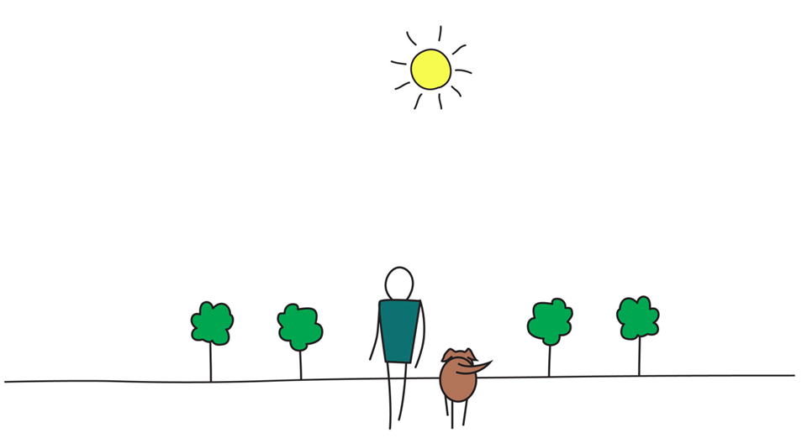

Be Mindful, Be Happy
Notes:
Casey-Marie:

Slide 23
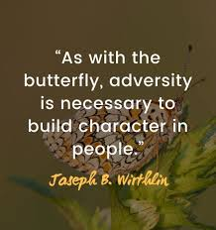
Cognitive Reframing - Example
When you reframe those thoughts to be looked at as challenges, it can show the person that they have the opportunity to turn it around, that there are better things that can come from it, and that you don’t have to be “stuck” with the problem.
Cognitive Restructuring in CBT: Steps, Techniques, & Examples (sandstonecare.com)
- https://www.sandstonecare.com/blog/cognitive-restructuring-cbt
Notes:
Casey-Marie: ??
(paraprhase the slide)
Resources:
Cognitive Restructuring in CBT: Steps, Techniques, & Examples (sandstonecare.com) - https://www.sandstonecare.com/blog/cognitive-restructuring-cbt
Cognitive reframing is a psychological technique that consists of identifying and then changing the way situations, experiences, events, ideas, and/or emotions are viewed.^{[1]} Cognitive reframing is the process by which such situations or thoughts are challenged and then changed. - https://en.wikipedia.org/wiki/Cognitive_reframing#:~:text=Cognitive%20reframing%20is%20a%20psychological,are%20challenged%20and%20then%20changed
What is an example of cognitive reframing?
One example of reframing is looking at problems as challenges. Everyone has difficulties that they experience in their life. Often, it can be difficult to navigate these problems and decide what to do about them. These problems can affect a person's life, health, and well-being. - https://www.sandstonecare.com/blog/cognitive-restructuring-cbt/#:~:text=One%20example%20of%20reframing%20is,health%2C%20and%20well%2Dbeing.
Short #dog #puppy #funny #bordoodle #prettydogs #doglovers #charliedog – YouTube - https://www.youtube.com/shorts/UtMY7S5XbSg
How to Reframe your Thoughts (youtube.com) - https://www.youtube.com/watch?v=VGIAbU_E244

Slide 24
Change, Chaos & Complexity:
Cynefin Framework
Adaptive Action – Power of Inquiry
VUCA
Notes:
Now we will explore a bit of Complexity models, and given the time we have available, I’ll ask you which one you’d prefer that we explore… take your arrow and point to the one of your preference. Only use the arrow for your input.
In the meantime you point to your preference, I strongly recommend you look at 3 short videos from the CSPS when you can… link to the first is shared on the chat
Short: Chaotic movement https://youtube.com/shorts/fK1VmX9mzRw?si=ZJ4uHGDgE69g5ubl
Change & Complexity:
TRN4-V01 - Introduction to Change and Complexity - Video 1 of 3 (csps-efpc.gc.ca) - https://app.csps-efpc.gc.ca/content/Introduction%20to%20Change%20and%20Complexity%20-%20Video%201%20of%203.html
TRN4-V02 - Introduction to Change and Complexity - Video 2 of 3 (csps-efpc.gc.ca) - https://app.csps-efpc.gc.ca/content/Introduction%20to%20Change%20and%20Complexity%20-%20Video%202%20of%203.html
TRN4-V03 - Introduction to Change and Complexity - Video 3 of 3 (csps-efpc.gc.ca) - https://app.csps-efpc.gc.ca/content/Introduction%20to%20Change%20and%20Complexity%20-%20Video%203%20of%203.html
https://www.ckju.net/en/dossier/complexity-leadership-complex-dynamic-organizations-social-interactions/32050#:~:text=Using%20complexity%20leadership%20means%20giving,that%20take%20place%20in%20organizations.

Slide 25
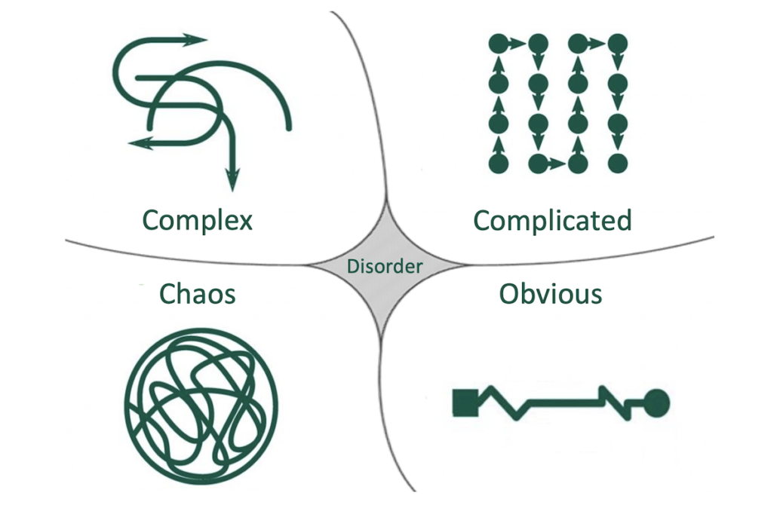
Cynefin Framework
Notes:
Resources:
VUCA and Cynefin’s organizational contexts » Paradigm21 - https://paradigm21.ch/en/articles/vuca-and-the-organizational-contexts-of-the-cynefin-model-1-2/

Slide 26
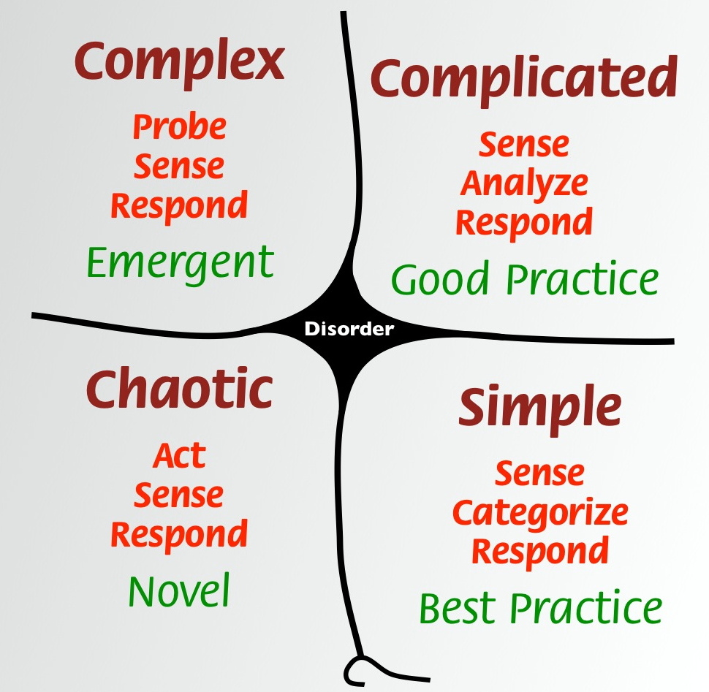
Cynefin Framework
Notes:
Cynefin model:
Cynefin model file download… https://gcconnex.gc.ca/file/download/43264048
Intro to Cynefin model (4 mins) - https://www.youtube.com/watch?v=epXqgrm2hs4
Cynefin Tools…
Complexity toolbox 1: How do you get your message across in a complex, changing world? (3 mins) - https://www.youtube.com/watch?v=llGDvQE1gl0
Complexity toolbox 2: Complexity Check-In (3.5 mins) - https://www.youtube.com/watch?v=D4MSzpqAKls
Complexity toolbox 3: Safe to fail experiments (3 mins)- https://www.youtube.com/watch?v=i_h2WJ1qNRA

Slide 27
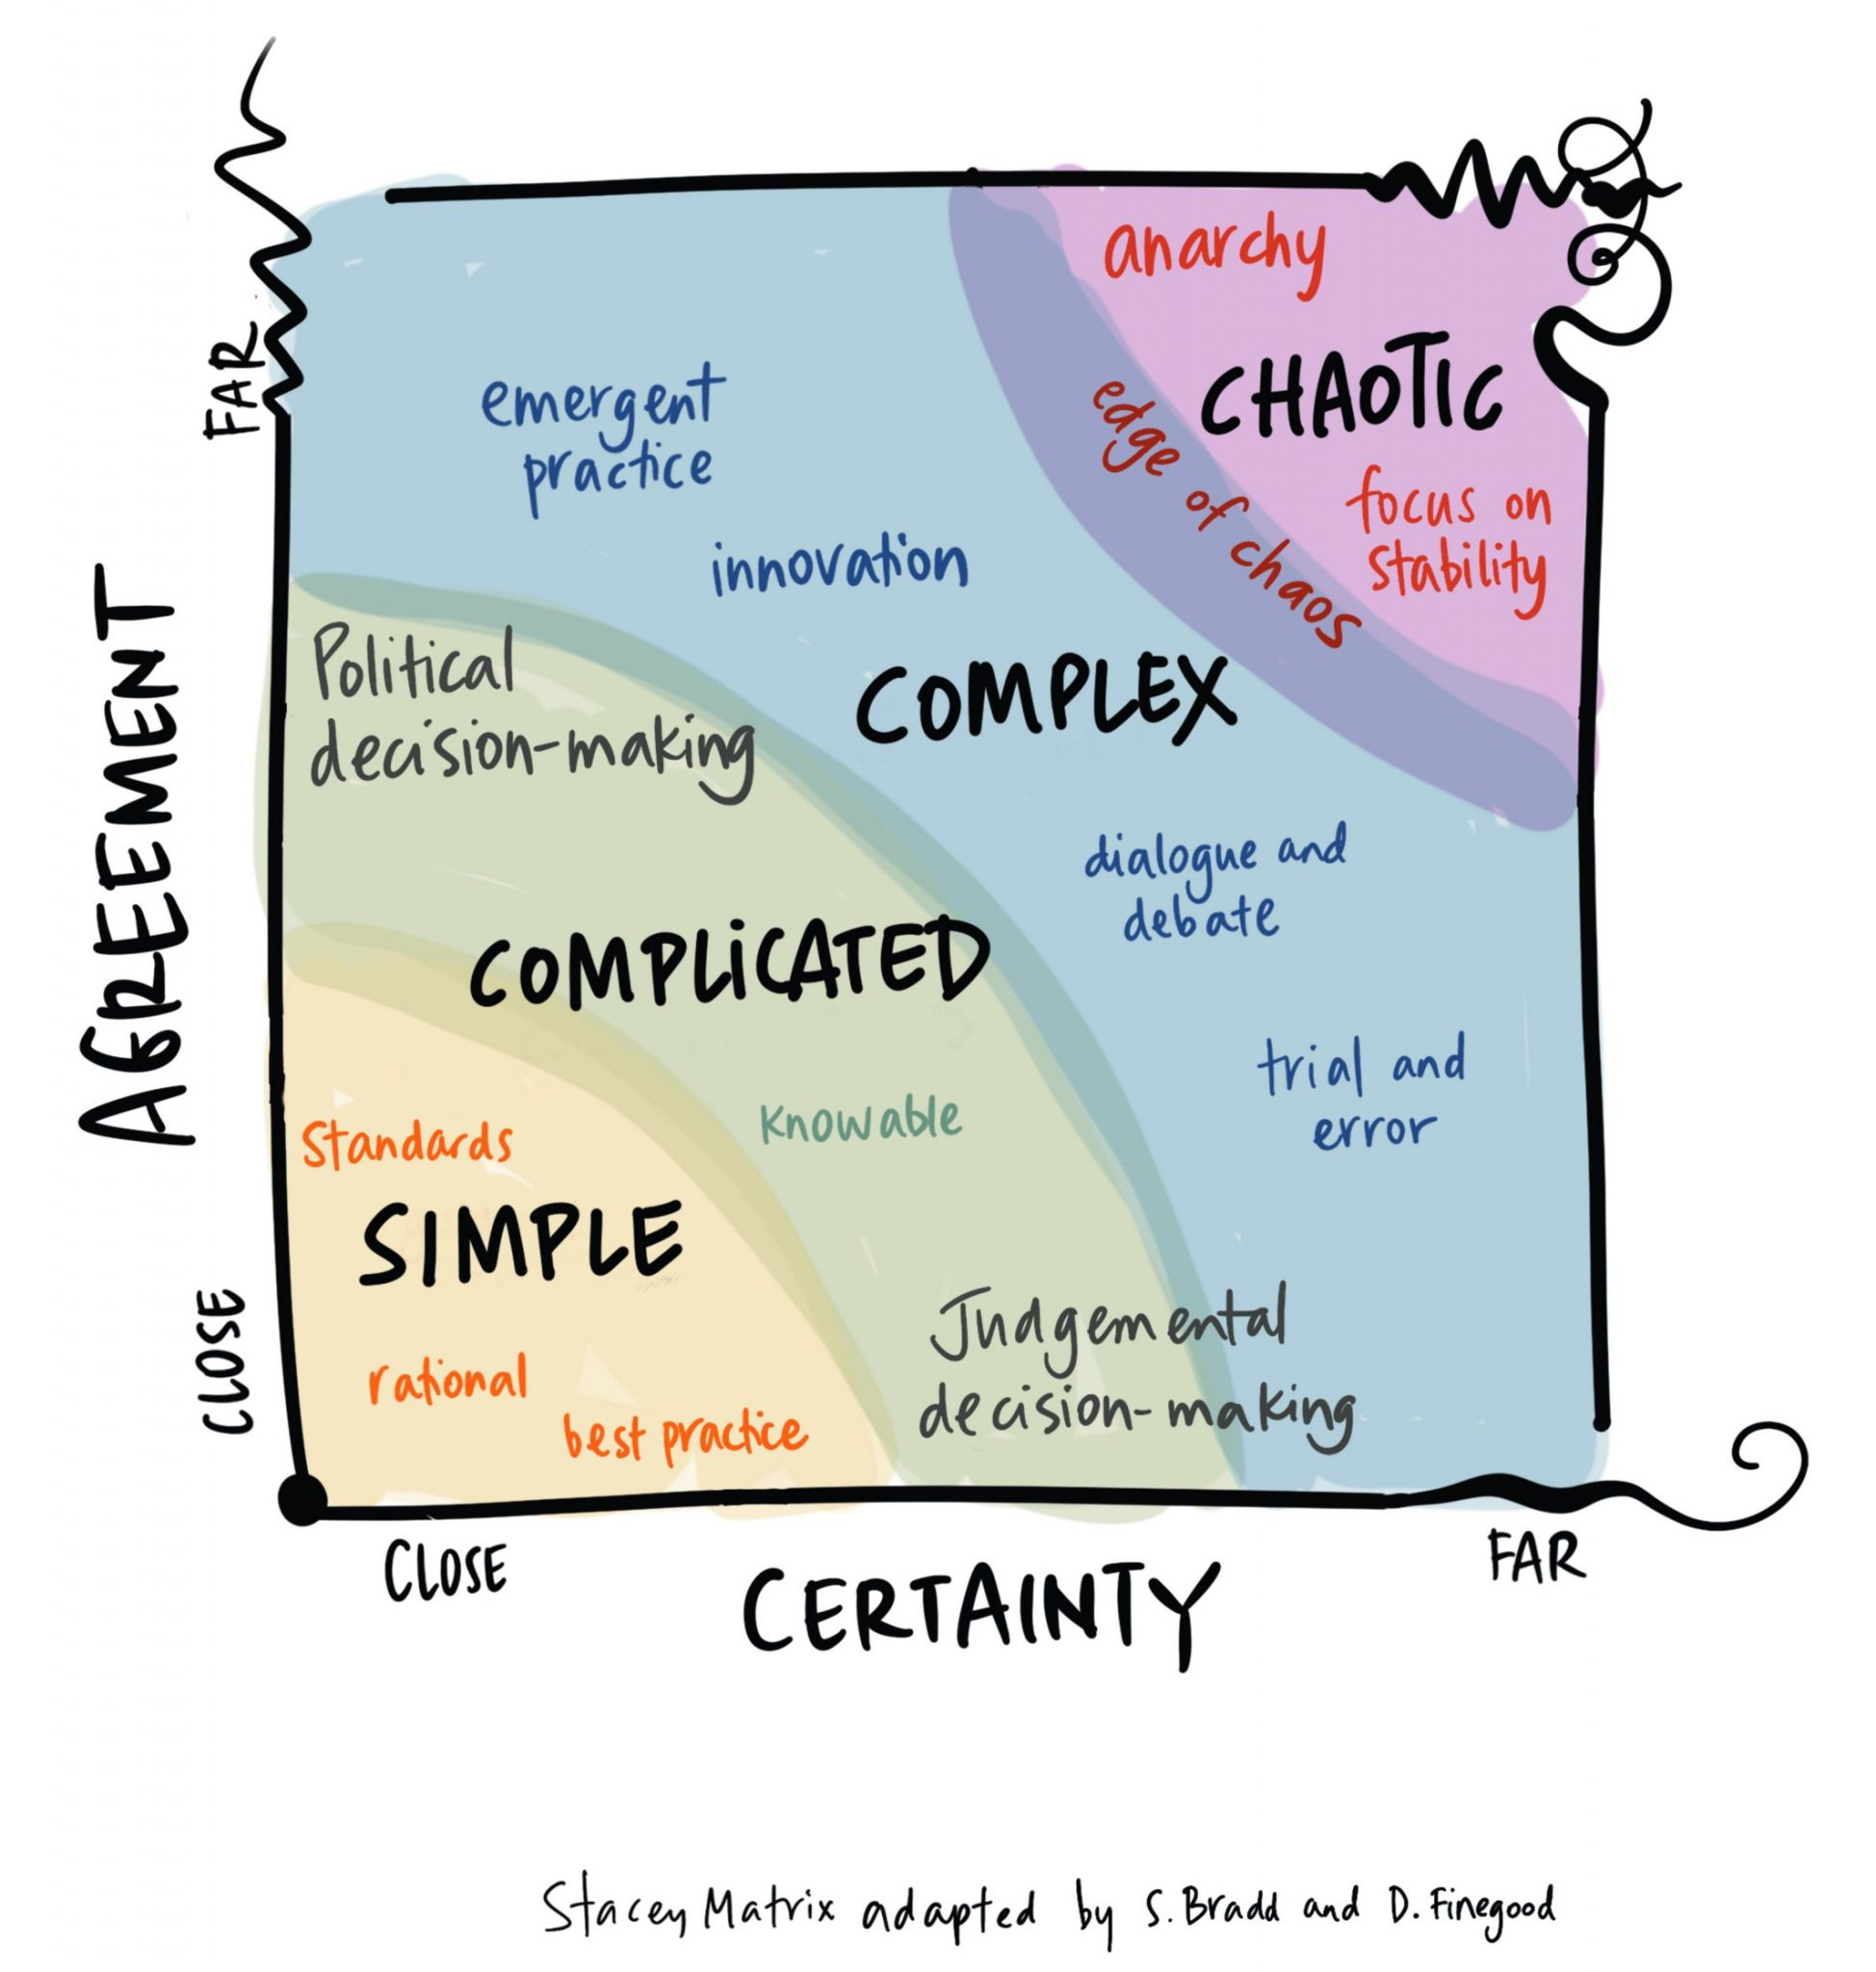
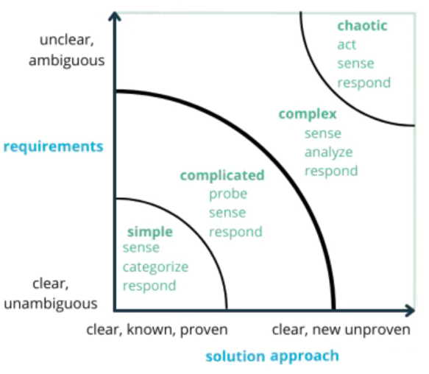
Stacey Matrix
Notes:
Sometimes the Cynefin model is compared with the Stacey Matrix model, now showing an « original » on the left with an adaptation on the right… The Stacey Matrix is a tool for representing and managing complexity in projects, likely IT projects. It consists of two axes: Requirements or Agreement (y-axis) and Approach or Certainty (x-axis). Requirements represent “what” needs to be developed, while the Approach represents the 'how'.
Simple, Complicated and Complex Decision-Making - new visual - Drawing Change - https://drawingchange.com/project/simple-complicated-and-complex-decision-making-new-visual/
On Complexity (Cynefin Framework & Stacey Matrix): Why Your Software Project Needs Scrum (linkedin.com)- https://www.linkedin.com/pulse/complexity-why-your-software-project-needs-scrum-christiaan-verwijs
How to use the Stacey Matrix in Consulting (preplounge.com) - https://www.preplounge.com/en/case-interview-basics/case-cracking-toolbox/structure-your-thoughts/the-stacey-matrix

Slide 28

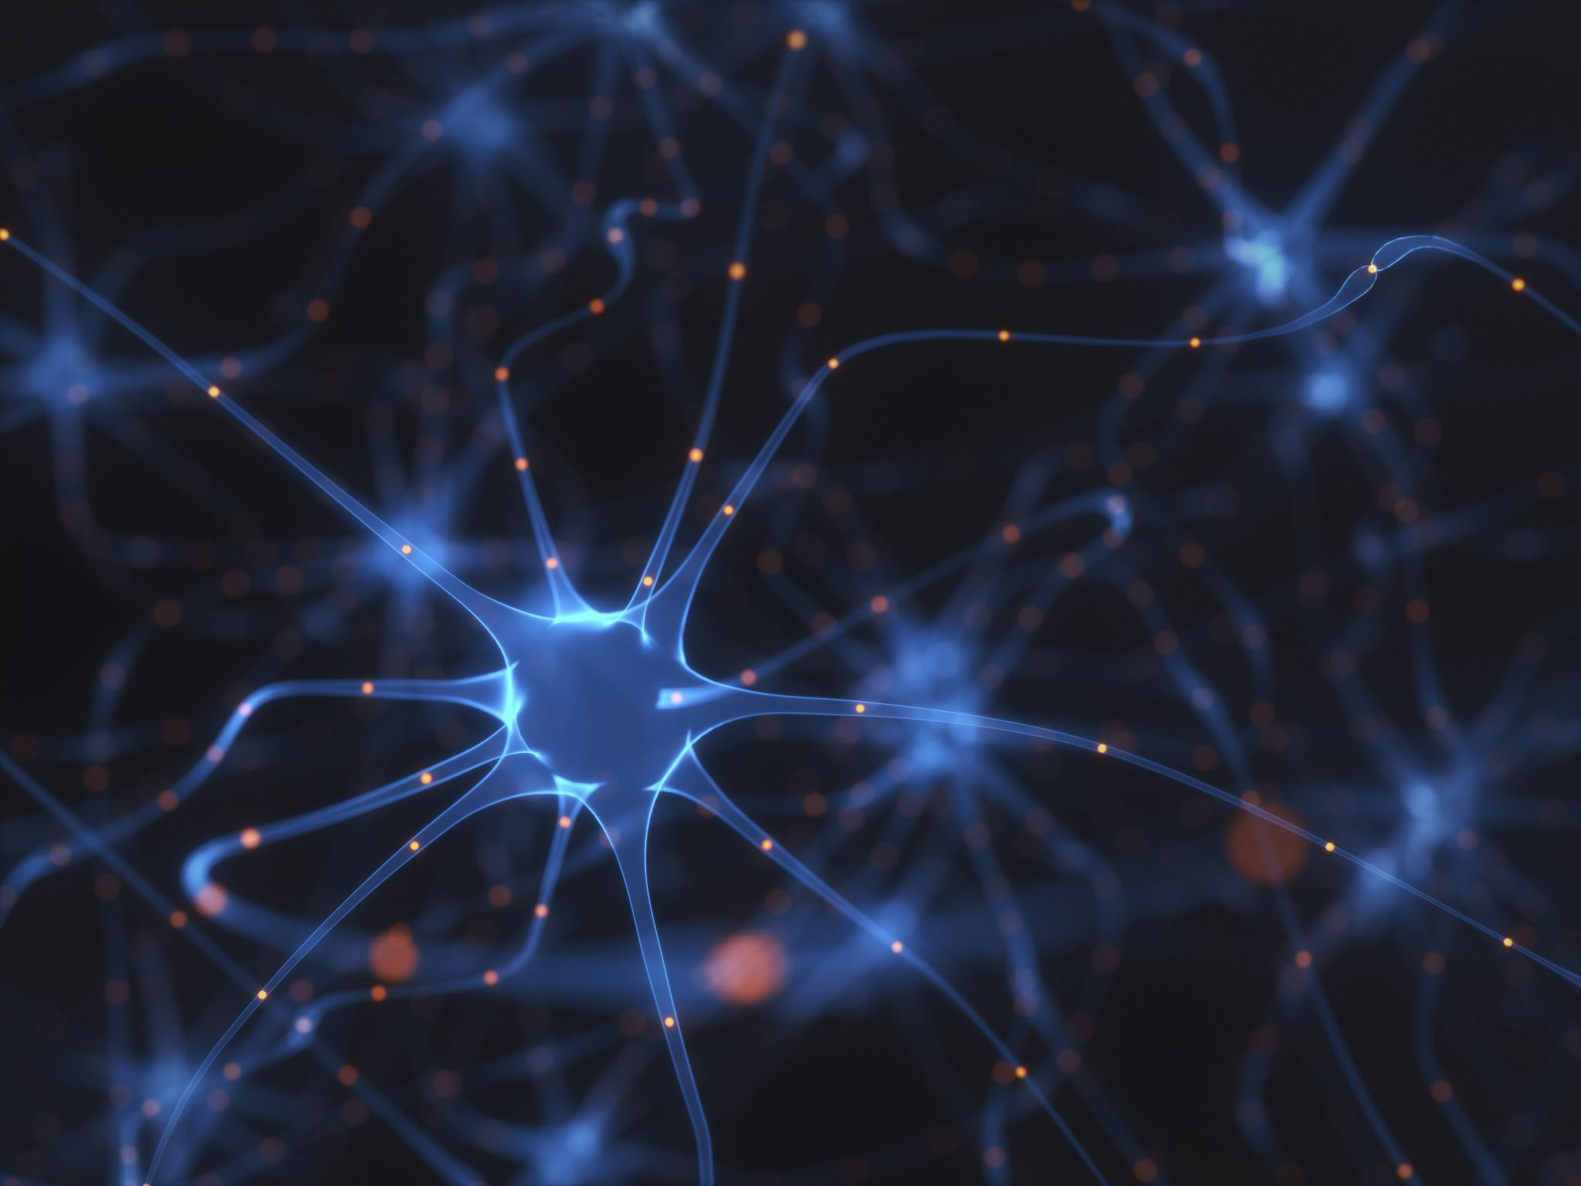
Why Inquiry?
“Inquiry is the key to transformation. In a complex system, answers have short shelf-lives, but good questions serve you forever. Questions help you see a wicked challenge clearly, understand it from a new perspective, and find surprising options for transformative action.” - HSD Institute, Power of Inquiry
In other words, “answers don't last long on complex systems, thus inquiry allows you to identify what the next wise step is.”
- Glenda Eoyang, Founder & Executive Director HSD Institute
* Used with permission: https://www.hsdinstitute.org
Notes:
« L’interrogation est la clé de la transformation. Dans un système complexe, les réponses expirent rapidement, mais les bonnes questions vous serviront toujours. Les questions vous permettent de voir clairement les défis pernicieux, de les comprendre d’une autre manière et de trouver des solutions surprenantes qui mènent à une transformation. »
En d’autres mots, « les réponses liées à des systèmes complexes ne restent pas bonnes longtemps, c’est donc l’interrogation qui vous permet de décider quelle est la prochaine étape intelligente. »
Resources:
Inquiry IS the Answer (hsdinstitute.org) - https://www.hsdinstitute.org/resources/inquiry-is-the-answer-covid-19-recordings.html

Slide 29
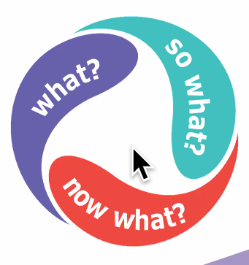
Identifying The Next Wise Action
What?
How is the pattern currently manifesting?
See the issue, with whatever you know.
So what?
What do you know? What are your insights and options?
Whatever sense you can make of the situation.
Now what?
What is the next wise action that will shift the pattern in a more productive direction?
With whatever power you have, find something that is doable, no need to be something big or work on the whole pattern at one time.
* Used with permission: https://www.hsdinstitute.org/
Notes:
Using an inquiry-based problem-solving approach that uses different tools and methods helps uncover patterns and understand complexities within the team or organization. We use simple models and methods to find the next wise action, we refer to complex issues as Wicked or Sticky Issues.
This model is simple, yet powerful
What? - How is the pattern currently manifesting?
(click)
Helps see the issue, with whatever you know.
So what? - What do you know? What are your insights and options?
(click)
Whatever sense you can make of the situation.
Now what? - What is the next wise action that will shift the pattern in a more productive direction?
(click)
With whatever power you have, no need to find something big or work on the whole pattern at one time, that is doable
I mentioned Wicked or Sticky issues, similarly are complex problems, or even simple problems can be influenced, any issues or challenges can benefit from this and similar methods
Resources:
Wicked or Sticky issues:
Many levels
Many stakeholders
Massive interdependencies
Fuzzy boundaries
Repeating, but never exactly the same
No root cause
Cannot be solved, only influenced
Nothing is Intractable? Right! (hsdinstitute.org) - https://www.hsdinstitute.org/resources/nothing-is-intractable-right.html
Tame Your Wicked Problem (hsdinstitute.org) - https://www.hsdinstitute.org/resources/tame-your-wicked-problem-blog.html
Taming a Wicked Issue: Building a Generative Team to Improve Access and Flow (hsdinstitute.org) - https://www.hsdinstitute.org/resources/taming-a-wicked-issue.html

Slide 30

Simple Rules: Stand in Inquiry?
Our intention is to cultivate relationships.
Turn judgment into curiosity
Turn disagreement into shared exploration
Turn defensiveness into self-reflection
Turn assumptions into questions
* Used with permission: https://www.hsdinstitute.org/
Notes:
Simple Rules are agreements that inform behavior, so a diverse group can function as one. They set conditions that shape the emergent patterns as a group self-organizes. The rules may emerge from covert or overt agreements among the players, and they inform decisions and actions to create coherence across the whole.
Among the Simple Rules used in this methodology is:
► Leverage the energy of difference
► Search for what is true and useful
► Zoom in and zoom out
► Connect through stories and impacts
► Celebrate life
And we’ll explore (click)
► Stand in inquiry: it calls you to a practice of perpetual and profound inquiry. With this, you are committed to constant inquiry and ongoing meaning making, and we use Inquiry and engage in four specific practices:
This is an invitation to…
(read slide)
Turn judgement…
Simple Rules - https://bit.ly/SimpleRulesHSD
Resources:
https://www.hsdinstitute.org/resources/simple-rules.html
https://www.hsdinstitute.org/resources/so-what.html
Asking Different Questions - https://www.youtube.com/watch?v=_90Cl1rTmSc

Slide 31
► Asking questions that explore the issue
Open-ended
Not disguised as advice
Beyond the knowledge of the asker
Simple Rules - https://bit.ly/SimpleRulesHSD
Notes:
(read slide)
If you are interesed, look for an invitation via the Cohort to a soon to re-launch Adaptive Action series. Everybody is invited to participate, and if you have a Sticky issue you’d like to explore, let the organizers know as only one issue is addressed per session
Resources:
https://www.hsdinstitute.org/resources/simple-rules.html
https://www.hsdinstitute.org/resources/so-what.html
Asking Different Questions - https://www.youtube.com/watch?v=_90Cl1rTmSc

Slide 32
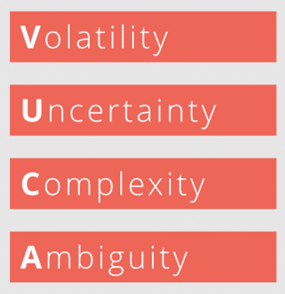




VUCA
Enacting our Knowing, Doing and Being – In Service in a VUCA World – Integral City - https://integralcity.com/2020/03/08/enacting-our-knowing-doing-and-being-in-service-in-a-vuca-world/
Notes:
Now we have an idea of what VUCA means
Volatility: a situation’s tendency to change rapidly and unpredictably, especially for the worse.
Uncertainty: Uncertainty or Incertitude refers to epistemic situations involving imperfect or unknown information. Or simpler said… a state of doubt about the future or about what is the right thing to do.
Complexity: the state or quality of being intricate or complicated.
Ambiguity: the quality of being open to more than one interpretation; inexactness.
And how we try to address a VUCA challenge is by moving from (A → B)
(clicks)
Volatility → Vision
When you have the feeling that everything is changing, you need one thing: a clear vision to guide you and the teams. Also create an environment in which you can easily keep information up to date and always make it available to everyone
Uncertainty → Understanding
In order to make decisions, information is needed. Therefore, ensure knowledge transfer between all stakeholders.
Complexity → Clarity
Give clear direction and try to make processes as simple as possible.
Ambiguity → Agility
Ensure cooperation and communication between all project participants. The best way to do this is to work in an agile way and, for example, to exchange ideas every morning in the Daily Scrum.
VUCA:
Leading in Uncertainty: Using the VUCA Approach (TRN4-J04) - CSPS (csps-efpc.gc.ca) https://www.csps-efpc.gc.ca/tools/jobaids/lead-uncertain-vuca-eng.aspx
Enacting our Knowing, Doing and Being – In Service in a VUCA World – Integral City - https://integralcity.com/2020/03/08/enacting-our-knowing-doing-and-being-in-service-in-a-vuca-world/
What does VUCA mean? | Knowledge Base | microtool - https://www.microtool.de/en/knowledge-base/what-does-vuca-mean/
How to “VUCA Proof” Your Leadership | Growing Leaders (davidspungin.com) - https://davidspungin.com/2021/02/02/how-to-vuca-proof-your-leadership/

Slide 33
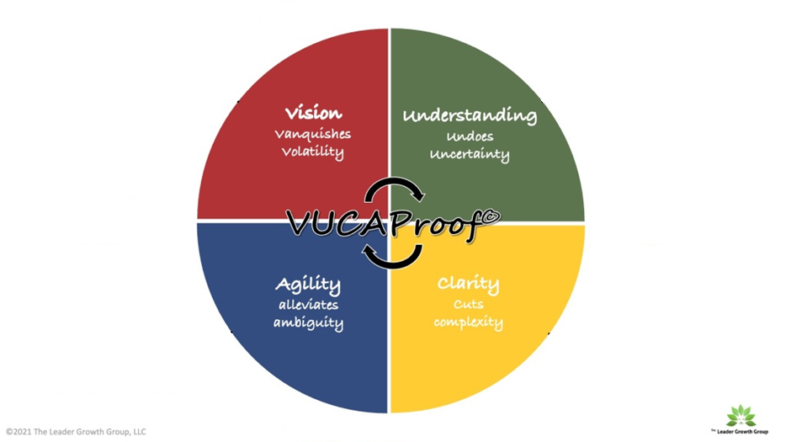
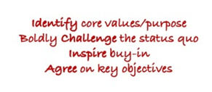
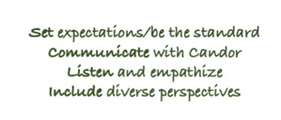



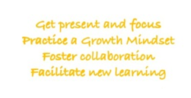
VUCA
How to “VUCA Proof” Your Leadership - https://davidspungin.com/2021/02/02/how-to-vuca-proof-your-leadership/
Notes:
In this slide we have a more detailed model…
(click and read what appears)
Volatility → Vision
Uncertainty → Understanding
Complexity → Clarity
Ambiguity → Agility
VUCA:
Leading in Uncertainty: Using the VUCA Approach (TRN4-J04) - CSPS (csps-efpc.gc.ca) https://www.csps-efpc.gc.ca/tools/jobaids/lead-uncertain-vuca-eng.aspx
Enacting our Knowing, Doing and Being – In Service in a VUCA World – Integral City - https://integralcity.com/2020/03/08/enacting-our-knowing-doing-and-being-in-service-in-a-vuca-world/
What does VUCA mean? | Knowledge Base | microtool - https://www.microtool.de/en/knowledge-base/what-does-vuca-mean/
How to “VUCA Proof” Your Leadership | Growing Leaders (davidspungin.com) - https://davidspungin.com/2021/02/02/how-to-vuca-proof-your-leadership/
A model for empathetic leadership in a (more than usual) VUCA world | by Agile Leadership | Medium - https://medium.com/@agileleadership/a-model-for-empathetic-leadership-in-a-more-than-usual-vuca-world-39e5c393e50a

