Slide 1



A day in-a-life in a GCworkplace
A presentation to help you define your own journey
Date: JANUARY 2023

Slide 2
How to use this document (1 of 2)
Instructions – Remove this page before using
PRE-REQUISITE:
Ensure that your project sponsor has sent out the invitation for this presentation to all impacted employees and their people managers.
OBJECTIVE and FOR WHO: This document is to be used to provide senior leaders, people managers and employees with knowledge and abilities on how to plan and organize their work week in an activity-based workplace, the design concept of a GCworkplace. Depending on the size of your organization you, presentations could be offer to more than one group. For example, a presentation could be offered to each branches.
WHEN: This presentation should be facilitated once employees are informed that they will be moving into a GCworkplace environment. Multiple sessions might be required depending on the size of the group. Please refer to the invitation template to invite employees to participate.
DURATION: 30-45 minutes + questions

Slide 3
How to use this document (2 of 2)
Instructions – Remove this page before using
HOW: Personalize the presentation. Throughout the slides there are areas highlighted in yellow and/or guidance boxes where personalization is required based on specifics of your organization. Make sure to remove those boxes.
Define who should present. You might feel that it would be a great idea to have multiple presenters.
Read and review the PowerPoint Presentation prior to the presentation and do a “dry-run” with the presenters to familiarize yourself with the rhythm of the presentation and when you will need to click for animations. Some guidance notes have been integrated for some slides.
In case of specific question on subject matter expertise, ensure that your representative for IT, IM, Security, HR and facilities are also participating into this presentation .
Optional: If you have access to slido, Microsoft Forms, Survey Monkey, etc, you could also integrate an interactive activity with the objectives of demonstrating that everyone will have a different journey based on how they perform their work activities and on their personal preferences. Of course, there is no good or bad journey, but just different ways to work and use the available tools!
* The French version of this document is available here : FR version

Slide 4




Getting ready to work in a GCworkplace
Understand your organization’s vision and expectations for the workplace
Understand what is an activity-based workplace
Understand activity-based working
Define your own journey!
Notes:
The objective of today’s presentation is ultimately to develop your new ways of working for your new workplace. To do so, you first need to understand our workplace vision and what is expected, understand what is GCworkplace, understand what an activity-based workplace is and understand activity-based working. We will cover all these topics throughout this presentation.

Slide 5
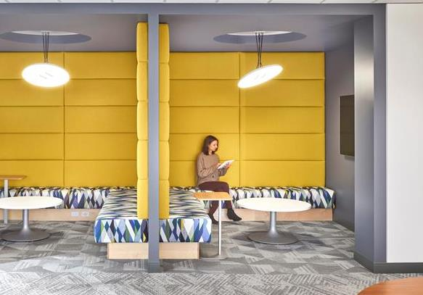
What is a GCworkplace?
A GCworkplace is a modern, efficient and inclusive workplace which responds to the public service workforce’s needs and supports a flexible way of working.
Why an Activity-Based Workplace (ABW) concept?
It is based on the implementation of Activity Based Working (ABW), which is a concept that offers all employees SHARED USE to a VARIETY of workpoints, allowing them to CHOOSE the optimal setting to perform their tasks and functions.
GCworkplace is designed based on an unassigned seating environment, where employees have access to all workpoints in both open and enclosed work areas.
Choice and flexibility of where & how to work
Adaptable to personal needs & preferences
Access to a wide range of workpoints and amenities
Accessible and inclusive
Enhances employee experience
Supports all workplace activities such as learning, focusing, collaborating and socializing
Notes:
Reference material:
GCWORKPLACE MYTHS: WHAT IT’S NOT.
It’s not just unassigned individual workstations: GCworkplace recognizes that work gets done at more places than a desk or a meeting room–that’s why a wide variety of work space types (referred to as workpoints) were developed to suit a variety of tasks, whether you need a distraction-free room, a collaborative team hub, or something in between. All workpoints are unassigned and available to everyone.
It’s not a one-size-fits-all solution: Because it’s designed to suit your organization’s specific needs, each workplace can be customized to support the type of work you do, and how you want to do it. The standard helps you get started with the most important components, then the space can be tailored to the types and quantities of workpoints and support spaces to suit your organization’s needs.
It’s not intended as a space-saving strategy: When you have a better understanding of how you use your space, you can reduce the types of spaces that are always empty, and increase the ones that you need most. Are some of your people always in meetings, or working remotely? Take that into account during the planning phase, and you may end up with some space savings–it’s a bonus, not a driver.
It’s not “Workplace 3.0”: Some important lessons were considered from previous workplace strategies. The move to open offices presented challenges for acoustic control and didn’t adequately support focus work. That’s why GCworkplace ensures a variety of open and enclosed, active and quiet spaces, as well as personal storage and shared amenities to support a diverse workforce.

Slide 6
Our vision for the workplace
[insert your vision as previously defined]

Slide 7
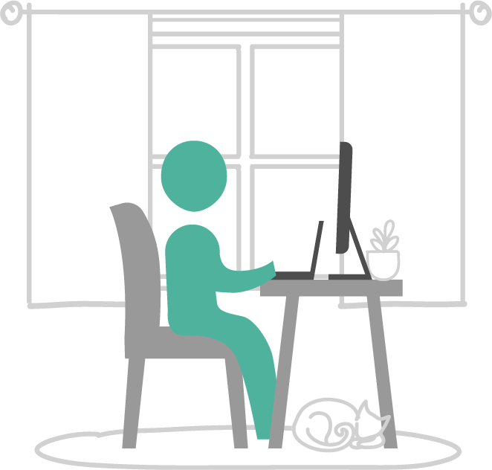
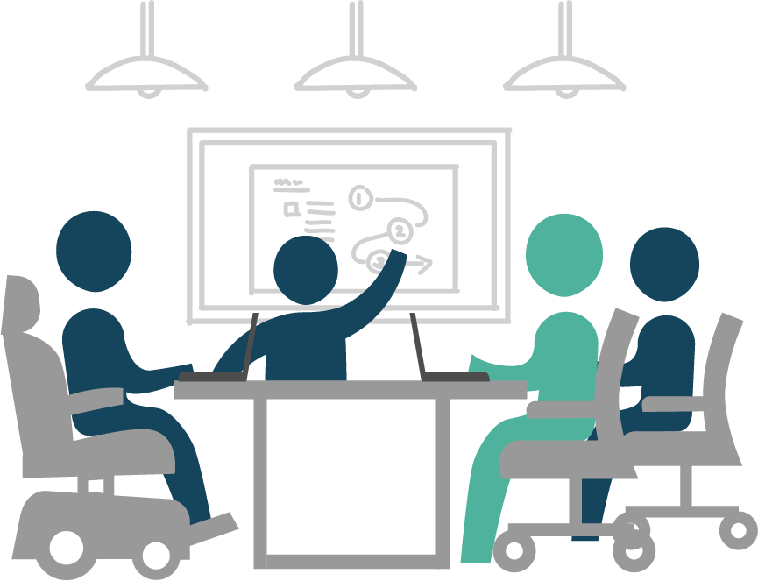
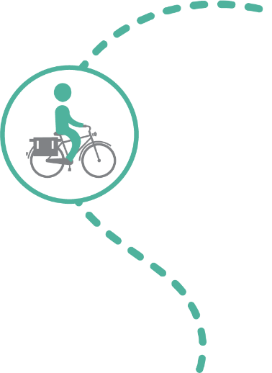
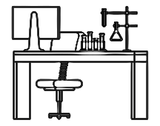
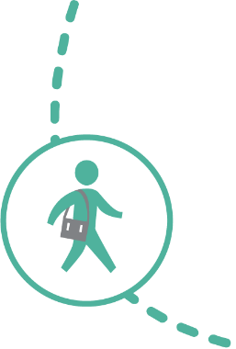
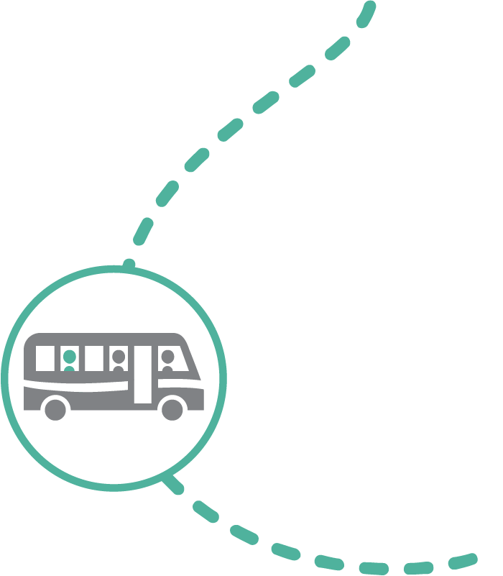
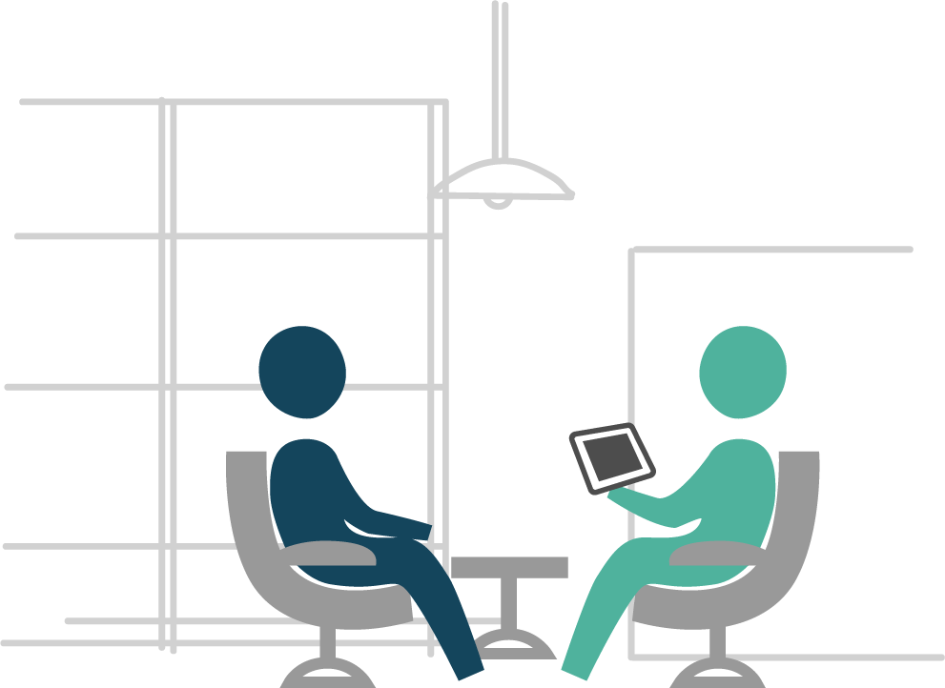
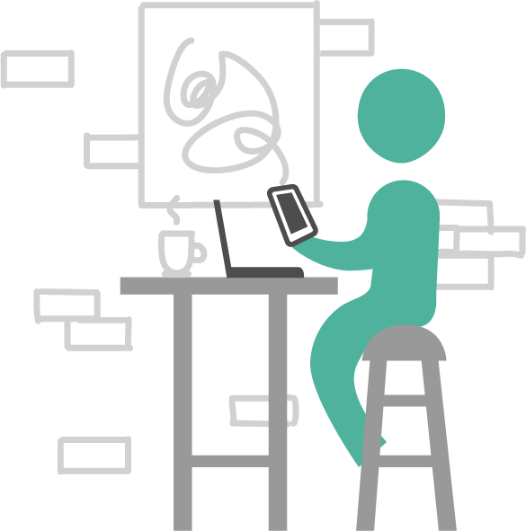
Understanding the flexibility provided by an ecosystem of spaces
Review to align to your organization’s ecosystem
Home
Office & Functional space
"I had an appointment this morning close to home, so I decided to work from home for the rest of the afternoon. I planned my week in advance to save my non-urgent individual tasks to complete this afternoon."
"Today my team is brainstorming for a new communications tool that we will be developing. The office is the best place for today's tasks as we will need a lot of space and a large TV monitor."
"Today I have to work at a lab where I need to perform some testing. This functional space will be the best place for today's tasks. If required, I will be able to also book a workpoint in the office space to perform other type of activities.
GCcoworking
Other
"I'm working on a project with my colleague today, and since we both live in the same neighbourhood we decided to meet at our local GCcoworking site. This will save us 30 minutes of commute time to the office!"
"My day today is filled with client meetings! There are no GCcoworking locations nearby and I would lose a lot of time by commuting back and forth to the office so I will be working in a coffee shop in between my meetings."
Notes:
Flexibility means employees are empowered to decide where it makes the most sense for them to work. Let’s look at a few real-life testimonials.
"I had an appointment this morning close to home, so I decided to work from home for the rest of the afternoon. I planned my week in advance to save my non-urgent individual tasks to complete this afternoon.“ Can you think of other reasons why it would make more sense for you to work from home?
"I'm working on a project with my colleague today, and since we both live in the same neighbourhood, we decided to meet at our local GCcoworking site. This will save us 30 minutes of commute time to the office!“ What are other reasons why you would decide to work from a GCcoworking site?
"Today my team is brainstorming for a new communications tool that we will be developing. The office is the best place for today's tasks as we will need a lot of space and a large TV monitor.“ Can you give examples of situations where going to the office would make the most sense?
"My day today is filled with client meetings! There are no GCcoworking locations nearby and I would lose a lot of time by commuting back and forth to the office so I will be working in a coffee shop in between my meetings.“ When you think about your typical week, can you think of a moment where you would be most efficient at another location like the coffee shop?
With these examples, we can see that having the flexibility to choose where and how you want to work allows for better productivity and can contribute to work-life balance. Having flexibility is what allows you to define your own ways of working; working where it makes the most sense to you!

Slide 8
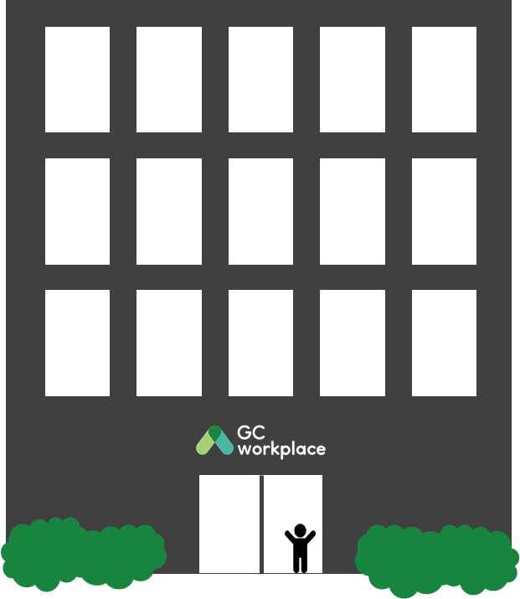


In an office setting…
ACTIVITY-BASED WORKING (ABW)
Notes:
This is an ACTIVITY-BASED WORKPLACE, an environment that supports a new way of working and is based on the principle of activity-based working (ABW). [CLICK TO ANIMATE SLIDE]
ACTIVITY-BASED WORKING (ABW) is a design concept that recognizes that through the course of any day, employees engage in many different activities and that they need and can choose different types of workpoints to accommodate these activities. An ABW environment focuses on the employees and provides the freedom to decide for themselves: how to work, where to work, which tools to use and with whom to collaborate to get the work done.

Slide 9
Understanding workpoints
In an ABW environment, WORKPOINTS are the building blocks and refer to any area where work can be done—this can range from a lounge chair or a desk, to a meeting room or collaborative hub.
Employees have access to all workpoints in all zones - both open and enclosed work areas.
This enables employees to choose from a multitude of settings to perform their work.

Slide 10
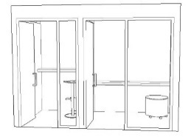
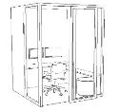
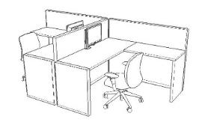


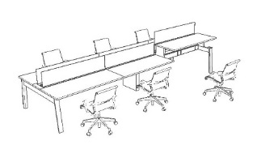
Understanding workpoints: individual work
Phone calls
Focused work
Quick chat
Routine tasks
Notes:
There used to be ONE workstation where we had to do ALL our activities [CLICK TO ANIMATE SLIDE]—take phone calls, do focus work, have a quick chat and accomplish routine tasks—always tethered to that spot. Now, we have the flexibility to choose from a variety of workpoints based on individual preferences and the tools we need. [CLICK TO ANIMATE SLIDE]
Need to take a private phone call or one that will last more than a few minutes? Get up with your mobile phone and walk to a phone booth.
Have to hand in a report and don’t want any distractions while you work? Head over to the nearest unreserved focus room. Want to get your colleague’s opinion on your presentation? Send them a quick message and agree to meet in a collaborative area like a chat point or lounge. Have 30 minutes between meetings and want to answer emails? No need for a full workstation, head over to a touchdown station where you can even choose to work standing up. Or find an active station and walk while working!

Slide 11
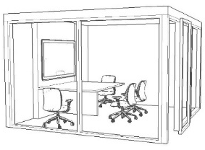
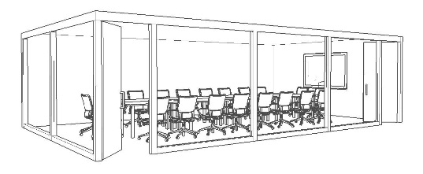
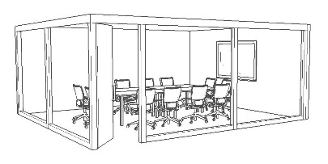
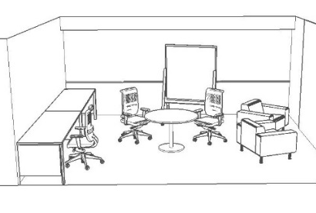
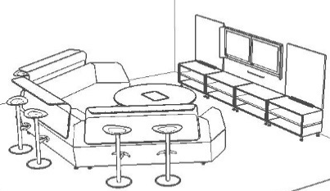
Understanding workpoints: collaborative work
Work room
Formal meetings & presentations
Coordinate
Assemble
Present
Create
Project room
Team work & ideation
Notes:
Same goes for the more collaborative type of workpoints. We used to coordinate, assemble, present and create in the same space: usually a big boardroom. But now, [CLICK TO ANIMATE SLIDE] each of those activities can be done in a workpoint that was designed for that specific activity; therefore, better supporting you in the way you choose to work.

Slide 12



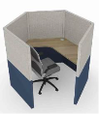
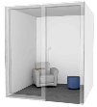
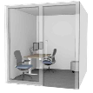

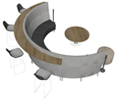
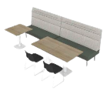


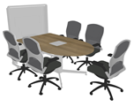



Understanding workpoints: variety for everyone and every task!
Confirm with the project team the workpoints that will be available in your future workspace
Types of individual workpoints
Workstation
Touchdown
Study
Focus pod
Phonebooth
Focus room
OPEN
SEMI-ENCLOSED
ENCLOSED
Chat point
Teaming area
Lounge
Huddle
Workroom
Project room
Meeting room
Types of collaborative workpoints
Notes:
In your future workplace, you will find a variety of workpoints available to you based on your requirement to perform individual or collaborative work—but also if an open, semi-enclosed or closed workpoint is required or preferred to perform your activity.
You can go through the different workpoints by naming them and explaining that they are organized by individual/collaborative workpoints, but also by open/semi-enclosed/enclosed workpoints.

Slide 13
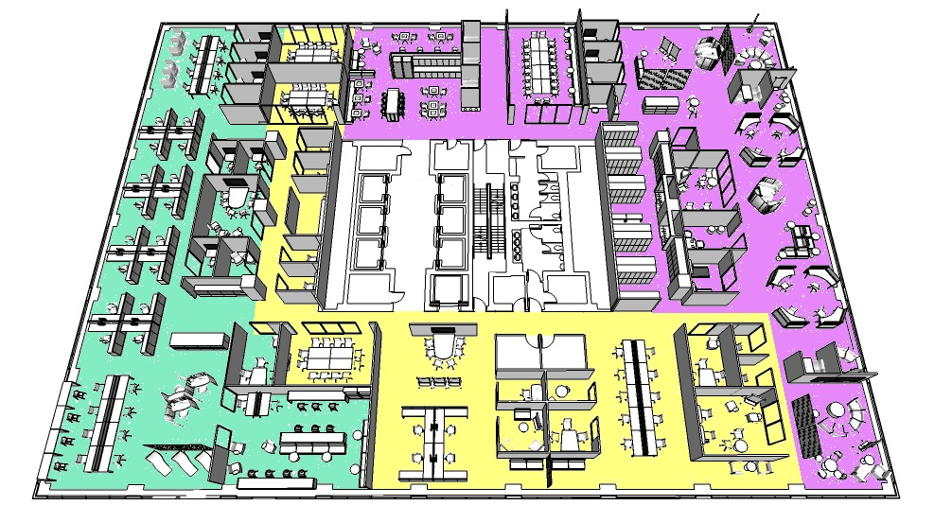
A GCworkplace is functionally zoned to support a variety of work activities
Consider replacing the sample floorplan with your floorplan and adjusting the zoning accordingly
A quiet zone includes open, semi-enclosed, and enclosed individual workpoints. In this zone, the intent is to encourage individual focus work and to support the need for quiet or private spaces.
In an interactive zone, socialization and group collaboration is promoted and strongly encouraged. Providing a variety of group workpoints, and locating these activities away from the quiet zone.
A transitional zone includes a variety of open and enclosed spaces where less intense concentration is supported. The transitional zone may include open individual and group workpoints, semi-enclosed collaboration, and support spaces such as lockers or shared equipment areas.

Slide 14
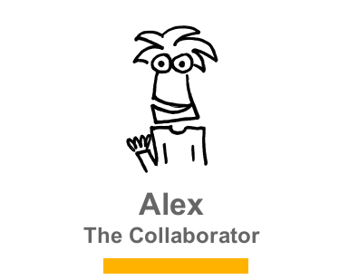
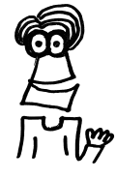
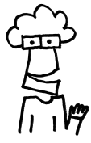
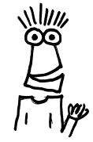
Different ways of working
Although we all work on the same team, with similar jobs, we all have different working styles.
There’s no WRONG way to work, just DIFFERENT ways.
I work best when I’m collaborating with my team.
I thrive when I have a strong routine that I can count on each day!
Trust and confidence from my team is important for my independent working style.
With the right tools and flexibility, I will get the job done!
ALEX
SAM
KRIS
PAT
Adaptable
Creative
Inclusive
Values interaction
Habitual
Organized
Detail oriented
Values predictability
Dynamic
Flexible
Early adopter
Autonomous
Pragmatic
Composed
Focused
Efficient
Notes:
Although you all might be part of the same team, with similar jobs, you all have your own preferences and working styles. There is no wrong way to work, just different ways. For example, these 4 collegues:
They all work in the same team and perform similar activities, but are very different from each other. *Notice that these personas are non-gender specific; therefore, try to refrain from using personal pronouns.
[CLICK TO ANIMATE SLIDE] Here’s Alex. Alex is very adaptable, creative and inclusive, and values facetime; [CLICK TO ANIMATE SLIDE] so Alex works best when collaborating with the team.
[CLICK TO ANIMATE SLIDE] This is Sam. Sam is habitual, organized, detail oriented and values personalization; [CLICK TO ANIMATE SLIDE] so Sam thrives when there is a strong routine to count on each day.
[CLICK TO ANIMATE SLIDE] That’s Kris, the dynamic, flexible, early adopter and autonomous one of the group. [CLICK TO ANIMATE SLIDE] Kris finds that trust and confidence from the team is important in order to have an independent working style.
[CLICK TO ANIMATE SLIDE] And finally, he’s Pat; a pragmatic, nonchalant, focused and efficient colleague. [CLICK TO ANIMATE SLIDE] Pat feels that with the right tools and flexibility, the job can get done.
As you can see, all of them work in the same team and are very different people, but they all benefit from the flexibility of choosing where and how to work.

Slide 15
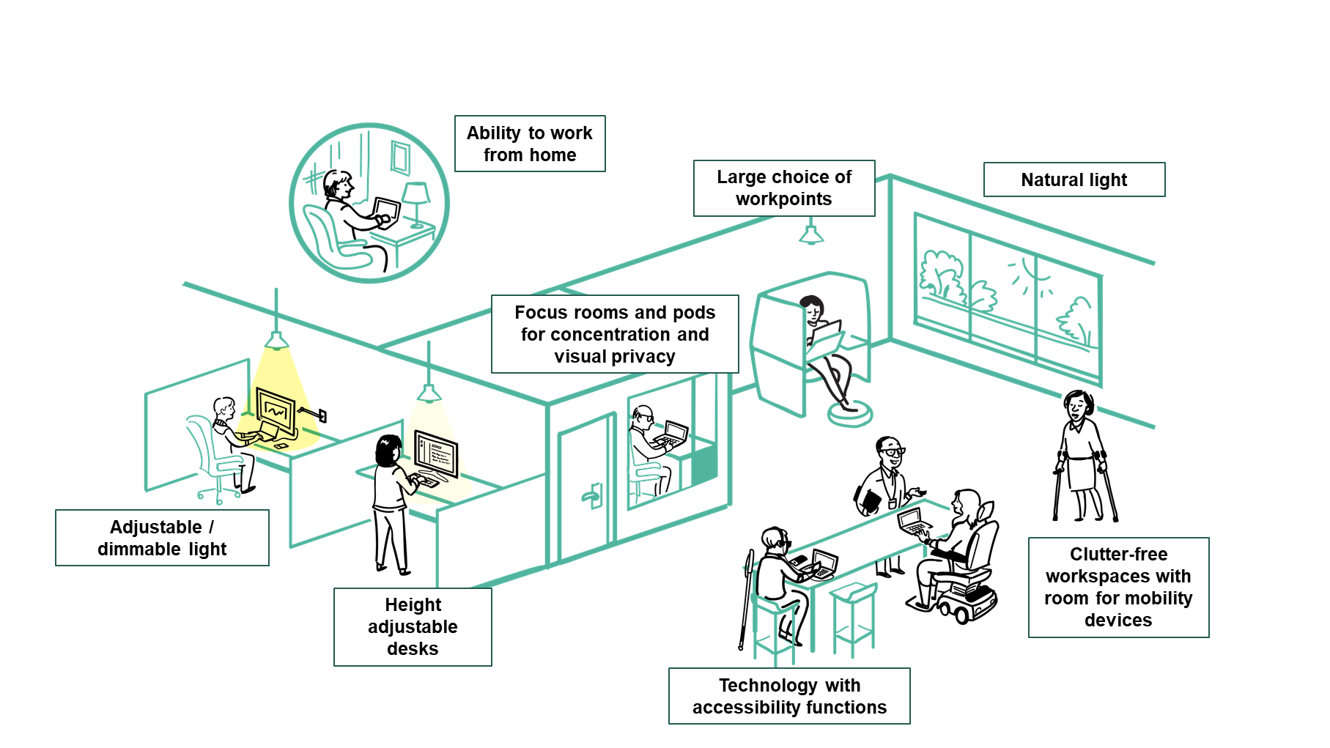
An accessible and inclusive workplace by design
GCworkplace has been developed to be an accessible and inclusive workplace design standard. It provides employees with full control over the work settings that best suits their functional needs, knowing that we all have different abilities, disabilities and personal preferences.

Slide 16





Defining your own journey
Planning ahead
Getting ready
Using the space
Notes:
Coming to work in a GCworkplace requires Everyone to design their own journey. The way you plan your typical work week has changed for the better as you now have access to multiple work spaces that can help you juggle your personal and professional lives.
Working in an activity-based environment requires the introduction of new ways of working which means new ways of planning!
We recognize that developing and adopting new ways of working does not happen overnight. We invite you to take the time to try out various ways of using the workspaces offered to you and the variety of different workpoints to perform your activities.

Slide 17

In-Office employee journey example
Here is an example of what your day could look like when you come into our new workspace! Everyone’s journey will be different, we encourage you to explore the various possibilities your new workplace has to offer.
5
7
4
6
1
Arrive at the office
You can replace the sample floor plan with your floor plan and adjust the activities accordingly
2
Use a locker for your personal items (as required)
3
Make your way to your pre-reserved workpoint to complete your daily tasks
2
4
Prepare and eat lunch, catch up with some colleagues
1
5
Meet a colleague to discuss a document at a chat point
6
Take a quick break in a wellness room, resting your eyes
3
7
Attend a team meeting in a meeting room

Slide 18

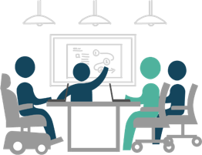

Planning ahead step-by-step
Step 3
Step 4
Where will I work from?
Select and book your
type of workpoint
Considerations for choosing your workpoints
Step 1
Home
GCcoworking
Office
Other
OPEN
Personal preferences &
tools required
ENCLOSED
In my office setting, considering my activities, do I need to work individually or
in collaboration?
Step 2
OPEN
Personal preferences &
tools required
ENCLOSED
Notes:
It might look like a decision tree but is just a new process for planning. The way you plan your typical work week has changed as you now have access to multiple work spaces that can help you juggle your personal and professional lives. working in an activity-based environment requires the introduction of new ways of working. we recognize that developing and adopting new ways of working does not happen overnight. We invite you to try out various ways of using the workspaces offered to you, the variety of different working points for your various activities, which will help you to define your own way of working.

Slide 19

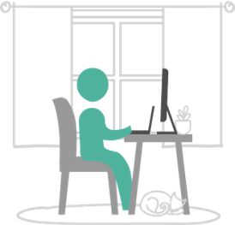
Planning ahead: Step 1- choosing the location
With my team charter in mind…
What’s on my schedule for the upcoming weeks?
Is our team planning to meet in person?
Are there some work activities that would be more efficient for me/us to perform in the office?
So, where should I be working each day?
 | Monday | Tuesday | Wednesday | Thursday | Friday
8:00 AM | Coffee chat |  |  | Content Creation
9:00 AM |  | Meeting with Sam | Project Report |  | Meeting with Alex
10:00 AM | Bilat with Pat | Committee Preparation |  |  | Client Meeting
11:00 AM | Weekly Update
12:00 PM | Lunch | Lunch | Lunch | Lunch | Lunch
13:00 PM | Presentation | Client Meeting | Weekly Update | Meeting with Kris | Wellness Training
14:00 PM |  | Project Executive Committee |  | Client Meeting
15:00 PM |  |  | Administration
16:00 PM
The way you plan your typical work week has changed as you now have access to multiple work spaces that can help you juggle your personal and professional lives.
Home
GCcoworking
Office
Other
Notes:
So, let’s start with the first step, which is all about location, location, location! The first question you should ask yourself is “What’s on my schedule for the week?” The answer to that will help you choose where you should work from.

Slide 20

Planning ahead: Step 2 - individually or in collaboration
Heads-down work?
Attend meetings virtually?
For my days at the office, considering my activities, will I work individually or in collaboration?
Brainstorm with team members ?
Meet with partners and colleagues?
Notes:
In Step 1, we chose the OFFICE as our work location, now what’s next? Ask yourself the following question: “Considering my activities, do I need to work individually or in collaboration?” Answering this question will help determine the best type of space to use in the office.

Slide 21
Planning ahead: Step 3 – choosing your workpoint
Elements to consider when choosing my workpoint to performed my activities…
Tools required:
Monitors
Network
Secure zone
Videoconference
Personal preferences:
Natural light
Temperature
Ergonomic settings
Acoustics
Visual or speech privacy
Focus levels
WORKPOINT
Individual
OPEN
In collaboration
ENCLOSED
OPEN
ENCLOSED
Notes:
Now that you have determined whether you need to work individually (TEAL path) or in collaboration (YELLOW path), the next and final step consists of choosing the best workpoint to accomplish your work. To help you choose this workpoint, there are important elements you should consider―whether you are working individually or in collaboration―like the tools you will require (monitors, network, etc.) and your personal preferences (natural light, temperature, etc.). These elements will guide you in choosing an OPEN or ENCLOSED workpoint.

Slide 22


Planning ahead: Step 4 - selecting and booking
Types of individual workpoints
Do I need to book my workpoint with a booking system?
Workstation
Touchdown
Study
Focus pod
Phonebooth
Focus room
OPEN
SEMI-ENCLOSED
ENCLOSED
Chat point
Teaming area
Lounge
Huddle
Workroom
Project room
Meeting room
Types of collaborative workpoints
Notes:
Based on your activities, decide where it would make the most sense for you to work from by selecting a workpoint for your day. You do not have to change workpoint every time you change activity. For example, you could stay half a day at the same workpoint to perform multiple activities of the same nature. Your workstyle will help inform which workpoints you will use to create your own way of working. You could even look at your agenda a day in advance and see which workpoint you might be using in the morning to fulfill your first activity/task of the day. Remember to respect the zoning of the space and workplace etiquette.

Slide 23








Getting ready – Booking your workpoint
Use your available booking system to select the adequate workpoint based on your personal preference, activities you need to performed and tools required.
Coordinate with your colleagues/team to book a workpoint in the same area or neighbourhood if you wish to work/sit close to each other.
Sharing your calendar amongst your team can be a good practice so that your colleagues know where you work from
Update the information from this slide according to the booking system strategy decided by your organization.
Remember to add your reservation to your calendar
Remember to cancel your booking if there is a change of plans

Slide 24


Getting ready – Preparing to go to the office
Ensure you have your Government ID access card
Pack your bag with your essentials: laptop, mobile phone, charging cables, headphones, mouse, notepad and pen (if needed) and any other personal items you may require for the day.

Slide 25


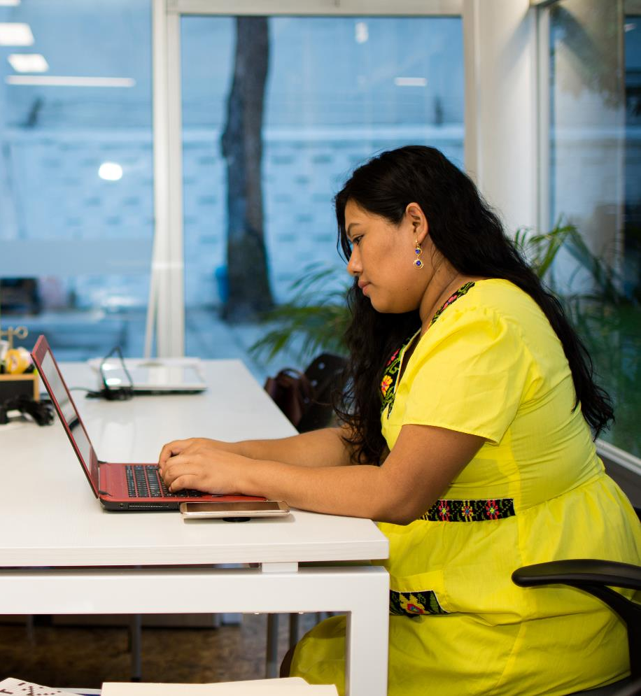




Using the space – Working on site
Once you are logged-in and installed at your workpoint, do not forget to check-in into your booking system.
Update your online status in MS Teams so your colleagues are able to know at any time where you are working from. Example:
“at the office today, @Portage II, 5th floor, workstation 27”.
All locations have printing, scanning and photocopying capacities through new FollowMe Print devices. Before printing, ask yourself if you really need to print. The new paperless habits we have recently developed should not change.

Slide 26
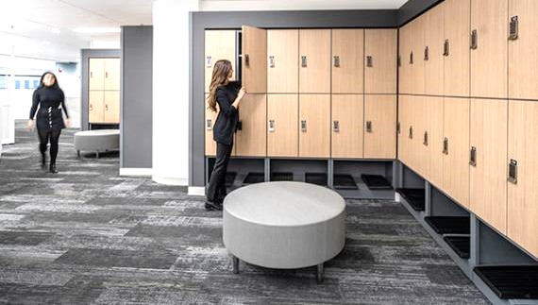
Using the space- Lockers
Lockers of various sizes are available at (location) when you first enter the workspace.
Coat closets are also available for you to use next to the lockers for both smokers and non-smokers
Insert description of the different type of lockers available in the workplace
The content of this slide will need to be adapted based on your location(s) and lockers strategy. This is a sensitive topic to address, make sure that your strategy is well developed before communicating information related to this topic.

Slide 27
Using the space – Community Norms / Etiquette
Include what you previously developed as part of activity 2.4

Slide 28

Using the space- Onsite support
A Workplace Coordinator will be available at each location and can support you to:
Provide basic IT technical support
Support you in the use of the booking system
Provide on-site communications
Support Occupational Health and Safety to meet requirements of the building
Act as the liaison with accommodations experts for
any issues with furniture or equipment
Ensure your employee experience is positive

Slide 29

QUESTIONS?

