Slide 1
Mood board activity guide
Guideline for change managers
Date : September 2023

Slide 2
About this Guide
* The French version of this document is available here : FR version
We have prepared these guidelines in order to help you lead this fun activity with all impacted employees. This activity will empower employees and foster ownership of the workplace by participating in the mood board selection process.
As part of your WTP project, the Project Design Team will propose up to three unique mood boards presenting different design elements (colors schemes, finishes, etc.) to be submitted to employees for a vote as an engagement activity. The Project Design Team will use the chosen mood board to guide color selection for the space. Elements presented in the mood board will not be exactly the same in the future workplace.
We added the WTP design inspiration as complementary information for your understanding. We also provided mood board examples to give you an idea of what you can expect from your Design Project Team.
This activity is essential to your project as it will shape the look and feel of your new workplace. Using your preferred voting method (MS Outlook, MS Forms, Slido, QR codes, etc.), invite all impacted employees or your employee representatives (depending on the number of employees and/or project timeline) to vote for their favorite mood board. Announce the chosen mood board to all employees and inform the Project Design Team.
In this guide you will find:
Activity Roadmap
Best Practices
Design Inspiration
Mood board examples

Slide 3
Activity Roadmap (1 of 2)
Consult the Project Design Team to determine if such an engagement activity is possible based on the project timeline. If so, ask when you can expect the mood boards and when the chosen design must be identified.
As part of your project, you will receive three mood boards proposed by the Project Design Team. Each mood board has a unique theme and is composed of a different set of colors, finishes, textures and accessories for your new workspace.
Work in collaboration with the Project Design Team to meaningfully name each mood boards if they are only numbered.
The selected mood board will guide the look and feel of your new workspace.
Review this guide and determine how you will conduct the activity.
Update the information in the ‘Mood Board Selection Activity Invitation’ template accordingly (all items highlighted in yellow).
Determine which tool you intend to use to collect the votes (MS Outlook, MS Forms, Slido, QR code, etc.).
Review the best practices for tips and tricks on how to lead this activity.

Slide 4
Activity Roadmap (2 of 2)
Invite all impacted employees or employee representatives to participate to the activity.
Invitation should be sent by the Executive Sponsor.
The voting activity can be conducted in various ways:
Email presenting the virtual mood boards with a link to vote (MS Outlook, MS Forms, Slido, etc.);
Voting activity with employee representatives during a sub-committee meeting;
Display the virtual mood board during a Townhall and use QR codes allowing employees to vote on the spot.
Monitor participation and send a reminder as needed.
Compile the votes and inform the Project Design Team on the chosen mood board.
Ensure to inform the Project Design Team by the established deadline.
Announce the chosen mood board to all impacted employees.
Update the ‘Mood Board Selection Results Announcement’ template accordingly (all items highlighted in yellow).

Slide 5
Best Practices
Depending on your number of impacted employees or the time available to complete the activity, you can turn to employee representatives who will vote on their behalf or reduce the allotted time to vote.
In order to promote employee engagement and participation, the mood board should be selected by employees or employee representatives, not Senior Management. We recommend using your Change Agent Network.
Name your mood boards instead of numbers to engage employees and motivate them to participate. Select names or themes to which employees can relate. Be cautious with your selection to avoid bias while ensuring inclusivity:
Valid – nature, seasons, regional landscapes, organization mandate, etc.
Avoid – Names of towns, mountains, rivers, etc. representing only one region of Canada (unless it is the intent to highlight a regional perspective)
Ask the Project Design Team for color, fabric and texture samples if you intend to make an in-person presentation.
To be representative, a level of participation of 40 % and above is ideal.

Slide 6
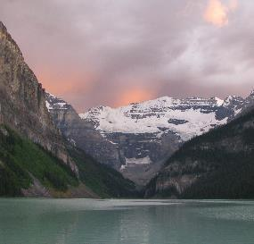
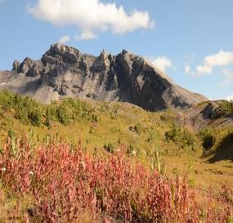
Design inspiration
The design inspiration for the Workplace Transformation Program is Canada’s Natural Landscapes.
The natural world is full of colors that attract attention, that blend beautifully with its background and create extraordinary displays.
The workplaces delivered through this program will strive to highlight the beauty of our country and the inspiration it provides by showcasing the stunning colors found in nature.
The designs will incorporate imagery of Canadian landscapes, natural colors and materials and deliberate emphasis on consideration of Indigenous design elements.
MOOD BOARD EXAMPLE ONLY – USE THE MOODS BOARDS PROVIDED BY YOUR PROJECT DESIGN TEAM

Slide 7
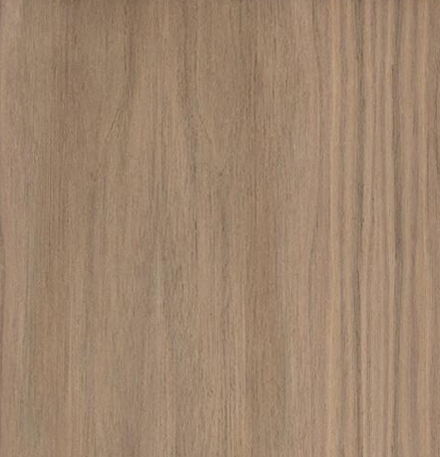
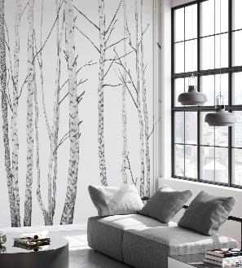
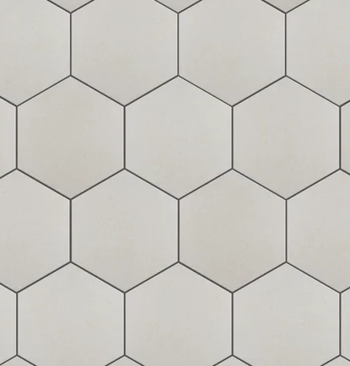
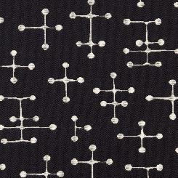
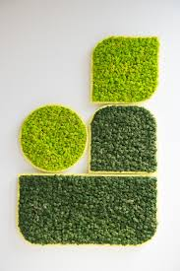
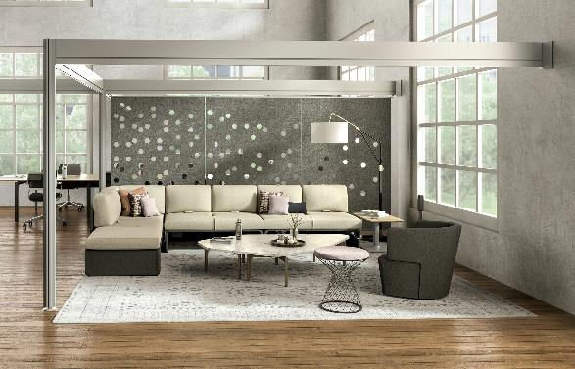
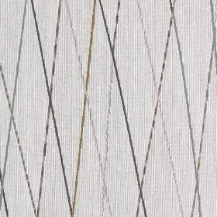
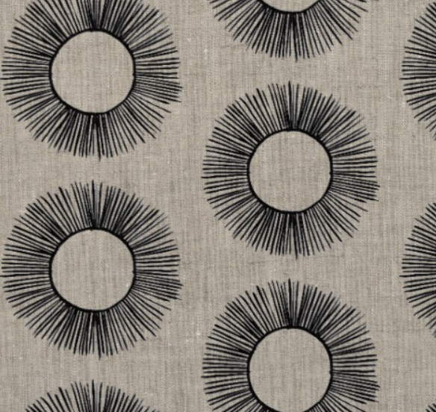
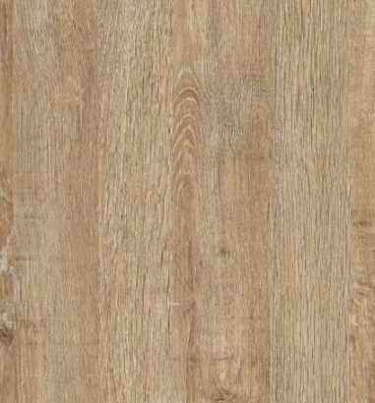
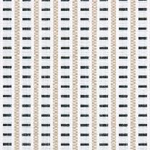
Mood Board 1
Pick a name that employees can relate to
Standard Finishes:
MOOD BOARD EXAMPLE ONLY – USE THE MOODS BOARDS PROVIDED BY YOUR PROJECT DESIGN TEAM
Cabinetry and tiles
Colour palette
Art concept and wall features
Flooring
Fabrics and textiles
Biophilic features
Acoustical solutions and accents

Slide 8
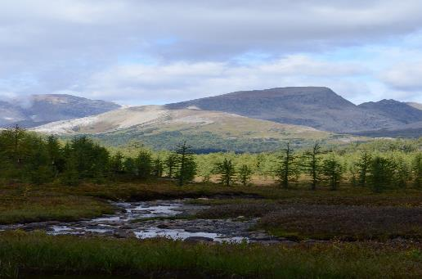
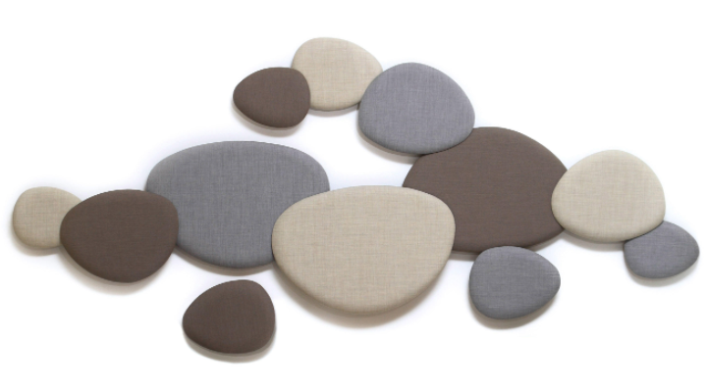
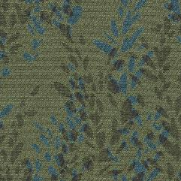
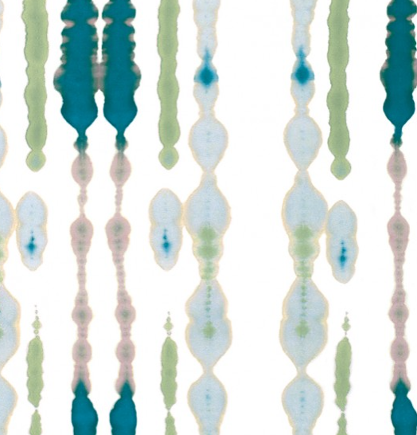
Mood Board 2
Pick a name that employees can relate to
Standard Finishes:
MOOD BOARD EXAMPLE ONLY – USE THE MOODS BOARDS PROVIDED BY YOUR PROJECT DESIGN TEAM
Cabinetry and tiles
Colour palette
Fabrics and textiles
Biophilic features
Acoustical solutions
Flooring

Slide 9
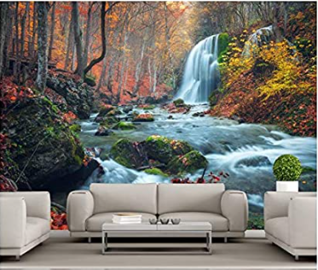
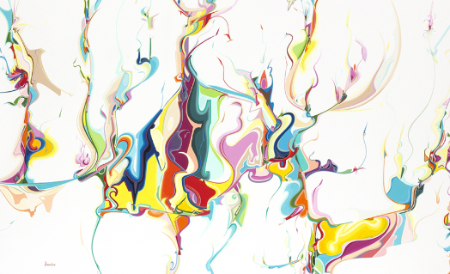
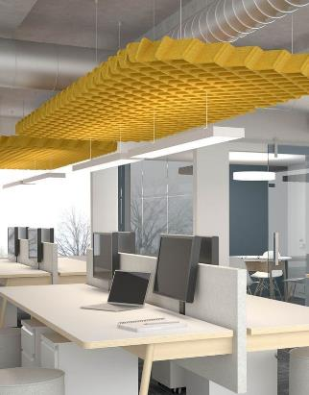
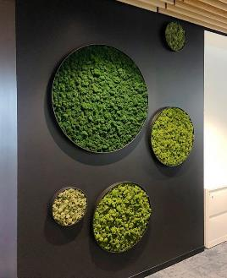
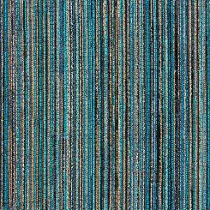
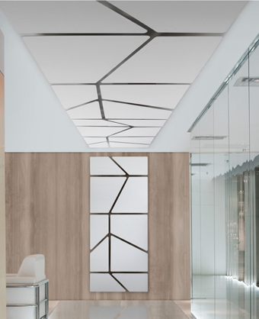
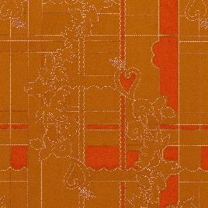
Mood Board 3
Pick a name that employees can relate to
Standard Finishes:
MOOD BOARD EXAMPLE ONLY – USE THE MOODS BOARDS PROVIDED BY YOUR PROJECT DESIGN TEAM
Colour palette
Cabinetry and tiles
Art and mural inspiration
Flooring
Fabrics and textiles
Biophillic features
Acoustical solutions

