Slide 1
Information session: Mindful Change Leadership Development program
April 2026
Notes:
Ginette
Hello Bonjour
Avant de commencer, j'aimerais reconnaitre que nous sommes réunis ici aujourd'hui sur le territoire non cédé et non abandonné de la nation algonquine Anishinaabe, dont la présence ici à Ottawa remonte à des temps immémoriaux. Je sais que d’autres parmi nous sont connectés de différentes régions du Canada, je vous invite à réfléchir et à reconnaître le territoire que vous habitez et vous travaillez.
// Before we begin, I would like to acknowledge that we are gathered here today on the unceded, unsurrendered territory of the Anishinaabe Algonquin Nation whose presence here in Ottawa reaches back to time immemorial. Knowing others are connected from different parts of Canada, I invite you to reflect and acknowledge the land you live and work.
Attention, aujourd'hui nous proposerons une séance bilingue, les premières diapositives seront en français, ensuite en anglais et de retour en français. J'espère que ceux d’entre vous qui préfèrent l'autre langue pourront suivre les diapositives en accédant directement au lien gcdocs et/ou en utilisant la fonction de sous-titrage sur MSTeams.
//
Heads up, today we will offer a bilingual session, first slides will be in French, then English and back to French. We hope those who prefer the other language can either follow the slides by directly accessing the gcdocs link, and/or by using the close caption feature on MSTeams.
Très heureuse d'animer cette séance, avec Alejandro Gonzalez.
***
Prep:
https://wiki.gccollab.ca/MCLD-DLCP , scroll down to the commitment section
MCLD - 8 Week Program Details (https://wiki.gccollab.ca/Mindful_Change_Leadership_Development_Program_Details)
MCLD – FAQ (https://wiki.gccollab.ca/Mindful_Change_Leadership_Development_Program_-_FAQ)
Ginette
Good morning good afternoon everyone, First, I would like to acknowledge that I am transmitting to you from the traditional Territory of the Anishnaabe Algonquin People; in Gatineau QC.
We are thrilled continue offering this program, thanks to the collaboration of volunteers and the support from various government Departments/Agencies.
Today’s objective is to offer you an overview of the Mindful Change Leadership Development (MCLD) program 2025, English offering, with a Q&A section.

Slide 2
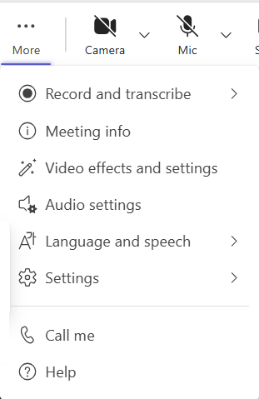
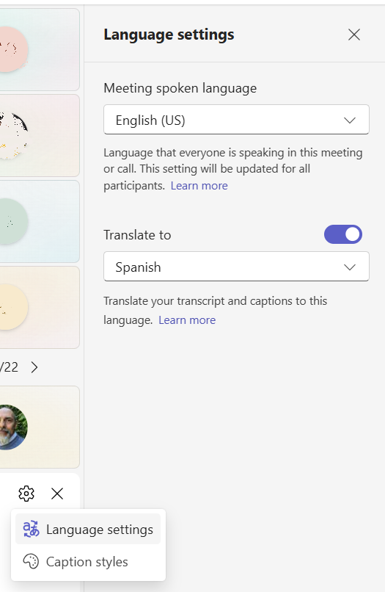
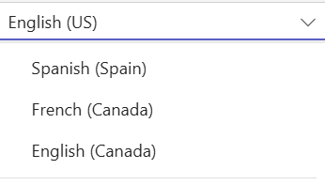

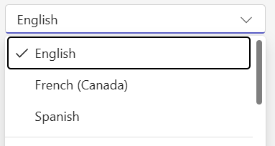

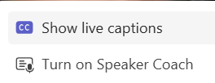
MSTeams automatic CC interpretation
This parameter changes the "Spoken Language" for everybody in this meeting, use with caution!
1
2
4
This parameter changes the "Translate to" for yourself only, enjoy ☺
3
Speaker name: The close caption will shows at the bottom of your screen…
Notes:
Ginette
To turn on the “automatic CC Interpretation, follow the next steps
From the “more” option at the top of your window, select “Language and speech”
Then select “Show live captions” It opens up a window at the bottom
Towards its right, there is an engine icon, from there select “Language settings”. On the right, the “Language settings” panel opens
Toggle the “Translate to” option, and select the language to translate the CC into
5 - Be aware that if you change the “Meeting spoken language”, it does for everybody on this meeting.

Slide 3
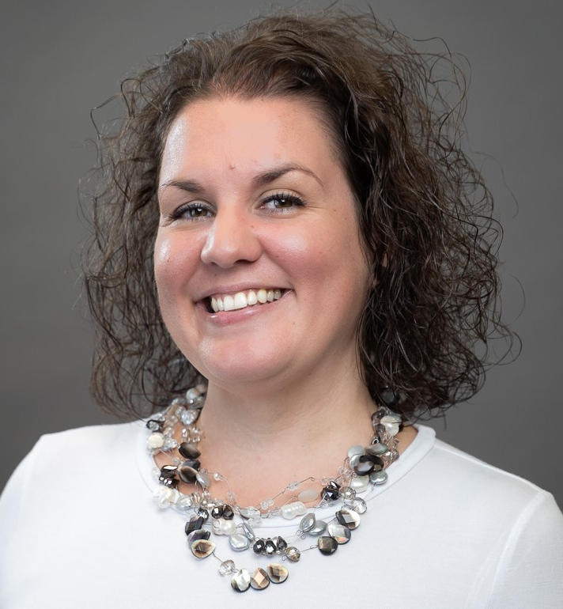
Words from our Sponsor
Marie-Claude is passionate about supporting continuous learning and development and helping people in different roles develop and embrace their full leadership potential.
She brings a wealth of knowledge and skills to this role including a background in human resources, a coaching certification and conflict management training.
She’s looks forward to fully participate in this program
Marie-Claude Lemieux, Ombud, TBS
Notes:
Ginette
Marie-Claude Lemieux, Ombud, TBS
Marie-Claude is passionate about supporting continuous learning and development and helping people in different roles develop and embrace their full leadership potential.
She brings a wealth of knowledge and skills to this role including a background in human resources, a coaching certification and conflict management training.
She’s looks forward to fully participate in this program

Slide 4

Agenda (In no particular order)
Words from a Sponsor
Share results of previous MCLD program
Share a definition of Mindfulness and Mindful Change Leadership
Experience quick mindful exercises
Overview of the MCLD program
Q&A
Notes:
Ginette
(paraphrase from slide)
Please write down your questions, at the end there will be time for Q&A
Raising hand
Comments via the chat
Ask questions anonymously via Sli.do https://app.sli.do/event/ndecSyr9sCAK8nCTSHMcjb code # mcld

Slide 5

“Leadership is not a rank or a position, it is a choice - a choice to look after the person to the left of us & the person to the right of us.”
- S. Sinek
Notes:
Ginette
Now, let’s define “leadership” via a quote from Simon Sinek, (read from the slide)
Strong leadership is one of the drivers of successful change, and leaders who support the people-side of change are essential to success.
This program delivers and promotes mindfulness practices to increase participants’ self-awareness and resilience, equipping leaders that can nurture mindfulness in their teams, with their colleagues and contribute to employee wellness and well-being.
This presentation will provide an overview of the program, share the highlights of the program

Slide 6
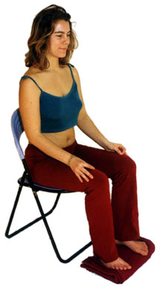

Exercise – Exploring Mindfulness – Body Scan
Time required: 5 minutes
If you haven’t, take advantage of the opportunity to experience this exercise
Sit as comfortable as possible in a straight position
Feel free to close your eyes
Follow my voice as I lead you through the exercise
Then, we will do a short debrief of what you noticed.
Notes:
Ginette
To start, let’s experience a mindful exercise…
Note that for some people, mindfulness exercises may be difficult as they tend to get you in touch with your body and feelings. Trust your judgement while doing them.
Trauma-Informed Mindfulness: Benefits, Risks, and Getting Started (psychcentral.com) - https://psychcentral.com/health/trauma-informed-mindfulness
If you haven’t, take this as an invitation to experience this exercise
Sit as comfortable as possible in a way that allows you to stay awake and attentive
Put your feet flat on the ground, your palms on you lap, upside or downside as it feels more comfortable
Feel free to close your eyes, or semi close them
Follow my voice as I lead you through the exercise
Gently bring attention to your breath, no need to change the way you’re breathing, just notice it
Now, direct your breath and attention and focus on…
Your face, your eyes, nose and mouth. Your jaw, noticing
Your head, your scalf, breath in and out
Now direct your breath and attention to your shoulders, breath in, breath out, and notice
Your arms, your hands and fingers, in and out
Every time your attention wanders away, just bring it back gently
Back to your shoulders, and neck, noticing
Your upper back, chest
Your lower back, your abdoment
Direct your breath towards your waist, in and out
Your lower leg, in and out and your upper leg, and notice what you feel
Your feet, in and out, notice what you feel
Your toes, breath in, breath out
Stay there for a few seconds, breathing in and out
When you feel like, open your eyes and come back
Debrief: Use the chat to mention What did you notice?
We’ll read some of your comments later during this session

Slide 7
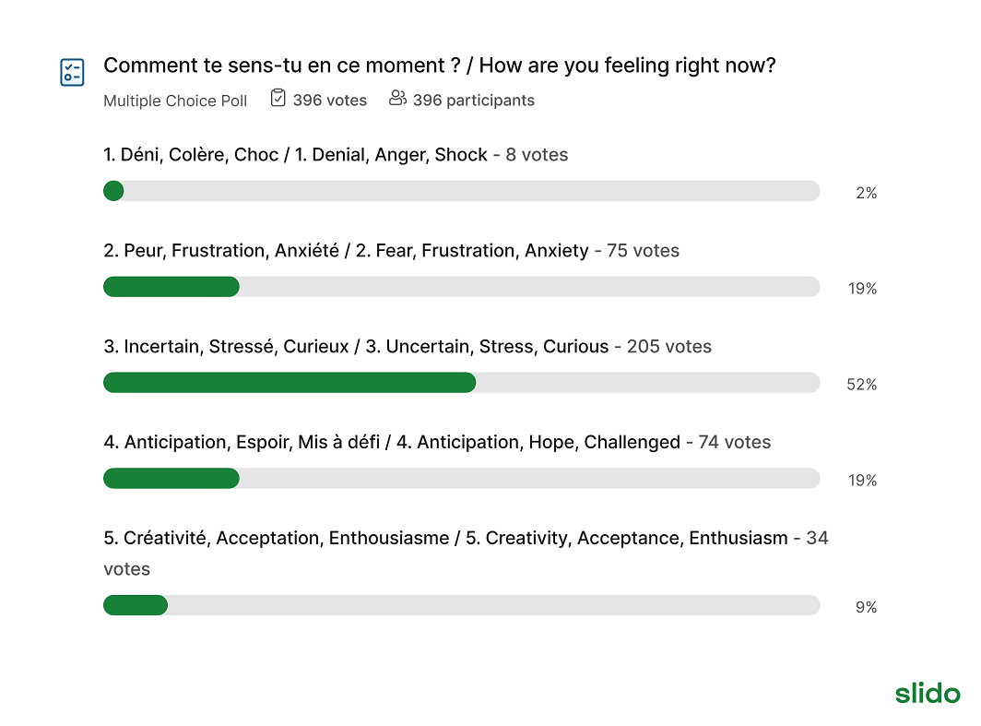
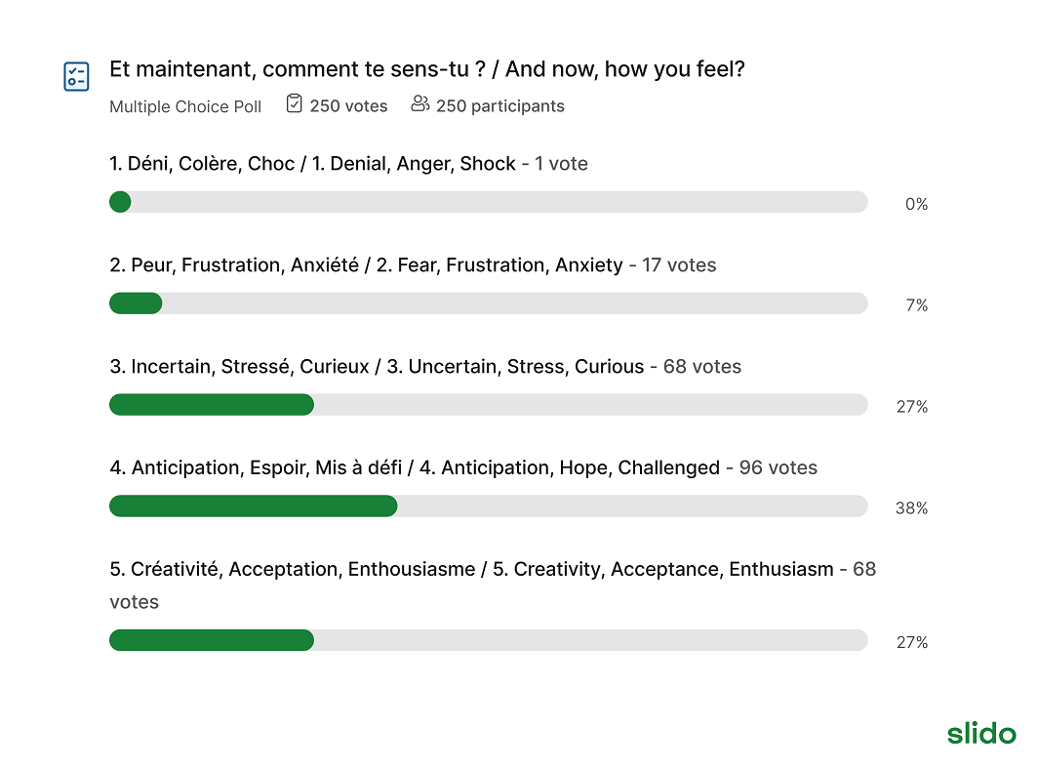
Before the mindfulness exercise, and After
Notes:
Ginette:
About the results of the Sli.do…
We have obtained Sli.do results from all sorts of audiences, from DFO Canadian Coast Guard people, from CRA folks, from Change Management practitioners, from Learning Advisors, from IRCC All Employees, this graphic in particular was created from a wide audience across GoC Departments via the IOCN. All of them showing very similar results.
The story obtained from the graphics is, regardless of the level of mindfulness practice a quick mindfulness exercise generates benefits, as per the images at the bottom there is a shift towards the groups of words in 4 and 5 which are aligned with the availability of the prefrontal cortex, also called the executive function, and it is needed to learn, have focus, clarity, creativity, curiosity and compassion in the service of others and for oneself.

Slide 8


Mindful Change Leadership Development Program (MCLD) Goal
To increase self-awareness by developing key skills:
Focus
Clarity
Creativity
Compassion in the service of others
… with a positive impact on well-being and resiliency.
“Individuals with higher mindfulness have greater resilience, thereby increasing their life satisfaction.” - ScienceDirect
Notes:
Ginette
When you think about your work and try to find a balance between work priorities, your relationships with colleagues and clients, along with home life responsibility, what strikes you as the key skills needed for this balance? Where would you like to improve?
Is it better presence, or more compassion? Is it increased self-awareness or tools for self-reflection?
We believe that this program helps to answer some of these questions and to improve the key skills of presence, self-compassion, relationality, life-work balance, self-awareness and more.
(click)
There are studies showing that individuals with higher levels of mindfulness tend to be more resilient. And also note that both mindfulness and resilience are important skills for improved well-being
By partaking in the program, you will likely increase the level of honesty and trust within yourself, and therefore with others, allowing for an authentic connection with the work that we do at across the Government of Canada.

Slide 9
Some Numbers about the MCLD program
Notes:
Alejandro:
Total registration to date: 1,271, Completed: 723
The graphic shows the progression of the MCLD program, in terms of registration and completion, showing an average slightly above 50%
How come 57% you may ask… among other reasons:
Change in work load for participants
Change in their work priorities (management changed their minds, new manager, re-organization, etc)
Misunderstanding of the commitment to participate
Among others

Slide 10
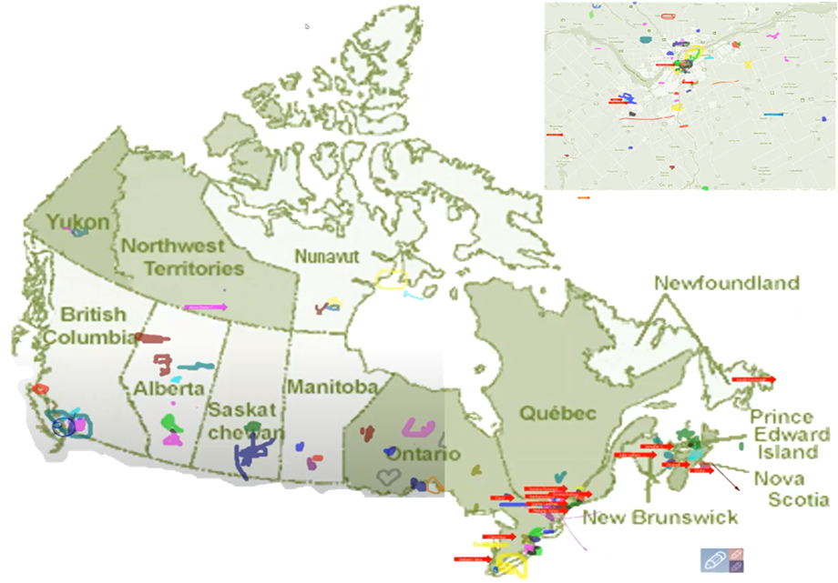
Map of Participation, 2022 English Offering
From across Canada:
From NCR:
Notes:
Alejandro:
The program had participants from across Government and across Canada, as you can see per the slide, the image was co-created at the beginning of the 2022 English offering

Slide 11
Key Findings - MCLD English Program 2025
13.5%
18.2%
14.7%
30.8%
22.2%
* People who answered "Always", "Usually", and "Sometimes"
Notes:
Alejandro:
Now, some details from participants’ self-assessment questionnaires which were filled at program registration and again three months after the eight-week program, and we have compiled the data to evaluate the results and impacts of the Mindful Change Leadership Development program.
(click)
The blue columns represent the results of the self-assessment questionnaires completed at registration.
(click)
The green columns represent the final assessment, and the differences between them indicate behavioural changes.
For this cohort, we got 127 registered participants, 93 completed the program, that’s a 73% rate, which is fantastic!!
We received 32 final assessments (34.5% return on self-assessments), and the key findings per category are:
(click on each bullet)
Almost 15% Increase in Employee Engagement – respondents tend to pay attention at the experience while doing their tasks.
(Q12. I tend to quickly do my task(s) without paying attention to the experience along the way. )
A 30.8% Increase in Promoting Sounder Decision Making - people take time everyday to optimize their productivity.
(Q16 I take time each day to optimize my personal productivity.)
With a 13.5% decrease in Behavioural Risks - participants focus on what they can influence.
(Q13 I influence where I can, rather than worrying about what I can’t influence. )
Slightly over 18% Increase in Well-Being – respondents are able to redirect the attention to the present moment.
(Q15 I am able to notice when my attention has been pulled away and redirect it to the present.)
And just over 22% Increase in Resiliency - people reported bouncing back faster after a challenging situation.
(Q4 I feel I can bounce back quickly after an emotionally challenge situation.)
What we heard from participants was that the program was a life changing experience, it helped them increased their own sense of well-being; and gave them the tools and practices to use with their teams to support employee wellness and well-being.

Slide 12

MCLD Program Testimonials (1-2)
the course provided me perspective on myself and how I react to my surroundings and others.
I really enjoyed this course, and it taught me a lot of practical skills that work for me… I am happy to have had this experience so that I know what I can go back to when I am struggling.
I am in a better mental state since taking it.
… There are so many tools presented in the program that I'd re-do it, just to incorporate more of the tools into my daily life…
It was through this course that I came to recognize the stressors and impacts on my mental health, and I was inspired to do something to improve my situation. Thank you so much!
This is the second time I've participated in the cohort and definitely strengthened my skills and realized that mindfulness is an ongoing practice that you need to keep constant although there are ebbs and flows with it. My cohort still meets once a month and we were fortunate to have two of us in the same work building although different departments, so we meet regularly to go walking.
Notes:
Alejandro:
Testimonials… I’m bias, it’s really hard to pick and chose which one to share (or not share for that matter)
Here are some of them, from the next page, I’ll allow myself to read one.

Slide 13
MCLD Program Testimonials (2-2)
"…in a way, your investment in becoming medicine... is a very important investment…" - Elder Malcom Saulis
"I found this course to be extremely powerful and grounding... this really helps to shape how I look at my relationships with my staff… it was excellent. "
"it was very powerful, very interesting, lots of insights. I learned a lot about myself. I found the exercises appropriate in me being more productive, more present in my relationships with my colleagues and also with my family.”
“This series is life changing. I hope to participate more in the future”
"These 8 weeks have been profound… in my view I think this should be mandatory for everyone. it's that powerful"
"Thank you for this valuable opportunity to grow personally and professionally. It has been an important adjunct to the transformational work we are doing at ISC.“
I wanted to also share some specific gratitude... I found the sessions incredibly helpful, useful and well structured… it's already had a wonderful effect on my life
Notes:
Alejandro:
(From this set of testimonials, I’ll allow myself to read the first one in full… )
from Elder Malcom Saulis: "... in a way, your investment in becoming medicine for yourself and for the rest of the world is something that I'm grateful to be witness to as an occasional participant in this program... any kind of investment like this in order to open your mind, your heart and your spirit to the presence of a larger world, which is either spiritual or physical, is a very important investment, and I applaud you for the investment that you've made." - Elder Malcom Saulis, session 8, 5456

Slide 14


Exercise – Noticing
Time required: 3 minutes
The trick is to shift from “doing” to “being”
Let’s start by doing the following...
Sit as comfortable as possible in a straight position
It helps if you close or semi-close your eyes
Let’s not worry about time
And take a minute, only a minute...
To breathe, just to breathe
That simple
I’ll let you know when the minute is over.
Just continue focusing on your breathing
We’ll do a short debrief of what you noticed
Notes:
Alejandro:
Now, before we go into the details of the program and the Q&A, let’s give a try to another mindful exercise…
As with the first exercise, sit as comfortable as possible in a position that allows you to be awake, attentive and comfortable at the same time
You can put your feet flat on the ground, your palms on you lap, upside or downside as it feels more comfortable
Feel free to close your eyes, or semi close them
Follow my voice as I lead you through the exercise
Gently bring attention to your breath, no need to change the way you’re breathing, just notice it
Let’s not worry about time
Just focus on
Breathing in
Breathing out
If at any time your mind wanders away, being gently with yourself, acknowledge that thought, let it be, and bring back your attention to your focus of attention, your breathing
Breathing in
Breathing out
I’ll let you know when the minute is over
Just continue focusing on your breathing
Debrief: Use the chat to mention What did you notice?
We’ll read some of your comments later during this session

Slide 15
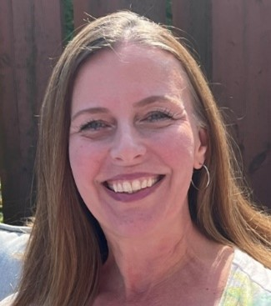
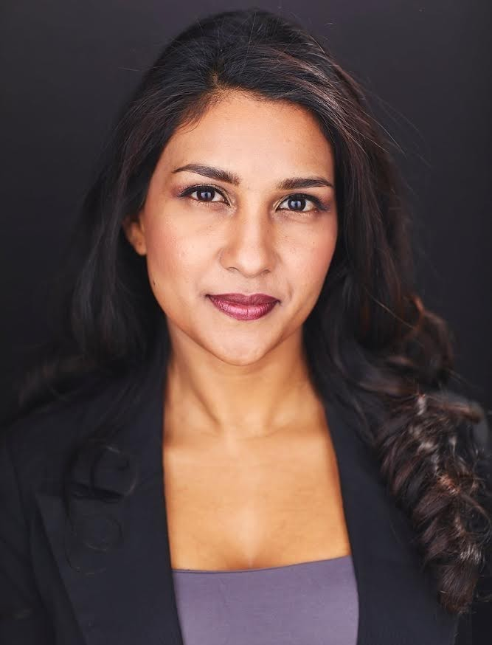
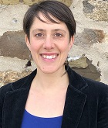
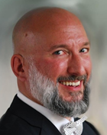
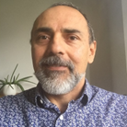
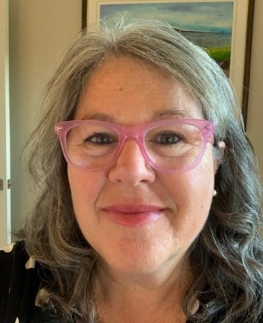
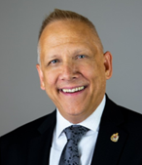
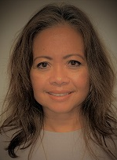
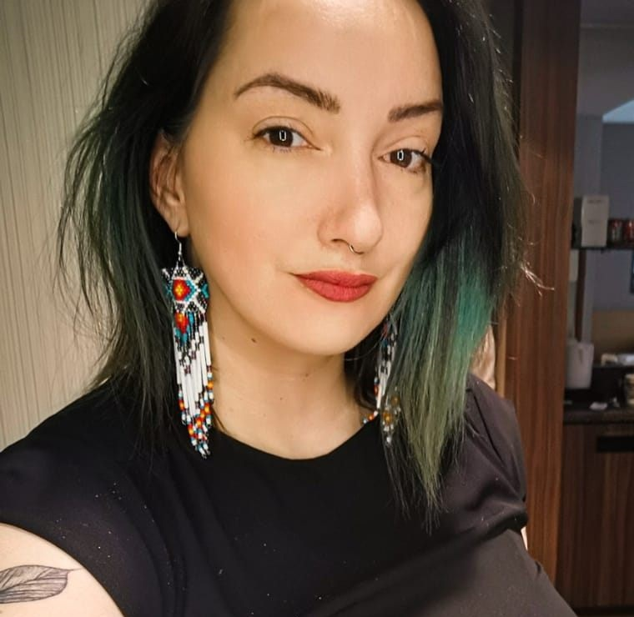
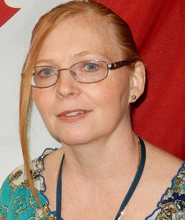
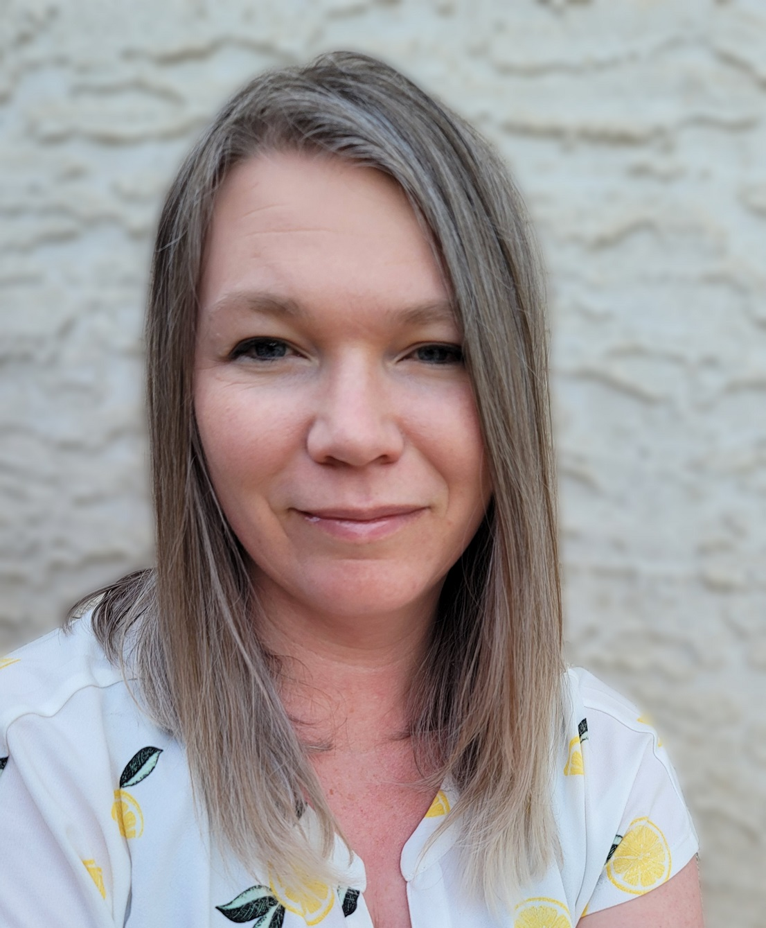

Delivered by a team of volunteer facilitators
Ginette
Casey-Marie
Annie-Claude
Carmen
Alejandro
Marie-Lyne
Robert
Jena
Dani
Leanne
Michelle
and others…
Notes:
Alejandro:
Supported by facilitators from the following departments:
Department of National Defense (DND)
Parks Canada (PC),
Financial Transactions and Reports Analysis Centre of Canada (FINTRAC)
Employment and Social Development Canada (ESDC)
Public Services and Procurement Canada (PSPC)
Indigenous Services Canada (ISC)
Canada Border Services Agency (CBSA)
Treasury Board of Canada Secretariat (TBS)
Canada Revenue Agency (CRA)
Immigration, Refugees and Citizenship Canada (IRCC)
Infrastructure Canada (Infr)
Innovation, Science and Economic Development Canada (ISED)
And others

Slide 16
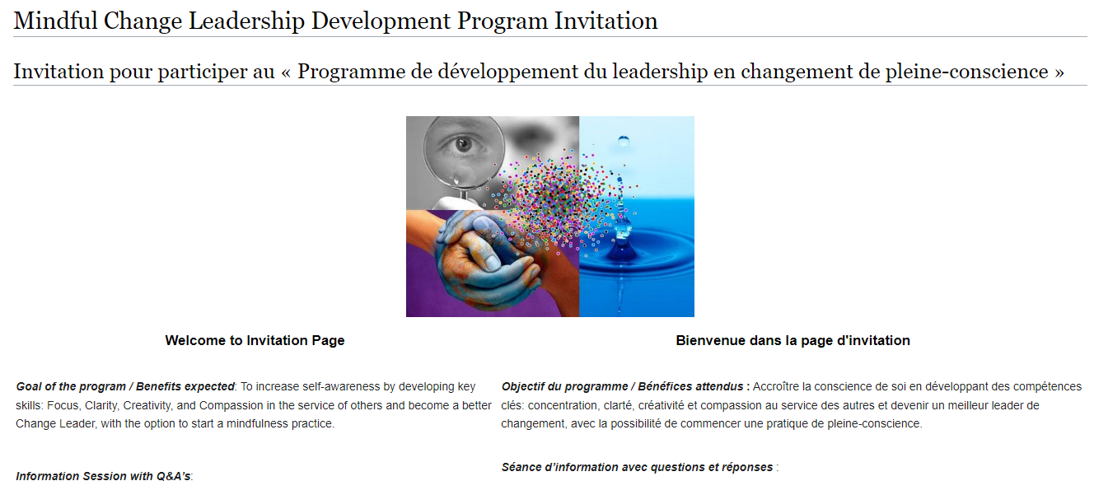
Cost, Time & Commitment
No cost, and you still need your manager's approval
Estimated time up to 4 hours average per week to participate
One webinar session a week, duration of 1.5 hours, for 8 weeks
Daily mindfulness practice, 5 to 20 minutes
One weekly call with a buddy system, approx. 30 minutes, in the official language of choice
Journaling throughout the 8 weeks, 5 to 10 minutes per week
Participate via the Cohort, a GCCollab Community of Practice and Interest Group, as needed
Complete a 5 min self-assessment, 2 times: before, and 3 months after the program
Start date: Tuesday, April 28, 2026
End date: Tuesday, June 16, 2026
Hour: from 12:30pm to 2:00pm ET (Ottawa time)
https://wiki.gccollab.ca/MCLD-DLCP
MCLD - 8 Week Program Details
MCLD - FAQ
Notes:
Alejandro:
Cost, Time & Commitment:
Although there is no cost to the program, you still need your manager's approval as there is an estimate of up to 4 hours average per week to participate, as per the following:
One webinar session a week, duration of 1.5 hours, for 8 weeks
Start date: Tuesday, April 28, 2026
End date: Tuesday, June 16, 2026
Hour: from 12:30pm to 2:00pm ET (Ottawa time)
Daily mindfulness practice, 5 to 20 minutes
One call a week with a buddy system, approx. 30 minutes (buddy system in the official language of choice randomly assigned)
Journaling throughout the 8 weeks, 5 to 10 minutes per week
Participate via the Cohort, a GCCollab Group. Now open as a Community of Practice and Interest
Complete a 5 min self-assessment, 3 times: before, at the end, and 3 months after the program
***
Pages to open and explore:
https://wiki.gccollab.ca/MCLD-DLCP , scroll down to the commitment section
MCLD - 8 Week Program Details (https://wiki.gccollab.ca/Mindful_Change_Leadership_Development_Program_Details)
MCLD – FAQ (https://wiki.gccollab.ca/Mindful_Change_Leadership_Development_Program_-_FAQ)

Slide 17
Program Overview & FAQ’s
Structure of sessions:
Centering exercise
Debrief & Intention
Theory & Videos
Week’s practice
Debriefs
Assignment
Main Topics:
Overview
Neuroplasticity & Change Leadership
Compassionate Leadership
Self-Compassion
Change & Transition
Presence
Loving Kindness
Resilience
https://wiki.gccollab.ca/MCLD-DLCP
MCLD - 8 Week Program Details
MCLD - FAQ
Notes:
Alejandro:

Slide 18


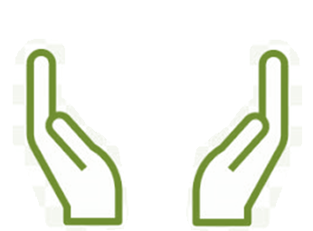
What’s Needed For Success?
Voluntary Participation
Support from Management
This opportunity could be added to your Performance Management Agreement & Learning Plan
Notes:
Ginette:
The sessions and take-home activities require a fairly significant investment by participants, and two components which will be key for ensuring the continued success of the program are maintaining voluntary participation and support from management.
(These 2 success factors are emphasized during the promotion of the program, and employees are encouraged to discuss with their managers to get their support)

Slide 19
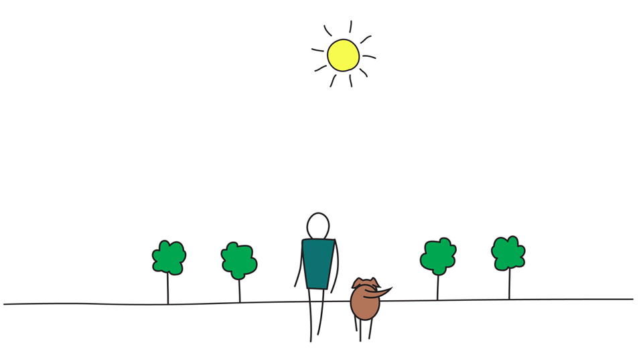

Be Mindful, Be Happy
Notes:
Ginette:
In the meantime that people raise their hand to ask questions), we’ll reflect back on some of the comments put on the chat…. (mention some of the comments for both exercises)
And now, we open the floor for questions, please observe:
One question, per participant, per turn
Alternating with the chat
And Sli.do

