Slide 1
Information session:
Mindful Change Leadership Development program
April 2026
Notes:
Prep:
Update the Sli.do #mcld - https://app.sli.do/event/b5V2V6PYg4WdPRqH5fPpEh
https://wiki.gccollab.ca/MCLD-DLCP , scroll down to the commitment section
MCLD - 8 Week Program Details (https://wiki.gccollab.ca/Mindful_Change_Leadership_Development_Program_Details)
MCLD – FAQ (https://wiki.gccollab.ca/Mindful_Change_Leadership_Development_Program_-_FAQ)
Dani // Jena:
Good morning good afternoon everyone, First, I would like to acknowledge that I am transmitting to you from the traditional Territory of the Anishnaabe Algonquin People; in Gatineau QC.
We are thrilled continue offering this program, thanks to the collaboration of volunteers and the support from various government Departments/Agencies.
Today’s objective is to offer you an overview of the Mindful Change Leadership Development (MCLD) program 2025, English offering, with a Q&A section.

Slide 2
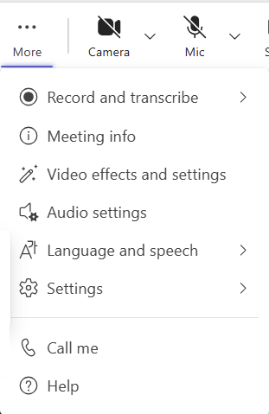
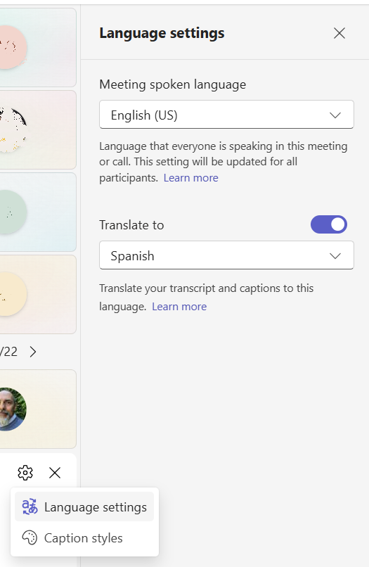
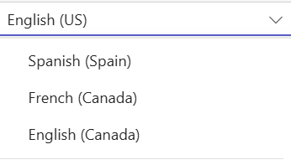

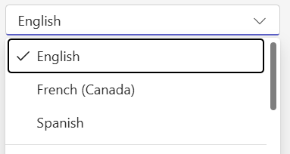

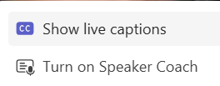
MSTeams automatic CC interpretation
This parameter changes the "Spoken Language" for everybody in this meeting, use
with caution!
1
2
4
This
parameter
changes
the "Translate to" for yourself only, enjoy ☺
3
Speaker name: The close caption
will shows at the bottom of
your screen…
Notes:
Dani // Jena:
To turn on the “automatic CC Interpretation, follow the next steps
From the “more” option at the top of your window, select “Language and speech”
Then select “Show live captions”
It opens up a window at the bottom
Towards its right, there is an engine icon,
from there select “Language settings”.
On the right, the “Language settings” panel opens
Toggle the “Translate to” option,
and select the language to translate the CC into
5 - Be aware that if you change the “Meeting spoken language”, it does for everybody on this meeting.

Slide 3

Agenda (In no particular order)
Words from a Sponsor
Share results of previous MCLD program
Share a definition of Mindfulness
and Mindful Change Leadership
Experience quick mindful exercises
Overview of the MCLD program
Q&A
Notes:
Dani // Jena:
(paraphrase from slide)
Please write down your questions, at the end there will be time for Q&A
Raising hand
Comments via the chat
Ask questions anonymously via Sli.do
https://app.sli.do/event/ndecSyr9sCAK8nCTSHMcjb
code # mcld

Slide 4

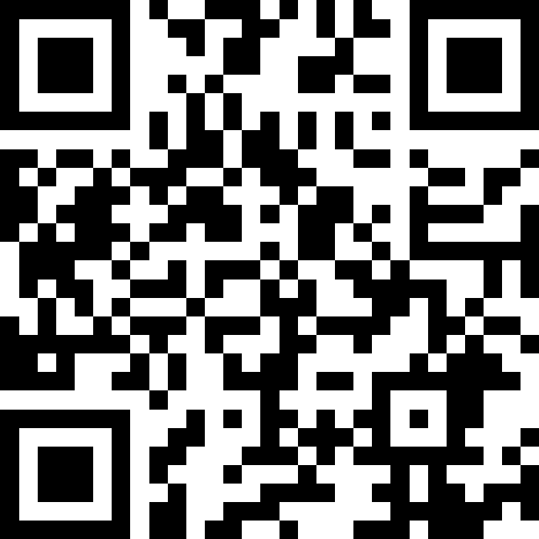
Sli.do
Anonymous questions?
https://www.slido.com/
# mcld
https://app.sli.do/event/b5V2V6PYg4WdPRqH5fPpEh
Notes:
Dani // Jena:
We have the Sli.do, in case anyone would prefer to anonymously ask a question
Now, introducing Marc Sanderson…

Slide 5

“Leadership is not a rank or a position, it is a choice - a choice to look after the person to the left of us & the person to the right of us.”
- S. Sinek
Notes:
Ginette // Casey-Marie:
Now, let’s define “leadership” via a quote from Simon Sinek, (read from the slide)
Strong leadership is one of the drivers of successful change, and leaders who support the people-side of change are essential to success.
This program delivers and promotes mindfulness practices to increase participants’ self-awareness and resilience, equipping leaders that can nurture mindfulness in their teams, with their colleagues and contribute to employee wellness and well-being.
This presentation will provide an overview of the program, share the highlights of the program

Slide 6
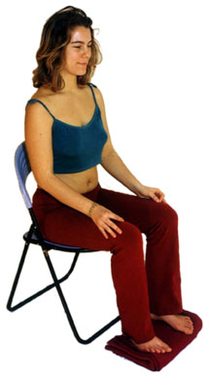

Exercise – Exploring Mindfulness – Body Scan
Time required: 5 minutes
If you haven’t, take advantage of the
opportunity to experience this exercise
Sit as comfortable as possible in a straight position
Feel free to close your eyes
Follow my voice as I lead you through the exercise
Then, we will do a short debrief of what you noticed.
Notes:
Ginette // Casey-Marie:
To start, let’s experience a mindful exercise…
Note that for some people, mindfulness exercises may be difficult as they tend to get you in touch with your body and feelings. Trust your judgement while doing them.
Trauma-Informed Mindfulness: Benefits, Risks, and Getting Started (psychcentral.com) - https://psychcentral.com/health/trauma-informed-mindfulness
If you haven’t, take this as an invitation to experience this exercise
Sit as comfortable as possible in a way that allows you to stay awake and attentive
Put your feet flat on the ground, your palms on you lap, upside or downside as it feels more comfortable
Feel free to close your eyes, or semi close them
Follow my voice as I lead you through the exercise
Gently bring attention to your breath, no need to change the way you’re breathing, just notice it
Now, direct your breath and attention and focus on…
Your face, your eyes, nose and mouth. Your jaw, noticing
Your head, your scalf, breath in and out
Now direct your breath and attention to your shoulders, breath in, breath out, and notice
Your arms, your hands and fingers, in and out
Every time your attention wanders away, just bring it back gently
Back to your shoulders, and neck, noticing
Your upper back, chest
Your lower back, your abdoment
Direct your breath towards your waist, in and out
Your lower leg, in and out and your upper leg, and notice what you feel
Your feet, in and out, notice what you feel
Your toes, breath in, breath out
Stay there for a few seconds, breathing in and out
When you feel like, open your eyes and come back
Debrief: Use the chat to mention What did you notice?
We’ll read some of your comments later during this session

Slide 7


Mindful Change Leadership Development Program (MCLD) Goal
To increase self-awareness by developing key skills:
Focus
Clarity
Creativity
Compassion in the service of others
… with a positive impact on well-being and resiliency.
“Individuals with higher mindfulness have greater resilience, thereby increasing their life satisfaction.” - ScienceDirect
Notes:
Ginette // Casey-Marie:
When you think about your work and try to find a balance between work priorities, your relationships with colleagues and clients, along with home life responsibility, what strikes you as the key skills needed for this balance? Where would you like to improve?
Is it better presence, or more compassion? Is it increased self-awareness or tools for self-reflection?
We believe that this program helps to answer some of these questions and to improve the key skills of presence, self-compassion, relationality, life-work balance, self-awareness and more.
(click)
There are studies showing that individuals with higher levels of mindfulness tend to be more resilient. And also note that both mindfulness and resilience are important skills for improved well-being
By partaking in the program, you will likely increase the level of honesty and trust within yourself, and therefore with others, allowing for an authentic connection with the work that we do at across the Government of Canada.

Slide 8
Some Numbers about the MCLD program
Notes:
Alejandro:
Total registration to date: 1,233, Completed: 698​
The graphic shows the progression of the MCLD program, in terms of registration and completion, showing an average slightly above 50%
How come 57% you may ask… among other reasons:
Change in work load for participants
Change in their work priorities (management changed their minds, new manager, re-organization, etc)
Misunderstanding of the commitment to participate
Among others

Slide 9
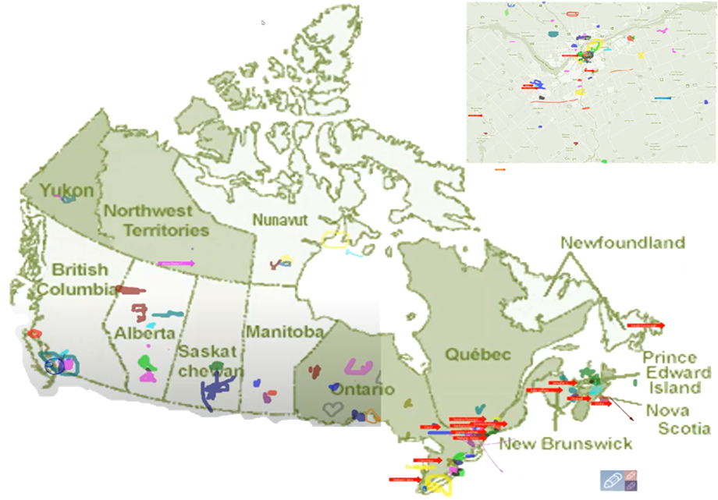
Map of Participation, 2022 English Offering
From across Canada:
From NCR:
Notes:
Alejandro:
The program had participants from across Government and across Canada, as you can see per the slide, the image was co-created at the beginning of the 2022 English offering

Slide 10
Key Findings - MCLD English Program 2025
13.5%
18.2%
14.7%
30.8%
22.2%
* People who answered "Always", "Usually", and "Sometimes"
Notes:
Alejandro:
Now, some details from participants’ self-assessment questionnaires which were filled at program registration and again three months after the eight-week program, and we have compiled the data to evaluate the results and impacts of the Mindful Change Leadership Development program.
(click)
The blue columns represent the results of the self-assessment questionnaires completed at registration.
(click)
The green columns represent the final assessment, and the differences between them indicate behavioural changes.
For this cohort, we got 127 registered participants, 93 completed the program, that’s a 73% rate, which is fantastic!!
We received 32 final assessments (34.5% return on self-assessments), and the key findings per category are:
(click on each bullet)
Almost 15% Increase in Employee Engagement – respondents tend to pay attention at the experience while doing their tasks.
(Q12. I tend to quickly do my task(s) without paying attention to the experience along the way. )
A 30.8% Increase in Promoting Sounder Decision Making - people take time everyday to optimize their productivity.
(Q16 I take time each day to optimize my personal productivity.)
With a 13.5% decrease in Behavioural Risks - participants focus on what they can influence.
(Q13 I influence where I can, rather than worrying about what I can’t influence. )
Slightly over 18% Increase in Well-Being – respondents are able to redirect the attention to the present moment.
(Q15 I am able to notice when my attention has been pulled away and redirect it to the present.)
And just over 22% Increase in Resiliency - people reported bouncing back faster after a challenging situation.
(Q4 I feel I can bounce back quickly after an emotionally challenge situation.)
What we heard from participants was that the program was a life changing experience, it helped them increased their own sense of well-being; and gave them the tools and practices to use with their teams to support employee wellness and well-being.

Slide 11

MCLD 2025 Program Testimonials
I definitely have come a long way in terms of personal growth over the past year…Would love to see more of these types of programs being implemented… Thank you for your support!
the course provided me perspective on myself and how I react to my surroundings and others.
I really enjoyed this course, and it taught me a lot of practical skills that work for me… I am happy to have had this experience so that I know what I can go back to when I am struggling.
I am in a better mental state since taking it.
It was such a privilege to participate in this program. It was occasionally a challenge to adjust my schedule to fully participate in the small group sessions, but was very rewarding when my group did find the time. The larger group sessions were a great space to connect with individuals across departments.
Thank you for the MLCD 2025
Thanks again for a great program!
the MCLD program is a constructive, practical, beautifully designed approach to helping people be more present and let go of distraction. There are so many tools presented in the program that I'd re-do it, just to incorporate more of the tools into my daily life. Kudos to all of the facilitators. I'm grateful for their engagement and efforts.
It was through this course that I came to recognize the stressors and impacts on my mental health, and I was inspired to do something to improve my situation. Thank you so much!
This is the second time I've participated in the cohort and definitely strengthened my skills and realized that mindfulness is an ongoing practice that you need to keep constant although there are ebbs and flows with it. My cohort still meets once a month and we were fortunate to have two of us in the same work building although different departments, so we meet regularly to go walking.
Notes:
Dani // Jena:
I definitely have come a long way in terms of personal growth over the past year between the Decompression Program and the Mindful Change Leadership sessions. I do believe that the culture at work needs to change as a whole, taking into consideration all of the changes that have occurred from 2019 - now. Would love to see more of these types of programs being implemented under the 'mandatory training' sessions in the federal government. Thank you for your support!
I enjoyed the course. It provided me perspective on myself and how I react to my surroundings and others.
I really enjoyed this course, and it taught me a lot of practical skills that work for me. While I haven't been keeping them up as much as I could, I am happy to have had this experience so that I know what I can go back to when I am struggling.
I very much appreciated the re-centering that this course offered. I am in a better mental state since taking it. I would love to see a portion about helping others to re-center, the leadership part. Lots of tools could be shared but broaching the subject of witnessing a need for some tools in others would be great. Obviously, the readiness and willingness is self directed, but how does one in a leadership role recommend to others without seeming too meddlesome.
It was such a privilege to participate in this program. It was occasionally a challenge to adjust my schedule to fully participate in the small group sessions, but was very rewarding when my group did find the time. The larger group sessions were a great space to connect with individuals across departments.
Thank you for the MLCD 2025
Thanks again for a great program!
the MCLD program is a a constructive, practical, beautifully designed approach to helping people be more present and let go of distraction. There are so many tools presented in the program that I'd re-do it, just to incorporate more of the tools into my daily life. Kudos to Alejandro and all of the facilitators. I'm grateful for their engagement and efforts.
This course helped me to realize that I am not looking after myself in the same way I look after others, and has inspired me to keep trying to find ways to calm my own central nervous system on a daily basis to improve my life and my experience at work. Thank you to the team that facilitates this session - I deeply wish these kinds of offers were more widely supported by senior management, and that a variety of options offering mindfulness and stress-reduction in the workplace were encouraged. It was through this course that I came to recognize the stressors and impacts on my mental health, and I was inspired to do something to improve my situation. Thank you so much!
This is the second time I've participated in the cohort and definitely strengthened my skills and realized that mindfulness is an ongoing practice that you need to keep constant although there are ebbs and flows with it. My cohort still meets once a month and we were fortunate to have two of us in the same work building although different departments, so we meet regularly to go walking.

Slide 12
MCLD Program Testimonials
"…in a way, your investment in becoming medicine... is a very important investment…" - Elder Malcom Saulis
"I found this course to be extremely powerful and grounding... this really helps to shape how I look at my relationships with my staff… it was excellent. "
"it was very powerful, very interesting, lots of insights. I learned a lot about myself. I found the exercises appropriate in me being more productive, more present in my relationships with my colleagues and also with my family.”
“This series is life changing. I hope to participate more in the future”
"These 8 weeks have been profound… in my view I think this should be mandatory for everyone. it's that powerful"
"Thank you for this valuable opportunity to grow personally and professionally. It has been an important adjunct to the transformational work we are doing at ISC.“
I wanted to also share some specific gratitude... I found the sessions incredibly helpful, useful and well structured… it's already had a wonderful effect on my life
Notes:
Dani // Jena:
From this set of testimonials, I’ll allow myself to read the first one in full… from Elder Malcom Saulis: "... in a way, your investment in becoming medicine for yourself and for the rest of the world is something that I'm grateful to be witness to as an occasional participant in this program... any kind of investment like this in order to open your mind, your heart and your spirit to the presence of a larger world, which is either spiritual or physical, is a very important investment, and I applaud you for the investment that you've made." - Elder Malcom Saulis, session 8, 5456

Slide 13


Exercise – Noticing
Time required: 3 minutes
The trick is to shift from “doing” to “being”
Let’s start by doing the following...
  Sit as comfortable as possible in a straight position
  It helps if you close or semi-close your eyes
  Let’s not worry about time
  And take a minute, only a minute...
  To breathe, just to breathe
  That simple
  I’ll let you know when the minute is over.
  Just continue focusing on your breathing
We’ll do a short debrief of what you noticed
Notes:
Dani // Jena:
Now, before we go into the details of the program and the Q&A, let’s give a try to another mindful exercise…
As with the first exercise, sit as comfortable as possible in a position that allows you to be awake, attentive and comfortable at the same time
You can put your feet flat on the ground, your palms on you lap, upside or downside as it feels more comfortable
Feel free to close your eyes, or semi close them
Follow my voice as I lead you through the exercise
Gently bring attention to your breath, no need to change the way you’re breathing, just notice it
Let’s not worry about time
Just focus on
Breathing in
Breathing out
If at any time your mind wanders away, being gently with yourself, acknowledge that thought, let it be, and bring back your attention to your focus of attention, your breathing
Breathing in
Breathing out
I’ll let you know when the minute is over
Just continue focusing on your breathing
Debrief: Use the chat to mention What did you notice?
We’ll read some of your comments later during this session

Slide 14
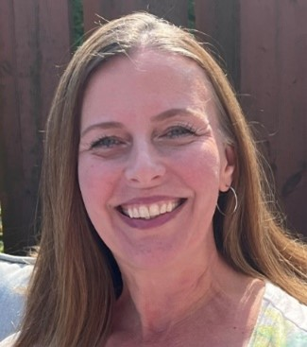
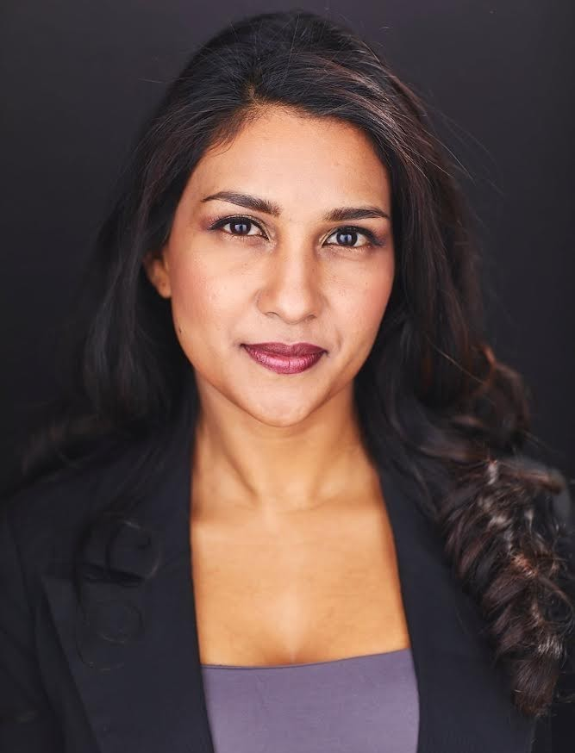
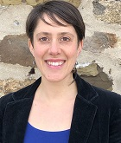

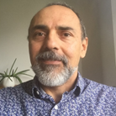
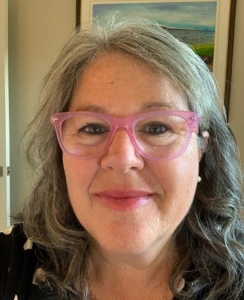
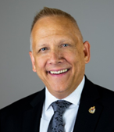
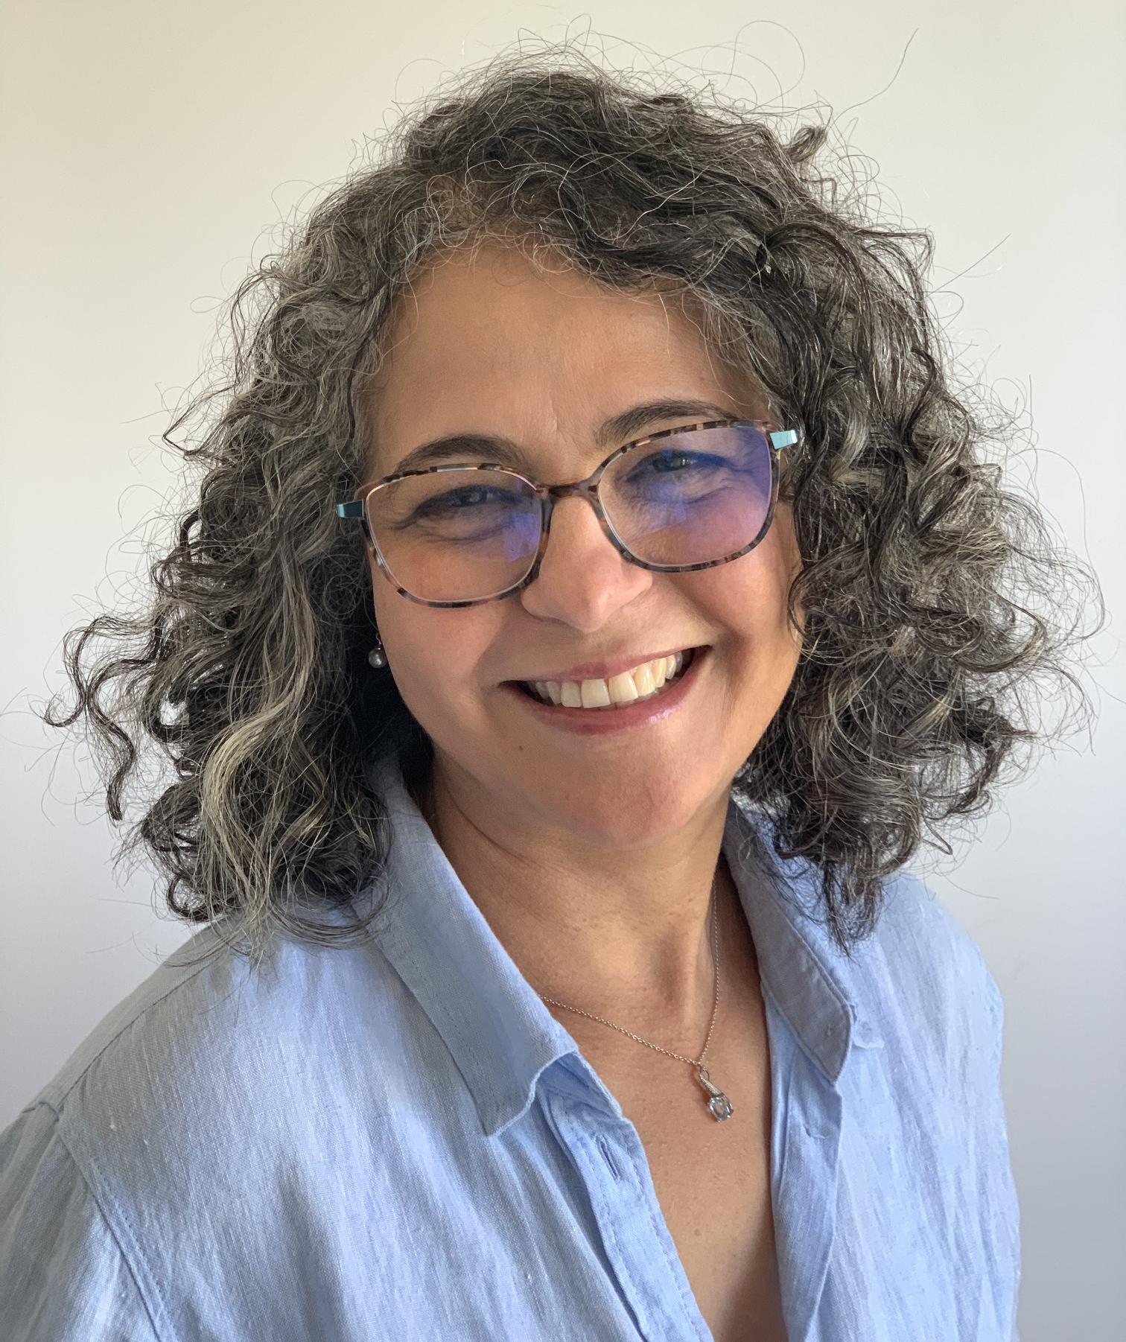
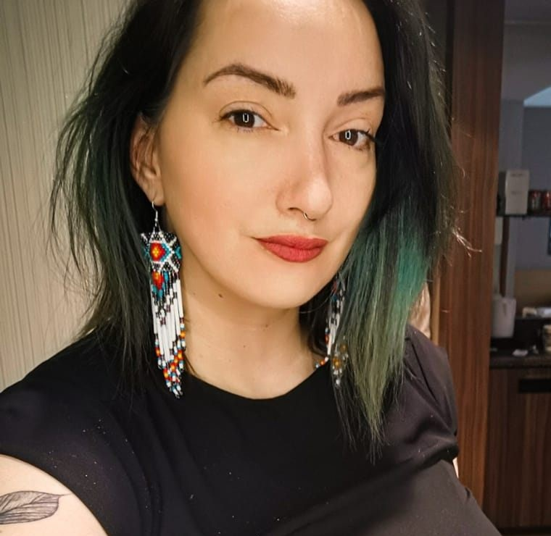
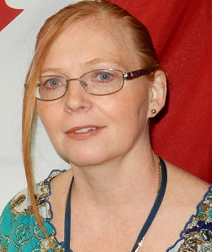
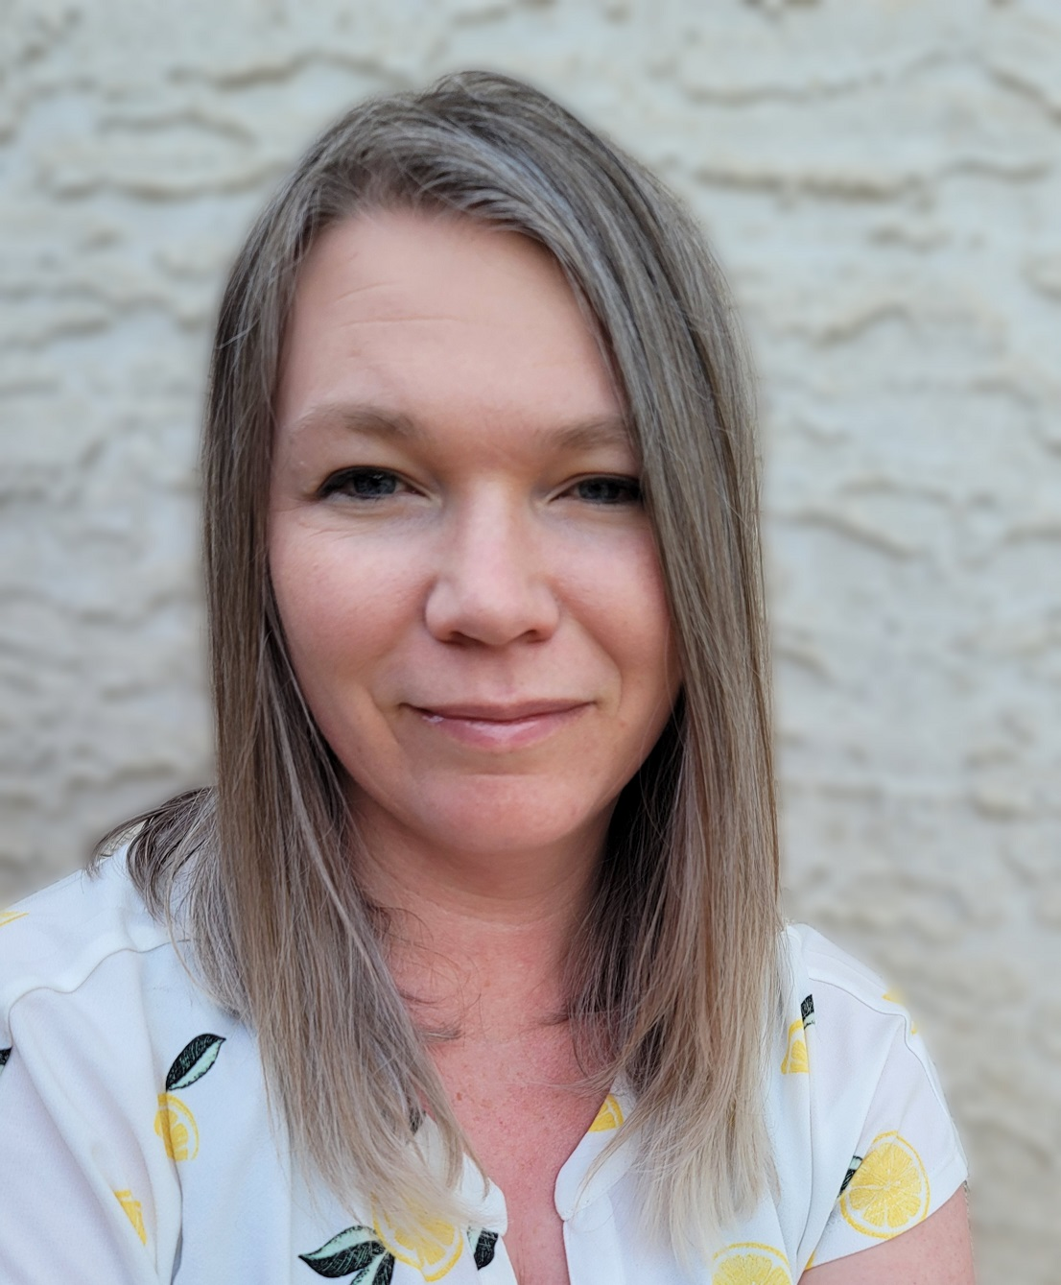
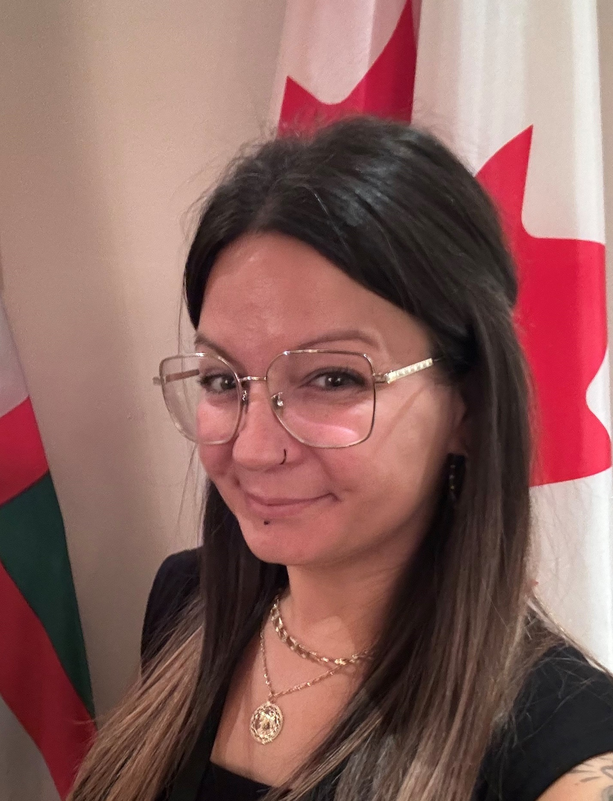
Delivered by a team of volunteer facilitators
Ginette
Casey-Marie
Annie-Claude
Carmen
Alejandro
Marie-Lyne
Robert
Rabia
Dani
Leanne
Michelle
Josée,
and others…
Notes:
Dani // Jena:
Supported by facilitators from the following departments:
Office of the Secretary to the Governor General (GG)
Parks Canada (PC),
Financial Transactions and Reports Analysis Centre of Canada (FINTRAC)
Employment and Social Development Canada (ESDC)
Public Services and Procurement Canada (PSPC)
Indigenous Services Canada (ISC)
Canada Border Services Agency (CBSA)
Treasury Board of Canada Secretariat (TBS)
Canada Revenue Agency (CRA)
Immigration, Refugees and Citizenship Canada (IRCC)
And others

Slide 15
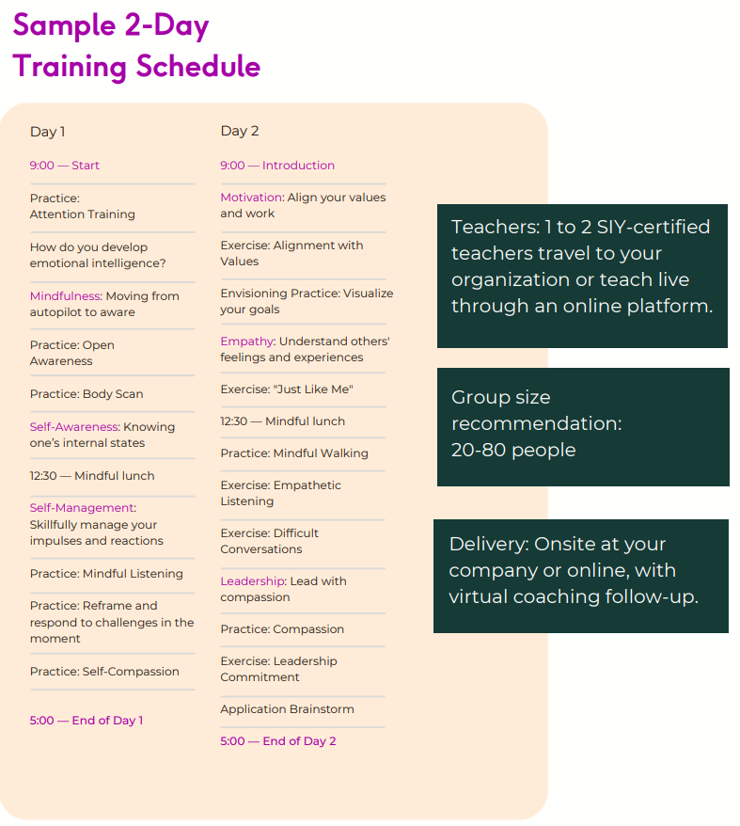
Commitment, Program Overview & FAQ
Algo asi
https://wiki.gccollab.ca/MCLD-DLCP
MCLD - 8 Week Program Details
MCLD - FAQ
Notes:
Update the overview to show something inspired by the image

Slide 16
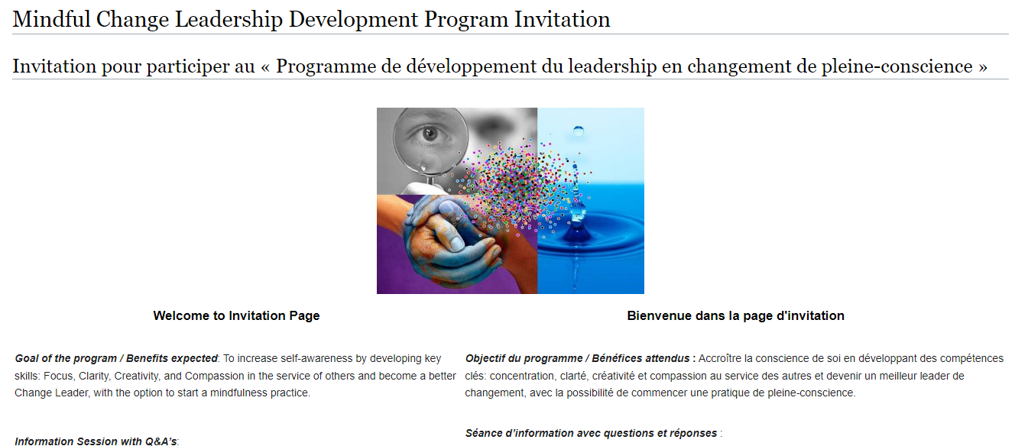
Commitment, Program Overview & FAQ
https://wiki.gccollab.ca/MCLD-DLCP
MCLD - 8 Week Program Details
MCLD - FAQ
Notes:
Ginette // Casey-Marie:
The program goes for 8 weeks, with a weekly session of 1.5 hours, plus additional homework to an approximate 2 to 3 hours a week total
“This program is aimed at someone who wants it” (not necessary for one who needs it)
Pages to open and explore:
https://wiki.gccollab.ca/MCLD-DLCP , scroll down to the commitment section
MCLD - 8 Week Program Details (https://wiki.gccollab.ca/Mindful_Change_Leadership_Development_Program_Details)
MCLD – FAQ (https://wiki.gccollab.ca/Mindful_Change_Leadership_Development_Program_-_FAQ)

Slide 17


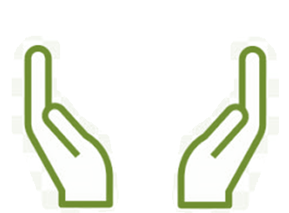
What’s Needed For Success?
Voluntary Participation
Support from Management
This opportunity could be added to your Performance Management Agreement & Learning Plan
Notes:
Ginette // Casey-Marie:
The sessions and take-home activities require a fairly significant investment by participants, and two components which will be key for ensuring the continued success of the program are maintaining voluntary participation and support from management.
(These 2 success factors are emphasized during the promotion of the program, and employees are encouraged to discuss with their managers to get their support)

Slide 18
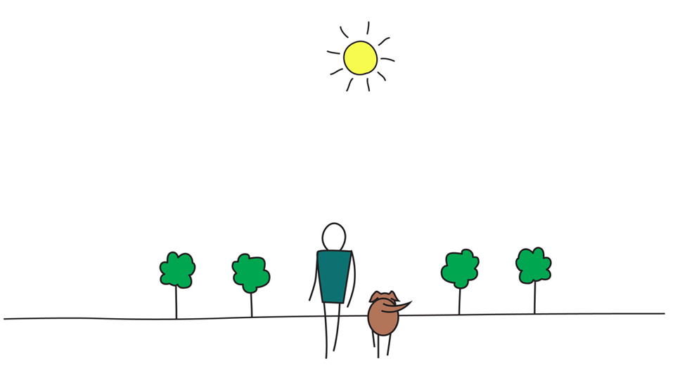

Be Mindful, Be Happy
Notes:
Ginette // Casey-Marie:
In the meantime that people raise their hand to ask questions), we’ll reflect back on some of the comments put on the chat…. (mention some of the comments for both exercises)
And now, we open the floor for questions, please observe:
One question, per participant, per turn
Alternating with the chat
And Sli.do

Slide 19
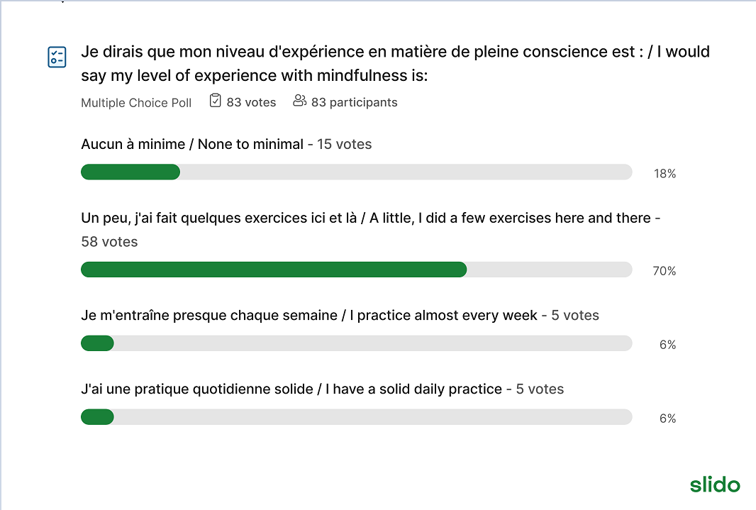
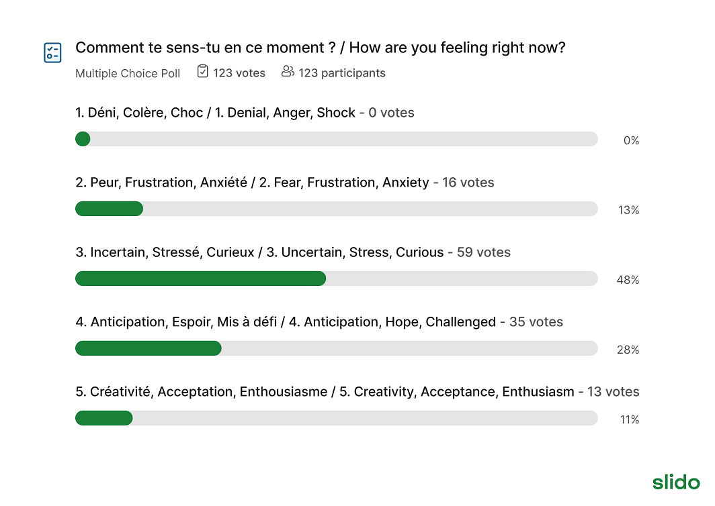
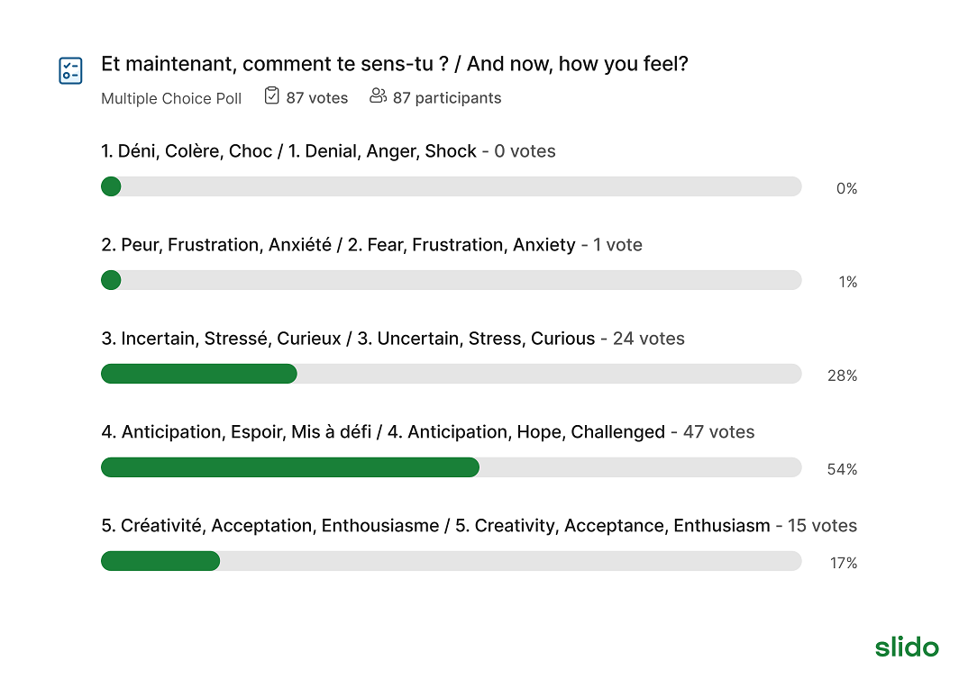
IOCN: Responding to Change with neuroplasticité & selfcompassion
Feb 4, 2025
Avant l’exercise en pleine-conscience, et en Après
Notes:
Facilitator 1:
Based on a Sli.do used on a recent session, like this one, we’re showing the impact of a quick mindfulness exercise.
We asked participants “How are you feeling?” before and after of doing a quick mindfulness exercise, like the one we just did, the images shows a shift towards the groups of words 4 and 5.
The groups represent the human transition and they contain normal reactions to change, we’ explore change and transition in the next slides.
A quick mindfulness exercise generates benefits, suggesting the availability of the prefrontal cortex, which is needed to learn, have focus, clarity, creativity, curiosity and compassion.
The same Sli.do have been used with many other audiences, including Canadian Coast Guard, CRA folks, Learning folks, and many more.
Reference:
- image: With a participation of approx. 975 people on the English session, on the French session we had about 200 participants with similar results, the session was presented to employees of all Government of Canada Departments, Feb 4 2025.
The whole section, including the 3 sli.do questions and the body scan mindfulness exercises, lasted about 7 mins
---
Avec la participation du approx 200 participantes, la séance s’a présentée aux employés du Gouvernement du Canada, le 4 février 2025.
L’image en haut à droite illustre le niveau de familiarité des participants avec la pratique de la pleine conscience.
Les deux images en bas montrent les résultats avant et après un exercice de balayage corporel en pleine conscience.
La conclusion est que l’image de droite révèle un déplacement vers les groupes de mots 4 et 5. Ces mots représentent la transition vers un « nouveau départ », favorisant ainsi une moindre résistance ou une meilleure acceptation du changement.
En d’autres termes, quel que soit le niveau de pratique en pleine conscience, un exercice rapide de pleine conscience procure des bénéfices. Comme le montre l’image, le déplacement vers les groupes de mots 4 et 5 est aligné avec l’activation du cortex préfrontal, essentiel pour apprendre, se concentrer, avoir de la clarté, de la créativité et de la curiosité.
L’ensemble de cette section, incluant les trois questions sur sli.do et les exercices de balayage corporel en pleine conscience, a duré environ 5 minutes.

