Slide 1
Onboarding Indigenous students in the public service: session for managers
Presentation by the Indigenous Centre of Expertise, National Recruitment Directorate for the Indigenous Student Employment Opportunity
April 2025

Slide 2
Session objectives
Equip hiring managers and HR specialists with knowledge and tools to effectively onboard and support Indigenous student workers.
Foster inclusive workplace practices that respect Indigenous cultures and lived experiences.
Encourage retention and professional development of Indigenous students within the public service.
Notes:
Cover:
Mandate of the Indigenous Centre of Expertise
Importance of Indigenous representation in the public service
Best practices in managing Indigenous student workers
Supports offered through the Indigenous Student Employment Opportunity (ISEO)

Slide 3
Indigenous Centre of Expertise
Mandate:
To promote Indigenous culture and facilitate the recruitment, retention, support, and advancement of Indigenous peoples within federal organizations through culturally competent advice and guidance to federal public service hiring managers in Canada.
Notes:
SUPPORT, ADVICE AND GUIDANCE
Provide culturally sensitive strategic advice and guidance to public service partners and other government organizations on hiring Indigenous talent;
support the creation of tailored recruitment initiatives;
Recommend best practices for inclusive and barrier-free staffing and recruitment processes.
ENGAGEMENT AND OUTREACH
Help build and sustain relationships with key Indigenous associations and community organizations.
RECRUITMENT PROGRAMS AND TOOLS
Design and manage Indigenous recruitment and support programs (i.e. the Indigenous Student Employment Opportunity)
Develop tools and resources for managers and HR professionals
Increase awareness of tools, supports and services available in support of Indigenous recruitment and inclusion

Slide 4
How the PSC supports hiring managers
Outreach, recruitment, engagement
Atlantic
Quebec
Ontario and Prairies
National Capital Region and Eastern Ontario
British-Columbia and Northern regions
The PSC's regional offices deliver recruitment outreach services to federal organizations and employees and offer support to:
Explore recruitment options to find graduates and students (high school, college and university)
Appoint from public-service-wide pools and inventories
Recruiting Indigenous talents
Promote employment opportunities and meet job seekers through outreach services

Slide 5
Common Challenges Faced by Indigenous Students
Cultural differences and misunderstandings
Lack of representation and role models
Discrimination and bias
Socioeconomic challenges
Access to support and resources
Cultural Identity and self-expression
Career advancement and development
Notes:
Common barriers faced by Indigenous students (e.g., relocation, culture shock, lack of support systems, imposter syndrome)
Diversity of Indigenous identities, backgrounds, and lived experiences
The importance of cultural safety and trauma-informed practices
What we’ve heard from past Indigenous student participants

Slide 6
Challenges specific to federal work experiences
Treasury Board Secretariat’ Student Experience Survey
  Welcome Experience from Supervisor/Manager and colleagues: Indigenous students reported slightly higher satisfaction compared to non-Indigenous students
  Orientation on Work Responsibilities: Indigenous students (80%) reported slightly lower satisfaction compared to non-Indigenous students (82%).
  Orientation on Organization: Indigenous students (80%) had slightly lower satisfaction compared to non-Indigenous students (84%).
  Indigenous students were more likely to request accommodations: 22% of Indigenous respondents requested workplace accommodations, compared to 14% of non-Indigenous respondents.
What we heard…
  Some students feel isolated, especially those onboarded remotely without a strong support system

Slide 7
Onboarding basics
A. Before the Student Arrives
Prepare your team: awareness and openness
Introduce the student in advance
Arrange logistics (workspace, IT, security clearance) early
Plan a welcoming message or kit
B. First Day/Week
Assign a buddy or informal mentor
Walk through expectations clearly and kindly
Encourage relationship building over formalities
Acknowledge and honour identity (e.g., allow for time off to attend ceremonies or cultural events)
C. During the Placement
Regular check-ins and supportive supervision
Opportunities for learning and growth
Create space for the student’s voice in team activities
Celebrate contributions, however big or small

Slide 8
Best practices for Onboarding Indigenous students – Cultural Sensitivity
Provide cultural awareness training for all employees to increase understanding and appreciation of Indigenous histories, cultures, and contributions.
💡A Brief History of the Relationship Between Indigenous Peoples and the Government of Canada
💡Reflecting on Cultural Bias: Indigenous Perspectives

Slide 9
Best practices for Onboarding Indigenous students – Personalized onboarding experience
Provide tailored training, resources and support to help Indigenous youth succeed in their roles and navigate the organization effectively.
💡Information Toolkit for Indigenous Students

Slide 10
Best practices for Onboarding Indigenous students – Inclusive management practices
Implement flexible work arrangements, accommodations, and support services to meet the diverse needs and preferences of Indigenous youth.
Hybrid work model exceptions provides an exception for Indigenous public servants whose location is critical to their identity to work from their communities
Scheduled and frequent check-ins; meet-ups to discuss non-work-related topics

Slide 11
Best practices for Onboarding Indigenous students – Mentorship and support programs
Connect Indigenous youth with mentors, employee resource groups to foster connections, share experiences, and build community.
💡 Indigenous Student Employment Opportunity - Mentorship

Slide 12
Best practices for Onboarding Indigenous students – Training and learning
Provide opportunities for Indigenous youth to take training and share their knowledge, experiences, and perspectives with colleagues and encourage mutual learning
💡 Learning path for students - CSPS

Slide 13
Best practices for Onboarding Indigenous students - Career Development and Advancement
Showcase available pathways for career development and advancement and offer opportunities for skill development, and professional growth
💡 Government of Canada jobs for Indigenous students and graduates

Slide 14
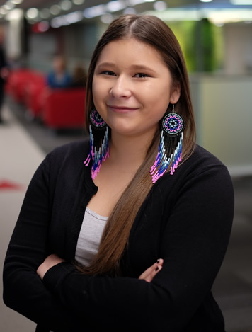
Indigenous Student Employment Opportunity
The Indigenous Student Employment Opportunity is a support program for First Nations, Inuit and Métis students to enhance their experience during their work terms in the Government of Canada.
The program was initially launched in 2016 as the Indigenous Youth Summer Employment Opportunity and was proposed by the Assembly of First Nations with the goal of expanding efforts to recruit and retain Indigenous youth into the federal public service.
The ISEO features support for onboarding, networking opportunities, a mentorship program and culturally respectful resources for both students and hiring managers.
Registration is required, which can be done by the hiring manager, human resources specialists or students themselves

Slide 15
Summer 2024 Programming Highlights
“ISEO program helped me discover new opportunities. ISEO gave me the opportunity of additional advice to navigate my career effectively that my regular job duties/team would not have prepared me for. ISEO gave me a sense of more understanding and confidence in the public service.” – anonymous
“Over the past three summers, I’ve had the privilege of working with Parks Canada, and this year, my first connected with ISEO, has been particularly rewarding. I’ve gained invaluable connections and opportunities that I wouldn’t have had elsewhere.” – Grace
146 students registered
47 participating federal organizations
2 events for managers with 400+ participants
6 events for students
average of 40 participants per event

Slide 16
What’s Next - Summer 2025 Programming
Manager Information Session
Mentor Information Session (new)
2 collaboration events with Federal Youth Network (FYN) & GC Students
7 events for students, including opening and closing events, a workshop on employment after graduation, testimonies and a new workshop on setting professional goals
Continued matching and support for mentorship
Notes:
Additional comms to managers encouraging their students’ participation in activities.

Slide 17

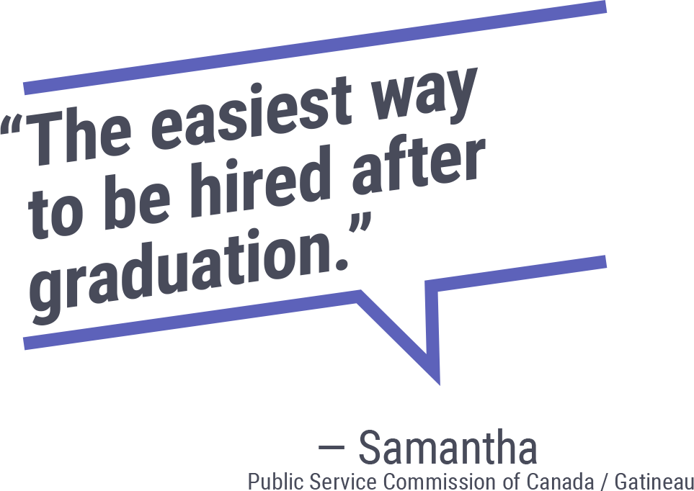
Indigenous Career Pathways
The Indigenous Career Pathways is a cost-efficient hiring solution that facilitates the matching between Indigenous talents with hiring managers across the public service.
It features:
  Graduates or soon-to-be graduates with previous student employment experience and eligible for bridging
  Pre-qualified candidates in a public service pool.
⚡ Hiring managers can help students who are not re-hired and are graduating by ensuring they are placed in the ICP.

Slide 18
Resources for hiring managers
Guidance, services and staffing resources
  Manager’s Guide to support the onboarding of Indigenous students
  Indigenous recruitment toolbox
  Indigenous recruitment – Information for hiring managers
  GC Hiring Managers Hub: Recruitment options
Publications and studies
  Barriers to Indigenous Recruitment
Training
  Roadmap for Managers of Indigenous Employees
  Making a Difference in Supporting the Careers of Indigenous Employees (for practitioners)
  Supporting Indigenous Talent (for executives)

Slide 19

Discussion
Have you experienced any challenges in recruiting, managing, retaining Indigenous students?
Are there successful practices you or your organization have put in place to support Indigenous students?

Slide 20

Your feedback is important!
Thank you for participating in our activity!
Please take a few minutes to answer out short questionnaire.

Slide 21
21
THANK YOU / Ekosani / Marsee / Miigwech / Meegwetch / Mutna / Marci Cho / ᖁᐊᓇᖅᑯᑎᑦ / Nakurmik / Nià :wen.
Any questions?
Contact the indigenous Centre of Expertise:
cfp.cea-icoe.psc@cfp-psc.gc.ca

