Slide 1
Mindful Change Leadership Development Program
Session 1 (of 8)
May 8, 2023
Notes:
Alison:
Hi everyone and a warm welcome to our first session of the Mindful Change Leadership Development Program.
Instructions:
Webcams are welcome
Remember logging off from VPN to have a better experience
Sessions are recorded:
Be assured, if ever there is something sensitive recorded, at the request of those interested, the recording will be edited before posting
The breakout rooms are not recorded, thus what is said in small groups stays there
The recording is also very helpful in case you miss a session
Then start sharing the screen, and read from the slide

Slide 2
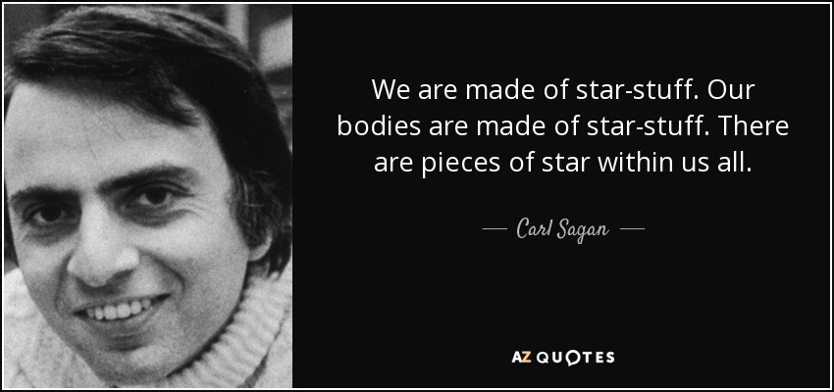
We all are STARS
Notes:
Alison:
This slide shows a quotation from the well known astronomer Carl Sagan.
Read the quote
(click)
We all are STARS
His statement sums up the fact that the carbon, nitrogen and oxygen atoms in our bodies, (as well as atoms of all other heavy elements), were created in previous generations of stars over 4.5 billion years ago. Because humans and every other animal as well as most of the matter on Earth contain these elements, we are literally made of star stuff.
What is more amazing is that the complex balance of these molecules gives way to a complex biological system that allows us to move, to feel emotions and even contemplate our existence.
This quote continues on to say, “Some part of our being knows this is where we came from. We long to return; and we can, because the cosmos is also within us. We’re made of star stuff. We are a way for the cosmos to know itself.”

Slide 3
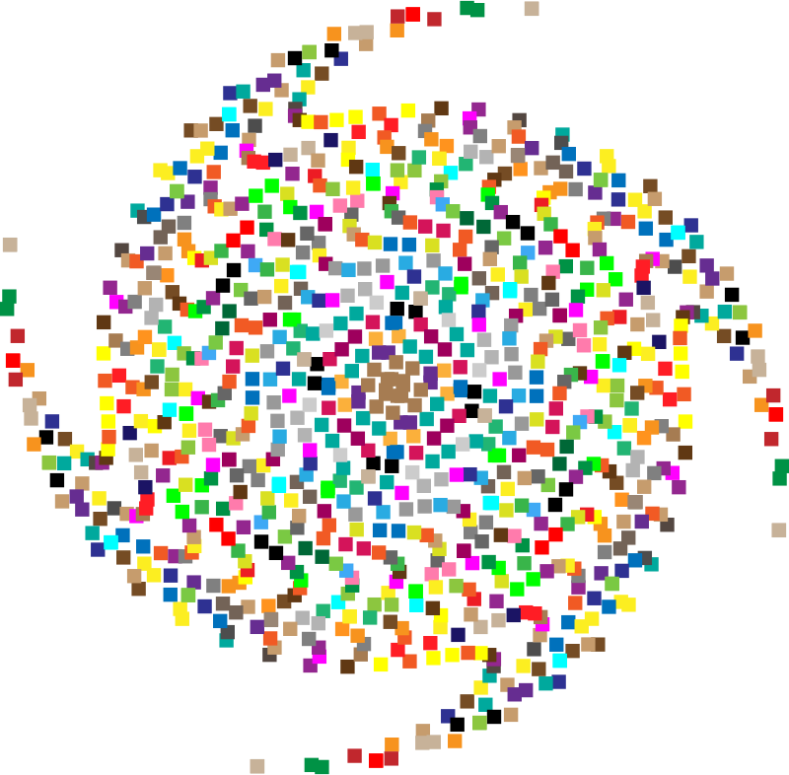
Mindful Breathing Exercise – Centering
Time required: 2 minutes
Sit comfortable, with back as straight as possible
Close your eyes or find a soft gaze
Focus on your breath
Notes:
Alison:
With this we will come into a mindful centering exercise, one of many, we will do these at the start of all sessions as a way to bring our attention and awareness to this moment and to set the space for a beneficial session for all.
Sit as comfortable as possible in a position that allows you to be awake, attentive and comfortable at the same time
You can put your feet flat on the ground, your palms on you lap, upside or downside as it feels more comfortable
Feel free to close your eyes, or semi close them
Follow my voice as I lead you through the exercise
Gently bring attention to your breath, no need to change the way you’re breathing, just notice it
Let’s not worry about time
Just focus on
Breathing in
Breathing out
If at any time your mind wanders away, being gently with yourself, acknowledge that thought, let it be, and bring back your attention to your focus of attention, your breathing
Breathing in
Breathing out
Now, we’ll take one full minute of breathing for centering ourselves
I’ll let you know when the minute is over
Just continue focusing on your breathing

Slide 4
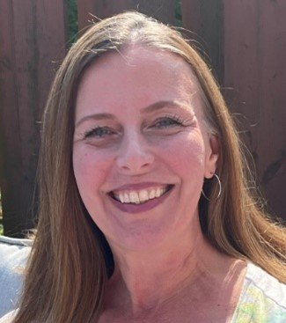
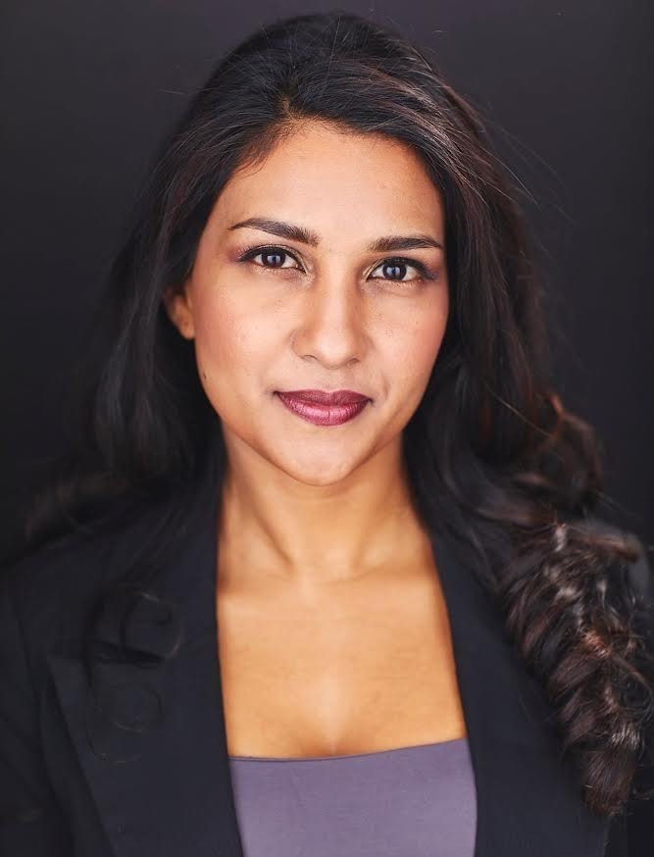
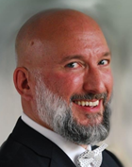
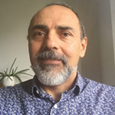
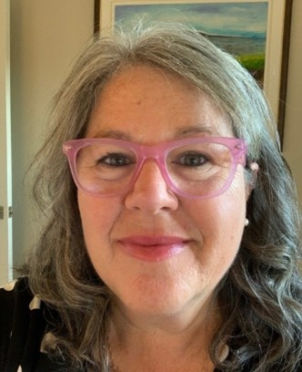
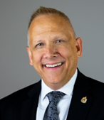
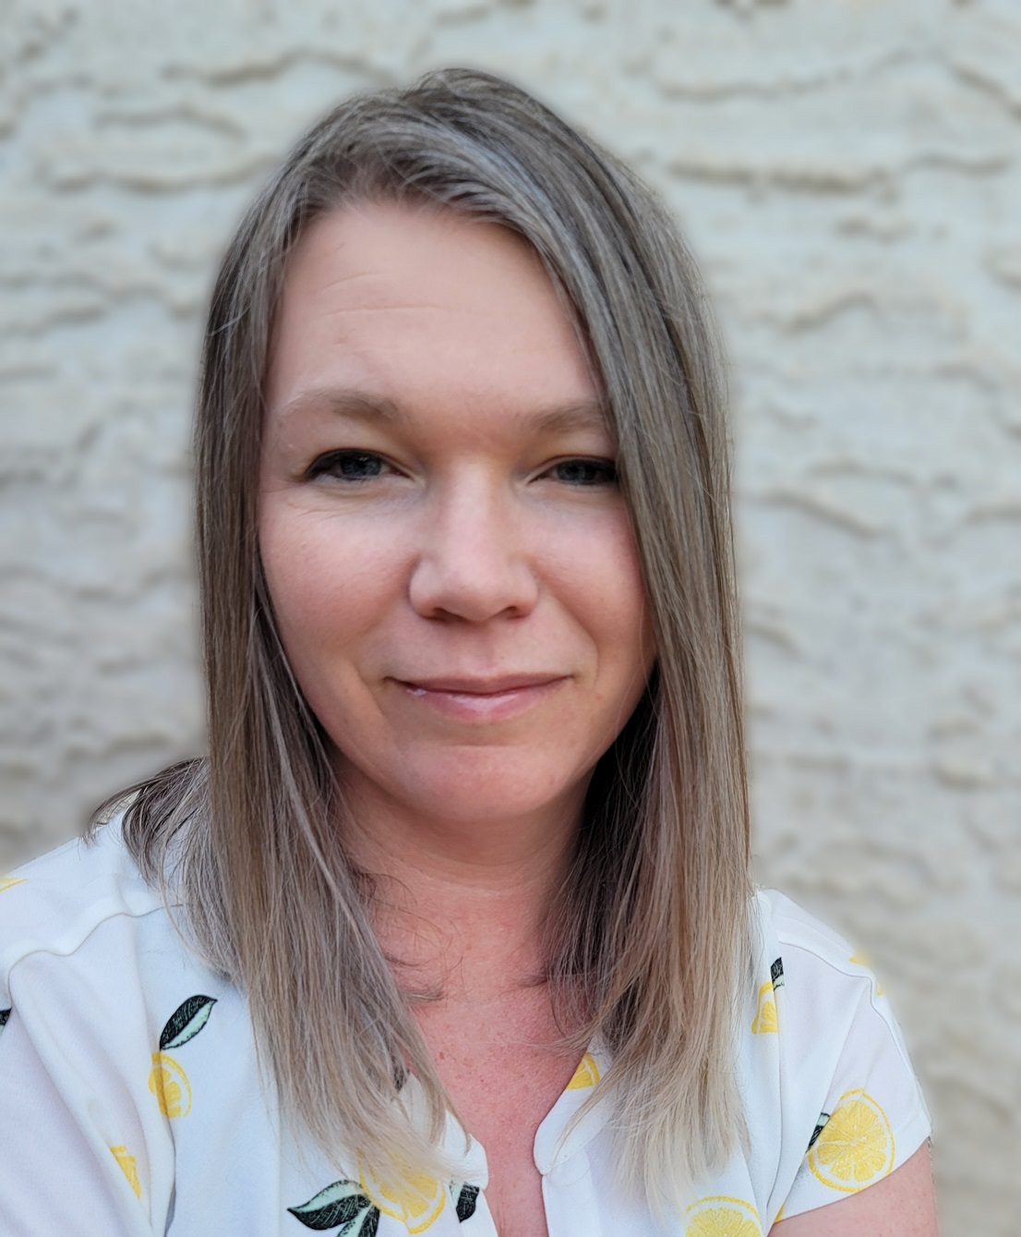
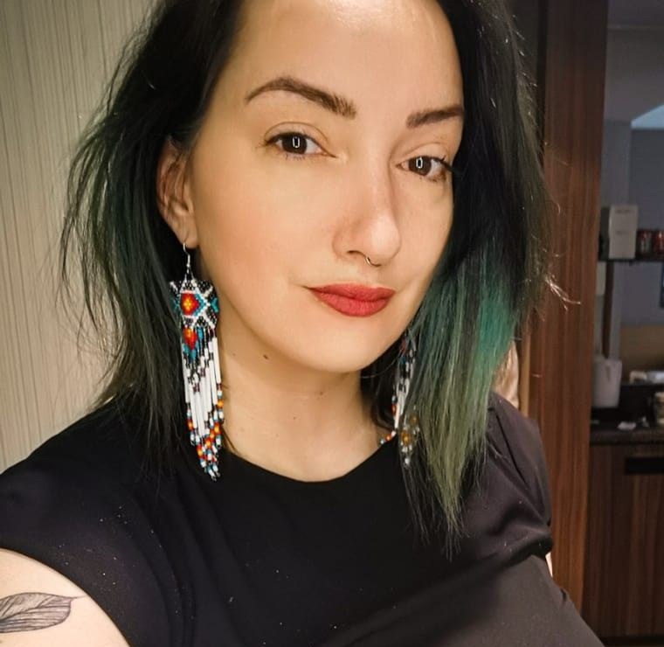
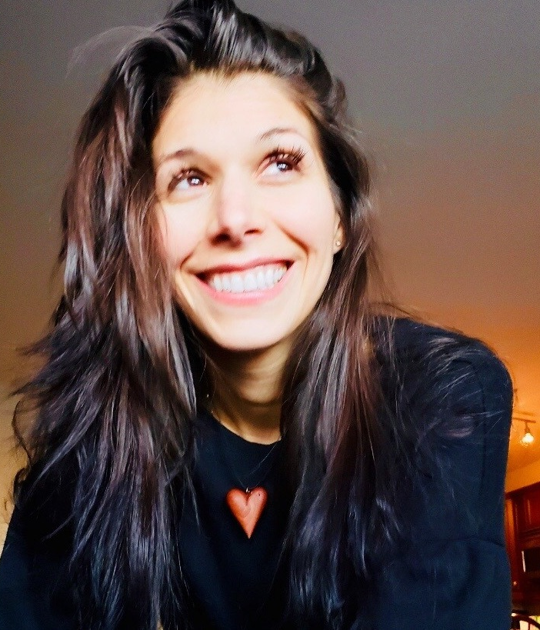
Delivered by a team of volunteer facilitators
Ginette
Casey-Marie
Alison
Carmen
Alejandro
Marie-Lyne
Robert
Michelle
Dani
Sonya
Laura
Leanne
Notes:
Ginette:
As you are aware, the program is hosted by the Canadian Innovation Centre for Mental Health in the Workplace – or “the Centre” as we call it-, and in collaboration with the Interdepartmental Organizational Change Network -IOCN for short-, this program is delivered to you with the support of facilitators from various government Departments/Agencies, including:
Service Canada
Governor General
Indigenous Services Canada
Public Services and Procurement Canada
Financial Transactions and Reports Analysis Centre of Canada
Canada Border Services Agency
Treasury Board of Canada Secretariat
Canada Revenue Agencie

Slide 5
This is a “hands-on” program
Raise
hand
Sub-groups
Video
Connecting
& Debriefs
Poll /
Evaluation
Buddy
System
Notes:
Ginette:
During the sessions, we may or may not use the mentioned functionality or activity
(click 6 times)
Mention each tool/activity

Slide 6
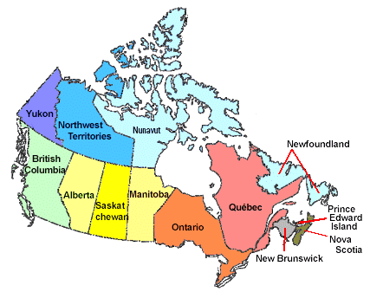
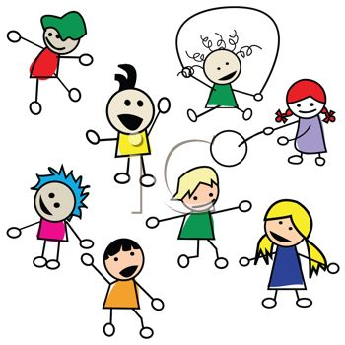
Welcoming
Welcome ☺
NCR – Next Slide
Notes:
Ginette:
If we can use the whiteboard, ask Michaela to open it and I’ll send her the picture for the whiteboard
Otherwise, we’ll skip this
From previous session…
(erase all marks, may need to remove the marking tool from everyone)
As part of the welcoming to this program, let’s take a couple of minutes to create a small mark, and I repeat « a small mark », representing where you are joining us from
(click for animation)
If you are joining from NCR, as we usually get a lot more people from this area, please wait for the next slide
For all others, using the Marker, place a small mark to indicate where you are connecting from
(may need to give marking permissions to everyone again)

Slide 7
Welcoming
Notes:
Ginette:
If we can use the whiteboard, ask Michaela to open it and I’ll send her the picture for the whiteboard
Otherwise, we’ll skip this
From previous session…
Just let me clean all the markers, and now for people in NCR please go ahead an put your mark
(give people a few seconds to set their mark)
(stop the marking tool)
Thanks for stating your mark, this helps us report to management too.
(remove the marking tool from everyone)

Slide 8
Hands on Workshop
Sub-group
Cohort, CoP, CoI (GCCollab)
Journaling
Buddy System
Debriefs
Weekly Sessions
Centering Excersices
Homework
Notes:
Alejandro:
Addition: this is a toolbox, don’t worry if you feel you’re getting overhwhelmed… just try to be present
Today’s Objective is to familiarize with the program
One thing to understand is that this program is a workshop, very hands on and there is a bit of homework to do every day, the idea is that you have the support for you to experience it in a welcoming environment, week by week, step by step, in community via this weekly sessions, your Buddy System & the Cohort.
The objective of today’s session is to familiarize with the way these sessions will be offered, to know the structure of the sessions and start your first week of your practice.
Now, here is an explanation of all the resources and activities we’ll be using throughout the program. It may take a bit of time to get used to everything, just be patient
(click on every main bullet, until the figure in the center appears)
Sessions 1 – 8: Once a week, 1.5 hours, generally on Mondays, we now use MSTeams
Debriefs (Breakout rooms) – this is to give time to reflect and share perspectives. Usually at the very last of every session, designed like that to give each breakout room as much time as needed
You’re encouraged throughout the sessions to write a few bullets so you can debrief in small groups at the end
Centering exercise, like the one we did when starting the session
The Buddy System: the same group of (4 to 6) people that you will meet at your convenience once a week to reflect and talk about the homework, and how things are going for you in the program.
The Buddy System are created randomly later today.
Be aware, the Buddy System is where the majority of the people obtain the best value for your efforts, so be sure to join and participate in yours
[file link here, and share LATER via the chat]
Gratitude journal – yes, you’ll need a notebook to write on.
The benefits of this is to reconnect with your feelings, particularly those related to gratitude
For journaling, it can be bullt form, or paragraph as you prefer, my own examples are something like:
I am grateful for food in my fridge
I am grateful for feeling the sun in my skin
The Cohort – is a GCCollab group, now morphed to include the CoP/CoI, in here you can find the recordings, slides, and homework. You can also ask questions, share resources, and more
[have the link here, and share LATER via the chat]
Homework/Mindfulness practices – there are plenty and it may be overwhelming, my preference is to share them gradually on every session, and if there is a need then you can explore and share
Sub-groups – in some sessions there will be exercises we practice in different small groups
And guess… who’s in the center of all of this?
Yourself!!
As mentioned, it may seem like a lot in one slide, keep in mind there will be the opportunity to get to know and use them gradually
And we’ll explain some of them in more detail in the next few slides

Slide 9
Agenda - Week 1 – (focus and clarity)
Centering – Breathing exercise – 2 minutes (done)
Welcoming (done)
This is a hands on workshop (done)
Etiquette / Structure / Cohort / Recordings
Main goal of the Program / Target Audience
Snail Model
The importance of “Connecting” & Buddy System
Gratitude Journaling
Your takeaway assignment for week 1.
Practice: 5 min body scan
Debriefs
Notes:
Alejandro:
Be advised: Today session will be the most lengthy… us talking most of the time
(review/read from the slide)

Slide 10
Dates adjusted
New Start date: May 8, 2023
New End date: June 27, 2023
Updated - Days: Mondays, exception on:
Tuesday May 23 (as the Monday, May 22, is a holiday) and
Tuesday June 27 (as the Monday, June 26, is a holiday in QC)
Notes:
Alejandro

Slide 11
Etiquette
What would we like to see happening in our sessions and during your Buddy System get togethers?
Respect
Having fun
Confidentiality
Consider and treat this virtual classroom as a safe space
We follow the Values and Ethics Code for the Public Sector
Notes:
Alejandro:
(kind request/reminder) Webcams are welcome, please avoid eating while your webcam is open
[[Values and Ethics Code for the Public Sector – https://www.tbs-sct.gc.ca/pol/doc-eng.aspx?id=25049 == https://www.tbs-sct.canada.ca/pol/doc-fra.aspx?id=25049]]

Slide 12
Structure of the weekly sessions
Weekly Sessions
Centering exercise
Agenda
Mindfulness Theory
Mindful exercise(s)
Practice for the week
Debrief in plenary session
Debrief in breakout rooms
2 minutes
2 minutes
5 - 25 minutes
5 - 25 minutes
5 minutes
3 minutes
5 - 20 minutes
Notes:
Alison:
This slide gives a general outline of what each weekly session will look like, the timings are approximate

Slide 13
The Cohort
We have many people registered for this program, thus it is considered to be a MOOC (Massive open online course - Wikipedia)
To support your learning experience, we will be using the “MCLD Cohort”, a GCCollab group that is also a Community of Practice:
To leverage the collective knowledge of the group
To access the recording and slides of all sessions
To ask questions
To share experiences
Notes:
Alison:
Addition: you’ll need to create a user and « join » the group
Gccollab reminder to join you need a user profile created and join :
https://account-compte.gccollab.ca/
https://gccollab.ca/groups/profile/7978973/mcld-program-cohort-cop-coi-program-dlpc-cohorte-cdp-et-cdi
[[Massive open online course – Wikipedia - https://fr.wikipedia.org/wiki/Massive_Open_Online_Course
* The link has been changed to reflect French. The title in French is still « Massive open online course MOOC »
]]
(click to show bullets, commenting on the end)
And we’ll do our best to treat it as one
And we use it…

Slide 14
Sessions are Recorded
For sharing via the Cohort page:
The recording is helpful for those who miss a session or would like to revisit the material
Be assured, if there is ever something sensitive recorded, at the request of those involved, the recording will be edited before posting
The breakout rooms are not recorded
Notes:
Alison:
(read from the slide)

Slide 15
The Main Goal of the MCLD Program
Is to increase self-awareness by developing key skills:
Focus
Clarity
Creativity
Compassion in the service of others
… with a positive impact on well-being and resiliency.
“Individuals with higher mindfulness have greater resilience, thereby increasing their life satisfaction.” - ScienceDirect
Notes:
Ginette:
When you think about your work and try to find a balance between work priorities, your relationships with colleagues and clients, along with home life responsibility, what strikes you as the key skills needed for this balance? Where would you like to improve?
Is it better presence, or more compassion? Is it increased self-awareness or tools for self-reflection?
We believe that this program helps to answer some of these questions and to improve the key skills of presence, self-compassion, relationality, life-work balance, self-awareness and more.
There are studies showing that individuals with higher levels of mindfulness tend to be more resilient. And also note that both mindfulness and resilience are important skills for improved well-being
By partaking in the program, you will likely increase the level of honesty and trust within yourself, and therefore with others, allowing for an authentic connection with the work that we do at ISC.

Slide 16
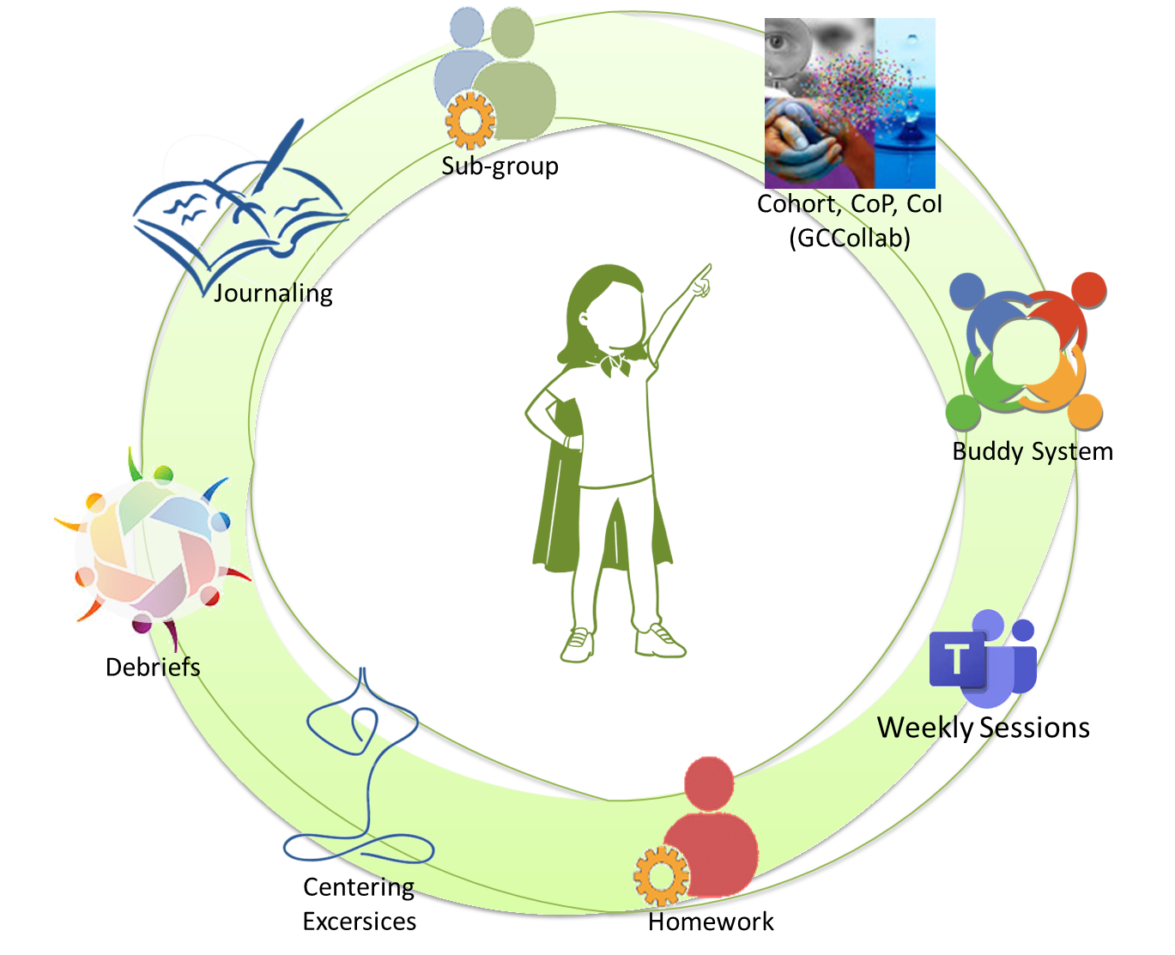
Target Audience
Notes:
Ginette:
Who is the target audience for this program?
(click on every bullet)
This program is those who are willing to invest in their selves and develop their self-awareness
This program is for you! the individual, not to your team, other employees, your bosses, other communities or trainings, or any other people who you think may benefit from this program
In other words, this program is for those wishing to take it, those who got the support from their management and voluntary joined the program to become more Self-Aware

Slide 17
What’s the difference between Mindfulness and Meditation?
*The way I see it
~ Time of exercise, the objective, and the experience ~
5 minutes
Relax and realise
Self-awareness
20 minutes to an hour
Engage in reflection or contemplation
Could be mind shifting
Notes:
Alejandro:
* If other than Alejandro is presenting this slide, then small changes has to be made.
This is Alejandro’s personal experience...
The core are the same, focus on your breathing. A way to compare them are:
The extent of time you typically take to do an exercise
The objective you aim for or achieve doing an exercise
The experience you perceive while doing the exercise
Mindfulness: like the body scan we just did.
Takes about 5 minutes
The objective is to relax and realise what’s going on in your mind
The experience could vary from person to person, but basically is a self-awareness experience
Meditation: having a practice of sitting and observing your breathe
May start by sitting 5 minutes for beginners
A good 20 minutes for those with an established practice, up to 8 hours a day in some days long retreats
The objective is to engage in contemplation or reflection.
The experience could be mind shifting
And keep in mind, Mindfulness is simple, not easy though
[[ Note for Translators: Not to be translated nor referenced during the presentation
La pleine conscience est une expression désignant une attitude d'attention, de présence et de conscience vigilante, qui peut être interne (sensations, pensées, émotions, actions, motivations, etc.) ou externe (au monde environnant, bruits, objets, événements, etc.).- Wikipedia
Pleine conscience — Wikipédia (wikipedia.org) – *we changed to reflect French
“Mindfulness means presence of heart” - John Kabbat Zinn https://www.youtube.com/watch?v=xoLQ3qkh0w0
“Meditation” noun the action or practice of meditating.
“Meditation” is a practice in which an individual trains the mind or induces a mode of consciousness
Forms: Buddhist meditation, Christian meditation, Daoist meditation, Jain meditation, Jewish meditation, Meditation in the Ravidasi Faith, Transcendental Meditation – Wikipedia
"Mindful meditation: Training the brain on attention and meta-attention with the purpose to develop Emotional Intelligence"
"Meta-attention: attention of the attention, being able to know that your attention has wandered away“
Tan, C (2013). Search Inside Yourself. NY; page 30.
]]

Slide 18
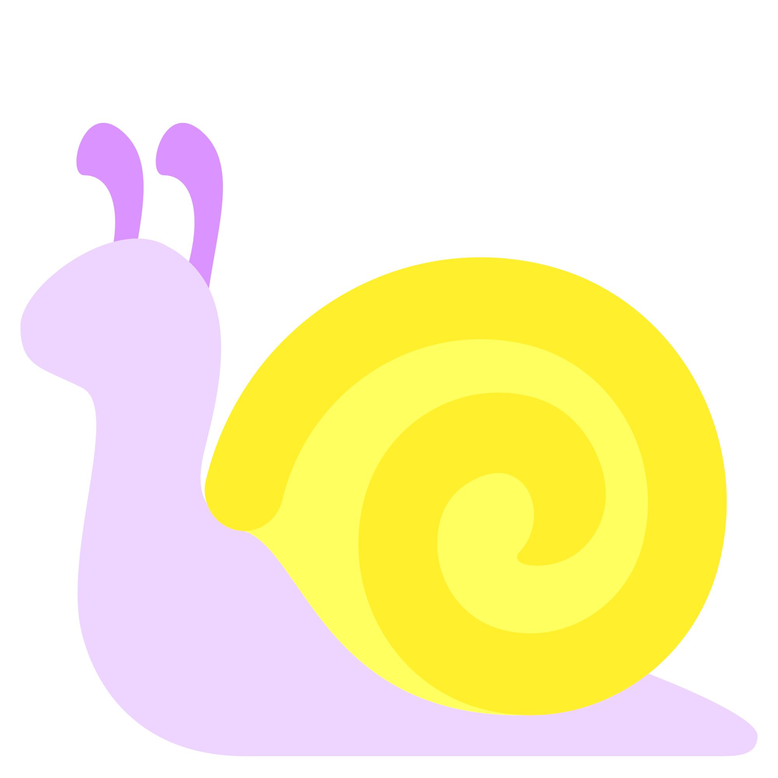
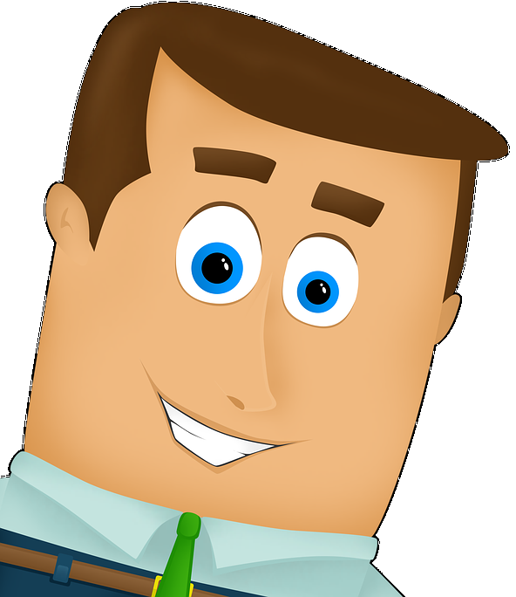
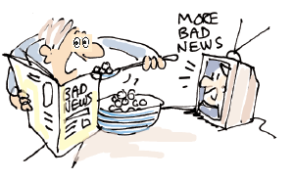
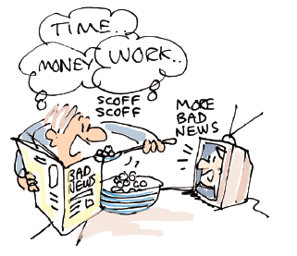
Snail model – From unaware to unaware
Desired
Aware - Desired
Unaware - Desired
Behaviours
Aware
Unaware
D i s r u p t i o n
Aware - Undesired
Unaware - Undesired
Undesired
Notes:
Alejandro:
Now let’s take a look at a model, I call it “the snail model”, it goes from unaware to unaware… adapted from the Four stages of competence model
(click on every main bullet)
This model is based on behaviours
We have desired and undesired behaviours,
We also have the aware and the unaware behaviours
To understand this model, let’s start at the bottom right quadrant, with the unaware-undesired behaviours
At some point we become aware of that undesired behaviour on the bottom left quadrant
And then we start to change that behaviour to a desired one while being very aware of it, on the top left
And after sometime, practice and effort we move to the top right quadrant, with the desired behaviour and unaware, because we do it automatically
Let’s review the model with a few graphics added and some examples
We start in the same sequence, bottom right, let’s say we are “multitasking”, having breakfast, reading the newspaper, while watching the news, planning the day with the partner, and encouraging the kids to go on their day
Then something happens, we become aware, see the expression on the face of the cartoon. There is something that happens that makes the person become aware
On the top left, you see the expression, the person is making a strong effort to do one thing at a time, is aware of the desired behaviour and is making an effort to focus on only reading the newspaper
Then with practice, the person does automatically and unaware the desired behaviour
The cycle typically starts with a disruption, it could be this program, or something recent because you’re already taking this program. There is something inside you that already started this cycle
And very rarely this change occurs quickly, that’s why it’s called snail model… it takes its time to arrive
[[Adapted form https://en.wikipedia.org/wiki/Four_stages_of_competence]]

Slide 19
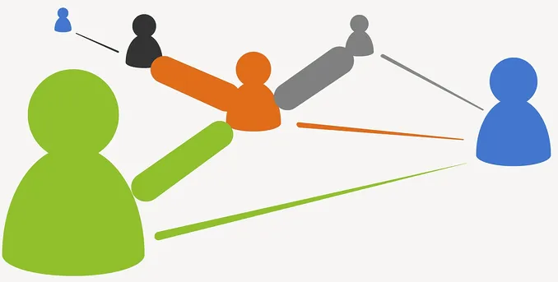
The importance of “Connecting”
How do you see us connecting throughout the weeks of this program?
During the session by Sub-groups and Debriefs (breakout rooms & plenary)
Buddy System
Cohort
The idea is to use all the tools for reflection and engagement
By sharing your experience, what you notice, a learning you had, an opportunity you saw, an insight you realized
All of these are what gives life to this program.
Notes:
Alejandro:
How important connecting is? Well it is very!!
(click once)
We connect throughout the program by doing the following
During the session, by doing different activities, like debriefs and sub-group exercises
In between sessions via
the Buddy System, it stays the same throughout the 8 weeks,
and via the Cohort, participating, asking questions, sharing your experience
(click again and read 3 LAST bullets from the slide)

Slide 20
Group Activities
Sub-group Activities
New group every time
Not every week
Plenary Session Debriefs
During weekly Sessions
Buddy System Conversations
Weekly, time chosen by the group
Same people every time
Notes:
Alison:
Through out the program we will have 3 types of group activities
One is debriefs on content from the weekly session, which happen during the weekly session, these are done in the plenary session and in smaller groups that are randomly assigned in breakout rooms
One is interactive sub group activities also in breakout rooms, where you are assigned a specific task and the groups are randomly assigned, however these are not every week
And One is your Buddy System, where you will meet every week with your buddies throughout the 8 weeks outside of the weekly session time, and this group will have the same people each time, and it is up to your group to decide on a time and day of the week that works for you

Slide 21
Throughout the program
Sub-group
Sub-group
Sub-group
Debriefs
Debriefs
Debriefs
Debriefs
Debriefs
Debriefs
Debriefs
Debriefs
Week
1
Week
8
Buddy System
Notes:
(Alejandro if at all):
(click on every main bullet)
Throughout the program:
Sometimes there will be sub-group activities
There are also debriefs every day, typically towards the end of the sessions,
These two, the sub-group and the debriefs are likely to occur with different colleagues every time, as they are randomly assigned
And you also have the Buddy System, which remains the same
You will meet every week with your buddies throughout the 8 weeks

Slide 22
The Buddy System
You are expected to touch base with your buddies once a week
During that conversation, you will:
Discuss your experiences of the week what was interesting, challenging, and what you liked the most
Minimum of a 30 minute call recommended (5 mins for each)
Helps with increasing support and accountability
Notes:
Alison:
Let’s talk about the Buddy System now,
(read the slide)
(click to have every bullet appear)
The people in your Buddy System group will be assigned randomly.

Slide 23
Meeting Your Buddy System Buddies
In the next 10 minutes (approx.):
Take note of who your buddies are
You have the opportunity to quickly introduce yourself to your Buddies:
1 minute per person
Introduce yourself
Share something you’re passionate about, or something you consider funny or interesting about yourself
Be sure to agree on a date and time to connect on a weekly basis
Notes:
Alison:
This is the time for you to know your Buddy System
(read the slide)
Take note of who your buddies are, share email addresses for further contact
Now you’ll be assigned to your Buddies in breakout rooms, you will get a 1 minute warning before closing the breakout rooms
(open the breakout rooms for 10 minutes, remember to broadcast the 1 minutes left warning)
Welcome back, I hope it went well for all of you…
if you need… take a breath or two and come back
Now, let’s move on
[[for translators, in WebEx…
“breakout sessions” = “Session scindées”
“Join Breakout Session” = “Rejoindre la session scindée”
]]

Slide 24
Gratitude journaling
Take a notebook that will serve you as your journaling reflection or diary – this is personal
Let’s take 2 minutes to write down what you are grateful for
This could be in bullet form
Even 2 or 3 things per day will do
They can be simple things you did or noticed during the day
http://greatergood.berkeley.edu/article/item/how_to_upgrade_your_gratitude_practice
Notes:
Ginette:
(read from slide)
(click on to show the bullets)
(after reading from the slide)
Some examples of what I write are:
I’m grateful for being able to feel the sun in my skin
I’m grateful for a night of sleep
If you seem to be stuck, start writing whatever is in your mind, even something like "I’m supposed to write something, and my mind is blank. Not sure what to write. What am I grateful for? What is the littlest of the things I’m grateful for?" and something will come any time. When that happens, feel free to leave your sentence interrupted as you are capturing what you’re grateful for.
I’ll start the timer now… (2 minutes)
During the debrief groups, you’ll have the opportunity to share what you noticed, what you found challenging, what amazed you, any other thing you’d like to share.
[[ Note for Translators: Not to be translated nor referenced during the presentation Some additional references:
The benefits of Gratitude Journaling: https://wanderersway.com/blogs/wanderers-way/what-are-the-benefits-of-gratitude-journaling
https://mindfulambition.net/gratitude-journal/
https://www.mindful.org/a-simple-weekly-mindfulness-practice-keep-a-gratitude-journal/
https://ggia.berkeley.edu/practice/gratitude_journalIf
]]

Slide 25
Practice – The basics (1/2)
The intention of being (as opposed to doing)
Posture: sit with a straight back, as comfortable as possible, as if your head is pending from the top
in the chair that you are sited, or cross legged if you feel comfortable
slightly tuck your chin
Mindset: keep an open mind, feel the experience
You experience may vary each day, all is good
Focus on the breathing
Notice
It is about feeling the way you feel, about noticing without judging
have no expectations
have no judgement
have a beginner's mind
be an observer... the mind may be busy and noisy, just observe it
Notes:
Ginette:

Slide 26
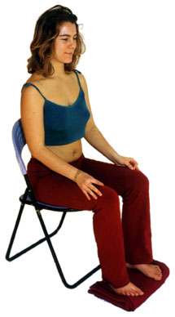
Exercise – Exploring Mindfulness – Body Scan
Time required: 5 minutes
If you haven’t, take advantage of the opportunity to experience this exercise
Sit as comfortable as possible in a straight position
Feel free to close your eyes
Follow my voice as I lead you through the exercise
Then, we will do a short debrief of what you noticed.
Notes:
Ginette:
To start, let’s experience a mindful exercise…
If you haven’t, take advantage of the opportunity to experience this exercise
Sit as comfortable as possible in a way that allows you to stay awake and attentive
Put your feet flat on the ground, your palms on you lap, upside or downside as it feels more comfortable
Feel free to close your eyes, or semi close them
Follow my voice as I lead you through the exercise
Gently bring attention to your breath, no need to change the way you’re breathing, just notice it
Now, direct your breath and attention and focus on…
Your head, particularly on your mouth, your teeth, your jaw, your lips,
breath in, noticing
your face, your eyes, nose, chicks, eyebrows, front head
As we breath out
Now focus on the top of your head, your scalp, your hair, your ears,
As we continue breathing,
Now focus your attention to your shoulders, breath in, breath out, and notice
Your arms, your hands and fingers, in and out
Every time your attention wanders away, just bring it back gently
Back to your shoulders, and neck, noticing
Your upper back, chest
Your lower back, your abdomen
Direct your breath towards your waist, in and out
Your lower leg, in and out and your upper leg, and notice what you feel
Your feet, in and out, notice what you feel
Your toes, breath in, breath out
Stay there for a few seconds, breathing in and out
When you feel like, open your eyes and come back
Debrief: Use the chat to mention What did you notice?
We’ll read some of your comments later during this session

Slide 27
Debrief – Plenary & Small Groups
Share how the experience went for you
What insight did you get?
What did you noticed?
What was challenging or surprisly easy?
You’ll be joining a small group of 4 to 6 people, randomly assigned.
Be conscious of your airtime.
A message will be sent to let you know how much time there is left
Notes:
Alejandro:
(click)
Before we go into debrief groups, we will open the floor to have a few shares in plenary, say 3 or 4 (depending on time).
(read slide… and give the microphone to 3 or 4 people)
(click)
Now it is time to debrief… (read the slide)

Slide 28
Your turn for week 1
Connecting – once a week with you buddies
Recommended 20 minutes call: 5 mins for each, you can discuss what you found interested, what was challenging, what you like the most
Gratitude Journaling – daily
This could be in bullet form, even 2 or 3 things per day will do, They can be simple things you did or noticed during the day
Practice 5 mins body scan – daily https://archive.org/details/BodyScan6minsB http://elishagoldstein.com/videos/sitting-with-awareness-of-thoughts/​
Questions or comments during the week? please ask and share via the Cohort
Notes:
Alejandro:
(Read from the slide the main bullets)

Slide 29
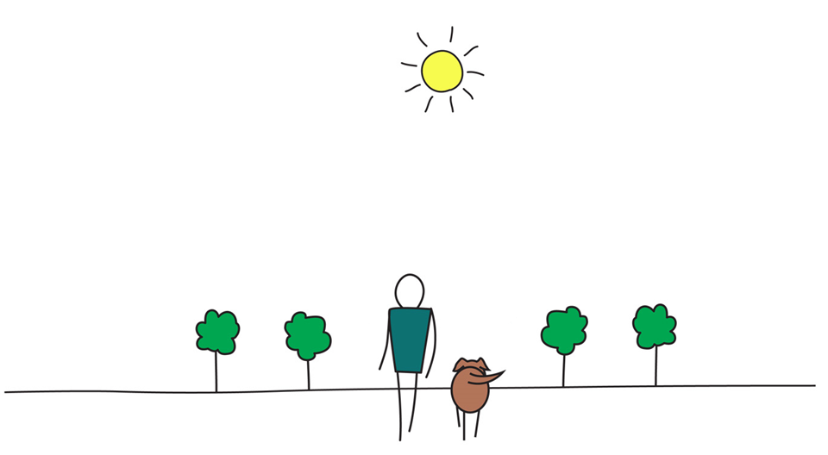
Be Mindful, Be Happy
Notes:
Alejandro:
Are there any questions?
Otherwise, I wish you happiness

