Slide 1
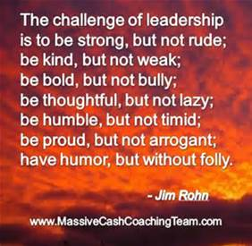
Notes:
Friendly reminder: prep for sharing audio & video!!
https://www.youtube.com/watch?v=uo8Yo4UE6g0
https://soundcloud.com/33voices/compassion-is-a-deep-understanding-janice-marturano

Slide 2
Mindful Change Leadership Development Program
Week 3 (of 8)
9 May 2022
Notes:
To mention the following in French:
« Comme avec toutes les sessions du GC, s'il vous plaît, sentez-vous libre d'utiliser la langue de votre choix pour poser des questions ou participer à la discussion., La séance d'aujourd'hui sera conduit principalement en anglais, il y aura d'autres sessions en français qui seront promus via le groupe GCConnex (ou donner des dates précises, si disponible). »
As with all GoC sessions, please, feel free to use the language of your choice to ask questions or participate in the discussion., today’s session will be conducted mainly in English, there will be other sessions in French that will be promoted via the GCConnex group (or give specific dates, if available).

Slide 3
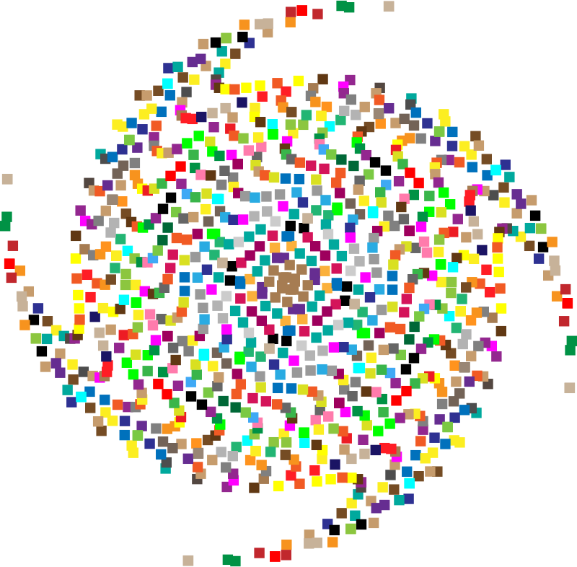
Mindful Breathing Exercise – Centering
Mindful breathing https://www.youtube.com/watch?v=ZE-r-x2T4ok
Notes:
Mindful breathing https://www.youtube.com/watch?v=ZE-r-x2T4ok
This is one way of doing it, getting it depends on the practice of.
Noticing is very important in the practice of Mindfulness.
Noticing where your thinking is, that’s the first step to become more Mindful.

Slide 4
The Structure of the program - explained
Sessions 1 – 8: Once a week, 1.5 hours, generally on Mondays (WebEx)
The Buddy System: the same group of 3 to 5 people that you meet at your convenience once a week to reflect and talk about the homework, and how things are going for you in the program
The Cohort: a GCCollab group where you can find the recordings, slides, and homework. You can also ask questions, share resources, and more
Notes:
In trying to clarify some of the questions from the poll…

Slide 5
Why the activities and homework
Gratitude journal – the idea is to reconnect with your feelings, particularly those related to gratitude (w/references)
Grateful for food in my fridge
Grateful for feeling the sun in my skin
Breakout rooms clarity – I took note, hope today it will be clearer
Mindfulness practices – there are plenty and it may be overwhelming, my preference is to share them gradually, and if there is a need then you can explore and share
Notes:
https://wanderersway.com/blogs/wanderers-way/what-are-the-benefits-of-gratitude-journaling
https://mindfulambition.net/gratitude-journal/
https://www.mindful.org/a-simple-weekly-mindfulness-practice-keep-a-gratitude-journal/
https://ggia.berkeley.edu/practice/gratitude_journal
And based on some feedback I got…

Slide 6
Debrief from last week (2)
Any Insights you’d like to share
Your Buddy Sytem
Your practice
Debrief
Anything we may be missing?
Notes:
The idea is to have 2 or 3 people share any insights you experienced or noticed from last week’s practice
Including the Mindfulness Breathing, and the gratitud journaling exercises.

Slide 7
Agenda – Week 3
Centering breathing exercise – 2 minutes
Debrief from last week (2)
Today’s Intentions
Mindful Leadership – theory (continued)
What is "Leadership" and What Makes a Good Leader?
3 Pillars of Compassionate Leadership
Practice – Mindful Leadership exercises
Your turn for week 3
Small Group Debriefs

Slide 8
Today’s Intentions: Clarity, Focus and Compassion
Deep Understanding – Compassionate Leader
Focus exercise – Mindful Listening
Clarity exercise – Mindful Decision Making
Compassion exercise – I wish you happiness
Notes:
Removed - Focus exercise – by doing a 10 mins Mindful Body Scan or Breathing *Dot – too much!

Slide 9
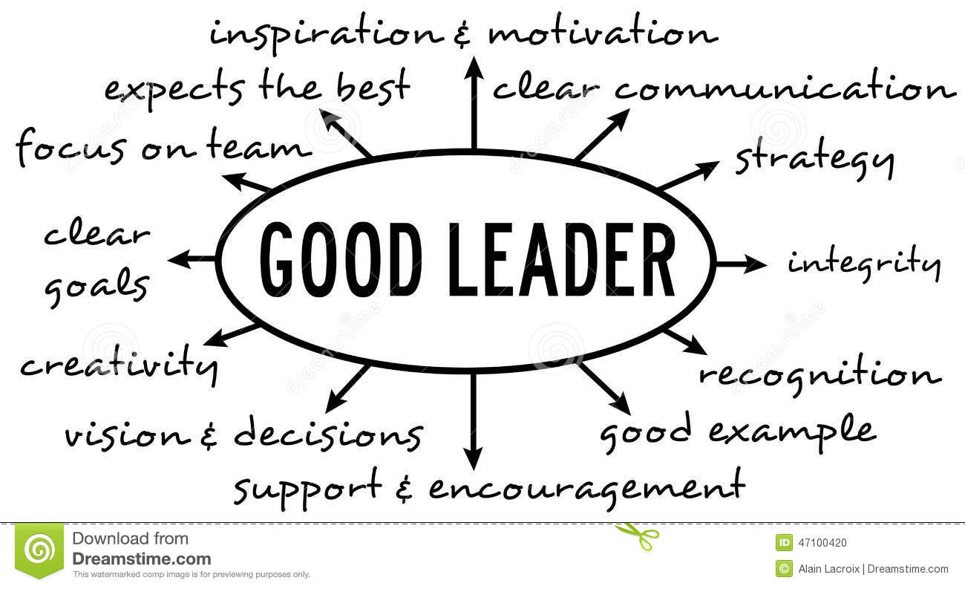
What is "Leadership" and What Makes a Good Leader?
The Characteristics of a Good Leader (Self-Awareness, Self-Direction, Vision, Ability to Motivate and Social Awareness)
Emotional Intelligence and Leadership - Leadership is more often than not about “soft skills” rather than hard skills https://siyli.org/what-is-leadership-what-makes-good-leader/
Competencies that distinguish star performers…
Strong achievement drive and high achievement standards
Ability to influence
Conceptual thinking
Analytical ability
Initiative in taking on challenges
Self-confidence
Of the top six, only two are purely intellectual competencies – SIY book, p13
Notes:
https://www.amazon.ca/Search-Inside-Yourself-Productivity-Creativity/dp/0062116924
https://siyli.org/what-is-leadership-what-makes-good-leader/

Slide 10
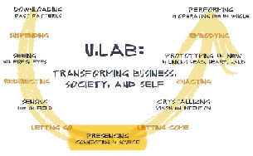
Organizations with Mindfulness programs
http://www.siyli.org
www.Mindfulnet.org
http://instituteformindfulleadership.org
Notes:
You see many different logos here, you may be familiar to more than one of them. Any of these organizations are big companies, and there is a serious reason why they are implementing Mindfulness programs.
Now, let me get your attention to some of the logos:
Phil Jackson’s eleven Rings – with Chicago Bulls and LA Lakers obtained 11 championships - https://www.amazon.ca/Eleven-Rings-Success-Phil-Jackson/dp/0143125346 And now, The Golden State Warriors (NBA basketball team) Mindful Mindset on Four Core values - http://yogadork.com/2015/12/09/the-golden-state-warriors-record-breaking-mindful-mindset/
1. Joy;
2. Mindfulness;
3. Compassion for team members and for the game of basketball; and
4. Competition
Google – who has not used google? it is big player in the booming of Mindfulness. Chad-Meng Tan started the ball rolling, and it grew big that now there is SIYLI delivering Mindfulness to the world
World Economic Forum – The Forum engages the foremost political, business and other leaders of society to shape global, regional and industry agendas.
U.Lab / MIT – Senior business management savvy, including mindfulness -they call it presencing- as part of the new way of doing ethical business.
Mindful Nation UK – Is co-chaired by the three main political parties in UK with the intention to apply mindfulness programs in the areas of National education, health, the workplace and the criminal justice system.
Some Group Discussion if there is time and want.
---
https://hbr.org/2015/12/why-google-target-and-general-mills-are-investing-in-mindfulness
Mentions some details about the Mindfulness programs at Google, Aetna, General Mills, Intel, Target & Green Mountain Coffee Roasters
DFO – started a MBSR pilot (estimate 2017-2018)
CSIS - have implemented Meditation in Progress program.
CSPS – is incorporating Mindfulness into their work.
I have delivered a session (intro, MCLD program, practice) now to over 3,000 people (updated 2021)

Slide 11
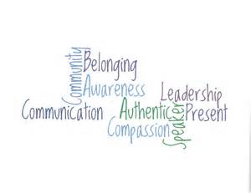
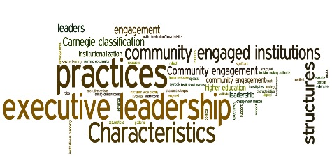
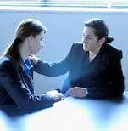
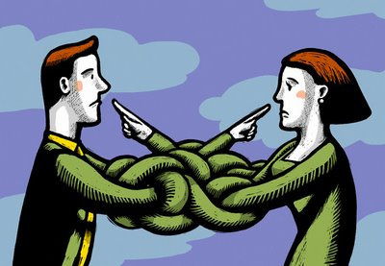
3 Pillars of Compassionate Leadership
Pillar #1: Cognitive Understanding
Pillar #2: Affective (Emotional) Understanding
Pillar #3: A Motivational Connection https://siyli.org/3-pillars-compassionate-leadership/
“…Specifically, he defines compassion as having three components:
A cognitive component: “I understand you”
An affective component: “I feel for you”
A motivational component: “I want to help you”
…This shift is the transformation from “I” (me) to “We.” It is the most important process leaders go through in becoming authentic. How else can they unleash the power of their organizations unless they motivate people to reach their full potential? If our supporters are merely following our lead, then their efforts are limited to our vision and our directions… Only when leaders stop focusing on their personal ego needs are they able to develop other leaders…”
http://greatergood.berkeley.edu/article/item/compassionate_leaders_are_effective_leaders
Dan Siegel: Me + We = Mwe https://www.youtube.com/watch?v=uo8Yo4UE6g0
Notes:
A minute and a half quick video

Slide 12
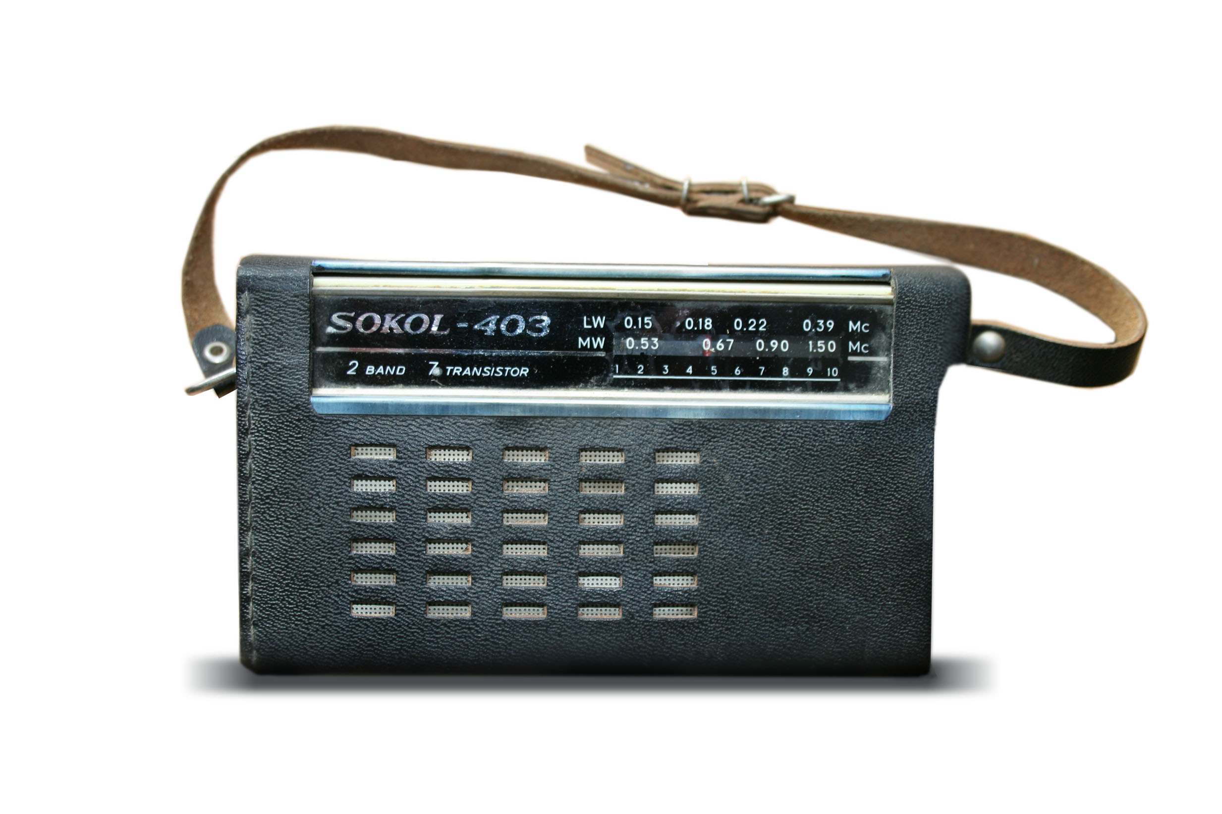
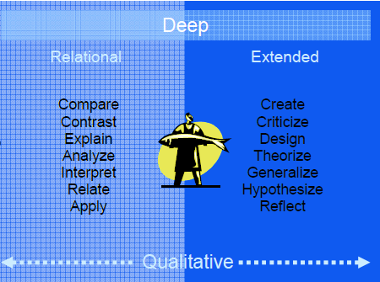
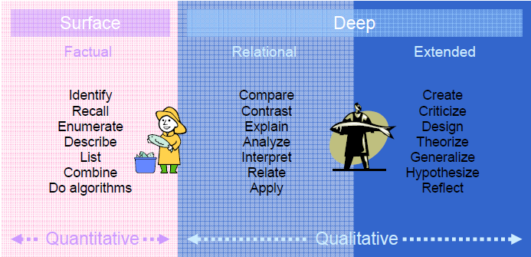
Compassionate Leadership– Deep Understanding
“Compassion is to have a deep understanding of what is, including our understanding on how we contribute to our own struggles, and then being able to offer ourselves and others an active kindness, that’s enabling us to be more of who we really are.” – Janice Marturano - https://soundcloud.com/33voices/compassion-is-a-deep-understanding-janice-marturano
The next time you have something to observe or listen to, do so with the intention to deep understanding it… for exploring later: http://www.polyu.edu.hk/obe/students/files/deep.pdf
Notes:
Listen, takes less than 2 minutes
https://soundcloud.com/33voices/compassion-is-a-deep-understanding-janice-marturano

Slide 13
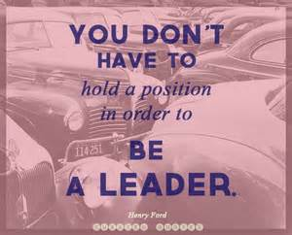
What Makes a Great Leader?
Self-awareness: understanding ones own emotions and their affect on others.
Self-regulation: the ability to control or redirect disruptive impulses.
Motivation: passion to work with energy and persistence for reasons beyond money or status.
Empathy: ability to understand the emotional needs of others and treat them accordingly.
Social skill: proficiency in managing relationships, developing networks, building rapport and finding common ground. https://siyli.org/great-leaders/
Notes:
https://gcconnex.gc.ca/blog/view/20353500/i-woke-up-like-this-how-to-be-a-fiece-youth-leader-in-the-public-service
https://siyli.org/great-leaders/

Slide 14
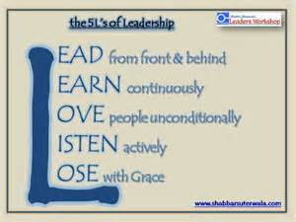
5 Ways Mindfulness Can Improve Your Leadership
Improve Your Intuition
Reduce Fight or Flight Response
Choose How You React to Emotions
Reduce procrastination
Boost happiness for yourself… https://siyli.org/5-ways-mindfulness-improve-leadership/

Slide 15
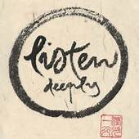
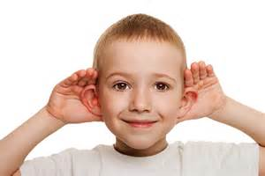
Mindful Listening (as) a Leader Exercise
Take a couple of minutes to write a description of yourself as a leader
Describe how you see yourself as a leader, this can be something you’re already working on or something you’re dreaming of. Include introducing yourself here.
Identify who is “A”
A talks for 1 minute, B listens
After the 1 minutes is over, then B reflects back what was heard A said
For the Talker
Feel free to talk without looking at your notes (that’d be reading)
Remember, you’re in a safe environment, nobody will judge you
For the Listener
Pay 100% of your attention and hold back any reactions you may have to interject/respond/assent.
You’ll reflect back what you listened to
No need to ask for clarifications, unless you can’t hear, this is not a conversation
Then B talks and A listens and reflects back
Notes:
First, I’ll explain what we’ll do
You’ll take a couple of minutes to describe… Use bullet points, don’t worry about your grammar or writing full sentences, this is not an essay
(go bullet by bullet, until « Then B talks and A listens and reflects back »)
« You can start now »
in the meantime we’ll create the breakout rooms and you’ll automatically join a colleague
I’ll broadcast the following messages, 1 minute appart each:
« A start talking »
« B reflects back »
« B start talking »
« A reflects back »
And we’ll close the breakout rooms

Slide 16
Practice – Mindful Decision Making
Practice Mindful Decision-Making: Most of us make a lot of decisions every single day. Some of these are minor decisions while others have far-reaching implications. Whether it’s the kind of toothpaste you buy or the kind of work you choose to dedicate your life to, we’re all faced with a dizzying array of choice. Some of our decisions are made consciously while others seem to happen on autopilot, without our full awareness.
Today’s challenge is about catching yourself in the act of decision-making and bringing more mindfulness to the process. Perhaps it’s with something as simple as choosing what to make or where to go for dinner, or maybe it’s regarding an upcoming purchase, or deciding how to respond to a hurtful email or action. Whatever the case may be, try bringing mindfulness to bear on the moment and see how it changes the process, and perhaps the outcome.
Are We In Control of Our Own Decisions is a TED talk by Dan Ariely that offers some powerful food for thought.
Think of an example when your decision was mindless (if you feel like, share example via the chat)
What do you do for a mindful decision making process?
Notes:
From: Day 20/21 days challenge - KindSpring - Practice Mindful Decision-Making (https://gcconnex.gc.ca/blog/view/14866638/day-2021-days-challenge-kindspring-practice-mindful-decision-making)
For today's challenge, comes to my mind the decision process I follow when craving... and believe me, I have them. For instance, I just went to buy some snack, to stretch my legs and get some fresh air. I have thought my decision before getting to the supermarket, I will buy a healthy snack (e.g. a banana, an orange, or similar).
The trick is to stick the my decision process... I often go to see the "unhealthy snacks" (not to say they seem delicious) and take a moment to just look at them and if I'm able to be mindful about my eating habits, I'm usually successful in my healthy snack decision process. You may have guessed, and that's right, when I rush my decision process I act in impulse and end up buying the unhealthy stuff.
The good thing is, with practice, I'm able to stick to my healthy snacks more than not and stay mindful about my decisions.
Video for later: https://www.karmatube.org/videos.php?id=3965

Slide 17
Mindful – Compassion exercise - I wish you happiness
There is a powerful exercise, very simple, I started using a few years ago.
Who is in my way, either an individual or an insect, the first thought ... I assume about this moment is "I wish you happiness."
This completely transforms what is going to happen between you and that person.
At this point, you create the opportunity to make more space around you ... You see how this negative emotion disappears before you take and gives you time to transform ... You see things as they are, as simple and obvious ignorance, anger, fear - not the other, but as ignorance on my part, your part...
Transform this, you let go, you become love.
I WISH YOU HAPPINESS!
Try to do and see everything change in your life. ~ Richard Gere
https://alvinalexander.com/photos/i-wish-you-happiness-richard-gere/
Notes:
https://alvinalexander.com/photos/i-wish-you-happiness-richard-gere/

Slide 18
Your turn for week 3
Connecting – once a week with you buddies
Gratitude Journaling – daily
Practice 10 mins… chose one of the following and keep doing it for the whole week - daily
Body scan https://archive.org/details/MFBodyScan10Minsb http://elishagoldstein.com/videos/10-minute-body-scan/ http://www.sharonsalzberg.com/body-scan-meditation-audio/
Breathing https://www.youtube.com/watch?v=Rah4IHHZyZU https://www.youtube.com/watch?v=aXItOY0sLRY https://www.mindful.org/10-minute-nourishing-breath-meditation/
Apply Mindful Listening (as) a Leader – as needed
Apply Mindful Decision Making – as needed
Apply (Compassion) "I wish you happiness" – as possible​
In case you have a question: Cohort
Notes:
http://marc.ucla.edu/mindful-meditations
If you’re up to, try increasing your daily mindfulness practice to 10 mins, if not, continue doing the 5 mins version of either option Body Scan or Breathing. The goal is to keep the practice, not suffer (too much) for it ☺

Slide 19
Debrief – What got your attention?
Mindful Leadership – theory (cont)
What is "Leadership" and What Makes a Good Leader?
3 Pillars of Compassionate Leadership
Practice – Mindful Leadership exercises
Mindful Listening (as) a Leader Exercise
Practice – Mindful Decision Making
Mindful – Compassion exercise - I wish you happiness
Compassion:
“I understand you”, “I feel for you”,
“I want to help you”
Notes:
Breakout rooms with 4-6 people will be randomly assigned
Be conscious and share the “air time” among participants
Similar to previous sessions, do a debrief among your colleagues and reflect on What got your attention the most?
When done, simply exit the WebEx

Slide 20
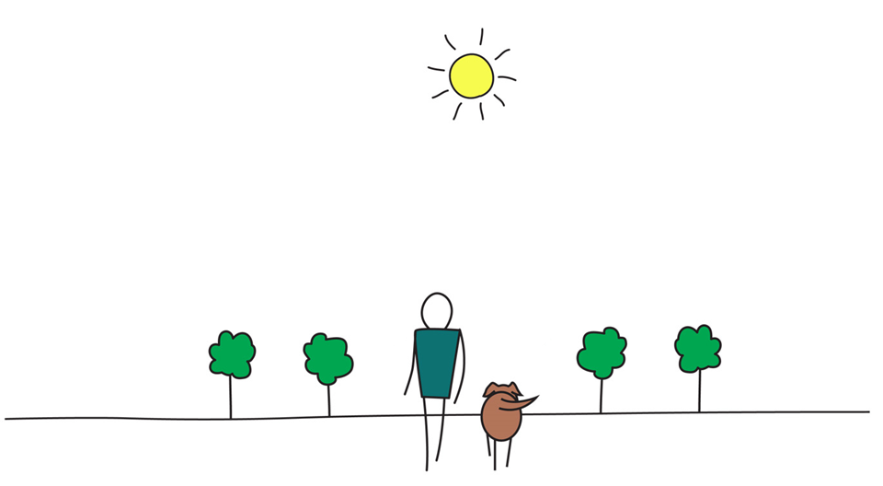
Be Mindful, Be Happy /
Prenez conscience, soyez heureux

