Slide 1
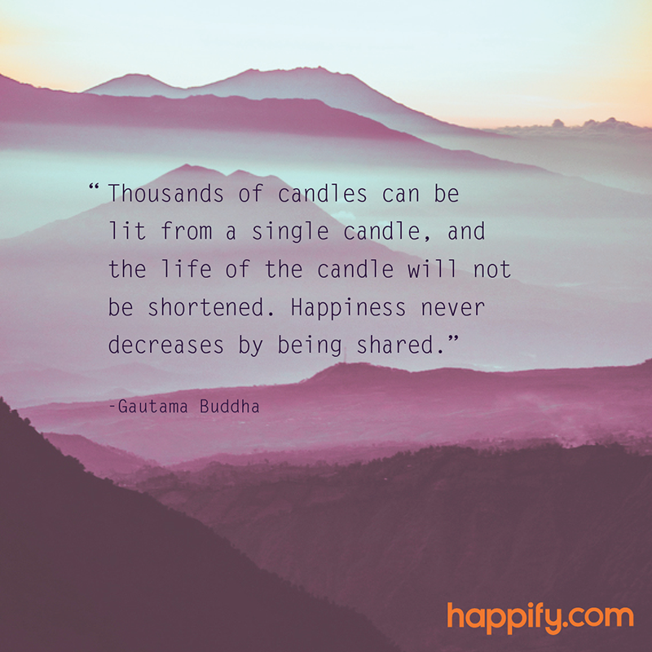
Today we will do a Mindfulness Water drinking exercise, please go grab a small glass of water
Notes:
Slide for when people wait to start the WebEx
REMEMBER:
Give participants the privilege to chat to “all participants” (by Ctl-K, checking the chat for “all participants” box)
Start the recording, and pause it while waiting for the participants to join.
Continue recording for starting the session, just before removing this slide.
Ask participants to use the check for yes and cross for no, so they warm up to the idea of interacting.
---
Please, via the chat box, introduce yourself with
Name
Department or Agency
Where you’re located
Your expectations for this session

Slide 2
Mindful Change Leadership Development Program
Week 4 (of 8)
20 May 2021

Slide 3
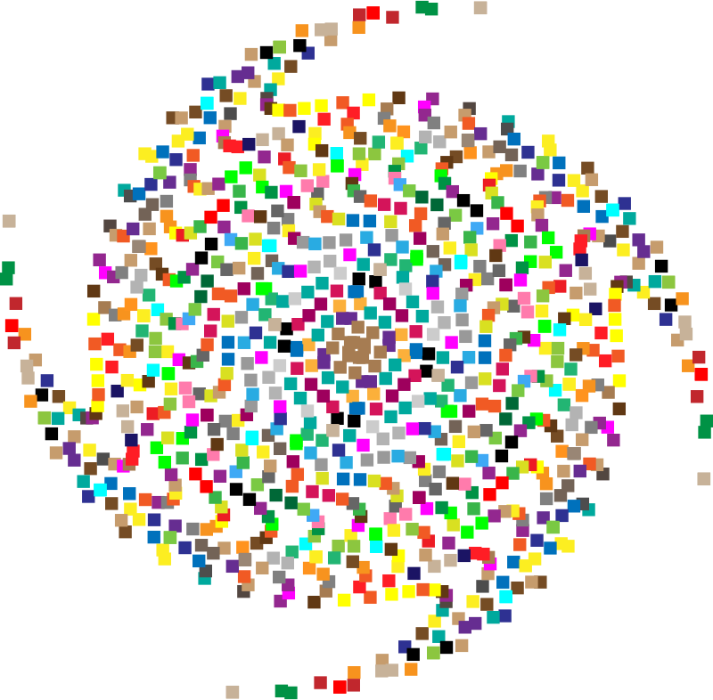
Mindful Breathing Exercise – Centering
Mindful breathing https://www.youtube.com/watch?v=ZE-r-x2T4ok
Notes:
Mindful breathing https://www.youtube.com/watch?v=ZE-r-x2T4ok
This is one way of doing it, getting it depends on the practice of.
Noticing is very important in the practice of Mindfulness.
Noticing where your thinking is, that’s the first step to become more Mindful.

Slide 4
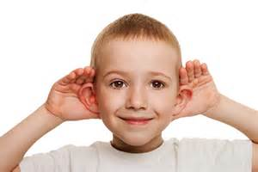
Debrief from last week (3)
Your Buddy System
Your practice :
Plenary
Notes:
Raise your hand to speak, type in the chat… let’s take as many as we can in 10 mins.

Slide 5
Agenda – week 4
Centering breathing exercise
Debrief from last week 3, poll on practice
Today’s intentions
Self-Compassion theory
A definition
The five myths of Self-Compassion
Your take away assignment

Slide 6
Today’s Intentions: Compassion, Clarity
Mindfulness – Water drinking
Mindful Cleaning Your Environment
Mindful Self-Compassion

Slide 7
Mindfulness – Water drinking
With your back straight, sit as comfortable as possible
Gently bring attention to your breath
Let’s take a moment to think about the origins of this water
As you continue breathing...
Think about the time it took for this water to come to you...

Slide 8
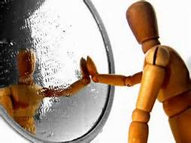
Self-compassion – a definition
Self-compassion is extending compassion to one's self in instances of perceived inadequacy, failure, or general suffering.
Dr. Kristin Neff has defined self-compassion as being composed of three main components - self-kindness, common humanity, and mindfulness.
Self-kindness: being kind and warm to oneself;
Common humanity: understanding that suffering and personal failure is part of the shared human experience; and
Mindfulness: being mindful of your negative thoughts and emotions to be observed with openness, so that they are held in mindful awareness, with no judgment.
Kristin Neff’s https://www.youtube.com/watch?v=Tyl6YXp1Y6M
Notes:
I can’t give what I don’t have… book: https://www.amazon.ca/Cant-Give-What-Dont-Have-ebook/dp/B07CYC32WT
From WikiPedia https://en.wikipedia.org/wiki/Self-compassion
Self-compassion is extending compassion to one's self in instances of perceived inadequacy, failure, or general suffering. Kristin Neff has defined self-compassion as being composed of three main components – self-kindness, common humanity, and mindfulness.^{[1]}
Self-kindness: Self-compassion entails being warm towards oneself when encountering pain and personal shortcomings, rather than ignoring them or hurting oneself with self-criticism.
Common humanity: Self-compassion also involves recognizing that suffering and personal failure is part of the shared human experience.
Mindfulness: Self-compassion requires taking a balanced approach to one's negative emotions so that feelings are neither suppressed nor exaggerated. Negative thoughts and emotions are observed with openness, so that they are held in mindful awareness. Mindfulness is a non-judgmental, receptive mind state in which individuals observe their thoughts and feelings as they are, without trying to suppress or deny them.^{[2]} Conversely, mindfulness requires that one not be "over-identified" with mental or emotional phenomena, so that one suffers aversive reactions.^{[3]} This latter type of response involves narrowly focusing and ruminating on one's negative emotions.^{[4]}

Slide 9
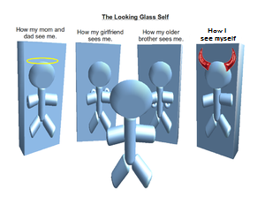
The Five Myths of Self-Compassion
Most people don’t have any problem with seeing compassion as a thoroughly commendable quality.
It refer to the following good qualities: kindness, mercy, tenderness, benevolence, understanding, empathy, sympathy, and fellow-feeling, along with an impulse to help other living creatures, human or animal, in distress.
But for many, self-compassion carries the whiff of all those other bad “self” terms: self-pity, self-serving, self-indulgent, self-centered, just plain selfish. Even many generations still seem to believe that if we aren’t blaming and punishing ourselves for something, we risk moral complacency, runaway egotism, and the sin of false pride.
The Five Myths of Self-Compassion – article, addresses these legends:
Self-compassion is a form of self-pity
Self-compassion means weakness
Self-compassion will make me complacent
Self-compassion is narcissistic
Self-compassion is selfish
Greater Good Science Center - Kristin Neff’s article: http://greatergood.berkeley.edu/article/item/the_five_myths_of_self_compassion
Notes:
How my mom and dad see me
How my girlfriend/wife sees me
How my older brother sees me
How I see myself

Slide 10
The Five Myths of Self-Compassion
Greater Good Science Center - Kristin Neff’s article: http://greatergood.berkeley.edu/article/item/the_five_myths_of_self_compassion
Notes:
How my mom and dad see me
How my girlfriend/wife sees me
How my older brother sees me
How I see myself

Slide 11
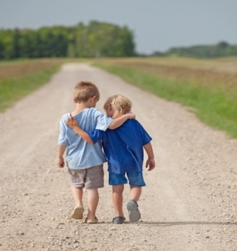
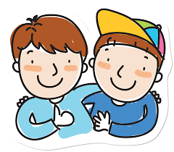
Mindful – self-compassion
If you want to hear it from Kristin Neff: Self-compassion Break: https://self-compassion.org/wp-content/uploads/2020/08/self-compassion.break__01-cleanedbydan.mp3 Time required – 5 minutes
Notes:
From: https://centerformsc.org/practice-msc/guided-meditations-and-exercises/
* Self-compassion brea, 5 mins: https://self-compassion.org/wp-content/uploads/2020/08/self-compassion.break__01-cleanedbydan.mp3
I’ll guide us doing a similar/shorter loving-kindness meditation
Time required – 20 minutes
http://self-compassion.org/wp-content/uploads/meditations/LKM.self-compassion.MP3
Iterations, as follow…
Think of something that hooked you, something that you keep repeating yourself in your mind, ideally something light…
Remember, We all are in the same boat
My I (we all) be safe
May I (we all) be peaceful
May I (we) be kind to myself (ourselves)
May I accept myself as I am (may we accept ourselves as we are)

Slide 12
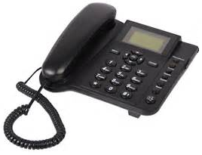
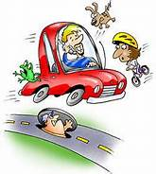
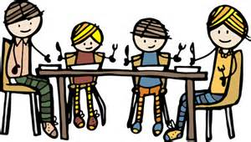
Mindful Cleaning Your Environment
Take on the mini-challenge to be mindful around the distractions
Day 17/21 days challenge - KindSpring - Make A Mindful Phone Call
Day 15/21 days challenge - KindSpring - Practice Digital Mindfulness; and
Day 9/21 days challenge - KindSpring - Practice Mindful Emailing
Shifting Priorities: The Art of the Mindful Email https://siyli.org/resources/multitasking
Check the story of the Monkey and the Panda, use it as for inspiration: https://www.youtube.com/watch?v=8FBIe9iFJ_U

Slide 13
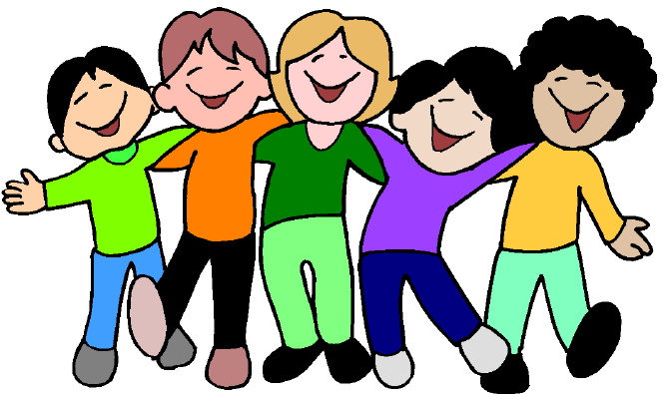
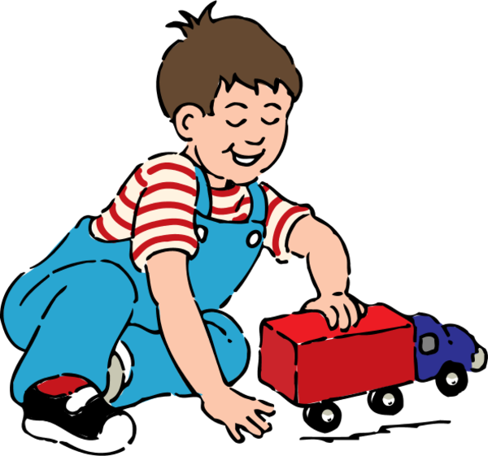
Your take away practice for week 4
Connecting – once a week with you buddy
Get in touch with your buddy (max 15 minutes: 5 minutes each, and 5 on something important for both, see next slide)
Gratitude Journaling – daily
Practice up to 15 mins… chose one of the following and keep doing it for the whole week - daily
Body scan or Breathing 15 mins – https://www.rightlifeproject.com/meditate (may need to scroll down) 15 mins – https://soundcloud.com/dharma-gus/15-min-body-scan-augusta-mbsr
Self-compassion 10 mins – https://soundcloud.com/breathworks-mindfulness/mindfulness-for-women-track-5-self-compassion-meditation 10 mins – https://soundcloud.com/user-640851605/self-compassion-giving-and-receiving-meditation-10-minutes 15 mins – https://soundcloud.com/mindfullivingcoach/self-compassion-meditation 15 mins – https://soundcloud.com/awakeningcompassion/awakening-compassion-class-4 20 mins – http://self-compassion.org/wp-content/uploads/meditations/LKM.self-compassion.MP3
Apply Mindful Cleaning Your Environment – as possible
Notes:
Next week: Mindful eating, grab a small fruit (grape, blueberry, or similar)… something you can put in your mouth without biting on it.

Slide 14
Reflect about the 3 exercises
Notes:
Take the next few minutes to debrief in small groups (of 4). As in previous weeks, when you’re done just leave the session.
Feel free to share:
What you noticed
What you had a hard time with
What you’re reailzing
An intention you have for the week
etc
I wish you happiness!!

Slide 15
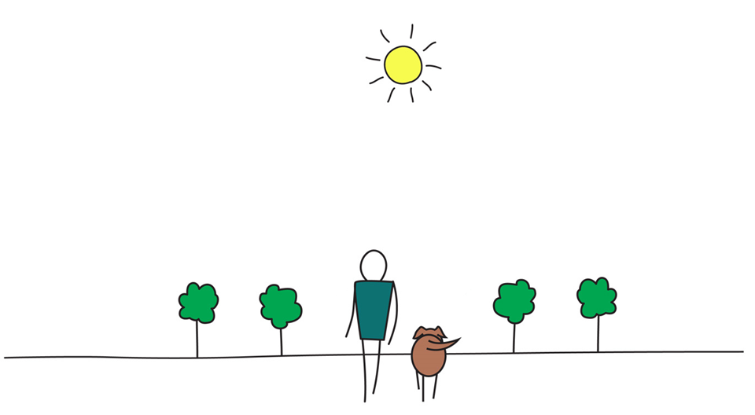
Be Mindful, Be Happy /
Prenez conscience, soyez heureux
Alejandro Gonzalez https://gcconnex.gc.ca/profile/alejgonz

