Slide 1
[PROJECT LOCATION]
Townhall: Preparing to participate
DATE

Slide 2
How to use this document
Instructions – Remove this page before using
The purpose of this document is to provide employees with information about the project vision, the GC Workplace design principles, how they can get involved and prepare to participate in design-related and other engagement activities.
Arrange a meeting with your PSPC change management consultant to discuss the best way to disseminate or present the content of this document to your employees.
This document should be used prior to the project announcement to employees and before the launch of engagement activities.
You will need to adapt the content and add some information. Some slides highlight elements that need to be adapted to your own organization. You can also add any information your organization wishes to communicate to its employees. The content of this document has been created by PSPC for use in your workplace transformation project. We recommend that you integrate it into your own branding template.
In order to offer a bilingual presentation to your staff, we recommend that you present the slides in alternating English and French.
* The French version of this document is available here: French version
Tips and tricks
Ensure that employees have access to the information immediately after the session, either on a shared space or on an intranet page.
Provide key messages and background information on the project to all managers, so that they are well equipped to answer any questions their employees may have.

Slide 3
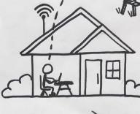
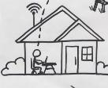
For many of you...
Background
[Project name
Month and year]
2020
March 2020
Work = Workplace
Static and compliant
Individual
In person social interactions
Work = Home
Work-life balance
Virtual and digital
Efficient
Work = Hybrid
Choose the best of both
Empowerment
Functionality
Notes:
Over the past few years, we have radically changed the way we work and interact. With COVID-19 and the introduction of the hybrid work model, it was essential for our organization to reflect in depth on different aspects of our work, more specifically on flexibility in the workplace and how best to take advantage of the benefits of our experience.
We recently announced to you by (insert the means by which you made the announcement: e-mail or other) that our organization will be proceeding with a modernization project.
The purpose of today's information session is to inform you about our modernization project, and more specifically about the concept we have chosen for our future workplace.
Before getting to the heart of the matter, I'd like to share with you what guides our choices and decisions.

Slide 4
Our Vision
Insert your vision, including the space targeted by this modernization.
Insert an image of your building or offices
Remove this box once you've customized the page.

Slide 5
GC Workplace: Activity-based
Notes:
To achieve our goals, we discussed with our PSPC colleagues and came to the conclusion that their Workplace Transformation Program was the best option for our organization.
This program aims to create a GC Workplace based on the implementation of activity-based work. It's a way of working that offers all employees SHARED USE of a VARIETY of work points.
As this is a key concept in our project, I invite you to watch the short video explaining what it's all about. I'll then go into more detail about the design of our new workplace.
Link to the video (you can share the video link in the other official language in the event chat):
EN: What’s an Activity Based Workplace? – YouTube
FR: Qu’est-ce qu’un milieu de travail axé sur les activités? – YouTube

Slide 6
Why lead this project?
Feel free to customize the statements to relate to your organization's mandate, values or objectives.
Remove this box once you've customized the page.
Continue to adapt to new ways of working and interacting, adopted during and after the pandemic.
Offer spaces that are more in tune with collaborative activities and the needs of focus work.
Improve our experience in the hybrid work model, notably through technological innovations.
Offer a more accessible and inclusive workplace, in compliance with the Canadian Accessibility Act.
Promote health and well-being in the workplace.
Insert an image of your building or offices.
Remove this box once you've customized the page.

Slide 7
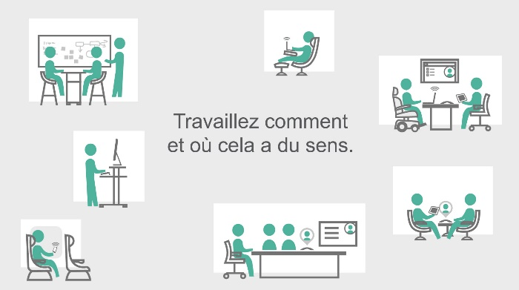
Activity-Based Workplace
Work how and where it makes sense.
Notes:
In a nutshell, modernization will offer you a number of advantages, such as :
a modern, efficient and inclusive workplace;
the freedom and flexibility to choose from among 13 workstations, the one that best suits your tasks and your own way of working;
The variety of workstations encourages all work-related activities, such as concentration, learning, collaboration and socialization;
Access to modern tools that facilitate collaboration within the hybrid work model.
In short, it's a concept that aims to enhance your employee experience by letting you work how and where it makes sense for YOU.

Slide 8
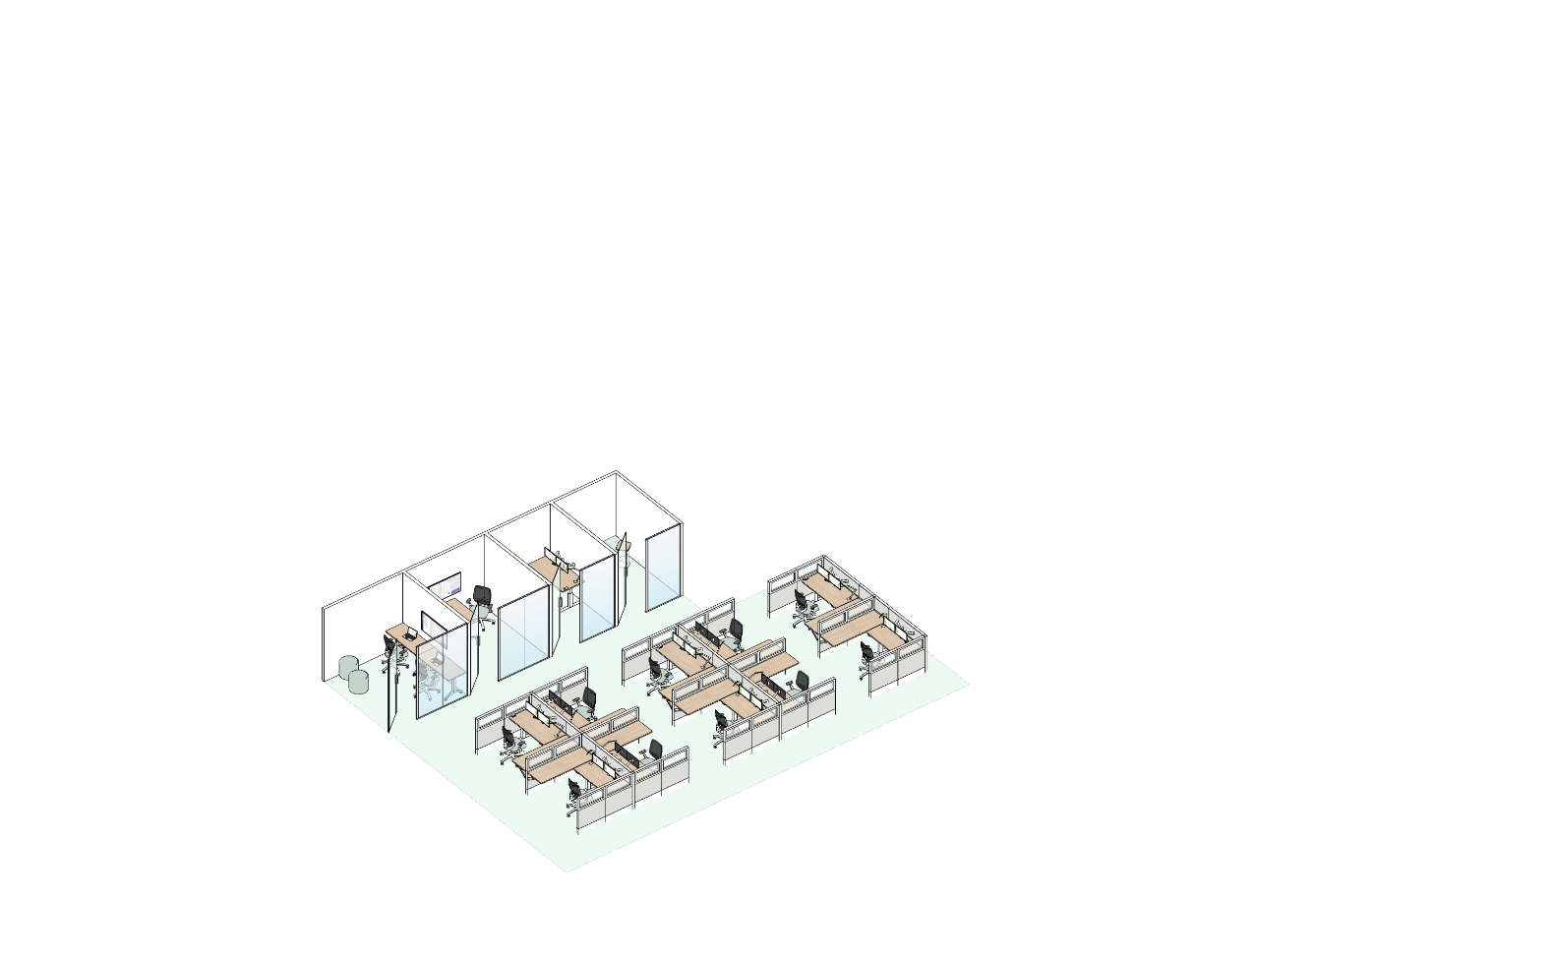
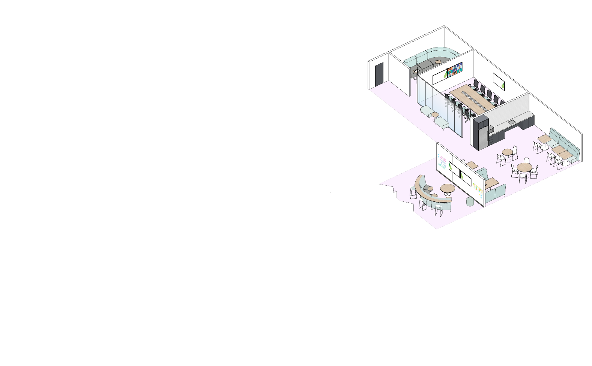
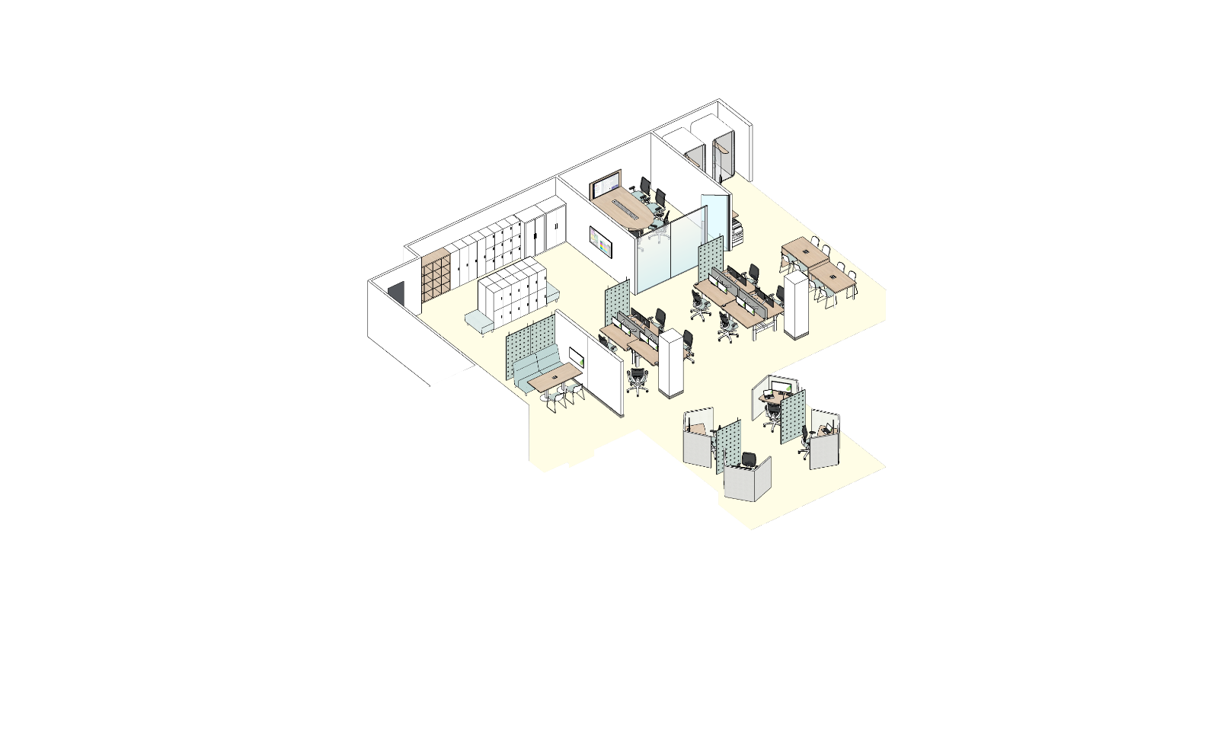
GC Workplace Design: Zoning
Quiet Zone
Transitional Zone
Interactive Zone
Notes:
The GC Workplace is designed to offer three functional zones:
In the quiet zone, in green, you'll find open and closed individual work points, more suited to doing work that requires concentration.
In the interactive zone, in purple, you'll find meeting rooms, the kitchen, team zones, and other work points that encourage collaboration.
The transition zone in yellow is normally located at the entrance or acts as a buffer between the other two zones. It's an area where we'll be spending less time, as its name suggests.
You can see that activities are grouped together to reduce noise disturbance. The zoning lets you know what to expect in terms of noise.
Speaking of activities, some of you may work with specialized equipment, or have specific activities that require a secure area or fixed space (specify whether it's a computer help desk, conflict resolution office or other). These needs are taken into account in the design of our floor plans, and areas will be set aside to meet them.
Since spaces are not assigned, you can use points and zones as you need them throughout the day.

Slide 9
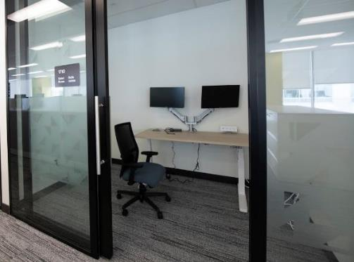
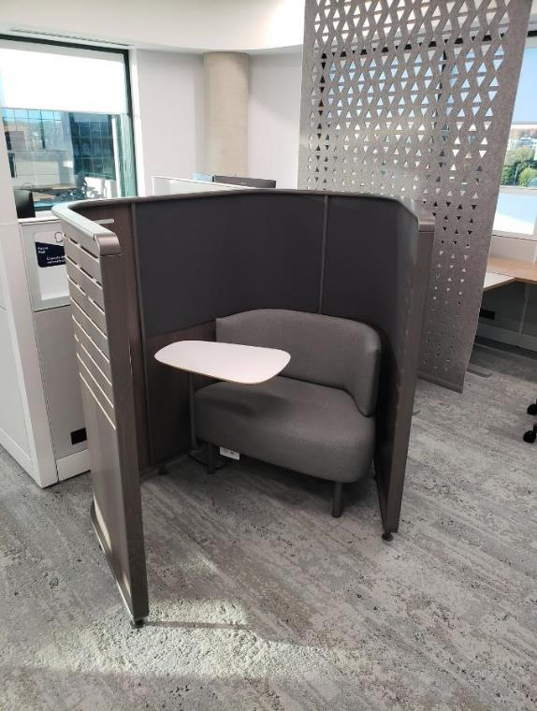
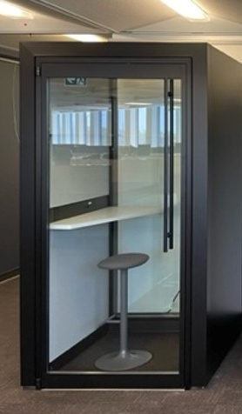
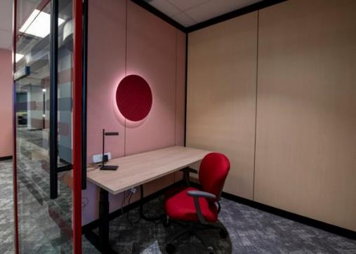
Concentration • Confidentiality
Notes:
To meet your needs for tranquility, concentration and confidentiality, you'll also have enclosed work points, such as focus rooms or phone booths. Again, you can choose the most appropriate according to the amount of time you'll be spending there.

Slide 10
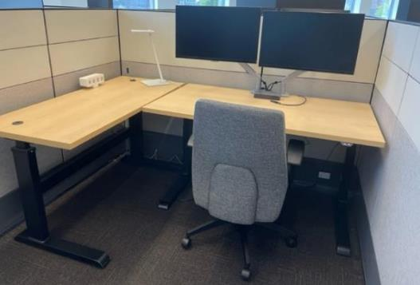
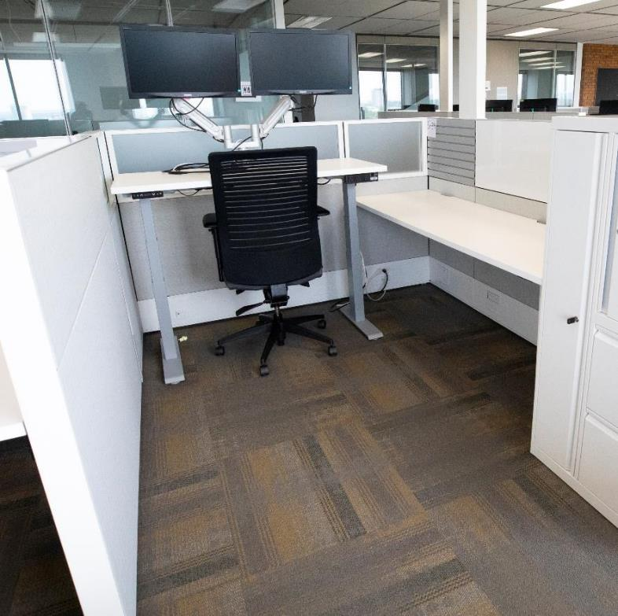
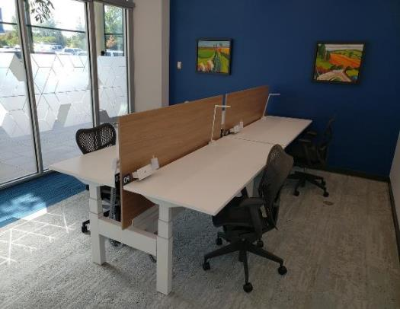
Well-being • Ergonomics
Notes:
For individual work, you'll find this type of workstation in the different zones.
The workstations where you'll be spending most of your time are equipped with two monitors, a height-adjustable desk and an ergonomic chair. You'll need to carry your own keyboard and mouse. These workstations meet a high ergonomic standard by default.
Work points are also available for shorter-term use, for example, between meetings, and are designed more for working with your laptop only.

Slide 11
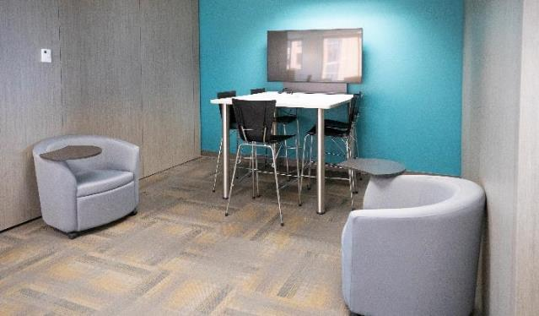
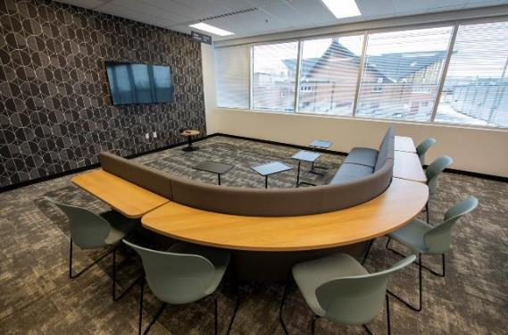
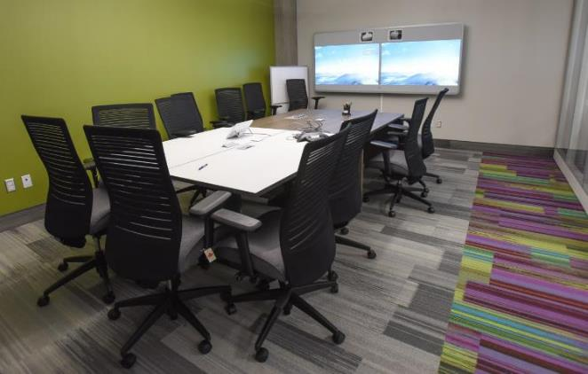
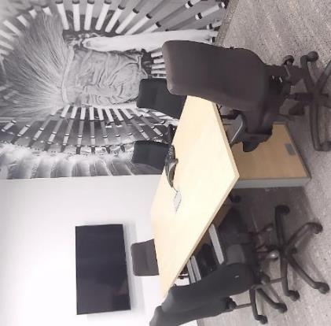
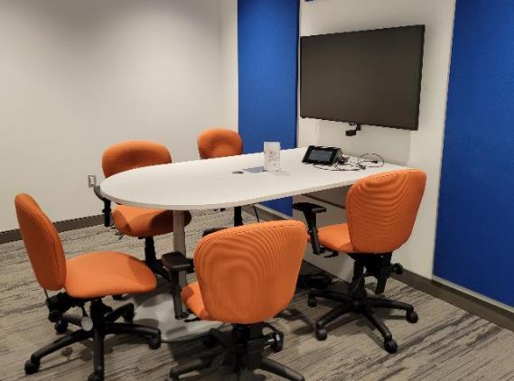
Collaborate • Create
Notes:
When we come to the office, we often take the opportunity to meet our colleagues. So there's also a wide variety of well-equipped workspaces for small or large group meetings. Most are equipped with the technology needed to hold hybrid meetings with our teleworking colleagues.

Slide 12
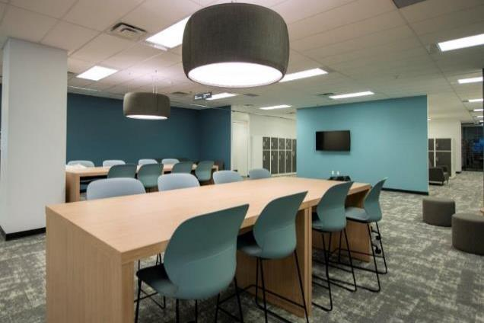
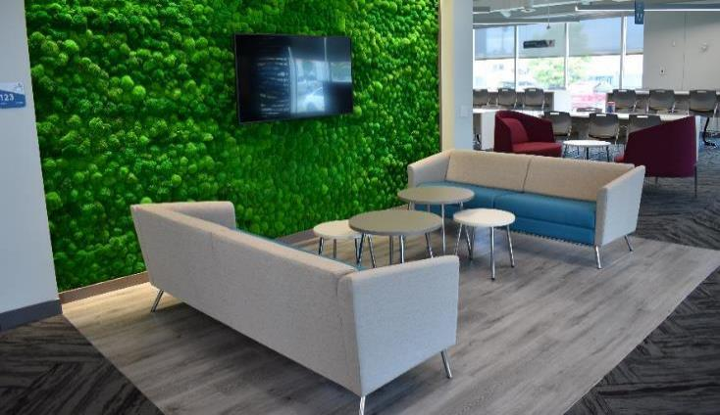
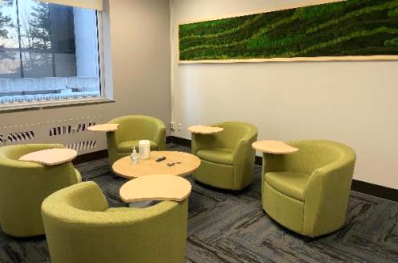
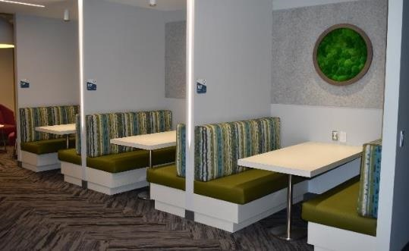
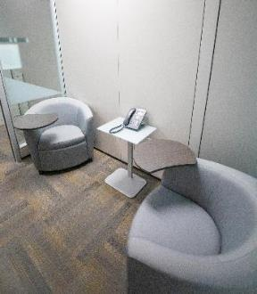
Connect • Networking
Notes:
Several work points are ideal for more ad hoc discussions in small or large groups, since they don't have to be reserved.

Slide 13
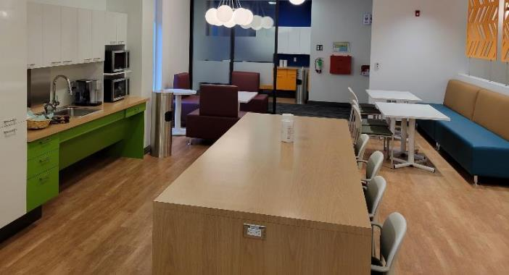
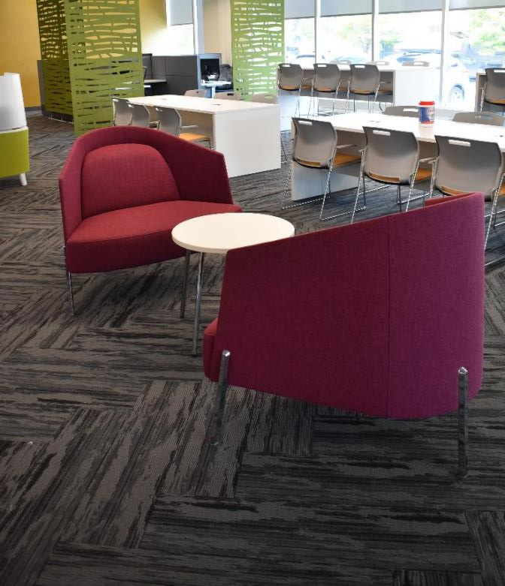
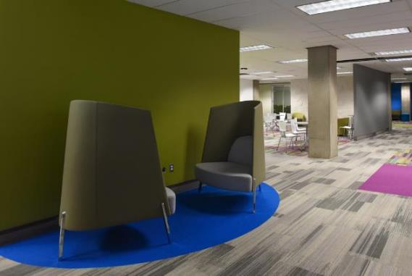
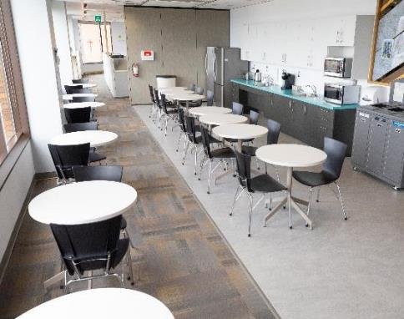
Share • Socialize
Notes:
Finally, work areas such as lounges, locker rooms and chat rooms are ideal places for "coffee machine conversations"!

Slide 14
Design elements for our modernization project
Various elements inspire and guide the design of our workplace.
Canadian Landscapes
Nature
Indigenous Elements
Inclusion
Sustainability
Notes:
Now that you've seen the different work points and how you can use them, here are a few more elements to guide the design of a GC Workplace:
Canada's natural landscapes are a great source of inspiration. Designs will incorporate Canadian landscape images, natural colors and materials.
Nature will be presented through: access to natural light, the integration of organic forms and textures, and the use of natural materials.
The strong link to nature is linked to the next point, that of Indigenous elements. In support of our organization's commitment to reconciliation, we will incorporate culturally appropriate elements that provide economic opportunities for Indigenous people.
Several elements of our future workplace are aimed at improving inclusion and accessibility, such as: a variety of workstations that naturally meet certain accommodation needs, accessible technological equipment, and more equitable access to ergonomic workstations.
For sustainability, we aim to reuse the finishes of our current offices, as well as any furnishings that can be reused. For anything that can't be reused, efforts are made to recycle and dispose of it properly. In addition to being ecologically responsible, this allows our project to be completed on an accelerated schedule.
Speaking of timelines, let's take a look at the major stages of our project.

Slide 15
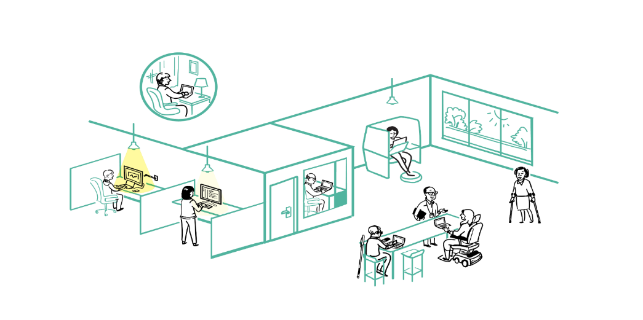
Accessibility and Inclusivity
Large enclosed workpoints that can accommodate mobility devices and support cognitive impairments and sound sensitivities
Small enclosed workpoints (phonebooths) that can support the need for stimulus free space for various mental health reasons
Semi-private workpoints with access to daylight and views to support mental health
Being able to work from home to support work-life balance
Generous circulation areas for various mobility requirements
Standing height workpoints for users with larger, upright mobility devices (scooters) or for standing preference
Notes:
The GC Workplace has been designed to be a standard for accessible and inclusive workplace design. The activity-based workplace is designed to accommodate the majority of employees. Activity-based working optimizes ergonomics through movement, rather than perfect static posture. It incorporates wayfinding cues, height-adjustable desks, accessible technologies and ample space for mobility, including in kitchens.

Slide 16
Our Project: Timeline
Ensure to adjust this page to reflect your main project’s steps.
Remove this box once you've customized the page.
All Staff Info-session
Today
Official Opening
DATE
(Insert impacted floors) closure
DATE

Slide 17
During the transition
Noise
Reduced work space
Adjustment period to new work environment
Be sure to adjust this page to reflect your organization's specific challenges and issues.
Remove this box once you've customized the page.
Notes:
When modernizing, it's normal to face challenges, and for some people, irritants - it's all part of the process.
We'll do our best to minimize the impact of the renovation on your work, but we'll still need your cooperation and patience.
Keep in mind that all this is temporary, and that in the end, our workplace will be better adapted to our needs and more pleasant to work in.

Slide 18
Next Steps
Withdrawal of business and personal assets
Functional programming survey / Mood board survey
Floor plans presentation
Be sure to adjust this page to reflect the next steps in your project.
Remove this checkbox once you've customized the page.

Slide 19
Project Team / Governance
Be sure to adjust this table to reflect the integrated project team of your project.
Delete or add boxes if necessary, but make sure that contacts are contributors who can support the feedback channels destined to people managers.
Remove this checkbox once you've customized the project’s organizational chart.
Executive Sponsor
NAME
Project Sponsor
NAME
Project Manager
NAME
Change Manager
NAME
Enabling Sector Representatives
Change Agent Network
Human Resources
NAME
IT
NAME
Information Management
NAME
Security
NAME
Notes:
As you can see, this is a major project, and we have a well-organized project team to ensure its success. It's my pleasure to introduce it to you.

Slide 20
Our Project: In Brief
Wide range of workstations and unassigned installations
User-friendly reservation system
Wi-Fi environment
Three distinct zones (quiet, transitional and interactive)
Audiovisual equipment adapted to the hybrid model
Accessible spaces
Ergonomic workstations
Inspiring and inclusive design
Notes:
I've shared a lot of information with you today, but in a nutshell, our new workplace will include:
A wide range of workstations and unassigned facilities
A user-friendly reservation system
A Wi-Fi environment
Three distinct zones (quiet, transitional and interactive)
Audiovisual equipment adapted to the hybrid model
Accessible spaces
Ergonomic workstations
Inspiring and inclusive design

Slide 21
Keep Informed!
Read the newsletter
Visit the page (insert the hyperlink to your intranet)
Contact us to (insert email address)

Slide 22
Annex: We are looking for Change Agents!
This role involves:
Participate in project information meetings to share with your colleagues
Raise concerns and issues with the project team
Support the integration of the new work environment and the related learning process
Set an example by adopting new ways of working
Time required: between 5 and 10 hours per month
Contact [name] to join the group!
Notes:
Note: Use this slide in your presentation if you're launching your change agent recruitment campaign. This announcement should be accompanied by a recruitment message on your other communication channels.

Slide 23
Annex: Get prepared to participate
Complete the Design Survey
Who: The survey will be distributed to all employees who will be assigned to this space.
When: You will receive the survey link in an e-mail sent to you by [name]. You will have five [5] days to complete the survey online. It only takes five minutes to complete!
How can I prepare: Think about your future workspace and new ways of working in a hybrid work model. You'll be asked to provide information about your professional activities, your functions and the activities you intend to carry out in an office environment equipped with information technology and adapted to employees' preferences and various tasks.
Notes:
Note: Use this slide in your main presentation if your organization intends to conduct a design survey and distribute it to all staff.
The first activity you'll be asked to participate in is the Short Design Survey. The data collected during this survey is essential so that PSPC’s Design Team can define the workplace's activity profile, zones and ideal distribution of work points to match the activities performed in the workplace.

Slide 24
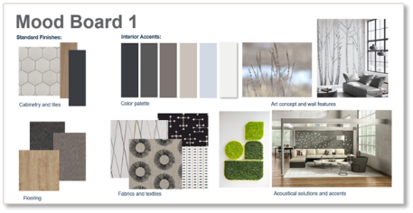
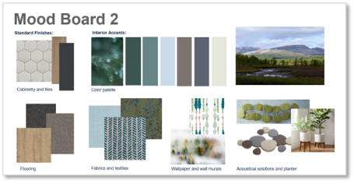
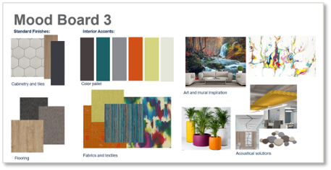
Annex: Get prepared to participate
Choose your favorite mood board!
What: Participate in the design of [name of project] by voting for one of the three proposed mood boards. You'll help choose the colors and finishes of your future workplace!
Who: The survey will be sent to all employees assigned to this space.
When: You will receive the survey link in an e-mail sent to you by [name]. You will have five [5] days to complete the survey online.
Notes:
Note: Use this slide in your main presentation if your organization intends to conduct a Mood Board Survey and send it out to all staff.
You'll be invited to choose the mood board for our future workplace! A mood board is the color palette that will be used and provides inspiration for the textures of materials used for furniture, decor and floor coverings.

Slide 25
Annex: Employee roadmap towards the future workplace
1
Learn
Understand the nature of the change and the need for change.
What benefits do you gain from this change?
2
Participate
Have your say and help shape the future of your new workplace.
Get involved and support the change.
3
Get equipped
Access resources on how to change, acquire new skills and learn new behaviours.
Get ready for the new way of work.
4
Live-it and celebrate!
Use your new knowledge, skills and behaviours to adopt the new way of working.
Celebrate your change journey.
Notes:
To support you through this transition, the team I've just introduced and I have put together a roadmap that will provide you with the essential information and tools you need to participate in shaping the workplace of the future and the experience you'll have, whether you're in the office or working remotely.
NOTE: This Employee Experience section is a proposed learning roadmap for employees in this program based on the content of the Change Management Program-in-a-box.

Slide 26
Annex: Employee roadmap – Activities overview
1
Learn
Project kick-off Townhall
Frequently asked questions
Newsletter and information hub
2
Participate
Design survey
Meeting room naming
Mood board vote
3
Get equipped
New tools and training
A day in the life presentation
Employee toolkit
4
Live it and celebrate!
Tour of modernized space
Ribbon-cutting ceremony
Post-occupancy survey

Slide 27
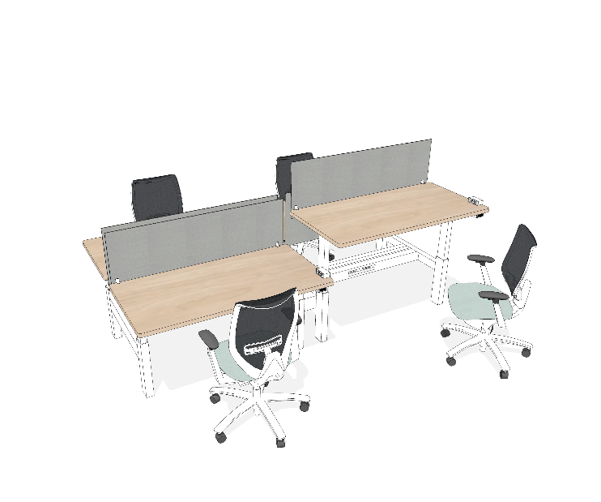
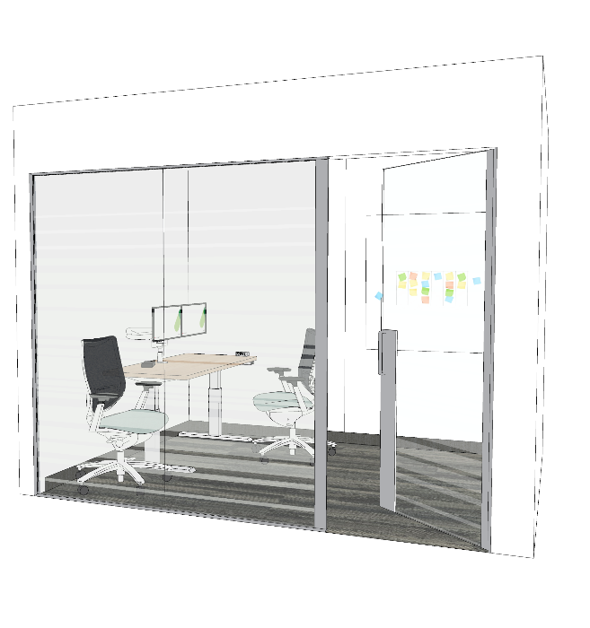
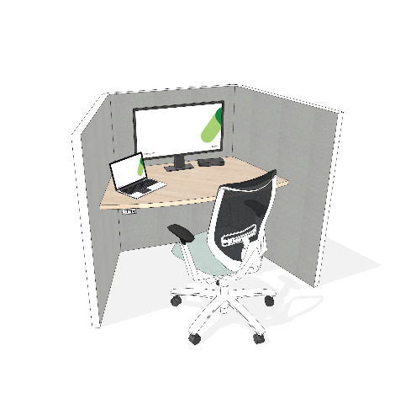
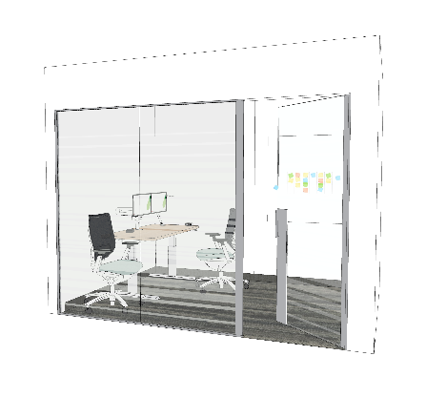
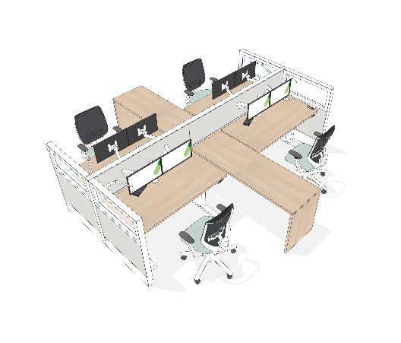
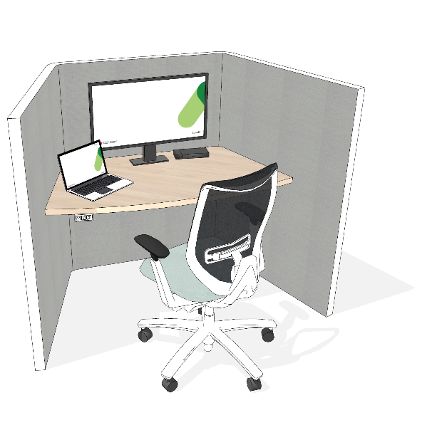
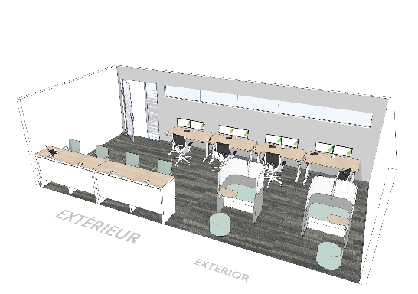
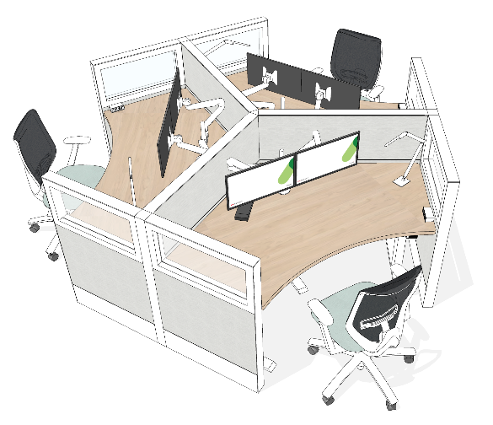
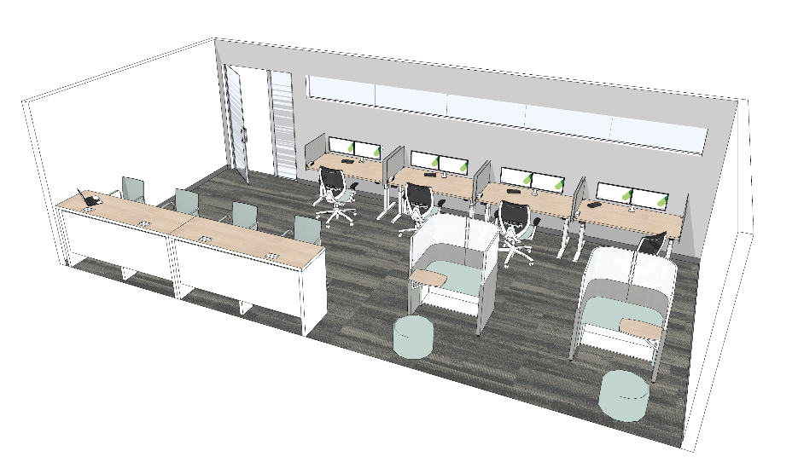
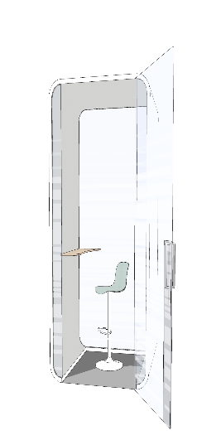
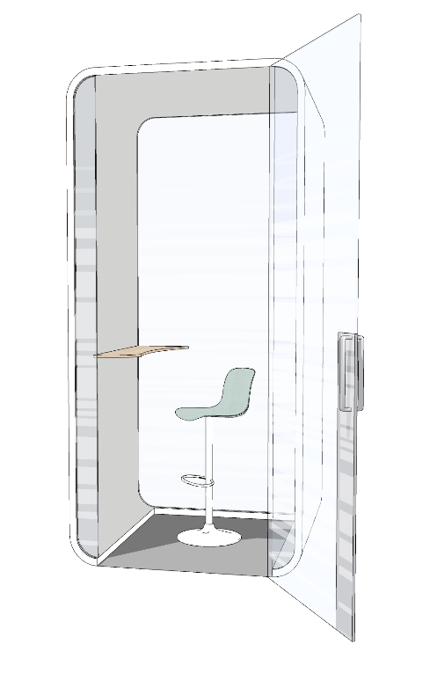
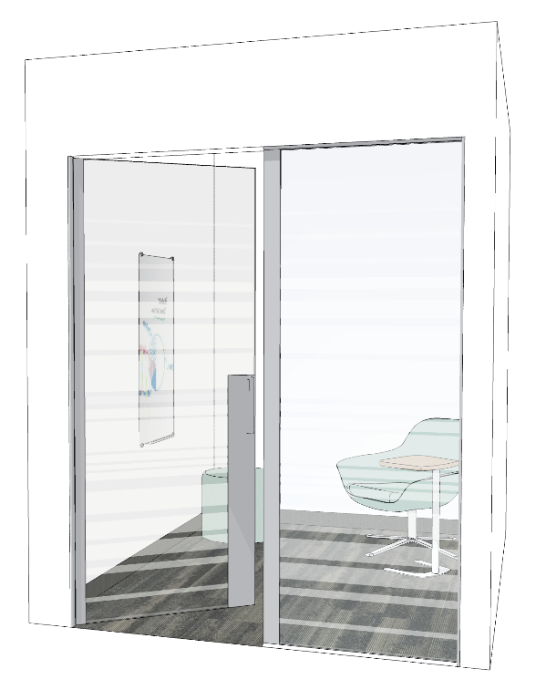
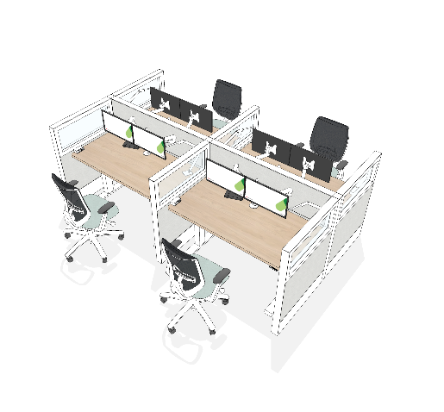
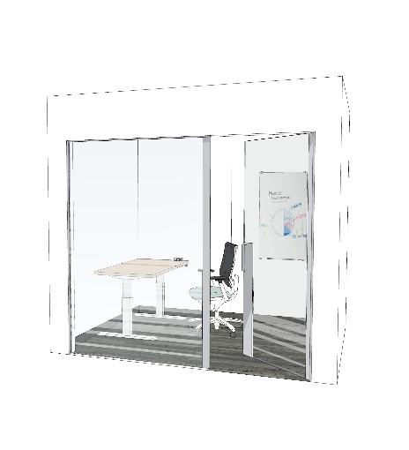
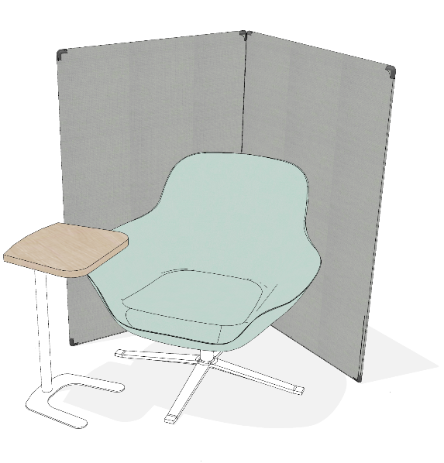
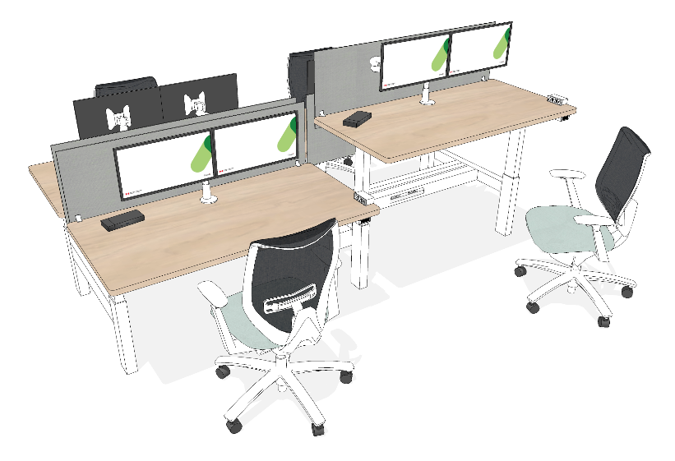
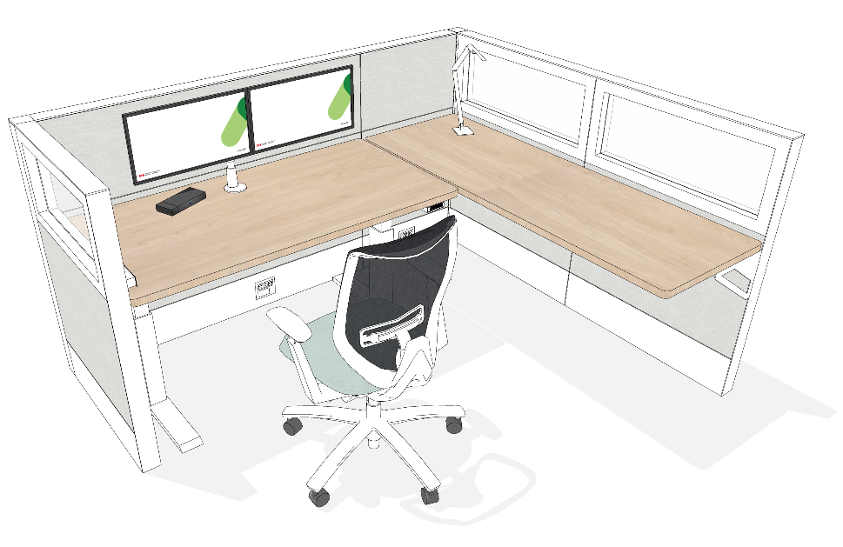
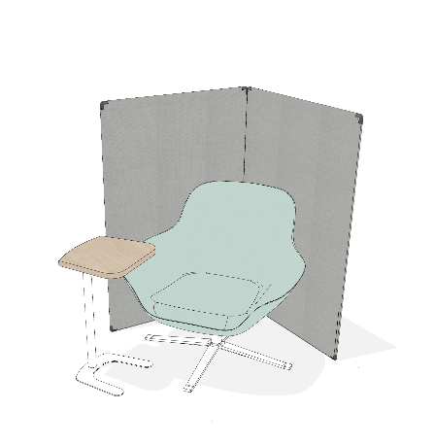
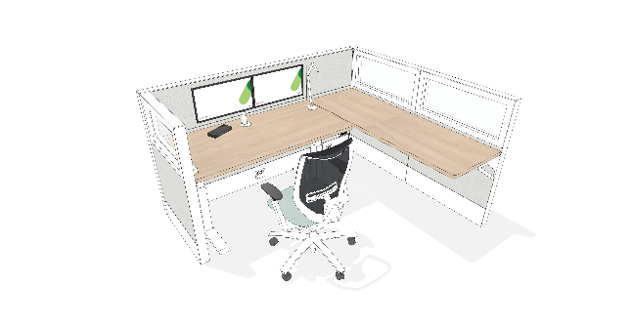
Annex: GC Workplace Design – Individual Workpoints
Touchdown
Focus room
Workstation
Work pod
Study room
Phonebooth
Workstation
Phonebooth
Workstation
Focus pod
Notes:
As mentioned earlier, the GC Workplace concept is a flexible environment where you choose where to work.
Here are a variety of work points for individual work. Some are open and others closed, so you can choose according to the level of concentration you need, or the noise you'll make, for example, if you have to make calls or take part in virtual meetings.
Many of these workstations offer ergonomic equipment such as ergonomic chairs, height-adjustable desks and two screens (or one gigantic one).
As you can see, these workstations don't come with a keyboard and mouse. You'll need to carry the equipment provided.

Slide 28
Annex: GC Workplace Design – Collaborative Workpoints
Teaming area
Huddle
Work room
Chat point
Meeting room
Lounge
Project room
Notes:
You'll have access to different types of rooms and work points to collaborate. You'll be able to choose the most appropriate based on capacity and functionality, whether you need to hold a formal meeting, brainstorm or simply chat with a colleague.
The Wi-Fi environment will be optimized to enable you to move around these rooms.
In all, some 15 workstations will be available. Some can be booked in advance via (reservation systems).
But don't worry about all these details, our teams will provide you with all the information you need to plan your working days and move around the space optimally.

