Slide 1
Our Workplace Transformation Project
Getting ready to participate
Presented by:
May 2022

Slide 2
How to use this document
Instructions – Remove this page before using
This document is to be used to provide employees with information on the project vision, the GCworkplace design principles, how they will be able to participate and get them ready to answer the functional programming survey (design survey)
Set-up a 30 minute meeting with your PSPC representative to discuss how best to share and/or facilitate the content of this document with your employees
This document is to be used after the project has been announced to employees and before launching the functional programming survey.
Two options are proposed on how to share the document (see next 2 slides):
Option 1: as an information package
Option 2: as a presentation in a townhall
If option 2 is your preferred option and you wish to have a PSPC representative present the Interior design & project methodology section, please let your PSPC representative know in advance.
For both options, you will have to adapt the content and add some information. Some slides (8-9-10-33) identify areas that need to be adapted for your own organization. You can also add any information that your organization wishes to share with your employees. The content of this document has been created by PSPC for the use of your Workplace Transformation project. We recommend incorporating it into your own branding template.
The section on employee experience (slide 30-31-32) is a proposed learning roadmap for employees as part of this program based on the content of the CM Program in-a-box.

Slide 3
Option 1: Share the document with employees
Instructions – Remove this page before use
Before sending this document, ensure you already have informed your employees via a communication about the upcoming project
We recommend that the project sponsor or champion send the information package to the impacted employees
You can use this generic Communication Template to employees to send the document as well as the key messages
Advice and tips
Make sure to have the information available to employees either on a shared space or on an intranet page.
Provide key messages and high level project information to all managers so they can be well-equipped to answer questions that their employees might have.

Slide 4
Option 2: Hold a townhall with employees
Instructions – Remove this page before use
We highly recommend this option for efficient two-way communication and to demonstrate leadership and support
Before organizing a townhall, ensure your have informed your employees about the upcoming project
Ensure that the project sponsor or champion for the workplace modernization project will be participating
Plan to have the project sponsor or champion kick-off the session to inspire and demonstrate support
Slide 5 to10 should be presented by the executive sponsor or champion. The other slides can be presented by a member of your Integrated Project Team.
Only slides from the interior design and project methodology could be presented by a PSPC representative.
Advice and tips
Make sure to have the information available to employees right after the session ends; either on a shared space or on an intranet page.
Provide key messages and high level project information to all managers so they can be well-equipped to answer questions that their employees might have.

Slide 5
What is the Workplace Transformation Program & how does it affect me as an employee
While PSPC had already begun modernizing federal workplaces with the launch of GCworkplace back in 2017 (officially becoming the new federal workplace design standard in 2019), the last two years have provided an opportunity to accelerate the pace of this modernization…
In support of federal departments who’s leadership have committed to modernize the way they work by providing employees with flexibility in where they work post-pandemic, PSPC has created the Workplace Transformation Program.
The Workplace Transformation Program aims to create a modern, activity-based GCworkplace in an accelerated timeframe to provide employees with an optimal workplace experience as part of a flexible return to the workplace and a hybrid* future of work.
*HYBRID WORK: Each organization defines their own hybrid model that will allow employees to work from various locations and work settings in support of flexibility.
GCworkplace and GCcoworking provides workplace solutions to support all hybrid work models.

Slide 6
Workplace Transformation Program
CURRENT
CONTEXT
What Matters to Employees
A Vision for the Future
An Ecosystem of Workspaces
What is GCworkplace
What to Expect
What is GCworkplace Design
Workplace Transformation Program Design Elements
Workplace Transformation Program Inclusions
Workplace Transformation Program Design Process Overview
On the way to the new workplace
Your learning roadmap to the new workplace
Resources
WORKPLACE
DESIGN
& PROCESS
YOUR EXPERIENCE
AS AN EMPLOYEE
ANNEX

Slide 7
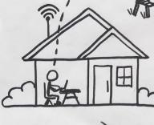
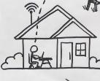
Context
Workplace Transformation Program
MARCH
2020
… 2020
2022…
Work = Workplace
Static & Standard
Individual
Social facetime
Work = Home
Work/Life Balance
Virtual & Digital
Efficient
Work = Hybrid*
Best of both!
Empowering
Flexible & Mobile
:
FOR MANY
EMPLOYEES
Although the sudden pivot from the ‘office-first’ model to working from home almost excluvively has proven benficial for most in many ways, it hasn’t been without its challenges. Allowing for flexibility in work location going forward will empower employees and teams to retain the benefits of what each work setting has to offer, while allowing for varying personal needs and preferences.
*HYBRID WORK: Each organization defines their own hybrid model that will allow employees to work from various locations and work settings in support of flexibility.
GCworkplace and GCcoworking provides workplace solutions to support all hybrid work models.

Slide 8
What Matters to [insert dep. name] Employees
We want to ensure that the future of work at [insert department name] is designed around what matters to you.
And this is what you told us:
Results from the
[insert department’s survey name]
Results from the
PSPC Interim Work Agreement Survey
XX%
of employees have expressed the desire to work from home full time (coming into the office by exception)
of employees are hoping to come in 1-3 days a week (hybrid work model)
of employees prefer to return to the office full time
(working remotely by exception)*
45%
of employees have expressed the desire to work from home full time (coming into the office by exception)
of employees are hoping to come in 1-3 days a week (hybrid work model)
of employees prefer to return to the office full time
(working remotely by exception)*
!! DELETE THIS !!
If your department does not have these stats., delete this slide and use the following slide
XX%
44%
8%
XX%
*4% no response. Similar results have emerged from Gartner, PricewaterhouseCoopers, Deloitte, and OGDs

Slide 9
What Matters to Employees
Consistent results have been emerging from multiple GoC departments, as well as other global leaders such as Gartner, Deloitte, PricewaterhouseCoopers, etc. We want to ensure that the future of work is designed around what matters to employees.
45%
of employees have expressed the desire to work from home full time (coming into the office by exception)
of employees are hoping to come in 1-3 days a week (hybrid work model)
of employees prefer to return to the office full time
(working remotely by exception)*
44%
!! DELETE THIS !!
If your department has its own stats., delete this slide and use the previous slide
8%
*Results from PSPC IWA (4% no response)

Slide 10
A Vision for the Future
at [insert department name]
Statement from [insert project sponsor’s name]
[PLACEHOLDER: statement should included the department’s plan/vision for the return to the workplace/future of work; intention for this specific project; how will this modernized workplace support employees in the return to the workplace/future of work (pathfinder? Department-wide coworking site? Support for a specific sector or branch? etc); communicate any relevant leadership decisions; highlight major changes that would affect employees associated to this project (work locations, depersonalization, new way of working, new behaviours to be adopted, etc); assure employees they will be supported through these changes (change management activities, support from leadership, etc)]
[insert project sponsor’s name]’s Hybrid Work Model
[PLACEHOLDER: define the hybrid working model for the department (ex: To allow for maximum flexibility, employees will have the autonomy to choose whether they prefer to work from home, the office or a GCcoworking site on any given day]

Slide 11
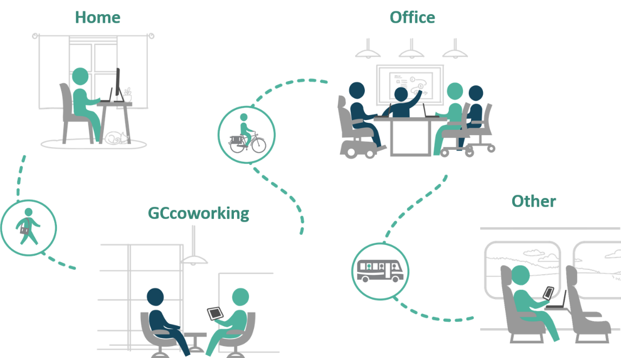
Supporting Flexibility with an Ecosystem of Workspaces
The Workplace Transformation Program will efficiently modernize your workplace using GCworkplace standards to provide you with a flexible, collaborative work environment in support of your organization’s new modern, hybrid way of working!
POSITIVE EMPLOYEE EXPERIENCE
*
*GCcoworking is a is a shared GCworkplace location where employees from multiple federal departments can work from, as an alternative to their home or usual workplace.
11
Notes:
Hybrid working is comprised of an ecosystem of workplaces: Home, Office, Shared spaces like Gccoworking and even other locations.
Change management alongside project management can help create a positive employee experience in all these workplaces using a employee-centric approach.
The Workplace Transformation Program will efficiently provide organizations with a modernized workplace that supports a hybrid working model. Providing a workplace that supports flexibility, collaboration and the new ways of working that contribute to a positive employee experience!

Slide 12
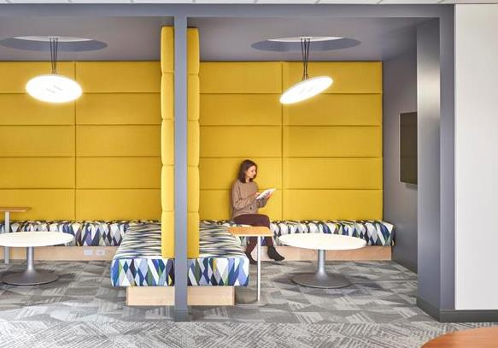
What is a GCworkplace?
A GCworkplace is a modern, efficient and inclusive workplace which responds to the public service workforce’s needs and supports a flexible way of working.
Why an Activity-Based Workplace (ABW) concept?
It is based on the implementation of Activity Based Working (ABW), which is a concept that offers all employees SHARED USE to a VARIETY of workpoints, allowing them to CHOOSE the optimal setting to perform their tasks and functions.
GCworkplace is designed based on an unassigned seating environment, where employees have access to all workpoints in both open and enclosed work areas.
Choice and flexibility of where & how to work
Adaptable to personal needs & preferences
Access to a wide range of workpoints and amenities
Accessible and inclusive
Enhance your employee experience
Supports all workplace activities such as learning, focusing, collaborating and socializing.

Slide 13
What to expect
An all-inclusive activity-based workplace supporting hybrid working that includes:
Wi-Fi environment
Variety of modern workpoints to focus, collaborate, socialize and think.
3 distinctive zones (Quiet, Transitional, Interactive)
Audio visual equipment adapted for each workpoint
Inspiring and inclusive design
Refreshed kitchenettes and business centre
Easy-to-use booking system

Slide 14
Workplace Transformation Program WORKPLACE DESIGN & PROCESS

Slide 15
How is a GCworkplace designed?
The ideal Activity Profile for your workplace will be determined by the Mini Survey and in the Functional Programming Workshop.
Because organizations all work somewhat differently, ACTIVITY PROFILES are used as a baseline to identify the organization’s way of working and determine an IDEAL workpoint distribution to reflect activities performed in the workplace.
COLLABORATIVE
INDIVIDUAL
AUTONOMOUS WORKPLACE
GCworkplace Design is USER-CENTRIC. Input from users is essential in order to provide a design that supports activities as well as workstyles.
Higher proportion of individual workpoints.
BALANCED WORKPLACE
COLLABORATIVE
INDIVIDUAL
Equal proportion of individual & collaborative workpoints.
More and more organizations are looking for their workplace to support collaboration and interaction due to individual focus work being performed primarily off site.
COLLABORATIVE
INDIVIDUAL
INTERACTIVE
WORKPLACE
Higher proportion of collaborative workpoints.

Slide 16
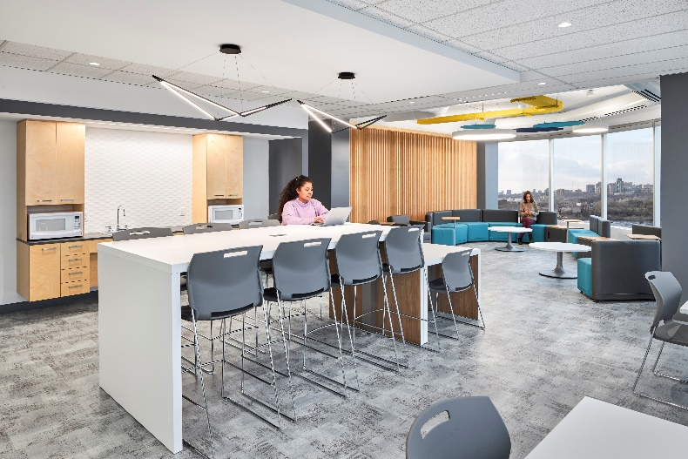
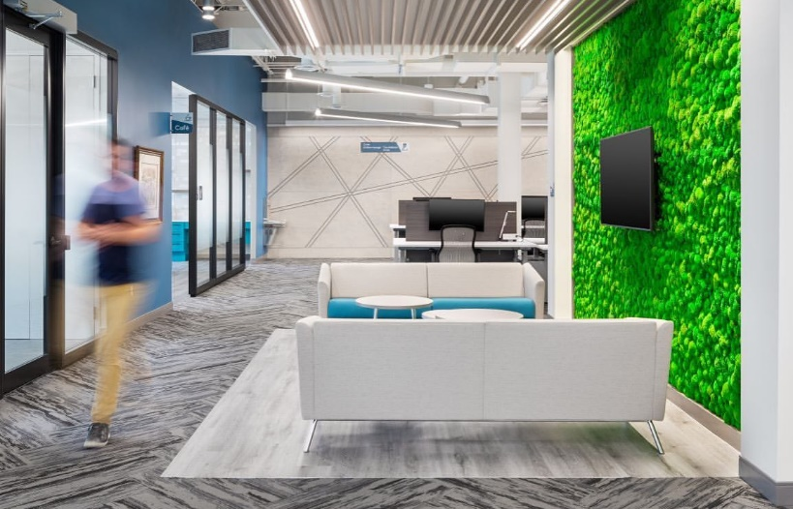
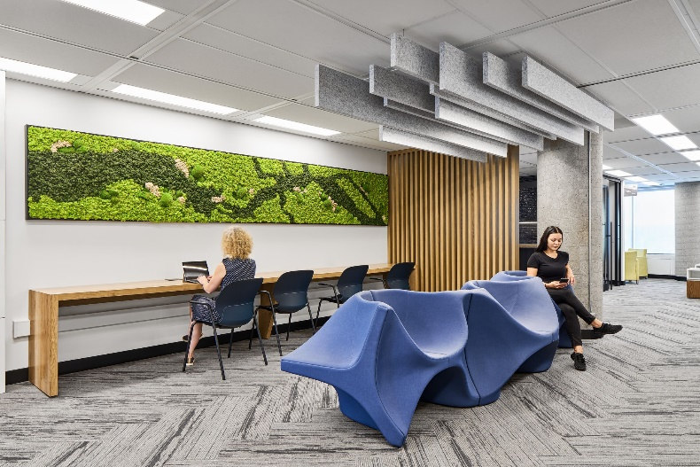
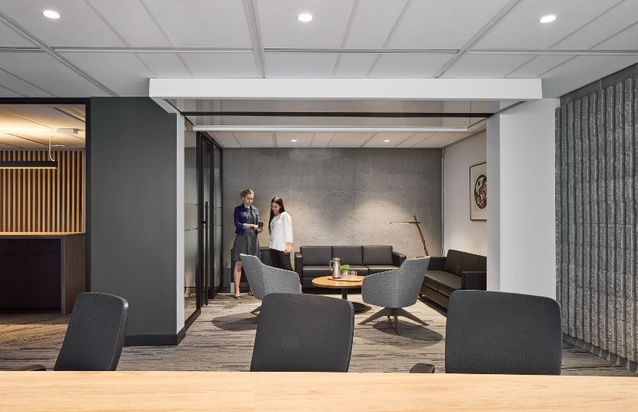
Standard Design Features
A Workplace Transformation project provides all the standard GCworkplace features:
Mutliple workpoint configurations (common kit-of-parts)
Functional zones (Quiet, Transitional, Interactive)
Biophilic and sustainable design elements (plants, natural materials)
Indigenous elements and identification (art, land recognition)
Accessible and inclusive design solutions (based on established best practices)
Predefined color schemes (mood boards)
Notes:
Following a standard design approach, Gcworkplaces are designed from a common kit-of-parts, which are the workpoints, following design principles and best practices outlined in the standard
A Gcworkplace becomes recognizable by its standard features, such as:
For efficient, effective repeatable design methodology
which ensures a common look and feel and a consistent user experience in all Gcworkplaces across the country

Slide 17
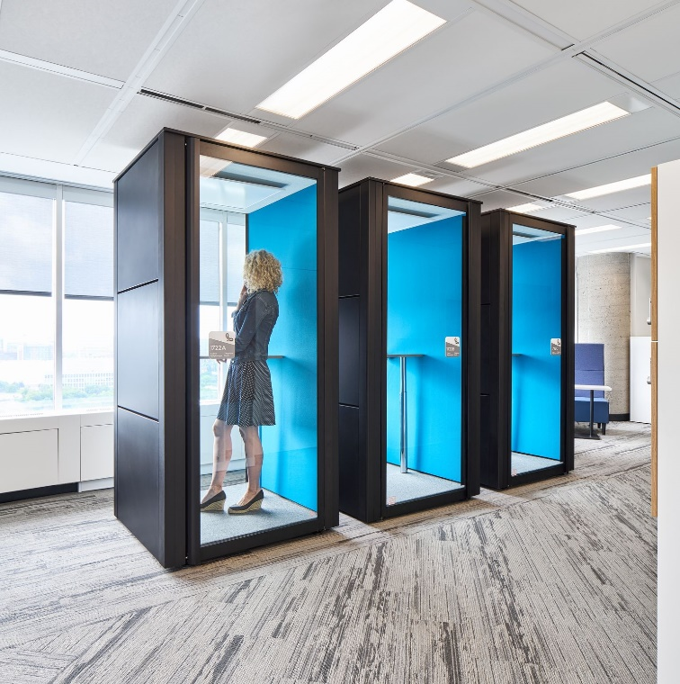
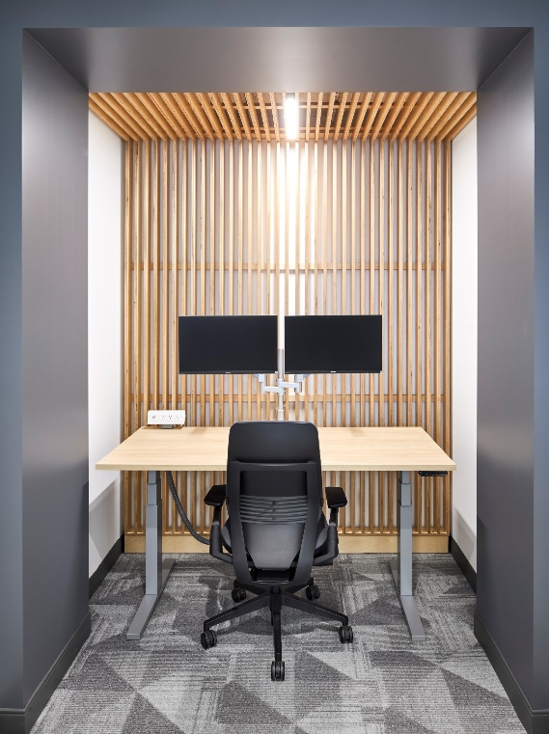
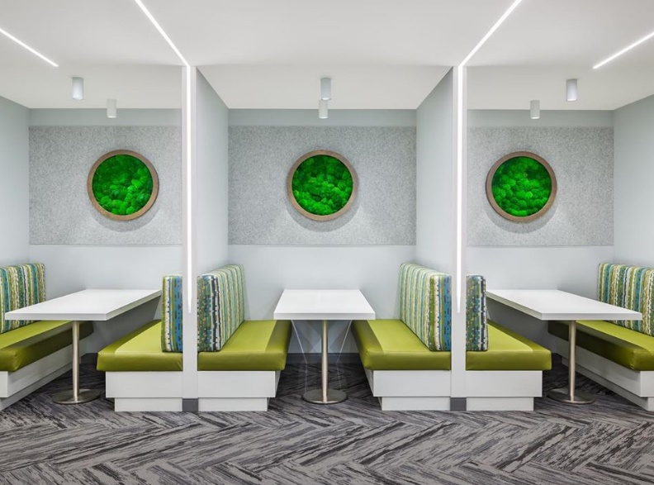
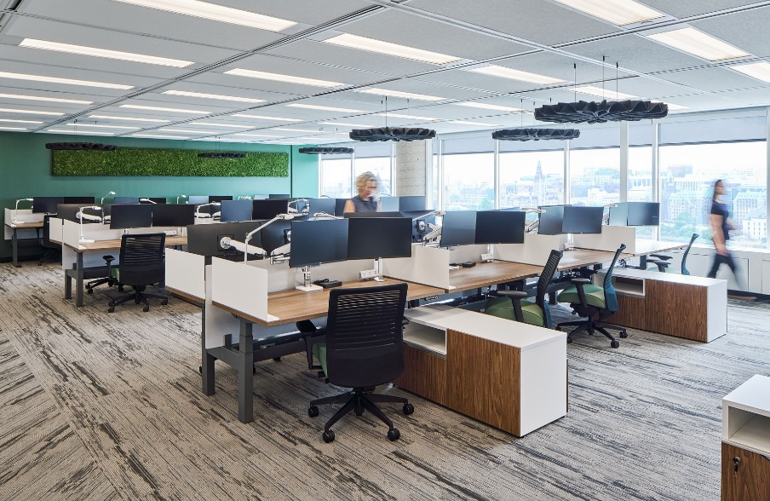
Understanding Workpoints
In a GCworkplace, WORKPOINTS are the building blocks and refer to any area where work can be done—this can range from a lounge chair or a desk, to a meeting room or a teaming area.
Workpoints are designed specifically to support different functional requirements and/or personal preferences. Each workpoint is equipped with furnishings and digital tools that support a variety of tasks and varying degrees of interaction or concentration.
There are 15 different workpoint types in the GCworkplace standard.
You will be asked about your workpoint requirements in the Mini Survey and the Functional Programing Workshop.
Notes:
Examples of recently delivered Gcworkplaces and workpoints
Most of these solutions are free-standing and require minor integration with the building

Slide 18
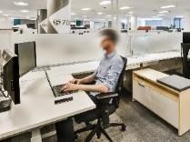
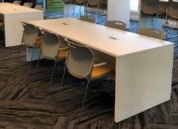
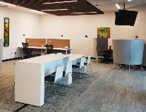
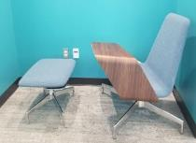
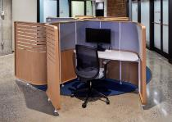
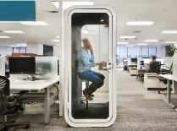
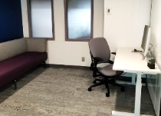
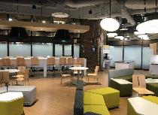
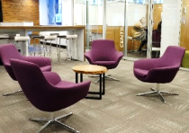
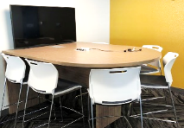
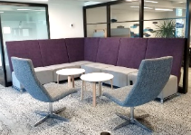
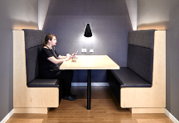
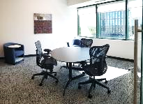
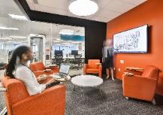
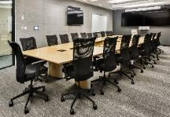
Understanding workpoints: variety for everyone and everything!
INDIVIDUAL WORKPOINTS
Workstation
Touchdown
Study
Reflection point
Focus pod
Phonebooth
Focus room
OPEN
SEMI-ENCLOSED
ENCLOSED
Café
Chat point
Teaming area
Lounge
Huddle
Workroom
Project room
Meeting room
COLLABORATIVE WORKPOINTS

Slide 19
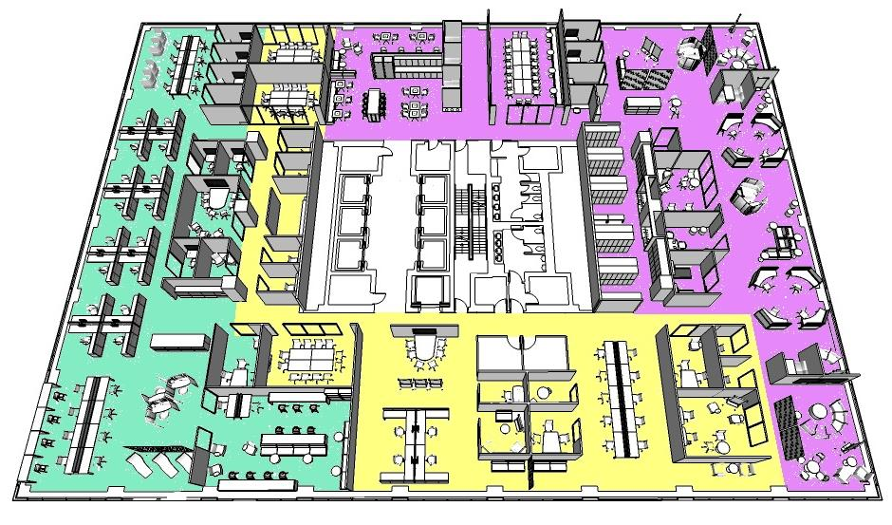
Zoning
The ideal zoning for your workplace will be determined by the Mini Survey and in the Functional Programming Workshop.
A GCworkplace is designed in three functional zones – Quiet, Transitional and Interactive - which ensures that activities are grouped together to reduce noise disruptions. Zoning is a key element of inclusive design as it helps manage acoustics, supports concentration and collaboration and provides people choice and control over their work setting.
The Transitional Zone is usually the entrance and serves as a buffer for noise transfer as well as a means to control traffic
Desiging for transitions between zones helps users navigate the space
Visual elements such as screens provide privacy and refuge in the Quiet Zone to support focus work
Grouping collaborative workpoints together in the Interactive Zone contains visual and auditory disruptions
QUIET ZONE
TRANSITIONAL ZONE
INTERACTIVE ZONE
Notes:
There are 3 different zones in a GCworkplace
The QUIET Zone, which mainly contains individual workpoints, both open and enclosed, provides the highest level of acoustic privacy
The INTERACTIVE Zone, which contains a mix of open or enclosed collaborative and open or enclosed individual workpoints, provides a space meet, socialize and speak at normal volume
And the TRANSITIONAL Zone is the buffer zone that allows the other two to co-exist.

Slide 20
Design Inspiration
The design inspiration for the Workplace Transformation Program is Canada’s Natural Landscapes.
The natural world is full of colors that attract attention, that blend beautifully with its background and create extraordinary displays.
The workplaces delivered through this program will strive to highlight the beauty of our country and the inspiration it provides by showcasing the stunning colors found in nature.
The designs will incorporate imagery of Canadian landscapes, natural colors and materials and deliberate emphasis on consideration of Indigenous design elements.
The Program offers the choice between 3 standard mood boards which illustrate the color palette and general aesthetic of the workplace.

Slide 21
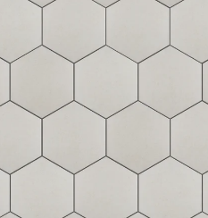
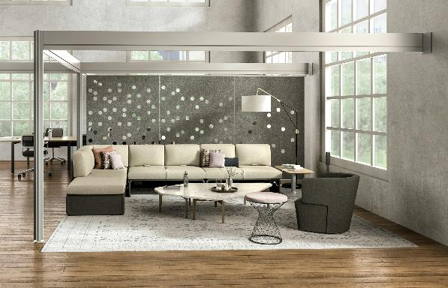
Mood Board 1
Standard Finishes:
Interior Accents:
Cabinetry and tiles
Color palette
Art concept and wall features
Fabrics and textiles
Acoustical solutions and accents
Flooring

Slide 22
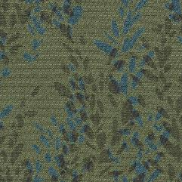
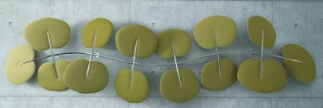
Mood Board 2
Standard Finishes:
Interior Accents:
Cabinetry and tiles
Color palette
Flooring
Fabrics and textiles
Wallpaper and wall murals
Acoustical solutions and planter

Slide 23
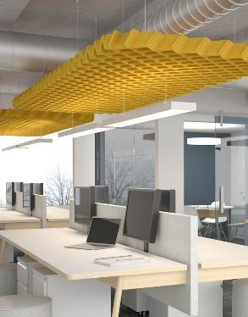
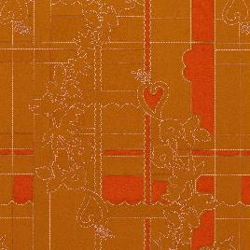
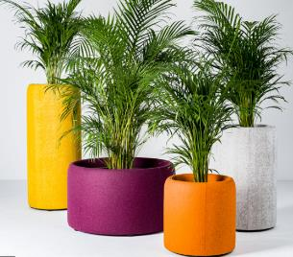
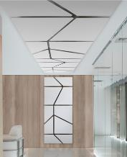
Mood Board 3
Standard Finishes:
Interior Accents:
Cabinetry and tiles
Color pallet
Art and mural inspiration
Fabrics and textiles
Acoustical solutions
Flooring

Slide 24
Indigenous Design Elements
In support of GoC reconciliation commitments, it is important to honour First Nations, Inuit, and Métis communities of Canada by incorporating culturally appropriate design elements and promoting Indigenous economic opportunities.
The goal is for all GCworkplaces to reflect and be representative of Indigenous cultures.
The GCworkplace Indigenous Design Guidelines
As per the Guideline, all Workplace Transformation projects will:
Create a design concept that conveys a strong connection to nature (land, water etc.)
Apply Indigenous design guiding principles such as maximizing access to daylight and connection to the outdoors
Use natural textiles (preferably bio-based) and materials
Focus on locally sourced materials and products
Integrate local indigenous art (when possible) and incorporate a permanent Indigenous Territorial Acknowledgement

Slide 25
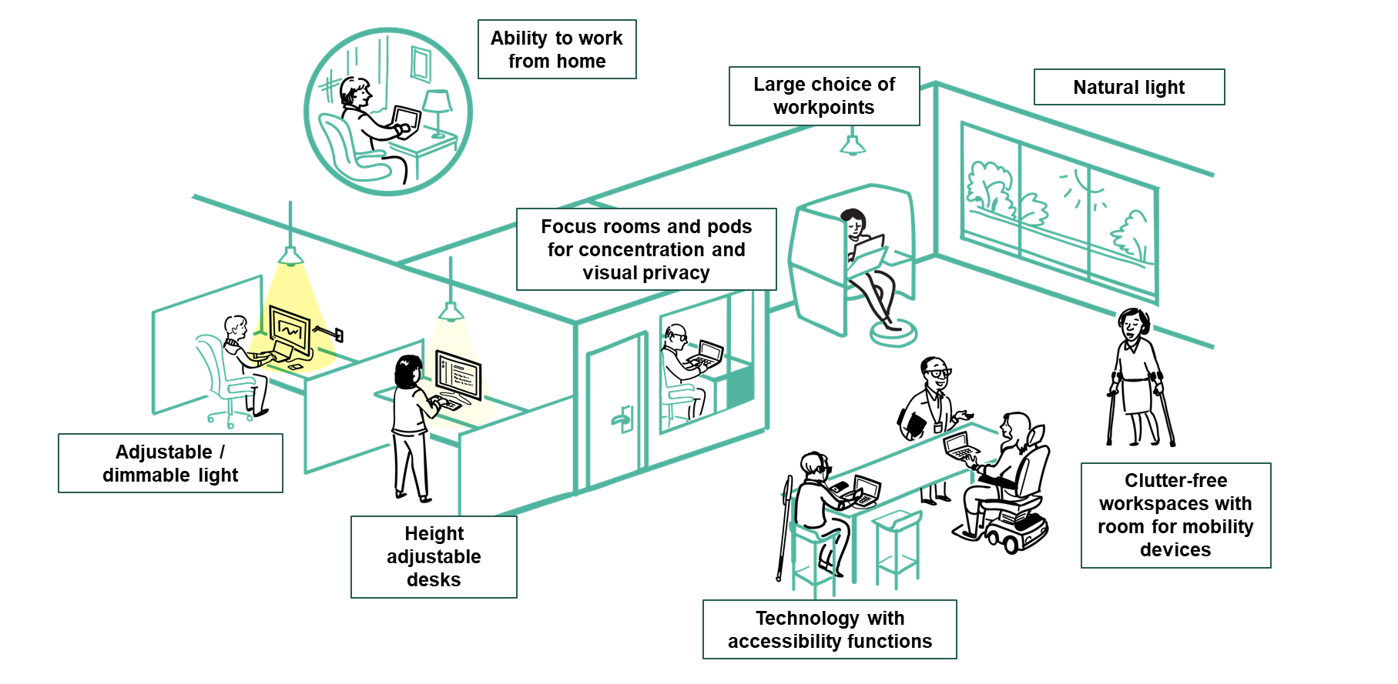
An Accessible and Inclusive Workplace by Design
GCworkplace has been developed to be an accessible and inclusive workplace design standard by providing occupants with full control over the work settings that best suits their functional needs, knowing that we all have different abilities, disabilities and personal preferences.
By integrating accessibility at the onset of the design phase, GCworkplace is promoting an inclusive, equitable and adaptive workplace.

Slide 26
Design Methodology
The program has a specific design methodology including predefined concept design steps. This process aims to ensure consistency, efficiency in delivery, and to clearly communicate the intent.
Employee input is crucial!
Pre-Planning
Client Consultation
Concept Design
STEP 1
STEP 2
STEPS 3a & 3b
STEP 4
STEP 5
STEP 6
Site
Assessment
Test Plan
a. Info Session b. Functional Programming Lite
Mini Design Brief
Concept Plan & Presentation
Client Selections and Approvals
A Generic Test Plan is developed to help visualize the design possibilities
a. Townhall Session
Brief report outlining results of functional programing lite
Identification of ideal Activity Profile
For client approval
Development of 1 preliminary concept plan
Presentation of plan and mood boards
Revised floor plan is issued for client approval
Feedback collected during workshop
Client selects preferred mood board
Concept plan may be revised once
Client sign-off of approved plan and mood board
The Site is assessed required intervention and furniture inventory
b. Mini functional programming survey & Project Initiation Form
Functional programming workshop

Slide 27
Design Methodology
Steps 3a, 3b & 4 – Client Consultation Process
The key to the success of a workplace modernization project is a clear understanding of the users’ workstyles and requirements.
This is where you come in! We need to hear from you. Your valuable contribution and engagement will be required
at the following 4 steps:
!! DELETE THIS !!
Ensure this text reflects your decisions on participation in the engagement activities
3a Workplace Transformation Townhall Session – HAPPENING NOW!
This session informs employees and representatives of the program objectives, process and inclusions. This event aims to ensure a clear understanding of the Workplace Transformation Project process and to prepare you to provide your requirements.
3b Functional Programming Lite
A Project Initiation Form will be sent to client representatives to obtain information on strategies and special requirements.
A mini web-based survey will be issued to all employees to collect information on activities and tasks performed in the office.
A Workshop is held to discuss and validate survey results, present options, and document specific requirements.

Slide 28
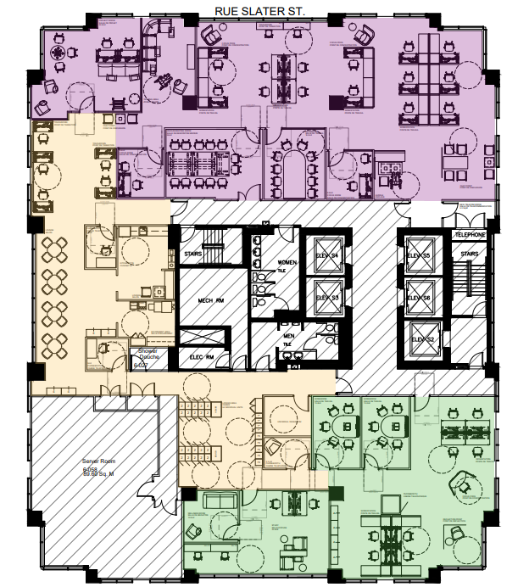
Design Methodology
Step 4 – Mini Design Brief
At the end of the consultation phase, a report is produced which contains all design requirements and proposed solutions for client approval.
Step 5 – Concept Plan & Presentation
Based on information gathered during the consultation process, a concept plan for each floor will be developed. The plan is developed based on the GCworkplace Activity Profile, and specific client requirements.
The concept plan is presented to the clients during a workshop. The presenter will walk-through the floor plan, explaining the design intent and rationale.
Step 6 – Client Selections & Approvals
Clients will be given the opportunity to provide feedback on the concept plan resulting in a maximum of 1 revision for approval.
Clients will also select their preferred mood board which will serve as the basis for the design development.

Slide 29
Workplace Transformation Program YOUR EXPERIENCE AS AN EMPLOYEE

Slide 30
On the way to the new workplace
Our organization's vision for this new workplace is fully adapted to a new reality where the workplace will be a tool that will allow you to perform your work activities based on both flexibility and preference. In order to support you in this transition, we are proposing a roadmap that will provide you with the essential information and tools you need to participate in shaping the workplace of the future and the experience you will have, whether you are in the office or working remotely.
Old workplace + old ways of working
Future workplace + new ways of working
Learning roadmap
The secret of change is to focus all of your energy not on fighting the old, but on building the new! - Socrates
Notes:
Peu importe la stratégie qui est en place ou planifier, il y a une opportunité de se questionner et repenser comment cette solution définie l'expérience employé.
L'expérience employé est un concept que nous mettons de l'avant depuis la mise en œuvre du programme de Milieu de travail GC. Cette expérience employée est influencer par trois dimensions: la dimension de l'espace, la dimension numérique et finalement la dimension sociale ou culturel de l'organisation. Ceci s’applique aussi dans le contexte du retour en milieu de travail.
Lors de la définition d’une stratégie, les éléments définis sont souvent axées sur le qui, quoi, quand et où, et c’est souvent ce qui est communiqué.
Afin de soutenir l'adoption de cette stratégie par les employés, il est primordiale de communiquer le pourquoi et le comment de ce retour en milieu de travail.
Pourquoi je retourne au milieu de travail?
Quel sera le cadre qui sera en place?
Quel seront les outils disponibles (autant outils de l'espaces de travail, les points de travail, la réservation de points de travail, que les outils numériques).
Comment tout cela fonctionnera-t-il?
Comment je serai équipé pour utiliser l'Espace et les outils?
Ce sont toutes des questions qu'ils faut se poser et adresser pour faciliter l'Expérience de l'Employé.

Slide 31
Employee roadmap towards the future workplace
1
Learn
Understand the nature of the change and the need for change.
What benefits do you gain from this change?
2
Participate
Have your say and help shape the future of your new workplace.
Get involved and support the change.
3
Get equipped
Access resources on how to change, acquire new skills and learn new behaviours.
Get ready for the new way of work.
4
Live it and celebrate!
Use your new knowledge, skills and behaviours to adopt the new way of working.
Celebrate your change journey.

Slide 32
Employee roadmap – Activities overview
1
Learn
Project kick-off Townhall
Information package + Q&As
Recurring newsletter
2
Participate
Mini Design Survey
Workplace engagement
activities
Community norms creation (etiquette)
3
Get equipped
New tools training
New ways of working workshops
Workplace user guide
4
Live it and celebrate!
Tour of the modernized space
Hybrid Ribbon-cutting ceremony
Post-occupancy survey
Notes:
Details for each activity included in the Employee presentation template, in the CM Program in-a-box

Slide 33
Get ready to participate
Answer the Mini Design Survey!
The first activity you will be asked to participate in is the completion of the Mini Design Survey. The data gathered from this survey is key for the PSPC Design Team to define the activity profile of the workplace, the zones and the ideal workpoint distribution to reflect activities performed in the workplace.
Who : The survey will be distributed to all employees that will be assigned to this space
When : You should expect to receive the survey link in an email that will be sent to you by [name]. You will have [5] days to answer the online survey. It only takes 5 minutes to answer!
How can I get prepared: Think about your future workspace and your new ways of working in a hybrid work model*…as you will be asked to provide information on your work activities, your functions and which activities you intend to perform in an office environment that will be IT enabled and suited to support employees preferences and various tasks.
*HYBRID WORK: Each organization defines their own hybrid model that will allow employees to work from various locations and work settings in support of flexibility.
GCworkplace and GCcoworking provides workplace solutions to support all hybrid work models.

Slide 34
Resources
Workplace Transformation GCpedia page - coming soon
GCworkplace/Resources - GCpedia
For more information on the Program, please write to :
TPSGC.SIMilieudeTravailGC-RPSGCWorkplace.PWGSC@tpsgc-pwgsc.gc.ca

