Slide 1
PFAN Programme francophone des autorités de noms
Description des collectivités
Module 4
Notes:
(Date of slide or last update given at the top of the notes for each slide)

Slide 2
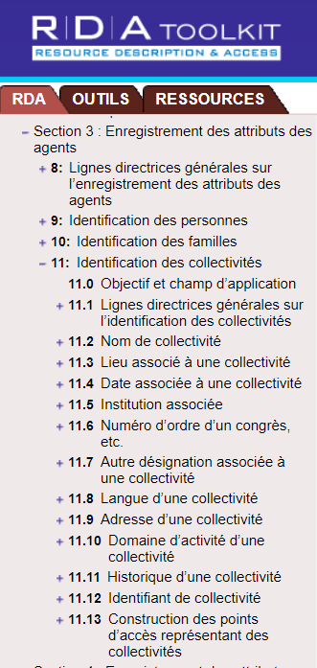
Chapitres 8 et 11 de RDA
Notes:
March 20, 2017
Guidelines for describing corporate bodies in authority records are found in RDA Chapters 8 and 11.

Slide 3
Définition de « collectivité » (RDA 8.1.2)
Le terme collectivité désigne une organisation, ou un groupe de personnes et/ou d’organisations, qui est identifiée par un nom particulier et qui agit ou peut agir comme une unité.
Notes:
May 1, 2013
There is also a definition given at 11.0, which appears in a later slide.

Slide 4
Codage MARC
• La plupart des collectivités sont codées dans une X10
Premier indicateur « 1 » pour le nom d’une juridiction
Premier indicateur « 2 » pour un nom en ordre direct
• Les réunions, les évènements et les expéditions en ordre direct sont codés dans une X11
Dans RDA, le premier indicateur est toujours « 2 »
• Comme pour les autres notices d’autorité, les notices RDA pour les collectivités sont codées « z » dans 008/10 (« Règles de catalogage descriptif ») et « rda » dans la sous-zone $e de la 040.
Notes:
Updated August 12, 2019

Slide 5
Publication en série
Society for Conservation Biology
Notes:
December 13, 2016. Removed MARC coding—premature.
Here’s an example of a corporate body, taken from a serial.

Slide 6
Monographie
Museum of Fine Arts, Houston
Notes:
December 13, 2016. Removed MARC coding.
Monographic example.

Slide 7
Fondation Kurt Weill pour la musique
Site Web
Notes:
December 13, 2016. Removed MARC coding.
Here we see the name of a corporate body as presented on its website.

Slide 8
Collectivités considérées comme créatrices (19.2.1.1.1)
Les collectivités créent des documents (des archives)
• Les collectivités créent des publications en série (p. ex. des bulletins d’information, des rapports trimestriels)
• Les collectivités créent des monographies (p. ex. des manuels, des actes de congrès, des catalogues, des annuaires)
• Les collectivités créent des ressources Internet (p. ex. des sites Web de compagnies ou des blogues)
Notes:
May 1, 2013
Like other entities, corporate bodies may serve as creators.
Some additional examples of corporate bodies as creators include some legal works (e.g. laws, treaties), the collective activity of a performing groups (e.g. sound recordings) and cartographic resources (maps, atlases).
They may also be contributors or subjects.

Slide 9
Collectivités considérées comme contributrices
Les collectivités peuvent contribuer à une expression ou
peuvent être associées à des manifestations ainsi qu’à des items, par exemple :
‐ Interprètes Sœurs Boulay Orchestre XL-5
‐ Éditeurs Weathervane Press Barbarian Press
‐ Propriétaires Québec (Province). Bibliothèque de l'Assemblée nationale
Galerie d'art d'Ottawa
Notes:
Updated August 12, 2019: added examples
In addition to these, there are many other ways corporate bodies can be related to works, expressions, manifestations, or items.

Slide 10
Collectivités comme sujets
Les collectivités peuvent également être le sujet d’œuvres
610 26 Society for Conservation Biology.
610 16 États-Unis. $b Department of Homeland Security.
611 26 Jeux olympiques $n (30es : $d 2012 : $c Londres, Angleterre)
Notes:
May 1, 2013
MARC coding for subjects is the 6xx fields. Second indicator shows the subject vocabulary, 0 indicates that this form conforms to use with LCSH.

Slide 11
Transcription et emploi des majuscules (RDA 11.2)
8.5.2. Se référer à l’annexe A.2 pour l’emploi des majuscules
8.5.4. Signes diacritiques : les enregistrer tels qu’ils figurent; les ajouter s’il est certain qu’ils font partie intégrante du nom mais qu’ils ont été omis dans la source
8.5.5. Conserver les traits d’union si la collectivité les utilise
8.5.6. Instructions sur les espaces entre les initiales
8.5.7. Abréviations. Observer l’usage de la collectivité
8.4. Langue et écriture. Politique du PFAN = Romanisation des écritures vernaculaires.
Notes:
March 20, 2017: updated speaker notes.
A.2.1
In general, capitalize the first word of each name; capitalize other words applying the guidelines given under A.10–A.55, as applicable to the language involved. For names with unusual capitalization, follow the capitalization of the commonly known form.
B.2
Use only the following abbreviations in names of agents and places:
a) those that are integral parts of the name (e.g., “Wm.”) if the agent or place* uses the abbreviation
b) certain names of larger places recorded as part of the name of another place
* There are some exceptions when dealing with geographic places. These are discussed in the Places module.

Slide 12
Source consultée (RDA 8.12)
Enregistrer dans une zone 670 ou dans les sous-zones $u et $v des 3XX
Toujours inclure une 670 pour la ressource à cataloguer
D’autres zones peuvent être incluses si nécessaire afin de justifier l’information dans la description
Présentation suggérée :
670 $a Titre propre, date : $b emplacement dans la source (données)
Notes:
May 1, 2013
This is a LC-PCC core element.

Slide 13
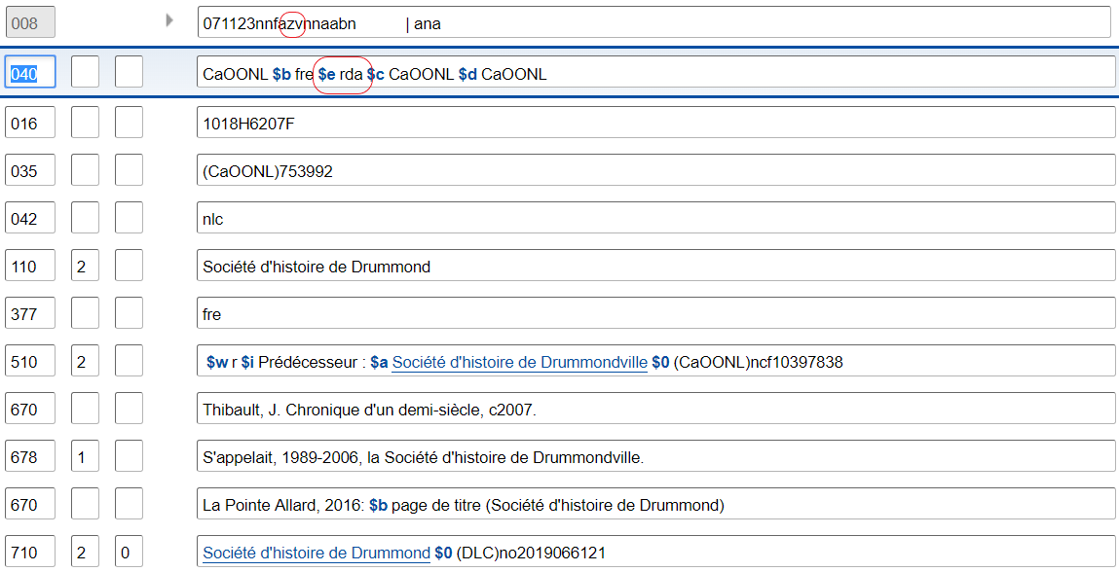
Notes:
December 4, 2019: replaced screenshot; added $i to the 510 field
[Note: do not use $q/$r in 046 until implemented]
The MARC fields 008/10 (Rules) and 040 indicate that an authority record was constructed according to RDA.
Note: The preferred order of the placement of subfields in 040 is: $a $b $e $c. Some earlier records (from before the policy was set) in the LC/NAF appear with $e rda in different position.

Slide 14
Définition de « collectivité »
RDA 11.0 : Doit être identifiée par un nom particulier et non par une description générale
Les exemples incluent les associations, les institutions, les entreprises sans but lucratif, les gouvernements, etc.
Inclut également les vaisseaux et les évènements ponctuels tels que les compétitions sportives, les expositions, les festivals
Notes:
Updated August 12, 2019: revised third bullet because vessels are not ad hoc events
First bullet: The name may actually be an acronym or initialism (RDA 11.2.2.5).
In order to meet the RDA definition of a corporate body:
1. It must be an organization or group;
2. It must be identified by a particular name; and
3. It must act or be capable of action.
Merriam-Webster dictionary definitions of “ad hoc”:
adverb: for the particular end or case at hand without consideration of wider application
adjective: 1. a: concerned with a particular end or purpose b: formed or used for specific or immediate problems or needs. 2. fashioned from whatever is immediately available: improvised

Slide 15
Identification des collectivités : Éléments fondamentaux (0.6.7)
• Nom privilégié de la collectivité
• Emplacement d’un congrès, etc.
• Date de congrès, etc.
• Institution associée (fondamental dans certains cas)
• Numéro d’ordre d’un congrès, etc.
• Autre désignation (si le nom d’une collectivité n’évoque pas une collectivité)
• Identifiant
Notes:
March 20, 2017
Open to RDA 0.6.7, looking for core elements for the corporate body. CLICK THROUGH as people find them.
Remember “core” does not necessarily mean the information has to become part of the authorized access point. It simply means it must be recorded as part of the description if applicable and readily ascertainable.

Slide 16
Identification des collectivités : Fondamental si nécessaire d’établir une distinction (RDA 0.6.7)
Autre lieu associé à la collectivité
Date de fondation
Date de cessation
Période d’activité de la collectivité
Institution associée
Autre désignation associée à la collectivité
Notes:
November 25, 2015
Open to RDA 0.6.7, looking for core elements for the corporate body. CLICK THROUGH as people find them.

Slide 17
Entités ambigües « Division du monde »
DCM Z1 App.1,
SHM H 405
Aéroport de Fredericton
Coupe Stanley (Hockey)
Tour de la Bourse
(Montréal, Québec)
Prix Juno
Elmendorf Air Force
Base (Alaska)
Aéroports : H 405 Groupe 1 -
MARC 110, RDA
Événements sportifs : H 405 Groupe 1 - MARC 111, RDA
Immeubles de bureaux : H 405 Groupe 2 - MARC 110, SHM
Prix, récompenses : H 405 Groupe 2 -
MARC 150, SHM
Camps militaires (Actifs) : H 405 Groupe 1 -MARC 151, RDA
Notes:
March 20, 2017 (reformatted, added animation, revised speaker notes)
January 19, 2017 (rewrote for SHM H 405)
Note to Instructor: arrows and group from H 405 appear on click. May use as exercise: For each entity, should it be established in the Name Authority File or Subject Authority File? What MARC tag?
Ambiguous Entities “Division of the World”:
Type 1 = establish in NAF = Name Authority File, following RDA
Type 2 = establish in SAF = Subject Authority File, unless needed for descriptive cataloging (if so, establish in NAF); follow SHM with RDA
1) If you’ll remember, we discussed this documentation at the beginning of the class on Day 1. This is the piece of info that is actually found in about three different places. It’s important to remember to check this anytime you are establishing a type of corporate body that you don’t usually establish, because it can surprise you. Plus, there is the fact that this list has changed over time, so you can’t blindly trust the database to guide you correctly as to whether something should be a name or subject authority record.
2) Remember that if this document does not answer your question, feel free to consult with the Policy & Standards Division.
SHM H 405: https://www.loc.gov/aba/publications/FreeSHM/H0405.pdf

Slide 18
Exercice
Quels éléments fondamentaux pouvez-vous identifier sur la Geological Society of America?
Notes:
Updated December 4, 2019: slide reference in speaker notes
Note to Instructor: Suggested answers are given on Slide 21, in the notes area, not on the slide. Trainees do not have answers for the exercise in their manuals.

Slide 19
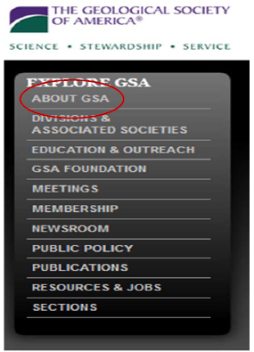
Exercice
Notes:
May 1, 2013

Slide 20
Exercice
Notes:
May 1, 2013

Slide 21
Exercice
Notes:
Updated: March 20, 2017
POSSIBLE ANSWERS:
**Preferred name: Geological Society of America
Variant name: GSA
*Date established: 1888
Field of activity: Geosciences
*Location: Boulder, CO
** = core element
* = core if needed to distinguish

Slide 22
Choix et enregistrement du nom privilégié (RDA 11.2)
Le nom privilégié devrait être la forme du nom sous laquelle la collectivité est couramment identifiée (RDA 11.2.2)
Les formes trouvées dans les sources d’information privilégiées dans les manifestations associées à la collectivité (p. ex. la page de titre de monographies) sont présumées correspondre à la forme du nom sous laquelle la collectivité est couramment identifiée
Notes:
March 20, 2017: updated to reflect current RDA language.

Slide 23
Nom privilégié choisi à partir des sources privilégiées
Notes:
May 1, 2013

Slide 24
Nom privilégié (RDA 11.2)
Enregistrer le nom sous lequel une collectivité est connue
directement sauf si son nom appartient à un ou plusieurs
des types classés sous 11.2.2.14
110 2_ Antioch University
110 2_ American Society for Engineering Education
110 2_ 5 Browns
110 2_ AFL-CIO
Notes:
March 4, 2020
5 Browns: this is the name of a classical piano ensemble consisting of five siblings
AFL-CIO: the commonly known name may be an abbreviated form or an acronym

Slide 25
Nom privilégié (articles initiaux)
11.2.2.8. Lors de l’enregistrement du nom privilégié d’une collectivité, inclure un article initial s’il y en a un
The Library Association
Alternative. Omettre un article initial, sauf si l’accès au nom doit se faire sous cet article
Library Association
Pratique du PFAN : Omettre les articles initiaux, sauf si l’accès au nom doit se faire sous cet article
110 2_ Library Association
mais
110 2_ Los Angeles String Orchestra
Notes:
New Slide: Feb. 24, 2014
RDA was revised in 2012 to call for including initial articles if an entity uses them. This follows the principle of representation (describe the entity as it describes itself). However, realizing that systems still needed to drop initial articles in order to file correctly, an alternative was given to omit the initial article. PCC will follow the alternative.

Slide 26
Nom privilégié (Termes indiquant que la collectivité est constituée en personne morale, etc.)
RDA 11.2.2.10. Omettre un adjectif ou une abréviation indiquant que la collectivité est constituée en personne morale (par exemple, Incorporated, Inc., e.V., ltée, etc.), sauf s’ils font partie intégrante du nom ou qu’ils sont nécessaires pour préciser que le nom est celui d’une collectivité
Note : « Compagnie » ou « Corporation » ne sont pas considérés de tels termes
Bailey Motor Company et non Bailey Motor Company Ltd.
Merck & Co. et non Merck & Co. Inc.
United Airlines et non United Airlines, Inc.
Deutsche Gesellschaft für Akustik et non Deutsche Gesellschaft für Akustik e.V.
Mais :
Accepted, Inc.
Seattle's Best Coffee, LLC
James R. Murphy Incorporated
Financial Skills Limited
26
Notes:
December 4, 2019: replaced Apple Computer, Inc. example with Accepted, Inc. because many catalogers feel that Apple Computer is so well known that it is clear as a corporate body
RDA 11.2.2.10 also instructs us to omit
b) a term indicating state ownership of a corporate body
c) a word or phrase, abbreviated or in full, indicating the type of incorporated entity (e.g., Aktiebolaget, Gesellschaft mit beschränkter Haftung, Kabushiki Kaisha, Società per azione).
These are not mentioned on the slide because they are rare in NACO work.
Note: the form of the term of incorporation is based on usage, so some names will have Inc. and others Incorporated, some Ltd. and others Limited.

Slide 27
Exercice
Enregistrer le nom privilégié des quatre collectivités que nous avons vues jusqu’ici dans vos formulaires de travail
Notes:
Updated: Feb. 24, 2014
Instructor’s note: Refer trainees back to slides 5, 6, 7 and 21 for the information needed to complete this exercise.
Suggested answers are given below. Trainees do not have answers for the exercise in their manuals.
ANSWERS:
110 2 $a Society for Conservation Biology
110 2_ $a Museum of Fine Arts, Houston
110 2_ $a Kurt Weill Foundation for Music
110 2_ $a Geological Society of America

Slide 28
Nom privilégié (RDA 11.2.2)
Formes différentes du même nom (11.2.2.5)
Si des variantes de forme du nom sont trouvées dans les manifestations associées à la collectivité, choisir le nom qui figure dans les sources d’information privilégiées
Si des variantes de nom figurent dans la source d’information privilégiée, choisir le nom qui est présenté de façon formelle comme le nom privilégié
Notes:
March 20, 2017: updated to reflect current RDA language.
The RDA glossary defines the preferred name for the corporate body as:
The name or form of name chosen to identify a corporate body.
The preferred name is used as the basis for the authorized access point representing that body.

Slide 29
Nom privilégié (RDA 11.2.2)
Formes différentes du même nom (11.2.2.5) - Suite
Si aucun nom n’est présenté de façon formelle, choisir la
forme du nom trouvée la plus couramment
S’il n’y a pas de forme du nom trouvée le plus
couramment, choisir une forme courte du nom
Notes:
Updated: Feb. 24, 2014
The brief form may be an initialism or an acronym. The brief form must be sufficiently specific to differentiate the body from others with the same or similar brief names.

Slide 30
Nom privilégié (RDA 11.2.2)
Langue du nom (11.2.2.5.2)
Si le nom se présente dans différentes langues, choisir la forme dans la langue officielle de la collectivité comme nom privilégié
ÉP de BAC-BAnQ : S’il y a plus d’une langue officielle
et que l’une d’elles est le français, choisir la
forme en français comme nom privilégié
Notes:
May 1, 2013

Slide 31
Nom privilégié (RDA 11.2.2)
Organisations internationales (11.2.2.5.3)
Si le nom d’une organisation internationale figure dans la
langue privilégiée par l’agence créant les données dans
les manifestations qui lui sont associées, choisir cette
forme comme nom privilégié.
ÉP de BAC-BAnQ : Si le nom d’une organisation internationale
figure en français dans les ressources qui lui sont associées,
choisir cette forme comme nom privilégié.
Notes:
August 12, 2019: added some examples in notes
Some examples:
United Nations, not Nations Unies, nor Naciones Unidas, nor Nações Unidas, nor Vereinigte Nationen,
nor Lian he guo, etc.
International Sauna Society, not Internationale Sauna-Gesellschaft, nor Société international de sauna
International Botanical Congress, not Congreso Internacional de Botánica, nor Congrès international
de botanique, nor Mezhdunarodnyĭ botanicheskiĭ congress
World Chess Federation, not Fédération internationale des échecs, nor Federación Internacional de
Ajedrez, nor Världsschackförbundet
Pan American Games, not Juegos Panamericanos, nor Jogos Pan-Americanos, nor Pan-Amerikaanse Spelen,
nor Jeux panaméricains

Slide 32
Nom privilégié (RDA 11.2.2)
Changement de nom (11.2.2.6)
Si une collectivité change de nom, créer une
nouvelle notice pour le nouveau nom. Utiliser la forme
antérieure avec les ressources associées au nom antérieur; et
la forme ultérieure avec les ressources associées au nom
ultérieur
Loft, Inc. Pepsi‐Cola Company PepsiCo
Notes:
May 1, 2013
11.2.2.6
If the name of a corporate body has changed (including changes from one language to another), choose the earlier name as the preferred name for use with resources associated with the earlier name. Choose the later name as the preferred name for use with resources associated with the later name.
LC-PCC PS for 11.2.2.6 says to treat minor differences in names as variants names, in the absence of “explicit evidence that a true name change has taken place.” Minor differences include: spelled out forms vs. acronyms; changes in prepositions, articles or conjunctions; a change in punctuation.
Historical note: Loft, Inc. was incorporated in 1919. In 1941 it changed its name to Pepsi-Cola Company and in 1965 to PepsiCo.
Subject treatment: SHM H 460 instructs:
“Assign the heading for the name used by the body during the latest period covered by the work being cataloged.”
However:
“If an earlier name is prominently featured in the work being cataloged, assign the heading for the earlier name as well.”

Slide 33
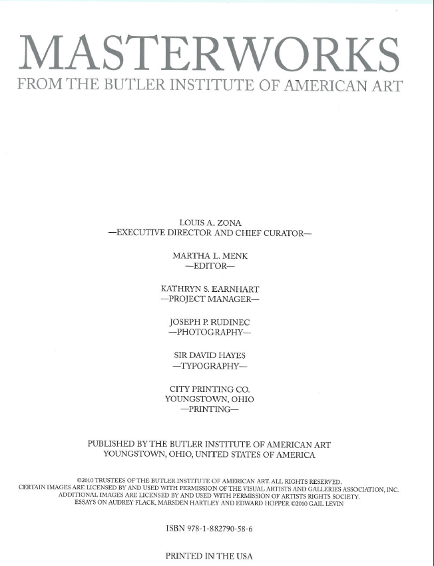
Exercice
Module 4. Description des collectivités
33
Notes:
May 1, 2013
Exercise.
Note to Instructor: Answers below. Trainees do not have the answers in their manuals.
Title page and back cover.
What attributes about the corporate body are found here?
Answers:
Preferred name.
Location

Slide 34
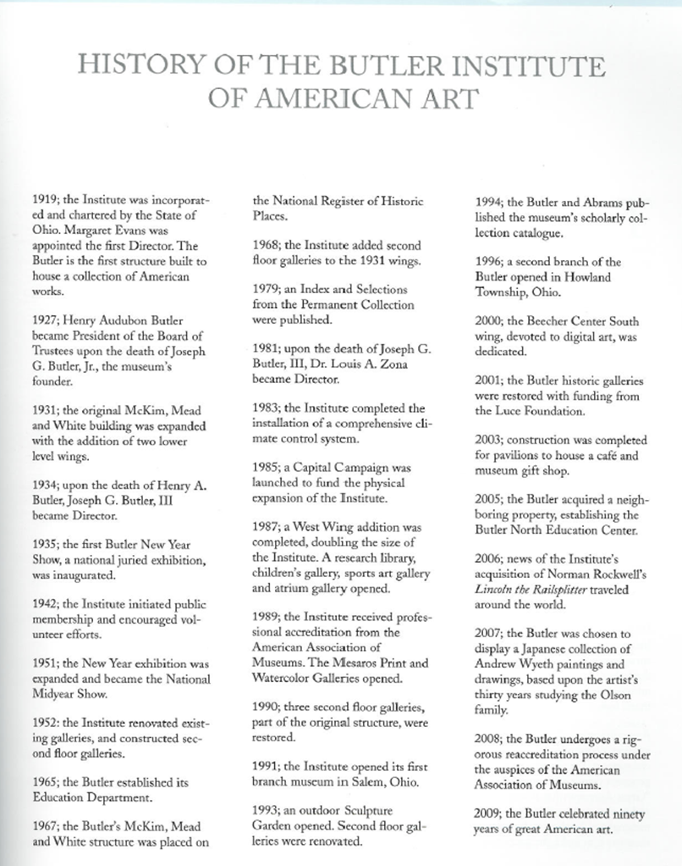
Exercice
Notes:
May 1, 2013
What attributes of the corporate body do we find on this page?
Note to Instructor: Suggested answers are given below. Trainees do not have answers for the exercise in their manuals.
Answer:
Date of incorporation, 1919.
Subordinate body, Butler North Education Center.

Slide 35
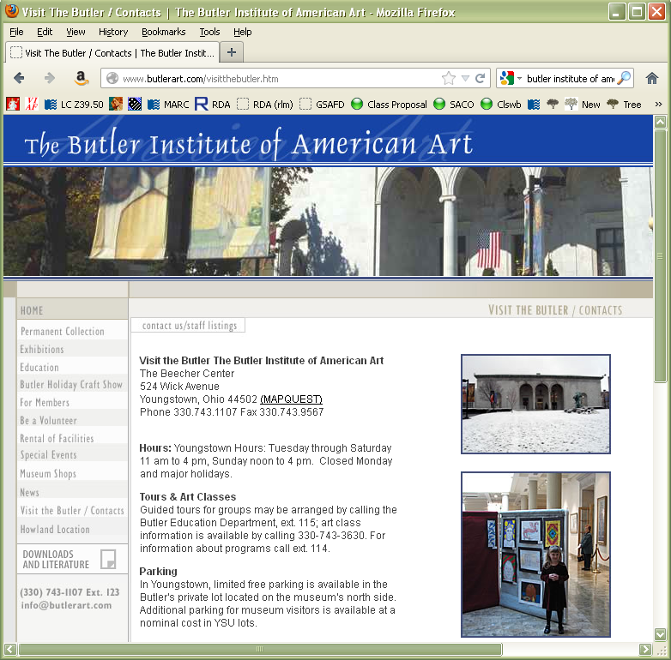
Exercice
Notes:
May 1, 2013
Other attributes?
Note to Instructor: Suggested answers are given below. Trainees do not have answers for the exercise in their manuals.
Answer:
Address: 524 Wick Avenue, Youngstown, Ohio 44502
E-mail: info@butlerart.com

Slide 36
Noms privilégiés pour les collectivités subordonnées et associées RDA 11.2.2.13‐14
Le nom privilégié enregistré directement est le nom par
défaut, sauf si…
… les critères énumérés sous 11.2.2.14 sont satisfaits
Notes:
Updated: Feb. 24, 2014
In AACR2, as well as the earliest releases of RDA, there was a difference in the treatment of governmental and non-governmental bodies regarding subordinate entry. Those differences are no longer made*.
Although most preferred forms are recorded directly, there are several specific instances in which corporate bodies should be recorded subordinately.
11.2.2.14 provides a list of criteria against which you need to test any new name to see if meets any of the criteria for subordinate recording before saying, yes, it should be recorded directly.
These are the rules that you need to constantly recheck when setting up corporate bodies.
* LC-PCC PS 11.2.2.14.6 makes an exception for subordinate U.S. government bodies when one body uses “United States” and another uses “U.S.”

Slide 37
Collectivités subordonnées et associées
Le nom privilégié et le nom en usage ne correspondent pas nécessairement
Nom utilisé : Agricultural Experiment Station of
Auburn University
Nom privilégié : Auburn University. Agricultural
Experiment Station
Notes:
May 1, 2013
What appears on the source does matter, but will not always determine the form of the preferred name.

Slide 38
RDA 11.2.2.14.1
Un nom contenant un terme qui, par définition, implique que la
collectivité fait partie d’une autre collectivité (p. ex.,
département, division, section, branche)
110 2_ Harvard University. $b Department of Physics
110 1_ Hawaii. $b Department of Human Resources Development
Notes:
May 1, 2013

Slide 39
RDA 11.2.2.14.2
Un nom contenant un terme qui suggère normalement une
subordination administrative (p. ex., Comité,
Commission)
110 2_ Medical Library Association. $b
Committee on Continuing Education
110 1_ San Francisco (Calif.). $b Art Commission
Appliquer seulement si le nom de la collectivité supérieure est requis pour
l’identification de la collectivité subordonnée.
mais 110 2_ Honolulu Committee on Aging
et non 110 1_ Honolulu (Hawaii). $b Committee on Aging
Notes:
March 29, 2017: corrected indicator.
The LC-PCC PS lists additional terms that may imply administrative subordination for corporate bodies whose official language is English, French, or Spanish, e.g. board, bureau, office, panel, etc.
N.B. This rule only applies when the name of the higher body is needed to identify the subordinate body, e.g. “Statistical Committee,” “Personnel Commission.”

Slide 40
RDA 11.2.2.14.3
Un nom de nature générale (p. ex., qui ne contient ni des noms
propres ou des adjectifs distinctifs, ni des mots sujets) ou qui
indique seulement une subdivision géographique,
chronologique, numérotée ou désignée par des lettres d’une
collectivité mère
110 1_ États-Unis. $b National Labor Relations Board. $b Library
110 2_ Society of Biblical Literature. $b Annual Meeting
Notes:
September 17, 2018: reformatted slide
Examples of names that are general in nature include: Technical Information Library, Friends of the Library, Annual Meeting.

Slide 41
RDA 11.2.2.14.3
Un nom de nature générale (p. ex., qui ne contient ni des noms propres ou des adjectifs distinctifs, ni des mots sujets) ou qui indique seulement une subdivision géographique,
chronologique, numérotée ou désignée par des lettres d’une
collectivité mère
110 2_ U.S. Fish and Wildlife Service. $b Region 6
110 1_ États-Unis. $b National Weather Service. $b Western Region
110 2_ University of Virginia. $b Class of 2008
Notes:
December 4, 2019

Slide 42
RDA 11.2.2.14.4
Un nom qui n’évoque pas
une collectivité et qui ne contient pas le nom de la
collectivité supérieure
110 2_ Tufts University. $b Human Resources
110 1_ Île-du-Prince-Édouard. $b Tourism Marketing
Branch. $b Research and Evaluation
mais 110 2_ California Records & Information Management
et non 110 1_ California. $b Records & Information Management
Notes:
May 1, 2013
Examples of names that would fail this test and consequently be recorded directly include:
BC Fisheries
California Records & Information Management

Slide 43
RDA 11.2.2.14.5
Le nom d’une faculté, d’une école, d’un collège, d’un
institut, d’un laboratoire, etc. universitaire qui
indique simplement un champ d’études particulier
110 2_ Rutgers University. $b Center for Latin American Studies
Notes:
May 1, 2013

Slide 44
RDA 11.2.2.14.5
mais…
110 2_ École de commerce John-Molson
et non Université Concordia. $b École de commerce John-Molson
110 2_ Chaire de théologie Monseigneur-de-Laval
et non Université Laval. $b Chaire de théologie Monseigneur-de-Laval
110 2_ Institut d’études canadiennes de McGill
et non McGill University. $b Institut d’études canadiennes
et non McGill University. $b Institut d’études canadiennes de McGill
Notes:
Updated August 12, 2019: added a few additional examples
The name of these bodies include more than just the field of study, so RDA 11.2.2.14.5 would not apply. None of these are included in RDA 11.2.2.14.6 because they do not include the entire name of the higher body (i.e. Rutgers University).
Other examples of Rutgers units that are entered directly:
110 2_ Alan M. Voorhees Transportation Center
110 2_ Bloustein Center for Survey Research
110 2_ Douglass College
110 2_ Robert Wood Johnson Medical School
110 2_ Waksman Institute of Microbiology

Slide 45
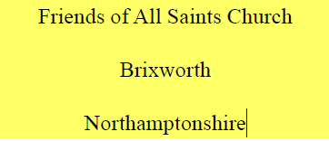
RDA 11.2.2.14.6
Le nom d’une collectivité non gouvernementale portant un nom
qui comprend le nom complet de la collectivité supérieure ou
associée
Notes:
May 1, 2013
This type only applies to non-governmental bodies.
RDA 11.2.2.14.6
Distinguish cases in which the subordinate body’s name includes the names of higher bodies from cases in which the names of higher bodies appear only in association with the subordinate body’s name.

Slide 46
RDA 11.2.2.14.6
Nom : Friends of All Saints’ Church
Nom privilégié de la collectivité supérieure ou associée :
All Saints’ Church
Point d’accès autorisé de la collectivité supérieure ou associée :
All Saints’ Church (Brixworth, Angleterre)
Point d’accès autorisé :
110 2_ All Saints’ Church (Brixworth, Angleterre). $b Friends
Notes:
March 5, 2019: added conference example to names that fail the test and added the entire names of the higher body
LC-PCC PS: The term "includes" in the instruction applies to any linguistic relationship between the name of the body and its parent (higher or related) body, not just to those shown in the examples for the instruction. The phrase "entire name" is the preferred name of the higher or related body, not necessarily the complete authorized access point of that body. For example, disregard additions to the preferred name or the fact that the higher or related body may be subordinate to another body.
Names that fail this test and would be recorded directly include:
BBC Symphony Orchestra (entire name of the higher body = British Broadcasting Corporation)
CU-Boulder Alumni Association (entire name of the higher body = University of Colorado Boulder)
Friends of the Corcoran (entire name of the higher body = Corcoran Gallery of Art)
Annual Meeting of FOIM (entire name of the higher body = Fellowship of Indian Missiologists)
If the authorized access point for the higher or related body includes an addition to the name, include that: in this example, the geographic location is added.

Slide 47
RDA 11.2.2.14.6
Nom : Annual Meeting of the International Whaling Commission
Nom privilégié de la collectivité supérieure ou associée :
International Whaling Commission
Point d’accès autorisé :
110 2_ International Whaling Commission. $b Annual Meeting
Notes:
Updated: Feb. 24, 2014

Slide 48
RDA 11.2.2.14.6
Noms qui ne se conforment pas aux exigences de cette
instruction :
BBC Symphony Orchestra
Collectivité supérieure : British Broadcasting Corporation
CU‐Boulder Alumni Association
Collectivité associée : University of Colorado Boulder
Annual Meeting of FOIM
Collectivité supérieure : Fellowship of Indian Missiologists
Notes:
March 5, 2019: corrected form of University of Colorado Boulder; added speaker note, added third example
In the second example, the University is a related body, not a higher body. Alumni associations are generally not controlled by their universities. They fit the “related” part of “higher or related body”.

Slide 49
Autres types
110 1_ États-Unis. $b General Services
Administration. $b Region 5
110 1_ Vanuatu. $b Ministry of Internal Affairs
and Social Services
110 1_ Boring (Or.). $b City Council
110 1_ Ontario. $b High Court of Justice
Notes:
August 12, 2019: corrected typo in notes
Other types of names that are recorded subordinately include agencies with names that are general in nature; ministries or major executive agencies with no parent agency; legislative bodies; courts, and a principal service of the armed forces of a government.
110 1_ United States. $b General Services Administration. $b Region 5 (Agency with a name that is general in nature. 11.2.2.14.3)
110 1_ Vanuatu. $b Ministry of Internal Affairs and Social Services (Ministry or similar executive agency. 11.2.2.14.7)
110 1_ Boring (Or.). $b City Council (Legislative body. RDA 11.2.2.14.9, see also RDA 11.2.2.19)
110 1_ Ontario. $b High Court of Justice (Court. RDA 11.2.2.14.11, see also RDA 11.2.2.21)

Slide 50
Autres types
110 1_ Allemagne. $b Heer
110 1_ Idaho. $b Gouverneur
110 1_ États-Unis. $b Consulate (Asunción, Paraguay)
Notes:
March 20, 2017: updated speaker notes.
110 1 $a Germany. $b Heer (Armed forces. RDA 1.2.2.14.12, see also RDA 11.2.2.22)
110 1 $a Idaho. $b Governor (Head of state. RDA 11.2.2.14.8, see also RDA 11.2.2.18) – Example included on next few slides.
110 1 $a United States. $b Consulate (Asunción, Paraguay) (Embassies, Consulates, etc. RDA 11.2.2.14.13, see also RDA 11.2.2.23)

Slide 51
Dignitaires gouvernementaux (RDA 11.2.2.18)
Enregistrer le titre des chefs d’État, des chefs de
gouvernement, etc., comme une subdivision de la
juridiction. Enregistrer le titre en français
110 1_ Indonésie. $b Président
110 1_ États-Unis. $b Président
110 1_ Chiapas (Mexique). $b Gouverneur
110 1_ Swaziland. $b Premier ministre
Notes:
March 5, 2019: changed second example Swaziland to France to show point that the English form is now chosen as the preferred form for the title
December 4, 2019: added two more examples at other jurisdiction levels
This category includes a sovereign, president, other head of state, governor, head of government, or chief executive who is acting in an official capacity.
LC-PCC PS to 11.2.2.18.1 instructs to record the title in English.
Recording all these in English represents a change from AACR2 and RDA as first published--in 2012 “record the title in a language preferred by the agency” was made applicable to both heads of state and heads of government; previously it was only applicable to heads of state. The titles of heads of government were recorded in their own language, e.g. the current “France. Prime Minister” was, under the previous instruction, “France. Premier ministre”.
Examples of English terms for heads of government: Prime Minister, Chancellor, Federal Chancellor, Chief Minister, Chief Executive, First Minister, Premier, Governor, Mayor
Examples of English terms for heads of state: President, Sovereign, Emperor, Governor, Governor-General, Sultan, Emir, Grand Duke

Slide 52
Dignitaires gouvernementaux (RDA 11.2.2.18)
Identification d’un titulaire particulier de la fonction
Ajouter :
les années extrêmes de son règne ou de son mandat
le nom de la personne dans une forme courte
110 1_ Indonésie. $b Président (1949‐1967 : Soekarno)
110 1_ Tucson (Ariz.). $b Maire (1951‐1955 : Emery)
Notes:
March 20, 2017: previously slide 90.

Slide 53
Dignitaires gouvernementaux (RDA 11.2.2.18)
Système/thésaurus de la vedette-matière : n
Utilisation de la vedette — Vedette-matière secondaire : b
110 1_ États-Unis. $b Président (1993‐2001 : Clinton)
500 1_ $w r $i Directeur général : $a Clinton, Bill, $d 1946‐
667 UTILISATION COMME VEDETTE-MATIÈRE : Ce point d’accès ne peut pas être employé comme vedette-matière. Les œuvres sur cette personne se trouvent sous Clinton, Bill, 1946-
Notes:
March 5, 2019: added note about requirement for recording the reciprocal relationship in the other NAR
It may be necessary to create an authorized access point for the personal name as well. For subject cataloging, only the personal name form may be used. A see also reference is given to the other form. Add a subject usage note in field 667. The fixed fields for subject heading system and subject usage are also coded to indicate that this form is not used in subject cataloging.
The relationship designator comes from Appendix K.2.3.
The reciprocal relationship must also be made (e.g., a 510 for United States. $b President (1993-2001 : Clinton) should be recorded in the NAR for Clinton, Bill, 1946- ). See PCC Guidelines for the Application of Relationship Designators in NACO Authority Records, Guideline 11.

Slide 54
Dignitaires religieux (RDA 11.2.2.26)
Système/thésaurus de la vedette-matière : n
Utilisation de la vedette — Vedette-matière secondaire : b
110 2_ Église catholique. $b Pape (2005‐2013 :
Benoît XVI)
500 0_ $w r $i Directeur général : $a Benoît, $b XVI, $c pape, $d 1927‐
667 UTILISATION COMME VEDETTE-MATIÈRE : Ce point d'accès ne peut pas être employé comme vedette-matière. Les œuvres sur cette personne se trouvent sous Benoît XVI, pape, 1927-
Notes:
March 5, 2019: added note about requirement for recording the reciprocal relationship in the other NAR
Religious officials, including popes, are treated in a similar manner.
The reciprocal relationship must also be made (e.g., a 510 for Catholic Church. $b Pope (2005-2013 : Benedict XVI) should be recorded in the NAR for Benedict XVI, Pope, 1927- ). See PCC Guidelines for the Application of Relationship Designators in NACO Authority Records, Guideline 11.

Slide 55
Subdivision directe ou indirecte (RDA 11.2.2.15) hiérarchie intermédiaire
Enregistrer le nom de la collectivité comme une subdivision de
l’unité organisationnelle la plus basse dans la hiérarchie qui est enregistrée directement sous son propre nom
• Omettre les unités intermédiaires dans la hiérarchie, sauf si le
nom de la collectivité subordonnée ou associée a été ou est susceptible d’être utilisé par une autre collectivité dans la même organisation
Notes:
May 1, 2013
What appears on the source does matter, but will not always determine the form of the preferred name.

Slide 56
Subdivision directe ou indirecte (RDA 11.2.2.15) hiérarchie intermédiaire
Hiérarchie : American Bar Association ‐ Section of
Business Law ‐ Committee on Nonprofit
Corporations
110 2_ American Bar Association. $b Committee on Nonprofit Corporations
Notes:
May 1, 2013
So, we’ve now covered the 6 types of subordinate bodies.
But once we’ve decided it must be subordinate, we need to look at that organization chart, if at all possible. How many levels are in the hierarchy? How many of those levels must be included in the heading? Remember the basic idea, only enough needed for identification.
The basic idea will be to only put the minimum number of levels of subordination in a heading. You do not want to include the entire organization chart if you don’t have to.
NOTE: Although we have not mentioned variant names, note that there will be a variant name with multiple levels.

Slide 57
Exercice : Collectivité enregistrée de façon subordonnée ou non?
Library of Congress
110 2_ Library of Congress (aucun des types sous RDA 11.2.2.14)
Student Society for Ancient Studies [à la Brigham Young University]
110 2_ Student Society for Ancient Studies (aucun des types sous RDA 11.2.2.14)
Advanced Plans Directorate [à l’Aerospace Corporation]
110 2_ Aerospace Corporation. $b Advanced Plans Directorate (RDA 11.2.2.14.2)
Corporate Grants [à l’Apple Computer, Inc.]
110 2_ Apple Computer, Inc. $b Corporate Grants (RDA 11.2.2.14.4)
Notes:
December 4, 2019: added explanation for first two examples in the slide
Look at LC-PCC PS 11.2.2.14.2 for list of words (Directorate is found there).
Note to Instructor: Answers appear on click. PDFs of slides will have the answers already present, so remind them to look at screen, not handout.

Slide 58
Exercice : Collectivité enregistrée de façon subordonnée ou non?
The Gallery [au Scarborough College]
110 2_ Scarborough College. $b Gallery (RDA 11.2.2.14.3)
Centre for Medieval Studies [à l’University of Toronto]
110 2_ University of Toronto. $b Centre for Medieval Studies (RDA 11.2.2.14.5)
Scripps College Press
110 2_ Scripps College. $b Press (RDA 11.2.2.14.6)
U.S. Department of Defense
110 1_ États-Unis. $b Department of Defense (RDA 11.2.2.14.1)
Notes:
December 13, 2016. Added RDA instruction number to last example.
Note to Instructor: Answers appear on click. Trainees do not have answers for the exercise in their manuals– encourage them to write them in.

Slide 59
Exercice : Collectivité enregistrée de façon subordonnée ou non?
Allegheny County Planning Commission
110 2_ Allegheny County Planning Commission
[La règle RDA 11.2.2.14.2 ne s’applique pas parce que le nom de la collectivité supérieure n’est pas nécessaire à l’identification de la collectivité subordonnée]
Sandy City Council
110 1_ Sandy (Utah). $b City Council (RDA 11.2.2.14.9)
Ambassade du Canada, Washington, DC
110 1_ Canada. $b Ambassade (É-U.) (RDA 11.2.2.14.13)
Notes:
August 12, 2019: replaced Honolulu example because it was identical to example on slide 39
Note to Instructor: Answers appear on click. PDFs of slides will have the answers already present, so remind them to look at screen, not handout.
Allegheny County Planning Commission is not RDA 11.2.2.14.2 (an agency with a name containing a word that normally implies administrative subordination) because the instruction goes on to say:
Apply only if the name of the higher body is required for the identification of the subordinate body.

Slide 60
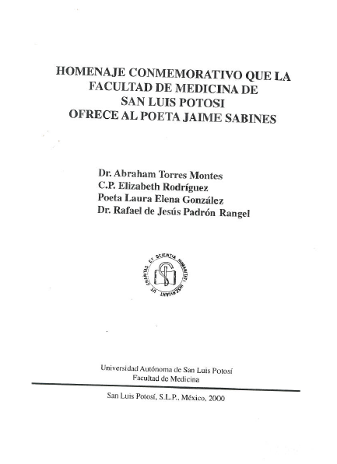
Module 4. Describing Corporate Bodies
60
Notes:
February 24, 2014
A title page from a resource associated with the Facultad de Medicina of Universidad Autónoma de San Luis Potosí. How does the name appear? “Facultad de Medicina” and “Facultad de Medicina de San Luis Potosí.” Is this a subordinate body? Yes. Should we record it under its own name or subordinately? Go through the types in 11.2.2.14. This is 11.2.2.14.5.

Slide 61
Collectivités subordonnées (RDA 11.2)
11.2.2.14. Enregistrer le nom d’une collectivité subordonnée
ou associée comme une subdivision du point d’accès
autorisé représentant la collectivité supérieure ou associée si son nom appartient à un ou plusieurs des types classés sous RDA 11.2.2.14.1–11.2.2.14.6
110 2_ Universidad Autónoma de San Luis Potosí. $b Facultad de Medicina
Notes:
Updated: March 20, 2017
NACO policy requires us to establish all levels in the hierarchy. So if the University hadn’t yet been established, it would have to be established before the Facultad de Medicina can be established. Also note that there is a variant, “Facultad de Medicina de San Luis Potosí.” Record that as is in a 410.

Slide 62
À retenir - important
La « division du monde » (DCM Z1 Annexe 1 et SHM H 405)
Enregistrer directement, sauf si les règles pour la subordination
s’appliquent
Utiliser la forme dans la langue officielle de la collectivité
Si une organisation internationale inclut un nom en français dans ses publications, choisir cette forme
Notes:
May 1, 2013
Base preferred names on the forms found in sources of body's own publications in its own
language.
If an international body includes an English form in its publications, use that form.

Slide 63
Attributs des collectivités : dates
Plusieurs types de date
– Date de congrès, etc. (11.4.2)
– Date de fondation (11.4.3)
– Date de cessation (11.4.4)
– Période d’activité (11.4.5)
• L’élément date de congrès est fondamental. Si cet élément est connu, il devrait être enregistré.
– Cela ne signifie pas nécessairement qu’il est enregistré comme partie du point d’accès
• D’autres dates connues peuvent aussi être enregistrées
Notes:
November 25, 2015
Go to 11.4. Read together.
NOTE: PCC has not yet implemented the period of activity element.

Slide 64
Attributs des collectivités : dates
Instructions de base :
– Date connue : 2005
– Date probable : 1957?
– L’une des deux dates : 1675 ou 1676
– Date approximative : environ 1953
– Une série de dates peut également être enregistrée
Notes:
November 25, 2015

Slide 65
Attributs des collectivités : dates
À l’exception des dates de siècles, cet élément est enregistré dans la zone 046 du MARC dans le format AAAA-MM-JJ ou AAAA-MM ou AAAA (en utilisant le format de date EDTF, avec $2 edtf).
Format EDTF : http://www.loc.gov/standards/datetime/. Consulter ce site Web pour des situations plus complexes.
Les dates de siècles ne s’écrivent pas avec le format EDTF. N’enregistrer que les deux premiers caractères du siècle correspondant (ex. : « 19 » = les dates commençant par « 19 » = 20e siècle) mais sans $2.
• MARC
$q – Date de fondation $s – Début de la période d’activité
$r – Date de cessation $t – Fin de la période d’activité
Notes:
December 4, 2019: added note about coding period of activity dates for corporate bodies
December 12, 2016: moved implementation information to slide (since participants probably do not have the notes)
GO TO MARC 046 field
* NOTE: PCC has not yet implemented $q and $r. DO NOT USE until implementation. Until then, $s and $t stand for date of establishment and date of termination. It is not currently possible to record period of activity of corporate body in 046 because that will eventually go in $s and $t and we don’t want to mix establishment/termination dates with period of activity dates.

Slide 66
Attributs des collectivités : dates
Pour une compagnie fondée en 1960
046 $q 1960 $2 edtf
Pour un groupe musical fondé en 1960 et dissous en 1970
046 $q 1960 $r 1970 $2 edtf
Date de fondation : $q
Date de cessation : $r
Notes:
December 13, 2016 (moved implementation note to slide)
* NOTE: PCC has not yet implemented $q and $r. DO NOT USE until implementation. Until then, $s and $t stand for date of establishment and date of termination.

Slide 67
Attributs des collectivités : dates
Comment exprimer les dates avec le format EDTF
1902? 046 $q 1902? $2 edtf
Environ 1902 046 $q 1902~ $2 edtf
1901 ou 1902 046 $q [1901,1902] $2 edtf
Entre 1950 et 1955 046 $q [1950..1955] $2 edtf
Les dates avant J.-C. sont précédées d’un signe négatif et sont décalées d’une année (parce qu’il n’y a pas eu d’année 0)
147 av. J.-C. 046 $q ‐0146 $2 edtf
Voir https://www.loc.gov/standards/datetime/
Notes:
December 13, 2016. Moved implementation note to slide.
BC dates are one year off because there was no year “0”.
* NOTE: PCC has not yet implemented $q and $r. DO NOT USE until implementation. Until then, $s and $t stand for date of establishment and date of termination.

Slide 68
Date associée à une collectivité (RDA 11.4)
046 $q 1178 $r 1536 $2 edtf
110 1_ Angleterre. $b Court of Common Pleas
510 1_ $w r $i Successeur : $a Angleterre et Pays de Galles. $b Court of Common Pleas
046 $q 1536 $r 1707 $2 edtf
110 1_ Angleterre et Pays de Galles. $b Court of Common Pleas
510 1_ $w r $i Prédécesseur : $a Angleterre. $b Court of Common Pleas
510 1_ $w r $i Successeur : $a Grande-Bretagne. $b Court of Common Pleas
Notes:
September 17, 2018: moved $w to beginning of 510 fields.
The records in this and the next slide show how dates in an authority record can be very helpful in identifying an entity.

Slide 69
Date associée à une collectivité (RDA 11.4)
046 $q 1707 $r 1875 $2 edtf
110 1_ Grande-Bretagne. $b Court of Common Pleas
510 1_ $w r $i Successeur: $a Grande-Bretagne. $b High Court of Justice. $b Common Pleas Division
510 1_ $w r $i Prédécesseur: $a Angleterre et Pays de Galles. $b Court of Common Pleas
Notes:
September 17, 2018: moved $w to beginning of 510 fields.

Slide 70
Lieu associé à une collectivité (RDA 11.3)
Le lieu associé à l’élément collectivité est un élément fondamental pour les congrès et pour les autres collectivités lorsqu’il est nécessaire d’établir une distinction entre des collectivités portant le même nom
• Enregistrer dans une zone 370
370 $e Hamden (Conn.) $2 lacnaf
370 $e Salt Lake City (Utah) $2 lacnaf
370 $e Allemagne $2 lacnaf
370 $e Espagne $2 lacnaf
• Si l’élément a été ajouté au point d’accès, enregistrer entre parenthèses sans codage de sous-zone
110 2_ Children’s Center (Hamden, Conn.)
110 2_ Children’s Center (Salt Lake City, Utah)
111 2_ Congreso Internacional de Linguística Hispánica (Allemagne)
111 2_ Congreso Internacional de Linguística Hispánica (Espagne)
Notes:
Updated: Feb. 18, 2015
NOTE on the conference examples. The qualifier was added to distinguish between two conferences of the same name. The qualifier is not the “conference additions” qualifier, which would be added after the “base” access point, for example:
111 2_ Congreso Internacional de Linguística Hispánica (Germany) $n (6th : $d 2003 : $c Leipzig, Germany)
NOTE TO SPEAKER: RDA REVISION: The example previously contained:
111 2_ West Cork Chamber Music Festival $c (Bantry, Ireland)
This followed RDA 11.13.1.8.2, which said that if a conference, etc. is held in the same place every year, to add the location of the conference to the access point representing the series of conferences. RDA 11.13.1.8.2 was revised in April 2014 and now says “If the access point represents a series of conferences, etc., do not add the number, date, or location of the conferences, etc.”

Slide 71
Exercice
Enregistrer le lieu associé à la Geological Society of America dans une 370
Notes:
December 4, 2019: corrected slide number in instructor’s note; added text to instructor note
Instructor’s note: Refer trainees back to the information on slide 21.
Note to Instructor: Answer given below. Trainees do not have answer for the exercise in their manuals.
370 $e Boulder (Colo.) $2 naf
Could also record associated country, either in same 370 or in a separate field:
370 $c United States $e Boulder (Colo.) $2 naf
or
370 $c United States $2 naf
370 $e Boulder (Colo.) $2 naf

Slide 72
Exercice
Enregistrer l’élément date associée à la Geological
Society of America dans les sous-zones $q et $r de la 046
Notes:
March 20, 2017: updated speaker notes.
Instructor’s note: Refer trainees back to the information on slide 21.
Note to Instructor: Answer given below. Trainees do not have answer for the exercise in their manuals.
Don’t add anything to the authorized access point yet.
046 $s 1888 $2 edtf

Slide 73
Institution associée (RDA 11.5)
Élément fondamental si :
‐ Congrès : Le nom de l’institution fournit une meilleure identification que le nom de lieu
‐ Autres collectivités : Lorsque nécessaire d’établir une distinction et fournit une meilleure identification que le nom de lieu
110 2_ National Portrait Gallery (Smithsonian Institution)
373 Smithsonian Institution $2 lacnaf
Notes:
December 6, 2019: updated speaker notes
RDA 11.5: Record the name of an associated institution by using the preferred name for the institution. Record an associated institution as a separate element, as a part of an access point, or as both. For additional instructions on recording an associated institution as part of the authorized access point, see 11.13.1.4.
11.13.1.4: Include the name of an associated institution if needed to distinguish one authorized access point from another (i.e., when two or more corporate bodies have the same name or have names so similar that they may be confused).
Include the name of an associated institution if the institution's name is commonly associated with a name of corporate body (see 11.5). Prefer this name instead of the local place name (see 11.13.1.3). Optional addition: Include the name of an institution associated with the body if the element assists in the identification of the body.
So: If using associated institution as an addition to a corporate body, use the preferred name for the institution, not the authorized access point form. As of February 2015, if you add an associated institution to the authorized access point for a corporate body, it is not necessary to establish a NAR for the associated institution, if a NAR does not exist. However, this policy is currently under consideration for possible change.
The associated institution element can be recorded in 373 whether or not it is core and whether or not it has been established. If it has been established, use the authorized access point. If it has not, determine the preferred name for it and use that.

Slide 74
Institution associée (RDA 11.5)
Utiliser seulement le nom privilégié dans le qualificatif, mais si la collectivité est établie, utiliser le point d'accès dans la zone 373
110 2_ National Immunization Program (Centers for Disease Control and Prevention)
373 Centers for Disease Control and Prevention (É.-U.) $2 lacnaf
110 2_ Cancer Prevention Fellowship Program (Center for Cancer Training)
373 Center for Cancer Training (National Cancer Institute) $2 lacnaf
Notes:
December 6, 2019
If using associated institution as an addition to a corporate body, use the preferred name for the institution, not the authorized access point form. It is not necessary to establish a NAR for an associated institution that is used only as a qualifier, but note that if it isn’t established, it won’t be possible to make a variant access point for the “Parent. Subordinate” combination, or a 510 hierarchical superior reference.
110 2_ National Immunization Program (Centers for Disease Control and Prevention)
373 Centers for Disease Control and Prevention (U.S.) $2 naf
410 2_ Centers for Disease Control and Prevention (U.S.). $b National Immunization Program
510 2_ $w r $i Hierarchical superior: $a Centers for Disease Control and Prevention (U.S.)
110 2_ Cancer Prevention Fellowship Program (Center for Cancer Training)
373 Center for Cancer Training (National Cancer Institute) $2 naf
410 2_ Center for Cancer Training (National Cancer Institute). $b Cancer Prevention Fellowship Program
510 2_ $w r $i Hierarchical superior: $a Center for Cancer Training (National Cancer Institute)
.

Slide 75
Autre désignation associée à une collectivité (RDA 11.7)
Type de collectivité
$1.09 (Groupe musical) Rock et Belles Oreilles (Groupe humoristique)
AP2PC (Atelier) Énergie canadienne responsable (Programme)
Capital-Familial (Parti politique) San Clemente (Église : Rome, Italie)
Type de juridiction
New York (État)
Bonaventure (Québec : Municipalité régionale de comté)
Autre désignation
Coupe du monde (Soccer) Missouri (Cuirassé : BB-11)
Allemagne (République fédérale) All Hallows (Église : Londres, Angleterre : Honey Lane)
Church of God (Adventiste) Algérie (Gouvernement provisoire, 1958-1962)
Notes:
Updated December 6, 2019: added a few more examples; used colors in slide to show the different types and some combination of types
These additional elements are core, but only if the name does not convey the idea of a corporate body, or if needed to distinguish from another corporate body with the same name.
Three types of other designations associated with a corporate body:
a) Type of corporate body
b) Type of jurisdiction
c) Other designation
Other designation can be anything that doesn’t fall into the other two types.
This element is recorded in field 368. Catalogers are encouraged to record this information even when it isn’t core.
368 $a Type of corporate body
368 $b Type of jurisdiction
368 $c Other designation
[Details about each are included on next slides.]

Slide 76
Autre désignation associée à une collectivité (RDA 11.7)
Type de collectivité. Enregistrer en $a de la zone 368. Privilégier un
vocabulaire contrôlé lorsque possible.
Type de collectivité ‐ $a
368 Groupes musicaux $2 rvm
368 Ateliers (Éducation des adultes) $2 rvm
368 Congrès et conférences $2 rvm
Éditeurs $2 rvm
368 Groupe humoristique
Notes:
December 6, 2019: changed next to last example to show use of a different controlled vocabulary (AAT); added an uncontrolled example; added to speaker notes
Type of Corporate Body: There is no standard list of types to must be used.
LC-PCC PS 11.7.1.4: Record the designation in English.
DCM Z1: Prefer controlled vocabulary for terms in subfields $a, $b, and $c, recording the source in subfield $2. For consistency, capitalize the first term in each subfield $a, $b and $c.
For $a and $b at least, when terms do not come from a controlled vocabulary, use a singular form.
If multiple types of corporate body are applicable, either repeat subfield $a (if the terms come from the same vocabulary) or repeat the field. For example:
110 2_ AC/DC (Musical group)
368 Musical groups $a Rock groups $2 lcsh
110 2_ AT & T (Firm)
368 Firm
368 Business enterprises $2 lcsh

Slide 77
Autre désignation associée à une collectivité (RDA 11.7)
Type de juridiction. Enregistrer en $b de la zone 368. Privilégier
un vocabulaire contrôlé lorsque possible.
Type de juridiction ‐ $b
368 $b État
368 $b Province
368 $b Villages $2 rvm
$b Villes $2 rvm
368 $b Powiat
Notes:
December 6, 2019: added note about AAT; added last example that has no equivalent in English and no controlled form in LCSH or AAT; added to speaker notes
Type of Jurisdiction: County, Province, State, etc.
LC-PCC PS 11.7.1.5: Record the type of jurisdiction in English. If there is no equivalent term for the type of jurisdiction in the language preferred by the agency, or in case of doubt, record it in the official language of the jurisdiction.
DCM Z1: Prefer controlled vocabulary for terms in subfields $a, $b, and $c, recording the source in subfield $2. For consistency, capitalize the first term in each subfield $a, $b and $c.
For $a and $b at least, when terms do not come from a controlled vocabulary, use a singular form.
Note: AAT includes a wide variety of terms for type of jurisdiction that are not in LCSH. Two of them are shown in the slide. Some of the many other terms available in AAT include: arrondissements (districts), autonomous regions, bailiwicks, Bezirke, caliphates, cantons (administrative bodies), countries (sovereign states), departments (political divisions), districts, earldoms, emirates, grand duchies, governorates, Länder, nations, principalities, quartieri, raions, sheikhdoms, shires, sultanates (administrative bodies), territories, voivodeships
If multiple types jurisdiction are applicable, either repeat subfield $b (if the terms come from the same vocabulary) or repeat the field. For example:
151 Stockholm (Sweden)
368 $b Cities and towns $b Capitals (Cities) $2 lcsh
151 Minneapolis (Minn.)
368 $b Cities and towns $2 lcsh
368 $b County seats $2 aat
151 Córdoba (Argentina : Province)
368 $b Province
368 $b Provinces $2 aat

Slide 78
Autre désignation associée à une collectivité (RDA 11.7)
Autre désignation. Enregistrer en $c de la zone 368. Privilégier un vocabulaire contrôlé ou le terme employé dans le qualificatif.
Autre désignation ‐ $c
368 $c Soccer $2 rvm pour Coupe du monde (Soccer)
368 $c République fédérale pour Allemagne (République fédérale)
368 $c Adventiste pour Church of God (Adventiste)
368 Cuirassés $2 rvm pour Missouri (Cuirassé : BB-11)
368 $c BB-11
Notes:
December 6, 2019: added fourth example to show use of two different subfields for one body; added to speaker notes
A core element if a body has a name that does not convey the idea of a corporate body and type of corporate body is not recorded.
Record a suitable designation if none of the following are sufficient or appropriate to distinguish: Place, date, associated institution, type of corporate body, type of jurisdiction.
LC PCC PS 11.7.1.6: Record the designation in English.
DCM Z1: Prefer controlled vocabulary for terms in subfields $a, $b, and $c, recording the source in subfield $2. For consistency, capitalize the first term in each subfield $a, $b and $c.
Because of the nature of the other designations recorded in 368 $c, there often will not be controlled vocabulary available for this element (see North, Whitmerites, and BB-11 examples in slide).

Slide 79
Autres éléments
Ces éléments ne sont pas fondamentaux, mais les catalogueurs sont encouragés à les enregistrer si l’information est facilement disponible
– Langue d’une collectivité (RDA 11.8)
– Adresse de la collectivité (RDA 11.9)
– Domaine d’activité de la collectivité (RDA 11.10)
– Historique d’une collectivité (RDA 11.11)
Notes:
December 13, 2016

Slide 80
Autres éléments
Langue de la collectivité (RDA 11.8)
• 377 MARC
• Enregistrer le code MARC de langue dans une $a; enregistrer le nom de la langue spécifique dans une $l seulement lorsque $a est un code collectif
377 __ fre
377__ myn $l chorti
377_7 caa $2 iso639-3
Notes:
December 6, 2019: revised second bullet text to make it clearer
August 12, 2019: added ISO code as optional additional code to record
It is LC-PCC practice to record these elements in English. When recording the language of a corporate body, the MARC language code is given in field 377. If the language code is for a collective group of languages, give the specific language in $l. Use the form of the name as found in the MARC language code list.
The second example shows the optional inclusion of a code from some other source code list. Chorti has its own code in ISO 639-3 and in other language code lists such as Glottolog (where it is chor1273).

Slide 81
Autres éléments
Adresse de la collectivité (RDA 11.9)
MARC 371
Il n’est pas nécessaire de l’actualiser lors de la mise à jour d’une notice
Répéter la sous-zone pour les renvois à la ligne de l’adresse
Adresse de courriel dans la sous-zone $m
371 Street no. 58 $a Service Road East $a F‐11/4 $b Islamabad $d Pakistan $m healthservices_cda@yahoo.com
Notes:
New Slide: Feb. 24, 2014

Slide 82
Autres éléments
Domaine d’activité de la collectivité (RDA 11.10). Utiliser un vocabulaire contrôlé si possible.
MARC 372
372 Papeterie $2 rvm
372 Production de films
ou Cinéma--Production et réalisation $2 rvm
Édition $2 rvm
372 Rock alternatif $2 rvmgf
Notes:
Updated December 9, 2019: changed third example and added example from AAT to show that vocabularies other than LCSH are permissible

Slide 83
Autres éléments
Historique d’une collectivité (RDA 11.11)
MARC 678 1_
678 1_ On considère généralement que le Moulin d'Arches a été fondé en 1492. Il a par la suite été acheté et développé par différents propriétaires terriens. Au 15e siècle et par la suite, il fut inclus avec d’autres moulins dans les Papeteries d'Archettes et plus tard dans les Papeteries Arches et Archettes. En 1954, Arches fusionne avec trois autres moulins à papier (Johannot, Marais, and Rives) pour former Arjomari.
Notes:
March 20, 2017: added speaker notes.
Construct the note in concise but complete sentences, keeping in mind that the information will be used in public displays.
Suggested format: [Entity’s name] ([variant name]) is/was [description of the entity].

Slide 84
Autres éléments
Identifiant de collectivité (RDA 11.12)
MARC 016 – Numéro Canadiana
MARC 024 – Autre identifiant normalisé
Voir Guide des autorités de noms, 016 et 024
Le moratoire du PCC ne s’applique pas dans Canadiana
Module 4. Describing Corporate Bodies
84
Notes:
February 30, 2020: added speaker note about URIs
There is a moratorium on adding or updating identifiers in field 024. However, participants in the PCC URIs in MARC Pilot Project may add URIs in 024 subfields $0 and $1. Others should not remove or edit them.

Slide 85
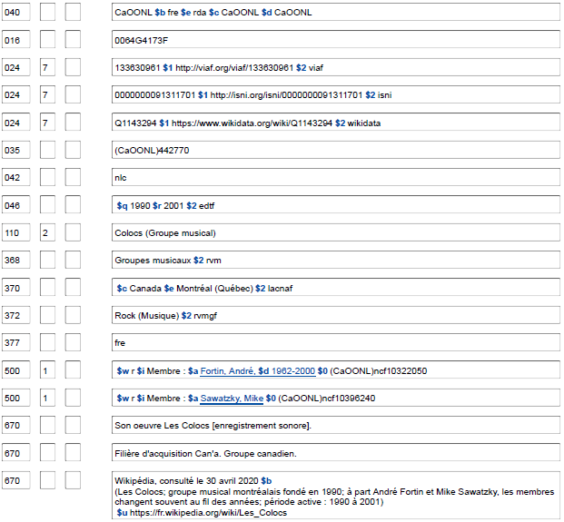
Identifiants
83
Notes:
March 4, 2020: updated screen image to show URIs in 024

Slide 86
Construction du point d’accès autorisé (RDA 11.13)
Enregistrer le nom privilégié dans la sous-zone $a de la zone 110 ou 111
110 2_ Kurt Weill Foundation for Music
2. Faire les ajouts requis
• Noms n’indiquant pas une collectivité (RDA 11.13.1.1)
110 2 _ Johann Traeg (Firme)
Notes:
March 20, 2017: reformatted slide, updated RDA instruction number and speaker notes.
Make additions to the name as instructed at 11.13.1.2–11.13.1.8, as applicable.
If the preferred name for the body does not convey the idea of a corporate body, add the type of corporate body or other designation. Record the designation in a language preferred by the agency creating the data (LC/PCC practice is to record it in English). Includes terms like Firm, Organization, Musical group, Spacecraft, Conference, Project, Program, Television station, etc.
Type of corporate body can also be used to distinguish.

Slide 87
Construction du point d’accès autorisé (RDA 11.13)
3. Faire d’autres ajouts au besoin afin d’établir une
distinction entre deux collectivités portant le même nom.
Choisir le qualificatif en faisant preuve de jugement.
• Lieu associé à la collectivité (RDA 11.13.1.3)
110 2_ Constitution Party (É.-U.)
• Institution associée (RDA 11.13.1.4)
110 2_ National Portrait Gallery (Smithsonian Institution)
Notes:
Updated: Feb. 18, 2015
Note that United States is abbreviated to U.S. as the instructions on recording place names point us to the short list of abbreviations in Appendix B.11.
If using associated institution, use the preferred name for the institution, not the authorized access point form. As of Feb. 2015, if you add an associated institution to the authorized access point for a corporate body, it is not necessary to establish a NAR for the associated institution, if a NAR does not exist. However, this policy is currently under consideration for possible change.

Slide 88
Construction du point d’accès autorisé (RDA 11.13)
Faire d’autres ajouts au besoin afin d’établir une distinction entre deux collectivités portant le même nom.
Choisir le qualificatif en faisant preuve de jugement.
Date associée à la collectivité (RDA 11.13.1.5)
110 2_ Constitution Party (É.-U. : 1952‐1968)
Type de juridiction (RDA 11.13.1.6)
151 __ Mayo (Irlande : Comté)
Autre désignation (RDA 11.13.1.7)
111 2_ Coupe du monde (Soccer)
Notes:
Updated: Feb. 24, 2014
Types of jurisdiction (RDA 11.13.1.6) is covered in more detail in the module on Places.

Slide 89
Congrès
Nom privilégié (RDA 11.2.2.5.4)
– Choisir la forme qui comprend le nom de
la collectivité
111 2_ FAO Technical Meeting on Coffee Production and Protection
– À moins qu’elle ne soit enregistrée de façon subordonnée -
RDA 11.2.2.14.6
110 2_ Hawaii Macadamia Nut Association. $b Annual Meeting
– Inclure le terme de fréquence s’il fait partie du nom
Notes:
March 20, 2017: previously slide 68, updated instruction number.
In most cases, choose the form including the name of the sponsoring body. If different forms of a conference’s name appear in the preferred source of information, choose a form of the name that includes the name (or abbreviation of the name) of the associated body.
Do not apply this instruction for a conference that is recorded as subordinate to the name of a body associated with the conference (e.g., the annual meeting of an association). Apply instead the instructions at 11.2.2.14.6.
Unlike AACR2, RDA instructs to include the frequency term (e.g. annual) if it is part of the name.

Slide 90
Congrès
11.2.2.11. Omettre du nom d’un congrès, d’un colloque, d’une réunion, d’une exposition, d’une foire, d’un festival, etc. (y compris le nom d’un congrès, etc. traité comme une collectivité subordonnée, voir 11.2.2.14.6), les indications sur son numéro d’ordre ou son ou ses années de convocation, etc.
Festival du son et de l'image
et non 12e Festival du son et de l'image
Notes:
March 20, 2017: previously slide 69, updated RDA instruction number.

Slide 91
Congrès
MARC :
Enregistrer les noms de réunions en 111 à moins qu’ils ne soient établis de façon subordonnée à une autre collectivité. Dans ce cas, utiliser la zone 110 ou 111 comme il convient. Fournir le point d’accès autorisé de la collectivité supérieure dans la sous-zone $a et le nom privilégié du congrès subordonné dans la sous-zone $b (pour la 110) ou $e (pour la 111).
111 2_ Annual Meeting on Oncogenes
110 2_ African Studies Association. $b Annual Meeting
111 2_ Conférence des Nations Unies sur la science et la technique au service du développement $d (1979 : $c Vienne, Autriche). $e Réunion régionale préparatoire
Notes:
December 9, 2019: added examples to slide
March 20, 2017: previously slide 71
Although it is most common to have conferences that are subordinate to a corporate body, which would be coded 110 with the subordinate conference coded in $b, there can be situations in which a conference is subordinate to another conference. In these unusual cases, the higher body would be coded 111, with the subordinate conference coded $e. For example:
111 2_ United Nations Conference on Science and Technology for Development $d (1979 : $c Vienna, Austria). $e Regional Preparatory Meeting
111 2_ Conference on Security and Cooperation in Europe. $e Follow-up Meeting
111 2_ International Economic History Congress $n (12th : $d 1998 : $c Madrid, Spain). $e Session C.8
111 2_ LISHEP (Conference) $d (2018 : $c Salvador, Brazil). $e Session C

Slide 92
Congrès
Série de congrès (ÉP de BAC-BAnQ 11.13.1.8)
Catalogage de monographies : Créer une notice d’autorité pour chaque occurrence
• On peut créer des notices d’autorité séparées pour la série de congrès de même que pour les occurrences individuelles au sein de la série
• Faire les liens entre les noms antérieurs et ultérieurs du congrès dans les notices pour les séries, et non dans les notices pour les occurrences individuelles
Notes:
March 20, 2017: previously slide 70, updated to reflect LC-PCC PS not RDA
Treatment of ongoing conferences differs for monographic vs. continuing resources cataloging. For monographic cataloging, an authority record should be made for each individual instance of the conference cataloged. For continuing resources cataloging, a collective authority record should be made for the ongoing conference.
LC-PCC PS 11.13.1.8
This PS contains the instructions for how to deal with conferences whose name changes. Earlier and later forms of the names are linked through 5xx fields in the collective authority record. While collective authority records are not always required, a record for the collective conference should always be made to connect the earlier and later names of the collective conference.
A 667 field is created to alert the user to related access points.

Slide 93
Congrès
111 2_ Pacific Rim Conference on Ceramic and Glass Technology
511 2_ $w r $i Successeur : $a International Meeting of Pacific Rim Ceramic Societies
667 Voir aussi les points d'accès connexes pour les occurrences individuelles de ce congrès, qui comprennent de l'information spécifique sur le numéro, la date ou le lieu du congrès individuel.
Notes:
September 17, 2018: moved $w to beginning of 511 field.
March 20, 2017: previously slide 72.
December 13, 2016. Removed instruction allowing continued use of $w codes rather than relationship designators.
Here’s an example of a conference that changed its name. A corresponding authority record must be made for the authorized access point in the 5xx field, which will be the 1xx of the related record. Always add the note in the 667 field when there are authority records for both collective and individual instances of an ongoing conference.

Slide 94
Congrès
Occurrence isolée d’un congrès (RDA 11.13.1.8.1)
Ajouter les éléments suivants au nom d’un congrès ponctuel, etc., s’ils sont applicables et s’ils peuvent être facilement établis. Les ajouter dans cet ordre :
‐‐ le numéro d’ordre du congrès, etc. (voir 11.6) en $n
‐‐ la date du congrès, etc. (voir 11.4.2) en $d
‐‐ l’emplacement du congrès, etc. (voir 11.3.2) en $c
Enregistrement du numéro d’ordre (RDA 11.6.1)
le rédiger ainsi : 1er, 2e, 3e, etc.
accorder en genre et en nombre si nécessaire : 1re, 1ers, 2es, etc.
Notes:
February 30, 2020: added subfield codes to slide; added note about $c repeatability
When constructing an authorized access point for a one-time conference or a single instance of a series of conferences, add the following elements to the name if applicable and readily ascertainable:
a) The number of the conference (see RDA 11.6) – $n in 110, 111, 410, 411, 510, 511
b) The date of the conference (see RDA 11.4.2) – $d in 110, 111, 410, 411, 510, 511; also record in 046 $s and $t [$q and $r once those subfields are implemented by NACO]
c) The location of the conference (see RDA 11.3.2) – $c in 110, 111, 410, 411, 510, 511; use repeatable $c for conferences held in more than one place; also record in 370 $e if a place or 373 $a if an associated institution
The location of the conference may be the name of a place or an associated institution if the associated institution provides better identification or the place is unknown.
Note: you can record BOTH the place and the associated institution as elements -- it’s only in the authorized access point that you have to make a choice.
LC-PCC PS 11.6.1.3: Use the form 1st, 2nd, 3rd, etc., for the English ordinal numeral in the addition to an access point for a conference, etc.

Slide 95
Congrès
Occurrence isolée d’un congrès (RDA 11.13.1.8.1)
S’il s’est tenu dans deux ou plusieurs lieux :
a) Inclure le nom de chacun des lieux dans une sous-zone $c distincte; les séparer par un point-virgule
Symposium on Breeding and Machine Harvesting of Rubus and Ribes $d (1976 : $c East Malling, Angleterre; $c Dundee, Écosse)
b) Inclure le nom du ou des lieux principalement associés au congrès, etc. (par exemple, une ville hôte) ou le nom du ou des lieux plus vastes où s’est tenu le congrès, etc.
Jeux olympiques d’hiver $n (21es : $d 2010 : $c Vancouver, C.-B.)
Tour de France (Course cycliste) $d (1970 : $c France; $c Belgique; $c Allemagne)
ou
Module 4. Describing Corporate Bodies
95
Notes:
February 30, 2020: new slide
If a conference, etc. is held in more than one place, RDA 11.13.1.8.1 says to either:
a) Include each place in the access point, separating them by semicolons. As of March 2020, each place is recorded in a separate subfield $c.
or
b) Include on the name of the place or places primarily associated with the conference, etc. (e.g., a host city) or include the name of the larger place or places where the conference, etc. was held. If multiple places are included, separate them by semicolons and record each in a separate subfield $c.
Change records to match the above practice when an NAR is needed for cataloging. This will include records created under AACR2 in which places were separated by the word “and”, as well as RDA records created prior to March 2020 when subfield $c was not repeatable.
Note that associated institution(s) can be recorded instead of places if the name of an associated institution provides better identification than the place name, or the place name or names are not known, or the place name or names cannot be readily determined (RDA 11.13.1.8.1 First Exception).

Slide 96
Exercice : Quels sont les points d’accès autorisés pour la série et les occurrences individuelles?
181st Semiannual General Conference of The Church of Jesus Christ of Latter‐day Saints, 1-2 octobre 2011
Série
110 2_ Church of Jesus Christ of Latter‐day Saints. $b Semiannual General Conference
Occurrence individuelle
110 2_ Church of Jesus Christ of Latter‐day Saints. $b Semiannual General Conference $n (181e : $d 2011)
Notes:
Updated December 9, 2019: revised instructor note
March 20, 2017: revised exercise to give authorized access points for collective and individual
conference not just preferred name, each exercise was moved to its own slide for clarity
Instructor Note: Answers appear on clicks. Advise trainees not to look at their manuals, which
will have the answers in the PDF of the slides

Slide 97
Exercice : Quels sont les points d’accès autorisés pour la série et les occurrences individuelles?
Seventh Annual Global Conference on Pharmaceutical Microbiology, October 22‐23 2012 (tenue à Bethesda au Maryland)
Série
111 2_ Annual Global Conference on Pharmaceutical Microbiology
Occurrence individuelle
111 2_ Annual Global Conference on Pharmaceutical Microbiology $n (7e : $d 2012 : $c Bethesda, Mar.)
Notes:
December 9, 2019: spelled out Maryland in slide to illustrate that the abbreviation of the larger
place is used in the access point
Instructor Note: Answers appear on clicks. Ask trainees to watch the screen rather than look
at their handout (which will have the answers).

Slide 98
Exercice : Quels sont les points d’accès autorisés pour la série et les occurrences individuelles?
The 13th International Symposium on Online Journalism (tenu au Blanton Museum of Art)
Série
111 2_ International Symposium on Online Journalism
Occurrence individuelle
111 2_ International Symposium on Online Journalism $n (13e : $c Blanton Museum of Art)
Notes:
March 7, 2019: revised instructor note
Instructor Note: Answers appear on clicks. Ask trainees to watch the screen rather than look
at their handout (which will have the answers).

Slide 99
Exercice : Congrès
Notes:
March 7, 2019: revised instructor note
Instructor Note: Answers appear on clicks. Ask trainees to watch the screen rather than look at their handout (which will have the answers).
Record the preferred name of this meeting.
Preferred name:
111 2_ International Workshop on Nude Mice
Authorized access point:
111 2_ International Workshop on Nude Mice $n (3rd : $d 1979 : $c Bozeman, Mont.)
or
111 2_ International Workshop on Nude Mice $n (3rd : $d 1979 : $c Montana State University)
but not
111 2_ International Workshop on Nude Mice $n (3rd : $d 1979 : $c Montana State University (Bozeman, Mont.))
If giving an associated institution for the location, use the preferred name for the body, not the authorized
access point (see LC-PCC PS 11.13.1.8.1 and RDA 11.5.1.3).

Slide 100
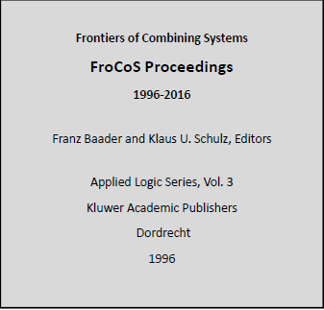
Notes:
March 7, 2019: revised note about trainees
Instructor Note: Answers appear on clicks. Ask trainees to watch the screen rather than look at their handout (which will have the answers).
LC-PCC PS 11.13.1.2:
Initialisms and Acronyms
LC practice/PCC practice: If the name chosen for the authorized access point for a corporate body is an initialism or acronym written in all capital letters (with or without periods between them), add a Type of corporate body qualifier to the name. Alternatively, a spelled out form of the name may be used as an Other designation addition if such an addition better identifies the corporate body.
Although the presentation of the acronym does not routinely use capital letters, the intent of the LC-PCC PS can be applied in this situation.
LC-PCC PS 11.13.1.8:
Authority Records for Ongoing Conferences
LC practice/PCC practice: For ongoing conferences, separate authority records may be created for the collective conference (typically made when cataloging a serial), an individual instance of an ongoing conference (typically made when cataloging a monograph), or both. These records may coexist in the LC/NACO authority file. A record for the collective conference should always be made to connect the earlier and later names of the collective conference.
Record the preferred name of this meeting.
Preferred name:
111 2_ FroCoS
Authorized access point:
111 2_ FroCoS (Symposium)
or
111 2_ FroCoS (Frontiers of Combining Systems)

Slide 101
Module 4 Description des collectivités
101
Notes:
March 7, 2019: revised note about trainees
Instructor Note: Answers appear on clicks. Ask trainees to watch the screen rather than look at their handout (which will have the answers).
LC-PCC PS 11.13.1.2:
Initialisms and Acronyms
LC practice/PCC practice: If the name chosen for the authorized access point for a corporate body is an initialism or acronym written in all capital letters (with or without periods between them), add a Type of corporate body qualifier to the name. Alternatively, a spelled out form of the name may be used as an Other designation addition if such an addition better identifies the corporate body.
Although the presentation of the acronym does not routinely use capital letters, the intent of the LC-PCC PS can be applied in this situation.
LC-PCC PS 11.13.1.8:
Authority Records for Ongoing Conferences
LC practice/PCC practice: For ongoing conferences, separate authority records may be created for the collective conference (typically made when cataloging a serial), an individual instance of an ongoing conference (typically made when cataloging a monograph), or both. These records may coexist in the LC/NACO authority file. A record for the collective conference should always be made to connect the earlier and later names of the collective conference.
Record the preferred name of this meeting.
Preferred name:
111 2_ FroCoS
Authorized access point:
111 2_ FroCoS (Symposium)
or
111 2_ FroCoS (Frontiers of Combining Systems)

Slide 102
Congrès À retenir – important
Quand créer des notices pour une série de congrès
Inclure la fréquence lorsqu’elle fait partie du nom
Ajouter le lieu sauf si l’institution fournit une meilleure indication (les deux éléments peuvent également être enregistrés)
Notes:
May 1, 2013
Collective authority records are created for a conference when the resource being cataloged is a continuing resource. Conference name changes may also be recorded in collective authority records.
Remember, many elements may be recorded in the authority record which may not be added to the authorized access point. These elements can be useful information helping the user to identify the entity.

Slide 103
Variantes de nom (RDA 11.2.3)
Des variantes de nom peuvent se présenter pour les collectivités, comme pour les autres types de noms
Enregistrer les variantes de nom :
Utilisées par la collectivité
Trouvées dans les sources de référence
- Résultant d’une translittération différente du nom
Notes:
May 1, 2013
Variant names are not considered core, but a cataloger should record them if s/he thinks they will help the user of the database; use cataloger’s judgment!

Slide 104
Variantes de nom (RDA 11.2.3)
110 2_ Museo del Prado
410 2_ Prado Museum
410 2_ Museo Nacional del Prado
410 2_ Museo Nacional de Pintura y Escultura (Espagne)
410 2_ Musée du Prado
410 2_ 프라도 미술관
410 2_ P'ŭrado Misulgwan
410 2_ Национальный музей Прадо
410 2_ Nacionalʹnyj muzeij Prado
410 2_ Музей Прадо
410 2_ Muzej Prado
410 2_ 普拉多博物馆
410 2_ Puladuo bo wu guan
410 2_ Puladuo bowuguan
Notes:
December 9, 2019

Slide 105
Variantes de nom (RDA 11.2.3)
Enregistrer les variantes de nom :
- Pour une forme directe du nom si le nom privilégié est enregistré comme une subdivision d’une collectivité supérieure ou associée.
110 2_ Smithsonian Institution. $b Center for
Folklife and Cultural Heritage
410 2_ Center for Folklife and Cultural Heritage
(Smithsonian Institution)
Notes:
May 1, 2013
Record variants only if the name might reasonably be searched in that variant form.
Apply the specific instructions at 11.2.3.4–11.2.3.7 and 11.2.2.5–11.2.2.31, as applicable. These deal with acronyms and initials in names, alternative linguistic forms, different spellings; fuller, shorter or inverted names, etc.

Slide 106
Variantes de nom (RDA 11.2.3)
Enregistrer les variantes de nom :
- Pour le nom sous la forme d’une subdivision d’une collectivité supérieure ou associée si le nom privilégié est enregistré sous une forme directe.
110 2_ National Portrait Gallery (Smithsonian
Institution)
410 2_ Smithsonian Institution. $b National Portrait
Gallery
Notes:
May 1, 2013
Record variants only if the name might reasonably be searched in that variant form.
Apply the specific instructions at 11.2.3.4–11.2.3.7 and 11.2.2.5–11.2.2.31, as applicable. These deal with acronyms and initials in names, alternative linguistic forms, different spellings; fuller, shorter or inverted names, etc.

Slide 107
Variantes de nom (RDA 11.2.3)
Les variantes de nom sont enregistrées dans une zone 410 ou 411 du MARC
110 2_ Nations unies
410 2_ ONU
410 2_ Naciones Unidas
410 2_ United Nations
410 2_ سازمان ملل متحد
410 2_ Организация Объединённых Наций
etc.
Notes:
March 20, 2017: removed instruction to record in $a—a variant name recorded as a subdivision of a higher or related body will be record in $a and $b.
If the name recorded as the preferred name for a corporate body has one or more alternative linguistic forms, record them as variant names. (RDA 11.2.3.6)

Slide 108
Variantes de nom (RDA 11.2.3)
Autres variantes de nom possibles :
Nom développé
110 2_ Euratom
410 2_ European Atomic Energy Community
Forme abrégée
110 2_ Communauté économique européenne 410 2_ CEE
Notes:
May 1, 2013
Record other variant names and variant forms of the name not covered by 11.2.3.4-11.2.3.6, if considered important for identification or access. (RDA 11.2.3.7)

Slide 109
Variantes de nom (RDA 11.2.3)
Autres variantes de nom possibles :
Symboles et nombres
110 2_ Third & Elm Press
410 2_ 3rd & Elm Press
410 2_ Third and Elm Press
Formes raccourcies
110 2_ Betty Shaw & Associates
410 2_ Shaw & Associates
410 2_ Betty Shaw and Associates
410 2_ Shaw and Associates (Jonesboro, Ark.)
Notes:
Updated December 9, 2019: replaced example G.M. Johnson & Associates Ltd. because inclusion of “Ltd.” in preferred name is questionable.
In the third 410 of the second example, a qualifier was added to break a conflict with a different firm with the same variant name.

Slide 110
Personnes en relation (RDA 30)
Les personnes en relation sont enregistrées dans les
zones 500. Si possible, inclure un indicateur de relation
dans la sous-zone $i (provenant de la liste de l’Annexe K de RDA ), avec $w r.
110 2_ Miles Davis Quintet
500 1_ $w r $i Fondateur : $a Davis, Miles
Notes:
September 17, 2018: moved $w to beginning of 500 field.

Slide 111
Familles en relation (RDA 31)
Les familles en relation sont également enregistrées dans les zones 500. Si possible, inclure un indicateur de relation dans la sous-zone $i (provenant de la liste de l’Annexe K de RDA ), avec $w r.
110 2_ San Francisco Coffee Company
500 3_ $w r $i Famille fondatrice : $a Larizadeh (Famille)
100 3_ Larizadeh (Famille)
510 2_ $w r $i Collectivité fondée d’une famille : $a San Francisco Coffee Company
Notes:
September 17, 2018: moved $w to beginning of 500 and 510 fields.

Slide 112
Collectivités en relation (RDA 32)
Les collectivités en relation sont enregistrées dans les zones 510. Si possible, inclure un indicateur de relation dans la sous-zone $i (provenant de la liste de l’Annexe K de RDA ), avec $w r.
110 2_ Verizon
510 2_ $w r $i Composante de fusion : $a Bell Atlantic Corporation
510 2_ $w r $i Composante de fusion : $a GTE Corporation
Notes:
September 17, 2018: moved $w to beginning of 510 field.
September 12, 2017: changed relationship designator to Component of merger (was Mergee)

Slide 113
Situations particulières : LC-PCC PS 32.1.1.3
Reprise des noms antérieurs
Traiter chaque instance du nom comme une collectivité distincte, sauf pour ces exceptions :
Type de collectivité susceptible de faire l'objet de fréquents changements de nom
Noms de lieux
Saint-Pétersbourg (Russie) > Petrograd (Russie) > Leningrad (Russie) > Saint-Pétersbourg (Russie)
Des collectivités à l'histoire complexe et incertaine
Noms antérieurs peu susceptibles de faire l’objet de relations
Il est permis de ne pas créer de notices d'autorité séparées pour les noms antérieurs qui ne seront probablement jamais nécessaires comme points d'accès dans les notices bibliographiques
Module 4. Describing Corporate Bodies
113
Notes:
113
August 12, 2019
LC-PCC PS for 32.1.1.3 has some very important guidance on what to do when a corporate body resumes an earlier name. It also provides an exemption to the general practice of making authority records for earlier names of a body.
Earlier Name Resumed
When a corporate body resumes an earlier form of name, treat each instance of the name as a separate body, and apply the instructions at Policy Statement 11.13.1.1 to distinguish between authorized access points.
However, when a corporate body belongs to one of the categories listed below, use one authorized access point to represent all instances of the same name, and include a 667 field on the authority record for the resumed name to alert other catalogers that this decision has been made. Include other clarifying information in the 667 note if it is useful.
If a body belonging to one of the categories listed below has already had separate authorized access points created for the earlier and resumed names, it is not required to retrospectively collapse the separate access points into one authorized access point.
A. Bodies of a Type Likely to Be Subject to Frequent Name Changes
When a corporate body is of a type likely to have frequent name changes because of its nature (e.g., firms named after individual members, legislative committees, conferences) use one authorized access point to represent both the earlier and resumed name.
B. Place Names
When a place resumes its earlier name, use the same authorized access point for both the earlier and resumed name provided the additions to the authorized access point are appropriate for each instance (see Policy Statement 11.13.1.6).
C. Bodies with Complex and Uncertain Histories
If a body has had a complex or uncertain history, and creating and applying separate authorized access points for each use of the same name is not feasible, use the same authorized access point for both the earlier and resumed name.
Earlier Names Not Likely to be Needed as Relationships
In some circumstances, research will indicate that the corporate body being established had earlier names that are not likely ever to be needed as access points in bibliographic records. If a decision is made not to create separate authority records for these earlier names, record them in the source citation along with an indication that separate records were not needed, such as "[no publications in LC database]" or "[no access point found in OCLC]."

Slide 114
008 180517n|fazvnnaabn |a ana
040 CaOONL $b fre $e rda $c CaOONL
046 $q 2008 $2 edtf
110 2 4-72 (Services postaux : Colombie)
370 $c Colombie $2 lacnaf
372 Postes $2 rvm
377 spa
410 1 Colombie. $b 4-72
670 El correo en Colombia, 2013$ : $b tome I, logo sur la couverture (4 72) tome II page 48 (4-72; Servicios Postales Nacionales [aucun point d’accès trouvé dans OCLC] remplace Adpostal [aucun point d’accès trouvé dans OCLC] en 2006 et assume les fonctions du service de postes officiel; devient connu sous l’appellation 4-72 en 2008) tome II, page 51 (4-72 est la compagnie officielle des services postaux gouvernementaux)
Module 4. Describing Corporate Bodies
114
Notes:
August 12, 2019
Earlier Names Not Likely to be Needed as Relationships
In some circumstances, research will indicate that the corporate body being established had earlier names that are not likely ever to be needed as access points in bibliographic records. If a decision is made not to create separate authority records for these earlier names, record them in the source citation along with an indication that separate records were not needed, such as "[no publications in LC database]" or "[no access point found in OCLC].“
Note: In AACR2 NACO practice, it was permissible to record earlier names that were not likely to be needed as access points in bibliographic records as variant access points in the record for the later name. This is no longer the practice under RDA, so there may be records being reevaluated for RDA where 4XXs should be deleted (or converted into 5XX with a new authority record for the earlier name).

Slide 115
Parcs, forêts, etc., désignés par les gouvernements
Demander au RVM de créer la vedette pour une entité géographique utilisée comme sujet et codée 151, habituellement avec un qualificatif géographique
Établir les points d’accès autorisés nécessaires pour la collectivité (c.-à-d. l’entité administrative) comme créatrice ou contributrice avec le qualificatif (Agence : [Nom du gouv.]). Employer la zone MARC 110
S'applique aux parcs, forêts, etc. canadiens et étrangers
http://www.loc.gov/catdir/cpso/parks2.html
Notes:
May 1, 2013; rev. June 8, 2017 (revised final sentence for clarity)
NOTE: Agency is the required qualifier. The name of the government, if applicable, is usually added in addition.
This practice applies not only to national parks and forests, but also to analogous entities such as battlefields, historic sites, lakeshores, memorials, monuments, parkways, recreation areas, rivers, scenic trails, seashores, wild and scenic rivers, as well as entities of any of these types established at the state, provincial, departmental, etc., level.
All government-designated parks, forests, etc., are established according to these rules, both foreign and domestic.

Slide 116
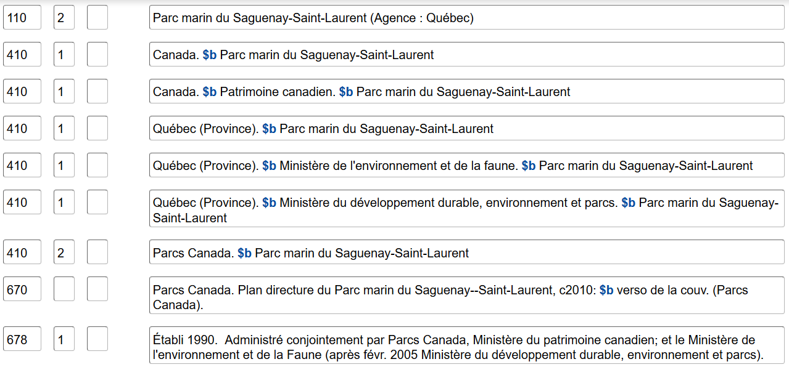
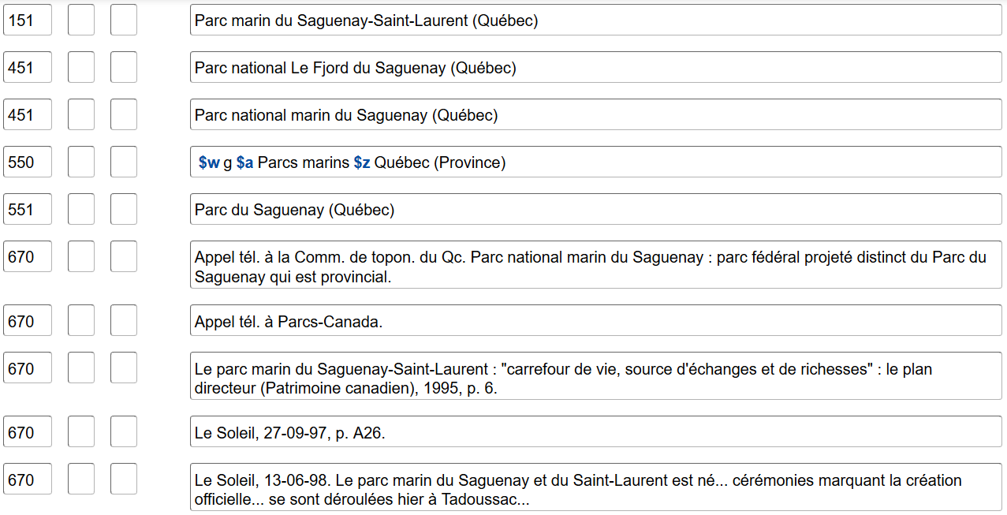
Vedette de nom
Vedette-matière
Notes:
September 17, 2018
Note that both have qualifiers, but different types as appropriate to the type of authorized access point.
If you are ever in doubt about what type of authority record you are looking at, look at the 010. If it has n number, then it is a name authority record. If the 010 is sh number, then it is a subject heading.

Slide 117
Exercice
Complétez les notices d’autorité pour ces collectivités :
Butler Institute of American Art
Facultad de Medicina of Universidad Autónoma de San Luis Potosí
Third International Workshop on Nude Mice
Notes:
March 20, 2017: updated 111 for workshop—use preferred name not authorized access point for associated institution.
Note to Instructor: Suggested answers are given below. Trainees do not have answers for the exercise in their manuals.
Possible answers:
046 $s 1919 $2 edtf $v Masterworks from the Butler Institute of American Art, 2010
110 2_ $a Butler Institute of American Art
368 $a Art museums $2 lcsh OR
368 $a Museums $2 lcsh
370 $c United States $e Youngstown (Ohio) $2 naf
371 $a 524 Wick Avenue $b Youngstown $c Ohio $d U.S. $e 44502 $m info@butlerart.com
372 $a Art, American $2 lcsh
$a Butler Institute of American Art webpage, viewed Feb. 2, 2013 $b (The Butler Institute of American Art; 524 Wick Avenue, Youngstown, Ohio 44502; email: info@butlerart.com)
110 2_ $a Universidad Autónoma de San Luis Potosí. $b Facultad de Medicina
368 $a Medical colleges $2 lcsh AND/OR
$a Universities and colleges $2 lcsh
370 $c Mexico $e San Luis Potosí (Mexico) $2 naf
372 $a Medicine--Study and teaching $2 lcsh
410 2 $a Facultad de Medicina de Universidad Autónoma de San Luis Potosí
$a Homenaje conmemorativo que la Facultad de Medicina de San Luis Potosi ofrece al poeta Jaime Sabines, 2000: $b t.p. (Universidad Autónoma de San Luis Potosí, Facultad de Medicina)
046 $s 1979-09-06 $t 1979-09-09 $2 edtf
111 2_ $a International Workshop on Nude Mice $n (3rd : $d 1979 : $c Montana State University)
368 $a Congresses and conventions $2 lcsh AND/OR
$a Conference AND/OR
368 $a Workshop AND/OR
368 $a Workshops (Adult education) $2 lcsh
370 $c United States $e Bozeman (Mont.) $2 naf
372 $a Nude mouse $2 lcsh OR
$a Nude mouse--Congresses $2 lcsh
373 $a Montana State University (Bozeman, Mont.) $2 naf
670 $a Proceedings of the Third International Workshop on Nude Mice, 1979: $b t.p. (Montana State University, Bozeman, Montana; September 6-9, 1979)

Slide 118
À retenir - important
Se rappeler quand on doit ajouter des éléments au nom
Lorsque le nom change, établir les formes antérieure et ultérieure
Bien faire la distinction entre les variantes de forme du nom et les changements de nom
Notes:
May 1, 2013
Make additions to the preferred name when:
-The authorized access point does not convey that it is a corporate body
-Name conflicts
-Certain government bodies

