Slide 1
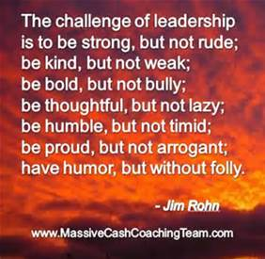
Notes:
Leanne:
(( Friendly reminder: prep for sharing audio & video!! w/cc 100%))
Prep:
Dan Siegel: Me + We = Mwe - https://www.youtube.com/watch?v=uo8Yo4UE6g0
Janice Marturano: Deep Understanding WEF - https://soundcloud.com/33voices/compassion-is-a-deep-understanding-janice-marturano
Dan Ariely Are We in Control of Our Own Decisions? (17 mins) https://www.ted.com/talks/dan_ariely_are_we_in_control_of_our_own_decisions?language=en

Slide 2
Mindful Change Leadership Development Program
Week 3 (of 8)
May 23, 2023
Notes:
Leanne:
Comme avec toutes les sessions du GC, s'il vous plaît, sentez-vous libre d'utiliser la langue de votre choix pour poser des questions ou participer à la discussion. La séance d'aujourd'hui sera conduit principalement en français, il y aura d'autres sessions en anglais qui seront promus via le groupe GCConnex (ou donner des dates précises, si disponible).
As with all GoC sessions, please, feel free to use the language of your choice to ask questions or participate in the discussion., today’s session will be conducted mainly in French, there will be other sessions in English that will be promoted via the GCConnex group (or give specific dates, if available).

Slide 3
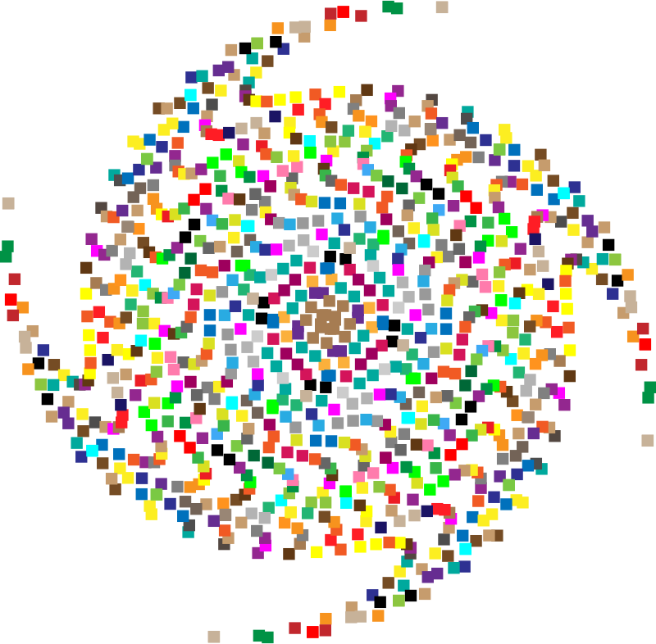
Mindful Breathing Exercise – Centering
Notes:
Leanne:
With this we will come into a mindful centering exercise to bring our attention and awareness to this moment and to set the space for a beneficial session for all.
Sit as comfortably as possible in a position that allows you to be awake, attentive or attentive and at ease at the same time.
You can put your feet flat on the floor; and rest your hands on your knees, palms up or down, whichever is more comfortable for you.
Feel free to close your eyes or close them halfway.
Follow my voice, which will guide you during the exercise.
Gently pay attention to your breathing. No need to change the way you breathe; just notice your breathing.
Don't worry about time.
Just pay attention:
On inspiration
At expiration
If at any point your mind wanders, be kind to your reason, acknowledge that thought, let it go, and bring your attention back to the object of your attention, which is your breath. .
Inspiration
Expiry
Now we are going to take a full minute of self-awareness breathing.
I'll have you sign when the moment has passed.
Just keep focusing on your breathing.

Slide 4
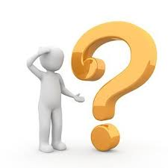
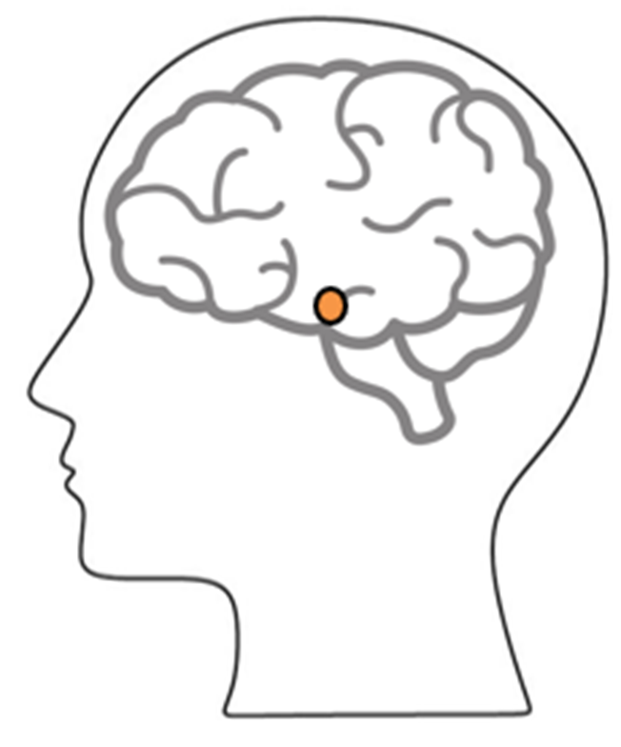
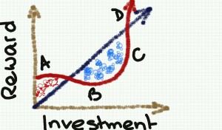
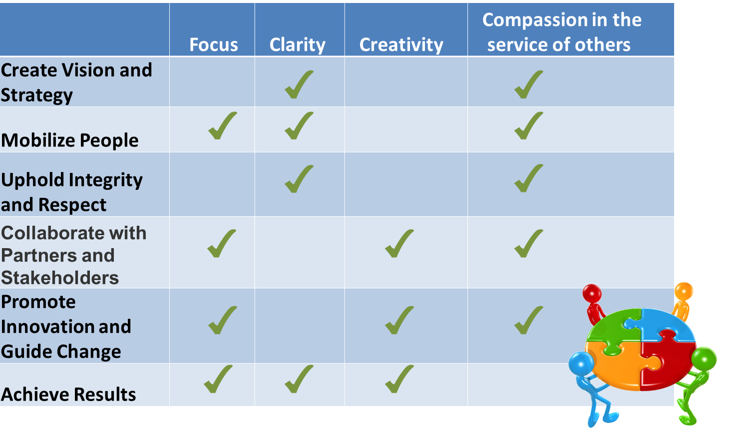
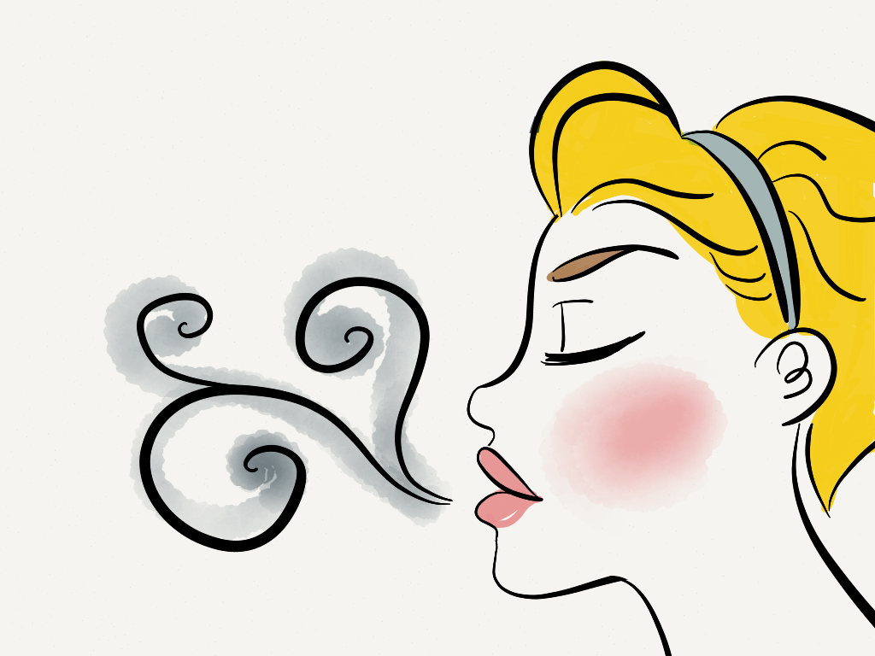
Debrief from last week (2)
Any Insights you’d like to share
Your Buddy Sytem
Your practice
Debrief
Anything we may be missing?
Notes:
Leanne:
The idea is to have 2 or 3 people share any insights they experienced or noticed from last week’s practice
Including the Buddy System, the Mindful Breathing, and the gratitude journaling exercises.
Everyone met with their Buddy System?
(click)
With honesty, please comment on the following:
What are your difficulties?
What did you notice?
Ideas that you have realized?
(click)
(lesson from the slide)
(click)
(lesson from the slide)

Slide 5
Agenda – Week 3
Centering breathing exercise – 2 minutes
Debrief from last week (2)
Today’s Intentions: Clarity, Focus and Compassion
Listening as a Leader
Mindful Decisions
Compassionate Leader: I whish you happiness
Leadership References
Your turn for week 3
Debriefs: Plenary and small group
Notes:
Leanne:
Just read the bullets off the slide…

Slide 6
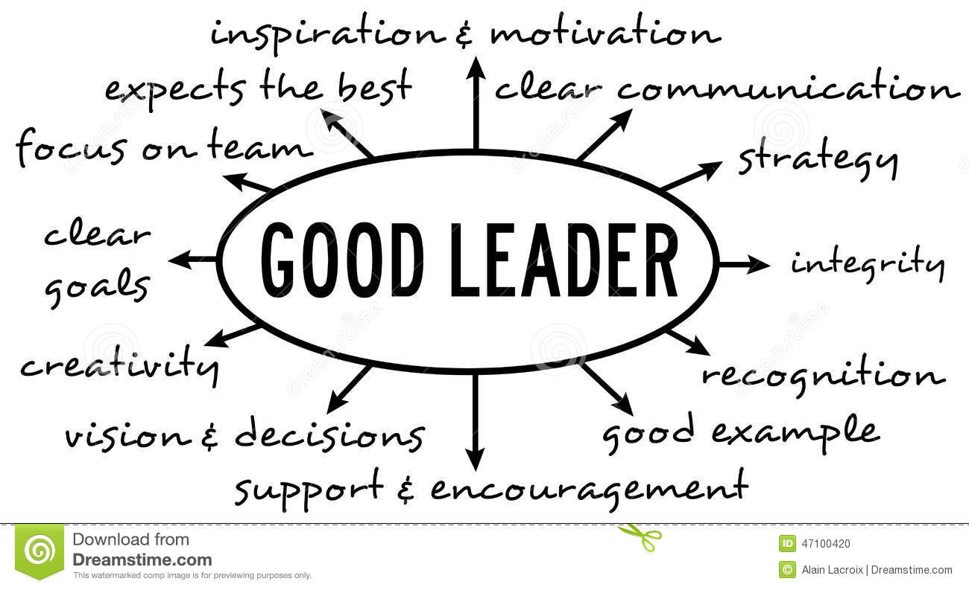
What is "Leadership" and What Makes a Good Leader?
The Characteristics of a Good Leader (Self-Awareness, Self-Direction, Vision, Ability to Motivate and Social Awareness)
Emotional Intelligence and Leadership - Leadership is more often about “soft skills” than “hard skills”
Competencies that distinguish star performers…
Strong achievement drive and high achievement standards
Ability to influence
Conceptual thinking
Analytical ability
Initiative in taking on challenges
Self-confidence
Of the top six, only two are purely intellectual competencies – SIY book, p13
Notes:
Ginette:
Leadership is the action of leading a group of people or an organization, but what makes a good leader?
I’d like to get your attention to the bottom right image (paraphrase from the image)… from the top 6 skills, only 2 are purely intellectual, which ones are those? Can you guess?
The third and the fourth.
Resources in English:
https://siyli.org/resources/
https://www.amazon.ca/Search-Inside-Yourself-Productivity-Creativity/dp/0062116924

Slide 7
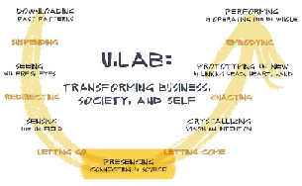
Organizations with Mindfulness Programs
http://www.siyli.org
www.Mindfulnet.org
http://instituteformindfulleadership.org
Notes:
Ginette:
Although this slide was created a few years ago (2017’ish), it is still very relevant. You see many different logos here, you may be familiar to more than one of them. Many of these are big companies, and there is a reason why they are implementing mindfulness programs.
Let me draw your attention to a couple of examples
((pick two that you like the most))
On the NBA, Phil Jackson, first with the Chicago Bulls and then with LA Lakers obtained 11 championships, having Michael Jordan, Koby Bryant and the alike do mindfulness exercises. They call it being in “the zone”. Also, the Golden State Warriors, have a Mindful Mindset on Four Core values, in order:
1. Joy;
2. Mindfulness;
3. Compassion for team members and for the game of basketball; and
4. Competition
Google – who has not used google? it is big player in the booming of Mindfulness. Chad-Meng Tan started a program in Google with great success that other silicon valley companies asked for it, he wrote the Search Inside Yourself (SIY) book and it grew so big that now there is a SIY Leadership Institute (SIYLI).
SIYLI now delivering Mindfulness programs across the world, certifying teachers, implementing programs into organizations and also some countries like Bhutan - https://siyli.org/bhutan-government-employees/
OR
Karen May, VP People Development, executives start meetings with mindfulness time - https://youtu.be/zVlXE1UtJKY?t=421
World Economic Forum – The Forum engages the foremost political, business and other leaders of society to shape global, regional and industry agendas. Janice Marturano, ex VP General Mills and now president of the Institute for Mindful Leadership, presented at that forum - https://www.youtube.com/watch?v=v0CNZLIkIqw
U.Lab / MIT – Senior business management savvy, including mindfulness -they call it presencing- as part of the new way of doing ethical business. The U model takes us from Ego-System to Eco-System - https://www.youtube.com/watch?v=GcbB1I__BmM
Mindful Nation UK – Is co-chaired by the three main political parties in UK with the intention to apply mindfulness programs in the areas of National education, health, the workplace and the criminal justice system. - https://www.themindfulnessinitiative.org/mindful-nation-report
---
Resources in English:
Phil Jackson’s eleven Rings – with Chicago Bulls and LA Lakers obtained 11 championships - https://www.amazon.ca/Eleven-Rings-Success-Phil-Jackson/dp/0143125346
Golden State Warriors, Four Core values - http://yogadork.com/2015/12/09/the-golden-state-warriors-record-breaking-mindful-mindset/
Article – mentions some details about the Mindfulness programs at Google, Aetna, General Mills, Intel, Target & Green Mountain Coffee Roastershttps://hbr.org/2015/12/why-google-target-and-general-mills-are-investing-in-mindfulness
http://www.siyli.org
http://www.Mindfulnet.org
http://instituteformindfulleadership.org

Slide 8
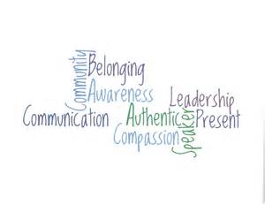
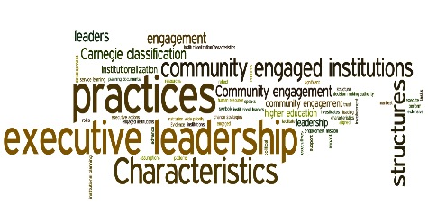
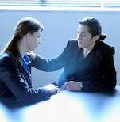
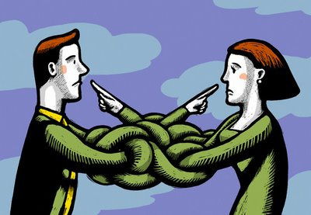
3 Pillars of Compassionate Leadership
Pillar #1: Cognitive Understanding
Pillar #2: Affective (Emotional) Understanding
Pillar #3: A Motivational Connection
“…Specifically defines compassion as having three components:
A cognitive component: “I understand you”
An affective component: “I feel for you”
A motivational component: “I want to help you”
…This shift is the transformation from “I” (me) to “We.” It is the most important process leaders go through in becoming authentic. How else can they unleash the power of their organizations unless they motivate people to reach their full potential? If our supporters are merely following our lead, then their efforts are limited to our vision and our directions… Only when leaders stop focusing on their personal ego needs are they able to develop other leaders…”
http://greatergood.berkeley.edu/article/item/compassionate_leaders_are_effective_leaders
Dan Siegel: Me + We = Mwe https://www.youtube.com/watch?v=uo8Yo4UE6g0
Notes:
Ginette:
(Read the 6 bullets
Then mention:) This shift is the transformation from “I” (me) to “We.” Great leaders have this transformation.
Play video: Dan Siegel: Me + We = Mwe https://www.youtube.com/watch?v=uo8Yo4UE6g0
There are similarities with indigenous traditions and other ancient practices, we all are interconnected, including the plants, the animals, everything. An example of this is, the oxygen in the air we breathe, when exhaling comes out as carbon dioxide, then goes through another process and the trees transform it back to oxygen in the air, right there is proof we all are interdependent and interconnected.
Resources in English:
https://siyli.org/resources/ (Expired - https://siyli.org/3-pillars-compassionate-leadership/)
Dan Siegel: Me + We = Mwe https://www.youtube.com/watch?v=uo8Yo4UE6g0
Compassionate Leaders are Effective Leaders - http://greatergood.berkeley.edu/article/item/compassionate_leaders_are_effective_leaders
The Power of One Tree - The Very Air We Breathe - https://www.usda.gov/media/blog/2015/03/17/power-one-tree-very-air-we-breathe#:~:text=Through%20a%20process%20called%20photosynthesis,and%20released%20by%20the%20tree.

Slide 9
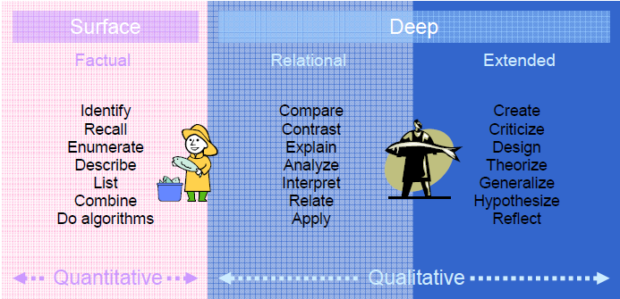
Compassionate Leadership – Deep Understanding
“Compassion is to have a deep understanding of what is, including our understanding on how we contribute to our own struggles, and then being able to offer ourselves and others an active kindness, that’s enabling us to be more of who we really are.” – Janice Marturano - https://soundcloud.com/33voices/compassion-is-a-deep-understanding-janice-marturano
The next time you have something to observe or listen to, do so with the intention of understanding it deeply… http://www.polyu.edu.hk/obe/students/files/deep.pdf
Notes:
Ginette:
Now talking about Deep Understanding, we have an audio from Janice Marturano, from Institute for Mindful Leadership, who presented at the World Economic Forum. (Play the audio, 2 minutes - https://soundcloud.com/33voices/compassion-is-a-deep-understanding-janice-marturano)
(cilck)
In this table we have left to right the levels of understanding. From surface understanding (Quantitative), to deep understanding (Qualitative)
The graphic is not that clear, the next slide explains details on the concepts
An analogy here is, if you fish on the surface, you’ll only get small fish… so go deep to get the big fish.
(go to the next slide)
Resources in English:
Listen, takes less than 2 minutes - https://soundcloud.com/33voices/compassion-is-a-deep-understanding-janice-marturano
http://www.polyu.edu.hk/obe/students/files/deep.pdf

Slide 10
Deep Understanding, Some of the Actions
Factual recall: Listing of pieces of information in unrelated manner. This is not deep understanding!
Compare: Show how things are alike or not alike
Contrast: Show the important difference between things.
Explain: Give the meaning of a topic clearly.
Analyze: Examine in detail the elements of a topic and how they relate to each other.
Relate: Show that the ideas are connected to each other.
Apply: Make use of specific knowledge or concepts to solve a problem.
Recommend: Suggest what is appropriate to do base on a critical evaluation of available information.
Theorize: Form general principles of an art or science.
Generalize: Draw a general conclusion from a number of facts.
Hypothesize: Propose an idea which can be used as a starting point for further study.
Reflect: Show new understanding of something by studying past experience.
You can only catch small fish at the surface. Therefore, think deep!
Notes:
Dani:
Here is a list of some of the actions associated with deep understanding
From here, I like to Reflect because I usually take time to reflect what was said, I usually take time to know how to respond to difficult emails or conversations, instead of just reacting.
I’ll let you quickly browse to the list
(give some time for people to read)

Slide 11
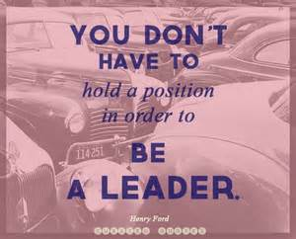
What Makes a Great Leader?
Self-awareness: understanding one’s own emotions and their effect on others.
Self-regulation: the ability to control or redirect disruptive impulses.
Motivation: passion to work with energy and persistence for reasons beyond money or status.
Empathy: ability to understand the emotional needs of others and treat them accordingly.
Social skill: proficiency in managing relationships, developing networks, building rapport and finding common ground.
https://siyli.org/great-leaders/
Notes:
Dani:
From this list of what makes a great leader, all of them soft skills, I just want to get your attention to the 4th bullet, (read the bullet)
As stated in the bottom, this list is from the « Search Inside Yourself Leadership Institute », or SIYLI for short
Resources in English:
https://gcconnex.gc.ca/blog/view/20353500/i-woke-up-like-this-how-to-be-a-fiece-youth-leader-in-the-public-service
https://siyli.org/great-leaders/

Slide 12
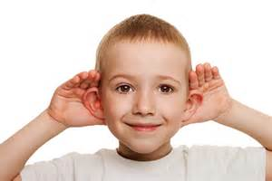
Mindful Listening as a Leader Exercise
This one needs to be really practiced / adjusted
Take a couple of minutes to write a description of yourself
Ideas: as a leader; as an employee, as a colleague, as a mom or dad, as a friend; or describe yourself as you’d like to be seens, Include introducing yourself here.
Identify who is “A”
A talks for 1 minute, B listens
After the 1 minute is over, B will paraphrase what they heard A say
For the Speaker
Feel free to talk without looking at your notes
Remember, you’re in a safe environment, nobody will judge you
For the Listener
Give 100% of your attention and hold back any reactions you may have to interject/respond/assent.
You’ll paraphrase what you heard
No need to ask for clarification, unless you can’t hear; this is an OBSERVATION exercise
Then you switch: B talks and A listens and paraphrases
Notes:
Dani:
(click)
First, I’ll explain what we’ll do… (read the slide: first bullet and sub-bullet) You can use bullet points, and don’t worry about your grammar or writing full sentences, this is not an essay
((continue clicking and reading the bullets until the end))
Keep in mind, there may be more than 2 people pre breakout room, if that’s the case, define who’s A, who’s B and the rest will be Observers.
You’ll be responsible for timing yourselves, about 1 minute for A to speak & 1 minute for B to paraphrase. I’ll broadcast a message half way through for switching.
Any questions?
You can start now, write your own description
in the meantime we’ll create the breakout rooms and you’ll automatically join a breakout room in about 2 minutes
((Facilitator to broadcast the following messages, approximate 3 minute after the breakout room started:
“switch, no B Speaks”
Close the breakout rooms around 6 minutes had passed))

Slide 13
Mindful Decision-making
Practice Mindful Decision-making: We all make a lot of decisions every day. Some are minor, while others have far-reaching implications. Whether it’s which toothpaste you buy or the work you dedicate your life to, we’re all faced with a dizzying array of choices. Some of our decisions are made consciously, while others seem to happen on autopilot without our full awareness.
Today’s challenge is to catch yourself in the act of decision-making and bring more mindfulness to the process. Perhaps with something as simple as choosing what to make or where to go for dinner, or maybe regarding an upcoming purchase, or deciding how to respond to a hurtful email or action. Whatever the case, try to bring mindfulness into the decision and see how it changes the process, and perhaps the outcome.
Are We In Control of Our Own Decisions is a TED talk by Dan Ariely that offers some powerful food for thought.
Think of an example when your decision was mindless (if you feel like, share example via the chat, and share it in the debrief in your small group)
What do you do for a mindful decision-making process?
Notes:
Michelle:
(click & paraphrase first bullet)
(click & paraphrase second bullet)
(please feel free to speak of your own decision-making process, or use the following as you see fit. ☺)
For example, the process I follow when craving... and believe me, I have them. For instance, I just went to buy some snacks, to stretch my legs and get some fresh air. If I think about my decision before getting to the store, I say I will buy a healthy snack (e.g. a banana, an orange, etc.).
The trick is to stick to my decision... I often walk by the "unhealthy snacks" and take a moment to look at them and if I'm able to be mindful about my eating habits, I'm usually successful in my healthy snack decision. You may have guessed, and you`re right, when I rush my decision process I act on impulse and end up buying the unhealthy snack.
The good thing is, with practice, I'm able to choose healthy snacks more often and stay mindful about my decisions.
(click)
Here we have an interesting video, « Are We in Control of Our Own Decisions? (17 mins) » where Dan Ariely he shares a perspective on how mindfulness or mindlessness we do decisions.
((Depending on the time: decide))
As we have time, let’s watch this video Dan Ariely Are We in Control of Our Own Decisions? (17 mins) https://www.ted.com/talks/dan_ariely_are_we_in_control_of_our_own_decisions?language=fr
Given the time we have for this session, I invite you to see the video afterwards, it lasts 17 minutes, worth watching
(2x click & read the last 2 bullets)
Now, let’s take 2 minutes or so to reflect and come with an example
You can use the chat in the meantime we get to the briefing time
Resources in English:
Dan Ariely Are We in Control of Our Own Decisions? (17 mins) https://www.ted.com/talks/dan_ariely_are_we_in_control_of_our_own_decisions?language=fr
From: Day 20/21 days challenge - KindSpring - Practice Mindful Decision-Making (https://gcconnex.gc.ca/blog/view/14866638/day-2021-days-challenge-kindspring-practice-mindful-decision-making)

Slide 14
Mindful Compassion exercise - I wish you happiness
There is a powerful exercise, a very simple one, I started using a few years ago.
Who or what am I focusing on or coming across, either an individual or an insect, your first thought is simply "I wish you happiness."
This completely transforms what is going to happen between you and the other party.
At this point, you create the opportunity to make more space around you ... You see how any negative emotion disappears and gives you time to transform ... You see things as they are, as simply ignorance, anger, fear, sadness … don’t blame the other party, but see it as ignorance on your part … you don’t know their history or how their day has been … you remove your interpretation or reaction. You transform this, you let go, you become love.
I WISH YOU HAPPINESS!
Try it and see everything change in your life. ~ Richard Gere
Notes:
Michelle:
(read from the slide, provide an example if you have one)
Resources in English:
https://www.dalailamafilm.com/actor-richard-gere-on-happiness-3031
https://alvinalexander.com/photos/i-wish-you-happiness-richard-gere/
Summary: When times are tough and you’re faced with hard decisions, it’s easy to get paralyzed by self-doubt and fear. To move to clarity and action, leaders need self-compassion. Research shows that it increases your levels of emotional intelligence, resilience, integrity, and makes you more compassionate toward others, all of which improves your effectiveness as a leader. The authors offer several exercises for cultivating this skill, from short daily practices to tactics that help you shift your mindset. - https://hbr.org/2020/11/self-compassion-will-make-you-a-better-leader

Slide 15
Your turn for week 3
Connecting – once a week with your buddies
Gratitude Journaling – daily
Practice 10 mins… chose one of the following and keep doing it for the whole week - daily
Body scan https://archive.org/details/MFBodyScan10Minsb http://elishagoldstein.com/videos/10-minute-body-scan/ http://www.sharonsalzberg.com/body-scan-meditation-audio/
Breathing https://www.youtube.com/watch?v=Rah4IHHZyZU https://www.youtube.com/watch?v=aXItOY0sLRY https://www.mindful.org/10-minute-nourishing-breath-meditation/
Apply Mindful Listening as a Leader
Apply Mindful Decision-making
Apply Compassion "I wish you happiness"​
Remember to use the Cohort if you have questions
Notes:
Michelle:
(read the slide)
If you’re up to, try increasing your daily mindfulness practice to 10 mins, if not, continue doing the 5 mins version of either option Body Scan or Breathing. WHATEVER WORKS FOR YOU; the goal is to practice and enjoy or challenge yourself… not to suffer because of it ☺
Resources in English:
http://marc.ucla.edu/mindful-meditations

Slide 16
Debrief – Breakout rooms What got your attention?
Compassionate Leadership
3 Pillars
Deep Understanding
Mindful Leadership exercises
Listening as a Leader
Decision-making
I wish you happiness
Compassion:
“I understand you”, “I feel for you”,
“I want to help you”
Notes:
Michelle:
We’re going to do the debriefs in a few minutes, both in plenary and in small groups. Just before we do that, is there any question regarding the homework?
(give people a few seconds)
Well, now, I’d like to open the floor to 2 or 3 people who would like to do a debrief in plenary. If you’re the first one, just open your mike and speak, if you’re the second or third one, please rise your hand.
((prep for the breakout rooms))
And now, you’ll have the opportunity to do a debrief, in small groups of 4-6 people who are randomly assigned. Just be conscious and share the “airtime” among participants
Debrief on today's exercises, Talk about how the experience went for you.
What did you learn ?
What did you notice?
What was difficult or excessively easy?
((open the breakout rooms))
When done, you can simply exit the WebEx, or come back if you have questions or would like to express a comment

Slide 17
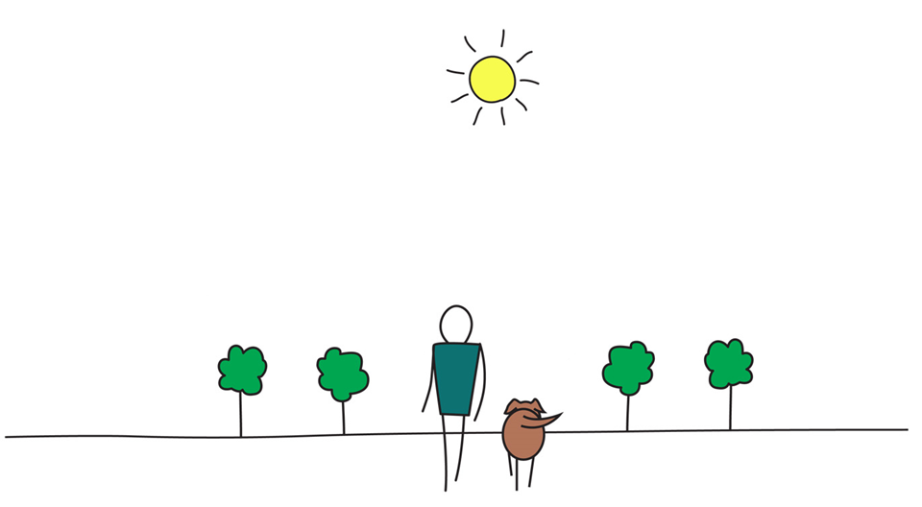
Be Mindful, Be Happy
Notes:
Michelle:
Any question?

