Slide 1
Workplace Etiquette Posters
A guide for managing change and supporting team members
Date : May 2023
* The French version of this document is available here : FR version

Slide 2
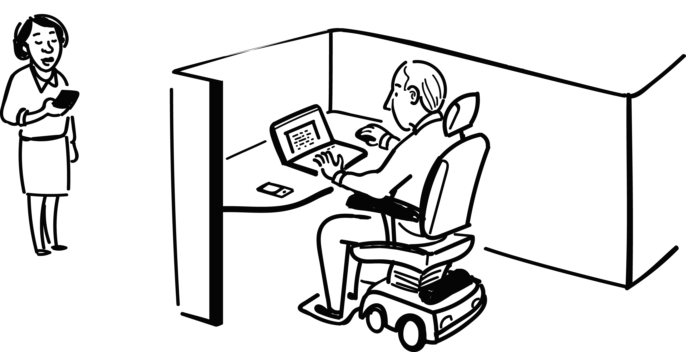
Quiet zone
AWARENESS • RESPECT • COURTESY • COMMUNICATION
*Instant message*
Can I talk to you about the new project?
*Instant message*
Sure, meet you in the lounge in half an hour?
Book your workpoint (if required)
Release your booking if you no longer need it
Help promote focus
Send a chat message to talk to a colleague working in the quiet zone
Mute your devices
Turn off device volume or use vibrate mode
Take it elsewhere
Use appropriate enclosed spaces for discussions, phone calls or virtual meetings
Ask others to tone it down
It is acceptable to politely remind others that this is a quiet zone
Report faulty equipment
If something is not working properly, please report it
Help the planet
Turn off monitors and task lighting when you leave
Tidy up after yourself
Dispose of garbage and clean surfaces with wipes provided

Slide 3
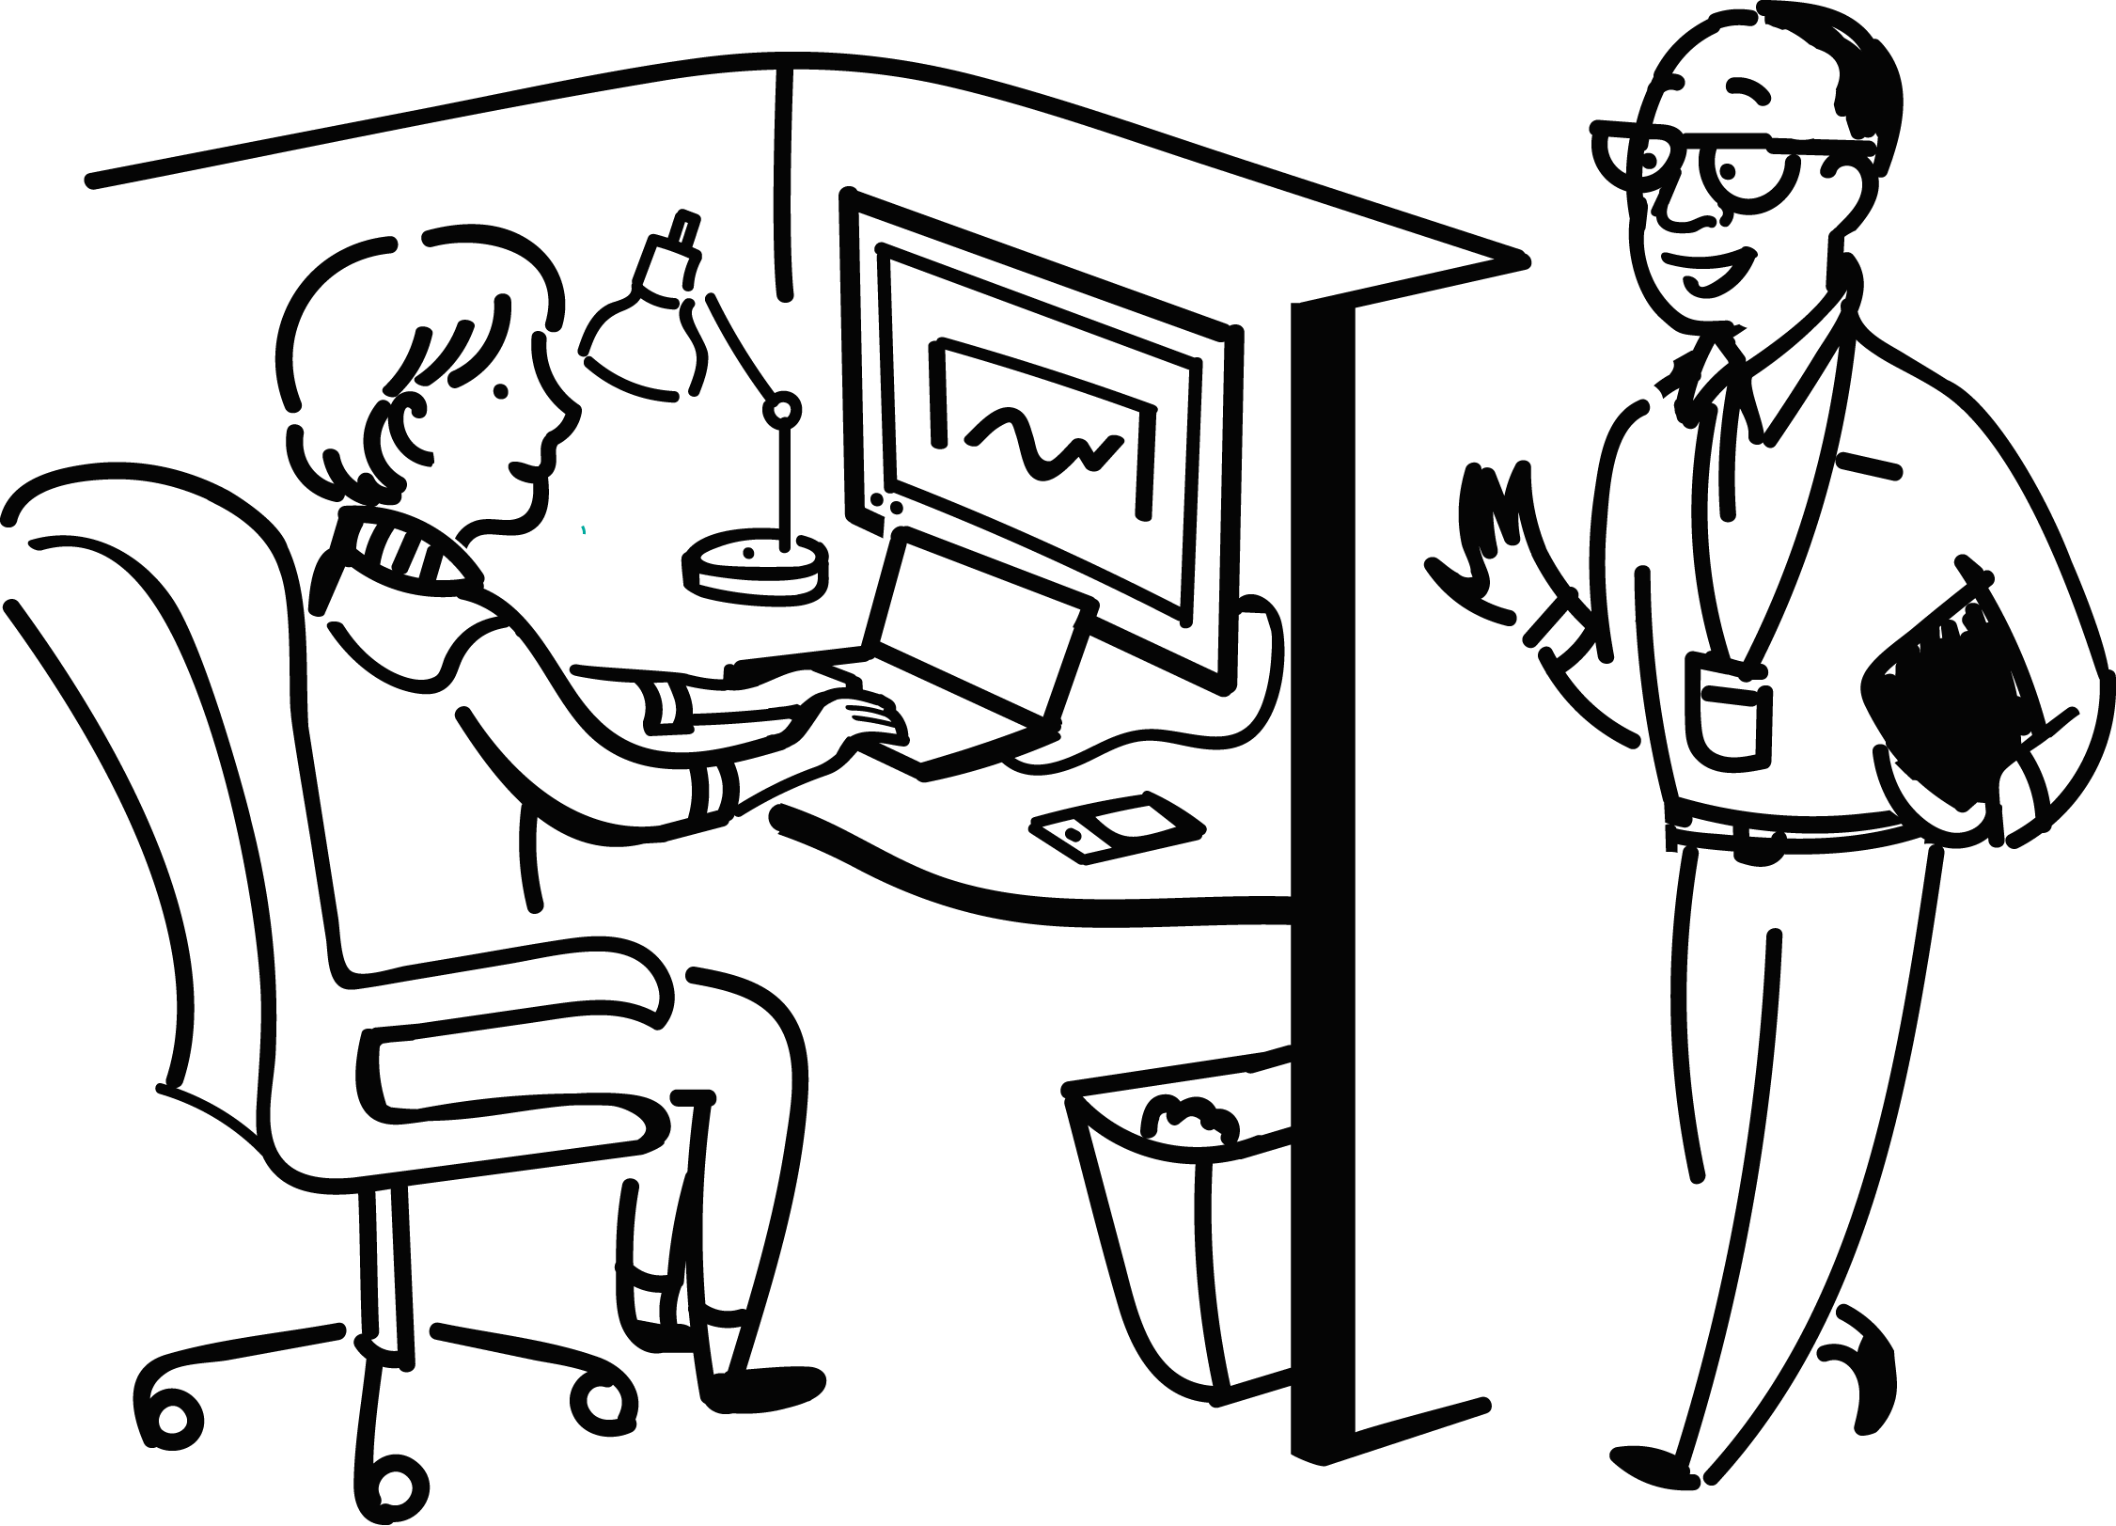
Transition zone
AWARENESS • RESPECT • COURTESY • COMMUNICATION
Book your workpoint (if required)
Release your booking if you no longer need it
Be aware of your noise
Use headphones to listen to music or participate in virtual meetings
Modulate your voice
Be considerate of your colleagues when speaking on the phone or collaborating with a co-worker
Take it elsewhere
Use collaborative spaces or appropriate enclosed spaces when discussions get lengthy
Switch it up
Explore the various workpoints available
Report faulty equipment
If something is not working properly, please report it
Help the planet
Turn off monitors and task lighting when you leave
Tidy up after yourself
Dispose of garbage and clean surfaces with wipes provided

Slide 4
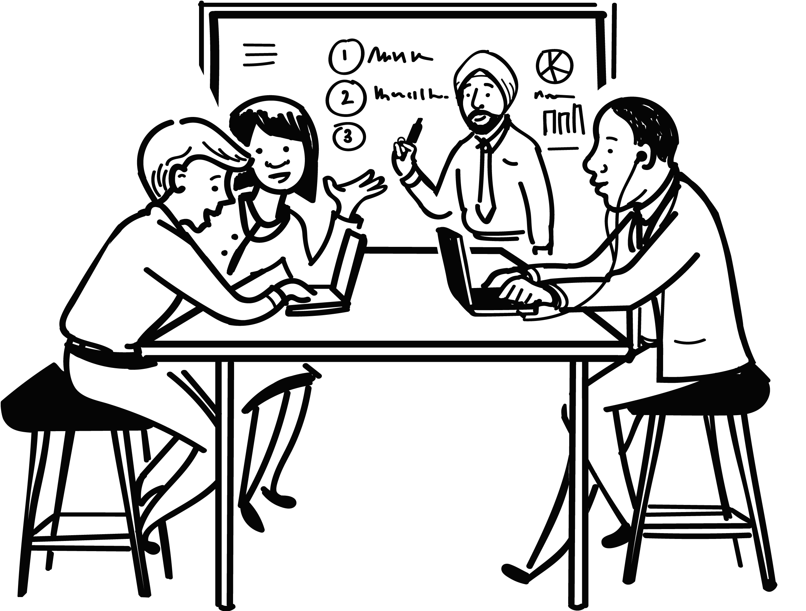
Interactive zone
AWARENESS • RESPECT • COURTESY • COMMUNICATION
Be respectful
Avoid inserting yourself into discussions in open areas near you, unless you are invited to do so
Return to order
Clean white boards and return furniture to original layout
Don’t expect silence
Others around you will be collaborating. If you need to focus, move to a quiet/focus area
Be aware of your noise
Use headphones to listen to music or participate in virtual meetings
Report faulty equipment
If something is not working properly, please report it
Help the planet
Turn off monitors and task lighting when you leave
Tidy up after yourself
Dispose of garbage and clean surfaces with wipes provided

Slide 5
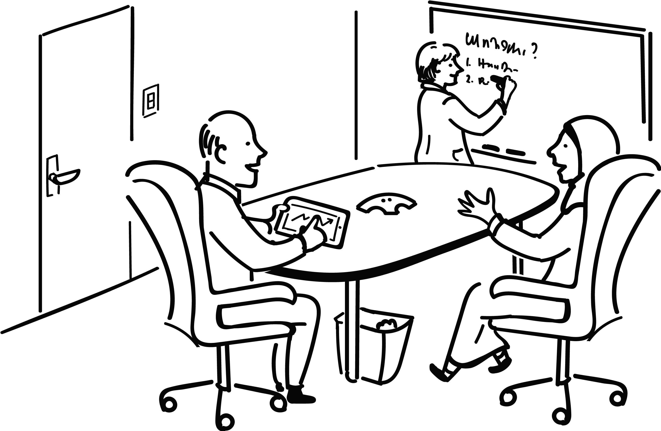
Enclosed spaces
AWARENESS • RESPECT • COURTESY • COMMUNICATION
Book a room (if required)
Release your booking if you no longer need it
Spontaneous use is ok
Check the booking system first
Don’t overstay
Respect scheduled meeting times – wrap it up 5 minutes before the end of your booking
Leave the room ready for others
Clean white boards and return furniture/equipment to original layout
Report faulty equipment
If something is not working properly, please report it
Help the planet
Turn off monitors and task lighting when you leave
Tidy up after yourself
Dispose of garbage and clean surfaces with wipes provided

Slide 6
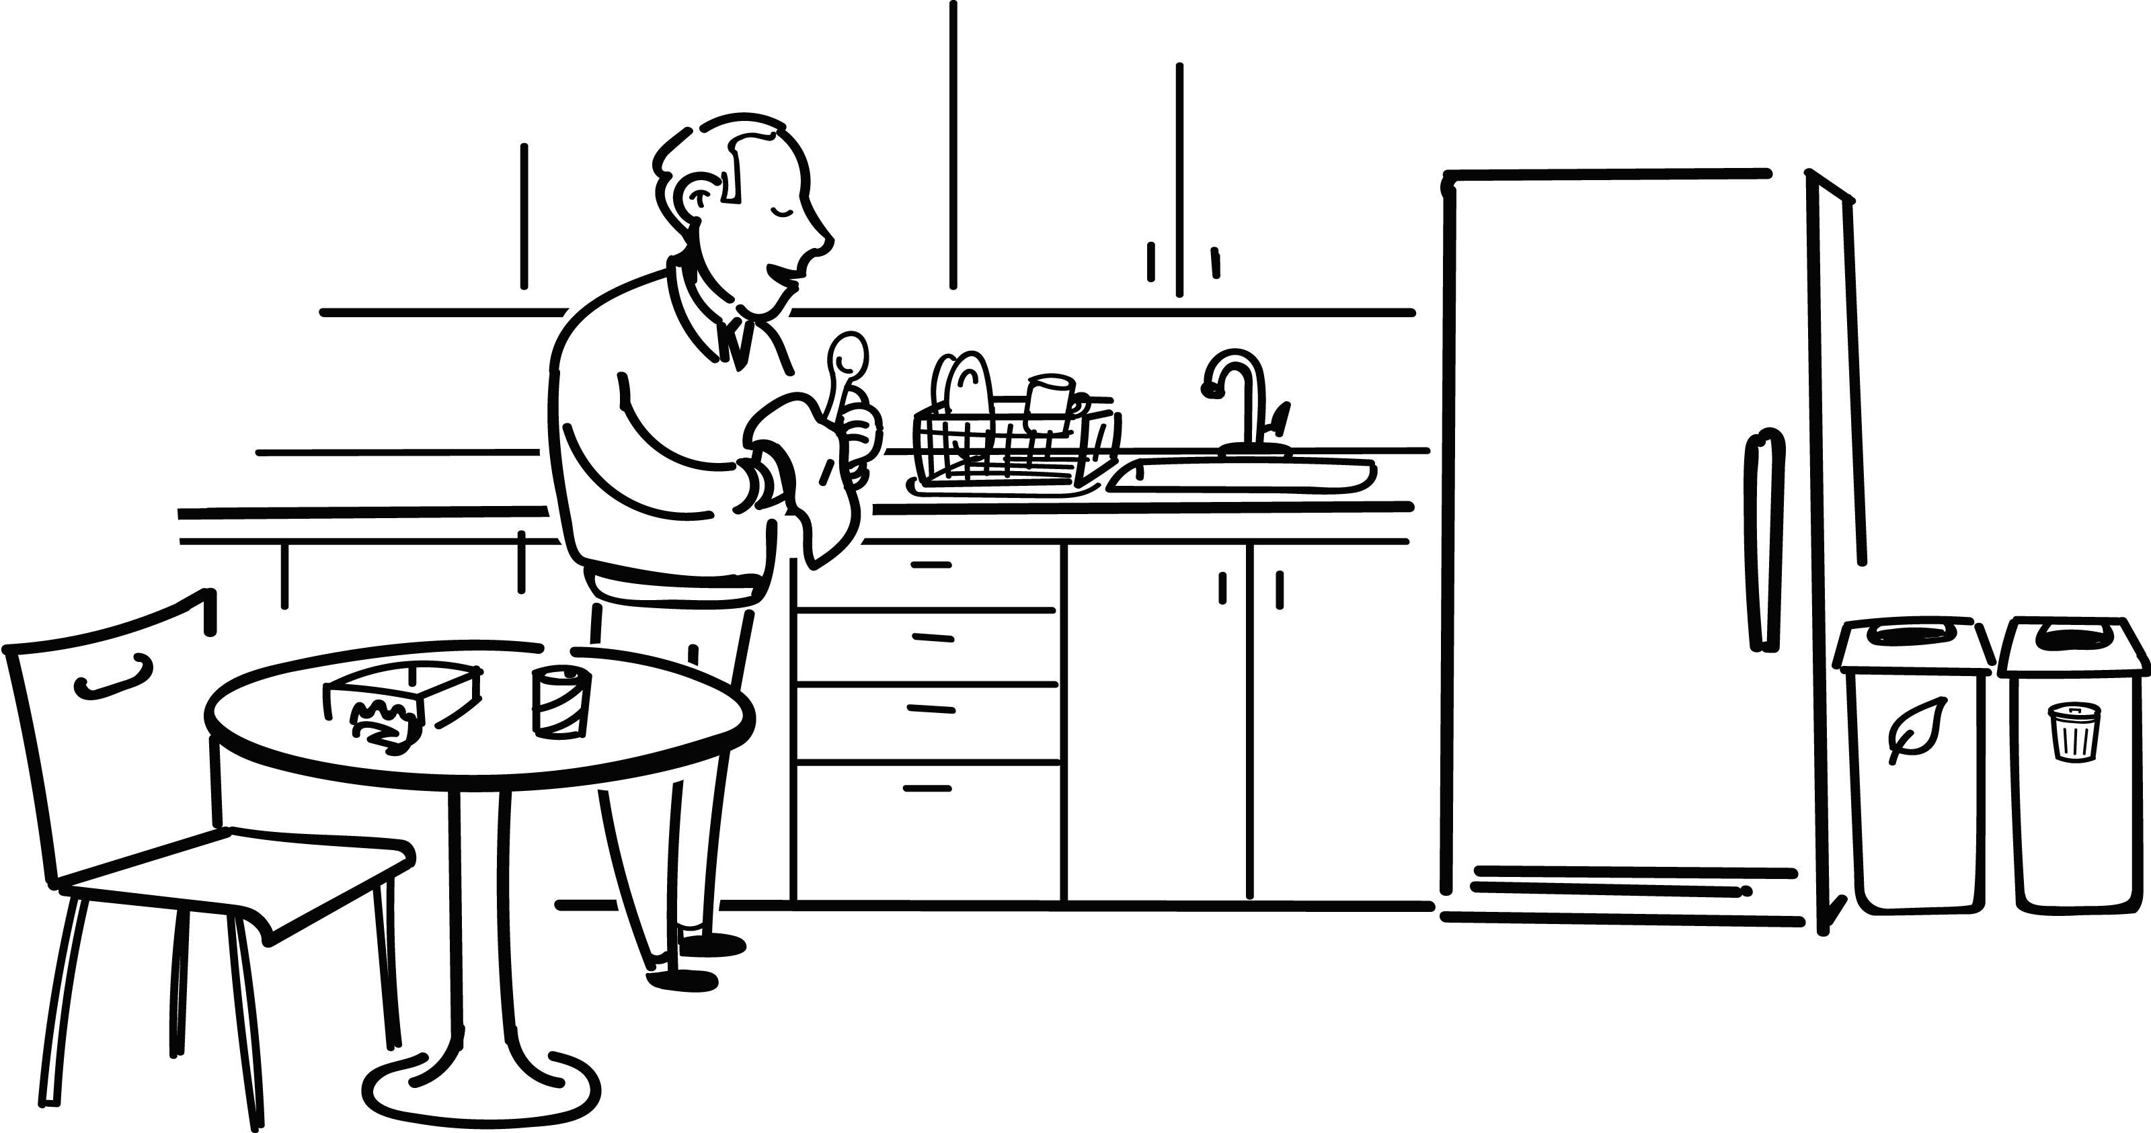
Kitchenette
AWARENESS • RESPECT • COURTESY • COMMUNICATION
Utensils and dishes
Don’t leave dirty utensils and dishes in the sink. Clean and dry what you use and put them back in their place
Shared use of refrigerator
Be mindful of expiry dates of any food you store in the refrigerator
Report faulty equipment
If something is not working properly, please report it
Help the planet
Use recycle and green bins/compost bins where available
Tidy up after yourself
Clean surfaces and appliances after use. Dispose of garbage and take any personal items with you when you leave

Slide 7
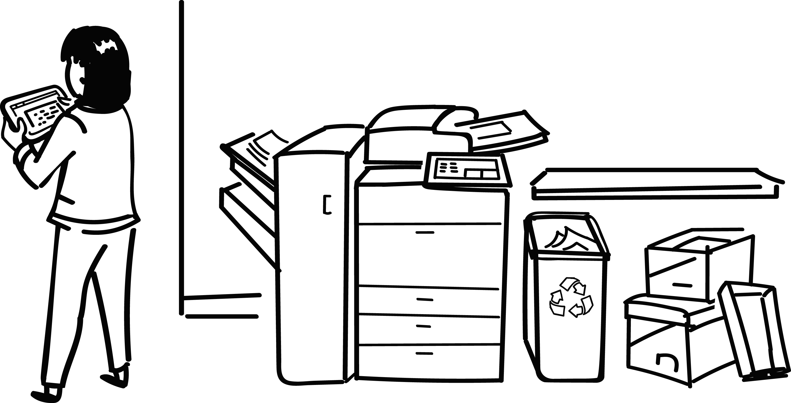
Equipment area
AWARENESS • RESPECT • COURTESY • COMMUNICATION
Think before you print
Try viewing on screen first, print only if necessary
Pick up your documents
Collect documents in a timely fashion
Safety first
Keep area clear of clutter
Think of others
Refill paper trays when empty
Report faulty equipment
If something is not working properly, please report it
Help the planet
Place discarded paper into recycle bins
Tidy up after yourself
Dispose of garbage and clean surfaces with wipes provided

