Slide 1
Change Management Strategy
Template
VERSION 1
September 2022

Slide 2
How to use this document
Instructions – Remove this page before use
To use this template, we highly recommend that you complete the first 3 tabs of the CM Workbook:
PRET form (Change Readiness Section)
Change Inventory and Impact Assessment
Contributors Table
The results from these 3 assessment documents will provide you with some insights that will help you to transform this predesigned CM strategy into a strategy that will be adapted to your organization’s needs.
Throughout this document, there is guidance and recommendations highlighted in yellow on how to adapt each page.

Slide 3
Context: Organizational and Project Vision
Include the vision developed in collaboration with the PSPC Strategic Workplace Advisory Group (SWAG) and approved by your senior leadership
[EXAMPLE]
After working from home for the last two years, it is now time to look to the future and plan our return to the workplace.
[Organization] will be taking part in the workplace transformation program, which aims to provide a department wide modernized workplace that will support all employees in a new hybrid work model.
The space at [Location] will be designed to foster a culture of innovation and improving digital technology to encourage government wide collaboration, flexibility and efficiency. It will also integrate sustainability and improve the overall health and well-being of employees and ensuring inclusivity for all.
As a starting point for our hybrid model, employees will be given the choice to work from the office based on operational requirements, functions or personal preferences. With flexibility in mind, this working model may evolve over time based on employee feedback.
We will continue to adapt and offer support to all employees during the course of this modernization project. Together our contributions help shape the future of our organization!

Slide 4
Context: Project Management Readiness
These are the 4 Project Management Readiness statements included in the PRET. If these are true for your organization, include them here as context. If the statements are somewhat or not in line with the reality at your organization, include them on the Risks and considerations slide.
Our organization's workplace strategy is being supported by a project sponsor that can be active and visible throughout the entire project. The project sponsor has the necessary authority over the people, processes, and systems to authorize and fund the necessary changes.
Our organization's leaders have made workplace modernization a priority. Leaders are ready to communicate this change in the context of other competing priorities and are willing to walk the talk.
Our organization has developed a workplace modernization strategy and has the necessary resources to implement the strategy, including project champions, a project integrator and subject matter experts.
Our organization has a structured change management approach for the project and has identified trained resources for change management. Resources are available to provide communication advice, develop communications products and provide training to employees.

Slide 5
Context: Change Readiness
These are the 4 Change Readiness statements included in the PRET. If these are true for your organization, include them here as context. If the statements are somewhat or not in line with the reality of your organization, include them on the Risks and considerations slide.
Our organization's history of change is successful, employees have embraced the past changes and did not revert back to old ways.
Our organization is open to new ideas and innovation, employees are rewarded for risk taking and embracing change.
Senior leaders and managers in our organization are highly skilled at managing change, performance is evaluated based on results and not based on employees’ presence.
Employees in our organization are encouraged, trusted and empowered to make choices about when, where and how they work based on what makes sense. Remote work (i.e. telework) is supported with policies, agreements and/or other mechanisms.

Slide 6
Change Management Strategy Objectives
[OPTIONAL] Add additional objective(s) based on Readiness Assessments and outcomes of the CM Kick-off Session.
Inform, involve and equip impacted employees towards the change and reinforce new mindsets and behaviours for the future.
Ensure employees feel informed and supported while the change is occurring, demonstrating the need for change, the impacts and the benefits the new ways of working will have on their daily work activities.
Build desire among people managers, senior leaders and all employees to actively participate in the change impacting their workplace, to develop a sense of ownership that will ensure a new mindset and behaviours are sustained.
Equip employees with the necessary resources, training and tools on how to change the way they work and their behaviours, to ensure they are confident to perform to work efficiently and productively in the new space.
Reinforce the change through people managers and senior leaders, to ensure employees adopt and sustain the new mindset and behaviours.

Slide 7
Objective 1 - Inform
If you are presenting your strategy to a senior audience, we recommend not including the next 4 slides as the information presented is too detailed. You can use Slide 13 High-Level CM Plan as an overview for that audience.
Ensure employees feel informed and supported while the change is occurring, demonstrating the need for change, the impacts and the benefits the new ways of working will have on their daily work activities.
Announcements from the project sponsor
Project announcement
Floor plan announcement
Pre-opening announcements
Communication channel(s) and content (intranet, newsletter and/or MS Teams channel)
Commonly asked questions
Key messages
PSPC Project Story Collection
Direct communication from people manager to employees
Manager toolkit

Slide 8
Objective 2 - Involve
Build desire among managers, executives and all employees to actively participate in the change impacting their workplace, to develop a sense of ownership that will ensure a new mindset and behaviours are sustained.
Townhalls and events
Project announcement townhall
Pre-opening townhall
Tour of the new workspace
Hybrid opening ceremony
Project engagement activities
Design survey
Removal of personal & business assets
Boardroom naming
New ways of working
Community norms (etiquette)
Team charters
Change Agent Network

Slide 9
Objective 3 - Equip
Equip employees with the necessary resources, training and tools on how to change the way they work and their behaviours, to ensure they are confident to perform to work efficiently and productively in the new space.
Toolkits/User guides
Managers
Employees
Training
A day in the life presentation
Training content

Slide 10
Objective 4 - Reinforce
Reinforce the change through managers and executives, to ensure employees adopt and sustain the new mindset and behaviours.
Communication from Project Sponsor
Change sustainment communiques
Workplace performance survey
Direct communication from manager to employees
Manager toolkit

Slide 11
Risks and considerations (1 of 2)
Complete this section based on the results of the Readiness assessments in the PRET and Contributors table in the CM Workbook, as well as the outcome of the CM Kick-off Session.
Add any of the Project Management Readiness Assessment and Change Readiness statements that are somewhat or not in line with the reality at your organization. Add a small paragraph on how you plan to address the condition(s).
EXAMPLE: Leaders are somewhat ready to communicate this change in the context of other competing priorities and are somewhat willing to walk the talk. In order to ensure our senior leaders are well equipped to manage this change, we will host a mandatory 1h session on how to manage change where the project sponsor will reiterate the priority of this initiative and its success. We will also provide a Leadership toolkit that contains relevant resources to equip the senior leaders. [include additional details as to how you will go about doing this]
Add any consideration relating to Contributors:
List any Resister groups and their challenges and barriers. Add a small paragraph on how you plan to address the condition(s).
EXAMPLE: Employees from Branch XYZ have shown resistance to the new workplace as the floor being renovated used to be ‘their’ floor and they are not please that it will now be shared with the entire organization. We will equip the managers and senior leaders of the Branch to reinforce key messages such as the ‘Why’ for the change and the ‘What’s in it for me’ for employees. Additional information sessions, question and answer periods as well as Ask Me Anything sessions with senior leaders will be scheduled. [include additional details as to how you will go about doing this]
List any Enthusiast groups with their opportunities. Add a small paragraph on how you plan to use these groups to help in your strategy.
EXAMPLE: Our organization has been actively engaging with our union(s) and they are strong supporters of the new workplace as it will provide flexibility for employees who choose to work from the office. As such, we will work with the union(s) and their employee representatives to communicate key elements for the new workplace directly to employees. [include additional details as to how you will go about doing this]

Slide 12
Risks and considerations (2 of 2)
Complete this section based on the results of the Readiness assessments in the PRET and Contributors table in the CM Workbook, as well as the outcome of the CM Kick-off Session.
Add any Client enabling initiatives in the Change inventory and impacts that have a High/Medium impact that have specific conditions that need to be addressed as part of your strategy.
EXAMPLE: The creation of a new interim/telework agreement has taken longer than anticipated. As a result, questions about this are being asked at all our engagements regarding the Workplace Transformation Project. Employees are concerned and confused as to what the future of hybrid will look like in our organization and therefore have a risk of becoming resistant. To address this, we will work with the HR representative on our Integrated project team to see if more frequent communication on the interim/telework agreement can be shared with employees. [include additional details as to how you will go about doing this]

Slide 13
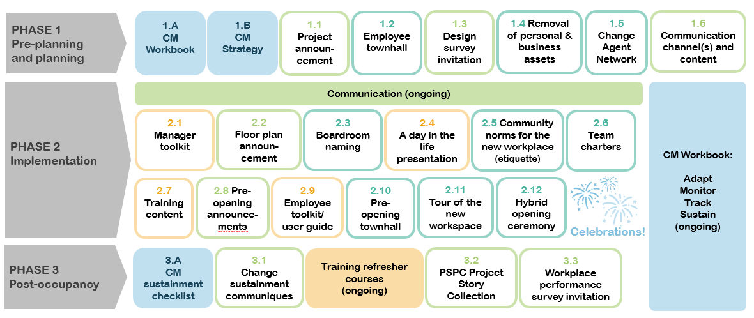
High-Level Change Management Plan
Present here a high-level CM plan. You can use the Content overview included in the CM Program in-a-box (as shown below) or your own timeline.

Slide 14
Expected outcomes
[OPTIONAL] If you added additional objective(s) on the Objectives slide, be sure to include their expected outcomes here.
Inform
Employees are well informed of the changes that will take place in their workplace
Employees understand the reasons for the upcoming changes to their workplace
Employees understand the impact of the upcoming changes to their workplace on their day-to-day work activities
Involve
People managers, senior leaders and all employees are motivated to be part of the change in their workplace
People managers, senior leaders and all employees look forward to the changes to their workplace
Employees feel people managers support the change
Employees feel senior leaders support the change
Equip
Employees know where to go to get information on the upcoming changes to their workplace
Employees have the knowledge to be successful in their new work environment
Employees are confident they will be able to perform their activities effectively in their future work environment
Employees have access to resources (training/people) to acquire the ability to work effectively in their new work environment
Reinforce
Employees feel the organization is supporting its employees to work in a mobile way
Senior leaders are supportive of new ways of working
People managers are supportive of new ways of working

Slide 15
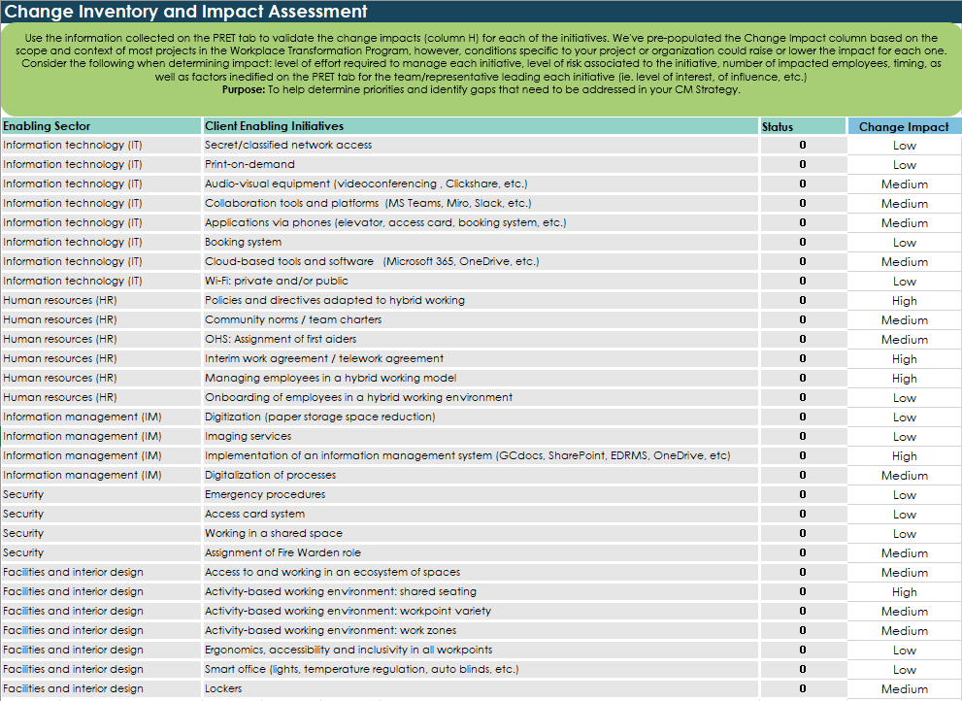
Change inventory and impact assessment
Include the results of your Change inventory and impact assessment
EXAMPLE

Slide 16
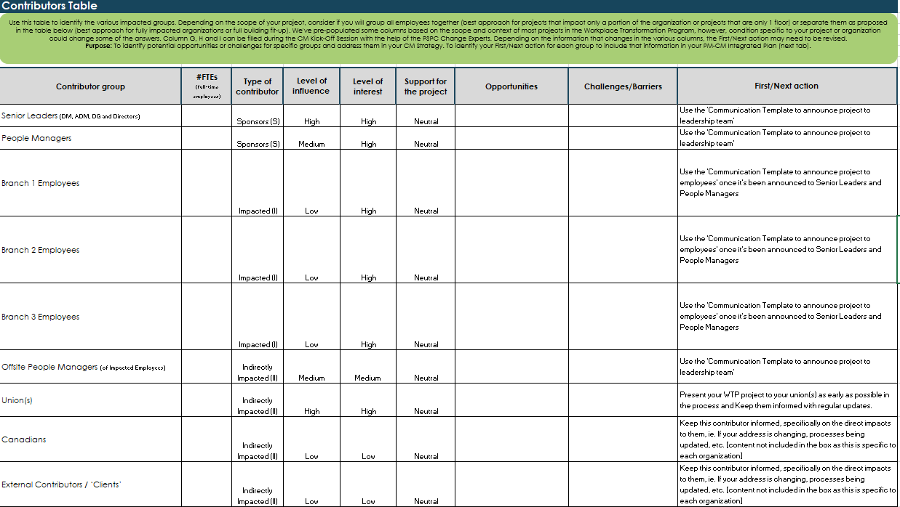
Contributors table
Include the results of your Contributors table
EXAMPLE

