Slide 1
Formation PFAN
PFAN​ Programme francophone des autorités de noms​
Préparée par
le Comité des normes du PFAN
À partir du matériel de formation élaboré par
le PCC Standing Committee on Training
RDA NACO Program Training Workshop Task Group
Notes:
(Date of slide or last update given at the top of the notes for each slide)
Trainers may customize this slide.
Introduce yourself and have attendees introduce themselves. Extend a welcome to the NACO program and mention that NACO libraries are valued participants in building the LC/NACO Authority File.
Be sure to talk about: where are the bathrooms; what is the schedule for breaks and lunch; where is the food to come from; is there a close source of drinks and/or coffee; inform people of any emergency information, such as where to go in the event of a fire alarm.
Breaks are typically 20-30 minutes. Lunch is generally an hour or no longer than one hour and fifteen minutes.
Note: this training is geared toward OCLC libraries.

Slide 2
Comité des normes du PFAN :
Nathalie Mainville, co-présidente; Daniel Paradis, co-président; Bernard Bérubé; Philippe Brosseau; Izidor Cirnatiu; Julie Gauthier
SCT RDA NACO Program Training Workshop Task Group (Groupe de travail sur les ateliers de formation du programme RDA NACO du Comité permanent sur la formation) :
Lori Robare, présidente; Michael Colby; Joanna Dyla; Paul Frank; Fang Gao; Robert Maxwell; Mark Scharff; Adam Schiff
Notes:
1er mai 2013

Slide 3
PFAN​ Programme francophone des autorités de noms​
Fondements du PFAN
Module 1
Notes:
1er mai 2013

Slide 4
Objectifs d’apprentissage (1)
À la fin du cours, les participants seront en mesure de :
consulter et utiliser le Format d’autorité du MARC, le Guide des autorités de noms et le Supplément MARC du Guide des autorités de noms
créer et réviser les notices d’autorité de noms selon RDA et les énoncés de politique de BAC-BAnQ
Notes:
Mis à jour : 24 février 2014
Consultez et utilisez le Format d’autorité du MARC 21, le LC Guidelines Supplement, le DCM Z1 comme outils pour la création d’autorité de noms.
Vous retrouverez ces outils dans le Bureau du catalogueur (Catalogers Desktop) et la page du PCC NACO page à http://www.loc.gov/aba/pcc/naco/doc-updates.html.
Nous irons à travers ces outils dans ce module.
2) Créez et révisez les notices d’autorité de noms selon RDA et les Énoncés de politique de LC-PCC (LC-PCC PS).

Slide 5
Objectifs d’apprentissage (2)
appliquer la désignation de contenu conformément au Format d’autorité du MARC
évaluer, mettre à jour et modifier les notices d’autorité de noms existantes
déterminer si une entité nommée est établie par le biais du PFAN ou du RVM
comprendre les aspects administratifs du PFAN
Notes:
20 mars 2017 : Notes du formateur mises à jour.
« Désignation de contenu » indique les étiquettes, les indicateurs et les codes de sous-zone dans une notice MARC – le codage qui rend possible à un ordinateur d’interpréter l’information trouvée dans une notice. RDA est une norme de contenu qui peut être utilisée avec plusieurs différents formats de données, non seulement le MARC, mais pour le moment nous travaillons toujours dans un environnement MARC 21, ce qui est le focus de cet atelier.
Le Module 7 de cet atelier comprend un ensemble d’exercices pour faire des changements aux notices d’autorité existantes.
Vous pouvez mentionner que de décider si une entité nommée est établie à travers NACO ou SACO peut à certain moment être un défi. Nous examinerons les façons dont vous pouvez en venir à cette décision.
Les aspects administratifs du NACO comprennent : l’indépendance du NACO, le processus de révision, etc. Ceci sera discuté dans le dernier module de l’atelier.

Slide 6
Jour 1 : Fondements du PFAN
Autorités dans une base de données partagée
Principes et paramètres du PFAN
Recherche/MFB (maintenance du fichier bibliographique)
Normalisation
FRBR et FRAD
Format d’autorité du MARC 21
Notes:
1er mai 2013
Normalisation : un ordinateur d’édition conçu pour conserver les caractères essentiels d’un point d’accès dans le but de comparer.
Format d’autorité du MARC 21 : préparé par Network Development & MARC Standards Office; définit les codes et les étiquettes de convention (étiquettes, indicateurs, codes de sous-zone et valeurs codées qui identifient les éléments de données dans les notices d’autorité du MARC).

Slide 7
Jour 2 : Description des personnes
Chapitres 8 et 9 de RDA
Révision des énoncés de politique de BAC-BAnQ
Travaux pratiques
Notes:
Mis à jour : 20 mars 2017
Note au formateur : allouez du temps pour la création de notices d’autorité des noms de personne au Jour 2.

Slide 8
Jour 3 : Description des familles Description des collectivités
Familles : Chapitres 8 et 10 de RDA
Collectivités : Chapitres 8 et 11 de RDA
Révision des énoncés de politique de BAC-BAnQ
Travaux pratiques
Notes:
Updated: March 20, 2017
Corporate bodies including conferences: RDA chapters 8 and 11 and corresponding LC-PCC PSs.
Other topics covered: Government and non-government bodies, direct/indirect entry, etc.
Note to trainer: practicum in the creation of NARs should be done by participants in the afternoon.

Slide 9
Jour 4 : Description des lieux Description des œuvres et expressions
Lieux : Chapitre 16 de RDA (conjointement avec le chapitre 11)
Œuvres et expressions : Chapitres 5 et 6 de RDA (conjointement avec les chapitres 8-11)
Révision des énoncés de politique de BAC-BAnQ
Travaux pratiques
Notes:
March 27, 2017: removed reference to Chapter 12 given RDA Toolkit Restructure and Redesign project.
Describing Works and Expressions: RDA Chapters 5 and 6 (in conjunction with Chapters 8-11, when constructing access points that include a personal, corporate, or family name as a creator)
Note to Trainer: practicum in the creation of NARs should be done by participants in the afternoon.

Slide 10
Jour 5 : Apporter des changements aux notices d’autorité de noms existantes et à l’administration du PFAN
Changements aux notices d’autorité de noms (Guide des autorités de noms)
Révision des énoncés de politique de BAC-BAnQ et du Guide des autorités de noms
Travaux pratiques
Aspects administratifs du PFAN
Notes:
Updated: Feb. 24, 2014
A great deal of NACO work involves access points that are already established. On the fifth day we talk about evaluating and changing NARs. It’s also the day to wrap up the training week and anticipate the next steps in the review process.
Note to trainer: practicum on the creation of new authority record in the afternoon, if necessary or time allows.

Slide 11
Jour 1 : Fondements du PFAN
Ce module permet de présenter aux participants du PFAN :
l’environnement de base de données partagée
les principes et les paramètres du PFAN
le Format d’autorité du MARC 21
Guide des autorités de noms
Supplément MARC du Guide des autorités de noms
Notes:
February 27, 2020: updated speaker notes (added URLs for documentation)​
​
Shared database environment: Define what this means (e.g., participants from national and international libraries working together to create NARs for the common good of all users).​
​
PCC NACO parameters: The underlying principle of the LC/NACO Authority File is that participants agree to follow a common set of standards and guidelines when creating or changing authority records in order to maintain the integrity of a large shared authority file. These guidelines will be discussed later. There is a need to streamline efforts while building a consistent and predictable file that will reduce the efforts of the global library community and maximize its resources.​
​
MARC 21 Authority Format: show if available. https://www.loc.gov/marc/authority/​
​
LC Guidelines Supplement to the MARC 21 Authority Format: available in Cataloger’s Desktop (linked from MARC 21 Authority Format and separately) and linked from NACO Documentation & Updates page. https://www.loc.gov/catdir/cpso/lcmarcsuppl.pdf​
​
DCM Z1: available in Cataloger’s Desktop (linked from MARC 21 Authority Format and separately) and linked from NACO Documentation & Updates page. https://www.loc.gov/catdir/cpso/dcmz1.pdf

Slide 12
Principes du PFAN :
Autorités dans une base de
données partagée
Notes:
May 1, 2013

Slide 13
Programme francophone des autorités de noms (PFAN)
Plus de 13 membres
- Bibliothèques universitaires membres de la plateforme partagée de services (PPS)
- Bibliothèques nationales (BAC, BAnQ)
Autorités de langue française
Le fichier de base est celui de BAC auquel se sont ajoutés des versements provenant des fichiers des autres participants
2 comités ont été formés pour mettre en place le fichier d’autorités de noms : le Comité directeur et le Comité des normes
1 groupe de travail : GT-BUQ-Autorités
WMS et fichier local pour BAnQ
Notes:
GT-BUQ-Autorités, mandat: Assurer une coordination entre les bibliothèques des universités et le Comité des normes du programme francophone des autorités de noms (PFAN) et soutenir le personnel des bibliothèques universitaires dans la gestion collaborative du fichier d’autorité francophone de noms.
December 12, 2016. Updated statistics.
NACO began in 1977 as a joint project between LC and the Government Publications Office (GPO) to use and maintain a common authority file which would reduce the cost of authority work, the most expensive aspect of cataloging.
At the end of fiscal 2016, there were 957 institutions participating as either full-level NACO members or in NACO funnel projects. [Note: This figure comes from adding the NACO-only institution number with the institutions in BIBCO and CONSER in the PCC statistics document]
NACO funnel projects are formed to pool resources, expertise and contributions.
NACO-contributed records account for well over half of all new name and series records in the authority file. In fiscal 2012, PCC contributions exceeded LC contributions by 127.8%.
The NAF contains about 9.7 million records (2016).

Slide 14
Programme francophone des autorités des noms (PFAN)
Comité directeur
Dominique Bourassa consultante
Bibliothèque et Archives Canada / Library and Archives Canada (BAC/LAC)
Représentante : Caitlin Horrall
Bibliothèque et Archives nationales du Québec (BAnQ)
Représentante : Danielle Poirier
Bureau de cooperation interuniversitaire (BCI)
Représentante : Julie Cardinal (Université de Montréal)
Comité des autorités de BAC
Bureau de la normalisation
Comité des normes
Groupe de travail des bibliothèques universitaires du Québec pour les autorités (GT-BUQ Autorités)

Slide 15
Comité directeur
Mandat
Planification du projet de fichier francophone d’autorités de noms
Supervision et administration du Programme francophone des autorités de noms (PFAN)
Composition
1 membre provenant de Bibliothèque et Archives Canada (BAC) : Caitlin Horrall
1 membre provenant de Bibliothèque et Archives nationales du Québec (BAnQ) : Danielle Poirier
1 membre provenant des universités francophones du Québec : Julie Cardinal

Slide 16
Comité des normes
Mandat
Le Comité des normes est responsable de la rédaction et de la mise à jour des lignes directrices pour la contribution des autorités au fichier d’autorité de noms en français et assure le soutien des partenaires dans l’utilisation des normes.
Composition
2 membres provenant de Bibliothèque et archives Canada (BAC) : Nathalie Mainville et Bernard Bérubé
2 membres provenant de Bibliothèque et Archives nationales du Québec (BAnQ) : Daniel Paradis et Izidor Cirnatiu
2 membres provenant des universités francophones du Québec : Philippe Brosseau et Julie Gauthier
Notes:
3 avril 2020
Comité des normes (relève du comité directeur)
Rôle : le comité assure le respect des normes, établit les pratiques communes et offre du soutien pour résoudre les cas problèmes, ou litigieux.
Composition : Ce comité sera formé d’experts qui devront être dégagés d’une partie de leurs tâches pour soutenir les bibliothèques participantes. 2 membres de BAC 2 membres de BAnQ 2 membres provenant des universités
Source: Fichier-commun-autorité-Bilan20180630(2) (5).pdf

Slide 17
Groupe de travail des bibliothèques universitaires sur les autorités (GT-BUQ-Autorités)
Mandat
Assurer une coordination entre les bibliothèques des universités et le Comité des normes du programme francophone des autorités de noms (PFAN)
Soutenir le personnel des bibliothèques universitaires dans la gestion collaborative du fichier d’autorité francophone de noms
Composition
9 membres provenant des universités francophones du Québec :
Philippe Brosseau Lucie Hamelin
Isabelle Dallaire Pierre-Étienne Lépine
Gaston Fournier Troy Pouliot
Julie Gauthier Azar Younespour
Irina Gherasim

Slide 18
Échange de notices
Nécessite plus de normalisation
Les systèmes/utilitaires locaux sont différents
MARC 21 est un dénominateur commun
Notes:
May 1, 2013
1) As the library becomes more globalized, we are making more and more efforts to harmonize the rules and standards we work under, not just in MARC formats, but also in how to establish a unique identifier.
2) There is still a great deal of work to be done, but international harmonization efforts continue to grow, and you are now going to be a part of that.

Slide 19
Du MARC 21 au BIBFRAME
Les efforts sont en cours pour la transition du MARC 21 au nouveau cadre bibliographique
Processus collaboratif
Focus : traduire le format MARC 21 en un modèle de données liées
- tout en conservant le plus possible les aspects robustes et bénéfiques du MARC
Modèle proposé : BIBFRAME
- http://bibframe.org/
Notes:
May 1, 2013
Libraries have used the MARC format for exchanging information since the 1960s. Efforts are now underway to transition to a new bibliographic framework that will better accommodate the future needs of the library community.
The Library of Congress is leading the Bibliographic Framework Transition Initiative as a collaborative process. LC contracted with Zepheira to provide a model as a starting point of discussion.
The proposed model is called BIBFRAME. Early experiments are underway, but it will take time for the model to be fully developed and implemented. We are still working in MARC 21 for now.

Slide 20
Valeur supérieure – Minimum d’effort
But du PFAN :
Construire un fichier d’autorité de noms
Pour le plus grand bien de tous
Avec un minimum d’effort par participant
Notes:
May 1, 2013

Slide 21
Fichier dynamique
Le fichier d’autorité Canadiana est un fichier dynamique, changeant en temps réel
Toute notice peut être changée par un autre participant du PFAN pour des raisons appropriées
Notes:
Updated: Feb. 24, 2014
1) The LC NACO Authority File is in constant flux, changing every 24 hours.
2) NACO members modify authority records frequently. In recent years, nearly half of NACO activity involved changes to existing records. As we transition to RDA, there are likely many more modifications than new records.
a) New information is constantly coming in through regular cataloging, so we can expect constant change. Even though this does cause a need for maintenance, it is nonetheless a good thing in the long run.
b) Remember that one of the most important rules of a shared database is to respect your colleagues. Everybody makes mistakes, and you are certainly free to modify an authority record if you discover an error in fact or form, or have new information to add.
c) But a difference of opinion is not an acceptable reason to make changes to the authorized access point. Reasons for making changes to an authorized access point include: conflict, author preference, record created in error, etc.
d) any other aspect of the record can be changed or added to, e.g., adding new RDA elements, new variant access points, etc.

Slide 22
Le catalogue dessert les utilisateurs
Selon les Principes internationaux de catalogage :
Les points d’accès contrôlés devraient être fournis pour les noms autorisés et les variantes de forme de noms
Les points d’accès contrôlés fournissent l’uniformité nécessaire au regroupement des notices bibliographiques pour des ensembles de ressources
Notes:
May 1, 2013
1) This comes from the Statement of International Cataloging Principles developed by the International Federation of Library Associations (IFLA): http://www.ifla.org/files/assets/cataloguing/icp/icp_2009-en.pdf
2) Remember that this basic idea applies to all names, not just people. In fact, that is what we are covering in this entire course, all the different entities that have names or titles and therefore need unique identifiers.

Slide 23
Notices d’autorité de noms et fichier d’autorité de noms
La notice d’autorité de nom affiche le point d’accès autorisé et les variantes de point d’accès, et décrit l’entité à l’aide des éléments de RDA
Le fichier d’autorité Canadiana comprend toutes les notices d’autorité de noms
Les bibliothèques choisissent les niveaux de contrôle d’autorité
L’introduction du Guide des autorités de noms décrit les politiques du PFAN lorsqu’il faut créer une notice d’autorité de nom
Notes:
December 12, 2016: updated first bullet point to more fully describe the function of the NAR
3rd bullet: Libraries in NACO may decide which areas of their collection will require name authority records. They may choose to contribute NARs to NACO for only certain parts of their collections. They may use slightly different practices for their local authority files. For example, a local author who has only a vanity press publication in your file may not need a national-level authority record. Or maybe that person is the one you need to make sure gets into the NAF. It’s up to your institution to decide on these policies.
4th bullet: DCM Z1 Introduction describes LC’s policies for when to create a name authority record.

Slide 24
Jugement du catalogueur
Faire preuve de jugement lorsqu’il faut appliquer plusieurs instructions
Un choix différent n’est pas toujours une erreur, donc respecter le jugement de vos collègues
Ne pas toucher à un point d’accès autorisé correct et unique
Notes:
May 1, 2013
1) Over time, each cataloger will find their judgment developing with their own area of specialty (e.g. public libraries vs. the needs of academic libraries). Learn to trust your judgment. Sometimes there is no right or wrong answer, just what is appropriate to the needs of your library.
2) As much as possible, leave a correct, unique authorized access point alone.

Slide 25
Pratiques spécifiques
Une pratique ne s’applique pas nécessairement de la même manière à toutes les parties du travail du PFAN
p. ex., les noms géographiques nécessitent
toujours une recherche, mais rarement les
noms de personne
Notes:
May 1, 2013
As we go through the instructions, we will show where there are practices specific to an area, and what exceptions exist to general policies.

Slide 26
Accent sur la ressource en main
Se concentrer sur les notices reliées à un document en train d’être catalogué
Les catalogueurs du PFAN (incluant BAC et BAnQ) ne doivent pas parcourir la base de données à la recherche d’erreurs
Notes:
Updated: Feb. 24, 2014

Slide 27
Aller à la source
Signaler au répondant PFAN de votre bibliothèque un problème dans une notice d’autorité provenant de votre établissement
Signaler un problème dans une notice d’autorité provenant d’une autre bibliothèque que la vôtre au répondant PFAN de cet établissement
Signaler un problème touchant plusieurs notices d’autorité provenant de plusieurs bibliothèques aux répondants de BAC (Nathalie Mainville) ou de BAnQ (Daniel Paradis).
Signaler un problème nécessitant une réflexion et une prise de décision commune au répondant PFAN, lequel s’assurera de transmettre l’information au Comité des normes
Notes:
May 1, 2013
The NACO liaisons or contacts’ email addresses and phone numbers for the various PCC NACO institutions are on the NACO web page.
If you spot a continuing pattern of suspicious cataloging practices, you could mention it to naco@loc.gov and let them investigate it. This is generally a better procedure than pointing out mistakes on public discussion lists.

Slide 28
Paramètres du PFAN
Documentation
Lignes directrices des contributions
Changements aux notices d’autorité de noms existantes
Annulation de notices d’autorité de noms
Maintenance du fichier bibliographique (à venir)
Recherche (pourquoi, comment et quand)
Règles de normalisation
Notes:
May 1, 2013
Participants agree to a common set of standards when creating or changing records.
This maintains the integrity of the LC/NACO Authority File (which will sometimes be call “NAF” in the following slides).
The primary purpose of this workshop is to teach you the standards that underlie our work.
The goal is to follow a common set of standards and guidelines when creating or changing authority records in order to maintain the integrity of a large shared authority file

Slide 29
Paramètre du PFAN : Documentation
RDA Toolkit
Énoncés de politique de BAC-BAnQ
Format d’autorité du MARC 21
Supplément MARC du Guide des autorités de noms
Guide des autorités de noms
Notes:
November 12, 2019: revised second bullet (current text of the old RDA in RDA Toolkit is no longer updated frequently)​
​
All new authority record contributions are to be formulated using the following documentation:​
RDA – Resource Description and Access. These instructions must be applied by NACO participants in conjunction with the LC-PCC PSs. Participants must have access to the RDA Toolkit. ​
LC-PCC PSs – Library of Congress/Program for Cooperative Cataloging Policy Statements. These guidelines provide the PCC and LC policies related to RDA, with clear labels indicating any differences in application. They identify core elements, explain practices for alternative instructions and options, and provide explanation and expansion of certain instructions in an attempt to assure uniformity which will facilitate retrieval, and increase the predictability of data elements in the NAF. NACO participants must use the published LC-PCC PSs.​
MARC 21 Authority Format – describes and illustrates the structural elements (content designation) of authority records, such as leader, fixed fields, variable fields, subfields and all codes which are defined for these fields. These fields will be discussed later in Day 1. Note: LC does not implement all of the MARC 21 elements described, and since the PCC program records follow LC guidelines, participants must refer to the LC Guidelines Supplement. ​
LC Guidelines Supplement – use when applying content designation​
DCM Z1 – Descriptive Cataloging Manual Z1 ​
​
Note: All of this documentation is available in Cataloger’s Desktop. In addition, LC-PCC PSs are freely available as part of the RDA Toolkit (on the Resources tab). The LC Guidelines Supplement and DCM Z1 are available as PDF files on the NACO Documentation & Updates page (http://www.loc.gov/aba/pcc/naco/doc-updates.html) and updates are posted on the NACO home page.​
​
Note: In the past, MARC 21 Authority Format was sometimes called the “white pages,” LC Guidelines were called “blue pages,” and DCM Z1 was called “yellow pages” because of the colors used for printing and interfiling. This terminology is no longer used as online documentation has become the norm.

Slide 30
Utiliser à la fois RDA et les énoncés de politique de BAC-BAnQ
RDA fournit les instructions de base
Les énoncés de politique de BAC-BAnQ fournissent davantage d’explications, des applications complémentaires et des exemples
Les énoncés de politique de BAC-BAnQ vous indiquent les options de RDA et les alternatives à appliquer
Les énoncés de politique de BAC-BAnQ ont préséance sur RDA
Notes:
May 1, 2013

Slide 31
Format MARC 21
Notes:
December 12, 2016 updated the image
Note to Trainer: If possible, demonstrate Cataloger’s Desktop directly in a browser.
This is a representation of the format of fields described in MARC 21 Format for Authority Data (Cataloger’s Desktop)—in this case the 053 field is demonstrated.
MARC 21 Format for Authority Format – The basic pages that describe and illustrate the structural elements (content designation) of authority records, such as the leader, fixed fields, variable fields, subfields, and codes defined for these fields.
LC does not implement all elements described in the MARC 21 Authority Format, and since the PCC program records follow LC guidelines, participants must refer to the supplements known as the “LC Guidelines” when applying the content designation to authority records.
A MARC record is composed of three elements: the record structure, the content designation, and the data content of the record.

Slide 32
Supplément MARC du Guide des autorités de noms
Instructions pour les pratiques du PFAN en ce qui concerne les autorités de noms et de collections
Plusieurs ont la mention « Ne pas utiliser cette zone/sous-zone »
Notes:
May 1, 2013
LC Guidelines are prepared by the MARC Standards Office at LC.
Libraries using the MARC record structure do not always implement every part of the MARC coding.
Since the PCC name and subject authority files are essentially LC local authority files, they follow LC’s implementation patterns.

Slide 33
Lignes directrices du PFAN
Notes:
December 12, 2016: updated image.
LC Guidelines (supplement to MARC21 Authority Format) are issued by the Network Development and MARC Standards Office at LC to state which MARC 21 elements in the MARC 21 Authority Format are not implemented by LC.
NOTE: In Cataloger’s Desktop, the LC Guidelines (Supplement) are found after the Appendices in the MARC 21 Format for Authority Data. They are usually accessed from links labeled “LC guidelines” at the end of the explanation of each MARC tag (shown in the next few slides).

Slide 34
Guide des autorités de noms Notices d’autorité de noms et de collections
Traduction et adaptation du manuel DCM Z1 de LC
Instructions sur les pratiques concernant les notices d’autorité de noms et de collections
Les pratiques de BAC et du PFAN là où elles diffèrent
Normalisation du PFAN
Exemples
Sera publié sur le wiki du PFAN au fur et à mesure qu’il sera complété; en attendant, consulter le manuel DCM Z1
Notes:
May 1, 2013
LC’s Policy and Standards Division maintains DCM Z1, reflecting the program practices for the content of name and series authority records.
DCM Z1 also includes:
1. Conversion tables for fixed field names and tags in OCLC
2. Suggested wording for notes fields
3. Instructions for using records from other sources
4. Appendix 1 – Alphabetic List of Ambiguous Entities
Trainer note: As of June 1, 2006, LC does not create or update SARs

Slide 35
DCM Z1
Notes:
December 12, 2016: updated image
DCM Z1:
1) The DCM Z1 is found directly under its own section: Descriptive Cataloging Manual – Z1. Name and Series Authority Records.

Slide 36
Liens des étiquettes : Lignes directrices de LC et DCM Z1
Notes:
December 12, 2016: updated image
Since the MARC format shows all the possibilities in a field, not all of which are used by PCC, there are links to the LC Guidelines from documentation for each MARC tag and to DCM Z1 from relevant tags. This additional documentation explains the limitations and how to use those fields according our standards.
HAVE PARTICIPANTS CLICK THROUGH TO LC GUIDELINES

Slide 37
Lignes directrices de LC : 053
Notes:
September 17, 2018: updated image.
This is an example of the guidance provided in the LC Guidelines for the 053 field. It explains the use of the field and specifics for coding for NACO, SACO, and for LC Name/Series and Subjects. It includes an indication of subfields that should NOT be used.
PARTICIPANTS: GO BACK TO MARC 21, NOW CLICK ON DCM Z1

Slide 38
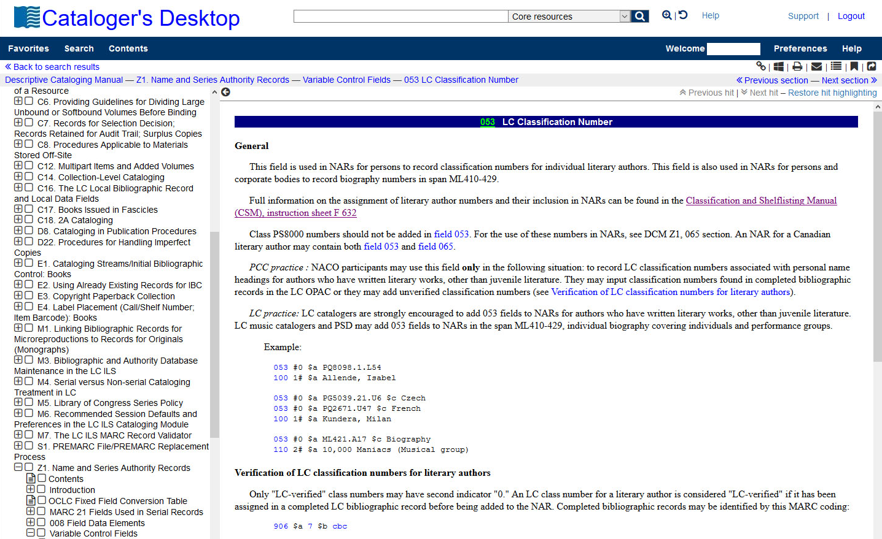
DCM Z1 : 053
Notes:
September 17, 2018: updated image​
​
This is an example of the guidance provided in DCM Z1 for the 053 field. It explains NACO practice and LC practice, verification of LC classification numbers for literary authors, and the use and order of 053 fields.​
​

Slide 39
Autre documentation
Liste alphabétique d’entités ambiguës
- Guide des autorités de noms : Points d’accès pour les entités ambiguës (DCM Z1: Headings for Ambiguous Entities)
- Subject Headings Manual (SHM) H 405
Tables de romanisation ISO et autres
Communiqués sur les politiques du PFAN, FAQ, Guide, etc. de PFAN et BAC
Notes:
August 5, 2019: revised third bullet, which didn’t match the content shown later in slides 45-47​
​
We’ll discuss these in the next few slides.

Slide 40
Division du monde : Fichier Canadiana ou RVM
RVM
Canadiana
L’entité est-elle un nom ou une vedette-matière?
Entités ambiguës
SHM H 405
Notes:
May 1, 2013
These two indexes are separate files, and this can be confusing.
Generally, most entities are not ambiguous and are simple to categorize -- it is not a problem to determine in which file they should reside. But some are less clear, and you must make that determination before you can create an authority record. These lists have changed over time, so what was once a name authority may now be a subject authority record, and vice versa.
Guidelines for the problematic entities were developed at LC in the early 1980s and revised in 1995 with respect to: the file in which the authority records will reside; the conventions to be used in formulating the access points; the tags to be used for content designation; and the responsibility for establishing access points.
These guidelines have been named the “Division of the World” although another way to think of them is the “Division of the Work.”
In some cases the decision of whether it's a name or a subject is arbitrary; a decision was needed simply to avoid duplication. Also, these decisions can change over time, in which cases the files are revised.

Slide 41
Nom ou vedette-matière? SHM H 405
Notes:
En attendant que la traduction de ce document soit complétée, les catalogueurs peuvent consulter la version anglaise.
March 20, 2017. Updated speaker notes to remove reference to print version of SHM and added URL to the free PDF files.
December 12, 2016. Replaced slide showing obsolete tabular version of H405.
Subject Headings Manual Instruction Sheet H 405 – Instructions to establish Certain Entities in the Name or Subject Authority File. The SHM is available as free, print-ready PDF files (https://www.loc.gov/aba/publications/FreeSHM/freeshm.html) and in Cataloger’s Desktop.

Slide 42
Notes:
March 4, 2020: new slide​
​
Group one headings are entities that are always established according to RDA with authority records that reside in the NAF.​
​
Note: If possible, show participants SHM

Slide 43
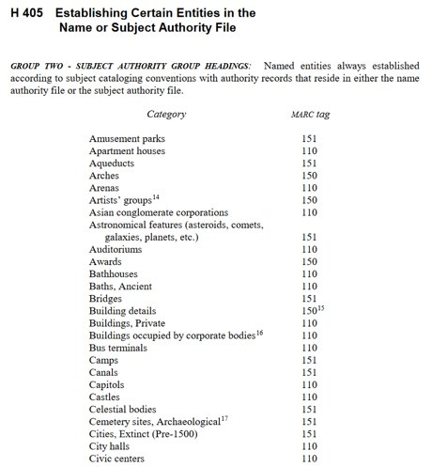
Notes:
March 4, 2020: new slide​
​
Group two headings are always established according to subject cataloging conventions as found in the SHM with authority records that reside in either the NAF or the LCSH subject authority file. The choice between residing in the NAF or subject authority file is explained in detail in the instruction sheet, and depends on whether the heading is needed as a subject or as a descriptive access point.

Slide 44
Tables de romanisation
Langue ou écriture | Table
Caractères arabes | ISO 233-2:1993 Translittération des caractères arabes (Partie 2: Langue arabe -- Translittération simplifiée)
Caractères arméniens | ISO 9985:1996 Translittération des caractères arméniens
Caractères cyrilliques | ISO 9:1995 Translittération des caractères cyrilliques (Langues slaves et non slaves )
Caractères géorgiens | ISO 9984:1996 Translittération des caractères géorgiens
Caractères hébraïques | ISO 259-2:1994 Translittération des caractères hébraïques (Partie 2: Translittération simplifiée)
Chinois | ISO 7098:2015 Romanisation du chinois
Devanagari et écritures indiennes liées | ISO 15919:2001 Translittération du Devanagari et des écritures indiennes liées
Inuktitut | ALA-LC 2011 Inuktitut romanization table
Persan | ISO 233-3:1999 Translittération des caractères arabes (Partie 3: Persan -- Translittération simplifiée)
Thaï | ISO 11940:1998 Translittération du thaï (à confirmer)
Notes:
February 26, 2019: updated image​
​
1) ALA-LC Romanization Tables are available at http://www.loc.gov/catdir/cpso/roman.html. There is a link from the NACO Documentation & Updates page.​
​
2) The 1997 edition of the tables is available for purchase in book form from the Cataloging Distribution Service (while supplies last).​
​
Not all alphabets have romanization tables and new tables are being developed all the time. If a new participant has a particular expertise in a particular writing system not already represented, he/she is encouraged to volunteer to work on a table in cooperation with ALA/LC.

Slide 45
Page d’accueil du wiki PFAN (http://pfan.pbworks.com)
Notes:
February 26, 2019: updated image​
​
The NACO home page includes information about the NACO program as well as extensive documentation and resources specific to NACO.​
​
Some relevant material may be linked from the PCC home page and not necessarily the NACO page. One example: Changes to the LC/NACO Authority File.

Slide 46
Source des derniers changements
Liste de discussion du PFAN
(https://listserv.collectionscanada.gc.ca/cgi-bin/wa?A0=PFAN-L)
Les responsables des services de catalogage des institutions participantes vont communiquer au Comité des normes les noms et courriels des membres de leur personnel qui doivent être abonnés à la liste
Les messages doivent être envoyés au PFAN-L@LISTSERV.LAC-BAC.GC.CA
Notes:
August 7, 2019: updated image​
​
LC’s Cataloging and Acquisitions home page has announcements and proposals and should be checked regularly.

Slide 47
Paramètre du PFAN Lignes directrices des contributions
Les bibliothèques du PFAN décident des notices d’autorité de noms à verser
Lors de la création de certains types de notices d’autorité de noms, d’autres notices d’autorité de noms connexes doivent être établies
Notes:
May 1, 2013
NACO libraries ARE NOT obligated to contribute all authorities generated by their cataloging or any one individual heading
NACO libraries may contribute series authority records and music work or expression records only after completing additional training. Information on series training and on joining the NACO-Music funnel project is available from the Cooperative Programs Section.
When creating certain types of NARs, other related NARs MUST be created, if not already established, and contributed to the NAF. The next slides illustrate situations in which related NARs must be established.

Slide 48
1. Hiérarchies mère-subordonnées
Pour cette notice d’autorité de nom :
1XX Collectivité mère. $b Collectivité subordonnée
Une autre notice d’autorité de nom est nécessaire pour :
1XX Collectivité mère
Notes:
May 1, 2013
1. Body entered subordinate to parent body:
All bodies that are part of an established hierarchy; e.g., when establishing a body that is entered subordinately to its parent body, if an NAR for the parent body is not present in the NAF, it must be established and contributed as well

Slide 49
1b. Hiérarchies mère-subordonnées
Pour cette notice d’autorité de nom :
110 2_ Universidad Complutense de Madrid. $b Biblioteca
Une autre notice d’autorité de nom est nécessaire pour :
110 2_ Universidad Complutense de Madrid
Notes:
May 1, 2013
Example: Body entered subordinate to parent body
Subordinate body: Biblioteca (entered subordinately under parent body)
Must create another NAR for parent body, if not established, and submit to NAF (e.g.: parent body: Universidad Complutense de Madrid
Trainer note: Remind participants that we are not showing $a in examples.

Slide 50
1c. Hiérarchies mère-subordonnées
Pour cette notice d’autorité de nom :
1XX Collectivité mère. $b Collectivité subordonnée. $b Collectivité subordonnée
Des notices d’autorité de noms sont nécessaires pour :
1XX Collectivité mère
1XX Collectivité mère. $b Collectivité subordonnée
Notes:
May 1, 2013
1XX Parent body. $b Subordinate body. $b Subordinate body
If the parent body is not established: a NAR is needed
If the immediate subordinate body is not established: a NAR is needed

Slide 51
1d. Hiérarchies mère-subordonnées
Pour cette notice d’autorité de nom :
110 2_ Universidad Complutense de Madrid. $b Colegio
Mayor de San Pablo. $b Centro de Estudios Universitarios
Des notices d’autorité de noms sont nécessaires pour :
110 2_ Universidad Complutense de Madrid
110 2_ Universidad Complutense de Madrid. $b Colegio
Mayor de San Pablo
Notes:
May 1, 2013
Example: Parent body. $b Subordinate body. $b Subordinate body

Slide 52
1e. Hiérarchies mère-subordonnées dans les variantes de points d’accès
Pour cette notice d’autorité de nom :​
1XX Collectivité subordonnée​
4XX Collectivité mère. $b Collectivité subordonnée​
Une autre notice d’autorité de nom est nécessaire pour :
1XX Collectivité mère ​
Notes:
October 29, 2018: new slide​
​
Applies also to variant access points!​
​
If a variant access point has a body entered subordinate to its parent body, must create another NAR for parent body, if not established, and submit to NAF.​
​

Slide 53
1f. Hiérarchies mère-subordonnées dans les variantes de points d’accès
Pour cette notice d’autorité de nom :​
110 2 _ Apple Industrial Design Group​
410 2 _ Apple Computer, Inc. $b Apple Industrial Design Group ​
Une autre notice d’autorité de nom est nécessaire pour :
110 2 _ Apple Computer, Inc. ​
Notes:
October 29, 2018: new slide​
​
Example: Variant access point has body entered subordinate to parent body: 4XX Parent body. $b Subordinate body​
​
Must create another NAR for parent body, if not established, and submit to NAF (e.g.: parent body: Apple Computer, Inc.)

Slide 54
2. Collectivités dans des variantes de points d’accès
Pour cette notice d’autorité de nom :
1XX Organisme gouvernemental
4XX Juridiction. $b Organisme gouvernemental
Une autre notice d’autorité de nom est nécessaire pour :
1XX Juridiction
Notes:
February 26, 2019: removed qualifier from 1XX to clarify difference between this slide and slide 73​
​
All bodies referred through in variant access points:​
When an authorized access point is entered independently but a variant access point is given through a higher body​
The higher body needs to be represented in the authority file. If the higher body is not represented in the authority file the library needs to create an additional name authority record.

Slide 55
2b. Collectivités dans des variantes de point d’accès
Pour cette notice d’autorité de nom :
110 2_ Seattle Municipal Archives
410 1_ Seattle (Wash). $b Municipal Archives
Une autre notice d’autorité de nom est nécessaire pour :
151_ _ Seattle (Wash.)
Notes:
February 26, 2019: changed example to clarify difference between this example and slide 73​
​
So, for the jurisdictional cross-reference to be given, the place name must exist already, or it must be contributed to the NAR at the same time.​
​
NOTE: The 151 to 410 MARC change is reflective of the use of a place as a jurisdiction. This will be covered in more detail later in the Describing Corporate Bodies and Describing Places presentations. Don’t worry about it here.

Slide 56
2c. Collectivités dans des variantes de point d’accès
Pour cette notice d’autorité de nom :
110 1_ Colombie-Britannique. $b School Facilities Planning
410 1_ Colombie-Britannique. $b Ministry of Education. $b School Facilities Planning
Une autre notice d’autorité de nom est nécessaire pour :
110 1_ Colombie-Britannique. $b Ministry of Education
Notes:
May 1, 2013
Example: Variant access point on NAR for body entered subordinately (applying RDA 11.2.2.20: direct or indirect subdivision)

Slide 57
2d. Collectivités dans des variantes de point d’accès
Pour cette notice d’autorité de nom :
1XX Lieu dans la ville (Ville)
4XX Ville. $b Lieu dans la ville
Une autre notice d’autorité de nom est nécessaire pour :
1XX Ville
Notes:
August 7, 2019​
​
For places within a city, etc., the authorized access point is formed by combining the preferred name for the place within the city with a qualifier containing the name of the city and the larger place the city is located in. A variant access point may be formed by recording the name of the place within the city as a subordinate body of the authorized access point for the city (RDA 16.2.3.8 and LC-PCC PS for 16.2.2.14). If the city is not already established, an authority record for it must also be created.​

Slide 58
2e. Collectivités dans des variantes de point d’accès
Pour cette notice d’autorité de nom :
151 _ _ Quartier chinois (Montréal, Québec)
410 1_ Montréal (Québec). $b Quartier chinois
Une autre notice d’autorité de nom est nécessaire pour :
151 _ _ Montréal (Québec)

Slide 59
3. Entités en relation (5XX)
Dans plusieurs cas, il est utile de créer des points d’accès pour les entités en relation (5XX)
Chaque entité dans une zone 5XX doit être établie
Les points d’accès réciproques pour les entités en relation sont requis dans quatre situations :
- Des personnes avec des identités différentes (pseudonymes)
- Des formes antérieures et ultérieures d’un nom de collectivité ou de famille
- Relations séquentielles entre collections et publications en série
- Des dignitaires gouvernementaux ou religieux
Notes:
March 6, 2019: revised to reflect PCC Guidelines for Relationship Designators in Authority Records, 2018 version​
​
The PCC Guidelines for the Application of Relationship Designators in NACO Authority Records (November 2018) require reciprocal access points to be explicitly made in corresponding authority records:​
​
Between real and alternate identities (Guideline 10)​
Between earlier and later forms of Corporate Bodies that have changed name (including mergers) (Guideline 11) and earlier and later forms of Families that have changed name (Guideline 14)​
Between earlier and later titles of series and serials that have changed title (Guideline 15b, see also LC-PCC PS 25.1, 25.1.1.3 and 26.1)​
Between the corporate body form of a government or religious official and the personal form of the name (Guideline 11)

Slide 60
3b. Entités en relation (5XX)
1XX Nom actuel de l’entité​
5XX $w r $i Prédécesseur :
$a nom précédent de l’entité​
1XX Nom précédent de l’entité
5XX $w r $i Successeur : $a Nom actuel de l’entité
Notes:
September 17, 2018: moved $w to beginning of 5XX fields.
ANIMATED SLIDE: arrows come in on click
This is an example of a situation in which reciprocal access points are required; in this case, the entity would be a corporate body. In order to avoid blind references – an access point that does not point to an actual record – the participant needs to make sure that the corresponding authorized access point is also established.
From DCM Z1: LC/NACO catalogers should use subfield $i with subfield $w coded “r” when providing relationship links between corporate entities and the names of other persons, families or corporate bodies, if appropriate. In subfield $i use a capital letter for the first letter of the term and follow the term with a colon.
NARs that contain the $w “a” (earlier) or “b” (later) values should be converted when otherwise being modified.

Slide 61
3c. Entités en relation (5XX)
110 2 _ International Business Machines Corporation​
​510 2_ $w r $i Prédécesseur : $a Computing-Tabulating-Recording Company​
110 2 _ Computing-Tabulating-Recording Company​
​
510 2_ $w r $i Successeur : $a International Business Machines Corporation​
Notes:
September 17, 2018: moved $w to beginning of 510 fields.
ANIMATED SLIDE: arrows come in on click
Here’s the same example but with the name(s) of an actual corporate body.
All corporate bodies used in access points for related entities (5XXs) must be established and have their own NAR.

Slide 62
3d. Entités en relation (5XX) Pratique précédente
1XX Nom actuel de l’entité​
5XX $w a $a Nom précédent de l’entité​
1XX Nom précédent de l’entité
5XX $w b $a Nom actuel de l’entité
Notes:
September 17, 2018: moved $w to beginning of 5XX fields.
There are different ways to show the relationship through coding.
The practice shown here was used for many years, in AACR2 records and many RDA records. Subfield $w here is coded “a” for earlier name and “b” for later name
Until early 2013, LC catalogers were instructed to use this coding when providing relationship links between corporate entities and the names of other persons, families or corporate bodies, so you will see this practice in many authority records. DCM Z1 now says that records containing this coding should be converted when otherwise being modified.

Slide 63
3e. Entités en relation (5XX)
Ce n’est pas toujours utile de créer des points d’accès réciproques pour des entités en relation
100 1_ Kimball, Edward L., $d 1930-2016
510 2_ $w r $i Employeur : $a University of Wisconsin
Notes:
September 17, 2018: moved $w to beginning of 510 field.
There are cases in which it is not useful to make reciprocal access points for related entities. For example, we would not want to have every employee of an organization listed on the authority record for that organization.
Use judgment! If recording the reciprocal relationships in the other authority record could cause an unwieldy number of 5XXs in that authority record (perhaps more than 5-10), it may be best not to make the reciprocal access points.
Keep in mind that in most cases, systems can automatically generate reciprocals.

Slide 64
3f. Entités en relation (5XX)
100 1_ Lennon, John, $d 1940-1980
510 2_ $w r $i Collectivité : $a Beatles
Notes:
September 17, 2018: moved $w to beginning of 510 field.
The authority record for John Lennon indicates that he was a member of the Beatles.

Slide 65
3g. Entités en relation (5XX)
Lorsque ce n’est pas requis, faire preuve de jugement! Quand les points d’accès réciproques sont-ils utiles?
110 2_ Beatles
500 1_ $w r $i Membre : $a Lennon, John, $d 1940-1980
500 1_ $w r $i Membre : $a McCartney, Paul
500 1_ $w r $i Membre : $a Harrison, George, $d 1943-2001
500 1_ $w r $i Membre : $a Starr, Ringo
Notes:
March 4, 2020: added the other two members that are found on this NAR​
​
On the previous slide we saw the relationship of John Lennon to the Beatles expressed in a 510 field. Should we also add a 500 for each group member to the record for the Beatles, as is shown in the slide? What are the pros and cons of making reciprocal references such as these, between a musical group and members of that group?
What are the pros and cons of making reciprocal references such as these, between a musical group and members of that group?

Slide 66
Correspondance obligatoire 5XX-1XX
La zone 5XX DOIT correspondre 110 2_ Dallas/Fort Worth
à la zone 1XX d’une autre International Airport
notice d’autorité de nom dans 510 2_ $w r $i Prédécesseur : $a le même fichier d’autorité Dallas/Fort Worth Regional Airport
110 2_ Dallas/Fort Worth Regional
Airport
510 2_ $ w r $i Successeur : $a Dallas/Fort Worth International Airport
Notes:
September 17, 2018: moved $w to beginning of 510 fields.
Remember that every entity in a 5XX must be established.
If you create a reciprocal relationship in both records, the 5XX must match its corresponding 1XX exactly.

Slide 67
4. Points d’accès créateur-œuvre
Pour cette notice d’autorité de nom :
1XX Créateur. $t Œuvre
Cette notice d’autorité de nom est nécessaire :
1XX Créateur
Notes:
May 1, 2013
For creator/work access points, there must also be a name authority record for the creator.

Slide 68
4b. Points d’accès créateur-œuvre
Pour cette notice d’autorité de nom :
1XX Créateur. $t Œuvre. $l Langue…
Cette notice d’autorité de nom est nécessaire :
1XX Créateur
Notes:
November 12, 2019: revised speaker notes​
​
If you are creating a NAR for a language expression (i.e., a translation), a NAR for the creator must also be created, if it is not already established.​
​
Optionally, libraries may also create a NAR for the work (1XX Creator. $t Work), but this is not a NACO requirement. ​
​

Slide 69
4c. Points d’accès créateur-œuvre
Pour cette notice d’autorité de nom :
100 1_ Le Guin, Ursula, $d 1929-2018 $t Earthsea. $l Chinois
Cette notice d’autorité de nom est nécessaire :
100 1_ Le Guin, Ursula, $d 1929-2018
Notes:
November 12, 2019: added to speaker notes​
February 26, 2019: added death date​
​
So, in order to establish the authorized access point for the Chinese translation of Ursula Le Guin’s Earthsea, Le Guin’s name must be established. ​
​
Optionally, libraries may also create a NAR for the work (100 1_ Le Guin, Ursula, $d 1929-2018. $t Earthsea), but this is not a NACO requirement. ​
​

Slide 70
4d. Points d’accès créateur-œuvre
Pour cette notice d’autorité de nom :
1XX Créateur. $t Œuvre. $k Extraits
Cette notice d’autorité de nom est nécessaire :
1XX Créateur
Notes:
Updated: Jun. 6, 2014
Similarly, if you are creating a NAR for a part of a larger work (e.g., Selections), a NAR for the creator must also be created, if it is not already established.
Optionally, libraries may create a NAR for the Work (1XX Creator. $t Work), but this is not a NACO requirement.

Slide 71
4e. Points d’accès créateur-œuvre
Pour cette notice d’autorité de nom :
100 1_ McDougall, Christopher, $d 1962- $t Born to run. $k Extraits
Cette notice d’autorité de nom est nécessaire :
100 1_ McDougall, Christopher, $d 1962-
Notes:
November 12, 2019: added to speaker notes​
March 20, 2017: corrected spacing in first 1XX​
​
So, in order to establish the authorized access point for Born to run. Selections, McDougall’s name must already be established. Optionally, you may also create an NAR for the whole work (100 1_ McDougall, Christopher, $d 1962- $t Born to run) if it is not already established.​

Slide 72
Nom de lieu dans le qualificatif
Si un nom de lieu est utilisé dans un qualificatif,
il doit être établi
110 2_ Galleria d’arte contemporanea (Turin,
Italie)
151 Turin (Italie)
130 0_ Financial chronicle (Hyderābād, Inde)
151 Hyderābād (Inde)
151 __ Wrigleyville (Chicago, Ill.)
151 Chicago (Ill.)
Doit être établi!
Notes:
August 7, 2019: added third example showing a place within a city​
March 29, 2017: removed indication that a corporate body must be established to be used as a qualifier. The Introduction to DCM Z1 only indicates places must be established; added second place example.​
​
In the first example, Turin, Italy is used as a qualifier for a corporate body. If there is not yet an authority record for Turin (Italy), it must be created.​
​
In the second example, Hyderabad, India is used as a qualifier for a work. If there is not yet an authority record for Hyderabad (India), it must be created.​
​
In the third example, Chicago, Ill. is used as part of the access point for a neighborhood within Chicago. If there is not yet an authority record for Chicago (Ill.), it must be created.​
​

Slide 73
Paramètre du PFAN Changements aux notices d’autorité de noms existantes
Tous les points d’accès autorisés dans
le fichier d’autorité de nom
peuvent être changés par
tous les participants du PFAN
Notes:
May 1, 2013
NACO parameter: Changes to existing NARs:
This parameter applies only to changes to the authorized access point; not additions of 046, 3XX, 4XX, 5XX or 670’s.
Additions and changes to authority records:
Almost as common as the need for a new authority record is the need to alter an existing record. New information can be received in various ways (e.g., new cataloging, investigation in response to a query) and may be significant enough to add to the authority record.
Normally a new variant access point or a change in authorized access point must be justified by the addition of new information to the authority record. Many other types of data can be added to the authority record when judged useful for proper identification. In order to minimize the impact of database maintenance with associated bibliographic records and/or name/title authority records, catalogers are urged to refrain from making unnecessary changes to authorized access points.
Although there are guidelines in the instructions and/or LC-PCC PSs that indicate when changes are or are not necessary, the necessity for other changes may be evident only to the agency making the change (for example, to break a conflict when the searching universe for the changing agency and the agency observing the change are different); assume that such changes are valid.
When the published work for an item cataloged through the CIP program shows a change in the form of name of a person, family, corporate body, work, expression, or series, change the authority record; add the published source after the CIP source in the 670 field to document the change. Changes in the imprint date, choice of main entry, and changes in title proper do not require changes to authority records created for CIP items.
More details about authorized changes to AAPs will be found in the "Changes" module on Day 5.

Slide 74
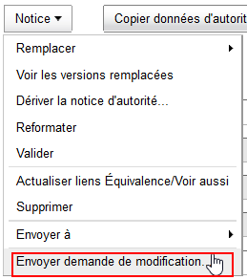
Paramètre du PFAN Suppression des notices d’autorité de noms
Seule BAC peut supprimer des notices d’autorité de noms dans le fichier d’autorité de nom
Les bibliothèques participant au PFAN font une demande de suppression de notice d’autorité de nom auprès de BAC (bac.pfan-fnap.lac@canada.ca)
Ne pas utiliser la fonction Envoyer demande de modification du menu Notice pour faire une demande de suppression
Notes:
May 1, 2013
LC does not allow for online deletion by NACO participants. This is because of database maintenance issues, which apparently cannot handle multiple sources of deletion. It is NOT a lack of trust. The NAF is LC’s local authority file, and for system and security reasons, delete capability needs to be limited to LC catalogers.
NACO participants notify LC about deletion requests via naco@loc.gov.
Deletions are most often made because of duplicate authorized access points for the same entity. There will be more details about this in a later session.

Slide 75
Paramètre du PFAN Maintenance du fichier bibliographique (MFB)
Les notices bibliographiques en français doivent rester synchronisées avec le fichier d’autorité Canadiana
Les partenaires du PFAN doivent s’informer les uns les autres lorsque certains types de changements aux notices d’autorité de noms affectent les points d’accès autorisés utilisés dans les notices bibliographiques en français
Des directives particulières seront émises plus tard
Notes:
November 12, 2019: revised notes: changed Cooperative Programs Section to Policy, Training, and Cooperative Programs Division; added 5th bullet​
​
1) Reporting records that need changes to authorized access points (BFM = Bibliographic File Maintenance)​
2) NACO participants must notify the Policy, Training, and Cooperative Programs Division via naco@loc.gov to perform BFM for certain types of changes to NARs that affect records at LC.​
3) The link in the record leads to Guidelines for Reporting NACO BFM.​
4) Reporting BFM to OCLC is not required, but it could be helpful to either correct affected records in the WorldCat database (if few in number) or report the need for change to OCLC.​
5) And don’t forget that records in your own catalog may need to be revised!​
​
​

Slide 76
Paramètre du PFAN Recherche
Les catalogueurs maintiennent la base de données
propre en cherchant les notices reliées avant
de verser une notice d’autorité au fichier d’autorité
Canadiana.
Notes:
May 1, 2013

Slide 77
Pourquoi chercher? (1)
Pour empêcher la duplication de notices d’autorité de noms
Le point d’accès autorisé pour l’entité est-il déjà établi?
Les programmes de détection de déduplication et de validation d’OCLC ont besoin d’être exécutés
Signalement des suppressions à BAC
Notes:
November 12, 2019: changed name in slide from Cooperative Programs Section to Policy, Training, and Cooperative Programs Division ​
​
Why search? (1):​
​
Duplicates are normally created by inefficient searching and the 24-hour upload gap in the Name authority file.​
​
Before creating a name authority record:​
​
Search the OCLC authority file for the authorized access point, including variant forms of the access point.​
In addition, search WorldCat for bibliographic records that contain the authorized access point or variant forms.​
​
Remember to search again every 24 hours for new NAR’s.​
​

Slide 78
Pourquoi chercher? (2)
Pour éviter des conflits dans les points d’accès autorisés et dans les variantes de points d’accès
- De l’information sur les règles de normalisation sera vue bientôt
Pour recueillir des renseignements des notices bibliographiques existantes
Pour trouver une notice équivalente créée par BAC dans le fichier LC et utiliser le même numéro Canadiana dans le fichier Canadiana
Notes:
May 1, 2013
NOTE for 2nd bullet: To gather information from existing bib records to assure proper choice and form of authorized access points and variant access points

Slide 79
Pourquoi chercher? (3)
Pour identifier les notices existantes qui pourraient nécessiter d’être évaluées et recodées pour RDA
Pour identifier et recoder en RDA une notice d’autorité de nom existante RCAA2 mais acceptable en RDA
Pour identifier les notices versées en lot qui nécessitent d'être évaluées avant d'être utilisées. La note suivante permet de les identifier :
667 CETTE NOTICE VERSÉE EN LOT DOIT ÊTRE ÉVALUÉE AVANT D’ÊTRE UTILISÉE, POUR S’ASSURER QU’ELLE RÉPONDE AUX NORMES DU PFAN.
Notes:
December 12, 2016
The presence of this 667 is a clear indication that the 1XX field and the other fields in the existing record must be evaluated. During Phase 1 of the authority file conversion from AACR2 to RDA, authorized access points that were not good candidates for a global, mechanical change were identified with this note. More information is available in the document Summary of Programmatic Changes to the LC/NACO Authority File.
If the review indicates that the 1XX can be used under RDA as given, the cataloger should remove the 667 note, add any additional elements needed, and re-code the record to RDA.
If the existing 1XX needs to be updated to be made acceptable for use under RDA, the cataloger should revise the authorized access point, make a reference from the former 1XX when applicable, remove the 667, add any additional elements needed, and re-code the record to RDA. Revising existing authority records is covered in more detail in the Authority Workflow module.
It is also important to be alert to changes that might be needed in records NOT flagged as needing review. Some examples are: persons with numerals at the end of the name, or terms like Jr., Sr., père.
For a summary of LC announcements about the various phases, see www.loc.gov/cds/notices/3A-141201a.pdf.

Slide 80
Pourquoi chercher? (4)
Pour identifier les notices bibliographiques qui auront besoin de MFB
Pour réviser une notice d’autorité existante
Changements aux noms de personne
Collectivités antérieures-ultérieures
Autres révisions
Notes:
May 1, 2013
When you are revising an existing NAR, it is helpful to search again to see what additional information you may be able to find.
Remember: Search WorldCat for bibliographic records that contain the authorized access point or variant forms of the authorized access point.

Slide 81
Recherche : Comment?
Chercher dans les fichiers bibliographiques et d’autorité
Peut-être même les points d’accès employés ou établis comme vedettes-matière dans les notices bibliographiques et d’autorité
Chercher plus d’une forme, p. ex. :
Fowler, Esther Miller
Fowler, E.
Miller, E.
Miller, Esther
Miller, E. Anne
Chercher les points d’accès autorisés et les variantes de points d’accès
Notes:
May 1, 2013
1) Be sure to search possible alternative forms of a person’s name to find any authorized access points that may been entered under those forms. You’re trying to find all the works by (and about) a person. This is even more necessary in languages with multiple surnames, etc.
2) Be sure to emphasize that the search strategies differ from program to program and person to person.
3) Places to search:
a) LC/NACO Authority File (NAF via OCLC)
b) OCLC bibliographic records
c) Your local files
d) Optionally: LC’s OPAC
f) Occasionally: other reference sources, databases, WWW, etc.

Slide 82
Recherche : Quand?
Ne pas conserver les notices d’autorité dans le fichier En cours trop longtemps
Après 24 heures, chercher à nouveau afin :
d’éviter les conflits
d’éviter les doublons
Notes:
May 1, 2013
Searching– When?:
Trainer note: Remind participants that they MUST search authorized access points and variant access points again before contributing to the NAF to ensure that the same has not been contributed by another library.

Slide 83
Normalisation du PFAN
La normalisation est la conversion d’une chaîne de caractères en une forme normalisée
Les chaînes de caractères qui se normalisent à la même forme sont considérées comme des doublons et doivent être différenciées les unes des autres
Le but de la normalisation est de s’assurer que chaque point d’accès autorisé est unique
Notes:
May 1, 2013
All contributors to the NAF have agreed to a common set of normalization rules.

Slide 84
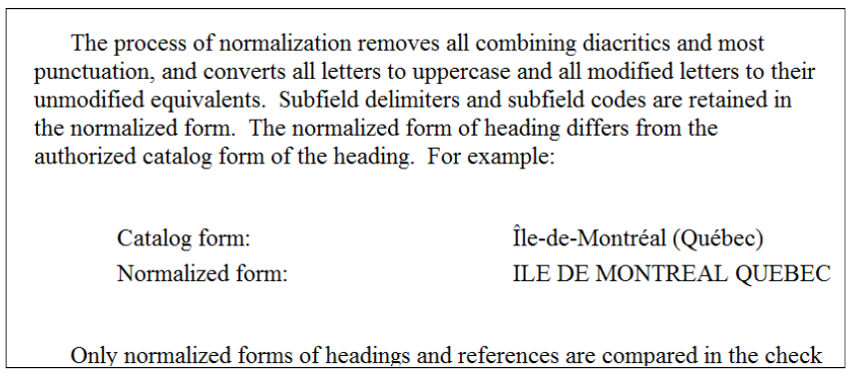
Normalisation : Documentation
Guide des autorités de noms : Introduction (DCM Z1 : Introduction)
Notes:
Updated: Feb. 24, 2014

Slide 85
Normalisation : Documentation
Lien vers le document dans le wiki du PFAN
Notes:
Updated Jan. 25, 2017: Replaced screenshot
December 12, 2016: URL added to speaker notes.
http://www.loc.gov/aba/pcc/naco/normrule-2.html

Slide 86
Impact de la normalisation
Il se peut que des notices d’autorité de noms pour les noms de personnes « non uniques » ou « indifférenciés » aient parfois été créées en raison de la normalisation. Exemples :
Martínez, José Nguyễn, Khôi ​
Martinez, Jose Nguyễn, Khởi ​
On demande maintenant aux catalogueurs d’éviter de créer des notices d’autorité pour les nouveaux noms de personne indifférenciés
Notes:
February 27, 2020: added examples to first bullet; revised speaker notes to include examples and explanations​
​
Normalization may affect how certain authorized access points and variant access points are formulated.​
​
Until January 2013, NACO contributors sometimes created “undifferentiated” personal name authority records in order to avoid duplicates due to normalization. For example, consider these names for different persons:​
​
Martínez, José​
Martinez, Jose​
​
Because both names would normalize to the same form, both persons might have had to be included on an undifferentiated record even though one uses diacritics and the other doesn’t.​
​
Nguyễn, Khôi​
Nguyễn, Khối​
Nguyễn, Khởi​
​
Because all three of these names would normalize to the same form, they all might have had to be included on an undifferentiated record even though each one uses different diacritics or special characters (hooked ơ vs. o).​
​
Catalogers are now asked to avoid creating new undifferentiated personal name authority records (or adding to existing ones) but there may still be some cases where it is unavoidable.

Slide 87
Que se passe-t-il lors du processus de normalisation?
Toutes les lettres sont converties en majuscules
Les lettres modifiées sont converties en lettres non modifiées
Tous les signes diacritiques sont enlevés
Notes:
May 1, 2013
So differing capitalization is not enough to differentiate otherwise identical forms; and the presence or absence of diacritics is not enough.
2nd bullet: an example of a modified letter is the Polish “l” (Ł (upper case) ł (lower case)), or the Turkish “i” (ı).

Slide 88
Que se passe-t-il lors du processus de normalisation?
La plupart de la ponctuation est enlevée
- Exception : la première virgule dans la sous-zone a
Les séparateurs de sous-zone et les codes de sous-zone sont conservés et pris en compte
Les contenus des zones 1XX, 4XX et 5XX sont comparés
Notes:
March 20, 2017: updated speaker notes about normalization of hyphens in birth and death dates.
Updated Jan. 25, 2017: removed incorrect info about normalization of hyphens in birth and death dates under first bullet.
1st bullet: The only mark of punctuation that is retained during normalization is the first comma in subfield $a. This exception means that the following two authorized access points normalize to different forms:
Catalog form: Chung, Hui
Normalized form: CHUNG, HUI
Catalog form: Chung-hui
Normalized form: CHUNG HUI
Hyphens in birth and death dates are removed, so “Smith, John, -1790" will normalize to the same string as "Smith, John, 1790-"
3rd bullet: the 7XX fields are not compared

Slide 89
Les étiquettes ne sont pas comparées
Les étiquettes du MARC 21 NE sont PAS prises en compte lorsque l’ordinateur compare les points d’accès pour leur valeur unique
- Les codes de sous-zone sont pris en compte
Des étiquettes MARC différentes (100, 110, 111, 151, 130) ne font pas en sorte qu’un point d’accès est unique
Notes:
February 26, 2019: revised last paragraph to clarify that subject and genre/form are in separate files​
​
MARC 21 tags are NOT considered by the computer when comparing the authorized access point string for uniqueness.​
​
Subfield codes ARE considered as part of the comparison. This allows the same term in a 150 $a and 180 $x to occur without conflict because the subfield codes ‘a’ and ‘x’ will make the strings unique.​
​
An authorized access point (1XX) must be the same as any other authorized access point, EXCEPT an established topical heading (150 field) in the subject authority file (LCSH) may be the same as an established form/genre heading (155 field) in the genre/form authority file (LCGFT).​

Slide 90
Qu’arrive-t-il aux symboles?
Supprimé avec aucune espace restante :
[ ] ‘
Remplacé par une espace :
@ ? / \ ( ) = ̏ , -
Inchangé :
& +
apostrophe
virgule après la première
trait d’union
guillemet
dièse
bémol
Notes:
Updated Jan. 25, 2017 (removed hyphen in birth and death dates from Unchanged bullet; removed incorrect info about hyphen being retained in birth and death dates from speaker’s notes)
Updated Jan. 19, 2017 (replaced hash tag and italic b with musical sharp and flat symbols)
Updated: Jan. 13, 2017 (removed exception for hyphen in birth and death dates)
Many more symbols may be changed in normalization. Please check the actual “NACO Normalization rules”
The first comma in the $a subfield (unless it is a terminal comma) is taken into account. In all other cases commas are converted to blank.

Slide 91
Qu’est-ce qui est comparé?
Ligne des caractères qui font partie de la zone étiquetée (« chaîne » de caractères)
100 1_ Le Bret, $c Monsieur $q (Alexis-Jean), $d 1693-1772?
SE NORMALISE COMME SUIT : LE BRET, $c MONSIEUR $q ALEXIS JEAN $d 1693 1772
Notes:
Updated Jan. 25, 2017: removed hyphen from $d and replaced with space; removed mention of hyphen from speaker’s notes.
May 1, 2013
DCM Z1 also give guidance on rules for normalization:
1) The process of normalization removes all diacritics and most punctuation, and converts all letters to uppercase and all modified letters to their unmodified equivalents.
2) Subfield delimiters and subfield codes are NOW considered as part of the comparison: http://www.loc.gov/catdir/pcc/naco/normrule-2.html
3) The only marks of punctuations that are retained during normalization are the first comma in subfield $a
4) The normalized access point is illustrated in red on the slide.

Slide 92
Point d’accès autorisé normalisé
Forme du catalogue :
151 _ _ Île-de-Montréal (Québec)
Forme normalisée :
151 _ _ ILE DE MONTREAL QUEBEC
Notes:
December 12, 2016: reversed bullet points.

Slide 93
Conflits et doublons
Notes:
May 1, 2013
To prevent conflicts and duplicates, a cataloger needs to know the rules that have been programmed into the computer’s normalization software.
Catalogers must also understand the difference between a conflict and a duplicate.

Slide 94
Qu’est-ce qu’un conflit?
Correspondance des formes normalisées entre
1XX et autres 1XX
4XX et zones 1XX ou 5XX
4XX et autres 4XX dans la même notice
Mais
5XX doit avoir une forme correspondante dans une 1XX
correspondance entre zones 4XX est correcte si dans des notices différentes
Notes:
May 1, 2013
Trainer note: Don’t spend much time here: examples that follow demonstrate these conflicts.
Conflict situations: These will all be discussed in upcoming slides
1) If a 1xx in one authority record normalizes to the same form as a 1xx in another authority record, there is a conflict.
2) If a 1xx in one authority record normalizes to the same form as a 4xx in another authority record, there is a conflict.
3) A 5xx in one authority record must correspond to a 1xx in another authority record. This is because the 5xx is referring to the 1xx in the other authority record, and the 5xx and the 1xx represent the same entity!
4) If a 4xx in one authority record normalizes to the same form as a 4xx in another authority record, there is no conflict. 4xx’s in different authority records may conflict with each other.

Slide 95
1XX en double
Une zone 1XX NE PEUT PAS se normaliser à la même chaîne qu’une autre zone 1XX
100 1 _ Smith-Jones, Barb
100 1 _ Smith Jones, Barb
(Ceci est un doublon)
Notes:
May 1, 2013
1) The “HYPHEN” becomes a blank space under normalization rules.
Note: If personal names normalize to the same string, catalogers use specific RDA instructions to add information in order to create a unique authorized access point (more on this in Describing Persons).
ANIMATION: arrows fly in separately to show differences in punctuation; phrase “This is a duplicate” dissolves in last.

Slide 96
Conflit 1XX-4XX
Une zone 4XX NE PEUT PAS se normaliser à la même chaîne qu’une zone 1XX ou 5XX
100 1 _ O’Brien, J. (Jack)
400 1 _ O’Brien, Jack
100 1 _ O’Brien, Jack
400 1 _ O’Brien, J. (Jack)
(Ceci est un conflit)
Notes:
May 1, 2013
Items in red conflict with one another. The apostrophe is deleted.
Do not trace a 4XX variant access point that normalizes to the same character string as an existing authorized access point (1XX) in the national authority file, including the authorized access point in the same authority record.
ANIMATON: “This is a conflict” dissolves in.

Slide 97
Conflit dans une notice
Une zone 4XX NE PEUT PAS se normaliser à la même chaîne dans la même notice d’autorité de nom
110 2 _ Winston-Salem Sunrise Hiking Club
410 2 _ Winston-Salem Hiking Club
410 2 _ Winston/Salem Hiking Club
(Ceci est un conflit)
Notes:
May 1, 2013
1) The HYPHEN and the SLASH becomes blank space.
2) Watch out for visually misleading presentations that normalize the same.
ANIMATION: arrows fly in separately to show differences in punctuation; phrase “This is a duplicate” dissolves in last.

Slide 98
Aucun conflit entre les notices
Une zone 4XX PEUT se normaliser à la même chaîne qu’une zone
4XX dans une autre notice d’autorité de nom
100 1 _ Potter, Harold
400 1 _ Potter, Harry
100 1 _ Potter, Henry
400 1 _ Potter, Harry
(Aucun conflit ici!)
Notes:
May 1, 2013
1) However a 4XX may normalize to another 4XX in another NAR in the catalog.

Slide 99
Exercices sur la normalisation
Examiner chaque notice et décider si l’une des variantes de point d’accès se normaliserait au point d’accès autorisé
Notes:
May 1, 2013
Normalization Exercises:
In the following exercises, which 4XX variant access points (if any) should be deleted because their normalized forms match the 1XX authorized access point?
Take 10 minutes for this exercise, then review together.

Slide 100
Exercice 1
151 T’bilisi (Géorgie)
451 Tiflis (Géorgie)
451 Tbilisi (Géorgie)
451 $w nnaa $a Tiflis
451 T’blisi (Géorgie)
Supprimer ce renvoi
Notes:
September 17, 2018: moved $w to beginning of 451 fields.
Normalizes to same form as authorized access point

Slide 101
Exercice 2
110 2 _ Ballard-Carlisle Historical &
Genealogical Society
410 2 _ Ballard-Carlisle Historical and
Genealogical Society
410 2 _ Ballard-Carlisle Historical-
Genealogical Society
TOUTES CORRECTES!
Notes:
September 17, 2018: updated speaker notes.
Ampersand is retained in normalized form.

Slide 102
Exercice 3
110 1 _ États-Unis. $b Office of the
Under Secretary of Defense,
Acquisition
410 1 _ États-Unis. $b Office of the
Under Secretary of Defense for
Acquisition
410 1 _ États-Unis. $b Under Secretary
of Defense, Acquisition
410 1 _ États-Unis. $b Office of the
Under Secretary of Defense
(Acquisition)
Supprimer ce renvoi
Notes:
September 17, 2018: reformatted slide.
Third 410 normalizes to same as authorized access point.

Slide 103
Exercice 4
100 1 _ Torrealba Ramos, Isabel
400 1 _ Ramos, Isabel Torrealba
400 1 _ Torrealba-Ramos, Isabel
400 1 _ Torrealba-Ramos, Isabel Teresa
Supprimer ce renvoi
Notes:
August 7, 2019: changed Isabela to Isabel (her actual name) and added third 4XX based on a real variant of her name​
ANIMATED SLIDE​
​
​

Slide 104
Exercice 5
151 _ _ San Jose (Calif.)
451 _ _ San José (Calif.)
451 _ _ City of San José (Calif.)
451 _ _ City of San Jose (Calif.)
Supprimer ce renvoi
Supprimer l’un de ces deux renvois
Notes:
May 1, 2013

Slide 105
Exercices sur la normalisation
Regarder ces notices et décider si
les deux doivent exister dans le
fichier d’autorité tel que montrés.
Notes:
February 27, 2020: new slide​
​
Normalization Exercises:​
​
This exercise asks whether two NARs have normalization conflicts that must be resolved.

Slide 106
Exercice 6
110 2 _ Chemical Industries Association​
410 2 _ CIA​
​
110 2 _ Culinary Institute of America​
410 2 _ CIA​
​
Des 4XX dans des notices différentes peuvent avoir la même forme
Notes:
March 4, 2020: new slide​
ANIMATED SLIDE​
​
The authorized access points on these two records are different, but the variant access point with an acronym are identical. This is not a conflict. 4XXs on different records are permitted to normalize to the same form. The cataloger may however choose to break the conflicts between the 4XXs by adding a qualifier to one or both of them. The fuller form of the acronym is one possible valid qualifier:​
​
110 2_ Chemical Industries Association​
410 2_ CIA (Chemical Industries Association)​
​
110 2_ Culinary Institute of America​
410 2_ CIA (Culinary Institute of America)​
​
​
​
​
​

Slide 107
Exercice 7
100 1 _ Phạm, Văn Ánh​
400 0 _ Phạm Văn Ánh​
​
100 1 _ Phạm, Vân Anh​
400 0 _ Phạm Vân Anh
Le conflit de normalisation entre les deux 100 doit être réglé
Notes:
March 4, 2020: new slide​
ANIMATED SLIDE​
​
The authorized access points on these two records are different, but the variant access point with an acronym are identical. This is not a conflict. 4XXs on different records are permitted to normalize to the same form. The cataloger may however choose to break the conflicts between the 4XXs by adding a qualifier to one or both of them. The fuller form of the acronym is one possible valid qualifier:​
​
110 2_ Chemical Industries Association​
410 2_ CIA (Chemical Industries Association)​
​
110 2_ Culinary Institute of America​
410 2_ CIA (Culinary Institute of America)​
​
​
​
​
​

Slide 108
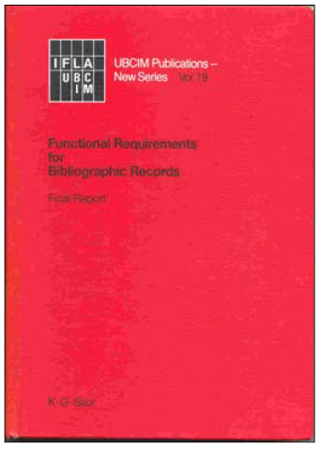
FRBR
Version française disponible au :
https://www.ifla.org/files/assets/cataloguing/frbr/frbr-fr_2012.pdf
Notes:
May 1, 2013
During the 1990s IFLA, the International Federation of Library Associations and Institutions, commissioned a new look at the bibliographic universe. The result was the document Functional Requirements for Bibliographic Records, or FRBR (published in 1998).

Slide 109
FRAD et FRSAD
Version française de FRAD disponible au :
https://www.ifla.org/files/assets/cataloguing/frad/frad_2009-fr.pdf
Version française de FRSAD disponible au :
https://www.ifla.org/files/assets/cataloguing/frsad/frsad-final-report-fr.pdf
Notes:
May 1, 2013
FRBR was joined by a companion volume, Functional Requirements for Authority data, or FRAD, published in 2009. FRAD is an expansion of FRBR and adds a number of entities not found in FRBR. There is also an extension of FRBR called Functional Requirements for Subject Authority Data. This training is be based on FRBR and FRAD, but I will refer to the model as a whole as FRBR.
FRBR analyzes the bibliographic universe and divides it into a set of entities, such as persons, corporate bodies, concepts, works, and so forth.

Slide 110
FRBR
Un modèle conceptuel de l’univers bibliographique
Fondé sur le modèle entité-relation développé pour les bases de données
Notes:
May 1, 2013
FRBR is not a cataloging code. It is a conceptual model of the bibliographic universe based on a database modeling technique called ...

Slide 111
Modèle entité-relation
Entité : Quelque chose qui peut être clairement identifié
Relation : Une association entre deux ou plusieurs entités
Attribut : Une caractéristique qui peut identifier des
occurrences d’entité ou de relation
Notes:
May 1, 2013
... “entity-relationship,” first introduced in the 1970s. This model is widely used in database design, but until recently hasn’t been used extensively in library databases. In this model a specific database universe is defined, and this universe is divided into specific entities linked by specific relationships.
An entity is something that can be distinctly identified within the context of the database. For example, a genealogical database might define as entities “persons,” “places,” “events.”
A relationship is an association between two or more entities. A genealogical database might define a “father-child” relationship between a male person and his children.
In the model, entities and relationships are defined by attributes (called “elements” in RDA). An attribute is a characteristic that may identify instances of entities or relationships. For example, one of the attributes of a person is his or her birth date; other possible attributes for a person might be where he lives, his profession, his marital status, and so forth. Entity-relationship databases are designed with the entities, relationships, and attributes needed for the purpose of the database. A personnel database might need to define lots of attributes and relationships for persons (e.g., SSN, sex, marital status, position in the company, salary, etc.). A bibliographic database would not define all possible attributes and relationships for “person”, just those needed for the purposes of the database, such as name, possibly birth and death dates, relationship to works he/she created, etc. RDA, based on FRBR, defines entities, relationships, and attributes. Most of our cataloging under RDA will consist of describing the attributes of the different FRBR entities.

Slide 112
Diagramme entité-relation
Entités
Relations
Attributs
Entité
Relation
Attribut
Notes:
May 1, 2013
There are many different conventions of diagramming the entity-relationship model. One of the most basic methods is to use a rectangle for an entity, a diamond for a relationship, and an oval for an attribute. This is the diagramming technique used during most of this presentation. FRBR’s diagramming model is a little different; I will show FRBR diagramming in a moment.

Slide 113
Diagramme entité-relation
Entité 1
Attribut 1
Attribut 2
Relation
Attribut 1
Entité 2
Attribut 2
Notes:
May 1, 2013
In this diagramming method entities, relationships, and attributes are linked by lines. The simplest version uses single lines, as shown here. To illustrate more complex situations other types of lines may be used, including lines with arrows at either end to show whether the relationship is reciprocal or not. In this presentation most of the diagrams will have the simple lines shown here. In the basic model both entities and relationships can have attributes, but in FRBR attributes have only been defined for entities, so no attributes for relationships will be shown in this presentation.

Slide 114
Diagramme FRBR
Œuvre
trouve sa réalisation dans
Expression
se concrétise dans
Manifestation
est représentée par
Item
Notes:
May 1, 2013
FRBR has two diagramming techniques, one for entity-relationship sets (i.e., the abstract model), and another for specific instances of entity-relationship. This slide illustrates the entity-relationship set diagramming technique. Entities are shown in rectangles as in the classic model, but relationships are simply shown by words next to the lines. In this illustration, “work”, “expression”, “manifestation”, and “item” are entities; “is realized through”, “is embodied in” and “is exemplified by” are relationships. Single arrows mean that only one instance of an entity can occur in the relationship; double arrows mean that more than one instance can occur. For example, look at the relationship between item and manifestation. In the FRBR model, a manifestation can be related to more than one item, but an item can be related to only one manifestation.

Slide 115
Diagramme FRBR
c₁ Kelmscott Press
est le producteur de →
← a un producteur
m₁ la publication 1891 de Poems by the Way par William Morris
m₂ la publication 1892 de The Recuyell of the Historyes of Troye
par Raoul Lefevre
m₃ la publication 1896 de The Works of Geoffrey Chaucer
Notes:
May 1, 2013
This slide illustrates FRBR’s diagramming technique when it wants to show specific instances of an entity. In this illustration, the corporate body entity “Kelmscott Press” has a specific relationship (producer) to three manifestation entities, Poems by the way, The Recuyell of the Historyes of Troye, and The works of Geoffrey Chaucer.
The two FRBR diagramming techniques are illustrated here in order to help you understand FRBR itself when you have a look at it. However, as mentioned, the traditional Entity-Relationship diagramming will be used in the rest of this presentation.

Slide 116
Entités FRBR
Groupe 1 : Les produits d’activité intellectuelle ou artistique.
Parfois appelé « les entités principales ».
- Œuvre : Création intellectuelle ou artistique déterminée
- Expression : Réalisation intellectuelle ou artistique
d’une œuvre sous une forme quelconque (p. ex., notation
alphanumérique, musicale)
- Manifestation : Matérialisation d’une expression
(p. ex., publication imprimée)
- Item : Exemplaire d’une manifestation
Notes:
May 1, 2013
To create a good entity-relationship database, careful planning is required. When you begin to design an entity-relationship database, one of the first things you need to do is define the entities and relationships. You need to define every entity and every relationship that is important to your particular database. On the other hand, one type of entity should not overlap with another. This careful planning process is exactly what the authors of FRBR, FRAD, and FRSAD have done, and it has taken years. The authors of FRBR thought about what types of things should be defined as entities in our bibliographic universe, and this is the result.
The entities in the FRBR model are divided into three groups. The first is defined as “the products of intellectual or artistic endeavor,” and the entities in this group are listed on this slide.
Work: “a distinct intellectual or artistic creation”
Expression: “intellectual or artistic realization of a work in the form of alpha-numeric, musical, or choreographic notation, sound, image,” etc.
Manifestation: “the physical embodiment of an expression of a work”
Item: “a single instance of a manifestation”--in other words, a copy
HERE ASK PEOPLE TO THINK OF EXAMPLES OF EACH. The next slide also has examples.

Slide 117
Entités FRBR
Groupe 1 (« Entités principales »)
- Œuvre
- Expression
- Manifestation
- Item
Gone with the wind
Texte anglais original de Gone with the wind
Traduction allemande de Gone with the wind
Publication de 1936 par Macmillan
Publication de 1937 de traduction allemande par Bertelsmann
Publication de 2006 par Scribner
Un des cinq exemplaires de la bibliothèque de la publication de 1936 (code à barres 31197011774061)
Exemplaire de la bibliothèque de la publication de 1937 (code à barres 31197222656115)
Exemplaire de la bibliothèque de la publication de 2006 (code à barres 31197226590575)
Notes:
March 27, 2017: revised speaker notes—physical form is an attribute of the manifestation not the expression.
Here are some specific examples of these abstract entities.
All of these entities have attributes. Attributes are characteristics that would be necessary to describe each entity, to distinguish it from other entities of the same type.
AS YOU GO THROUGH, ASK PEOPLE TO SAY WHAT THEY THINK THE ATTRIBUTES OF EACH ENTITY WOULD BE BEFORE TELLING THEM THE FRBR/RDA ATTRIBUTES.
Work: (what distinguishes it from other works?) title (“Gone with the wind”), form (novel), date of composition (pre-1936), etc. (music attributes include key, medium of performance)
Expression: (what distinguishes it from other expressions?) form (not literary form—form of expression, e.g., alpha-numeric notation, musical notation, spoken word, musical sound, photographic image, dance); date (in the case of the German translation, the date it was composed); language (1st expression = English; there may be other English expressions; language of the German translation is German, etc.); extent (e.g., the number of words, the duration of a recording, etc.)
Manifestation: (what distinguishes it from other manifestations?) title (i.e. exactly what is printed on the title page), statement of resp. (ditto), edition/issue designation, place of publication, publisher, date of publication, etc., form of carrier (i.e., physical form, e.g., text on paper, cassette, compact disc, electronic)
Item: (what distinguishes it from other items?) item identifier (e.g. barcode, possibly call number); provenance (who has owned the item?); marks/inscriptions; condition (missing its cover, etc.); access restrictions; location of the item (where is it vs. others?)
NOTE: Much of RDA consists of instructions for naming and describing the attributes of the entities. It looks to a situation where we might have a separate record or description for each entity, and so tells us what we should include in the descriptions of those entities—i.e., we’ll need to enter the attributes of the entities into our records.

Slide 118
Relations FRBR (Groupe 1)
Œuvre
trouve sa réa-lisation dans
Expression
se concrétise dans
Manifestation
représentée par
Item
Notes:
May 1, 2013
This is how the primary entities are related to each other (read from slide)

Slide 119
Relations FRBR
Relations œuvre-à-œuvre
Relation dérivée
Relations
descriptives
adaptée comme / adaptation de
Œuvre : Gone with the Wind (roman)
Œuvre : Gone with the Wind (film)
décrit dans / description de
décrit dans / description de
Œuvre : Vanity Fair
Œuvre : Gone with the wind on film: a complete reference
décrit dans / description de
Œuvre : Vanity fair and Gone with the wind: a critical comparison
Notes:
Updated: Jun. 6, 2014
To get more concrete, here are some specific instances of the FRBR work entity with various types of relationships. In this slide the novel is shown to have a relationship to two other works: a derivative relationship with the movie, and a descriptive relationship with the work Vanity fair and Gone with the wind: a critical comparison. In a real database the work Gone with the wind (the novel) would have relationships with many other works; and it would also potentially have relationships with instances of all the other types of FRBR entities. The database becomes like a web, with dozens, hundreds, or even thousands of relationship links between any one entity and other entities. In this slide you can see further relationships between the movie and a work that describes it, and the work Vanity Fair and the work that also describes Gone with the wind. In a FRBR/RDA based database each of these work entities would have separate descriptions that the user could examine.

Slide 120
Entités FRBR/FRAD
Groupe 2 : Entités responsables pour les entités du groupe 1
- Personne
- Famille
- Collectivité
Notes:
May 1, 2013
The second group of entities are those responsible for creating intellectual or artistic content in Group 1 entities. FRBR/FRAD have defined three: Person, Family, Corporate body. Note “family” is new to descriptive cataloging rules, and was added to the FRBR model through FRAD. RDA incorporates guidelines for describing instances of the family entity. This should be helpful to us as we move forward.
The three entities here are defined much as we would expect
Person: “an individual or persona established or adopted by an individual or group”
Family: “Two or more persons related by birth, marriage, adoption, or similar legal status, or who otherwise present themselves as a family.”
Corporate body: “an organization or group of individuals and/or organizations acting as a unit”

Slide 121
Groupe 3 Relations FRBR
Œuvre : Gone with the wind
Concept : Géorgie (État)—Histoire—1861-1865 (Guerre de Sécession)—Romans, nouvelles, etc.
créée par
a un sujet
Personne : Margaret Mitchell
Personne : O’Hara, Scarlett—Romans, nouvelles, etc.
a un genre
Concept : Romans de guerre
Concept : Romans historiques
Notes:
May 1, 2013
Here are a few group three relationships to the work Gone with the wind. In order to keep on familiar ground I’ve used LCSH style subject strings. However, note that with current LCSH practice there is a mixture of FRBR entities when a subject string is subdivided. For example, Georgia is a FRBR place entity, History and fiction are concept entities, and Civil war is an event entity. When combined as a string the whole thing would probably be regarded as a concept. If the strings were broken up (faceted) it would be possible to be more precise about the entity. This needs thinking out. Another point to note: in RDA fictitious characters are grouped within the person entity, not the concept entity, so Scarlett O’Hara is labeled a “person” in this example. [Pause to look at the diagram.]

Slide 122
Attributs FRBR/RDA
FRBR, un modèle, définit les attributs, mais ne nous dit pas comment enregistrer les données
RDA, un code de catalogage, définit les attributs et nous dit comment enregistrer les données
Notes:
May 1, 2013
FRBR defines a set of attributes for each entity in the model. Because it is not a cataloging code, FRBR does not define how the information is to be recorded. For example, “name of person” is one of the attributes of the “person” entity in FRBR. FRBR defines this attribute: “The name of a person is the word, character, or group of words and/or characters by which the person is known”, and points out that a person may be known by more than one name, and that libraries normally select one of the names as a uniform heading. But it does not tell us how to form the data to be recorded in this element, and if we are one of the libraries that wants to select one as a uniform heading, it does not tell us how to make that choice. That is the province of a cataloging code, such as RDA. RDA also defines attributes for entities, but because it is a cataloging code it also informs us how to record the data and in the case of the “name of person” attribute, it tells us how to choose between competing forms.

Slide 123
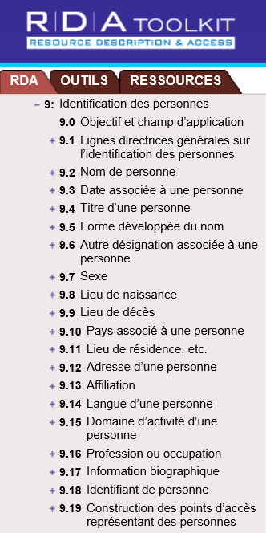
Attributs de l’entité Personne
dans RDA
Notes:
May 1, 2013
In this module we will examine the FRBR entity, “person”, and demonstrate how this works out in RDA. We will be looking at this entity in much more detail later.
FRBR and FRAD define several attributes of “person”. These are mostly taken directly into RDA, where they are worked out more fully, and in some cases refined with subelements. In RDA the act of recording attributes of an entity is referred to as “identifying” so RDA chapter 9 is called “Identifying Persons”. Chapter 9 is within a larger RDA section called “Recording attributes.” Within each “entity” chapter the guidelines begin with a scope note and general guidelines defining the entity, as you can see here. The central portion of each chapter consists of subsections detailing each attribute of the entity, including a definition of the attribute (also referred to as an “element” in RDA) and guidelines for recording the information. Finally, at the very end of each chapter, is a subsection detailing how to construct an access point to represent the entity. [Draw attention to 9.19.] It is extremely important that you understand this structure or you will get confused. The central subsections of the chapter do not necessarily have anything to do with the access point. They are intended to give guidance for recording attributes, not constructing an access point.

Slide 124
Attributs de l’entité Personne
Personne (Margaret Mitchell)
Nom privilégié : Mitchell, Margaret
Forme développée du (pré)nom : Margaret Munnerlyn
Variante de nom : Marsh, John Robert, Mrs.
Date de naissance : 1900 novembre 8
Date de décès : 1949 août 16
Sexe : féminin
Lieu de naissance : Atlanta, Géorgie.
Langue de la personne : Anglais
Notes:
January 19, 2017 (controlled form for gender)
How might this work in the real world? “Margaret Mitchell” is an instance of the “person” entity. Many of the RDA-defined attributes apply to her. How would we work RDA out in a FRBR-based database?
The first RDA attribute is “name of person”. RDA works this out into two subelements, “preferred name” and “variant name.” RDA instructs us, for all of these forms, to invert; and it instructs us to choose the commonly known form as the preferred name. In this demonstration I will record the preferred name and one variant name. The preferred name is based on usage. Variant names can come from any source. Regarding Mrs. John Robert Marsh, in RDA, as in AACR2, if a married person is identified only by a partner’s name, the term of address is considered an integral part of the name, and hence is recorded as part of the name attribute, as here.
In RDA a fuller form of name is not required to “fill out” elements already found in a preferred or variant name. Because Mitchell had a middle name, the fuller form of her forename is “Margaret Munnerlyn”.
“Date associated with the person” is an element which RDA has subdivided into subelements: date of birth, date of death, and period of activity. Note the RDA element only calls for the year to be recorded in most cases. I am giving the format RDA prescribes if two persons with the same name are born or died in the same year. We will see that this data is recorded slightly differently in MARC.
The attribute “gender” in RDA is recorded from controlled vocabulary.
Place of birth and language of the person are other possible attributes to record. RDA prescribes the forms shown.
There are many other elements and subelements called for in RDA. Note that only a few are core or required. Preferred name and dates are core. Remember this doesn’t mean the dates necessarily have to be part of the access point. It just means they need to be recorded as an element of the RDA record if known. There are a few other elements that are core if needed to distinguish one person from another.

Slide 125
Attributs de l’entité Personne (MARC)
046 $f 1900-11-08 $g 1949-08-16 $2 edtf
100 1 _ Mitchell, Margaret, $d 1900-1949
400 1 _ Marsh, John Robert, $c Mrs., $d 1900-1949
370 Atlanta (Géorgie) $2 lacnaf
375 féminin
377 eng
378 $q Margaret Munnerlyn
Notes:
March 27, 2017 (recorded gender in plural)
January 19, 2017 (controlled form for gender)
These same RDA elements translate into MARC in this way.
There is no discrete field in current MARC for recording the preferred name. The only place to record it is as a part of the authorized access point in 100. Subfield $a and $c (not present in this example) contains the preferred name prescribed by RDA.
Similarly there is no discrete place to record the variant name. Until MARC expands to allow this, it has to be recorded as part of a variant access point, in $a and $c of a 4XX field.
The fuller form of name element is recorded in field 378.
The date subelements are recorded in field 046; subfield f is date of birth, subfield g is date of death. Note the MARC formatting is different from the formatting called for in RDA.
Place elements associated with a person are recorded in 370; $a is the place of birth. The form in the 370 doesn't match identically the form found in the previous slide because PCC policy is to use the form of place found in the NAF rather than the form prescribed by RDA. A good illustration of LC-PCC/NACO policy trumping RDA instructions.
375 contains the gender element. Use controlled form (here from LCDGT)
The language of the person element is recorded in 377. In current MARC practice, languages are recorded as the MARC language code in subfield $a, which is repeatable if the person used more than one language (we don’t record all languages the person knows, just the ones he or she actually produces works in).
To complete this record we would include notes for the sources we consulted to find the information. RDA instructions for this are in chapter 8; for the most part they would be recorded in 670 fields, just as NACO practice has been until now.

Slide 126
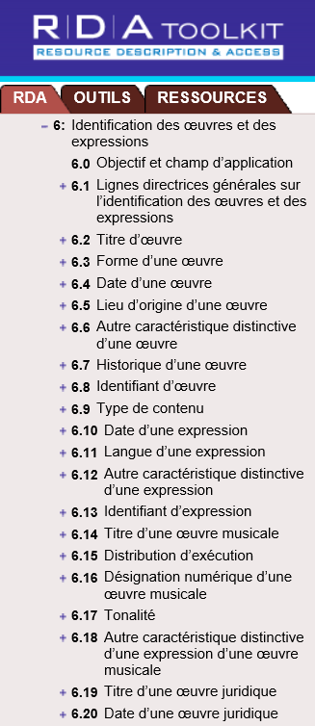
Attributs de l’entité Œuvre
dans RDA
Notes:
May 1, 2013
Now let’s create a record for a work. The attributes, or elements, of the work entity are found in RDA chapter 6, “Identifying works and expressions.” Elements or attributes of work include title, form, date of the work (date the work was created), other distinguishing characteristic, and special guidelines for particular kinds of works like musical works. There are more elements and subelements defining work in RDA than there were for person, so I can’t fit them all on the screen, but these are enough to get us started. Let’s create a record for Gone with the wind using some of these elements.
One thing to note before we start: “Author” or “Creator” is not an attribute of work in RDA or FRBR. The author is a person, family, or corporate body, and as such is a separate entity with a relationship to the work. In a pure RDA work record the author’s name would not appear in the record, but the record instead would be linked to the record for the author. This is a dramatic difference from current MARC practice.

Slide 127
Attributs de l’entité Œuvre
Œuvre (Gone with the wind)
Titre privilégié : Gone with the wind
Variante de titre : GWTW
Forme de l’œuvre : Roman
Date de l’œuvre : 1936
Historique de l’œuvre : Roman historique publié en mai 1936; a remporté le prix Pulitzer en 1937.
Notes:
March 27, 2017: removed “Summarization of the content: Scarlett O’Hara, the spoiled daughter of a well-to-do plantation owner, must overcome the challenges facing the South during and after the Civil War”. Summarization of content is an attribute of the expression not the work.
“The title of the work” element in RDA is subdivided into subelements “preferred title for the work” and “variant title for the work.” The preferred title is chosen as you would expect: choose the title by which the work is commonly known.
Gone with the wind does have a form. It is a novel.
We are instructed in RDA to record the date of the work, defined as the earliest date associated with the work. If we don’t know the complete history of the work, which we usually won’t, we can record the date of the first expression of the work; this date in turn may be the first time the expression was published in a manifestation. In this case that would be 1936.
History of the work is another possible element, which is totally free text. There isn’t a prescribed form.

Slide 128
Attributs de l’entité Œuvre (Pratique courante du MARC)
046 $k 1936 $2 edtf
100 1 _ … . $t Gone with the wind
380 Romans d’amour $a Romans historiques $2 rvmgf
678 Roman d’amour publié en mai 1936; a remporté le prix Pulitzer en 1937.
Notes:
February 26, 2019: updated speaker notes to clarify that more than one form can be recorded​
​
This slide shows the elements of the entity “work” as currently recorded in the MARC authority format. ​
​
We’ve already noted that the creator is not one of the elements of “work.” The creator is a separate entity as we’ve already seen, and it is linked to the authority record for the work by recording the exact string found in the 1XX field of the creator’s own record at the beginning of the 1XX field in the authority record for the work. We will see this on the next slide.​
​
Preferred title is recorded in $t of the 1XX field as part of the authorized access point because there is no discrete place to record the element outside the authorized access point.​
​
Date of work is recorded in 046 subfield $k.​
​
Form of work is recorded in 380 subfield $a. Could also have used 380 Novels $2 rbgenr OR 380 Novels $2 aat OR 380 Fiction $2 marcgt. NOTE: more than one form can be recorded, either as repeated subfields $a in 380 or in separate 380 fields. For example, War fiction, Historical fiction, Romance fiction all could have been included (from LCGFT).​
​
An uncontrolled form could also be included as an additional 380.​
​
History of the work is recorded in 678.

Slide 129
Lien Entité-Relation
Personne : Margaret Mitchell
créée par
Œuvre : Gone with the wind
Notes:
May 1, 2013
As a reminder, here is how the linking of the two entity descriptions we just created would appear in an entity-relationship diagram. The next slide shows how this same thing is done in MARC.

Slide 130
Lien dans le MARC
Notice d’autorité pour l’entité Œuvre
046 $k 1936 $2 edtf
100 1_ Mitchell, Margaret, $d 1900-1949. $t Gone with the wind
380 Romans d’amour $a Romans historiques $2 rvmgf
678 Roman historique publié en mai 1936; a remporté le prix Pulitzer en 1937.
Mitchell, Margaret, $d 1900-1949
Notice d’autorité pour l’entité Personne
046 $f 1900-11-08 $g 1949-08-16 $2 edtf
100 1_ Mitchell, Margaret, $d 1900-1949
400 1_ Marsh, John Robert, $c Mrs., $d 1900-1949
370 Atlanta (Géorgie) $2 lacnaf
375 féminin
377 eng
378 $q Margaret Munnerlyn
Notes:
February 26, 2019: clarified that adding 500 to make the “author” relationship explicit is permitted under PCC policy​
August 7, 2019: revised 678 to put it in form PCC best practices require (complete sentences)​
​
We create links in MARC records by using text strings. In this case the work record for Gone with the wind is linked to the person record for Margaret Mitchell because an exactly-matching text string (the authorized access point for Margaret Mitchell) is in the appropriate fields in the linked records. The type of relationship seen on the previous slide, “created by”, is implied by the position of Mitchell’s authorized access point at the beginning of the 100 field in the work description. It would be possible to make this even more explicit in a MARC authority record by recording another link to Margaret Mitchell in a 500 field and recording with it the relationship designator “author”: 500 1_ $w r $i Author: $a Mitchell, Margaret, $d 1900-1949. This may, in fact, be done under current PCC policy (see PCC Guidelines for the Application of Relationship Designators in Authority Records, November 2018, Guideline 15a)​
​
To repeat: “Mitchell, Margaret, $d 1900-1949” is not one of the elements of the work description. Its presence in the authority record for the work is only to create the link.​
​
PAUSE HERE TO LET PEOPLE LOOK.

Slide 131
Tâches des utilisateurs de FRBR/FRAD
Trouver
Identifier
Sélectionner
Obtenir
Contextualiser
Justifier
Notes:
trouver les ressources correspondant aux critères de recherche établis par l’utilisateur
trouver toutes les ressources matérialisant une œuvre particulière ou une expression particulière de cette œuvre
trouver toutes les ressources associées à un agent particulier
trouver toutes les ressources sur un sujet donné
trouver les œuvres, expressions, manifestations et items en relation avec ceux obtenus en réponse à la recherche de l’utilisateur
trouver les agents correspondant aux critères de recherche établis par l’utilisateur
trouver les agents en relation avec l’agent représenté par les données obtenues en réponse à la recherche de l’utilisateur
identifier la ressource décrite (c’est-à-dire confirmer que la ressource décrite correspond à la ressource recherchée ou bien établir une distinction entre deux ou plusieurs ressources ayant des caractéristiques identiques ou semblables)
identifier l’agent représenté par les données (c’est-à-dire confirmer que l’entité décrite correspond à l’entité recherchée ou bien établir une distinction entre deux ou plusieurs entités portant un nom identique ou semblable, etc.)
sélectionner une ressource pertinente pour les besoins de l’utilisateur en matière de caractéristiques physiques du support matériel et de formatage et d’encodage de l’information stockée sur ce support matériel
sélectionner une ressource pertinente pour les besoins de l’utilisateur en matière de caractéristiques du contenu de l’œuvre ou de l’expression (par exemple, la forme, le public cible, la langue)
obtenir une ressource (c’est-à-dire acquérir une ressource par achat, prêt, etc. ou avoir accès électroniquement à une ressource par une connexion en ligne à un serveur distant)
comprendre la relation existant entre deux ou plusieurs entités
comprendre la relation existant entre l’entité décrite et un nom par lequel cette entité est connue (par exemple, une forme linguistique différente de ce nom)
comprendre pourquoi un nom ou un titre particulier a été choisi comme nom ou titre privilégié de l’entité.
May 1, 2013
So how does all this help our users? After all, that’s the main point of what we’re up to.
FRBR and FRAD define tasks that the user wants to accomplish when he or she approaches the library’s database. For FRBR these are:
1. The user needs to find materials relevant to his or her needs. A user begins this process by doing a search in the database.
2. Once a search is executed, users need to identify the resource, that is, they must confirm that the resource corresponds to what they were looking for.
3. If more than one resource corresponds to the search, they then need to select the resource most appropriate to their needs.
4. Finally, once the user has selected a resource he or she wants to obtain it.
FRAD adds the following tasks:
1. Contextualize. This means the user needs be able to place the entity he or she is seeing into context. This was apparently meant to apply mainly to creators and users of authority data, but it seems a useful task to keep in mind for all our users.
2. Justify means to document one’s reasons for choosing a name or term on which a controlled access point is based. This task is probably undertaken only by creators of authority data.

Slide 132
Format MARC pour les vedettes d’autorité
Dans la pratique du PFAN, les descriptions des personnes, des familles, des collectivités, des œuvres et des expressions sont créées dans le Format MARC 21 Vedettes d’autorité.
Notes:
May 1, 2013
There will be separate modules for persons, families, corporate bodies, and works and expressions which will give description details. This module will cover MARC issues that are common to all authority records.

Slide 133
Structure du MARC pour les autorités
Zones
- Les zones sont les divisions de la notice
- Étiquette
Une séquence de trois chiffres nommant la zone
- Indicateurs
Deux caractères donnant des instructions sur le traitement pour la zone
- Sous-zones
Division de la zone dans différents types de données
Notes:
May 1, 2013

Slide 134
Structure du MARC pour les autorités
0XX – zones de contrôle, numéros normalisés, etc.
1XX – le point d’accès autorisé (un seul est permis)
3XX – là où la majorité des attributs des entités de RDA
sont enregistrés
4XX – variantes de point d’accès
5XX – liens aux entités en relation
6XX – traitement des notes et des collections
Notes:
Updated: Jun. 6, 2014
Presenter suggestion: you may want to compare and contrast the MARC authority tag structure with the MARC bibliographic tag structure.
The MARC authority structure contains a number of mnemonics that help us remember the tags and subfields. In this module “X” as a part of a tag number means any digit.
Note: in case someone wonders, 046 is in the 0XX block because it contains a standardized form of the date. In case anyone asks, we’re skipping 260 because it’s only rarely used if at all.
4XX. Variant access points recorded in 4XX fields are either supposed to direct the user to the authorized form he/she needs to use in searching, or to automatically redirect the user. This is where non-Latin script forms of names are recorded (another difference from the MARC bibliographic format)
5XX. We’ve traditionally called these “see also” references, but in fact they are links within the MARC structure to other entities.
In addition to the blocks shown on this slide are 7XX, linking fields, and 8XX. 7XX links are used to link to other authorized forms of the entity described in the record and could be used, as an example, to link the NACO form to the authorized form found in the German National Library’s authority file for the same entity. It is not generally used in this way in NACO practice (a few national libraries have exceptional permission to use the field, but most NACO catalogers will not), but during the transition between AACR2 and RDA it was briefly used to record the RDA authorized access point when that was different from the AACR2 authorized access point. This practice has been discontinued. An 8XX block also exists, but is not covered in this training workshop, and is rarely used in NACO authority records.

Slide 135
Structure du MARC pour les autorités
X00 – Personnes et familles
Également les œuvres ou les expressions avec une personne ou une famille comme créatrice
X10 – Collectivités
Également les œuvres ou les expressions avec une collectivité comme créatrice
X11 – Réunions, événements, expéditions, etc.
Également les œuvres ou les expressions avec une réunion (etc.) comme créatrice
X30 – Œuvres ou expressions sans créateur explicite
X51 – Entités géographiques
Notes:
May 1, 2013

Slide 136
Structure du MARC pour les autorités : Quiz
____ = point d’accès autorisé pour une personne
____ = variante de points d’accès pour une collectivité
____ = lien à une réunion en relation (etc.)
____ = variante de points d’accès (sans un créateur explicite)
pour une œuvre ou une expression
____ = point d’accès autorisé pour une entité géographique
Notes:
May 1, 2013
Combining the previous two slides: what are the MARC tags for these elements?
Note: the answers are in the next slide. You may want to encourage participants to look at the screen rather than at their manual when thinking about this exercise.

Slide 137
Structure du MARC pour les autorités: Quiz
100
410
511
430
151
= point d’accès autorisé pour une personne
= variante de points d’accès pour une collectivité
= lien à une réunion en relation (etc.)
= variante de points d’accès (sans un créateur explicite)
pour une œuvre ou une expression
= point d’accès autorisé pour une entité géographique
Notes:
May 1, 2013
ANIMATED SLIDE: MARC tag comes in on each click

Slide 138
00X : Zones de contrôle
008/09 – « Genre de notice »
– a = « vedette établie »
– b et c = « notice de renvoi »
Les catalogueurs du PFAN coderont presque toujours
la valeur « a »
Notes:
May 1, 2013
The leader is supplied automatically by the software and is not treated here.
Note to presenter: do not linger on most of these—most are automatically filled out when creating a record in OCLC.

Slide 139
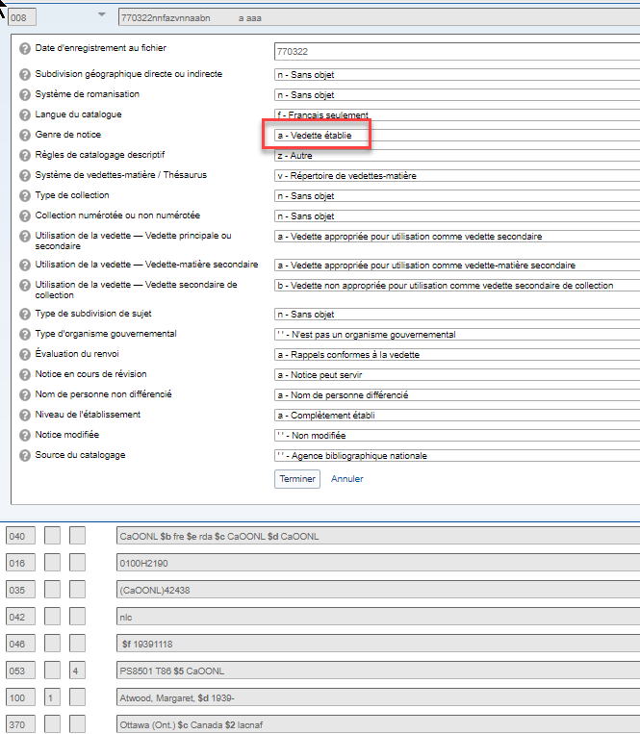
Notes:
February 4, 2019: updated authority record​
​
This is a record containing an established authorized access point.

Slide 140
00X : Zones de contrôle
008/10 – « Règles de catalogage descriptif »
– a - d = règles antérieures, y compris RCAA2
a – Règles antérieures
b – RCAA 1 c - RCAA 2 d – Vedette compatible avec les RCAA 2 – z = Autre
Utiliser « z »
Notes:
November 12, 2019: revised to give meanings of each code on the slide​
​
Note: be careful when you encounter a record with anything other than “z”. “a”, “b”, and “d” are records formulated under earlier codes than AACR2 and there is a high likelihood that the authorized access point will not be appropriate for RDA. Even “c” (AACR2) formulated authorized access points might not be appropriate for RDA, though most are.​
​
Codes for earlier rules:​
​
a – earlier than AACR​
b – AACR1​
c – AACR2​
d – AACR2 compatible

Slide 141
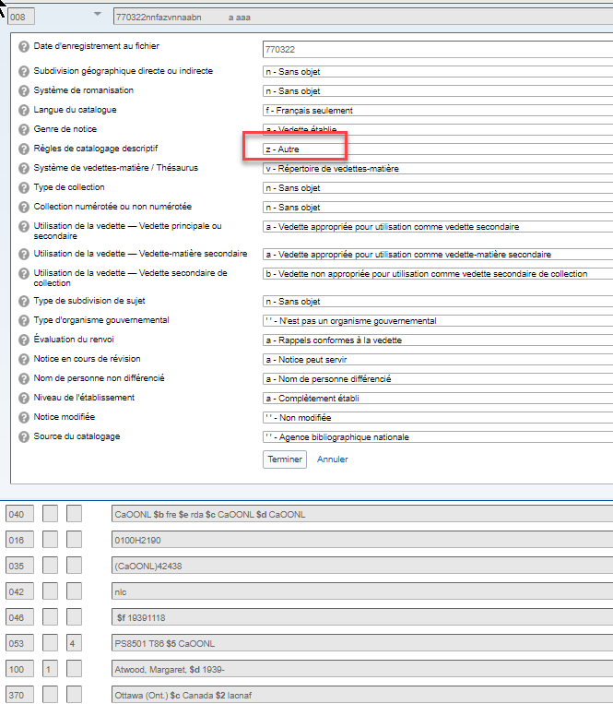
Notes:
February 4, 2019: updated authority record​
​
This record is coded “other”, which is what we use for RDA

Slide 142
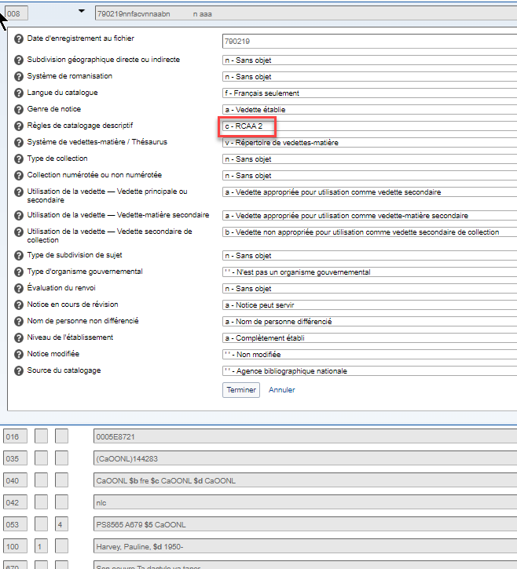
Notes:
Updated: Jun. 6, 2014
This record is coded “c”, for AACR2. If anyone makes any changes to this record it should be evaluated and upgraded to RDA.
Based on usage shown in the 670s, "Jr." should be included in the RDA access point.

Slide 143
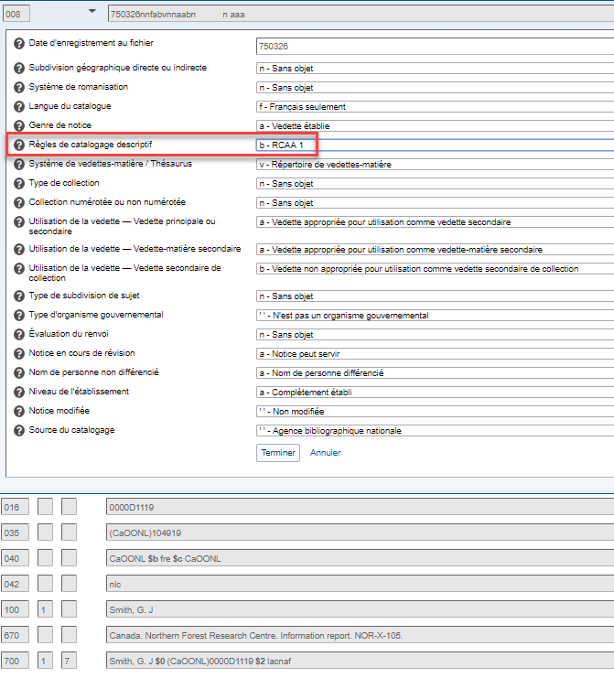
Notes:
Updated September 17, 2018
This record is coded “b” for AACR1. The form in 111 should not be used in an RDA record; if needed the record needs to be updated to RDA (including revising the form in 111).

Slide 144
00X : Zones de contrôle
008/12 – « Type de collection »
a = Collection monographique
b = Document en plusieurs parties
c = Phrase analogue à une collection
n = Sans objet
008/13 – « Collection numérotée ou non numérotée »
a = Numérotée
b = Non numérotée
c = Numérotation variable
n = Sans objet
008/16 – « Utilisation de la vedette – vedette secondaire
de collection »
a = Appropriée
b = Non appropriée
Notes:
May 1, 2013

Slide 145
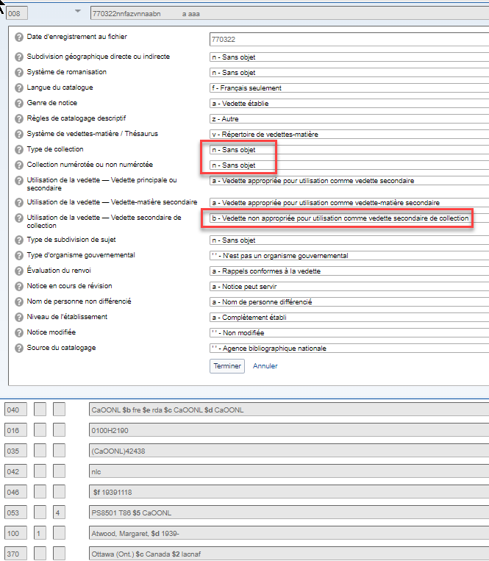
Notes:
February 4, 2019: updated authority record​
​
This authorized access point cannot be used as a series.

Slide 146
00X : Zones de contrôle
008/14 – « Utilisation de la vedette – vedette principale ou secondaire » (1XX/7XX dans la notice bibliographique)
a = Appropriée
b = Non appropriée
008/15 – « Utilisation de la vedette – vedette-matière secondaire » (6XX dans la notice bibliographique)
a = Appropriée
b = Non appropriée
Notes:
May 1, 2013
All authorized access points created under the NACO authority program are appropriate for use in a 1XX or 7XX bibliographic field (so always code “a”); most are appropriate for use as a subject.

Slide 147
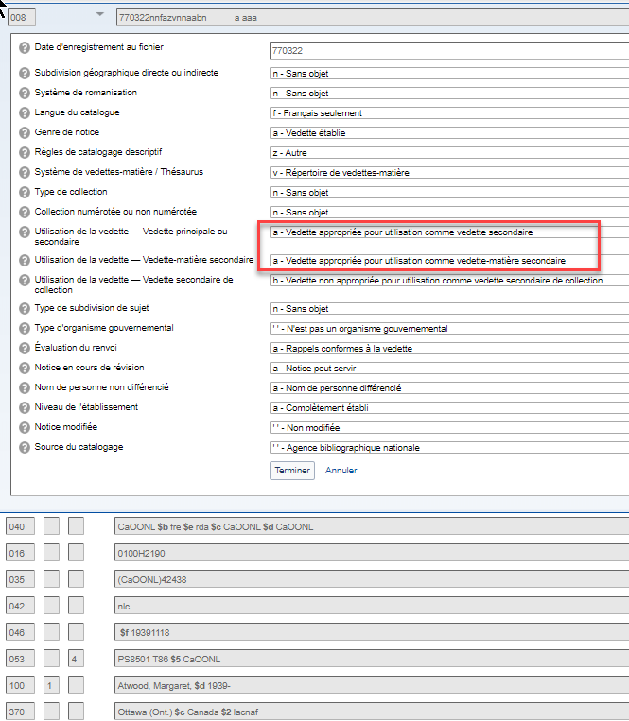
Notes:
February 4, 2019: updated authority record​
​
This authorized access point may be used in 100 and 700 fields (“Name use”) and in 600 fields (“Subj use”)

Slide 148
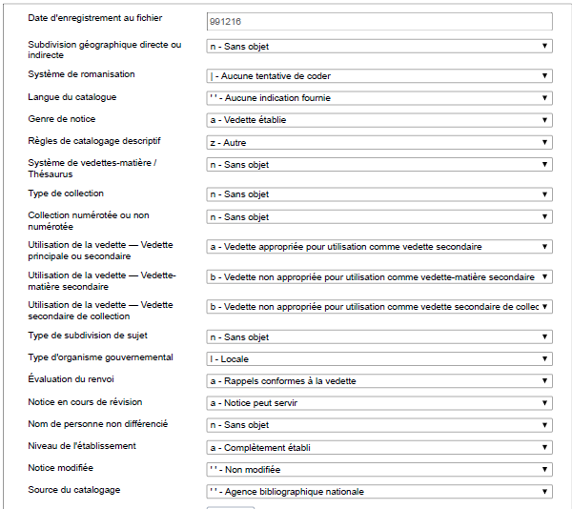
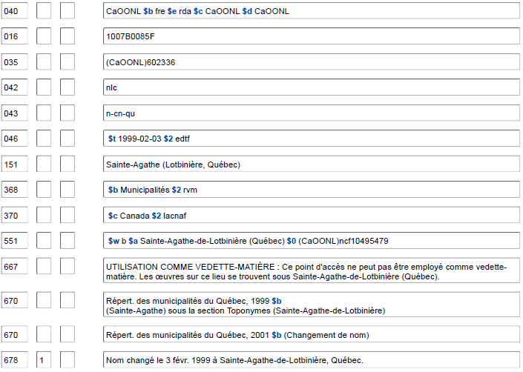
Notes:
November 12, 2019​
​
This NAR for the earlier name of a place is valid for use as a name, but may not be used as a subject. In addition to a 667 note explaining this, the fixed fields Subj (008/11) and Subj use (008/15) are also coded to indicate this. With the correct coding in the fixed field, OCLC will not allow this heading to be controlled as a subject heading (either in 610 or 651). It can still be used as an access point in a 110 or 710 field (Name use is coded “a”).​

Slide 149
00X : Zones de contrôle
008/29 – « Évaluation du renvoi »
a = zones 4XX ou 5XX présentes dans la notice
b = comprend les zones 4XX qui ne sont pas « évaluées »
n = aucune zone 4XX ou 5XX présente dans la notice
Puisque les lignes directrices pour l’évaluation des renvois en écriture non latine n’ont pas encore été établies, utiliser « b » si des zones 4XX pour une écriture non latine sont présentes
Notes:
May 1, 2013

Slide 150
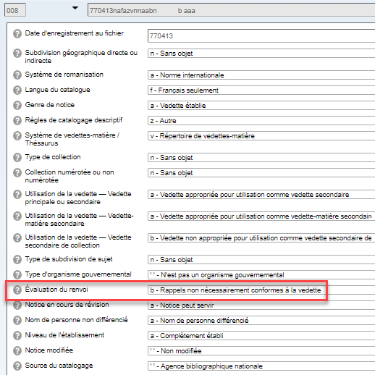
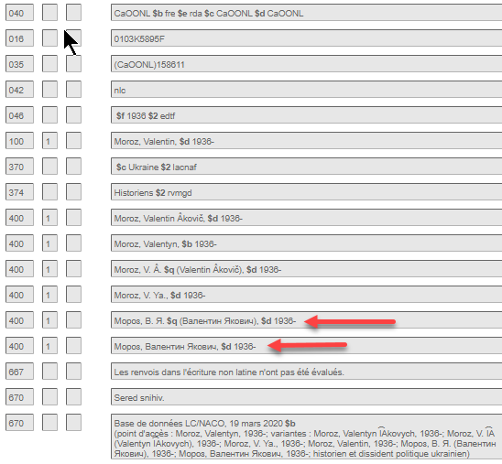
Notes:
November 12, 2019: replaced screen image and added arrows pointing to non-Latin script references​
February 4, 2019: updated authority record​
​
​
Coded “b” because of the non-Latin script (Hebrew and Cyrillic depicted in slide) 4XX fields​

Slide 151
00X : Zones de contrôle
008/32 – « Nom de personne non différencié »
a = Nom de personne différencié
b = Nom de personne non différencié
n = Sans objet
Notes:
Updated: Feb. 24, 2014
A differentiated personal name is an authorized access point that is unique to the person described in the record. An undifferentiated personal name is an authorized access point that is used for more than one person (because they share the same name and nothing could be found to differentiate their authorized access points). More on this in the “Describing Persons” module.
Undifferentiated name records are no longer permitted under PCC policy, but you will still encounter undifferentiated name records in the LC/NACO authority file. We will learn what to do when we encounter these in the next module, Module 2.

Slide 152
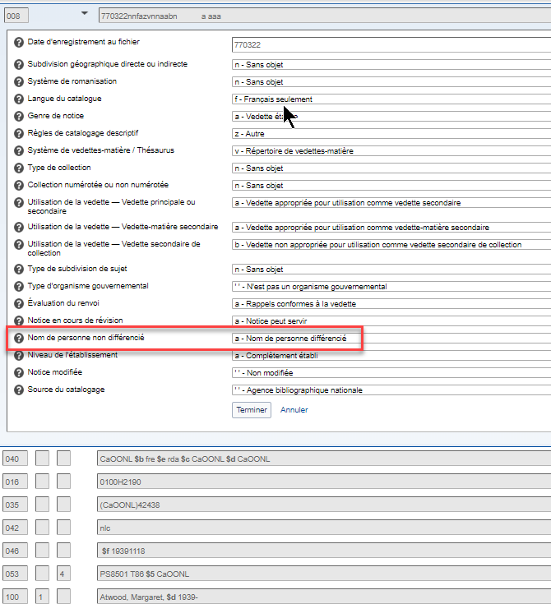
Notes:
February 4, 2019: updated authority record​
​
The authorized access point in this record is “differentiated”—it applies only to the science fiction/fantasy author Terry Pratchett.

Slide 153
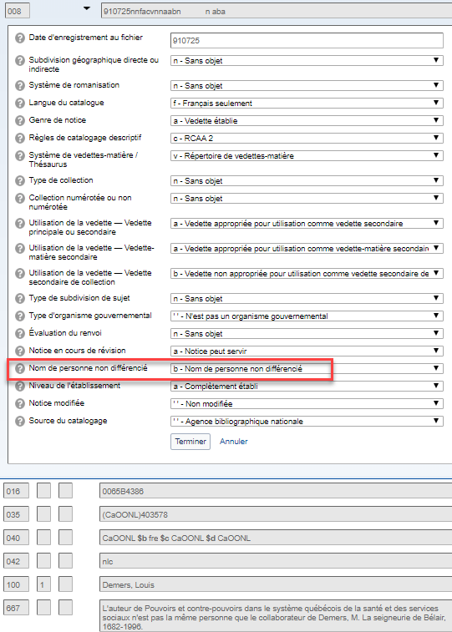
Notes:
February 27, 2020: updated speaker notes​
​
The authorized access point in this record is “undifferentiated”—it applies to three different individuals named Carol Jones. One compiled Early Rush County marriages; one illustrated They shell be covered; and one is the co-author of Can anyone get on these?​
​
Please note: this is an AACR2 record. Undifferentiated name authority records in RDA NACO authority records are no longer created under PCC policies. No additional individuals may be added to existing undifferentiated records either.​

Slide 154
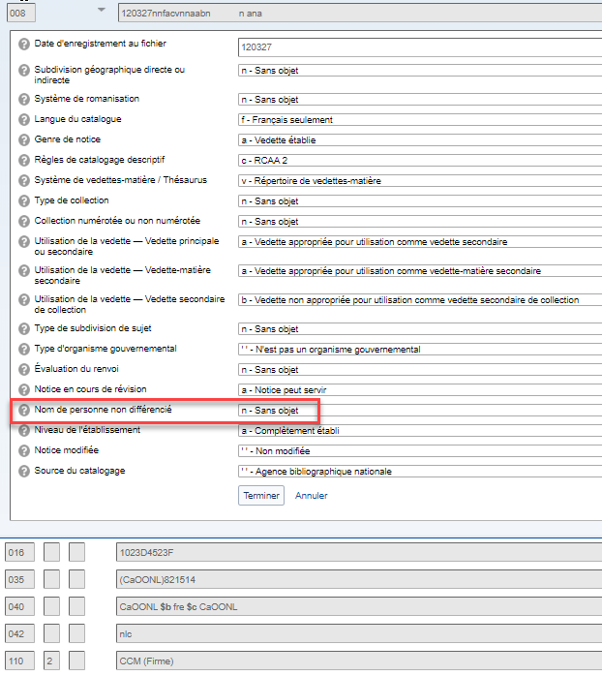
Notes:
Updated Nov. 2, 2016
The entity on this record is not a person, so the “Name” position is coded “not applicable.” Records describing families (X00 3_), corporate bodies (X10), meetings (X11), places (X51), and works/expressions without an explicit creator (X30) are coded “n”. Records describing works or expressions that have an explicit personal creator (authorized access point for the work/expression begins with the authorized access point for a person) are coded “a” or “b”, depending on how the record for the person is coded.

Slide 155
00X : Zones de contrôle
008/33 – « Niveau de l’établissement »
a = Complètement établi
c = Provisoire
Notes:
November 12, 2019: added list of all codes and their definitions and notes about the DCM Z1​
​
There are a few other possible codes, but “a” or “c” are what NACO catalogers will use. “c” is rarely used, normally because the cataloger does not have enough information to decide what the preferred name of the entity is. This usually involves a language issue (e.g. for a corporate body the cataloger does not know the name of the body in its own language).​
​
a - Fully established ​
The heading may be used without reservation in a bibliographic record. ​ b - Memorandum ​
The heading is fully established but it has not been used in a bibliographic record. The authority work was done before the decision was made to not use the heading in a bibliographic record; however, the information is retained for probable future use. When the heading is used in a bibliographic record, code b may be changed to code a or c.​ c - Provisional ​
The heading cannot be formulated satisfactorily because of inadequate information. Further investigation should be made when the heading is next used in a bibliographic record. When the needed information is available, code c may be changed to code a. ​ d - Preliminary ​
The heading is taken from a bibliographic record because the bibliographic item is not available at the time the heading is established. When the heading is used in a bibliographic record created from cataloging with an item in hand, code d may be changed to code a.​ n - Not applicable ​
1XX field contains an unestablished heading in a reference, subdivision, reference and subdivision, or node label record. ​ | - No attempt to code​
​
The DCM Z1 008/33 contains further details on when code “c” for provisional should be used, and what to do when using a preliminary (code “d”) record. “Preliminary authority records (008/33 value ‘d’) generally are the result of retrospective projects. LC catalogers are expected to upgrade NARs coded preliminary when using the heading on a bibliographic record. PCC catalogers are expected to routinely upgrade NARs coded preliminary when making other modifications to the record.

Slide 156
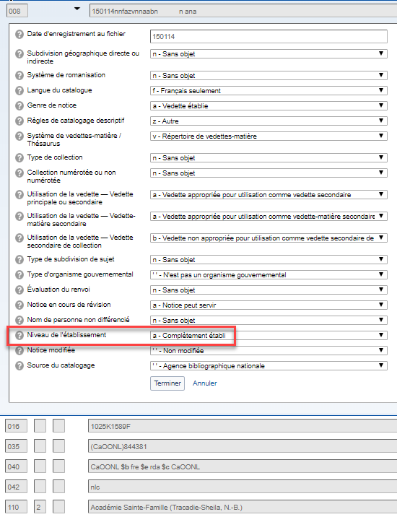
Notes:
February 4, 2019: updated authority record​
​
This record is “fully established”.

Slide 157
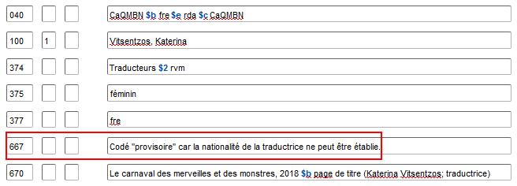
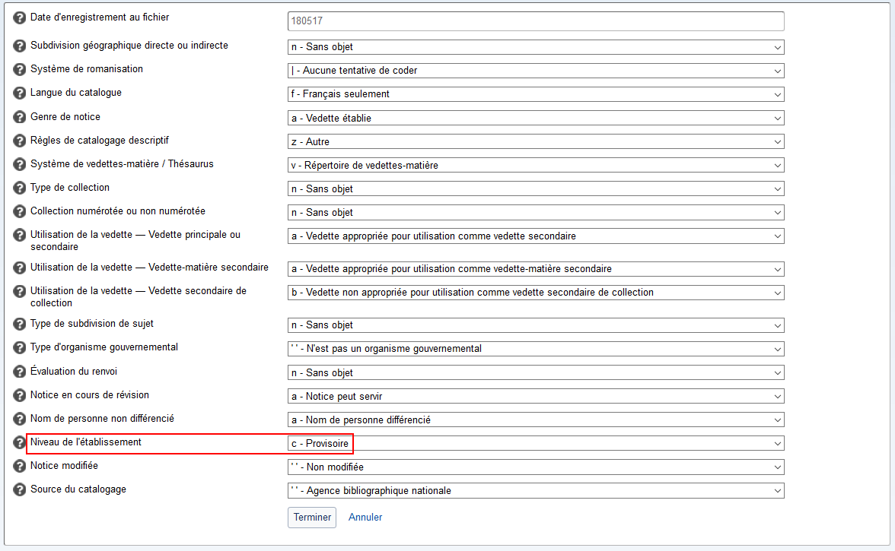
Notes:
Dans ce cas, le catalogueur ne connaissait pas la nationalité de la traductrice et ne pouvait donc determiner si le nom privilégié était en écriture latine ou grecque et s’il devait être systématiquement romanisé ou non.
February 26, 2019: replaced example​
​
In this case the cataloger did not know the Mongolian name of the entity, so the code is “provisional”. If the name in Mongolian becomes available later, the 110 should be changed and the level of establishment changed from “c” to “a”.

Slide 158
00X : Zones de contrôle
008/39 – « Source du catalogage »
« Blanc » = Agence bibliographique nationale
c = Programme de catalogage coopératif
BAC et BAnQ enregistreront un « Blanc » à cette position
Toutes les autres bibliothèques participant au PFAN, dont les bibliothèques universitaires, enregistreront un « c » à cette position
Notes:
May 1, 2013

Slide 159
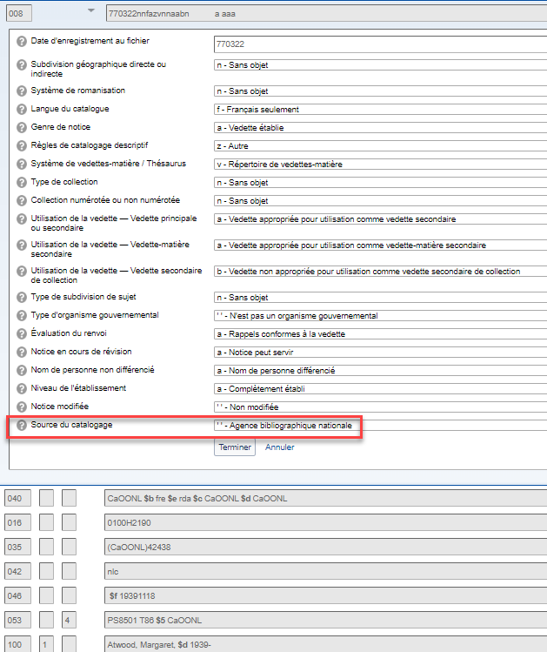
Notes:
February 4, 2019: updated authority record​
​
Coded blank because initially created by LC. The “Source” code is automatically entered by the software and is based on the MARC organization code in 040 $a. NACO catalogers should not attempt to change the code.

Slide 160
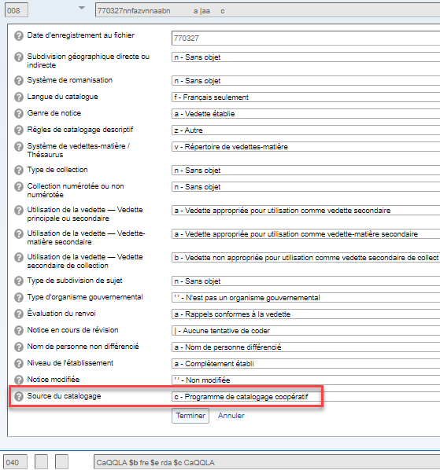
Notes:
March 8, 2019: replaced example with updated image​
​
Coded “c” because initially cataloged by a PCC library (CSt = Stanford University).

Slide 161
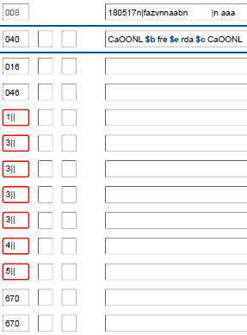
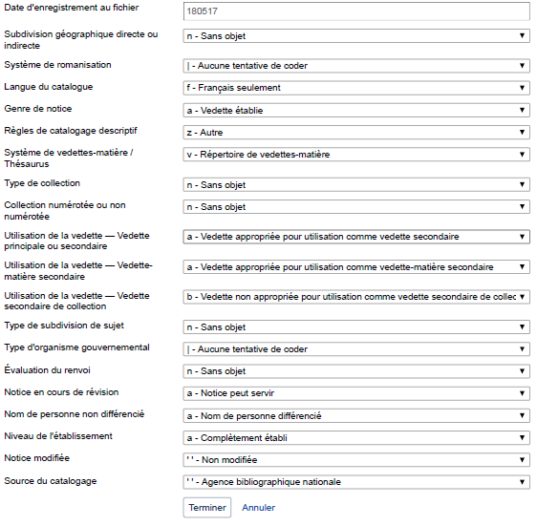
Notes:
May 1, 2013
We’ve just gone over most of the fixed field values in the MARC authority record, but most are filled out automatically by the software. There are three, however, that need special attention (whether they’ve been automatically filled out or not) because their values vary more than the others.
This is the OCLC RDA authorities workform, showing these three fixed fields. When creating or editing authority records, pay particular attention to “Ref status”, “Auth status”, and “Name.”

Slide 162
01X-09X : Zones de code
016 – Numéro de contrôle de l’agence bibliographique nationale
- zone obligatoire; doit être ajoutée dans les nouvelles notices et dans les notices migrées qui sont rehaussées
- le 1er indicateur est toujours « blanc » (Bibliothèque et Archives Canada) peu importe qui ajoute le numéro
- ajouté par la bibliothèque participante à partir d’une liste fournie par BAC
- doit toujours comprendre le code de langue « F » comme 10e caractère (ex. 0115E5000F)
- il faut prendre soin de vérifier si l’entité a déjà été établie par BAC dans le fichier LC pour réutiliser le même numéro
024 – Autre numéro ou code normalisé
040 – Source du catalogage
- toujours inclure « $e rda » tout de suite après « $b fre »
Notes:
February 27, 2020: added speaker note about the PCC URIs in MARC Pilot Project​
August 8, 2019: added 024 to slide​
​
024: There is currently a moratorium on adding identifiers (including those in the form of URIs) to NARs. However in 2020 the PCC started a URIs in MARC Pilot Project. Participants in the project are permitted to revise or add this field in existing or new authority records. These records will include a 667 note saying: “URIs added to this record for the PCC URI MARC Pilot. Please do not remove or edit the URIs.”​
​
040: In new records, “$e rda” may be automatically added by default depending on your option settings. It needs to be added manually when upgrading pre-RDA records.

Slide 163
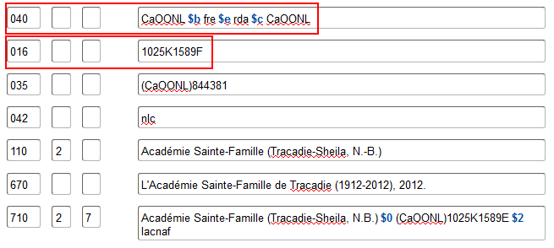
Notes:
February 4, 2019

Slide 164
Notices équivalentes dans les fichiers LC et Canadiana
Notice du fichier LC avec code « E » à la fin du numéro Canadiana
Notice du fichier Canadiana avec code « F » à la fin du numéro Canadiana

Slide 165
01X-09X : Zones de code
024 – Autre numéro ou code normalisé
Premier indicateur:​
7 - Source indiquée dans la sous-zone $2​ 8 – Genre non précisé de numéro ou de code normalisé​
Codes de sous-zones:​
$a – Numéro ou code normalisé (NR)​
$0 – Numéro normalisé ou de contrôle de la notice d’autorité (NR)​
$1 – URI de l’objet du monde réel (NR)​
$2 - Source (NR)​
Code de la sous-zone $2 dans Codes sources pour les numéros et codes normalisés​
Consulter le Guide des autorités de noms pour des orientations et des instructions​
Notes:
February 27, 2020: updated notes with information about the URIs in MARC Pilot Project​
​
Field 024 can be used to record other standard identifiers, including URIs, for the entity described in the NAR. The DCM Z1 includes instructions for using this field, but there is currently a moratorium on adding it until best practices for recording URIs in the new subfields $0 and $1 are developed. You can find numerous records in which the 024 field was added prior to the moratorium. For the time being, no new 024s can be added to records.​
​
In 2020 the PCC started a URIs in MARC Pilot Project. Participants in the project are permitted to revise or add this field in existing or new authority records. These records will include a 667 note saying: “URIs added to this record for the PCC URI MARC Pilot. Please do not remove or edit the URIs.”​
​
​

Slide 166
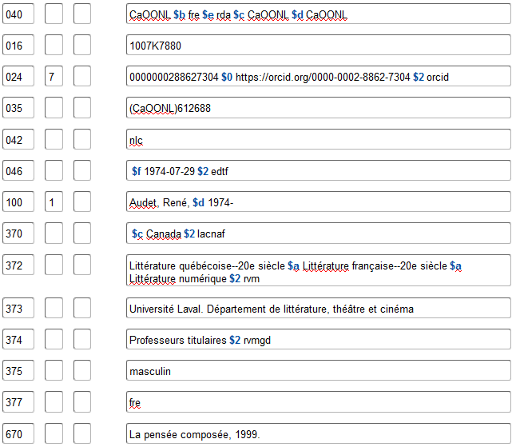
Notes:
August 8, 2019: new slide​
​
Example of an authority record with other standard identifiers (MARC 024) included. There is currently a moratorium on adding this field to NARs. PCC is developing best practices for recording URIs in field 024 subfields $0 and $1.

Slide 167
01X-09X : Zones de code
046 – Dates spéciales codées
$f Date de naissance
$g Date de décès
$k Date du début de la période de création
$l Date de la fin de la période de création
$o Date unique ou date de début pour contenu groupé
$p Date de fin pour contenu groupé
$q Date de fondation
$r Date de cessation
$s Début de la période d’activité
$t Fin de la période d’activité
$u Identificateur de ressource uniforme
$v Source d’information
$2 Source du terme
Notes:
August 7, 2019: added subfields $u and $v​
February 26, 2019: added subfield $o and subfield $p​
​
DO NOT USE $q and $r until PCC implements. Until then, use $s for date of establishment and $t for date of termination.

Slide 168
01X-09X : Zones de code
046 – Dates spéciales codées
– Enregistrer les dates en utilisant le format Extended Date/Time Format (EDTF)
dans tous les cas à l’exception des dates pour les siècles
– Voir https://www.loc.gov/standards/datetime/
– Utiliser le modèle AAAA ou AAAA-MM ou AAAA-MM-JJ
– Inclure $2 edtf
2012 $2 edtf 2012
2012-01 $2 edtf 2012 janvier
2012-01-13 $2 edtf 2012 janvier 13
1855? $2 edtf probablement 1855
[1930,1931] $2 edtf 1930 ou 1931
1957~ $2 edtf environ 1957
Notes:
March 4, 2020: updated notes to show that EDTF provides for other kinds of coded dates​
​
Note: Because PCC practice for formulating dates in the 046 field changed in 2015, you will encounter many older NACO records that do not have 046 field data formulated according to EDTF. If you are updating such a record, you must bring the 046 data up to current PCC standards.​
​
The slides show the most commonly forms of EDTF-coded dates (exact dates, probable dates, and approximate dates). The EDTF standard provides for coding many other kinds of dates that could sometimes be needed in authority records. Examples:​
​
201X = an unspecified year in the 2010s​
2010-21 = spring of 2010 (independent of location)​
2010-29 = spring of 2010 in the Southern Hemisphere​
[2010..2014] = one of the years from 2010 to 2014​
[..1760-12-03] = on or before 1760 December 3​
[1985..] = in 1985 or a later year​

Slide 169
01X-09X : Zones de code
046 – Dates spéciales codées
– Dates antérieures à 1000 apr. J.-C. (à l’exception des siècles) :
– Enregistrer la date avec quatre chiffres (utiliser les zéros de gauche au besoin)
– Précéder les dates av. J.-C. avec un signe moins et enlever une année
(parce qu’il n’y a pas d’« année zéro »)
0951 $2 edtf 951 apr. J.-C.
0031~ $2 edtf environ 31 apr. J.-C.
0006 $2 edtf 6 apr. J.-C.
-0360 $2 edtf 361 av. J.-C.
-0035? $2 edtf probablement 36 av. J.-C.
Notes:
Updated Oct. 27, 2016

Slide 170
01X-09X : Zones de code
046 – Dates spéciales codées
– Dates pour les siècles :
– Suivre la norme ISO 8601 (et non EDTF)
– Enregistrer le siècle avec deux chiffres en suivant ce modèle :
19 = toutes les années « 19XX » = 20e siècle
– Utiliser les zéros de gauche au besoin
– Précéder une date de siècle av. J.-C. avec un signe moins
– Ne pas inclure un code de source $2
20 21e siècle
09 10e siècle
00 1er siècle
-00 1er siècle av. J.-C.
-04 5e siècle av. J.-C.
Notes:
Updated Nov. 2, 2016

Slide 171
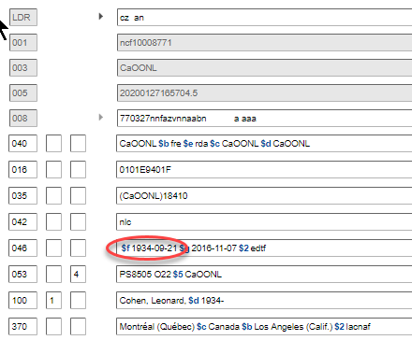
Notes:
Updated December 12, 2016
Date of birth

Slide 172
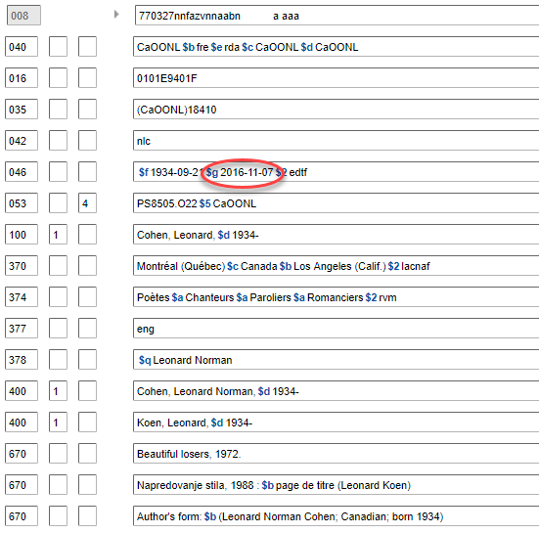
Notes:
Replacement slide: December 12, 2016
Date of death

Slide 173
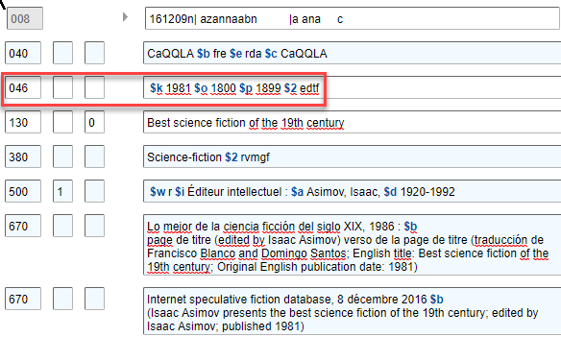

Slide 174
053 : Indice de classification LC
Les bibliothèques du PFAN peuvent ajouter des indices de classification locaux pour les auteurs littéraires classifiés dans PA-PT qui n’utilisent pas de numéros cutter successifs
Ne pas ajouter pour les auteurs littéraires :
Dont le nom a changé de façon significative en raison de changements dans les règles de catalogage, de l’état civil, etc.
Nés avant 1925
Ayant des pseudonymes ou des pseudonymes conjoints, peu importe la date de naissance
La zone 065 est utilisée pour les indices de la classe PS 8000
Notes:
September 17, 2018: updated slide and speaker notes to reflect policy change; deleted slide with link to 053 (literary author number) request form.
053 is an optional field but NACO libraries may add field 053 for locally assigned LC classification numbers associated with a personal name heading for literary authors who have written works of the imagination, other than works for children.
Previously, NACO members would suggest literary author numbers to the Library of Congress; the suggestions were reviewed by LC staff and added to the name authority record as “LC-verified” with second indicator value “0”. On July 1, 2018, LC announced that it was discontinuing the NACO Literary Author Number Program. Instead, NACO members may input locally assigned literary author numbers in name authority records.
To include a literary author number in a differentiated NAR, the author must be classified in PA-PT and must not use successive cutter numbers. Literary author numbers cannot be included in undifferentiated personal name authority records or for authors classified in PZ.
There are also four conditions under which literary author numbers should not be added by NACO members:
Literary authors whose name has changed significantly due to changes in cataloging rules, marital status, etc.
Literary authors born before 1925
Literary authors who have pseudonyms, regardless of date of birth
Literary authors who have joint pseudonyms, regardless of date of birth
In those cases, a proposal must be submitted through SACO to include the literary authors in the LC classification schedules. The LC Policy and Standards Division will add literary author numbers to the name authority records after the proposals are approved.

Slide 175
053 : Indice de classification LC
Premier indicateur : non défini
Deuxième indicateur :
0 - Attribué par la LC
4 - Attribué par un organisme autre que la LC
Sous-zones :
$a - Indice unique ou premier indice d’une séquence
$b - Dernier indice d’une séquence
$c - Terme explicatif
$5 - Institution à laquelle s'applique la zone
Notes:
March 4, 2020: new slide showing indicator values and subfields that will be used

Slide 176
053 : Indice de classification LC
Utiliser le deuxième indicateur « 4 » avec le code MARC de l’institution dans la sous-zone $5
053_4 [indice] $5 [code MARC de l’institution]
Exemple: 053 _4 PS3556.F683 $5 CaQQLA
100 1_ Fontenot, Scott Michael, $d 1968-
Aucune limite au nombre d’indices locaux assignés
La zone 053 est répétable pour les auteurs qui écrivent dans plus d’une langue
Notes:
24 avril 2020
La pratique de l'Université Laval illustrée dans la zone 053 donnée en exemple consiste à faire le cutter de l'auteur à la première lettre du nom de famille, contrairement à ce qui est prescrit dans la classe PS.
New: September 17, 2018
To add a locally assigned literary author number in field 053, use second indicator “4” with your MARC institution code in subfield $5. At this time, there is no limit to the number of locally assigned numbers that may be present in a name authority record.

Slide 177
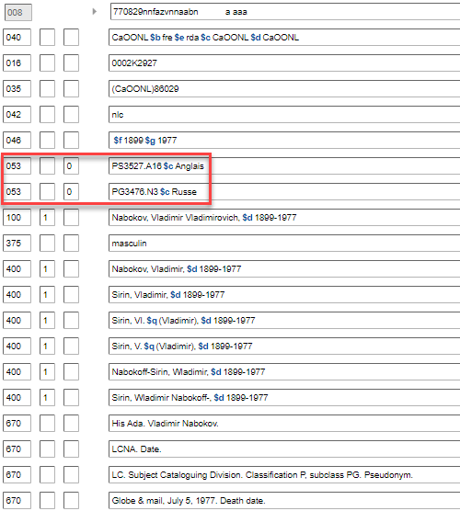
Notice avec des zones 053
Notes:
May 1, 2013

Slide 178
065 : Autre indice de classification
Premier indicateur : non défini
Deuxième indicateur : non défini
Sous-zones :
$a - Indice unique ou premier indice d’une séquence
$b - Dernier indice d’une séquence
$c - Terme explicatif
$2 – Source du code
$5 - Institution à laquelle s'applique la zone

Slide 179
065 : Autre indice de classification
Zone utilisée par les bibliothèques participant au PFAN pour les indices de classification de la classe PS 8000​
https://epe.lac-bac.gc.ca/100/200/301/lac-bac/class_ps8000-f/4e_ed/index.html
Ajouter $2 fcps pour indiquer la source de l’indice
Utiliser le code de bibliothèque en sous-zone $5 pour indiquer l’institution à laquelle la zone s’applique​
Exemple : 065 ## PS8603.A593 $2 fcps $5 CaQMG​
Les notices d’autorité pour les auteurs littéraires canadiens peuvent contenir les zones 053 et 065​
Notes:
March 4, 2020: updated speaker notes with final sentence about updating 053s that really belong in 065
065: Other Classification Number
LC Guidelines Supplement
This field may be supplied in a personal name heading only by Canadian agencies in consultation with LC’s Cooperative Programs Section. Its use is limited to classification numbers in the PS8000 schedule for Canadian literature. Other NACO participants should not supply, update, or delete this field.
DCM Z1
The 065 field may be used by Canadian agencies in consultation with LC’s Cooperative Programs Section for class PS8000 numbers. Other NACO participants should not supply, modify, or delete this field. Subfield $2 with value “fcps” is used to indicate Class PS8000 : a classification for Canadian literature as the source of the number.
Example: 065 ## $a PS8576.U57 $2 fcps $5 [MARC institution code]
Note: 065 didn’t validate in OCLC Connexion until March 2020. Prior to then some Canadian libraries may have put PS8000 numbers in 053. Canadian agencies should move them to 065 when encountered.

Slide 180
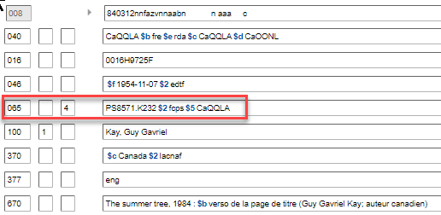
Notes:
24 avril 2020
La pratique de l'Université Laval consiste à faire le cutter de l'auteur à la première lettre du nom de famille, contrairement à ce qui est prescrit dans la classe PS.

Slide 181
083 : Indice de la Classification décimale Dewey
Premier indicateur : Type d'édition
0 - Intégrale
1 - Abrégée
7 - Autre édition mentionnée à la sous-zone $2
Deuxième indicateur :
0 - Attribué par la LC
4 - Attribué par un organisme autre que la LC
Sous-zones :
$a - Indice unique ou premier indice d’une séquence
$b - Dernier indice d’une séquence
$c - Terme explicatif
$2 - Numéro d’édition
$5 - Institution à laquelle s'applique la zone

Slide 182
083 : Indice de la Classification décimale Dewey
Utiliser le deuxième indicateur « 4 » avec le numéro de l’édition dans la sous-zone $2 et le code MARC de l’institution dans la sous-zone $5
083_4 [indice] $2 [numéro d’édition] $5 [code MARC de l’institution]
Exemple: 083 04 C841.6 M32185 $2 23 $5 CaQMBN
083 04 C843.6 M3223 $2 23 $5 CaQMBN
100 1_ Marcoux, Marie-Rose, $d 1946-
Aucune limite au nombre d’indices locaux assignés
La zone 083 est répétable pour les auteurs qui écrivent dans plus d’une langue, dans plus d’un genre, etc.
Notes:
Note : BAnQ inclut le Cutter de l’auteur dans la sous-zone $a.

Slide 183
087 : Indice de classification d’une publication officielle
Premier indicateur : Source de l’indice
# - Source indiquée dans la sous-zone $2
0 - Superintendent of Documents Classification System
1 - Publications du gouvernement du Canada : exposé de la Classification
Deuxième indicateur : non défini
Sous-zones :
$a - Indice unique ou premier indice d’une séquence
$b - Dernier indice d’une séquence
$c - Terme explicatif
$2 - Source de l’indice de classification

Slide 184
087 : Indice de classification d’une publication officielle
Le cas échéant, utiliser le premier indicateur « blanc » avec un terme explicatif dans la sous-zone $c et la source de l’indice dans la sous-zone $2; la sous-zone $5 n’est pas définie pour cette zone
087__ [indice] $c [terme explicatif] $2 [source de l’indice]
Exemple: 087 __ A32B52 $c 1967-1992 $2 ccpgq
087 __ C84B52 $c janvier 1993-janvier 2006 $2 ccpgq
110 2_ Bibliothèque nationale du Québec
Aucune limite au nombre d’indices locaux assignés
La zone 087 est répétable pour les organismes qui ont plus d’un indice

Slide 185
1XX : Point d’accès autorisé
100 1 _ = Nom de famille formaté dans l’ordre inversé (nom de famille,
prénom) ou un nom sans prénom(s) qui est connu comme un nom de famille
100 0 _ = Prénom ou un nom constitué de mots, d’expressions, d’initiales, de
lettres séparées ou de chiffres qui sont formatés en ordre direct
100 3 _ = Famille
110 1 _ = Collectivité (juridiction)
110 2 _ = Collectivité (autre que juridiction)
111 2 _ = Réunion (etc.)
130 _0 = Œuvre, expression sans créateur explicite
151 = Entité géographique
Notes:
Updated: Jun. 6, 2014

Slide 186
1XX : Point d’accès autorisé
Comprend au minimum le nom privilégié de l’entité
Peut également inclure des éléments ajoutés par le catalogueur tels que des dates, des qualificatifs
Notes:
May 1, 2013

Slide 187
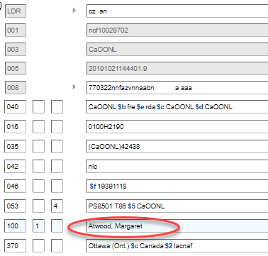
Notes:
Updated December 12, 2016

Slide 188
3XX : Éléments de RDA
370 – Lieu associé
$a Lieu de naissance $s Début de la période
$b Lieu de décès $t Fin de la période
$c Pays associé $u Identificateur de ressource uniforme
$e Lieu de résidence/siège social $v Source de l’information
$f Autre lieu associé $0 Numéro de contrôle de la notice
$g Lieu d’origine de l’œuvre $1 URI de l’objet du monde réel
$i Information sur la relation $2 Source
$3 Documents précisés
$4 Relation
Notes:
February 27, 2020: updated slide with addition of $u, $v, $0, $1; added note about URIs in $0, $1, and $4 ​
August 7, 2019: updated name of subfield $g; added $i, $3, and $4​
​
Only RDA elements applicable to all kinds of entities are covered here. Those specific to particular kinds of entities are discussed in the following modules.​
​
It is assumed that these places are or could be established in the NAF. If they have been, $2 naf may be added. If the place name comes from another thesaurus (e.g. LCSH), this needs to be indicated (“$2 lcsh”). If the name has not been established, omit $2, but formulate it the way it would be if it were established (e.g., include a larger place as a qualifier if appropriate).​
​
URIs for places are being added to the 370 field in $0 and/or $1 by some participants of the URIs in MARC Pilot Project. Subfield $4 can hold a code and/or a URI for the relationship. Example:​
​
370 $i Setting: $f Arizona $2 naf $4 http://id.loc.gov/vocabulary/relators/stg $0 http://id.loc.gov/authorities/names/n79034873

Slide 189
Enregistrement de l’attribut Lieu (1XX, 4XX, 5XX)
La forme du nom de lieu est régie par RDA, chapitre 16
Les points d’accès autorisés pour les noms de lieu autres que des juridictions sont en général formés comme dans les RCAA2, p. ex., « Paris (France) », cependant :
16.2.2.4. Si le nom de lieu est utilisé pour enregistrer… un lieu associé à [une entité] … faire précéder d’une virgule le nom du lieu plus vaste, p. ex., « Paris, France »
Mais, suivant la politique du PFAN, enregistrer le point d’accès autorisé dans la 370, et non la forme selon 16.2.2.4
Notes:
September 17, 2018: 16.2.2.4 updated to reflect current RDA language.

Slide 190
Enregistrement de l’attribut Lieu (370)
Utiliser la forme du point d’accès autorisé si elle existe déjà
Ne pas utiliser la forme abrégée pour les noms de lieu trouvés dans l’annexe B.11 (Noms de certains pays, États, provinces, territoires, etc.)
370 $c États-Unis $2 lacnaf
et non 370 $c É.-U.
Conserver les termes de juridiction ou autres désignations
Québec (Province) et non Québec
Allemagne (République fédérale) et non Allemagne
Napo (Équateur : Province) et non Napo
Toscane (Grand duché) et non Toscane
Castille (Royaume) et non Castille
Notes:
November 12, 2019: added example for second bullet​
LOOK at B.11​
​
In the 370 field attribute for the associated place, use the authorized access point form found in the authority record in the LC/NAF. ​
If no authorized access point exists in the LC/NACO Authority File for the place, it is not necessary to create a NAR in order to code the 370 field. Use the RDA preferred name for the place, but note that when there is no authorized source, a subfield $2 cannot be added.​
​

Slide 191
Exercice : Enregistrement de l’attribut Lieu (370)
Toutes ces formes RDA se retrouvent dans le fichier d’autorité. Quelle forme utiliseriez-vous pour enregistrer l’attribut?
Londres (Angleterre) Mexico (Mexique)
Austin (Tex.) Ontario (Calif.)
Arizona Washington (D.C.)
États-Unis Auckland (Nouvelle-Zélande)
France Porto Rico
Mile-End (Montréal, Québec)
Notes:
August 12, 2019: added a neighborhood example​
​
Take time to look at Appendix B.11. Suggestion: Write forms on the board before going to the next slide.

Slide 192
Enregistrement de l’attribut Lieu (370)
370 Londres (Angleterre) $2 lacnaf [lieu de naissance]
370 $b Mexico (Mexique) $2 lacnaf [lieu de décès]
$e Austin (Tex.) $2 lacnaf [lieu du siège social]
370 $f Ontario (Calif.) $2 naf [autre lieu associé]
370 Arizona $2 lacnaf [lieu de naissance]
370 $b Washington (D.C.) $2 lacnaf [lieu de décès]
$b États-Unis $2 lacnaf [lieu de décès]
Auckland (Nouvelle-Zélande) $b Porto Rico $c France $2 lacnaf
[lieu de naissance, lieu de décès, pays associé]
370 $e Mile-End (Montréal, Québec) $2 rvm [Lieu de résidence]
Notes:
August 12, 2019: added “jurisdictions” to caption. Added note about DCM Z1​
​
Note that 370 can be repeated, or alternately subfields can be repeated within a single 370.​
​
DCM Z1 370: For jurisdictions or other place names with authority records in the LC/NAF, use the authorized access point form as found, recording the source in subfield $2.

Slide 193
Enregistrement de l’attribut Lieu (370) : RVM
Les noms de lieu peuvent également être pris du RVM. Si tel est le cas, les enregistrer tels qu’ils ont été trouvés et inclure $2 rvm
370 Paria, Vallée de la (Utah et Ariz.) $2 rvm [lieu de naissance]
370 $b Pompéi (Ville ancienne) $2 rvm [lieu de décès]
370 $e Tahoe, Lac (Calif. et Nev.) $2 rvm [lieu de résidence]
Ne pas combiner les termes du fichier d’autorité de Canadiana et les termes du RVM dans la même zone 370. Si vous devez utiliser les deux, les enregistrer dans des zones séparées
370 Long Island (N.Y.) $2 rvm [lieu de naissance]
370 $e New York (N.Y.) $2 lacnaf [lieu de résidence]
Notes:
August 12, 2019: changed caption by adding “Non-jurisdictions”; changed Lake Tahoe coding from $e to $f; added info on use of other vocabularies​
September 17, 2018: replaced “NACO AF” with standard abbreviation “NAF”​
​
For non-jurisdictions, other controlled vocabularies may be used in field 370.​
​
DCM Z1 370: For non-jurisdictions, prefer names from an authorized vocabulary such as LCSH and identify the source in subfield $2. If the name is not found in an authorized vocabulary, record it in field 370 without giving a subfield $2 (it is not necessary for SACO participants to submit a subject heading proposal.) ​
​
Subfield $2 for the source of the term must be provided for controlled terms. Code from: Subject Heading and Term Source Codes.

Slide 194
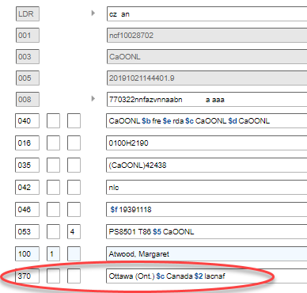
Notes:
Updated December 12, 2016

Slide 195
3XX : Éléments RDA
377 – Langue associée
– $a Code de langue
– $l Terme de langue
– $2 Source du code (non requis si un code de langue du MARC est utilisé; requis si
une liste de codes différente est utilisée)
PFAN : Utiliser le code de langue du MARC
http://www.marc21.ca/M21/COD/LNG-C.html
377 fre
– De plus, vous pouvez fournir une zone 377 additionnelle d’une autre liste de codes
de langue (plus utile lorsque le MARC a seulement un code collectif pour un groupe
de langues et qu’une autre liste a un code spécifique)
Ne pas enregistrer un terme de langue à moins que le code ne soit un code collectif
377 nic $l abidji
Notes:
February 27, 2020: added speaker note about $0 and $1​
August 8, 2019: added to speaker notes for instructions on what to choose when a language term is being recorded​
February 26, 2019: added final paragraph about sign languages to speaker notes​
​
DCM Z1: “Prefer language codes over language terms, using codes from the MARC Code List for Languages available at: http://www.loc.gov/marc/languages/langhome.html as the source for language codes. Use subfield $l (Language term) only to provide information not available in the MARC Code List for Languages. Encode multiple languages for a person or corporate body only if more than one language is used for publication, communication, etc.”​
​
LC PCC-PS for 6.11.1.3: “When recording the language of expression, base the name of the language on the form found in the current edition of MARC Code List for Languages”. The language term for persons, families, and corporate bodies should also be based on the form found in the MARC code list.​
​
Subfield $2 is not required when the MARC Code List for Languages is used as the language source code (second indicator value "#"). NACO institutions may supply an additional 377 field from another language code list by using second indicator value "7," with subfield $2 containing a code for a language source list taken from the list of MARC-registered language lists in Language Code and Term Source Codes (http://www.loc.gov/standards/sourcelist/language.html).​
​
All entities except “work” can record an associated language. For persons, families, or corporate bodies, it is the language the entity USES to create works or expressions. For expressions, it is the language of the expression.​
​
The last example shows the language Abidji, which hasn’t been assigned its own MARC language code. It has instead been assigned the collective code “nic” for Niger-Kordofanian languages.​
​
ISO 639-3 includes codes for the names of individual sign languages, which are lacking from MARC. In MARC, there is just a single collective code “sgn” for all sign languages.​
​
Note: Subfields $0 (authority record control number or standard identifier) and $1 (Real World Object URI) are not shown on the slide, but are also defined for the 377 field, and may be found in some records created or revised by participants in the PCC URIs in MARC Pilot Project. Do note remove or edit them. Example: 377 fre $0 http://id.loc.gov/vocabulary/languages/fre

Slide 196
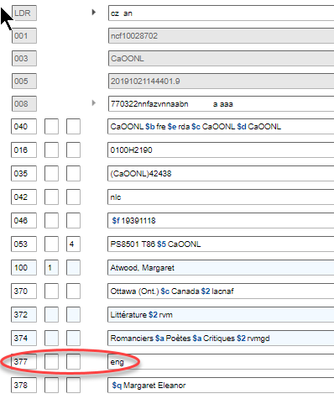
Notes:
Updated December 12, 2016

Slide 197
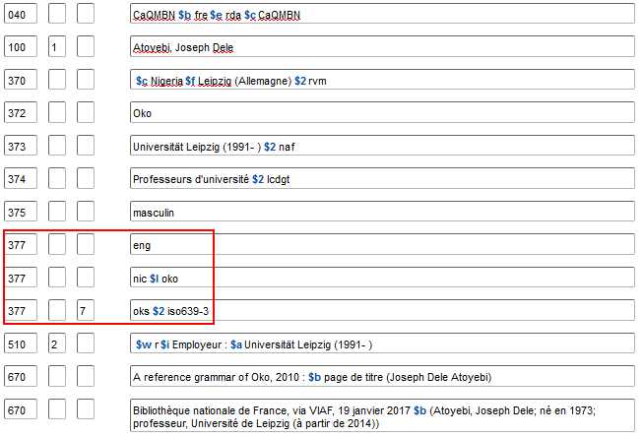
Notes:
January 19, 2017 updated NAR (incl. current form for 375)

Slide 198
4XX : Variante de points d’accès
400 1 _ = Nom de famille formaté en ordre inversé (nom de
famille, prénom) ou un nom sans prénom(s) qui est
connu comme un nom de famille
400 0 _ = Prénom ou un nom constitué de mots, d’expressions,
d’initiales, de lettres séparées ou de chiffres qui
sont formatés en ordre direct
400 3 _ = Famille
410 1 _ = Collectivité (juridiction)
410 2 _ = Collectivité (autre que juridiction)
411 2 _ = Réunion (etc.)
430 _0 = Œuvre/expression sans créateur explicite
451 = Entité géographique
Notes:
Updated: Jun. 6. 2014

Slide 199
4XX : Variante de points d’accès
Au moins inclure une variante de nom de l’entité
Peut aussi inclure des éléments ajoutés par le catalogueur tels que les dates, les qualificatifs. Facultatif dans RDA
Dans la pratique du PFAN, les variantes de point d’accès peuvent être en conflit avec d’autres variantes de point d’accès. Elles ne peuvent pas entrer en conflit avec aucun point d’accès autorisé
Notes:
February 26, 2019: revised bullet 3 to clarify that variant access points can only conflict with other variant access points in other NARs​
​
In April 2017, RDA was revised so variant access points can be constructed using either a preferred name or a variant name.

Slide 200
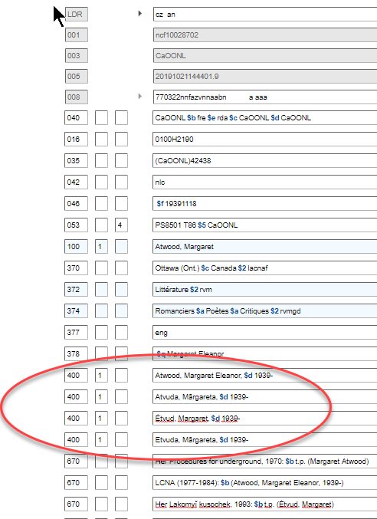
Notes:
Updated: Oct. 26, 2016
Note: the Hebrew reference displays in OCLC either to the right or the left of the screen, depending on how the user’s preferences are set.

Slide 201
4XX ou 5XX sous-zone $w
La sous-zone $w est une sous-zone de contrôle qui peut être utilisée en zone 4XX ou 5XX pour indiquer si des directives particulières s'appliquent à l'affichage de la vedette dans la zone
Elle comprend quatre positions (numérotées de 0 à 3), chacune ayant une signification particulière et des codes disponibles​
La signification dépend de la position du caractère. Si une position est codée, toutes les positions précédentes doivent également être codées (même si c’est seulement avec « n » pour non applicable). Les positions suivantes, si elles ne sont pas nécessaires, n'ont pas besoin d'être codées.
La sous-zone $w se situe au tout début de la zone
Notes:
March 1, 2019

Slide 202
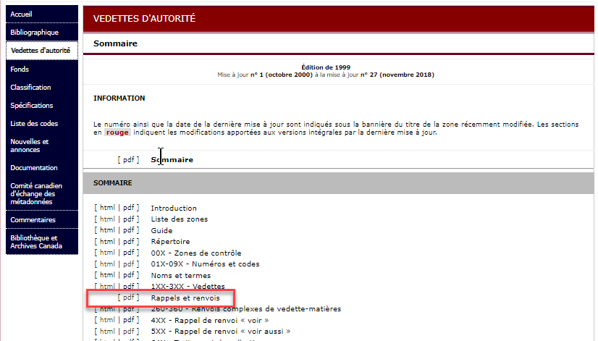
4XX ou 5XX sous-zone $w
L’information nécessaire au codage se trouve dans le format MARC 21 – Vedettes d’autorité
Notes:
March 1, 2019

Slide 203
4XX sous-zone $w
Les troisième et quatrième positions (positions « 2 » et « 3 ») peuvent être utilisées en zone 4XX
La position 2 indique que la forme en zone 4XX est une forme préalablement autorisée, soit avant les RCAA2 (codée « a »), soit après les RCAA2 ou RDA (codée « e »)
Les positions 0 et 1 n'étant pas utilisées, elles sont codées « n »
Notes:
November 12, 2019: added notes​
​
Instructor may wish to have trainees look at the MARC authority format for this, which is found in the Tracings and References-General Information section (https://www.loc.gov/marc/authority/adtracing.html). ​
​
$w - Control subfield ​
Up to four character positions (designated as $w/0, etc.) that indicate whether special instructions apply to the display of the heading in the 4XX or 5XX field and whether a tracing is restricted to the reference structure of a particular type of authority. Subfield $w need not be used if none of the characteristics is applicable. Because the definitions of the codes in subfield $w are dependent on the character position in which they occur, the coding of any character position mandates that each preceding character position contains a code or a fill character (|); succeeding character positions need not be used. For example, if $w/0 and $w/1 are not applicable but $w/2 is applicable, then $w/0 and $w/1 each contain code n (Not applicable) or a fill character (|).​
​
/0 - Special relationship​
/1 - Tracing use restriction​
​
/2 - Earlier form of heading​
One-character alphabetic code that indicates whether the heading in the 4XX field is an earlier form in which the name or subject was established either in the relevant national authority file or in an authority file other than the national authority file. ​
a - Pre-AACR 2 form of heading (national name authority file) ​
e - Earlier established form of heading (national authority file) ​
o - Earlier established form of heading (other authority file) ​
n - Not applicable ​
​
/3 - Reference display​
One-character alphabetic code that enables the generation or suppression of a cross reference from a 4XX or 5XX field. ​
a - Reference not displayed ​
b - Reference not displayed, field 664 used ​
c - Reference not displayed, field 663 used ​
d - Reference not displayed, field 665 used ​
n - Not applicable

Slide 204
4XX sous-zone $w
100 1_ Jenner, Caitlyn, $d 1949-​
400 1_ $w nne $a Jenner, Bruce, $d 1949-​
La forme antérieure préalablement autorisée sous RDA demeure une variante appropriée du point d’accès​
100 1_ Joad, C. E. M. $q (Cyril Edwin Mitchinson), $d 1891-1953​
400 1_ $w nna $a Joad, Cyril Edwin Mitchinson, $d 1891-1953​
La forme précédemment autorisée avant les RCAA2, basée sur les règles de catalogage de l'ALA de 1949, reste appropriée comme variante de point d'accès RDA
Notes:
March 1, 2019​
​
Joad example: 1949 ALA cataloging rules for author and title entries rule 37 called for forming the authorized access point based on the full form of the forenames rather than usage (as AACR2 and RDA require). Usage supports “Joad, C. E. M.”, not “Joad, Cyril Edwin Mitchinson” so the authorized access point was changed to reflect the current rules, but the previous form is appropriate as a variant access point.

Slide 205
4XX sous-zone $w
La position 3 indique que la forme en zone 4XX ne devrait pas être affichée​
100 1_ Previn, André, $d 1929-2019. $t Quintettes, $m clarinette, violons (2), alto, violoncelle​
400 1_ $w nnea $a Previn, André, $d 1929- $t Quintette, $m clarinette, violons, alto, violoncelle​
La forme RCAA2 préalablement autorisée (« nnea ») est codée pour ne pas s'afficher (« nnea ») parce que les termes de la distribution d’exécution ne sont pas appropriés sous RDA
Noter que la forme antérieure n'est modifiée en aucune façon, pas même par l'ajout de la date de décès au point d'accès autorisé pour Previn qui ne faisait pas partie du point d'accès lorsqu'il a été autorisé précédemment.
Notes:
March 1, 2019​
​
Note: this NACO training does not cover authorized access points for musical works, but this is an example of the type of 4XX field that might be coded not to display in an RDA database.​
​
Here is the order of what happened to this record: The AACR2 authorized access point was revised because of RDA; a new authorized access point was recorded in 100, and the previous one was re-recorded in 400 with $w nnea. A few years later Previn died. The name form in the 100 field was changed to reflect his updated authorized access point, but the form that had already been recorded in 400 as a previously authorized form was not changed. Once a 4XX is coded with $w nne, $w nna, $w nnea, or $w nnaa, it is frozen and not changed again.

Slide 206
4XX sous-zone $w
La position 3 indique que la forme en zone 4XX ne devrait pas être affichée​
110 2_ E.I. du Pont de Nemours & Company​
410 0_ $w nnaa $a Du Pont de Nemours (E. I.) and Company​
La forme pré-RCAA2 préalablement autorisée (« nna ») est codée pour ne pas s'afficher (« nnaa ») parce que la forme inversée n'est pas basée sur l'usage et n'est pas appropriée en RDA.
Noter que la forme antérieure n'est modifiée en aucune façon, y compris pour ce qui est du codage du premier indicateur 0 pour le nom inversé, un codage qui n'a jamais été utilisé sous les RCAA2 ou RDA
Notes:
March 1, 2019​
​
Pre-AACR2 form was based on 1949 ALA Cataloging Rules 144A, which called for inversion if the corporate body name began with a forename or initials of a personal name.

Slide 207
5XX : Liens aux entités en relation
500 1 _ = Nom de famille formaté en ordre inversé (nom de
famille, prénom) ou un nom sans prénom(s) qui est
connu comme un nom de famille
500 0 _ = Prénom ou un nom constitué de mots, d’expressions,
d’initiales, de lettres séparées ou de chiffres qui
sont formatés en ordre direct
500 3 _ = Famille
510 1 _ = Collectivité (juridiction)
510 2 _ = Collectivité (autre que juridiction)
511 2 _ = Réunion (etc.)
530 _0 = Œuvre/expression sans créateur explicite
551 = Entité géographique
Notes:
June 6, 2014

Slide 208
5XX sous-zone $w
La sous-zone $w est utilisée en zone 5XX dans deux situations
Pour coder des relations (position 0)
Pour supprimer les points d'accès des entités en relation (position 3)
Notes:
November 12, 2019: added notes​
​
Instructor may want to have trainees look at the MARC authority format section Tracings and References-General Information section (https://www.loc.gov/marc/authority/adtracing.html).​
​
$w - Control subfield ​
Up to four character positions (designated as $w/0, etc.) that indicate whether special instructions apply to the display of the heading in the 4XX or 5XX field and whether a tracing is restricted to the reference structure of a particular type of authority. Subfield $w need not be used if none of the characteristics is applicable. Because the definitions of the codes in subfield $w are dependent on the character position in which they occur, the coding of any character position mandates that each preceding character position contains a code or a fill character (|); succeeding character positions need not be used. For example, if $w/0 and $w/1 are not applicable but $w/2 is applicable, then $w/0 and $w/1 each contain code n (Not applicable) or a fill character (|).​
​
/0 - Special relationship​
One-character alphabetic code that describes a relationship of an entity in a 4XX or 5XX field to that in the 1XX field that is more specific than the relationship implicit in the tag. The codes may be used to generate a special reference instruction phrase in a cross reference display. ​
a - Earlier heading h - Narrower term​
b - Later heading i - Reference instruction phrase in subfield $i​
d - Acronym n - Not applicable​
f - Musical composition r - Relationship designation in $i or $4​
g - Broader term t - Immediate parent body​
​
In NACO records, only codes “a”, “b”, and “r” are used in 5XX fields.​
​
/1 - Tracing use restriction​
/2 - Earlier form of heading​
​
/3 - Reference display​
One-character alphabetic code that enables the generation or suppression of a cross reference from a 4XX or 5XX field. ​
a - Reference not displayed ​
b - Reference not displayed, field 664 used ​
c - Reference not displayed, field 663 used ​
d - Reference not displayed, field 665 used ​
n - Not applicable ​
​

Slide 209
5XX sous-zone $w (Relations)
La sous-zone $w position 0
a = nom antérieur
b = nom postérieur
r = indicateur de relation dans la sous-zone $i
La plupart des notices du PFAN utilisent le « r » à cette position mais « a » ou « b » sont encore utilisés pour indiquer la relation entre les noms antérieurs et postérieurs des lieux juridictionnels
Notes:
March 4, 2020: removed families from second bullet and notes; removed sentence “Subfield $4 is not used in NACO authority records” because it will be used in the future when URIs are added​
​
/0 - Special relationship​
One-character alphabetic code that describes a relationship of an entity in a 4XX or 5XX field to that in the 1XX field that is more specific than the relationship implicit in the tag. The codes may be used to generate a special reference instruction phrase in a cross reference display. ​
a - Earlier heading h - Narrower term​
b - Later heading i - Reference instruction phrase in subfield $i​
d - Acronym n - Not applicable​
f - Musical composition r - Relationship designation in $i or $4​
g - Broader term t - Immediate parent body​
​
In NACO records, only codes “a”, “b”, and “r” are used in 5XX fields.​
​
Code “r” means that the relationship is indicated in subfield $i (relationship designator) or subfield $4 (relationship code or URI). ​
​
“a” and “b” are still used for jurisdictions because there are no relationship designators in RDA for earlier/later names of these entities. This will probably change after the “beta” RDA is implemented in 2021.

Slide 210
5XX sous-zone $w (Relations)
Famille – utiliser des renvois « voir aussi » simples pour les noms antérieurs/postérieurs​
100 3_ Mountbatten (Famille : $d 1917- : $c Grande-Bretagne)​
500 3_ Battenberg (Famille : $d -1917 : $c Grande-Bretagne)​
Lieu – utiliser un code « a » ou « b » pour les noms antérieurs/postérieurs​
151 Eswatini 151 Swaziland​
551 $w a $a Swaziland 551 $w b $a Eswatini​
Toutes les autres relations entre entités - utilisez le code « r » et un indicateur de relation dans la sous-zone $i
100 1_ Atwood, Margaret, $d 1939- $t Handmaid's tale​
500 1_ $w r $i Auteur : $a Atwood, Margaret, $d 1939-​
500 1_ $w r $i Suite : $a Atwood, Margaret, $d 1939- $t Testaments
530 _0 $w r $i Adapté en émission de télévision (œuvre) : $a Handmaid's tale (Émission de télévision)​
Notes:
March 4, 2020: changed coding for families, added reciprocal place example, and replaced example in third bullet; updated speaker notes​
​
Families: There are no relationship designators for earlier/later family names in RDA. “a” and “b” do not validate in OCLC Connection with family names, so simple see also references must be used (no $w at all). This will probably change after the “beta” RDA is implemented in 2021, since the “beta” RDA does include relationship elements for successor and predecessor families.​
​
Places: “a” and “b” are still used for jurisdictions because there are no relationship designators in RDA for this relationship. This will probably change after the “beta” RDA is implemented in 2021.​
​
Fuller information about relationships is coming up in a few slides.

Slide 211
5XX sous-zone $w (Suppression)
Sous-zone $w position 3​
- Utilisé lorsque plus de deux identités bibliographiques sont liées​
- Code « c » = renvoi non affiché, la zone 663 étant utilisée à la place pour expliquer la relation. Ceci a pour but de supprimer les zones 500 de l'affichage dans l'index.
100 1_ Carr, John Dickson, $d 1906-1977​
500 1_ $w nnnc $a Dickson, Carter, $d 1906-1977​
500 1_ $w nnnc $a Dickson, Carr, $d 1906-1977​
500 1_ $w nnnc $a Fairbairn, Roger, $d 1906-1977​
663 Pour les œuvres de cette personne écrites sous d'autres noms, chercher aussi sous :
$b Dickson, Carr, 1906-1977 $b Dickson, Carter, 1906-1977 $b Fairbairn, Roger, 1906- 1977
​
Pour des informations complètes sur le traitement des identités bibliographiques multiples, voir « Personnes apparentées » dans le module 2.
Notes:
August 8, 2019: revised 663 to have punctuation between $b subfields agree with instructions in the FAQ – LC/PCC Practice for Creating NARs for Persons Who Use Pseudonyms. No punctuation is given between separate instances of $b.​
​
The coding here is intended to have systems display the note in field 663 instead of the see also references in the 500 fields.

Slide 212
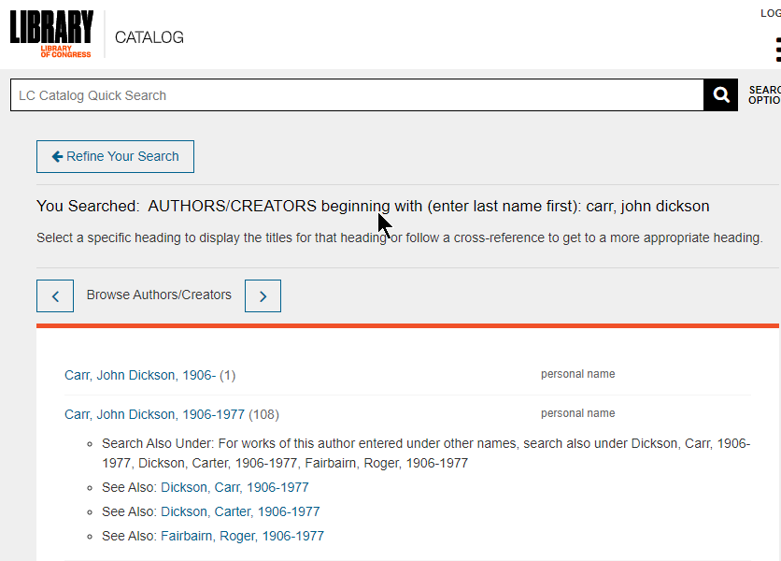
Notes:
November 12, 2019​
​
Results of a browse author search for Carr, John Dickson in the LC Catalog. The system displays the note in the 663 field of the authority record, but it does not also suppress the see also references in the 500 fields.​

Slide 213
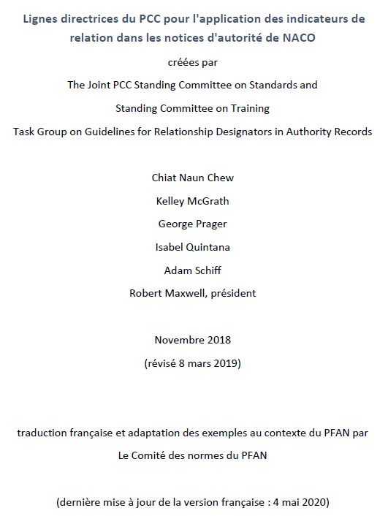
Lignes directrices du PCC
https://drive.google.com/file/d/1URStT5DgcEj52ghmYFq8oCbNXpXhvZX-/view?usp=sharing
Notes:
Follow the PCC Guidelines for the Application of Relationship Designators in NACO Authority Records. A summary of the more important guidelines follows in the next few slides.

Slide 214
5XX : Liens aux entités en relation
Le lien est créé par l’enregistrement de la forme exacte du point d’accès autorisé d’une autre entité
Une notice d’autorité pour l’autre entité doit exister dans Canadiana
Un lien correspondant peut exister ou ne pas exister dans l’autre notice
Parce qu’il y a plusieurs genres différents de relations possibles, l’utilisation des indicateurs de relation pour spécifier la nature de la relation est encouragée
Si la nature exacte de la relation est inconnue ou si aucun indicateur de relation n'est disponible pour la décrire, un renvoi « voir aussi » simple peut être fait (5XX sans $w ou $i)
Notes:
February 26, 2019: added last bullet point, clarified second bullet point​
​
First bullet: The easiest way to make sure you’re doing this correctly is to copy the 1XX field from the record for the related entity and paste it into your 5XX field.

Slide 215
5XX : Liens aux entités en relation Indicateurs de relation
Enregistrer l’indicateur dans la sous-zone $i, avant le point d’accès autorisé
Inclure la sous-zone $w r
Mettre en majuscules la première lettre de l’indicateur et le faire suivre d’une espace, deux points
100 1_ Lewis, Meriwether, $d1774-1809
511 2_ $w r $i Collectivité : $a Lewis and Clark Expedition $d (1804-1806)
Notes:
November 12, 2019: added 100 field in example to explicitly show the relationship more clearly​
March 1, 2019: added last line to speaker note​
​
Second bullet: $w r is a MARC requirement. It has nothing to do with RDA.​
​
NOTE: remember however the information a few slides ago about using the coding “a” or “b” for earlier/later forms of name for geographic places and families.

Slide 216
5XX : Liens aux entités en relation Indicateurs de relation
Les indicateurs pour les relations entre personnes/familles/collectivités et autres personnes/familles/collectivités sont tirés de l’annexe K de RDA
Les indicateurs pour les relations entre les œuvres/expressions et autres œuvres/expressions sont tirés de l’annexe J de RDA
Les indicateurs pour les relations entre les personnes/familles/collectivités et les œuvres/expressions sont tirés de l’annexe I de RDA
Les indicateurs pour les relations entre les œuvres et les sujets sont tirés de l’annexe M2.2-M2.3 de RDA
Politique du PFAN : tous les types de relations, y compris les relations de sujet, ne peuvent avoir pour objet que des entités figurant dans le fichier d’autorité Canadiana
Notes:
February 26, 2019: revised in light of the PCC Guidelines for the Application of Relationship Designators in NACO Authority Records​
​
The Joint Steering Committee welcomes suggestions for new relationship designators. PCC participants may send proposals/suggestions to the PCC Standing Committee on Standards, which will review them and forward them to the ALA Representative to the JSC for fast track consideration.

Slide 217
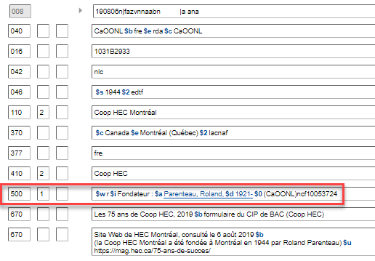
Notes:
Updated: September 17, 2018
Relationship between a corporate body and two persons (its founders) – Relationship designator from Appendix K.

Slide 218
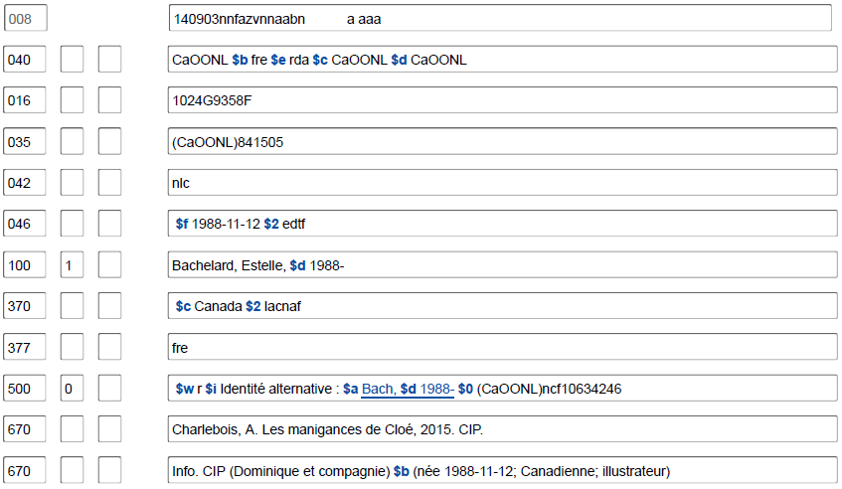
Notes:
Updated: September 17, 2018
Relationship between a person and another person. Relationship designator from Appendix K. NOTE: Appendix K is somewhat limited but will be expanded greatly soon.

Slide 219
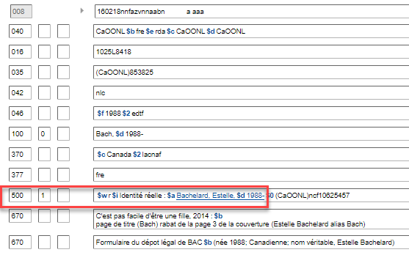
Notes:
Updated: September 17, 2018
Reciprocal record for the same relationship between a person and another person. Relationship designator from Appendix K.

Slide 220
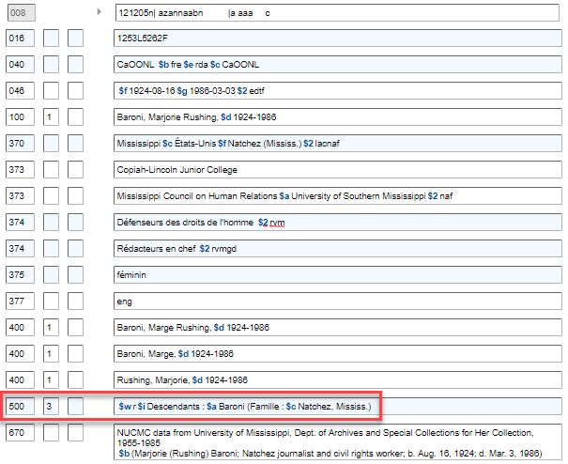
Notes:
Updated: September 17, 2018
Relationship between a person and a family. Relationship designator from Appendix K.

Slide 221
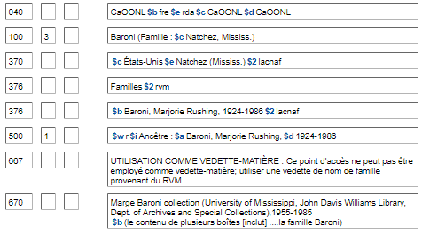
Notes:
Updated: September 17, 2018
Reciprocal record for the previous slide. Relationship between a family and a person. Relationship designator from Appendix K.

Slide 222
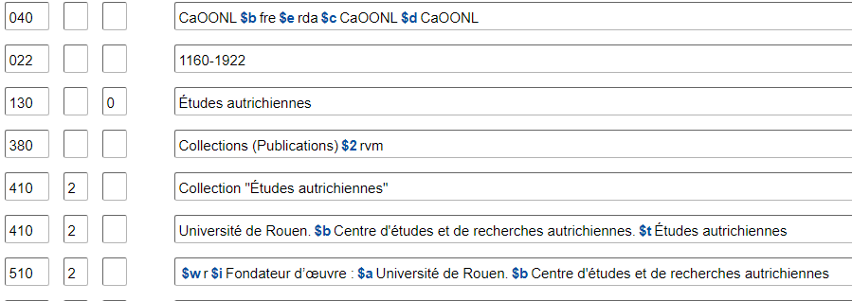
Notes:
November 13, 2019​
​
Relationship between a person and a work. Relationship designator from Appendix I:​
​
founder of work: An agent responsible for establishing a serial, integrating resource, or multipart monograph. ​
Reciprocal relationship: founder of work of. ​
​
​

Slide 223
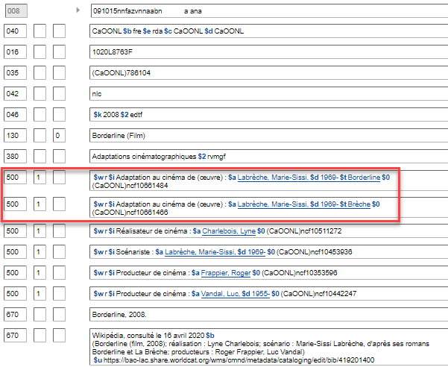
Notes:
November 12, 2019: added blue box and second paragraph of notes​
​
Circled in red: Relationship between a work (the film) and another work (the novel). Relationship designator from Appendix J.​
​
Boxed in blue: Relationship between a work (the film) and three persons associated with the work (the director, screenwriter, and producer). Relationship designators from Appendix I.

Slide 224
Notes:
Updated: September 17, 2018
Relationship between a work (the novel) and another work (the film). Relationship designator from Appendix J.

Slide 225
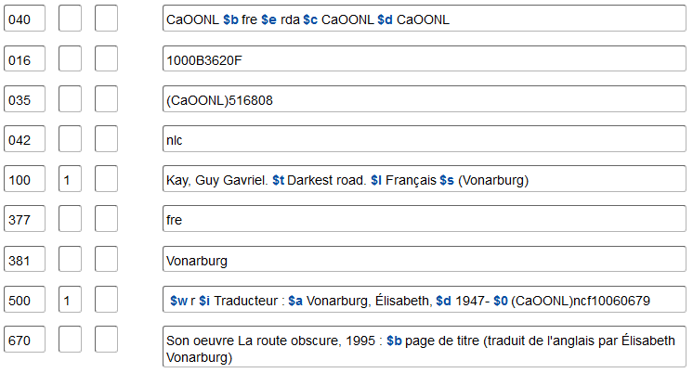
c
Notes:
February 26, 2019: removed reference to the MARC relator terms list​
​
Relationship between an expression and two persons (its translators). Relationship designator from Appendix I.

Slide 226
Notes:
September 17, 2018​
​
Relationship between a work and its subject. Relationship designator from RDA Appendix M.

Slide 227
Notes:
March 5, 2020: new slide​
​
Identifiers may also be added to 5XX fields in OCLC Record Manager when catalogers “validate” a field. The OCLC software adds a subfield $0 in with the authority record control number in these cases. The $0 then serves as a hotlink to the related record that catalogers may click on and view. $0’s added in Record Manager can also be viewed in OCLC Connexion (next slide).

Slide 228
6XX : Notes
667 – Note du catalogueur (RDA 5.9, 8.13)
Destinée aux catalogueurs et non au public
Texte libre, aucun format requis, bien qu’il y ait certaines phrases communes utilisées
Le Guide des autorités de noms présente des exemples représentatifs
Notes:
February 26, 2019: added last bullet point, all speaker notes​
​
Examples from DCM Z1:​
​
667 ## $a Not same as: [name or title, LCCN]. ​
667 ## $a Cannot identify with: [name or title, LCCN]. ​
667 ## $a Reinvestigate before using again. ​
667 ## $a Formerly on undifferentiated name record: [LCCN of undifferentiated name record]. ​
667 ## $a Coded provisional because [reason for coding]. ​
667 ## $a Date of birth removed from all fields per author request, [date updated]. ​
667 ## $a For works issued before/after [date]. (Used for official language changes)​
667 ## $a See also related access points for individual instances of this conference which include specific information about the number, date, or place of the individual conference.​
667 ## $a SUBJECT USAGE: This heading is not valid for use as a subject. Works about this person are entered under [personal name heading].​
667 ## $a SUBJECT USAGE: This heading is not valid for use as a subject. Works about this place are entered under Sri Lanka.​
667 ## $a SUBJECT USAGE: This heading is not valid for use as a subject; use a family name heading from LCSH.​
667 ## $a SUBJECT USAGE: This heading is not valid for use as a geographic subdivision.​
667 ## $a Non-Latin script references not evaluated.​
​

Slide 229
Notes:
August 8, 2019​
​
A common example. The 667 note here explains the reason why the cataloger has coded the record “provisional” in the 008/33 (Level of Establishment).​

Slide 230
Notes:
October 26, 2016​
​
Another common example. The second 667 note is required for NARs that contain non-Latin script 4XX fields.

Slide 231
Notes:
November 13, 2019​
​
“Cannot identify with” is used in a 667 note to record another established name that may or may not represent the same entity, but the cataloger has not been able to identify them definitively as the same entity. As illustrated in this particular example, there are separate NARs for two playwrights named Elizabeth Hart who both published in the 1930s. Because it was not possible to definitively identify them as the same person, two authorities were created, each with a 667 note referring to the other one.

Slide 232
6XX : Notes
670 – Source consultée (RDA 5.8, 8.12)
Comporte les sources d’information utilisées pour enregistrer d’autres éléments dans la description
Utiliser une zone 670 par source
Dans la pratique du PFAN, la première est en général la ressource cataloguée lors de la création de la notice d’autorité
Format suggéré :
670 Titre propre, date : $b emplacement dans la source (données
trouvées)
Notes:
May 1, 2013

Slide 233
6XX : Notes
Pour les sources en ligne, on peut utiliser la sous-zone $u pour établir un lien avec la ressource citée si celle-ci contient des informations importantes qui ne peuvent être citées de manière succincte dans la notice
Ne se substitue pas à l'obligation de citer les données pertinentes en $a et $b des 670 nécessaires pour justifier les 1XX ou 4XX
670 Site Web de Heather Hiestand, consulté le 13 juin 2018 : $b homepage (Heather​ Hiestand) about (née en Illinois; sa famille a migré vers l’Ouest avant qu’elle ne commence l’école; depuis elle considère l’État de Washington comme son lieu de résidence, sauf pour les quelques années qu’elle a passées en Californie; a écrit des romans policiers et du fantastique historique;​ autrice de plusieurs romans, novellas et nouvelles; écrit également sous les pseudonymes Heather Redmond et Anh Leod) $uhttp://heatherhiestand.com/about-heather/​

Slide 235
Notes:
Updated: December 12, 2016
The first and third 670 in this record show how to deal with vernacular if recording nonroman script references (see the 400 field). According to DCM Z1 670, give subfield $a in romanized form. In subfield $b give the information in both the nonroman script form found in the resource followed by an equals sign and the systematically romanized form.

Slide 236
6XX : Notes
La zone 046 ou la zone 3XX, sous-zones $v et $u, peuvent être utilisées comme alternative pour enregistrer une source consultée. Cependant :
Dans la pratique du PFAN, l’information utilisée pour créer le point d’accès autorisé (1XX) ou les variantes de point d’accès (4XX) doit être enregistrée dans la/les zones 670
$v peut être utilisée seule; $u doit toujours être précédée de $v
100 1_ Antonelli, Lou, $d 1957-
Medford (Mass.) $e Mount Pleasant (Tex.) $2 lacnaf $v Site Web de l’auteur, consulté le 19 mars 2015 $uhttp://www.louantonelli.blogspot.com/
Notes:
February 28, 2020: added 046 to first bullet and text from DCM Z1 to speaker notes​
August 8, 2019: revised $v, which should contain the title of the source consulted. Added note in instructor notes.​
​
Note: that when using $v, you do not need to give the location that the information was found. Only the source title, and date of publication (or viewed on date) are necessary.​
​
DCM Z1 670: Information found in online sources may be added to the 046 or 3XX fields with the appropriate citations in subfields $v and $u and not repeated in a 670 when that information is not used in the 1XX or a 4XX.

Slide 237
6XX : Notes
675 – Source des données non trouvée
– Une citation d’une source consultée dans laquelle aucune information ne se trouve liée en aucune manière à l’entité représentée par la notice d’autorité ou aux entités en relation
– Toujours citer la ressource en cours de catalogage si elle ne fournit aucune information relative à l'entité lors de la création de la notice d'autorité
– Utiliser avec discrétion – il n’est pas nécessaire de citer toutes
les sources que vous avez cherchées. Gagner du temps pour les autres en citant les sources que vous pensez que d’autres catalogueurs pourraient tenter de chercher
Notes:
September 17, 2018: In November 2013, DCM Z1 was updated to indicate that field 675 should be used if the item being cataloged provides no information related to the entity represented in the authority record. Previous practice was to use field 670 with the phrase “name not given” or “title not given” in $b. Deleted two slides covering the previous practice.
Speaker: Note that the definition was recently changed to include “related entities” – previously 675 was used to justify 5XX fields. 670 will now be used for this. There is no need to correct the coding of older records, however, although you may if you like.

Slide 238
6XX : Notes
675 – Source des données non trouvée
– Non répétable
– Seulement la sous-zone $a disponible
– Répéter la sous-zone $a pour chaque source
– Séparer chaque sous-zone $a par un point-virgule
675 $a GNIS, 2 février 2013; $a The Columbia gazetteer
of the world, 1998
Notes:
May 1, 2013
Speaker: Note that the definition was recently changed to include “related entities” – previously 675 was used to justify 5XX fields. 670 will now be used for this. However, there is no need to correct the coding of older records, although you may if you like.

Slide 239
Notes:
March 10, 2014
This person has a common name that will likely need differentiating in the future. The cataloger listed likely sources checked for differentiating information such as a birth date so that future catalogers wouldn’t try the same sources again.

Slide 240
6XX : Notes
672 - Titre associé à l'entité
673 - Titre distinct de l'entité
Sous-zone $a = Titre
Sous-zone $b = Reste du titre
Sous-zone $f = Date
Sous-zone $w = Numéro de contrôle de la notice bibliographique
Facultatif, mais utile lorsqu'il peut y avoir confusion sur l'identité du créateur pour des œuvres similaires d'auteurs portant le même nom
Voir MARC 21 et le Guide des autorités de noms pour des informations détaillées
Notes:
March 7, 2019​
​
672: The 672 field may be used to record a title that is related to the entity represented by the 100, 110, 111, or 151 in the name authority record. For example, the field may be used to record titles for which the entity is a creator, contributor, issuing body, or subject. ​
Use of the 672 field does not negate the need to use the 670 field for the title for which the authority record is being created, nor to use the 670 fields to justify information recorded in the 1XX and 4XX such as preferred and variant forms of name.​
Apply the same instructions on non-filing characters in the 245 field to record the number of non-filing characters in the second indicator of the 672 field.​
Subfield $f is used to record a date appropriate to the entity recorded in $a (e.g., use date of work for a preferred title and date of publication for a title proper). Do not use brackets in $f when recording a supplied date of publication or production. Do not give a date of distribution, date of manufacture, or copyright date in $f.​
Subfield $w is used to record bibliographic record control number s (e.g., 001, 010, and 016 fields in bibliographic records). It is recommended that catalogers provide $w when readily available. Subfield $w should only be used with titles for the manifestation record control number. ​
​
673: The 673 field may be used to record a title that is not related to the entity represented by the 100, 110, 111, or 151 in the name authority record. For example, in an authority record for a person, the 673 may be used to record the titles of works written by a different person with a similar name. ​
Use of the 673 field does not negate the need to use the 675 field as described in the 675 section of DCM Z1.

Slide 241
Notes:
March 8, 2019​
​
The 673 fields in this record inform us that the novels Good intentions and Seattle green, both by Jane Adams, are not by this Jane Adams, who is also a novelist and could have been writing in the 1980s.

Slide 242
6XX : Notes
678 – Données biographiques ou historiques (RDA 6.7, 9.17, 10.8, 11.11)
– Enregistrer une brève mention sur la personne, la famille, la
collectivité ou l’œuvre. Cette mention est entièrement en
texte libre, dans vos propres mots, basée sur toutes les
sources que vous avez consultées
– Destinée à être lue par le public
– Format recommandé
[Le nom de l’entité en ordre direct] ([dates si disponibles]) était/est un …
[décrire l’entité]
Notes:
May 1, 2013

Slide 243
Notes:
Updated Nov. 2, 2016

Slide 244
Notes:
Updated Nov. 2, 2016

Slide 245
Notes:
December 12, 2016

Slide 246
Module 1 : Fondements du PFAN
Questions?
Notes:
May 1, 2013

