Slide 1
ISED CHARITABLE CAMPAIGN IN A NUTSHELL

Slide 7
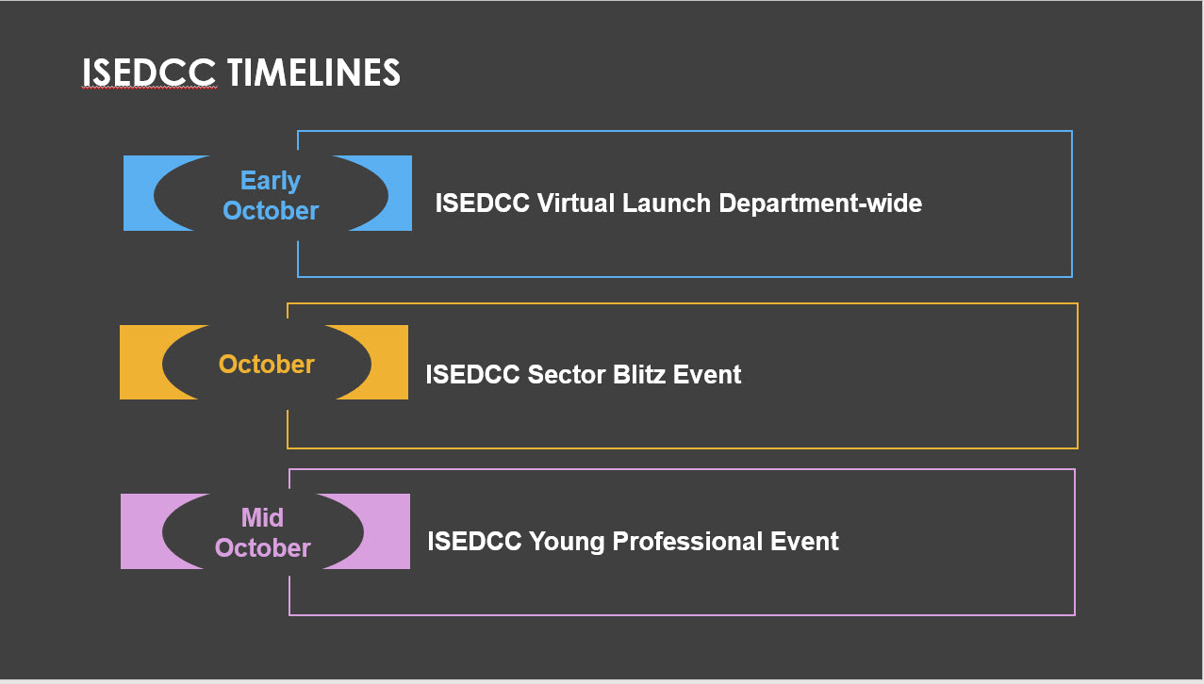

Slide 11
ISED Charitable Campaign (ISEDCC) 2023

