Slide 1
Workplace Transformation Program
Information Session
Accommodations Management & Workplace Solutions, Real Property Services
April 2022

Slide 2
The Workplace Transformation Program
PROGRAM DEFINITION & OBJECTIVES
Current Context
What is the Workplace Transformation Program?
Workplace Transformation Program Process Map
INTERIOR DESIGN & PROJECT METHODOLOGY
What is GCworkplace Design
Workplace Transformation Program Design Elements
Workplace Transformation Program Inclusions
Workplace Transformation Program Design Methodology Overview
SUPPORTING THE EMPLOYEE EXPERIENCE
Success Factors for a Positive Employee Experience
Change Management Approach for the Workplace Transformation Program

Slide 3
Workplace Transformation Program PROGRAM DEFINITION & OBJECTIVES

Slide 4
Current Context For Most Employees…
MARCH
2020
Work = Workplace
Static & Standard
Hierarchical
Individual
Work = Home
Work/Life Balance?
Virtual & Digital
Efficient
UP UNTIL 2020…
LAST 2 YEARS…
Work = Hybrid
Best of Both!
Empowering
Flexible
Mobile
FUTURE OF WORK

Slide 5
Current Context Return to the Workplace
“The Treasury Board of Canada Secretariat continues to support deputies in their transition to hybrid work models, where applicable and operationally feasible.”
- The Honourable Mona Fortier, February 28, 2022 LINK TO FULL STATEMENT
MODERN, UNASSIGNED
THE FUTURE IS FLEXIBLE!
TELEWORK NOT SUPPORTED
FULL FLEXIBILITY & HYBRID WORK*
HOW IT’S ALWAYS BEEN
YOU ARE HERE
TRADITIONAL, ASSIGNED OFFICE SPACE
*HYBRID WORK is a flexible work model that provides a spectrum of work locations and arrangements, typically a balance between home and the office, or any other location such as a GCcoworking site. GCworkplace and the Workplace Transformation Program provide an accelerated workplace solution to support various hybrid work models.

Slide 6
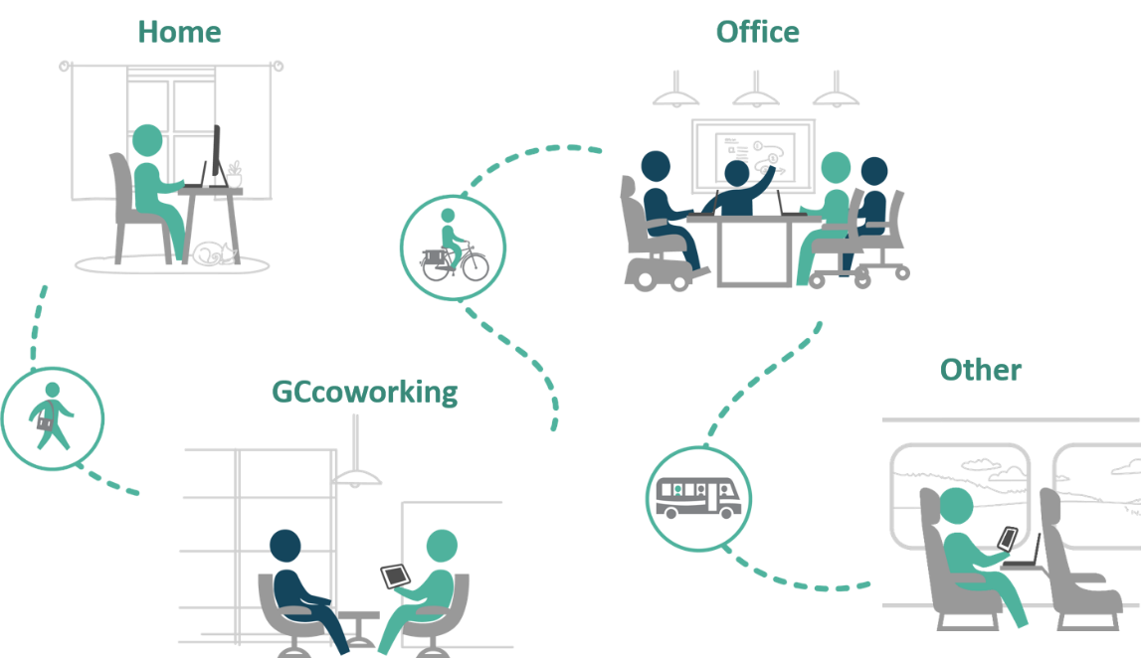
Current Context The Office as Part of an Ecosystem
The Workplace Transformation Program will efficiently provide organizations with a modernized workplace that supports a hybrid working model.
POSITIVE EMPLOYEE EXPERIENCE
6
Notes:
Hybrid working is comprised of an ecosystem of workplaces: Home, Office, Shared spaces like Gccoworking and even other locations.
Change management alongside project management can help create a positive employee experience in all these workplaces using a employee-centric approach.
The Workplace Transformation Program will efficiently provide organizations with a modernized workplace that supports a hybrid working model. Providing a workplace that supports flexibility, collaboration and the new ways of working that contribute to a positive employee experience!

Slide 7
What is the Workplace Transformation Program? Overview
In response to a growing desire for flexibility and agility...
GCworkplace accommodation project, funded by PSPC
“Furniture first” solution
Accelerated delivery
All-inclusive solution in support of modernizing the way we work
Notes:
An office accommodation project based on GCworkplace standards. Designed to deliver activity-based workplaces via furniture-first solutions and repurposing existing constructed elements. The projects are delivered in a shorter timeframe and are more cost-effective than full fit-ups due to simplified scope and standardized processes.
This is an all-inclusive workplace solution developed to support client departments who are looking to quickly provide a modern workplace to their employees in support of a hybrid workforce and the return to the workplace.

Slide 8
What is the Workplace Transformation Program? Project Criteria
Organization and their asset must meet the 4 following criteria:
Project must enable a net reduction in the office space portfolio
Ready and willing client with minimum 50% mobility rate
Asset must have medium to long-term retention strategy in OLTP
Existing space must meet specific requirements & new design must comply to GCworkplace
Notes:
Plan to reduce space
Whether by avoiding acquiring additional space, increasing the density of the population or releasing space one of the objective of Rapid Modernization seeks to achieve some cost savings or avoidance through its implementation.
Client Readiness
The project has to align with the client’s long term vision and strategy. A client has to adhere to the GCworkplace through a written attestation. These will be validated and confirmed by the Change Management Team. More information in the slide attached regarding the required written attestation.
Assets that we want to keep
The assets in which the project is being considered should be identified as a medium-long term (10y) keeper asset and will be validated and confirmed by PAIM. Projects need to demonstrate a clear and tangible portfolio benefit (i.e. release of space) to be considered.
Current Space Design has to be Compatible with Workplace Transformation Program
The project only involves minimal base building work ‒ that being the minimum essential to support GCworkplace principles and design within the office space area. A more in-depth definition can be found in the following slide. To avoid delays, PSPC through a site visit conducted through the guidance of the ID NCOE will validate if the current space is adequate for Rapid Modernization.

Slide 9
What is the Workplace Transformation Program?
Who are Potential Candidates?
Organizations must commit to the following criteria in order to ensure that the workplace will be used as intended as well as be fully adopted by employees:
Support hybrid working (minimum 50% mobility rate)
Remain compliant to GCworkplace Design Standards
Establish a workplace vision and strategic objectives
Assign required resources
Commitment to reduce and optimize space
Measure space utilization and performance
Fund ongoing costs
Notes:
Workplace Transformation projects are to be delivered on an accelerated timeline. Participating organizations must make sure that other key elements that create an employee centric solution are also implemented in the same timeframe. Therefore, organizations must commit to the following criteria in order to ensure that the workplace will be used as intended as well as fully adopted by the employees:

Slide 10
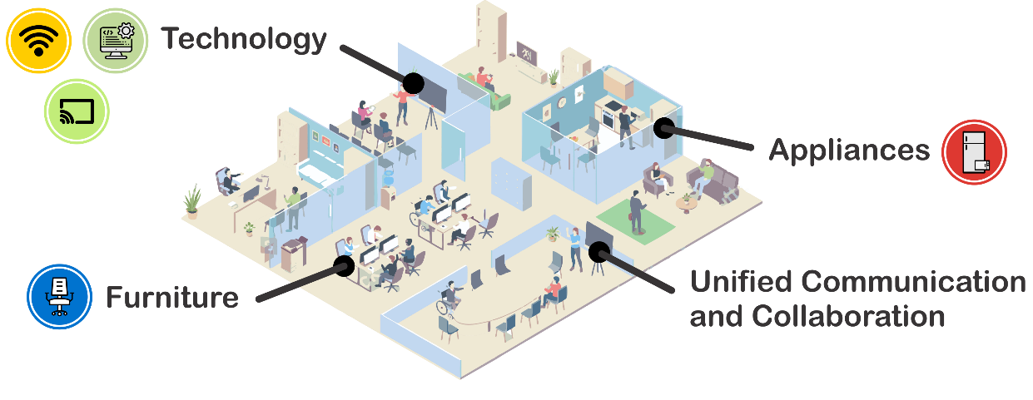
What is the Workplace Transformation Program?
What Will You Get?
A modern GCworkplace
Complete bundle of goods
Advice and guidance from a PSPC workplace strategist and Change management expert
A change management program in-a-box
Interior Design services to assess your requirements and translate your needs into a design solution

Slide 11
What is Included in a Workplace Transformation Project?
new furniture solutions (with re-use of existing furniture deemed re-useable)
refresh of paint and replacement or repair/cleaning of flooring;
accessibility upgrades or refresh of existing kitchenettes and millwork in printer areas;
basic electrical wiring and mechanical changes to support furniture configuration;
installation of Wi-Fi and associated IT cabling as required;
Audio-Visual (A/V) equipment included in the GCworkplace standard bundle of goods;
one time initiation and set up costs associated with the reservation system;
replacement of damaged ceiling tiles;
wayfinding signage related to the GCworkplace; and
minor work required to upgrade existing individual washrooms to comply with All-Access washroom standards if applicable (i.e. replacement of interior fixtures, grab bars, signage, etc.).
minimal base building work*
*If more extensive base building work is required, specific exemptions will need to be sought through governance and rationale be provided as to why it would not better suited as a traditional GCworkplace project
Notes:
^{[1]} If more extensive base building work is required, specific exemptions will need to be sought through governance and rationale be provided as to why it would not better suited as a traditional GCworkplace project
^{[2]} Accessibility upgrades will be evaluated on a case by case basis to determine feasibility. Where extensive, these may be excluded from the scope of the Rapid Modernization Program
^{[3]} Extensive renovations to existing washrooms or installation of new All Access washrooms is excluded from the Rapid Modernization Program of Work

Slide 12
What is the Workplace Transformation Program?
How Can PSPC Support?
You’re not in it alone!
to ensure a successful outcome like any other PSPC-lead real property project…
The
PROJECT
DELIVERY TEAM
to help define a workplace modernization plan for the future of work..
The
STRATEGIC WORKPLACE ADVISORY GROUP
“SWAG”
to help create a great employee experience and ensure the adoption of the new modern workplace…
The
CHANGE MANGEMENT NATIONAL CENTRE OF EXPERTISE
Notes:
In order to equip you with the right tools to define the scope of your workplace transformation program, and prepare employees for this new working environment, our team of experts in workplace strategy and change management will guide you throughout the project to make sure that you are well equipped and supported towards the implementation of the new workplace and its adoption. They will provide you with tools, advice and guidance on:
The
STRATEGIC WORKPLACE ADVISORY GROUP “SWAG”
to help define a workplace modernization plan for the future of work
Provide expert support, advice and guidance to client leadership, accommodations teams and key stakeholders for:
Awareness and education on workplace transformation, trends, return to the workplace, impacts of mobility (telework, hybrid) and future of work
GCworkplace fundamentals;
Assessing readiness, current state and definition of a transformation plan;
Developing a vision and strategic objectives for the WTP project;
Setting up the integrated project team for success;
Development of a workplace modernization plan that reflects the vision;
Ongoing advice and guidance throughout planning and implementation of the WTP program.
The
CHANGE MANGEMENT NATIONAL CENTRE OF EXPERTISE
to help create a great employee experience
Provides expert support, advice and guidance to the assigned client change management resource/team for:
Awareness and education on the importance to change management;
How to get set-up;
Early communication and engagement activities;
Development of a change management program using the newly created WTP Change Management Program in-a-box;
Ongoing change management advice and guidance throughout planning and implementation of the program;
Change adoption and performance evaluation;
Best practices in the creation of a workplace change management program and how to sustain the change.​

Slide 13
What is the Workplace Transformation Program?
How Will it Work?
Once admitted to the program, the project follows a specific process that has been defined to support the speed of delivery.
A condensed methodology for design of the space and change management have been developed.
This process aims to ensure consistency and overall success of the project.
How will the project unfold?

Slide 14
Workplace Transformation Program Process Map
Pre-planning and planning
Implementation
Post-occupancy
Approx. 2-3 months
Approx. 4-12 months (depending on scope)
Approx. 3-12 months months
PROGRAM
Preliminary discussion with clients
WTP Information Session
WTP Townall for employees
WTP Townall for employees
Post-Occupancy Workspace adjustment (if required)
PROJECT
Assignment of a CM resource
PROJECT CHARTER
Design process
Renovation and furniture installation
WORKSPACE DELIVERED
Post-Occupancy Workplace Performance Survey
Lessons learned and post-mortem
DESIGN
FP survey
FP workshop
Design Brief
Concept Plan presentation
CLIENT APPROVAL ON DESIGN
EMPLOYEES READY!!
WORKPLACE STRATEGY
Definition of Project Scope, FoW framework & vision
Sponsorship & Leadership
Client responsibilities supported by PSPC
CHANGE MANAGEMENT
Change management program in-a-box

Slide 15
Workplace Transformation Program INTERIOR DESIGN & PROJECT METHODOLOGY

Slide 16
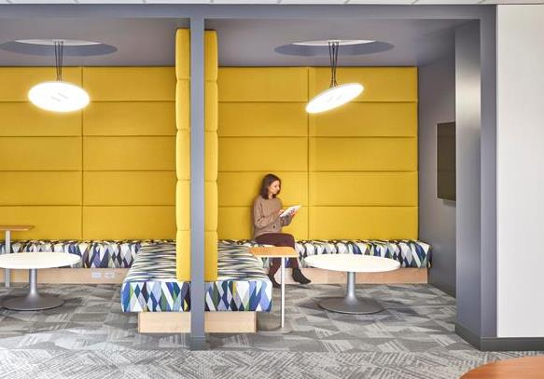
What is a GCworkplace?
A GCworkplace is a modern, efficient and inclusive workplace which responds to the public service workforce’s needs and supports a flexible way of working.
Why an Activity-Based Workplace (ABW) concept?
It is based on the implementation of Activity Based Working (ABW), which is a concept that offers all employees SHARED USE to a VARIETY of workpoints, allowing them to CHOOSE the optimal setting to perform their tasks and functions.
For the user:
Choice and flexibility of where & how to work
Adaptable to personal needs & preferences
Access to a wide range of workpoints and amenities
Accessible and inclusive
Asset management:
Flexibility to suit within the design standard
Eliminates many common tenant service requests
Portfolio:
Optimizes use of space

Slide 17
How is a GCworkplace designed?
Activity Profiles
5 Key Design
Principles
COLLABORATIVE
INDIVIDUAL
AUTONOMOUS WORKPLACE
USER-CENTRIC DESIGN
PROMOTE EQUAL ACCESS
DESIGN FOR ACTIVITIES
ZONE BY FUNCTION
PLAN FOR CHANGE
COLLABORATIVE
INDIVIDUAL
BALANCED WORKPLACE
COLLABORATIVE
INDIVIDUAL
INTERACTIVE
WORKPLACE
ENCLOSED COLLABORATIVE
OPEN COLLABORATIVE
SECONDARY INDIVIDUAL
PRIMARY INDIVIDUAL ENCLOSED

Slide 18
Design Inspiration
The design inspiration for the Workplace Transformation Program is Canada’s Natural Landscapes.
The natural world is full of colors that attract attention, that blend beautifully with its background and create extraordinary displays.
The workplaces delivered through this program will strive to highlight the beauty of our country and the inspiration it provides by showcasing the stunning colors found in nature.
The designs will incorporate imagery of Canadian landscapes, natural colors and materials and deliberate emphasis on consideration of Indigenous design elements.

Slide 19
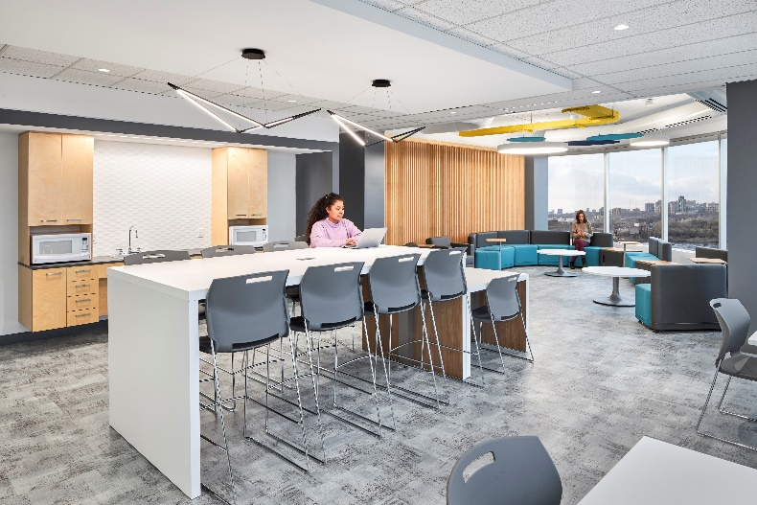
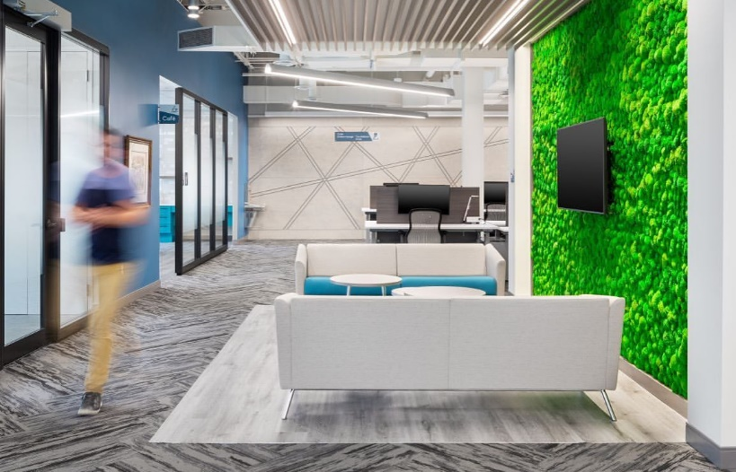
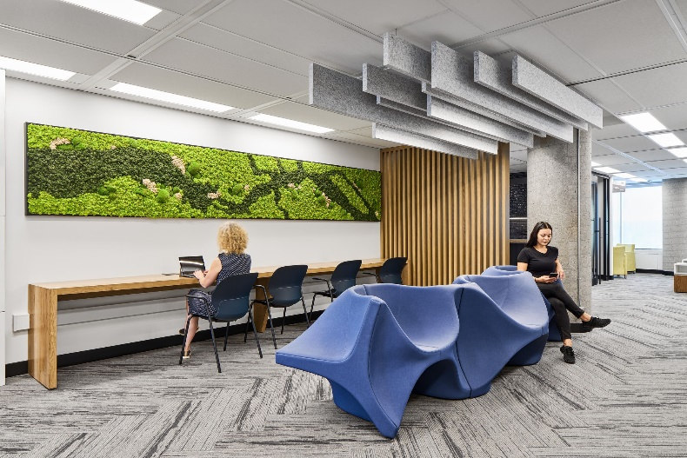
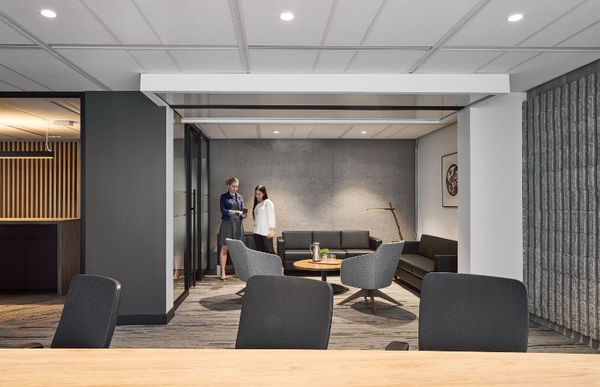
Standard Design Features
A Workplace Transformation strives to deliver a workplace in an accelerated, efficient and effective manner. In order to do so, standardized components and features have been developed to facilitate implementation.
A GCworkplace is recognizable by its standard features:
Typical workpoint configurations (common kit-of-parts)
Functional zones (Quiet, Transitional, Interactive)
Biophilic and sustainable design elements (plants, natural materials)
Indigenous elements and identification (art, land recognition)
Accessible and inclusive design solutions (based on established best practices)
Predefined color schemes (mood boards)
Notes:
Following a standard design approach, Gcworkplaces are designed from a common kit-of-parts, which are the workpoints, following design principles and best practices outlined in the standard
A Gcworkplace becomes recognizable by its standard features, such as:
For efficient, effective repeatable design methodology
which ensures a common look and feel and a consistent user experience in all Gcworkplaces across the country

Slide 20
Indigenous Design Elements
In support of GoC reconciliation commitments, it is important to honour First Nations, Inuit, and Métis communities of Canada by incorporating culturally appropriate design elements and promoting Indigenous economic opportunities.
The goal is for all GCworkplaces to reflect and be representative of Indigenous cultures.
OBJECTIVES
The GCworkplace Indigenous Design Guidelines
As per the Guideline, all Workplace Transformation projects will:
Create a design concept that conveys a strong connection to nature (land, water etc.).
Apply Indigenous design guiding principles such as maximizing access to daylight, views and the connection to the outdoor environment.
Use natural textiles (preferably bio-based) and materials
Focus on locally sourced materials and products
Integrate local indigenous art (when possible) and incorporate a permanent Indigenous Territorial Acknowledgement
*link to Guideline presentation
Allow for Indigenous Peoples to see themselves and their cultures reflected in GoC workplaces;
Provide opportunities for non-Indigenous employees and visitors to be exposed to and learn about Indigenous cultures;
Improve the health and wellness of all by embracing a holistic, natural and sustainable design approach, which celebrates interconnectedness

Slide 21
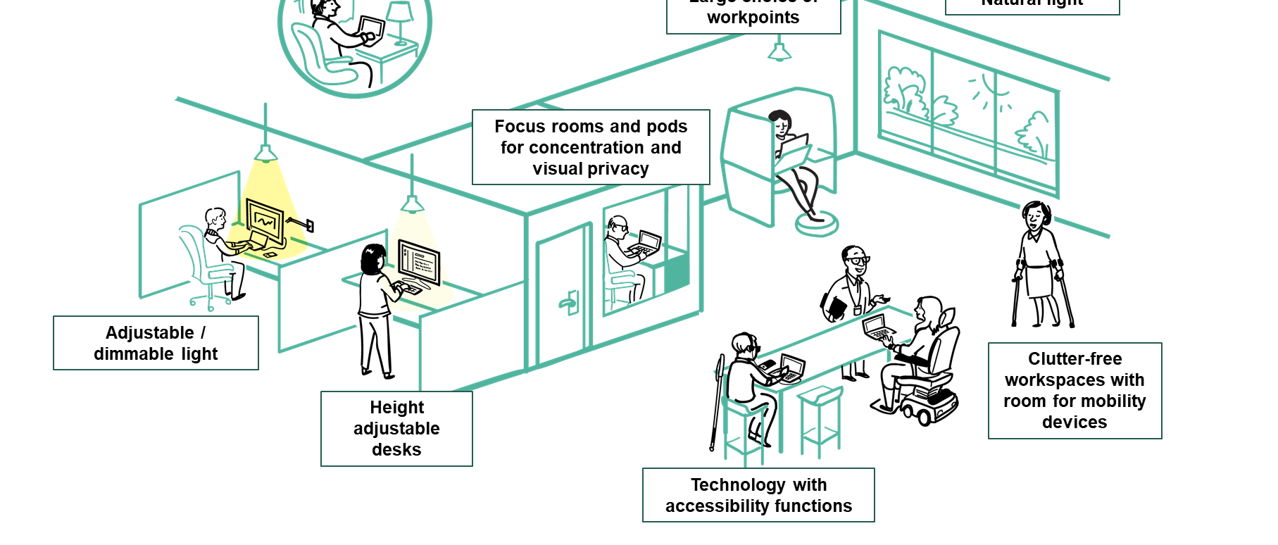
An Accessible and Inclusive Workplace by Design
GCworkplace has been developed to be an accessible and inclusive workplace design standard by providing occupants with full control over the work settings that best suits their functional needs, knowing that we all have different abilities, disabilities and personal preferences.
By integrating accessibility at the onset of the design phase, GCworkplace is promoting an inclusive, equitable and adaptive workplace.

Slide 22
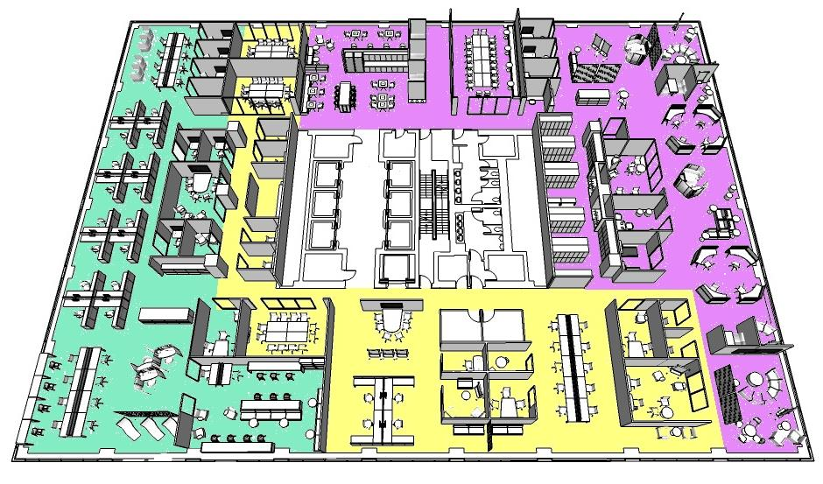
Zoning
GCworkplace is designed in three functional zones – Quiet, Transitional and Interactive - which ensures that activities are grouped together to reducing noise disruptions. Zoning is a key element of inclusive design as it helps manage acoustics, supports concentration and collaboration and provides people choice and control over their work setting.
The Transitional Zone is usually the entrance and serves as a buffer for noise transfer as well as a means to control traffic
Desiging for transitions between zones helps users navigate the space
Visual elements such as screens provide privacy and refuge in the Quiet Zone
Many cognitive impairements are best supported in the this zone
Grouping collaborative workpoints together in the Interactive Zone contains visual and auditory disruptions
QUIET ZONE
TRANSITIONAL ZONE
INTERACTIVE ZONE
Notes:
There are 3 different zones in a GCworkplace
The QUIET Zone, which mainly contains individual workpoints, both open and enclosed, provides the highest level of acoustic privacy
The INTERACTIVE Zone, which contains a mix of open or enclosed collaborative and open or enclosed individual workpoints, provides a space meet, socialize and speak at normal volume
And the TRANSITIONAL Zone is the buffer zone that allows the other two to co-exist.

Slide 23
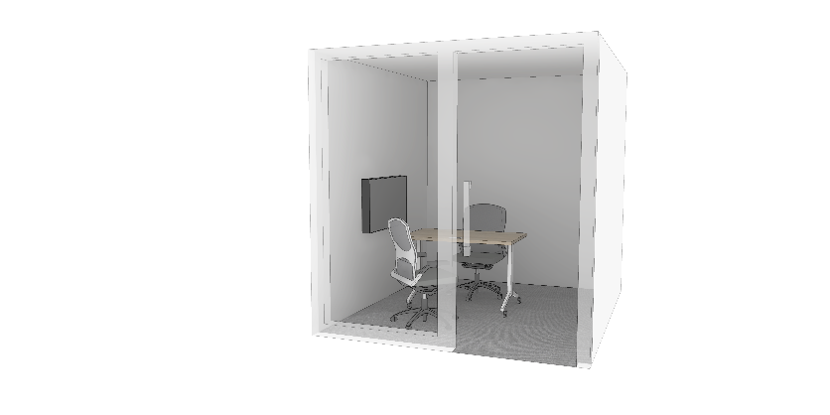
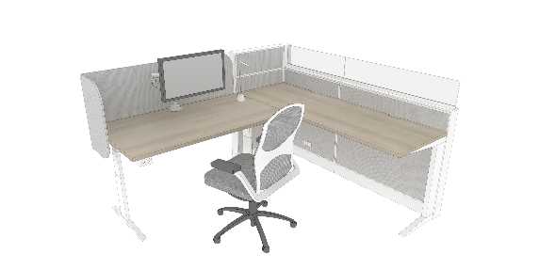
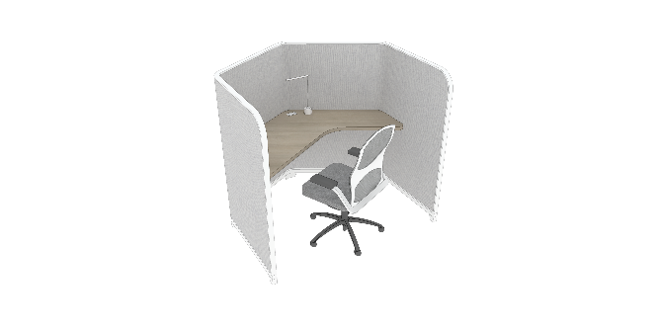
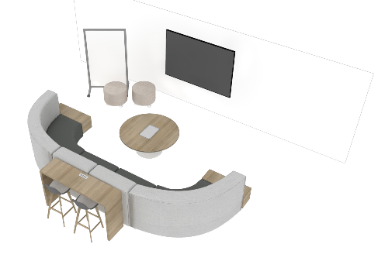
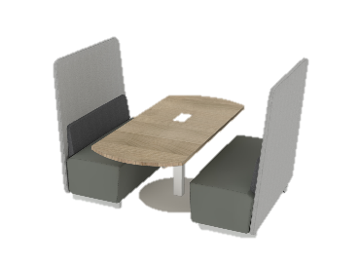
Workpoint Typicals
A key factor to the success and repeatability of the Workplace Transformation approach is a standardized methodology and kit-of-parts. This kit is comprised of standard all-in-one furniture and technology configurations, namely, the workpoint typicals.
For the Rapid Modernization program, select workpoint typicals have been defined in order to expedite the furniture and equipment selection, as well as the procurement process across all projects.
The complete workpoint typicals offering can be found in the Workplace Transformation Workpoint Package.

Slide 24
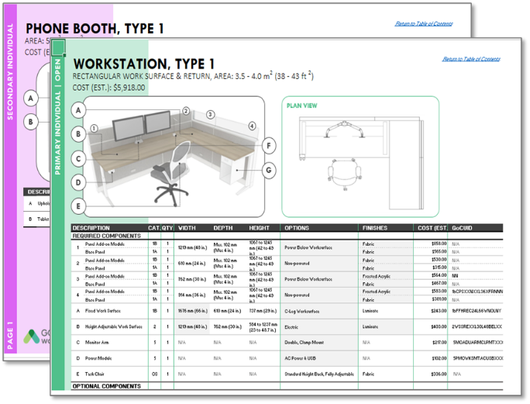
Workplace Bundle of Goods

Slide 25
Design Methodology
Concept Design Process
The program has a specific design methodology including predefined concept design steps. This process aims to ensure consistency, efficiency in delivery, and to clearly communicate the intent with all stakeholders.
Pre-Planning
Client Consultation
Concept Design
STEPS 3a & 3b
STEP 4
STEP 5
STEP 6
Site
Assessment
Test Plan
a. Info Session b. Functional Programming Lite
Mini Design Brief
Concept Plan & Presentation
Client Selections and Approvals
Development of generic test plan
a. Info Session
Brief report outlining results of functional programing lite
Identification of ideal Activity Profile
For client approval
Reflects work required based on results of Step 1
Development of 1 preliminary concept plan
Presentation of plan and mood boards
Revised floor plan is issued for client approval
Feedback collected during workshop
Client selects preferred mood board
Concept plan may be revised once
Client sign-off of approved plan and mood board
Assess site for intervention required and furniture inventory
b. Issue mini functional programming survey
Functional programming workshop
STEP 1
STEP 2
Project Charter
Revised Project Charter

Slide 26
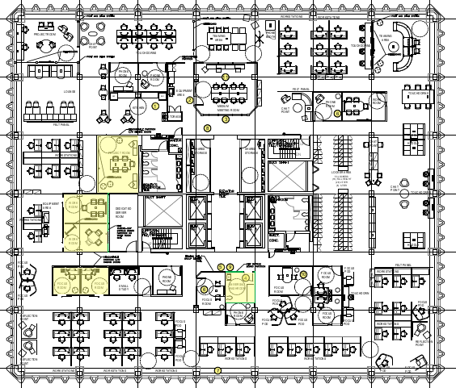
Design Methodology
Step 1 - Initial Site Assessment
Once a site and its tenant have been preliminarily identified as meeting the objectives of the Workplace Transformation Program, an initial site verification will be conducted. During this verification, the condition, quality and quantity of the existing fit-up elements will be assessed for suitability for the Program
SAMPLE
Step 2 - Test Plan
Following the site assessment, a test plan will be developed. This plan will reflect an ideal layout for the workplace based on the findings of the site assessment.
The Test Plan typically applies the Balanced Activity Profile, however, the existing fit-up may affect the Profile selection.
The Plan will also indicate any potential preliminary architectural requirements beyond furniture solutions.

Slide 27
Design Methodology
Steps 3a, 3b & 4 – Client Consultation Process
3a – Workplace Transformation Info Session – NOW
3b – Functional Programming Lite
Functional Programming (FP) survey
Functional specialists to prepare specific requirements for upcoming workshop
FP Workshop to discuss specific requirements & validate survey results.
Information presented will include:
Recommended Activity Profile
Specific workpoint requirements
Specific adjacency requirements
Zoning recommendations
The Test Plan will be used as a visual tool
Step 4 – Mini Design Brief
A report which contains all design requirements and solutions for client approval.

Slide 28
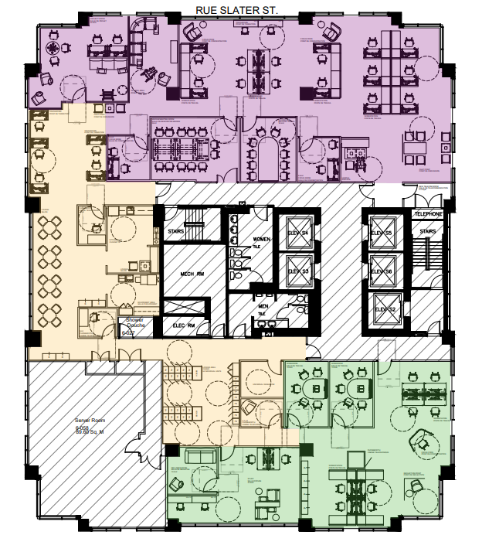
Design Methodology
Step 5 – Concept Plan & Presentation
Based on information gathered during the consultation process, a concept plan for each floor will be developed. The plan is developed based on the ideal workpoint distribution that the GCworkplace Space Planning Workbook defines for the Activity Profile, as well as specific client requirements.
Presentation
The concept plan is presented to the clients during a workshop. The presenter will walk-through the floor plan, explaining the design intent and rationale. The 3 mood boards will be presented for client selection.
Step 6 – Client Selections & Approvals
Clients will be given the opportunity to provide feedback on the concept plan resulting in a maximum of 1 revision for approval.
Clients will also select their preferred mood board which will serve as the basis for the design development.

Slide 29
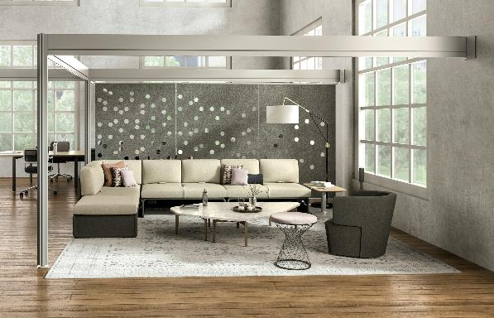
Mood Board 1
Standard Finishes:
Interior Accents:
Cabinetry and tiles
Color palette
Art concept and wall features
Fabrics and textiles
Acoustical solutions and accents
Flooring

Slide 30
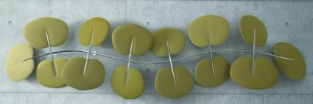
Mood Board 2
Standard Finishes:
Interior Accents:
Cabinetry and tiles
Color palette
Flooring
Fabrics and textiles
Wallpaper and wall murals
Acoustical solutions and planter

Slide 31
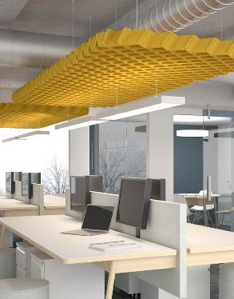
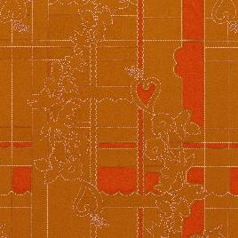
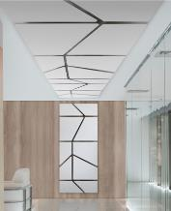
Mood Board 3
Standard Finishes:
Interior Accents:
Cabinetry and tiles
Color pallet
Art and mural inspiration
Fabrics and textiles
Acoustical solutions
Flooring

Slide 32
Workplace Transformation Program SUPPORTING THE EMPLOYEE EXPERIENCE

Slide 33
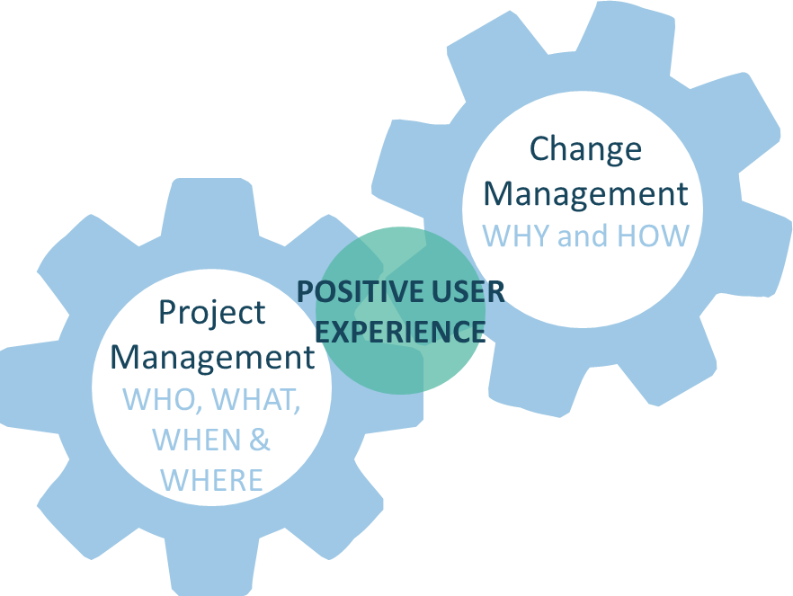
What is change management
Change management is an approach for preparing employees and its leaders to understand and adapt to changes.
Change management is the “people side” of change. It includes activities that will prepare employees in an organization for the transition from the way things are now to a new way of doing things. An integrated solution that focuses on a positive user experience will facilitate the adoption of the new workplace.
It guides and equips the people who will be affected by the change so that the change is successfully adopted.

Slide 34
Why do we need change management?
In the context of this Workplace Transformation Project, the transition towards the future modernized workplace will come quickly! Organizations will want to ensure that all employees will be supported and equipped to transition smoothly towards the future state. They will need to learn new ways of working in a new ecosystem of space supported by new IT tools.
Poorly managed change
Very well managed change
Current
Transition
Future
Current
Transition
Future

Slide 35
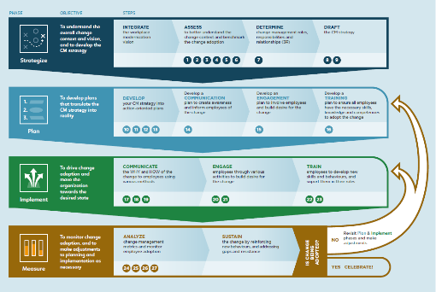
When does change management start?
It starts when the change has been decided. From the moment you first communicate the project and the “WHY” to employees.
Change is decided
Change is managed
Change is adopted
The organization and its leaders are ready to change:
How we work
How we use the workplace
How our business operates
Employees adopt the new workplace, the new ways of working and are competent and satisfied with the workspace and tools

Slide 36
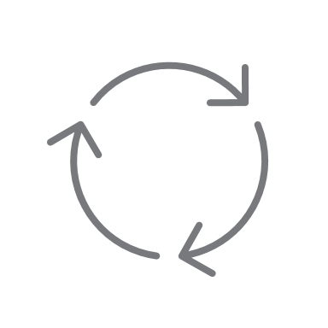
WTP CM program in-a-box
at a glance
Pre-planning and planning
Implementation
Post-occupancy
Approx. 2-3 months
Approx. 4-12 months (depending on scope)
Approx. 3-12 months months
Reinforcement
Communication
(Awareness)
Project kick-off Communication
Townhall
Removal of personal & business assets communication*
Creation of monthly newsletter
Recurring monthly newsletter
Move communication
New ways of working communication
PSPC Project Story Collection
Design Survey Communication
Announce floor plans and mood board
Employee/team recognition
FAQs
Engagement
(Desire)
Removal of personal & business assets*
Creation of change agent network
Recurring monthly change agent meetings
Definition of Community Norms
(Etiquette)
Tour of the new workspace (in-person or video)
Workplace performance survey
(post-occupancy)
Design Survey kick-off
Design engagement activities
Naming boardrooms contest activity
Pre-move Town hall
Hybrid Ribbon-cutting ceremony CELEBRATION!
Training
(Knowledge and Ability)
IM refresher*
Managers Toolkit
Collaborative IT tools training
Move how-to & welcome kit
New AV equipment training
Various ongoing refresher courses
New employee onboarding toolkit
Clean desk refresher*
Managing a hybrid team
New Ways of Working workshop
Booking System training
Ergonomic Refresher
*as required

Slide 37
Getting ready to manage the change
Key success factor for managing change:
Organization has a clearly defined vision and is willing to change and adopt new ways of working
Sponsor and leadership are ready to be engaged, support the change and communicate often
PSPC Change Management National Centre of expertise
A change expert from the Change Management National Centre of Expertise will provide advice and guidance to the assigned client change management resource/team to:
Get set-up
Support to define the employee experience
Direct support on how to customize the tools in the box
Share best practices and how to sustain the change.​
Assign a change management resource(s) for your workplace transformation project to:
Develop and implement a change management program;
Monitor change adoption.
CM Program in-a-box
Notes:
A change management advisor from the PSPC Change Management National Centre of expertise will provide advice and guidance to the client change manager for the duration of the project + 6 months post project delivery. The level of service required will be adapted based on the change readiness of the organization and the change management competency in place.
A generic CM Program in-a-box as been developed to support Workplace Transformation Project is adapted from the Approach of our CM Playbook. It has been condensed and reviewed for the context of the scope of this program to be easily adapted based of the organizational attribute of the organizations and their needs. Some tools available in the CM Playbook have been adapted and pre-populated for the context of this program therefore required less involvement and adaption from the client organization. A workshop approach is proposed to support the client change manager to develop a change strategy based on the level of knowledge and experience of the client change manager.

Slide 38
Ready to embark?
Here are the next steps:
Communicate your firm interest to your PSPC Representative
Gather and share the name of integrated project team who will be involved in the project:
Project Sponsor
Project manager / Accommodation Lead
Representatives from IT, IM, OSH, Security, HR
Change Manager and/or communication officer
Design representative
3. Share your planned mobility rate and anticipated activity profile (if known)
Organize an activity to communicate the project to your employees (in collaboration with PSPC)
Launch the Design survey (in collaboration with PSPC)

Slide 39
Resources
Workplace Transformation GCpedia page - coming soon
GCworkplace/Resources - GCpedia
For more information on the Program, please write to :
TPSGC.SIMilieudeTravailGC-RPSGCWorkplace.PWGSC@tpsgc-pwgsc.gc.ca

Slide 40
Clients commitment for participation in the program
Workplace Transformation projects are to be delivered on an accelerated timeline. Participating organizations must make sure that other key elements that create an employee centric solution are also implemented in the same timeframe. Therefore, organizations must commit to the following criteria in order to ensure that the workplace will be used as intended as well as fully adopted by the employees:
Support hybrid working (minimum 50% mobility rate)
Remain compliant to GCworkplace Standards
Establish a workplace vision and strategic objectives
Assign required resources to actively lead the:
Transformation of key enabling elements and its operations (e.g., IM, IT, Security, culture, business processes, etc.) that will support the adoption of the integrated workspace solution by employees
Development and implementation of change management programs to support employees in the transition and facilitate their adoption of the future workplace.
Use the project to help reduce and optimize assigned space, as part their overall workplace strategy and;
Agree to fund and use a booking system to manage occupancy;
Agree to measure actual utilization and performance, and share results with PSPC;
Agree to fund certain ongoing costs; and
Understand that no swing space will be required.
Clients must provide written attestation of their agreement by signing a project charter
Notes:
Rapid modernization projects are being piloted to be delivered on an accelerated timeline. Participating organizations must make sure that other key elements that create an employee centric solution are also implemented in the same timeframe. Therefore, organizations must commit to the following criteria in order to ensure that the workplace will be used as intended as well as fully adopted by the employees:

Slide 41
Not included in the package Short & Long term
Reservation system application,
ongoing cost & maintenance;
Wi-Fi
Ongoing cost and maintenance;
Building Access
Administer access and security cards with building security;
Providing office supplies, ongoing Wi-Fi costs, security cards or
Audio visual and IT equipment
Provide equipment, A/V equipment not found on site or not available via the bundle of Goods
Furniture and Equipment
Replacement of broken, missing or defective furniture or equipment (should be covered under the warranty);
Decommissioning and disposal of non-repurposed furniture
Health and Safety and emergency
procedures and signage necessary for the occupancy of this floor
Assignment of a “Co-Pro”

Slide 42
Accessibility Best Practices
GCworkplace has been developed to be an accessible and inclusive workplace design standard by providing occupants with full control over the work settings that best suits their functional needs, knowing that we all have different abilities, disabilities and personal preferences. By integrating accessibility at the onset of the design phase, GCworkplace is promoting an inclusive, equitable and adaptive workplace.
Design solutions will contribute to a more accessible and inclusive workplace for all 8 types of disabilities; • seeing, • hearing, • mobility, flexibility or dexterity, • mental health, • sensory/environmental, • cognitive, • intellectual disabilities, and • chronic health conditions or pain.
Design solutions:
Paint (appropriate contrast between carpet, walls and doors/door frame, light switches etc.)
Carpet with appropriate pattern selection, integration of wayfinding via carpet color changes.
Accessible millwork and appliances
Accessible door handles
GCworkplace layout:
Integration of appropriate zoning
Accessible signage and wayfinding elements
Furniture & equipment solutions:
Benches in locker area
Accessible individual workpoints
Accessible collaborative workpoints
Lockers with digital locks with appropriate color contrast
Base-Building Upgrades:
Minor upgrades to washrooms to comply with accessibility standards and All-Access Washroom guidelines when required

