Slide 1
PFAN Programme francophone des autorités de noms
Description des lieux
Module 5
Notes:
(Date of slide or last update given at the top of the notes for each slide)

Slide 2
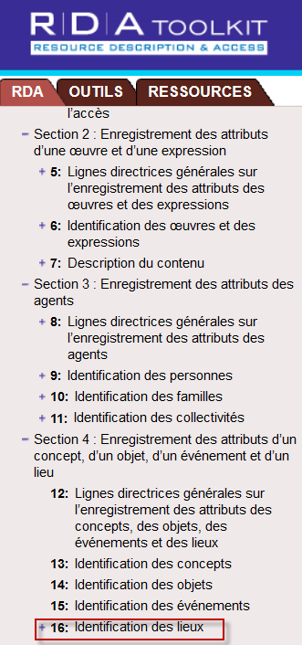
Chapitre 16 de RDA (à utiliser conjointement avec les chapitres 8 et 11)
Notes:
March 21, 2017: updated screenshot, removed reference to Chapter 12 on slide given RDA Toolkit Restructure and Redesign project, revised speaker notes.
Typically, guidelines for describing places in authority records would be found in RDA chapters 12 and 16, but chapter 12 has not been developed, and chapter 16 is not complete. At the present time, chapter 16 only provides general guidelines and instructions on choosing and recording preferred and variant names for places. The only places currently covered are the same kinds of places that were covered by chapter 25 of AACR2, i.e., places that could be considered capable of authorship, or in RDA parlance, places that can be associated with group 1 entities as creators, contributors, etc. of/to works, expressions, manifestations, or items. The section on constructing access points for places is not yet developed in RDA. For names of places used as the names of governments, RDA refers catalogers to chapter 11 (11.2.2.5.4 for the preferred name and 11.13.1.1 for construction of access points). However, there are several LC-PCC Policy Statements for 16.4 that deal with access points for places.
Since all the places we are covering in this module are considered jurisdictions, and jurisdictions are corporate bodies, all of the appropriate guidelines in chapters 8 and 11 apply to them as well as what is in chapter 16. The core elements in chapter 11 apply, and other elements applicable to corporate bodies (e.g., associated place, associated date, associated institution, language of the body, corporate history) can also be recorded for places.

Slide 3
Lieux comme créateurs d’œuvres ou associés à des œuvres
Noms de lieux utilisés le plus couramment comme noms de gouvernements (voir 11.2.2.5.4) et communautés qui ne sont pas des gouvernements (p. ex., quartiers de ville)
Les gouvernements créent des lois, des constitutions, des règlements, etc.; signent des traités; ont des fonctionnaires et des employés; ont des cadres subalternes et législatifs et des corps judiciaires; produisent des rapports et des énoncés de positions; créent des ressources cartographiques; ont des règles de tribunaux; etc.
Les dignitaires gouvernementaux créent des communications officielles
Notes:
May 1, 2013
19.2.1.1.1 lists the cases in which corporate bodies (including governments and governmental bodies) are considered to be creators. 19.2.1.1.2 details when government and religious officials are considered to be creators. The names of places are used to represent a government as a corporate body, and form the first part of the authorized access points for government bodies recorded subordinately, including some government agencies, legislative bodies, courts, armed forces, and government officials (heads of state, heads of government, or ruling executive bodies), embassies, consulates, etc., and delegations to international or intergovernmental bodies.

Slide 4
Exercices
Point d’accès autorisé
RDA : Côte d’Ivoire
Notes:
May 1, 2013
19.2.1.1.1 lists the cases in which corporate bodies (including governments and governmental bodies) are considered to be creators. 19.2.1.1.2 details when government and religious officials are considered to be creators. The names of places are used to represent a government as a corporate body, and form the first part of the authorized access points for government bodies recorded subordinately, including some government agencies, legislative bodies, courts, armed forces, and government officials (heads of state, heads of government, or ruling executive bodies), embassies, consulates, etc., and delegations to international or intergovernmental bodies.

Slide 5
Point d’accès autorisé RDA : Utah
Notes:
May 1, 2013
ANIMATED SLIDE
This work is a directory of Utah state employees. The creator is the state of Utah.
110 1_ Utah.
245 10 Utah state directory of employees.
[Source: Utah.gov: http://web.state.ut.us/phone.htm]

Slide 6
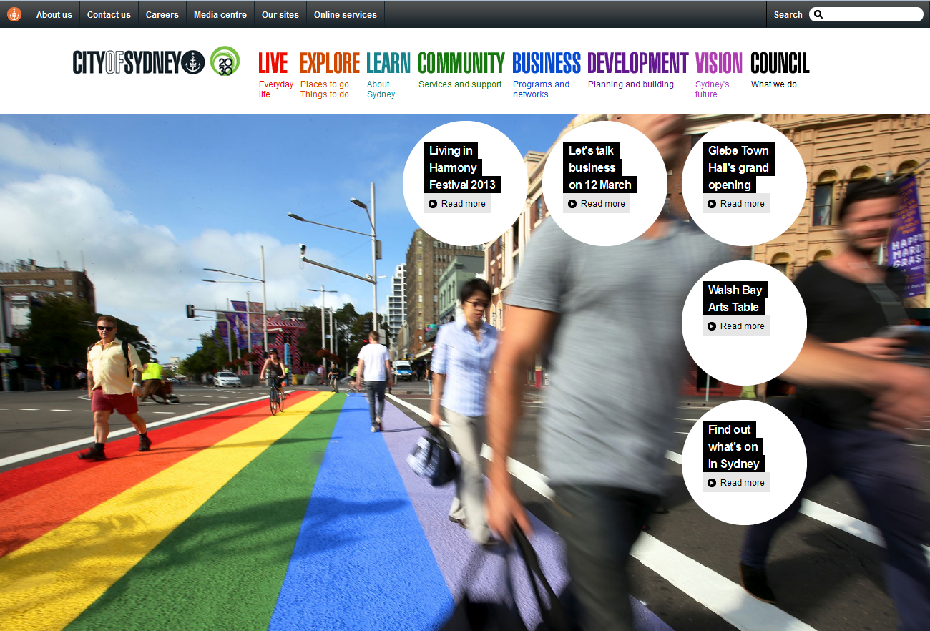
Point d’accès autorisé RDA : Sydney (N.-G. du S.)
Notes:
May 1, 2013
ANIMATED SLIDE
This work is the website of the city of Sydney, New South Wales, Australia. The creator is Sydney (N.S.W.).
110 1_ Sydney (N.S.W.)
245 10 City of Sydney.
[Source: City of Sydney website: http://www.cityofsydney.nsw.gov.au/]

Slide 7
Point d’accès autorisé RDA : Tulsa (Okl.). Mayor’s Commission on the Status of Women
Notes:
May 1, 2013
ANIMATED SLIDE
This is the website of the Tulsa, Oklahoma Mayor’s Commission on the Status of Women. Here we have an example of a government body that would be recorded subordinately. The first part of the name of this agency would be the authorized access point for Tulsa, Oklahoma, which would be followed by the name of the commission:
110 1_ Tulsa (Okla.). $b Mayor’s Commission on the Status of Women
If there was no authority record already created for the place, it would have to be created as a separate NAR at the same time as the NAR for this agency.
[Source: https://www.cityoftulsa.org/community-programs/human-rights/commissions/mayor's-commission-on-the-status-of-women.aspx]

Slide 8
Point d’accès autorisé RDA : Brésil
Notes:
August 13, 2019
ANIMATED SLIDE
An example of a legal work created by a government (Brazil).
110 1_ Brazil, $e enacting jurisdiction.
240 10 Constituição (1988)
245 10 Constituição da República Federativa do Brasil : $b texto constitucional promulgado em 5 de outubro de 1988, com as alterações determinadas pelas Emendas Constitucionais de Revisão nos 1 a 6/94, pelas Emendas Constitucionais nos 1/92 a 91/2016 e pelo Decreto Legislativo no 186/2008.
[Source: Senado Federal Biblioteca Digital website: https://www2.senado.leg.br/bdsf/bitstream/handle/id/518231/CF88_Livro_EC91_2016.pdf]

Slide 9
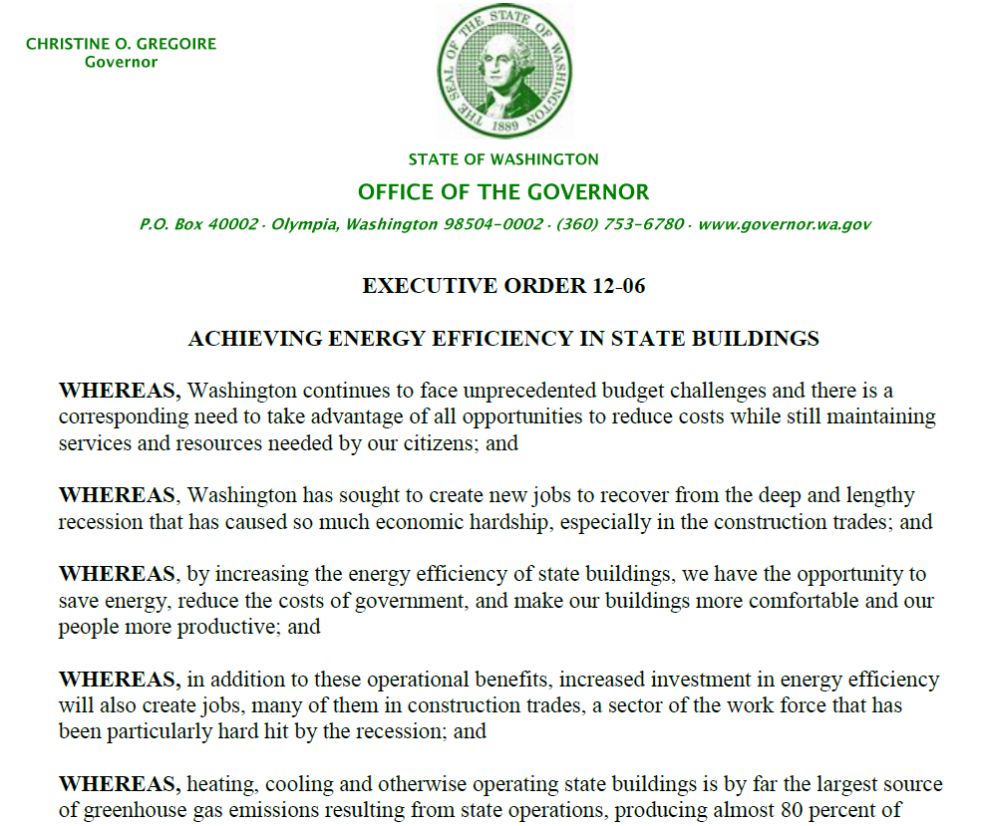
Point d’accès autorisé RDA : Washington (État). Gouverneur (2005-2013 : Gregoire)
Notes:
May 1, 2013
ANIMATED SLIDE
An example of an official communication - in this case, an executive order of the Governor of Washington State. This is another example of a body that would be recorded subordinately under the name of the government:
110 1_ Washington (State). $b Governor (2005-2013 : Gregoire)
245 10 Executive order 12-06 : $b achieving energy efficiency in state buildings.
[Source: Washington State Office of the Governor: http://www.governor.wa.gov/execorders/eo_12-06.pdf]

Slide 10
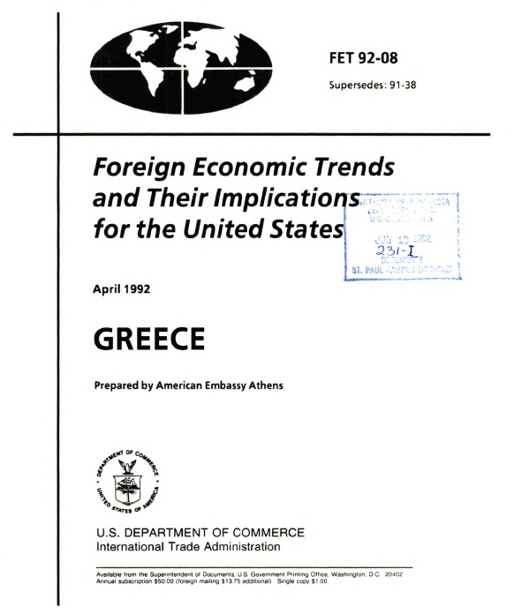
Point d’accès autorisé RDA : États-Unis. Embassy (Grèce)
Notes:
May 1, 2013
ANIMATED SLIDE
An example of an embassy as creator, another type of body that is recorded subordinately:
110 1_ United States. $b Embassy (Greece)
Statement of responsibility reads: “Prepared by American Embassy Athens”
[Source: HathiTrust: http://babel.hathitrust.org/cgi/pt?id=umn.31951d002879490]

Slide 11
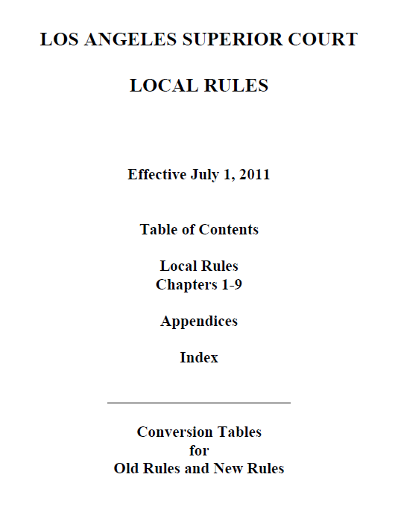
Point d’accès autorisé RDA : Californie. Superior Court (Los Angeles : Comté)
Notes:
May 1, 2013
ANIMATED SLIDE
An example of court rules, a form of legal work. The creator is the court, which is established as a subordinate body under the name of the California government:
110 1_ California. $b Superior Court (Los Angeles County)
[Source: Los Angeles County Bar Association website: http://www.lacba.org/Files/Main%20Folder/CourtNotices/files/LASC_Local_Rules_Effective_July_1_2011.pdf]

Slide 12
Lieux comme contributeurs, etc.
Les gouvernements et les collectivités gouvernementales peuvent
être contributeurs à une expression ou peuvent être associés à des
manifestations ou des items comme c’est le cas, par exemple, des :
– Interprètes (p. ex., musique militaire)
– Éditeurs; distributeurs
– Imprimeurs
– Producteurs de ressources non publiées
– Distributeurs
– Propriétaires (p. ex., les bibliothèques gouvernementales et musées)
Notes:
May 1, 2013
In addition to these, there are many other ways places can be related to works, expressions, manifestations, or items.

Slide 13
Point d’accès autorisé RDA : États-Unis. Embassy (Tanzanie)
Notes:
May 1, 2013
ANIMATED SLIDE
An example of a government body as a contributor: “based in part on information provided by the U.S. Embassy in Tanzania”
110 1_ United States. $b Embassy (Tanzania)
[Source: HathiTrust: http://babel.hathitrust.org/cgi/pt?id=umn.31951003049783y]

Slide 14
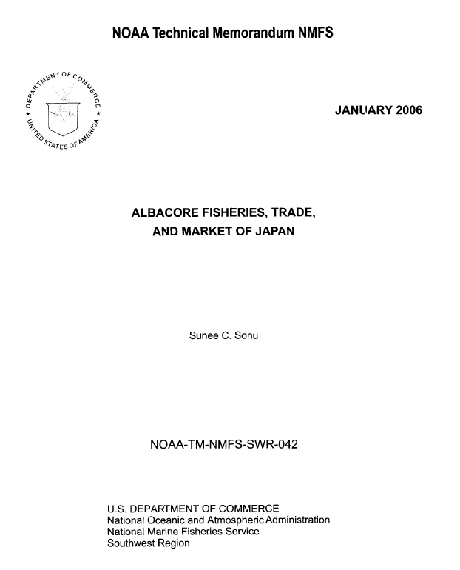
Point d’accès autorisé RDA : États-Unis. National Marine Fisheries Service. Southwest Region
Notes:
May 1, 2013
ANIMATED SLIDE
An example of a government body as a publisher (manifestation relationship): U.S. Department of Commerce, National Oceanic and Atmospheric Administration, National Marine Fisheries Service, Southwest Region.
110 1_ United States. $b National Marine Fisheries Service. $b Southwest Region
[Source: Southwest Fisheries Science Center website: http://swfsc.noaa.gov/publications/TM/SWR/NOAA-TM-NMFS-SWR-042.PDF]

Slide 15
Lieux comme sujets
Les lieux sont couramment les sujets d’œuvres
Subject Headings Manual H 405 : Name vs. Subject Authority File
DCM Z1 Appendix 1 : Ambiguous Entities
Groupe un : Les entités sont toujours établies selon les conventions de catalogage descriptif. Les notices d’autorité sont toujours comprises dans le fichier d’autorité de noms
Aires de conservation
Anciennes juridictions (autres que les villes)
Collectivités nouvelles
Comarques
Communautés
Communes
Districts de parcs, districts de services publics, districts des eaux, districts forestiers, districts récréatifs, districts sanitaires
Installations militaires (actives; y compris celles après 1899)
Pueblos
Quartiers de ville
Régions minières
Tribus indiennes des É.-U./Premières Nations du Canada (comme gouvernements/juridictions)
Tous les exemples ont la zone 151 pour étiquette dans les notices d’autorité de nom
Notes:
Updated: Nov. 14, 2016
ANIMATED SLIDE
The Subject Headings Manual H 405 and the DCM Z1 Appendix 1 provide guidance on whether certain entities are established as name authorities through NACO or subject authorities through SACO. Group One entities are always established as name authorities. This slide lists those ambiguous entities that are tagged as 151 geographic access points in the name authority file. For any entity falling into Group One, follow RDA and the LC-PCC PS’s to establish its authorized access point.
Note: Do not confuse “group one” and “group two” entities as described in the Subject Headings Manual and DCM Z1 with the FRBR group 1, 2, and 3 entities. The groups we are talking about here in this module are solely for the purposes of deciding whether an entity is established according to descriptive (RDA) or subject (LCSH) rules and whether it should be a name authority record in the LC/NACO Authority File or an LCSH subject authority record.

Slide 16
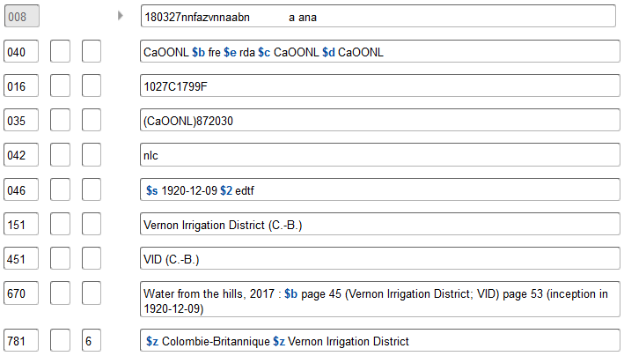
Exercices
Entité géographique du groupe 1
Notes:
May 1, 2013
An example of an ambiguous entity that is included in Group 1 in The Subject Headings Manual H 405 and the DCM Z1 Appendix 1, and which is coded as a geographic place in the LC/NACO Authority File. The 010 prefix beginning with “n” indicates that this is a name heading, and the coding in the 008/10 (Rules) combined with 040 subfield $e “rda” identify it as an RDA record. Many (but by no means all) types of districts are treated as geographic entities and established in the LC/NAF. When in doubt, consult the list of ambiguous entities and inquire with the Cooperative Programs Section at LC if necessary.

Slide 17
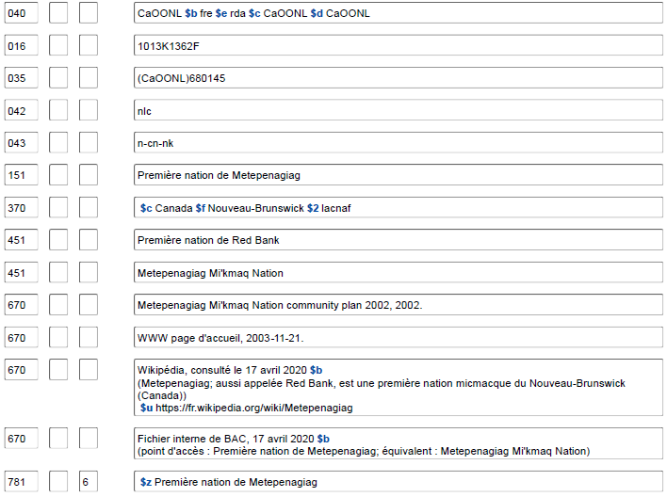
Entité géographique du groupe 1
Notes:
Updated: Feb. 24, 2014
Another group 1 entity: U.S. Indian tribes

Slide 18
Lieux comme sujets
Groupe deux : Les entités sont toujours établies selon les conventions de catalogage matière. Les notices d’autorité sont comprises soit dans le fichier d’autorité de noms ou dans le fichier d’autorité de vedettes-matière.
Aqueducs
Canaux
Cimetières (Sites archéologiques)
Colonies de vacances
Concessions de terres
Dépôts de déchets dangereux
Domaines (Lieux géographiques)
Écluses
Entités astronomiques (astéroïdes, comètes, galaxies, planètes. etc.
Exploitations agricoles
Forêts
Forteresses
Îles qui ne sont pas des juridictions
Installations militaires (avant 1900 et inactives)
Jardins
Lieux historiques (y compris les quartiers historiques hors des villes)
Mines
Parcs (Entités géographiques)
Parcs d'attractions
Pipelines
Places publiques
Ponts
Ports (Installations physiques)
Quais
Ranchs
Routes
Terrains de golf
Terrains de jeux
Villes disparues (avant 1500)
Notes:
March 21, 2017: updated speaker notes to spell out “Hdgs.” in 667.
The Subject Headings Manual H 405 and the DCM Z1 Appendix 1 provide guidance on whether certain entities are established as name authorities through NACO or subject authorities through SACO. Group two entities are established according to subject cataloging conventions in the Subject Headings Manual. Their authority records may reside either in the LC/NACO Authority File or in LCSH. The slide lists some of the ambiguous entities that are in group two and tagged as 151 geographic. Consult SHM H 405 for the complete list.
DCM Z1: Appendix 1: Ambiguous Entities
If a group two entity is needed as a descriptive access point create a name authority record according to subject cataloging rules. Add a 667 note to the NAR with the statement “Subj. Headings Manual/RDA”. If a Group 2 Heading for the same entity exists in the LCSH Authority File create an NAR (cf. DCM Z1 Appendix 1: Ambiguous Entities, Section 3.1) and send a notification to saco@loc.gov to delete the existing subject authority record.

Slide 19
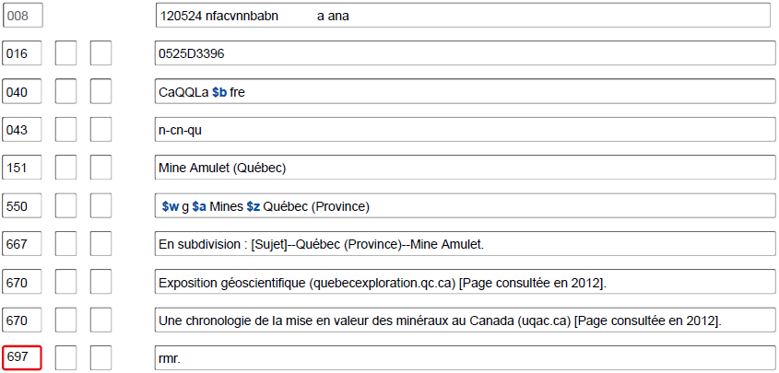
Entité géographique du groupe 2 nécessaire comme vedette-matière
Notes:
À noter qu'il s'agit d'une notice du RVM et qu'elle présente une pratique différente dans l'indication de la forme de la subdivision (667 plutôt que 781).
September 17, 2018
An example of a group 2 heading that was needed as a subject, and established in the subject authority file - note the LCCN prefix of “sh” rather than one beginning with “n”. The 008/10 (Rules) is coded “n” for “not applicable” (since no descriptive cataloging rules were used to formulate this heading). Note also the presence of a broader topical subject term (550), found only in subject authority records.
In case anyone inquires further:
008/10 Descriptive cataloging rules code
Represents the cataloging rules used for establishing the name, name/title, or uniform title heading in the 1xx field.
The possible values are:
a Earlier rules
b AACR1
c AACR2
d AACR2 compatible heading
n Not applicable
z Other

Slide 20
Aperçu du codage MARC pour les autorités
Les lieux sont codés dans les X51 dans les notices d’autorité
– Excepté lorsque la juridiction correspond à la première partie du point
d’accès d’une collectivité subordonnée ou d’une œuvre/expression :
dans ce cas
X10 1_
151 Manitoba
mais
110 1_ Manitoba. $b Department of Education
110 1_ Manitoba. $t Highway Traffic Act
• Les deux indicateurs dans les X51 contiennent un blanc
• Tout comme avec les autres notices d’autorité, les notices RDA pour les
lieux sont codées « z » dans 008/10 (« Règles de catalogage descriptif ») et « rda » dans la sous-zone $e de la 040
Notes:
May 1, 2013
NAR for jurisdiction:
151 Manitoba
NAR for subordinate unit of Manitoba:
110 1_ Manitoba. $b Department of Education
110 1_ Manitoba. $b Legislative Assembly
NAR for work/expression created by Manitoba:
110 1_ Manitoba. $t Highway Traffic Act
110 1_ Manitoba. $t Laws, etc. (Statutes : 1871)
110 1_ Manitoba. $t Laws, etc. (Statutes : 1871). $l French

Slide 21
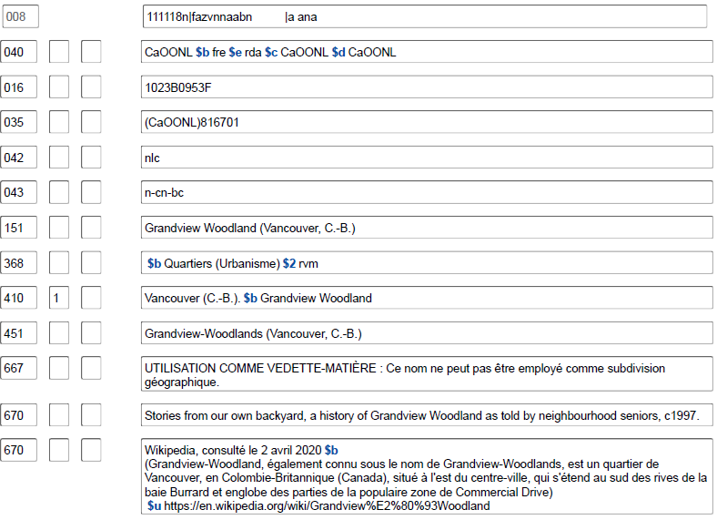
Notes:
May 1, 2013
Another example of an RDA geographic name authority, in this case for a neighborhood in Vancouver, British Columbia. Note the tagging in the authorized access point is 151. The 010 prefix beginning with “n” indicates this is a name authority record, and the combination of codes in 008/10 (Rules) and 040 subfield $e indicate that this is an RDA record.

Slide 22
Aperçu du codage MARC pour les autorités
Dans les notices bibliographiques :
la zone 151 dans les autorités devient
110 1_ ou 710 1_ pour les points d’accès
651 _6 pour les vedettes-matière (et non 610 16)
Notes:
May 1, 2013

Slide 23
Notice d’autorité RDA Notices bibliographiques RDA
040 CaOONL $b fre $e rda $cCaOONL
151 Zambie
451 Republic of Zambia
451 Sambia
451 Zanbia
451 Saambiya
451 Замбія
551 Rhodésie du Nord
...
781 _0 $z Zambie
110 1_ Zambie, $e juridiction promulgatrice
240 10 Constitution (1996)
245 10 Constitution of the Republic of Zambia.
100 1_ Kaela, Laurent C. W., $d 1950- $e auteur.
245 10 Zambia national governance baseline survey : $b report / $c prepared for the Government of the Republic of Zambia by the Department of Political and Administrative Studies, University of Zambia ; Laurent C.W. Kaela, lead consultant.
651 _6 Zambie $x Politique et gouvernement
710 1_ Zambie.
710 2_ University of Zambia. $b Department of Political and Administrative Studies, $e auteur.
Notes:
March 4, 2020: updated notes
Example showing how the 151 in the authority record becomes 110, 651, and 710 in bibliographic records.
In the second bibliographic example, the first 710 is lacking a relationship designator. This is because there is currently no appropriate relationship designator available in RDA I.2.2 (Relationship Designators for Other Persons, Families, or Corporate Bodies Associated with a Work) to describe this particular type of relationship (“prepared for the Government of the Republic of Zambia”). PCC participants may suggest new relationship designators for RDA by filling out a form on the PCC website (http://www.loc.gov/aba/pcc/scs/RD-Requests.html), which will then be reviewed by the PCC Standing Committee on Standards. If the Standing Committee approves the proposal, it will forward it to the ALA representative to the RSC for submission as a fast track proposal.

Slide 24
Exercices
Codage MARC
Notes:
May 1, 2013

Slide 25
Parmi les points d’accès suivants, quels sont ceux qui seraient incorrectement codés dans une notice d’autorité?
151 Missouri
110 1_ Las Vegas (Nev.). $b Office of Business Development
151 Emerald People's Utility District (Or.)
410 2_ Republic of Botswana
410 1_ Government of Belize
151 Canada. $b Ambassade (France)
410 2_ N.S.W.
110 2_ Toronto Board of Education
151 Ontario International Airport (Calif.)
110 2_ Public Utility District No. 2 of Grant County (Wash.)
451 Chicago (Ill.). $b Wrigleyville
151 Anchorage School District (Alaska)
151 Algérie (Gouvernement provisoire, 1958‐1962)
Notes:
August 13, 2019
ANIMATED SLIDE
The incorrectly coded ones are:
410 2_ Republic of Botswana - should be 451
410 1_ Government of Belize - should be 451
151 Canada. $b Embassy (France) - should be 110 1_
410 2_ N.S.W. - should be 451
151 Ontario International Airport (Calif.) - should be 110 2_ - airports are not treated/coded as geographic places unless they are military installations (air bases)
110 2_ Skagit Soil Conservation District (Wash.) - should be 151
451 Chicago (Ill.). $b Wrigleyville - should be 410 1_
151 Anchorage School District (Alaska) - should be 110 2_ - school districts are not treated/coded as geographic places
In case anyone asks, there is also a place in Kentucky named Anchorage, so that may be the reason the Anchorage School District was qualified by (Alaska).

Slide 26
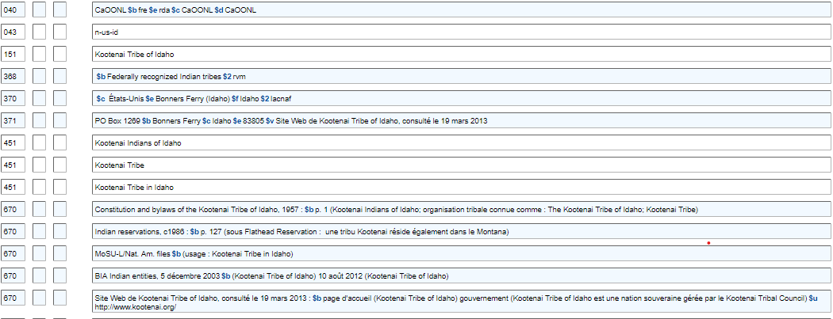
En se basant sur cette notice d’autorité de nom…
Notes:
Updated: Feb. 24, 2014

Slide 27
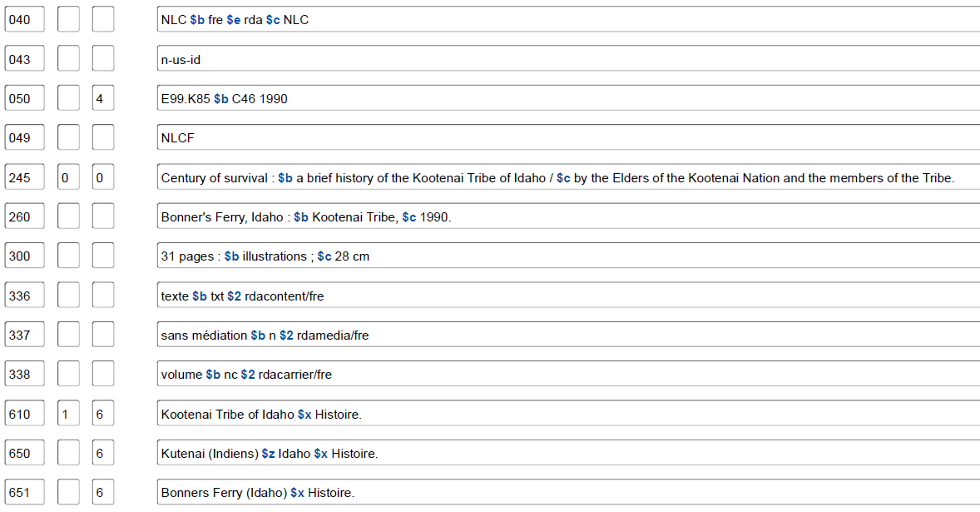
... Y a-t-il quelque chose qui cloche avec le codage MARC dans cette notice bibliographique?
Notes:
May 1, 2013
The NAR on the previous slide shows that this entity is a geographic place/jurisdiction, tagged 151. In the bibliographic record, the 610 10 should be 651 _0. The 710 first indicator should be a 1, for a corporate body jurisdictional access point.

Slide 28
Nom privilégié d’un lieu
RDA 16.2.2
Nom ou forme de nom choisie pour identifier un
lieu.
Le nom privilégié sert :
• de nom conventionnel à un gouvernement, etc.,
• d’ajout à un nom d’une famille, de collectivité, de congrès, etc., ou d’œuvre,
• à enregistrer un lieu associé à un agent ou à une œuvre.
Notes:
March 21, 2017: updated to reflect current RDA language.
December 12, 2016. Language updated to reflect current RDA language; “work” added to third bullet point, since place of origin of the work is an element of the work entity (RDA 6.5)

Slide 29
Sources pour le nom privilégié (RDA 16.2.2.2)
Sources (en ordre de préférence)
a) répertoires géographiques et autres sources de référence dans une langue privilégiée par l’agence créant les données
b) répertoires géographiques et autres sources de référence publiés dans la juridiction où le lieu est situé dans la ou les langues officielles de cette juridiction
Notes:
May 1, 2013
Read RDA 16.2.2.2-16.2.2.3 together.

Slide 30
ÉP de BAC-BAnQ pour 16.2.2.2
Canada : Se fonder sur la forme trouvée sur le site Web de la Base de données toponymiques du Canada (BDTC) de Ressources naturelles Canada : http://www4.nrcan.gc.ca/recherche-de-noms-de-lieux/search? et Recherche de noms : http://www.rncan.gc.ca/sciences-terre/geographie/noms-lieux/recherche/9171
Québec :
Municipalités : se fonder sur la forme trouvée dans les sources suivantes (dans cet ordre de préférence) :
1. le Répertoire des municipalités du Québec : http://www.mamrot.gouv.qc.ca/repertoire-des-municipalites
2. la Banque de noms de lieux du Québec : http://www.toponymie.gouv.qc.ca/ct/accueil.aspx
3. d’autres sources de référence
4. la manifestation cataloguée
Lieux autres que les municipalités : se fonder sur la forme trouvée dans la Banque de noms de lieux du Québec : http://www.toponymie.gouv.qc.ca/ct/accueil.aspx

Slide 31
ÉP de BAC-BAnQ pour 16.2.2.2
Pour les pays suivants, se fonder sur la forme trouvée dans les sources suivantes (dans l’ordre de préférence indiqué) si des sources en anglais doivent être consultées
Pays | Sources
Australie | VIAF Geoscience Australia Place Name Search
États-Unis | Fichier LC Geographic Names Information System (GNIS)
Grande-Bretagne | Fichier LC The Ordnance Survey gazetteer of Great Britain ou GEOnet Names Server (GNS)
Nouvelle-Zélande | Fichier LC New Zealand Gazetteer of Place Names
Notes:
March 4, 2020: updated source for N.Z. Links in LC-PCC PS now resolve to New Zealand Gazetteer of Place Names
The LC-PCC Policy Statement for 16.2.2.2 gives preferred online sources that should be used to determine the preferred form of a place name.

Slide 32
Exercices
Exercices
Notes:
March 4, 2020: updated screenshot
The Canadian Geographical Names Data Base is searchable at: http://www.nrcan.gc.ca/earth-sciences/geography/place-names/search/9170

Slide 33
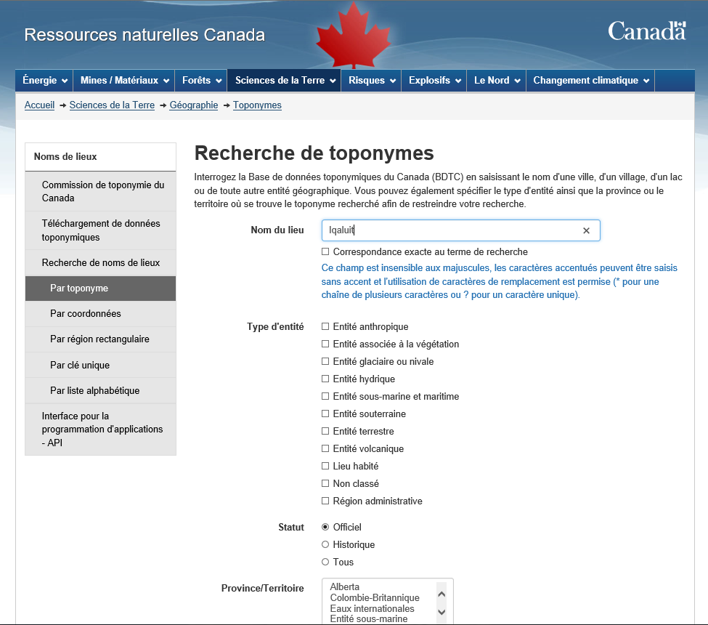
Exercices
Notes:
November 25, 2015
This slide shows a search by geographical name for the name “Iqaluit.”

Slide 34
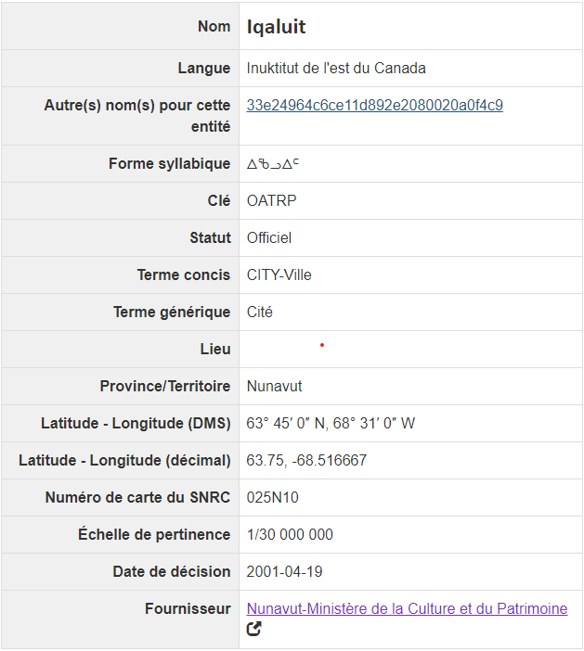
FORME AUTORISÉE
VARIANTE DE FORME (ÉCRITURE DIFFÉRENTE)
Notes:
March 4, 2020: updated screenshot and notes
Results of searching the Canadian Geographical Names Data Base for a place in Nunavut. This record shows a different script form. These are treated as variant names in RDA (16.2.3.7). This particular script (Canadian Aboriginal syllabics) is not currently permitted in LC/NACO authority records. The only scripts currently allowed in NARs are those that represent the MARC-8 repertoire of UTF-8: Arabic, Chinese, Cyrillic, Greek, Hebrew, Japanese, and Korean. If the script form found here transliterates to a form that is different from the preferred name, it can be included as a variant access point.

Slide 35
Notes:
Cette diapositive montre l’écran de recherche dans le Répertoire des municipalités du Québec., avec une recherche du mot Rimouski.

Slide 36
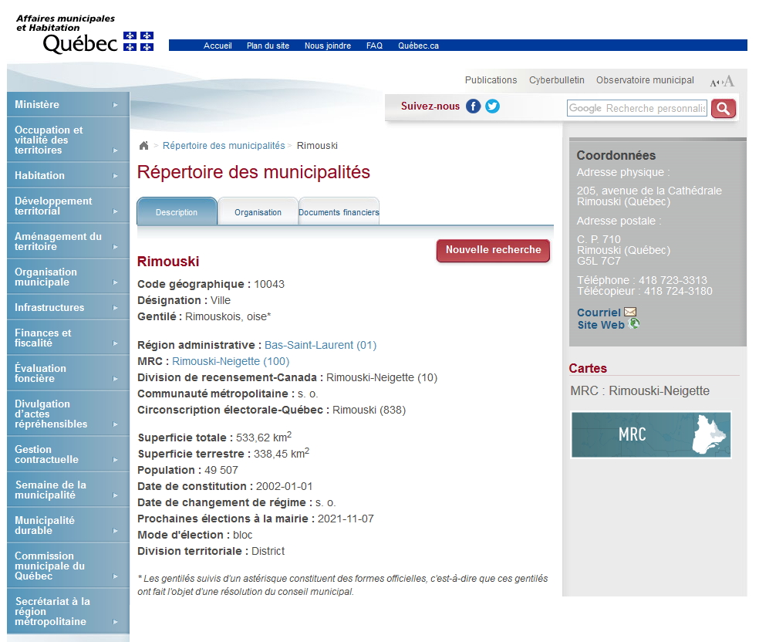
Notes:
Résultat de la recherche pour la ville de Rimouski.

Slide 37
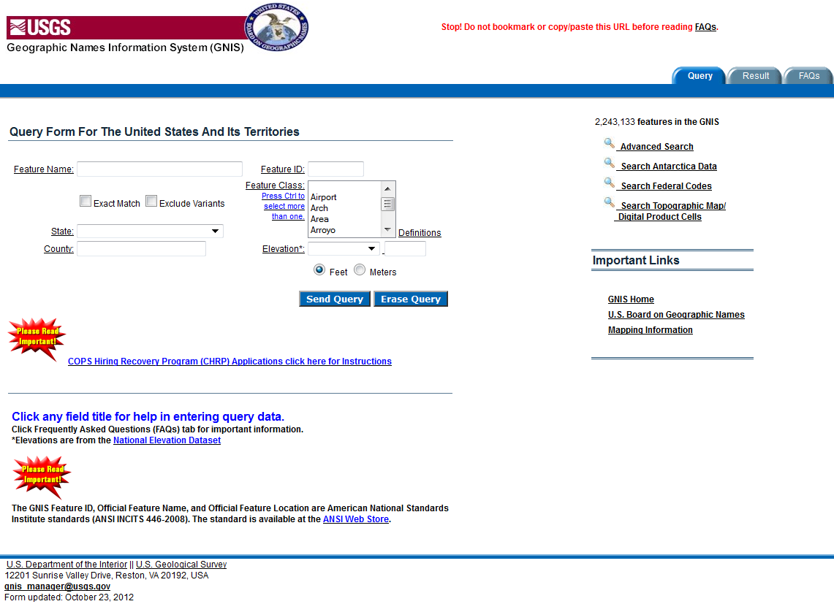
Notes:
May 1, 2013
Geographic Names Information System (GNIS): http://geonames.usgs.gov/pls/gnispublic/
Base the preferred name for places in the United States on the form found in GNIS.

Slide 38
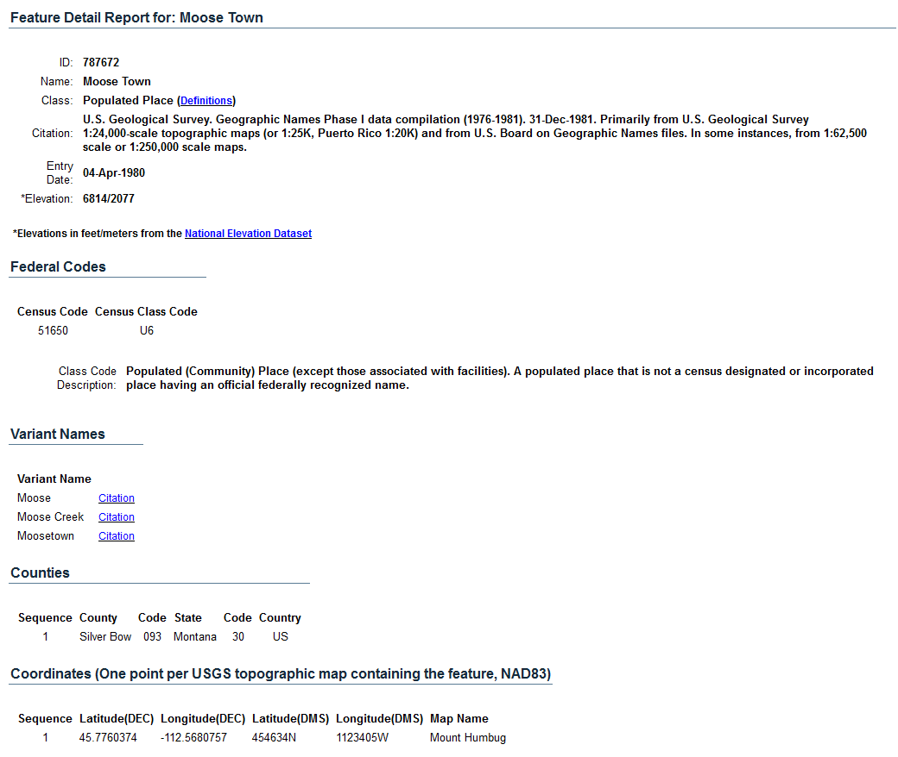
FORME AUTORISÉE DU GNIS
VARIANTES DE FORME
Notes:
May 1, 2013
GNIS record for a populated place in Montana. The record shows the authorized name (Moose Town) and several variant names (Moose, Moose Creek, and Moosetown).
If time permits and Internet access is available, have the trainees try searching a place in GNIS, to get some hands-on experience with the database. Or if access is available on the trainer’s computer, demonstrate a search.

Slide 39
Choix du nom privilégié (RDA 16.2.2.3 & 16.2.2.6)
Choisir dans cet ordre :
La forme du nom dans la langue privilégiée par l’agence préparant les données, s’il en existe une d’usage courant
la forme du nom dans la langue officielle de la juridiction où le lieu est situé.
ÉP de BAC-BAnQ pour 16.2.2.6 : Choisir une forme de nom en français si une telle forme est d’usage courant; déterminer la forme à partir des sources de référence en français.
Notes:
May 1, 2013
16.2.2.6
Choose as the preferred name for a place a form in the language preferred by the agency preparing the data if there is one in general use. Determine this from gazetteers and other reference sources published in the language preferred by the agency. [For the NACO Program, the language preferred is English (LC-PCC PS 16.2.2.6).]
Austria not Österreich
Copenhagen not København
If the form of name for a place in the language preferred by the agency is the name of the government that has jurisdiction over the place, choose that form.
Soviet Union not Sovetskiĭ Soi͡uz not Russia
If there is no form in the language preferred by the agency in general use, choose the form in the official language of the jurisdiction in which the place is located.
Buenos Aires
Horlivka
Tallinn
Livorno not Leghorn (English form no longer in general use)
If the jurisdiction has more than one official language, choose the form most commonly found in sources in the language preferred by the agency.
Louvain not Leuven
Helsinki not Helsingfors
LC-PCC for 16.2.2.6 Choose a form of name in English if one is in general use, determining this from reference sources in English.

Slide 40
Choix du nom privilégié
ÉP de la BAC-BAnQ pour 16.2.2.5 :
– Si un nom de lieu est trouvé dans une écriture non-latine, toujours utiliser la forme translittérée systématiquement dans le point d’accès autorisé; utiliser les tables de translittération prescrites (ISO ou autres)
Notes:
May 1, 2013
Third bullet: BGN doesn’t always follow ALA-LC romanization practices. Slavic place names in Cyrillic script are a very common example of this:
Kamchatskaya Oblastʹ (Approved)
Камчатская Область (Non-Roman Script)
The ALA-LC romanization of the Cyrllic script is different from the BGN-approved form above: Kamchatskai︠a︡ Oblastʹ
151 Kamchatskai︠a︡ oblastʹ (Russia)
451 Kamchatskaya oblastʹ (Russia)
451 Камчатская область (Russia)

Slide 41
Choix du nom privilégié
ÉP de la LC‐PCC pour 16.2.2.3 :
– Si le GEOnet Names Server présente à la fois une forme approuvée et une forme abrégée du BGN comme nom de lieu, choisir, habituellement, la forme plus longue comme nom privilégié, à moins que la règle 16.2.2.8 de RDA ne s’applique (noms de lieux qui commencent par un terme indiquant le type de juridiction et qui sont couramment classés sous une autre partie du nom)
Borno State (approuvé); Borno (Abrégé)
point d’accès autorisé : Borno (Nigeria : État)
cependant
County Kerry (approuvé); Kerry (Abrégé)
point d’accès autorisé : Kerry (Écosse)
Notes:
March 21, 2017: updated RDA instruction number.
Note to Instructor: RDA 16.2.2.8 is discussed in detail on upcoming slides.
16.2.2.8 Terms Indicating Type of Jurisdiction
If the first part of a place name is a term indicating a type of jurisdiction and the place is commonly listed under another part of its name in lists published in the language of the country in which it is located, omit the term indicating the type of jurisdiction.
Kerry (Ireland)
not County Kerry (Ireland)
Ostholstein (Germany)
not Kreis Ostholstein (Germany)
In all other cases, include the term indicating the type of jurisdiction.
Città di Castello (Italy)
Ciudad Juárez (Mexico)
District of Columbia
Distrito Federal (Brazil)

Slide 42
Choix du nom privilégié – articles initiaux
ÉP de BAC-BAnQ pour 16.2.2.4 :
– Supprimer les articles initiaux placés au début du premier élément des toponymes en arabe et dans les autres langues employant l’article initial en arabe
Aqaba (Jordanie) et non al‐’Aqabah (Jordanie)
– Supprimer également les articles initiaux en hébreu et en yiddish
– Conserver l’article initial si l’accès au nom doit se faire sous l’article initial, peu importe la langue
Y Felinheli (Pays de Galles) et non Felinheli (Pays de Galles)
– Conserver les articles initiaux pour les noms de lieux dans les pays anglophones si le nom n’est pas en anglais
Los Angeles (Calif.) et non Angeles (Calif.)
– Supprimer tous les autres articles initiaux
Dalles (Or.) et non The Dalles (Or.)
Notes:
March 21, 2017: updated to reflect current policy statement.
RDA 16.2.2.4 provides two alternatives for recording the preferred name of places that begin with articles. The basic rule says: “When recording the preferred name of a place, include an initial article if present.” The alternative says “Omit an initial article (see appendix C) unless the name is to be accessed under the article.” NACO libraries will be doing a little bit of both, by following the LC-PCC PS for 16.2.2.4:
LC-PCC PS for 16.2.2.4 Initial Articles
Drop initial articles from the beginning of the first element of geographic names in Arabic and other languages employing the Arabic initial article. Similarly, drop Hebrew and Yiddish initial articles. Retain the initial article when the name is to be accessed under the initial article, regardless of language (e.g., “Los Angeles”). Retain initial articles for non-English place names in English-speaking countries. Drop all other initial articles (e.g., drop “The” from “The Dalles”).
Note: 16.2.3.4 instructs that if the initial article was retained in the authorized access point, a variant access point may be made without the initial article. If the initial article was dropped from the authorized access point, a variant access point with the initial article may be made.

Slide 43
Choix du nom privilégié – Monts et Saints
ÉP de BAC-BAnQ pour 16.2.2.3 :
– Mount/Mt.
Toujours utiliser la forme écrite en toutes lettres « Mount » et ce même si « Mt. » figure sur la ressource cataloguée ou dans d’autres sources
– Saint/St.
Lieux ou juridictions au Royaume-Uni et en
République d’Irlande : préférer l’abréviation « St. »
Lieux ou juridictions au Canada : utiliser la forme approuvée
trouvée dans la Base de données toponymiques du Canada ou la Banque des noms et de lieux du Québec
Lieux dans les autres pays : Toujours utiliser la forme écrite en toutes lettres « Saint » même si « St. » figure sur la ressource cataloguée ou dans d’autres sources
Notes:
March 7, 2019: revised note about Canada
LC-PCC PS for 16.2.2.3 gives instructions on places with the word Mount or its abbreviation and Saint or its abbreviation.
Always use “Mount” in the preferred name. If you have a usage with the abbreviated form, record that as a variant name.
For the U.K. and Ireland, prefer the abbreviation “St.” over the spelled-out form. Provide a variant access point for the spelled out.
For Canada, use the approved form found in Canadian Geographical Names Data Base (http://www4.rncan.gc.ca/search-place-names/search?lang=en). Catalogers may also wish to check Canadiana Authorities online or VIAF to see if Library and Archives Canada has established the place and use those resources as additional reference sources. However, according to the LAC website, Library and Archives Canada (LAC) will no longer be updating the Canadiana database and the site will no longer be searchable after March 2019. LAC stopped creating new authorities in AMICUS in September 2018 and will resume creating English-language authorities in the Name Authority Cooperative Program (NACO) file; French-language authorities will be created in a separate file. (Note: AACR2/LCRI practice was to use the form established by LAC and to have LAC verify the form of any newly created corporate body and jurisdiction headings that they had not yet established. This is no longer the policy. NACO libraries, including Library and Archives Canada, follow RDA and the LC-PCC Policy Statements)
For everywhere else, always use the spelled-out form “Saint” in the preferred name. If there is usage for the abbreviated form, provide a variant access point for it.
[Sources: City of Mt. Healthy logo: http://www.mthealthy.org/. City of St. Louis banner: http://stlouis-mo.gov/]

Slide 44
Enregistrement du nom privilégié (RDA 16.2.2.4)
Enregistrer comme une partie du nom de lieu (autre qu’un pays ou un État, etc., listé sous 16.2.2.9.1, 16.2.2.10 ou 16.2.2.11) le nom du lieu plus vaste dans lequel il est situé ou de la juridiction plus vaste à laquelle il appartient (voir 16.2.2.9–16.2.2.14).
Pour le comté de Coles enregistrer aussi Ill.
Pour Budapest enregistrer aussi Hongrie
Pour Toronto enregistrer aussi Ont.
Pour Édimbourg enregistrer aussi Écosse
UTILISER LES ABRÉVIATIONS DE L’ANNEXE B.11 POUR LE LIEU PLUS VASTE
Notes:
May 1, 2013
Note that when you are recording the name of the larger place, you must apply appendix B.11 and use the abbreviation found there for the place:
B.11
Use the abbreviations in table B.1 for the names of certain countries and of the names of states, provinces, territories, etc., of Australia, Canada, and the United States when the names are recorded:
a) as part of the name of a place located in that state, province, territory, etc. (see 16.2.2.9) or other jurisdiction (see 16.2.2.11)
b) as the name or part of the name of a place associated with a person (see 9.8-9.11) family (see 10.5), or corporate body (see 11.3).
The following four slides cover the detailed instructions (16.2.2.9-16.2.2.12) on when and when not to record the name of a larger jurisdiction associated with a place.

Slide 45
Australie, Canada, É.-U., ex-URSS et ex-Yougoslavie (16.2.2.9)
États, provinces, territoires, etc. ou pays constitutifs : Ne pas
enregistrer le nom de la juridiction plus vaste
Delaware Yukon Queensland
Lieux dans les États, provinces, territoires, etc. ou pays constitutifs : Enregistrer le nom de l’État, de la province, etc. Abréger selon les indications de l’annexe B.11
Newark (Del.) Whitehorse (Yukon)
Brisbane (Queensl.) Kiev (Ukraine)
Notes:
May 1, 2013
For states, provinces, territories, etc. in Australia, Canada, and the U.S., for the constituent republics of the former Soviet Union and Yugoslavia, do not record the name of the larger jurisdiction:
Delaware not Delaware (U.S.)
Yukon not Yukon (Canada)
Queensland not Queensland (Australia)
Ukraine not Ukraine (U.S.S.R.)
Slovenia not Slovenia (Yugoslavia)
This rule also covers overseas territories of the U.S. (there is a reference from 16.2.2.11 to 16.2.2.9.1):
Puerto Rico not Puerto Rico (U.S.)
Guam not Guam (U.S.)
For places within these states, provinces, territories, etc. of Australia, Canada, and the U.S., and places within the constituent republics of the former Soviet Union and Yugoslavia, record the name of the state, province, territory, etc. or constituent republic. Use abbreviations for the larger place found in B.11.
Kent County (Del.)
Whitehorse (Yukon)
Brisbane (Qld.)
Kiev (Ukraine)
Bled (Slovenia)
San Juan (P.R.)
Andersen Air Force Base (Guam)

Slide 46
Angleterre, Irlande du Nord, Écosse et pays de Galles (16.2.2.10)
Pays constitutifs du Royaume-Uni : Ne pas enregistrer le nom de la juridiction plus vaste
Angleterre et non Angleterre (Grande-Bretagne)
Lieux dans les pays constitutifs : Enregistrer le nom du pays constitutif
Hampshire (Angleterre)
Glasgow (Écosse)
Cardiff (Pays de Galles)
Belfast (Irlande du Nord)
Notes:
May 1, 2013

Slide 47
Territoires, dépendances, etc., d’outre-mer (16.2.2.11)
Territoires, dépendances, etc. d’outre-mer : Ne pas enregistrer le nom de la juridiction plus vaste
Groenland non Groenland (Danemark)
Nouvelle-Calédonie et non Nouvelle-Calédonie (France)
Aruba et non Aruba (Pays-Bas)
Île de Man et non Île de Man (Grande-Bretagne)
Lieux dans les territoires, les dépendances, etc. d’outre-mer : Enregistrer le nom des territoires d’outre-mer, des dépendances, etc.
Nuuk (Groenland)
Nouméa (Nouvelle-Calédonie)
Oranjestad (Aruba)
Papeete (Polynésie française)
Notes:
May 1, 2013
For overseas territories of the U.S. (e.g., Guam, Puerto Rico), see 16.2.2.9.1.

Slide 48
Partout ailleurs (16.2.2.12)
Pour les lieux dans les juridictions partout ailleurs (sauf la Malaisie) :
Enregistrer le nom du pays dans lequel le lieu est situé.
Abréger les noms des pays (voir la section de l’annexe B.11)
Buenos Aires (Argentine)
Paris (France)
Vladivostok (Russie)
Copperbelt (Zambie)
Wellington (Nouvelle-Zélande)
Séoul (Corée du Sud)
Notes:
Note : En français, les seuls noms de pays qui s’abrègent sont “États-Unis” et “Union des républiques socialistes soviétiques”.
August 13, 2019: added “(except Malaysia)” to slide
Note that terms for type of jurisdiction (e.g., Federation) and other distinguishing characteristics (e.g., South) are not included in the qualifier. Only the preferred name for the larger place is used, not the authorized access point. Vladivostok (Russia) and Seoul (Korea) illustrate this in this slide (see also slide 50).

Slide 49
Malaisie (ÉP de BAC-BAnQ pour 16.2.2.12)
Appliquer l’alternative sous 16.2.2.12 (d’enregistrer le nom d’un État, d’une province ou de la division administrative la plus grande avant le nom du pays) seulement pour les lieux en Malaisie.
Segamat (Johore, Malaisie)
Jasin (Malacca, Malaisie)
Port Dickson (Negeri Sembilan, Malaisie)
Ipoh (Perak, Malaisie)
George Town (Pulau Pinang, Malaisie)
Kota Kinabalu (Sabah, Malaisie)
Bintulu (Sarawak, Malaisie)
Notes:
August 13, 2019
There is an alternative in 16.2.2.12 to record the name of a state, province, or highest-level administrative division preceding the name of the country. LC/PCC policy for this alternative is to apply it only to Malaysia (LC-PCC PS for 16.2.2.12, May 2013). For example:
Segamat (Johor, Malaysia) [town of Segamat, located in the state of Johor]
Jasin (Malacca, Malaysia) [town of Jasin, located in the state of Malacca]
Port Dickson (Negeri Sembilan, Malaysia) [town of Port Dickson, located in the state of Negeri Sembilan]
Ipoh (Perak, Malaysia) [city of Ipoh, located in the state of Perak]
George Town (Pulau Pinang, Malaysia) [city of George Town, the capital of the state of Pulau Pinang]
Kota Kinabalu (Sabah, Malaysia) [city of Kota Kinabalu, located in state of Sabah]
Bintulu (Sarawak, Malaysia) [city of Bintulu, located in the state of Sarawak]
There are 13 states in Malaysia: Johor, Kedah, Kelantan, Melaka, Negeri Sembilan, Pahang, Perak, Perlis, Pulau Pinang, Sabah, Sarawak, Selangor, Terengganu; and 1 federal territory (Wilayah Persekutuan) with 3 components, Kuala Lumpur, Labuan, and Putrajaya.

Slide 50
Forme du lieu plus vaste
ÉP de BAC-BAnQ pour 16.2.2.4
Ne pas inclure un terme pour le type de juridiction ou une autre désignation lorsque le lieu plus vaste est ajouté au lieu plus petit
Albany (N.Y.) et non Albany (N.Y. (État))
Sherbrooke (Québec) et non Sherbrooke (Québec (Province))
Tbilissi (Géorgie) et non Tbilissi (Géorgie (République))
Kinkala (Congo) et non Kinkala (Congo (Brazzaville))
Kinshasa (Congo) et non Kinshasa (Congo (République démocratique))
Notes:
May 1, 2013
LC practice/PCC practice: If the heading for the larger place being added to the smaller place is created according to the provisions of RDA 11.13.1.6 (type of jurisdiction) or RDA 11.13.1.7 (other designation associated with the body), do not include the term for type of jurisdiction or the other designation associated with the body.

Slide 51
Enregistrement du nom privilégié (RDA 16.2.2.4)
Si le nom de lieu est utilisé comme nom conventionnel pour un gouvernement (voir 11.2.2.5.4), inclure le nom du lieu plus vaste entre parenthèses
Budapest (Hongrie)
Toronto (Ont.)
Édimbourg (Écosse)
RDA : Si le nom de lieu est utilisé pour enregistrer l’emplacement d’un congrès, etc., (voir 11.3.2), l’emplacement du siège social d’une collectivité (voir 11.3.3), le lieu d’origine d’une œuvre (voir 6.5) ou un lieu associé à une personne (voir 9.8‐9.11), famille (voir 10.5) ou collectivité (voir 11.3), faire précéder le nom du lieu plus vaste par une virgule
Budapest, Hongrie
Toronto, Ont.
Édimbourg, Écosse
NOTEZ BIEN, la politique du PFAN est d’enregistrer cet élément en utilisant la forme autorisée du nom
370 $e Budapest (Hongrie) $2 lacnaf
Notes:
Updated: Feb. 24, 2014
Note that when you are recording the name of the larger place, you must apply appendix B.11 and use the abbreviation found there for the place:
B.11
Use the abbreviations in table B.1 for the names of certain countries and of the names of states, provinces, territories, etc., of Australia, Canada, and the United States when the names are recorded:
a) as part of the name of a place located in that state, province, territory, etc. (see 16.2.2.9) or other jurisdiction (see 16.2.2.11)
b) as the name or part of the name of a place associated with a person (see 9.8-9.11) family (see 10.5), or corporate body (see 11.3).

Slide 52
Lieux enregistrés dans les notices d’autorité de noms
Notice d’autorité de nom pour la juridiction:
151 Toronto (Ont.)
et
100 1_ Gould, Glenn
370 Toronto (Ont.) $b Toronto (Ont.) $2 lacnaf
110 2_ Beth Tikvah Synagogue (Toronto, Ont.)
370 $e Toronto (Ont.) $2 lacnaf
111 2_ RSKT (Congrès) $n (2e : $d 2007 : $c Toronto, Ont.)
370 $e Toronto (Ont.) $2 lacnaf
130 _0 Signature series (Toronto, Ont.)
370$g Toronto (Ont.) $2 lacnaf
Notes:
Updated: May 15, 2014
In the geographic place (jurisdiction) name authority record, the name of the larger place will be recorded in parentheses.
In the 370 field attribute for the associated place, use the authorized access point form found in the authority record in the LC/NAF.
If no authorized access point exists in the LC/NACO Authority File for the place, it is not necessary to create a NAR in order to code the 370 field. Use the RDA preferred name for the place, but note that when there is no authorized source, a subfield $2 cannot be added.
370 subfields used in the examples in this slide:
$a Place of birth
$b Place of death
$e Place of residence/Location of headquarters [includes location of conference]
$g Place of origin of work

Slide 53
Lieux enregistrés dans les notices d’autorité de noms
Notice d’autorité de nom pour la juridiction :
151 Québec (Province)
Forme du nom dans la 370 :
370 $c Québec (Province) $2 lacnaf
Comme ajout à un point d’accès : Québec
110 2_ Institut national des mines (Québec)
Comme partie du nom privilégié d’une localité : Québec
151 Trois-Rivières (Québec)
Notice d’autorité de nom pour la juridiction :
151 Congo (République démocratique)
Forme du nom dans la 370 :
370 $c Congo (République démocratique) $2 lacnaf
Comme ajout à un point d’accès : Congo
110 2_ Archives nationales (Congo)
Comme partie du nom privilégié d’une localité : Congo
151 Niangara (Congo)
Notes:
Updated: November 25, 2015 (no change in content; change in formatting of slide only)
Note: The form of place name in 370 may differ from the form of place name added to a preferred name of place or an access point per RDA and LC-PCC PS instruction (updated in Nov. 2013)

Slide 54
Enregistrement du nom privilégié ‐ Noms de lieux pour les juridictions (RDA 16.2.2.8)
Si la première partie d’un nom de lieu est un terme indiquant un type de juridiction et que le lieu est couramment classé sous une autre partie de son nom dans les listes publiées dans la langue du pays dans lequel il est situé, omettre le terme indiquant un type de juridiction
Kerry (Irlande) non Comté de Kerry (Irlande)
Ostholstein (Allemagne) non Kreis Ostholstein (Allemagne)
mais
Città di Castello (Italie)
Ciudad Juárez (Mexique)
District of Columbia
Distrito Federal (Brésil)
Notes:
December 13, 2016. RDA instruction number corrected.

Slide 55
Enregistrement du nom privilégié ‐ Noms de lieux pour les juridictions (RDA 16.2.2.8)
Si le nom d’un lieu autre que le nom d’une municipalité ou d’une
ville n’inclut pas de terme indiquant un type de juridiction
et que le nom de lieu sert de nom conventionnel à
un gouvernement, appliquer les instructions données sous 11.13.1.6.
• 11.13.1.6 : Ajouter un terme désignant le type de juridiction
au nom d’un gouvernement autre que celui d’une municipalité ou
d’une ville (voir 11.7.1.5), s’il est nécessaire d’établir une
distinction entre des points d’accès de deux ou plusieurs
gouvernements portant le même nom ou des noms si semblables
qu’ils pourraient être confondus.
Notes:
December 13, 2016. RDA instruction number corrected in header, speaker notes modified to account for the deletion from RDA of 16.2.2.8.2.
11.13.1.6 tells us that we do not add a term for type of jurisdiction for cities and towns. Terms for type of jurisdiction are only added to jurisdictions at higher political/administrative levels than cities and towns (e.g., counties, districts, states, provinces, regions) or places within a city or town (e.g., neighborhoods, parishes, historic districts, special zones, etc.). If two or more places have the same name in the same larger jurisdiction, 16.2.2.13 applies, and the conflict is usually broken by adding the name of an appropriate smaller place before the name of the larger place.
11.7.1.5, to which 11.13.1.6 refers, gives instructions for recording the type of jurisdiction as an element. This element can be recorded for any jurisdiction, including cities and towns (MARC 368 $b).
If needed in the authorized access point under 11.13.1.6, record the type of jurisdiction for a government other than a city or a town in the language preferred by the agency creating the data. If there is no equivalent term for the type of jurisdiction in the language preferred by the agency, or in case of doubt, record it in the official language of the jurisdiction.
LC-PCC PS for 11.7.1.5: Record the type of jurisdiction in English. If there is no equivalent term for the type of jurisdiction in the language preferred by the agency, or in case of doubt, record it in the official language of the jurisdiction. Descriptive Cataloging Manual Z1, 368 says to prefer controlled vocabulary for terms describing type of jurisdiction. Controlled vocabulary is not used when type of jurisdiction is recorded under 11.13.1.6 as part of the authorized access point. This means the term recorded as an 11.7.1.5 element (in MARC 368 $b) might not be the same as the term recorded in the authorized access point.
Common types of jurisdictions recorded in the preferred name as a qualifier: District; County; State; Province; Republic; Kingdom; Duchy; Town*; Township*
* See LC-PCC PS for 16.4, covered in an upcoming slide. In this case “town” and “township” refer to jurisdictions below the county level in many U.S. states made up of multiple local places.

Slide 56
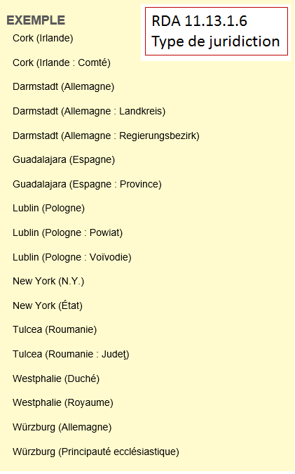
151 Cork (Irlande : Comté)
368 $b Comtés $2 rvm
151 Guadalajara (Espagne : Province)
368 $b Province
151 Lublin (Pologne : Powiat)
368 $b Powiat
151 Lublin (Pologne : Voïvodie)
368 $b Voïvodies $2 rvm
151 Westphalie (Duché)
368 $b Duchés $2 rvm
151 Westphalie (Royaume)
368 $b Royaume
Notes:
December 14, 2016
This slide shows authorized access points for places for which a term for type of jurisdiction is added to differentiate the place from another with the same name. When recorded as a separate element, the type of jurisdiction is put in MARC field 368, subfield $b. Note: DCM Z1 says to “Prefer controlled vocabulary for terms, recording the source in subfield $2.” See next two slides for more examples showing this. If there is no controlled term, the term should be recorded in the singular (see the Powiat example)
11.7.1.5, to which 11.13.1.6 refers, gives instructions for recording the type of jurisdiction as an element. This element can be recorded for any jurisdiction, including cities and towns (MARC 368 $b).
If needed in the authorized access point under 11.13.1.6, record the type of jurisdiction for a government other than a city or a town in the language preferred by the agency creating the data. If there is no equivalent term for the type of jurisdiction in the language preferred by the agency, or in case of doubt, record it in the official language of the jurisdiction.
LC-PCC PS for 11.7.1.5: Record the type of jurisdiction in English. If there is no equivalent term for the type of jurisdiction in the language preferred by the agency, or in case of doubt, record it in the official language of the jurisdiction. Descriptive Cataloging Manual Z1, 368 says to prefer controlled vocabulary for terms describing type of jurisdiction. Controlled vocabulary is not used when type of jurisdiction is recorded under 11.13.1.6 as part of the authorized access point. This means the term recorded as an 11.7.1.5 element (in MARC 368 $b) might not be the same as the term recorded in the authorized access point.
The slide illustrates instances where there is no good English term for the type of jurisdiction, so the term in the official language of the jurisdiction is used instead: Landkreis; Regierungsbezirk; Powiat; Judet. Other common ones in use are Amphoe [Thailand jurisdiction]; Arrondissement [French jurisdiction]; Oblast [jurisdiction in many East European countries].
Common types of English-language jurisdictions recorded in the preferred name as a qualifier: Town*; Township*; District; County; Parish; State; Province; Canton; Region; Republic; Kingdom; Duchy; Principality
* See LC-PCC PS for 16.4, covered in an upcoming slide. In this case “Town” and “Township” as a qualifier refer to jurisdictions below the county level in many U.S. states made up of multiple local places.
Even if a term for type of jurisdiction is not needed in an access point, one or more can be recorded in the 368 field. The cataloger has the choice of recording it in singular form if the term does not come from any controlled vocabulary, or in plural if the term is found in a controlled vocabulary that uses plural forms.
Examples: City [uncontrolled] vs. Cities and towns [LCSH form]; Duchy [uncontrolled] vs. Duchies [LCSH form]; Village [uncontrolled] vs. Villages [LCSH form]; Country or Nation [both uncontrolled - no equivalent in LCSH];
Tribe or Indian tribe or First Nation or Indian band [all uncontrolled - no exact equivalent in LCSH or Canadian Subject Headings, although LCSH does have “Federally recognized Indian tribes”]

Slide 57
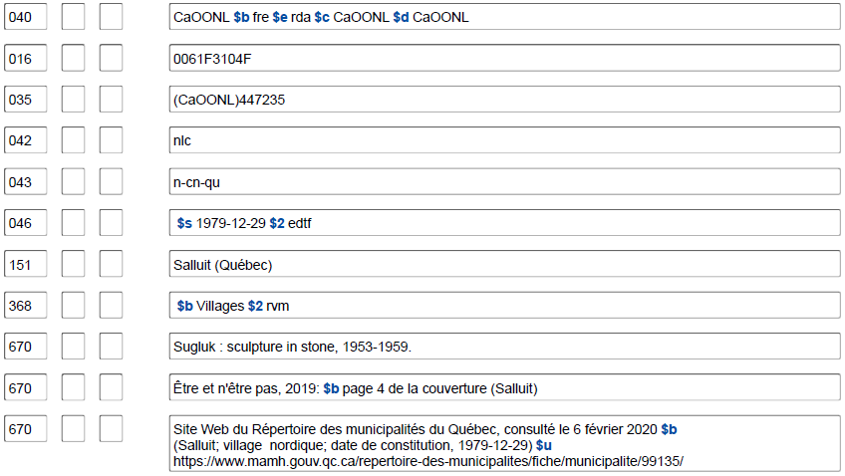
11.7.1.5 Type de juridiction
Notes:
May 1, 2013
Type of jurisdiction may be recorded as a separate element even if it is not needed in the authorized access point. The following examples follow the DCM Z1 instruction for field 368 to “Prefer controlled vocabulary for terms, recording the source in subfield $2.”

Slide 58
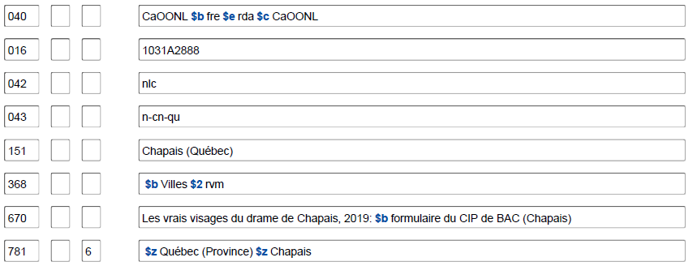
11.7.1.5 Type de juridiction
Notes:
Updated: Feb. 24, 2014

Slide 59
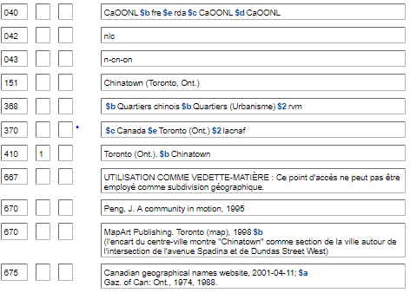
11.7.1.5 Type de juridiction
Notes:
Updated: November 25, 2015 (highlight box moved to show field 368)
Multiple types of jurisdiction may be recorded as attributes if applicable and appropriate.

Slide 60
11.7.1.5 Type de juridiction
040 CaOONL $b fre $e rda $cCaOONL
034 $d W0762932 $e W0762932 $f N0385842 $g N0385842 $2 geonames
034 $d W0763222 $e W0762811 $f N0390008 $g N0385634 $2 bound
034 $d W0763222 $e W0762811 $f N0390010 $g N0385631 $2 bound
043 n-us-md
046 $q 1694 $2 edtf
151 Annapolis (Mar.)
451 Anne Arundel Town (Mar.)
451 Providence (Mar.)
368 $b Villes $b Capitales $2 rvm
368 $b Siège de comté
370 $c États-Unis $e Maryland $2 lacnaf
451 City of Annapolis (Mar.)
670 GeoNames, algorithmically matched, 2009 $b (ppl; 38°58ʹ42ʺN 076°29ʹ32ʺW)
670 Wikipédia en anglais, 12 août 2015 $b (Annapolis, Maryland; City of Annapolis; capitale de l'État américain du Maryland de même que siège du comté d'Anne Arundel; en 1694, peu après le renversement du gouvernement catholique de Thomas Lawrence, Francis Nicholson a déplacé la capitale de la colonie royale à Anne Arundel’s Towne [pas de points d'accès dans OCLC] et a rebaptisé la ville Annapolis en l'honneur de la princesse Anne de Danemark et de Norvège, qui sera bientôt reine de Grande-Bretagne. Annapolis a été constituée en ville en 1708; 38°58ʹ22.6ʺN 76°30ʹ4.17ʺW)
Notes:
August 13, 2019
If the terms for types of jurisdiction come from different thesauri/controlled vocabularies, the field must be repeated.

Slide 61
ÉP de BAC-BAnQ pour 16.4
Les cantons aux É.-U. (entités qui englobent une ou plusieurs communautés locales et le territoire environnant; appelées townships et parfois towns)
– En général, ne pas inclure le terme « township » ou « town » comme partie du nom. Au lieu de cela, ajouter le terme canton après le nom de l’État.
– Appliquer l’ÉP de la BAC-BAnQ pour 16.2.2.13 si plus d’un canton portent le même nom dans le même État
Notes:
March 21, 2017: updated to reflect current LC-PCC PS, revised speaker notes.
LC-PCC PS for 16.4
U.S. Townships
For U.S. townships (called “towns” in some states) that encompass one or more local communities and the surrounding territory, apply RDA 16.2.2.8 to determine whether the term “township” or “town” should be included as part of the name. If such a term is not included in the name, add the term after the name of the state, etc. in the authorized access point. Generally consider U.S. townships listed in GNIS in the form “Township of” or “Town of” to fall under the first condition in RDA 16.2.2.8 and establish them without the first part of the name indicating a type of jurisdiction.
If the jurisdictional term is not part of the preferred name, add it as an addition to the authorized access point.
EXAMPLE
BGN GNIS: Township of Kintire
151 ## $a Kintire (Minn. : Township)
BGN GNIS: Town of Milo
151 ## $a Milo (Me. : Town)
[No longer included in LC-PCC PS 16.4.] These non-local jurisdictions are called “townships” in Arkansas, California, Illinois, Indiana, Iowa, Kansas, Michigan, Minnesota, Missouri, Nebraska, New Jersey, North Carolina North Dakota, Ohio, Pennsylvania, and South Dakota; they are called “towns” in Connecticut, Maine, Massachusetts, New Hampshire, New York, Rhode Island, Vermont, and Wisconsin.

Slide 62
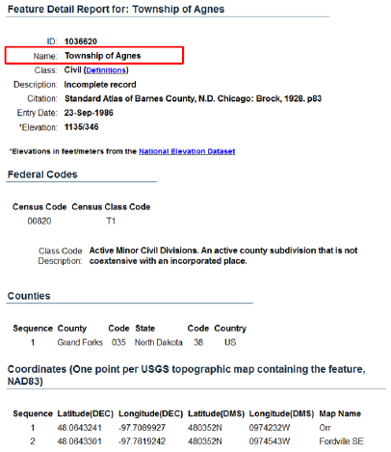
Notice GNIS pour Township
Notes:
May 1, 2013
Screen shot of a record for the Township of Agnes in North Dakota. Note that the class code description indicates that this is a county subdivision that is not coextensive with an incorporated place.

Slide 63
040 CaOONL $b fre $e rda $c CaOONL
034 $d W0974212 $e W0974212 $f N0480325 $g N0480325 $2 wikiped
043 n-us-nd
151 Agnes (Dak. du N. : Canton)
368 $b Canton
370 $c États-Unis $f Dakota du Nord $2 lacnaf
451 Agnes Township (Dak. du N.)
451 Township of Agnes (Dak. du N.)
670 NUCMC data from University of North Dakota Library for Grand Forks County (N.D.). Records, 1881-1958 $b (Agnes Township; Grand Forks County; township records, 1904-1958)
670 GNIS, 4 mars 2013 $b (Township of Agnes, civil, comté : Grand Forks, État : Dakota du Nord)
670 Wikipédia en anglais, 4 mars 2013 $b (Agnes Township, Grand Forks County, North Dakota; 48°3ʹ25ʺN 97°42ʹ12ʺW)
675 Rand McNally comm'l atlas, 1984; $a Wick, D.A. North Dakota place names, c1988
781 6 $z Dakota du Nord $z Agnes (Canton)
Notes:
Updated: Feb. 24, 2014

Slide 64
Exercices Choix et enregistrement du nom privilégié
Notes:
May 1, 2013

Slide 65
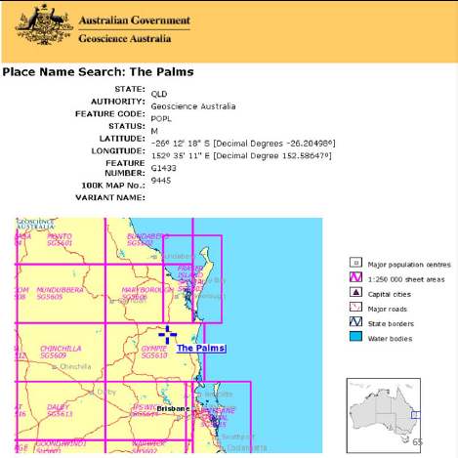
Choix du nom privilégié
Quel est le nom privilégié de ce lieu en se fondant sur la
source de référence
illustrée?
Nom privilégié : Palms (Queensl.)
Notes:
March 21, 2017: corrected LC-PCC PS number in speaker notes.
Answer:
Preferred name: Palms (Qld.)
Why?: LC-PCC PS for 16.2.2.4 says to drop the initial article in a name like this. Reminder: According to 16.2.2.4, the preferred name for the place (other than a country, state, etc. listed in 16.2.2.9.1, 16.2.2.10, or 16.2.2.11) includes the name of the larger place in which it is located or the larger jurisdiction to which it belongs. If the place name is being used as the conventional name for a government, the name of the larger place is enclosed in parentheses. 16.2.2.9.2 says to abbreviate the name of the larger place as instructed in Appendix B (B.2) and B.2 refers catalogers to B.11 (Names of Certain Countries, States, Provinces, Territories, Etc.). The abbreviation found in B.11 for Queensland is Qld.
Access point for the place (assuming no conflict): Palms (Qld.)

Slide 66
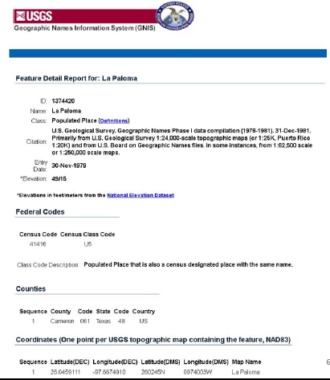
Choix du nom privilégié
Quel est le nom privilégié de ce lieu en se fondant sur la
source de référence
illustrée?
Nom privilégié : La Paloma (Tex.)
Notes:
March 21, 2017: corrected LC-PCC PS 16.2.2.4 number and text in speaker notes.
Answer:
Preferred name: La Paloma (Tex.) Note: La Paloma means “The Dove” in English.
Why?: LC-PCC PS for 16.2.2.4 says to retain the initial article when the name is to be accessed under the initial article, regardless of language (e.g., “Los Angeles”). Retain initial articles for non-English place names in English-speaking countries.
Reminder: According to 16.2.2.4, the preferred name for the place (other than a country, state, etc. listed in 16.2.2.9.1, 16.2.2.10, or 16.2.2.11) includes the name of the larger place in which it is located or the larger jurisdiction to which it belongs. If the place name is being used as the conventional name for a government, the name of the larger place is enclosed in parentheses. 16.2.2.9.2 says to abbreviate the name of the larger place as instructed in Appendix B (B.2) and B.2 refers catalogers to B.11 (Names of Certain Countries, States, Provinces, Territories, Etc.). The abbreviation found in B.11 for Texas is Tex.
Access point for the place (assuming no conflict): La Paloma (Tex.)

Slide 67
Enregistrement du lieu
Différenciez ces œuvres avec l’ajout
du pays d’origine :
a. The X Factor ‐ des États-Unis
b. The X Factor ‐ de la Grande-Bretagne
c. The X Factor ‐ de la Nouvelle-Zélande
d. Ik’s‐faktor ‐ d'Arménie
Variante de nom : X‐Factor
B.11 Tableau B.1 : États-Unis : É.-U.
a, b et c:
130 _0 X factor (Émission de télévision : _________)
370 $g _____________
d:
130 _0 Ik’s-faktor
430 _0 X-factor (Émission de télévision : _________)
370 $g ______________
Notices d’autorité de noms : 151 États-Unis 151 Grande-Bretagne 451 Royaume-Uni 151 Nouvelle-Zélande 151 Arménie
Notes:
May 1, 2013
Answers on next slide

Slide 68
Réponses exercice X Factor
a) 130 _0 X factor (Émission de télévision : É.-U.)
370 $g États-Unis $2 lacnaf
b) 130 _0 X factor (Émission de télévision : Grande-Bretagne)
370 $g Grande-Bretagne $2 lacnaf
c) 130 _0 X factor (Émission de télévision : Nouvelle-Zélande)
370 $g Nouvelle-Zélande $2 lacnaf
d) 130 _0 Ik’s-faktor
430 _0 X-factor (Émission de télévision : Arménie)
370 $g Arménie $2 lacnaf
Notes:
Note : Nouvelle-Zélande ne s’abrège pas en français.
March 21, 2017: updated answers and reference to DCM Z1 in speaker notes.
ANSWERS - ANIMATED SLIDE. Click to bring in each answer
You must apply Appendix B.11 and use abbreviations for places listed there, so N.Z. for New Zealand, and U.S. for United States.
a) 130 _0 $a X factor (Television program : U.S.)
370 $g United States $2 naf
b) 130 _0 $a X factor (Television program : Great Britain)
370 $g Great Britain $2 naf
Note: LC-PCC PS for 16.4 says “Follow the British Library’s practice of using ‘Great Britain’ as the conventional name for the government of the United Kingdom.” Therefore, the abbreviation U.K. will never be used when recording a place. Always use “Great Britain” for the name of that country.
c) 130 _0 $a X factor (Television program : N.Z.)
370 $g New Zealand $2 naf
d) 130 _0 $a Ikʻs-faktor
430 _0 $a X-factor (Television program : Armenia)
370 $g Armenia (Republic) $2 naf
Note from the last example that any qualifying term for type of jurisdiction that may be included in the authorized access point is not included in the qualifier. DCM Z1 for field 370:
For jurisdictions or other place names with authority records in the LC/NAF, use the authorized access point form as found, recording the source in subfield $2. The form of place name in 370 may
differ from the form of place name added to a preferred name of place or an access point per RDA and LC-PCC PS instructions.

Slide 69
Déterminer le nom privilégié et le point d’accès autorisé pour ce lieu
Nom privilégié du lieu : ______________
151
670 Carte routière, territoire de la MRC de Rivière-du-Loup, [2010?]
670 Site Web du Répertoire des municipalités du Québec, consulté le 26 avril 2020 $b (Rivière-du-Loup; MRC; région administrative : Bas-Saint-Laurent (01); date d'entrée en vigueur : 1982-01-01)
670 Site Web Banque de noms de lieux du Québec, consulté le 26 avril 2020 $b (Rivière-du-Loup; municipalité régionale de comté située dans le Bas-Saint-Laurent; instituée en janvier 1982; se compose de seize municipalités dont Rivière-du-Loup; en plus de la ville, la Banque liste aussi une division de recensement et une circonscription électorale du même nom)
Notes:
May 1, 2013
Answer on next slide.
Preferred name for the place: Ujjain (India)
Access points:
151 __ $a Ujjain (India : District)
451 __ $a Ujjain District (India)
Explanation: BGN approved form is selected as the basis for the preferred name, but it conflicts with a city/town. Therefore type of jurisdiction (11.7.1.5) becomes a core element, since it is needed to differentiate the two jurisdictions with the same name. 11.13.1.6 requires the type of jurisdiction to be added to distinguish one access point from another, but it is only added to the access point for the district in this case. According to 11.13.1.6, a term for type of jurisdiction is only ever added to the name of a government other than a city or a town.

Slide 70
Déterminer le nom privilégié et le point d’accès autorisé pour ce lieu
Rivière-du-Loup (Québec)
Nom privilégié du lieu :
151
670 Carte routière, territoire de la MRC de Rivière-du-Loup, [2010?]
670 Site Web du Répertoire des municipalités du Québec, consulté le 26 avril 2020 $b (Rivière-du-Loup; MRC; région administrative : Bas-Saint-Laurent (01); date d'entrée en vigueur : 1982-01-01)
670 Site Web Banque de noms de lieux du Québec, consulté le 26 avril 2020 $b (Rivière-du-Loup; municipalité régionale de comté située dans le Bas-Saint-Laurent; instituée en janvier 1982; se compose de seize municipalités dont Rivière-du-Loup; en plus de la ville, la Banque liste aussi une division de recensement et une circonscription électorale du même nom)
Rivière-du-Loup (Québec : Municipalité régionale de comté)
Notes:
May 1, 2013
ANSWER. ANIMATED SLIDE. Click to bring in each answer.
Preferred name for the place: Ujjain (India)
Access points:
151 __ $a Ujjain (India : District)
451 __ $a Ujjain District (India)
Explanation: BGN approved form is selected as the basis for the preferred name, but it conflicts with a city/town. Therefore type of jurisdiction (11.7.1.5) becomes a core element, since it is needed to differentiate the two jurisdictions with the same name. 11.13.1.6 requires the type of jurisdiction to be added to distinguish one access point from another, but it is only added to the access point for the district in this case. According to 11.13.1.6, a term for type of jurisdiction is only ever added to the name of a government other than a city or a town.

Slide 71
Plus d’information sur l’enregistrement du nom privilégié
Lieux portant le même nom
Lieux dans des villes
Cas particuliers
Notes:
May 1, 2013

Slide 72
Enregistrement du nom privilégié ‐ Lieux portant le même nom (RDA 16.2.2.13)
• ÉP de BAC-BAnQ
– Une recherche est toujours nécessaire afin de déterminer s’il y a un conflit
– Les conflits doivent être résolus, même si l’autre lieu n’est pas compris dans le fichier d’autorité Canadiana
« Les conflits pour les noms de lieux ne se limitent pas à ceux déjà représentés dans le fichier dans lequel la recherche et le
catalogage sont effectués. Au lieu de cela, s’il n’y a pas de conflit dans ce fichier, consulter des répertoires géographiques, p. ex., afin de déterminer si deux ou plusieurs lieux relevant de la même juridiction portent le même nom ou si deux ou plusieurs lieux ayant le même nom porteraient le même qualificatif pour le lieu plus vaste. »
Notes:
March 21, 2017: corrected RDA instruction number.
Before we look at the instructions for recording the preferred name for places with the same name, it’s important to remember what the LC-PCC Policy Statement for 16.2.2.13 tells us: research must always be done for place names to determine if there is more than one place with the same name in a particular jurisdiction. Conflicts must be broken even in cases where the other place is not yet established in the name authority file.
Conflicts
LC practice/PCC practice: Apply either RDA 16.2.2.13 or RDA 11.13.1.6 (type of jurisdiction) to resolve conflicts in preferred names for geographic names and names of governments not already resolved by the additions called for by RDA 16.2.2.9-16.2.2.13. Conflict in place names is not restricted to those already represented in the file against which the searching and cataloging is being done. Instead, if there is no existing conflict in that file, search gazetteers, etc., to determine if two or more places within the same jurisdiction have the same name or if two or more places with the same name would bear the same qualifier for the larger place.

Slide 73
Enregistrement du nom privilégié ‐ Lieux portant le même nom (RDA 16.2.2.13)
Inclure comme partie du nom privilégié d’un lieu un mot ou une
expression couramment utilisés pour les distinguer
Alhama de Almería (Espagne)
Forme abrégée du nom : Alhama
Alhama de Granada (Espagne)
Forme abrégée du nom : Alhama
Francfort-sur-le-Main (Allemagne)
Forme abrégée du nom : Francfort
Francfort-sur-l'Oder (Allemagne)
Forme abrégée du nom : Francfort
Notes:
March 21, 2017: updated to reflect current RDA language.
If two or more places have the same name in the same larger jurisdiction, 16.2.2.13 applies. There are two cases addressed by this instruction:
1) If the inclusion of the name of the larger place or jurisdiction (see 16.2.2.9–16.2.2.12) is insufficient to distinguish between two or more places with the same name, include as part of the preferred name a word or phrase commonly used to distinguish them.
2) If there is no commonly used word or phrase to distinguish between places in the same larger place or jurisdiction, record the name of an intermediate place between the name of a place being identified and the larger place or jurisdiction. [next slide]

Slide 74
Enregistrement du nom privilégié ‐ Lieux portant le même nom (RDA 16.2.2.13)
S’il n’existe pas de mot ou d’expression couramment utilisés
pour les distinguer, enregistrer le nom d’un lieu intermédiaire
entre le nom d’un lieu en cours d’identification et le lieu ou la
juridiction plus vaste
Friedberg (Bavière, Allemagne)
Friedberg (Hesse, Allemagne)
Northfield (Atlantic, N.J.)
Northfield (Essex, N.J.)
Saint-Cyprien (Les Etchemins, Québec)
Saint-Cyprien (Rivière-du-Loup, Québec)
Notes:
Dans le cas des deux Saint-Cyprien, le lieu intermédiare est la MRC.
March 21, 2017: updated to reflect current RDA language.
If two or more places have the same name in the same larger jurisdiction, 16.2.2.13 applies. There are two cases addressed by this instruction:
1) If the inclusion of the name of the larger place or jurisdiction (see 16.2.2.9–16.2.2.12) is insufficient to distinguish between two or more places with the same name, include as part of the preferred name a word or phrase commonly used to distinguish them.
2) If there is no commonly used word or phrase to distinguish between places in the same larger place or jurisdiction, record the name of an intermediate place between the name of a place being identified and the larger place or jurisdiction.

Slide 75
Enregistrement du nom privilégié ‐ Lieux portant le même nom
ÉP de BAC-BAnQ pour 16.2.2.13
– Conflit entre des cantons dans le même État : ajouter le
nom privilégié du comté à chaque nom avant le type de
juridiction
Amity (Berks, Penns. : Canton)
Amity (Erie, Penns. : Canton)
Amity (Washington, Penns. : Canton)
– Hawaii : S’il y a conflit, ajouter le nom privilégié désignant l’île sur laquelle le lieu est localisé au lieu du comté
Waialua (Oahu, Hawaii) et non Waialua (Honolulu, Hawaii)
Notes:
March 21, 2017: updated to use preferred name as the qualifier not authorized access point; LC-PCC PS for Hawaii needs to be updated.
If two or more places have the same name in the same larger jurisdiction, 16.2.2.13 applies. There are two cases addressed by this instruction:
1) If the inclusion of the name of the larger place or jurisdiction (see 16.2.2.9–16.2.2.12) is insufficient to distinguish between two or more places with the same name, include as part of the preferred name a word or phrase commonly used to distinguish them.
2) If there is no commonly used word or phrase to distinguish between places in the same larger place or jurisdiction, record the name of an intermediate place between the name of a place being identified and the larger place or jurisdiction.
LC-PCC PS for 16.2.2.13
U.S. Townships
LC practice/PCC practice: If a name of a U.S. township (called “towns” in some states) conflicts with the name of another township within the same state, add the preferred name for the county to each name. Consult GNIS to determine if there is more than one township with the same name in the same state: http://geonames.usgs.gov/pls/gnispublic.
EXAMPLE
151 Spring (Berks County, Pa. : Township)
151 Spring (Centre County, Pa. : Township)
Before May 2007 as the result of differing instructions, some towns or townships that were coextensive with the populated place were subsumed under the authorized access point for the populated place. As these civil jurisdictions are encountered, establish them separately.
Hawaii
If local places in Hawaii conflict, add to each name the authorized access point preferred name for the island on which the place is located rather than the authorized access point for the county.
In each of the examples in the slide, there is another place with the same name on a different island/different county.
[In case anyone wonders, Honolulu is both a city and county (the same as San Francisco, California and Denver, Colorado) and has jurisdiction over the entire island of Oahu and a few small outlying islands:
Honolulu (Hawaii)
City and County of Honolulu (Hawaii)
451 Honolulu County (Hawaii)]

Slide 76
Enregistrement du nom privilégié ‐ Lieux dans des villes, etc. (RDA 16.2.2.14)
Parties de villes, quartiers, secteurs, etc.
Enregistrer le nom de la ville, etc. et le lieu plus vaste
dans lequel la ville, etc., est située
Andersonville (Chicago, Ill.)
Little Italy (Philadelphie, Penns.)
Rose Quarter (Portland, Or.)
Garment District (New York, N.Y.)
Vieux-Montréal (Montréal, Québec)
Kings Cross (Sydney, N.-G. du S.)
Art Deco Historic District (Miami Beach, Flor.)
11e Arrondissement (Paris, France)
Ninth Ward (La Nouvelle-Orléans, Louis.)
Circoscrizione XVI (Rome, Italie)
Notes:
May 1, 2013
[Little Italy image from http://www.web-books.com/eLibrary/Books/B0/B52/MAIN/images/C8S2a.jpg]
[Rose Quarter image from http://rosequarterblog.com/about/p1000016/]
[Kings Cross image from http://chanshirley04.blogspot.com/2011/08/kings-cross.html]
[Art Deco Historic District image from http://ollie.neglerio.com/wp-content/uploads/2011/07/miami-beach-art-deco-district-ocean-blvd-12.jpg]

Slide 77
Enregistrement du nom privilégié ‐ Lieux dans des villes, etc. (RDA 16.2.2.14)
Lieux portant le même nom dans la même ville : appliquer les indications sous 16.2.2.13 et inclure comme partie du nom privilégié un mot ou une expression couramment utilisés pour les distinguer, ou s’il n’existe pas de mot ou d’expression de ce type, enregistrer le nom approprié d’un lieu plus petit avant le nom de la ville
Chelsea (Manhattan, New York, N.Y.)
Chelsea (Staten Island, New York, N.Y.)
Little Italy (Bronx, New York, N.Y.)
Little Italy (Manhattan, New York, N.Y.)
Hayes (Bromley, Londres, Angleterre)
Hayes (Hillingdon, Londres, Angleterre)
Notes:
May 1, 2013

Slide 78
Lieux dans des villes, etc. – Directives sur les vedettes
Subject Headings Manual H 720 : Parties de villes
Les vedettes pour les parties de villes déjà comprises dans le fichier d’autorité de vedettes-matière devraient être versées dans le fichier d’autorité de noms si elles sont requises pour l’utilisation des vedettes-matière dans le catalogage actuel.
H 830 : Subdivision géographique
Ne pas diviser les sujets géographiquement à un niveau inférieur à celui d’une ville, d’une municipalité, etc. Au lieu de cela, assigner des vedettes additionnelles afin de mettre en évidence les entités et les caractéristiques géographiques des villes, incluant les sites archéologiques, les parcs et jardins, les rues et les routes, les quartiers de ville, etc.
Notes:
May 1, 2013

Slide 79
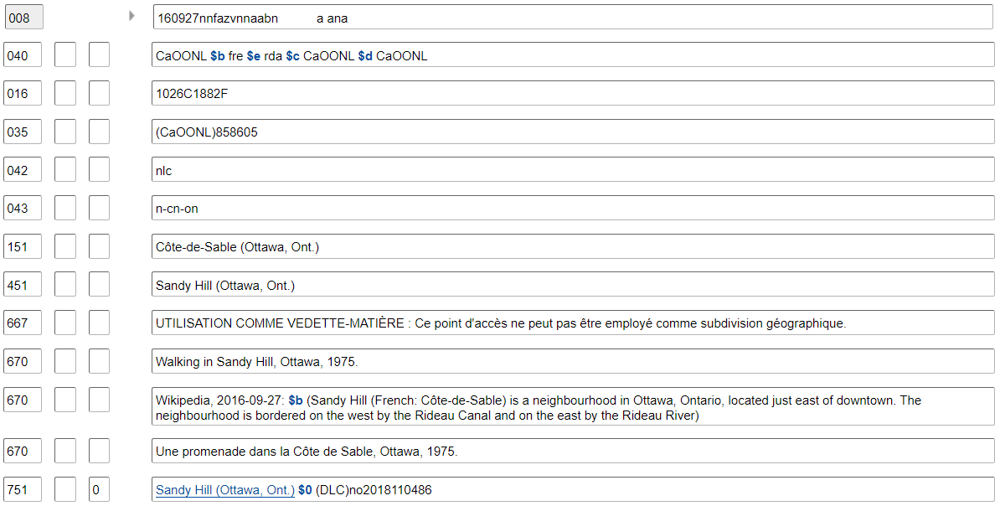
Autorité de vedette-matière – Partie de ville
Notes:
23 avril 2024 : Changement de l’exemple; note 667 mise à jour.
May 1, 2013
This is an example of a city section that is currently found in the LC Subject Authority File that should be transferred to the LC/NACO Authority File when needed as a subject in current cataloging (by creating a new NAR for the place and then requesting/proposing the cancellation of the subject authority record).
The fact that this record is a subject authority is seen by the prefix “sh” in the LCCN in the 010 field, as well as by the coding in 008/14 (Heading use code—main or added entry) of “b” (Heading not appropriate for main or added entry) and in 008/10 (Descriptive cataloging rules code) of “n” (Not applicable). The NAR created for this place would have a prefix beginning with “n”, “nb”, “no”, or “ns”; 008/14 “a” (Heading appropriate for main or added entry); and 008/10 “z” (Other) with subfield $e rda in the 040 field.

Slide 80
Lieux dans des villes, etc. – Directives sur les vedettes
Exemple :
Point d’accès autorisé : Chinatown (San Francisco, Calif.)
Pour une œuvre portant sur le tourisme dans le Chinatown
de San Francisco, assigner deux vedettes-matière :
650 _6 Tourisme $z Californie $z San Francisco.
651 _6 Chinatown (San Francisco, Calif.)
et non
650 _6 Tourisme $z Californie $z Chinatown (San Francisco)
ni
650 _6 Tourisme $z Californie $z San Francisco $z Chinatown.
Notes:
May 1, 2013
LCSH policy is that subject headings may not be subdivided below the level of a city or town. In order to bring out a topic in conjunction with a particular city section, the topic can be subdivided down to a particular city and then an additional subject heading for the specific city section is added.

Slide 81
Lieux dans des villes, etc. – Directives sur les vedettes
Subject Headings Manual H 835 : Information sur les subdivisions géographiques dans les notices d’autorités de nom
On emploie la zone 667 pour enregistrer le fait qu’une vedette de nom géographique ne peut pas être utilisée comme subdivision géographique. Les vedettes pour les entités géographiques dans des villes qualifiées par le nom de la ville, p. ex., les quartiers de ville, quartiers, secteurs, etc. ne peuvent pas être utilisées comme subdivisions géographiques.
Guide des autorités de noms 667 ‐ Les notices d’autorités de nom géographique et l’utilisation comme vedette-matière
En option, ajouter aux points d’accès géographiques qui ne sont pas appropriés pour l’utilisation des subdivisions géographiques :
667 UTILISATION COMME VEDETTE-MATIÈRE : Ce point d’accès ne peut pas être employé comme subdivision géographique.
Notes:
May 1, 2013
DCM Z1 667 - NARs and subject usage
PCC optional practice:
Add a 667 note to name authority records for geographic names that are not appropriate for use as geographic subdivisions in subject cataloging usage (per SHM H 835) when the name represents an entity within a city and is qualified by the city name. Such notes will most frequently be needed for names of city sections, districts, neighborhoods, etc. Make no changes to values in bytes of the 008.
667 SUBJECT USAGE: This name is not valid for use as a geographic subdivision.
Example:
151 Hollywood (Los Angeles, Calif.)
667 SUBJECT USAGE: This name is not valid for use as a geographic subdivision.
Follow these guidelines for newly-created authority records. Add the note to an existing record when making any other change to the record.
See DCM Z1 781 for guidelines on adding 781 fields to name authority records for geographic names that may also be used as geographic subdivisions.

Slide 82
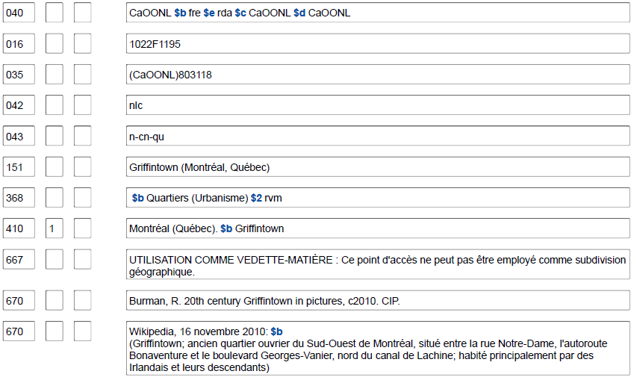
667 UTILISATION COMME VEDETTE-MATIÈRE Note pour les parties de villes
Notes:
May 1, 2013
Example of a name authority record for a city section, showing the inclusion of the 667 field alerting catalogers that the access point is not valid for use as a geographic subdivision.

Slide 83
Cas particuliers ‐ ÉP de BAC-BAnQ pour 16.4.1
Installations militaires
– Traiter les installations militaires (forts, bases, camps,
Aérodromes et stations de la Garde côtière, excepté les
chantiers maritimes) comme des localités
– Ajouter comme qualificatif le pays, l’État, la province, etc., qui aurait pu être ajouté(e) à une municipalité ou à un village situés dans le même lieu, même si l’installation est située à l’extérieur du pays contrôlant celle-ci
151 Fort Knox (Kent.)
151 Camp Pendleton (Calif.)
151 Guantánamo Bay Naval Base (Cuba)
151 Yokota Air Force Base (Japon)
Notes:
May 1, 2013
Note that even though the last two examples are U.S. military installations, since they are located in another country that other country is used as the qualifier.

Slide 84
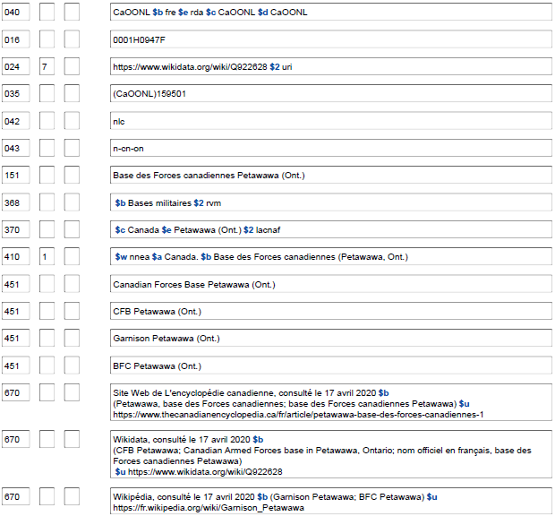
Notes:
Updated: September 17, 2018
An example of a Canadian military base. The name used in AACR2 (which by agreement with Library and Archives Canada would have followed the LAC-established form) did not necessarily follow the NACO policy of establishing military bases as geographic places. LAC coded bases as corporate bodies (110) and established them as subordinate units of Canada. When upgraded to RDA, the authorized access point for a Canadian military installation will need to be reevaluated to see if it follows the policy statement for 16.4.1. The earlier established AACR2 form can be seen in the slide in the 410 field that has $w nnea. When this record was upgraded to RDA, since the access point is now coded as a geographic place that is eligible for use as a geographic subdivision, a 781 was also added to the record, as were coded geographic coordinates (034). An 043 geographic area code could also have been added.

Slide 85
Cas particuliers ‐ ÉP de la LC‐PCC pour 16.4.1
Tribus d'Indiens des États-Unis
– Les tribus reconnues par le gouvernement des É.-U. sont des
entités politiques indépendantes dotées de pouvoirs autonomes; elles peuvent exercer leur souveraineté au même titre que les gouvernements nationaux
– Établir en tant que juridictions dans une zone 151
– Pour le nom approuvé, consulter la liste officielle publiée dans
le registre fédéral « Indian Entities Recognized and Eligible To Receive Services From the Bureau of Indian Affairs » (peut être cité « BIA Indian entities »).
http://www.bia.gov/DocumentLibrary/index.htm
Notes:
September 17, 2018: removed URL to http://www.bia.gov/DocumentLibrary/index.htm, added hyperlink to slide and instructions in speaker notes to find most recent list in the Federal Register.
LC-PCC PS for 16.4.1
American Indian Tribes
Tribes recognized by the U.S. government are independent, autonomous political entities with inherent powers of self-government; they possess sovereignty and are equal to national governments. There are over 500 recognized tribes within the continental United States. Nearly all federally recognized tribes have jurisdiction over some delimited area of land, a geographic place, although land and area vary with each tribe.
Consult the official list created and maintained by the Department of the Interior, Bureau of Indian Affairs, published and updated in the Federal Register. The list of federally recognized tribes, published bi-annually since 1979, entitled: Indian Entities Recognized and Eligible to Receive Services from the United States Bureau of Indian Affairs is accessed through the Federal Register website. This source may be cited as “BIA Indian Entities.” If a name for a tribal entity is not found in the BIA list, conduct additional research and/or construct the authorized access point from information on the resource being cataloged.
To find the most recent list:
Go to https://www.gpo.gov/fdsys/search/home.action
In the search box, enter: title:(Indian Entities Recognized and Eligible To Receive Services From the Bureau of Indian Affairs) AND collection:FR
Click Search.
Sort by: Date (New to Old).
Click Go.
Official list as of July 23, 2018: https://www.gpo.gov/fdsys/pkg/FR-2018-07-23/pdf/2018-15679.pdf
PSD website has a link to version from January 14, 2015: http://www.loc.gov/catdir/cpso/biaind.pdf
EXAMPLE
151 San Carlos Apache Tribe of the San Carlos Reservation, Arizona
670 BIA Indian entities, 2005, Dec. 14, 2005 $b (San Carlos Apache tribe of the San Carlos Reservation, Arizona)
Some tribes have federally-approved names that sound as if the name were for a populated place rather than a tribe. Confusion may result when there actually is a populated place of that name. In such cases, the tribe and the populated place are separate entities.
EXAMPLE
151 Native Village of Nunapitchuk
Tribe
151 Nunapitchuk (Alaska)
Populated place

Slide 86
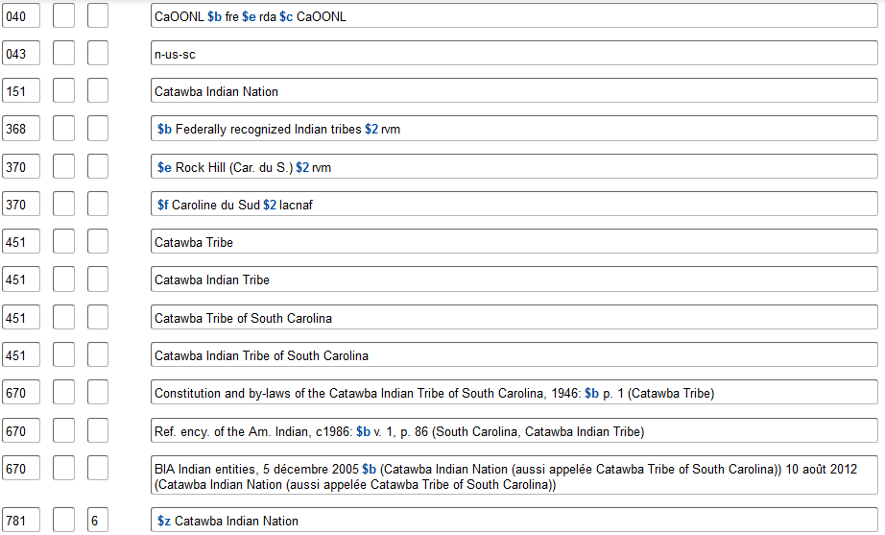
Notes:
Updated: Feb. 24, 2014
Example of an authority for an Indian tribe as a geographic place/sovereign nation. For the preferred name for the tribe, use the form found in BIA Indian Entities. No qualifier is added to the authorized access point.
Note also the geographic subdivision practice: as sovereign nations, geographic subdivision is direct through the name of the tribe.

Slide 87
Premières Nations du Canada dans RDA
Règles de catalogage descriptif : c
Traiter les Premières Nations du Canada comme des lieux géographiques/juridictions; convertir le codage pour collectivités dans les notices RCAA2 en codage pour lieux géographiques
Notes:
May 1, 2013
In AACR2, NACO policy was to use the form for Canadian places and corporate bodies approved by Library and Archives Canada. LAC establishes Canadian First Nations as corporate bodies tagged 110, so this is how you will find them if established under AACR2 (see slide). Under RDA, they may be treated the same as American Indian tribes. Establish new records for First Nations as geographic places. When upgrading a record for a Canadian First Nation to RDA, evaluate the access points and retag them as geographic places (X51). As with American Indian tribes, geographic subdivision is direct through the name of the First Nation. BFM may need to be reported when upgrading these records.

Slide 88
Premières Nations du Canada dans RDA
Règles de catalogage descriptif : z
Traiter les Premières Nations du Canada comme des lieux géographiques/juridictions; convertir le codage pour collectivités dans les notices RCAA2 en codage pour lieux géographiques
Notes:
May 1, 2013
In AACR2, NACO policy was to use the form for Canadian places and corporate bodies approved by Library and Archives Canada. LAC establishes Canadian First Nations as corporate bodies tagged 110, so this is how you will find them if established under AACR2 (see slide). Under RDA, they may be treated the same as American Indian tribes. Establish new records for First Nations as geographic places. When upgrading a record for a Canadian First Nation to RDA, evaluate the access points and retag them as geographic places (X51). As with American Indian tribes, geographic subdivision is direct through the name of the First Nation. BFM may need to be reported when upgrading these records.

Slide 89
Variantes de nom (16.2.3)
Non fondamental
Prendre de n’importe quelle source
Quelques exemples de cas spécifiques sont fournis
– Articles initiaux
– Nom développé
– Sigle/Forme abrégée
– Forme linguistique alternative du nom
– Autre variante de nom
Notes:
May 1, 2013

Slide 90
Variantes de nom – Articles initiaux (16.2.3.4)
Si le nom privilégié comprend un article, enregistrer comme
variante le nom sans l’article
151 Los Angeles (Calif.)
451 Angeles (Calif.)
Si l’article est omis d’un nom privilégié, enregistrer comme
variante le nom avec l’article
151 Dalles (Or.)
451 The Dalles (Or.)
Notes:
March 5, 2019: made grammatical correction to slide

Slide 91
Variantes de nom – Nom développé (16.2.3.5)
Si le nom privilégié est ou comprend un sigle ou une
forme abrégée ou écourtée d’un nom, enregistrer la
forme développée du nom comme variante
151 St. John's (T.-N.-L.)
451 Saint John's (T.-N.-L.)
151 Tribeca (New York, N.Y.)
451 Triangle Below Canal (New York, N.Y.)
Notes:
May 1, 2013
N.L. is the abbreviation used for the province Newfoundland and Labrador. The province’s name changed officially from Newfoundland to Newfoundland and Labrador on December 6, 2001. The former abbreviation was Nfld., which would still be used for any places that existed only during the time when the province was known by the earlier name.

Slide 92
Variantes de nom – Sigle/forme abrégée (16.2.3.6)
Si le nom choisi comme nom privilégié d’un lieu est une
forme complète du nom, enregistrer un sigle ou une
forme abrégée du nom comme variante de nom
151 Île-du-Prince-Édouard
451 Î.-P.-É.
451 Î.P.É.
151 South of Market (San Francisco, Calif.)
451 SOMA (San Francisco, Calif.)
Notes:
May 1, 2013
Examples of initialisms recorded as variant names

Slide 93
Variantes de nom – Sigle/forme abrégée (16.2.3.6)
Si le nom choisi comme nom privilégié d’un lieu est une
forme complète du nom, enregistrer un sigle ou une
forme abrégée du nom comme variante de nom
151 Saint Louis (Mont.)
451 St. Louis (Mont.)
151 Mount Airy (Philadelphie, Penns.)
451 Mt. Airy (Philadelphie, Penns.)
151 South Daytona (Flor.)
451 So. Daytona (Flor.)
Notes:
May 1, 2013
Examples of abbreviated forms recorded as variant names

Slide 94
Variantes de nom – Sigle/forme abrégée (16.2.3.6)
Si le nom choisi comme nom privilégié est constitué d’un
sigle, enregistrer comme variante la forme avec/ou sans les points
151 R.A.F. Kenley (Angleterre)
451 RAF Kenley (Angleterre)
Si le nom complet est choisi comme nom privilégié, enregistrer
comme variante de nom le sigle sans les points ainsi qu’avec les
points
151 Territoires du Nord-Ouest
451 T.N.-O.
451 TNO
Notes:
May 1, 2013

Slide 95
Variantes de nom – Sigle/forme abrégée (16.2.3.6)
Langue différente Suomi / Finland
Écriture différente Србија / Srbija
Orthographe différente Lituanie / Lithuanie
Translittération différente Aqaba / Akaba / ʿAqabah
Représentation des nombres (lettres ou chiffres)
9th Ward / Ninth Ward
Zweiter Bezirk / 2. Bezirk
日本 اليابان Япония Ιαπωνία 일본 יפן
Японія ژاپن 日本國 Јапонија
جاپان Јапан יאפאן ياپونىيە Япунмастор
Notes:
May 1, 2013
16.2.3.7 deals with alternative linguistic forms of the name for a place, and the examples are categorized as seen in the bullets in this slide.
Different Language: Suomi vs. Finland
Different Script: Србија vs. Srbija
Different Spelling: Rumania vs. Romania
Different Transliteration: Aqaba or Akaba vs. ʿAqabah
Different Representation of Numbers: Zweiter Bezirk vs. 2. Bezirk; Tredicesima Circoscrizione vs. XIII Circoscrizione; East Seventh Avenue Historic District vs. East 7th Avenue Historic District; 9th Ward vs. Ninth Ward
FYI: All the names shown at the bottom of this slide are for Japan, in various languages and in scripts that are eligible for inclusion in name authority records (Arabic, Chinese, Cyrillic, Greek, Hebrew, Japanese, and Korean scripts). If you have a name in any other script (examples include: Armenian, Burmese, Cherokee, Devanagari, Georgian, Inuktitut, Mongolian, Sinhalese, Tamil, Thai, Tibetan) you must transliterate it according to the ALA-LC Romanization Tables (online at http://www.loc.gov/catdir/cpso/roman.html). At the present time, only the romanized forms of names in such scripts may be included in NARs.

Slide 96
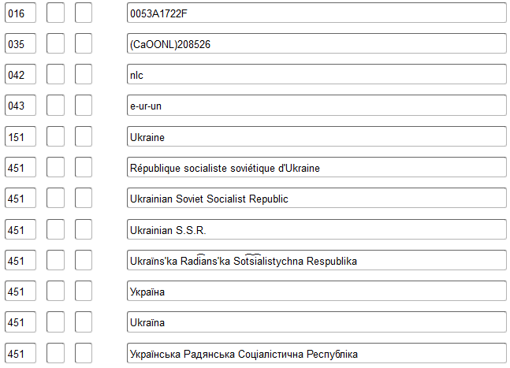
Evaluation du renvoi : b
Guide des autorités de noms - Supplément MARC 21 : 008/29 : utiliser le code « b » dans toutes les notices d’autorité de noms comprenant des renvois en caractères non-latins. La note 667 « Le renvoi en écriture non latine n'a pas été évalué » doit aussi être présente. S'il y a plusieurs variantes de points d'accès dans une écriture non latine, utiliser une note indiquant « Les renvois en écriture non latine n'ont pas été évalués ».
Notes:
May 1, 2013
The slide shows a number of variant names for Hawaii, including some variant English names, names in other languages, and names in other scripts. Remember that if you add non-Latin script references (and you are encouraged to!), that the 008/29 (Ref status in OCLC) must be coded with value “b” and a 667 note “Non-Latin script reference(s) not evaluated” must also be added (next slide).
LC Guidelines 008/29: Code b will also occur in all name/series records with non-Latin script references until guidelines for evaluating non-Latin script references are developed. When code b is used in this latter case assure that a 667 note with the statement: "Non-Latin script reference not evaluated" is also present in the NAR.
(Diapos suivante en anglaise, masque)
May 1, 2013
Remember: Justify any non-Latin references you add with 670s. Only romanized forms of names in non-Latin scripts are required in NARs; addition of the non-Latin script form is optional.

Slide 97
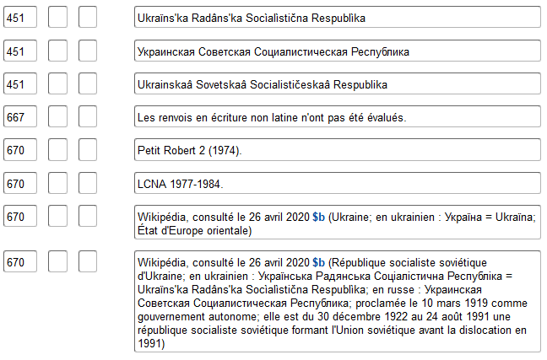
Guide des autorités de noms - Supplément MARC 21 : 008/29 : utiliser le code « b » dans toutes les notices d’autorité de noms comprenant des renvois en caractères non-latins. La note 667 « Le renvoi en écriture non latine n'a pas été évalué » doit aussi être présente. S'il y a plusieurs variantes de points d'accès dans une écriture non latine, utiliser une note indiquant « Les renvois en écriture non latine n'ont pas été évalués ».

Slide 98
Variantes de nom – Autres formes (16.2.3.8)
Noms différents
Lieu dans une ville comme subdivision du point
d’accès autorisé pour la ville
151 Garment District (New York, N.Y.)
451 Fashion District (New York, N.Y.)
451 Garment Center (New York, N.Y.)
410 1_ New York (N.Y.). $b Garment District
Notes:
March 21, 2017: updated speaker notes to reflect current RDA language.
16.2.3.8 tells us to record other variant names and variant forms of the name not covered by 16.2.3.4–16.2.3.7, if considered important for identification or access. It lists two situations covered in this instruction: different names, and name of place within a city as subdivision of authorized access point for the city. But the instruction does not limit catalogers to these two situations. Anything not covered under 16.2.3.4-16.2.3.7 is eligible for recording as a variant name under 16.2.3.8.
Here’s an example not covered by any of the rules: a neighborhood or other kind of city section within some larger neighborhood or city section. For example, the Garment District of New York City is located within the borough of Manhattan. In addition to the variant access point shown in the slide, the cataloger might decide it was useful to record a variant access point for the neighborhood as a subdivision of the borough in which it is located:
410 1_ Manhattan (New York, N.Y.). $b Garment District

Slide 99
040 CaOONL $b fre $e rda $c CaOONL $d CaOONL
043 n-us-wa
151 Lower Queen Anne (Seattle, Wash.)
368 $b Quartiers (Urbanisme) $2 rvm
410 1 Seattle (Wash.). $b Lower Queen Anne
451 LQA (Seattle, Wash.)
410 1 Queen Anne (Seattle, Wash.). $b Lower Queen Anne
667 UTILISATION COMME VEDETTE-MATIÈRE : Ce point d’accès ne peut pas être employé comme subdivision géographique.
670 McDevitt, G.D. A catalyst for the reconstruction of an urban block : the Lower Queen Anne QFC store fire, 1982.
670 Wikipédia en anglais, 6 septembre 2012 : $b Seattle Center (Seattle Center; situé juste au nord de Belltown dans le quartier Lower Queen Anne) Lower Queen Anne, Seattle (Lower Queen Anne est un quartier de Seattle, Washington, à la base de la colline Queen Anne. Bien que ses limites ne soient pas précises, le toponyme fait généralement référence aux quartiers commerciaux, de bureaux et résidentiels situés au nord et à l'ouest de Seattle Center. Les quartiers à l'ouest du centre sont également connus sous le nom de Uptown. Le quartier est relié à Upper Queen Anne - le quartier commercial en haut de la colline - par une section extrêmement raide de Queen Anne Avenue N. connue sous le nom de « Counterbalance », en mémoire des téléphériques qui y circulaient autrefois; 47°37ʹ30ʺN 122°21ʹ33ʺW)
670 Site Web NFT Not for Tourists Seattle, consulté le 6 septembre 2012 : $b quartiers - Lower Queen Anne / Seattle Center (Lower Queen Anne / Seattle Cente. Les résidents du LQA sont pour la plupart des célibataires, des professionnels urbains entre la mi-vingtaine et le début de la trentaine, qui bénéficient d'une vie nocturne saine et de résidences haut de gamme sans prétention. Le quartier conserve une atmosphère de Belltown un peu plus économique)
670 Site Web de GoTime.com Seattle, consulté le 6 septembre 2012 : $b neighborhood (Lower Queen Anne)
670 Seattle City Clerk's Office geographic indexing atlas neigbhorhood terms list, via WWW, consultée le 6 septembre 2012 $b (Lower Queen Anne; énuméré hiérarchiquement sous Queen Anne)
675 GNIS 2012-09-06
Autre variante de nom : lieu dans une ville comme subdivision du lieu plus vaste dans une ville
Notes:
May 1, 2013
A situation not explicitly covered in RDA, but permitted under instruction 16.2.3.8: a neighborhood that is part of a larger neighborhood. Lower Queen Anne in Seattle is a separately named part of the Queen Anne neighborhood. In addition to a variant access point made for the neighborhood as a subdivision of the city (first 410 in the record), an additional variant access point has been made for the neighborhood as a subdivision of the larger neighborhood.

Slide 100
040 CaOONL $b fre $e rda $c CaOONL $d CaOONL
043 n-us-ca
151 South of Market (San Francisco, Calif.)
368 $b Quartiers (Urbanisme) $2 rvm
451 South of Market District (San Francisco, Calif.)
451 SOMA (San Francisco, Calif.)
410 1 San Francisco (Calif.).$bSouth of Market
451 South of the Slot (San Francisco, Calif.)
451 100 Vara Survey (San Francisco, Calif.)
451 One Hundred Vara Survey (San Francisco, Calif.)
667 UTILISATION COMME VEDETTE-MATIÈRE : Ce point d’accès ne peut pas être employé comme subdivision géographique.
670 SOMA : South of Market analysis, 1984 : $b préface (the South of Market; San Francisco) p. 1 (The South of Market District) p. 5 (The South of Market district)
670 San Francisco County street guide & directory, c1986 : $b p. D (list of San Francisco County communities: South of Market)
670 California road & recreation atlas, c1998 : $b p. 36 (South of Market)
670 Wikipédia en anglais, 1er mars 2013 $b (South of Market, San Francisco; South of Market (ou SoMa) est un quartier relativement grand de San Francisco, Californie, situé juste au sud de Market Street et comprend plusieurs sous-quartiers dont South Beach, Mission Bay et Rincon Hill; la tendance est de raccourcir le nom en SOMA ou SoMa; avant d'être appelé South of Market, ce quartier était appelé "South of the Slot", une référence aux téléphériques qui parcouraient Market le long d'une fente à travers laquelle ils se fixaient aux câbles; depuis 1847, le nom officiel de la zone South of Market est "100 Vara Survey" (alternativement "100 Vara District") ou simplement "100 Vara" pour faire court (avec "100" parfois écrit en toutes lettres). Depuis le milieu du 20e siècle, le nom officiel a été progressivement oublié et on le trouve aujourd'hui principalement dans les livres d'histoire, les documents juridiques, les titres de propriété et les rapports de génie civil; 37°46ʹ38ʺN 122°24ʹ40ʺW)
670 Bay Area neighborhoods, sur le site Web SFGate.com, consulté le 1er mars 2013 : $b San Francisco > SoMa (South of Market est un immense quartier, qui s'étend de l'Embarcadero à la onzième rue, entre Market et Townsend; SoMa; le provient de l'ancien surnom "South of the Slot", en référence à sa position sur le mauvais côté de la voie de téléphérique de Market Street lorsqu'il était un quartier industriel d'usines et de travailleurs immigrés de la ruée vers l'or) $u http://www.sfgate.com/neighborhoods/sf/soma/
675 GNIS 2013-03-01;$aRand McNally, 1998;$aDurham, D.L. California's geographic names, c1998;$aGudde, E.G. California place names, c1998
Noms différents
Sigle
Nom comme subdivision d’une ville
Représentations différentes des nombres
Notes:
May 1, 2013
Summary example: This slide illustrates a number of different kinds of variant names that have been recorded in the authority record for the neighborhood South of Market in San Francisco.
Reminder: Places within cities cannot be used as geographic subdivisions, so including a 667 SUBJECT USAGE note would be helpful to other catalogers.

Slide 101
Variantes de nom – ÉP de BAC-BAnQ pour 16.4.2
Choix du lieu plus vaste lorsque le nom plus petit reste le même, mais que le nom du lieu plus vaste change
– Dans la 151, utiliser le nom actuel du lieu plus vaste dans le
qualificatif
– Si le nom présent dans la ressource appartient à la période antérieure, considérer l’enregistrement d’une variante de point d’accès d’après la forme avec un qualificatif pour le nom antérieur du lieu plus vaste
151 Torit (Soudan du Sud) 151 Charles Town (Virg.-Occ.)
451 Torit (Soudan) 451 Charles Town (Virg.)
Notes:
Updated: Nov. 14, 2016
LC-PCC PS for 16.4.2
Choice of Larger Place
LC practice/PCC practice: When adding the name of a larger place as a qualifier, use the current name of the larger place (see RDA 16.2.2.9-RDA 16.2.2.12), and apply Appendix B.11, as applicable. If the smaller place existed when the larger place had an earlier name, and the name in the resource pertains to the earlier period, consider recording a variant access point from the form that shows the earlier name of the larger place if the qualifier is appropriate for the smaller place.
EXAMPLE
151 ## $a Minsk (Belarus)
451 ## $w nne $a Minsk (Byelorussian S.S.R.)
Variant access point that was previously used as authorized form. Byelorussian S.S.R. became Belarus
151 ## $a Torit (South Sudan)
451 ## $w nne $a Torit (Sudan)
Variant access point that was previously used as authorized form. Torit became part of the new country South Sudan
151 ## $a Charles Town (W. Va.)
451 ## $a Charles Town (Va.)
Variant access point that was not previously used as authorized form
151 ## $a Ballard (Seattle, Wash.)
451 ## $a Ballard (Wash.)
Variant access point that was not previously used as authorized form. The city Ballard became a city section of Seattle

Slide 102
040 CaOONL $b fre $e rda $c CaOONL
151 Ouagadougou (Burkina Faso)
451 $w nnaa $a Ouagadougou, Haute-Volta
451 $w nne $a Ouagadougou (Haute-Volta)
451 Ouagaduga (Burkina Faso)
451 Wagadugu (Burkina Faso)
Le nom du lieu plus vaste a changé. Variante de point d’accès produite à partir du nom avec le qualificatif antérieur
Notes:
Updated: September 17, 2018
Slide illustrates the situation where there is already an established access point for a place, and the name of the larger place in which the smaller place is located changes. This can happen with mergers and splits (e.g., Prague, Czechoslovakia becomes Prague, Czech Republic) or simply when a larger jurisdiction changes its name (example in this slide; another example is Kinshasa, Zaire becomes Kinshasa, Congo). In this case, the qualifier in the 151 and 451s is changed to the current name for the larger place, and a 451 is made for the previously authorized access point for the place. Don’t forget also to change the 781 field if it is in the record!

Slide 103
Variantes de nom – ÉP de BAC-BAnQ pour 16.4.2
Choix du lieu plus vaste lorsqu’un lieu dans une ville avait une
existence auparavant indépendante, pourvu que son nom demeure constant (voir également l’ÉP de BAC-BAnQ pour 16.2.2.14)
– Dans la 151, utiliser le nom de la ville comme lieu plus vaste
– Vous pouvez fournir une variante de point d’accès avec un qualificatif
approprié à l’existence précédemment indépendante de la collectivité
151 Verdun (Montréal, Québec)
451 Verdun (Québec)
Un seul point d’accès autorisé est utilisé pour Verdun, à la fois comme arrondissement de la ville de Montréal et comme ville précédemment indépendante.
Notes:
Updated: Nov. 14, 2016 (and moved slide position)
Ballard example from LC-PCC PS for 16.4.2.
Note: Rule for qualifier is in LC-PCC PS for 16.2.2.14:
LC practice/PCC practice: For places within cities, add the city in parentheses. Use the access point reflecting its current status for the entire period of the place within the city’s existence, including any earlier independent existence it may have had, provided the name remains constant. Consider making a variant access point from the name of the place within the city as a subheading of the name of the city.
Based on this policy statement, Ballard (Seattle, Wash.) is used as the access point for both the current section/neighborhood of Seattle as well as for the place when it was a separate city prior to annexation by Seattle (1890-1907).
However, if the place within the city once had an independent existence but changed its name when it was absorbed into the larger place, create an authorized access point for each name.
EXAMPLE
For resources issued before 1975:
151 Endersbach (Germany)
For resources issued after 1974:
151 Weinstadt-Endersbach (Weinstadt, Germany)
410 1_ Weinstadt (Germany). $b Weinstadt-Endersbach

Slide 104
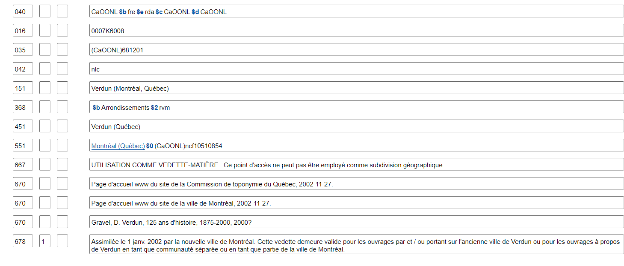
Employer le point d’accès représentant le lieu actuel. S’applique aussi aux collectivités supérieures de la juridiction jusque-là séparée :
110 1_ Verdun (Montréal, Québec). $b Service de l'urbanisme
110 1_ Verdun (Montréal, Québec). $b Service des incendies
Notes:
Updated: September 17, 2018
This practice means that you could have a somewhat unusual situation where a subordinate body for the period where the place had an independent existence, would be entered under the access point for the current city section:
110 1_ Ballard (Seattle, Wash.). $b City Council
110 1_ Ballard (Seattle, Wash.). $b Fire Department

Slide 105
Variantes de nom – ÉP de BAC-BAnQ pour 16.4.2
Installations militaires
– Fournir des variantes de points d’accès à partir du nom comme sous-vedette du pays le contrôlant et comme sous-vedette de la branche militaire à laquelle il appartient
151 Fort Knox (Kent.)
410 1_ États-Unis. $b Fort Knox
410 1_ États-Unis. $b Army. $b Fort Knox
151 Guantánamo Bay Naval Base (Cuba)
410 1_ États-Unis. $b Guantánamo Bay Naval Base
410 1_ États-Unis. $b Navy. $b Guantánamo Bay Naval Base
Notes:
May 1, 2013
LC-PCC PS for 16.4.2
Military Installations
LC practice/PCC practice: Construct variant access points from the name as a subheading of the country that controls it and as a subheading of the military branch to which it belongs.
EXAMPLE
151 Fort Hood (Tex.)
410 1_ United States. $b Fort Hood
410 1_ United States. $b Army. $b Fort Hood
151 March Air Force Base (Calif.)
410 1_ United States. $b March Air Force Base
410 1_ United States. $b Air Force. $b March Air Force Base
151 Yokosuka Naval Base (Japan)
410 1_ United States. $b Yokosuka Naval Base
410 1_ United States. $b Navy. $b Yokosuka Naval Base

Slide 106
040 CaOONL $b fre $e erda $c CaOONL
043 e-gi---
151 RAF Gibraltar (Gibraltar)
368 $b Bases aériennes $b Bases militaires $2 rvm
370 $c Gibraltar $2 lacnaf
410 1 Grande-Bretagne. $b RAF Gibraltar
410 1 Grande-Bretagne. $b Royal Air Force. $b RAF Gibraltar
451 North Front (Gibraltar)
451 Royal Air Force Station Gibraltar (Gibraltar)
510 2 Gibraltar International Airport
670 RAF Gibraltar, 2002 : $b page de titre (RAF Gibraltar)
670 Overseas Royal Air Force stations, via WWW, 19 septembre 2005 $b (RAF Gibraltar; la station de la RAF à Gibraltar fait partie du quartier général des forces britanniques à Gibraltar. Bien que les avions ne soient plus stationnés sur "The Rock", divers avions de la RAF effectuent des visites régulières)
670 Wikipedia, 3 mars 2013 : $b RAF Gibraltar (La RAF Gibraltar, également connue sous le nom de North Front, est une station de la Royal Air Force sur Gibraltar. Aucun avion militaire n'y est actuellement stationné, mais il y a des visites régulières. Administrée par les forces britanniques de Gibraltar, la station fonctionne comme l'aéroport civil du Rocher - l'aéroport de Gibraltar, avec le terminal des passagers et les installations de l'aire de trafic de l'aéroport civil situés sur le côté nord de la piste, tandis que l'aire de trafic et le hangar de la RAF Gibraltar sont situés sur le côté sud de la piste; Royal Air Force Station Gibraltar; 36. 149565°N 5.34764°W) L'aéroport international de Gibraltar (Gibraltar International Airport ou North Front Airport (IATA : GIB, OACI : LXGB) est l'aéroport civil qui dessert le territoire britannique d'outre-mer de Gibraltar. La piste est la propriété du ministère de la défense et est utilisée par la Royal Air Force sous le nom de RAF Gibraltar; 36°09ʹ04ʺN 005°20ʹ59ʺW
781 6 $z Gibraltar $z RAF Gibraltar
Notes:
Updated: Feb. 24, 2014
An example of a non-U.S. military installation authority record.

Slide 107
Exercices
Variantes de nom
Notes:
May 1, 2013

Slide 108
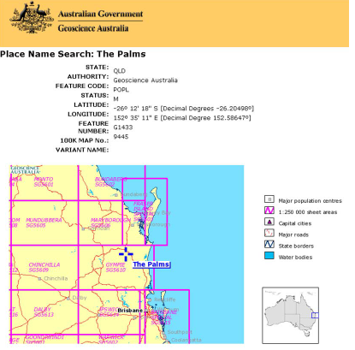
Rédigez les zones suivantes :
151
451
Notes:
May 1, 2013
NOTE: ANSWER SLIDES TO VARIANT NAMES EXERCISES ARE AFTER ALL THE VARIANT NAME EXERCISES
ANSWER:
151 Palms (Queens.)
451 The Palms (Queens.)
Remember: You must also check for conflicts for any variant forms of names that you are recording, and if there is a conflict with other places in the same larger place, you must break that conflict if possible. Assume no conflicts in this example.

Slide 109
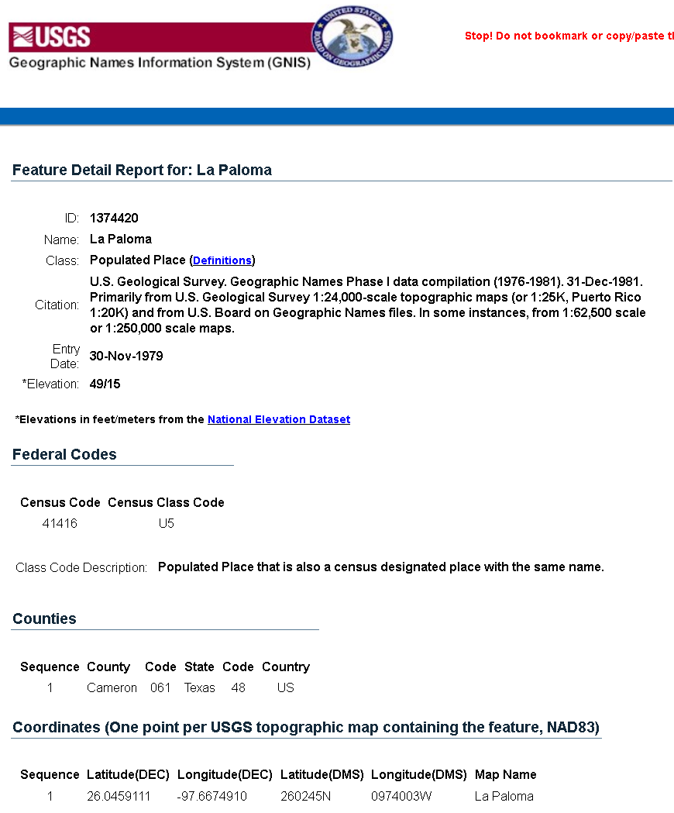
Rédigez les zones suivantes :
151
451
Notes:
May 1, 2013
ANSWER
151 La Paloma (Tex.)
451 Paloma (Tex.)
Remember: You must also check for conflicts for any variant forms of names that you are recording, and if there is a conflict with other places in the same larger place, you must break that conflict if possible. Assume no conflicts in this example.

Slide 110
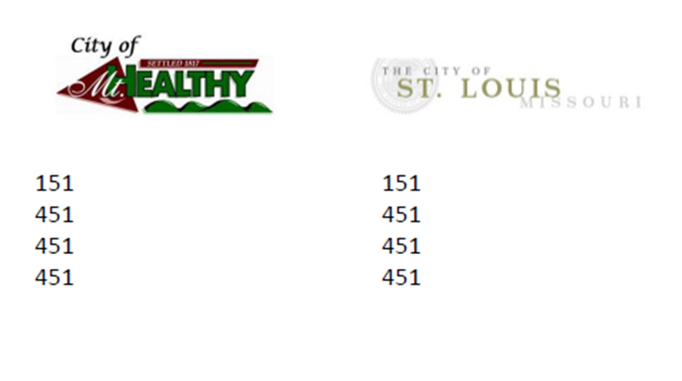
Note : Le lieu se trouve en Ohio
Notes:
Updated: November 25, 2015
ANSWERS
151 Mount Healthy (Ohio)
451 Mt. Healthy (Ohio)
451 City of Mt. Healthy (Ohio)
451 City of Mount Healthy (Ohio) is also a possible variant
151 Saint Louis (Missouri)
451 St. Louis (Missouri)
451 City of St. Louis (Missouri)
City of Saint Louis (Missouri) is also a possible variant
Missouri ne s’abrège pas en français

Slide 111
Déterminer le nom privilégié et le point d’accès autorisé pour ce lieu
Nom privilégié du lieu : ______________
151
451
670 Carte routière, territoire de la MRC de Rivière-du-Loup, [2010?]
670 Site Web du Répertoire des municipalités du Québec, consulté le 26 avril 2020 $b (Rivière-du-Loup; MRC; région administrative : Bas-Saint-Laurent (01); date d'entrée en vigueur : 1982-01-01)
670 Site Web Banque de noms de lieux du Québec, consulté le 26 avril 2020 $b (Rivière-du-Loup; municipalité régionale de comté située dans le Bas-Saint-Laurent; instituée en janvier 1982; se compose de seize municipalités dont Rivière-du-Loup; en plus de la ville, la Banque liste aussi une division de recensement et une circonscription électorale du même nom)
Notes:
May 1, 2013
Preferred name for the place: Ujjain (India)
151 Ujjain (India : District)
451 Ujjain District (India)
Explanation: BGN approved form is selected as the basis for the preferred name, but it conflicts with a city/town. Therefore type of jurisdiction (11.7.1.5) becomes a core element, since it is needed to differentiate the two jurisdictions with the same name. 11.13.1.6 requires the type of jurisdiction to be added to distinguish one access point from another, but it is only added to the access point for the district in this case. According to 11.13.1.6, a term for type of jurisdiction is only ever added to the name of a government other than a city or a town.

Slide 112
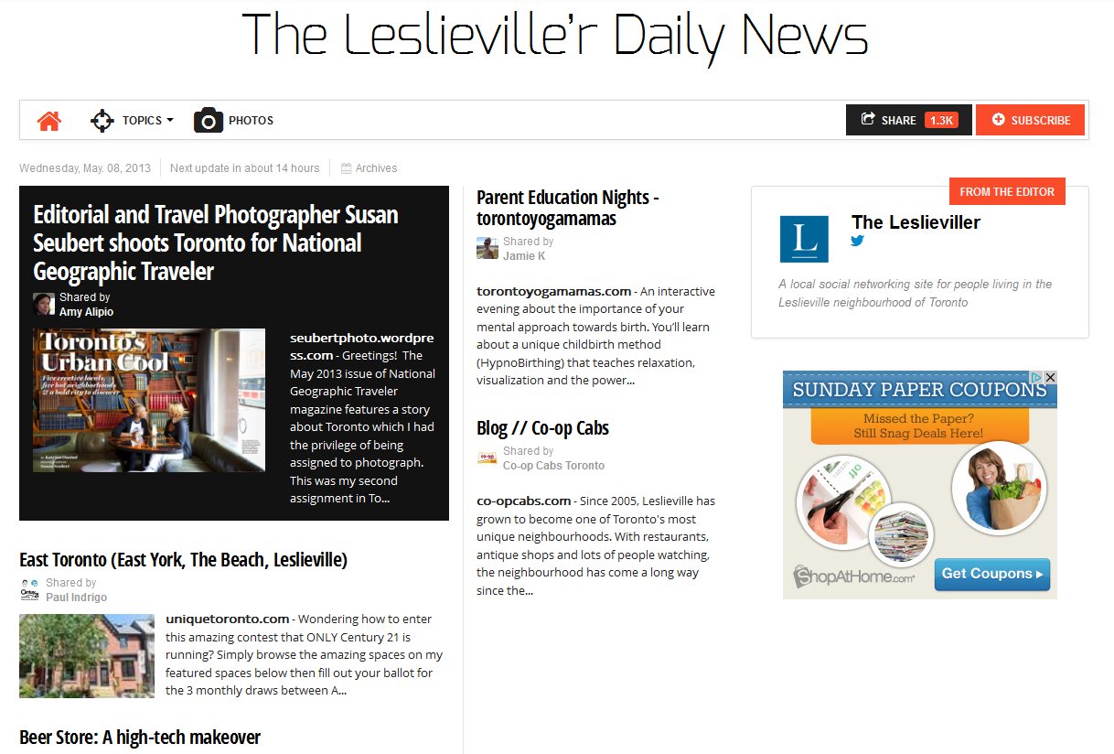
151
4__
670 Site Web de The Leslieville’r daily news, consulté le 25 avril 2013: $b page d’accueil (the Leslieville neighbourhood of Toronto) $u http://paper.li/leslieviller/1291175230
Notes:
May 1, 2013
ANSWER
151 Leslieville (Toronto, Ont.)
410 1_ Toronto (Ont.). $b Leslieville

Slide 113
Notes:
May 1, 2013

Slide 114
Notes:
May 1, 2013

Slide 115
151
4__
4__
4__
670 NODO : creating destination at the pedestrian scale, 2007: $b page
ii (North Downtown; qui se transforme en l'un des plus passionnants et actifs des quartiers) page 1 (North Downtown Omaha (NODO))
670 North Downtown : Omaha’s new urban neighborhood, 2006?
670 Wikipédia en anglais, 25 avril 2013 $b (sous Downtown Omaha : North Downtown s'étend sur 80 blocs, du campus de l'université de Creighton au CenturyLink Center et aux nouveaux développements le long de la Missouri River; la zone comprenant le NoDo est au centre de l'histoire d’Omaha)
675 GNIS 2013-04-25
Notes:
May 1, 2013
POSSIBLE ANSWERS
151 NODO (Omaha, Nebr.) ou NoDo (Omaha, Nebr.)
410 1_ Omaha (Nebr.). $b NODO
451 North Downtown (Omaha, Nebr.)
451 North Downtown Omaha (Omaha, Nebr.)
ou
151 North Downtown (Omaha, Nebr.)
410 1_ Omaha (Nebr.). $b North Downtown
451 NODO (Omaha, Nebr.) or NoDo (Omaha, Nebr.)
451 North Downtown Omaha (Omaha, Nebr.)
The example illustrates that the choice of preferred and variant names is not always straightforward. Based on the information available, a cataloger might select one form or the other, especially when no BGN-approved form of name is found.

Slide 116
Rédigez les zones suivantes :
151
451
Palms (Queensl.)
The Palms (Queensl.)
Notes:
May 1, 2013
ANIMATED SLIDE
ANSWER:
151 Palms (Queens.)
451 The Palms (Queens.)
Remember: You must also check for conflicts for any variant forms of names that you are recording, and if there is a conflict with other places in the same larger place, you must break that conflict if possible. Assume no conflicts in this example.

Slide 117
Rédigez les zones suivantes :
151
451
La Paloma (Tex.)
Paloma (Tex.)
Notes:
May 1, 2013
ANIMATED SLIDE
ANSWER
151 La Paloma (Tex.)
451 Paloma (Tex.)
Remember: You must also check for conflicts for any variant forms of names that you are recording, and if there is a conflict with other places in the same larger place, you must break that conflict if possible. Assume no conflicts in this example.

Slide 118
151
451
451
451
Note : le lieu se trouve en Ohio
151
451
451
451
Mount Healthy (Ohio)
Saint Louis (Missouri)
Mt. Healthy (Ohio)
St. Louis (Missouri)
City of Mt. Healthy (Ohio)
City of St. Louis (Missouri)
City of Saint Louis (Missouri)
City of Mount Healthy (Ohio)
Notes:
Updated: November 25, 2015
ANIMATED SLIDE
ANSWERS
151 Mount Healthy (Ohio)
451 Mt. Healthy (Ohio)
451 City of Mt. Healthy (Ohio)
451 City of Mount Health (Ohio) is also a possible variant
151 Saint Louis (Mo.)
451 St. Louis (Mo.)
451 City of St. Louis (Mo.)
451 City of Saint Louis (Mo.) is also a possible variant

Slide 119
Déterminer le nom privilégié et le point d’accès autorisé pour ce lieu
Rivière-du-Loup (Québec)
Nom privilégié du lieu :
151
451
670 Carte routière, territoire de la MRC de Rivière-du-Loup, [2010?]
670 Site Web du Répertoire des municipalités du Québec, consulté le 26 avril 2020 $b (Rivière-du-Loup; MRC; région administrative : Bas-Saint-Laurent (01); date d'entrée en vigueur : 1982-01-01)
670 Site Web Banque de noms de lieux du Québec, consulté le 26 avril 2020 $b (Rivière-du-Loup; municipalité régionale de comté située dans le Bas-Saint-Laurent; instituée en janvier 1982; se compose de seize municipalités dont Rivière-du-Loup; en plus de la ville, la Banque liste aussi une division de recensement et une circonscription électorale du même nom)
Rivière-du-Loup (Québec : Municipalité régionale de comté)
MRC de Rivière-du-Loup (Québec)
Notes:
May 1, 2013
ANIMATED SLIDE. Click to bring in each answer.
ANSWER
Preferred name for the place: Ujjain (India)
Access points:
151 Ujjain (India : District)
451 Ujjain District (India)
Explanation: BGN approved form is selected as the basis for the preferred name, but it conflicts with a city/town. Therefore type of jurisdiction (11.7.1.5) becomes a core element, since it is needed to differentiate the two jurisdictions with the same name. 11.13.1.6 requires the type of jurisdiction to be added to distinguish one access point from another, but it is only added to the access point for the district in this case. According to 11.13.1.6, a term for type of jurisdiction is only ever added to the name of a government other than a city or a town.

Slide 120
151
410 1_
670 Site Web de The Leslieville’r daily news, consulté le 25 avril 2013: $b page d’accueil (the Leslieville neighbourhood of Toronto) $u http://paper.li/leslieviller/1291175230
Leslieville (Toronto, Ont.)
Toronto (Ont.). $b Leslieville
Notes:
November 25, 2015
ANIMATED SLIDE
ANSWER
151 Leslieville (Toronto, Ont.)
410 1_ Toronto (Ont.). $b Leslieville

Slide 121
NODO (Omaha, Nebr.)
10 1_ Omaha (Nebr.). $b NODO
51 North Downtown (Omaha, Nebr.)
51 North Downtown Omaha (Omaha,
Nebr.)
151
4__
4__
4__
670 NODO : creating destination at the pedestrian scale, 2007: $b page ii (North Downtown; qui se transforme en l'un des plus passionnants et actifs des quartiers) page 1 (North
Downtown Omaha (NODO))
670 North Downtown : Omaha’s new urban neighborhood, 2006?
670 Wikipedia, 25 avril 2013 $b (sous Downtown Omaha : North Downtown s'étend sur 80 blocs, du campus de l'université de Creighton au CenturyLink Center et aux nouveaux développements le long de la Missouri River; la zone comprenant le NoDo est au centre de l'histoire d’Omaha)
675 GNIS, 2013-04-25
151
4__
4__
4__
670 NODO : creating destination at the pedestrian scale, 2007: $b page ii (North Downtown; qui se transforme en l'un des plus passionnants et actifs des quartiers) page 1 (North Downtown Omaha (NODO))
670 North Downtown : Omaha’s new urban neighborhood, 2006?
670 Wikipedia, 25 avril 2013 $b (sous Downtown Omaha : North Downtown s'étend sur 80 blocs, du campus de l'université de Creighton au CenturyLink Center et aux nouveaux développements le long de la Missouri River; la zone comprenant le NoDo est au centre de l'histoire d’Omaha)
675 GNIS, 2013-04-25
North Downtown (Omaha, Nebr.)
10 1_ Omaha (Nebr.). $b North Downtown
51 NODO (Omaha, Nebr.)
51 North Downtown Omaha (Omaha,
Nebr.)
OU
Notes:
May 1, 2013
ANIMATED SLIDE
POSSIBLE ANSWERS
151 NODO (Omaha, Nebr.) or NoDo (Omaha, Nebr.)
410 1_ Omaha (Nebr.). $b NODO
451 North Downtown (Omaha, Nebr.)
451 North Downtown Omaha (Omaha, Nebr.)
or
151 North Downtown (Omaha, Nebr.)
410 1_ Omaha (Nebr.). $b North Downtown
451 NODO (Omaha, Nebr.) or NoDo (Omaha, Nebr.)
451 North Downtown Omaha (Omaha, Nebr.)
The example illustrates that the choice of preferred and variant names is not always straightforward. Based on the information available, a cataloger might select one form or the other, especially when no BGN-approved form of name is found.

Slide 122
Changement de nom (16.2.2.7)
Généralement, lorsqu’un nom de lieu change, rédiger des notices d’autorité de noms séparées et faire le lien entre le nom antérieur et le nom ultérieur
151 Woodbridge (Québec)
551 $w b $a Saint-Bruno-de-Kamouraska (Québec)
et
151 Saint-Bruno-de-Kamouraska (Québec)
551 $w a $a Woodbridge (Québec)
Notes:
March 5, 2020: updated speaker notes
The city currently called Oslo, was known as Christiania from 1624-1877, and as Kristiania (due to orthographic reform) from 1877-1925.
Note: As of March 2020, the DCM Z1 for field 551 says: “Do not use subfield $i with subfield $w coded “r” until relationship designators for places are developed. (Currently RDA has a placeholder for Appendix L).” Therefore, $w a and $w b have been used in the examples in this and other slides. Also as of March 2020, OCLC Connexion will not validate records that have subfield $i in 551. Practically, this means that the earlier/later $w codes “a” and “b” must be used in 551 fields until OCLC changes its validation parameters

Slide 123
Changement de nom (16.2.2.7)
SHM H 708/DCM Z1 667 NAR et utilisation de vedettes : Seulement le nom le plus récent d’une juridiction politique ayant eu un ou plusieurs noms antérieurs peut être utilisé comme vedette-matière ou comme subdivision de vedette-matière, pourvu que l’identité territoriale demeure essentiellement inchangée. Ajouter une note 667 à la notice pour le nom antérieur afin de préciser ce point. À noter, la zone 008/11 est codée « n » et 008/15 « b ».
151 Woodbridge (Québec)
551 $w b $a Saint-Bruno-de-Kamouraska (Québec)
667 UTILISATION COMME VEDETTE-MATIÈRE : Ce point d'accès ne peut pas être employé comme vedette-matière. Les œuvres sur ce lieu se trouvent sous Saint-Bruno-de-Kamouraska (Québec).
Notes:
September 17, 2018: moved $w to beginning of 551 field.
The same information can be found in the Subject Headings Manual H 708 Linear Jurisdictional Name Changes in Name Authority Records and in the DCM Z1 667 in the section “NARs and subject usage”. For linear changes where the territory of a jurisdiction stays essentially unchanged, only the latest name may be used as a subject heading. The earlier name(s) for the jurisdiction must be coded as follow:
008/11 Subject heading system (OCLC: Subj) - “n” = Not applicable
008/15 Heading use code--subject added entry (OCLC: Subj use) - “b” = Heading not appropriate as subject added entry
667 SUBJECT USAGE: This name is not valid for use as a subject. Works about this place are entered under [access point for latest name].

Slide 124
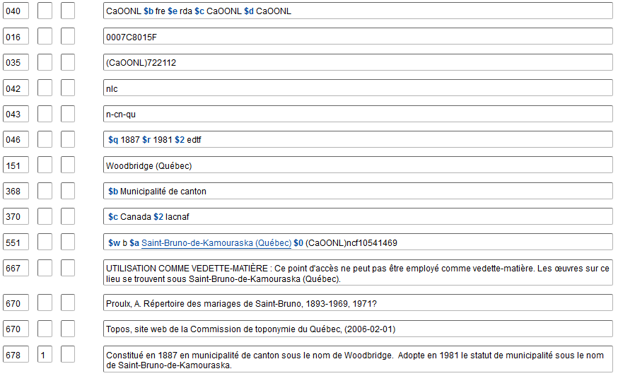
Système/thésaurus de la vedette-matière : n
Utilisation de la vedette — Vedette-matière secondaire : b
Notes:
Updated: September 17, 2018

Slide 125
Changement de nom – Directives sur les vedettes
SHM H 710 Fusions et scissions de nature juridictionnelle
Pour les fusions et les scissions, pour les cas où l’identité
territoriale a changé, tous les noms sont valides comme
vedettes-matière et comme subdivisions géographiques
151 Tchécoslovaquie 151 Allemagne (Est)
551 République tchèque 551 Allemagne
551 Slovaquie 781 _0 $z Allemagne (Est)
781 _0 $z Tchécoslovaquie
Utilisation de la vedette —
Vedette principale ou secondaire : a
Utilisation de la vedette —
Vedette-matière secondaire : a
Utilisation de la vedette —
Vedette principale ou secondaire : a
Utilisation de la vedette —
Vedette-matière secondaire : a
Notes:
May 1, 2013
SHM 710 Jurisdictional Mergers and Splits
1. General principles. For situations where jurisdictions have merged or split, various headings may be appropriate depending on the area and the time period being discussed. In general, assign subject headings that correspond to the physical extent of the area being discussed.
2. Mergers.
a. Pre-merger coverage. For the area corresponding to the post-merger jurisdiction, assign the heading for the post-merger jurisdiction. Assign this heading even though the jurisdiction did not exist for the pre-merger time period. For an area corresponding to one of the pre-merger jurisdictions, assign the heading for the pre-merger jurisdiction.
b. Post-merger coverage. For the area corresponding to the post-merger jurisdiction, assign the heading for the post-merger jurisdiction. For an area corresponding to one of the pre-merger jurisdictions, assign the heading for the pre-merger jurisdiction. Assign the heading for the pre-merger jurisdiction even if the jurisdiction no longer exists or the heading is not valid for descriptive access for that time period.
3. Splits.
a. Name of earlier jurisdiction not reused by later jurisdiction.
(1) Pre-split coverage. For the area corresponding to the pre-split jurisdiction, assign the heading for the pre-split jurisdiction even if that jurisdiction no longer exists. For an area corresponding to one of the post-split jurisdictions, assign the heading for the post-split jurisdiction.
(2) Post-split coverage. For the area corresponding to the pre-split jurisdiction, assign the heading for the pre-split jurisdiction if the name is still in use for the region. If the former jurisdictional name is no longer in common use as a name for the region, assign an equivalent subject heading, or assign the headings for the post-split jurisdictions. For an area corresponding to one of the post-split jurisdictions, assign the heading for the post-split jurisdiction.
b. Name of earlier jurisdiction retained by one of the later jurisdictions.
(1) Pre-split coverage. For the area corresponding to the pre-split jurisdiction, assign the heading for the pre-split jurisdiction. For an area corresponding to one of the post-split jurisdictions, assign the heading for the post-split jurisdiction.
(2) Post-split coverage. For the area corresponding to the pre-split jurisdiction, assign headings for all post-split jurisdictions. For an area corresponding to one of the post-split jurisdictions, assign the heading for the post-split jurisdiction.
4. Geographic subdivision usage. Subject headings for merged or split jurisdictions follow the normal procedures for use as geographic subdivisions. For place names using the practice of indirect subdivision, assign the name as a subdivision following the name of the country where currently located, regardless of the time period covered. For detailed instructions see H 830.
5. Special or complex situations. Because there are a variety of ways in which jurisdictions may be merged, split, or otherwise reorganized, the above instructions may not apply in every case. In exceptional or complex situations, subject usage notes may be added to name authority records according to the procedures in H 432, or scope notes may be added to subject authority records. For instructions on Germany, see H 945; for Soviet Union, see H 1023; for Yugoslavia, see H 1055.

Slide 126
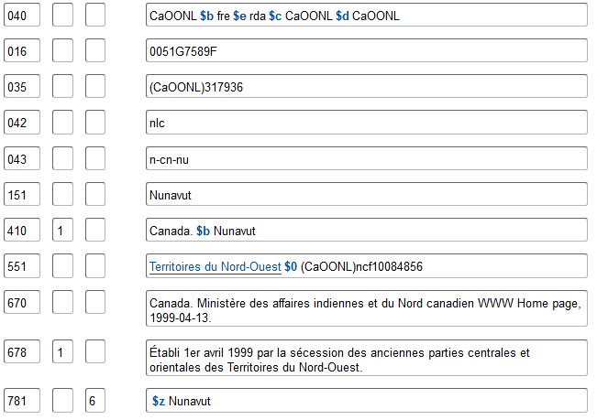
Utilisation de la vedette — Vedette principale ou secondaire : a
Utilisation de la vedette — Vedette-matière secondaire : a
Notes:
May 1, 2013
NAR for Illinois Territory, a jurisdiction that was split off from the Indiana Territory and that then split into Michigan Territory and the state of Illinois. Since the territory of the jurisdictions changed substantially in size, all the access points are valid for use as subjects and geographic subdivisions.

Slide 127
Utilisation des zones optionnelles
Utiliser ces zones seulement avec les lieux géographiques :
– 034 (coordonnées géographiques codées)
– 043 (code de région géographique)
- BAnQ utilise des codes locaux pour les régions administratives du Québec dans la sous-zone $b avec le code $2 cagraq
043 __ n-cn-qu $b n-cn-qb $2 cagraq
– 781 (forme de subdivision géographique)
• Peuvent aussi être utilisées :
– 024 (autres identificateurs normalisés)
– 046 (dates de début et de fin)
– 3XXs (type de juridiction; autre désignation; pays associé; autre lieu associé; adresse; langue associée; etc.)
– 678 (données historiques)
Notes:
March 5, 2020
* Effective September 13, 2018, there has been a temporary moratorium on adding or editing 024 fields in NACO records. However, participants in the PCC URIs in MARC Pilot Project are adding URIs in this field. NACO catalogers are asked to not remove or edit them.

Slide 128
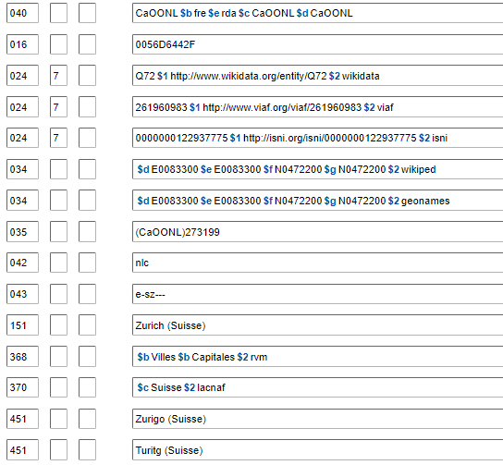
Zones optionnelles
024
Notes:
March 5, 2020: updated slide and notes
Effective September 13, 2018, there is a temporary moratorium on adding or editing 024 fields in NACO records. However, participants in the PCC URIs in MARC Pilot Project are now adding and revising URIs in this field. Other NACO catalogers should not remove or edit them.
DCM Z1 024 (last updated August 2019):
General
Do not add field 024 to an authority record. As of September 2018, there is a moratorium on adding this field in authority records (see http://www.loc.gov/aba/pcc/naco/documents/024-moratorium.pdf). An announcement will be made when catalogers may use this field again.
Maintenance:
LC/PCC catalogers are not required to maintain identifiers coded in the 024 field of NACO authority records. When an 024 field is present in a personal name record that is being reported for deletion (for example, in the case of a duplicate), LC/PCC catalogers should transfer the field to the record that is to be retained. When two personal name authority records are being collapsed into one, and each record has a different 024 field, LC/PCC catalogers should include both 024 fields in the updated record.

Slide 129
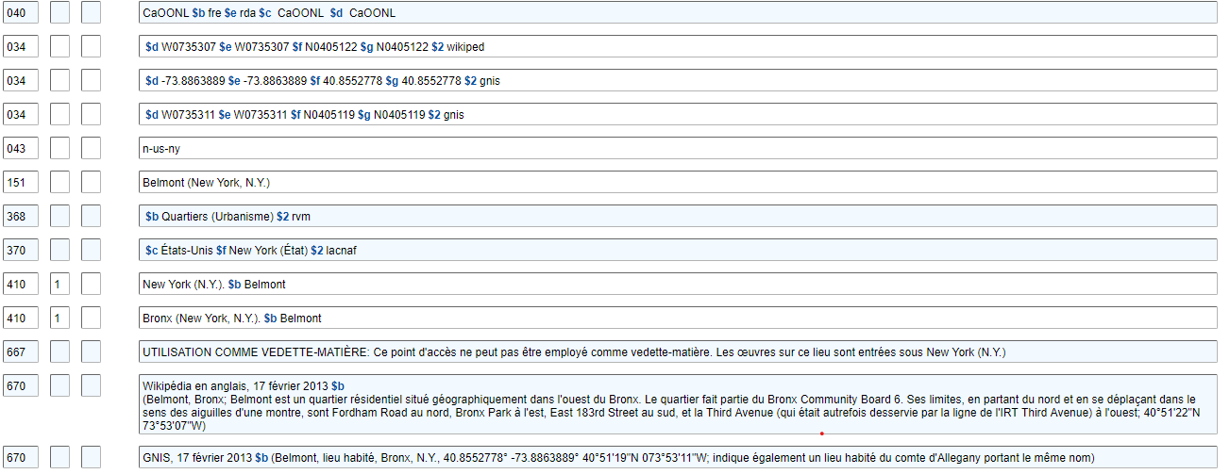
034, 043
Notes:
Updated: November 25, 2015
ANIMATED SLIDE for each of these fields (boxes will come in on mouse click):
Use field 034 to record coded geographic coordinates for the place. The DCM Z1 034 provides detailed guidance on how to encode the field. NACO institutions are encouraged to provide both degrees/minutes/seconds and decimal degrees when available (see second and third 034 fields in the slide). Tip: GNIS, GEOnet, and several other online gazetteers provide coordinates in both degrees/minutes/seconds and decimal degrees.
In 670s, when giving coordinates, do not use the apostrophe and quotation mark for minutes and seconds. LC-PCC PS for 1.4 instructs catalogers to use the soft sign, or prime sign (in OCLC diacritics called miagkiĭ znak) (ʹ) for minutes and the hard sign, or double prime (in OCLC, tvërdyĭ znak) (ʺ) for seconds. For degrees, use the degree symbol, not superscript 0. Many websites don’t use the ALA diacritics for these characters, so you may need to fix them when cutting and pasting from a web page.
Field 043 may be included in an NAR to record the geographic area code that is used for the place. Consult the MARC Code List for Geographic Areas online at http://www.loc.gov/marc/geoareas/ or available through Cataloger’s Desktop.

Slide 130
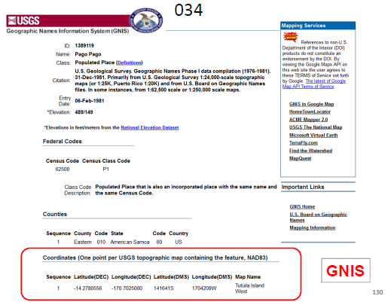
Notes:
May 1, 2013
ANIMATED SLIDE
GNIS provides coordinates in both decimal degrees and in degrees/minutes/seconds. Both can be recorded in coded form in repeatable 034 fields.

Slide 131
$d Coordonnées – longitude ouest 034
$e Coordonnées – longitude est
$f Coordonnées – latitude nord
$g Coordonnées – latitude sud
Abréviations pour les hémisphères : N = Nord, S = Sud, E = Est, W = Ouest
Les coordonnées peuvent être enregistrées en plusieurs formats :
hdddmmss (hémisphère‐degrés‐minutes‐secondes)
hddd.dddddd (hémisphère-degrés.degrés décimaux)
+/‐ddd.dddddd (degrés décimaux, précédés par + pour N et E et par ‐ pour S
et W; le signe + est toutefois optionnel)
Aussi d’autres formats (voir DCM Z1 034)
$2 ‐ Source
gnis, geonet, geonames, wikiped, et plusieurs autres sont définis. Voir la page Web
Cartographic Data Source Codes
41°18′52″N 122°18′41″W est habituellement codé comme suit :
034 $d W1221841 $e W1221841 $f N0411852 $g N0411852
41.314444, ‐122.311389 est habituellement codé comme suit :
034 $d ‐122.311389 $e ‐122.311389 $f 41.314444 $g 41.314444
Notes:
Updated: November 25, 2015
Trainers may choose to skip over the details on this slide, but it is here for reference and to help trainees complete the exercises.
Use field 034 to record coded geographic coordinates for the place. The DCM Z1 034 provides detailed guidance on how to encode the field. NACO institutions are encouraged to provide both degrees/minutes/seconds and decimal degrees when available (see second and third 034 fields in the slide). Tip: GNIS and several other online gazetteers provide coordinates in both degrees/minutes/seconds and decimal degrees. In GEOnet, the default display has coordinates in degrees/minutes/seconds, but if you click on them the display changes to decimal degrees.
In 670s, when giving coordinates, do not use the apostrophe and quotation mark for minutes and seconds. LC-PCC PS for 1.4 instructs catalogers to use the soft sign, or prime sign (in OCLC diacritics called miagkiĭ znak) (ʹ) for minutes and the hard sign, or double prime (in OCLC, tvërdyĭ znak) (ʺ) for seconds. For degrees, use the degree symbol, not superscript 0. Many websites don’t use the ALA diacritics for these characters, so you may need to fix them when cutting and pasting from a web page.
Cartographic Data Source Codes webpage: http://www.loc.gov/standards/sourcelist/cartographic-data.html

Slide 132
Exercice
034/043
Plus tôt, vous avez déterminé le
nom privilégié du lieu. Maintenant, ajoutez les zones 034 et 043 à la notice d’autorité créée pour ce lieu.
Le code source cartographique pour cette ressource est gnis
Notes:
May 1, 2013

Slide 133
Enregistrement des zones 034 et 043
034 $d $e $f $g $2
034 $d $e $f $g $2
043
151 La Paloma (Tex.)
451 Paloma (Tex.)
670 GNIS, 26 avril 2013 $b (La Paloma, lieu habité,
Cameron County, Texas, 26.0459111° ‐97.6674910°,
26°02′45″N 097°40′03″W)
Notes:
May 1, 2013

Slide 134
034 $d ‐97.6674910 $e ‐97.6674910 $f 26.0459111 $g 26.045911 $2 gnis
034 $d W0974003 $e W0974003 $f N0260245 $g N0260245 $2 gnis
043 n-us-tx
151 La Paloma (Tex.)
451 Paloma (Tex.)
670 GNIS, 26 avril 2013 $b (La Paloma, lieu habité,
Cameron County, Texas, 26.0459111° ‐97.6674910°,
26°02′45″N 097°40′03″W)
Notes:
May 1, 2013
ANIMATED SLIDE
ANSWER
034 $d -97.6674910 $e -97.6674910 $f 26.0459111 $g 26.0459111 $2 gnis
034 $d W0974003 $e W0974003 $f N0260245 $g N0260245 $2 gnis
043 n-us-tx

Slide 135
Coordonnées Bounding Box
Bounding Box Tool peut être utilisé pour obtenir des coordonnées sous la forme d'un carré ou d'un rectangle qui délimite le lieu
https://boundingbox.klokantech.com/
034 $d W0875624 $e W0873126 $f N0420122 $g N0413838 $2 bound
034 $d -087.940101 $e -087.523984 $f 042.023022 $g 041.643919 $2 bound
Notes:
March 5, 2020: new slide
Instead of point coordinates, there is an online tool available for catalogers to obtain coordinates in the form of a square or rectangle that encompasses a place. It is called the Bounding Box Tool.
You can see in the example in this slide that the coordinates in each subfield are different. These coordinates are for the city of Chicago. The source code for the Bounding Box Tool is “bound.”

Slide 136
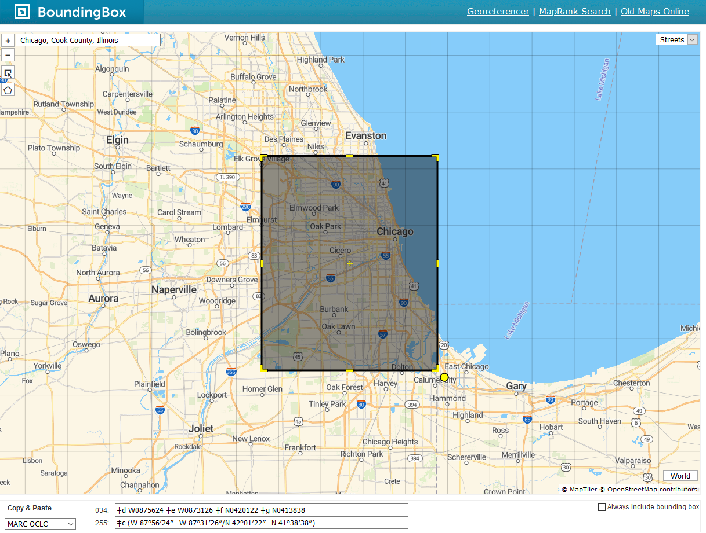
Notes:
March 5, 2020: new slide
You can get bounding box coordinates for a place from the Bounding Box Tool. It will give coordinates in a variety of formats, including MARC OCLC, and it will give them in both degrees, minutes, and seconds (as shown in the slide) and in decimal degrees. You can copy and paste them from the tool directly into an authority record.

Slide 137
781
Forme de la subdivision géographique
DCM Z1 781
Se référer à SHM H 830 afin de déterminer la forme
Voir également SHM H 835 Geographic Subdivision Information in Name Authority Records (Information sur les subdivisions géographiques dans les notices d’autorité de nom)
Soyez conscients des lieux qui sont appropriés comme subdivisions géographiques et de ceux qui ne le sont pas
Soyez conscients des situations inhabituelles (par exemple, les juridictions anciennes ou obsolètes tel que les royaumes historiques, les duchés, etc.; les lieux en Australie; les qualificatifs complexes; les Premières Nations)
Souvenez-vous de la « division du monde » et de quels lieux sont établis
comme autorités de nom et lesquels sont établis comme vedettes-matière
Zones optionnelles
Notes:
May 1, 2013
Catalogers may optionally add a 781 field (Subdivision Linking Entry-Geographic Subdivision) to records for places that can be used as a geographic subdivision. Consult DCM Z1 781, which refers catalogers to Subject Headings Manual instruction sheet H 830.
DCM Z1 781: PCC optional practice:
For a geographic name heading that may also be used as a geographic subdivision, determine the form in which the heading is to be used as a geographic subdivision following the guidelines in instruction sheet H 830 of the Subject Headings Manual. Enter the text of the geographic subdivision form in a 781 field with second indicator 0. For a geographic heading that is used directly, such as a country, enter the data in a single $z subfield. For a geographic heading that is used indirectly through a larger geographic entity, such as a city, enter the data in two successive $z subfields. Use no other subfields. Make no changes to values in bytes of the 008. Examples:
151 France 151 Paris (France)
781 _0 $z France 781 _0 $z France $z Paris
151 Lycia
781 _0 $z Turkey $z Lycia [This is an ancient jurisdiction. As a geographic subdivision, it is subdivided through the modern place in which it is located]
151 Sydney (N.S.W.) 151 Valencia (Spain : Region)
781 _0 $z Australia $z Sydney (N.S.W.) 781 _0 $z Spain $z Valencia (Region)
Do not add a 781 field to a record for a geographic name heading that is not appropriate for use as a subject added entry (008/15 value "b"), such as the earlier name of a jurisdiction that has undergone a linear name change, for example, Ceylon. See also DCM Z1 667 for guidelines on adding 667 fields with notes indicating subject cataloging usage to name authority records for geographic headings that may not be used as geographic subdivisions, such as entities within cities that are qualified by the city name. Follow these guidelines for newly-created authority records. Add a 781 field to an existing record when making any other change to it. If revising an existing record that contains a 667 field subject cataloging usage note indicating the proper geographic subdivision form, delete the 667 field and replace it with a 781 field.

Slide 138
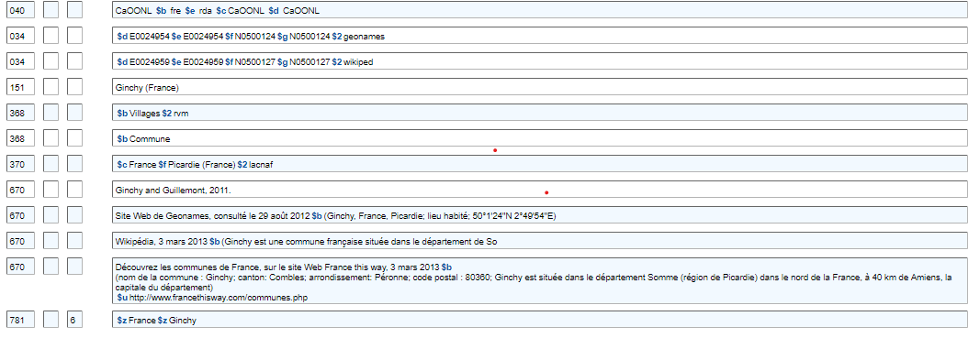
Zones optionnelles
Notes:
Updated: Feb. 24, 2014
Example of a 781 field in a record for a French village.

Slide 139
Zones optionnelles
Notes:
May 1, 2013
An obsolete jurisdiction. SHM H 830 says “Divide historic kingdoms, former jurisdictions, extinct cities, etc., that lie wholly within a currently existing jurisdiction through that jurisdiction.”

Slide 140
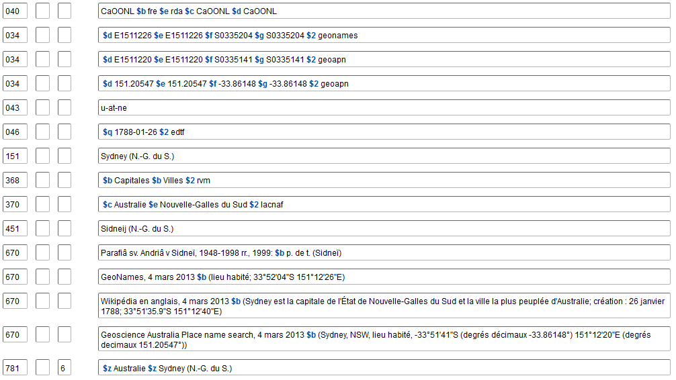
Zones optionnelles
Notes:
Updated: Nov. 1, 2016
Australia is an unusual situation. The larger place added to the preferred name is the name of the state or territory, not the country, but as a geographic subdivision, places are subdivided through Australia, and the state or territory qualifier is retained in the second $z.

Slide 141
Exercice 781 : Enregistrer la zone 781
034 $d ‐97.6674910 $e ‐97.6674910 $f 26.0459111 $g
26.0459111 $2 gnis
034 $d W0974003 $e W0974003 $f N0260245 $g N0260245
$2 gnis
043 n‐us‐tx
151 La Paloma (Tex.)
451 Paloma (Tex.)
670 GNIS, 26 avril 2013 $b (La Paloma, lieu habité,
Cameron County, Texas, 26.0459111° ‐97.6674910°,
26°02′45″N 097°40′03″W)
781 _0 $z $z
Texas
La Paloma
Notes:
May 1, 2013
ANIMATED SLIDE
ANSWER
781 _0 $z Texas $z La Paloma

Slide 142
046, 3XX, 678
Vous pouvez enregistrer les zones suivantes comme il convient :
046 : date de création/de fin
368 : type de juridiction/autre désignation
370 : lieux associés
371 : adresse
373 : institution associée
377 : code de langue pour les ressources publiées par le lieu
678 : données historiques
Notes:
May 1, 2013
Since these fields are not unique to geographic places and have already been covered previously in other modules, we will not dwell on them here or go into great detail on their definitions and how to record data in them.

Slide 143
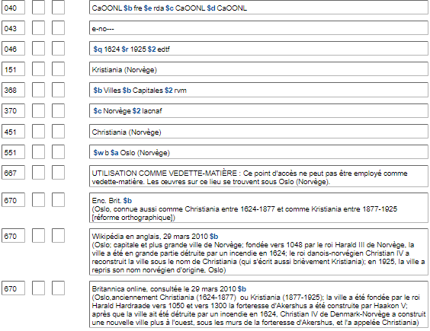
Notes:
Updated: September 17, 2018
Record showing the optional recording of start and termination dates (046), type of jurisdiction (368 $b), and associated country (370 $c).
046 $s= Start period
046 $q = Date of establishment *
046 $r = Date of termination *
046 $t= End period
* NOTE: PCC has not yet implemented $q and $r. DO NOT USE until implementation. Until then, $s and $t stand for date of establishment and date of termination.
368 $b = Type of jurisdiction
370 $c = Associated country
370 $e = Place of headquarters
370 $f = Other associated place

Slide 144
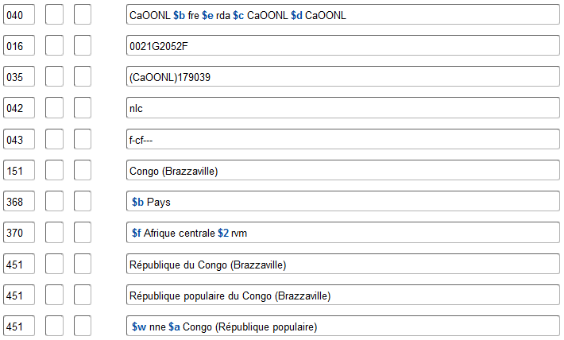
Notes:
August 13, 2019
Record showing type of jurisdiction (368 $b), other designation (368 $c), and other associated place (370 $f).

Slide 145
371
Notes:
Updated: Feb. 24, 2014
Example of 371 field to record address of the government.
371 $a = Address
371 $b = City
371 $c = Intermediate jurisdiction
371 $d = Country
371 $e = Postal code
371 $m = Electronic mail address
371 $u = Uniform Resource Identifier
371 $v = Source of information

Slide 146
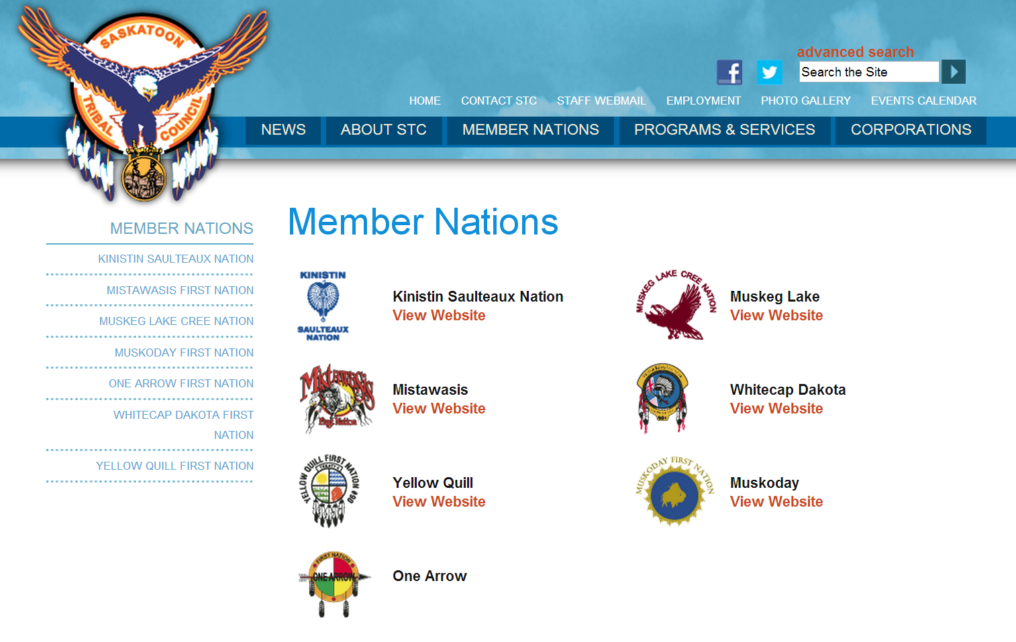
Notes:
May 1, 2013
It might not be first very obvious whether a place can have an associated institution, but as you can see from this slide, it can. Seven First Nations in Saskatchewan are members of a body called the Saskatoon Tribal Council.

Slide 147
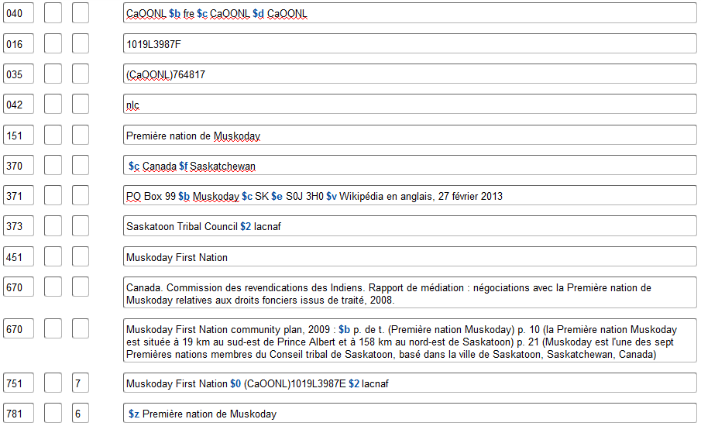
373
Notes:
Updated: September 17, 2018
Example of an associated institution or affiliation. The council has been established in the LC/NACO Authority File, so the cataloger records the authorized access point for the corporate body and adds a subfield $2 for naf.

Slide 148
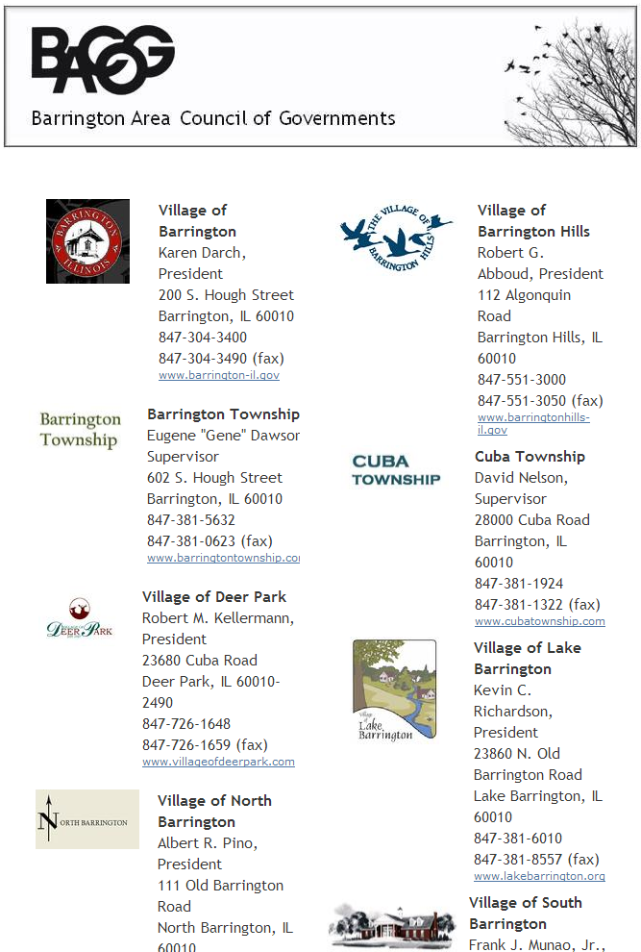
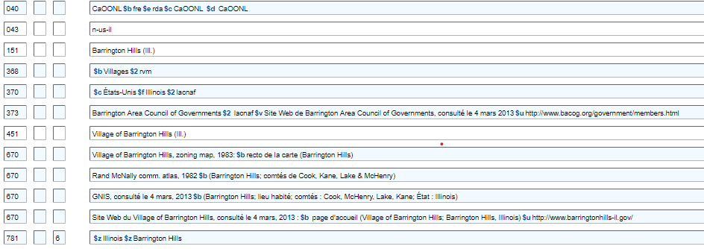
373
Notes:
Updated: Feb. 24, 2014
Another example of an associated institution. The Village of Barrington Hills, Illinois is a member of the Barrington Area Council of Governments.

Slide 149
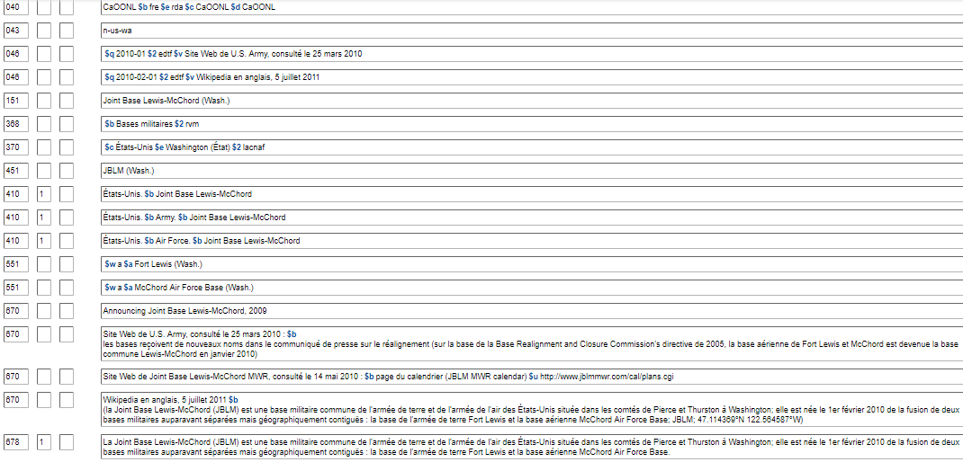
678
Notes:
Updated: September 17, 2018
Optional administrative history note.

Slide 150
Exercices Création de notices d’autorité complètes pour les lieux
Notes:
May 1, 2013
Using all that you’ve learned and practiced, create complete NARs for the places in the following exercises. Don’t worry if you don’t know the correct Cartographic Data Source Code(s) to use in field 034, or the correct Geographic Area Code to use in field 043. They can easily be looked up online when you need to use them in NARs that you’re creating. The answers to these exercises will have them. Concentrate on the authorized access point, variant access points, and the 046 and 3XX fields.

Slide 151
034
034
043
151
368
370
451
451
670 Mt. Nebo phone directory, 1979.
670 GNIS, 6 mars 2013 $b (Mount Nebo; lieu habité;
variante de nom : Elberta; comté Utah, Utah; 39.9527303°‐111.9563298°; 39°57’10”N 111°57’23”W)
781 _6
Notes:
Updated: Jan. 16, 2015
Based on information provided in the 670 citations, create an NAR for the place. Optionally record attributes of the place in 034, 043, 3XX, and form of geographic subdivision in 781.
034 $d -111.9563298 $e -111.9563298 $f 39.9527303 $g 39.9527303 $2 gnis
034 $d W1115723 $e W1115723 $f N0395710 $g N0395710 $2 gnis
043 n-us-ut
151 Mount Nebo (Utah)
368 $b Cities and towns $2 lcsh
370 $c United States $e Utah and/or perhaps: $e Utah County (Utah) $2 naf
451 Mt. Nebo (Utah)
451 Elberta (Utah)
781 _0 $z Utah $z Mount Nebo
Note: always choose “Mount” over “Mt.” for the preferred name, even if sources consulted only use “Mt.” Conflicts in NARs only have to be broken between jurisdictions, not with non-jurisdictional geographic features like mountains, rivers, lakes, etc. If a subject heading for a place with the same name is needed, the conflict will be broken in the subject heading: Nebo, Mount (Utah : Mountain)

Slide 152
034
034
043
046
151
368
370
451
451
451
451
551
670 Santa Elena Province, 2009? : $b recto de la carte (Gobierno Provincial de Santa Elena)
670 Wikipédia, 7 mars 2013 $b (Santa Elena (province); la province de Santa Elena (en espagnol : Provincia de Santa Elena) est une province de l'Équateur, créée en 2007 à partir de la province du Guayas. Sa capitale est la ville éponyme de Santa Elena; la province est divisée en trois cantons : La Libertad, Salinas, Santa Elena)
670 GEOnet, 7 mars 2013 $b (Santa Elena (forme approuvée); Provincia de Santa Elena (forme approuvée); Santa Elena (forme courte); division administrative de premier ordre; Ecuador; 02°05’00”S 080°35’00”W; ‐2.083333° ‐80.583333°)
781 _6
Déjà établie :
151 Guayas (Équateur : Province) Voir prochaine diapo
Notes:
September 17, 2018: moved $w to beginning of 551 field
March 21, 2017: added controlled vocabulary to 368
Based on information provided in the new 670 citations, revise this NAR.
034 $d W0800000 $e W0800000 $f S0020000 $g S0020000 $2 other [one might also decide to delete this, since the GEOnet data are more current than the coordinates from 1982]
034 $d W0795000 $e W0795000 $f S0020000 $g S0020000 $2 geonet
034 $d -79.833333 $e -79.833333 $f -2 $g -2 $2 geonet
043 s-ec---
151 Guayas (Ecuador : Province)
368 $b Province or $b Provinces $2 aat
370 $c Ecuador $2 naf
451 Provincia del Guayas (Ecuador)
451 Guayas Province (Ecuador)
451 Province of Guayas (Ecuador)
551 $w a $a Guayaquil (Ecuador : Province)
551 Santa Elena (Ecuador : Province)
781 _0 $z Ecuador $z Guayas (Province)
Note: Here we have a case of a split of territory. In such a case, both the resulting entities are valid for use as a subject, as is the earlier entity. In this situation, Guayas province didn’t split into two new provinces, it just gave up some territory to a new province, Santa Elena. RDA has a relationship designator that could be used to describe this: product of a split. However, at the present time, OCLC does not validate the use of subfield $i in 551 fields, so a simple see also reference must be used for now.

Slide 153
034 $d W0800000 $e W0800000 $f S0020000 $g S0020000 $2 other
034
043 s‐ec‐‐‐
046
151 Guayas (Équateur : Province)
368
370
451
451
451
Guayaquil (Équateur : Province) $w a
551
670 BGN 5/28/82 $b (Provincia del Guayas [Guayas=brief], ADM1, 2°00’S
80°00’W)
670 Historia social y económica de la antigua provincia de Guayaquil, 1763‐
1842, 1973.
670 GEOnet, March 7, 2013 $b (Guayas (approuvée); Provincia del Guayas
(approuvée); division administrative de premier ordre; Ecuador; 02°00’00”S
079°50’00”W; ‐2° ‐79.833333°)
670 Wikipedia, 7 mars 2013 $b (Guayas Province; Guayas est une province côtière de l'Équateur; Province de Guayas; la province de Guayaquil a été rebaptisée plus tard Guayas) version espagnole (Guayas, officiellement Provincia del Guayas; récemment le territoire de la province Santa Elena a été séparé de Guayas)
781 _6 $z Équateur $z Guayas (Province)
Réviser cette notice d’autorité après l’ajout des deux dernières 670 illustrées ci-dessous
Notes:
September 17, 2018: moved $w to beginning of 551 field.
March 21, 2017: added controlled vocabulary to 368.
Based on information provided in the new 670 citations, revise this NAR.
034 $d W0800000 $e W0800000 $f S0020000 $g S0020000 $2 other [one might also decide to delete this, since the GEOnet data are more current than the coordinates from 1982]
034 $d W0795000 $e W0795000 $f S0020000 $g S0020000 $2 geonet
034 $d -79.833333 $e -79.833333 $f -2 $g -2 $2 geonet
043 s-ec---
151 Guayas (Ecuador : Province)
368 $b Province or $b Provinces $2 aat
370 $c Ecuador $2 naf
451 Provincia del Guayas (Ecuador)
451 Guayas Province (Ecuador)
451 Province of Guayas (Ecuador)
551 $w a $a Guayaquil (Ecuador : Province)
551 Santa Elena (Ecuador : Province)
781 _0 $z Ecuador $z Guayas (Province)
Note: Here we have a case of a split of territory. In such a case, both the resulting entities are valid for use as a subject, as is the earlier entity. In this situation, Guayas province didn’t split into two new provinces, it just gave up some territory to a new province, Santa Elena. RDA has a relationship designator that could be used to describe this: product of a split. However, at the present time, OCLC does not validate the use of subfield $i in 551 fields, so a simple see also reference must be used for now.

Slide 154
Notes:
May 1, 2013
You are cataloging this document and will need an access point for the creator and a subject heading for the place.

Slide 155
043
151
368
370
451
451
670 Deerfield Township comprehensive plan, 2008 : $b p. 4
(Deerfield Township, situé dans le comté Warren, Ohio;
la deuxième juridiction la plus peuplée du comté de Warren)
670 GNIS, 6 mars 2013 $b (Township of Deerfield, civil;
comté : Warren, État : Ohio; énumère également trois autres juridictions civiles du même nom dans d'autres comtés)
781 _6
Notes:
March 21, 2017: added controlled vocabulary to 368.
Based on information provided in the 670 citations, create an NAR for the place. Optionally record attributes of the place in 043, 3XX, and form of geographic subdivision in 781.
LC-PCC PS for 16.4 tells us that for U.S. townships (called “towns” in some states) that encompass one or more local communities and the surrounding territory, do not include the term “township” or “town” as part of the name. Instead, add the term after the name of the state. In this particular case, since there is more than one township in Ohio with the same name, the county name must also be included in the access point, followed by the term for type of jurisdiction.
043 n-us-oh
151 Deerfield (Warren County, Ohio : Township)
368 $b Township or $b Townships $2 aat
370 $c United States $e Warren County (Ohio) $2 naf
451 Deerfield Township (Warren County, Ohio)
451 Township of Deerfield (Warren County, Ohio)
781 _0 $z Ohio $z Deerfield (Warren County : Township)
The PDF for the work being cataloged can be viewed at http://virtuallibrary.cincinnatilibrary.org/lib/25/1612/deerfld-twnshp-compreh-plan.pdf

Slide 156
Zones fixes 008 à compléter pour chaque exercice
Subdivision géographique directe ou indirecte | n – Sans objet
Système de romanisation | n – Sans objet
Langue du catalogue | f – Français seulement
Genre de notice | a –Vedette établie
Règles de catalogage descriptif | z – Autre
Système de vedettes-matière / Thésaurus | À compléter
Type de collection | n – Sans objet
Collection numérotée ou non numérotée | n – Sans objet
Utilisation de la vedette — Vedette principale ou secondaire | a – Vedette appropriée pour utilisation comme vedette secondaire
Utilisation de la vedette — Vedette-matière secondaire | À compléter
Utilisation de la vedette — Vedette secondaire de collection | b – Vedette non appropriée pour utilisation comme vedette secondaire de collection
Type de subdivision de sujet | n – Sans objet
Type d'organisme gouvernemental | | – Aucune tentative de coder
Évaluation du renvoi | À compléter
Notice en cours de révision | a – Notice peut servir
Nom de personne non différencié | n – Sans objet
Niveau de l'établissement | a – Complétement établie
Notice modifiée | ’’ – Non modifiée
Source du catalogage | ’’ – Agence bibliographique nationale

Slide 157
CRÉER UNE NOTICE D’AUTORITÉ POUR LE LIEU DÉCRIT DANS LA CARTE
034
034
043
046
151
368
370
451
451
451
551
667
670 Grande-Bretagne. Admiralty. Pôrto Alexandre : from the Portuguese government chart of 1941, 1952.
670 Wikipédia, 7 mars 2013 $b (Tomboa (aussi orthographiée Tombwe ou Tombua) est une ville de la province de Namibe en Angola; 15°48’S 11°51’E)
670 Wikipédia en portugais, 7 mars 2013 $b (Tômbua ou Tombwa; fondée en 1895; a été nommée Porto Alexandre jusqu'en 1975)
670 GEOnet, consulté le 7 mars 2013 $b (Tombua (forme approuvée); variantes de nom: Port Alexander, Porto Alexandre; lieu habité; Angola, ADM1: Namibe; 15°48’00”S 011°51’00”E; ‐15.8° 11.85°)
670 Angola : on old boot tracks in Angola, sur le site Web Drive out, 7 mars 2013 $b (Tombua (auparavant Porto Alexandré))
781 _ 6
Notes:
March 5, 2020: update box on slide
You are cataloging a map. Based on information provided in the 670 citations, create an NAR for the place depicted in the map. Optionally record attributes of the place in 034, 043, 046, 3XX, and 667 or 781.
This is an example of a name change. LCSH policy is that only the latest/current name of the place is valid for use as a subject. The fixed fields Subj and Subj use must be coded to indicate that the earlier name is not valid for use as a subject. A subject usage note may also be added in field 667. Even though the map being cataloged is from the time when the place was named Porto Alexandre, the subject that would be assigned to it is Tombua (Angola) $v Maps. Therefore, in addition to the NAR for the former name of the place, another NAR is needed for its current name (see next slide).
Ref status: a
Subj: n Subj use: b
034 $d E0115100 $e E0115100 $f S0154800 $g S0154800 $2 geonet
034 $d 11.85 $e 11.85 $f -15.8 $g -15.8 $2 geonet
043 f-ao---
046 $s 1895 $t 1975 $2 edtf
151 Porto Alexandre (Angola)
368 $b City or if using LCSH: $b Cities and towns $2 lcsh EN FRANÇAIS : Villes $2 rvm
370 $c Angola $2 naf $2 lacnaf
451 Port Alexander (Angola)
551 $w b $a Tombua (Angola) Tomboa (Angola) ???
667 SUBJECT USAGE: This name is not valid for use as a subject. Works about this place are entered under Tombua (Angola).
Note: Because OCLC does not currently validate relationship designators in subfield $i of field 551, the previous practice of using codes in subfield $w for earlier/later must still be followed.
Note: Because the earlier name is not valid for use as a subject, it is also not valid as a geographic subdivision, so no 781 field is recorded.

Slide 158
CRÉER UNE NOTICE D’AUTORITÉ POUR LE NOM ACTUEL
034
034
043
046
151
368
370
451
451
451
551
667
670 Grande-Bretagne. Admiralty. Pôrto Alexandre : from the Portuguese government chart of 1941, 1952.
670 Wikipédia, 7 mars 2013 $b (Tomboa (aussi orthographiée Tombwe ou Tombua) est une ville de la province de Namibe en Angola; 15°48’S 11°51’E)
670 Wikipédia en portugais, 7 mars 2013 $b (Tômbua ou Tombwa; fondée en 1895; a été nommée Porto Alexandre jusqu'en 1975)
670 GEOnet, consulté le 7 mars 2013 $b (Tombua (forme approuvée); variantes de nom: Port Alexander, Porto Alexandre; lieu habité; Angola, ADM1: Namibe; 15°48’00”S 011°51’00”E; ‐15.8° 11.85°)
670 Angola : on old boot tracks in Angola, sur le site Web Drive out, 7 mars 2013 $b (Tombua (auparavant Porto Alexandré))
781 _ 6
Notes:
March 5, 2020: updated box on slide
Based on information provided in the 670 citations, create an NAR for the current name of the place. Optionally record attributes of the place in 034, 043, 046, 3XX, 781.
This is an example of a name change. LCSH policy is that only the latest/current name of the place is valid for use as a subject. Even though the map being cataloged is from the time when the place was named Porto Alexandre, the subject that would be assigned to it is Tombua (Angola) $v Maps. Therefore, an NAR for Tombua is needed.
Ref status: a
Subj: a Subj use: a
034 $d E0115100 $e E0115100 $f S0154800 $g S0154800 $2 geonet
034 $d 11.85 $e 11.85 $f -15.8 $g -15.8 $2 geonet
043 f-ao---
046 $s 1975 $2 edtf
151 Tombua (Angola)
368 $b City or if using LCSH: $b Cities and towns $2 lcsh
370 $c Angola and perhaps $e Namibe (Angola) $2 naf
451 Tombwa (Angola)
451 Tombwe (Angola)
551 $w a $a Porto Alexandre (Angola)
781 _0 $z Angola $z Tombua
Note: Because OCLC does not currently validate relationship designators in subfield $i of field 551, the previous practice of using codes in subfield $w for earlier/later must still be followed.

Slide 159
Notes:
May 1, 2013
You are cataloging this website and you will need a subject heading for the neighborhood.
[Source: http://miamiroads.org/]

Slide 160
Notes:
May 1, 2013
Wikipedia article for the place

Slide 161
Notes:
May 1, 2013
City of Miami neighborhoods maps (from Wikipedia article on the place): http://en.wikipedia.org/wiki/File:Miami_neighborhoodsmap.png

Slide 162
034
034
043
151
368
370
4__
4__
4__
667
670 Site Web de Miami Roads Neighborhood Civic Association, consulté le 7 mars 2013: $b About us (“The Roads”; “The Roads” neighborhood) $u http://miamiroads.org/about_us.htm
670 GNIS, 7 mars 2013 $b (The Roads; lieu habité; comté : Miami‐Dade; État : Floride; 25.7555556° ‐80.2050000° 25°45’20”N 080°12’18”W)
670 Wikipédia en anglais, 7 mars 2013 $b (The Roads; un quartier de Miami dans le comté de Miami-Dade, en Floride; 25.756°N 80.205°W)
781 _6
Notes:
Updated: Feb. 24, 2014
Based on information provided in the 670 citations, create an NAR for the place. Optionally record attributes of the place in 034, 043, 046, 3XX, and 667 or 781.
The place’s name begins with an initial article. LC-PCC PS for 16.2.2.4 instructs you to drop the initial article in this case (English-language name in an English-speaking country). RDA 16.2.3.4 says that if an initial article present in the name of the place has been omitted from the preferred name of the place, record the name with the initial article as a variant name. Another variant name can be made in the form of the name of the neighborhood as a subdivision of the city.
This is an example of a neighborhood. It may be used as a subject, but is not valid for use as a geographic subdivision. A 667 could be included to specify this. 781 is not appropriate.
Ref status: a
Subj: a Subj use: a
034 $d W0801218 $e W0801218 $f N0254520 $g N0254520 $2 gnis
034 $d -80.2050000 $e -80.2050000 $f 25.7555556 $g 25.7555556 $2 gnis
043 n-us-fl
151 Roads (Miami, Fla.)
368 $b Neighborhood or if using LCSH: $b Neighborhoods $2 lcsh
370 $c United States $e Miami (Fla.) and perhaps $e Florida $2 naf
451 The Roads (Miami, Fla.)
410 1_ Miami (Fla.). $b Roads
667 SUBJECT USAGE: This name is not valid for use as a geographic subdivision.
Note: Because the name is not valid for use as a geographic subdivision, no 781 field is recorded.
Of course, if there were no NAR for the city that a neighborhood is in, it would also need to be created.

Slide 163
Notes:
May 1, 2013
You are cataloging this entity’s website. You will need a corporate body access point for the jurisdiction as well as a subject heading for it.

Slide 164
CRÉER UNE NOTICE D’AUTORITÉ POUR LE NOM ACTUEL
034
034
043
151
368
370
551
667
670 Site Web de Greenville Rancheria , consulté le 7 mars 2013 $b page d’accueil (Greenville Rancheria; actuellement situé dans Indian Valley dans les montagnes de la Sierra Nevada en Californie du Nord; les bureaux du gouvernement tribal ont été historiquement situés à Redding, Red Bluff et Greenville, et se trouvent actuellement à Greenville) $u http://www.greenvillerancheria.com/
670 BIA Indian entities, 10 août 2012 $b (Greenville Rancheria, qui figurait auparavant dans la liste sous le nom Greenville Rancheria of Maidu Indians of California)
670 Wikipédia en anglais, 7 mars 2013 $b (Greenville Rancheria of Maidu Indians; The Greenville Rancheria of Maidu Indians of California est une tribu reconnue au niveau fédéral dans les comtés de Plumas et de Tehama; Greenville Rancheria a son siège à Greenville, California)
670 GNIS, 7 mars 2013 $b (Greenville Rancheria, civil, Plumas County, California, 40.1487839°
-120.8933990° 40°08’56”N 120°53’36”W; designation: Administered Tribal)
781 _6
Notes:
September 17, 2018: moved $w to beginning of 551 field.
Based on information provided in the 670 citations, create an NAR for the place. Optionally record attributes of the place in 034, 043, 3XX, and 667 or 781.
This is a federally recognized Indian tribe, which is considered a jurisdiction. BIA Indian entities gives the current and former names, so two NARs are needed. This record is for the current name.
Ref status: a
Subj: a Subj use: a
034 $d -120.8933990 $e -120.8933990 $f 40.1487839 $g 40.1487839 $2 gnis
034 $d W1205336 $e W1205336 $f N0400856 $g N0400856 $2 gnis
043 n-us-ca
151 Greenville Rancheria
368 $b Federally recognized Indian tribes $2 lcsh
370 $c United States $e Greenville (Calif.) and perhaps $f California $2 naf
551 $w a $a Greenville Rancheria of Maidu Indians of California
781 _0 $z Greenville Rancheria
Note: Until OCLC validates the use of relationship designators in subfield $i of 551 fields, the previous practice of using subfield $w codes for earlier/later names will continue to be followed.
The second NAR would be for the earlier name (next slide).

Slide 165
CRÉER UNE NOTICE D’AUTORITÉ POUR LE NOM ANCIEN
034
034
043
151
368
370
551
667
670 Site Web de Greenville Rancheria , consulté le 7 mars 2013 $b page d’accueil (Greenville Rancheria; actuellement situé dans Indian Valley dans les montagnes de la Sierra Nevada en Californie du Nord; les bureaux du gouvernement tribal ont été historiquement situés à Redding, Red Bluff et Greenville, et se trouvent actuellement à Greenville) $u http://www.greenvillerancheria.com/
670 BIA Indian entities, 10 août 2012 $b (Greenville Rancheria, qui figurait auparavant dans la liste sous le nom Greenville Rancheria of Maidu Indians of California)
670 Wikipédia en anglais, 7 mars 2013 $b (Greenville Rancheria of Maidu Indians; The Greenville Rancheria of Maidu Indians of California est une tribu reconnue au niveau fédéral dans les comtés de Plumas et de Tehama; Greenville Rancheria a son siège à Greenville, California)
670 GNIS, 7 mars 2013 $b (Greenville Rancheria, civil, Plumas County, California, 40.1487839°
-120.8933990° 40°08’56”N 120°53’36”W; designation: Administered Tribal)
781 _6
Notes:
September 17, 2018: moved $w to beginning of 551 field.
Based on information provided in the 670 citations, create an NAR for the place. Optionally record attributes of the place in 034, 043, 3XX, and 667 or 781.
This is a federally recognized Indian tribe, which is considered a jurisdiction. BIA Indian entities gives the current and former names, so two NARs are needed. This record is for the current name.
Ref status: a
Subj: a Subj use: a
034 $d -120.8933990 $e -120.8933990 $f 40.1487839 $g 40.1487839 $2 gnis
034 $d W1205336 $e W1205336 $f N0400856 $g N0400856 $2 gnis
043 n-us-ca
151 Greenville Rancheria
368 $b Federally recognized Indian tribes $2 lcsh
370 $c United States $e Greenville (Calif.) and perhaps $f California $2 naf
551 $w a $a Greenville Rancheria of Maidu Indians of California
781 _0 $z Greenville Rancheria
Note: Until OCLC validates the use of relationship designators in subfield $i of 551 fields, the previous practice of using subfield $w codes for earlier/later names will continue to be followed.
The second NAR would be for the earlier name (next slide).

Slide 166
Notes:
May 1, 2013
You are cataloging this thesis and will need a subject heading for the district.

Slide 167
043
046
151
368
370
371
372
451
551
667
670 The Brazos Valley Groundwater Conservation District, 2011 : $b p. 10 (dans Eastern Central
Texas; BVGCD) p. 45 (créé par la législature de l'État en tant que district temporaire en 2001, à compter du 1er septembre 2001; rendu permanent en 2002)
670 Site Web de Brazos Valley Groundwater Conservation District , consulté le 7 mars 2013 $b (Brazos Valley Groundwater Conservation District; un gouvernement local à but non lucratif qui a été créé avec une directive pour protéger et conserver les ressources en eaux souterraines des comtés de Brazos et de Robertson; 112 West 3rd Street, Hearne, TX 77859) $u http://brazosvalleygcd.org/
675 GNIS, 7 mars 2013
781 _6
Notes:
Updated: Oct. 31, 2016
Based on information provided in the 670 citations, create an NAR for the place. Optionally record attributes of the place in 043, 046, 3XX, and 667 or 781.
This is one of those “ambiguous entities” that is listed as a Type 1 heading (“Conservation districts”): entities established through NACO, tagged 151.
Ref status: a
Subj: a Subj use: a
043 n-us-tx
046 $s 2001-09-01 $2 edtf
151 Brazos Valley Groundwater Conservation District (Tex.)
368 $b Conservation district or if using LCSH: Water districts $2 lcsh
370 $c United States $e Hearne (Tex.) $f Brazos County (Tex.) $f Robertson County (Tex.) $2 naf
371 112 West 3rd Street $b Hearne $c TX $e 77859
372 Water conservation $2 lcsh or perhaps: Water conservation--Texas--Brazos County $a Water conservation--Texas--Robertson County $2 lcsh
451 BVGCD (Tex.)
781 _0 $z Texas $z Brazos Valley Groundwater Conservation District

Slide 168
034
034
034
034
043
046
046
151
368
370
451
667
670 A brief history of Rantem, Newfoundland, 1945.
670 Site Web de la Base de données toponymiques du Canada, consulté le 20 mars 2013 $b (Rantem; Terre-Neuve-et-Labrador; terme concis : lieu non organisé; terme générique : établissement abandonné ou saisonnier; lieu :
Bellevue; Placentia; 47°41’40”N, 53°51’30”W; 47.6943999°, ‐53.8582999°)
670 Wikipédia en anglais, 20 mars 2013 $b (Rantem, Newfoundland and Labrador; était une petite colonie située au sud-est de Swift Current, Newfoundland and Labrador; 47°41’N 53°53’W)
670 Site Web de Newfoundland and Labrador abandoned communities index, consulté le 20 mars 2013 $b (Rantem; 47°42’ 53°57’; fondé en 1869, abandonné en 1960)
675 GEOnet, 20 mars 2013
781 _6
Note : La province de « Terre-Neuve » a changé son nom
pour « Terre-Neuve-et-Labrador » en décembre 2001.
Notes:
Updated: Oct. 31, 2016
This is an example of an historical place that no longer exists. LC-PCC PS for 16.2.2.4 says “If the smaller place has changed its name or has ceased to exist, use as a qualifier the name the larger place had during the period in which the name of the smaller place is applicable.” The province of Newfoundland changed its name to Newfoundland and Labrador in December 2001. Rantem ceased to exist by 1960. Therefore, following the abbreviations found in Appendix B.11, the qualifier used for Rantem should be Nfld. rather than N.L.
Ref status: n Subj: a Subj use: a
034 $d W0535130 $e W0535130 $f N0474140 $g N0474140 $2 cgndb
034 $d -53.8582999 $e -53.8582999 $f 47.6943999 $g 47.6943999 $2 cgndb
034 $d W0535300 $e W0535300 $f N0474100 $g N0474100 $2 wikiped
034 $d W0535700 $e W0535700 $f N0474200 $g N0474200 $2 nlaci
043 n-cn-nf
046 $s 1869 $t [..1960] $2 edtf [This is the way “1960 or earlier” is coded in EDTF. A cataloger would have to look up the EDTF specification to figure this out.]
151 Rantem (Nfld.)
368 $b Unincorporated area or if using LCSH: Unincorporated areas $2 lcsh $b Vacated settlement or Abandoned community or if using LCSH perhaps: Extinct cities $2 lcsh
$c Canada $e Newfoundland $2 naf
781 _0 $z Newfoundland and Labrador $z Rantem (Nfld.)
Note: SHM H 715 Extinct cities says: “If it is necessary to assign as a subject heading the name of a city or town that existed beyond 1500, or that still exists, establish it as a name heading” and “As a geographic subdivision, the heading for an extinct city is divided through the appropriate modern jurisdiction.” Similar information is found in SHM H 830 Geographic Subdivision: “As a general rule, subdivide to subordinate localities located wholly within a country by interposing the name of the relevant country between the heading and the name of the subordinate locality. Subordinate localities include: subordinate political jurisdictions, such as provinces, districts, counties, cities, etc.; historic kingdoms, principalities, etc. ... Divide historic kingdoms, former jurisdictions, extinct cities, etc., that lie wholly within a currently existing jurisdiction through that jurisdiction. ... If the heading for the locality being brought out as a geographic subdivision has as its qualifier the same name as the country or division through which it is being subdivided, delete the country or division name from the qualifier of the locality, even if it is abbreviated, in order to avoid redundancy. Retain in parentheses any other data included in the qualifier to differentiate the heading, including names of obsolete jurisdictions.”
Heading: Matabeleland (Southern Rhodesia)
Subdivision usage: 650 #0 $a Gold mines and mining $z Zimbabwe $z Matabeleland (Southern Rhodesia)
Heading: Sibirskiĭ kraĭ (R.S.F.S.R.) [a jurisdiction that existed only during the period of the Soviet Union]
Subdivision usage: 650 #0 $a Minorities $z Russia (Federation) $z Sibirskiĭkraĭ (R.S.F.S.R.)

Slide 169
RÉPONSES Notices d’autorités complètes pour les lieux
Notes:
May 1, 2013
Image courtesy of samuiblue / FreeDigitalPhotos.net
The answers are also in the trainees manuals in the Appendix.

Slide 170
034 $d ‐111.9563298 $e ‐111.9563298 $f 39.9527303 $g 39.9527303 $2 gnis
034 $d W1115723 $e W1115723 $f N0395710 $g N0395710 $2 gnis
043 n‐us‐ut
151 Mount Nebo (Utah)
368 $b Villes $2 rvm
370 $c États-Unis $e Utah et/ou $e Utah (Utah) $2 lacnaf
451 Mt. Nebo (Utah)
451 Elberta (Utah)
670 Mt. Nebo phone directory, 1979.
670 GNIS, 6 mars 2013 $b (Mount Nebo; lieu habité; variante de nom : Elberta; comté Utah, Utah; 39.9527303°‐111.9563298°; 39°57’10”N 111°57’23”W)
781 _6 $z Utah $z Mount Nebo
Notes:
Updated: Jan. 16, 2015
Based on information provided in the 670 citations, create an NAR for the place. Optionally record attributes of the place in 034, 043, 3XX, and form of geographic subdivision in 781.
034 $d -111.9563298 $e -111.9563298 $f 39.9527303 $g 39.9527303 $2 gnis
034 $d W1115723 $e W1115723 $f N0395710 $g N0395710 $2 gnis
043 n-us-ut
151 Mount Nebo (Utah)
368 $b Cities and towns $2 lcsh
370 $c U.S. $e Utah and/or perhaps: $e Utah County, Utah $2 naf
451 Mt. Nebo (Utah)
451 Elberta (Utah)
781 _0 $z Utah $z Mount Nebo
Note: always choose “Mount” over “Mt.” for the preferred name, even if sources consulted only use “Mt.” Conflicts in NARs only have to be broken between jurisdictions, not with non-jurisdictional geographic features like mountains, rivers, lakes, etc. If a subject heading for a place with the same name is needed, the conflict will be broken in the subject heading: Nebo, Mount (Utah : Mountain)

Slide 171
034 $d W0803500 $e W0803500 $f S0020500 $g S0020500 $2 geonet
034 $d ‐80.583333 $e ‐80.583333 $f ‐2.083333 $g ‐2.083333 $2 geonet
043 s‐ec‐‐‐
046 $q 2007 $2 edtf
151 Santa Elena (Équateur : Province)
368 $b Province
370 $c Équateur $2 lacnaf
451 Santa Elena Province (Équateur)
451 Gobierno Provincial de Santa Elena (Équateur)
451 Province de Santa Elena (Équateur)
451 Provincia de Santa Elena (Équateur)
551 Guayas (Équateur : Province)
670 Santa Elena Province, 2009? : $b recto de la carte (Gobierno Provincial de Santa Elena)
670 Wikipédia, 7 mars 2013 $b (la province de Santa Elena (en espagnol : Provincia de Santa Elena) est une province de l'Équateur, créée en 2007 à partir de la province du Guayas. Sa capitale est la ville éponyme de Santa Elena; la province est divisée en trois cantons : La Libertad, Salinas, Santa Elena)
670 GEOnet, 7 mars 2013 $b (Santa Elena (forme approuvée); Provincia de Santa Elena (forme approuvée); Santa Elena (forme courte); division administrative de premier ordre; Ecuador; 02°05’00”S 080°35’00”W; ‐2.083333° ‐80.583333°)
781_6 $z Équateur $z Santa Elena (Province)
Déjà établi :
151 Guayas (Équateur : Province)
Voir diapo suivante
Notes:
March 21, 2017: added controlled vocabulary to 368.
Based on information provided in the 670 citations, create an NAR for the place. Optionally record attributes of the place in 034, 043, 046, 3XX, and form of geographic subdivision in 781.
034 $d W0803500 $e W0803500 $f S0020500 $g S0020500 $2 geonet
034 $d -80.583333 $e -80.583333 $f -2.083333 $g -2.083333 $2 geonet
043 s-ec---
046 $s 2007 $2 edtf
151 Santa Elena (Ecuador : Province)
368 $b Provinces $2 aat or $b Province
370 $c Ecuador $2 naf
451 Santa Elena Province (Ecuador)
451 Gobierno Provincial de Santa Elena (Ecuador)
451 Province of Santa Elena (Ecuador)
451 Provincia de Santa Elena (Ecuador)
551 Guayas (Ecuador : Province)
781 _0 $z Ecuador $z Santa Elena (Province)
Note: Here we have a case of a split of territory. In such a case, both the resulting entities are valid for use as a subject, as is the earlier entity. In this situation, Guayas province didn’t split into two new provinces, it just gave up some territory to a new province, Santa Elena. RDA does not currently contain a relationship designator appropriate for use here, so the relationship between the two entities is coded as a simple see also relationship.
LC-PCC PS for 16.2.2.3: If the GEOnet Names Server (GNS) shows both a BGN standard and a BGN short form of the place name, generally select the longer form as the preferred name, unless RDA 16.2.2.8.1 (place names that include a term indicating type of jurisdiction) is applicable. So the short form is selected, but it conflicts with a city and a canton with the same name, so there is a conflict, and the type of jurisdiction must be added to the preferred name.
In addition to the new NAR, the NAR already existing for Guayas province will also need to be revised to show the reciprocal relationship between it and Santa Elena province (next slide).

Slide 172
034 $d W0800000 $e W0800000 $f S0020000 $g S0020000 $2 other
034 $d W0795000 $e W0795000 $f S0020000 $g S0020000 $2 geonet
043 s‐ec‐‐‐
151 Guayas (Équateur : Province)
368 $b Province
370 $c Équateur $2 lacnaf
451 Provincia del Guayas (Équateur)
451 Guayas Province (Équateur)
451 Province of Guayas (Équateur)
551 $w a $a Guayaquil (Équateur : Province)
551 Santa Elena (Équateur : Province)
670 BGN 5/28/82 $b (Provincia del Guayas [Guayas=brief], ADM1, 2°00’S
80°00’W)
670 Historia social y económica de la antigua provincia de Guayaquil, 1763‐
1842, 1973.
670 GEOnet, March 7, 2013 $b (Guayas (approuvée); Provincia del Guayas
(approuvée); division administrative de premier ordre; Ecuador; 02°00’00”S
079°50’00”W; ‐2° ‐79.833333°)
670 Wikipédia, 7 mars 2013 $b (Guayas Province; Guayas est une province côtière de l'Équateur; Province de Guayas; la province de Guayaquil a été rebaptisée plus tard Guayas) version espagnole (Guayas, officiellement Provincia del Guayas; récemment le territoire de la province Santa Elena a été séparé de Guayas)
781 _6 $z Équateur $z Guayas (Province)
Réviser cette notice d’autorité après l’ajout des deux dernières 670 illustrées ci-dessous
Notes:
September 17, 2018: moved $w to beginning of 551 field.
March 21, 2017: added controlled vocabulary to 368.
Based on information provided in the new 670 citations, revise this NAR.
034 $d W0800000 $e W0800000 $f S0020000 $g S0020000 $2 other [one might also decide to delete this, since the GEOnet data are more current than the coordinates from 1982]
034 $d W0795000 $e W0795000 $f S0020000 $g S0020000 $2 geonet
034 $d -79.833333 $e -79.833333 $f -2 $g -2 $2 geonet
043 s-ec---
151 Guayas (Ecuador : Province)
368 $b Provinces $2 aat or $b Province
370 $c Ecuador $2 naf
451 Provincia del Guayas (Ecuador)
451 Guayas Province (Ecuador)
451 Province of Guayas (Ecuador)
551 $w a $a Guayaquil (Ecuador : Province)
551 Santa Elena (Ecuador : Province)
781 _0 $z Ecuador $z Guayas (Province)
Note: Here we have a case of a split of territory. In such a case, both the resulting entities are valid for use as a subject, as is the earlier entity. In this situation, Guayas province didn’t split into two new provinces, it just gave up some territory to a new province, Santa Elena. RDA has a relationship designator that could be used to describe this: product of a split. However, at the present time, OCLC does not validate the use of subfield $i in 551 fields, so a simple see also reference must be used for now.

Slide 173
043 n‐us‐oh
Deerfield (Warren, Ohio : Canton)
368 $b Canton ou $b Cantons $2 rvm
370 $c États-Unis $e Warren (Ohio : Comté) et peut-être $e Ohio $2 lacnaf
451 Deerfield Township (Warren, Ohio)
Township of Deerfield (Warren, Ohio)
670 Deerfield Township comprehensive plan, 2008: $b p. 4 (Deerfield Township, situé dans le comté Warren, Ohio; la deuxième juridiction la plus peuplée du comté de Warren)
670 GNIS, 6 mars 2013 $b (Township of Deerfield, civil; comté : Warren, État : Ohio; énumère également trois autres juridictions civiles du même nom dans d'autres comtés)
781 _6 $z Ohio $z Deerfield (Warren : Canton)
Notes:
March 21, 2017: added controlled vocabulary to 368.
Based on information provided in the 670 citations, create an NAR for the place. Optionally record attributes of the place in 043, 3XX, and form of geographic subdivision in 781.
LC-PCC PS for 16.4 tells us that for U.S. townships (called “towns” in some states) that encompass one or more local communities and the surrounding territory, do not include the term “township” or “town” as part of the name. Instead, add the term after the name of the state. In this particular case, since there is more than one township in Ohio with the same name, the county name must also be included in the access point, followed by the term for type of jurisdiction.
043 n-us-oh
151 Deerfield (Warren County, Ohio : Township)
368 $b Townships $2 aat or $b Township
370 $c United States $e Warren County (Ohio) and perhaps $e Ohio $2 naf
451 Deerfield Township (Warren County, Ohio)
451 Township of Deerfield (Warren County, Ohio)
781 _0 $z Ohio $z Deerfield (Warren County : Township)
The PDF for the work being cataloged can be viewed at http://virtuallibrary.cincinnatilibrary.org/lib/25/1612/deerfld-twnshp-compreh-plan.pdf

Slide 174
CRÉER UNE NOTICE D’AUTORITÉ POUR LE LIEU DÉCRIT DANS LA CARTE
034 $d E0115100 $e E0115100 $f S0154800 $g S0154800 $2 geonet
034 $d 11.85 $e 11.85 $f ‐15.8 $g ‐15.8 $2 geonet
043 f‐ao‐‐‐
046 $q 1895 $r 1975 $2 edtf
151 Porto Alexandre (Angola)
368 $b Ville ou $b Villes $2 rvm
370 $c Angola $2 naf
451 Port Alexander (Angola)
$w b $a Tomboa (Angola)
667 UTILISATION COMME VEDETTE-MATIÈRE : Ce point d'accès ne peut pas être employé comme vedette-matière. Les œuvres sur ce lieu se trouvent sous Tomboa (Angola).
670 Grande-Bretagne. Admiralty. Pôrto Alexandre : from the Portuguese government chart of 1941, 1952.
670 Wikipédia, 7 mars 2013 $b (Tomboa (aussi orthographiée Tombwe ou Tombua) est une ville de la province de Namibe en Angola; 15°48’S 11°51’E)
670 Wikipédia en portugais, 7 mars 2013 $b (Tômbua ou Tombwa; fondée en 1895; a été nommée Porto Alexandre jusqu'en 1975)
670 GEOnet, consulté le 7 mars 2013 $b (Tombua (forme approuvée); variantes de nom: Port Alexander, Porto Alexandre; lieu habité; Angola, ADM1: Namibe; 15°48’00”S 011°51’00”E; ‐15.8° 11.85°)
670 Angola : on old boot tracks in Angola, sur le site Web Drive out, 7 mars 2013 $b (Tombua (auparavant Porto Alexandré))
781 _ 6
Notes:
September 17, 2018: moved $w to beginning of 551 field.
This is an example of a name change. LCSH policy is that only the latest/current name of the place is valid for use as a subject. The fixed fields Subj and Subj use must be coded to indicate that the earlier name is not valid for use as a subject. A subject usage note may also be added in field 667. Even though the map being cataloged is from the time when the place was named Porto Alexandre, the subject that would be assigned to it is Tombua (Angola) $v Maps. Therefore, in addition to the NAR for the former name of the place, another NAR is needed for its current name.
Ref status: a
Subj: n Subj use: b
034 $d E0115100 $e E0115100 $f S0154800 $g S0154800 $2 geonet
034 $d 11.85 $e 11.85 $f -15.8 $g -15.8 $2 geonet
043 f-ao---
046 $s 1895 $t 1975 $2 edtf
151 Porto Alexandre (Angola)
368 $b City or if using LCSH: $b Cities and towns $2 lcsh
370 $c Angola $2 naf
451 Port Alexander (Angola)
551 $w b $a Tombua (Angola)
667 SUBJECT USAGE: This name is not valid for use as a subject. Works about this place are entered under Tombua (Angola).
Note: Because OCLC does not currently validate relationship designators in subfield $i of field 551, the previous practice of using codes in subfield $w for earlier/later must still be followed.
Note: Because the earlier name is not valid for use as a subject, it is also not valid as a geographic subdivision, so no 781 field is recorded.

Slide 175
Codage des zones fixes pour le lieu décrit dans la carte
Subdivision géographique directe ou indirecte | n – Sans objet
Système de romanisation | n – Sans objet
Langue du catalogue | f – Français seulement
Genre de notice | a –Vedette établie
Règles de catalogage descriptif | z – Autre
Système de vedettes-matière / Thésaurus | n– Sans objet
Type de collection | n – Sans objet
Collection numérotée ou non numérotée | n – Sans objet
Utilisation de la vedette — Vedette principale ou secondaire | a – Vedette appropriée pour utilisation comme vedette secondaire
Utilisation de la vedette — Vedette-matière secondaire | b – Vedette non appropriée pour utilisation comme vedette-matière secondaire
Utilisation de la vedette — Vedette secondaire de collection | b – Vedette non appropriée pour utilisation comme vedette secondaire de collection
Type de subdivision de sujet | n – Sans objet
Type d'organisme gouvernemental | | – Aucune tentative de coder
Évaluation du renvoi | a – Rappels conformes à la vedette
Notice en cours de révision | a – Notice peut servir
Nom de personne non différencié | n – Sans objet
Niveau de l'établissement | a – Complétement établie
Notice modifiée | ’’ – Non modifiée
Source du catalogage | ’’ – Agence bibliographique nationale

Slide 176
CRÉER UNE NOTICE D’AUTORITÉ POUR LE NOM ACTUEL
034 $d E0115100 $e E0115100 $f S0154800 $g S0154800 $2 geonet
034 $d 11.85 $e 11.85 $f ‐15.8 $g ‐15.8 $2 geonet
043 f‐ao‐‐‐
046 $q 1975 $2 edtf
151 Tomboa (Angola)
368 $b Ville ou $b Villes $2 rvm
370 $c Angola et peut-être $e Namibe (Angola) $2 lacnaf
451 Tombwa (Angola)
451 Tombwe (Angola)
451 Tombua (Angola
551 $w a $a Porto Alexandre (Angola)
667
670 Grande-Bretagne. Admiralty. Pôrto Alexandre : from the Portuguese government chart of 1941, 1952.
670 Wikipédia, 7 mars 2013 $b (Tomboa (aussi orthographiée Tombwe ou Tombua) est une ville de la province de Namibe en Angola; 15°48’S 11°51’E)
670 Wikipédia en portugais, 7 mars 2013 $b (Tômbua ou Tombwa; fondée en 1895; a été nommée Porto Alexandre jusqu'en 1975)
670 GEOnet, consulté le 7 mars 2013 $b (Tombua (forme approuvée); variantes de nom: Port Alexander, Porto Alexandre; lieu habité; Angola, ADM1: Namibe; 15°48’00”S 011°51’00”E; ‐15.8° 11.85°)
670 Angola : on old boot tracks in Angola, sur le site Web Drive out, 7 mars 2013 $b (Tombua (auparavant Porto Alexandré))
781 _ 6 $z Angola $z Tomboa
Notes:
September 17, 2018: moved $w to beginning of 551 field.
This is an example of a name change. LCSH policy is that only the latest/current name of the place is valid for use as a subject. Even though the map being cataloged is from the time when the place was named Porto Alexandre, the subject that would be assigned to it is Tombua (Angola) $v Maps. Therefore, an NAR for Tombua is needed.
Ref status: a
Subj: a Subj use: a
034 $d E0115100 $e E0115100 $f S0154800 $g S0154800 $2 geonet
034 $d 11.85 $e 11.85 $f -15.8 $g -15.8 $2 geonet
043 f-ao---
046 $s 1975 $2 edtf
151 Tombua (Angola)
368 $b City or if using LCSH: $b Cities and towns $2 lcsh
370 $c Angola and perhaps $e Namibe (Angola) $2 naf
451 Tombwa (Angola)
451 Tombwe (Angola)
551 $w a $a Porto Alexandre (Angola)
781 _0 $z Angola $z Tombua
Note: Because OCLC does not currently validate relationship designators in subfield $i of field 551, the previous practice of using codes in subfield $w for earlier/later must still be followed.

Slide 177
Codage des zones fixes pour le nom actuel
Subdivision géographique directe ou indirecte | n – Sans objet
Système de romanisation | n – Sans objet
Langue du catalogue | f – Français seulement
Genre de notice | a –Vedette établie
Règles de catalogage descriptif | z – Autre
Système de vedettes-matière / Thésaurus | v – Répertoire de vedettes-matière
Type de collection | n – Sans objet
Collection numérotée ou non numérotée | n – Sans objet
Utilisation de la vedette — Vedette principale ou secondaire | a – Vedette appropriée pour utilisation comme vedette secondaire
Utilisation de la vedette — Vedette-matière secondaire | a – Vedette appropriée pour utilisation comme vedette-matière secondaire
Utilisation de la vedette — Vedette secondaire de collection | b – Vedette non appropriée pour utilisation comme vedette secondaire de collection
Type de subdivision de sujet | n – Sans objet
Type d'organisme gouvernemental | | – Aucune tentative de coder
Évaluation du renvoi | a – Rappels conformes à la vedette
Notice en cours de révision | a – Notice peut servir
Nom de personne non différencié | n – Sans objet
Niveau de l'établissement | a – Complétement établie
Notice modifiée | ’’ – Non modifiée
Source du catalogage | ’’ – Agence bibliographique nationale

Slide 178
034 $d W0801218 $e W0801218 $f N0254520 $g N0254520 $2 gnis
034 $d ‐80.2050000 $e ‐80.2050000 $f 25.7555556 $g 25.7555556 $2 gnis
043 n‐us‐fl
151 Roads (Miami, Flor.)
368 $b Quartier ou $b Quartiers (Urbanisme) $2 rvm
370 $c États-Unis $e Miami (Flor.) et peut-être $e Floride $2 lacnaf
451 The Roads (Miami, Flor.)
410 1_ Miami (Flor.). $b Roads
667 UTILISATION COMME VEDETTE-MATIÈRE : Ce point d'accès ne peut pas être employé comme vedette-matière.
670 Site Web de Miami Roads Neighborhood Civic Association, consulté le 7 mars 2013: $b About us (“The Roads”; “The Roads” neighborhood) $u http://miamiroads.org/about_us.htm
670 GNIS, 7 mars 2013 $b (The Roads; lieu habité; comté : Miami‐Dade; État : Floride; 25.7555556° ‐80.2050000° 25°45’20”N 080°12’18”W)
670 Wikipédia en anglais, 7 mars 2013 $b (The Roads; un quartier de Miami dans le comté de Miami-Dade, en Floride; 25.756°N 80.205°W)
781 _6
Notes:
Updated: Feb. 24, 2014
Based on information provided in the 670 citations, create an NAR for the place. Optionally record attributes of the place in 034, 043, 046, 3XX, and 667 or 781.
The place’s name begins with an initial article. LC-PCC PS for 16.2.2.4 instructs you to drop the initial article in this case (English-language name in an English-speaking country). RDA 16.2.3.4 says that if an initial article present in the name of the place has been omitted from the preferred name of the place, record the name with the initial article as a variant name. Another variant name can be made in the form of the name of the neighborhood as a subdivision of the city.
This is an example of a neighborhood. It may be used as a subject, but is not valid for use as a geographic subdivision. A 667 could be included to specify this. 781 is not appropriate.
Ref status: a
Subj: a Subj use: a
034 $d W0801218 $e W0801218 $f N0254520 $g N0254520 $2 gnis
034 $d -80.2050000 $e -80.2050000 $f 25.7555556 $g 25.7555556 $2 gnis
043 n-us-fl
151 Roads (Miami, Fla.)
368 $b Neighborhood or if using LCSH: $b Neighborhoods $2 lcsh
370 $c U.S. $e Miami, Fla. and perhaps $e Fla.
451 The Roads (Miami, Fla.)
410 1_ Miami (Fla.). $b Roads
667 SUBJECT USAGE: This name is not valid for use as a geographic subdivision.
Note: Because the name is not valid for use as a geographic subdivision, no 781 field is recorded.
Of course, if there were no NAR for the city that a neighborhood is in, it would also need to be created.

Slide 179
Codage des zones fixes pour Miami Roads
Subdivision géographique directe ou indirecte | n – Sans objet
Système de romanisation | n – Sans objet
Langue du catalogue | f – Français seulement
Genre de notice | a –Vedette établie
Règles de catalogage descriptif | z – Autre
Système de vedettes-matière / Thésaurus | v – Répertoire de vedettes-matière
Type de collection | n – Sans objet
Collection numérotée ou non numérotée | n – Sans objet
Utilisation de la vedette — Vedette principale ou secondaire | a – Vedette appropriée pour utilisation comme vedette secondaire
Utilisation de la vedette — Vedette-matière secondaire | a – Vedette appropriée pour utilisation comme vedette-matière secondaire
Utilisation de la vedette — Vedette secondaire de collection | b – Vedette non appropriée pour utilisation comme vedette secondaire de collection
Type de subdivision de sujet | n – Sans objet
Type d'organisme gouvernemental | | – Aucune tentative de coder
Évaluation du renvoi | a – Rappels conformes à la vedette
Notice en cours de révision | a – Notice peut servir
Nom de personne non différencié | n – Sans objet
Niveau de l'établissement | a – Complétement établie
Notice modifiée | ’’ – Non modifiée
Source du catalogage | ’’ – Agence bibliographique nationale

Slide 180
CRÉER UNE NOTICE D’AUTORITÉ POUR LE NOM ACTUEL
034 $d ‐120.8933990 $e ‐120.8933990 $f 40.1487839 $g 40.1487839 $2 gnis
034 $d W1205336 $e W1205336 $f N0400856 $g N0400856 $2 gnis
043 n-us-ca
151 Greenville Rancheria
368 $b Federally recognized Indian tribes $2 rvm
370 $c États-Unis $e Greenville (Calif.) et peut-être $f Californie $2 lacnaf
551 $w a $a Greenville Rancheria of Maidu Indians of California
667
670 Site Web de Greenville Rancheria , consulté le 7 mars 2013 $b page d’accueil (Greenville Rancheria; actuellement situé dans Indian Valley dans les montagnes de la Sierra Nevada en Californie du Nord; les bureaux du gouvernement tribal ont été historiquement situés à Redding, Red Bluff et Greenville, et se trouvent actuellement à Greenville) $u http://www.greenvillerancheria.com/
670 BIA Indian entities, 10 août 2012 $b (Greenville Rancheria, qui figurait auparavant dans la liste sous le nom Greenville Rancheria of Maidu Indians of California)
670 Wikipédia en anglais, 7 mars 2013 $b (Greenville Rancheria of Maidu Indians; The Greenville Rancheria of Maidu Indians of California est une tribu reconnue au niveau fédéral dans les comtés de Plumas et de Tehama; Greenville Rancheria a son siège à Greenville, California)
670 GNIS, 7 mars 2013 $b (Greenville Rancheria, civil, Plumas County, California, 40.1487839°
-120.8933990° 40°08’56”N 120°53’36”W; designation: Administered Tribal)
781 _6 $z Greenville Rancheria
Notes:
September 17, 2018: moved $w to beginning of 551 field.
Based on information provided in the 670 citations, create an NAR for the place. Optionally record attributes of the place in 034, 043, 3XX, and 667 or 781.
This is a federally recognized Indian tribe, which is considered a jurisdiction. BIA Indian entities gives the current and former names, so two NARs are needed. This record is for the current name.
Ref status: a
Subj: a Subj use: a
034 $d -120.8933990 $e -120.8933990 $f 40.1487839 $g 40.1487839 $2 gnis
034 $d W1205336 $e W1205336 $f N0400856 $g N0400856 $2 gnis
043 n-us-ca
151 Greenville Rancheria
368 $b Federally recognized Indian tribes $2 lcsh
370 $c United States $e Greenville (Calif.) and perhaps $f California $2 naf
551 $w a $a Greenville Rancheria of Maidu Indians of California
781 _0 $z Greenville Rancheria
Note: Until OCLC validates the use of relationship designators in subfield $i of 551 fields, the previous practice of using subfield $w codes for earlier/later names will continue to be followed.
The second NAR would be for the earlier name (next slide).

Slide 181
Codage des zones fixes pour le nom actuel
Subdivision géographique directe ou indirecte | n – Sans objet
Système de romanisation | n – Sans objet
Langue du catalogue | f – Français seulement
Genre de notice | a –Vedette établie
Règles de catalogage descriptif | z – Autre
Système de vedettes-matière / Thésaurus | v – Répertoire de vedettes-matière
Type de collection | n – Sans objet
Collection numérotée ou non numérotée | n – Sans objet
Utilisation de la vedette — Vedette principale ou secondaire | a – Vedette appropriée pour utilisation comme vedette secondaire
Utilisation de la vedette — Vedette-matière secondaire | a – Vedette appropriée pour utilisation comme vedette-matière secondaire
Utilisation de la vedette — Vedette secondaire de collection | b – Vedette non appropriée pour utilisation comme vedette secondaire de collection
Type de subdivision de sujet | n – Sans objet
Type d'organisme gouvernemental | | – Aucune tentative de coder
Évaluation du renvoi | a – Rappels conformes à la vedette
Notice en cours de révision | a – Notice peut servir
Nom de personne non différencié | n – Sans objet
Niveau de l'établissement | a – Complétement établie
Notice modifiée | ’’ – Non modifiée
Source du catalogage | ’’ – Agence bibliographique nationale

Slide 182
CRÉER UNE NOTICE D’AUTORITÉ POUR LE NOM ANCIEN
043 n‐us‐ca
151 Greenville Rancheria of Maidu Indians of California
368 $b Federally recognized Indian tribes $2 rvm
370 $c États-Unis $e Greenville (Calif.) et peut-être $f Californie $2 lacnaf
451 Greenville Rancheria of Maidu Indians
551 $w b $a Greenville Rancheria
667 UTILISATION COMME VEDETTE-MATIÈRE : Ce point d'accès ne peut pas être employé comme vedette-matière. Les œuvres sur ce lieu se trouvent sous Greenville Rancheria.
670 Site Web de Greenville Rancheria , consulté le 7 mars 2013 $b page d’accueil (Greenville Rancheria; actuellement situé dans Indian Valley dans les montagnes de la Sierra Nevada en Californie du Nord; les bureaux du gouvernement tribal ont été historiquement situés à Redding, Red Bluff et Greenville, et se trouvent actuellement à Greenville) $u http://www.greenvillerancheria.com/
670 BIA Indian entities, 10 août 2012 $b (Greenville Rancheria, qui figurait auparavant dans la liste sous le nom Greenville Rancheria of Maidu Indians of California)
670 Wikipédia en anglais, 7 mars 2013 $b (Greenville Rancheria of Maidu Indians; The Greenville Rancheria of Maidu Indians of California est une tribu reconnue au niveau fédéral dans les comtés de Plumas et de Tehama; Greenville Rancheria a son siège à Greenville, California)
670 GNIS, 7 mars 2013 $b (Greenville Rancheria, civil, Plumas County, California, 40.1487839°
-120.8933990° 40°08’56”N 120°53’36”W; designation: Administered Tribal)
781 6 $z
Notes:
September 17, 2018: moved $w to beginning of 551 field.
This record is for the former name of the federally recognized Indian tribe. The earlier name is not valid for use as a geographic subject.
Ref status: a
Subj: n Subj use: b
043 n-us-ca
151 Greenville Rancheria of Maidu Indians of California
368 $b Federally recognized Indian tribes $2 lcsh
370 $c United States $e Greenville (Calif.) and perhaps $f California $2 naf
451 Greenville Rancheria of Maidu Indians
551 $w b $a Greenville Rancheria
667 SUBJECT USAGE: This name is not valid for use as a subject. Works about this place are entered under Greenville Rancheria.
Note: Until OCLC validates the use of relationship designators in subfield $i of 551 fields, the previous practice of using subfield $w codes for earlier/later names will continue to be followed.

Slide 183
Codage des zones fixes pour le nom ancien
Subdivision géographique directe ou indirecte | n – Sans objet
Système de romanisation | n – Sans objet
Langue du catalogue | f – Français seulement
Genre de notice | a –Vedette établie
Règles de catalogage descriptif | z – Autre
Système de vedettes-matière / Thésaurus | n – Sans objet
Type de collection | n – Sans objet
Collection numérotée ou non numérotée | n – Sans objet
Utilisation de la vedette — Vedette principale ou secondaire | a – Vedette appropriée pour utilisation comme vedette secondaire
Utilisation de la vedette — Vedette-matière secondaire | b – Vedette non appropriée pour utilisation comme vedette-matière secondaire
Utilisation de la vedette — Vedette secondaire de collection | b – Vedette non appropriée pour utilisation comme vedette secondaire de collection
Type de subdivision de sujet | n – Sans objet
Type d'organisme gouvernemental | | – Aucune tentative de coder
Évaluation du renvoi | a – Rappels conformes à la vedette
Notice en cours de révision | a – Notice peut servir
Nom de personne non différencié | n – Sans objet
Niveau de l'établissement | a – Complétement établie
Notice modifiée | ’’ – Non modifiée
Source du catalogage | ’’ – Agence bibliographique nationale

Slide 184
043 n‐us‐tx
046 $q 2001‐09‐01 $2 edtf
151 Brazos Valley Groundwater Conservation District (Tex.)
368 $b Districts de conservation ou peut-être $b Districts des eaux $2 rvm
370 $c États-Unis $e Hearne (Tex.) $f Brazos (Tex.) $f Robertson (Tex.) $2 lacnaf
371 112 West 3rd Street $b Hearne $c TX $e 77859
372 Eau—Conservation $2 rvm ou peut-être Eau--Conservation‐‐Texas‐‐Brazos $a Eau--Conservation‐‐Texas‐‐
Robertson $2 rvm
451 BVGCD (Tex.)
670 The Brazos Valley Groundwater Conservation District, 2011 : $b p. 10 (dans Eastern Central
Texas; BVGCD) p. 45 (créé par la législature de l'État en tant que district temporaire en 2001, à compter du 1er septembre 2001; rendu permanent en 2002)
670 Site Web de Brazos Valley Groundwater Conservation District , consulté le 7 mars 2013 $b (Brazos Valley Groundwater Conservation District; un gouvernement local à but non lucratif qui a été créé avec une directive pour protéger et conserver les ressources en eaux souterraines des comtés de Brazos et de Robertson; 112 West 3rd Street, Hearne, TX 77859) $u http://brazosvalleygcd.org/
675 GNIS, 7 mars 2013
781 _6 $z Texas $z Brazos Valley Groundwater Conservation District $2 lacnaf
Notes:
Updated: Oct. 31, 2016
Based on information provided in the 670 citations, create an NAR for the place. Optionally record attributes of the place in 043, 046, 3XX, and 667 or 781.
This is one of those “ambiguous entities” that is listed as a Type 1 heading (“Conservation districts”): entities established through NACO, tagged 151.
Ref status: a
Subj: a Subj use: a
043 n-us-tx
046 $s 2001-09-01 $2 edtf
151 Brazos Valley Groundwater Conservation District (Tex.)
368 $b Conservation district or if using LCSH: Water districts $2 lcsh
370 $c United States $e Hearne (Tex.) $f Brazos County (Tex.) $f Robertson County (Tex.) $2 naf
371 112 West 3rd Street $b Hearne $c TX $e 77859
372 Water conservation $2 lcsh or perhaps: Water conservation--Texas--Brazos County $a Water conservation--Texas--Robertson County $2 lcsh
451 BVGCD (Tex.)
781 _0 $z Texas $z Brazos Valley Groundwater Conservation District

Slide 185
Codage des zones fixes pour Brazos Valley
Subdivision géographique directe ou indirecte | n – Sans objet
Système de romanisation | n – Sans objet
Langue du catalogue | f – Français seulement
Genre de notice | a –Vedette établie
Règles de catalogage descriptif | z – Autre
Système de vedettes-matière / Thésaurus | v – Répertoire de vedettes-matière
Type de collection | n – Sans objet
Collection numérotée ou non numérotée | n – Sans objet
Utilisation de la vedette — Vedette principale ou secondaire | a – Vedette appropriée pour utilisation comme vedette secondaire
Utilisation de la vedette — Vedette-matière secondaire | a – Vedette appropriée pour utilisation comme vedette-matière secondaire
Utilisation de la vedette — Vedette secondaire de collection | b – Vedette non appropriée pour utilisation comme vedette secondaire de collection
Type de subdivision de sujet | n – Sans objet
Type d'organisme gouvernemental | | – Aucune tentative de coder
Évaluation du renvoi | a – Rappels conformes à la vedette
Notice en cours de révision | a – Notice peut servir
Nom de personne non différencié | n – Sans objet
Niveau de l'établissement | a – Complétement établie
Notice modifiée | ’’ – Non modifiée
Source du catalogage | ’’ – Agence bibliographique nationale

Slide 186
034 $d W0535130 $e W0535130 $f N0474140 $g N0474140 $2 cgndb046
034 $d ‐53.8582999 $e ‐53.8582999 $f 47.6943999 $g 47.6943999 $2 cgndb
034 $d W0535300 $e W0535300 $f N0474100 $g N0474100 $2 wikiped
034 $d W0535700 $e W0535700 $f N0474200 $g N0474200 $2 nlaci
043 n-cn-nf
046 $q 1869 $r [..1960] $2 edtf
Rantem (T.-N.) et non Rantem (T.-N.-L.)
368 $b Territoire non organisé ou $b Territoires non organisés $2 rvm
$b Établissement abandonné ou $b Communauté abandonnée ou peut-être $b Villes disparues, en ruines, etc.
$2 rvm
$c Canada $e Terre-Neuve $2 lacnaf
670 A brief history of Rantem, Newfoundland, 1945.
670 Site Web de la Base de données toponymiques du Canada, consulté le 20 mars 2013 $b (Rantem; Terre-Neuve-et-Labrador; terme concis : lieu non organisé; terme générique : établissement abandonné ou saisonnier; lieu :
Bellevue; Placentia; 47°41’40”N, 53°51’30”W; 47.6943999°, ‐53.8582999°)
670 Wikipédia en anglais, 20 mars 2013 $b (Rantem, Newfoundland and Labrador; était une petite colonie située au sud-est de Swift Current, Newfoundland and Labrador; 47°41’N 53°53’W)
670 Site Web de Newfoundland and Labrador abandoned communities index, consulté le 20 mars 2013 $b (Rantem; 47°42’ 53°57’; fondé en 1869, abandonné en 1960)
675 GEOnet, 20 mars 2013
781 _6 $z Terre-Neuve-et-Labrador $z Rantem (T.-N.)
Note : La province du « Terre-Neuve » a changé son nom
en « Terre-Neuve-et-Labrador » en décembre 2001.
Notes:
Updated: Oct. 31, 2016
This is an example of an historical place that no longer exists. LC-PCC PS for 16.2.2.4 says “If the smaller place has changed its name or has ceased to exist, use as a qualifier the name the larger place had during the period in which the name of the smaller place is applicable.” The province of Newfoundland changed its name to Newfoundland and Labrador in December 2001. Rantem ceased to exist by 1960. Therefore, following the abbreviations found in Appendix B.11, the qualifier used for Rantem should be Nfld. rather than N.L.
Ref status: n Subj: a Subj use: a
034 $d W0535130 $e W0535130 $f N0474140 $g N0474140 $2 cgndb
034 $d -53.8582999 $e -53.8582999 $f 47.6943999 $g 47.6943999 $2 cgndb
034 $d W0535300 $e W0535300 $f N0474100 $g N0474100 $2 wikiped
034 $d W0535700 $e W0535700 $f N0474200 $g N0474200 $2 nlaci
043 n-cn-nf
046 $s 1869 $t [..1960] $2 edtf [This is the way “1960 or earlier” is coded in EDTF. A cataloger would have to look up the EDTF specification to figure this one out.]
151 Rantem (Nfld.)
368 $b Unincorporated area or if using LCSH: Unincorporated areas $2 lcsh $b Vacated settlement or $b Abandoned community or if using LCSH perhaps: Extinct cities $2 lcsh
$c Canada $e Newfoundland $2 naf
781 _0 $z Newfoundland and Labrador $z Rantem (Nfld.)
Note: SHM H 715 Extinct cities says: “If it is necessary to assign as a subject heading the name of a city or town that existed beyond 1500, or that still exists, establish it as a name heading” and “As a geographic subdivision, the heading for an extinct city is divided through the appropriate modern jurisdiction.” Similar information is found in SHM H 830 Geographic Subdivision: “As a general rule, subdivide to subordinate localities located wholly within a country by interposing the name of the relevant country between the heading and the name of the subordinate locality. Subordinate localities include: subordinate political jurisdictions, such as provinces, districts, counties, cities, etc.; historic kingdoms, principalities, etc. ... Divide historic kingdoms, former jurisdictions, extinct cities, etc., that lie wholly within a currently existing jurisdiction through that jurisdiction. ... If the heading for the locality being brought out as a geographic subdivision has as its qualifier the same name as the country or division through which it is being subdivided, delete the country or division name from the qualifier of the locality, even if it is abbreviated, in order to avoid redundancy. Retain in parentheses any other data included in the qualifier to differentiate the heading, including names of obsolete jurisdictions.”
Heading: Matabeleland (Southern Rhodesia)
Subdivision usage: 650 #0 $a Gold mines and mining $z Zimbabwe $z Matabeleland (Southern Rhodesia)
Heading: Sibirskiĭ kraĭ (R.S.F.S.R.) [a jurisdiction that existed only during the period of the Soviet Union]
Subdivision usage: 650 #0 $a Minorities $z Russia (Federation) $z Sibirskiĭkraĭ (R.S.F.S.R.)

Slide 187
Codage des zones fixes pour Rantem
Subdivision géographique directe ou indirecte | n – Sans objet
Système de romanisation | n – Sans objet
Langue du catalogue | f – Français seulement
Genre de notice | a –Vedette établie
Règles de catalogage descriptif | z – Autre
Système de vedettes-matière / Thésaurus | v – Répertoire de vedettes-matière
Type de collection | n – Sans objet
Collection numérotée ou non numérotée | n – Sans objet
Utilisation de la vedette — Vedette principale ou secondaire | a – Vedette appropriée pour utilisation comme vedette secondaire
Utilisation de la vedette — Vedette-matière secondaire | a – Vedette appropriée pour utilisation comme vedette-matière secondaire
Utilisation de la vedette — Vedette secondaire de collection | b – Vedette non appropriée pour utilisation comme vedette secondaire de collection
Type de subdivision de sujet | n – Sans objet
Type d'organisme gouvernemental | | – Aucune tentative de coder
Évaluation du renvoi | n – Sans objet
Notice en cours de révision | a – Notice peut servir
Nom de personne non différencié | n – Sans objet
Niveau de l'établissement | a – Complétement établie
Notice modifiée | ’’ – Non modifiée
Source du catalogage | ’’ – Agence bibliographique nationale

Slide 188
Module 5
Description des lieux
Des questions?
Notes:
May 1, 2013
Image “Balancing Question Mark With Earth” courtesy of jscreationzs / FreeDigitalPhotos.net

