Slide 1
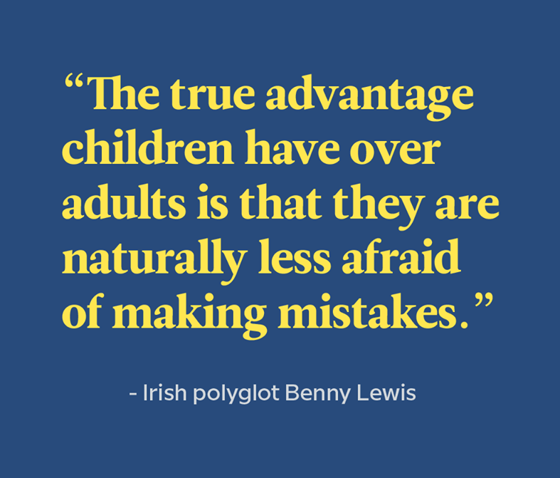
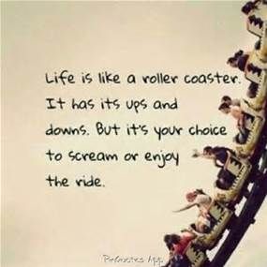
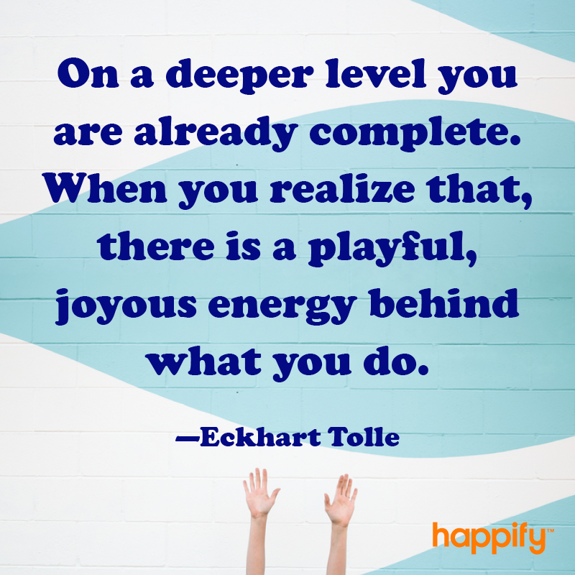
Welcome

Slide 2

Mindful Change Leadership Development Program
Session 6
June 12, 2023
Notes:
**** YOU WILL NEED A SNACK OR SMALL PORTION OF FOOD – FOR THE MINDFUL EATING EXERCISE***

Slide 3


Agenda
Debrief From Last Week /Session 5
Mindfulness Exercise – 5 minutes
Where We Are In The Universe
Being Who You Are Is Enough
The Concept Of Being Present
Presencing And The Theory-U
Mindful Eating Exercise
Benefits Of Mindful Eating
Finding A Win, Win Win Solution
Practice For Next Week And Breakout Rooms
Notes:
Agenda and Debrief from last week
Any questions?
Feel free to share insights or takeaways with the rest of the group/cohort
Discussions, or exchanges during check-in with your buddy system that sparked your attention
Observations on any of the practices from last week (i.e., gratitude journaling, breathing or body scan exercise, self-compassion, etc.)
Any tips and tricks, or resources could be beneficial to share with the rest of the group/cohort
ENGAGE PARTICIPANTS - Open the floor – invite 2/3 individuals to share…You can use the « Raise hand feature » in Teams or use the chat function to speak.
CHECK INS with buddy system: Feel free to break yourself into smaller group if finding common time slots or time zones to meet with your entire group is challenging.
Let us know if you need a new group.
---------

Slide 4


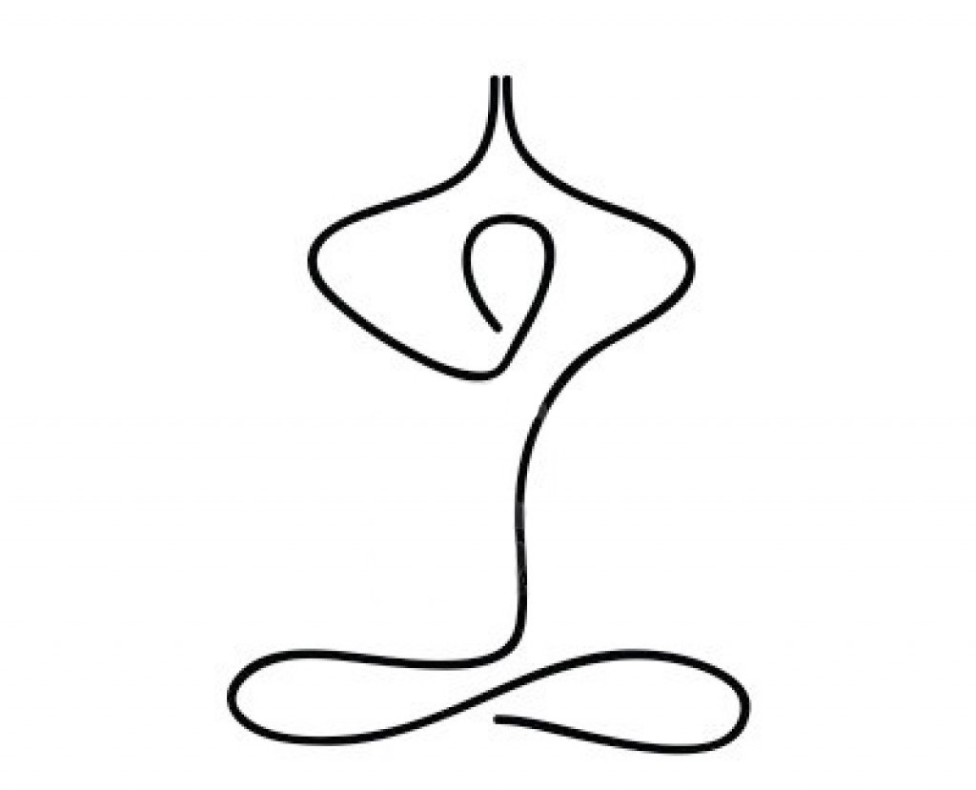

Mindfulness Exercise
Today’s Intention
Links to the guided practices, and videos are available on the last slide –titled “Resource slide”
“Wherever You Go, there you are”
Notes:
Today’s intentions:
Clarity, focus, creativity and compassion: these are the attributes of mindful leadership, Or it can also be something personal – whatever speaks to you in this moment.
---------

Slide 5
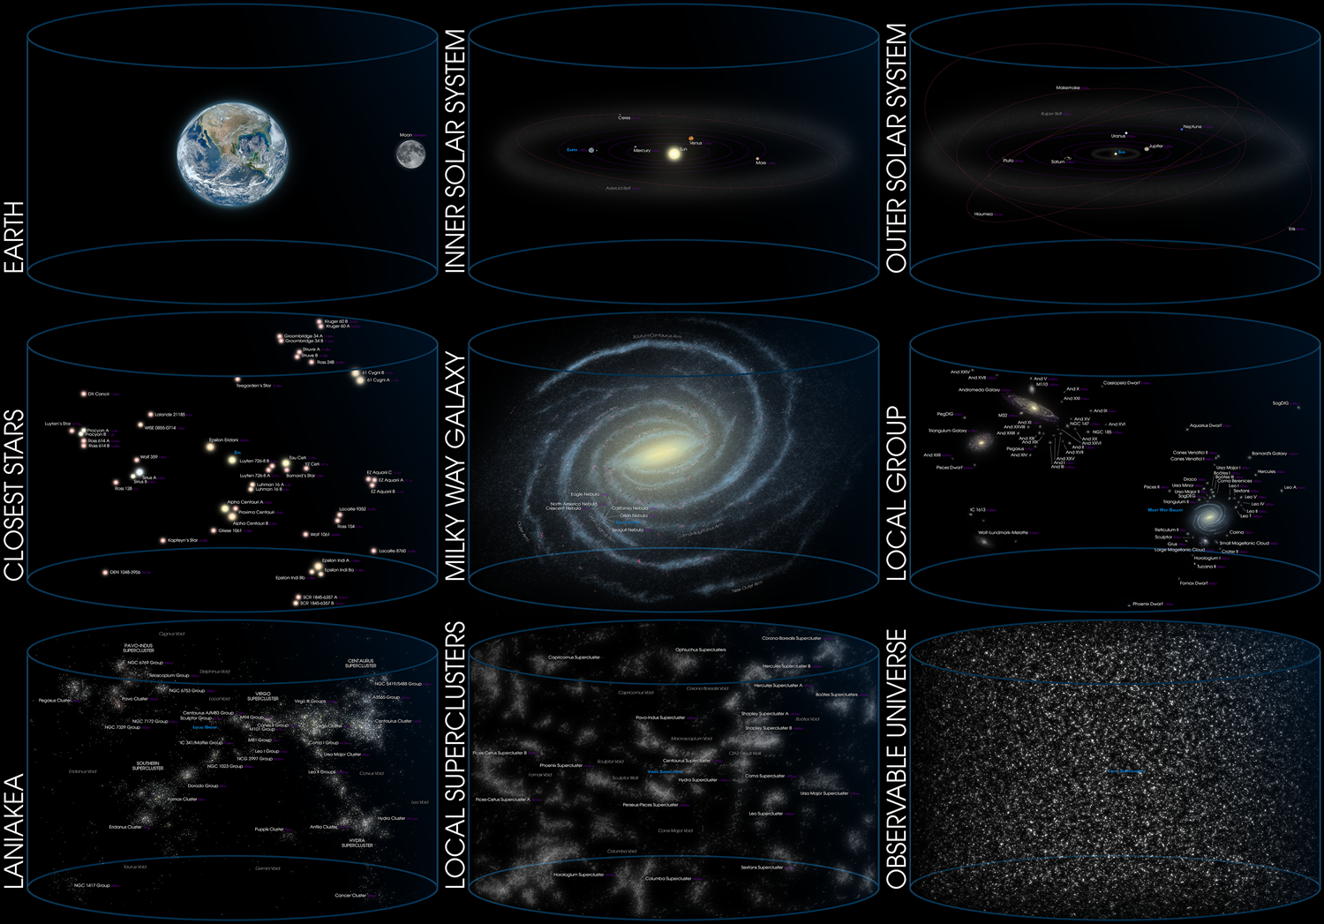
Where We Are In The Universe
Notes:
As human beings – Why is it important to know our place in the universe
By studying the cosmos beyond our own planet, we can understand where we came from, where we are going. Philosophical viewpoint that human beings are the central or most significant entities in the world.
We all know that the universe is big. Let's start out by looking at the Earth, and then zoom out to progressively larger and larger structures to an incredible scale, so that we can see for ourselves where WE Are in totality, in essence, the way that everything in the world seems to be organized. We realize that we are infinitely small within the scheme of things.
------------
The intent is to offer an overall perspective – Zooming Out From Earth to the Edge of the “Observable Universe”
-----------
Explore the following cosmic map, while mentioning the different titles of structures:
-Local superclusters
-Laniakea
-Local group
-Milky Way Galaxy
-Closest stars
-Outer solar system
-Inner solar system
-Earth
------------
Resources:
The Universe:
https://en.wikipedia.org/wiki/Universe
https://upload.wikimedia.org/wikipedia/commons/4/4a/Location_of_Earth_%283x3-English_Annot-smaller%29.png
Interactive map of the observable universe Charts from where you are to the edge of the observable universe map: http://www.atlasoftheuniverse.com/universe.html
Johns Hopkins University: https://www.youtube.com/watch?v=Oekma9SZMMI

Slide 6
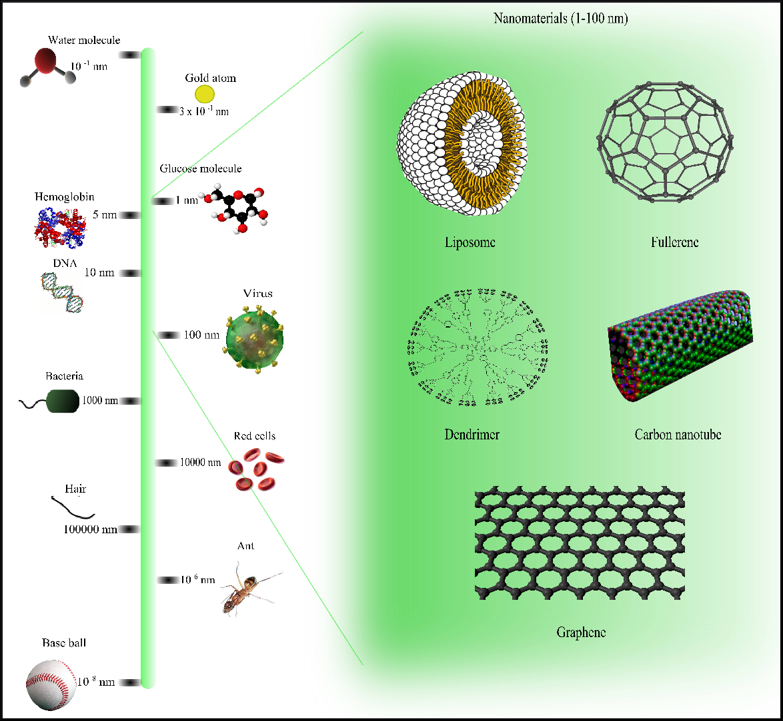
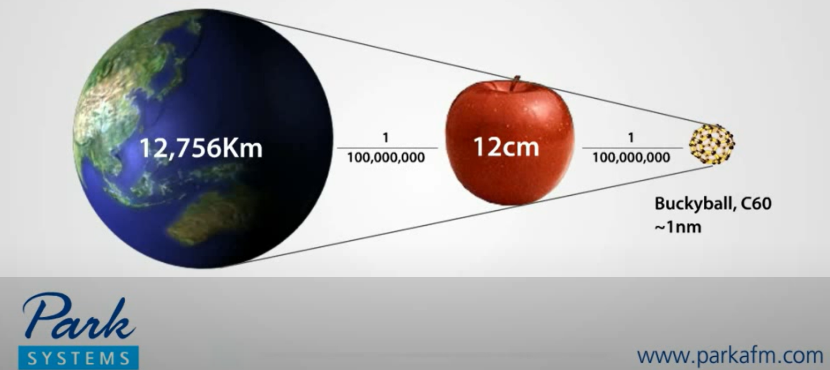
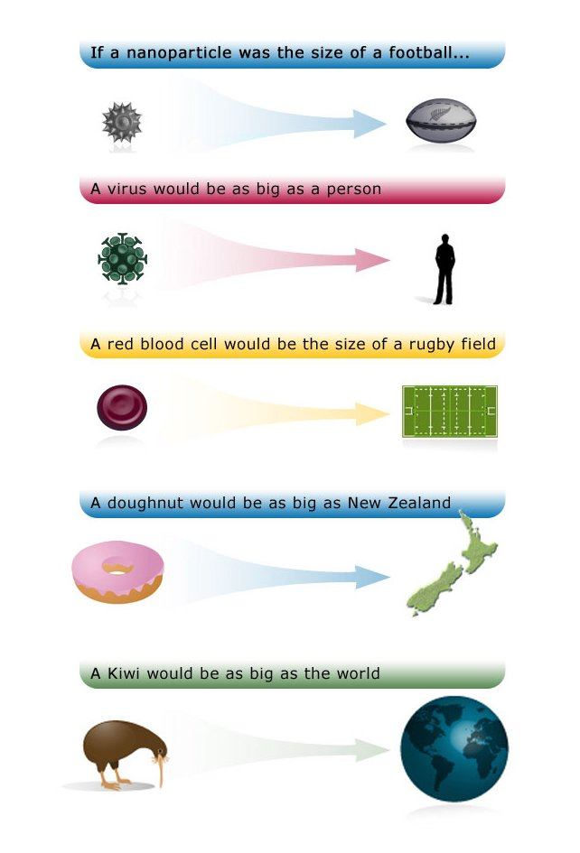
Continued…Where We Are In The Universe
Notes:
Continued…As human beings – Why is it important to know our place in the universe
---------------
On the following image, explore from the baseball smallest item or element, mentioning the different titles.
-----------------
-Ant
-Hair
-Red cells
-Bacteria
-Virus
-DNA
-Hemoglobin
-Glucose molecule
-Gold atom
-Water molecule
-Liposome, fullerene, dendrimer, carbon nanotube, graphene
---------------
Play video:
How Big Is a Nanometer – 1:28 MINS
https://www.youtube.com/watch?v=IC3AcItKc3U
Nano World – What is NANO – How small is Nano - 2 mins
https://www.youtube.com/watch?v=EYzO9OcBxNg
Resources:
Nanometer
https://upload.wikimedia.org/wikipedia/commons/a/ae/Comparison_of_nanomaterials_s izes.jpg
https://en.wikipedia.org/wiki/Nanotechnology
https://www.britannica.com/technology/nanotechnology
https://www.nanowerk.com/nanotechnology/introduction/introduction_to_nanotechnology_1.ph

Slide 7
Being Who You Are Is Enough
Who I am, that’s the ideal me;
Not who others want me to be;
Not who I would prefer to be;
I am enough.
Space, Time, and Beings
Notes:
The key message here is, existing as you are, and being who you are is enough.
-----------
Some may think, what does the whole universe and the nano world has to do with this program?
Well, it has to do with “being”, the human side of us, as opposed to the “doing”.
(click)
On this slide, at the bottom, you see a horizontal line, representing space, time, and beings
(click)
Now, there is a little dot, representing us, me, you
(click)
And all this space represents all of what we saw in the last two slides, the universe, the nano world and everything in between.

Slide 8


The Concept Of Being Present
“Being fully present means having your focus, your attention, your thoughts and feelings all concentrated on the task at hand”
Think
Say
Express
Feel
Do
Believe
Notes:
What is being present
Being present (or living mindfully) simply means you're focused and engaged in the here and now, not distracted or mentally absent.
------
What is the act of being present
Being present means being fully conscious of and engaged with our experience, even if that experience is difficult. When we are lost in thought, reliving the past, or going through the motions, it interferes with how we act in the present.
-------
“Wherever You Go, there you are”
--------
Each moment in your life has meaning, whether you notice that importance immediately or some time down the line.
Making the most of life as it happens, rather than wishing for the past or worrying about the future, can improve your quality of life and help you feel more optimistic and prepared to face any challenge.
----------
Key Words:
Moment-to-moment experience;
Moment-to-Moment Awareness;
Instead of letting your mind wander;
If you notice your thoughts wandering, gently bring yourself back to the present — without judgment or negative self-talk
Move mindfully between activities
Once you finish a task, take a minute or two to rest instead of rushing immediately to the next item on your list.
------------
It can make it easier to manage stress
Many people respond to emotional distress and uncertainty by disengaging from the source. It can certainly seem counterintuitive to stay present when you feel anxious or nervous. Distracting yourself from unwanted or unpleasant thoughts can bring short-term relief. But you can’t permanently hide from reality. Acknowledging fears and stress triggers, and working to mindfully accept them, can have more benefit in the long run.
It may help relieve mental health symptoms
According to research mindfulness practices, including present-moment awareness, may help reduce symptoms of anxiety and depression.
When you focus on the present moment, you’re paying attention to the things currently happening. These events might range from joyous to downright heartbreaking (or anywhere in between).
If you’re going through a tough time, you might understandably wonder how increasing your awareness of these experiences can benefit you.
Mindfulness helps you recognize anxious or depressed thoughts as just that: thoughts. Eventually, you can learn to recognize these thoughts as you notice them and interrupt their patterns before they trap you in a spiral of distress.
It can strengthen your relationships
Ever spent time with a friend or partner who kept looking at their phone or saying, “Sorry, what?” Maybe you’ve been the one to lose the train of a conversation when you had something else on your mind.
Everyone gets distracted from time to time, but when this happens often, it can negatively affect relationships.
Where to start
Committing to being present can feel particularly challenging in turbulent times, especially if you tend toward avoidance as a coping strategy.
Try thinking of the whole thing like a pair of new shoes: At first, it might seem uncomfortable and not quite right. But over time, you may begin to realize you’re living your days more mindfully without even thinking about it — just like those new shoes eventually start to feel as comfortable as your beloved, worn-out kicks.
Use your 5 senses for observation
Most people pay some level of attention to what they see and hear. Ask yourself whether you use your other senses with the same regularity.
Being more present is often as simple as:
savoring the taste and fragrance of your morning tea or coffee
relishing the softness of your favorite sweater
noting distant sounds, like music, your neighbors’ voices, birdsong, and so on
enjoying the warmth of the water on your skin as you shower or wash your hands
That old saying “Stop and smell the roses” isn’t bad advice. If you have the ability to use all five senses, practice observing what you feel, smell, or taste.
Focus on your breath
Deep breathing and other breathing exercises help you remember to take a moment and mindfully connect with your surroundings. You might find these particularly helpful while driving in traffic or during other times of stress. Breathing exercises can help you ground yourself and help you avoid distracting yourself further by ruminating on worries or picking up your phone.
Practice gratitude
It’s a concept that gets thrown around a lot, but practicing gratitude can make a big difference in your ability to remain present. By taking time to embrace and reflect on your appreciation for aspects of your life, you’re also paying more attention to them.
We often feel grateful for something until we’re in danger of losing it. Maybe your present situation isn’t ideal. You might feel as if you don’t have much to be grateful for.
But try to recognize small positives, like:
sunshine
your loved ones
working internet
a roof over your head
Take it to work
Staying present is key when it comes to managing work-related stress and being productive.
Your job may not always interest or challenge you, but remaining present can help you stay productive, even when you feel bored.
Use your break time mindfully
What’s the first thing you do when you start your break? There’s nothing wrong with checking your phone or grabbing a snack, but give yourself a few minutes for mindfulness first.
Closing your eyes and doing a quick body scan can help you note areas of stress or tension. Sometimes, just acknowledging these feelings can help relieve them.
Take a few deep breaths, imagining stress and tension leaving your body with each exhale.
Also consider changing up your break by taking a walk. A few minutes outside, feeling fresh air, can help you feel more present and connected.
------------------------------
Being present is the ultimate goal of being mindful, all of what I do, what I think, and what I feel are aligned and in harmony.

Slide 9
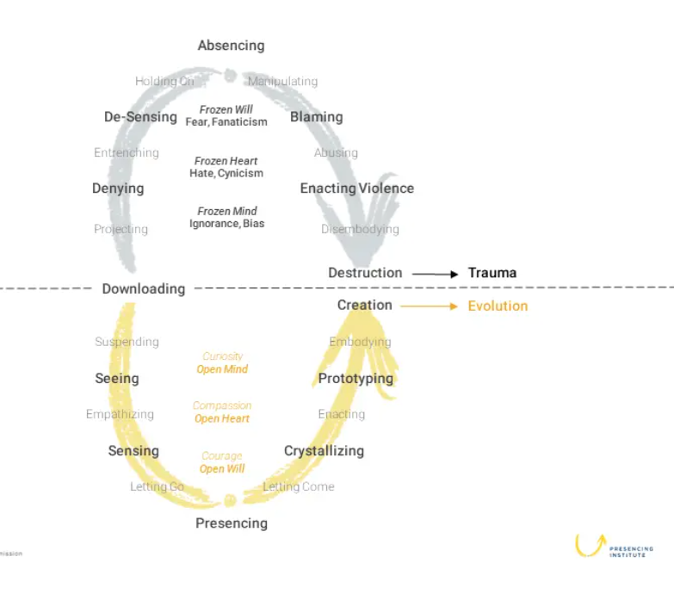
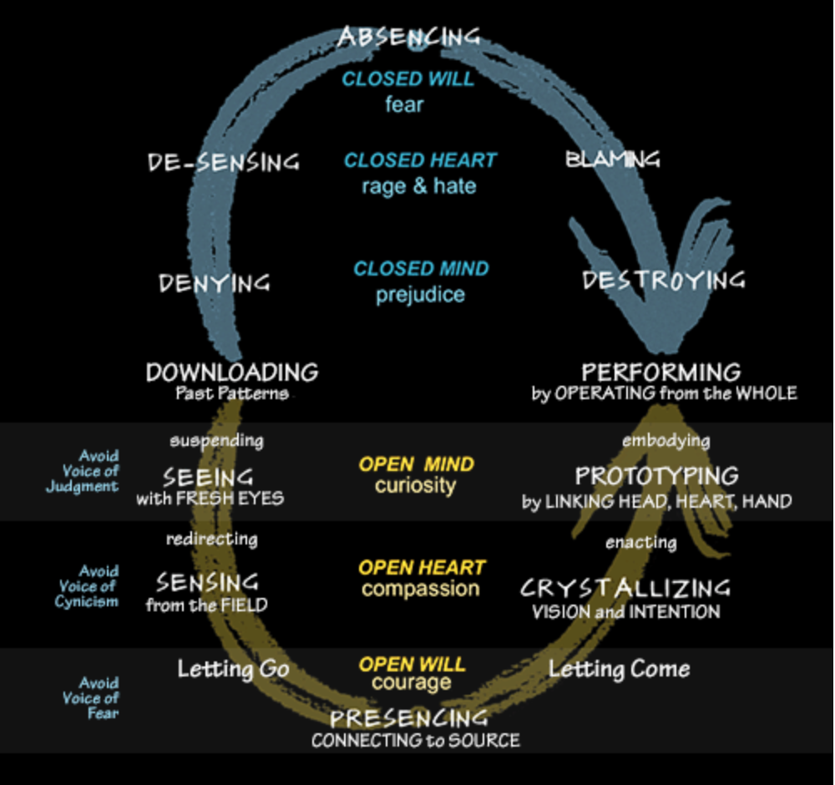
Presencing and The Theory U
Presencing is a blended word combining “sensing” (feeling the future possibility) and “presence” (the state of being in the present moment)
Absencing or presencing
Three different responses to disruption
Notes:
Have any of you heard of the concept of “Presencing” ?
------------
The concept was co-founded by Otto Scharmer, co-founder of the Presencing Institute, and an american academic author senior lecturer. And action researcher who co-creates pathways of transformation for individuals, institutions, and larger systems.
To create an action research platform at the intersection of science, consciousness, and profound social and organizational change.
------------
The Presencing Institute and The U-school for Transformation
The Presencing Institute is the holding entity that maintains the governance of The U-school and other initiatives supporting awareness-based systems change.
The U-school for Transformation: Our curriculum blends systems thinking, action learning, social arts, awareness-based practices and multi-sector learning and collaboration.
------------------
Presencing, the blending of sensing and presence, means to connect from the Source of the highest future possibility and to bring it into the now. Presencing happens when our perception begins to happen from the source of our emerging future. The boundaries between three types of presence collapse: the presence of the past (current field), the presence of the future (the emerging field of the future), and the presence of one’s authentic Self. When this co-presence, or merging of the three types of presence, begins to resonate, we experience a profound shift, a change of the place from which we operate.
-----------------
We can choose to operate from a closed mind, closed heart, and closed will, or we can choose to operate from an open mind, open heart, and open will. Accordingly, our actions give rise to a social field of self-destruction (absencing) or of collective creativity (presencing).
So, what are the conditions that determine whether a person or community activates the field of absencing or presencing? Whether we collectively enact a social architecture of separation or connection? In essence, the difference is about a shift of the heart on the level of the individual and the collective.
----------------------
There are three different responses to disruption that are playing out in all sectors and systems in the present moment:
Response 1 | Muddling through: downloading (maintaining the status quo), doing nothing.
Response 2 | Moving backward: the system is broken and that we need to orient ourselves backward. It operates on the closing of the mind, heart, and will, i.e., the amplification of prejudice, ignorance, hate, and fear.
Response 3 | Moving forward: leaning into the unknown to co-sense and co-create the future. Byleaning forward into the unknown, by sensing and actualizing the future that wants to emerge. To do that you need three critical capacities: listening and curiosity (an open mind), empathy and compassion (an open heart), as well as confidence and courage (an open will).
-----------
Theory U also uses Social Presencing Theater, which is very simple yet very innovative dynamic, by incorporating theatrical movements and other concepts or elements, accesses the intuition, making visible aspects otherwise overseen, creating profound and transformative change.
Social presencing theatre is not theater in the conventional sense, it uses simple body postures and movements to dissolve limiting concepts, to communicate directly, to access intuition, and to make visible both current reality, and the deeper, often invisible, and leverage points for creating profound change.
Social Presencing Theater where participants can cultivate personal embodied presence through guided practices that include mindfulness, movement and reflection. Social Presencing Theater can provide a strong ground for sensing into ourselves and into our contexts, leading to fresh insights, an ability to prototype creative ways of moving forward, and the courage to extend kindness and compassion to the systems and communities we care so deeply about. intensive training in applying Social Presencing Theater expertise to enable shifts in the social field.
Visual Practice (VP) is a field of work that weaves together the disciplines of presencing, Theory U, systems thinking, and dialogue with “scribing”. It is a 2-dimensional social art that helps systems see and sense their reality and potential.
These methods stand for deeper levels of listening and scribing, shining light on relationships, root causes, and energy that is felt. It is always done in service of a group, to 'presence' what a group or a social system wants to express, and then make it visible. The drawing establishes connections within content, aids with insight, and supports decision making.
-------------
I invite you to have a look at their WEBSITE for additional information. The links are available on the last slide, on the resources slide.
------------
Resources:
Otto Scharmer: https://ottoscharmer.com/
https://www.u-school.org/presencing
https://www.presencing.com/theoryu
https://www.presencing.com/overview
https://www.presencing.org/aboutus/spt
https://www.presencing.org/#/aboutus/theory-u
Dr. Dan Siegel: https://drdansiegel.com/
Dr. Dan Siegel: “Me + We = Mwe” https://www.youtube.com/watch?v=uo8Yo4U

Slide 10
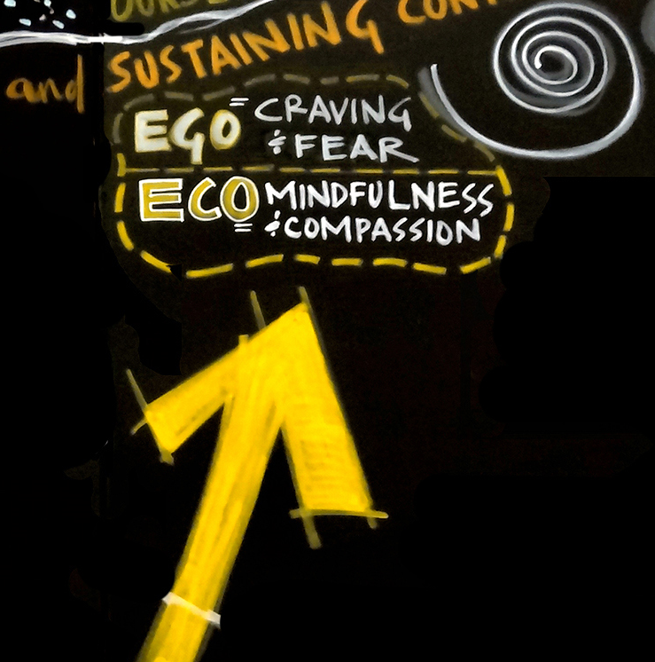
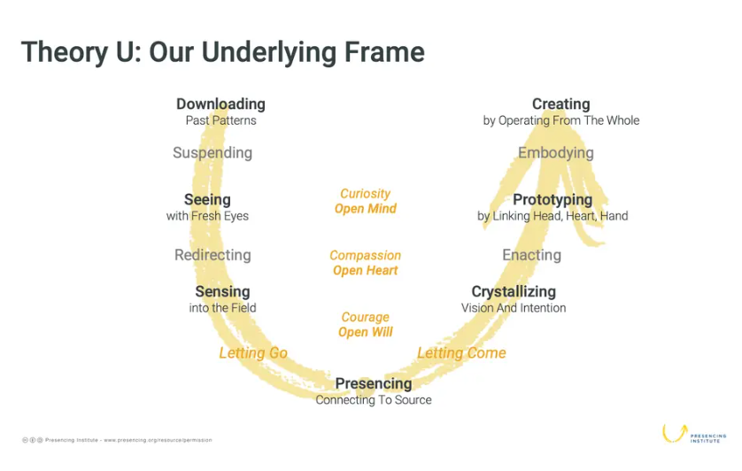
Continued…Presencing and The Theory U
Awareness-based method for changing systems
Blends systems thinking, innovation, and leading change from the viewpoint of an evolving human consciousness
Revolves around a core process of co-sensing and co-shaping emerging future possibilities.
Notes:
"In order to operate in the complexity of this century we have to do some inner work." - Otto Scharmer
We live in a time of massive institutional failure, in which we collectively create results that (almost) nobody wants. The list is well known: Climate change. Hunger. Poverty. Terrorism. Violence. Destruction of communities, nature, life—the foundations of our social, economic, ecological, and spiritual well being. These times call for a new consciousness and a new collective leadership capacity to meet these challenges in a more conscious, intentional, and strategic way. The development of such a capacity would allow us to create a future of greater possibilities.
--------------
The Presencing Institute has developed Theory U as a change framework and set of methodologies that have been used by thousands of organizations and communities worldwide to address our most pressing global challenges: climate change, food systems, inequality and exclusion, finance, healthcare and education.
---------------
Theory U is an awareness-based method for changing systems.
Theory U blends systems thinking, innovation, and leading change -- from the viewpoint of an evolving human consciousness.
Theory U revolves around a core process of co-sensing and co-shaping emerging future possibilities.
-----------------
Theory U offers a method for rethinking the parts and the whole by making it possible for the system to sense and see itself. When that happens, the collective consciousness begins to shift from ego-system awareness to eco-system awareness - from a silo view, to a systems view.
Meeting the challenges of this century requires updating our operating system from an obsolete “ego-system” focused entirely on the well-being of oneself to an eco-system awareness that emphasizes the well-being of the whole.
The Ego to Eco framework applies a Theory U lens to the transformation of the economy and its key social systems.
One of the core ideas of Theory U is that form follows attention or consciousness. We can change reality by changing the inner place from which we operate. The first step in understanding the impact of attention on reality is to look at how we operate on the individual level.
---------------
At its core, Theory U comprises three main elements:
A framework for seeing the blind spot of leadership and systems change: the "interior condition" from which we operate;
A method for implementing awareness-based change: practical methods and tools for change makers. The focus is on building the collective capacity to shift the inner place from which we operate;
A new narrative for evolutionary societal change: updating our mental and institutional operating systems in all of society's sectors. What does it take to redesign societies in ways that address the pressing challenges of our time? What does it take to apply the power of mindfulness and awareness to the transformation of the collective system?
-------------
Leadership essentially is not what a person or an individual does, that's the biggest misunderstanding. The essence of leadership is the capacity of the system, in which everyone is participating, to sense and shape the future, and to be in touch with what is wanting to emerge, and then stepping into that. That really is what leadership is all about. And that's why leadership is a distributive phenomenon.
It needs to include all of us, it's not something we can delegate to the one person at the top. The essential leadership capacities needed to address the root causes of today’s social, environmental, and spiritual challenges.
-----------------
You can only change a system when you transform consciousness
You can only transform consciousness when the system see and sense itself
The U-Theory makes reference to the Ego, summarized by craving and fear, summarized with mindfulness and compassion.
Theory-U proposes that the quality of the results that we create in any kind of social system is a function of the quality of awareness, attention, or consciousness.
The Theory U increases level of consciousness, as in self-awareness, which is the aim in this program, of a mindful change leader!
----------------
Dr. Dan Siegel is a Clinical Professor of Psychiatry at the UCLA School of Medicine and the founding co-director of the Mindful Awareness Research Center at UCLA.
Dr. Dan Siegel: “Me + We = Mwe” Relates to the “collective consciousness”
-----------------------
I invite you to have a look at their WEBSITE for additional information. The links are available on the last slide, on the resources slide.
--------------------
Resources:
Otto Scharmer: https://ottoscharmer.com/
https://www.u-school.org/presencing
https://www.presencing.com/theoryu
https://www.presencing.com/overview
https://www.presencing.org/aboutus/spt
https://www.presencing.org/#/aboutus/theory-u
Dr. Dan Siegel: https://drdansiegel.com/
Dr. Dan Siegel: “Me + We = Mwe” https://www.youtube.com/watch?v=uo8Yo4UE6g0

Slide 11

Mindful Eating Exercise
For this exercise, you will need a snack or small portion of food (e.g., fruit, vegetable, energy bar)
Shift your focus and awareness on what you are about to eat
Notes:
It is time for the mindful eating exercise, grab a snack, or small portion of food.
-------
Sit in a comfortable position, with straight back
Take deep breaths
Gently bring attention to your breath while you inhale and exhale
Without taking a bite…think about what you are about to eat
Think about the time it took for this food to come to you
Let’s take a moment to think about the origins of this food
Think about its nourishing nature
As you continue breathing
Think about the time it took for this food to come to you...to reach your mouth
-----------
Let’s think about its origin, let’s imagine where it came from, and to do so, let’s go back in time, to its origins.
Let’s go back a few billions years ago, all the way to the big-bang, you may identify with the creation of the universe…and from there, think about all the billions and billions of years that took for the universe to be formed. Then think about the billions of years for our solar system. Now consider the millions of years for the earth to cool down, the air, the water and the soil to form, and give life in our planet.
Now, think about more recent time, the seed that was seeded for the plant that produced what we’re about to eat. The person who took care of it, that watered it, the sun and the air which helped it grow.
Think about the time it took from the plant to your house, perhaps it is something you cultivated in your backyard, or something you bought at the grocery store.
Think about the preparation you took, you may have washed it, peeled it, chopped it, and now it is in front of you.
Now, I invite you to take your food you’re about to eat, pick it up, feel it in your hands, can you tell its temperature, its texture, its form. Now, put in your mouth without biting it, feel its temperature, its texture, its form. And now, bite on the food, being aware of the flavour in your mouth, conscious of your chewing, and swallow it when you feel ok to do so.
Be conscious. Enjoy the moment
-----------
Resources:
Headspace: https://www.headspace.com/mindfulness/mindful-eating
Guided meditation on mindful eating: https://declutterthemind.com/guided-meditation/mindful-eating/
Guided Mindful Eating Meditation: https://craoi.com/mindful-eating/
Benefits of mindful eating: https://health.clevelandclinic.org/mindlessly-snacking-again-try-these-3-simple-mindful-eating-exercises/
Mindful Eating - James Madison University: https://www.jmu.edu/counselingctr/files/Mindful%20eating.pdf
6 Ways to Practice Mindful Eating: https://www.mindful.org/6-ways-practice-mindful-eating/
Article - Why You Should Take a Relaxing Lunch Break: http://greatergood.berkeley.edu/article/item/why_you_should_take_a_relaxing_lunch_break

Slide 12

The Benefits Of Mindful Eating
Slide 12 - deleted at the request of Alejandro
May be replaced with an alternate slide on the benefits of mindful eating
Notes:
Now, I bring this slide because Judson Brewer is bringing a different angle to mindful eating. He explores some addictions like food and smoking with mindfulness.
We’re going to watch a video that lasts about 13 minutes, it is an interview of Anderson Cooper (you may know him or be able recognize him) with Jon Kabat-Zinn.
In it, some interesting people participate like
Rich Fernandes, ex google Sr People Development Lead, SIY Global/SIYLY CEO
Karen May, google VP People Development
Chad Meng-Tan, Google Jolly Good Fellow, creator of the SIY mindfulness program
Tim Ryan, Ohio democrat, and
Judson Brewer, himself
I hope you like it.
(play the video)
You may have recognize some of the people I mentioned during the video.
This is something we wanted to share with you.
Resources…
60 minutes interview… 13 mins - https://www.youtube.com/watch?v=ozyr7jVucz0
Great Conference - A Mindful Society @ U of Toronto - https://gcconnex.gc.ca/discussion/view/26025923/great-conference-a-mindful-society-u-of-Toronto

Slide 13

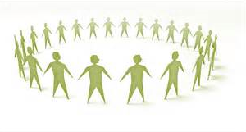
Finding a Win, Win, Win Solution
The benefits of A Win, Win, Win Solution practice
A guided reflection investigating how to solve difficult problems in a way that brings the broadest benefit to all
Notes:
The benefits of Finding A Win, Win, Win Solution
“No member of a crew is praised for the rugged individuality of his rowing.” - Ralph Waldo Emerson
Together we always achieve more.
We live in an abundant world, with many resources. It’s a pity to not find the best ways to use them and to not share them when this is a sound option.
Win-win solutions are the most desirable way to solve problems and conflicts. When you win and the other person wins, instead of one winning and the other losing, then everybody is happy and the relationship gets stronger as a bonus. Although win-win solutions exist in many situations, it is often hard to see them. We need a special way of looking at things in order to discover them.
------------
We often ask the question; Is there a ‘win-win-win’ here? We can ask if it is possible today to make a choice that will have a positive ripple effect for our organizations, for our clients, customers and patients, and for our communities.
--------------
Think about a professional or personal challenge or difficult situation (past or present), where getting to a Win Win outcome, bringing forward a Win Win Solution could be beneficial to those in your organization, your team, to yourself and, also the wider community.
-----------
Here are different ways we can use to reach a win-win outcome:
Focus on the problem, not the person; Separate the issue from the person
Focus on solving the problem, avoid blaming the other person
Listen intently
Focus on interests, not positions; A position is simply a suggested solution
Do your research; Generate many different options
Use objective criteria
Remember the other person's goals
Evaluate expectations; Create mutually beneficial opportunities for mutual gain
Remain objective
Determine best alternative
Work together toward a common goal
Be honest about any potential issues
-----------
Senior Instructor Patrick Briody leads a guided reflection investigating how to solve difficult problems in a way that brings the broadest benefit to all.
Start audio at minute 4 : http://instituteformindfulleadership.org/guided-reflection-finding-win-win-win-solution/
A guided reflection: Win Win mindfulness practice by Senior Instructor Patrick Briody from the “Institute for Mindful Leadership”.
-----------
The path to a win-win solution - liveyourtruestory.com
How Do The Best Leaders Find ‘Win-Win-Win’ Solutions? A Mindful Approach
The 3 Steps to Finding Win-Win Solutions – Life Optimizer
6 Steps to Creating a Win Win Solution | Win as a Team
Step 1: Take your negative emotions out of the equation
The situations where win-win solutions are not evident and need to be found are situations where our interests initially seem to clash with those of another person. They are situations of apparent opposition and conflict.
It is in these kinds of situations that our negative emotions tend to manifest the most: the fear of losing, the anxiety of not finding a convenient way out, or the anger at the other person. These emotions, especially when they are intense, tend to cloud our judgment and our creativity, which are the exact tools we need to find a win-win solution.
This is why it’s fundamental that you detach from any negative emotions. Firstly, recognize them when they manifest and bring into your awareness the fact they sabotage the process of finding a solution. Secondly, combat the irrational thoughts you may have which feed these emotions. This is in my view the most effective way to deal with them.
Step 2: Focus on the solution
If at the emotional level we have the inconvenience of negative emotions, at the behavioral level we have the trouble brought by passive and aggressive communication. It’s very tempting in a conflict situation to communicate this way: to justify ourselves, blame the other person, criticize, avoid the discussion or dig up the past.
As we do this, we lose track of finding a win-win solution and so we do not find one. The best way to avoid this phenomenon is to anticipate that it may happen and to notice your focus and communication style in conflict situations. And, every time you catch yourself or the other person straying from the solution finding process, bring the focus and the conversation back to it.
Step 3: Explore the context and options
A significant reason why we often don’t find a win-win solution is that we don’t insist hard enough with the solution finding process. We just give a shot in a semi-chaotic way, and then we give up. What we need to do is truly explore the context and the options.
In any conflict situation, start by ensuing that both parts agree to try and work together instead of fighting, and state their goals clearly. Continue by exploring the deeper motivations behind the stated goals and understanding each part’s story. Then, get creative and generate solutions. Analyze each solution together; compare them in terms of costs and benefits for each side and agree on one win-win solution which best serves both parts. Finally, put that solution into practice.
Creating A Win Win Solution:
How does one go about creating a win-win solution, when a team is faced with various challenges?
How do team members go about defeating the challenge rather than defeating each other?
How do team members develop trust so that all members in the team can win?
1) Recognize and acknowledge differences
This is, at times, difficult but extremely helpful to the team. Issues, challenges, or conflicts must be recognized and discussed. This recognition helps the team come together to find a mutually agreed upon solution or goal that will help each team member find greater commitment in working together.
2) Gain common ground
How can you put the conflict in perspective with team goals? Is everyone on the team committed to the team goals? Are there issues that could prevent the goals from being attained? If so, these matters need to be brought forward.
3) Understand different opinions
Step in another’s shoes to gain their insight. This step is intended to gain insight, not necessarily to gain agreement.
4) Work to overcome the issue
Differences in opinion are acceptable and even welcome! Remember, attack the issues and not the person. As a team, what is the best solution that can help the team achieve its goals? One should not have to compromise his or her values in reaching a solution.
5) Develop a plan of action
Outline what each member of the team will do, and be extremely specific. This document will also serve as an accountability document.
6) Follow up
Put the plan into action, follow up, and revise as needed in order to optimize performance.
Tips for reaching a win-win situation
When negotiating toward a winning resolution, the following tips may be helpful:
Stay calm. Though the personal hope for a win is strong, it is beneficial to stay calm and ensure your actions work toward a win-win scenario. If necessary, take a break to clear your mind, gather your thoughts, and contemplate your words before responding to a proposed solution you may find less than desirable
Remain positive. Understanding that there will be both gains and sacrifices, that this is a normal part of negotiations, and that perceived setbacks are not personal helps achieve a positive atmosphere. A positive attitude can also prime the atmosphere for the negotiations, helping the entire process take on a more positive tone.
Depersonalize the focus. By focusing on mutual interests rather than on opposing positions, it may be easier to find some common ground. For example, when negotiating with your manager for a new team training initiative, it may be beneficial to focus on your mutual interest in team productivity than on divergent positions.
Be respectful. Try to keep in mind that the other party to a negotiation is trying to get what they believe is fair. Be respectful of other peoples' time, opinions and requests to help negotiations run smoothly.
Step 1: Take your negative emotions out of the equation
The situations where win-win solutions are not evident and need to be found are situations where our interests initially seem to clash with those of another person. They are situations of apparent opposition and conflict.
It is in these kinds of situations that our negative emotions tend to manifest the most: the fear of losing, the anxiety of not finding a convenient way out, or the anger at the other person. These emotions, especially when they are intense, tend to cloud our judgment and our creativity, which are the exact tools we need to find a win-win solution.
This is why it’s fundamental that you detach from any negative emotions. Firstly, recognize them when they manifest and bring into your awareness the fact they sabotage the process of finding a solution. Secondly, combat the irrational thoughts you may have which feed these emotions. This is in my view the most effective way to deal with them.
Step 2: Focus on the solution
If at the emotional level we have the inconvenience of negative emotions, at the behavioral level we have the trouble brought by passive and aggressive communication. It’s very tempting in a conflict situation to communicate this way: to justify ourselves, blame the other person, criticize, avoid the discussion or dig up the past.
As we do this, we lose track of finding a win-win solution and so we do not find one. The best way to avoid this phenomenon is to anticipate that it may happen and to notice your focus and communication style in conflict situations. And, every time you catch yourself or the other person straying from the solution finding process, bring the focus and the conversation back to it.
Step 3: Explore the context and options
A significant reason why we often don’t find a win-win solution is that we don’t insist hard enough with the solution finding process. We just give a shot in a semi-chaotic way, and then we give up. What we need to do is truly explore the context and the options.
In any conflict situation, start by ensuing that both parts agree to try and work together instead of fighting, and state their goals clearly. Continue by exploring the deeper motivations behind the stated goals and understanding each part’s story.
Then, get creative and generate solutions. Analyze each solution together; compare them in terms of costs and benefits for each side and agree on one win-win solution which best serves both parts. Finally, put that solution into practice. Stick to this process, apply it systemically, and if there is a win-win solution for your situation you will find it.
I believe it is always best to try and find a win-win solution to a conflict. Many viable solutions remain just unapplied theory because people don’t put in the effort to find them and don’t approach the whole process in a constructive, effective way.
We live in an abundant world, with many resources. It’s a pity to not find the best ways to use them and to not share them when this is a sound option.

Slide 14




Practice For Next Week
Schedule weekly check-in with your buddy system
Daily Gratitude Journaling
Daily Practice
  Choose an intention and practice one exercise per day and take note of how you feel
Links to the guided practices, and videos are available on the last slide – “Resource slide”
Notes:
Plenary debrief and practice for next week
--------
ENGAGE PARTICIPANTS - Open the floor – invite 2/3 individuals to share. If you have any questions, or observations on today’s session, or takeaways from today’s session, now is the moment to do so.
You can use the « Raise hand feature » or «chat function» to speak.
CHECK IN with buddy system: Feel free to break yourself into smaller group if finding common time slots or time zones to meet with your entire group is challenging.
Let us know if you need any assistance with respect to the buddy system.

Slide 15

Breakout Rooms
Share and exchange on today’s session and practices:
  What was helpful for you
  What was challenging for you
  What sparked your attention
Feel free to share challenges, tips and tricks or helpful resources
Notes:
Prep for the breakout rooms
The breakout rooms will commence shortly, just before we do, if you do not intend to participate, please end the session prior we start assigning participants to breakout rooms, that way no one is left alone in a room.
--------
A 5 minutes heads up will be given before ending the breakout rooms. That way the discussion will not be interrupted without notice.
----------
You’ll have the opportunity to exchange, in small groups of 4-6 people who are randomly assigned. Just be conscious and share the “airtime” among participants.
---------
When discussions have ended, you can simply exit the session, or come back if you have questions or would like to express feedback

Slide 16
EXERCISES
3-minutes -Body Scan – HeadSpace
5-minutes -BODY SCAN
15-minutes -Body Scan - SoundCloud
2-minutes – Loving Kindness - HeadSpace
5-minutes - BREATHING – HeadSpace
5-minutes -Breathing - SoundCloud
2-15 minutes - Various practices - Jim Hjort
5-15 minutes - Mindfulness Exercises For Loving Kindness & Compassion
5-20 minutes - Dr. Kristin Neff - Self-Compassion Guided Practices and Exercises
5 minutes - Self-Compassion Break
15 minutes - Mindful Self-Compassion - SoundCloud
15-minutes - Awakening Compassion – SoundCloud
15 mins – Self Compassion Meditation by Awakening Compassion | SoundCloud
15 mins – Loving Presence and Body Scan - SoundCloud
5 mins – Brief Meditation: Arriving in Mindful Presence - Tara Brach
Mindful Eating – Headspace
Guided Meditation for Mindful Eating - Declutter The Mind
Guided Mindful Eating Meditation – CRAOI
Mindful Eating Exercises to Try – Cleveland Clinic
One-minute Mindful Eating: The Art of Being Present – YouTube
Notes:
The Universe and Nanometer:
https://upload.wikimedia.org/wikipedia/commons/a/ae/Comparison_of_nanomaterials_s izes.jpg
https://en.wikipedia.org/wiki/Nanotechnology
https://www.britannica.com/technology/nanotechnology
https://www.nanowerk.com/nanotechnology/introduction/introduction_to_nanotechnology_1.ph
https://en.wikipedia.org/wiki/Universe
https://upload.wikimedia.org/wikipedia/commons/4/4a/Location_of_Earth_%283x3-English_Annot-smaller%29.png
https://upload.wikimedia.org/wikipedia/commons/4/4a/Location_of_Earth_%283x3-English_Annot-smaller%29.png
https://upload.wikimedia.org/wikipedia/commons/a/ae/Comparison_of_nanomaterials_s izes.jpg

Slide 17

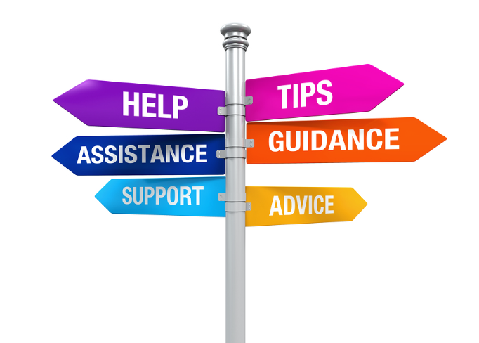
USEFUL LINKS
EXERCISES
3-minutes -Body Scan – HeadSpace
5-minutes -BODY SCAN
15-minutes -Body Scan - SoundCloud
2-minutes – Loving Kindness - HeadSpace
5-minutes - BREATHING – HeadSpace
5-minutes -Breathing - SoundCloud
2-15 minutes - Various practices - Jim Hjort
5-15 minutes - Mindfulness Exercises For Loving Kindness & Compassion
5-20 minutes - Dr. Kristin Neff - Self-Compassion Guided Practices and Exercises
5 minutes - Self-Compassion Break
15 minutes - Mindful Self-Compassion - SoundCloud
15-minutes - Awakening Compassion – SoundCloud
15 mins – Self Compassion Meditation by Awakening Compassion | SoundCloud
15 mins – Loving Presence and Body Scan - SoundCloud
5 mins – Brief Meditation: Arriving in Mindful Presence - Tara Brach
One-minute Mindful Eating: The Art of Being Present – YouTube
Mindful Eating – Headspace
Guided Meditation for Mindful Eating - Declutter The Mind
Guided Mindful Eating Meditation – CRAOI
Mindful Eating Exercises to Try – Cleveland Clinic

Slide 18
USEFUL LINKS
YouTube VIDEOS
The Universe within 14 billion Light Years - The Visible Universe (atlasoftheuniverse.com)
Nano World - What is NANO? How small is nano? – YouTube
How Big Is a Nanometer? – YouTube
ARTICLES ON MINDFUL EATING
6 Ways to Practice Mindful Eating – Mindful
Why You Should Take a Relaxing Lunch Break (berkeley.edu)
ARTICLE ON BEING PRESENT
How to Be Present at Work, In Relationships, and More (healthline.com)
THEORY ON PRESENCING AND THEORY U
Otto Scharmer
Presencing | u-school for Transformation
Theory U | u-school for Transformation
u-school for Transformation | u-school for Transformation
Resources | u-school for Transformation
Dr. Dan Siegel Home Page
Dan Siegel: Me + We = Mwe – YouTube
ARTICLES ON HOW TO FIND A WIN, WIN WIN SOLUTION
Guided Reflection: Finding a Win, Win, Win Solution - Institute for Mindful Leadership
The path to a win-win solution - liveyourtruestory.com
How Do The Best Leaders Find ‘Win-Win-Win’ Solutions? A Mindful Approach
The 3 Steps to Finding Win-Win Solutions – Life Optimizer
6 Steps to Creating a Win Win Solution | Win as a Team

Slide 19


Be Mindful, Be Happy

