Slide 1
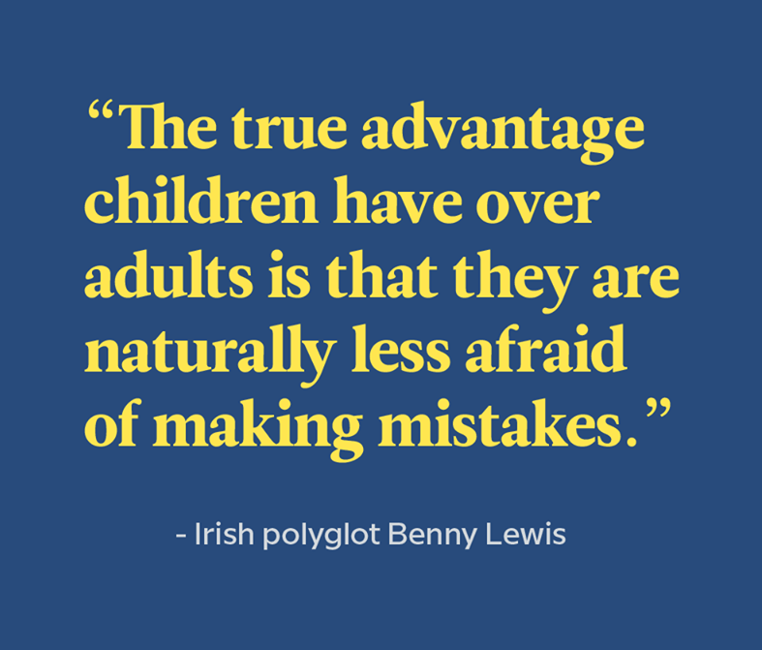
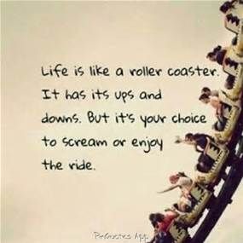
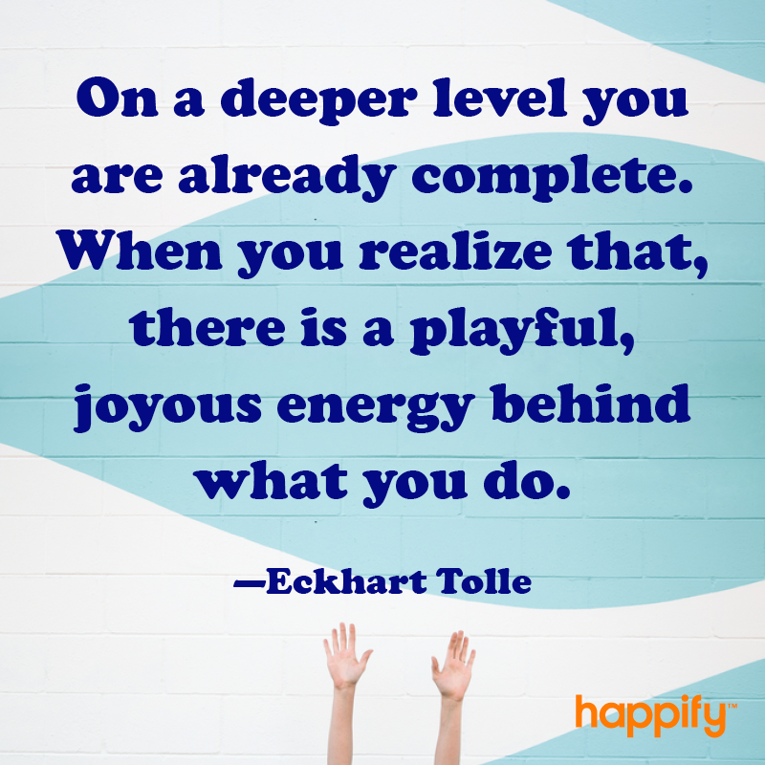
Welcome
Notes:
(Friendly reminder: prep for sharing audio & video, including French CC and 100% font size)
Space image: Have the file locally saved and turned to show correctly: https://upload.wikimedia.org/wikipedia/commons/4/4a/Location_of_Earth_%283x3-English_Annot-smaller%29.png
Nanometer Image: Have the file locally saved and turned to show correctly: https://upload.wikimedia.org/wikipedia/commons/a/ae/Comparison_of_nanomaterials_s izes.jpg
Nanometer: https://www.youtube.com/watch?v=EYzO9OcBxNg
Takes about 12 minutes total, we’ll start at minute 4 http://instituteformindfulleadership.org/guided-reflection-finding-win-win-win-solution/
60 minutes (13 minutes total): https://www.youtube.com/watch?v=ozyr7jVucz0

Slide 2
Mindful Change Leadership Development Program
Week 6 (of 8)
tbd
Notes:
« Vous savez maintenant que vous pouvez utiliser la langue de votre choix pour exprimer vos commentaires ou vos questions »
By now, you know you can use the language of your choice to express your comments or questions

Slide 3



Mindful Self-Compassion Exercise – Centering
Notes:
For today’s centering exercise, we’ll use a slight variation…. Similar to previous ones, the trick is to shift from “doing” to “being”
Let’s start by doing the following...
Sit with a straight position, as comfortable as possible
It helps if you close or semi-close your eyes
Focus on your breathing and repeat in your mind the following sentences that feel right to you, in this moment…
Repeat twice or three times:
May I be safe
May I be peaceful
May I be kind to myself
May I accept myself as I am

Slide 4






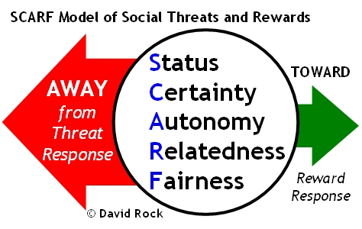
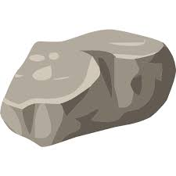






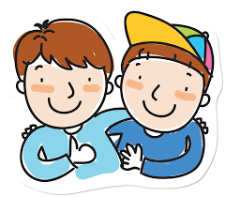

Debrief from last week (5)
Any insights?
SBN-RR
Plenary
Notes:
Let’s open the mic to some people who would like to share your comments, challenges, surprises… particularly would like to hear from someone who hasn’t spoke
Raise your hand to speak, type in the chat… be mindful about the time, let’s take as many as we can in 10 mins.
Consider the last week activities and your own experiences, including
the gratitude journaling.
the Mindfulness Breathing or Body Scan,
SCARF Model
I love myself
SBN RR technique
((manage the participation & the comments on the chat))

Slide 5

Agenda – week 6
Centering breathing exercise
Debrief from last week 5
Today’s session intentions:
Focus, Compassion, Clarity, Creativity
Human being is enough
Present – Presence – Presencing
Mindful Eating exercise
Mindful Win-Win-Win exercise
Your takeaway assignment

Slide 6
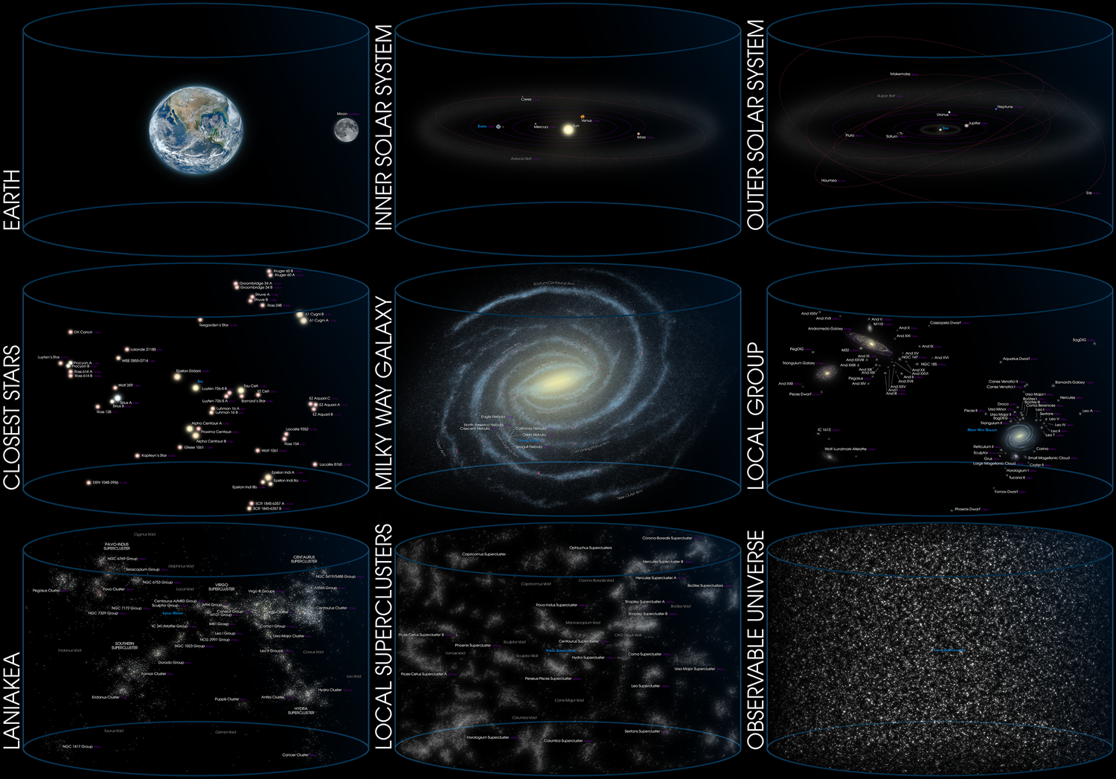
https://en.wikipedia.org/wiki/Universe
Notes:
As humans, where are we?
Let’s try to have a perspective, for that, let’s explore the following image.
((explore the image from the “observable univierse” to the “Earth”, mentioning the different titles))
Observable Universe - Univers observable
local superclusters - superamas locaux
Laniakea – laniakea
Local group - Groupe local -
Milky Way Galaxy - Galaxie de la voie lactée
closest stars - étoiles les plus proches
outer solar system - système solaire extérieur
inner solar system - système solaire intérieur
earth - la terre
And in the world, we have the continents, North America, Canada, the territory or province, down to your neighborhood and the house/apartment
I’ll let the image there for a few seconds to have it settle with us
(((Space image, have the file locally saved and turned to show correctly: https://upload.wikimedia.org/wikipedia/commons/4/4a/Location_of_Earth_%283x3-English_Annot-smaller%29.png ))
Resources in French:
https://fr.wikipedia.org/wiki/Univers
https://upload.wikimedia.org/wikipedia/commons/3/3a/Observable_Universe_French_Annotations_for_wiki.png

Slide 7
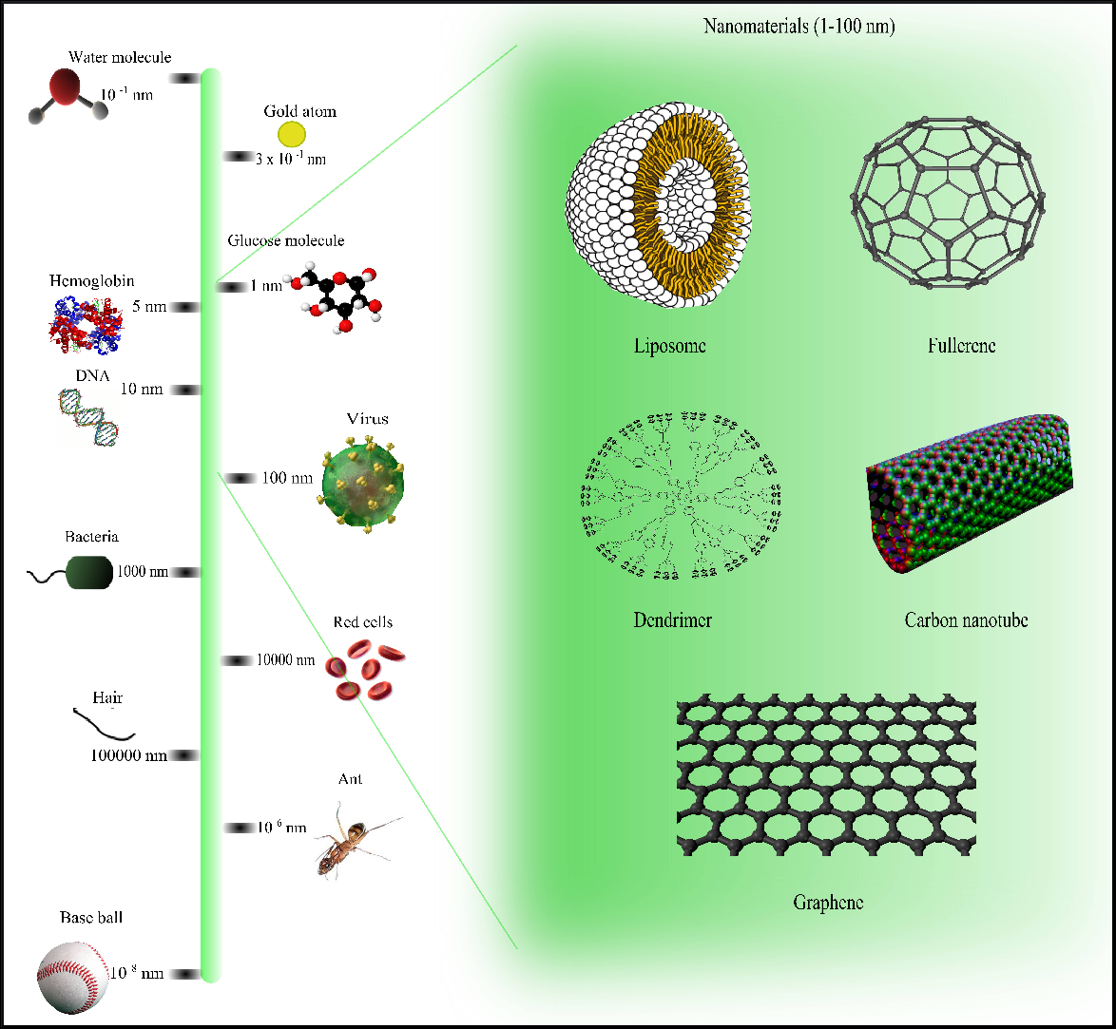
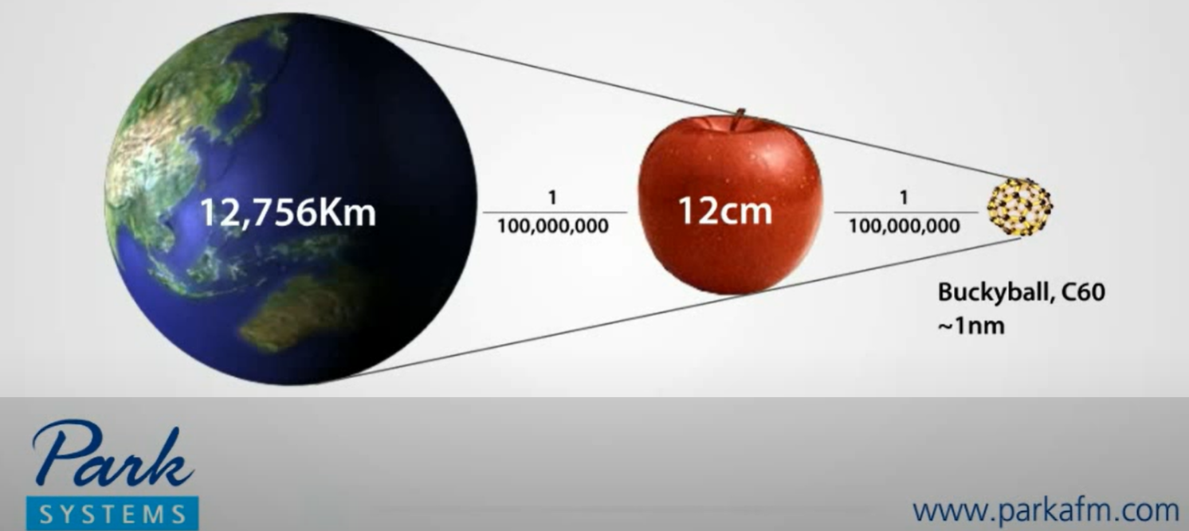
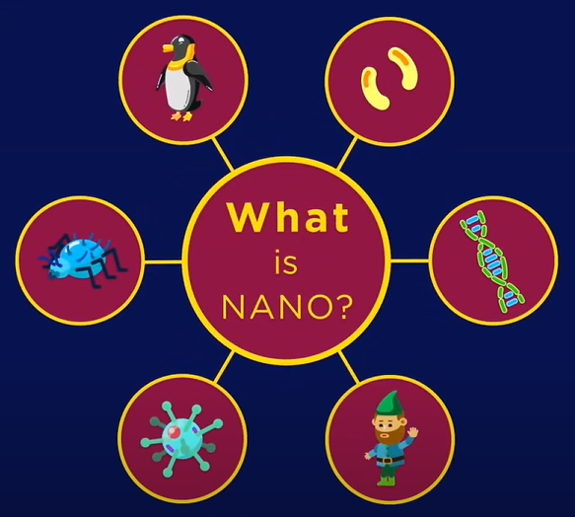

https://www.youtube.com/watch?v=EYzO9OcBxNg
https://upload.wikimedia.org/wikipedia/commons/a/ae/Comparison_of_nanomaterials_sizes.jpg
https://en.wikipedia.org/wiki/Nanotechnology
Notes:
((explore the image from the “baseball” to the smallest image, mentioning the different titles))
(English – Français)
Baseball ball - Balle de baseball
Ant - Fourmi
Hair – Cheveu
Red cells - Globules rouges
Bacteria – Bactéries
Virus – Virus
DNA – ADN
Hemoglobin – Hémoglobine
Glucose molecule - Molécule de glucose
Gold atom - Atome d'or
Water molecule – Molécule d’eau
Et les nanomatériaux sont listes :
(English: liposome, fullerene, dendrimer, carbon nanotube, graphene)
Français : liposome, fullerène, dendrimère, nanotube de carbone, graphène
((Then play the video))
Resources:
Nanometer Image: Have the file locally saved and turned to show correctly: https://upload.wikimedia.org/wikipedia/commons/a/ae/Comparison_of_nanomaterials_s izes.jpg
Video Nanometer: https://www.youtube.com/watch?v=EYzO9OcBxNg
https://www.britannica.com/technology/nanotechnology
https://www.nanowerk.com/nanotechnology/introduction/introduction_to_nanotechnology_1.php
Resources in French…
https://fr.wikipedia.org/wiki/Nanotechnologie
https://www.futura-sciences.com/tech/definitions/technologie-nanotechnologie-4783/

Slide 8
Human being – because being is enough
Who I am, that’s the ideal me
Not who others want me to be,
Not who I would prefer to be
I am enough
Space, time, beings
Notes:
Some may think, what does the whole universe and the nano world has to do with this program?
Well, it has to do with the being, the human side of us, as opposed to the doing.
(click)
On this slide, at the bottom, you see a horizontal line, representing space, time, and beings
(click)
Now, there is a little dot, representing us, me, you
(click)
And all this space represents all of that we saw in the last two slides, the universe, the nano world and everything in between
(click)
The key message here is that, by being is enough
Who I am, that’s the ideal me
Not who others want me to be,
Not who I would prefer to be
I am enough

Slide 9

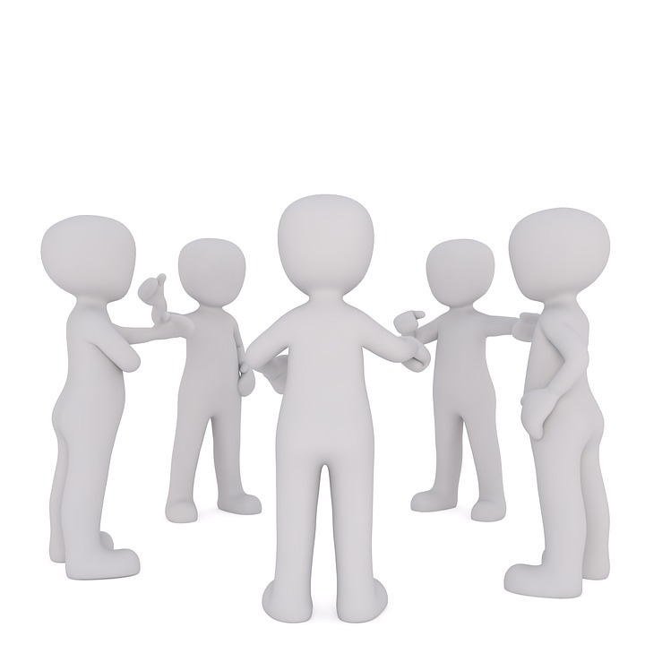

Present
“Being fully present means having your focus, your attention, your thoughts and feelings all concentrated on the task at hand”
Think
Feel
Do
Say
Express
Believe
Notes:
What does being present means?
(read the slide)
(click)
Or in other words, what you say, what you think, what you express, what you do, what you believe, all of these things
(click)
sometimes happens in parts of us, sometimes they are not necessarily aligned;
(click)
and being present, as the ultimate goal of being mindful, means that all of them what I do, what I think, and what I feel are being one, aligned and in harmony

Slide 10
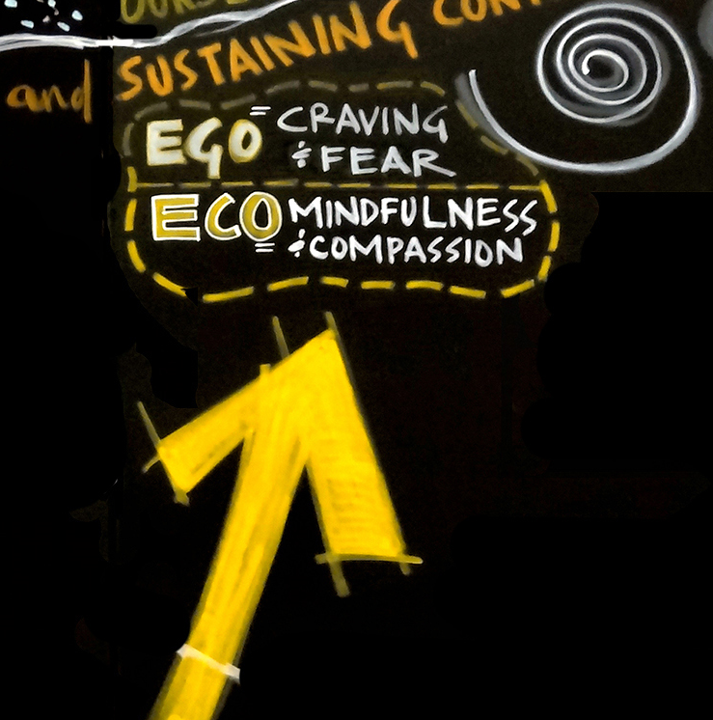
Presencing
… is a blended word combining “sensing” (feeling the future possibility) and “presence” (the state of being in the present moment)
https://www.presencing.com/theoryu
Theory - U
Theory U proposes that the quality of the results that we create in any kind of social system is a function of the quality of awareness, attention, or consciousness that the participants in the system operate from. *
Notes:
Now let’s share about the Presencing Institute. Some of you may already know of it
(read first bullet from the slide)
And the U-Theory makes reference to the Ego, summarized by craving and fear, and the Eco, summarized with mindfulness and compassion
(read second bullet from the slide)
Resources…
https://www.presencing.com/theoryu
https://www.presencing.com/overview

Slide 11
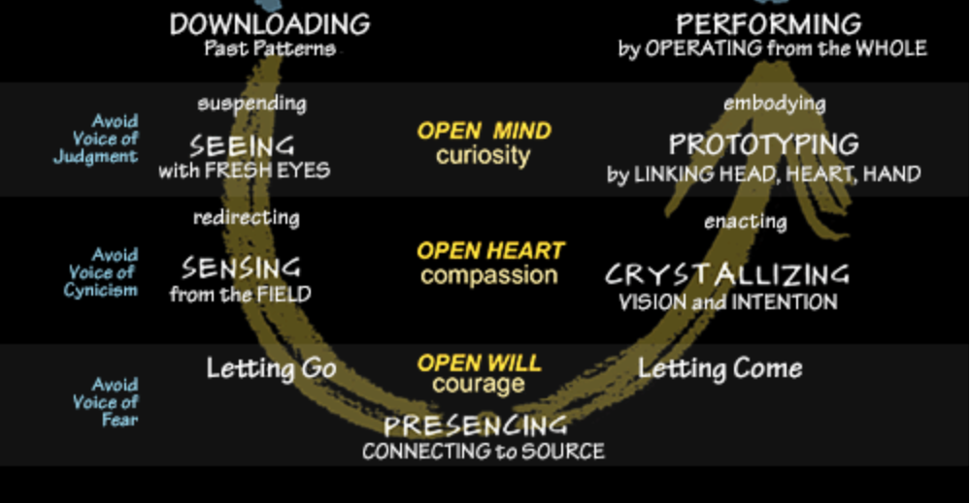
Theory - U
Embodies awareness-based systems change…
You can only change a system when you transform consciousness.
You can only transform consciousness when the system see and sense itself -- Otto Scharmer
Theory – U uses "social presencing theatre“, this is not "theater" in the conventional sense, it uses simple body postures and movements to dissolve limiting concepts, to communicate directly, to access intuition, and to make visible both current reality, and the deeper – often invisible – leverage points for creating profound change.
https://www.presencing.org/aboutus/spt
Notes:
(read from slide first 3 bullets)
In other words, what Theory U does is, increases of consciousness, as in self-awareness, and that’s what we aim at this program
(click)
Theory U also uses “social presencing theatre”, which is very simple yet very innovative dynamic… by incorporating theatrical movements and other concepts or elements, accesses the intuition, making visible aspects otherwise overseen, creating profound and transformative change.
I invite you to explore the presencing institute website to get more information
Resources…
https://www.presencing.org/aboutus/spt
https://www.presencing.org/#/aboutus/theory-u
(relates to the collective consciuosness from Dan Siegel: Me + We = Mwe https://www.youtube.com/watch?v=uo8Yo4UE6g0 )
Ressources en français :
The "I" and the "We" - https://www.youtube.com/watch?v=dIcmpy10PaE
https://www.facebook.com/groups/VoyageGaiaHubFrancophone/?tn-str=*F
https://www.youtube.com/c/PresencingInstitute/search?query=Francophone
https://www.u-school.org/community/hubs/gaia-francophone-hub

Slide 12
Mindful Eating Exercise
With your back straight, sit as comfortable as possible
Take a couple of deep breaths…
Gently bring attention to your breath
Let’s think about what we are about to eat
As you continue breathing...
Think about the time it took for this food to come to you...
Notes:
It is time to do the mindful eating exercise, hope you got with you the small fruit or veggies that were requested, if not, now it is the time to go grab something small that you can put in your mouth without biting on it.
Like I brought with me slices of an orange, it can be slices of an apple, or small chunks of cucumber, or pieces of celery or carrot, or similar.
For this exercise we adopt a dignifying posture, (repeat the prep steps, as per other mindfulness instructions)
Now think about this fruit or veggie you’re about to eat, let’s think about its origin, let’s imagine where it came from, and to do so, let’s go back in time, to its origins. Let’s go back a few billions years ago, all the way to the big-bang, you may identify with the creation of the universe… and from there, think about all the billions and billions of years that took for the universe to be formed.
Then think about the billions of years for our solar system to form. Now consider the millions of years for the earth to cool down, the air, the water and the soil to form, and give life in our planet.
Now, think about more recent time, the seed that was seeded for the plant that produced what we’re about to eat. The person who took care of it, that watered it, the sun and the air which helped it grow.
Think about the time it took from the plant to your house, perhaps it is something you cultivated in your backyard, or something you bought at the grocery store.
Think about the preparation you took, you may have washed it, peeled it, chopped it, and now it is in front of you.
Now, I invite you to take the piece of food you’re about to eat, pick it up, feel it in your hands, can you tell its temperature, its texture, its form. Be conscious of that.
Now, I invite you to put it in your mouth without biting it, with your tongue, again, feel its temperature, its texture, its form. Be conscious of that.
And now, I invite you to bite on this food, being aware of the explosion of flavour in your mouth, conscious of your chewing, and swallow it when you feel ok to do so.
(give some time for participants to chew and pass the food)
Enjoy the moment
If you have a second piece of food, you’re welcome to eat it
(give participants some time)
… and when you’re done, I invite you to join us and come back
Resources…
* Why You Should Take a Relaxing Lunch Break – Article http://greatergood.berkeley.edu/article/item/why_you_should_take_a_relaxing_lunch_break

Slide 13
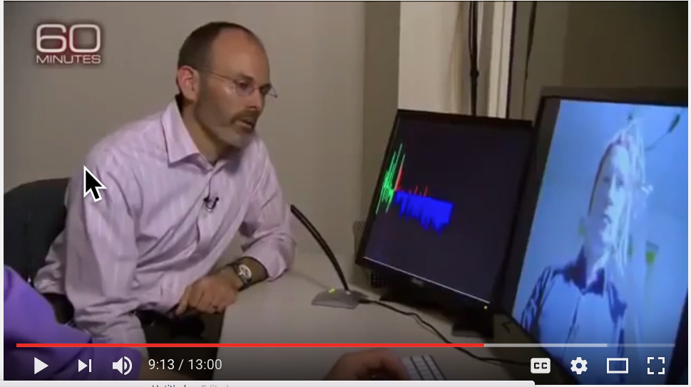
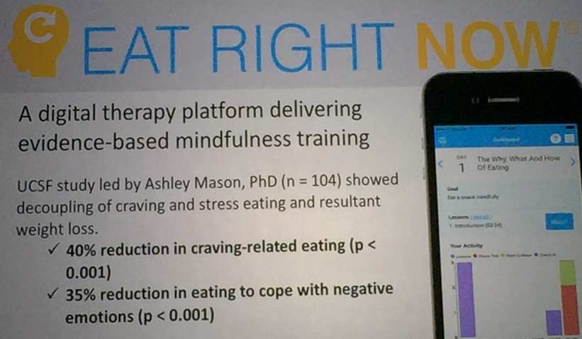
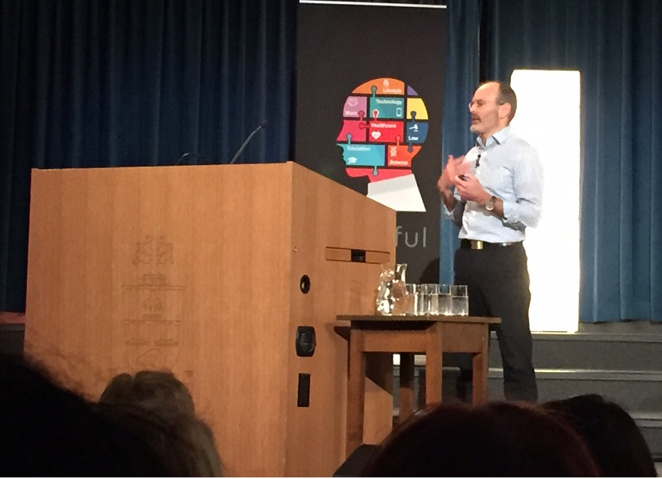
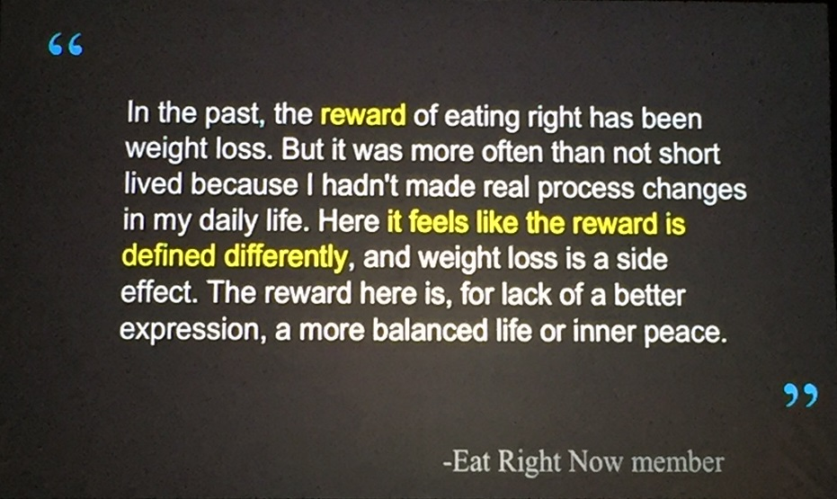
From Mindful Society Conference
https://www.youtube.com/watch?v=ozyr7jVucz0
Notes:
Now, I bring this slide because Judson Brewer is bringing a different angle to mindful eating. He explores some addictions like food and smoking with mindfulness.
We’re going to watch a video that lasts about 13 minutes, it is an interview of Anderson Cooper (you may know him or be able recognize him) with Jon Kabat-Zinn.
In it, some interesting people participate like
Rich Fernandes, ex google Sr People Development Lead, SIY Global/SIYLY CEO
Karen May, google VP People Development
Chad Meng-Tan, Google Jolly Good Fellow, creator of the SIY mindfulness program
Tim Ryan, Ohio democrat, and
Judson Brewer, himself
I hope you like it.
(play the video)
You may have recognize some of the people I mentioned during the video.
This is something we wanted to share with you.
Resources…
60 minutes interview… 13 mins - https://www.youtube.com/watch?v=ozyr7jVucz0
Great Conference - A Mindful Society @ U of Toronto - https://gcconnex.gc.ca/discussion/view/26025923/great-conference-a-mindful-society-u-of-Toronto

Slide 14

Mindful – Win Win Win
Think about an issue where you’d like to bring a win-win-win, benefiting those in your team, your organization, and also the wider community
Listen as Institute for Mindful Leadership Senior Instructor Patrick Briody leads a short guided reflection investigating how to solve difficult problems in a way that brings the broadest benefit to all
http://instituteformindfulleadership.org/guided-reflection-finding-win-win-win-solution/
Notes:
This is the win-win-win mindfulness practice
(read from slide)
. – The audio takes a total of 12 minutes, we’ll start at minute 4
http://instituteformindfulleadership.org/guided-reflection-finding-win-win-win-solution/
…and I invite you to open your eyes and come back.
Keep in mind, shortly you’ll have time to share your reflections in the debrief

Slide 15


Your take away practice for week 6
Connecting – once a week with you buddy
Gratitude Journaling – daily
Practice, chose one of the following and
keep doing it for the whole week - daily
  Self-compassion
  15 mins – https://soundcloud.com/mindfullivingcoach/self-compassion-meditation
  15 mins – https://soundcloud.com/awakeningcompassion/awakening-compassion-class-4
  20 mins – http://self-compassion.org/wp-content/uploads/meditations/LKM.self-compassion.MP3
Be Mindful of your Presence – as much as possible
  20 mins – Loving https://www.tarabrach.com/meditation-loving-presence-2/
  5 mins – Arriving - https://www.tarabrach.com/brief-meditation-5-minute/
Apply Mindful Eating – as needed
Apply Mindful Win-Win-Win – as much as possible
http://instituteformindfulleadership.org/guided-reflection-finding-win-win-win-solution/
Notes:
For this week… as usual, if you have any questions, now is the time to ask…
(read from slide until the end)

Slide 16

Reflect about today’s exercises
Notes:
Now, before going into small groups debrief, let’s do a plenary debrief, let’s open the microphone for a few of you who would like to share your reflections about today’s exercises
Human Being is enough
Presence
Mindful Eating Exercise
Mindful – Win Win Win
(Give the voice to 2-4 participants, depending on time, likely to start the small groups around 20 minutes before the end of the session)
(Then create breakout rooms of 6)
As in previous weeks, you’re going to be randomly assigned to a breakout room so you can do your debriefs inn small groups, when you’re done just leave the session.
(open the breakout rooms while mentioning the following)
Feel free to share:
What you noticed
What you had a hard time with
What you’re reailzing
An intention you have for the week
I wish you happiness!!

Slide 17


Be Mindful, Be Happy /
Prenez conscience, soyez heureux

