Slide 1
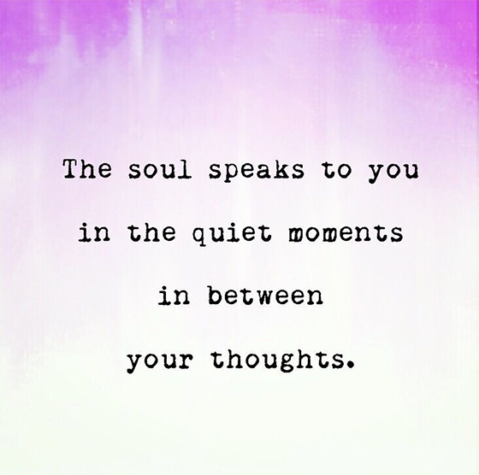
Notes:
Carmen 1-5
Friendly reminder: Disconnect from VPN to have a better experience
(Friendly reminder: prep for sharing audio & video, including French CC and 100% font size)
SCARF Model https://www.youtube.com/watch?v=hNAcCc1oWR4
Self-compassion break, 5 mins: https://self-compassion.org/wp-content/uploads/2020/08/self-compassion.break__01-cleanedbydan.mp3
How to Practice Mindful Emailing: https://www.youtube.com/watch?v=qBBy5Jx_xrQ

Slide 2
Mindful Change Leadership Development Program
Week 5 (of 8)
24 May 2021
Notes:
Carmen
« Vous savez maintenant que vous pouvez utiliser la langue de votre choix pour exprimer vos commentaires ou vos questions »
By now, you know you can use the language of your choice to express your comments or questions

Slide 3
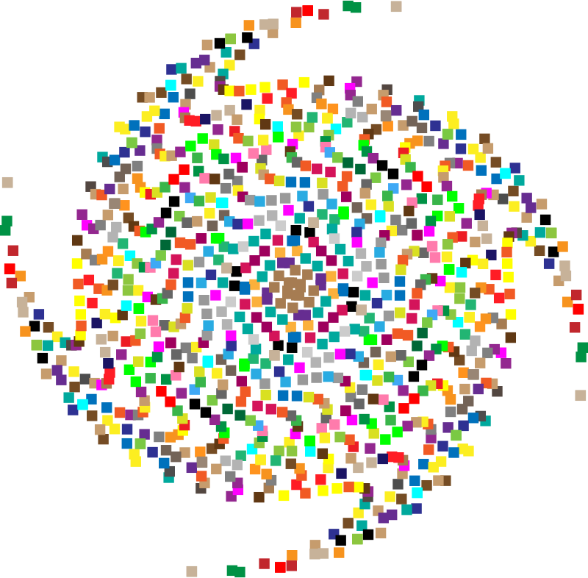
Mindful Self-Compassion Exercise – Centering
Mindful breathing https://www.youtube.com/watch?v=ZE-r-x2T4ok
Notes:
Carmen
For today’s centering exercise, we’ll use a slight variation…. Similar to previous ones, the trick is to shift from “doing” to “being”
Let’s start by doing the following...
Sit with a straight position, as comfortable as possible
It helps if you close or semi-close your eyes
Focus on your breathing and repeat in your mind the following sentences that feel right to you, in this moment…
Repeat twice or three times:
May I be safe
May I be peaceful
May I be kind to myself
May I accept myself as I am

Slide 4
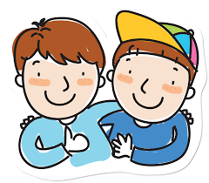
Insigths from last week (4)
Your Buddy System
Your practice :
Plenary
Notes:
Carmen
Please raise your hand to speak, or type in the chat… let’s have a few people sharing insights, challenges or surprises you experienced or noticed from last week’s practice
If you haven’t spoke, we would like to hear from you
Including
the gratitud journaling.
the Mindfulness Breathing or Body Scan,
Mindful Water Drinking
Self-Compassion
Cleaning up your e-environment

Slide 5
Poll Results from Last Week (4)
Q1.I have done my daily mindfulness practice, either body scan or breathing exercises…
Q2.The daily mindfulness practice I do, either body scan or breathing exercises, I do it for…
Q3.I have done my daily gratitude journaling...
Q4.I have been connecting with my Buddy System...
Q5.What I have liked the most about these sessions is...
Q6.Any additional comment you may want to share?
Plenary
Notes:
Carmen
Please raise your hand to speak, or type in the chat… let’s have a few people sharing insights, challenges or surprises you experienced or noticed from last week’s practice
If you haven’t spoke, we would like to hear from you
Including
the gratitud journaling.
the Mindfulness Breathing or Body Scan,
Mindful Water Drinking
Self-Compassion
Cleaning up your e-environment

Slide 6
Agenda – week 5
Centering breathing exercise
Debrief from last week 4
Today’s session intentions: Compassion, Clarity, Creativity
The SCARF model
Technique - SiBerian North RailRoad
Your take away assignment
Notes:
Carmen

Slide 7
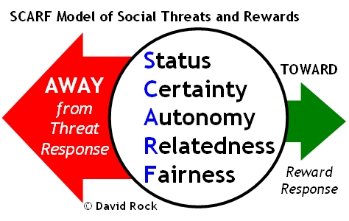
SCARF Model
Status is about relative importance to others.
Certainty concerns being able to predict the future.
Autonomy provides a sense of control over events.
Relatedness is a sense of safety with others – of friend rather than foe.
Fairness is a perception of fair exchanges between people
http://www.edbatista.com/2010/03/scarf.html
Notes:
Alejandro 6-8
http://www.edbatista.com/2010/03/scarf.html
https://www.psychologyafrica.com/2013/05/when-leaders-use-their-brain/

Slide 8
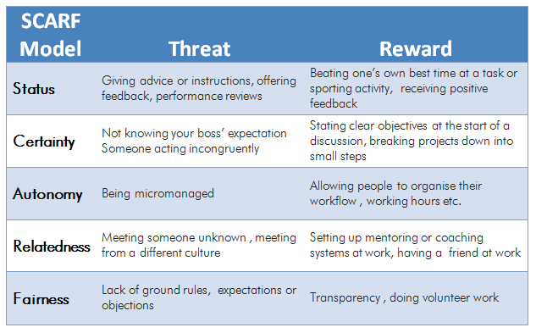
SCARF Model – Some Examples of Actions
That can evoke either a threat response or a reward response:
https://www.psychologyafrica.com/2013/05/when-leaders-use-their-brain/
Notes:
Alejandro
Have a minute to think and reflect about a situation when we chose one or the other, Threat or Reward response
http://www.edbatista.com/2010/03/scarf.html
https://www.psychologyafrica.com/2013/05/when-leaders-use-their-brain/
https://childcareta.acf.hhs.gov/systemsbuilding/systems-guides/leadership/leading-ourselves/scarf-model
https://www.mindtools.com/pages/article/SCARF.htm

Slide 9
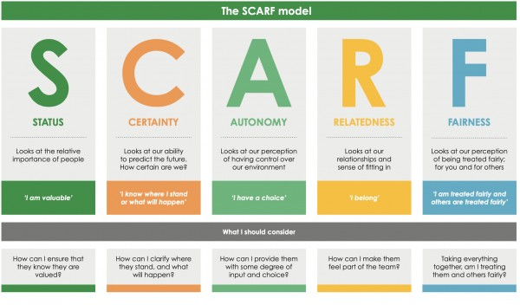
https://www.youtube.com/watch?v=hNAcCc1oWR4
Notes:
Alejandro
https://www.youtube.com/watch?v=hNAcCc1oWR4

Slide 10
Technique – SBN-RR
Stop – whenever you feel a trigger coming
Breathe – focus your mind on your breath
Notice – experience how you feel, notice your emotions
Reflect – where is that coming from? Is there any judgment?
Respond – take the opportunity to respond with a positive and compassionate outcome in mind.
This is a technique that could be used in your everyday work.
From: https://siyli.org/take-the-railroad-to-avoid-triggers/
Notes:
Carmen
Think about it for a minute and come up with real examples on when this technique could have been used for good.
Come up with real examples
And here, you can consult the technique for the SBN Rail Road practice: https://siyli.org/take-the-railroad-to-avoid-triggers/

Slide 11
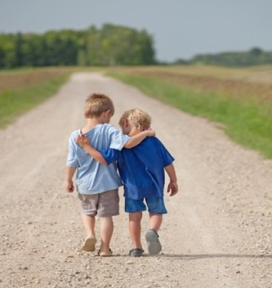
Reminder… Mindful – self-compassion
If you want to hear it from Kristin Neff: Self-compassion Break: https://self-compassion.org/wp-content/uploads/2020/08/self-compassion.break__01-cleanedbydan.mp3 Time required – 5 minutes
Notes:
Carmen
From: https://centerformsc.org/practice-msc/guided-meditations-and-exercises/
* Self-compassion break, 5 mins: https://self-compassion.org/wp-content/uploads/2020/08/self-compassion.break__01-cleanedbydan.mp3
I’ll guide us doing a similar/shorter loving-kindness meditation
Time required – 20 minutes
http://self-compassion.org/wp-content/uploads/meditations/LKM.self-compassion.MP3
Iterations, as follow…
Think of something that hooked you, something that you keep repeating yourself in your mind, ideally something light…
Remember, We all are in the same boat
My I (we all) be safe
May I (we all) be peaceful
May I (we) be kind to myself (ourselves)
May I accept myself as I am (may we accept ourselves as we are)

Slide 12
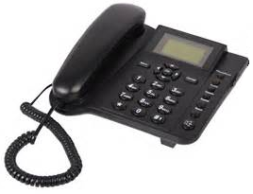
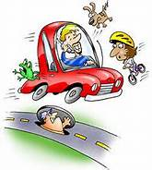
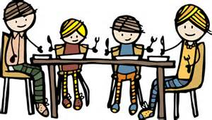
Reminder… Mindful Cleaning Your Environment
Take on the mini-challenge to be mindful around the distractions
Day 17/21 days challenge - KindSpring - Make A Mindful Phone Call
Practice Digital Mindfulness
How to Practice Mindful Emailing and How to Manage Emails Mindfully
Check the story of the Monkey and the Panda, use it as for inspiration: https://www.youtube.com/watch?v=5nsySCMH36s
Notes:
Carmen
Phone call: https://gcconnex.gc.ca/blog/view/14813318/day-1721-days-challenge-kindspring-make-a-mindful-phone-call
Digital Mindfulness: https://learn.rumie.org/jR/bytes/practice-digital-mindfulness-for-wellbeing
The Six Rules of Conscious Emailing: https://www.mindful.org/the-six-rules-of-conscious-emailing/
How to Practice Mindful Emailing: https://www.youtube.com/watch?v=qBBy5Jx_xrQ
How to Manage Emails Mindfully: https://siyli.org/mindful-emails/
Updated the Monkey and Panda story: https://www.youtube.com/watch?v=5nsySCMH36s

Slide 13
Your take away practice for week 5
Connecting – Buddy System
Gratitude Journaling – daily
Practice up to 15 mins… chose one - daily
Body scan or Breathing 15 mins – https://www.rightlifeproject.com/meditate (may need to scroll down) 15 mins – https://soundcloud.com/dharma-gus/15-min-body-scan-augusta-mbsr
Self-compassion 10 mins – https://soundcloud.com/breathworks-mindfulness/mindfulness-for-women-track-5-self-compassion-meditation 10 mins – https://soundcloud.com/user-640851605/self-compassion-giving-and-receiving-meditation-10-minutes 15 mins – https://soundcloud.com/mindfullivingcoach/self-compassion-meditation 15 mins – https://soundcloud.com/awakeningcompassion/awakening-compassion-class-4 20 mins – http://self-compassion.org/wp-content/uploads/meditations/LKM.self-compassion.MP3
Apply the SCARF Model – as needed
Technique - SiBerian North RailRoad
Reminder… Mindful Cleaning Your Environment
Reminder… Mindful – self-compassion
Notes:
Carmen
Be aware: next week we’ll do a Mindful Eating exercise, you’ll need a small fruit or a veggie for this, something like a grape, blueberry or a slice of an orange or mandarin, a piece of a carrot, cucumber or any veggie

Slide 14
Reflect about the 3 exercises
Notes:
Carmen
Now, before going into small groups debrief, let’s do a plenary debrief, let’s open the microphone for a few of you who would like to share your reflections about today’s exercises in plenary
Give the voice to 2-4
Then create breakout rooms of 6
As in previous weeks, you’re going to be randomly assigned to a breakout room to do your debriefs, when you’re done just leave the session.
Feel free to share:
What you noticed
What you had a hard time with
What you’re reailzing
An intention you have for the week
About the SCARF model,
The SiBerian North RailRoad
etc
I wish you happiness!!

Slide 15
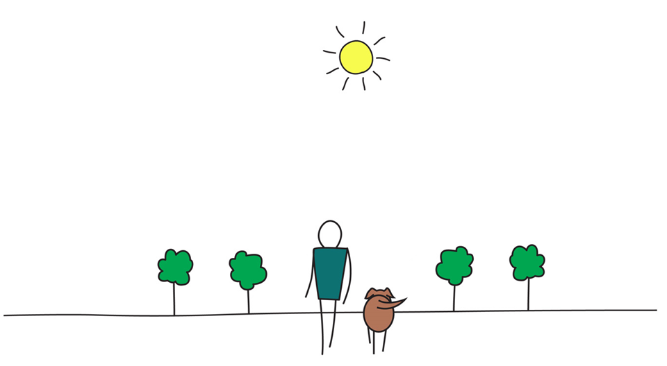
Be Mindful, Be Happy /
Prenez pleine-conscience, soyez heureux
Alejandro Gonzalez https://gcconnex.gc.ca/profile/alejgonz

