Slide 1
Mindful Change Leadership
Development Program
English Offering 2022
Summary of Results
Notes:
Strong leadership is one of the drivers of successful change, and leaders who support the people-side of change are essential to success.
This program delivers and promotes mindfulness practices to increase participants’ self-awareness and resilience, equipping leaders that can nurture mindfulness in their teams, and contribute to employee wellness and well-being.
This presentation will provide an overview of the program, and share highlights of the program
The Mindful Change Leadership Development Program has been in development since 2016 and was launched by ISC as a pilot project, in April 2021, and then delivered in 2022 as a program.
The program is sponsored mainly by ISC and supported by other government Departments including A, B, C, D
Invitation is also extended to all other Government employees by the Interdepartmental Organizational Change Network, via its GCTools groups
Keep in mind, at the end we’ll open the floor for Q&A via:
Raising your virtual hand
Comments in the chat
Anonymously comments on Sli.do (provide the Sli.do link and code)

Slide 2
“Leadership is not a rank or a position, it is a choice - a choice to look after the person to the left of us & the person to the right of us.”
- S. Sinek
Notes:
The program is run under the principle that everyone is a potential Leader.
Alejandro Gonzalez is an Organizational Development and Change management advisor within the Community Infrastructure Branch @ ISC. He is part of the Leadership Team of the Interdepartmental Organizational Change Network and is dedicated to raising awareness of change management and mindful leadership within the public service.
Alejandro has facilitated the 2021 pilot, and the 2022 English sessions of the Mindful Change Leadership Development Program.
We will be sharing some information about the benefits of the program.

Slide 3
Mindful Change Leadership Development (MCLD) Program Goal
To increase self-awareness by developing key skills:
Focus,
Clarity,
Creativity, and
Compassion in the service of others
… with a positive impact on well-being and resiliency.
“Individuals with higher mindfulness have greater resilience, thereby increasing their life satisfaction.” - ScienceDirect
Notes:
:
When you think about your work and try to find a balance between work priorities, your relationships with colleagues and clients, along with home life responsibility, what strikes you as the key skills needed for this balance? Where would you like to improve?
Is it better presence, or more compassion? Is it increased self-awareness or tools for self-reflection?
We have found that this program helps to answer some of these questions and to improve the key skills of presence, self-compassion, relationality, life-work balance, self-awareness and more.
There are studies showing that individuals with higher levels of mindfulness tend to be more resilient. And also note that both mindfulness and resilience are important skills for improved well-being
By partaking in the program, you will likely increase the level of honesty and trust within yourself, and therefore with others, allowing for an authentic connection with the work that we do at the Government of Canada.

Slide 4
MCLD 2022 English - Program Highlights
The program was offered from April to June 2022, one hour once a week.
The invitation was sent to Indigenous Services Canada (ISC), Crown-Indigenous Relations and Northern Affairs Canada (CIRNAC) and all other Government of Canada (GC) departments.
239 registrants with corresponding preliminary assessments were received.
130 participants from across Canada completed the program.
n=239
Notes:
:
54% of completion from those who started the program
CIRNAC - Crown-Indigenous Relations and Northern Affairs Canada

Slide 5
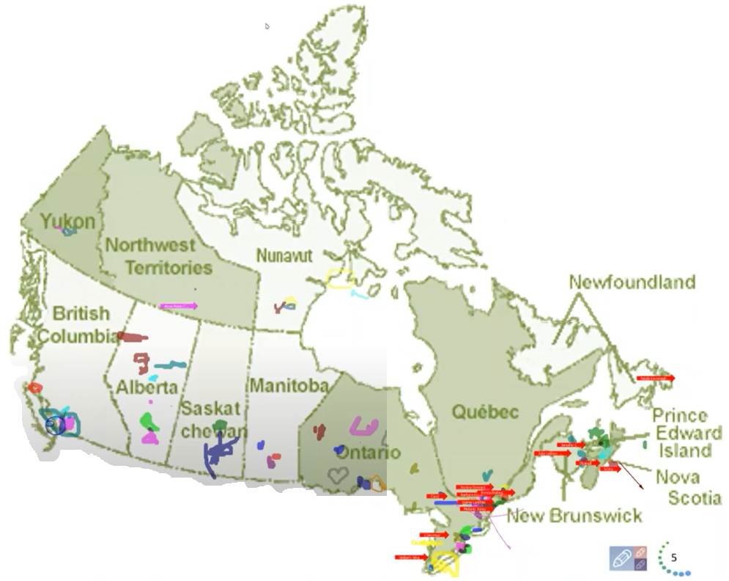
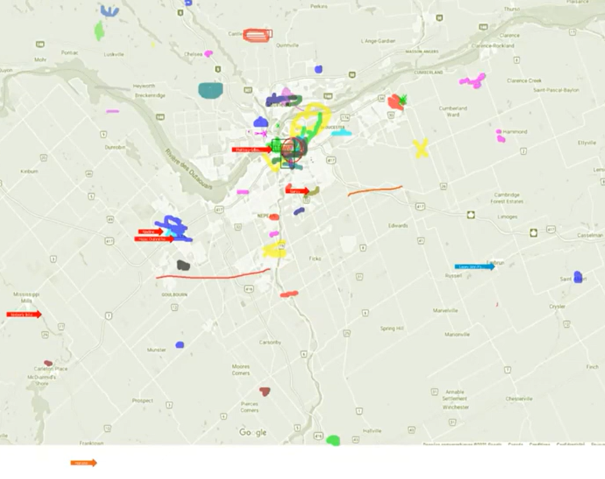
Map of Participants – First Session of MCLD 2022 En
From across Canada:
From NCR:
5
Notes:
:
The program had participants from across Canada; this slide was co-created BY THE PARTICIPANTS at the beginning of the 2022 English Program.

Slide 6
Key Findings - MCLD English Program 2022
20.8%
23.0%
14.0%
20.5%
12.6%
, 3 months after
* People who answered "Almost Always", "Very Frequently", and "Somewhat Frequently"
Notes:
:
Participants completed self-assessment questionnaires at program registration and again three months after the eight-week program, and we have compiled the data to evaluate the results and impacts of the Mindful Change Leadership Development program.
The blue columns represent the results of the self-assessment questionnaires completed at registration.
The green columns represent the final assessment, and the differences between them indicate behavioural changes.
A total of 130 participants completed the program, we received 99 final assessments, and the key findings per category are:
An increase of 12.6% Increase in Employee Engagement – respondents show a sense of clarity of mind.
(Q2. I have difficulty distinguishing what day it is.)
A 23.0% Increase in Promoting Sounder Decision Making - people report taking time to optimize their productivity.
(Q7. I take time each day to optimize my personal productivity)
Slightly over 20% decrease in Behavioural Risks - participants indicated being more aware of the task at hand.
(Q13. It seems I am running on automatic, without much awareness of what I am doing.)
Close to 21% Increase in Well-Being – respondents feel they are more present while at work and at home.
(Q1. I notice that I am distracted by thoughts about work after working hours or about home related things when I'm working.)
And 14.0% Increase in Resiliency - people report an improvement in their ability to be present.
(Q21. I find myself listening to someone with one ear, doing something else at the same time.)
What we heard from participants was that the program was a life changing experience, it helped them increased their own sense of well-being; and gave them the tools and practices to use with their teams to support employee wellness and well-being.

Slide 7
MCLD Program Testimonials
"…in a way, your investment in becoming medicine... is a very important investment…" - Elder Malcom Saulis
"I found this course to be extremely powerful and grounding... this really helps to shape how I look at my relationships with my staff… it was excellent. "
"it was very powerful, very interesting, lots of insights. I learned a lot about myself. I found the exercises appropriate in me being more productive, more present in my relationships with my colleagues and also with my family.”
“This series is life changing. I hope to participate more in the future”
"These 8 weeks have been profound… in my view I think this should be mandatory for everyone. it's that powerful"
"Thank you for this valuable opportunity to grow personally and professionally. It has been an important adjunct to the transformational work we are doing at ISC." - participant
Notes:
:
From this set of testimonials, I’ll allow myself to read one in full…
"... in a way, your investment in becoming medicine for yourself and for the rest of the world is something that I'm grateful to be witness to as an occasional participant in this program... any kind of investment like this in order to open your mind, your heart and your spirit to the presence of a larger world, which is either spiritual or physical, is a very important investment, and I applaud you for the investment that you've made." - Elder Malcom Saulis, session 8, 5456

Slide 8
What’s Needed For Success?
Voluntary Participation
Support from Management
Notes:
:
The sessions and take home activities require an fairly significant investment by participants, and two components that will be key for ensuring the continued success of the program are maintaining voluntary participation and support from management.
We encourag you to discuss with your managers in order to get their support
And now, we open the floor for questions, please observe:
One question at a time
Alternating with the chat
and Sli.do, for those who prefer anonymity

